Slide 1








Development of MAPS with Intrinsic Amplification
A.Dorokhov on behalf of APICS project
IPHC/UdS C4Pi Strasbourg
18/11/2025
Bi-national conference on Detectors R&D
grant
ANR-23-CE31-0012

Slide 2
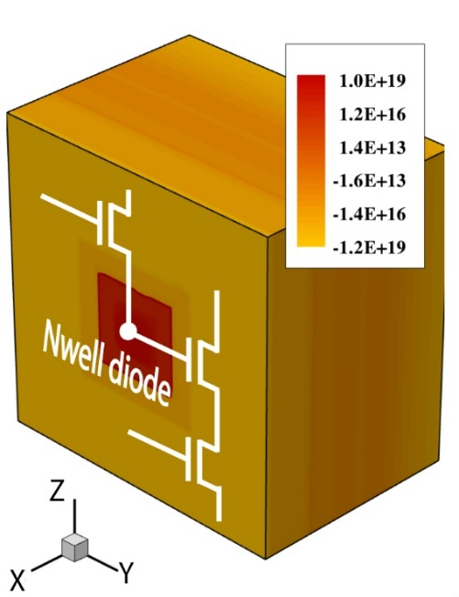
Sensor requirements for trackers in future experiments/upgrades
 | Spatial resolution, μm | Consumption, mW/cm² | Time resolution | Limit on FE power current, nA
ALICE3 tracker | 10 | 20 | 100 ns | 80
CBM Micro Vertex Detector | 5 | 50 | ~25 ns | 50
BELLE II VerteX Detector | 15 | 50 | ~ 1 ns | 450
LHCb Upstream Tracker | 10 | 100 | 20 ns (1us) | 400
FCCee VT/PID | 10 | 20 | 1 ns / 100ps | 80
CMOS pixels (MAPS) used as sensor
Low material budget (<1 % X0/layer)
High granularity, enabling excellent spatial resolution (<10 µm)
Low fabrication cost, CMOS technology
Image of one pixel containing sensing element (Nwell diode) and CMOS circuit, FE and readout
Assumptions:
Expected pitch = sqrt(12)*resolution
FE current is 50% of total current
Power ~1.5V
Same current, but 3 orders of timing:
What technology for analogue front end?

Slide 3
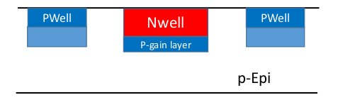
Typical FE in MAPS
CBM Micro Vertex Detector, real example, MIMOSIS2 chip:
  Sensor thickness: ~O (10um) -> sensor signal ~ 800 – 2000e and due to charge sharing we need to detect <200 e signal
  Input capacitance ~ 4 fF -> ~8 mV ~O (10mV) input should be detected
  For input of discriminator we need ~300 mV , ~O (300mV)
Analog Amplifier
300 mV
Discriminator
Discriminator
8 mV
300 mV
FE voltage gain ~ 30
What if we would have 30 times more charge at the sensor?
We would no need FE at all (assuming input capacitance not changed much) …
Gain layer inside the pixel amplifies signal ~x 30
Avalanche diodes can be used to multiply number of charges at the sensing node
Can we implement them in MAPS and what are the performances? -> APICS project
APICS (Impact Amplification with CMOS pixel Sensor)
Simulate APD test structures, propose options for prototyping
Implement them in silicon, prepare for tests
Measure and compare with simulations: verify that we can match the required performances, make optimizations …
Design complete pixel circuit with digital readout and characterize it in tests

Slide 4
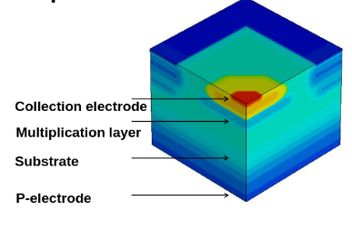
Avalanche diodes
¼ of pixel
Challenges to achieve
/green: in general, red: in particular for APICS/:
  Controlled gain O(~10)
  Charge collection efficiency (required nearly 100%)
  Stability (temperature, power)
  Low dark count rate, low noise
  Radiation tolerance
  Integrating to MAPS: fit high voltage device in CMOS circuit
Electric field >10⁵
impact ionization
CMOS electronics
sensor
PWell
Nwell
Advantages/benefits:
  No FE: smaller pitch -> better spatial resolution
  Lower power consumption -> more digital processing
  Faster response: usually FE slope ~ 10ns, without FE can be <1ns
P-gain layer
p-Epi
For some applications (picoseconds timing) may be the only way to go…

Slide 5
Avalanche diode structures simulated with TCAD
Structure 1
Structure 2
Considerations for geometry:
Reasonable pitch for majority of applications (15um) and substrate (18um)
Test several gain layer options, provided that we have limited number of tests structures
Compatibility with technology and design rules (180 nm) – makes some combinations not possible
Large NWELL pixel top view
Small NWELL pixel top view
4 um
2.2 um
2 um
Depth:
GL1, GL2, GL3
Depth:
GL2, GL3, GL4
COLLECTION ELECTRODE
COLLECTION ELECTRODE
Gain layer options:
changing depth of doping profile ->No info on exact doping : the expected closest options are: Structure1(GL1) and Structure2(GL3)
PWELL
NWELL
PWELL
PWELL
NWELL
PWELL
DEEP PWELL
GAIN LAYER
DEEP PWELL
DEEP PWELL
GAIN LAYER
DEEP PWELL
1.5 um
4 um
3.4 um
3 um
P- EPITAXIAL LAYER
P- EPITAXIAL LAYER
P+ SUBSTRATE
P+ SUBSTRATE

Slide 6

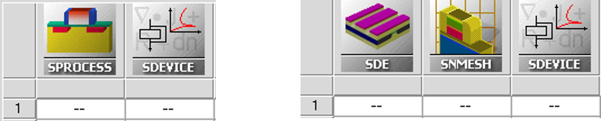
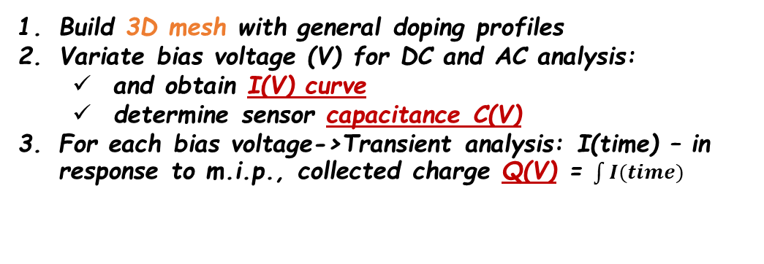

Simulation procedure
Build 3D mesh with general doping profiles
Variate bias voltage (V) for DC and AC analysis:
  and obtain I(V) curve
  determine sensor capacitance C(V)
For each bias voltage->Transient analysis: I(time) – in response to m.i.p., collected charge Q(V) = $\int{I(time)}$
TCAD: Sentaurus structure/mesh editor and device simulator
m.i.p. track is perpendicular to sensor and strikes at several fixed positions: center, corner, side and intermediate
s
cor
Gain (V) = $\frac{Q(V)}{ Q (generated by m.i.p. and could be potentially collected by the pixel ) }$
i
the measure of multiplication, at low voltages ~=1
c
Signal(V) = $\frac{Q(V)}{ C (V ) }$
real voltage signal at sensing node for m.p.v. of m.i.p. particle
From m.i.p. particle and taking into account of charge sharing and multiplication

Slide 7
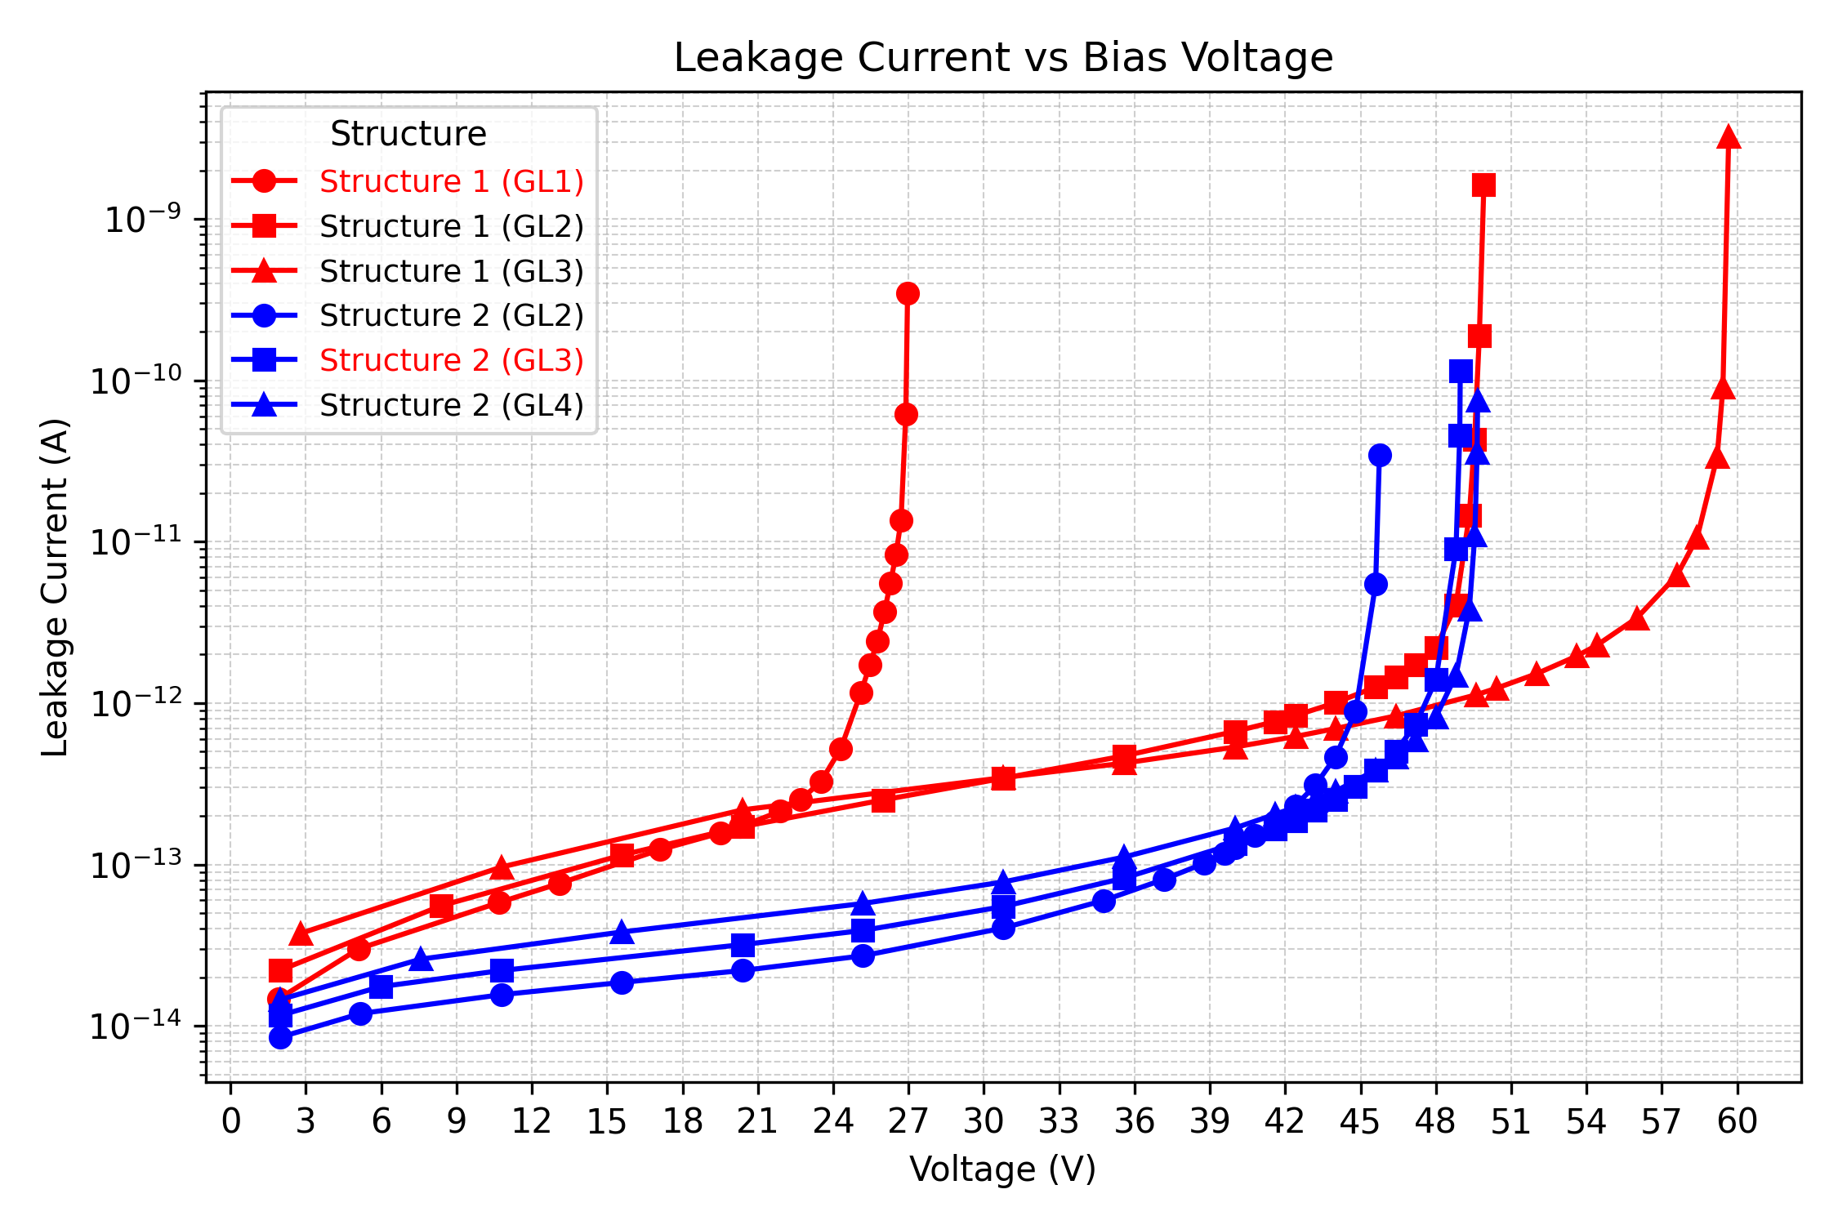
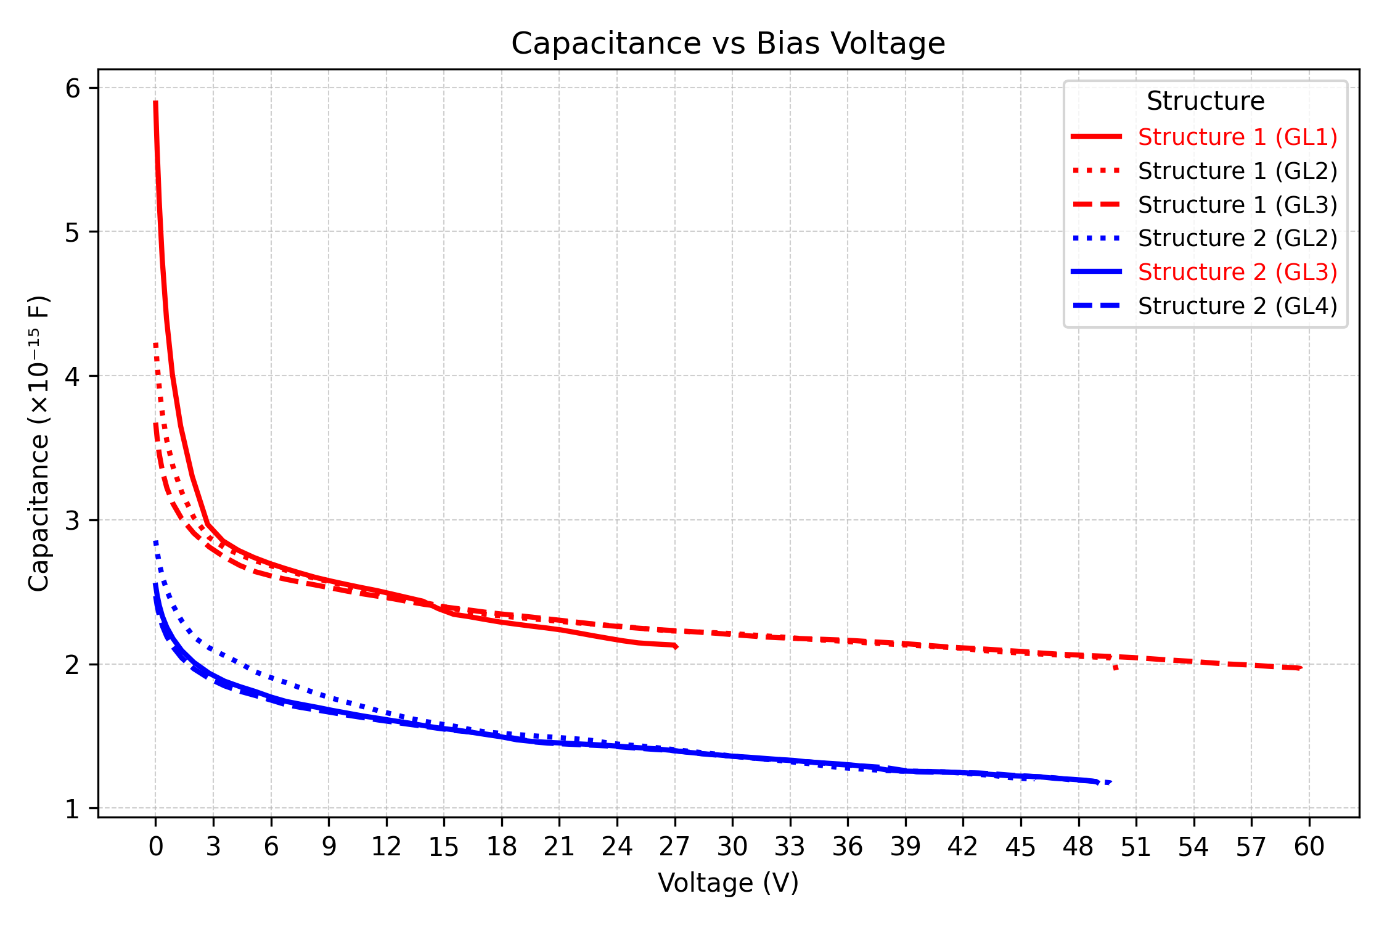
Results for DC/AC simulation I-V, C-V curves
For diode without gain typical leakage current <1pA, so the FE circuit should compensate it
In case of APD, the current limit can be relaxed: we do not have FE, but dedicated compensation circuit, so we accept < 1nA, which happens nearly at breakdown
Typical diode capacitance at low voltage <4fF and it is getting smaller with voltage
It is not changing much in APD working range > 20 V for all structures and gain layers
expected foundry option
expected foundry option
expected foundry options: Structure1(GL1) and Structure2(GL3), but if GL varied still OK
First checkpoint passed -> gain?

Slide 8
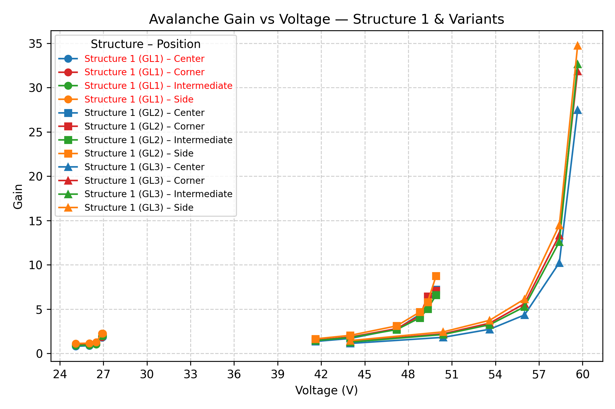
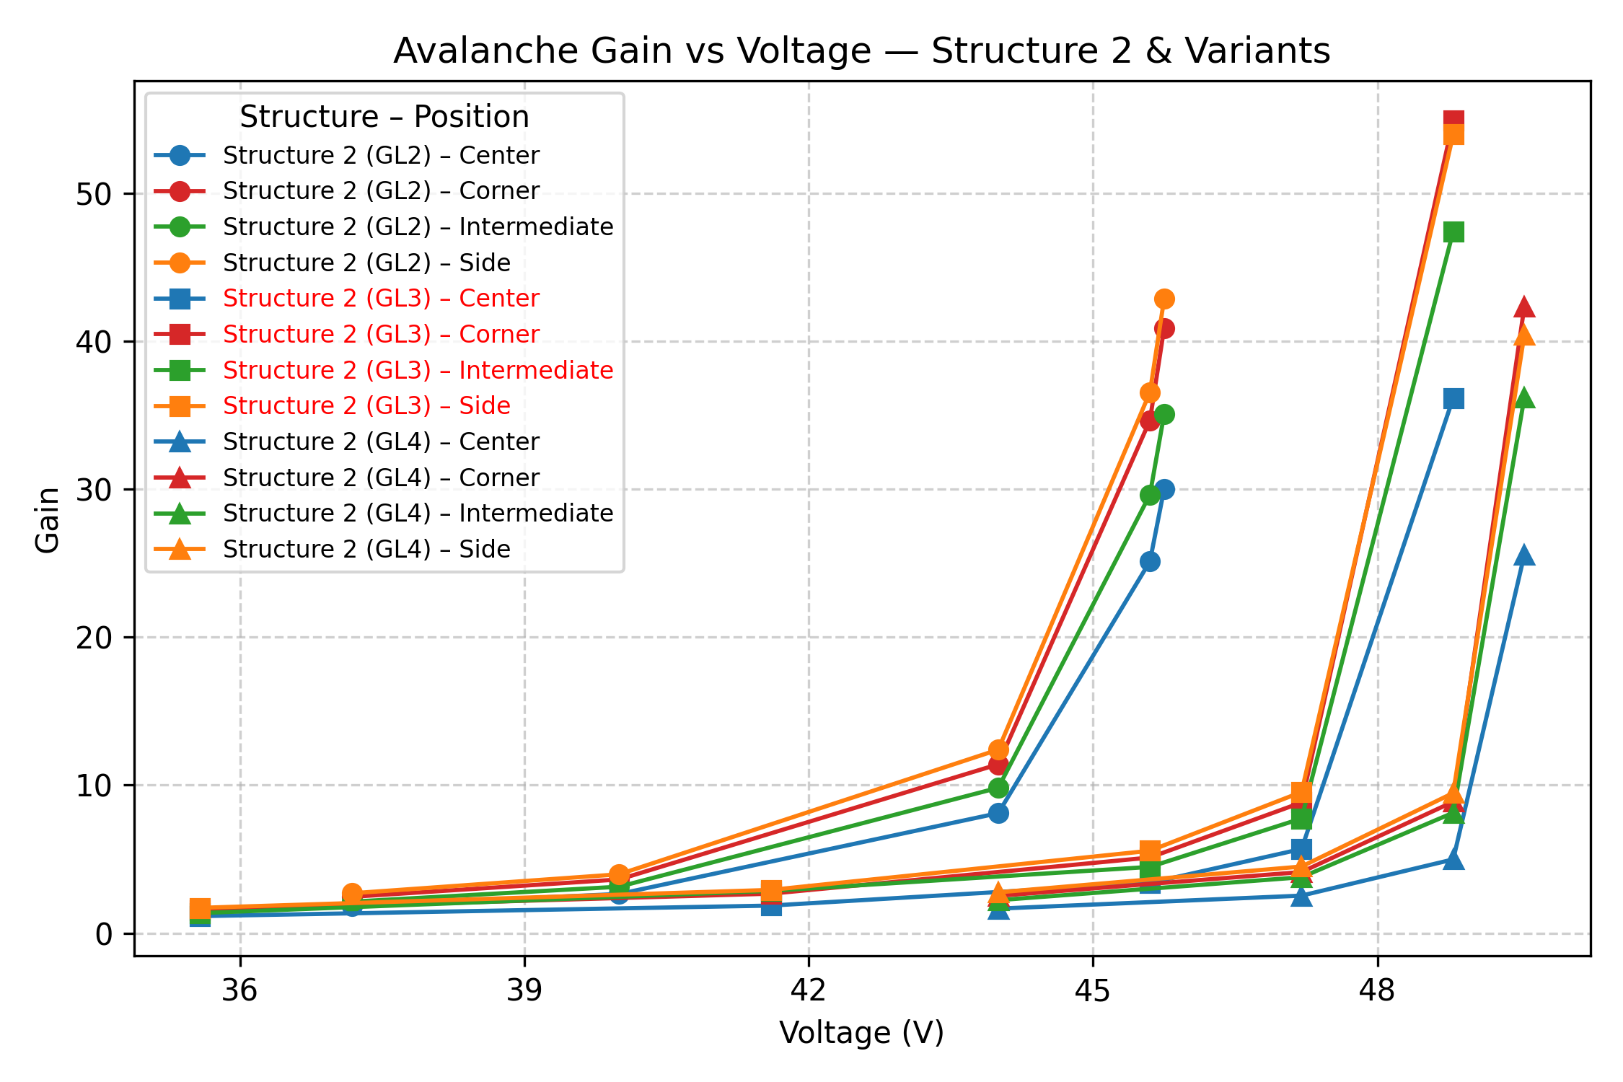
Results for transient simulation
To work without FE, we need gain ~30
expected foundry option
expected foundry option
Geometry of Structure 1 is at the limit of acceptance, but if real gain layer doping profile is closer to GL2 still OK
Structure 2 seems to be OK, even if GL varied, we can find the biasing which provides required gain
In all cases, we have sufficient gain for all particle track positions-> good efficiency for all tracks expected

Slide 9
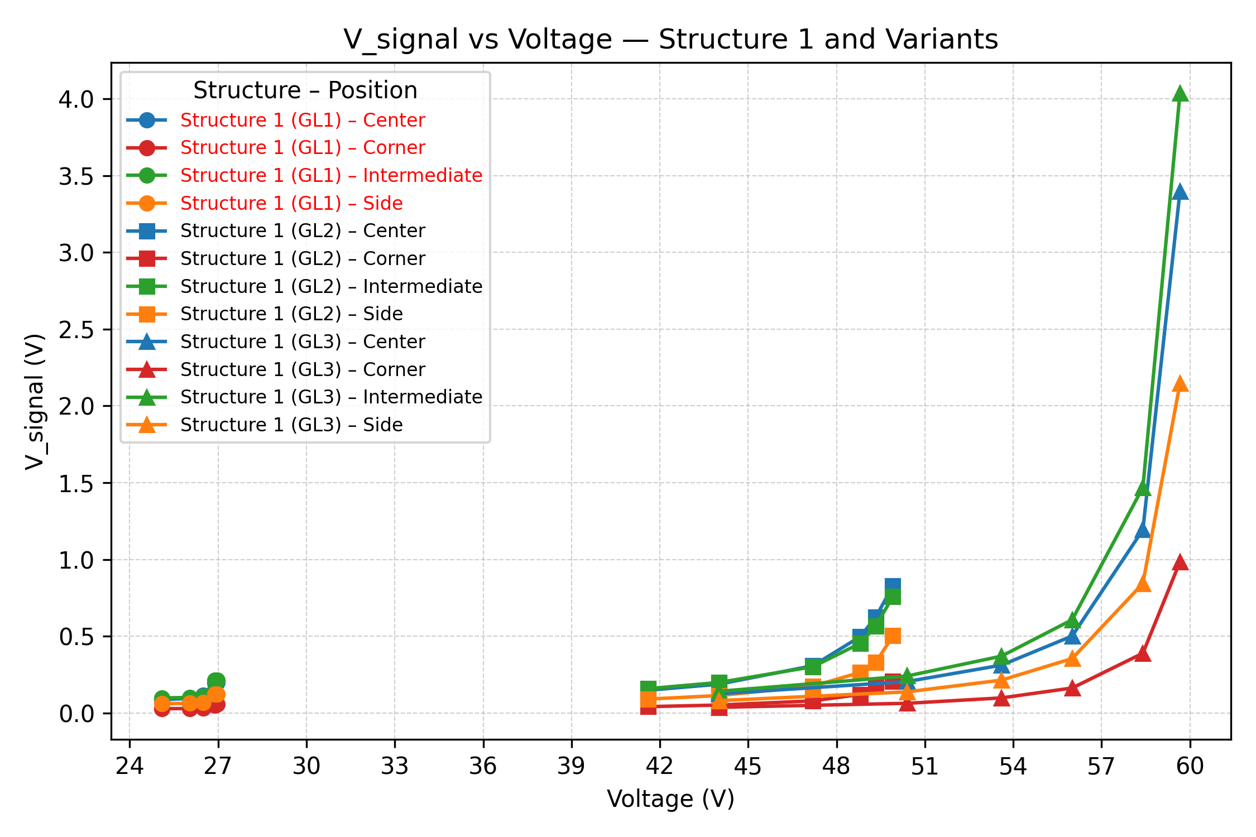
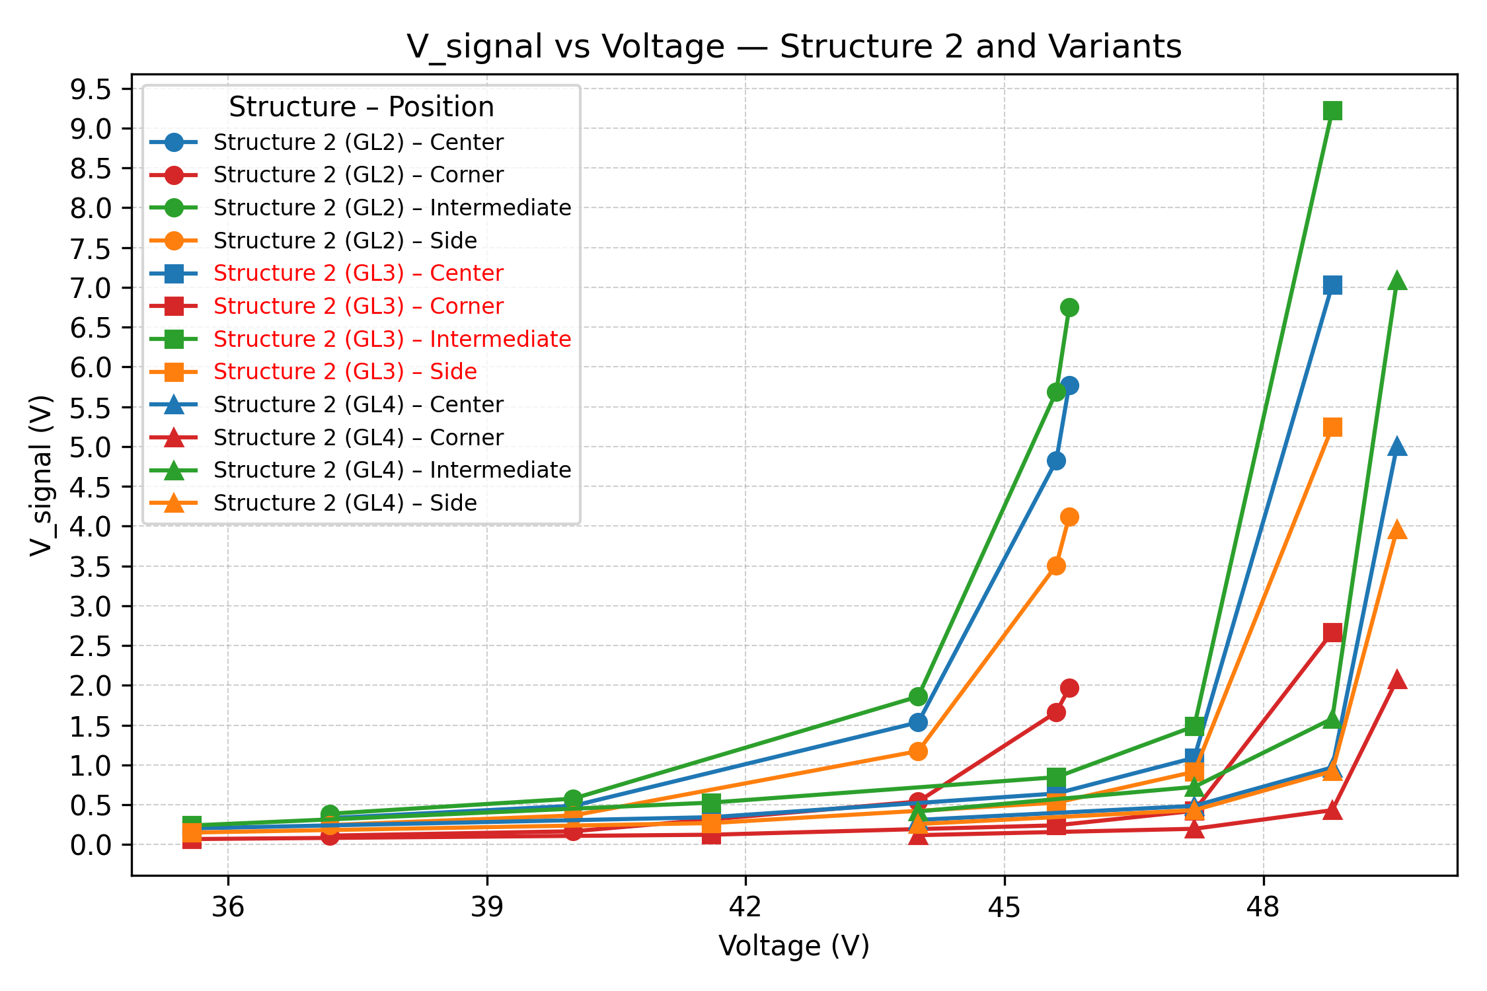
Results for transient simulation
To work without FE, we need ~300mV for simple discriminator
expected foundry option
expected foundry option
In all cases, we have sufficient voltage for discriminator, except structire1(GL1) which is at limit for our expectation of GL-> not necessary precise, so still would check it

Slide 10
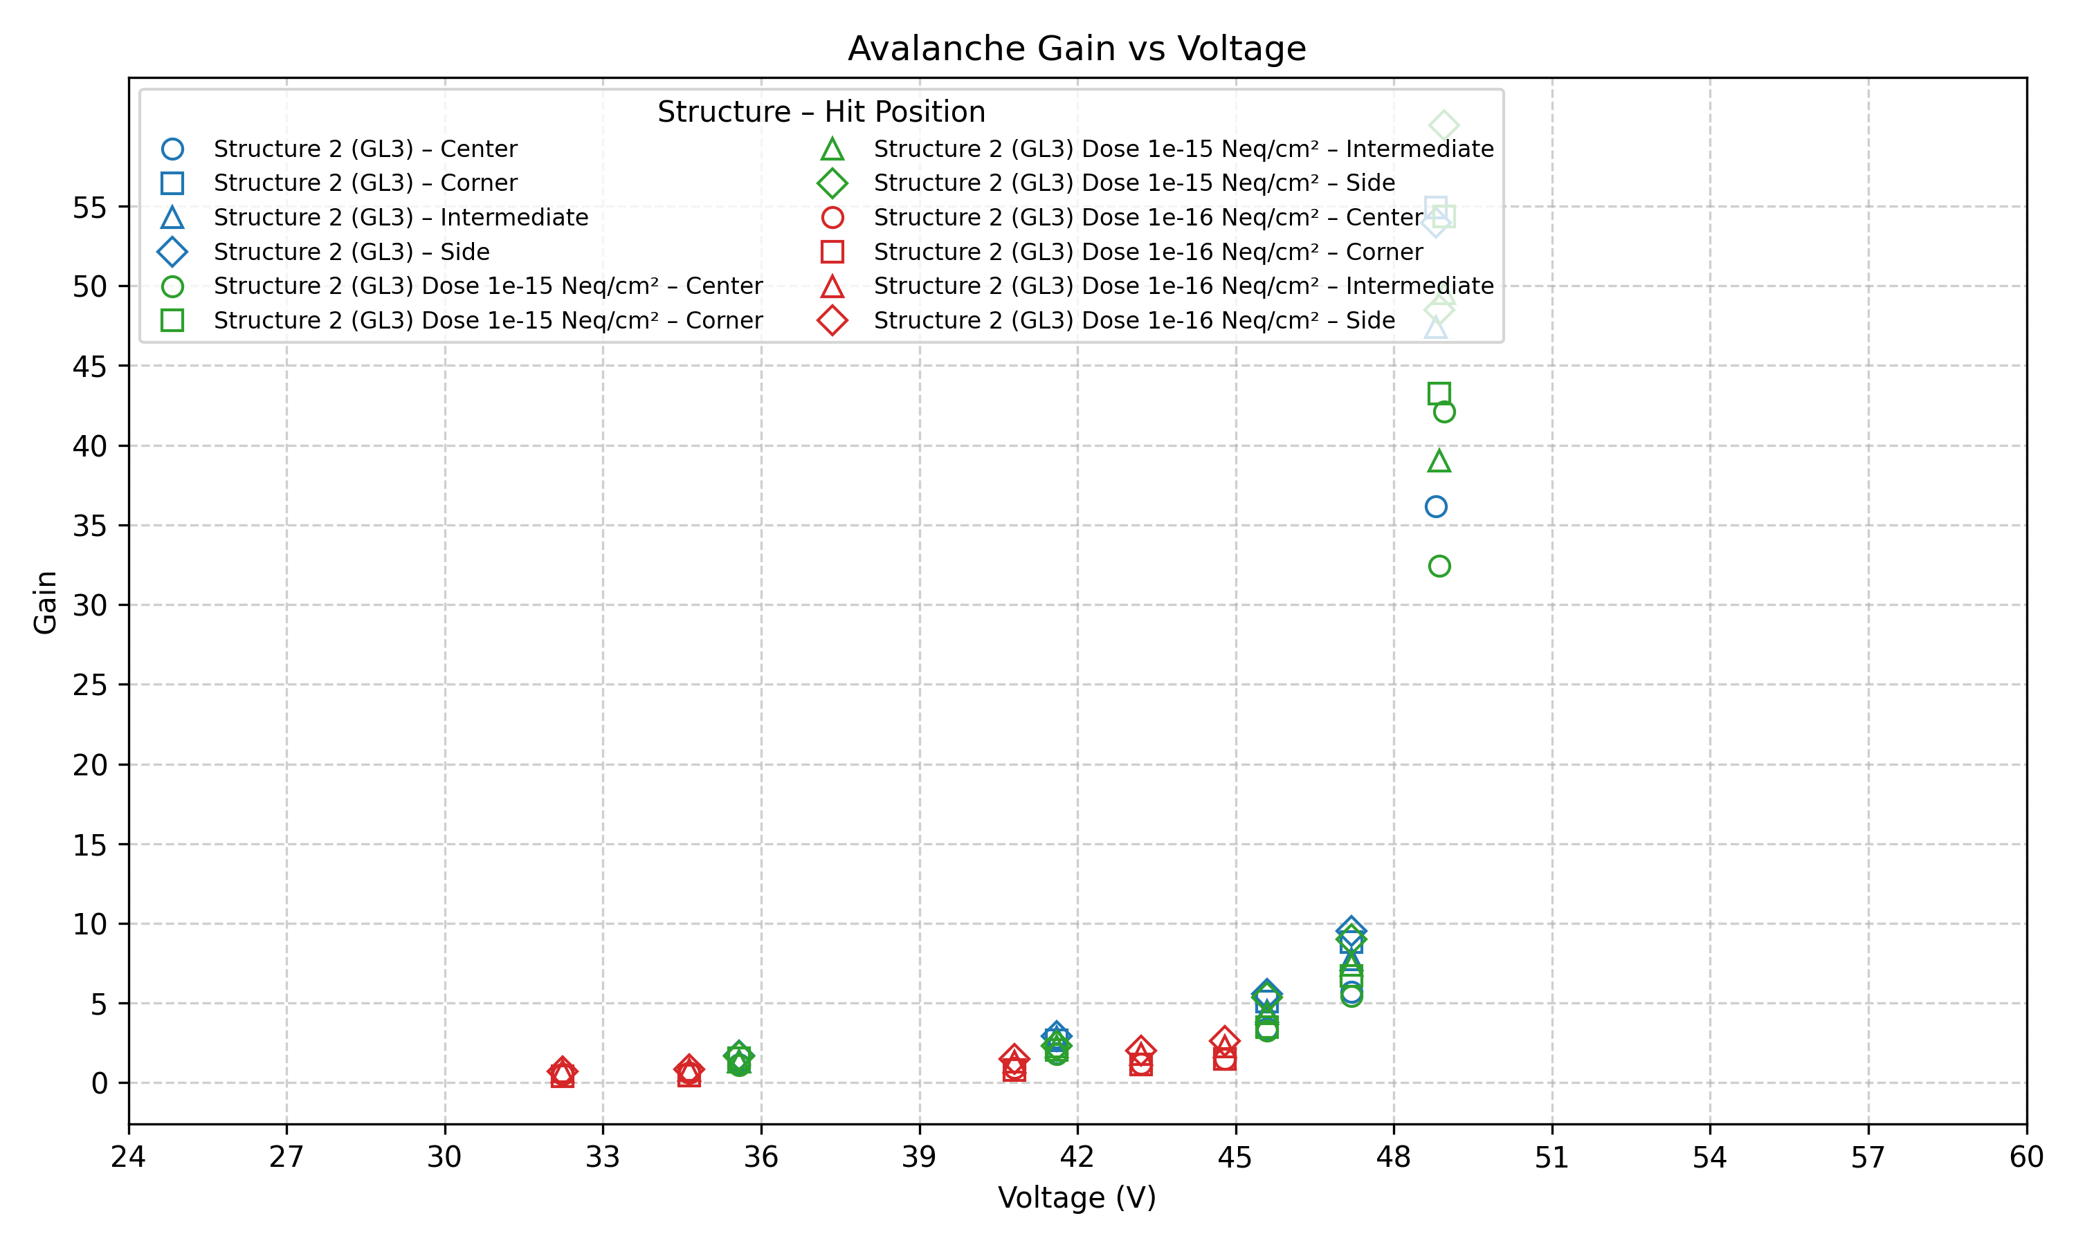
Results for transient simulation after damage from neutron irradiation
Perugia model for traps: F. Moscatelli et al., IEEE Trans. Nucl. Sci. 64 (2017) 2259
Ongoing simulations,
Preliminary results:
Gain is OK for up to 1e15neq/cm2

Slide 11
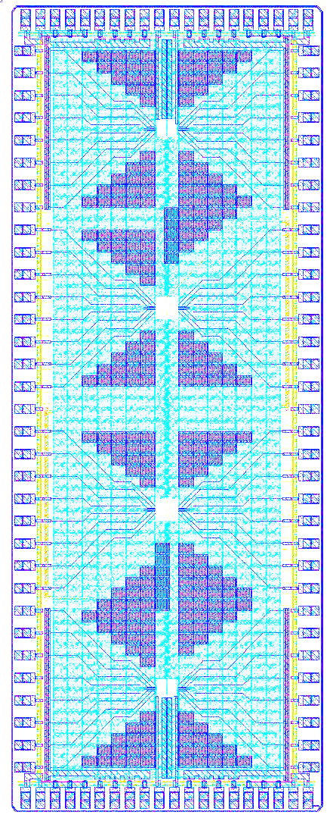
Chip submission Q4/2025
20 PADS
In total 106 PADS
2 chips of size ~2 X 5 mm
in each chip 4 matrixes of 8x8 pixels of 15umx15um
only internal part of matrix (4x4) read-out
33 PADS
Readout variants: DC and AC with buffer
Matrix 4
DC
HV
AC+BUF
OUT
  1st chip - Matrixes (geometry from simulations)
BUF
OUT
Matrix 3
Matrix | Collection electrode | Gain layer | Circuit
1 | Nwell, r=4um | GL1 | AC+BUF
2 | Nwell, r=4um | GL1 | DC
3 | Nwell, r=2.2um | GL3 | DC
4 | Nwell, r=2.2um | GL3 | AC+BUF
Parasitic capacitance is
> 1000 compared to APD
Parasitic capacitance is comparable to APD
Matrix 2
  2nd chip –
Matrix 1 and 2 but with n-implant under matrix
Optional 3 and 4 with n-implant and some experimental circuits (from KEK)
Use for depletion, leakage current study
+ laser pulse
Use for tests with particles
Matrix 1
11

Slide 12
Conclusions & Future Work
Feasibility of introduction of APD structures into MAPS technology is confirmed by TCAD simulations: gain >30, pitch 15um, standard CMOS process, bias voltage 30.. 50V
The simulations guided the design choices : optimal gain layer width and electrode configurations: two chips are designed ready for submission
Next and ongoing steps:
Completion the study for radiation tolerance
Development test system for measurements (current range from fA to uA)
Characterization the structures which are fabricated within APICS and other (CASSIA) projects, comparison data with simulations
Development the concept and design of next test chip with pixel circuitry, digital readout

Slide 13
Extra slides
Notes:
This table gives an overview of some ongoing cps projects and its different applications.
Highliting in red the best performance so in terms of pitch size and spatial reso octopus project aims to 3 um spatial resolution using small pitch size for fccce collider . TRACKER aims to 100 ps timing resolution also for fcce collider and MOSIAX have a lower power dissipation <40 mW/Cm2 for the alice its3.
So Applications are becoming more demanding — driving the need for advanced CPS designs that require:

Slide 14
Motivation-Overview of CPS Projects
Project | Year | Technology | Pitch | Spatial Res. | Time Res. | Power dissipation | Application
MIMOSIS | 2025 | TJ180 nm | ~28 um | ~5 µm | ~5 µs | <100 mW/cm² | Vertex detector (CBM)
OBELIX | 2027 | TJ180 nm | ~30 um | ~15 µm | ~100 ns | <200 mW/cm² | Tracking/counting (Belle II)
MOSAIX | 2026 | TPSCO 65 nm | ~22 um | ~4 um | ~5 us | <40 mW/cm² | ALICE ITS3
OCTOPUS | 2028 | TPSCO 65 nm | <20 um | ~3 um | ~5 ns | <50 mW/cm² | FCCee collider
TRACKER | 2028 | TPSCO 65 nm | ~25 um | ~10 um | ~100 ps | TBD | FCCee collider
Applications are becoming more demanding — driving the need for advanced CPS designs that require:
Smaller pixel pitch (higher spatial resolution)
Improved timing performance
Lower power consumption
Notes:
This table gives an overview of some ongoing cps projects and its different applications.
Highliting in red the best performance so in terms of pitch size and spatial reso octopus project aims to 3 um spatial resolution using small pitch size for fccce collider . TRACKER aims to 100 ps timing resolution also for fcce collider and MOSIAX have a lower power dissipation <40 mW/Cm2 for the alice its3.
So Applications are becoming more demanding — driving the need for advanced CPS designs that require:

Slide 15
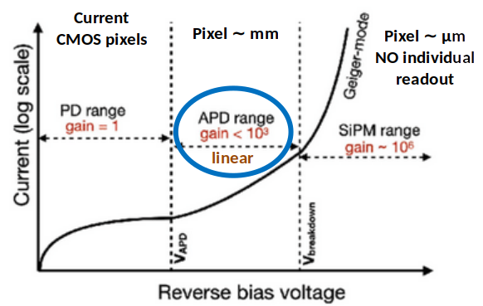
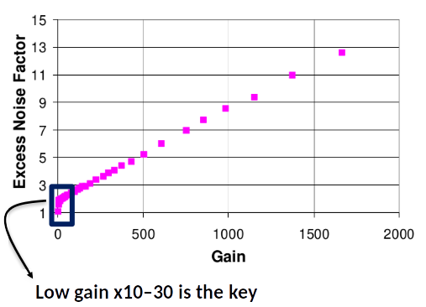
A Closer Look at Pixel Amplification Challenges
Amplifications in small (10 µm) pixels ?
Additional noise / thermal noise
Border conditions
Uniformity over matrix
Issues with shrinking pixel size:
Notes:
On the left, we see how avalanche photodiodes behave with increasing bias voltage. The goal is to operate in the linear gain region, where we can achieve controlled amplification, without entering Geiger mode.
However, when we scale down to small pixels, we encounter issues. There’s less space for electronics, border effects become more significant, and maintaining uniform gain across the entire pixel matrix becomes difficult.
On the right-hand graph, we also have to consider excess noise, which increases significantly at high gain. That’s why we carefully target a low-gain window — staying in the 10 to 30 range — to balance signal amplification with acceptable noise performance.

Slide 16
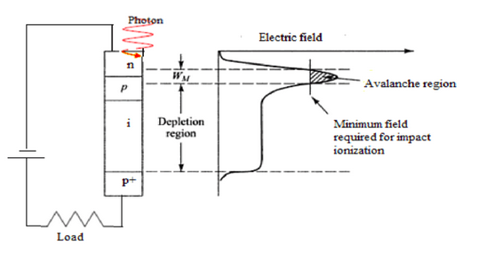
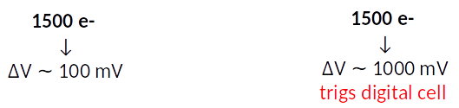
Internal Amplification as the Solution
In-silicon amplification => no need for electronic amplifier
>200kV/cm
Analog Amplifier
Gain layer inside the pixel amplifies signal directly
This allows us to:
Gain on area
Gain on power dissipation
Notes:
So to overcome these limitations , we use internal amplification as the solution.
So Instead of placing an analog amplifier, we add a gain layer inside the pixel itself. This gain layer amplifies the signal directly by creating high electric field. As we need around 1v to trigiger the discriminator
By doing this, we eliminate the analog amplifier completely. That means:
More space inside the pixel → smaller pixel pitch
Less power consumption

