Slide 1
Current status and future plans

Slide 2
Current situation
3 instances of VRE deployed at LAPP
2 for production purpose: jupyter, eosc-vre
jupyter = LAPP VRE, LDAP, a few users
eosc-vre = EOSC VRE, IAM
1 for testing purpose: jupyter-test
https://jupyter.must-dc.cloud/
https://eosc-vre.must-dc.cloud/

Slide 3
LAPP VRE
Currently implementing new features on the test instance so that we can reach production for the LAPP VRE
Retrieving automatically user data to get personal user
Access to NFS storage
/home1, /home3, …

Slide 4
LAPP VRE
Access to CVMFS storage
CERN tools

Slide 5
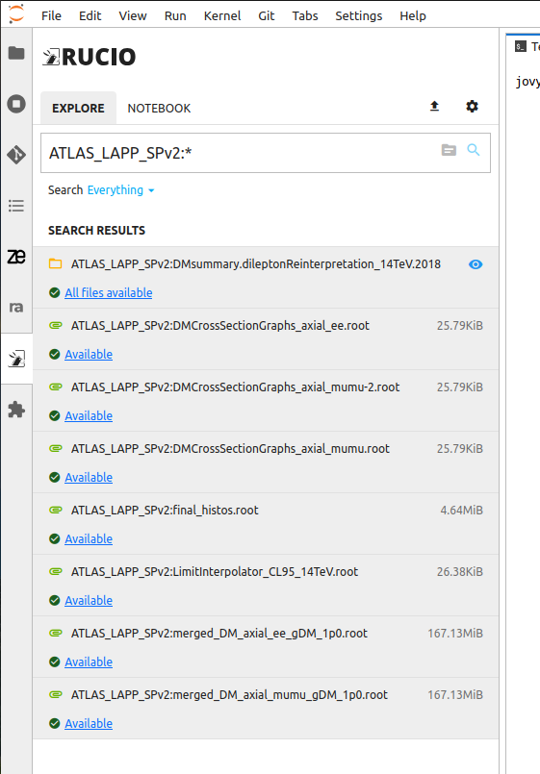
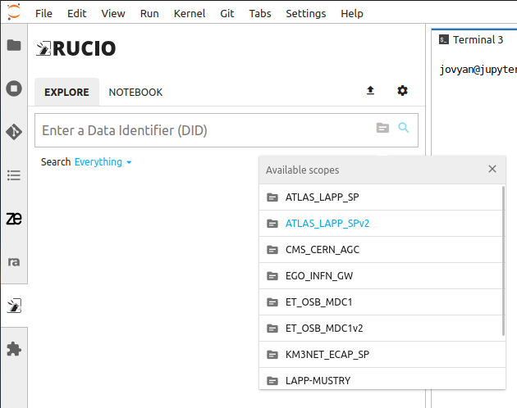
EOSC VRE
Access to Rucio data
Creation of v2 scopes to make data available once again

Slide 6
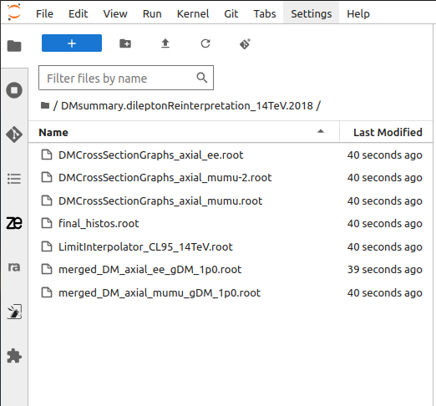
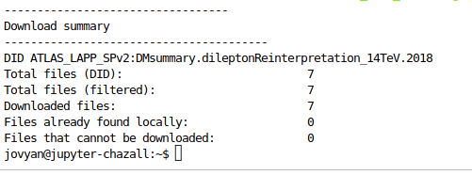
EOSC VRE

Slide 7
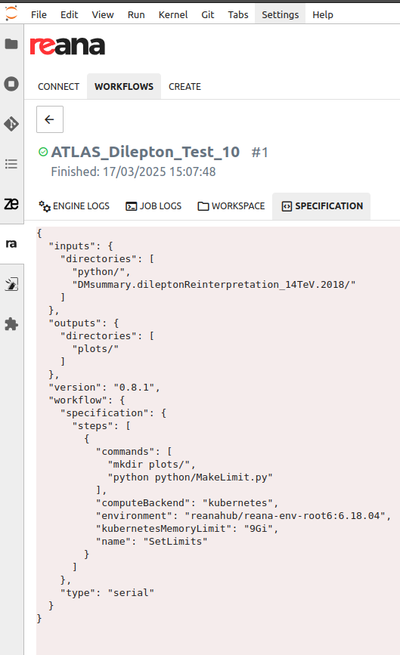
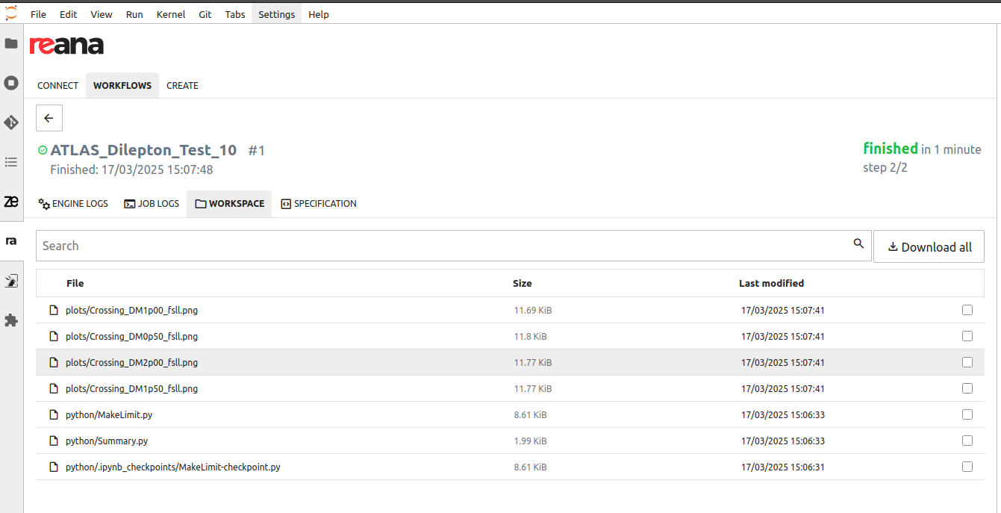
EOSC VRE
Use of REANA workflow using the downloaded data
https://github.com/jared-little/atlas-dilepton/tree/bfb8ab9b99c2eceaf3d80ea53d70f33ceb087526

Slide 9
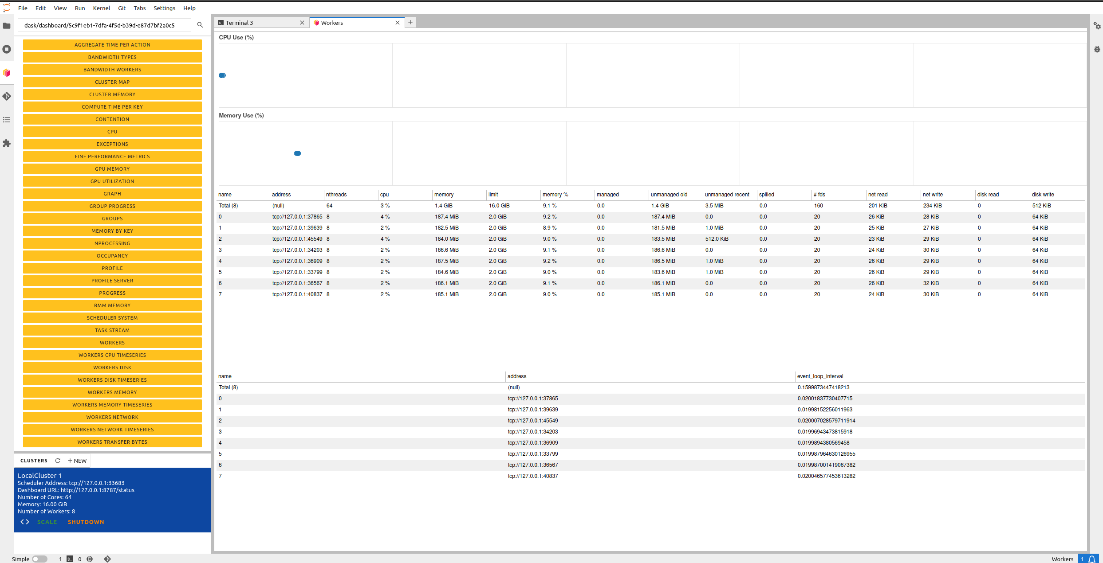
Appendix

