Slide 1
R&D prospectives Groupe Neutrino
Luis Manzanillas pour le groupe Neutrino
LAPP R&D prospectives
31/03/2025

Slide 2
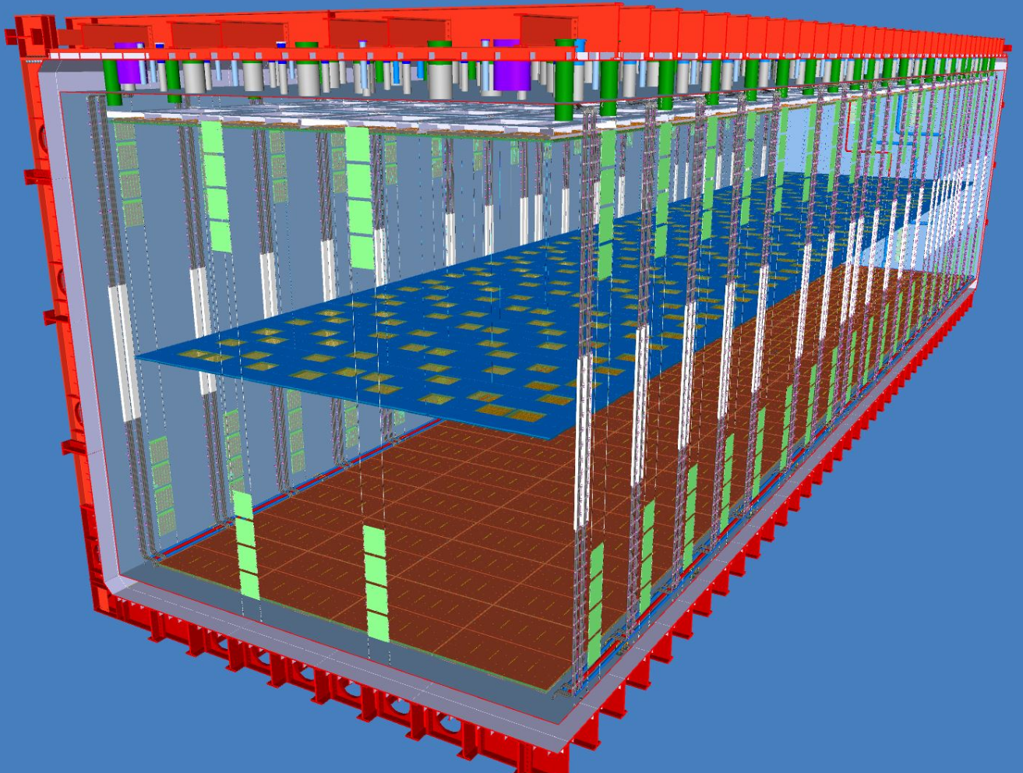
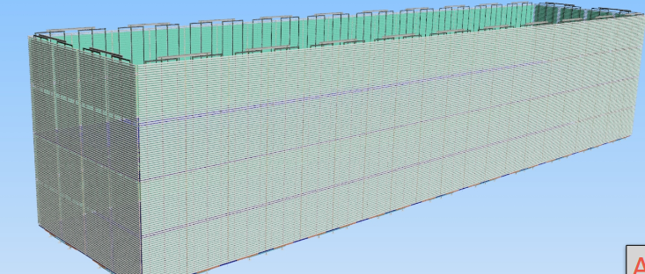
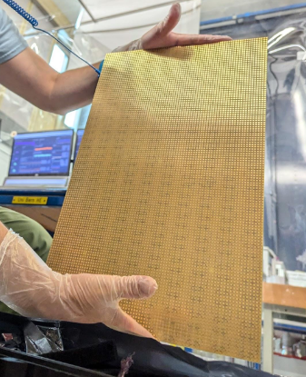
DUNE phase II
Baseline design for FD3 is a VD like module with improvements
Possible CRP optimizations: strip pitch, simpler construction techniques, ASIC upgrade
Photon detector system on field cage with larger coverage (x10 compared to VD)
Pixels for charge/light readout
Final decision ~2027
FD4 technology decision ~2028
Currently the baseline is VD
R&D for FD3/FD4 already started
Full scale prototyping and optimization starting in 2025 - 2027
VD
VD +
VD + +

Slide 3
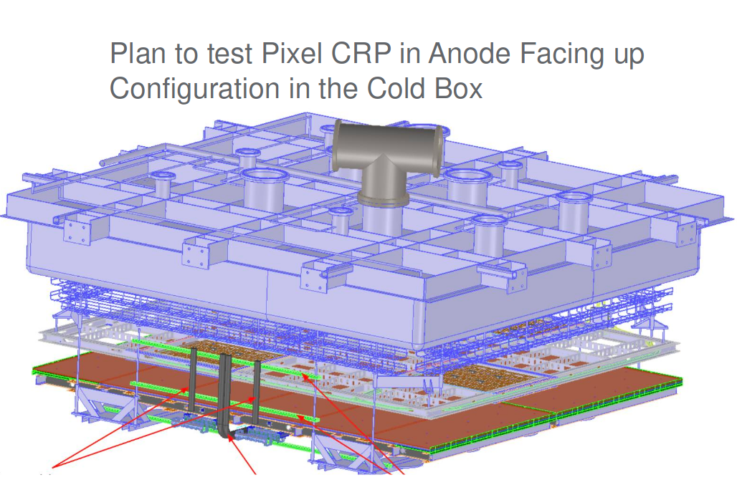
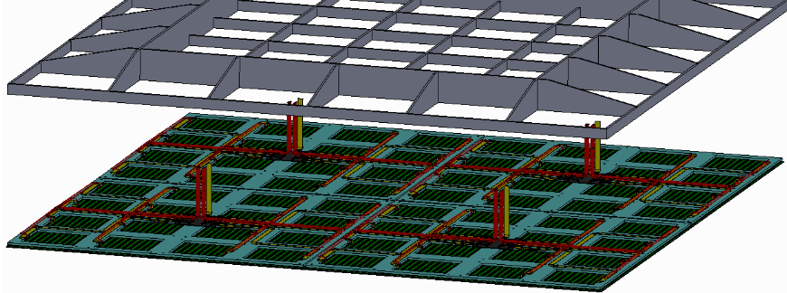
Possible LAPP contributions for DUNE phase II R&D
Pixelated CRP and APEX prototype to be constructed and tested in 2025/2026
Leverage LAPP's expertise in mechanics, LAPP's key role in CERN tests
LAPP group already contacted
Possible LAPP contributions
Adapt composite structure to receive pixel frame
Pixelated CRP assembly procedure
Installation and operations at CERN
Cold box data reconstruction and data analysis (LARDON+)
Pixel design variations/optimizations
Performance studies
Operation in protoDUNE-III

Slide 4
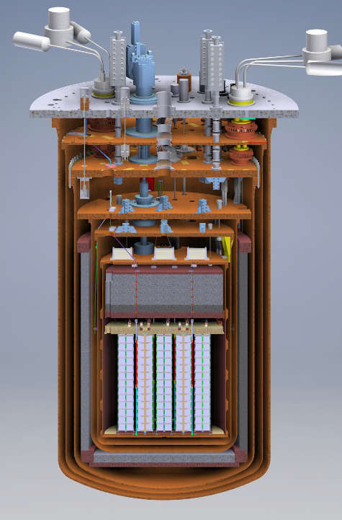
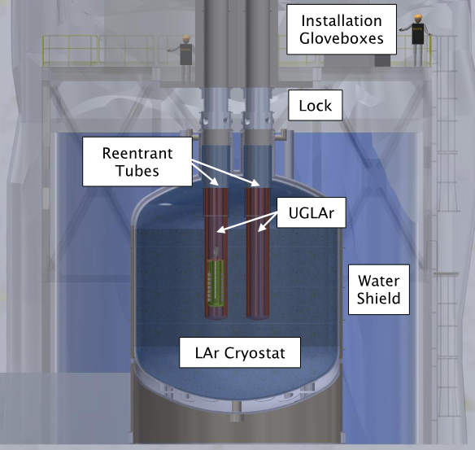
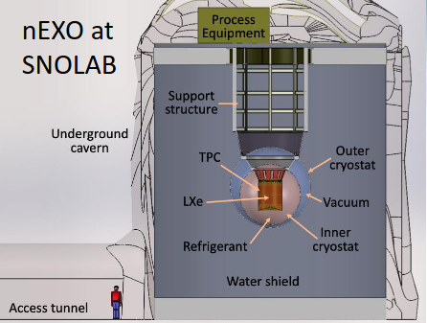
Neutrinoless double beta decay
Only possible if reinforcement occurs in the coming years.
Neutrinoless double-beta decay: “Previously” on LAPP portfolio (SuperNEMO)
-> acquired skills in radiopurity
Joining a dedicated next generation neutrinoless double-beta decay experiment that will be able to scale to 1-ton isotope mass to explore the full inverted mass ordering and beyond during the next decade
LEGEND to be deployed at LNGS (Italy). HPGe detectors in Liquid Argon.
CUPID to de deployed at LNGS (Italy). Scintillating bolometers.
nEXO to be deployed at SNOLAB (Canada ). Liquid Xenon TPC.
CUPID
LEGEND

Slide 5
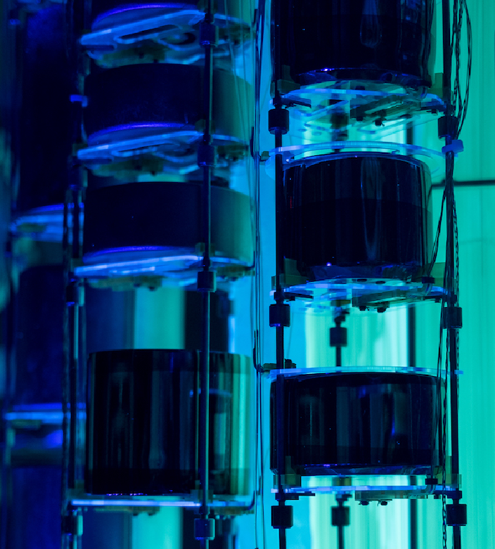
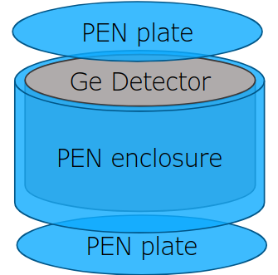
R&D in the context of LEGEND
Proposal of expand the use of scintillating structural materials such as PEN (Polyethylene Naphtalate plastic scintillators)
Self-vetoing capabilities
Encapsulation of detectors
Production of components in SuperNEMO clean room ?
PEN thin sheets for WLS in cryostat wall
Also possible to use in DUNE
Light readout optimization
Need at least 1 FTE Physicist + 1 FTE engineer

Slide 6
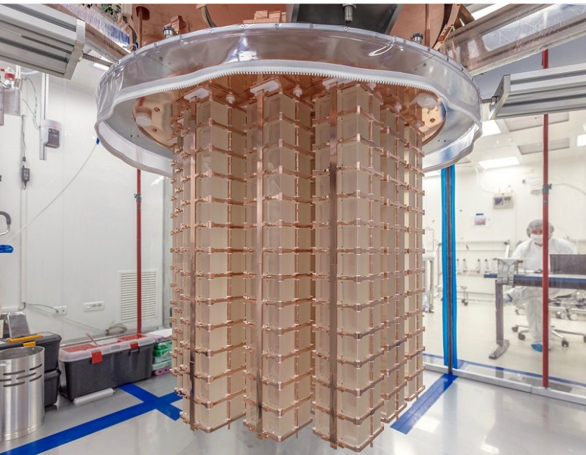
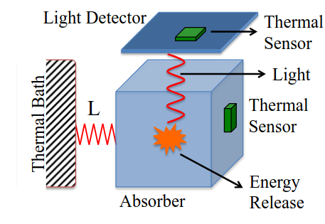
R&D in the context of CUPID
Light – temperature sensor position optimization
Reflecting foil around crystals
Self-vetoing structural components
Optimization of mechanical structure

Slide 7
Conclusions
R&D for DUNE Phase II is ramping up now!
The LAPP neutrino group aims to join these efforts.
Not an easy task as work continues toward the successful implementation of LAPP commitments for Phase I
LAPP’s expertise in Phase I will be leveraged to contribute to Phase II
We envision contributing to the prototyping of various options for Phase II
With reinforcement of the group, LAPP could also contribute to one of the next-generation neutrinoless double-beta decay experiments
LEGEND and CUPID (both at LNGS) are among the options being considered
LAPP's expertise in radiopurity techniques and low-energy physics are valuable assets to develop contributions

