Slide 1
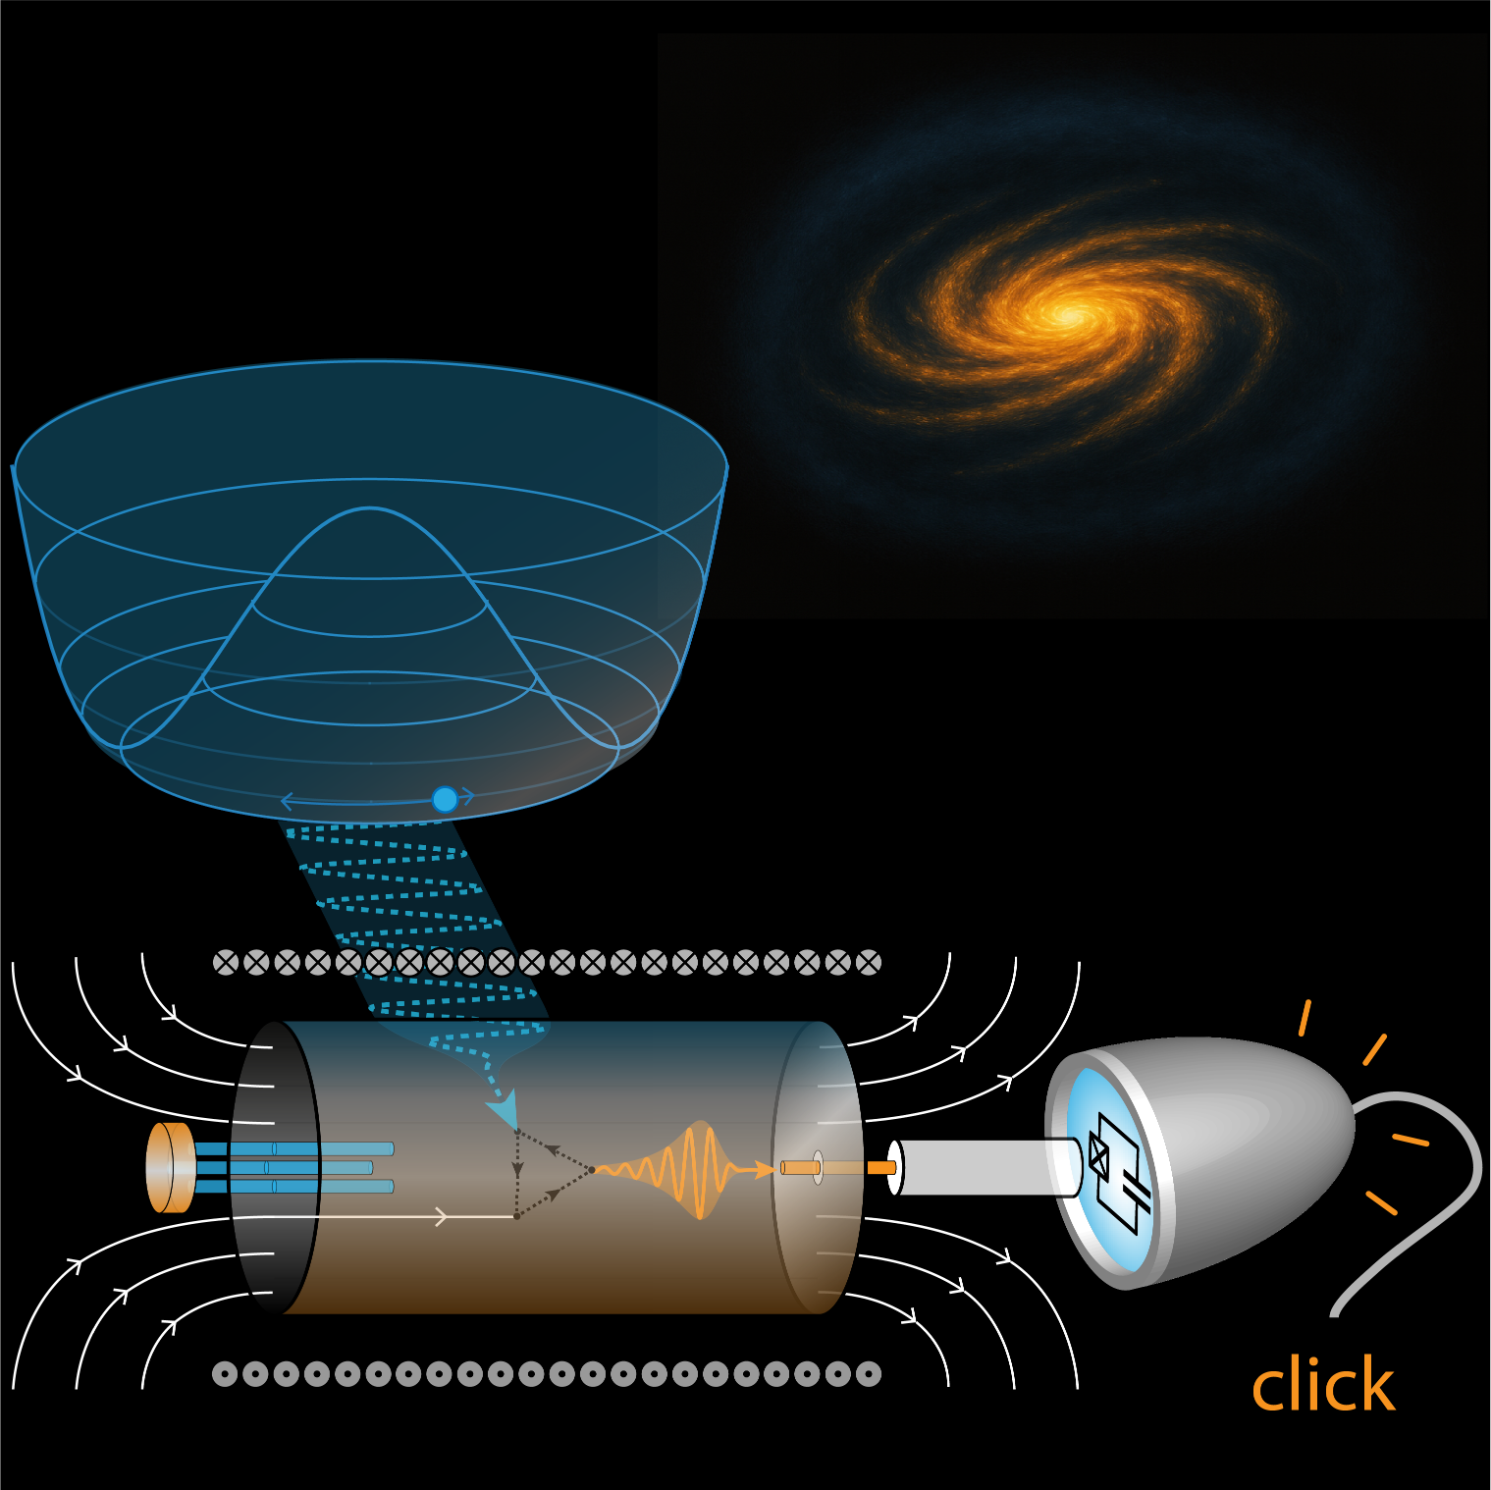
Counting Microwave Photons
From Qubits to the Search for Dark Matter
Phys. Rev. X 15, 021031 (2025)
Alexandre MAY, Emmanuel FLURIN
Quantronics group - CEA SPEC

Slide 2
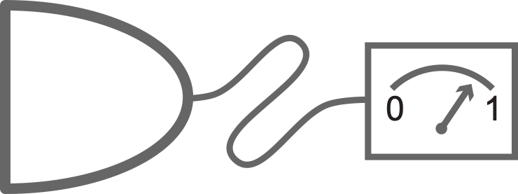
EM field detection
Photon detectors
Temperature
(K)
Notes:
Here, I represent the electromagnetic spectrum, one can identify two domains: optics and electronics, which are separated by five orders of magnitude in energy. In optics, photon detectors are fundamental tools as they are essential for detecting sources that emit a very weak flow of photons, incoherently and over many modes. Their ability to resolve single atoms and molecules by fluorescence microscopy led to far-reaching applications. However, such a tool is lacking in the microwave domain due to the very weak energy of microwave photons. Instead, linear amplifiers are commonly employed but they experience a fundamental noise floor caused by vacuum fluctuations, which make them ineffective at detecting single photons.

Slide 3
EM field detection
Photon detectors
Temperature
(K)
Notes:
Here, I represent the electromagnetic spectrum, one can identify two domains: optics and electronics, which are separated by five orders of magnitude in energy. In optics, photon detectors are fundamental tools as they are essential for detecting sources that emit a very weak flow of photons, incoherently and over many modes. Their ability to resolve single atoms and molecules by fluorescence microscopy led to far-reaching applications. However, such a tool is lacking in the microwave domain due to the very weak energy of microwave photons. Instead, linear amplifiers are commonly employed but they experience a fundamental noise floor caused by vacuum fluctuations, which make them ineffective at detecting single photons.

Slide 4
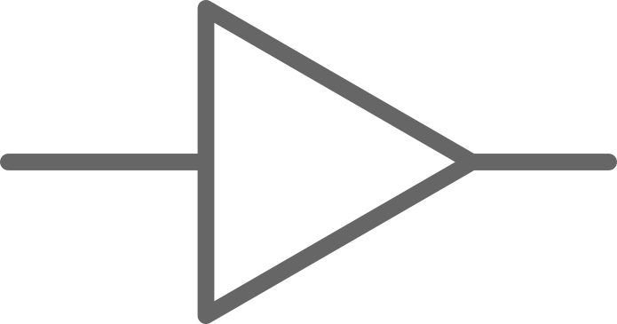
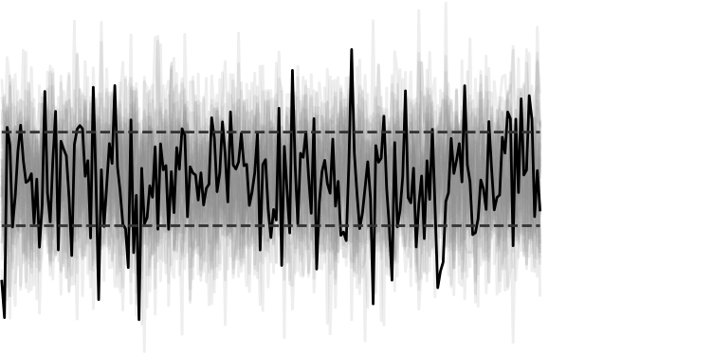
MW field detection
Field (Quadrature) detectors
Photon detectors
energy ÷ 10⁵
Quadrature detection ($\hat{X}$)
C.M. Caves, PRD (1982)
…
Bergeal et al, Nature (2010)
Zhong et al, NJP (2013)
White et al, APL (2015)
Macklin et al, Science (2015)
…
Malnou et al, PRA (2018)
Wurtz et al, PRX (2021)
ADMX collab & al, RSI (2021)
Jiang et al, PRX (2023)
All Quadrature detectors: JTWPA, JPA, JRM…

Slide 5
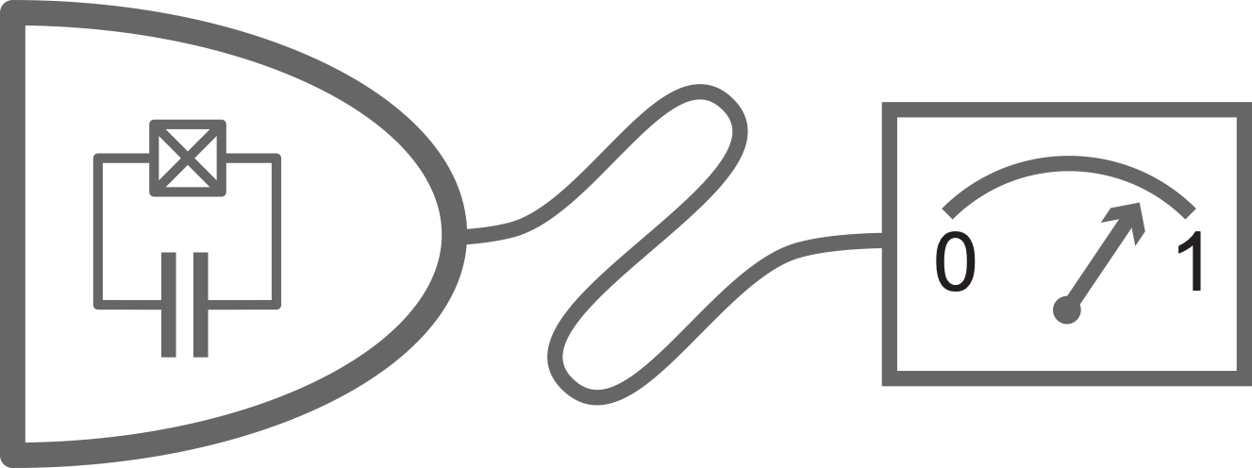
MW photodetection
Microwave photon detectors
Photon detectors
energy ÷ 10⁵
Energy detection ($\hat{N}$)
Y-F Chen et al., PRL (2011)
K. Inomata et al., Nature (2016)
S. Kono et al., Nature (2018)
J-C. Besse et al., PRX (2018) G. Lee et al., Nature (2020)
R. Lescanne et al., PRX (2020)
E. Albertinale et al., Nature (2021)
L. Balembois et al., PRApp (2023)
R. Albert et al, PRX (2024)
L. Pallegoix et al, PRApplied (2025)
A. May et al, arXiv (2025)

Slide 6
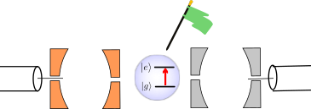
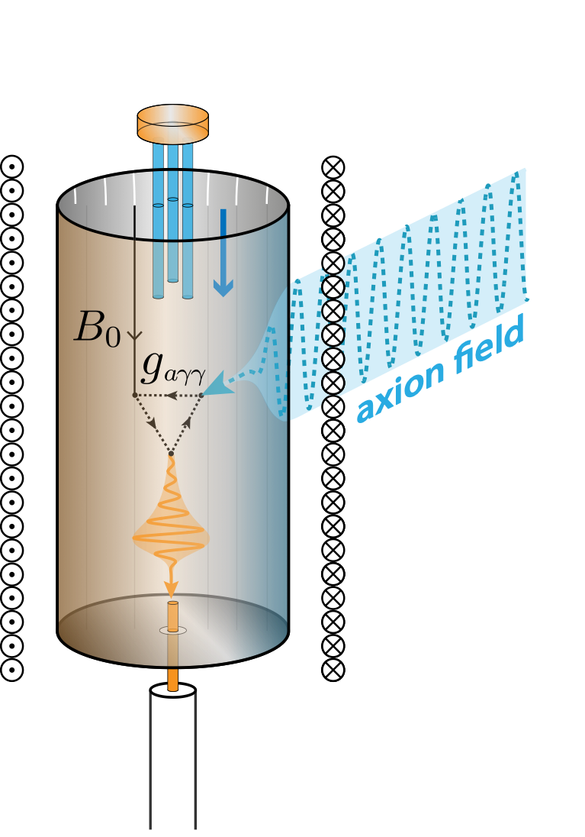
Outline
Photon Detection vs Field Detection
Superconducting Qubit-based Single Microwave Photon Detector (SMPD)
Counting Photon for Axion Dark Matter Search
Enhanced sensitivity with Multiqubit Photon Counter

Slide 7
Outline
Photon Detection vs Field Detection
Superconducting Qubit-based Single Microwave Photon Detector (SMPD)
Counting Photon for Axion Dark Matter Search
Enhanced sensitivity with Multiqubit Photon Counter

Slide 8
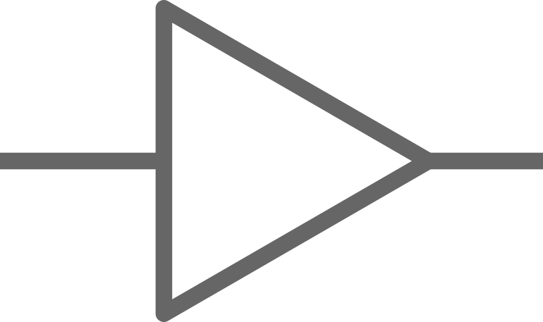
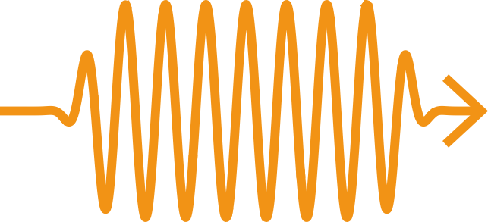
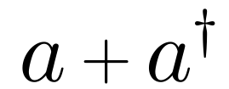
Quantum Optics 101
Field detector
wave-like
quantum light
particle-like
Photon detector

Slide 9
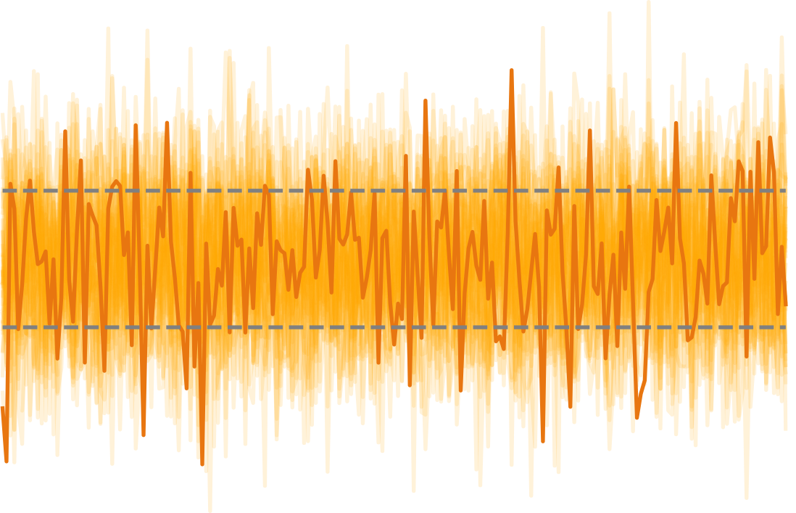
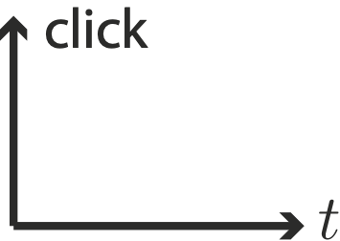
Quantum optics 101
Quantum Optics 101
Field detector
wave-like
vacuum
vacuum fluctuations
particle-like
Photon detector
noiseless
absence of clicks

Slide 10
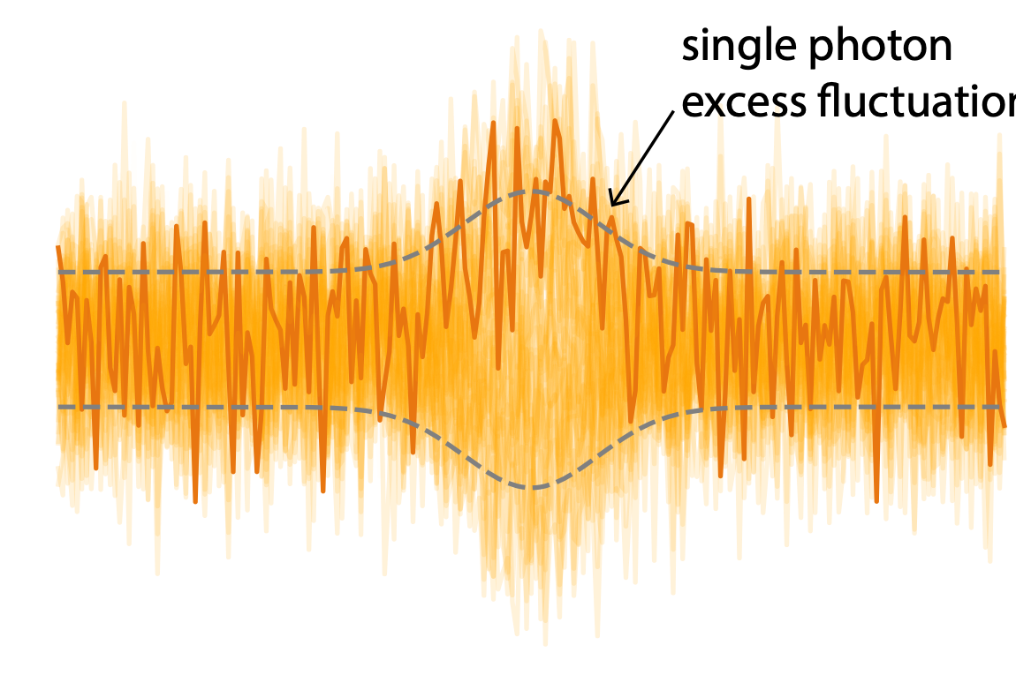
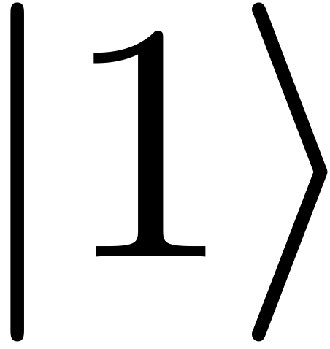
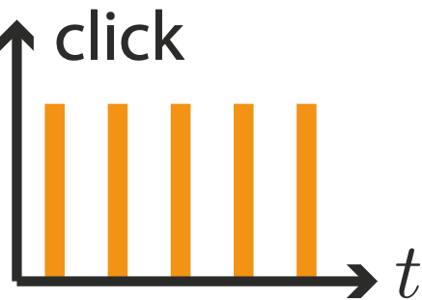
Quantum Optics 101
Field detector
wave-like
Single Photon
Excess fluctuations
particle-like
Photon detector
single clicks

Slide 11
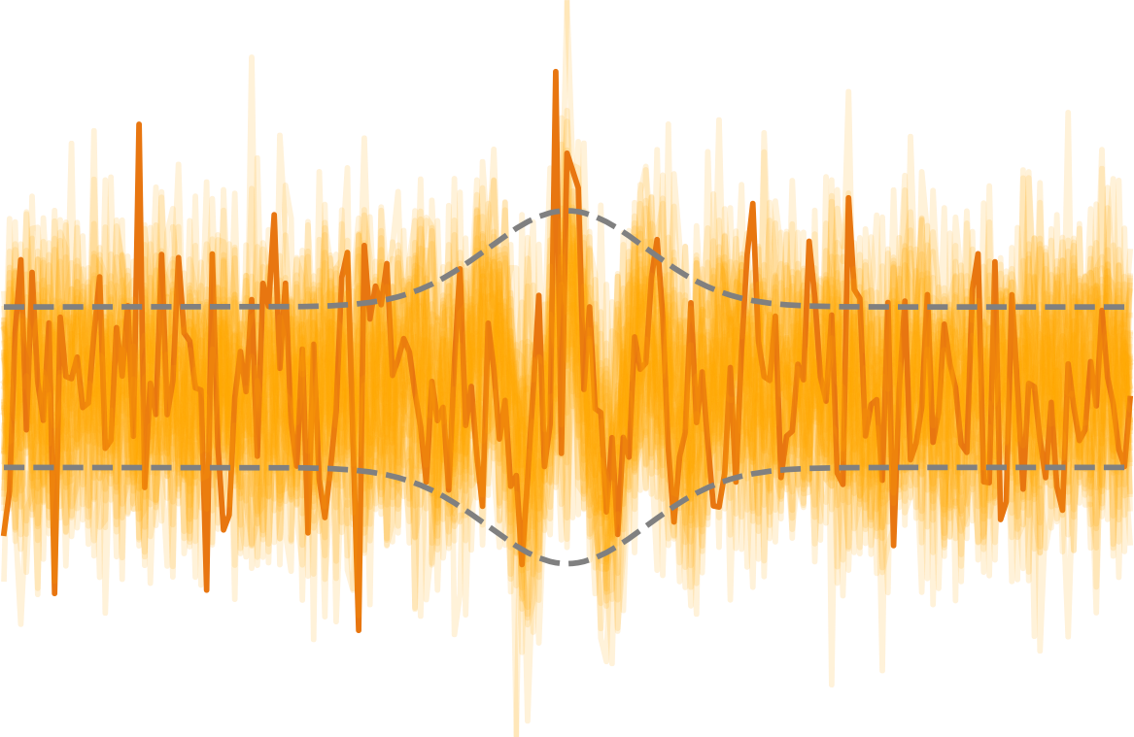
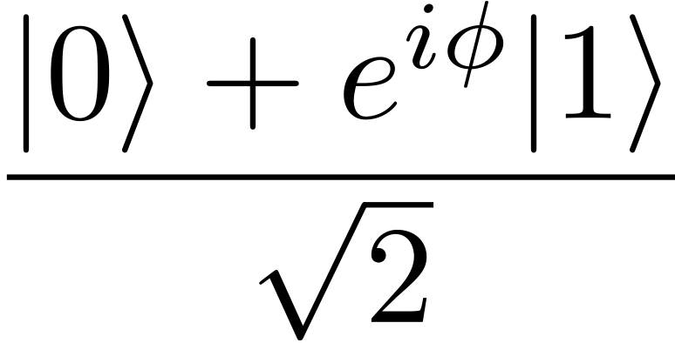
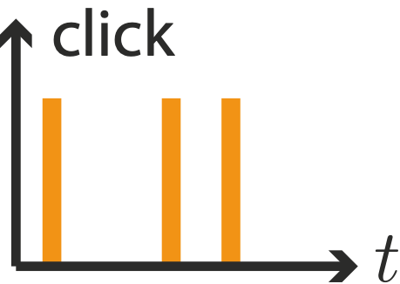
Quantum optics 101
Quantum Optics 101
Field detector
wave-like
Coherent superposition
phase
particle-like
Photon detector
noisy clicks

Slide 12
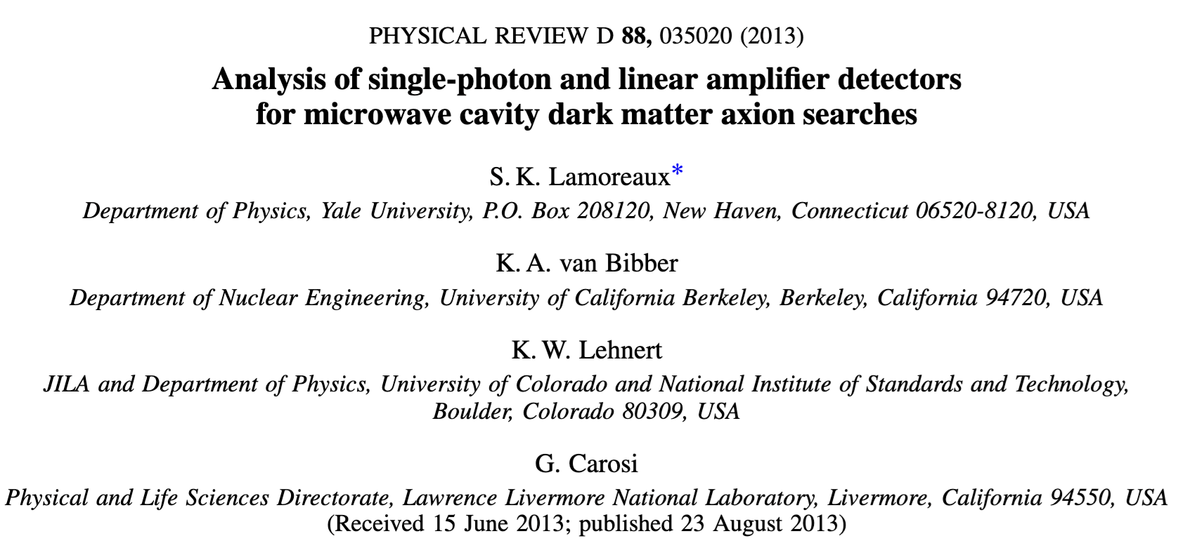
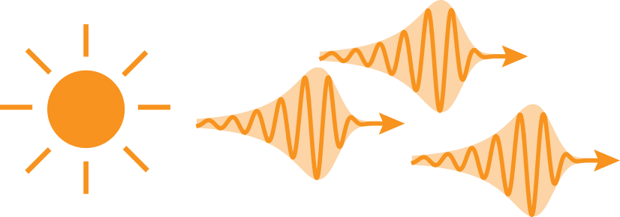
Quantum optics 101
Quantum Optics 101
weak & incoherent photon source
emission rate:
emission bandwidth:
integration time:
temperature:

Slide 13
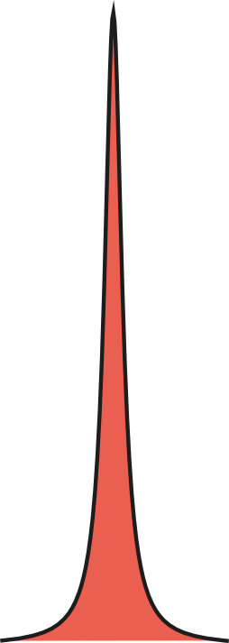
Quantum optics 101
Quantum Optics 101
weak & incoherent photon source
emission rate:
emission bandwidth:
integration time:
temperature:

Slide 14
Quantum optics 101
Quantum Optics 101
weak & incoherent photon source
emission rate:
emission bandwidth:
integration time:
temperature:

Slide 15
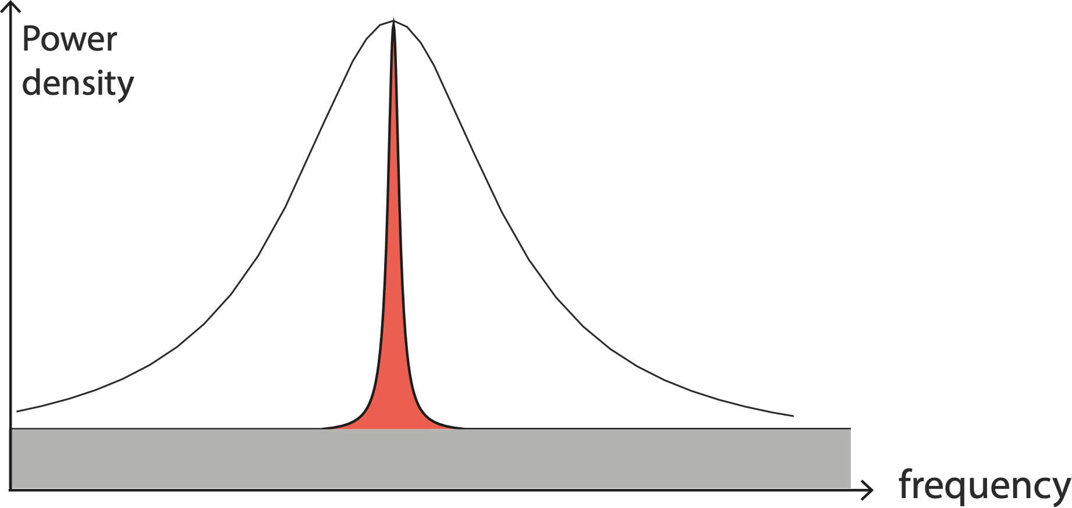
Quantum tics 101
Quantum Optics 101
weak & incoherent photon source
emission rate:
emission bandwidth:
integration time:
temperature:

Slide 16
Quantum Optics 101
Field detector
weak & incoherent photon source
emission rate:
emission bandwidth:
integration time:
temperature:
Photon detector

Slide 17
Quantum Optics 101
Field detector
Integrated Power
weak & incoherent photon source
emission rate:
emission bandwidth:
integration time:
temperature:
Photon detector

Slide 18
Quantum Optics 101
Field detector
Integrated Noise
weak & incoherent photon source
(Dicke radiometer equation)
emission rate:
emission bandwidth:
integration time:
(Shot noise due to thermal fluctuation)
temperature:
Photon detector

Slide 19
Quantum Optics 101
Field detector
Signal-to-Noise Ratio
weak & incoherent photon source
emission rate:
emission bandwidth:
integration time:
temperature:
Photon detector

Slide 20
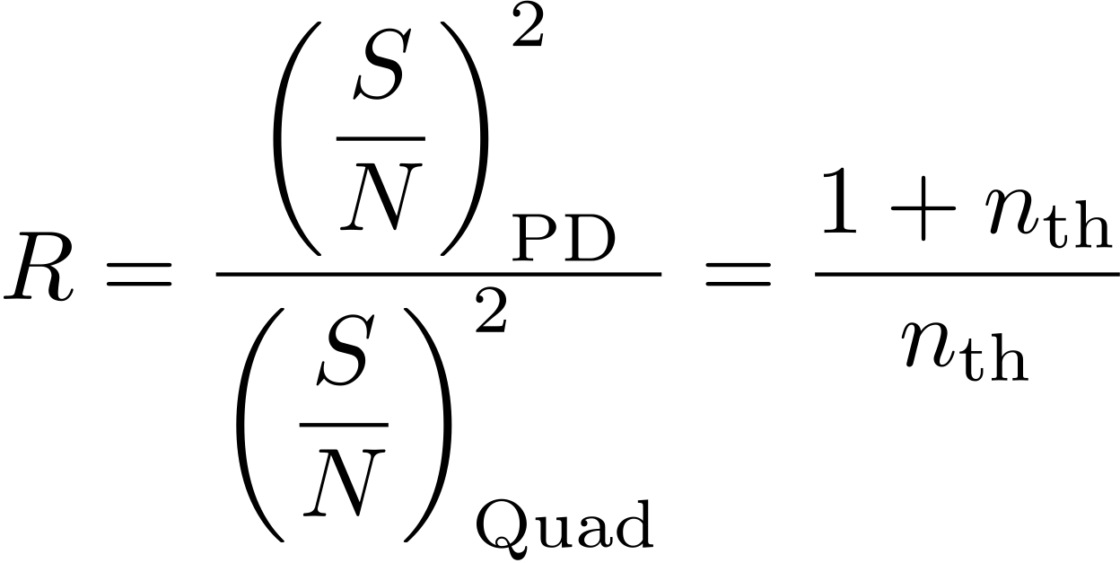
Quantum Optics 101
Field detector
Photon Detector Speedup
weak & incoherent photon source
emission rate:
emission bandwidth:
integration time:
temperature:
Photon detector

Slide 21
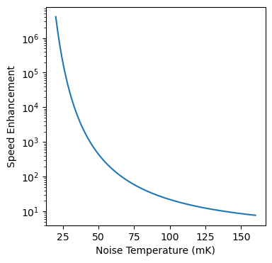
Quantum Optics 101
Field detector
photon detector speedup over linear amplifier
weak & incoherent photon source
emission rate:
emission bandwidth:
integration time:
temperature:
Photon detector

Slide 22
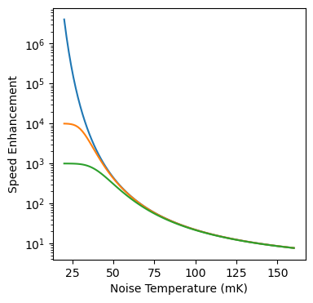
Quantum Optics 101
Field detector
photon detector speedup over linear amplifier
weak & incoherent photon source
Speedup experimentally limited by detector dark count
emission rate:
emission bandwidth:
integration time:
temperature:
Photon detector

Slide 23
Outline
Photon Detection vs Field Detection
Superconducting Qubit-based Single Microwave Photon Detector (SMPD)
Counting Photon for Axion Dark Matter Search
Enhanced sensitivity with Multiqubit Photon Counter

Slide 24
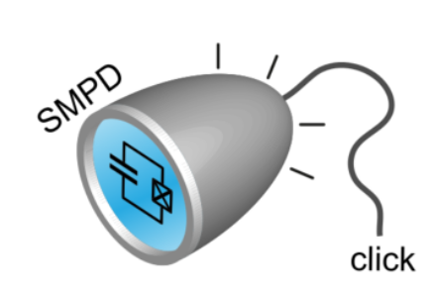
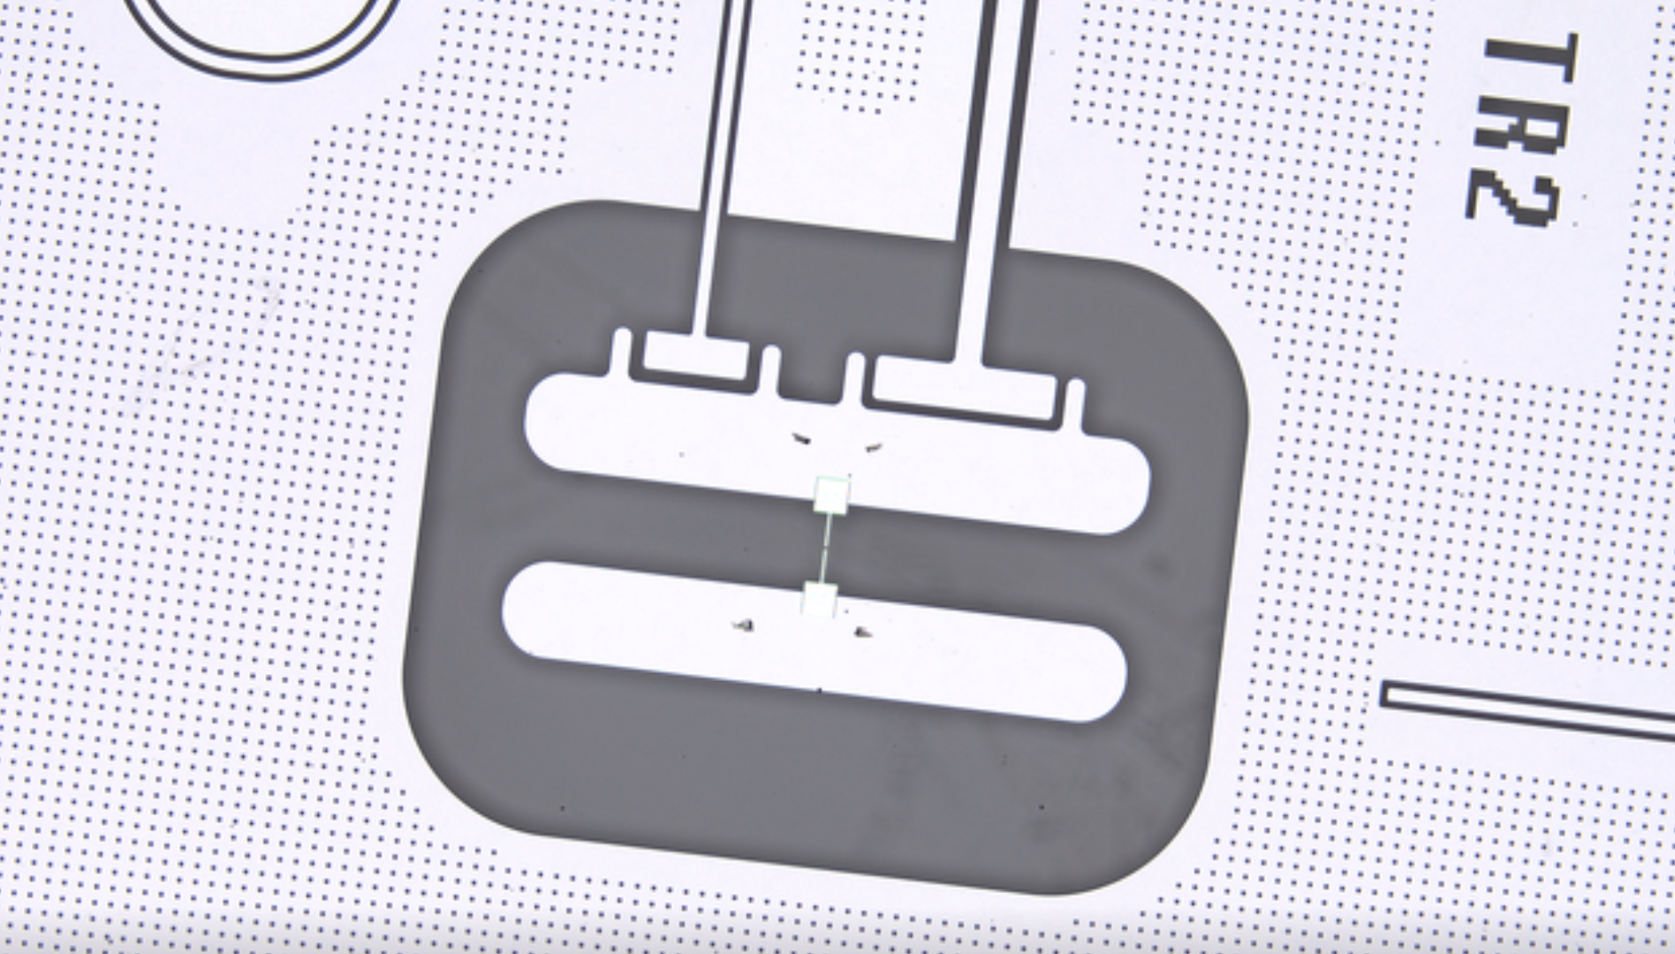
Circuit QED for Quantum sensing
=
25 years of superconducting quantum circuits pioneered by the Quantronics/CEA, Yale, NEC…

Slide 25
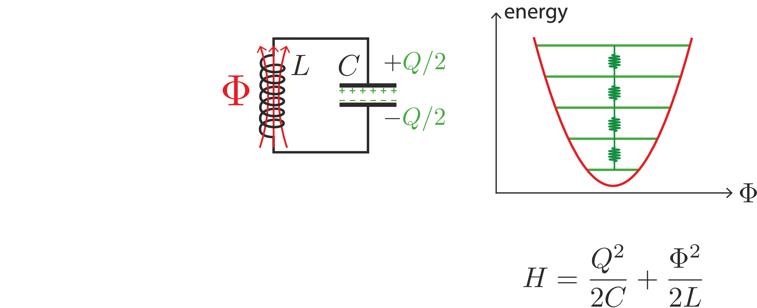
Artificial atoms

Slide 26
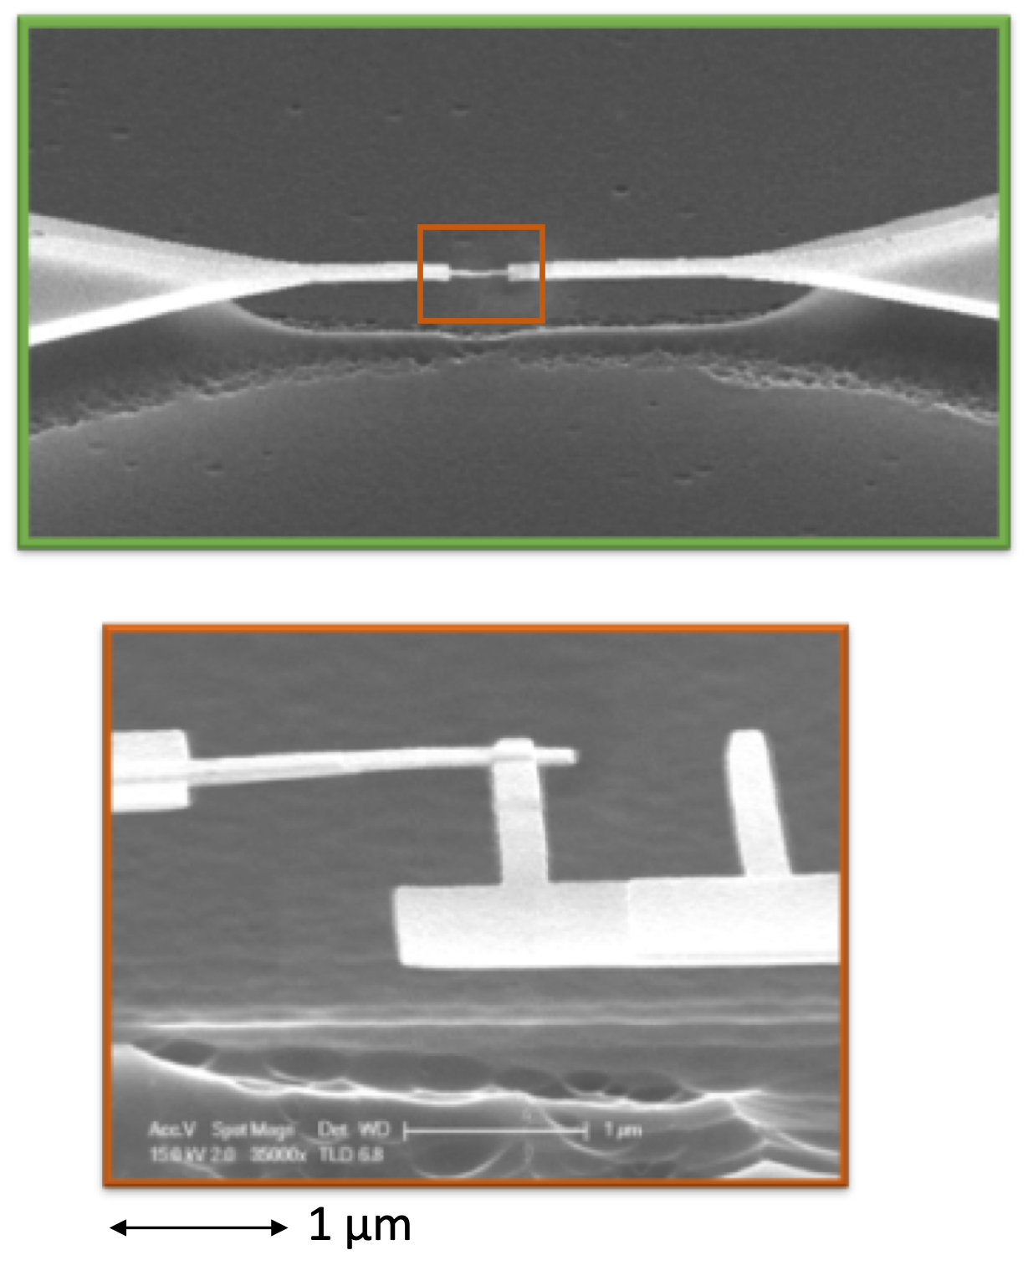
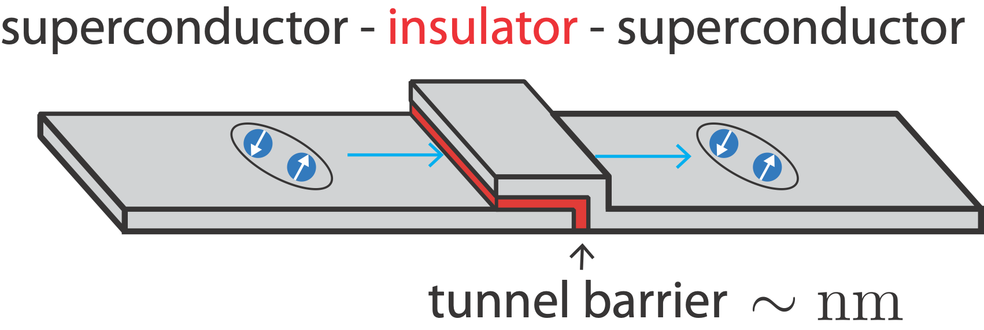
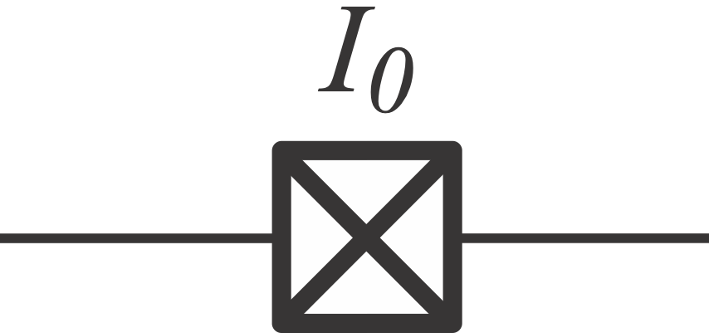
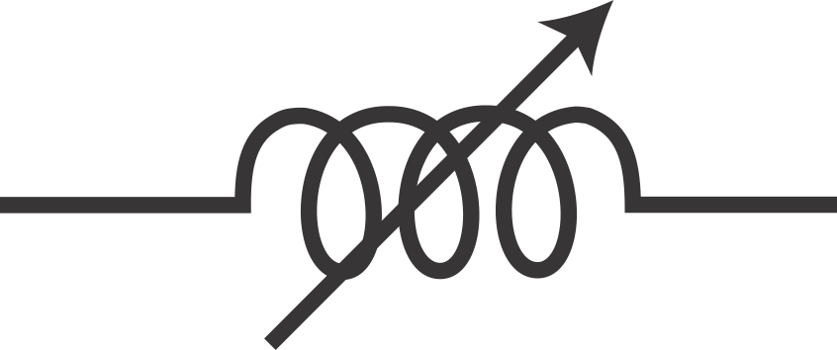
Artificial atoms
Josephson junction
dissipationless non-linear inductor
Notes:
To generate more exotic quantum states, one needs to add some non-linear element.
It turns out that a basic component of superconducting circuits provides this non-linearity. This is the Josephson junction. It is a superconducting tunnel junction which consists in a thin insulating barrier made of aluminum oxide placed between two superconducting electrodes.
In practice, this component behaves as an inductance whose the value depends on the current that goes through.

Slide 27
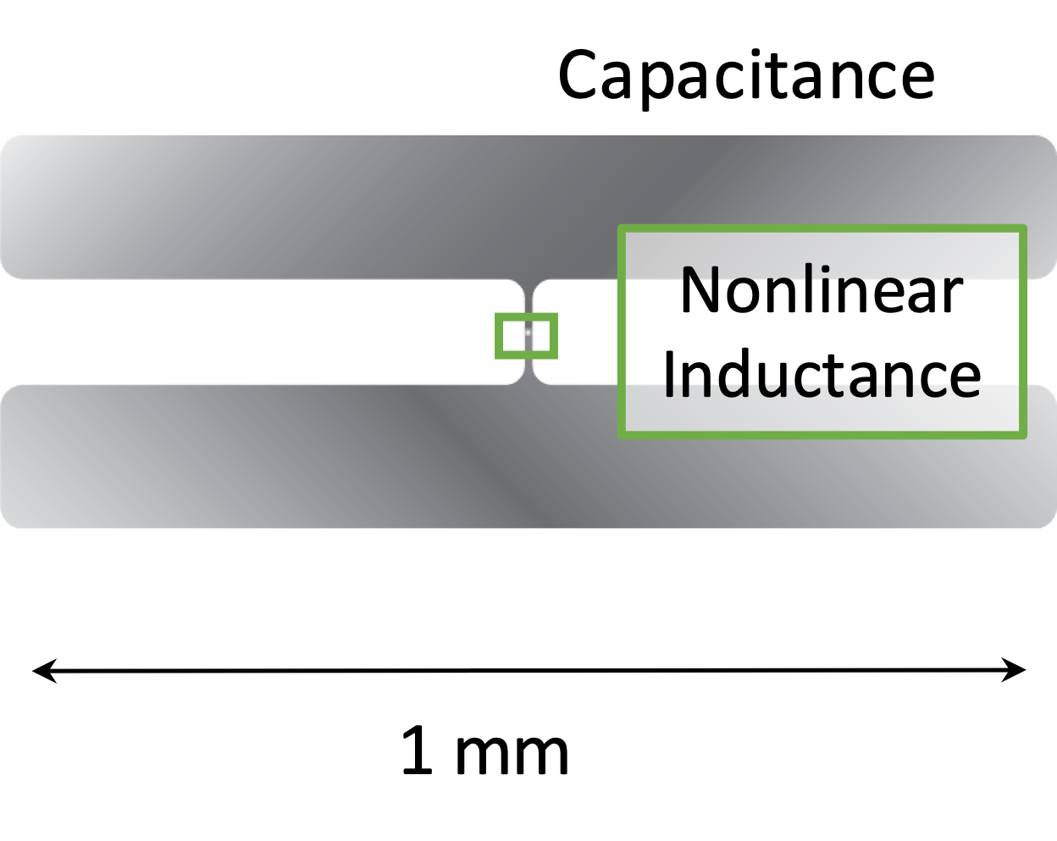
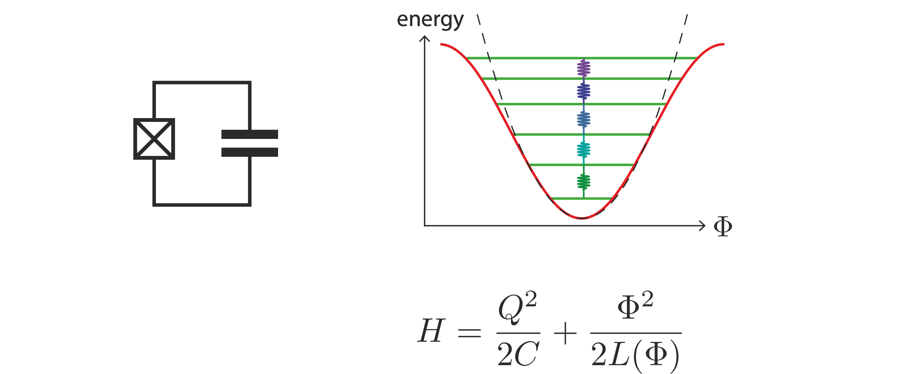
Artificial atoms

Slide 28
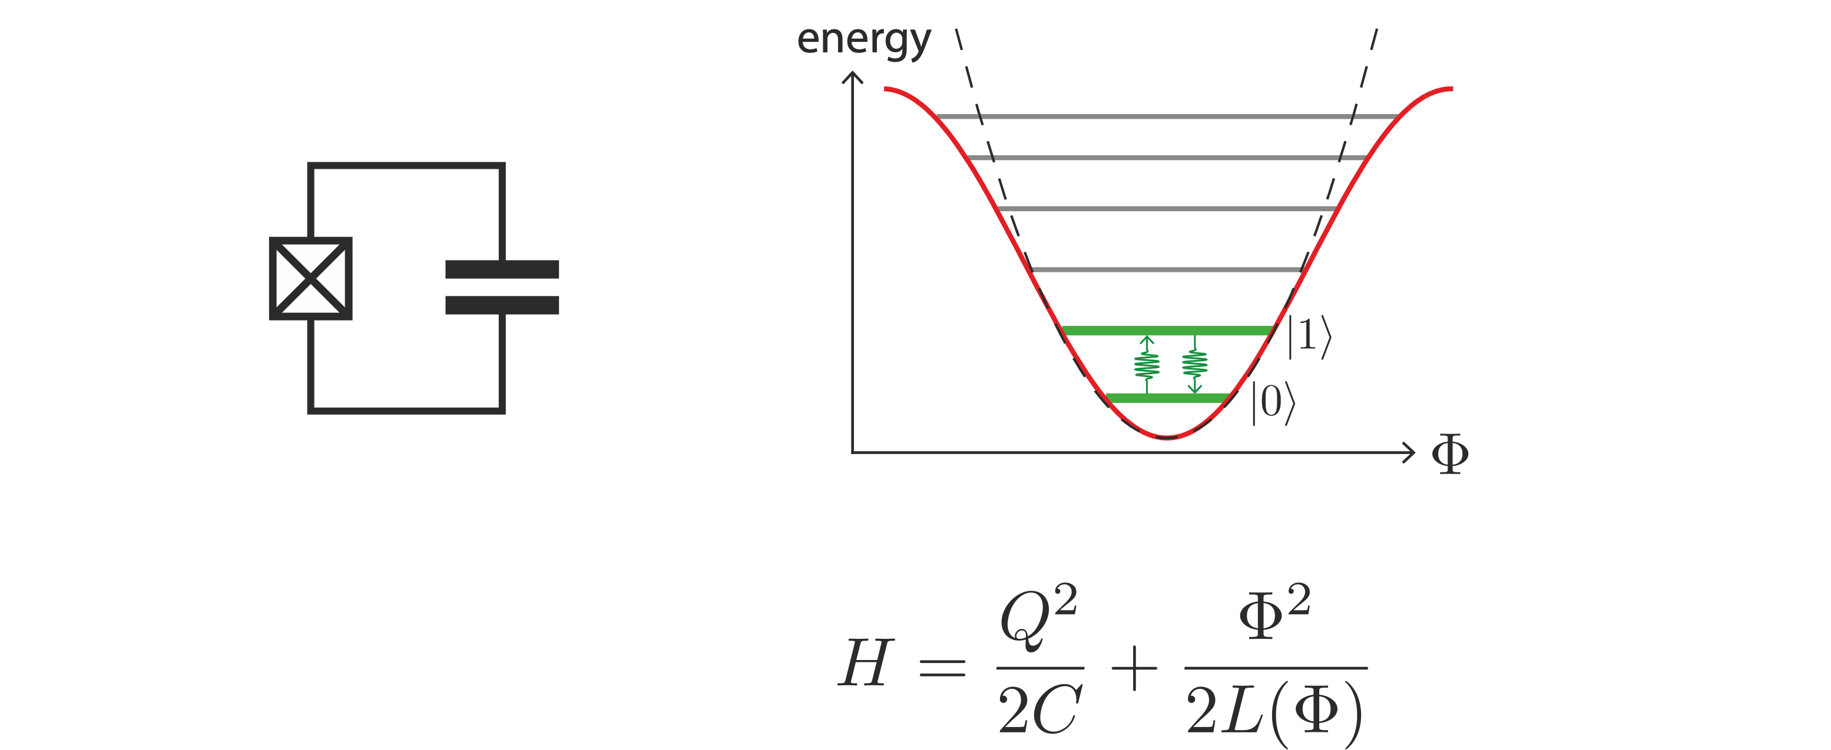
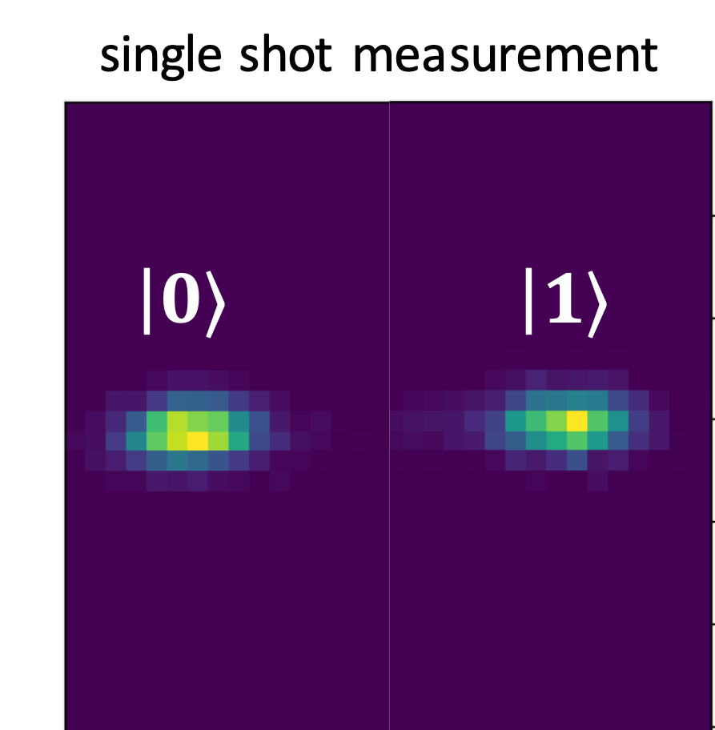
Artificial atoms

Slide 29
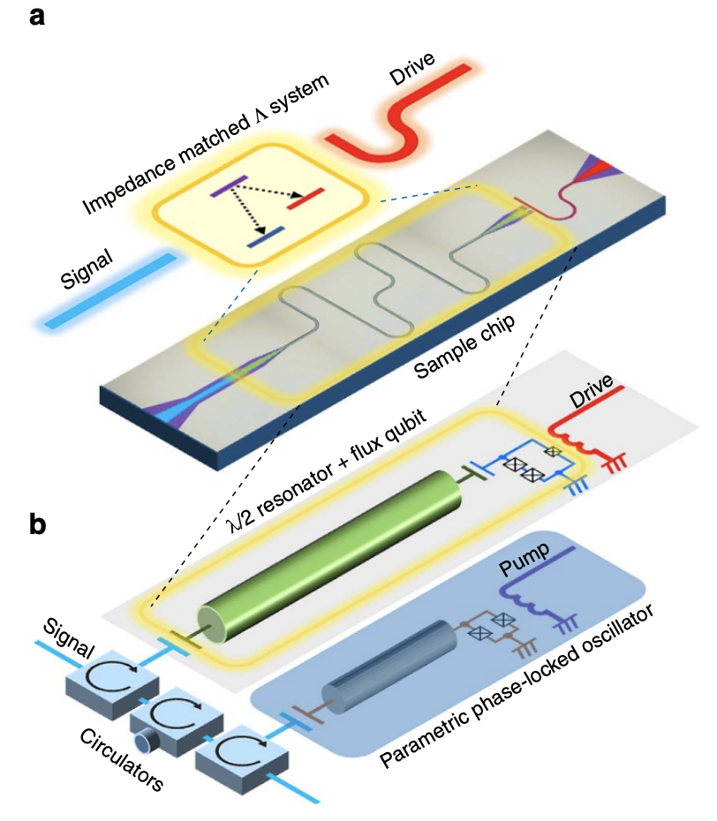
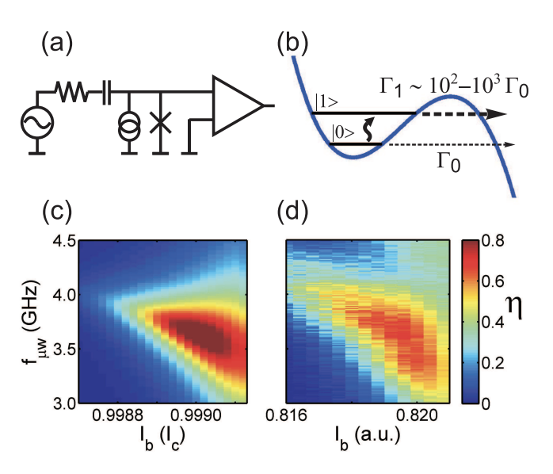
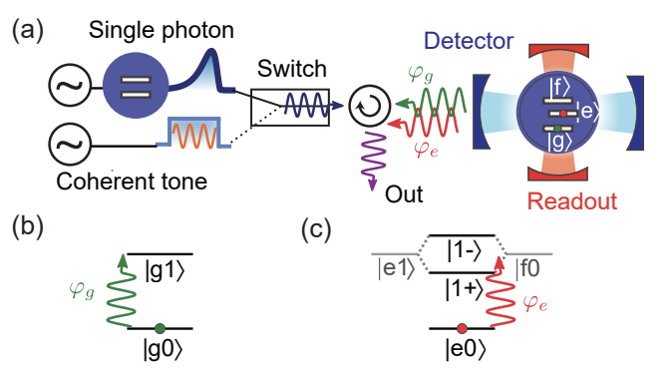
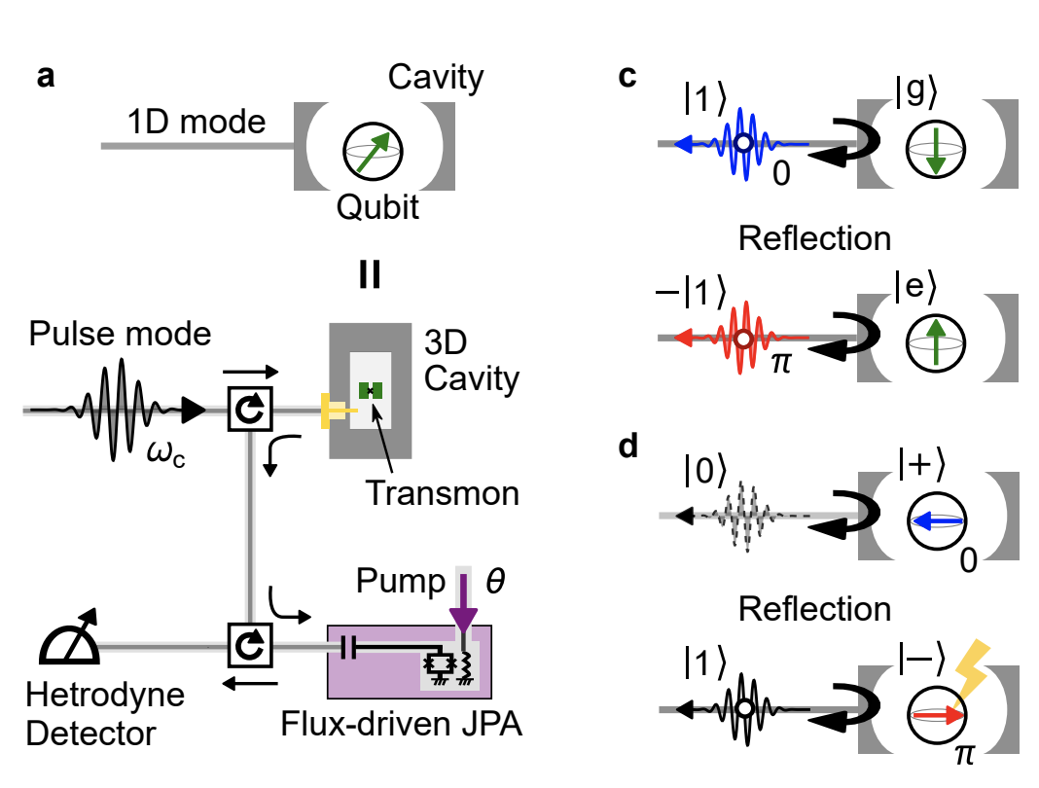
Circuit QED for Microwave Photon Counting
[Chen et al.,Physical review letters 107.21 (2011)]
[Inomata et al., Nature communications, 7(1), 12303.]
[Kono et al., Nature Physics 14 (6), 546-549]
[Besse et al, Physical Review X 8.2 (2018): 021003.]

Slide 30
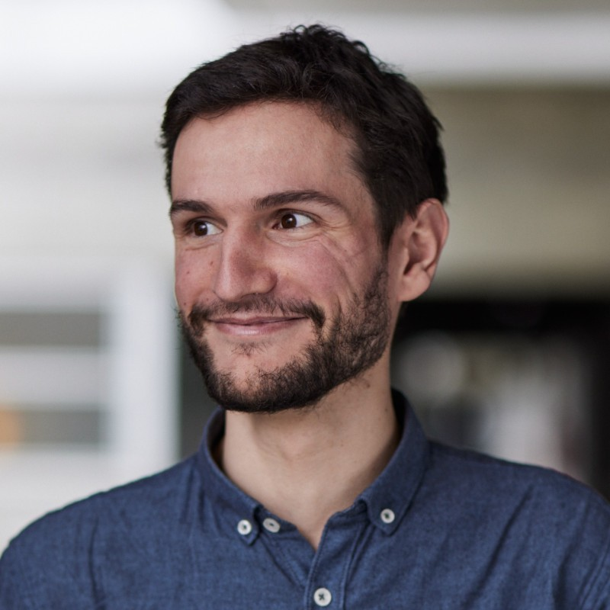
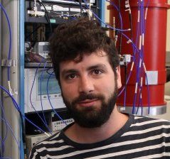
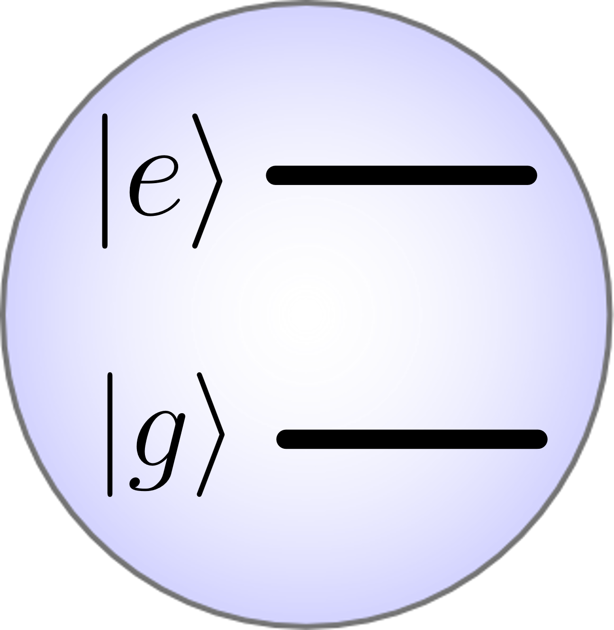
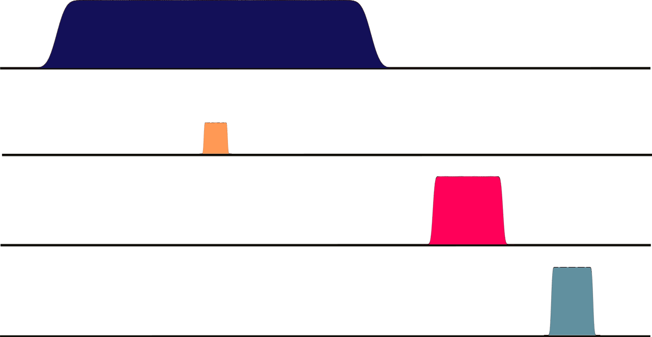
Single MW photon detector
Pump
R. Lescanne & al., PRX (2020)
$${5×10}^{−21} W/{\sqrt{Hz}}^{ ∗}$$
Buffer
Qubit
Waste
$g_{4}^{ }ξ{\hat{b}\hat{σ}}_{ }^{†}{\hat{w}}^{†}$ + $g_{4}^{∗ }ξ{\hat{b}}_{ }^{†}\hat{σ}\hat{w}$
$$N_{cycles}$$
Pump
Buffer
$$ω_{2}$$
Readout
if e
Qubit
* NEP @ 7 GHz

Slide 31
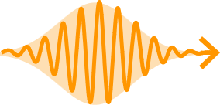
Single MW photon detector
Pump
R. Lescanne & al., PRX (2020)
$${5×10}^{−21} W/{\sqrt{Hz}}^{ ∗}$$
Buffer
Qubit
Waste
$g_{4}^{ }ξ{\hat{b}\hat{σ}}_{ }^{†}{\hat{w}}^{†}$ + $g_{4}^{∗}ξ{\hat{b}}_{ }^{†}\hat{σ}\hat{w}$
$$N_{cycles}$$
Pump
Buffer
$$ω_{2}$$
Readout
if e
Qubit
* NEP @ 7 GHz

Slide 32
Single MW photon detector
Pump
R. Lescanne & al., PRX (2020)
$${5×10}^{−21} W/{\sqrt{Hz}}^{ ∗}$$
Buffer
Qubit
Waste
$g_{4}^{ }ξ{\hat{b}\hat{σ}}_{ }^{†}{\hat{w}}^{†}$ + $g_{4}^{∗ }ξ{\hat{b}}_{ }^{†}\hat{σ}\hat{w}$
$$N_{cycles}$$
Pump
Buffer
$$ω_{2}$$
Readout
if e
Qubit
* NEP @ 7 GHz

Slide 33
Single MW photon detector
Pump
R. Lescanne & al., PRX (2020)
$${5×10}^{−21} W/{\sqrt{Hz}}^{ ∗}$$
Buffer
Qubit
Waste
$g_{4}^{ }ξ{\hat{b}\hat{σ}}_{ }^{†}{\hat{w}}^{†}$ + $g_{4}^{∗ }ξ{\hat{b}}_{ }^{†}\hat{σ}\hat{w}$
$$N_{cycles}$$
Pump
Buffer
$$ω_{2}$$
Readout
if e
Qubit
* NEP @ 7 GHz

Slide 34
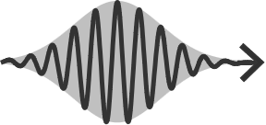
Single MW photon detector
Pump
R. Lescanne & al., PRX (2020)
$${5×10}^{−21} W/{\sqrt{Hz}}^{ ∗}$$
$$\text{dissipation}\text{ !}$$
Buffer
Qubit
Waste
$g_{4}^{ }ξ{\hat{b}\hat{σ}}_{ }^{†}{\hat{w}}^{†}$ + $g_{4}^{∗ }ξ{\hat{b}}_{ }^{†}\hat{σ}\hat{w}$
$$N_{cycles}$$
Pump
Buffer
$$ω_{2}$$
Readout
if e
Qubit
* NEP @ 7 GHz

Slide 35
Single MW photon detector
Pump
R. Lescanne & al., PRX (2020)
$${5×10}^{−21} W/{\sqrt{Hz}}^{ ∗}$$
$$\text{dissipation}\text{ !}$$
Buffer
Qubit
Waste
$g_{4}^{ }ξ{\hat{b}\hat{σ}}_{ }^{†}{\hat{w}}^{†}$ + $g_{4}^{∗ }ξ{\hat{b}}_{ }^{†}\hat{σ}\hat{w}$
$$N_{cycles}$$
Pump
Buffer
$$ω_{2}$$
Readout
if e
Qubit
* NEP @ 7 GHz

Slide 36
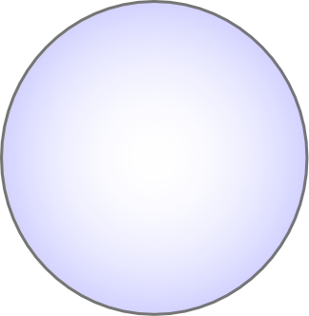
Single MW photon detector
Pump OFF
Readout
R. Lescanne & al., PRX (2020)
$${5×10}^{−21} W/{\sqrt{Hz}}^{ ∗}$$
Buffer
Qubit
Waste
$$N_{cycles}$$
Pump
Buffer
$$ω_{2}$$
Readout
if e
Qubit
* NEP @ 7 GHz

Slide 37
Single MW photon detector
Qubit reset
R. Lescanne & al., PRX (2020)
$${5×10}^{−21} W/{\sqrt{Hz}}^{ ∗}$$
Buffer
Qubit
Waste
$$N_{cycles}$$
Pump
Buffer
$$ω_{2}$$
Readout
if e
Qubit
* NEP @ 7 GHz

Slide 38
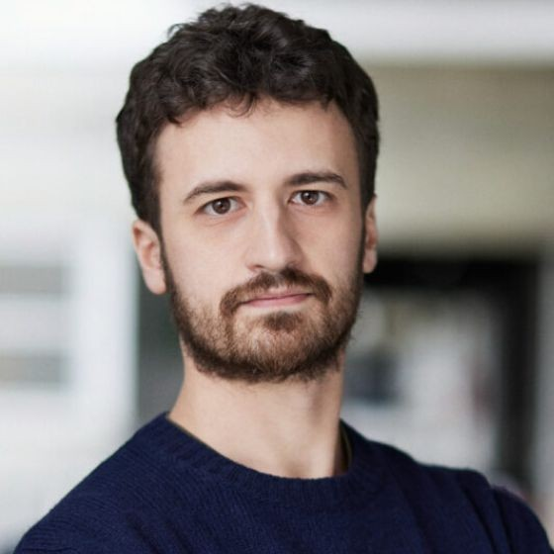
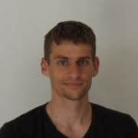
Single MW photon detector
Pump
R. Lescanne & al., PRX (2020)
E. Albertinale & al., Nature (2021)
L. Balembois & al., PR Applied (2023)
L. Pallegoix & al., under review PR Applied (2025)
$${5×10}^{−21} W/{\sqrt{Hz}}^{ ∗}$$
$${2×10}^{−21} W/{\sqrt{Hz}}^{ ∗}$$
$${9×10}^{−23} W/{\sqrt{Hz}}^{ ∗}$$
Buffer
Qubit
Waste
$g_{4}^{ }ξ{\hat{b}\hat{σ}}_{ }^{†}{\hat{w}}^{†}$ + $g_{4}^{∗}ξ{\hat{b}}_{ }^{†}\hat{σ}\hat{w}$
$${3×10}^{−23} W/{\sqrt{Hz}}^{ ∗}$$
$$N_{cycles}$$
Pump
Buffer
$$ω_{2}$$
Readout
if e
Qubit
* NEP @ 7 GHz

Slide 39
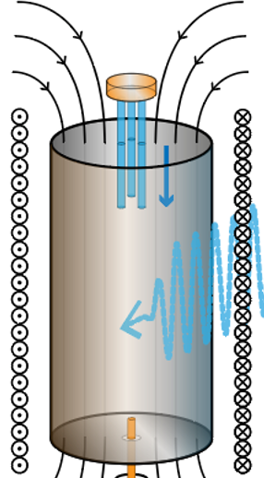
Single MW photon detector
Pump
Range of applications:
Axion search
Small ensemble of electronic spins
Single electronic spin
Single nuclear spin
On going collaboration with QUAX consortium (INFN Padova)(in preparation)
C. Braggio & al., PRX (2025)
E. Albertinale al., Nature (2021)
Buffer
Qubit
Waste
Z. Wang, L. Balembois & al., Nature (2023)
O’Sullivan & al, Nature Physics (2025)
Travesedo & al, Science Advanced (2025)

Slide 40
Single MW photon detector
Pump
Range of applications:
Axion search
Small ensemble of electronic spins
Single electronic spin
Single nuclear spin
$$T_{eff}≈40 mK$$
On going collaboration with QUAX consortium (INFN Padova)(in preparation)
C. Braggio & al., PRX (2025)
E. Albertinale al., Nature (2021)
Buffer
Qubit
Waste
$g_{4}^{ }ξ{\hat{b}\hat{σ}}_{ }^{†}{\hat{w}}^{†}$ + $g_{4}^{ }ξ{\hat{b}}_{ }^{†}\hat{σ}\hat{w}$
Z. Wang, L. Balembois & al., Nature (2023)
$$η≈0.75$$
$$α_{err}≈20 c/s$$
O’Sullivan & al, Nature Physics (2025)
$$α≈40 c/s$$
Travesedo & al, Science Advanced (2025)
$$α_{th}≈20 c/s$$

Slide 41
Design & Packaging
Sample holder JAWS
by Marius Villier (ENS Paris)
Key ingredients
Tantalum sputtered on sapphire
SQUID for frequency tunability
Purcell filters to protect the qubit from external environment
Notes:
Substrat, Ta sur sapphire. Les résoanteurs correspondant aux différentes cavités sont des guides d’ondes coplanaire auxquels on impose des conditions limites. Le qubit est représenté en bleu, il s’agit de deux plan métallique définissant la capacité, court circuité par un jonction josephson. Les résonateurs d’entrés (en orange) et de sortie (en vert) sont couplés capacitivement via ces pads métallique en regard de la des capacités du qubit. La ligne de pompe est représentée en violet. Entre les résoanteurs et les lignes micro-ondes, on ajoute des filtres passe bande pour limiter le couplage du qubit au ligne et donc limité ses pertes radiatives.
Le SMPD est fondamentalement étroit n bande passante → Le résonanteur d’entrée est rendu accordable sur plusieurs centaines de MHz en fréquence grâce à un SQUID. Un SQUID est un dispositif composé de eux jonction josephson en parallele qui se comporte comme une inductance variable en fonction du flux magnétique qui le traverse. La ligne rouge permet de régler ce flux grâce à une ligne de courant placé à proximité du SQUID. Les données que je vais vous présenter dans la suite vont être prise à ce point de fonctionnement du détecteur avec un résonateur d’entrée autour de 6.97 GHz.

Slide 42
4WM as a detection mechanism
Average detection time: $10 μs$
Average cycle time: $12.5 μs$
Average cycle rate: $80 000 /s$
$$ω_{p}+ω_{b}=ω_{q}+ω_{w}$$
$$g_{4}^{ }ξ{\hat{b}\hat{σ}}_{ }^{†}{\hat{w}}^{†}$$
$$g_{4}^{ }ξ{\hat{b}\hat{σ}}_{ }^{†}{\hat{w}}^{†}$$

Slide 43
Efficiency & Dark count rate calibration
Dark-count rate :
0 photon/s
43 clicks/s
0.0
1.0
2.0
Notes:
La première chose à faire quand on a un compteur de photon c’st de venir caractériser deux paramètre clé, le taux de compte d’obscurité qui correspond au signal donné par le compteur en l’absence de photons incident le second paramètre c’est l’éfficacité quantique qui correspond à la probabilité que le compteur donne un clique quand il est frappé par un photon

Slide 44
Efficiency & Dark count rate calibration
Dark-count rate :
650 photon/s
487 clicks/s
0.0
1.0
2.0

Slide 45
Efficiency & Dark count rate calibration
Dark-count rate :
2000 photon/s
1419 clicks/s
0.0
1.0
2.0

Slide 46
Efficiency & Dark count rate calibration
Dark-count rate :
3800 photon/s
2895 clicks/s
0.0
1.0
2.0

Slide 47
Efficiency & Dark count rate calibration
Dark-count rate :
7000 photon/s
4872 clicks/s
0.0
1.0
2.0

Slide 48
Efficiency & Dark count rate calibration
Dark-count rate :
Efficiency :
0
40
80
0.0
1.0
2.0
0
4000
8000

Slide 49
$$T_{eff}≈40 mK$$
Efficiency & Dark count rate calibration
Dark-count rate :
Buffer
Qubit
Waste
Efficiency :
Power sensitivity:
Most sensitive power detector at mw freqs
0
40
80
L. Pallegoix et al, PRApplied (2025)
1.0
2.0
0
4000
8000
Notes:
À connaissance détecteur de puissance le plus sensible au monde on a battu le dernier compteur.
Meilleur detecteur dans la gamme micro-onde

Slide 50
Dark count rate vs Temperature
L. Pallegoix et al, PRApplied (2025)
Notes:
À connaissance détecteur de puissance le plus sensible au monde on a battu le dernier compteur.
Meilleur detecteur dans la gamme micro-onde

Slide 51
A frequency tunable, Narrow band, Spectrum analyzer
Narrow band…
… but Frequency tunable
L. Pallegoix et al, PRApplied (2025)
Thermal dark counts scales with bandwidth

Slide 52
Sensitivity improvements, years after years

Slide 53
Outline
Photon Detection vs Field Detection
Superconducting Qubit-based Single Microwave Photon Detector (SMPD)
Counting Photon for Axion Dark Matter Search
Enhanced sensitivity with Multiqubit Photon Counter

Slide 54
Axion search with Haloscope + Photodetection
QCD Axions could solve two problem at a time:
85% of the mass is missing in the visible universe
Absence of electric dipole moment for the Neutron
QCD: Quantum Chromodynamics
EDM: Electric Dipole Moment
CP: Charge/Parity symmetries
CP violating term in QCD
implies a non-zero EDM for neutrons
@ n2EDM
Notes:
Travaillez l’intro. Wikipedia ?

Slide 55
Peccei-Quinn theory to solve the strong CP problem
New pseudo-scalar field V with Higgs Mechanism
Symmetry breaking

Slide 56
Axion search with Haloscope + Photodetection
QCD Axions could solve two problem at a time:
Absence of electric dipole moment for the Neutron
axion-2photon coupling
85% of the mass is missing in the visible universe

Slide 57
Axion search with Haloscope + Photodetection
Primakoff effect
https://github.com/cajohare/AxionLimits
axion – photon coupling
QCD axion coupling leads to an axion - photon decay channel under strong magnetic field
$g_{γ}$ models
KSVZ: Kim-Shifman-Vainshtein-Zakharov
DFVZ: DineFischler-Srednicki-Zhitnitsky

Slide 58
Axion search with Haloscope + Photodetection
Primakoff effect
https://github.com/cajohare/AxionLimits
axion – photon coupling
QCD axion coupling leads to an axion - photon decay channel under strong magnetic field
${10}^{−6}≤m_{a}≤{10}^{−4}$
or
$0,3 ≤f_{a}≤300$ GHz
$g_{γ}$ models
KSVZ: Kim-Shifman-Vainshtein-Zakharov
DFVZ: DineFischler-Srednicki-Zhitnitsky

Slide 61
QCD coupling
KSVZ
Haloscope parameters
Mode volume
Mode frequency
Quality factor
Mode overlap
DM density
magnetic field

Slide 62
The signal power we expect ...
… the sensitivity we have.
$P_{αγγ}∼{10}^{−24}W$
$∼{10}^{−23}W/√Hz$
QCD coupling
KSVZ
Haloscope parameters
Mode volume
Mode frequency
Quality factor
Mode overlap
DM density
magnetic field

Slide 63
Axion search with Haloscope + Photodetection
MIT JTWPA
Single Microwave Photon Detector
W.D. Oliver
3T Magnet
Collaboration with QUAX (Padova University, ITA)
C. Braggio & G. Carugno

Slide 64
How to align the counter with the haloscope at B=2T
Detector Frequency
Tuning + Detection
Haloscope drive

Slide 65
How to align the counter with the haloscope at B=2T
Detector Frequency Tuning
Detector Frequency
Tuning + Detection
Haloscope
Reflection Coefficient
Haloscope drive

Slide 66
How to align the counter with the haloscope at B=2T
Detector Frequency Tuning
Haloscope frequency tuning with sapphire rods
Haloscope
Reflection Coefficient

Slide 67
Axion search by Photon Counting
Data acquisition

Slide 68
Axion search by Photon Counting
Data acquisition
Data processing

Slide 69
Axion search by Photon Counting
Data acquisition
Data processing
Signal & Background
channels have different
noise levels.
Haloscope is hot ~70mK
No axion… maybe an other time!

Slide 70
Axion search by Photon Counting

Slide 71
Realistic axion search POC landscape
Scan rate speed up over SQL
$$R\sim 1300$$
… but not very realistic because
No B field applied (the qubit would die due to Supra to Normal transition)
Storage not frequency tunable

Slide 72
Conclusion
01.
Design of a practical SMPD with frequency / bandwidth tunability, and sensitivity $3×{10}^{−23}W/\sqrt{Hz}$ @7.3 GHz.
02.
Axion search most realistic POC with such a device. Demonstrate a 20x scan rate improvement over ideal Quantum Limited Amplifiers.
Tunable haloscope with sapphire rods (~500 kHz)
Magnetic field applied (2T)
$$R=\frac{t_{SQL}}{t_{PC}}=η^{2}\frac{Δν_{a}}{Γ_{dc}}\sim 20$$
Next.
POC in real experimental conditions under 9T (collab. Padova University QUAX & FermiLab SQMS). Currently ongoing!

Slide 73
Outline
Photon Detection vs Field Detection
Superconducting Qubit-based Single Microwave Photon Detector (SMPD)
Counting Photon for Axion Dark Matter Search
Enhanced sensitivity with Multiqubit Photon Counter

Slide 74
Cascaded Single MW photon detector
Pump
Pump 1
Pump 2
Pump
Buffer
Qubit 1
Bus
Qubit 2
Waste
Buffer
Qubit
Waste
Buffer
Qubit
Waste
$g_{4}^{ }ξ{\hat{b}\hat{σ}}_{ }^{†}{\hat{w}}^{†}$ + h.c + dissipation
$g_{4}^{ }ξ{\hat{b}\hat{σ}}_{ }^{†}{\hat{w}}^{†}$ + h.c + dissipation
${g_{4,1}ξ}_{1}{\hat{b}\hat{σ}}_{1}^{†}{\hat{r}}^{†}$+ $g_{4,2}ξ_{2}{\hat{r}\hat{σ}}_{2}^{†}{\hat{w}}^{†} \text{+} \text{h}\text{.}\text{c}\text{ + }\text{dissipation}$

Slide 75
Cascaded Single MW photon detector
Pump 1
Pump 2
Buffer
Qubit 1
Bus
Qubit 2
Waste
${g_{4,1}ξ}_{1}{\hat{b}\hat{σ}}_{1}^{†}{\hat{r}}^{†}$+ ${{g_{4,1}^{∗}ξ}_{1}^{∗}{\hat{b}}_{ }^{†}{\hat{σ}}_{1}\hat{r} \text{+ }g_{4,2}ξ_{2}{\hat{r}\hat{σ}}_{2}^{†}{\hat{w}}^{†} \text{+} g}_{4,2}^{∗}ξ_{2}^{∗}{\hat{r}}_{ }^{†}{\hat{σ}}_{2}\hat{w}$

Slide 76
Cascaded Single MW photon detector
Pump 1
Pump 2
Buffer
Qubit 1
Bus
Qubit 2
Waste
${g_{4,1}ξ}_{1}{\hat{b}\hat{σ}}_{1}^{†}{\hat{r}}^{†}$+ ${{g_{4,1}^{∗}ξ}_{1}^{∗}{\hat{b}}_{ }^{†}{\hat{σ}}_{1}\hat{r} \text{+ }g_{4,2}ξ_{2}{\hat{r}\hat{σ}}_{2}^{†}{\hat{w}}^{†} \text{+} g}_{4,2}^{∗}ξ_{2}^{∗}{\hat{r}}_{ }^{†}{\hat{σ}}_{2}\hat{w}$
Pump 1
$$N_{cycles}$$
Pump 2
Buffer
Readout 1
Readout 2
if e
Qubit 1
Qubit 2

Slide 77
Cascaded Single MW photon detector
Pump 1
Pump 2
Buffer
Qubit 1
Bus
Qubit 2
Waste
${g_{4,1}ξ}_{1}{\hat{b}\hat{σ}}_{1}^{†}{\hat{r}}^{†}$+ ${{g_{4,1}^{∗}ξ}_{1}^{∗}{\hat{b}}_{ }^{†}{\hat{σ}}_{1}\hat{r} \text{+ }g_{4,2}ξ_{2}{\hat{r}\hat{σ}}_{2}^{†}{\hat{w}}^{†} \text{+} g}_{4,2}^{∗}ξ_{2}^{∗}{\hat{r}}_{ }^{†}{\hat{σ}}_{2}\hat{w}$
Pump 1
$$N_{cycles}$$
Pump 2
Buffer
Readout 1
Readout 2
if e
Qubit 1
Qubit 2

Slide 78
Cascaded Single MW photon detector
Pump 1
Pump 2
Buffer
Qubit 1
Bus
Qubit 2
Waste
${g_{4,1}ξ}_{1}{\hat{b}\hat{σ}}_{1}^{†}{\hat{r}}^{†}$+ ${{g_{4,1}^{∗}ξ}_{1}^{∗}{\hat{b}}_{ }^{†}{\hat{σ}}_{1}\hat{r} \text{+ }g_{4,2}ξ_{2}{\hat{r}\hat{σ}}_{2}^{†}{\hat{w}}^{†} \text{+} g}_{4,2}^{∗}ξ_{2}^{∗}{\hat{r}}_{ }^{†}{\hat{σ}}_{2}\hat{w}$
Pump 1
$$N_{cycles}$$
Pump 2
Buffer
Readout 1
Readout 2
if e
Qubit 1
Qubit 2

Slide 79
Cascaded Single MW photon detector
Pump 1
Pump 2
Buffer
Qubit 1
Bus
Qubit 2
Waste
${g_{4,1}ξ}_{1}{\hat{b}\hat{σ}}_{1}^{†}{\hat{r}}^{†}$+ ${{g_{4,1}^{∗}ξ}_{1}^{∗}{\hat{b}}_{ }^{†}{\hat{σ}}_{1}\hat{r} \text{+ }g_{4,2}ξ_{2}{\hat{r}\hat{σ}}_{2}^{†}{\hat{w}}^{†} \text{+} g}_{4,2}^{∗}ξ_{2}^{∗}{\hat{r}}_{ }^{†}{\hat{σ}}_{2}\hat{w}$
Pump 1
$$N_{cycles}$$
$$\text{dissipation}\text{ !}$$
Pump 2
Buffer
Readout 1
Readout 2
if e
Qubit 1
Qubit 2

Slide 80
Cascaded Single MW photon detector
Pump 1
Pump 2
Buffer
Qubit 1
Bus
Qubit 2
Waste
${g_{4,1}ξ}_{1}{\hat{b}\hat{σ}}_{1}^{†}{\hat{r}}^{†}$+ ${{g_{4,1}^{∗}ξ}_{1}^{∗}{\hat{b}}_{ }^{†}{\hat{σ}}_{1}\hat{r} \text{+ }g_{4,2}ξ_{2}{\hat{r}\hat{σ}}_{2}^{†}{\hat{w}}^{†} \text{+} g}_{4,2}^{∗}ξ_{2}^{∗}{\hat{r}}_{ }^{†}{\hat{σ}}_{2}\hat{w}$
Pump 1
$$N_{cycles}$$
$$\text{dissipation}\text{ !}$$
$$\text{dissipation}\text{ !}$$
Pump 2
Buffer
Readout 1
Readout 2
if e
Qubit 1
Qubit 2

Slide 81
Cascaded Single MW photon detector
Pump 1
Pump 2
Buffer
Qubit 1
Bus
Qubit 2
Waste
${g_{4,1}ξ}_{1}{\hat{b}\hat{σ}}_{1}^{†}{\hat{r}}^{†}$+ ${{g_{4,1}^{∗}ξ}_{1}^{∗}{\hat{b}}_{ }^{†}{\hat{σ}}_{1}\hat{r} \text{+ }g_{4,2}ξ_{2}{\hat{r}\hat{σ}}_{2}^{†}{\hat{w}}^{†} \text{+} g}_{4,2}^{∗}ξ_{2}^{∗}{\hat{r}}_{ }^{†}{\hat{σ}}_{2}\hat{w}$
Pump 1
$$N_{cycles}$$
$$\text{dissipation}\text{ !}$$
$$\text{dissipation}\text{ !}$$
Pump 2
Buffer
Readout 1
Readout 2
if e
Qubit 1
Qubit 2

Slide 82
Cascaded Single MW photon detector
Pump 1 OFF
Pump 2 OFF
Readout 1
Readout 2
Buffer
Qubit 1
Bus
Qubit 2
Waste
Pump 1
$$N_{cycles}$$
Pump 2
Buffer
Readout 1
Readout 2
if e
Qubit 1
Qubit 2

Slide 83
Cascaded Single MW photon detector
Qubit reset 1
Qubit reset 2
Buffer
Qubit 1
Bus
Qubit 2
Waste
Pump 1
$$N_{cycles}$$
Pump 2
Buffer
Readout 1
Readout 2
if e
Qubit 1
Qubit 2

Slide 84
Cascaded Single MW photon detector
Pump 1
Pump 2
Buffer
Qubit 1
Bus
Qubit 2
Waste
${g_{4,1}ξ}_{1}{\hat{b}\hat{σ}}_{1}^{†}{\hat{r}}^{†}$+ ${{g_{4,1}^{∗}ξ}_{1}^{∗}{\hat{b}}_{ }^{†}{\hat{σ}}_{1}\hat{r} \text{+ }g_{4,2}ξ_{2}{\hat{r}\hat{σ}}_{2}^{†}{\hat{w}}^{†} \text{+} g}_{4,2}^{∗}ξ_{2}^{∗}{\hat{r}}_{ }^{†}{\hat{σ}}_{2}\hat{w}$
Pump 1
$$N_{cycles}$$
$$\text{dissipation}\text{ !}$$
$$\text{dissipation}\text{ !}$$
Pump 2
Buffer
Readout 1
Readout 2
if e
Qubit 1
Qubit 2

Slide 85
Efficiency & Dark count rate calibration
Input Photon flux ($s^{−1}$)
Input Power (zW)
Qubit 1
Qubit 2
Qubit 1 & Qubit 2
$$0$$
$$120$$
$$463$$
$$1526$$
$$4665$$

Slide 86
Efficiency & Dark count rate calibration
Input Photon flux ($s^{−1}$)
Input Power (zW)
Qubit 1
Qubit 2
Qubit 1 & Qubit 2
$$0$$
$$120$$
$$463$$
$$1526$$
$$4665$$

Slide 87
Efficiency & Dark count rate calibration
Input Photon flux ($s^{−1}$)
Input Power (zW)
Qubit 1
Qubit 2
Qubit 1 & Qubit 2
$$0$$
$$120$$
$$463$$
$$1526$$
$$4665$$

Slide 88
Efficiency & Dark count rate calibration
Input Photon flux ($s^{−1}$)
Input Power (zW)
Qubit 1
Qubit 2
Qubit 1 & Qubit 2
$$0$$
$$120$$
$$463$$
$$1526$$
$$4665$$
$$η≈0.25$$
$$α_{err}≈0.1 c/s$$
$$α≈5 c/s$$
$$α_{th}≈5 c/s$$
$$Q_{1} \& Q_{2}$$

Slide 89
Where we were, are, and are headed
1 qubit
Freq & BW tunable
2 qubits
BW tunable
2 qubits, higher frequency
BW tunable
$$T_{eff}≈40 mK$$
Buffer
Qubit
Waste
Input frequency [GHz] | 7,3 | 8,8 | 11,7
Efficiency | 0,75 | $$0,25$$ | $$0,35$$
$$α_{th}$$ | $≈20$ (BW~170 kHz) | $≈5$ (BW~230 kHz) | $≈0,01$ (BW~300 kHz)
$$α_{q}$$ | $$≈10$$ | $$≈0,1$$ | $$≈0,1$$
$$α_{p}$$ | $$≈2$$ | $$≈0,01$$ | $$≈4$$
$Sensitivity=ℏω\frac{√α}{η} [\frac{W}{\sqrt{Hz}}]$ | $$≈3×{10}^{−23}$$ | $$≈5×{10}^{−23}$$ | $$≈4×{10}^{−23}$$
Better $T_{1}$

Slide 90
Aknowledgements
J. Travesedo
D. Haegi
W. Huang
L. Suteveski
L. Pallegoix
A. May
X. Zhou
A. Pscherer
J. O’Sullivan
D. Vion
E. Flurin
P. Bertet

Slide 91
Thermometry across several SMPD devices
Lowest equilibrium population
ever measured in a MW resonator

Slide 92
Proof of principle
“ON”
$Q_{1}$
$Q_{2}$
$$Q_{1} \& Q_{2}$$
$$ω_{1}$$
$Q_{1}$
Pump 1
Pump 2
$$ω_{2}$$
Buffer
click probability
Readout 1
Readout 2
Qubit 1
if e
Qubit 2
$p^{th} \sim 4 ×10^{−4}$ *
$$p^{th} \sim 2−3 ×10^{−3 } \text{∗}$$
* With active reset

Slide 93
Proof of principle
“ON”
$Q_{1}$
$Q_{2}$
$$Q_{1} \& Q_{2}$$
$$ω_{1}$$
$Q_{1}$
$Q_{2}$
Pump 1
Pump 2
$$ω_{2}$$
Buffer
click probability
Readout 1
Readout 2
Qubit 1
if e
Qubit 2
* With active reset

Slide 94
Proof of principle
“ON”
$Q_{1}$
$Q_{2}$
$$Q_{1} \& Q_{2}$$
$$ω_{1}$$
$Q_{1}$
$Q_{2}$
$$Q_{1} \& Q_{2}$$
Pump 1
Pump 2
$$ω_{2}$$
Buffer
click probability
Readout 1
Readout 2
Qubit 1
if e
Qubit 2
* With active reset

Slide 95
Proof of principle
“ON”
$Q_{1}$
$Q_{2}$
$$Q_{1} \& Q_{2}$$
$$ω_{1}$$
$Q_{1}$
$Q_{2}$
$$Q_{1} \& Q_{2}$$
Pump 1
Pump 2
$$ω_{2}$$
Buffer
click probability
Readout 1
Readout 2
Qubit 1
if e
Qubit 2
“OFF”
$$ω_{1}$$
$p^{th} \sim 4 ×10^{−4}$ *
Pump 1
Pump 2
$$ω_{2}$$
Buffer
click probability
Readout 1
Readout 2
Qubit 1
if e
Qubit 2
* With active reset

Slide 96
Proof of principle
“ON”
$Q_{1}$
$Q_{2}$
$$Q_{1} \& Q_{2}$$
$$ω_{1}$$
$Q_{1}$
$Q_{2}$
$$Q_{1} \& Q_{2}$$
Pump 1
Pump 2
$$ω_{2}$$
Buffer
click probability
Readout 1
Readout 2
Qubit 1
if e
Qubit 2
“OFF”
$$ω_{1}$$
$p^{th} \sim 4 ×10^{−4}$ *
$$p^{th} \sim 2−3 ×10^{−3 } \text{∗}$$
Pump 1
Pump 2
$$ω_{2}$$
Buffer
Readout 1
click probability
Readout 2
Qubit 1
if e
Qubit 2
* With active reset

Slide 97
Proof of principle
“ON”
$Q_{1}$
$Q_{2}$
$$Q_{1} \& Q_{2}$$
$$ω_{1}$$
$Q_{1}$
$Q_{2}$
$$Q_{1} \& Q_{2}$$
Pump 1
Pump 2
$$ω_{2}$$
Buffer
click probability
Readout 1
Readout 2
Qubit 1
if e
Qubit 2
“OFF”
$$ω_{1}$$
$p^{th} \sim 4 ×10^{−4}$ *
$$p^{th} \sim 2−3 ×10^{−3 } \text{∗}$$
Pump 1
Pump 2
$$ω_{2}$$
Buffer
Readout 1
click probability
Readout 2
Qubit 1
if e
Qubit 2
* With active reset

Slide 98
Proof of principle
“ON”
$Q_{1}$
$Q_{2}$
$$Q_{1} \& Q_{2}$$
$$ω_{1}$$
$Q_{1}$
$Q_{2}$
$$Q_{1} \& Q_{2}$$
Pump 1
Pump 2
$$ω_{2}$$
Buffer
click probability
Readout 1
Readout 2
Qubit 1
if e
Qubit 2
“OFF”
$${∝α}_{err}$$
$$ω_{1}$$
$p^{th} \sim 4 ×10^{−4}$ *
$$p^{th} \sim 2−3 ×10^{−3 } \text{∗}$$
$$p^{th} ≪ 10^{−5} ∗$$
Pump 1
$$p^{th} \sim 5× 10^{−5} ∗$$
Pump 2
$$ω_{2}$$
Buffer
Readout 1
click probability
Readout 2
Qubit 1
if e
Qubit 2
$${∝α}_{th}$$
* With active reset

Slide 99
Intrinsic Bandwidth tunability
$$P_{e}$$
$$∝\frac{g_{4,1}^{2}}{κ_{b}}$$
$$∝\frac{g_{4,2}^{2}}{κ_{w}}$$
$$BW ∝ \frac{ξ_{1}^{2}}{κ_{b}} ∝ \frac{ξ_{2}^{2}}{κ_{w}}$$

