Slide 1
Quantum sensors activities @ IN2P3-France
I. Laktineh

Slide 2
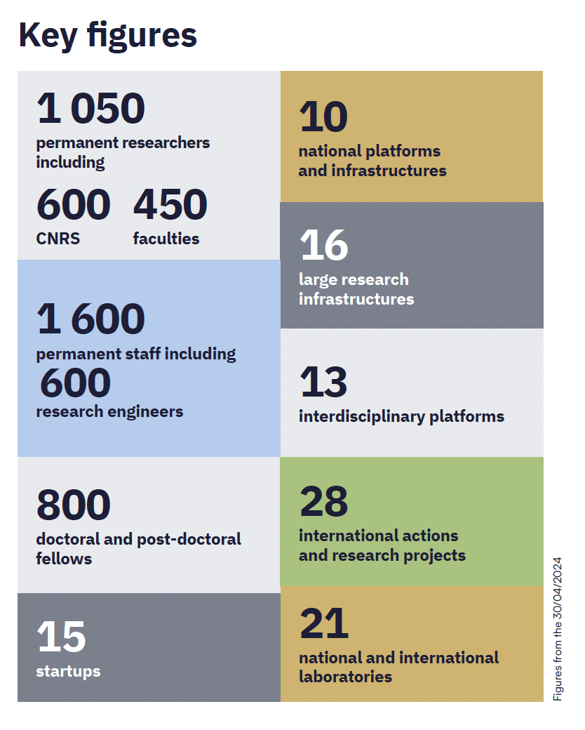
IN2P3
Institut National de La Physique des Particules et de la Physique Nucléaire
IN2P3 is one of the ten French CNRS institutes. It focuses on probing the two infinites from particles to cosmos
Although IN2P3 contributes to many activities that are directly or indirectly related to Quantum Sensors, there is no axis identified as such.
So in the next slides I will show the different activities I identified, up to now, that could either be considered as quantum activities oras important elements that can/may contribute to quantum technologies.

Slide 3
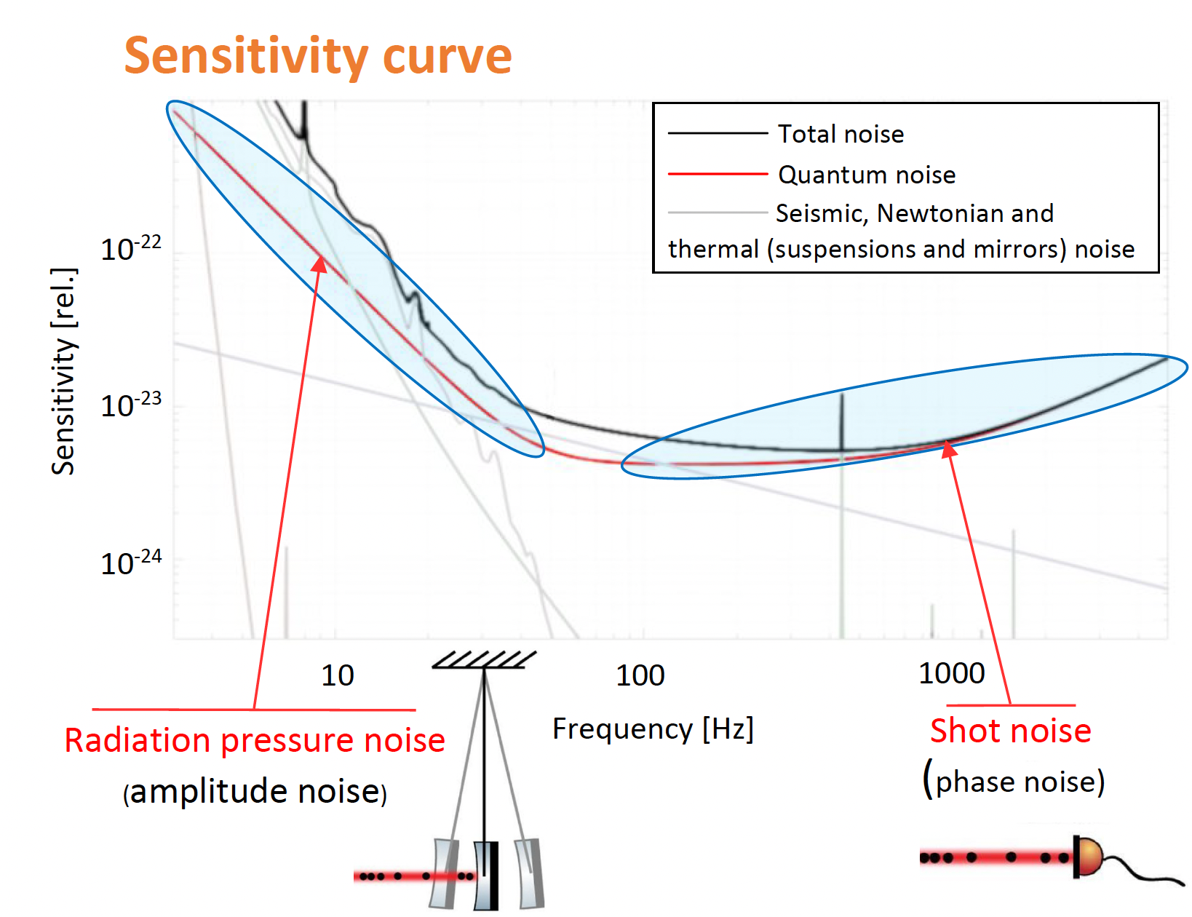
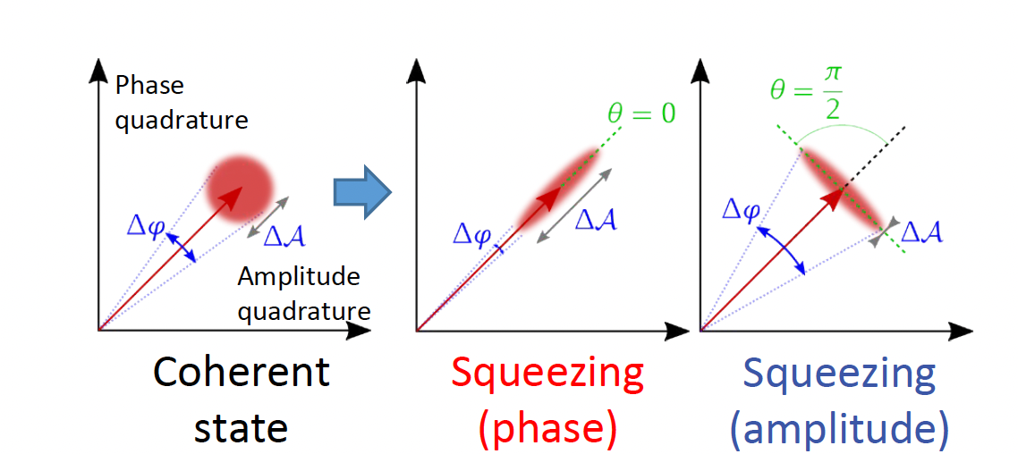
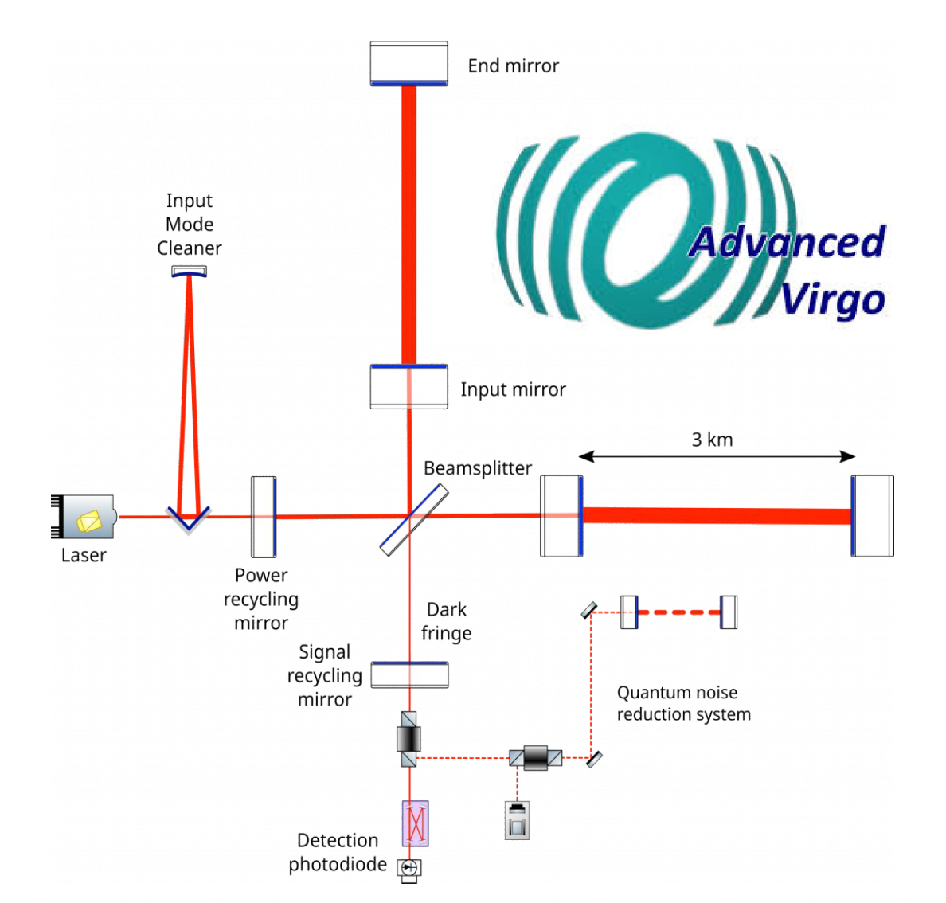
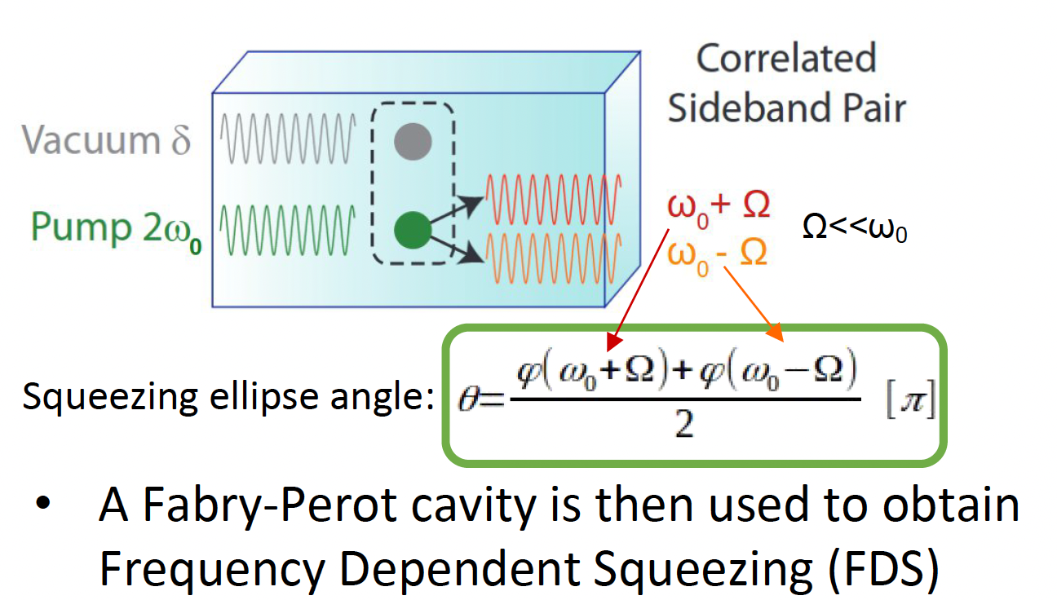
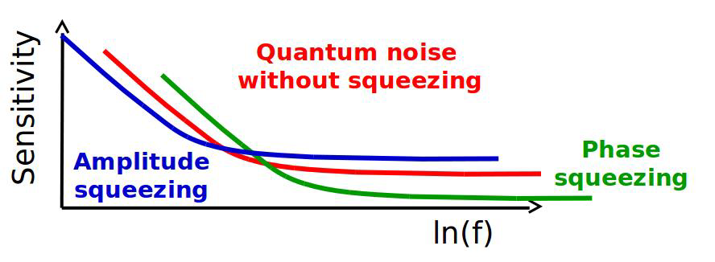
Squeezed states for Gravitational waves
Angélique Artaud (IJCLAB)
Jérôme Degallaix (LMA-IP2I)
Several French labs are involved in Virgo and preparing the future (ET): IJCLAB, LAPP, APC, LMA, IP2I

Slide 4
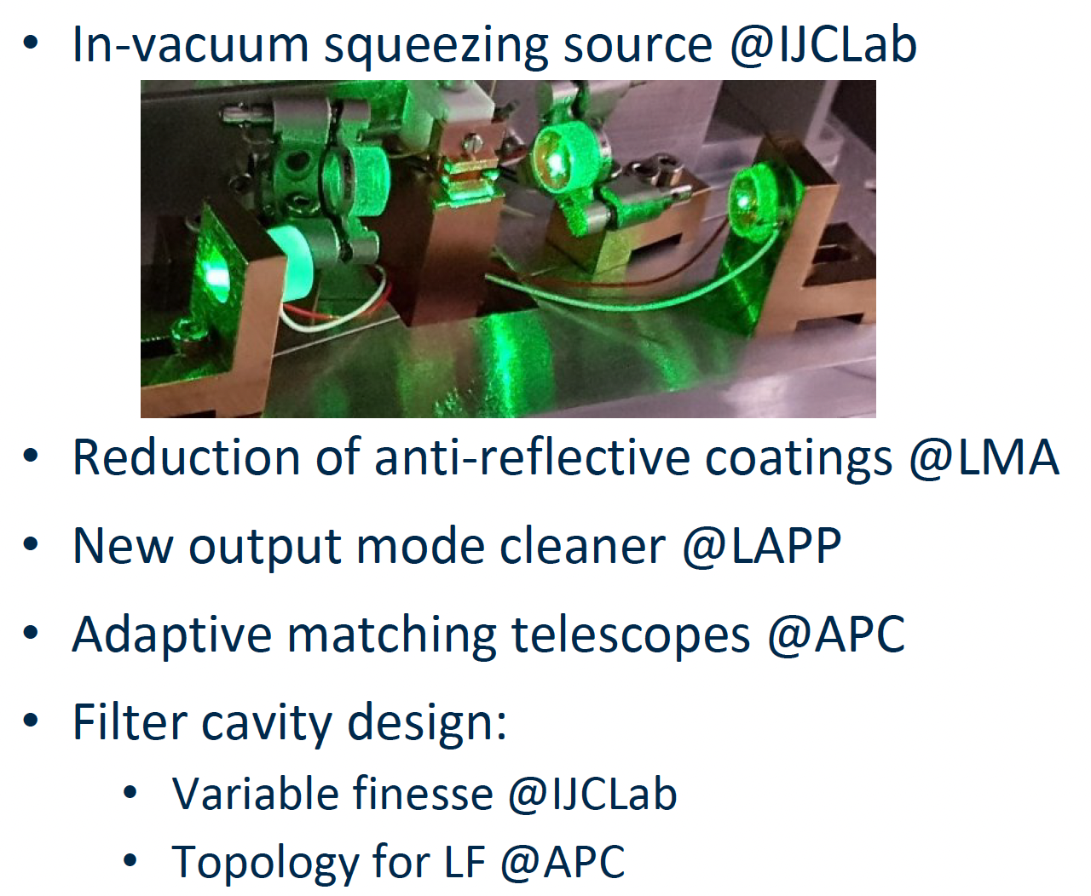
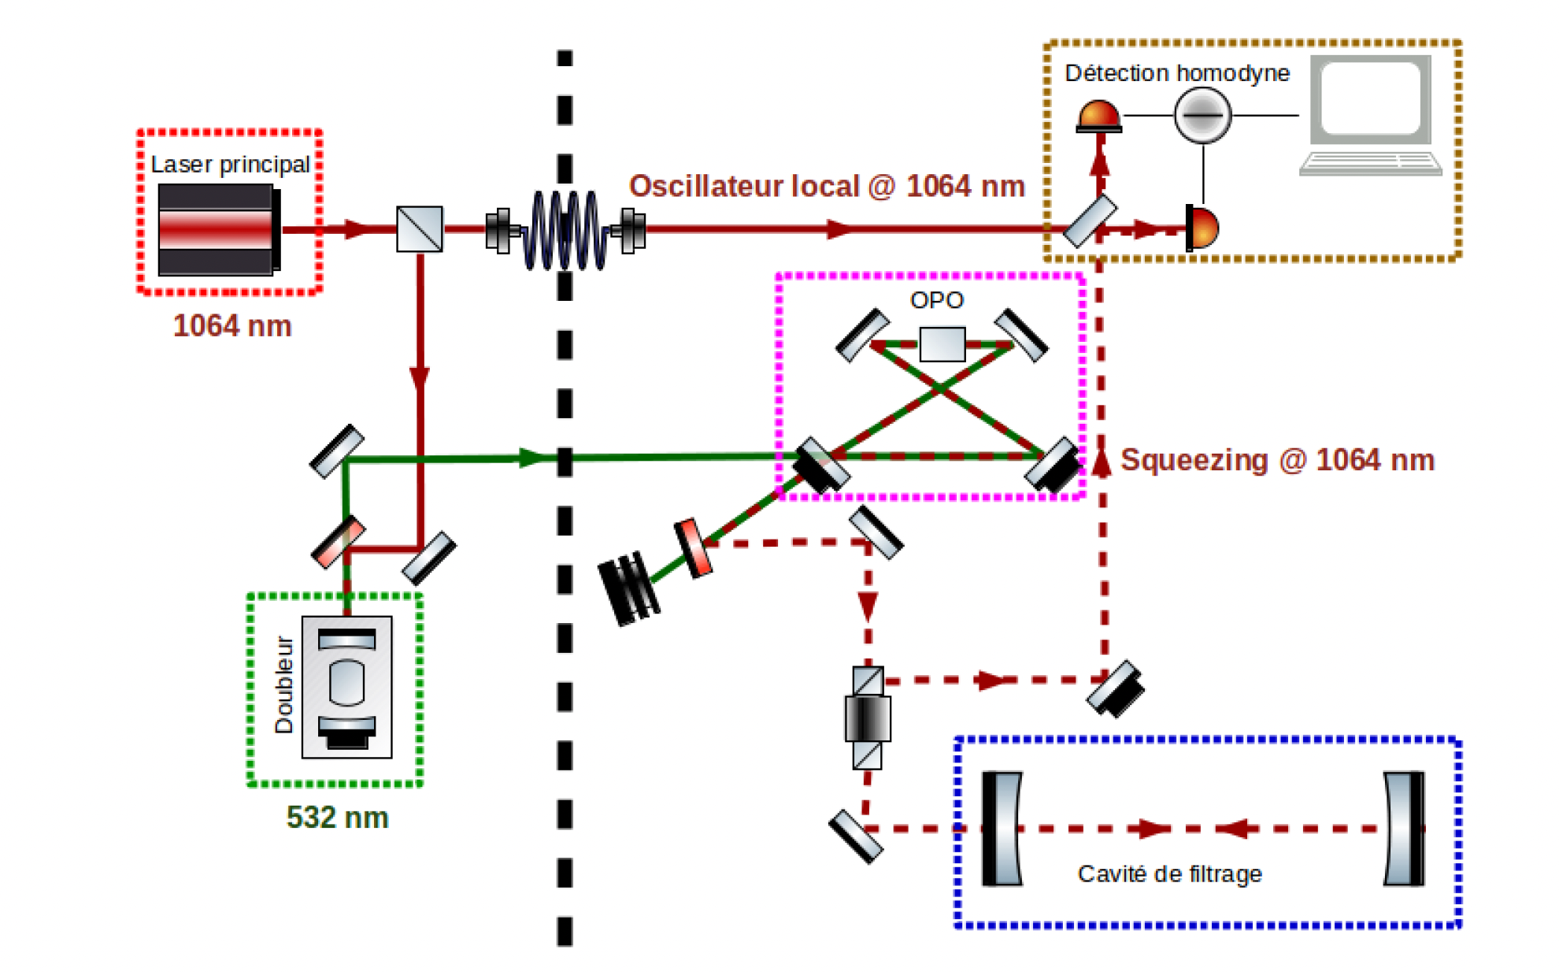
Squeezed states for Gravitational waves
Angélique Artaud (IJCLAB)
Jérôme Degallaix (LMA-IP2I)
In collaboration with LKB
The squeezing at a given frequency depends on two parameters: The length of FP cavity and its quality Q
In addition, optical loss reduces the impact of the squeezing performance.

Slide 5
3D SRF cavities
D. Longuevergne (IJCLAB)
Akira Miyazaki (IJCLAB)
IJCLAB has an established knowledge of conceiving, producing and testing SRF cavities of high quality
Surface treatment
Annealing and baking
Cavities with very high Q₀ are extraordinary tools in quantum technologies

Slide 6
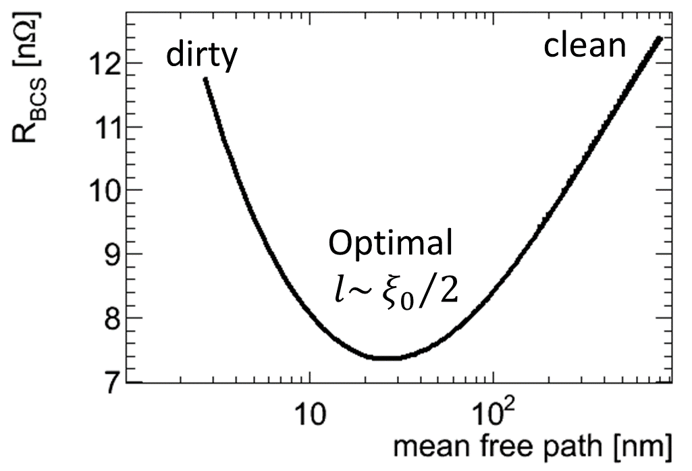
Thermal doping and alternative materials
D. Longuevergne (IJCLAB)
Akira Miyazaki (IJCLAB)
Superconductor (NbN)
~ 50 nm
Two methods are under study for High Qo and strong Gradient:
Isolator (AlN)
< 1 um
Superconductor
~ 10 nm
Superconductor (doped Nb, other)
Isolator
Nb/Cu
Nb
Couches épaisses :
Dopage surfacique du Niobium par diffusion thermique
(Four SUPRATECH) => Haut Qo
Dépôt d’un matériaux supraconducteur alternatif (élaborations via partenaires, analyses Vide&Surface) => Haut Qo, Haut Gradient
Les multi-couches (SIS)
Couches supraconductrices (NbN) séparées par une couche isolante (AlN) déposées par ALD
(élaborations via partenaires, analyses Vide&Surface)
Materials | Tc (K) | Brf_limit (mT) | Coherence length (nm) | Comments
Nb | 9.2 | 220 | 28
NbN | 17.1 | 215 | < 5 | Pour multi-layerss
MgB2 | 39 | 170 | 5
Base Fer | 10-40 | < 760 | ? | Arsenic or Selenium
Nb as received
Doping

Slide 7
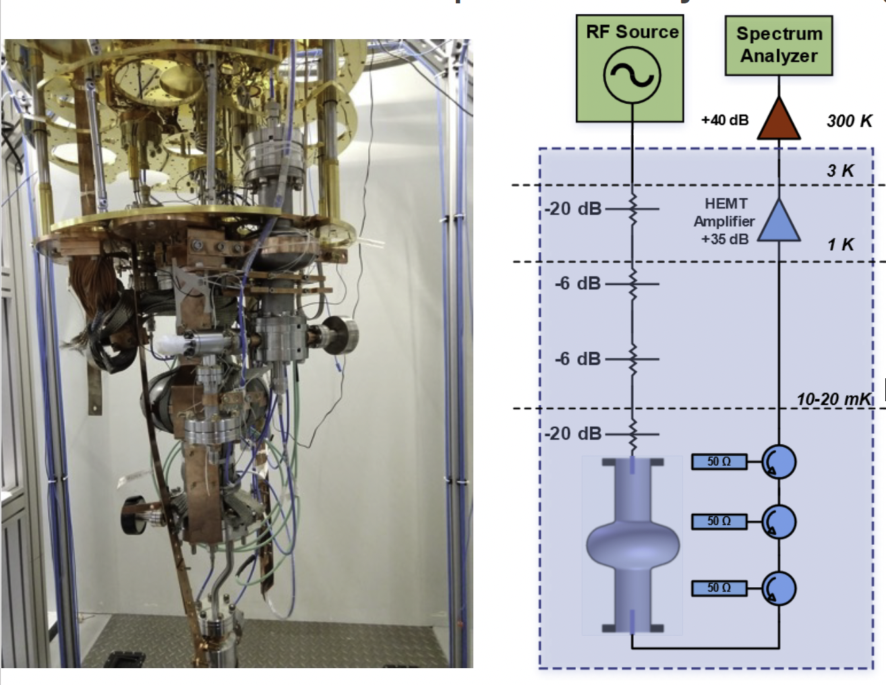
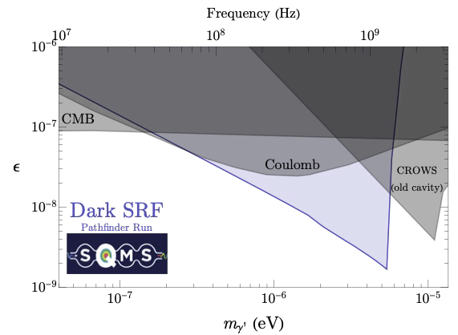
D. Longuevergne (IJCLAB)
Akira Miyazaki (IJCLAB)
SRF cavities are excellent tools to search for DM at very low mass
IN2P3 is interested to join the efforts initiated at FERMILAB under the leadership of A. Grasselino.
We are discussing internally the best way to contribute to these efforts.

Slide 8
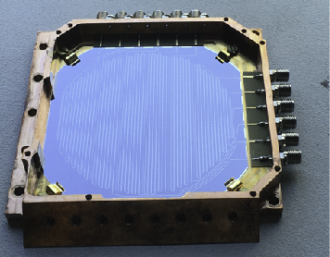
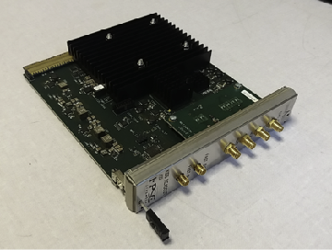
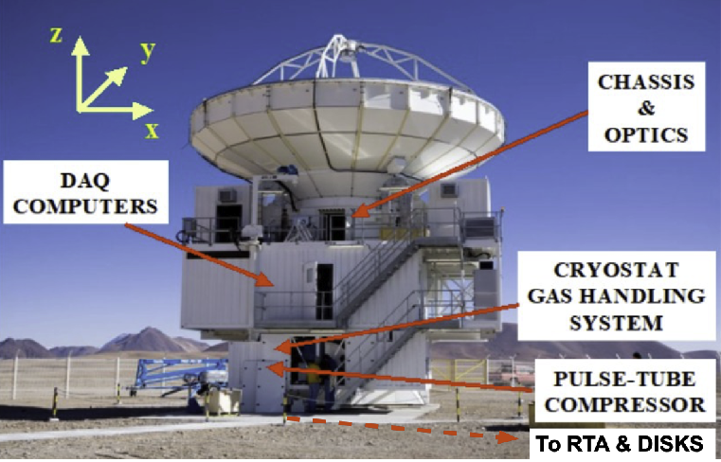
Superconducting circuits sensors
Sky Survey
Andrea Catalano (LPSC)
Damien Prêle, Michel Piat (APC)
mKIDs and their readout electronics were developed by LPSC in collaboration with NEEL institute in Grenoble to study the impact of dusty star-formation to the early formation of the early galaxy evolution.
Concerto is one of the experiments using this technology.
Activities based on SQUIDS, TES and low temperature electronics for astronomy applications are also developed at APC

Slide 9
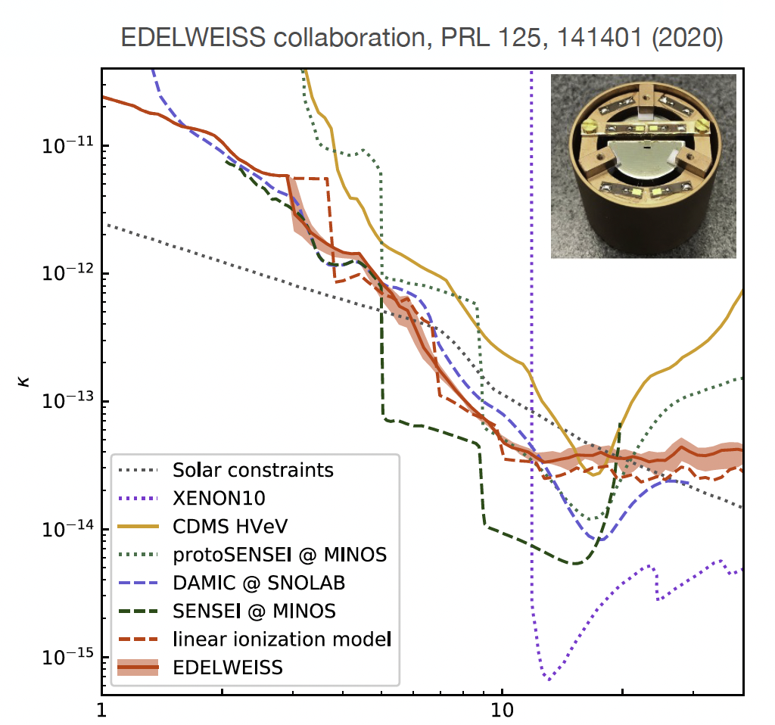
Superconducting circuits sensors
TES for DM
Julien Billard (IP2I)
Silvia Scorza (LPSC)
Experiments searching for Dark Matter based on bolometers such Edelweiss
and more recently RICOCCHET in Modane (LSM) provided the French groups
of IN2P3 with precious expertise on the use of cryogenics, Ge/Si and the
associated readout electronics .
IP2I, LPSC and IJCLAB have recently joined the TESSERACT collaboration which
intends to extend the DM search down to the meV level.
Different technologies are proposed. The French groups propose the Ge/Si technology

Slide 10
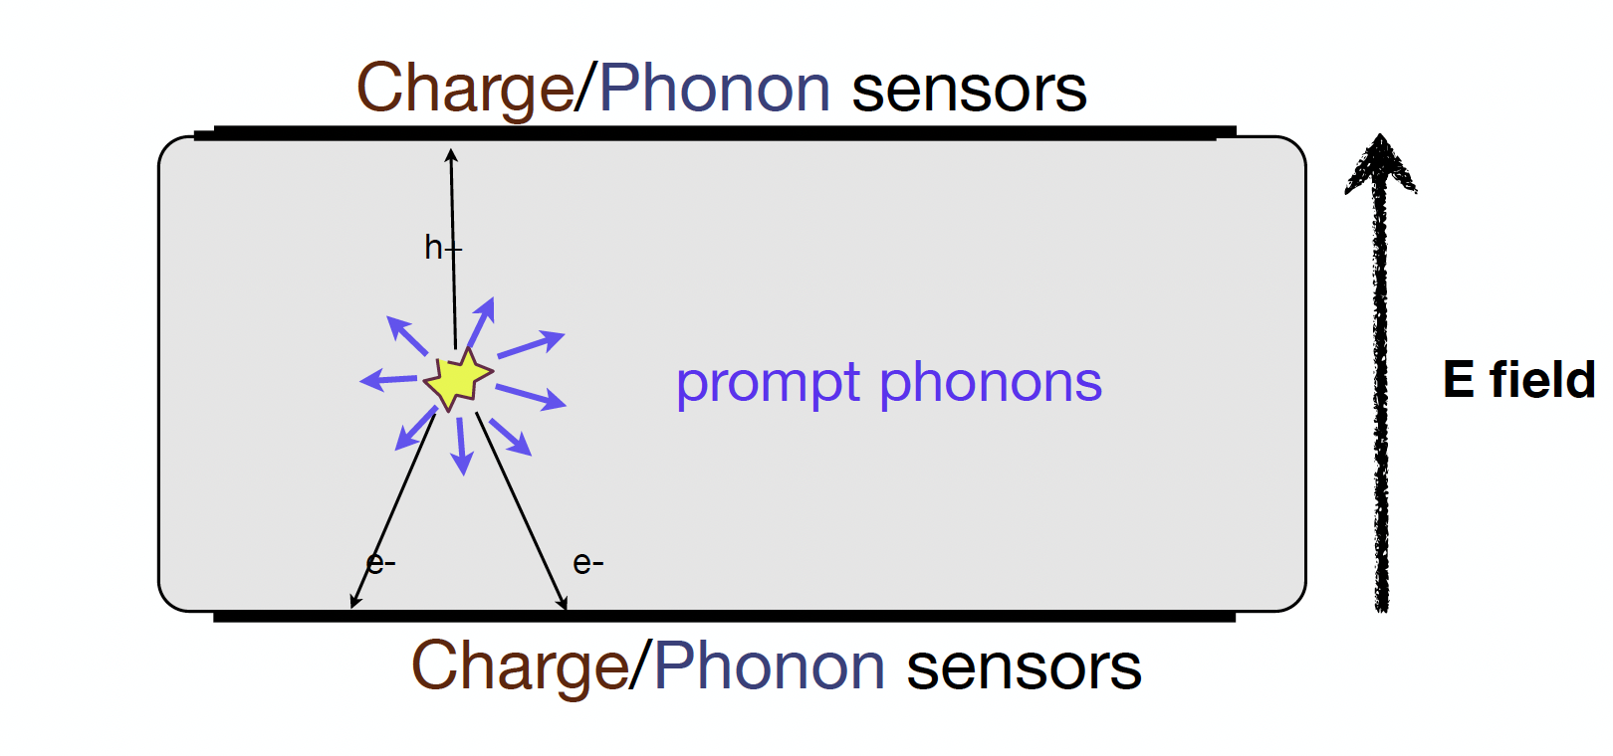
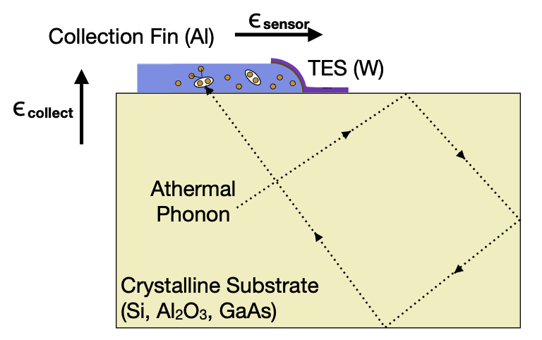
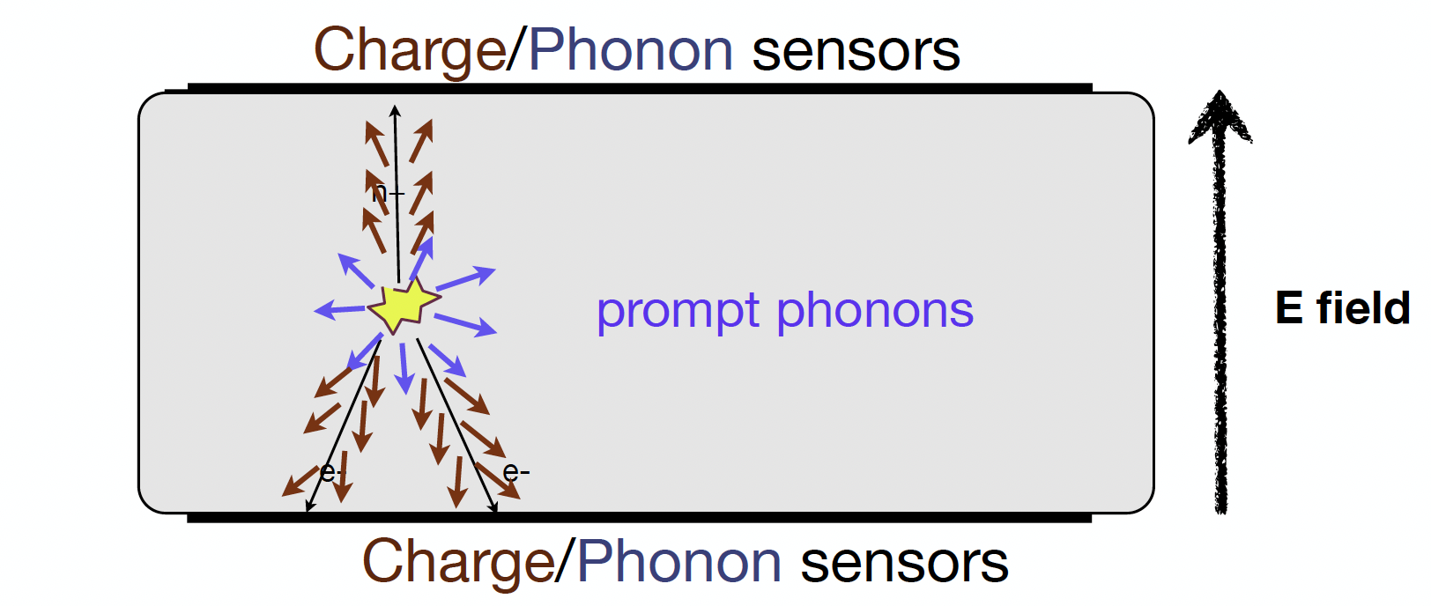
Superconducting circuits sensors
TES for DM
Julien Billard (IP2I)
Silvia Scorza (LPSC)
TES technology will be used to detect athermal phonons
Ge/SI
Ge/SI by detecting phonons and charges could improve on the detection performances by reducing the impact of LEE.

Slide 11
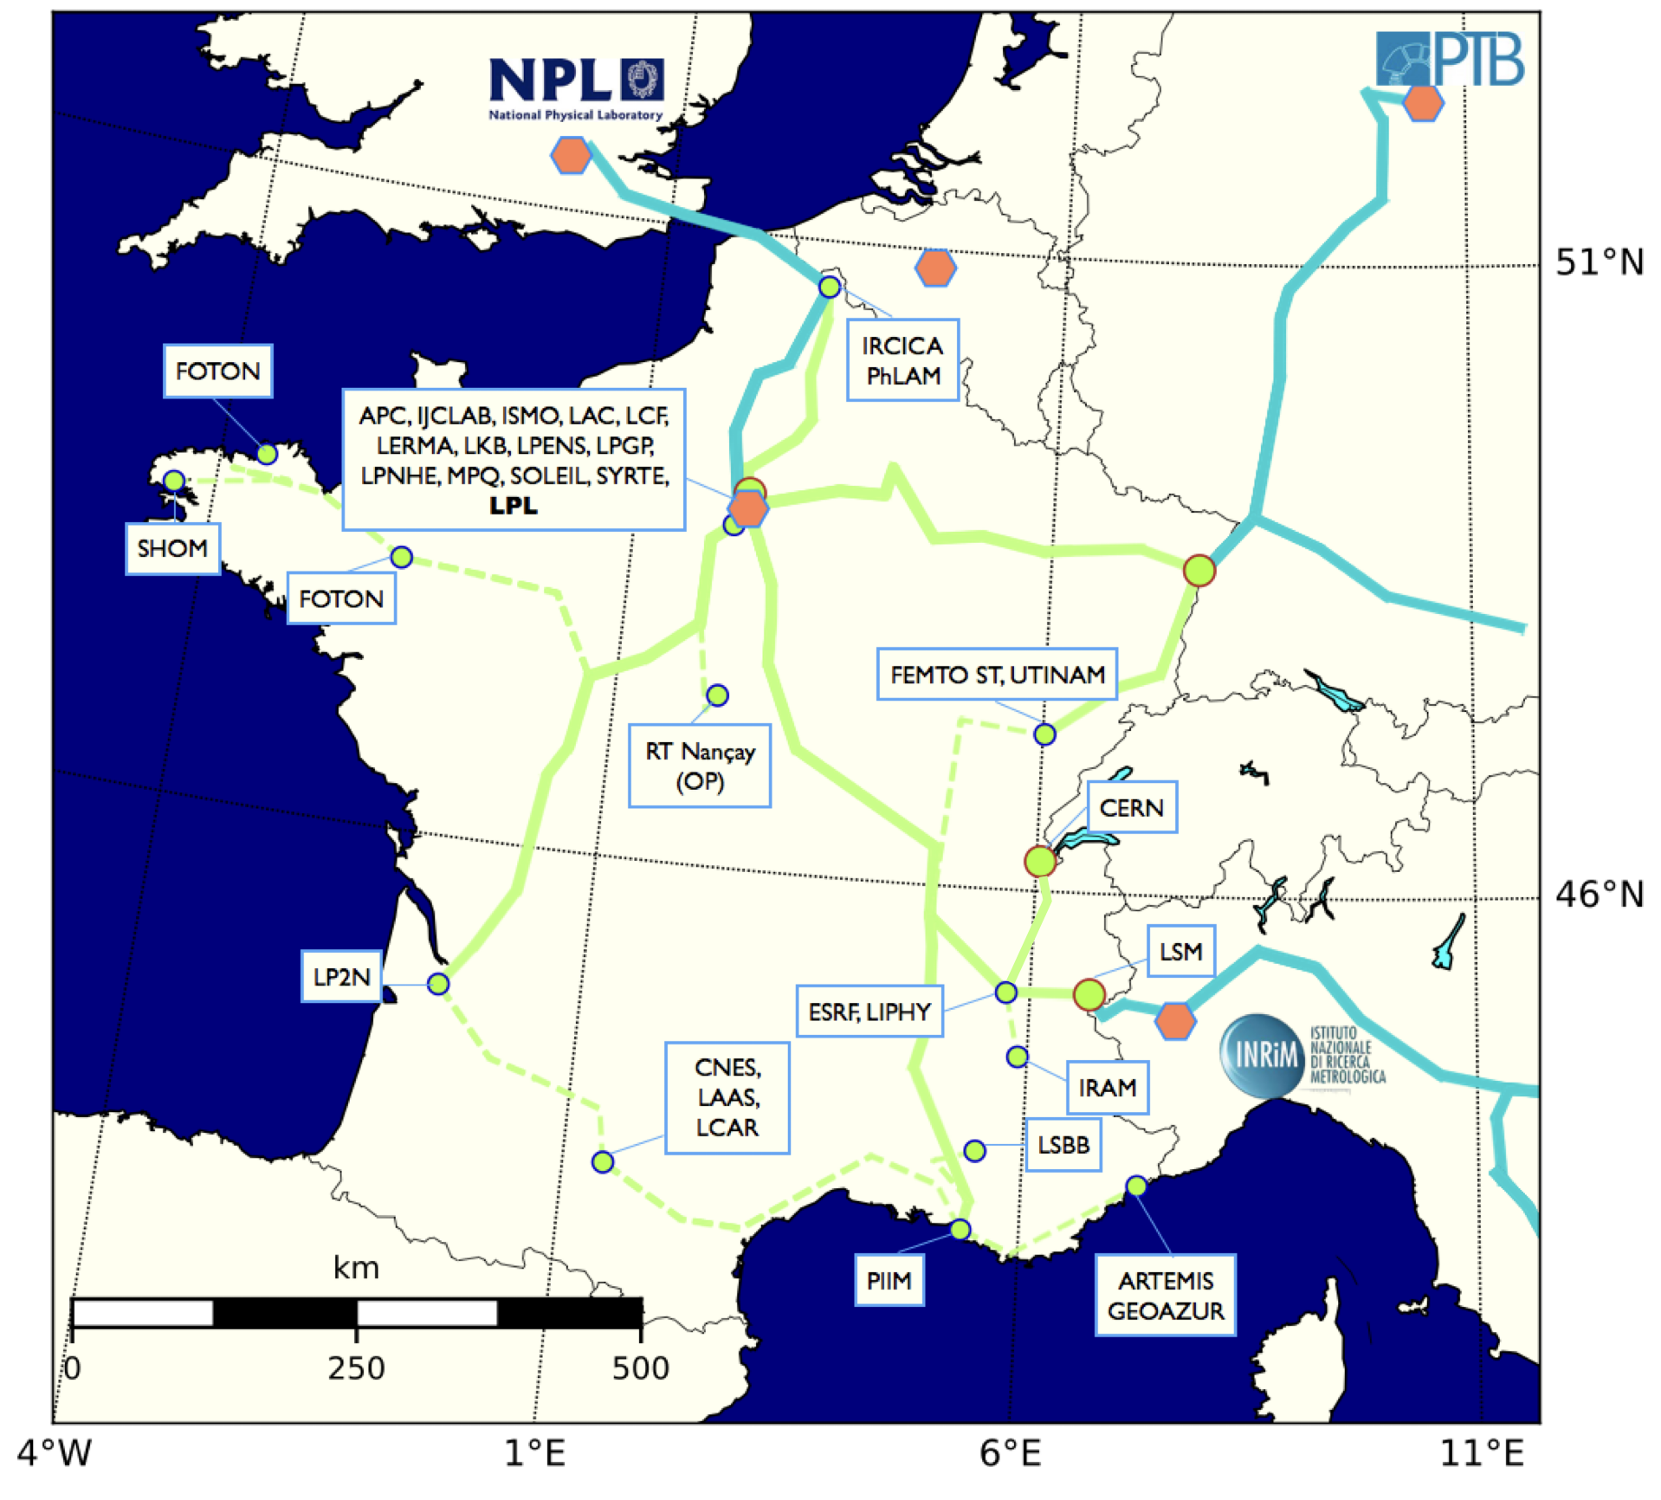
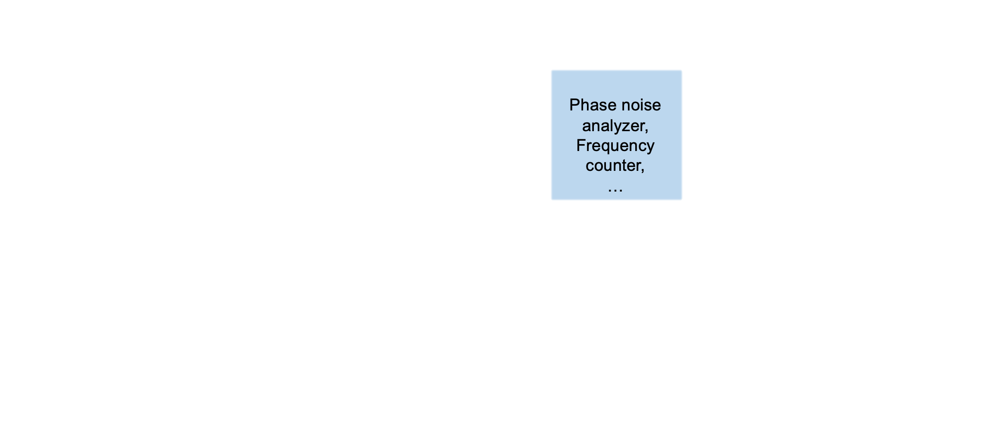
Clock distribution
Daniel Charlet (IJCLAB)
IJCLAB collaborate with SYRTE and others to distribute clocks generated at SYRTE (3 optical clocks) in different places in France and Europe within the framework of the T+REFIMEVE project
IJCLAB has led the development of IDROGEN board that uses the White-Rabbit protocol to regenerate the signal with high precision

Slide 12
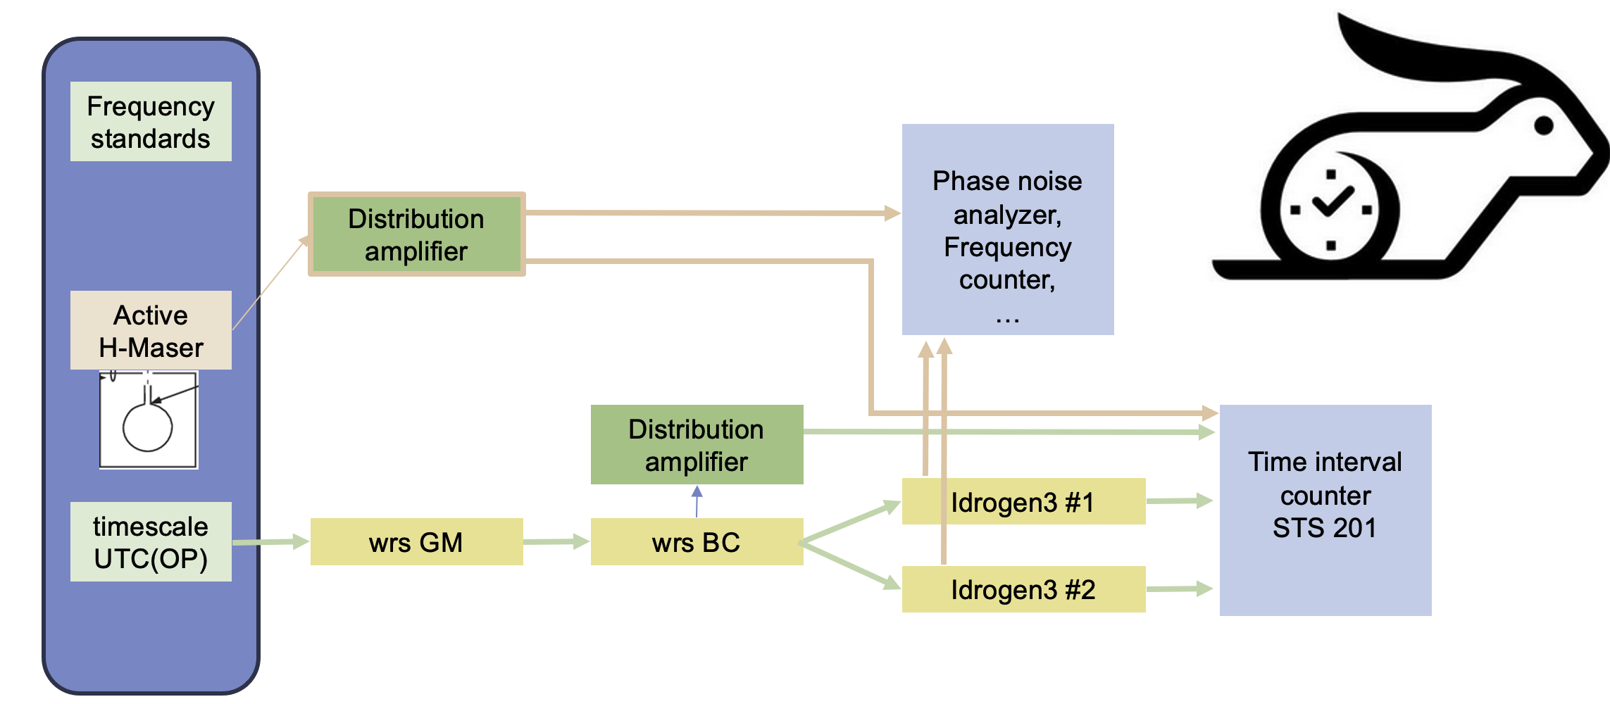
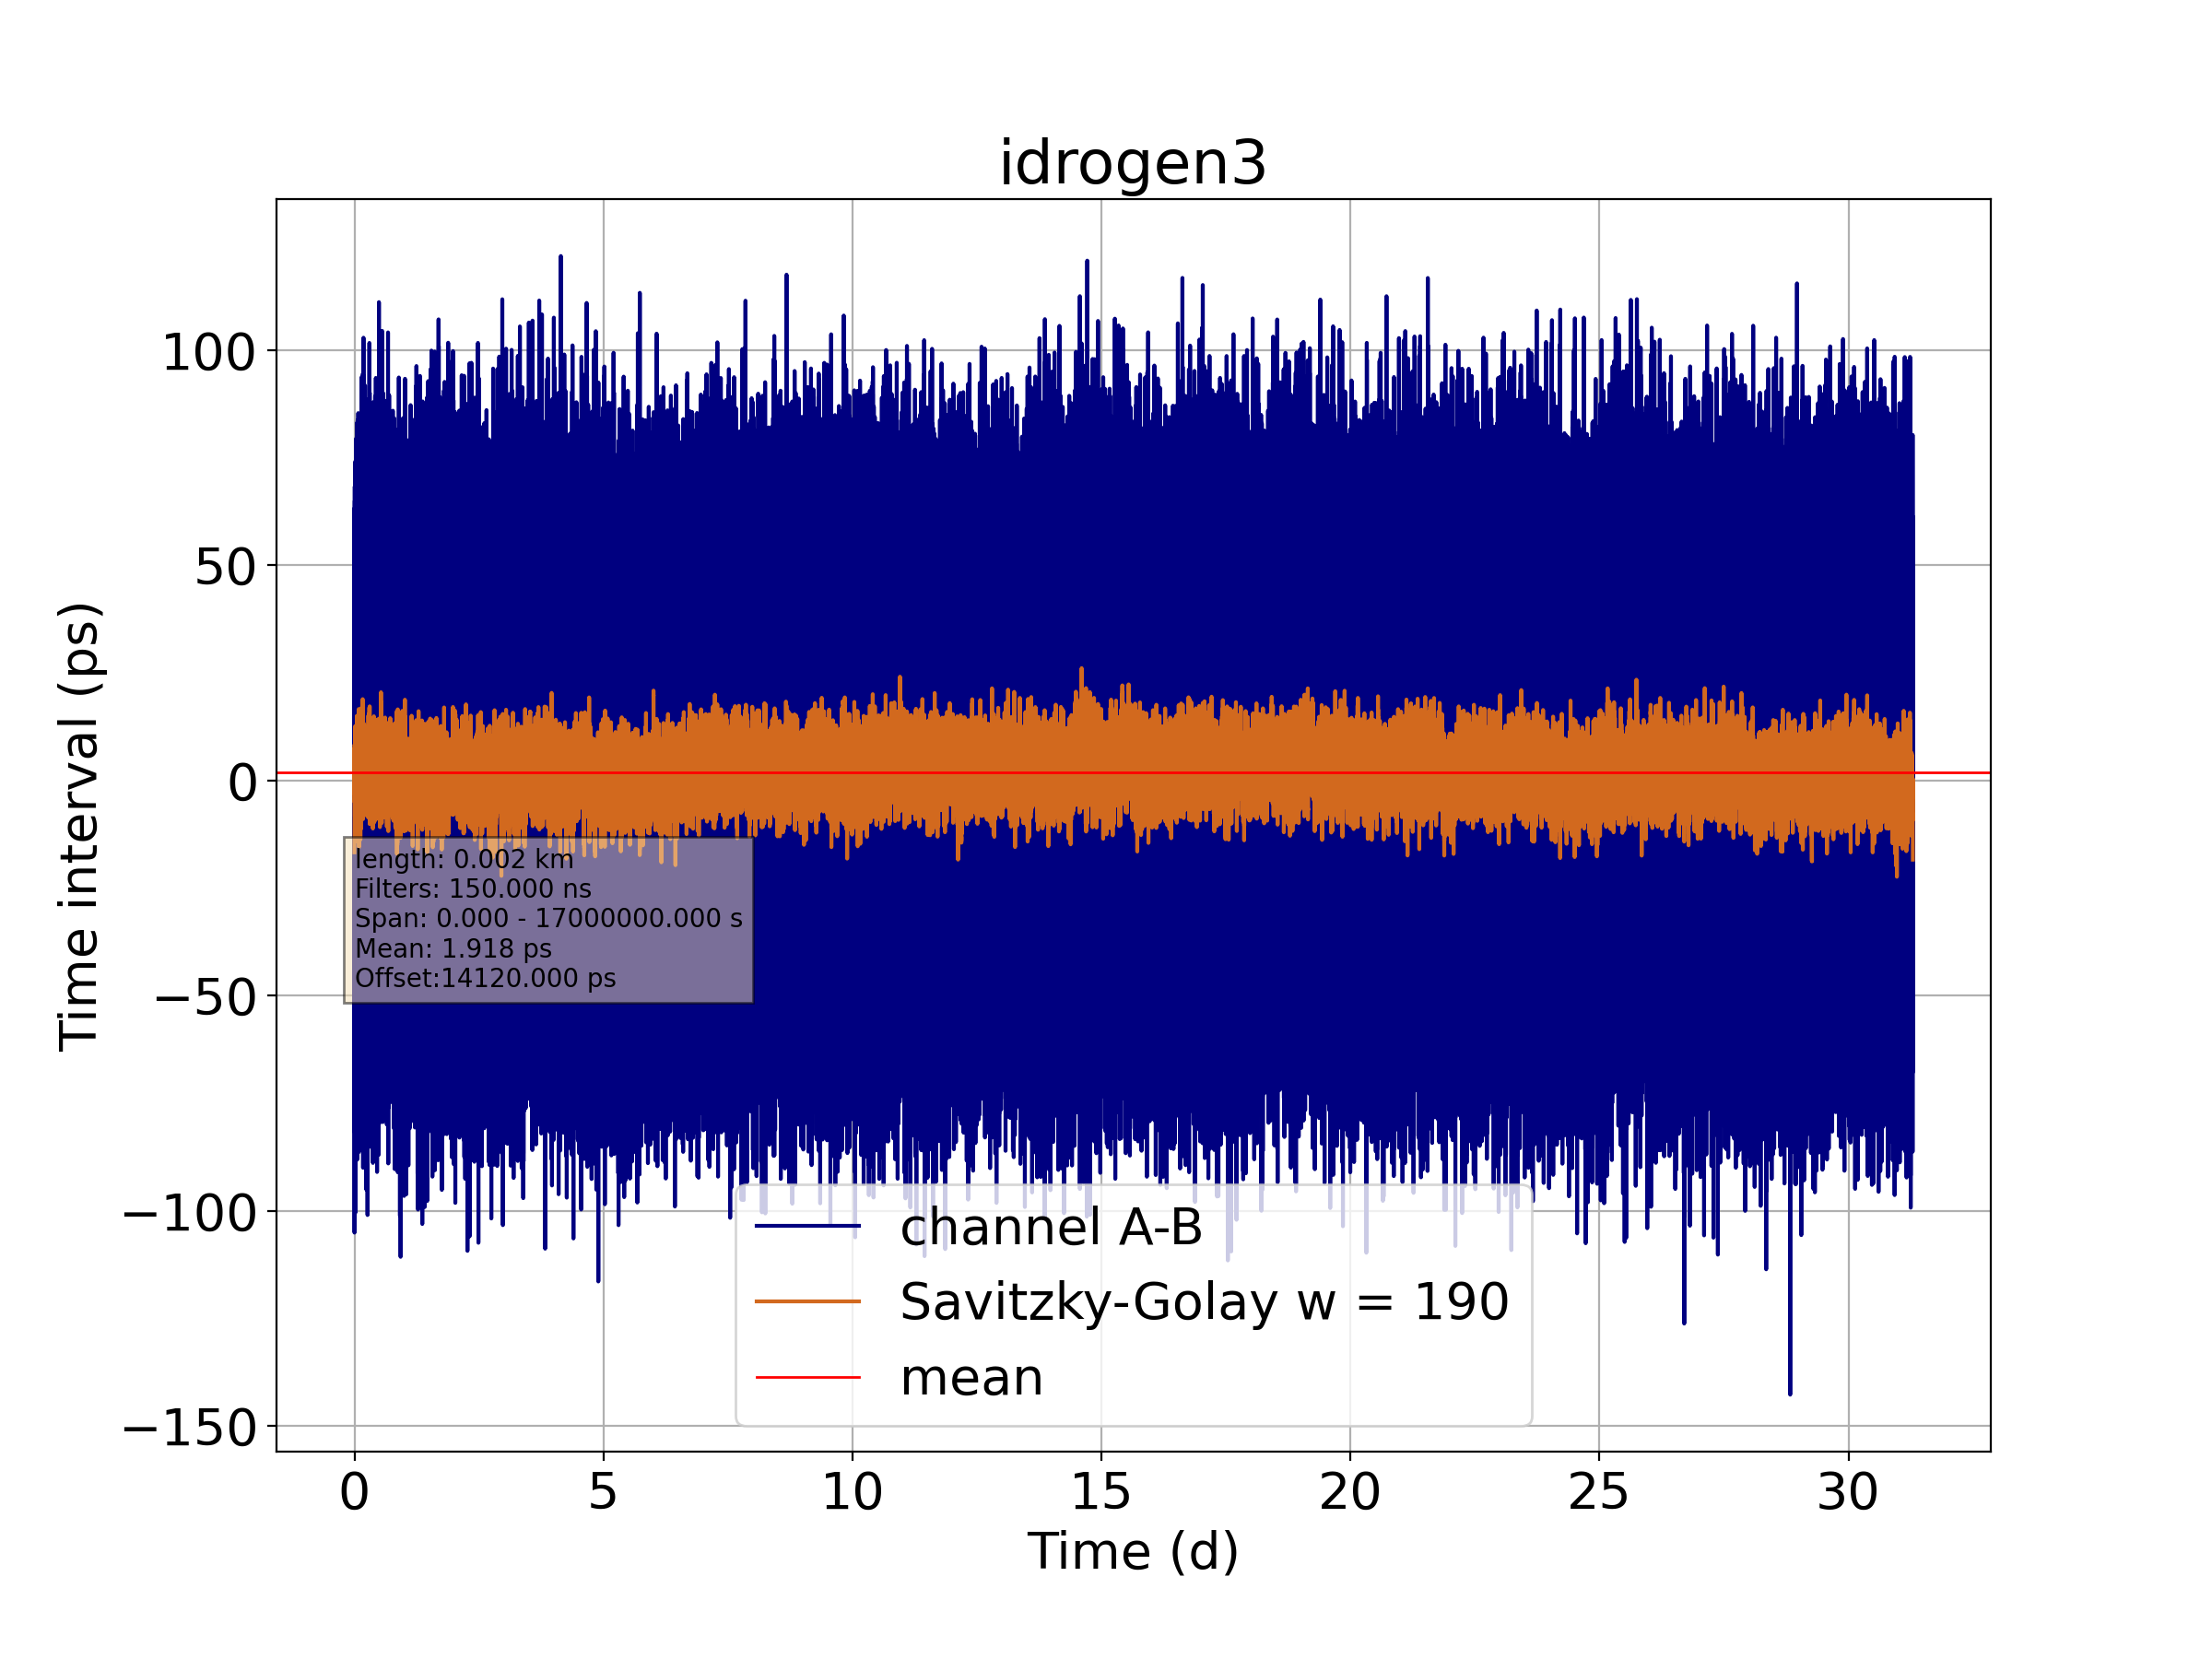
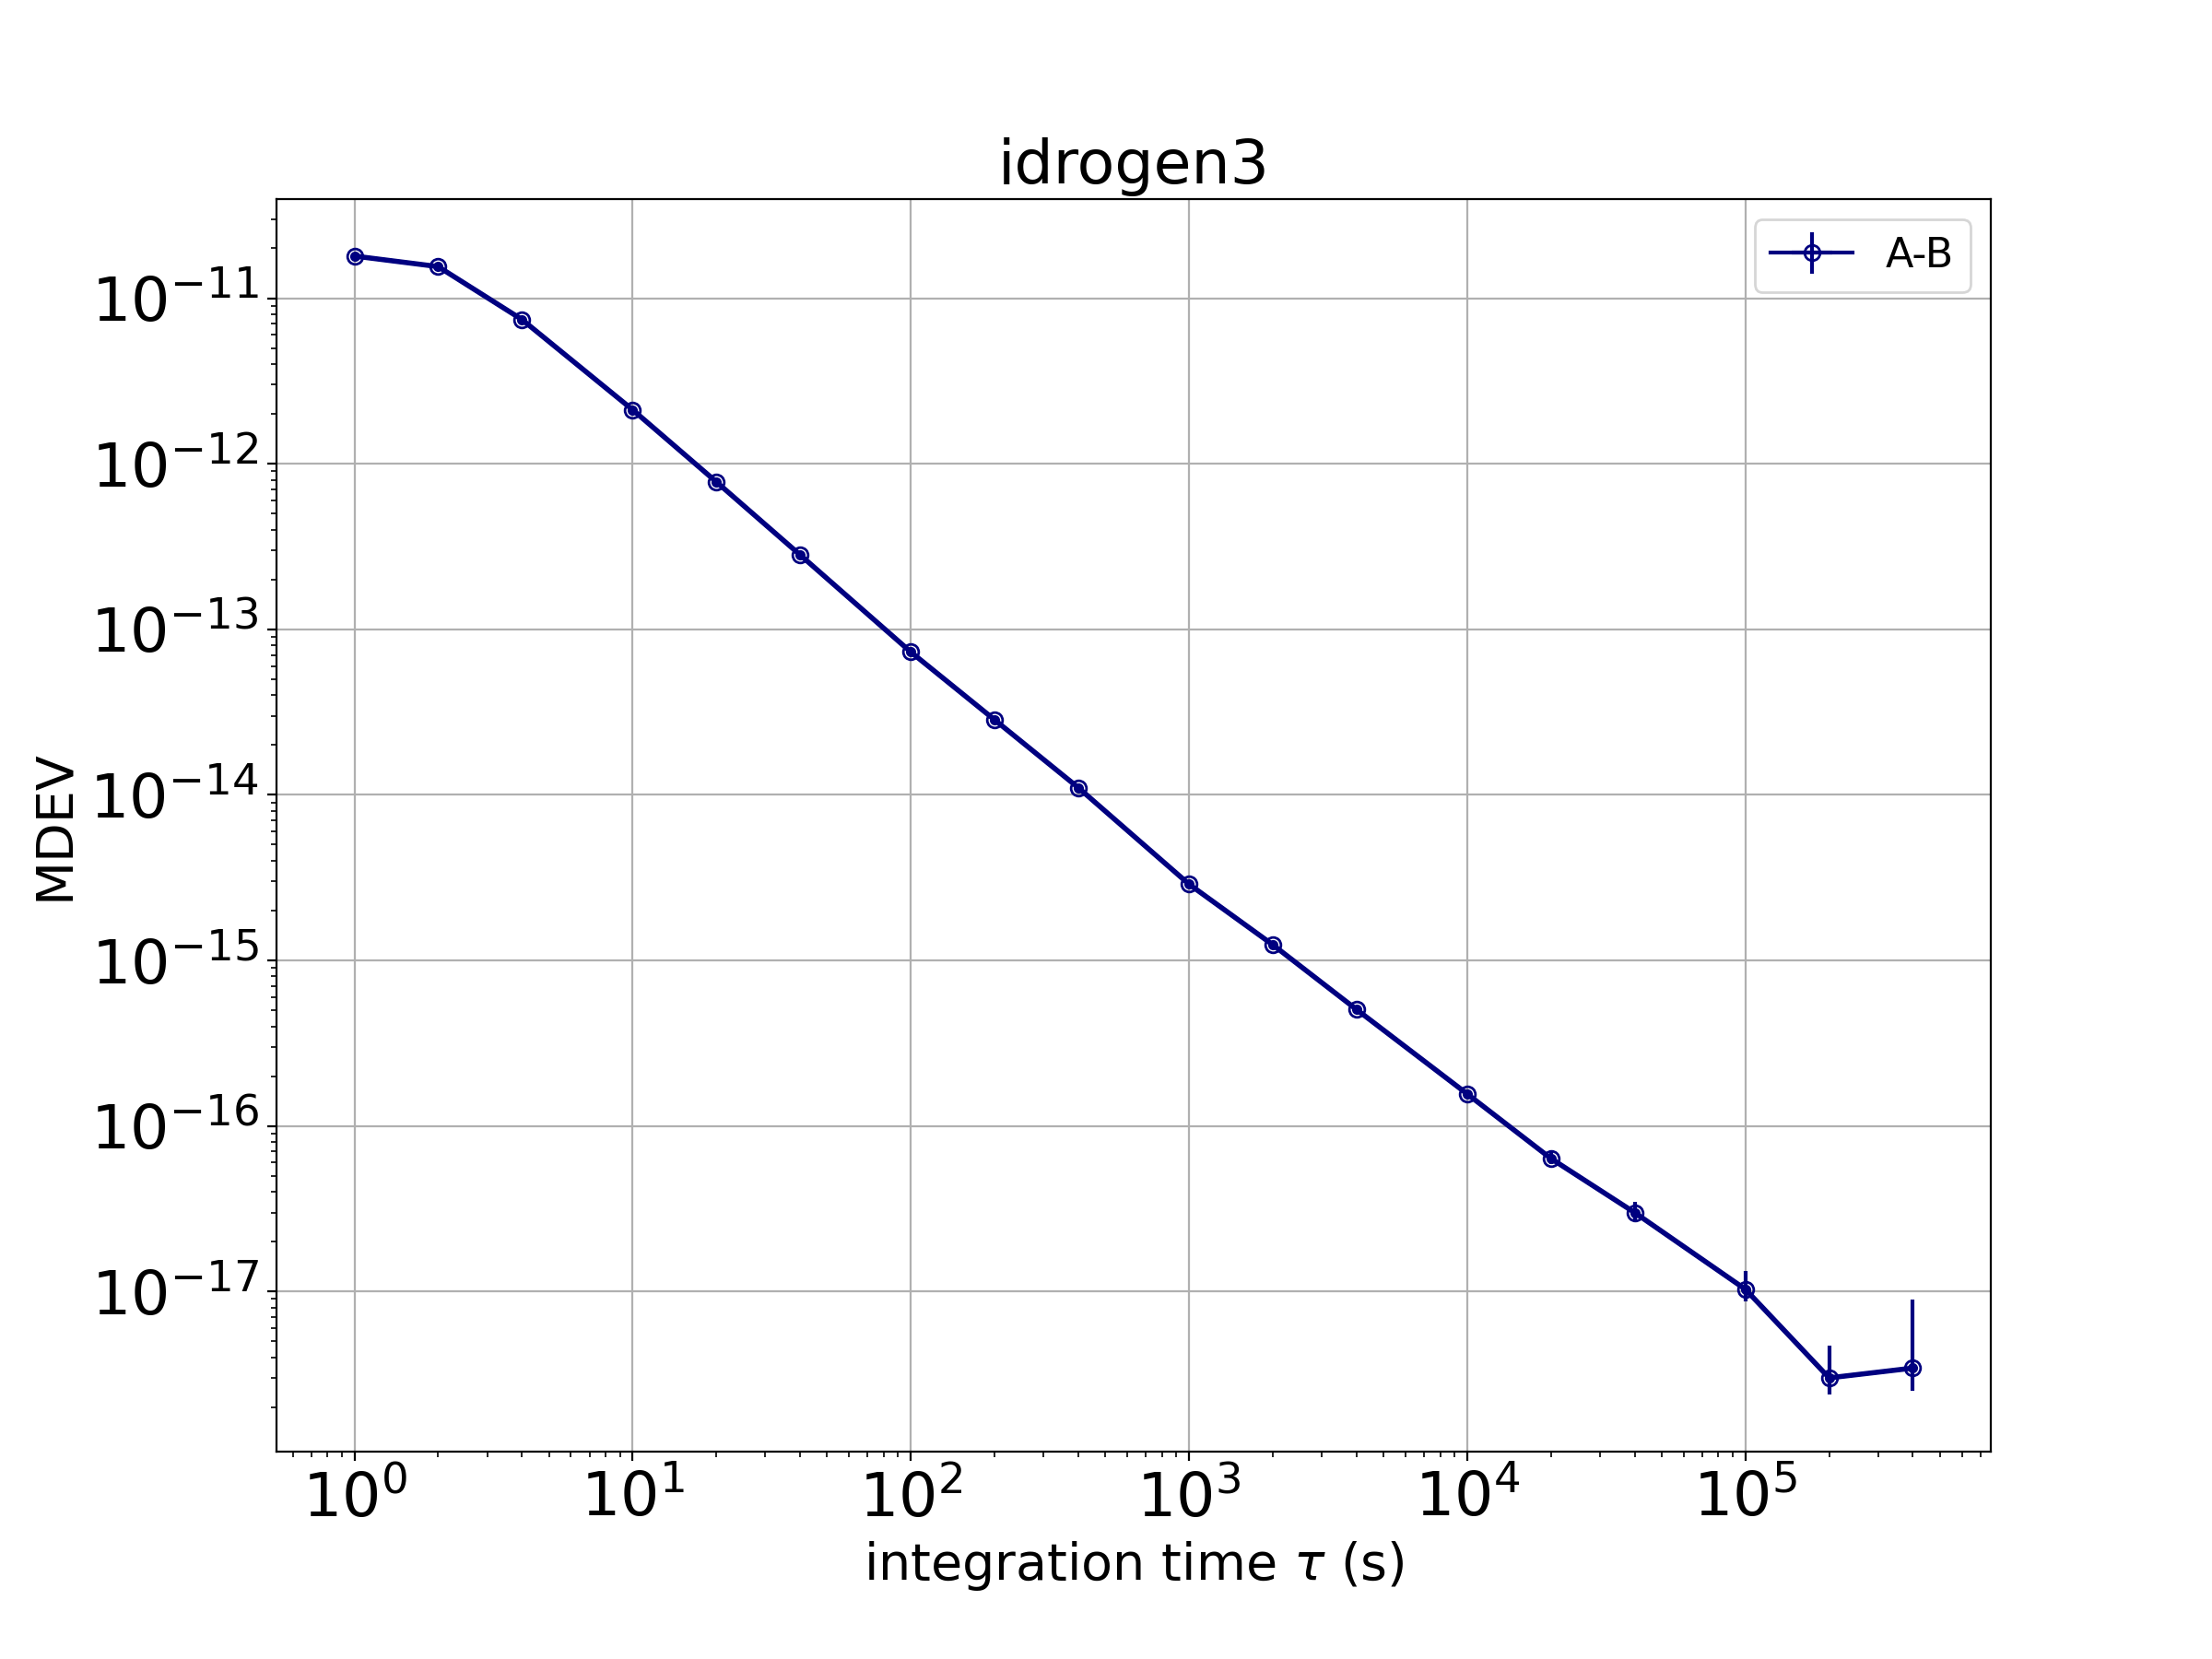
Clock distribution
Daniel Charlet (IJCLAB)
2 IDROGEN boards on the WR switch configured in Grand Master and synchronized by T+ REFIMEVE fiber
from Paris Observatory (SYRTE)
PPS time difference between two independent IDROGEN3 boards
Excellent long term stability : ~ 3E-18 s
On-going work: improve short term performances
Achieved performances
Goal performances

Slide 13
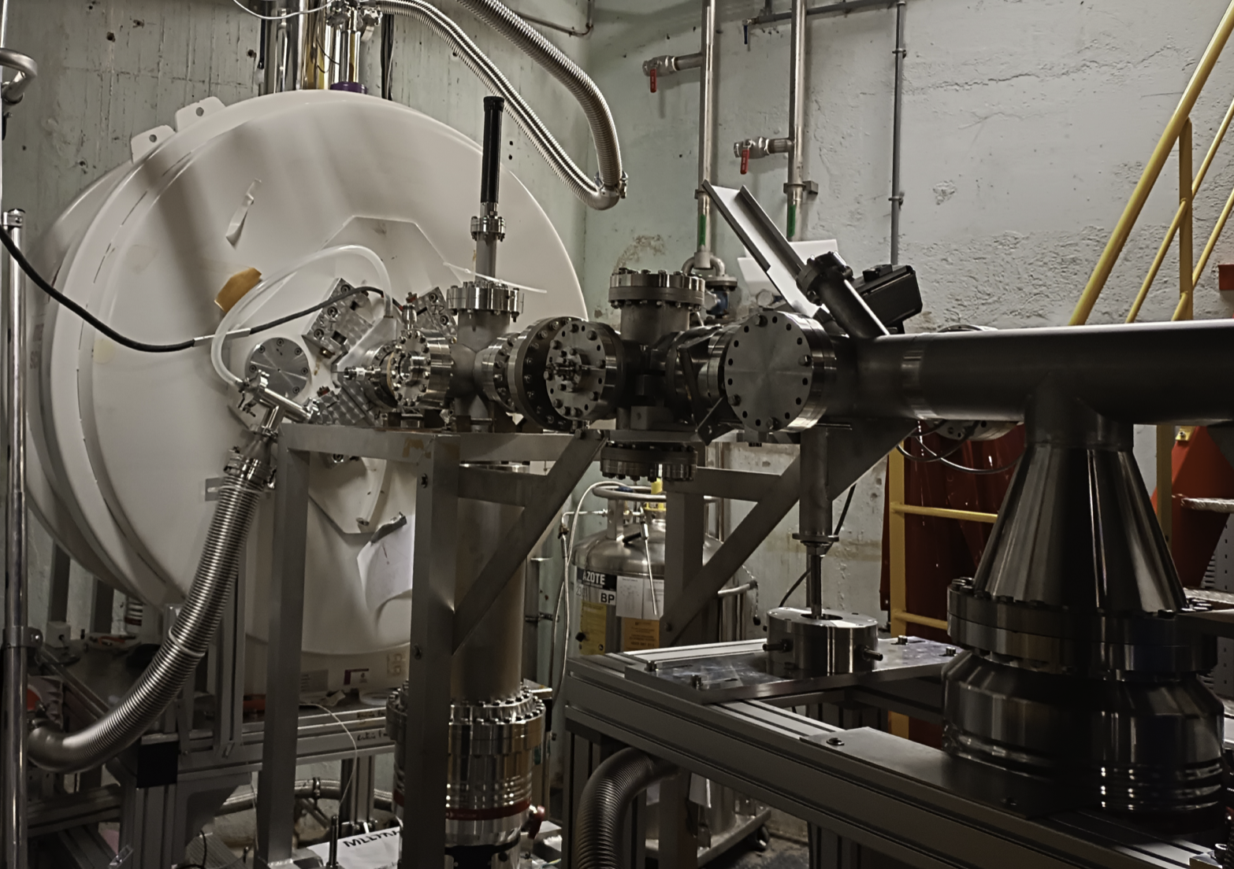
Penning&Paul traps
Enrique Minaya (IJCLAB)
Pauline Ascher (LP2I)
Penning and Paul traps are used as excellent tools for mass spectroscopy studies.
IJCLAB and LP2I have developed such traps for DESIR experiment to be installed in GANIL
The traps they conceived and the expertise they acquired could be exploited in two fields:
Precision study (QED, etc…)
Developing qubits system after introducing
LASER control system in collaboration with other
labs like CIML (Marseille University)

Slide 14
Vladimir Manea (IJCLAB)
Louis Lalanne (IPHC)
Simon Lechner (LP2I)
Sarina Geldhof (GANL)
Nuclear clocks
IN2P3 is considering the possibility to join the efforts to develop nuclear clocks
By contributing to new ways of exploiting ^{229m}Th
Looking for new clocks in which the isomer has energy difference with the fundamental state of the same order of that observed in ^{229m}Th (8.338 eV) or slightly higher with equivalent stability. Collaboration with theorists will be precious

Slide 15
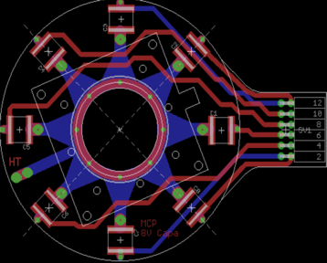
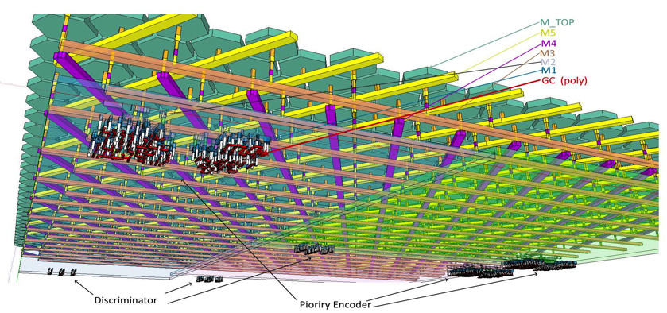
PICMIC
A new concept to reach simultaneously 1 ps and submicron measurement resolutions
Patented concept:
PCT/EP2020/050058
MCP
T₃
T₂
T₄
T₁
Time + position
Grid
Delay plane concept
T₅
T₆
Pixels
Position+ time
X,Y
Woven strips concept

Slide 16
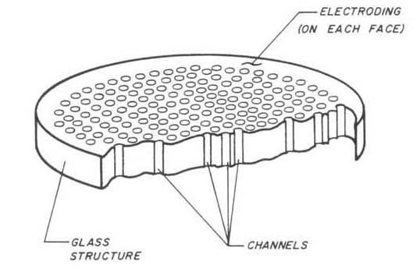
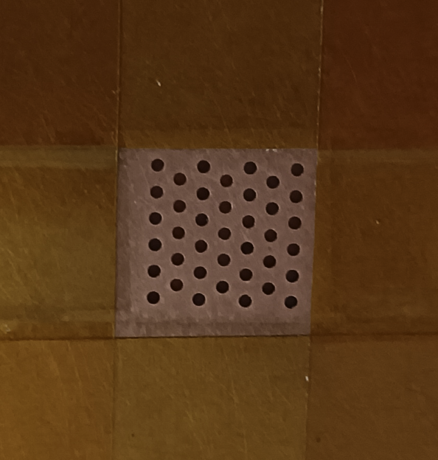
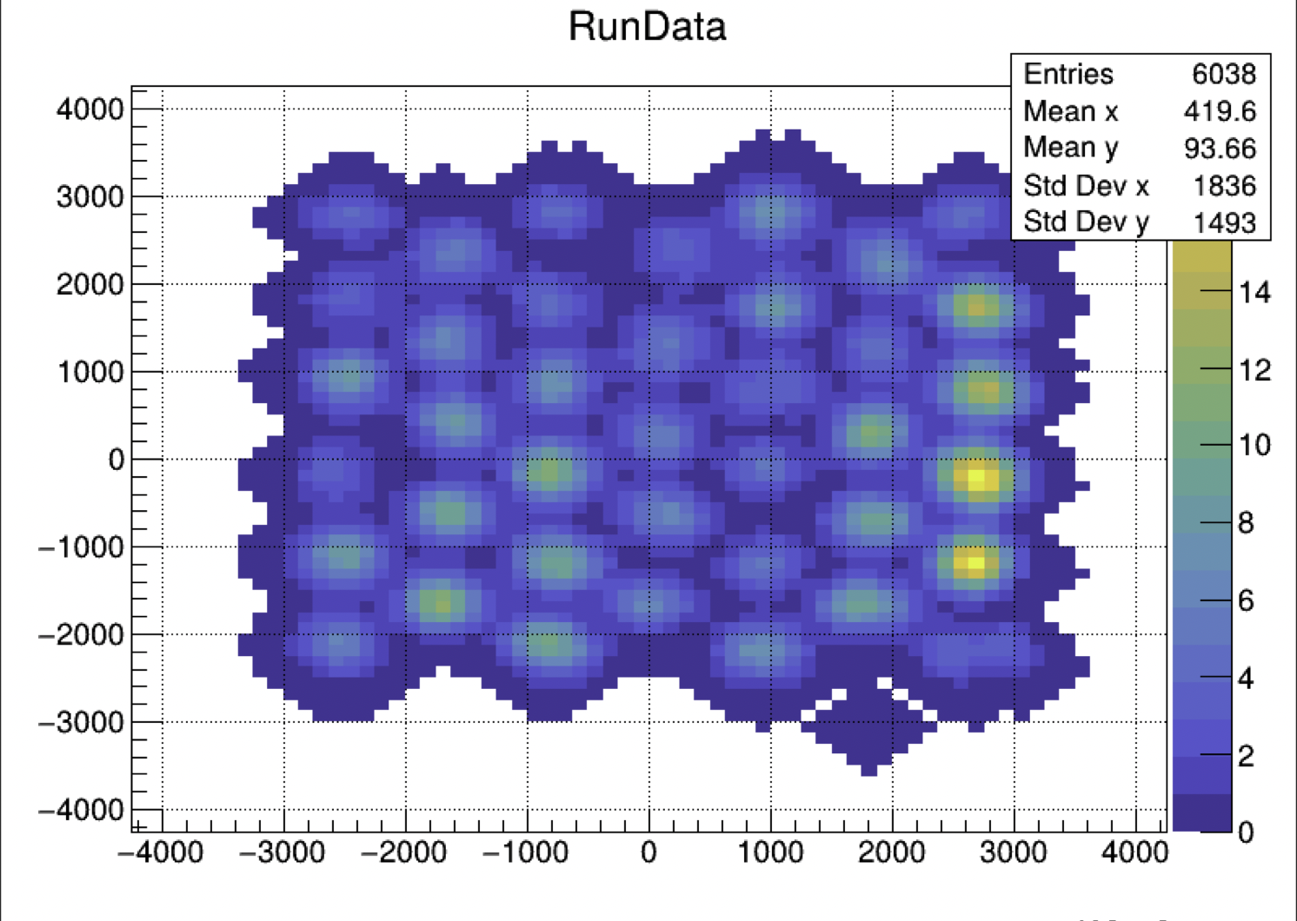
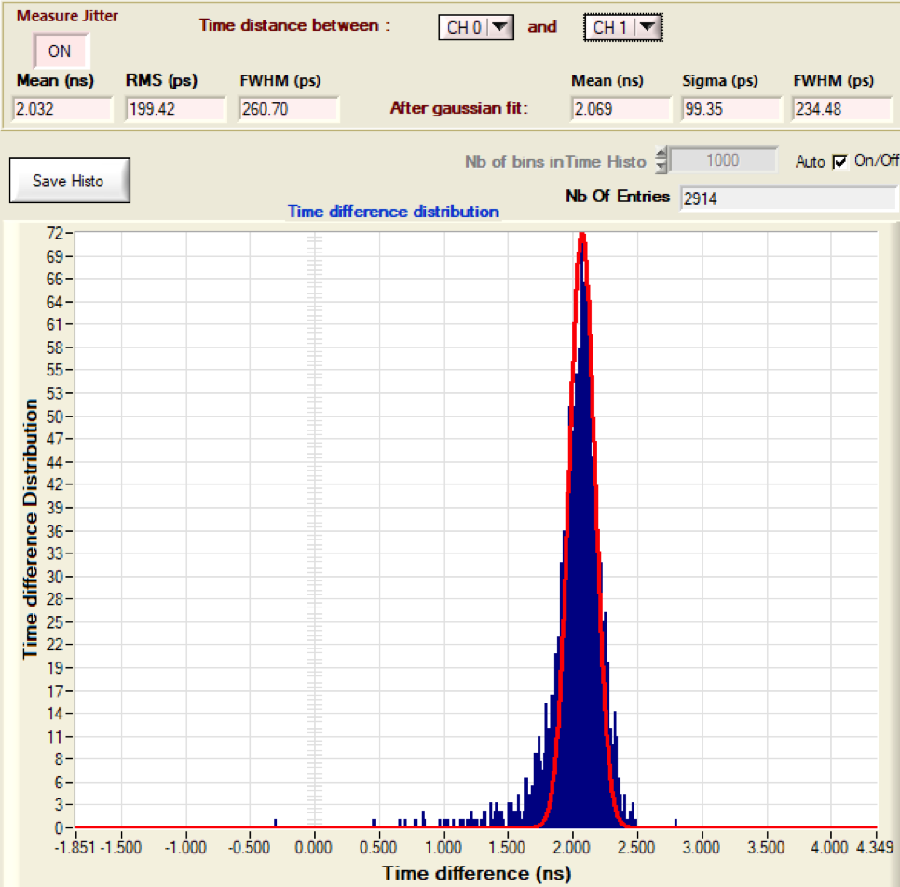
First demonstrator:
Doublet of MicroChannel Plate
Time measurement using waveform techniques
Position measurement with a new sensors using
interconnected pixels of 5 µm
Spatial dispersion < 70 µm
Next version of pixels sensor has been submitted and we expect to reach 10 µm
σ (T_{i} -T_{j}) is better than 100 ps
σ_{abs} is around 25-30 ps
Even with our first version we have better results than Timepix4

Slide 17
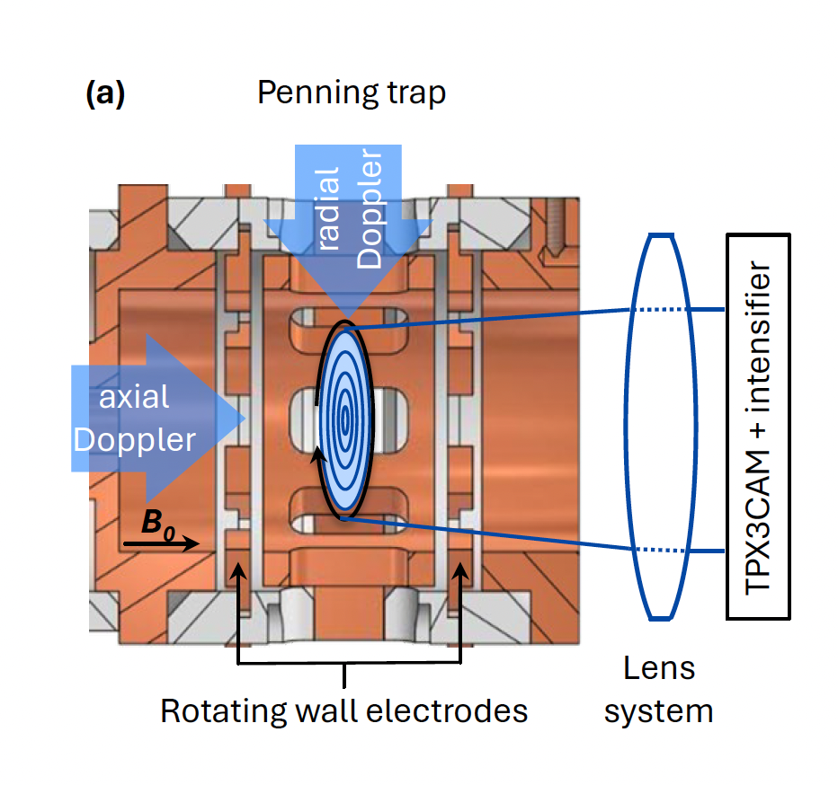
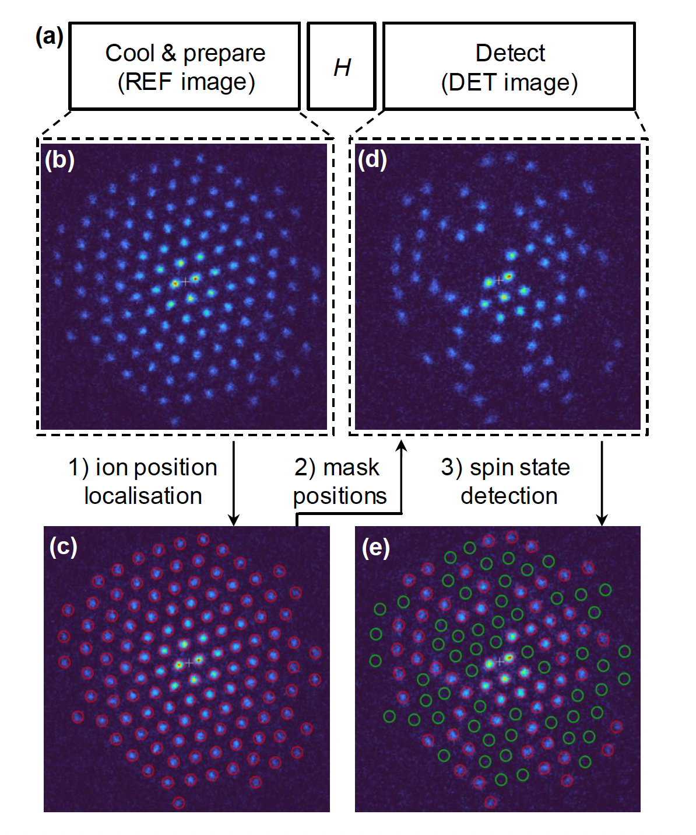
PICMIC and quantum technologies
arXiv:2303.10801v4 :Efficient site-resolved imaging and spin-state detection in dynamic two-dimensional ion crystals by R.N Wolf et al.
Study with Timepix3 → PICMIC could do much better
Controlling the quantum states always need an excellent photodetector device. PICMIC could provide the best one in standard conditions

Slide 18
Summary
Some quantum sensor activities at IN2P3 exist but remain relatively weak or isolated
We have started to organize these activities around a few projects
We will encourage the French groups to join DRD5 to build collaboration with others from other countries
We will organize workshops and summer schools so the new subatomic physicists can get the extraordinary potential of quantum sensors

