Slide 1


MRPC&SDHCAL
I. Laktineh

Slide 2
Outline
SDHCAL technological prototype
Short description
Performances
SDHCAL @Circular Collider
SDHCAL depth
SDHCAL power consumption and active cooling
SDHCAL timing
Rate capabilities
Summary

Slide 3
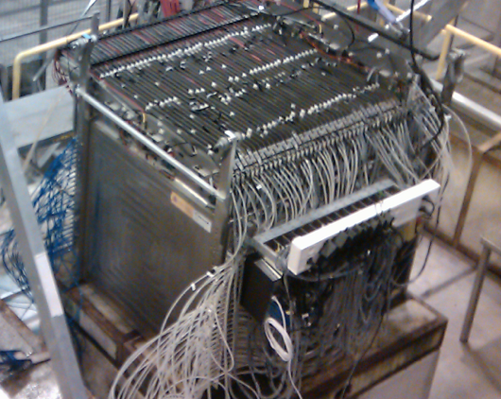
Completed in 2011 and tested in 2012
48 layers (-6λ_{I})
1 cm X 1 cm granularity
3-threshold, 500000 channels
Power-Pulsed
Triggerless DAQ system
Self-supporting mechanical structure
Resistive Plate Chambers (RPC)
Gas mixture:
93%TFE+5%Co2+2%SF6
Published: JINST 10 (2015) P10039

Slide 4
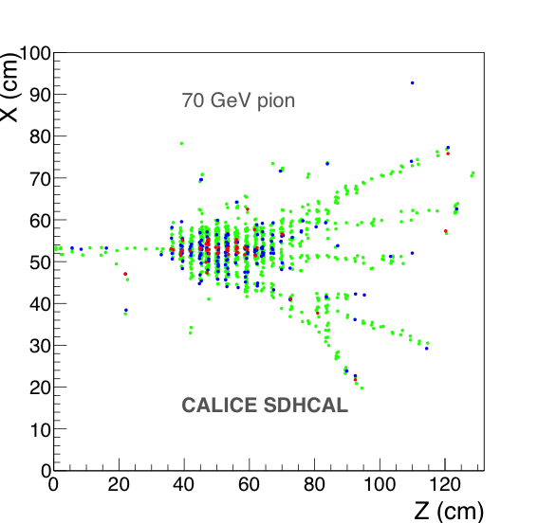
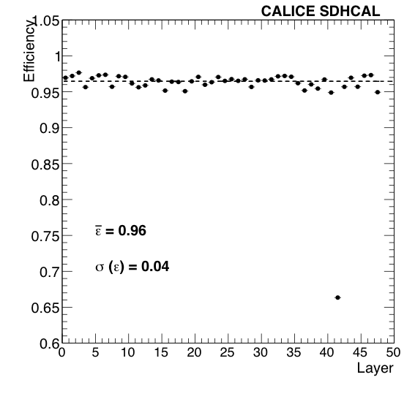
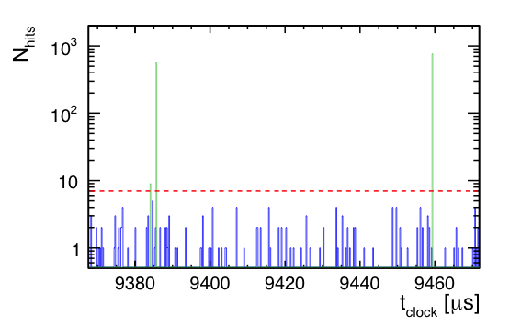
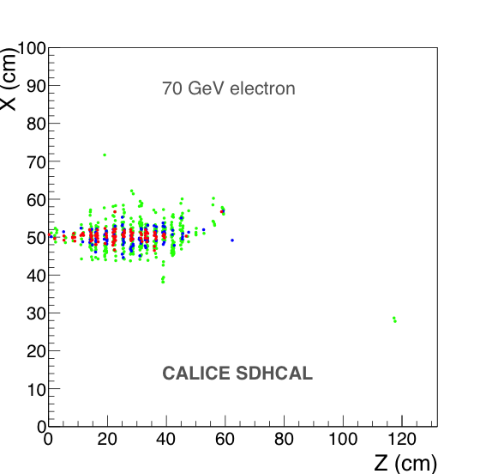
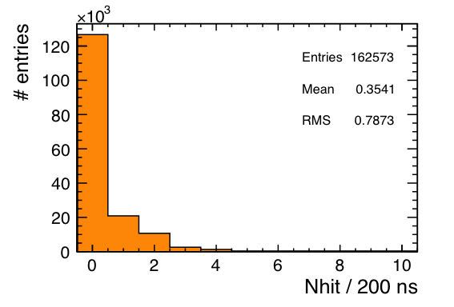
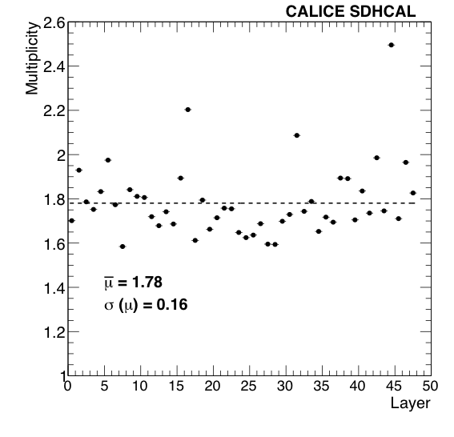
SDHCAL performances
The SDHCAL prototype was exposed to hadron, muon and electron
beams in 2012 on both H6 and H6-SPS lines.
Power-pulsing using the SPS spill structure was used to reduce the
power consumption.
Self-triggering mode is used but external trigger mode is possible
The threshold information helps to improve on the energy rec.
by better accounting for the number of tracks crossing one pad

Slide 5
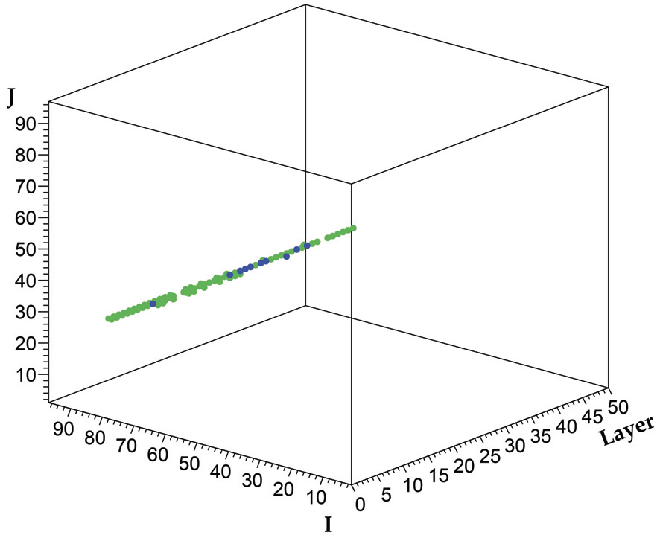
SDHCAL prototype was exposed to beam particles
at CERN PS, SPS in 2012, 2015, 2017,2018 and 2022

Slide 6
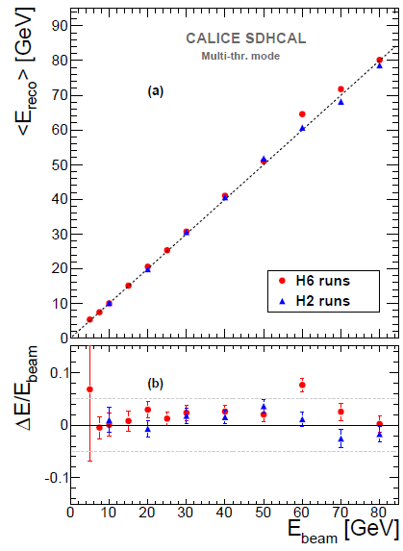
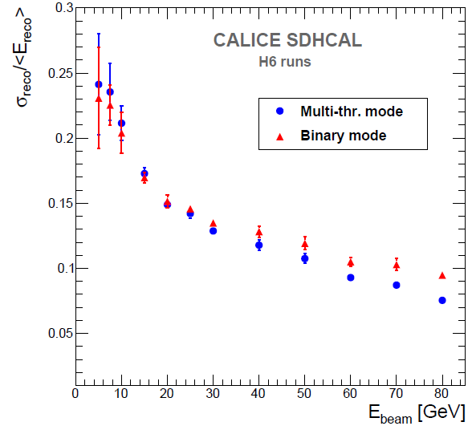
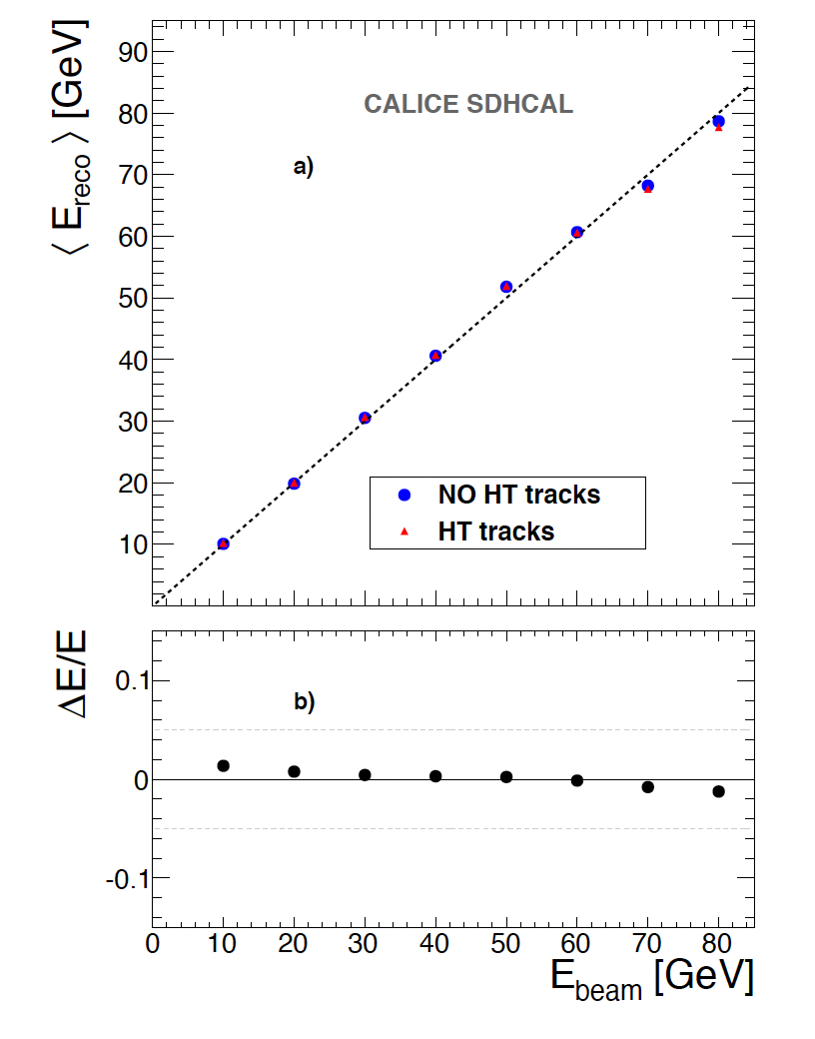
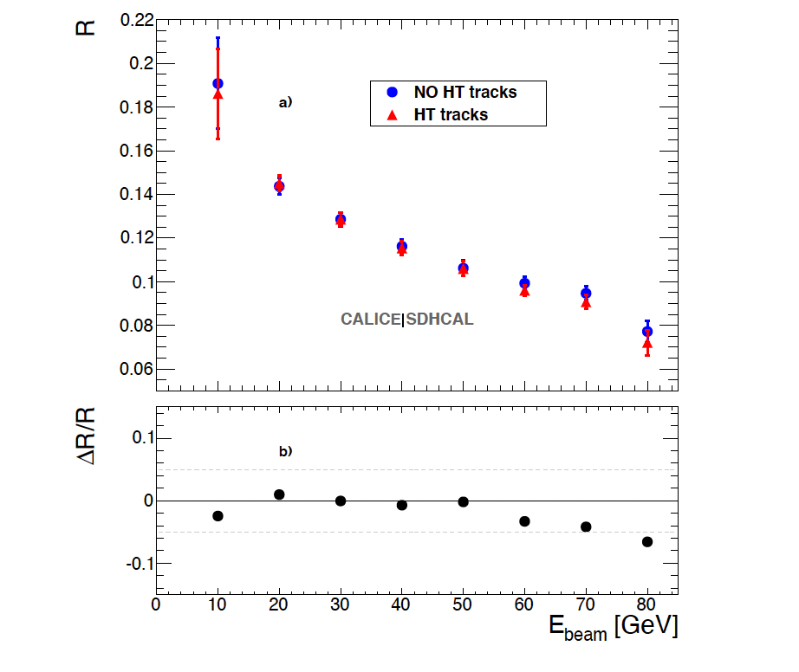
Energy reconstruction
N₁= Nb. of pads with first threshold <signal < second threshold
N₂ = Nb. of pads with second threshold <signal < third threshold
N₃ = Nb. of pads with signal> third threshold
E_{rec =} α (N_{tot}) N₁ + β (N_{tot}) N₂ + γ (N_{tot}) N₃
α , β , γ are quadratic functions of
They are computed by minimizing :
N_{tot} = N₁ + N₂ + N₃
χ²= (E_{beam}-E_{rec})²/E_{beam}
Hough-Transform
Track segments reconstruction using 3D-Hough Transform helps to apply different treatment to the hits of these segments.
JINST 11 (2016) P04001
E_{rec =} α (N_{tot}) N’₁ + β (N_{tot}) N’₂ + γ (N_{tot}) N’₃ + c N_{HT}
N_{tot} = N’₁ + N’₂ + N’₃+ N_{HT}
JINST 12 (2017) P05009

Slide 7
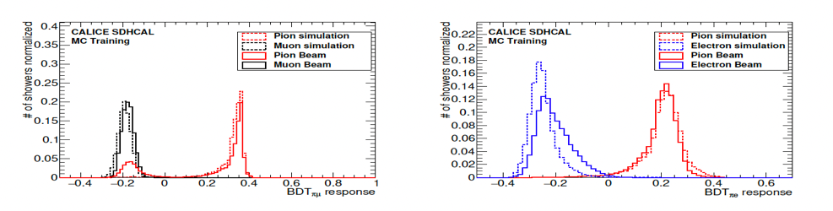
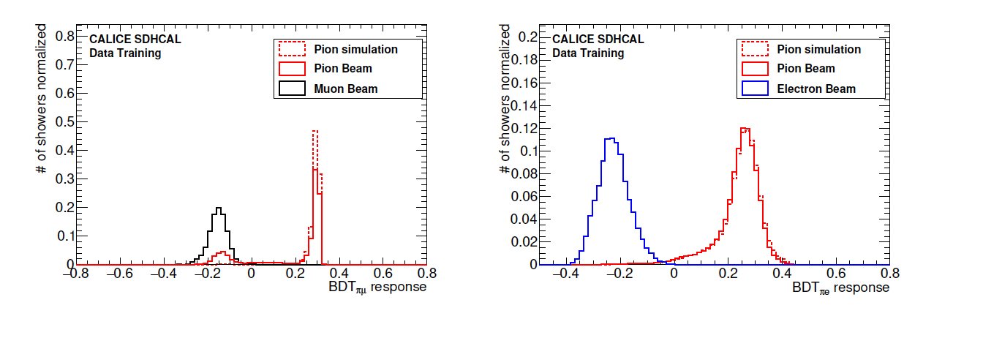
Particle Identification
The high granularity of SDHCAL allows one to discriminate different kinds of particles (pions, electrons and muons). The discrimination power is well exploited using MVT (BDT in our case)
Electron and muon rejection > 99%
JINST 15 (2020) P10009
B. Liu PhD thesis

Slide 8
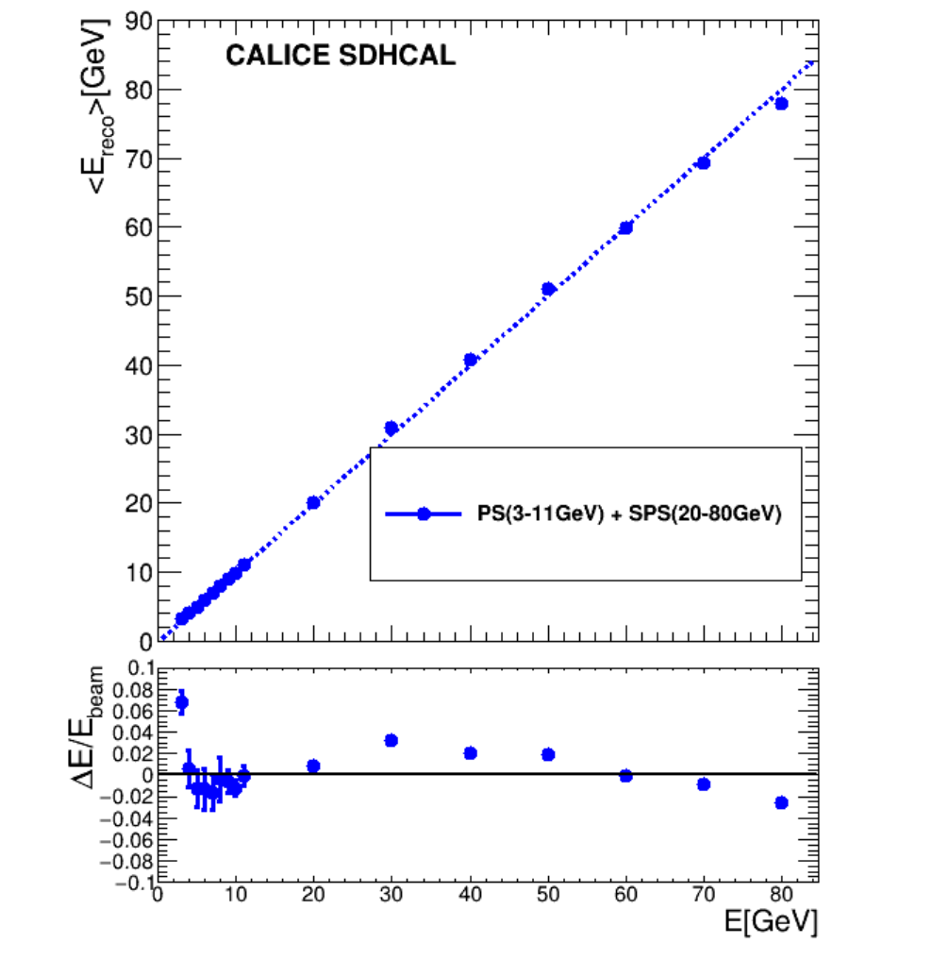
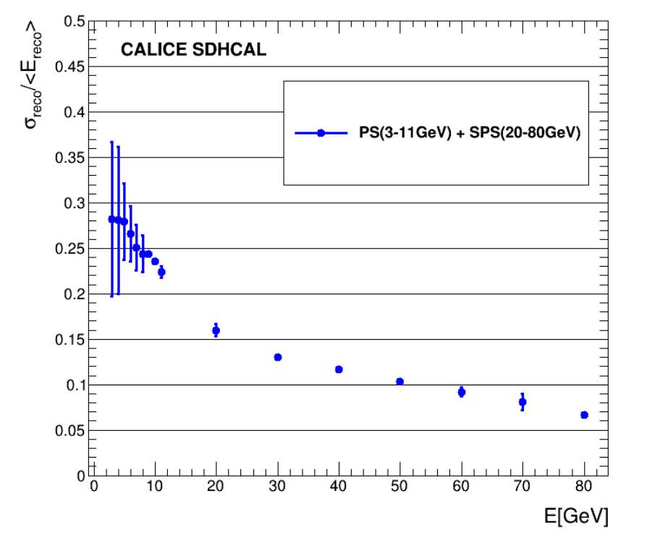
The BDT-based PID technique was also applied to the PS (3-80 GeV) samples
Linearity
Resolution
JINST_058P_0222 i

Slide 9
SDHCAL@CC

Slide 10
Strategy followed by the SDHCAL groups
Four important aspects were studied to cope with the constraint of CC:
SDHCAL depth
SDHCAL power consumption and active cooling
SDHCAL timing
Rate capabilities

Slide 11
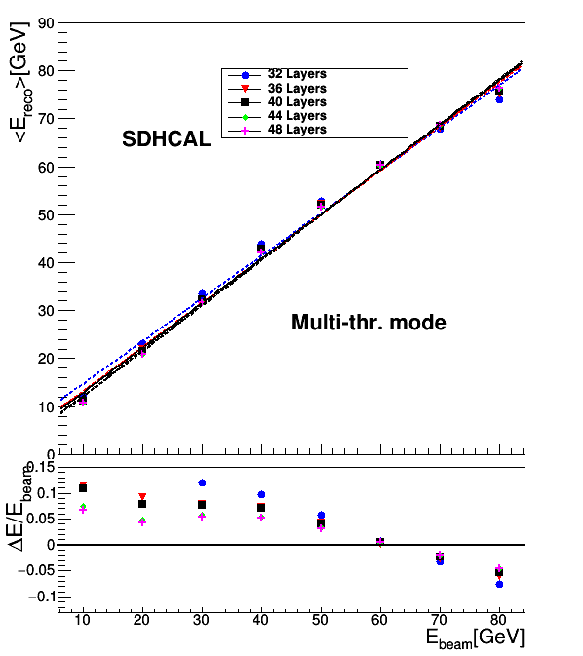
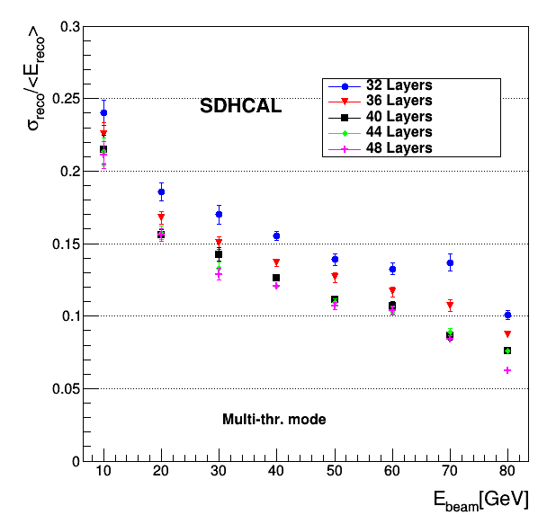
SDHCAL depth
Due to L* constraint of CC like CEPCFCCee the detector radius is smaller than the one for ILC. This leads to that fact that the depth of the HCAL is smaller than that of ILD@ILC.
The option to reduce the number of SDHCAL layers by 4 and 8 and 12 layers was studied on the simulation and on the data collected at TB@CERN.
Reducing by 4 layers seem to have small effects but one can still be efficient with 40 layers

Slide 12
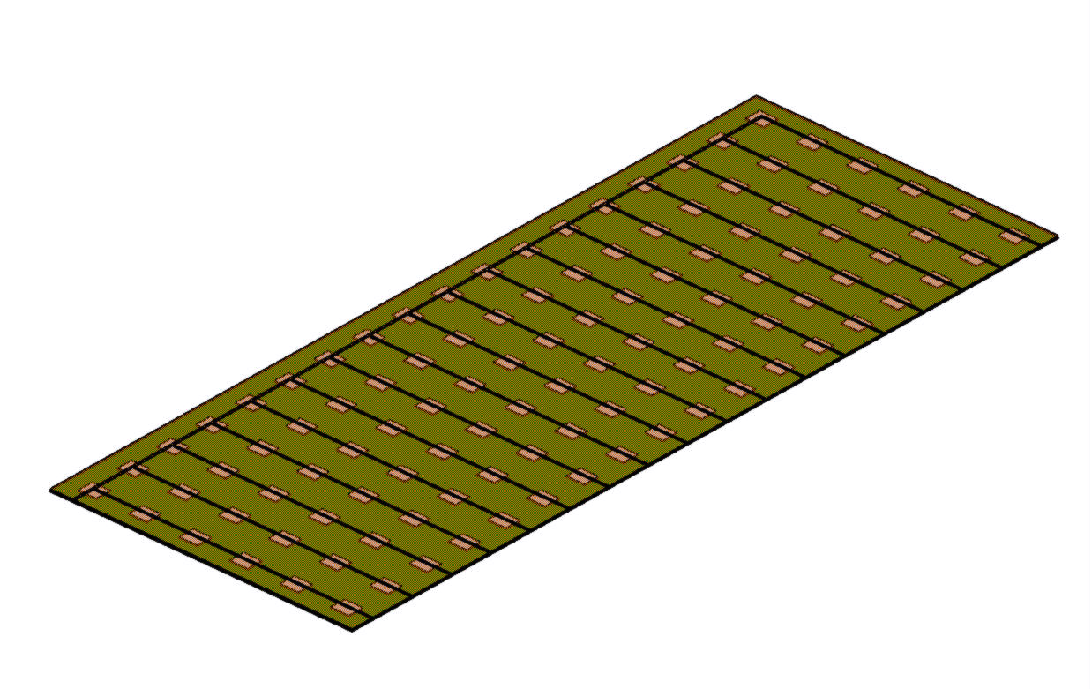
SDHCAL power consumption and cooling
The duty cycle of a CC is different from that of ILC and no power pulsing is possible.
The power consumption is therefore increased by a factor of 100-200 with respect to ILC and active cooling is needed.
Lyon and Shanghai groups worked on a simple cooling system for SDHCAL based on using water circulating into copper pipes
0.8 mW/chip of 64 ch with power pulsing, 80 mW/chip without power pulsing
0.5 m
108 chips
Rectangular section tubes : 2x1 mm
1.5 m
Copper plate over: 1.5 mm
Flow out
symmetry
PCB plate under: 1.4 mm
Flow in

Slide 13
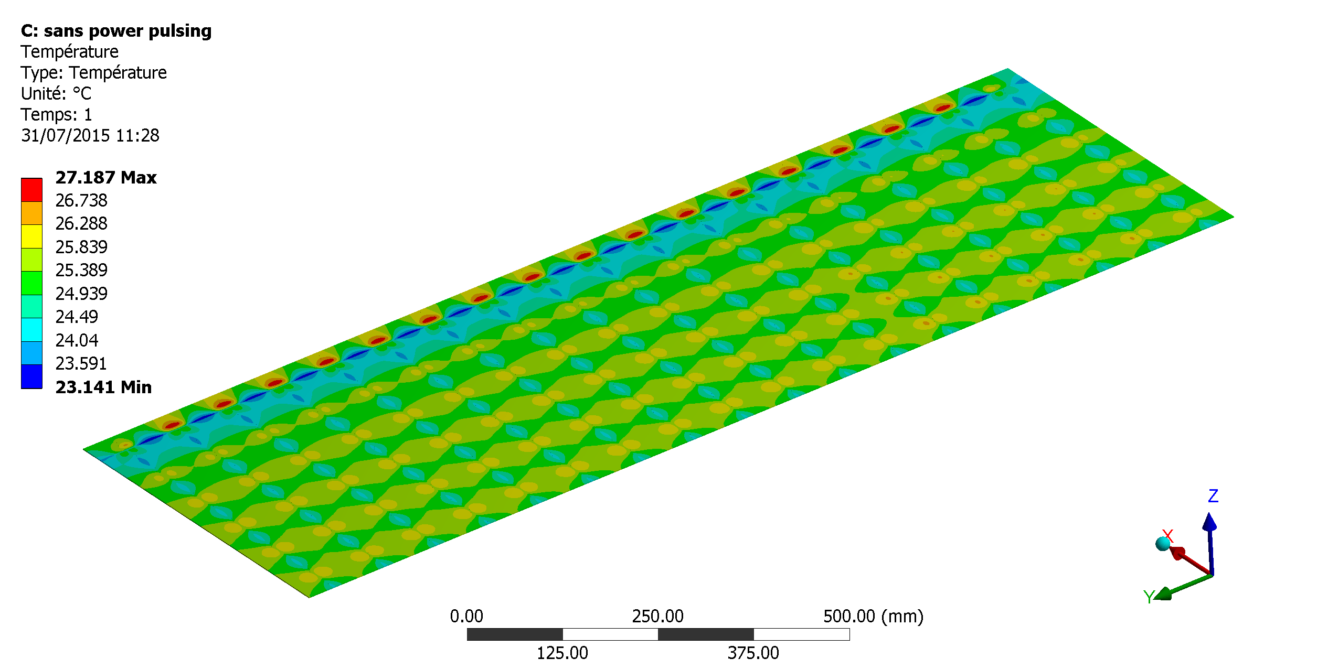
SDHCAL power consumption and cooling
The duty cycle of CEPC is different from that of ILC and no power pulsing is possible.
The power consumption is therefore increased by a factor of 100-200 with respect to ILC and active cooling is needed.
Lyon and Shanghai groups worked on a simple cooling system for SDHCAL based on using water circulating into copper pipes
0.8 mW/chip of 64 ch with power pulsing, 80 mW/chip without power pulsing

Slide 14
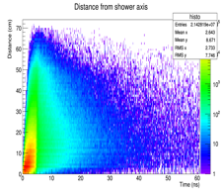
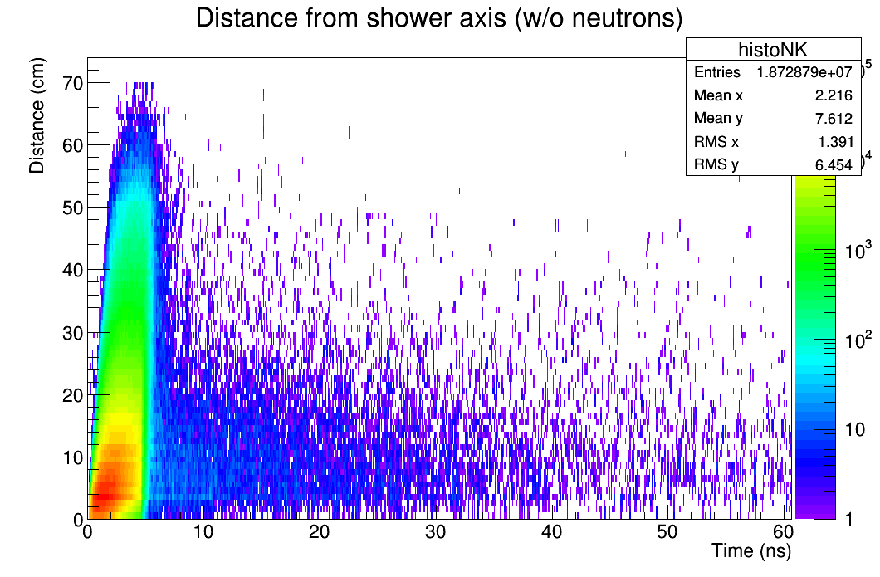
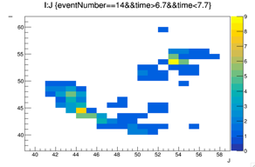
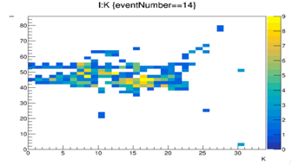
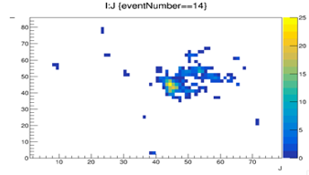
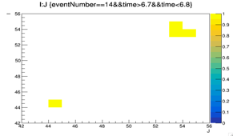
First step towards transforming SDHCAL into T-SDHCAL
Timing is an important factor to identify delayed neutrons and better reconstruct their energy
Timing can help to separate close-by showers and reduce the confusion for a better PFA application. Example: pi-(20 GeV), K-(10 GeV) separated by 15 cm.
1 ns resolution
Y
Y
Z
X
100 ps resolution
Y
X
X

Slide 15
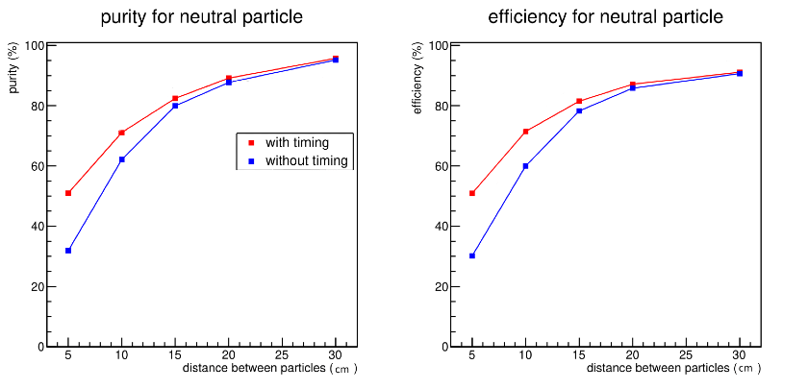
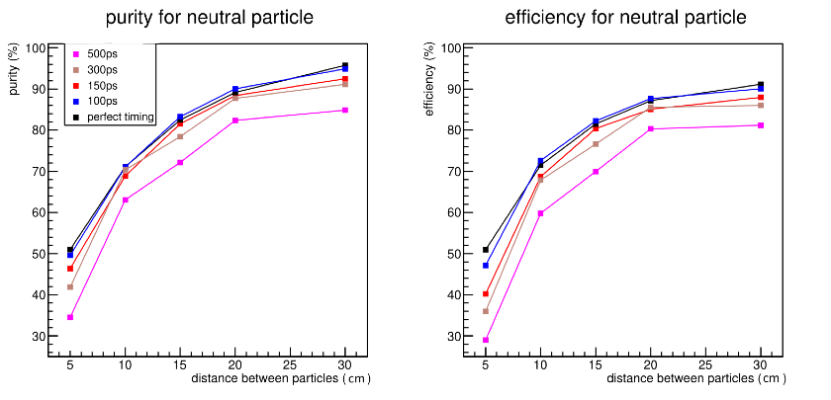
First step towards transforming SDHCAL into T-SDHCAL
Including time information in the simulation to separate hadronic showers ( 10 GeV neutral particle from 30 GeV charged particle) using techniques similar to ARBOR’s ones.
Master work of C Devanne

Slide 16
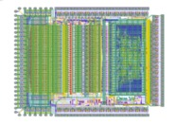
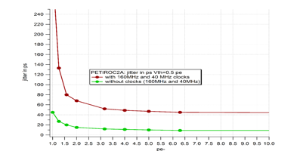
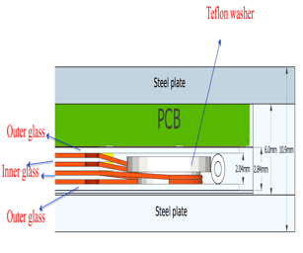
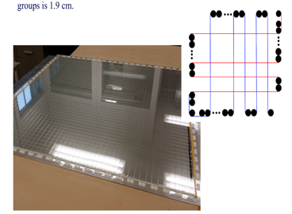
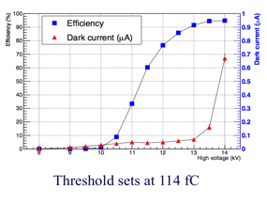
First step towards transforming SDHCAL into T-SDHCAL
How to achieve an excellent time resolution:
An ASIC with a fast preamplifier, precise discriminator and excellent TDC
is needed
→PETIROC 32-channel, high bandwidth preamp (GBWP> 10 GHz), <3 mW/ch, dual time and charge measurement (Q>50 fC)
jitter < 20 ps rms @ Q>0.3 pC
TDC either internal or external (delay-line, Vernier,.etc on FPGA as for iRPC CMS upgrade project)
A fast-time DETECTOR
MultiGAP RPC is an excellent candidate.
4-5 gaps of 250 µm each can provide 100 ps tim resolution

Slide 17
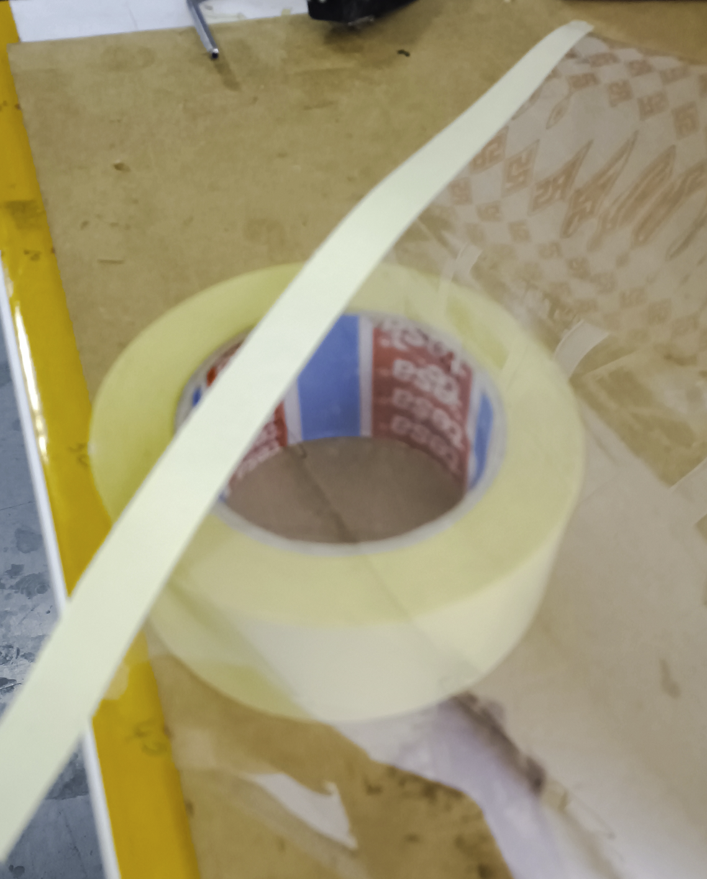
Using spacers/washers as done in single gap RPC is highly desired but unfortunately round spacers of a few mm with thickness between 200 and 400 µm are not available.
The only way to overcome this difficulty is to fabricate the spacers oneself but how*?
Mylar foil: many thickness possibilities. At CERN there are three: 50, 100 and 175 µm
Double face tape
paper
glue
Mylar
paper
glue
Mylar
glue
paper
* I got the idea during the installation of a closet at home by using the spot provided to hide the screw’s holes

Slide 18
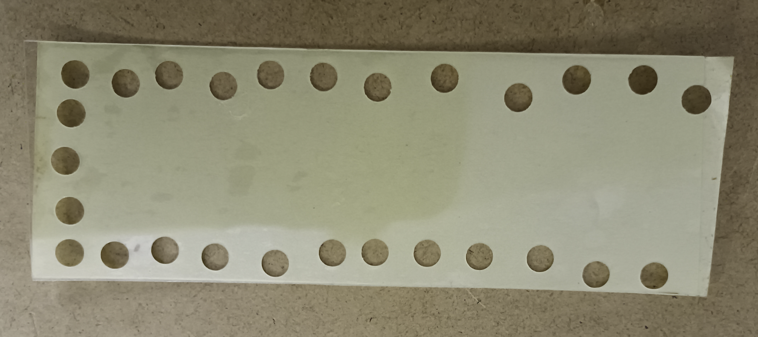
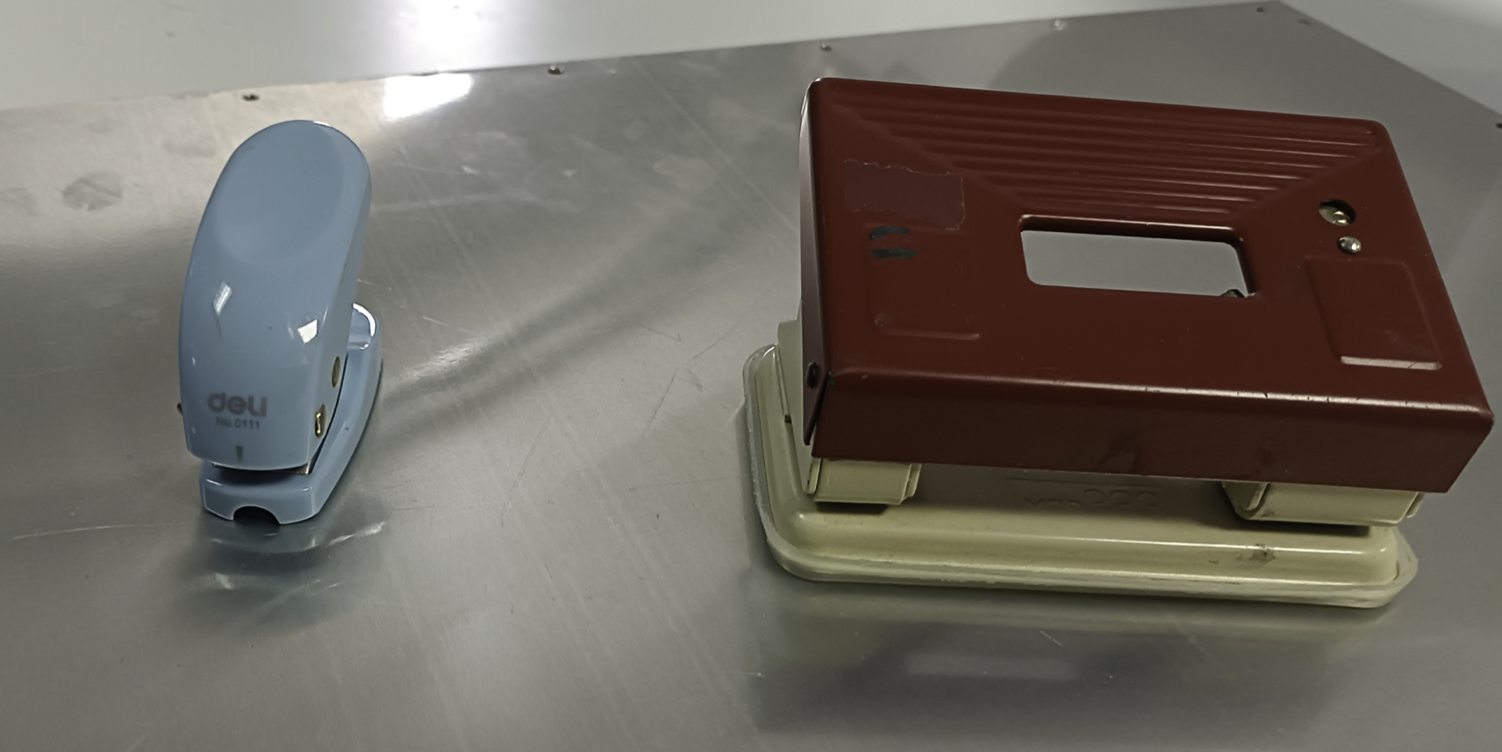
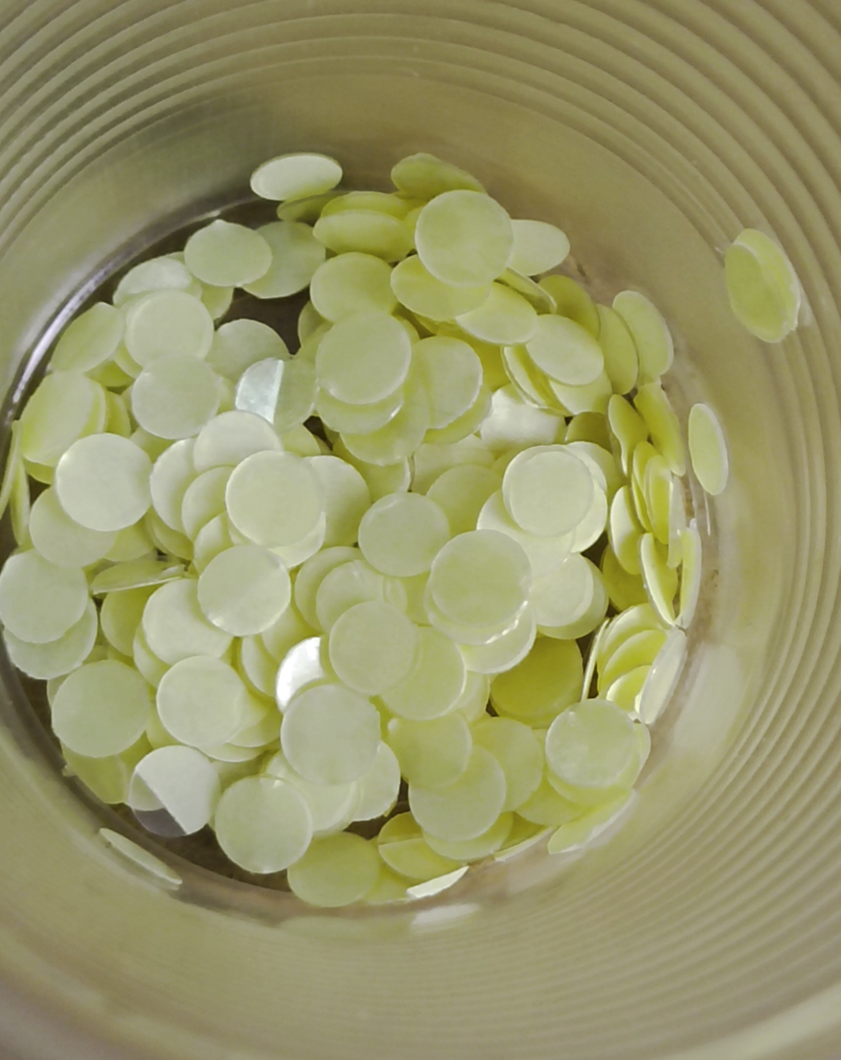
Production chain
waste
Production apparatus
Products*
* I produced many spacers during many boring ZOOM meetings…..

Slide 19
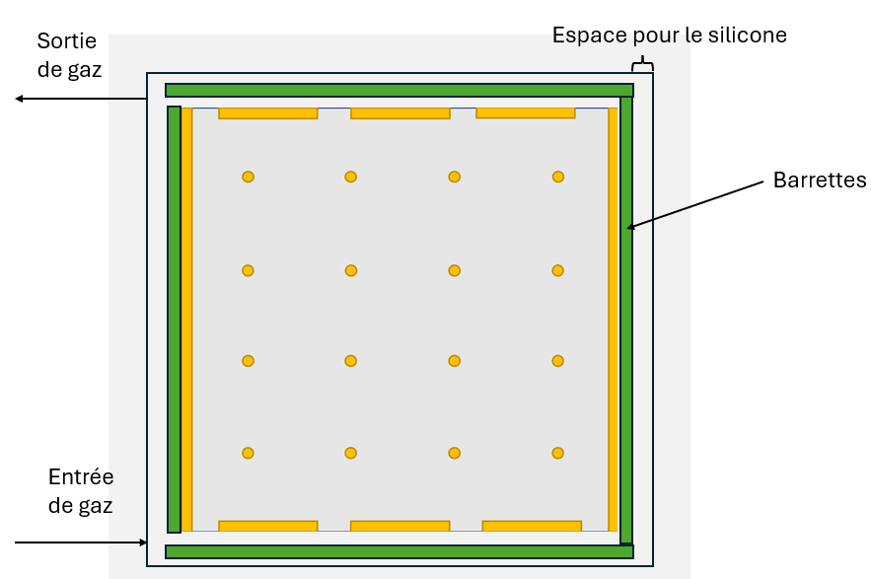
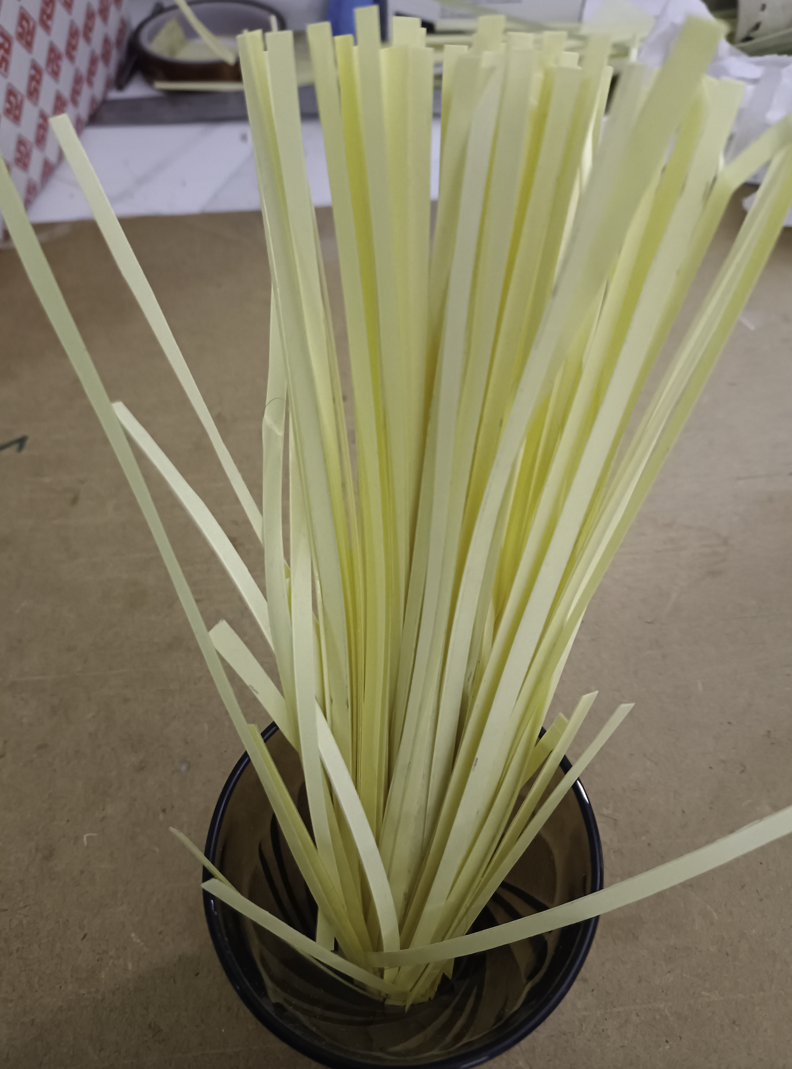
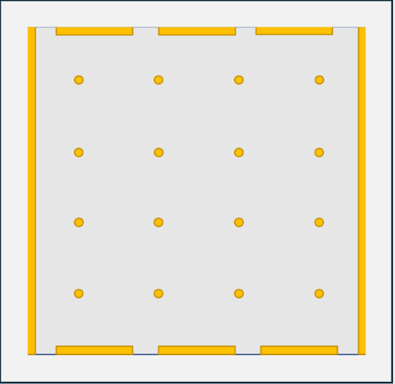
Inner plates
Gas outlet
Silicone filling area
Outer frame
Gas inlet
Inner frame
Inner frame
Outer plates

Slide 20
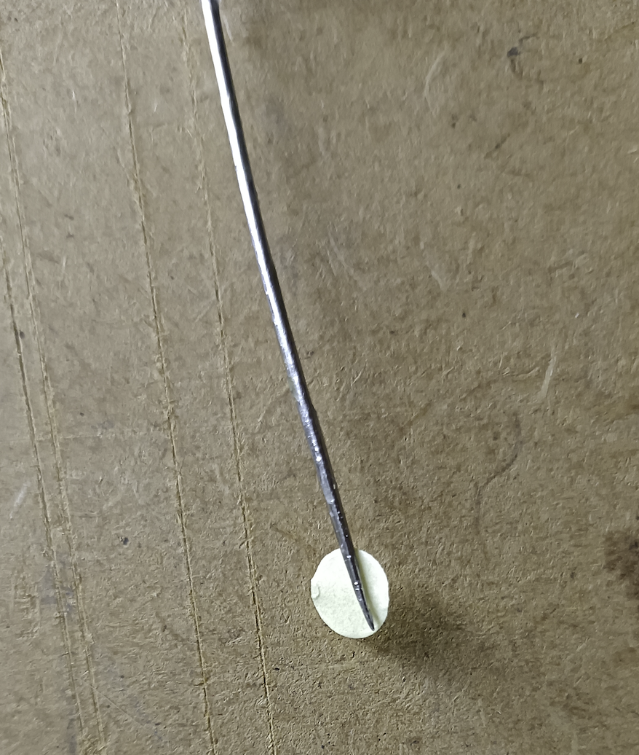
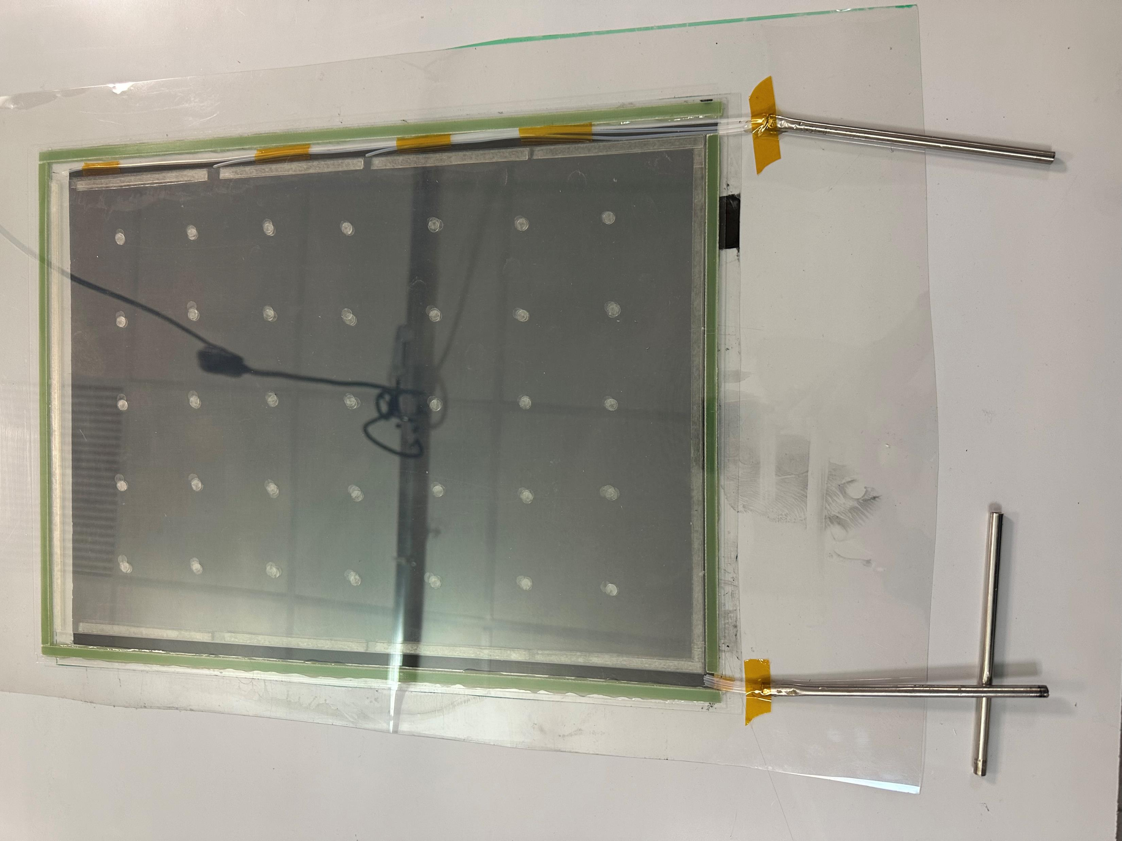
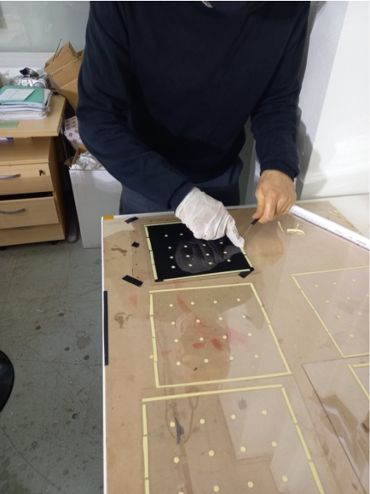
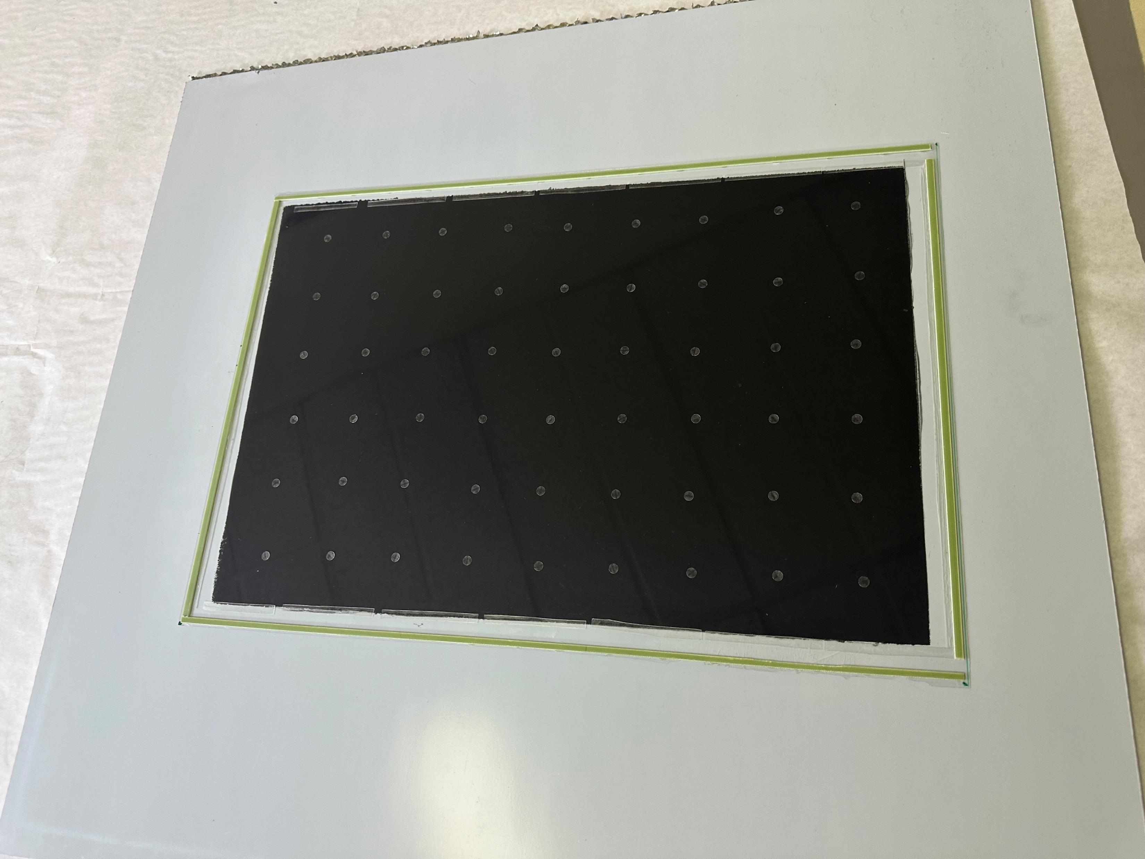
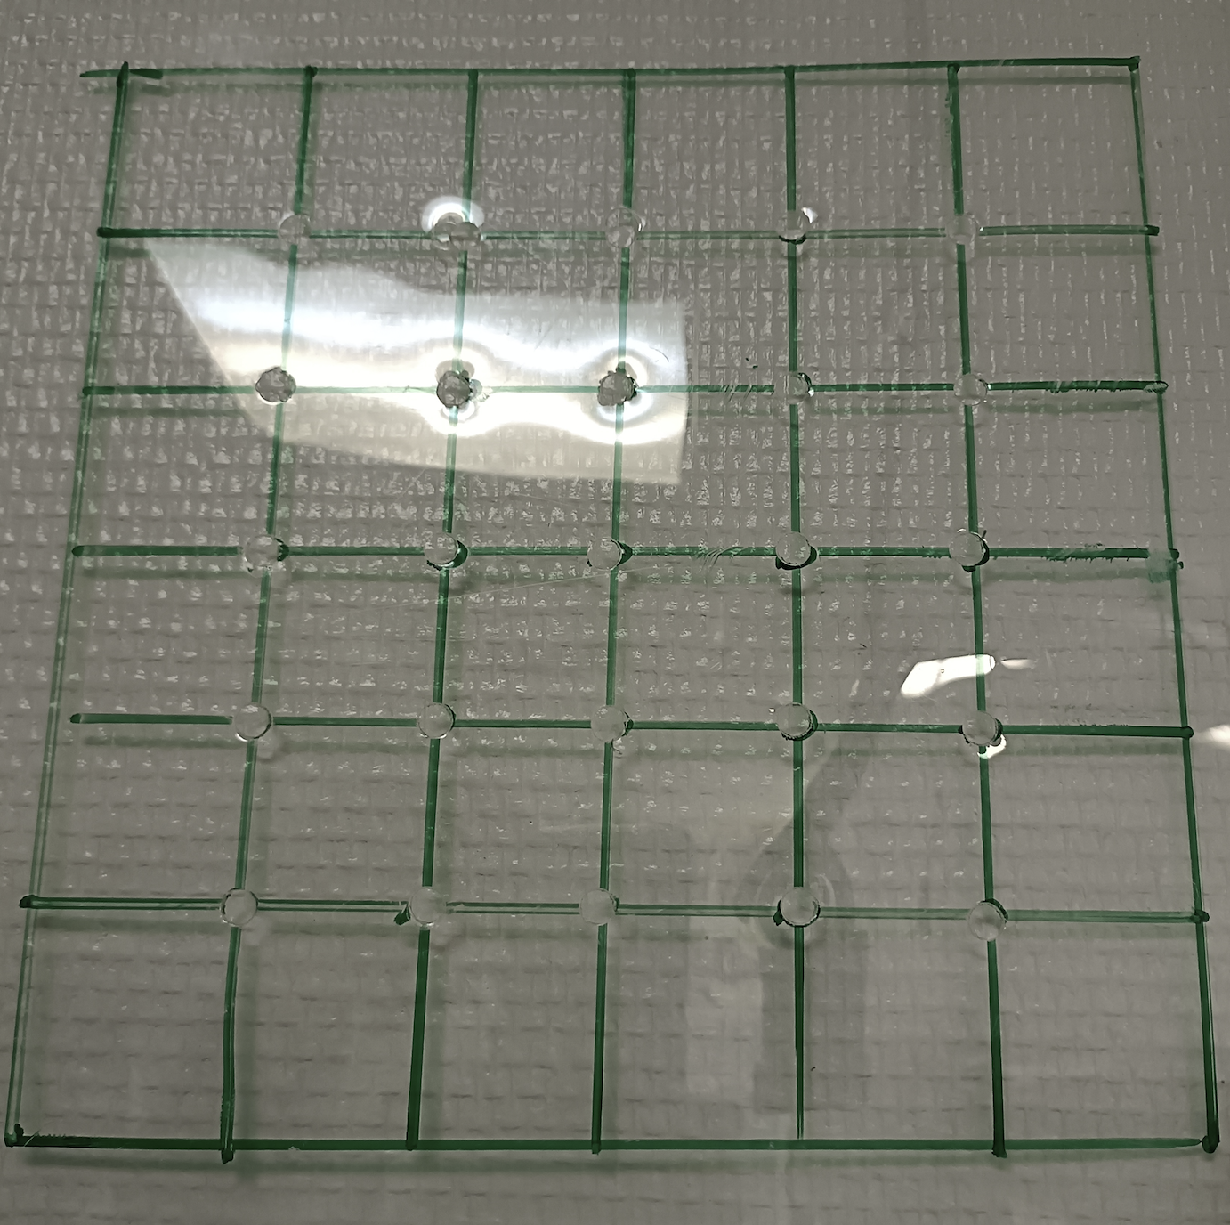
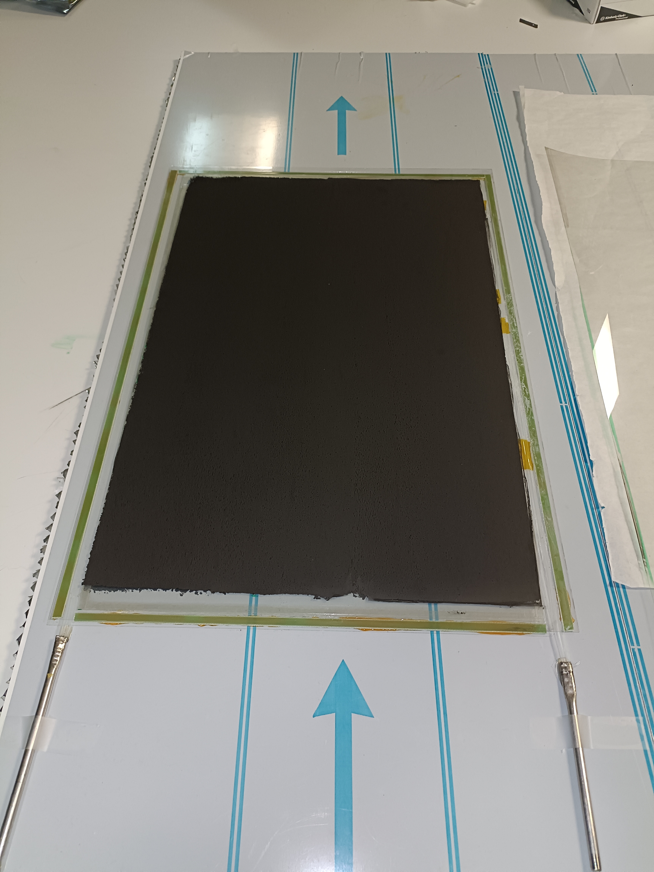
Protection paper to be taken off
Several gaps put one over the the other
Anode (last plate with coating)
Spacers are placed
4-gap RPC
Glass thickness: 280 µm
Gas gap: 220 µm
Grid for spacer positioning

Slide 21
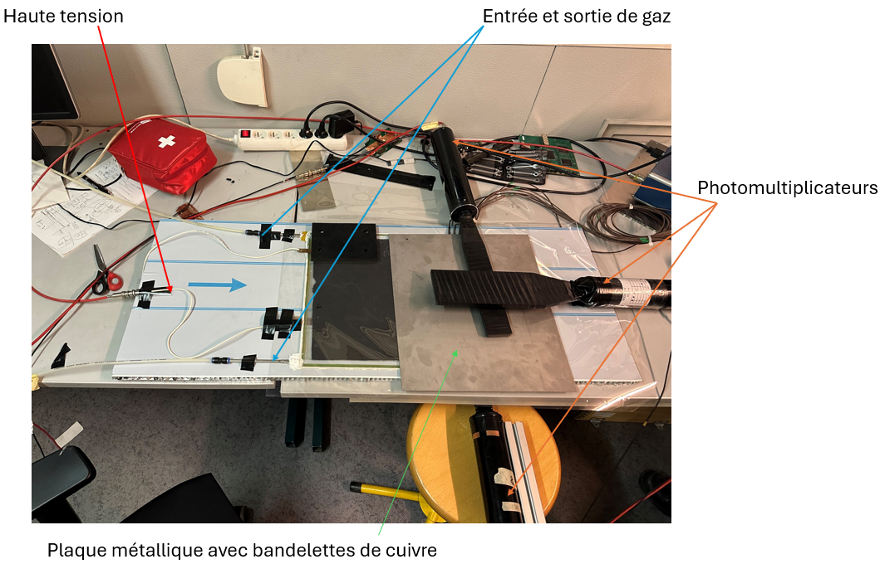
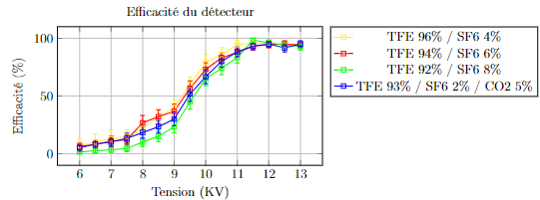
Efficiency study provided a proof of concept
Strips panel
produced by M. Verzeroli (CERN-IP2I)
Strips panel

Slide 22
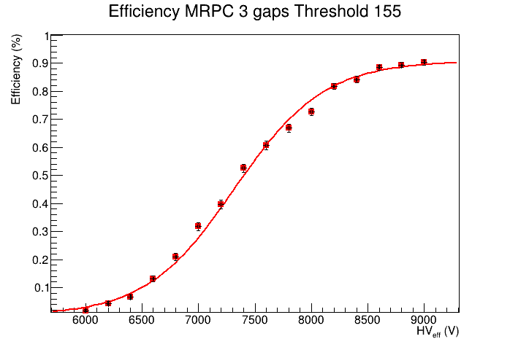
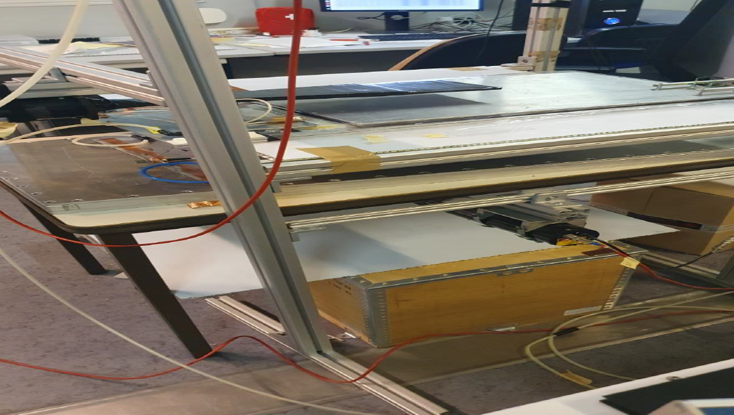




Ongoing studies:
MRPC of 3, 4 and 5 gaps of 50 cm X 33 cm were built using home made spacers of 220 µm height and glass plates of 330 µm
Homogeneity studied thanks to 1 cm x 1 cm pickup pads with HR ASICs from SDHCAL electronics
3 cm pitch leads to better homogeneity and lower noise than 5 cm pitch.
Lyon team
5 cm pitch
3 cm pitch

Slide 23



Ongoing studies:
In parallel, M. Verzeroli (CERN-IP2I) , have produced a few MRPC using the same method at CERN and is testing them with CAEN Desktop Digitizer v1730 to assess their timing performance in an independent way using standard gas mixture and new eco-friendly gases
M. Verzeroli et al, NIMA 1078 (2025) 170591

Slide 24
First step towards transforming SDHCAL into T-SDHCAL
Front-End Electronics for MRPC readout with high timing resolution
The system includes a front-end board (FEB), a detector interface card (DIF) and a data acquisition system(DAQ) based on ZCU102.
Test System and Setup

Slide 25





σ_{t} = 36 ps
σ_{t} = 75 ps
collaboration with SJTU
Electronics only

Slide 26


SDHCAL rate capability
GRPC have low rate detection capability (a few hundreds of Hz/cm2)
This is ok for ILC.
For CEPC with 1.5 MHz cycle duty (Higgs factory) this is still ok since the probability to have the same pad fired in one BC (0.7 µs) is about 10⁻⁵ and the probability to be fired once again before the electric field of the GRPC has reached its full value after a depletion is still small.
In case of Z-run the rate may be a problem, in particular at high eta.
Several scenarios are proposed:
Replace glass by other low resistivity electrodes leading to higher rate
(a factor of 100-1000 higher)→ PEEK doped with nanoparticles
AIDA2020

Slide 27
Summary
SDHCAL concept with its high granularity provides an excellent tool not only to apply PFA by separating nearby showers but also to measure their energy.
Different techniques were used to measure hadronic shower energy
excellent linearity and very good resolution are obtained
SDHCAL will be optimized now for Circular Colliders.
  Cooling
  Timing
  Rate capability
Switching to eco-friendly gases has started and collaboration with CERN gas group will be very important for the future of this activity.

Slide 28
Backup

Slide 29

SDHCAL R&D towards ILD@ILC
GRPC
Glass Resistive Plate Chambers
Detectors as large as 3m X 1m need to be built
Electronic readout should be the most robust with
minimal intervention during operation.
DAQ system should be robust and efficient
Mechanical structure to be similar to the final one
Envisage new features such timing, etc..
SDHCAL
ILD Module
Goal: to build new prototype with few but large GRPC with the new components
→ ILD Module0

Slide 30




Detector conception
Construction and operation of large GRPC necessitate some improvements with respect to the present scenario.
Gas distribution : new scheme is proposed
Prototype circulation system
New circulation system
inlet
outlet
1 m
2 m
Cassette conception to ensure good contact between the detector and electronics is to be improved

Slide 31






New electronics
Electronics readout for the 1m³ prototipo
HADROC chip
(ASIC)
1m² board ➔ 6 ASUs hosting 24 ASICs
3072 ch
DIF #1
144 ASICs= 9216 channels/1m²
USB
ASU1
ASU2
33 cm
DIF #2
HDMI
DIF
100 cm
DIF #3
1 DIF (detector InterFace) for 2 ASU (Active Sensor Unit.- PCB+ASICs) ➔ 3 DIFs for ONE 1m2 GRPC detector
Electronics readout for the final detector
Only 1 DIF per GRPC (any size) with small dimensions to fit in the small space available at the ILD detector
Uo to 9
DIF dimensions

Slide 32



New electronics: ASIC
Large SDHCAL module
HARDROCR3 main features:
  Independent channels
  Zero suppress
  Extended dynamic range (up to 50 pC)
  I2C link with triple voting for slow control parameters
  packaging in QFP208, die size ~30 mm²
  Consumption increase (internal PLL, I2C)
  800 ASICs were produced
H3B TESTED : 786, Yield : 83.3 %
6,3 mm
4,7 mm

Slide 33




HARDROC3: Analog linearity
Fast shaper outputs (mV) vs Qinj (fC)
FSB0
FSB1
Up to 10 pC
50% trig. Eff. (DAC units) vs Qinj (fC)
FSB0: 5σ noise limit= 15 fC
FSB2
Up to 50 pC
Dynamic range: 15fC - 50 pC

Slide 34


ASU (Active Sensor Unit)
An important challenge is to build a PCB up to 1m length with good planarity to have a homogeneous contact of pads with RPCs in order to guarantee an uniform response along all the detector.
A company was found and 1x0.33 m2 with 13 layer ASUs have been built.
ASU
HR3
ASICs
PCB
The ASU-ASU (= ASU-DIF) connections also produced

Slide 35


New electronics : DIF
DIF sends DAQ commands (config, clock, trigger) to front-end and transfer their signal data to DAQ. It controls also the ASIC power pulsing
• Only one DIF per plane (instead of three)
• DIF handle up to 432 HR3 chips (vs 48 HR2 in previous DIF)
• HR3 slow control through I2C bus (12 IC2 buses).
Keeps also 2 of the old slow control buses as backup &
redundancy.
• Data transmission to/from DAQ by Ethernet
• Clock and synchronization by TTC (already used in LHC)
• 93W Peak power supply with super-capacitors
(vs 8.6 W in previous DIF)
• Spare I/O connectors to the FPGA (i.e. for GBT links)
• Upgrade USB 1.1 to USB 2.0
TEXAS TM4C1294U
FPGA XC7A35TFGG484
POWER
POWER
POWER

Slide 36

New readout electronics is being tested
All functionalities seem ok
100 cm
33 cm

Slide 37


Slide 38

Time correction

Slide 39



SDHCAL High-granularity impact
Hough Transform is an example to extract tracks within hadronic showers and to use them to control the calorimeter in situ
ρ_{xz} = z sin(θ) + x cos(θ)
Excellent agreement with efficiency/multiplicity results obtained with cosmic and beam-muons. Excellent agreement data/MC

Slide 40

Gas system
Gas recycling is necessary to reduce cost :
-Goal: reduce the gas consumption to reduce the cost.
-Gas renewal of 5-10% rather than 100%
-Conceived by the CERN gas group

