Slide 1







PICMIC: The First Results
H. Abreu⁽¹⁾, E. Bechetoille^{(1,4)},G. Bertolone^{(2,4)}, G. Claus⁽²⁾, C. Colledani^{(2,4)}, C. Combaret⁽¹⁾, G. Doziere^{(2,4)}, C. Hu-Guo^{(2,4)}, I. Laktineh⁽¹⁾, H. Mathez^{(1,4)}, H. Pham^{(2,4)}, M. Specht⁽²⁾, I. Valin^{(2,4)}, L. Zhang⁽³⁾, Y.Zhao^{(2,4)}
(1) IP2I, Institut de Physique des 2 infinis, CNRS/IN2P3
(2) IPHC, Institut Hubert Curien, CNRS/IN2P3
(3) SDU : Shandong University, China
(4) Mi2i: Microélectronique des deux infinis (CNRS/IN2P3)
Assemblée Générale du GDR DI2I
IP2I, 18-20 Juin 2025, Lyon
<number>

Slide 2
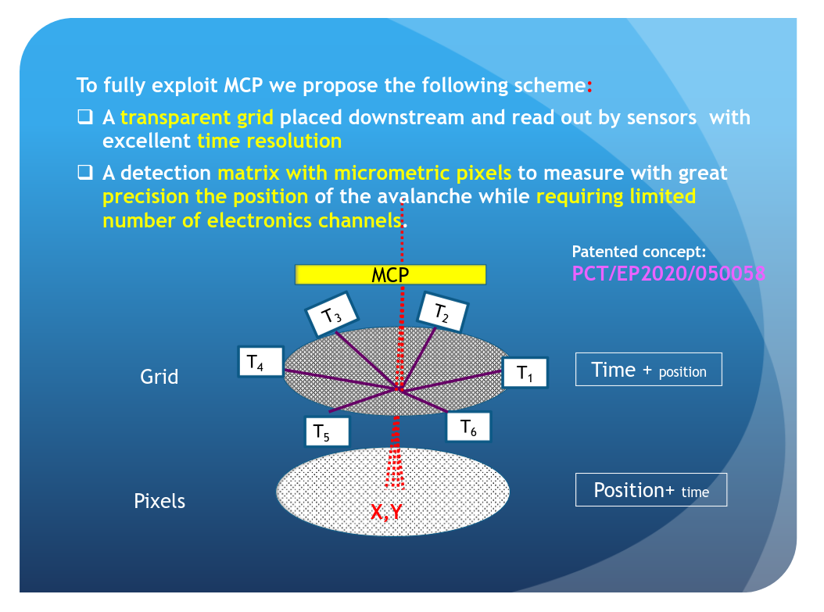
PICosencod subMICron detector:
Imad’s presentation at
https://t.ly/Iiw7G
<number>

Slide 3
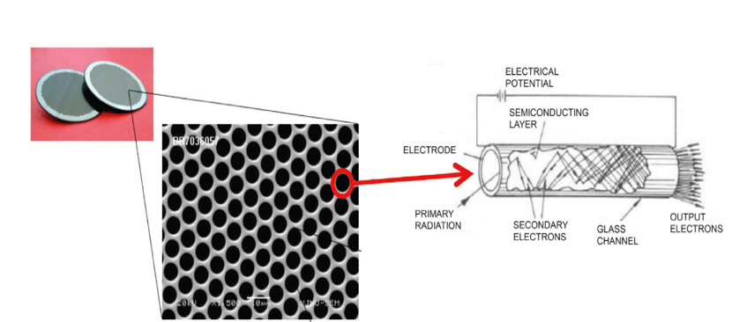
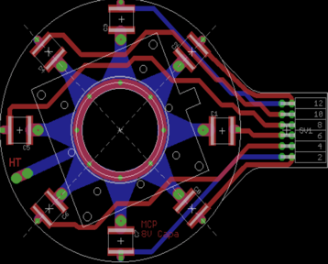
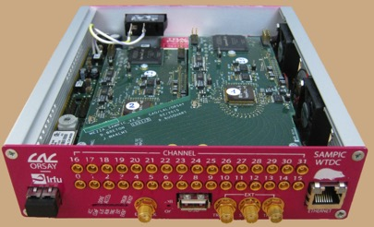
PICosencod subMICron detector:
MCP
it allows the detection of charged particles but also
neutral ones such as γ and neutrons when equipped
with appropriate converters (photocathode)
Imad’s presentation last year
L/D = 40-200
L is the plate thickness and D the tube diameter
D=3-25 µm
Gain/MCP ≂ 10000
TIME+position
8-point PCB for the time measurement.
PCB to be in contact with the grid
SAMPIC: WTDC ASIC allowing to reach ~3 ps time resolution
A modified version is used: mezzanine development for time and spatial syncro.
<number>

Slide 4
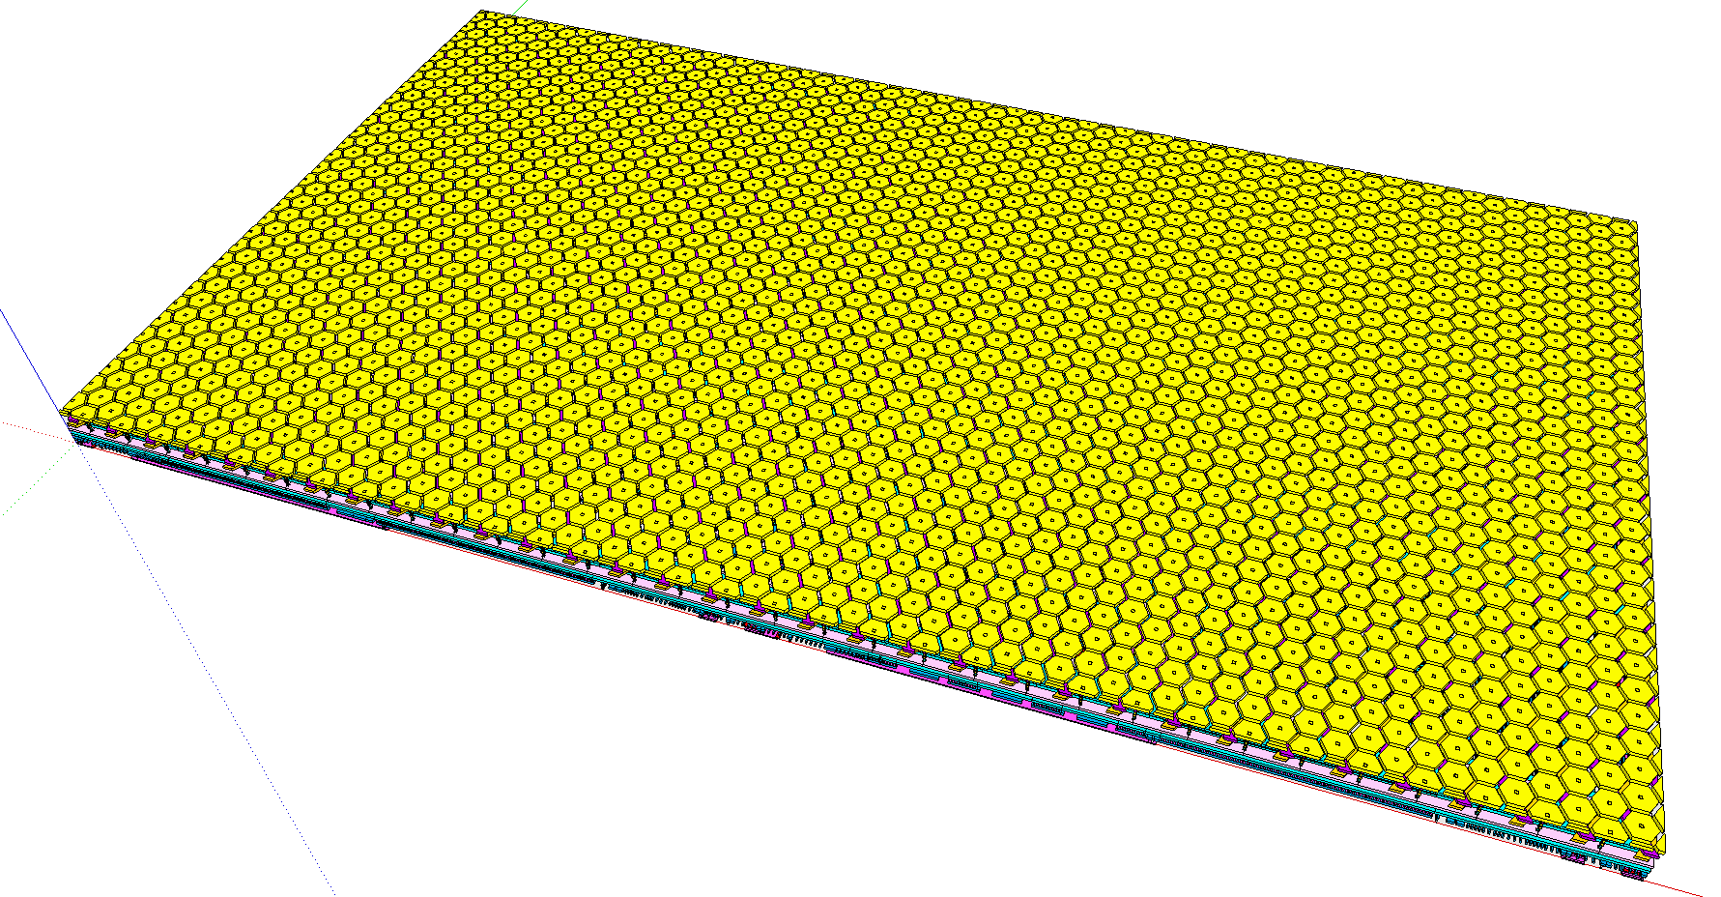
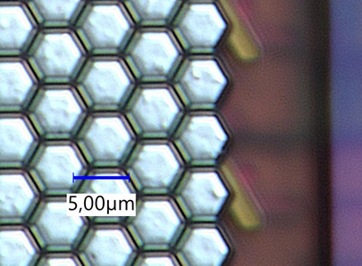
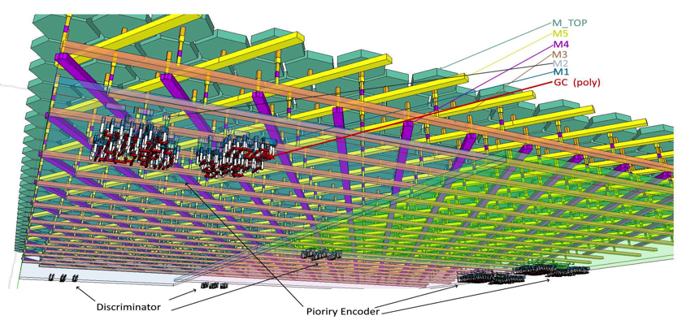
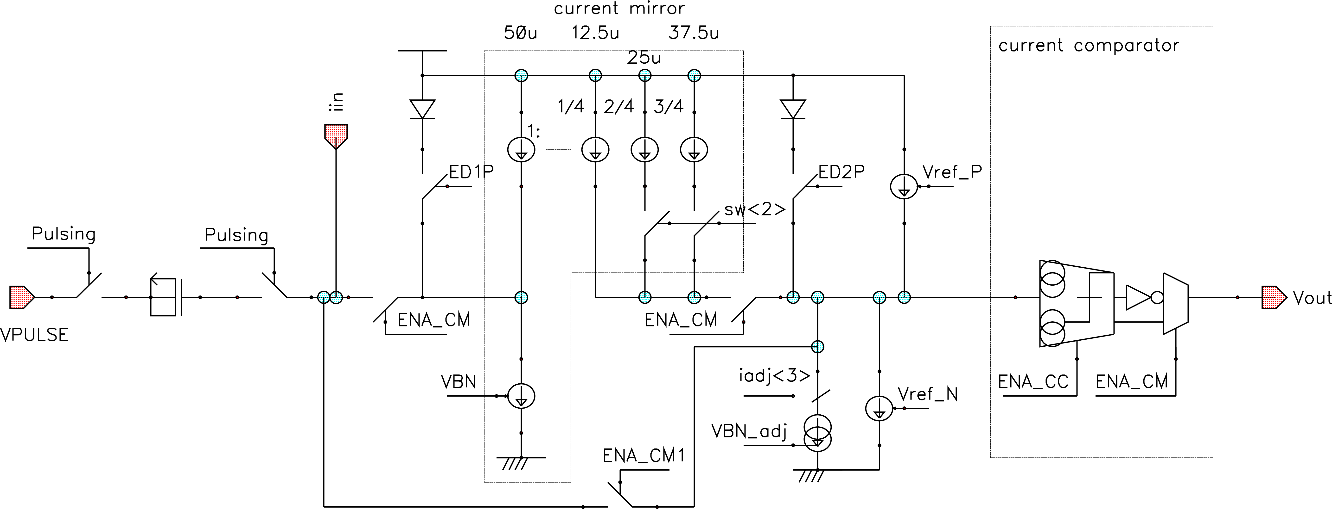
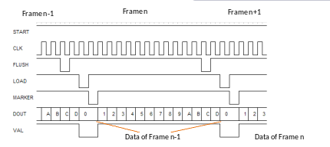
PICosencod subMICron detector:
POSITION+time
6.5 mm x 7.5 mm
6 metal layer technology:
3xdirectionsx852 hexagon(5μm)-strip-lines, in TOP metal interconnector Metal-5-4-3
[53,128] matrix of Analog+Digital comparator readout in M2 & M1, each line gets a comparator.
Very front-end:
- Current mirror + current comparator
- Current reference: global 8-bit tuning DAC + 3-bit local
- protection diodes
Analog readout
i2c Slow control :
- global registers + each readout-cell locally
- Column readout by priority encoder
Parallel readout :
- 13-bit data (touched pixel address) + Marker
- 40MHz // readout speed
- 16 sample by frame : 16* 25ns => 400ns frame
Digital readout
<number>

Slide 5
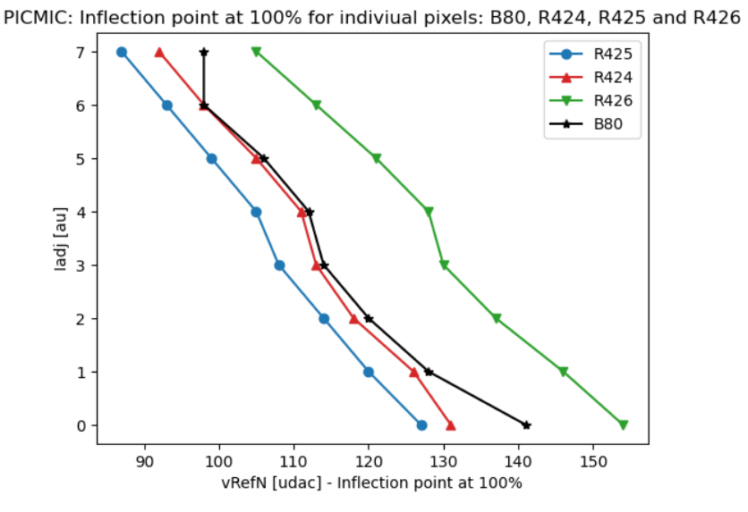
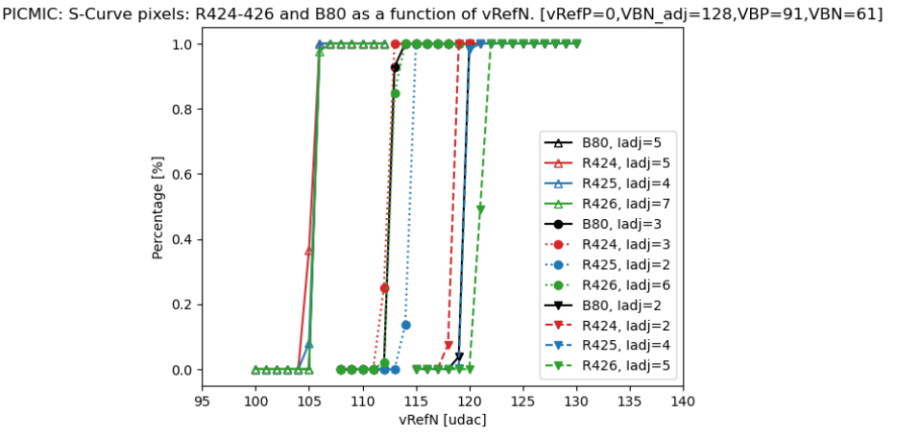
Pedestal threshold calibrations
(1/2)
[Protocol]
Freeze a set of DAC(Global) values driven by :
- small dispersion between s-Curves
- bigger number of sCurves in a given
space of phase vs VRefN(quite sensitive)
Then, additional scan in local values are performed:
- iadj<3bits>, sw<2bits>, EN_CM, EN_CC.
To determine value @50% inflection point.
To select the closest sCurves@50% to VRefN
PICMIC Very Front-End synoptic(Analog part)
The first tries were performed choosing a few channels (among the 2556 available):
2D scan [iadj vs VRefN] results following steps1-3 of the protocol
Matched sCurves(VRefN) for sets of values in iadj
<number>

Slide 6
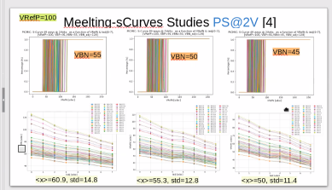
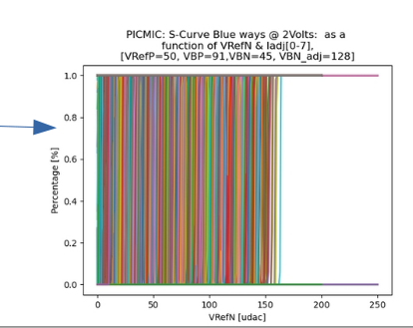
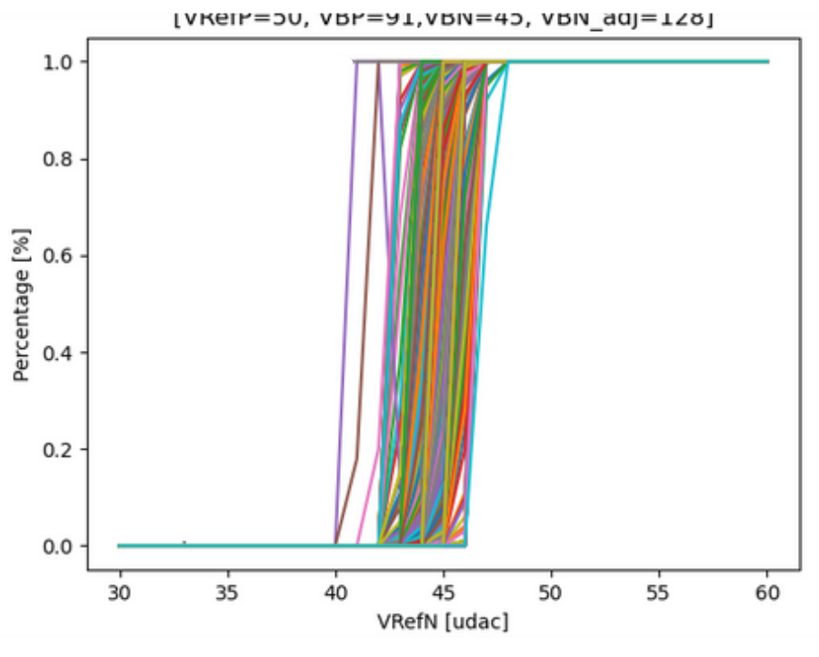
Pedestal threshold calibrations
(2/2)
[Protocol]
Freeze a set of DAC(Global) values driven by :
- small dispersion between s-Curves
- bigger number of sCurves in a given
space of phase vs VRefN(quite sensitive)
-- VRefP=50, VBP=90, VNB=45, VBN_adj=128
Then, additional scan in local values are performed:
- iadj<3bits>, sw<2bits>, EN_CM, EN_CC.
To determine value @50% inflection point.
To select the closest sCurves@50% to VRefN.
The software’s interface of the test bench modified to allow up to 5-Dimensional scans.
Full calibration of 2556 channels. Global fixed, varying local:
32 configurations per channel: ~81800 sCurves to analyse.
full matched sCurves(VRefN)
<number>
*Excluded 38 Yellow channels (Metal 3), noisy due to coupling between memory flush signal in Metal 2

Slide 7
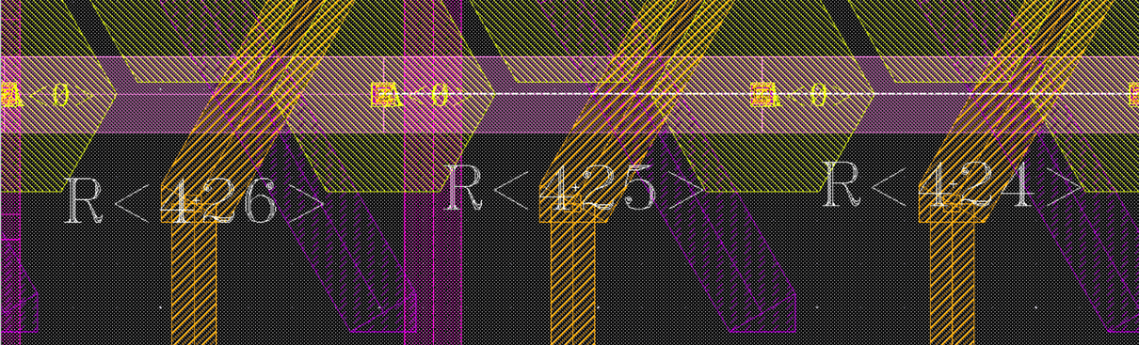
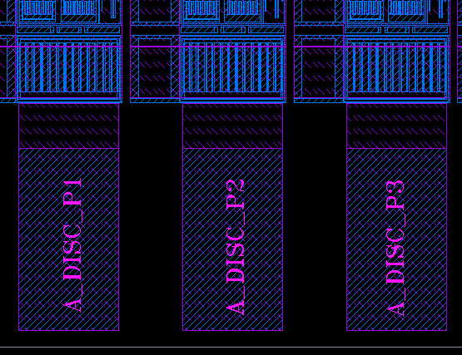
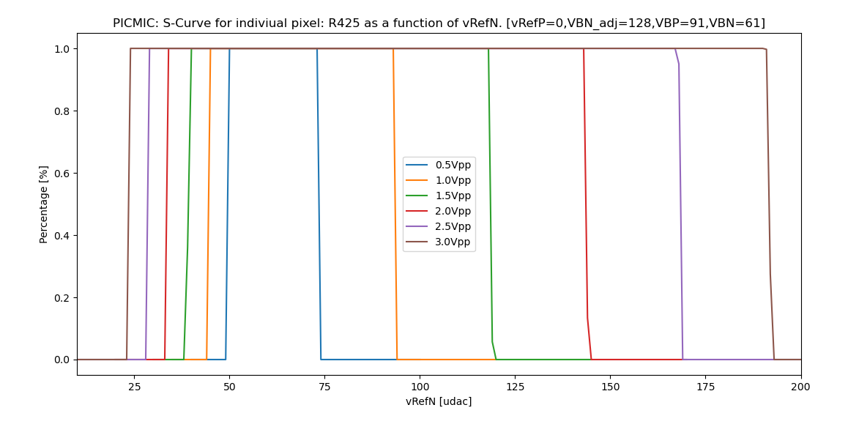

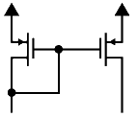

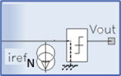
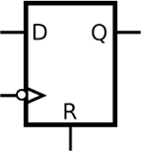
Injections Studies
(1/2)
PICMIC allows external signal injection trough the (PAD):
- R424[R68,C28],R425[R103,C35] and R426[R6,C15].
- * it also allows to excite whole columns in the channel matrix (no shown in above layouts).
Voltage injection through external 1pF, then scan of the threshold of Current Comparator.
Below the current threshold, the falling edge sensitive does not trig.
The signal is recorded on falling edge, so above a certain value of iRefN added to threshold current, the comparator does not trig anymore-→ chapeau!
Efficiency [%]
VRefN [udac]
iComp
iComp
iComp
iRefN
‘1’
VPULSE
Dout
ith+iin
iRefN
ith+iin
iRefN
ith+iin
1pF
Vout
1
Vout
1
Vout
1
0
No edges
0
0
fall edge
No edges
Dout
Dout
Dout
1
<number>
1
1
0
0
0

Slide 8

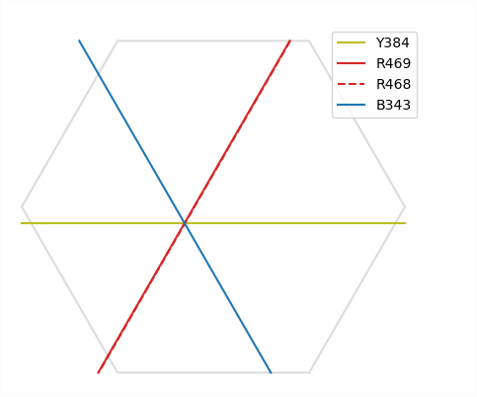
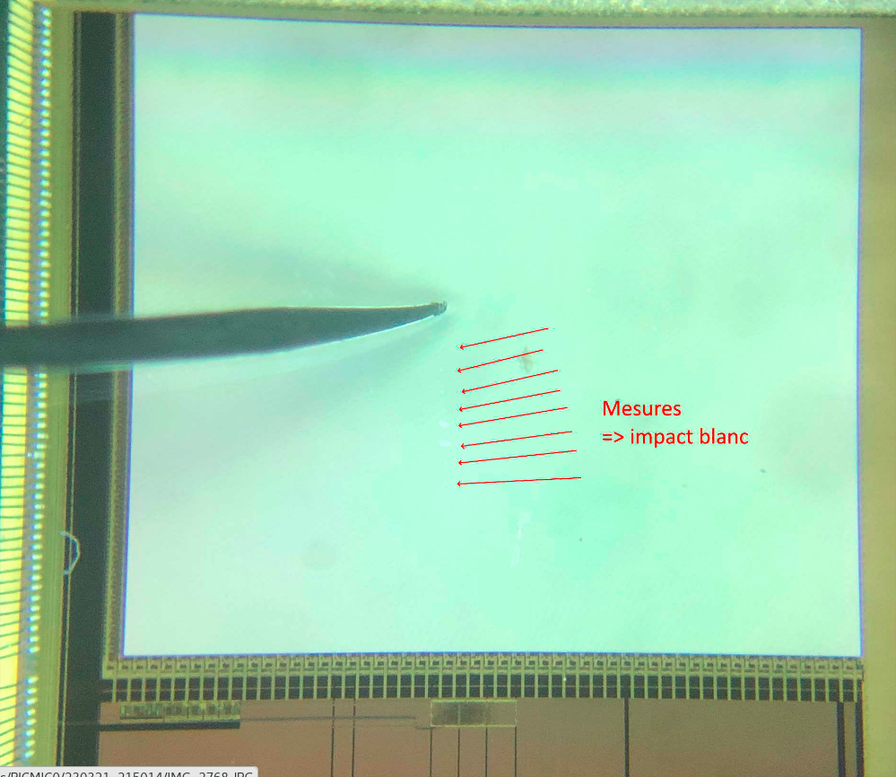
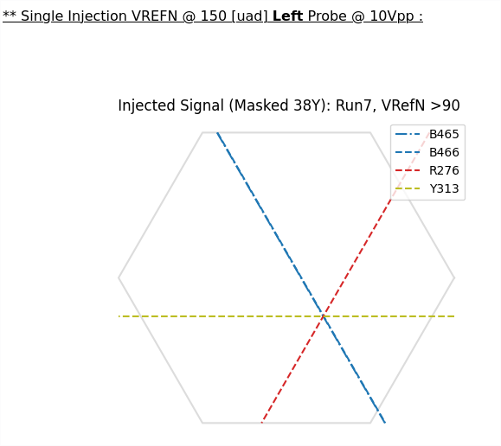
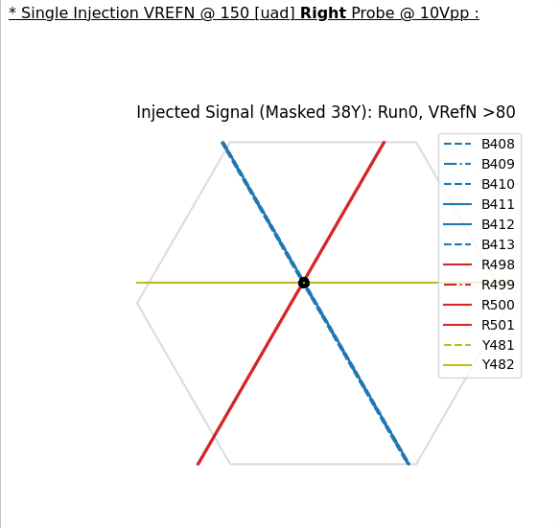
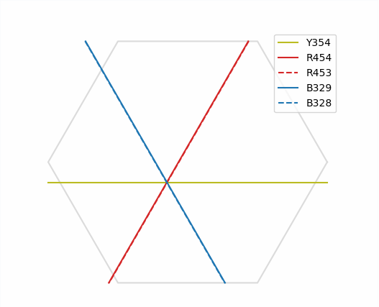
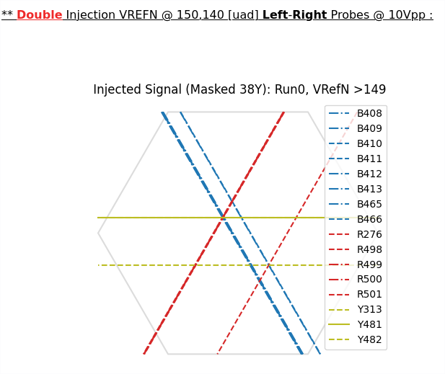
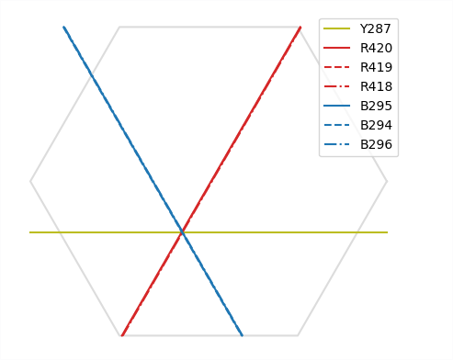
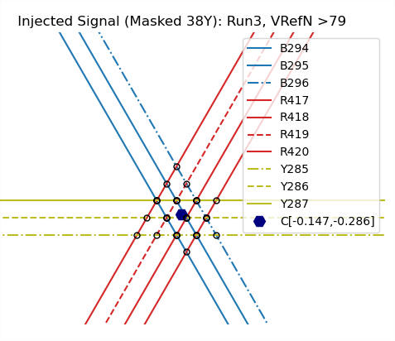
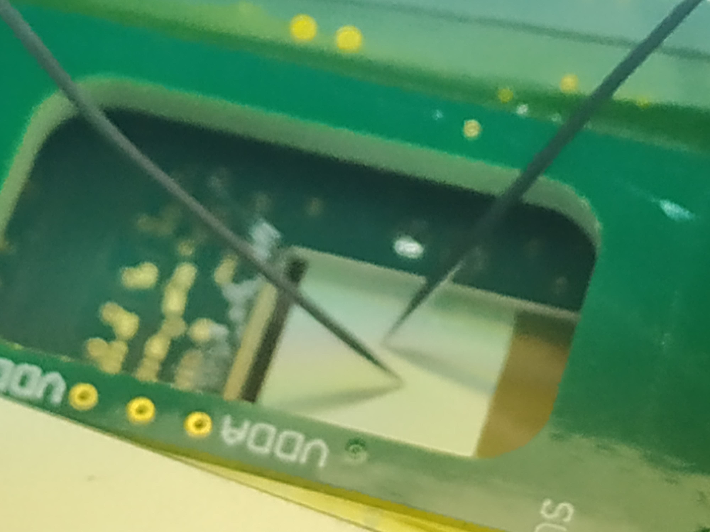
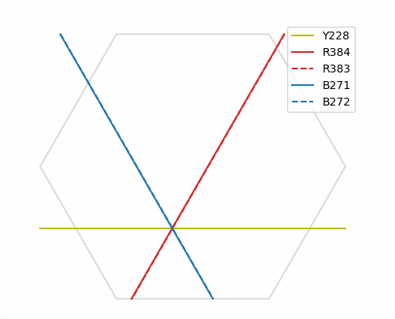
(2/2)
Injections Studies (Probes)
Having the full pedestal thresholds under control (PICMIC calibrated). We proceeded to accomplish an important mainstone. Direct inject on the surface.
Two probes injection
left-probe
right-probe
both-probes
Probe scan from bottom - top
Clustering and
centroid estimation
<number>

Slide 9
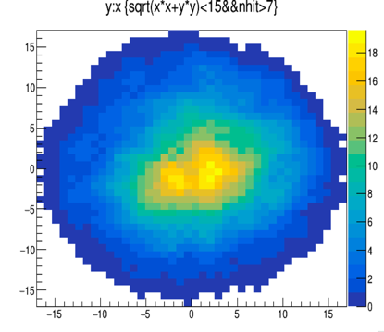
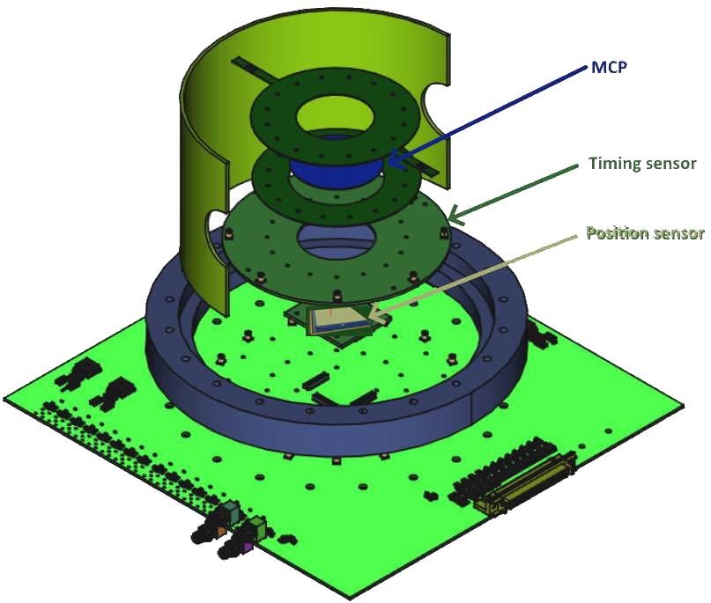



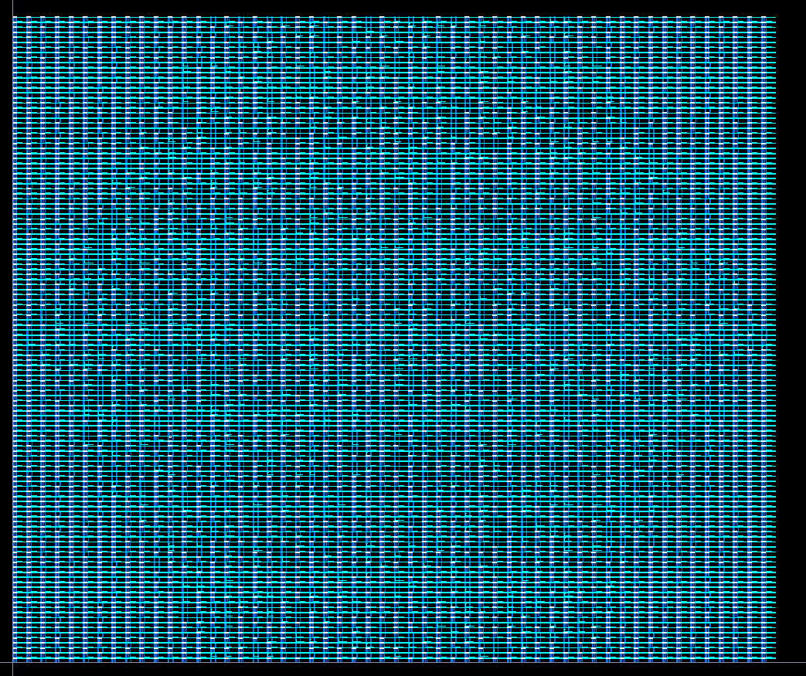
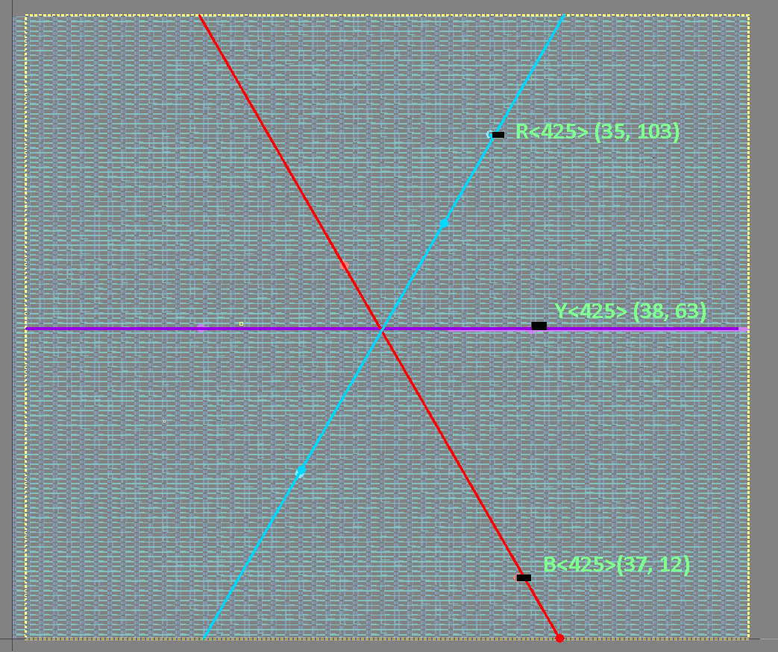

Proof-of-concept Demonstrator
3ps Time precision + 1mm position estimation
t_{i}-t_{j}
=>
(tracker-like)
SAMPIC
HW
(electron absorber)
(Row,Col)(35,103)(38,63)(37,12)
SAMPIC
FirmWare
5µm position, in 400ns frame resolution
E. Bechetoille, PICMIC, TWEPP, 1–6 oct. 2023, Geremeas, Sardinia, Italy
Notes:
Today, the MCP, is not cabable of generating 3ps resolution signal, but SAMPIC measure at the precision.
<number>

Slide 10
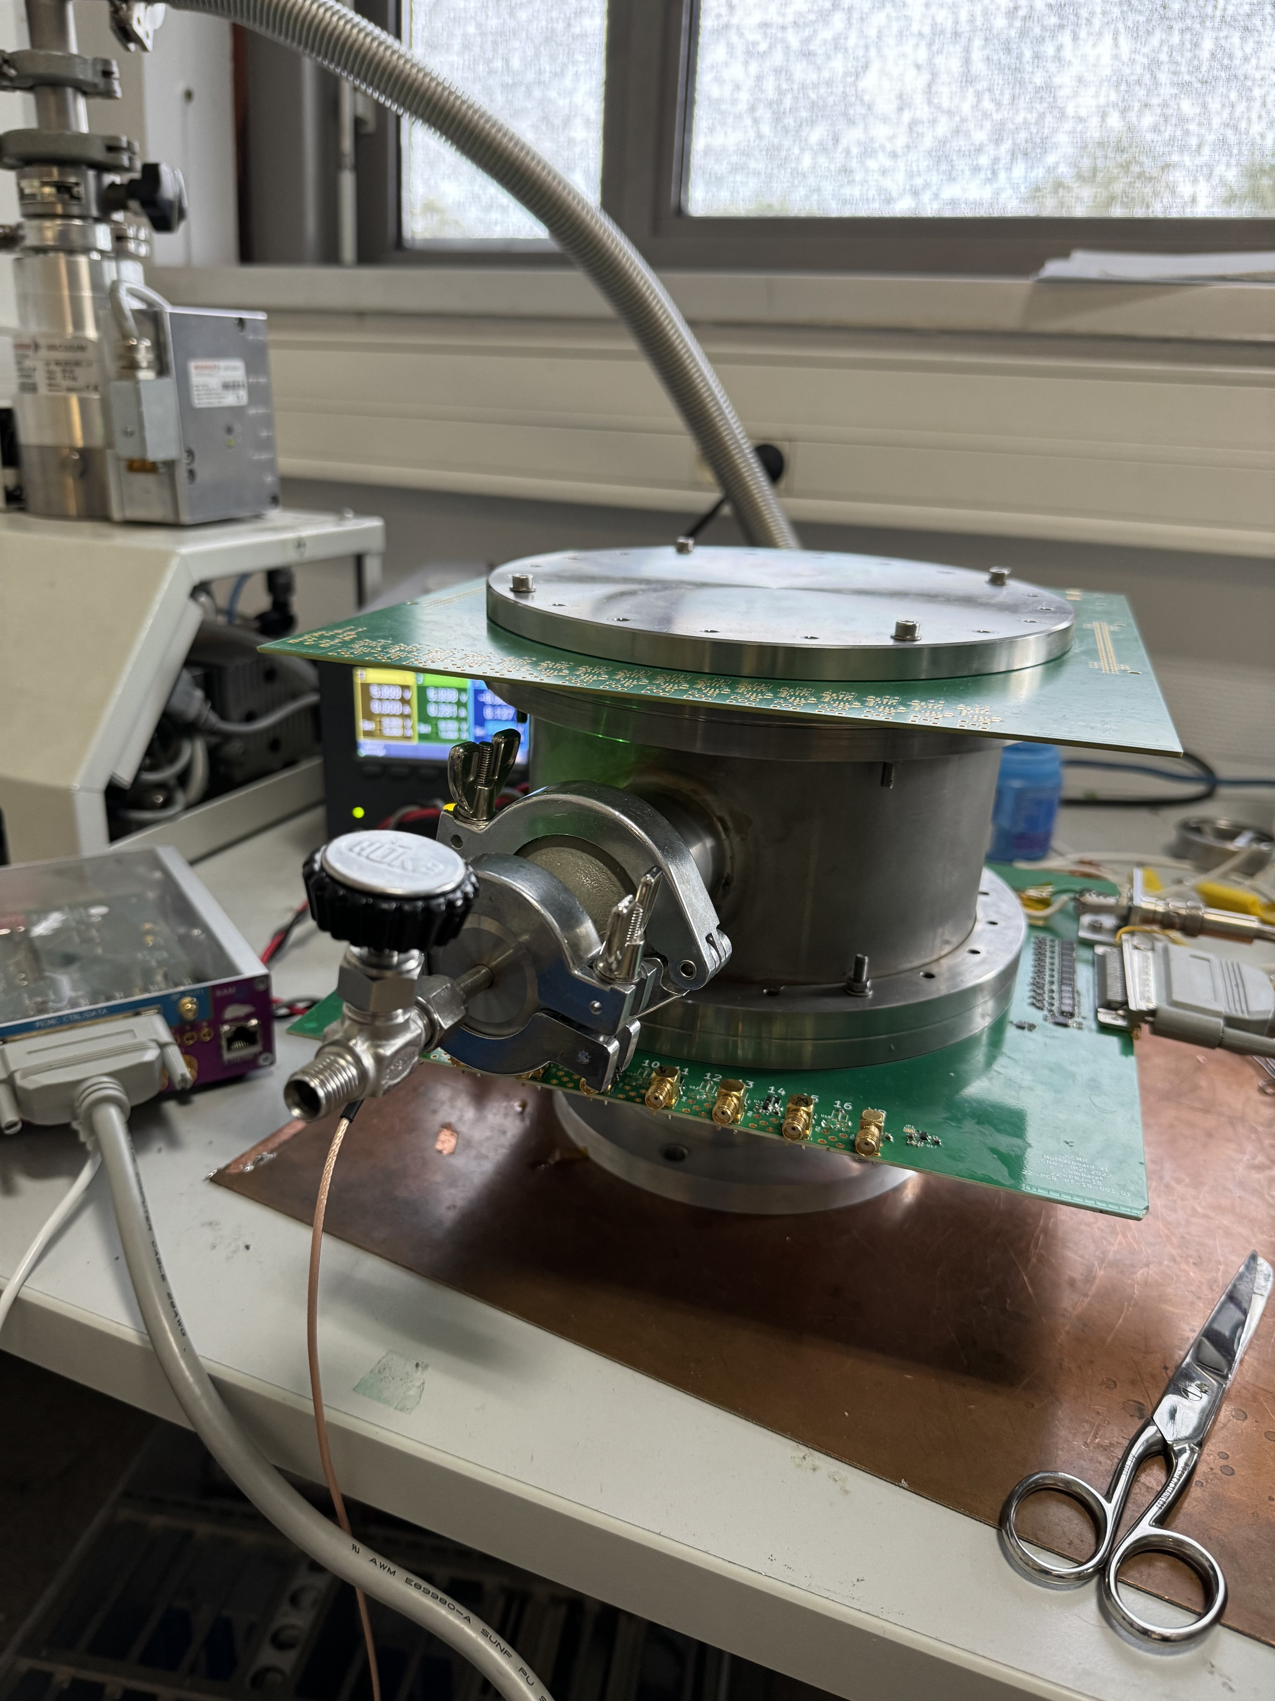
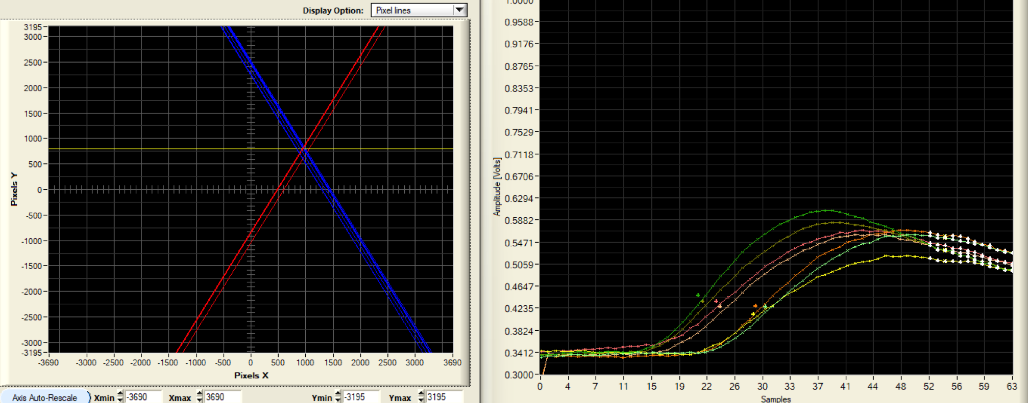
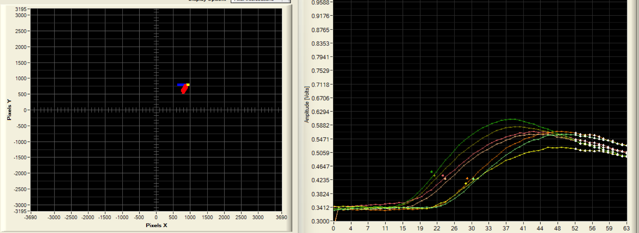
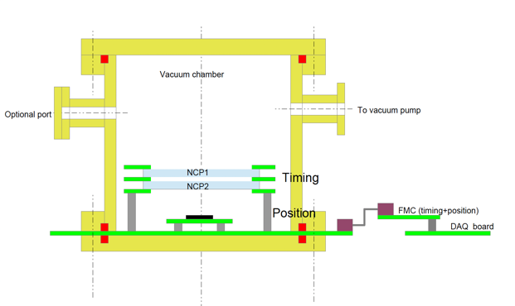
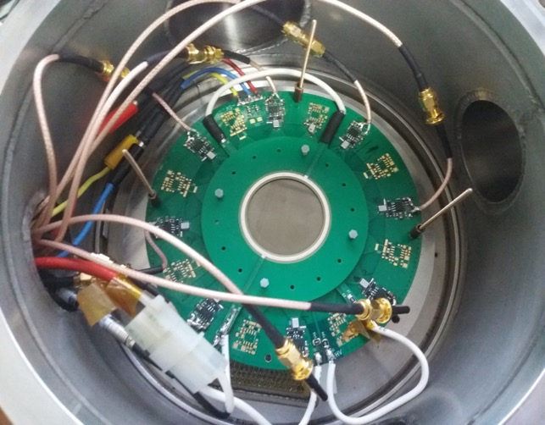
Proof-of-concept demonstrator
- SAMPIC WTDC integrated with the PICMIC0.
- New Calibration (pedestal threshold) in-situ, to avoid potential noise from the setup.
- concept validated!.
- Work in progress to reduce channels dispersion. Fine tune at the calibration level.
- Developing coincidence protocols (SAMPIC+PICMIC0)
- Looking forward to move and test with beams.
<number>

Slide 11
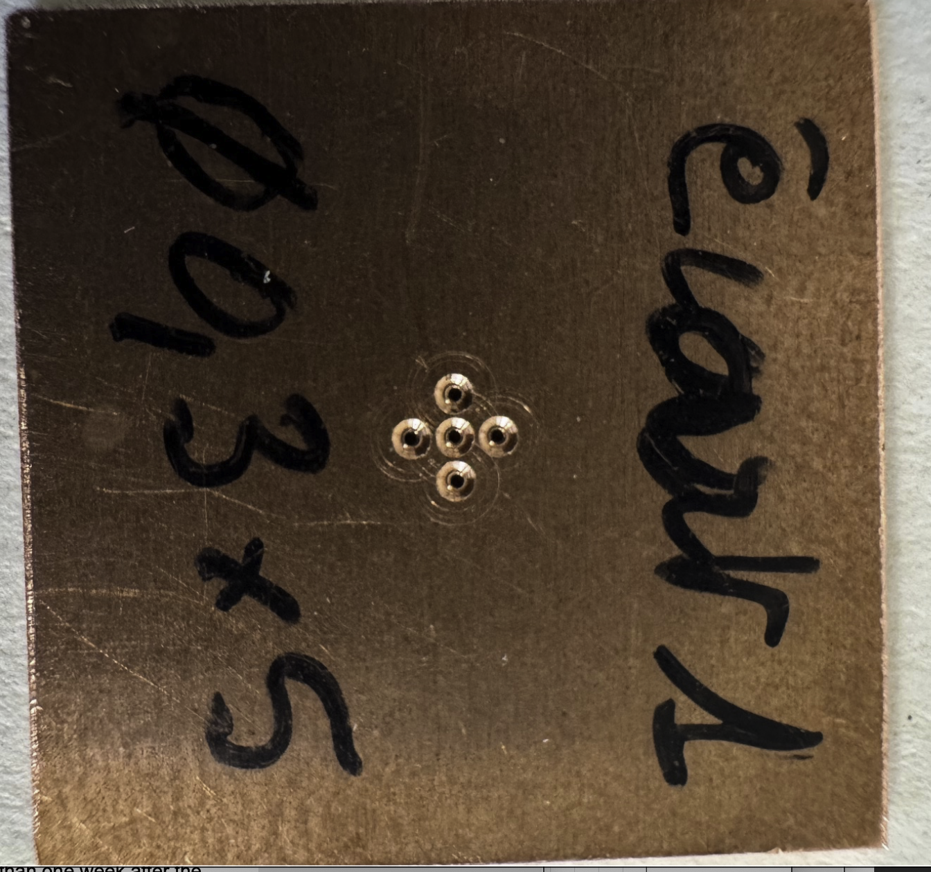
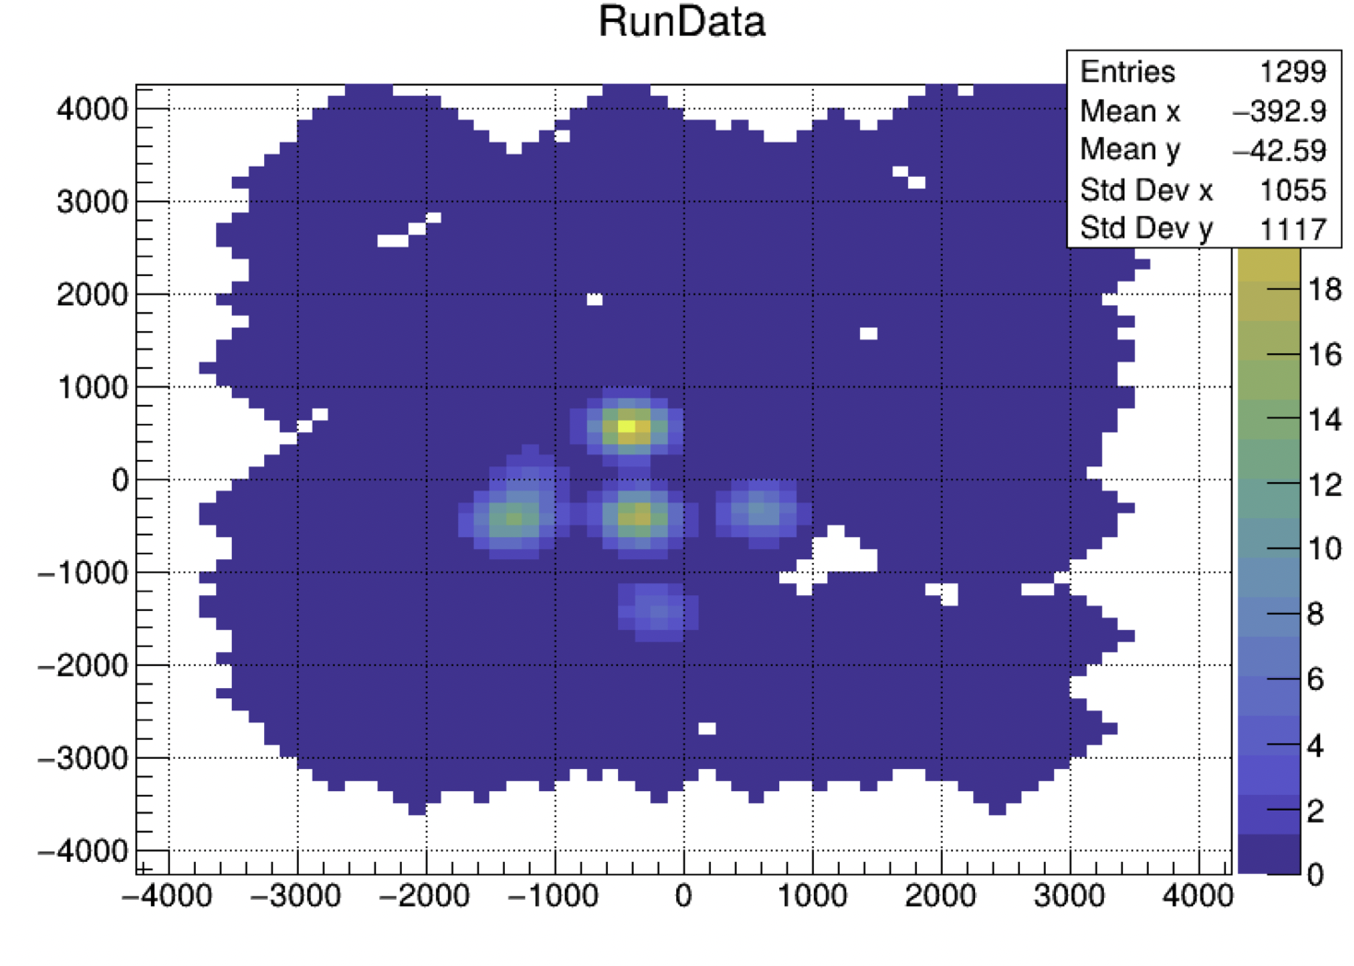
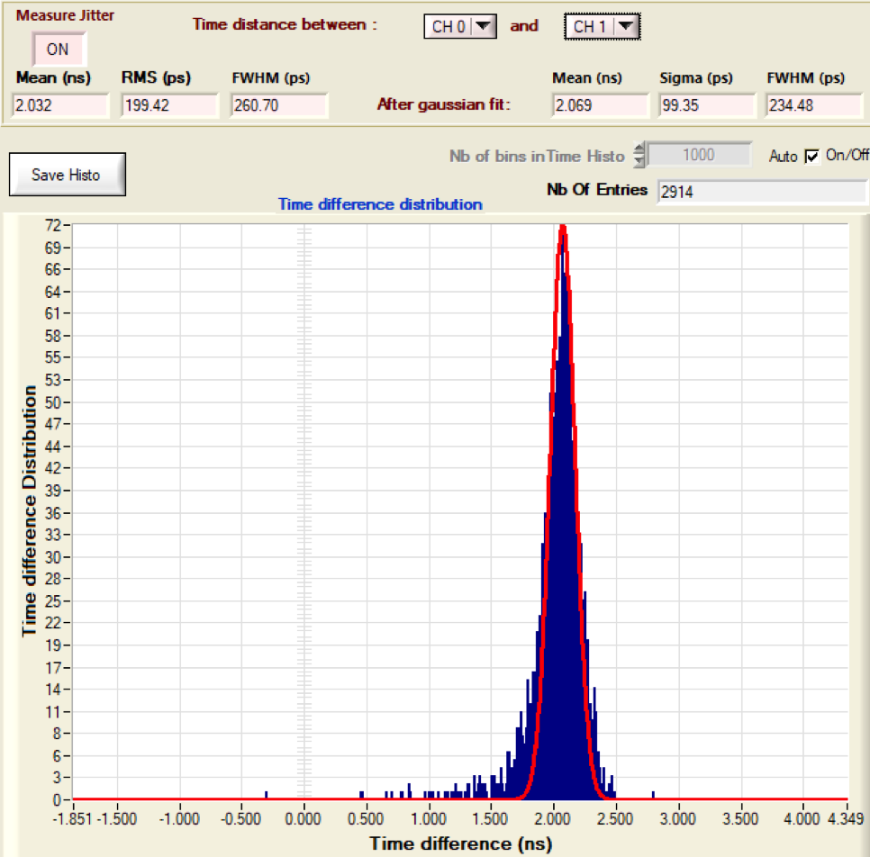
Proof-of-concept demonstrator
First demonstrator results:
- Spatial dispersion < 70 µm
-Next version of pixels sensor has been submitted and we expect to reach 10 µm
σ (T_{i} -T_{j}) is better than 100 ps
σ_{abs} is around 25-30 ps
- Even with our first version we have better results than Timepix4
<number>

Slide 12
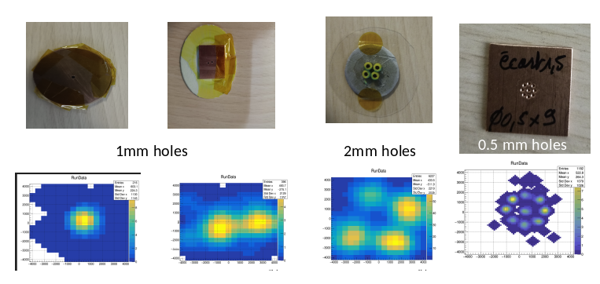
Proof-of-concept demonstrator
First demonstrator results:
- Spatial dispersion < 70 µm
-Next version of pixels sensor has been submitted and we expect to reach 10 µm
σ (T_{i} -T_{j}) is better than 100 ps
σ_{abs} is around 25-30 ps
<number>

Slide 13
Future plans:
- Hit rate improvement from 40Mhz to 160MHz
- Sensor size to increase x 4
- Hexagon pitch from 5um to 1.25um, no for next version
- migrated in a smaller tech node like 65nm or less (with more metal layers)
- narrow electron shower to keep PICMIC0 target resolution → Going beyond of MCP
- Idrogen (high rate readout).
- Small feature corrections from PICMIC0
<number>

Slide 14
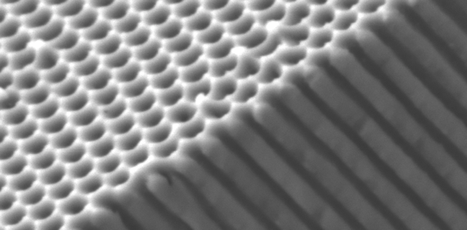

Going beyond to MCP to NCP
A new kind of MCP that we call NanoChannel Plate (NCP) is being developed. It aims at producing structures with nanoholes that could be coated with emissive and resistive materials to achieve unprecedented performances.
Three technologies are followed :
- Nanopores → NCP? We need to coat the holes’ walls with resistive and emissive material:
  Anodized Aluminium Oxide AAO * (IP2I-IMP) – testing!
  Silicon electrochemical etching (IP2I-INL)
- Femto-laser digging (IP2I-LabHC)
<number>
* A try with a good polymer was also tested.

Slide 15
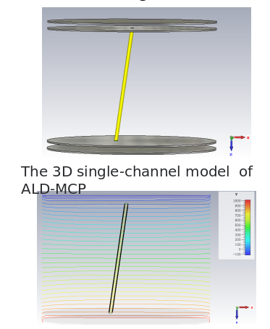
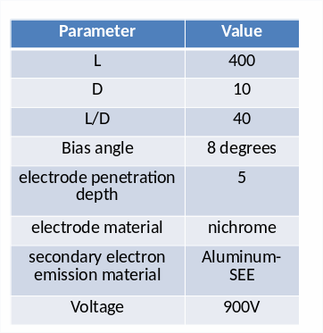
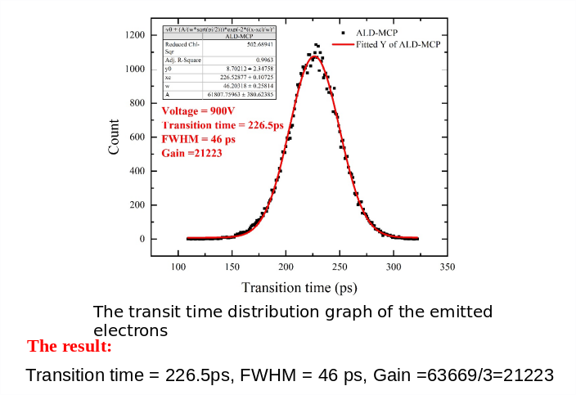
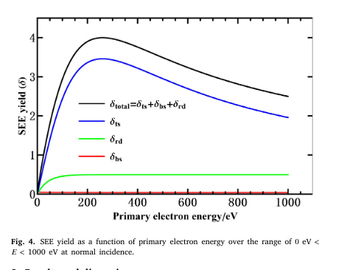
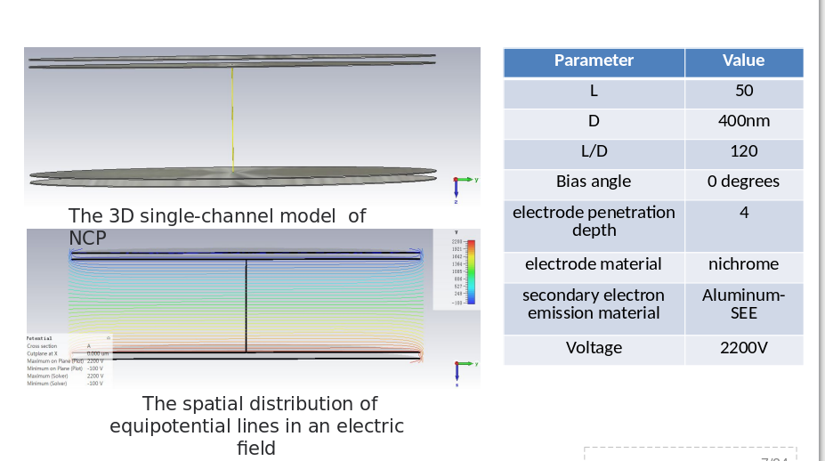
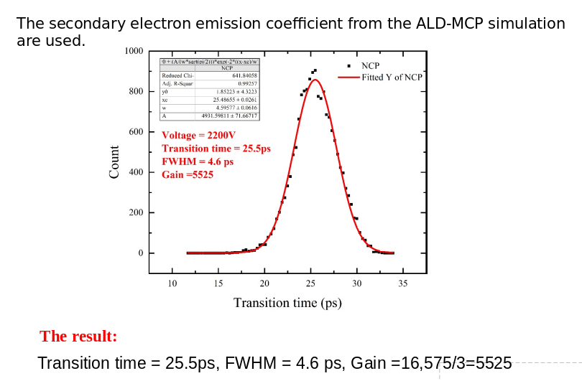
Nano-Channel Plates (NCP)
Simulations (Lili LI)
DOI:10.1103/PhysRevSTAB.5.124404
Durham-Pivi; Probabilistic model for the simulation of secondary electron emission
MCP ALD Al2O3
Total Electron Yield Al2O3
NCP ALD Al2O3
- Time and spatial resolutions are expected to be 10 times better.
- NCP has very good time characteristics. When the voltage is higher, the FWHM may
reach 1ps and the gain can be higher.
- The space charge effect is considered in the simulation..
- a couple of more configurations have been tested (Voltage, L/D, etc), quite time consuming.
<number>

Slide 16




Nano-Channel Plates (NCP)
Simulations (IP2I-ONERA)
We are able to get similar Lili LI NCP Gain results by using GEANT4+Onera microelectronics (an optimization of the stopping power for low energy particles + work function, and for certain materials when needed phonon interactions in order to simulate properly the SEY for several materials)
G4 low energy
G4 low energy
+ onera
Preliminary result
Gain vs applied Voltage for a NCP, L=50μm, D=400nm
<number>

Slide 17


Going beyond to MCP to NCP
In collaboration with the IMP-Lyon, we identified a good polymer (a semi-conductor) and the preliminary result are very encouraging, still needs performance studies at vacuum and under radiation conditions.
Thanks to Gaël SATTONAY and their colleagues at the IJCLab to make possible this measurements!
-At present moment, we are testing a NCP with an emissive layer=P3HT(30%) +PS(70%)+ dopped with Alumina powder. – Quite promising
NCP, L=50μm, D=400nm
- A new material (emissive layer) is being studied,
backup solution for NCP walls (P3HT+ polystyrene)
certainly with a SEY of 2 but still greater than 1.
<number>

Slide 18



Photocathodes for the NCP
In collaboration with INL at Lyon.
We are using “Silicon on Insulator” (SOI) wafers to produce inverted pyramid that could coated and used as photocathodes with very high granularity.
G4 low energy
<number>

Slide 19




Photocathodes for the NCP
In collaboration with INL at Lyon.
We are using “Silicon on Insulator” (SOI) wafers to produce inverted pyramid that could coated and used as photocathodes with very high granularity.
Highly granular Photocathode
G4 low energy
1 cm radius
Photonis has produced a 1cm MCPs for us to be used with this future photocathode
photocqthode
MCP
<number>

Slide 20
Summary
PICMIC concept validated:
    Very precise time and positions measurement already validated.
A first demonstrator using SAMPIC for time measurement and combining both time and position measurements based on SAMPIC DAQ is being used to combine both very precise time and position measurements.
Test beam at ChannelTron (single e- beams, ILM)
A new detector NCP is being developed to reach unprecedented resolutions in both time and position.
Medical applications will greatly benefit from the new concept and associated developments.
<number>

Slide 21
BACKUP
<number>

Slide 22


Single pixel s-curves
<number>

Slide 23


s-curves [update]
Picmic has 5-DAC [VRefN,VRefP,VBN,VBN_adj and VBP]. Global variables.
2 local variables → Iadj<4bits> + SW<2bits>
We started to performing studies to understand relationship between DACs[Globals] +and Local one.
Two-Dimensional scans :
    VRefN and VrefP Scan : VRefN and VBN_adj Scan
      In both cases, nice linear trend
<number>

Slide 24

s-curves [update]
Now, Three-dimensional scan. Everything fix except VRefN, VRefP and VBN_adj :
It allows to see previous results and to define the following for the protocol:
  Vg= VrefN*400nA-VrefP*80nA-VBN*80nA*10*(1.5 - 0.75*SW<0> - 0.5*SW<1>) (step 1)
  Vl= iadj<2>*0.2+iadj<1>*0.6+iadj<0>*1 (step2)
  – step1 → compute the mean value at 50% inflection point Vg
  – step2 → from step1 estimate values in DACs, then fine tune using locals .
    As already shown in the last meeting
<number>

Slide 25


Effects # of ways in sCurve Scan
In order to reduce the iteration time (data production), we studied the effect as is affected the sCurve for a way according the number of ways added together
<number>

Slide 26




Effects # of ways in sCurve Scan
In order to reduce the iteration time (data production), we studied the effect as is affected the sCurve for a way according the number of ways added together
In agreement within 1 [udac]
<number>

Slide 27

Injection [update]
We roughly know how to melt a few curves. So, lets try again signal injection for three pixels studied previously (R424, R425 and R426) his effect over there.
S-curves in three ways after calibration.
<number>
<number>

Slide 28




Temperature Tests
Temperature lows and stables during DAQ scans (ON during several days).
Effects within 1[udac] in VBN_adj(low current step) value scans.
<number>

Slide 29



Slide 30


Test Bench
Test bench HW developed by IPHC
- New design for sensor board & Arduino shield
- Most of the test bench HW reused from a
previous project
- I2C: Arduino DUE board
- DAQ: NI PXI6562 board 16 I/O up to 200 MHz
PICMIC DAQ Sequence Schematic:
<number>

