Slide 1
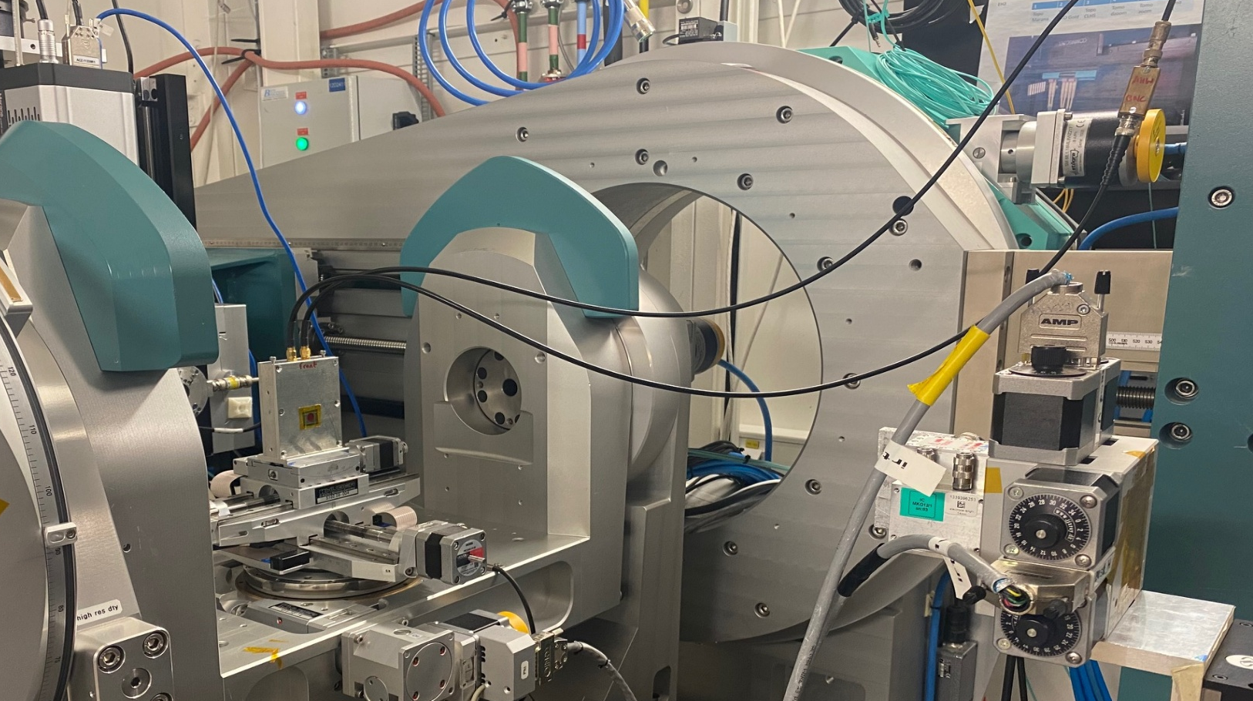
New X-ray analysis techniques for performance characterization of semiconductors for electronics
Pierre Everaere
Presented by : Robin Molle

Slide 2
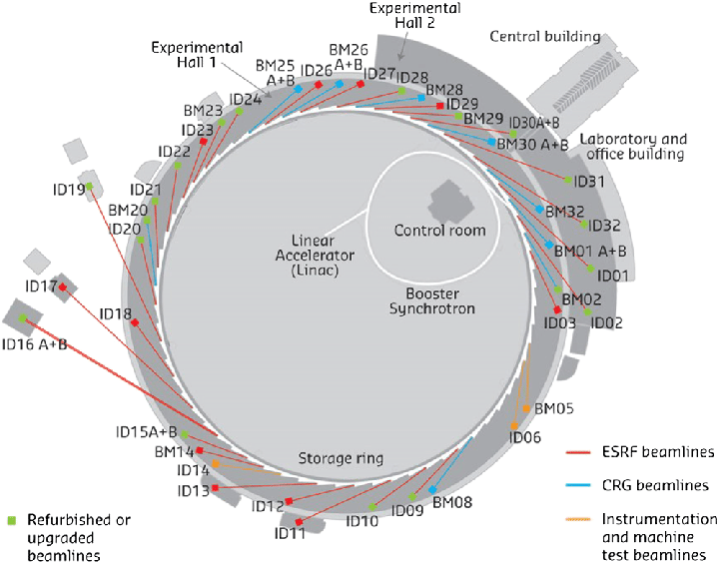
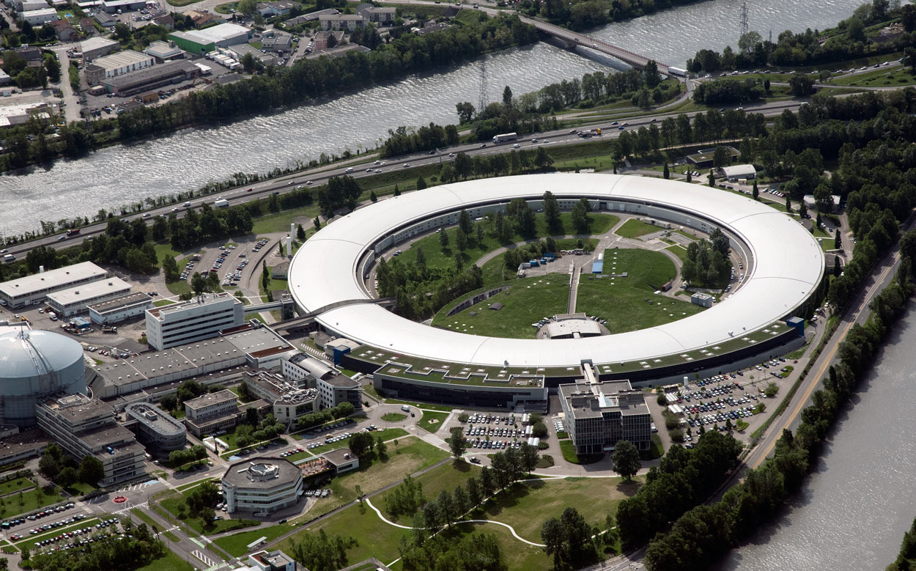
ESRF - European Synchrotron Radiation Facility and BM05 Beamline
BM05
From 2020, ESRF-Extreme Brilliant Source, the first of a new generation of high-energy synchrotron sources, opens up new opportunities in X-ray science.
Grenoble, France
BM05 beamline:
60 m far from source
Parallel beam to cm size
Focused beam to µm size
White beam Energy:3 to 160keV
Monochromatic Energy: 4 to 60 keV

Slide 3
Experiment on BM05 beamline
Context
Semiconductor industry often requires high quality crystalline thin layers and substrates to create their devices otherwise it generates defects.
Defects characterization techniques at BM05 by:
Bragg Diffraction Imaging
X-Ray Beam induced Current (XBIC)
Time of Flight XBIC (ToF-XBIC)

Slide 4
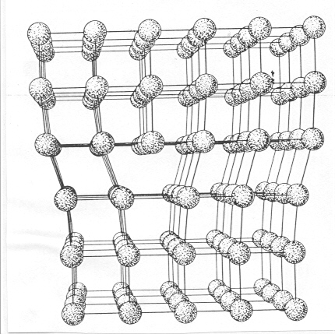
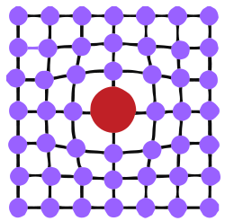
Experiment on BM05 beamline
Context
Semiconductor industry often requires high quality crystalline thin layers and substrates to create their devices otherwise it generates defects.
Defects characterization techniques at BM05 by:
Bragg Diffraction Imaging
X-Ray Beam induced Current (XBIC)
Time of Flight XBIC (ToF-XBIC)
Linear dislocation
« Punctual »
Precipitate / Inclusion
Other defects: twins, stacking faults, growth striations, subgrain boundaries, ….

Slide 5
Experiment on BM05 beamline
Context
Semiconductor industry often requires high quality crystalline thin layers and substrates to create their devices otherwise it generates defects.
Defects characterization techniques at BM05 by:
Bragg Diffraction Imaging
X-Ray Beam induced Current (XBIC)
Time of Flight XBIC (ToF-XBIC)

Slide 6
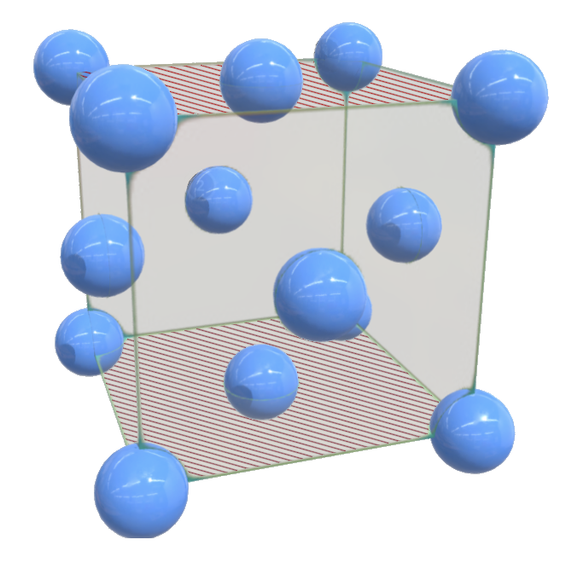
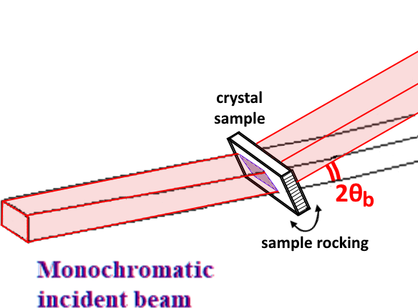
x RAY DIFFRACTION Imaging
Based on the X-ray diffraction on crystal planes
Here Si monocrystal
Bragg’s law: $n.λ=2.d.sin\left(θ_{b}\right)$
with $λ$ X-ray wavelength ↔ $E$ X-ray energy (Planck-Einstein law)
$d$ interplanar distance, linked to the material
$θ_{b}$ Bragg’s angle, between the material plane and the X-ray beam
(and we use $n=1$)
In this configuration, a part of the X-ray beam is diffracted with the same angle $θ_{b}$, instead of passing straight through the material.
A disturbance in the crystalline stack, which can affect the material properties (damage, deformation, curvature, defects…), affects also the diffraction

Slide 7
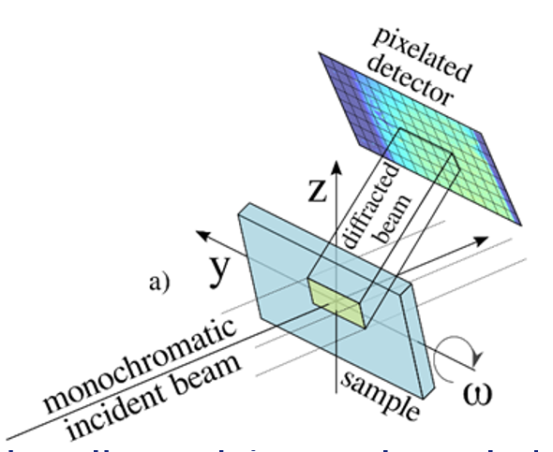
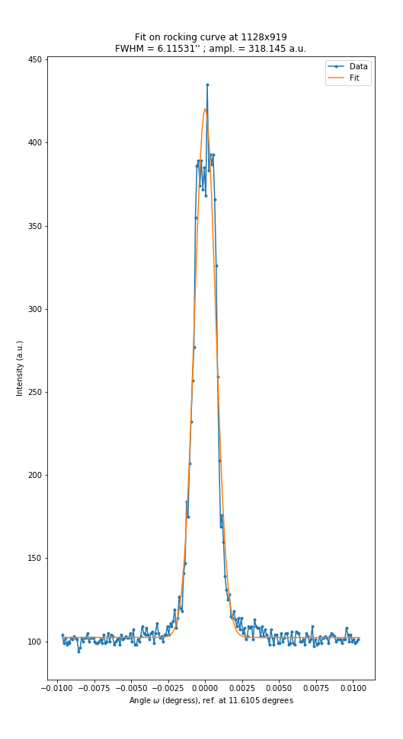
Characterization techniques : Bragg diffraction Imaging (monocrystal)
Rocking Curve Imaging
Density of defects
No Sample preparation
Bragg’s law : λ = 2d sin(ϴ).
The sample is tilted (steps of ${10}^{−4} °)$ at the Bragg angle ϴ and a 2D X-ray detector at 2 ϴ. => Rocking curve
Parameter extraction (FWHM, integral and peak position)
2D map
Orientation of defects
Notes:
The EPN science campus is an international science hub hosting three major European institutes along with joint partnerships. It hosts a staff of 1500, including 500 scientists or postgraduate students, and welcomes more than 8000 guest researchers every year, resulting in more than 2500 publications annually in peer-reviewed journals.
Grenoble, in the heart of the French Alps, is famous for science and innovation. In a world where technological progress depends more than ever on fundamental research, the European Photon and Neutron Science Campus (EPN) offers not only the world’s most powerful neutron source, the ILL, but also the world’s premier source of protons, the ESRF.
As service institutes, the ILL and the ESRF provide facilities for scientists from their 19 member countries and others from all over the world. The EMBL has its Grenoble laboratories on the campus and runs a scientific programme strongly related to the neighbouring neutron and photon facilities and amplified through numerous collaborative projects.
Scientific instrumentation of this quality has made the campus a unique location for experiments breaking new ground in modern research, in fields as diverse as structural biology, fundamental physics, or the science of materials.
To maintain this momentum the institutes seek synergies and scientific partnerships at every level. As science advances and research needs develop, new support facilities are provided such as the Partnership for Structural Biology (PSB), with its highly specialised laboratory for the deuteration of biological samples (D-Lab), and its materials science support laboratory. At the ESRF, eleven Collaborating Research Groups complement the offer of beamlines to the European scientific community.

Slide 8
Experiment on BM05 beamline
Context
Semiconductor industry often requires high quality crystalline thin layers and substrates to create their devices otherwise it generates defects.
Defects characterization techniques at BM05 by:
Bragg Diffraction Imaging
X-Ray Beam induced Current (XBIC)
Time of Flight XBIC (ToF-XBIC)
Crystal and semiconductor as GaN, SiC, Diamonds, solar panel, aluminium nitride, etc…

Slide 9
Characterization techniques : X Beam Induced Current
XBIC
+
—
Electrode
+
SemiC.
—
+
—
+
—
+
—
—
+
+
—
Electrode
X-ray
X-ray interaction with semiconductor:
Photoelectric effect
Compton effect
Pair creation

Slide 10
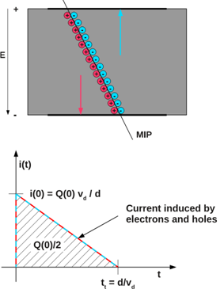
Characterization techniques : X Beam Induced Current
XBIC
Pico-ammeter
A
+
—
Electrode
+
SemiC.
—
+
—
+
—
+
—
—
+
+
—
Electrode
X-ray
X-ray interaction with semiconductor:
Photoelectric effect
Compton effect
Pair creation
Electric field apply
=> Induced current inside the semiconductor

Slide 11
Characterization techniques : X Beam Induced Current
XBIC
Pico-ammeter
A
+
—
Electrode
+
SemiC.
—
+
—
+
—
+
—
—
+
+
—
Electrode
X-ray

Slide 12
Characterization techniques : X Beam Induced Current
XBIC
Pico-ammeter
A
+
—
Electrode
+
SemiC.
—
+
—
+
—
+
—
—
+
+
—
Electrode
X-ray
Monochromatic beam (Energy around 10 keV) (Diameter around 20 µm)
Monitoring by pin diode and ionization chamber
Scan with beam => 2D current map
Measure the impact of defects and impurities in the material on the transport of the charge carrier
Parameters : Beam energy, beam flux and beam size
Induced
Current

Slide 13
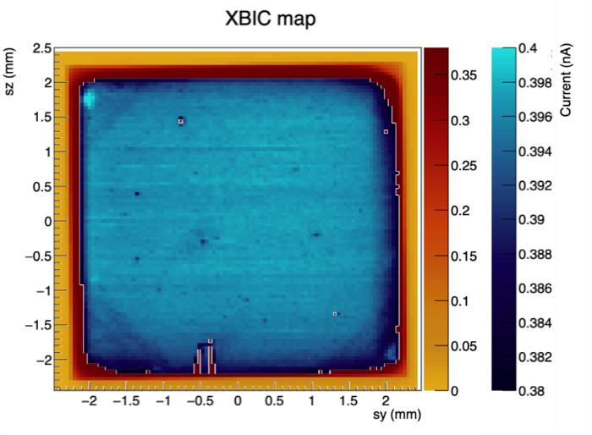
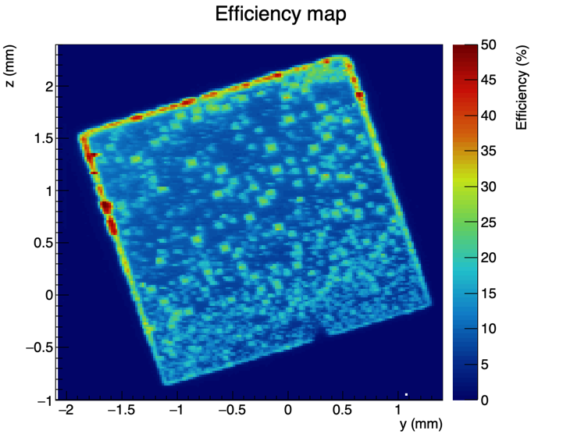
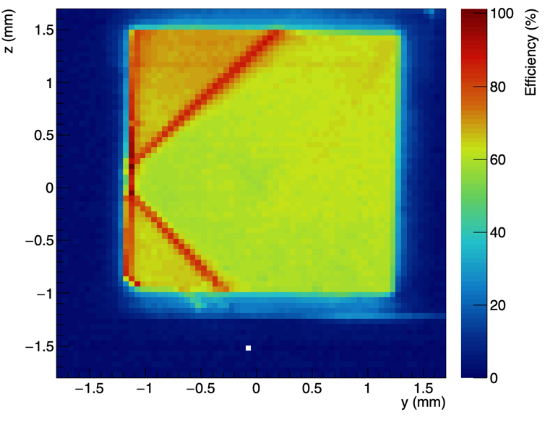
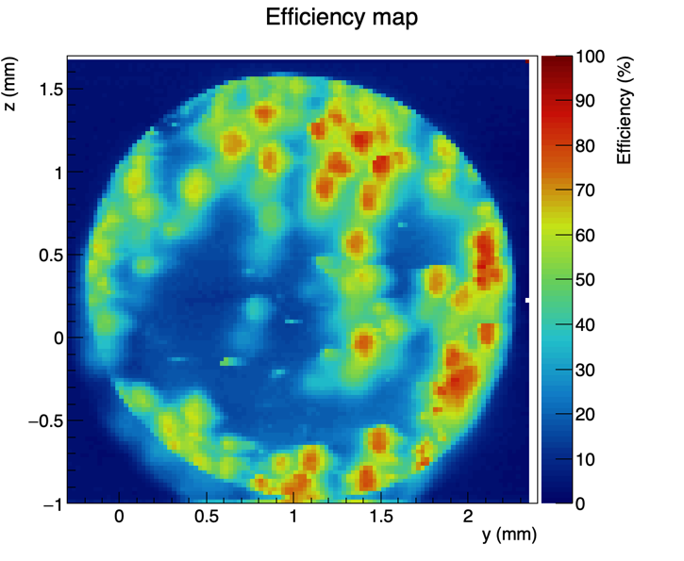
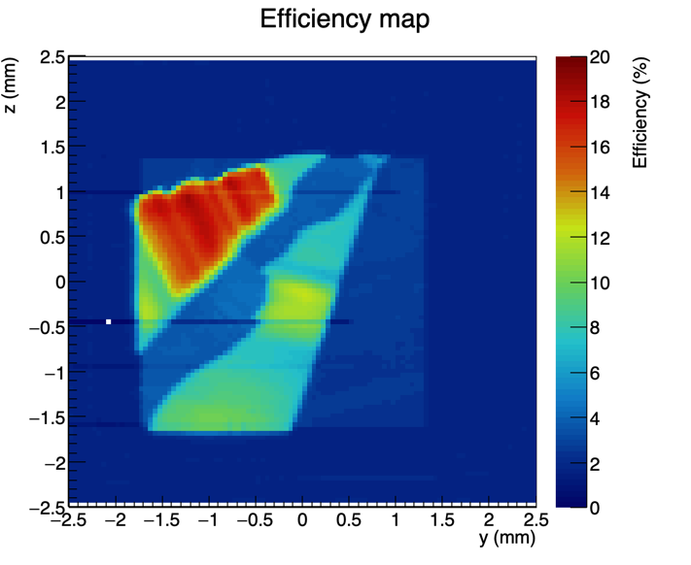
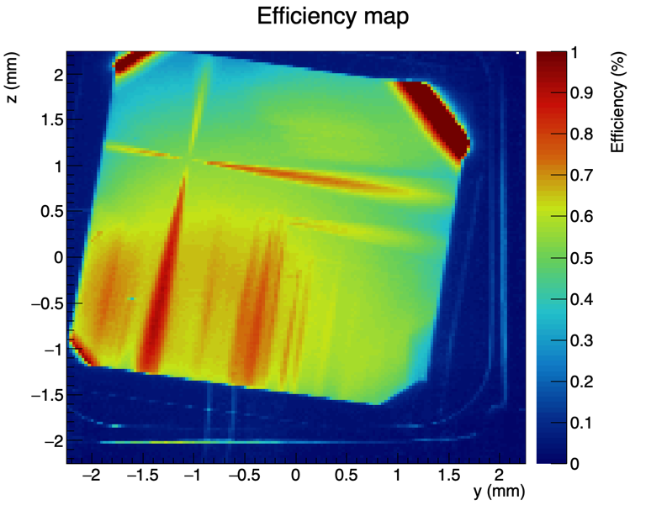
XBIC maps of various diamonds substrates
“Electronic grade”
“Optical grade”
“HPHT”
CVD diamond
100-oriented CVD diamond
HPHT IIa diamond
The electronic response of diamond substrates strongly depends on the type of growth and orientation.
It can be very heterogeneous even with crystals with low structural defects density
and the XBIC technique is particularly adequate to measure precisely this property.
Diamond grown on iridium
110-oriented CVD diamond
HPHT Ib diamond
Notes:
The EPN science campus is an international science hub hosting three major European institutes along with joint partnerships. It hosts a staff of 1500, including 500 scientists or postgraduate students, and welcomes more than 8000 guest researchers every year, resulting in more than 2500 publications annually in peer-reviewed journals.
Grenoble, in the heart of the French Alps, is famous for science and innovation. In a world where technological progress depends more than ever on fundamental research, the European Photon and Neutron Science Campus (EPN) offers not only the world’s most powerful neutron source, the ILL, but also the world’s premier source of protons, the ESRF.
As service institutes, the ILL and the ESRF provide facilities for scientists from their 19 member countries and others from all over the world. The EMBL has its Grenoble laboratories on the campus and runs a scientific programme strongly related to the neighbouring neutron and photon facilities and amplified through numerous collaborative projects.
Scientific instrumentation of this quality has made the campus a unique location for experiments breaking new ground in modern research, in fields as diverse as structural biology, fundamental physics, or the science of materials.
To maintain this momentum the institutes seek synergies and scientific partnerships at every level. As science advances and research needs develop, new support facilities are provided such as the Partnership for Structural Biology (PSB), with its highly specialised laboratory for the deuteration of biological samples (D-Lab), and its materials science support laboratory. At the ESRF, eleven Collaborating Research Groups complement the offer of beamlines to the European scientific community.

Slide 14
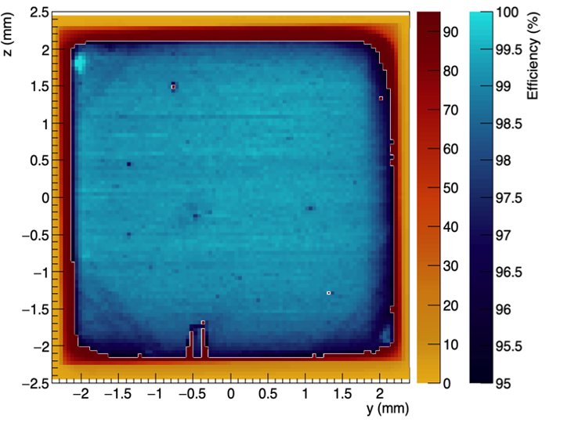
Example of Characterization : scvd diamond as alpha beam monitor
Diamond
Notes:
The EPN science campus is an international science hub hosting three major European institutes along with joint partnerships. It hosts a staff of 1500, including 500 scientists or postgraduate students, and welcomes more than 8000 guest researchers every year, resulting in more than 2500 publications annually in peer-reviewed journals.
Grenoble, in the heart of the French Alps, is famous for science and innovation. In a world where technological progress depends more than ever on fundamental research, the European Photon and Neutron Science Campus (EPN) offers not only the world’s most powerful neutron source, the ILL, but also the world’s premier source of protons, the ESRF.
As service institutes, the ILL and the ESRF provide facilities for scientists from their 19 member countries and others from all over the world. The EMBL has its Grenoble laboratories on the campus and runs a scientific programme strongly related to the neighbouring neutron and photon facilities and amplified through numerous collaborative projects.
Scientific instrumentation of this quality has made the campus a unique location for experiments breaking new ground in modern research, in fields as diverse as structural biology, fundamental physics, or the science of materials.
To maintain this momentum the institutes seek synergies and scientific partnerships at every level. As science advances and research needs develop, new support facilities are provided such as the Partnership for Structural Biology (PSB), with its highly specialised laboratory for the deuteration of biological samples (D-Lab), and its materials science support laboratory. At the ESRF, eleven Collaborating Research Groups complement the offer of beamlines to the European scientific community.

Slide 15
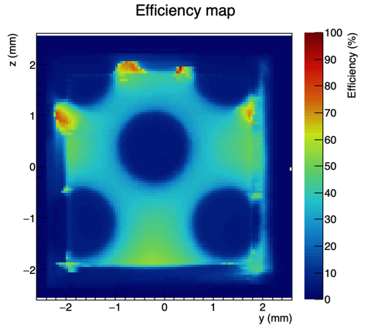
Example of Characterization : scvd diamond as alpha beam monitor
Diamond
Irradiated
Creation of mono-vacancies Altered Metallization
Used as beam monitor for charged particle
Quantify the impact of irradiation
F. Lafont, 2023
https://doi.org/10.1016/j.diamond.2023.110454
The diamond was irradiated on several points :
Same fluence
Different flux
Notes:
The EPN science campus is an international science hub hosting three major European institutes along with joint partnerships. It hosts a staff of 1500, including 500 scientists or postgraduate students, and welcomes more than 8000 guest researchers every year, resulting in more than 2500 publications annually in peer-reviewed journals.
Grenoble, in the heart of the French Alps, is famous for science and innovation. In a world where technological progress depends more than ever on fundamental research, the European Photon and Neutron Science Campus (EPN) offers not only the world’s most powerful neutron source, the ILL, but also the world’s premier source of protons, the ESRF.
As service institutes, the ILL and the ESRF provide facilities for scientists from their 19 member countries and others from all over the world. The EMBL has its Grenoble laboratories on the campus and runs a scientific programme strongly related to the neighbouring neutron and photon facilities and amplified through numerous collaborative projects.
Scientific instrumentation of this quality has made the campus a unique location for experiments breaking new ground in modern research, in fields as diverse as structural biology, fundamental physics, or the science of materials.
To maintain this momentum the institutes seek synergies and scientific partnerships at every level. As science advances and research needs develop, new support facilities are provided such as the Partnership for Structural Biology (PSB), with its highly specialised laboratory for the deuteration of biological samples (D-Lab), and its materials science support laboratory. At the ESRF, eleven Collaborating Research Groups complement the offer of beamlines to the European scientific community.

Slide 16
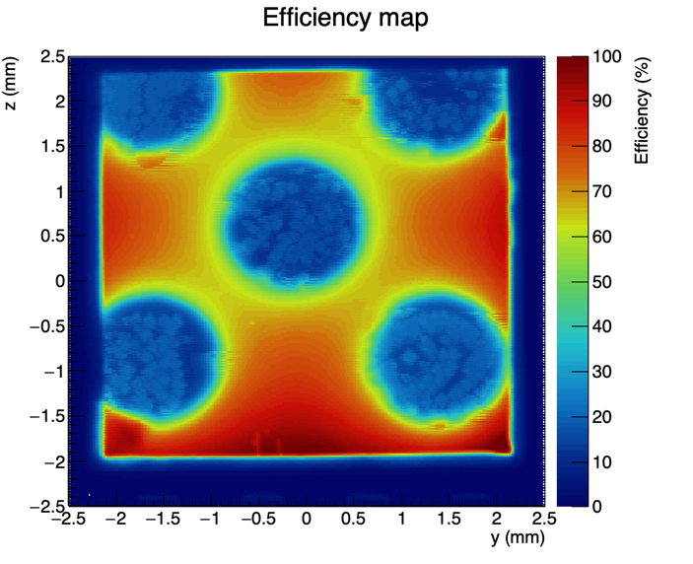
Example of Characterization : scvd diamond as alpha beam monitor
Diamond
Irradiated
Annealing at 1000 °C (6h)
Creation of mono-vacancies Altered Metallization
Regain efficiency in irradiated and non-irradiated areas
Used as beam monitor for charged particle
Quantify the impact of irradiation
F. Lafont, 2023
https://doi.org/10.1016/j.diamond.2023.110454
The diamond was irradiated on several points :
Same fluence
Different flux
Notes:
The EPN science campus is an international science hub hosting three major European institutes along with joint partnerships. It hosts a staff of 1500, including 500 scientists or postgraduate students, and welcomes more than 8000 guest researchers every year, resulting in more than 2500 publications annually in peer-reviewed journals.
Grenoble, in the heart of the French Alps, is famous for science and innovation. In a world where technological progress depends more than ever on fundamental research, the European Photon and Neutron Science Campus (EPN) offers not only the world’s most powerful neutron source, the ILL, but also the world’s premier source of protons, the ESRF.
As service institutes, the ILL and the ESRF provide facilities for scientists from their 19 member countries and others from all over the world. The EMBL has its Grenoble laboratories on the campus and runs a scientific programme strongly related to the neighbouring neutron and photon facilities and amplified through numerous collaborative projects.
Scientific instrumentation of this quality has made the campus a unique location for experiments breaking new ground in modern research, in fields as diverse as structural biology, fundamental physics, or the science of materials.
To maintain this momentum the institutes seek synergies and scientific partnerships at every level. As science advances and research needs develop, new support facilities are provided such as the Partnership for Structural Biology (PSB), with its highly specialised laboratory for the deuteration of biological samples (D-Lab), and its materials science support laboratory. At the ESRF, eleven Collaborating Research Groups complement the offer of beamlines to the European scientific community.

Slide 17
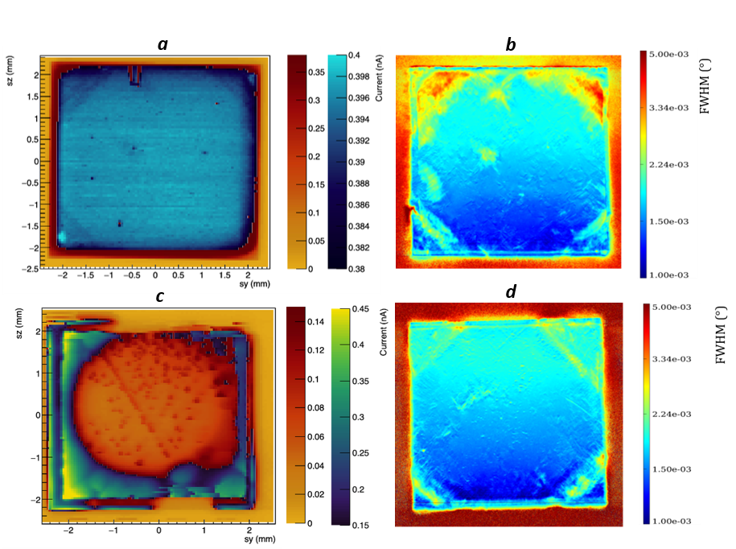
Characterization techniques comparison
a) XBIC map for a 500 µm thick high quality diamond
b) FWHM X-ray RCI map of the same sample as in a). The red arrow shows a bunch of dislocations and the black arrows growth sector boundaries
c) XBIC map for a 150-um diamond from the same batch but irradiated with 68 MeV protons
d) FWHM X-ray RCI map of the same sample as in c)

Slide 18
Experiment on BM05 beamline
Context
Semiconductor industry often requires high quality crystalline thin layers and substrates to create their devices otherwise it generates defects.
Defects characterization techniques at BM05 by:
Bragg Diffraction Imaging
X-Ray Beam induced Current (XBIC)
Time of Flight XBIC (ToF-XBIC)
Crystal and semiconductor as GaN, SiC, Diamonds, solar panel, aluminium nitride, etc…

Slide 19
Characterization techniques : Time of flight-XBIC
XBIC
For timing studies
Pico-ammeter
A
Preamp
+
—
Electrode
+
SemiC.
SAMPLING
&
DAQ
—
+
—
+
—
+
—
—
+
$$1 V∙{µm}^{−1}$$
+
—
Electrode
X-ray
C. Hoarau, 2021
https://doi.org/10.1088/1748-0221/16/04/T04005
Notes:
The EPN science campus is an international science hub hosting three major European institutes along with joint partnerships. It hosts a staff of 1500, including 500 scientists or postgraduate students, and welcomes more than 8000 guest researchers every year, resulting in more than 2500 publications annually in peer-reviewed journals.
Grenoble, in the heart of the French Alps, is famous for science and innovation. In a world where technological progress depends more than ever on fundamental research, the European Photon and Neutron Science Campus (EPN) offers not only the world’s most powerful neutron source, the ILL, but also the world’s premier source of protons, the ESRF.
As service institutes, the ILL and the ESRF provide facilities for scientists from their 19 member countries and others from all over the world. The EMBL has its Grenoble laboratories on the campus and runs a scientific programme strongly related to the neighbouring neutron and photon facilities and amplified through numerous collaborative projects.
Scientific instrumentation of this quality has made the campus a unique location for experiments breaking new ground in modern research, in fields as diverse as structural biology, fundamental physics, or the science of materials.
To maintain this momentum the institutes seek synergies and scientific partnerships at every level. As science advances and research needs develop, new support facilities are provided such as the Partnership for Structural Biology (PSB), with its highly specialised laboratory for the deuteration of biological samples (D-Lab), and its materials science support laboratory. At the ESRF, eleven Collaborating Research Groups complement the offer of beamlines to the European scientific community.

Slide 20
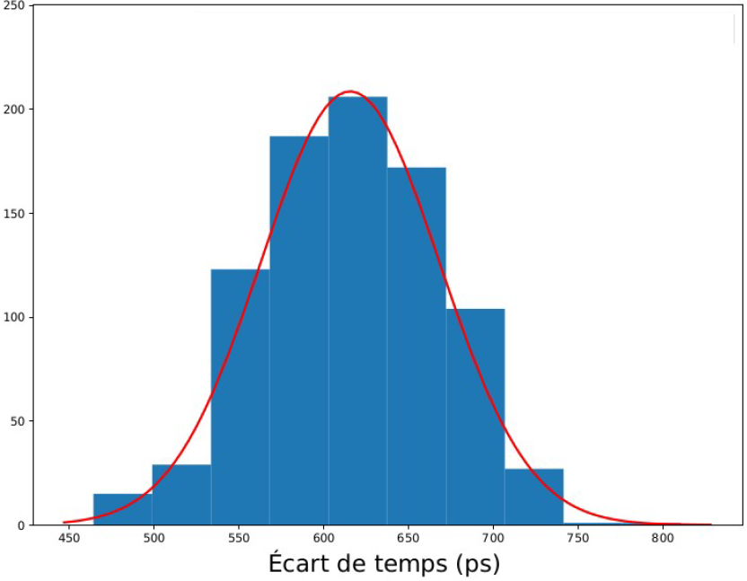
Characterization techniques : Time of flight-XBIC
XBIC
For timing studies
Pico-ammeter
A
Preamp
+
—
Electrode
+
SemiC.
SAMPLING
&
DAQ
—
+
—
+
—
+
—
—
+
$$1 V∙{µm}^{−1}$$
+
—
Electrode
X-ray
50%
Time difference
FWHM
Time resolution
Both sides of the sample
Notes:
The EPN science campus is an international science hub hosting three major European institutes along with joint partnerships. It hosts a staff of 1500, including 500 scientists or postgraduate students, and welcomes more than 8000 guest researchers every year, resulting in more than 2500 publications annually in peer-reviewed journals.
Grenoble, in the heart of the French Alps, is famous for science and innovation. In a world where technological progress depends more than ever on fundamental research, the European Photon and Neutron Science Campus (EPN) offers not only the world’s most powerful neutron source, the ILL, but also the world’s premier source of protons, the ESRF.
As service institutes, the ILL and the ESRF provide facilities for scientists from their 19 member countries and others from all over the world. The EMBL has its Grenoble laboratories on the campus and runs a scientific programme strongly related to the neighbouring neutron and photon facilities and amplified through numerous collaborative projects.
Scientific instrumentation of this quality has made the campus a unique location for experiments breaking new ground in modern research, in fields as diverse as structural biology, fundamental physics, or the science of materials.
To maintain this momentum the institutes seek synergies and scientific partnerships at every level. As science advances and research needs develop, new support facilities are provided such as the Partnership for Structural Biology (PSB), with its highly specialised laboratory for the deuteration of biological samples (D-Lab), and its materials science support laboratory. At the ESRF, eleven Collaborating Research Groups complement the offer of beamlines to the European scientific community.

Slide 21
Characterization techniques : Time of flight-XBIC
XBIC
For timing studies
Pico-ammeter
A
Preamp
+
—
Electrode
+
SemiC.
SAMPLING
&
DAQ
—
+
—
+
—
+
—
—
+
$$1 V∙{µm}^{−1}$$
+
—
Electrode
X-ray
Monochromatic beam (Energy around 10 keV) (Diameter around 100 µm)
Monitoring by pin diode and ionization chamber
Scan with beam => 2D Time resolution map
Measure the impact of defects and impurities in the material on the transport of the charge carrier
Parameters : Beam energy, beam flux and beam size
Time resolution

Slide 22
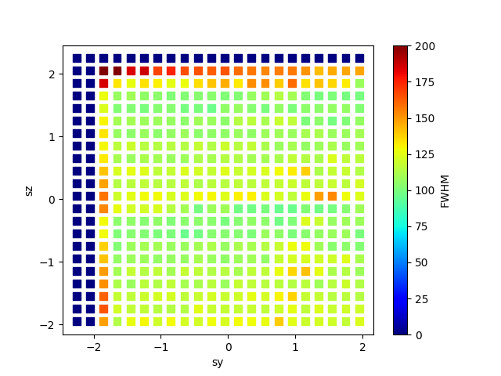
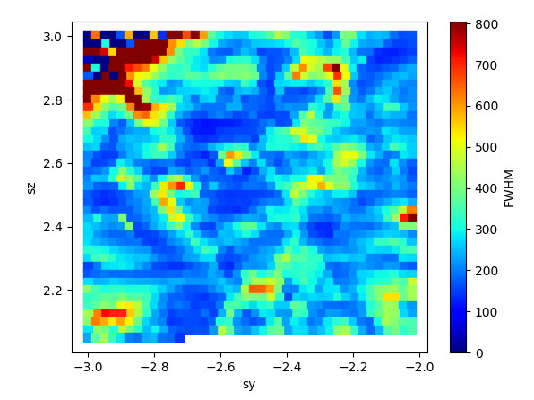
Characterization techniques : Time of flight-XBIC
XBIC
For timing studies
Pico-ammeter
A
Preamp
+
—
Electrode
+
SemiC.
SAMPLING
&
DAQ
—
+
—
+
—
+
—
—
+
$$1 V∙{µm}^{−1}$$
+
—
Electrode
X-ray
sCVD
pCVD
Notes:
The EPN science campus is an international science hub hosting three major European institutes along with joint partnerships. It hosts a staff of 1500, including 500 scientists or postgraduate students, and welcomes more than 8000 guest researchers every year, resulting in more than 2500 publications annually in peer-reviewed journals.
Grenoble, in the heart of the French Alps, is famous for science and innovation. In a world where technological progress depends more than ever on fundamental research, the European Photon and Neutron Science Campus (EPN) offers not only the world’s most powerful neutron source, the ILL, but also the world’s premier source of protons, the ESRF.
As service institutes, the ILL and the ESRF provide facilities for scientists from their 19 member countries and others from all over the world. The EMBL has its Grenoble laboratories on the campus and runs a scientific programme strongly related to the neighbouring neutron and photon facilities and amplified through numerous collaborative projects.
Scientific instrumentation of this quality has made the campus a unique location for experiments breaking new ground in modern research, in fields as diverse as structural biology, fundamental physics, or the science of materials.
To maintain this momentum the institutes seek synergies and scientific partnerships at every level. As science advances and research needs develop, new support facilities are provided such as the Partnership for Structural Biology (PSB), with its highly specialised laboratory for the deuteration of biological samples (D-Lab), and its materials science support laboratory. At the ESRF, eleven Collaborating Research Groups complement the offer of beamlines to the European scientific community.

Slide 23
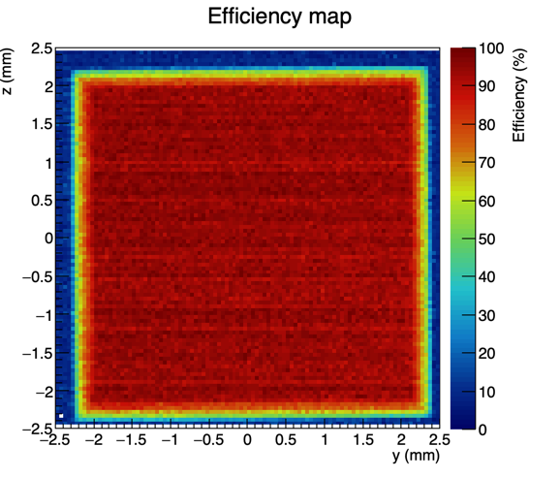
Example of Characterization : scvd diamond as proton beam monitor
XBIC
TOF-XBIC

Slide 24
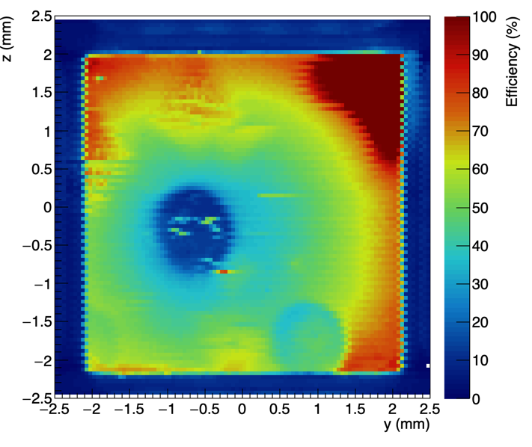
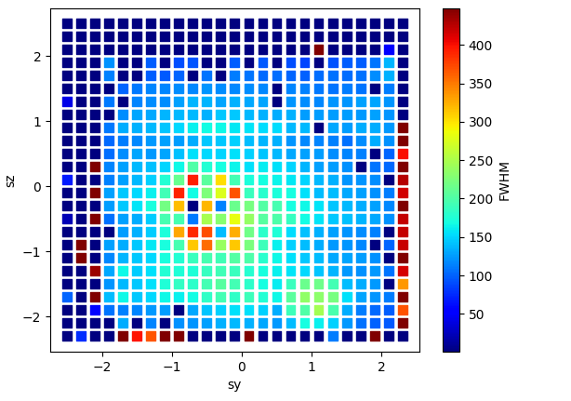
Example of Characterization : scvd diamond as proton beam monitor
The diamond was irradiated on several points :
Same flux
Different fluence
XBIC
Correlation between the XBIC and ToF-XBIC map
More diffused protons
TOF-XBIC

Slide 25
Conclusion
Unique setup available at BM05-ESRF to characterize both structural (X-ray diffraction) and electronic (XBIC and ToF-XBIC) properties of a semiconductor as diamond
Adaptable setup in function of the sample (size, thickness, kind of crystal or semiconductor)
Open to collaboration and industrial access possible
P. Everaere : pierre.everaere@esrf.fr

Slide 26
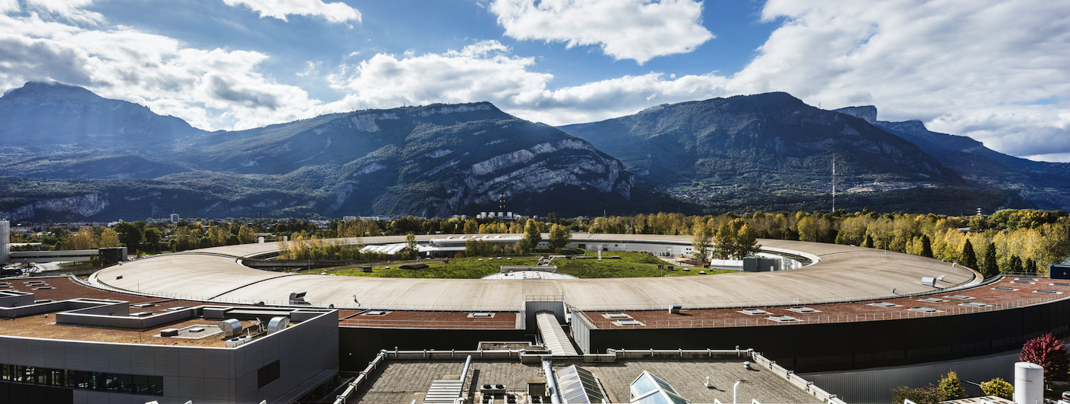
PIONEERING SYNCHROTRON SCIENCE
THANK YOU FOR YOUR ATTENTION
BM05 Team:
P. Everaere
J. Baruchel
S. Benichou
R. Dowek
T.N. Tran Caliste

Slide 28
Precedent experiment

Slide 29
LPSC 0V
Refill
Lot of instability (20%) is still observe during a long time
XBIC mapping not possible at 0V
Diamond Current (A)
Beam off
Time (s)

Slide 30
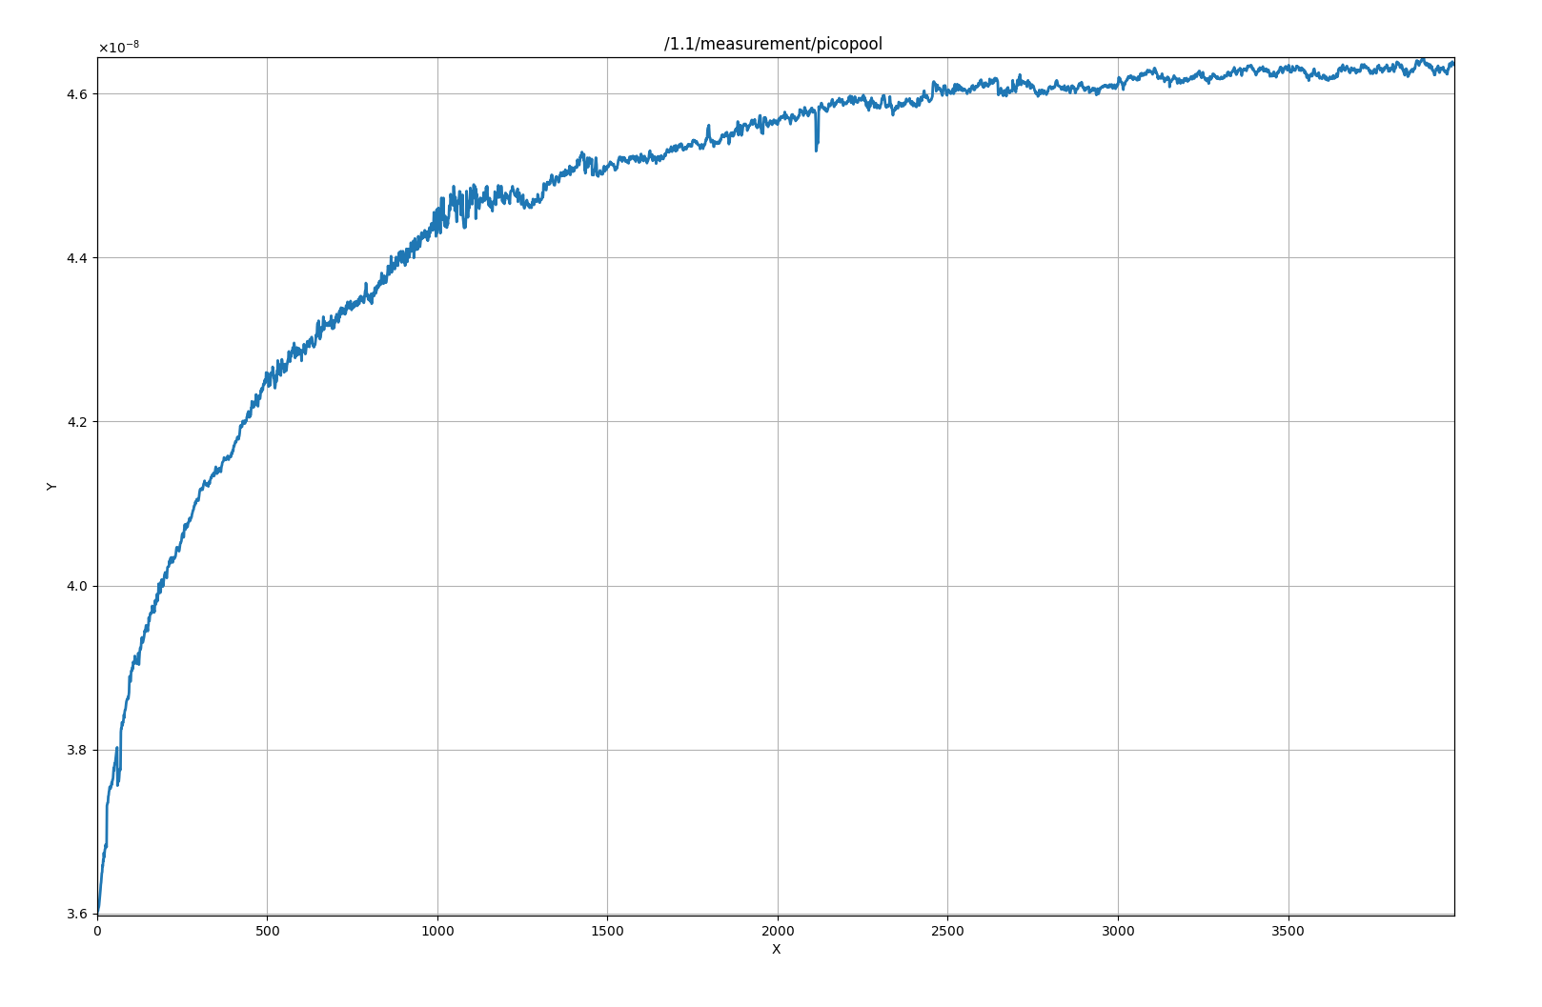
LPSC 25 V
Beam off
Refill
Previous experiment
High difference between beam on and beam off due to the high photons flux provide by ML
Diamond Current (A)
Time (s)
Beam off

Slide 31
LPSC 25 V
Refill
Still 10 % variation on the current measured (static beam)
XBIC Mapping not possible, this variation will be superposed to the map and not removable
Diamond Current (A)
Time (s)

