Slide 1

Development of monolithic sensors
in LFoundry 150 nm technology
with 60 ps time resolution
Roy ALEKSAN, Yavuz DEGERLI, Fabrice GUILLOUX, Jean-Pierre MEYER, Philippe SCHWEMLING*
CEA/Irfu
*also Université Paris Cité
Raimon CASANOVA, Yujing GAN, Sebastian Grinstein
IFAE Barcelona
Archie HANLON, Eva VILELLA
University of Liverpool
Tomasz HEMPEREK
(U. Bonn, now at DECTRIS)

Slide 2
Timing with HV-CMOS/DMAPS*
HV-CMOS Sensor Pixel
The objective of this R&D is the development of a monolithic timing sensor in a commercial HV-CMOS process for future high energy physics experiments or for LHC upgrades (timing detectors, after phase 2 upgrades)
LFoundry 150 nm HV-CMOS is one of the CMOS processes studied extensively for the CMOS option of the ATLAS Inner Tracker Upgrade
Several large size demonstrators already designed and tested for tracking applications (LF-CPIX, LF-MONOPIX1, LF-MONOPIX2) in this process with proven radiation hardness (Bonn, IRFU and CPPM coll.)
The monolithic sensors potentially cheaper and more reliable than dedicated hybrid solutions
Possibility to integrate all functionalities (detection, analog + digital signal processing) on the same chip
Wafers can be thinned and backside processed (for backside polarization and good charge collection uniformity)
80 e⁻-h pairs/µm
DNW/HR p-substrate charge collection diode
HV (≥ 300 V) applied on the substrate (from top or back)
Large depletion depth with HR wafers (≥ 300 µm)
Charge collection by drift (fast)
No internal amplification
Electronics can be integrated inside charge collection diode
→ Particularly suitable for timing
*Depleted MAPS

Slide 3
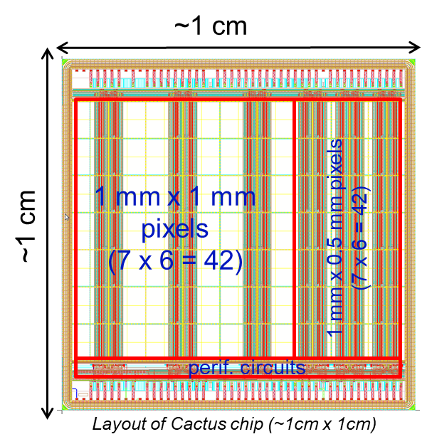
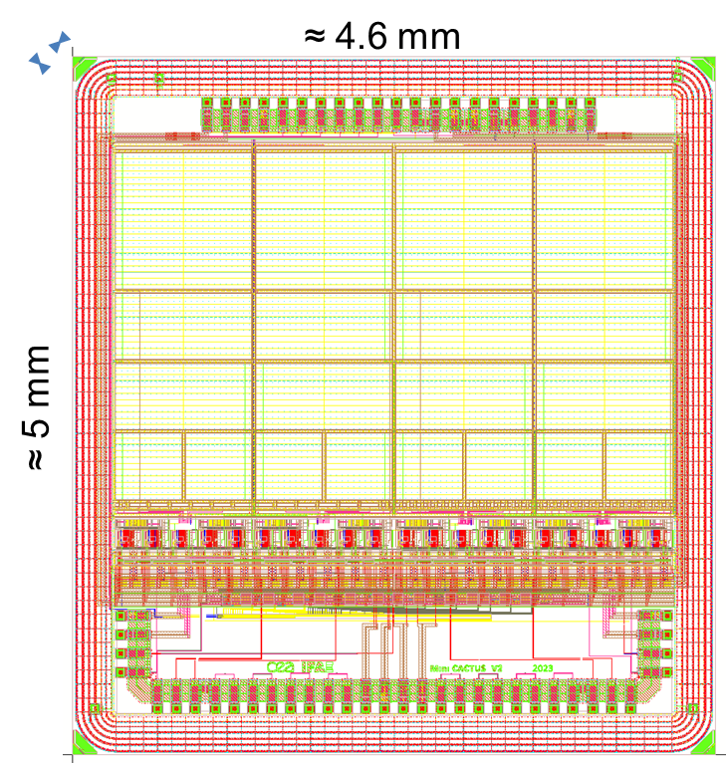
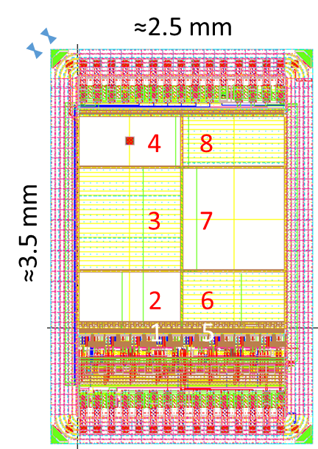
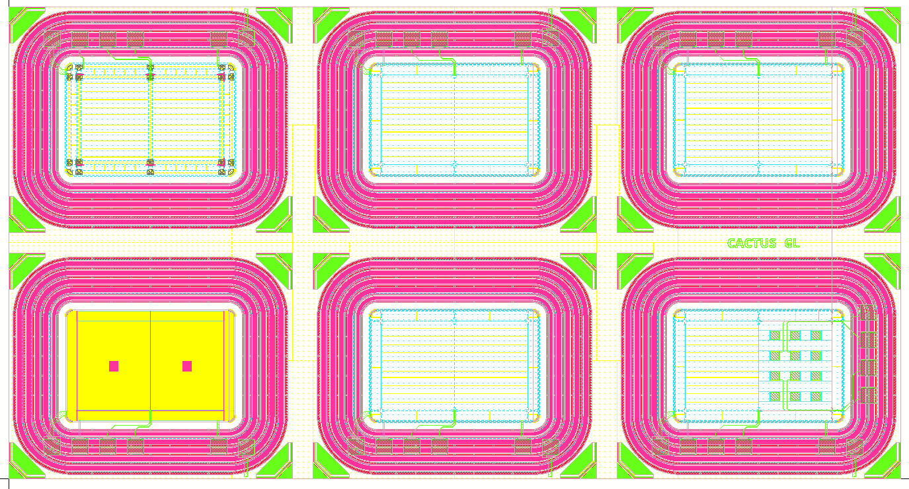
Timeline of CACTUS/MiniCACTUS chips in LF150 nm technology
2017-2020
2020-2023
2023-2025- …
CACTUS demonstrator
MiniCACTUS v1
MiniCACTUS v2
Ringing on digital outputs addressed by several modifications. New analog front-ends.
Very high breakdown voltage < -500 V
Up to now, best time resolution with MIPs ≈ 60 ps @ -350V on 0.5 x 0.5 mm pixel (175 µm-thick sensor)
No analog/digital coupling anymore
Design inspired from LFCPIX/LF-MONOPIX chips
Initially motivated by ATLAS/HGTD
High breakdown voltage < -300 V
Homogeneous charge collection, deep depletion depth
Good yield (Engineering Run)
Poor timing performance (≈ 500 ps) due to high in-pixel parasitic capacitances
High in-pixel parasitic capacitance addressed by moving the FEs at column-level
Time resolution with MIPs ≈ 65 ps @ -450V on 0.5 x 1 mm² pixel (200 µm-thick sensor)
Ringing on digital outputs due to coupling from the digital buffers impacting the Time Walk correction
2024- …
≈4.3 mm
CACTUS-GL
≈2.3 mm
Implantation of a gain layer
DJ-LGAD concept, buried PN junction implemented by the foundry
6 different chips with passive diodes

Slide 4
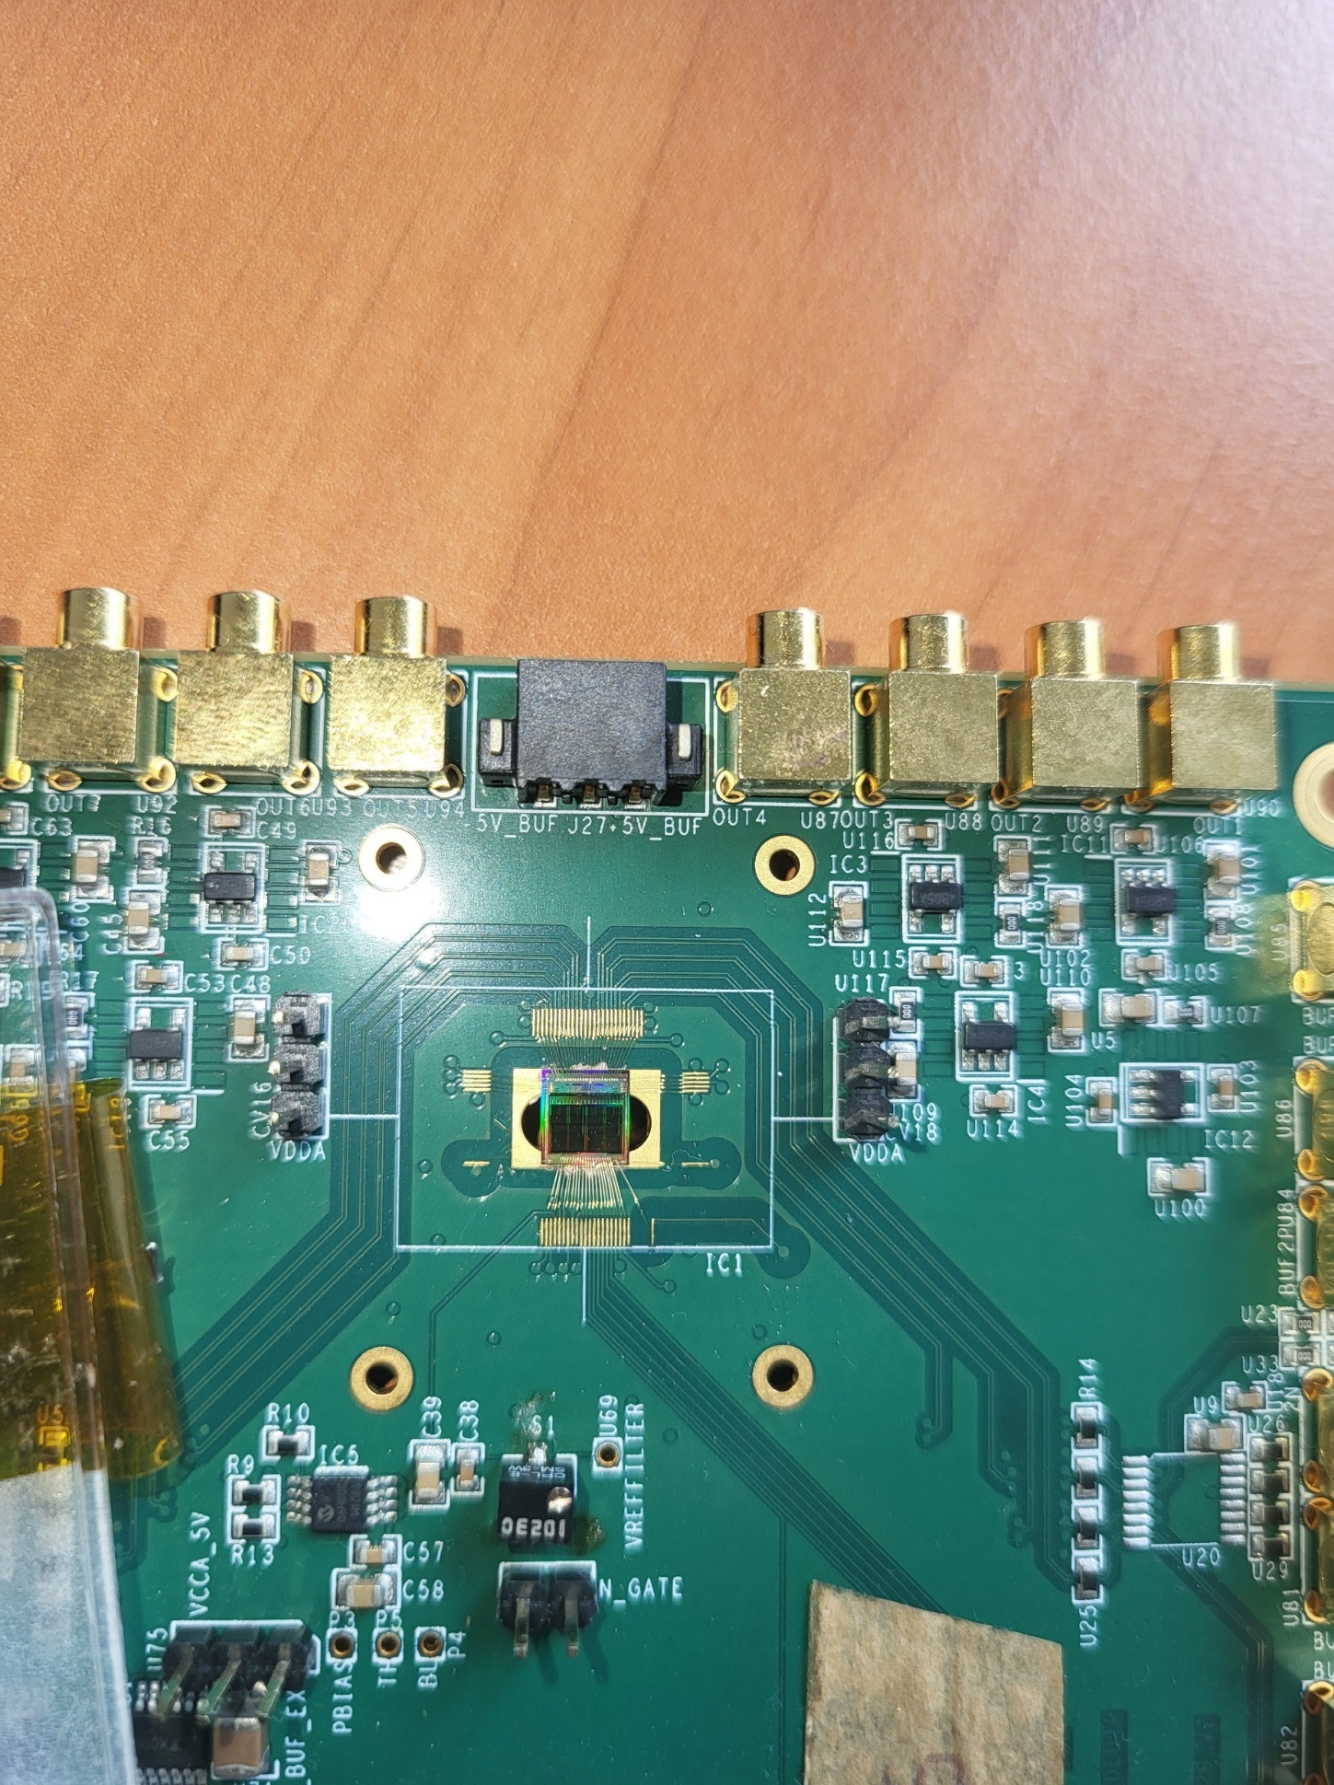
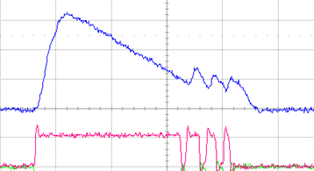
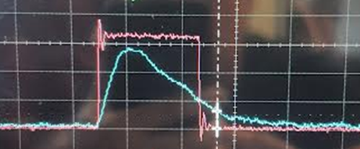
Focus on MiniCACTUS v2 sensor chip
~ 2 times larger than MiniCACTUS v1
On-chip FE, Slow Control, DACs, bias circuitry
0.5 mm x 1 mm, 1 mm x 1 mm and 0.5 mm x 0.5 mm diodes
50 µm x 150 µm and 2 50 µm x 50 µm small test diodes
3 different preamps
New multistage discriminator with programmable hysteresis
Improved layout for better mixed-signal coupling rejection
CEA-IRFU & IFAE-Barcelona coll.
Submitted in May 2023, chips came back from post-processing end May 2024 with 150, 175, 200 µm thicknesses
Layout of MiniCACTUS v2 chip
Analog/Digital couplings were efficiently corrected
MiniCACTUS v2 wire-bonded on its PCB
MiniCACTUS v1
MiniCACTUS v2

Slide 5
Typical architecture of front-ends of CACTUS/MiniCACTUS sensors
Cfb
4-bits
DAC
IFB
BL
Th. tuning
Cac
BLRES
CSA
Vth
CMOS buffers
-HV
Pixel
Enable
Enable
Analog Mon. Output
LVDS
Output
AmpOut
DigOut

Slide 6
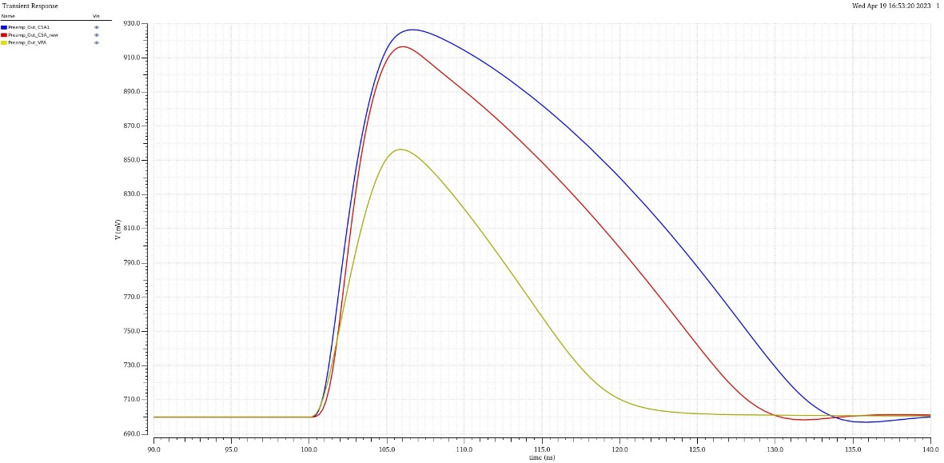
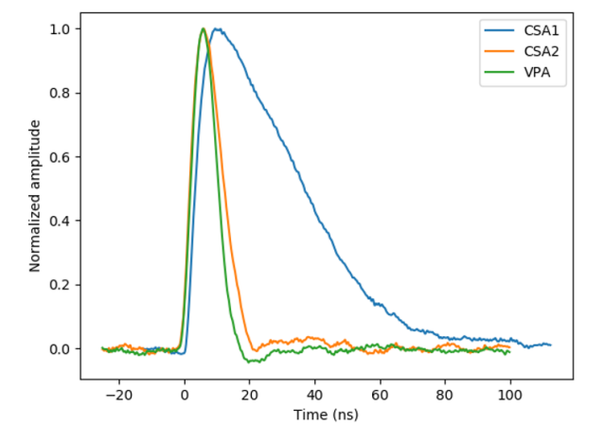
MiniCACTUS_V2 Sensor Chip
3 different preamps implemented in MiniCACTUS v2
2 new preamps (CSA 2 and VPA) designed by IFAE-Barcelona for better jitter and reduced ToT
CSA1
CSA2
VPA
Simulation of responses of the 3 preamps to an input pulse of 12 ke- (Tcoll = 5 ns)
Analog pulses recorded in TB with MIPs for the 3 different preamps

Slide 7
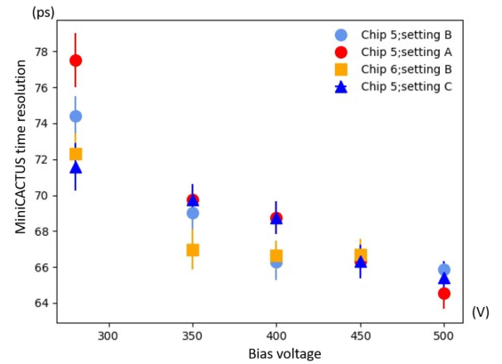
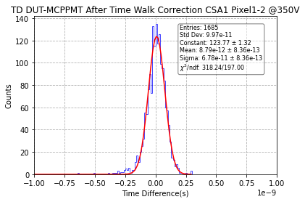
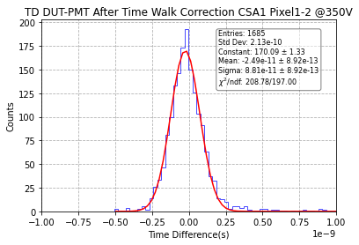
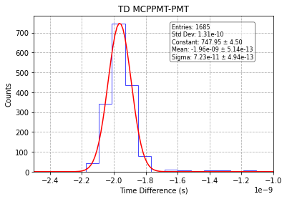
First MiniCACTUS v2 Test-Beam Results
[P. Schwemling et al., PIXEL 2024]
Measured time resolution of MiniCACTUS v1 as a function of HV_bias for different front-end settings (0.5 x 1 mm² pixel, 200 µm sensor)
[Y. Degerli et al., IEEE TNS, Nov. 2023]
Sigma matrix after time walk correction
Reverse of the matrix to get the sigma of each devices
Sig(DUT-MCP) | Sig(DUT-PMT) | Sig(MCP-PMT)
67.8 ps | 88.1 ps | 72.3 ps
Sig(DUT) | Sig(PMT) | Sig(MCP)
59.9 ps | 64.4 ps | 32.5 ps
The time resolution of several MiniCACTUS v2 sensors with different thicknesses has been measured in using high-energy muons (MIPs) at CERN SPS in June-July 2024.
Testbeam setup has 3 time measurement devices: Beamline MCP-PMT, MiniCACTUS v2 and PMT → can extract time resolution of the 3 devices
The best timing resolution measured so far is 59.9 ps after time walk correction with the on-chip FE and discriminator on a 0.5 x 0.5 mm² pixel from a 175 µm sensor (@350V bias)

Slide 8
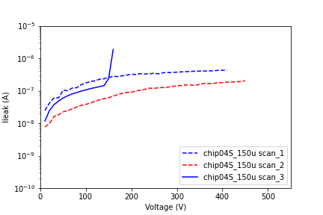
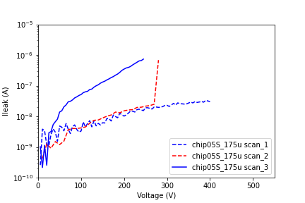
Improvements since July 2024
2024 Testbeam MiniCACTUS v2 measurements have been limited by recurrent HV problems
  Unusually high and unstable leakage currents (> 2-3 µA), while MiniCACTUS v1 was typically running at tens nA @450V
  Unexpected device failures after some time (leakage current would increase suddenly, and device found to be permanently damaged/shorted after that
After careful investigation, several causes identified, now corrected
  No-clean process used for PCB → cabled boards could be cleaned with isopropylic alcohol in ultrasound batch
  Design mistake on PCB : HV strip separated from a connector body (GND) only by a thin layer of varnish (sparks observed) → connector mounting changed
  Suspect that some changes in the metal layer affectation of the guard-rings and pads created a weakness → not connecting some auxiliary bias pads over guard-rings cured the problem
PCB level
Chip level
→ Typical 2 different sensors damaged during the second I-V scan (still alive and responding to the source)

Slide 9
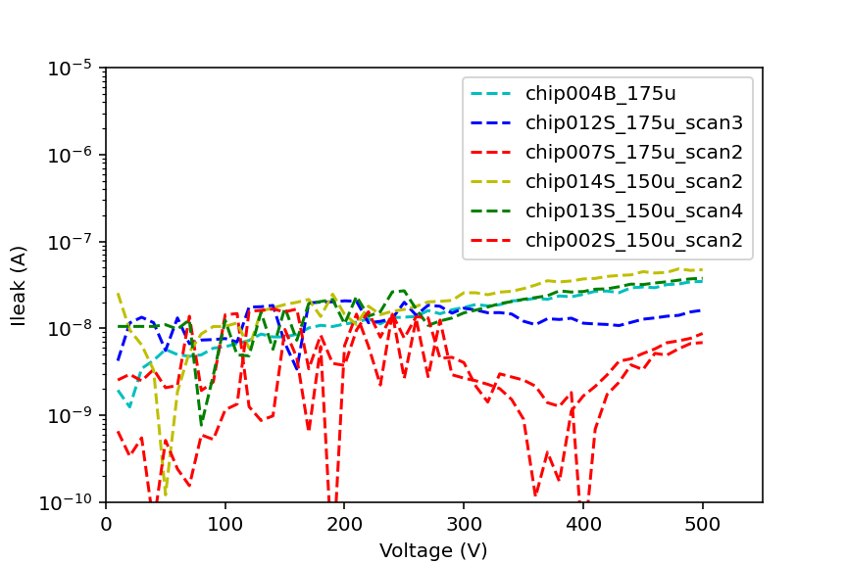
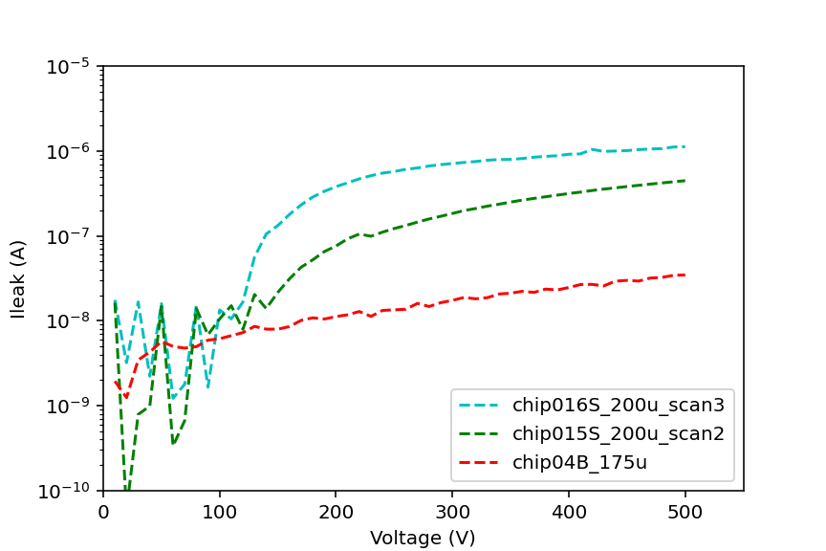
New MiniCACTUS v2 I-V Curves
No sensor broken after cleaning up the PCBs and modifying the bonding diagram
I-V curves measured on 8 different sensors from 3 different wafers (150, 175 and 200 µm)
Sensors from 150 and 175 µm wafers show very low leakage current at least up to 500 V
200 µm sensors have higher leakage current with a jump around 120 V → postprocessing issue ? (discussions with the post-processing company not very concluding)
Breakdown voltage > 500 V for all tested sensors

Slide 10
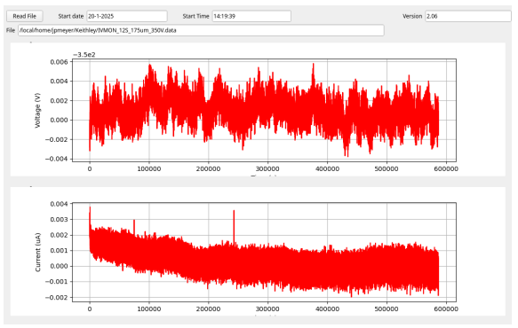
New MiniCACTUS v2 I-V Curves
Long-term stability of leakage currents
Two sensors biased @350 V during 1 week each
Very good operating stability

Slide 11
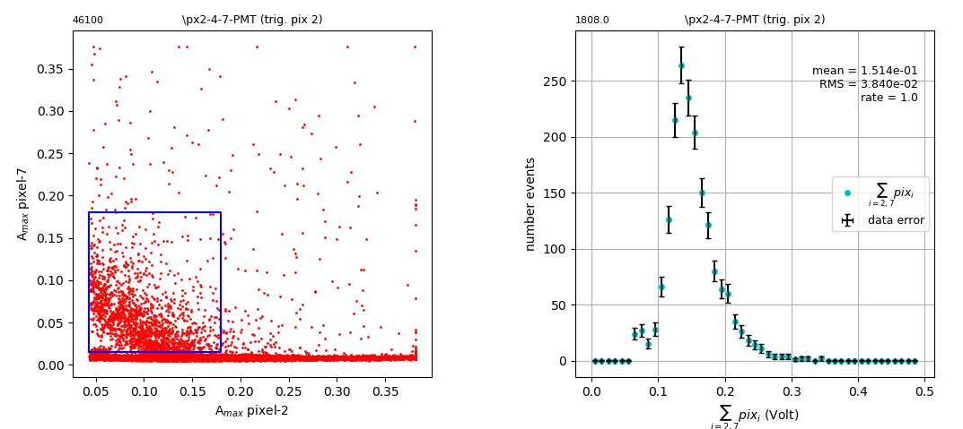
Charge sharing study with ⁹⁰Sr
Charge sharing between two neighboring pixels (2 and 7)
Shared hits between 2 pixels estimated to ≤ 4% of the total hits

Slide 12
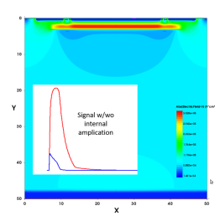
How to improve further the performances: CACTUS-GL
Add intrinsic gain to:
  Improve S/N → Improvement on time resolution
  Reduce sensor thickness → Reduce Landau dispersions
  Reduce FE power consumption
  Reduce pixel pitch
Ultimate goal is to reaching 20 ps resolution in the frame of DRD3
CACTUS-GL prototype submitted to fabrication in May 2024 (MPW run)
  DJ-LGAD concept with buried PN-junction
  Better radiation hardness expected with this concept
  TCAD simulations done with Sentaurus
  Gain of ~10 expected form these simulations
  PN junction implemented by the foundry
  Production implied only minimal modifications to LF15A standard process
    change of implant energy of 1 layer (DNW)
    addition of 1 customer layer
  6 different diode structures, 1 without gain layer
  2 epi and 2 HR wafers asked, HR wafers thinned & post processed similar to previous MiniCACTUS prototypes
Typical Sentaurus TCAD simulation of a diode with buried PN junction
Layout of MiniCACTUS v2 chip (4.3 mm x 2.7 mm)

Slide 13
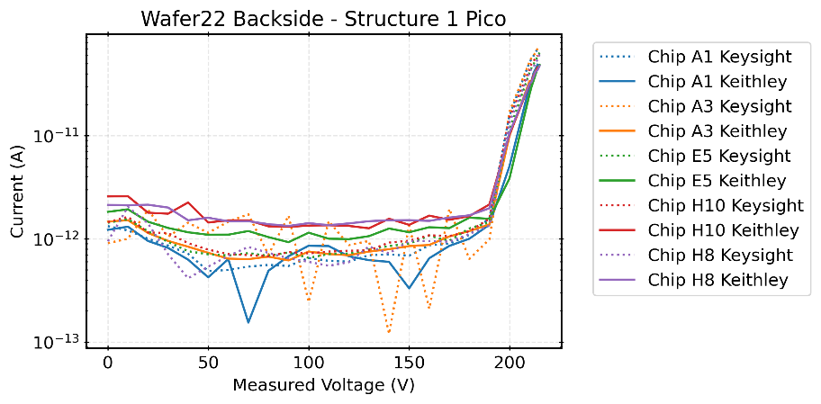
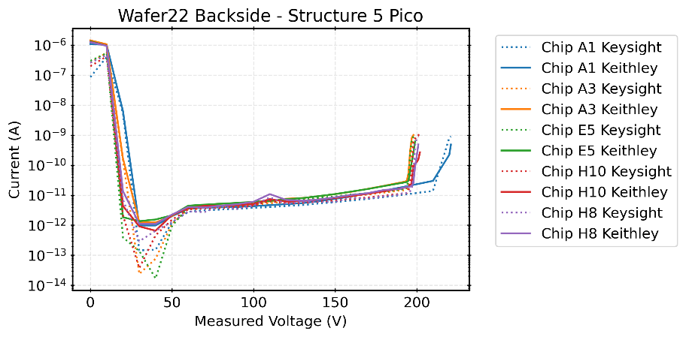
Status of CACTUS-GL Tests
Fabricated and post-processed sensors received at the beginning of this year
Preliminary I-V measurements done at Liverpool using a probe-station
→ All the 6 structures are alive (responding to the light) and should be useable for particle detection
Test PCB ready at Saclay, 2 different discrete front-ends
  A copy of TIA based on an RF transistor, used for LGAD tests. Needs an external high speed amplifier
  A TIA based on a high speed commercial opamp (4 GHz GBW product). No external amplifier needed but BW lower than transistor-based design
  First sensors will be bonded soon on these PCBs
Structure wo gain layer
One of structures with gain layer
→ BV ≈ 200 V

Slide 14
CONCLUSIONS AND NEXT STEPS
Short term: In-lab preparation of July 2025 testbeam period of MiniCACTUS v2 (H4, DRD1):
  Systematic scan of all promising pixels/thicknesses with ⁹⁰Sr
  Check of front-end optimal parameters with ⁹⁰Sr
Medium term: Investigate test structures with integrated gain layer. With a bit of luck, may be able to have some testbeam data in November 2025 ?
If test structures work, integrate front-end, and submit a MiniCACTUS-like design in LF15A (end 2025-mid 2026 ?)

Slide 15
ANNEXES

Slide 16
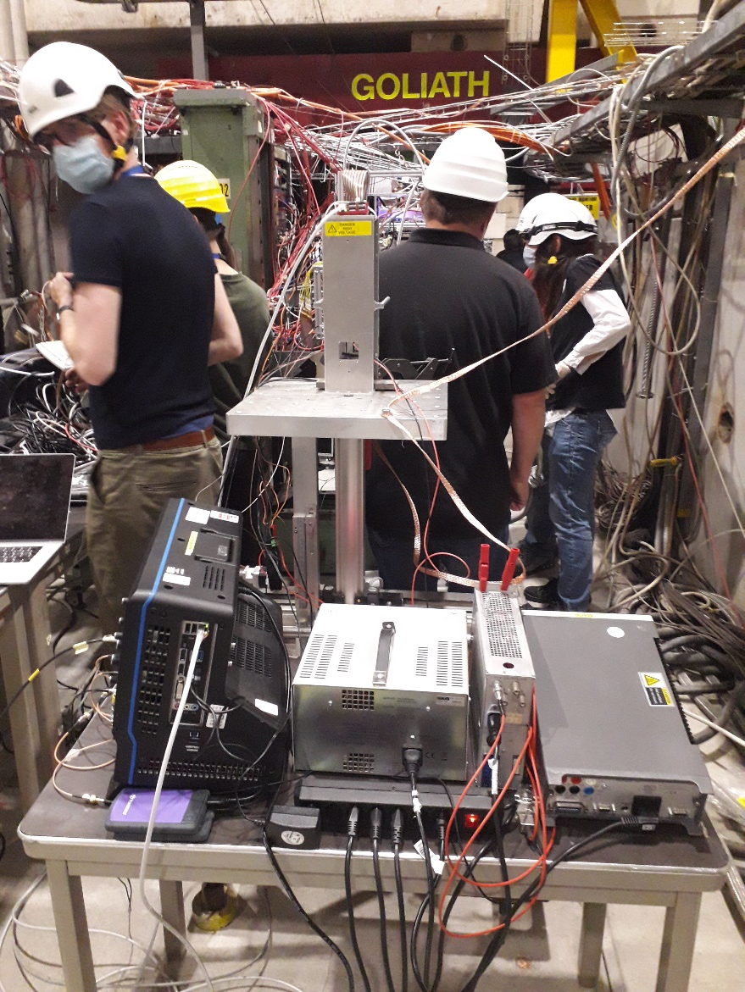
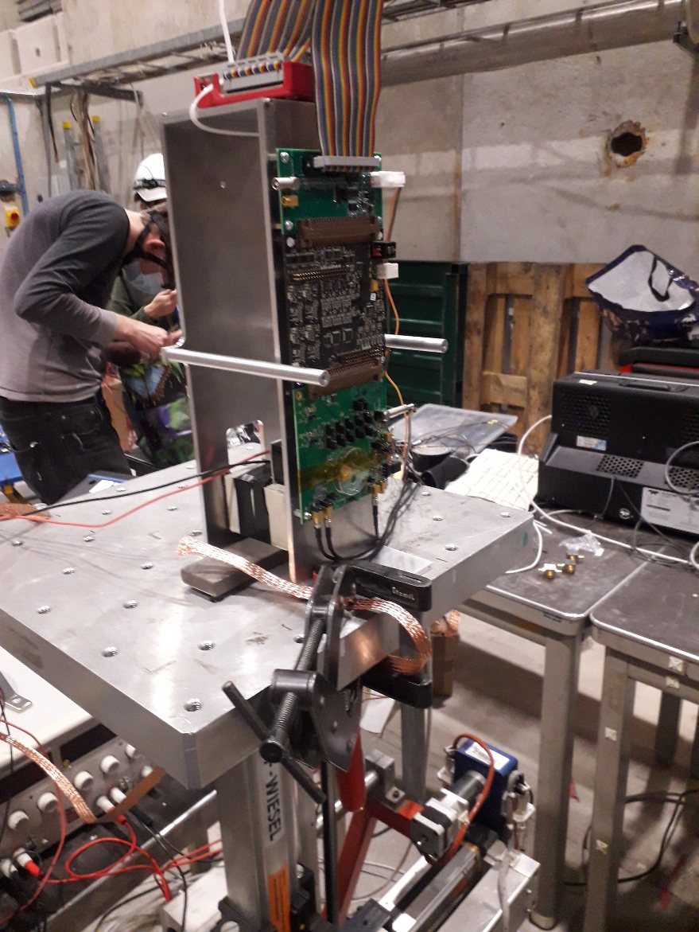
TESTBENCH OF MINICACTUS IN TESTBEAM
MiniCACTUS
Power Supplies
(LV and HV)
Setup installed on H4 line at SPS-CERN during RD-51 test-beam period in parasitic mode (October 2021)

Slide 17
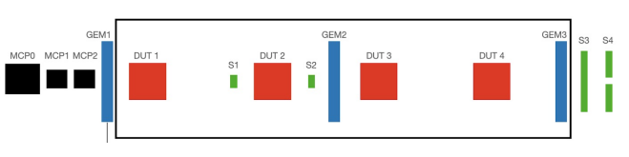
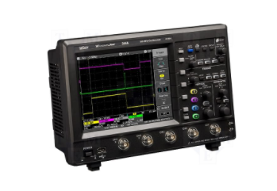

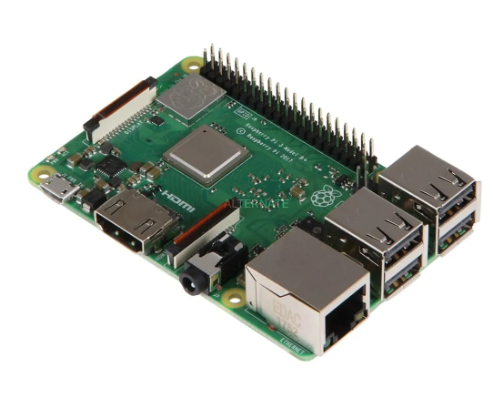
TESTBENCH OF MINICACTUS IN TESTBEAM
SC+PMT
MiniCACTUS
Tracker
H4 BEAM
μ/π
Program & slow control
Digit.+Ana.
Event counter
Ethernet
Setup installed on H4 line at SPS-CERN during RD-51 test-beam period in parasitic mode (October 2021)

Slide 18
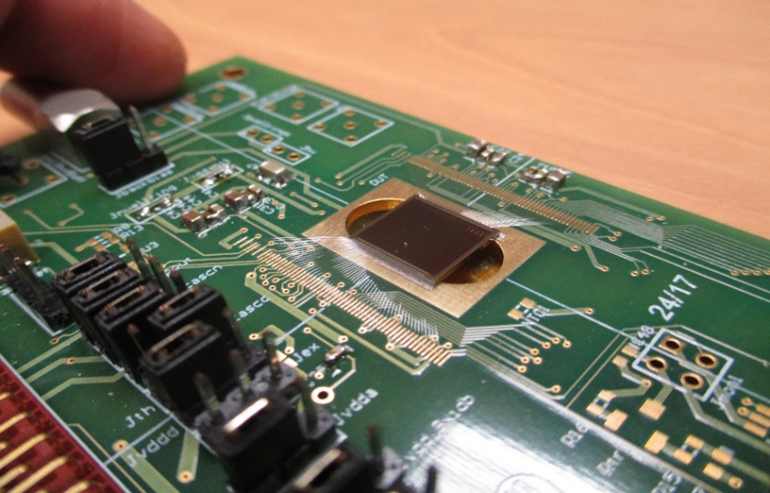
CACTUS* DEVELOPMENT
The first demonstrator called CACTUS for timing in LF 150 nm process designed in 2019
The front-end in CACTUS is based on an in-pixel fast preamplifier followed by a leading edge discriminator
Time walk corrections done off-line by ToT measurement
Promising results obtained with the CACTUS detector developed in this process (high breakdown voltage, homogenous charge collection, deep depletion depth, good yield), but very low S/N observed
Very long & large power rails needed to distribute power into pixels increased significantly detector capacitance in CACTUS
Timing possible only with high thresholds (leading to very low efficiency)
The CACTUS demonstrator on PCB
(chip size : 1 cm x 1 cm)
[Y. Degerli et al. JINST 15, 2020]
*CMOS ACtive Timing µSensor

Slide 19
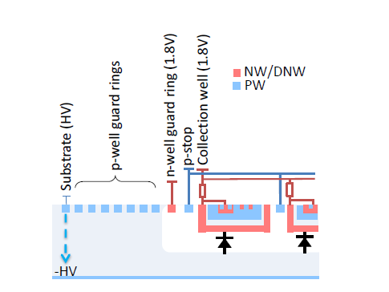
GUARD-RINGS OF LF-MONOPIX1
[M. Barbero et al. JINST 15, 2020]

Slide 20
COUPLING FROM DIGITAL BUFFERS
(Chip#4, pixel 8)
Discri ON, CMOS buffers OFF
Discri ON, (VTH=0.75V)
ToT
Discri ON, vdd_cmos_buffers=1.5V
Minicactus LVDS output (100Ω-terminated)
Clean leading edge
Reducing vdd_cmos_buffers
improves slightly oscillations
20

