Slide 1
Ultra-thin Diamond Detectors for On-line Monitoring of Ion Microbeams
80|PRIME
Mission pour les Initiatives Transverses et Interdisciplinaires
Claire Léonhart
JUIN 2025 – Assemblée Générale du GDR DI2I

Slide 2
Table of contents
Context
Microbeam and their monitoring
Diamond detectors
Diamond etching
Why an ultra-thin diamond ?
Etching technique and parameters
Defects and consequences
Optimization of etching recipe
Membrane detector fabrication
Etching masks and steps of process
In lab characterization of membrane
Conclusion

Slide 3
Contexte: Ion microbeam and monitoring
01

Slide 4
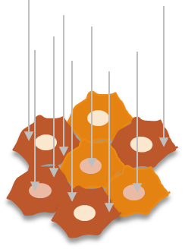
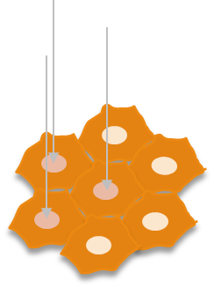
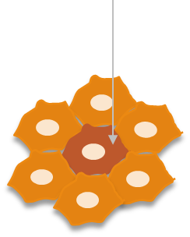
Microbeam’s interest in radiobiology
Global irradiation
Each cell receives a mean number of particle
Irradiation by microbeam
Targeted irradiation
-> select the irradiated cells
-> select the part of each cell
Irradiated cytoplasm
Irradiated nucleus

Slide 5
Two microbeam line with few differences
MIRCOM
Solid and gaseous ion sources
AIFIRA
Gaseous ion sources
Singeltron 3,5 MV accelerator
3 MeV Proton 3 MeV Alpha
TandetronTM 2 MV accelerator
4 MeV Proton 6 MeV Alpha 8 MeV C³⁺, O³⁺

Slide 6
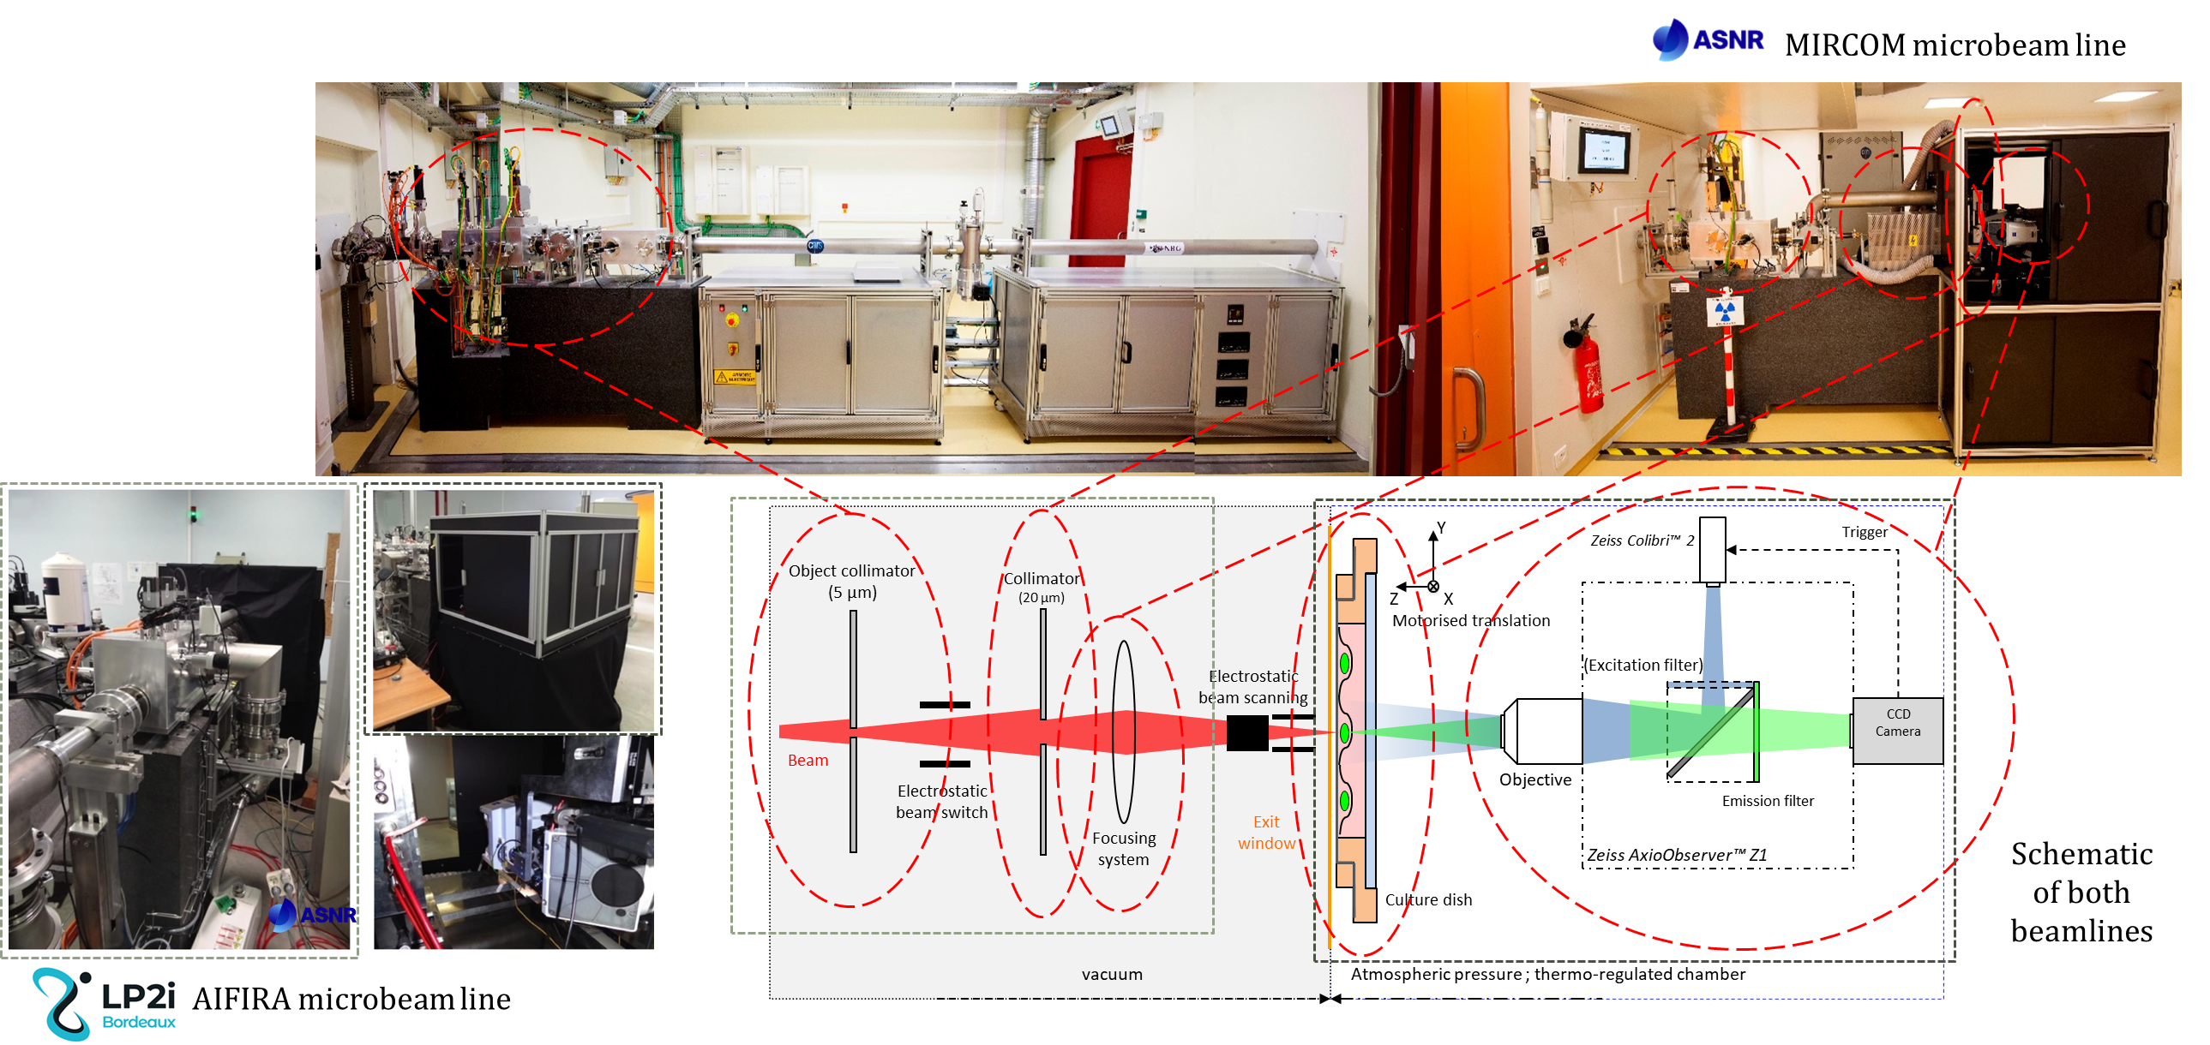
Presentation of microbeam lines

Slide 7
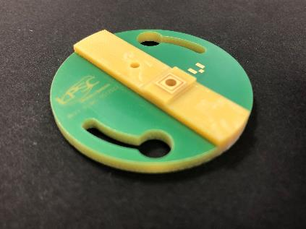
Microbeam monitoring
Sample holder - Produced by the Detector, Instrumentation and Electronics Departments at LPSC
vacuum
air
Si₃N₄ extraction window
ions
secondary electrons
Activ Diamond window
PIPS detector
The detector must be able to:
- efficiently detect protons as well as heavier ions
- count ions at very low (single ion) and high beam intensities (10⁴ particle.s⁻¹)
Chaneltron detector
Efficient detection of carbon and oxygen ions
Efficient detection of alpha particle but need to adapt the extraction window
Not efficient for protons
(Lalanne, 2023, PhD thesis)
×

Slide 8
The diamond as a solid-state ionization chamber
Incident particle
+
-
+
-
Read out electronics
+
-
E
+
-
+
-
+
-
+
-
Diamond as a detector:
Very low leakage current
Low noise
Good radiation hardness
Very fast
Work at room temperature
Diamond = Wide band-gap semiconductor

Slide 9
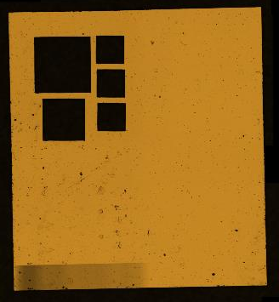
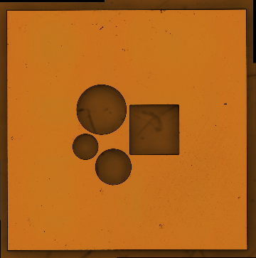
Ultra-thin diamonds and their problematics
Why ultra-thin?
To have a minimum quantity of material before the biological environment,
And to limit disturbances: loss of energy and spatial deviation.
scCVD diamond
Electronical or optical grade
50 µm
Window Ø 500 µm, few micrometers thin
Metallized electrodes for diamond biased and signal read-out
How to obtain this kind of thinness ?
Etching of diamond
Polycrystalline diamond mask
Objectives :
- good thickness homogeneity
- sufficiently low surface roughness to limit leakage currents
Polycrystalline diamond masks with laser cut square and round patterns
1 mm

Slide 10
Diamond etching
02

Slide 11
Plasma etching of diamond
Reactive Ion Etching : use of a mix of chemical reactant and chemically inert species ; physical and chemical process
Can be of two types :
CCP = Capacity Coupled Plasma : only one RF parameter
Need a highly chemical specy (like O₂) for good kinetic.
ICP = Inductively Coupled Plasma : two RF powers permitting to separate plasma density and its acceleration
More suitable for deep etching because plasma can be denser.
plasma
Sample
~
~
plasma
~

Slide 12
Important characteristics to evaluate an etching
Etching rate (nm/min) measured with profilometers
Final rugosity of sample (nm RMS) measured with profilometers
to be compared with initial rugosity
Thickness homogeneity (%) depends on initial planarity of sample
Etching defects : etch pit / microtrenching
Etch pits : preferential etching of dislocation by oxygen resulting in pits
Microtrenching : overetching on the side of the pattern, due to the important thickness of both mask and deep etching

Slide 13
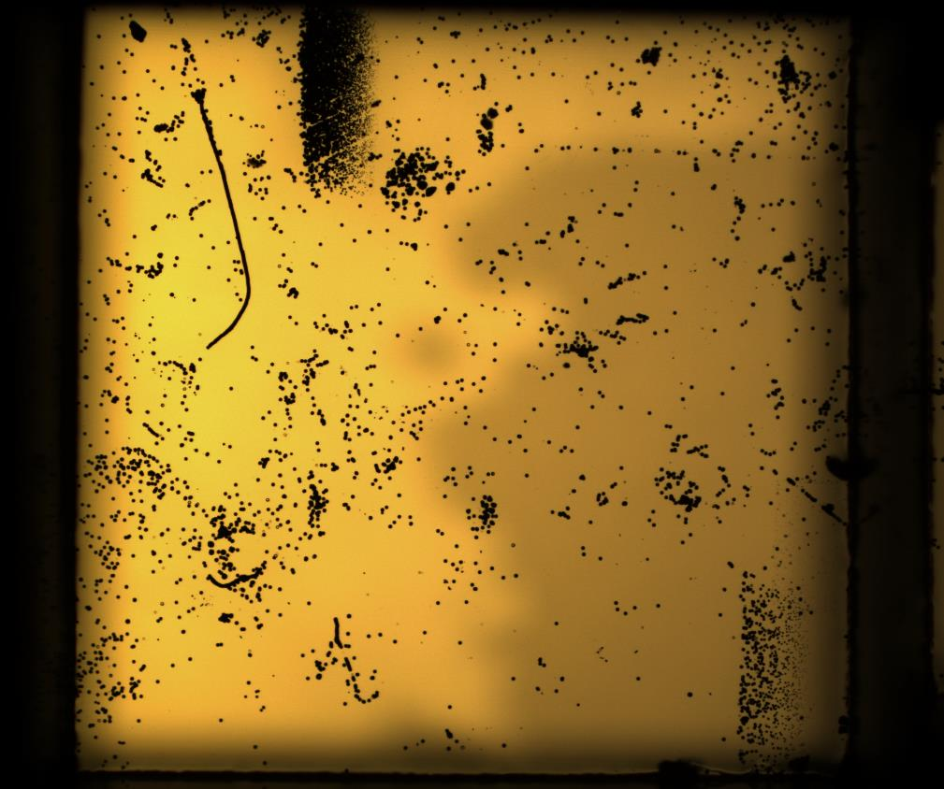
Etching defect : etch pits
RIE-CCP : 280 W Platen
CF₄ 7 sccm + O₂ 40 sccm
77 mTorr
19,2 µm etched (80 nm/min)
!!! Each black dot on the surface is a hole about 1 µm deep !!!
SEM picture
250 µm
Resolved by eliminating O₂ in the process

Slide 14
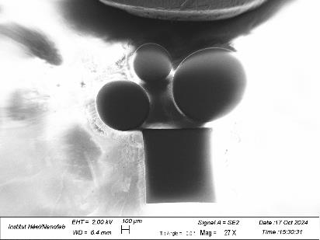
Etching defect : microtrenching
RIE-ICP : 400 W Platen + 1600 W ICP
CF₄ 25 sccm + Ar 25 sccm
10 mTorr
27,1 µm etched (113 nm/min)
Microtrenching : 800 nm (3 % of etched depth)

Slide 15
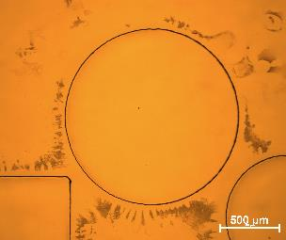
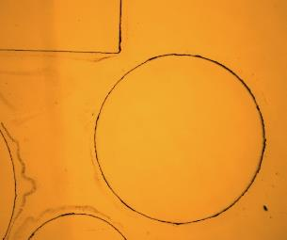
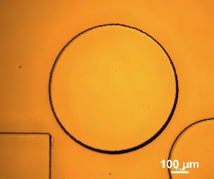
Comparing etching recipes
Recipe | RIE-CCP : 280 W 50 sccm O₂ + 7 sccm CF₄ 77 mTorr | RIE-CCP : 280 W Only CF₄ 77 mTorr | RIE-ICP : 400 W + 1600 W Only CF₄ 10 mTorr | RIE-ICP : 400 W + 1600 W 50 % CF₄ + 50 % Ar 10 mTorr | RIE-ICP : 400 W + 1600 W 40 % CF₄ + 60 % Ar 10 mTorr
Kinetic | 80 nm/min | 31 nm/min | 133 nm/min | 114 nm/min | 83 nm/min
Optical characterization
Profilometry (microtrenching) | No | No | 10 % ( ~800 nm for 8,5 µm) | 3 % (~800 nm for 27,1 µm) | 1 % (~100 nm for 10 µm)
Promising but needed to be confirmed in longer etching

Slide 16
FABRICATION OF Membrane detector
03

Slide 17
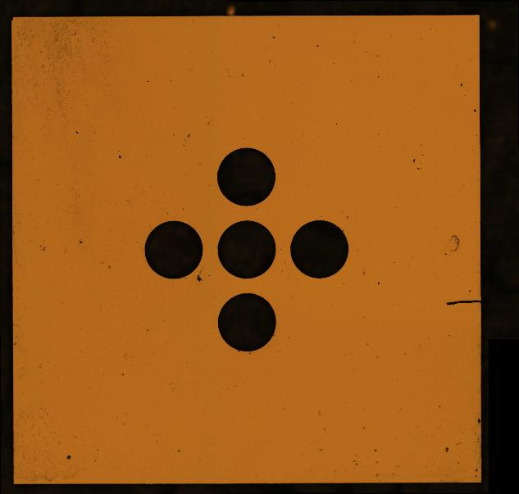
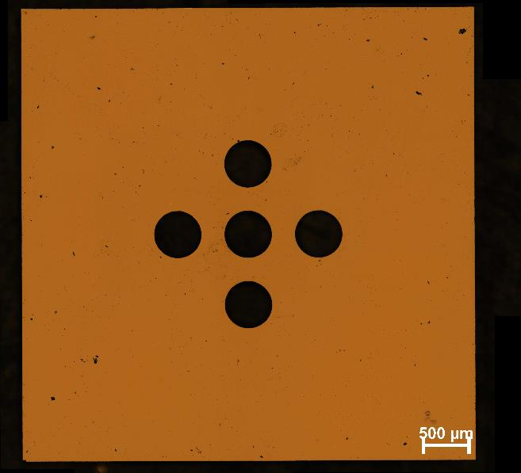
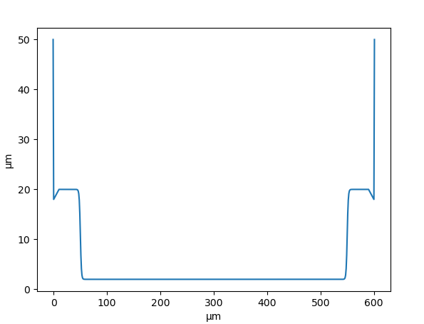
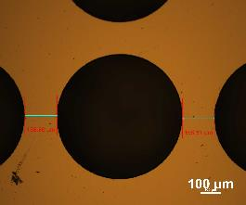
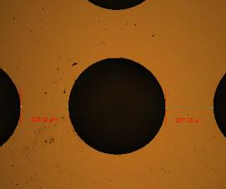
Etching process with two masks
Concentric patterns
Diameters difference of 100 µm
Expected profile:
Apparition of microtrenching on long etching.
Smooth edge on the small diameter after 2nd short etch.

Slide 18
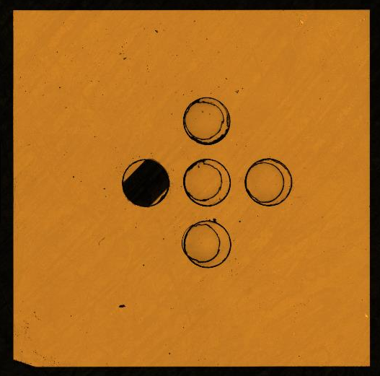
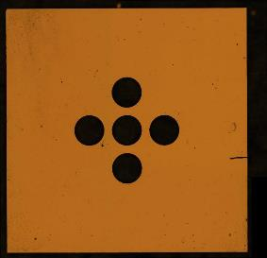
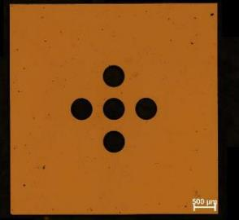
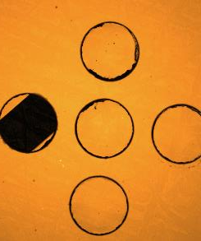
Etching process with two masks : optical and profilometer characterization
First deep etching
With Ø 600 µm mask
Second deep etching
With Ø 500 µm mask
Imperfect alignment of the two masks resulted in an offset in patterns.
42,4 µm etched in total, membrane is less than 8 µm thick.
37,8 µm etched in 6h.
One of the window broke during cleaning steps using ultrasound.
No microtrenching measured by profilometer.
Profil ligne

Slide 19
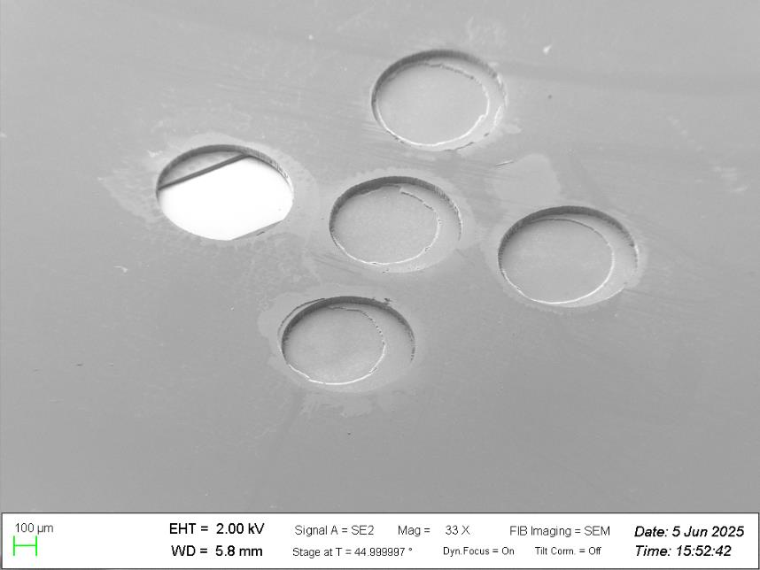
Etching process with two masks : MEB characterization
42,4 µm
Microtrench spread out on ~10 µm but limited in depth.
Etched surface is smooth and defect free.

Slide 20
Conclusion & Perspectives
Thinning of diamond for membrane detector is a real challenge:
Etching defects are a problem for detection and could rupture the window. Oxygen in etching recipes is responsible for revealing etch pits. High kinetic recipe produce also microtrenching.
Adjustments on etching recipe permit a sufficient kinetic with good surface quality for detector purpose but do not eliminate microtrenching problematic, only reduce it.
A 8 µm-thick membrane was fabricated, with limited microtrenching and low surface defects concentration.
Test on detector capability are planned in July at AIFIRA.
Ultimate thinning of the membrane without any mask is considered.

Slide 21
80|PRIME
F. Vianna-Legros
M. Cardot-Martin
K. Lalanne
M-L. Gallin-Martel
D. Dauvergne
A. Bes
J-F. Muraz
M. Reynaud
Mission pour les Initiatives Transverses et Interdisciplinaires
E. Gheeraert
J-F. Motte
F. Donatini
J. Pernot
P. Barberet
J. Jouve
C. Léonhart

Slide 22
Back-up slides

Slide 23
Contact deposition for bias and signal collection
27,1 µm on a test sample (etching rate = 113 nm/min)
400 W Platen + 1600 W ICP
CF₄ 25 sccm + Ar 25 sccm
10 mTorr
Deepest etching yet with this surface quality
Ω
Next step = aluminum deposition
To ensure electric continuity between the bottom of the pit and the non-etch surface of the diamond
The technique of deposition is suitable for contact even with steep angles.
Measured resistance of a few ohms only

Slide 24
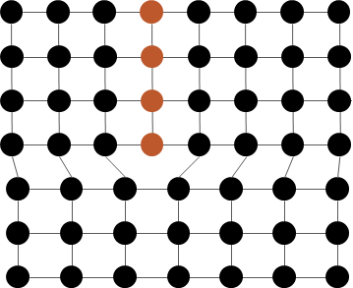
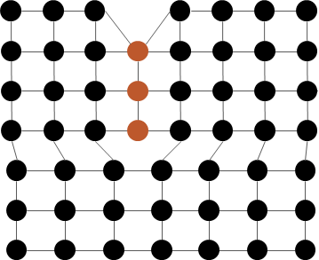
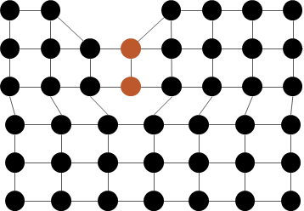
Evolution of the etching recipe: oxygen-free = etch pits-free
O₂
CF₄
125 µm
1h20 etching
2,4 µm
Etching rate = 31 nm/min
280 W
CF4 50 sccm
77 mTorr
250 µm
Really slow, but without any etch pit.
Dislocation

Slide 25
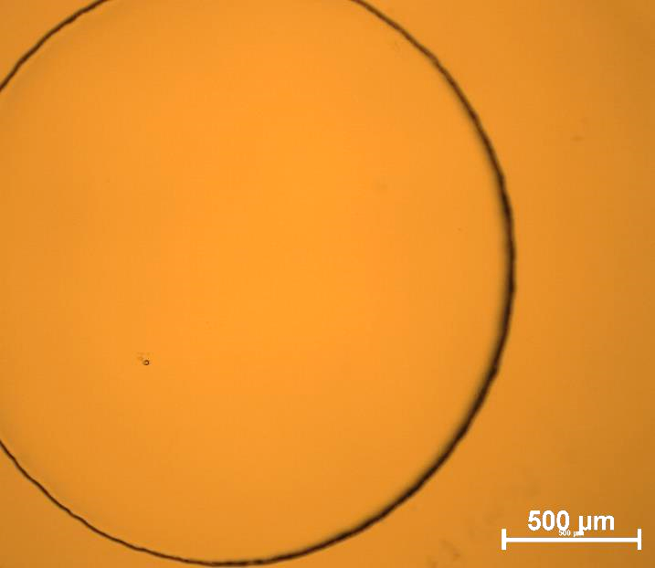
Change of etching device: RIE ICP (oxford @ CEA)
ICP: Inductively Coupled Plasma, Decoupling plasma density and acceleration with two distinct RF power
400 W Platen + 1600 W ICP
CF₄ 50 sccm
10 mTorr
Circle 500 µm
125 µm
1h etching
8,5 µm
Etching rate = 142 nm/min
Compatible with detection device manufacturing requirements
Rugosity: 14 nm RMS
for 9 nm initially

