Slide 1



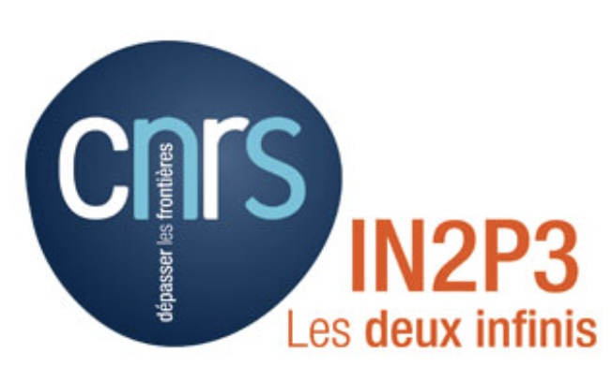

YOLO-CL : Deep Machine Learning for Galaxy Cluster detection with LSST (DESC projects [428] and [429])
Tran Vinh Phat, PhD student, APC/IN2P3/University Paris Cité
Simona Mei (APC, FR), Michel Aguena (Obs. Trieste, IT) , Stephane Ilic (IJCLab, FR)

Slide 2
Introduction
Galaxy Clusters Detections => Largest gravitationally bound system => Key cosmological probes (matter density, structure evolution, etc…) => Excellent tracers of LSS => Offer insights to the inner workings of galaxies
Traditional Methods => based on catalogs (galaxy colors, photometric redshifts) that can lead to bias

Slide 3
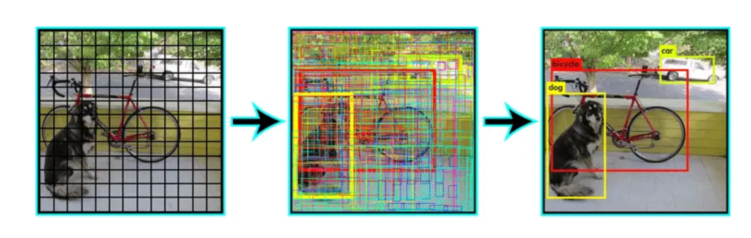
What is YOLO-CL ?
YOLOv3 (Redmon 2015; Redmon & Fahradi 2018)
Convolutional Neural-Network (CNN)
Modified to detect galaxy clusters in color images -> YOLO-CL (Grishin, Mei, Ilic 2023)
One-shot bounding box and classification

Slide 4
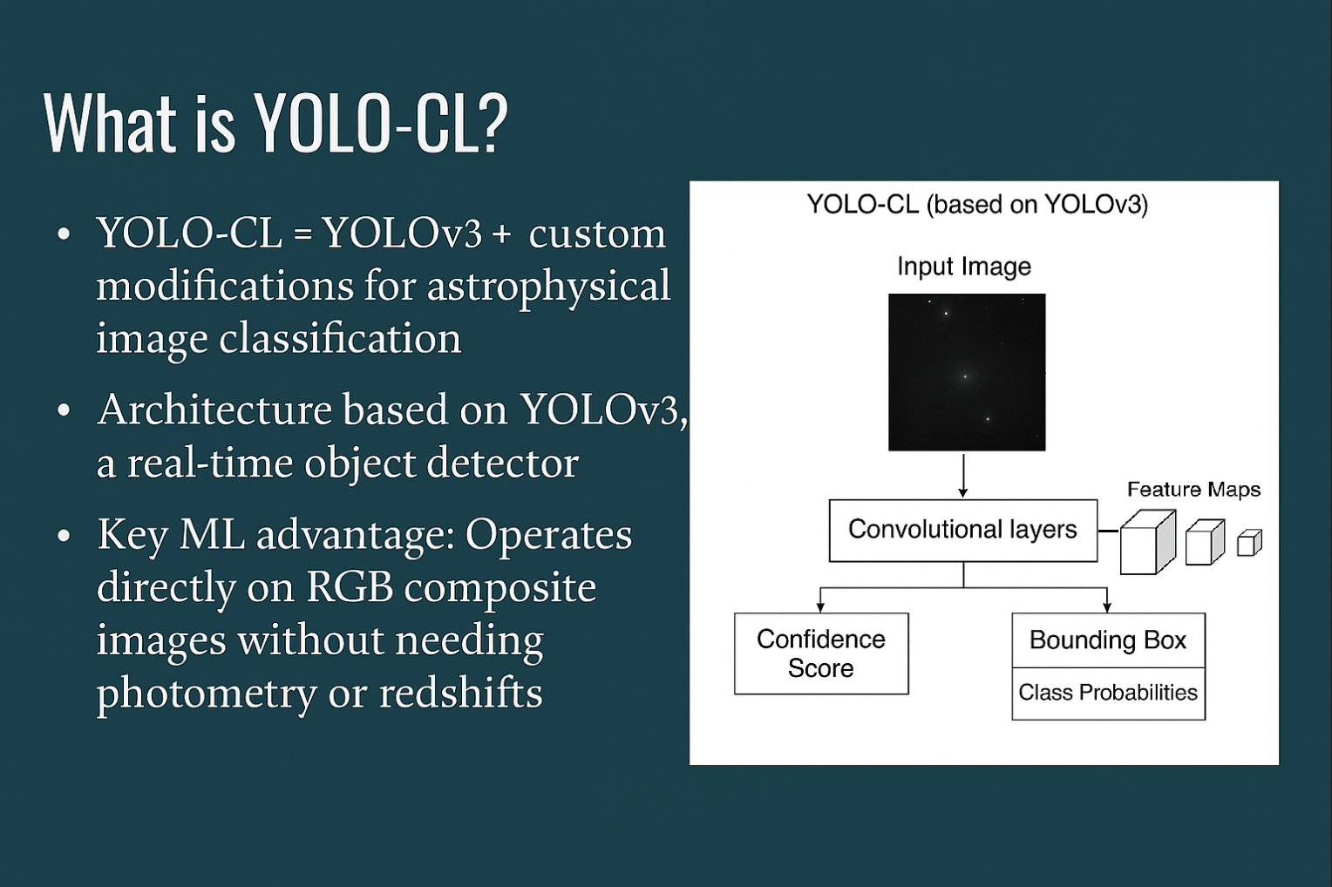

YOLO-CL Architecture
Grishin, Mei, Ilic 2023

Slide 5
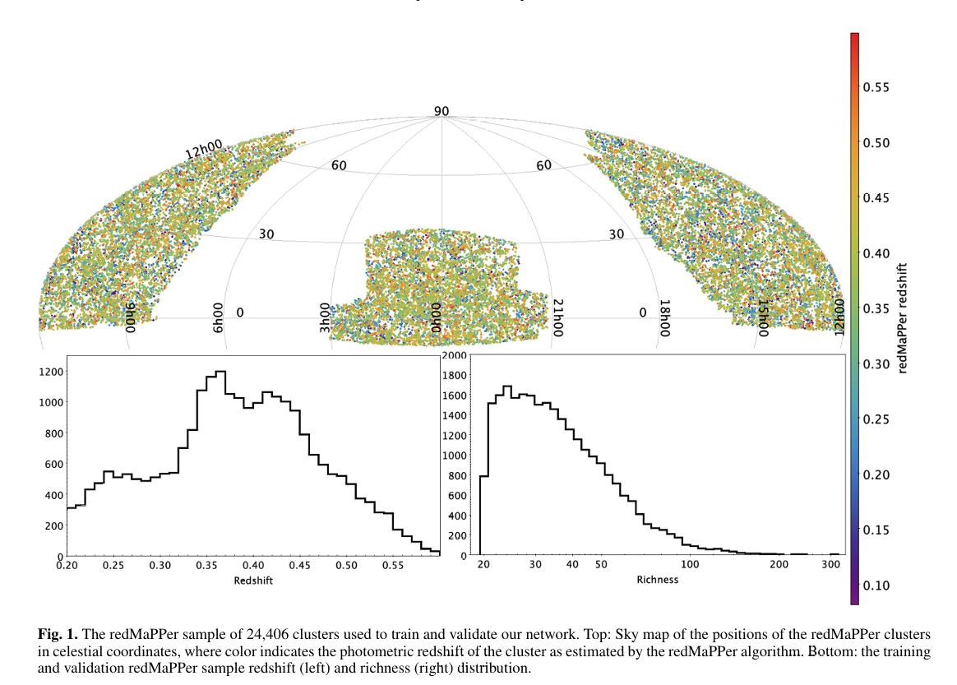
Training Dataset for SDSS
SDSS: 24,406 redMaPPer clusters => training and validation each with half sample + blank fields for validation
Grishin, Mei, Ilic 2023; Grishin et al. 2025

Slide 6
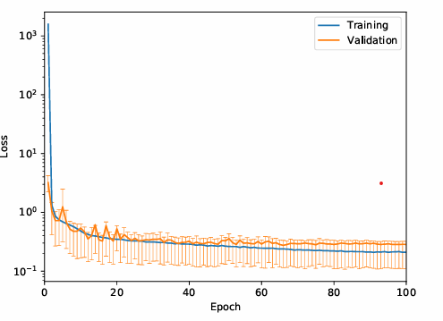
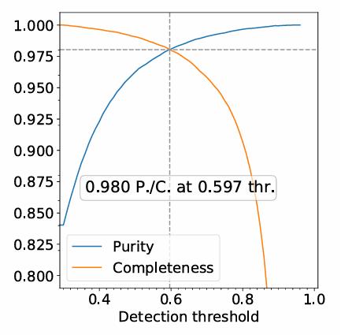
Performance (SDSS)
YOLO-CL SDSS Completeness and Purity: 98%
Grishin, Mei, Ilic 2023

Slide 7
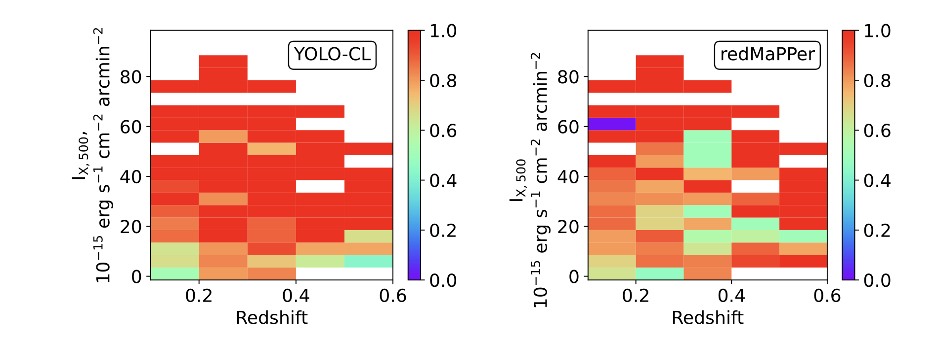
Performance (SDSS)
YOLO-CL outperforms RedMaPPer when comparing detections of the same MCXC2021 clusters, and the YOLO-CL selection function is flat with X-ray surface brightness
Completeness
Grishin, Mei, Ilic 2023

Slide 8
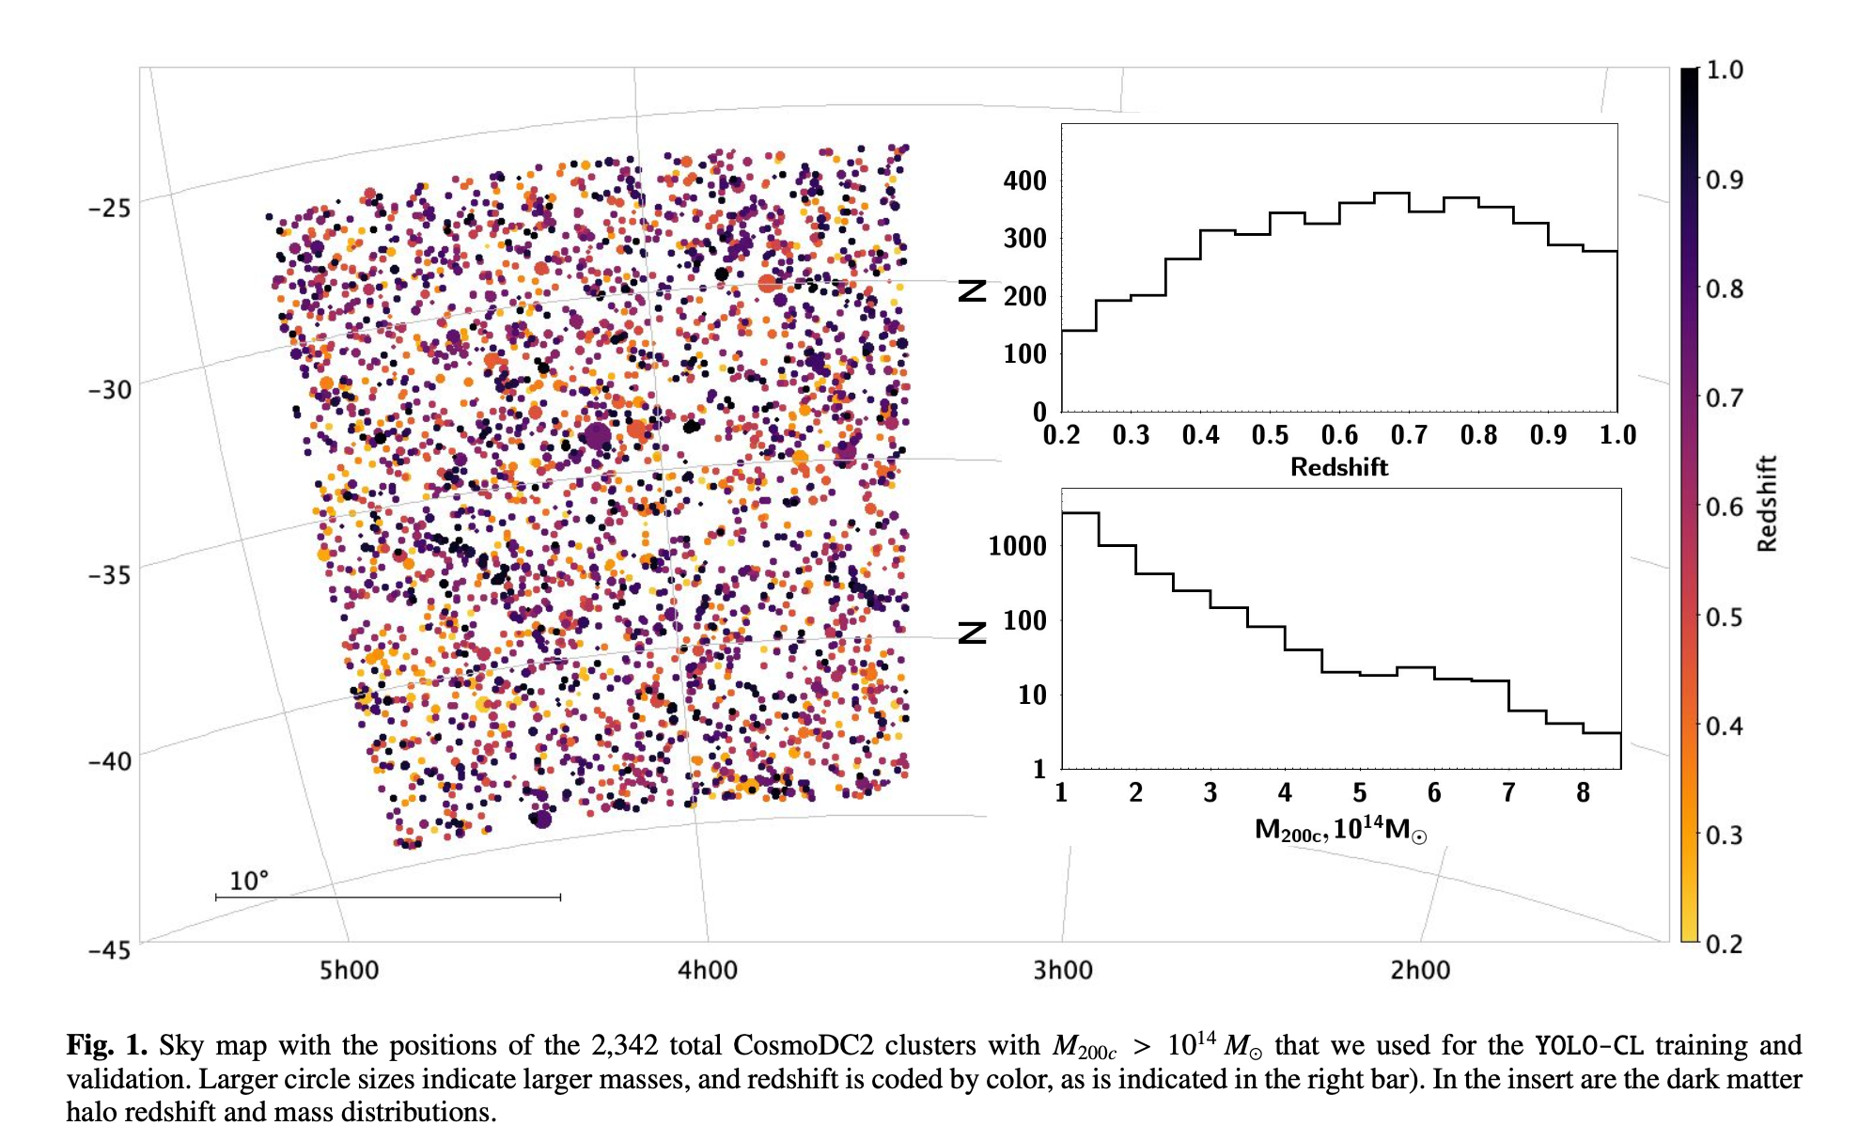
Training Dataset for application on LSST DC2 simulations
Transfer learning approach = SDSS + DC2 clusters
Hybrid training with SDSS and DC2 simulations: 24,406 SDSS redMaPPer clusters + 2342 LSST DC2 simulated halos => training each with half sample + validation on DC2 and blank fields
Grishin, Mei, Ilic 2023, Grishin et al. 2025

Slide 9
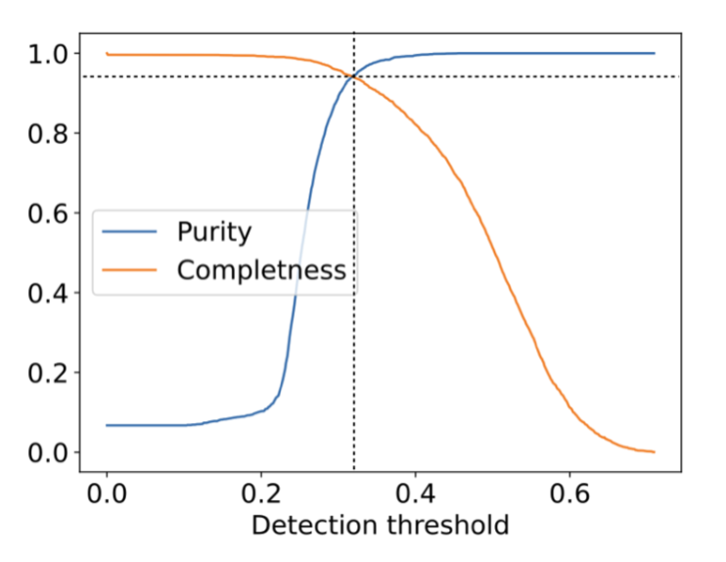
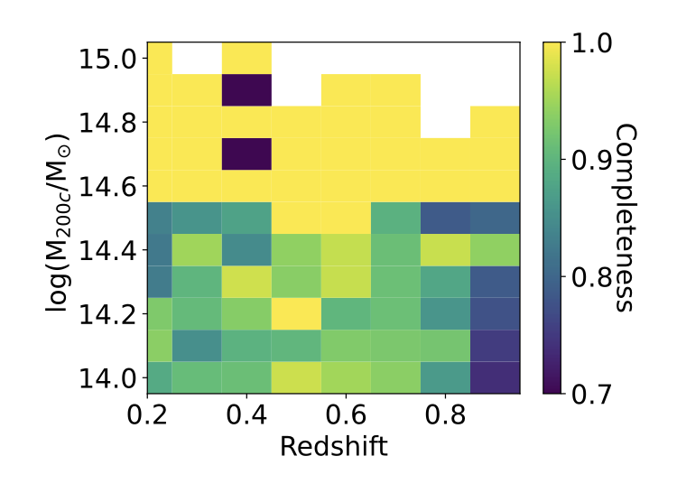
Performance for LSST DC2
Completeness and purity: 94% for halos with M_{200c} > 10¹⁴ M☉ at z ≲ 1.
100% for M > 10^{14.6} M☉ at 0.2 < z < 0.8
Grishin et al. 2025

Slide 10
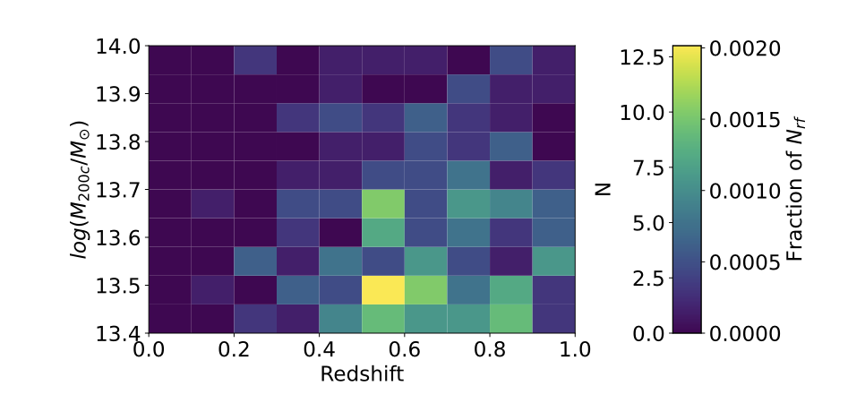
FALSE POSITIVE DC2 (6% catalog contaminant)
Grishin et al. 2025

Slide 11
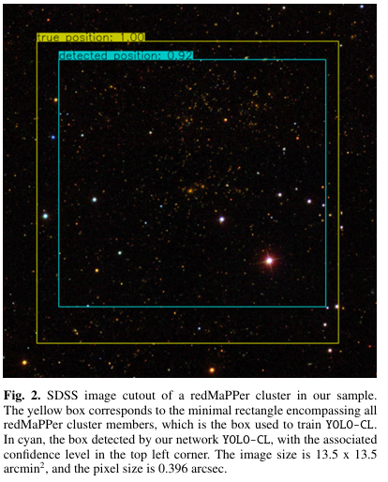
Advantages of YOLO-CL
No photometric redshift and galaxy catalog or stellar masking needed
Robust to systematics and the presence of crowded star fields and artifacts
Fast inference (single forward pass)
Scalable to large-area surveys

Slide 12
Current status & Future steps and challenges
Currently only tested in “targeted mode” meaning that YOLO-CL was applied to images that were cut around the simulated clusters: what happens when we do not know where the clusters are?
My goal to optimize YOLO-CL for “Survey mode” in order to apply the model to LSST (DESC projet [428]) and combined LSST and EUCLID images (DESC projet [429]) => based on the latest version of the network developed by Michel Aguena.
I will also improve the network to include more information on the cluster such as redshifts, members and mass.

Slide 13
Summary
YOLO-CL is fast, robust, and accurate -> Image-based Machine Learning = promising future
Outperforms or matches traditional algorithms
False Positives in DC2 simulations are massive groups within the mass uncertainty in observations = interesting massive objects to be analyzed
Optimization of “survey mode” for large-scale surveys LSST and LSST/EUCLID

Slide 14
Questions ?
Thank You !

Slide 15
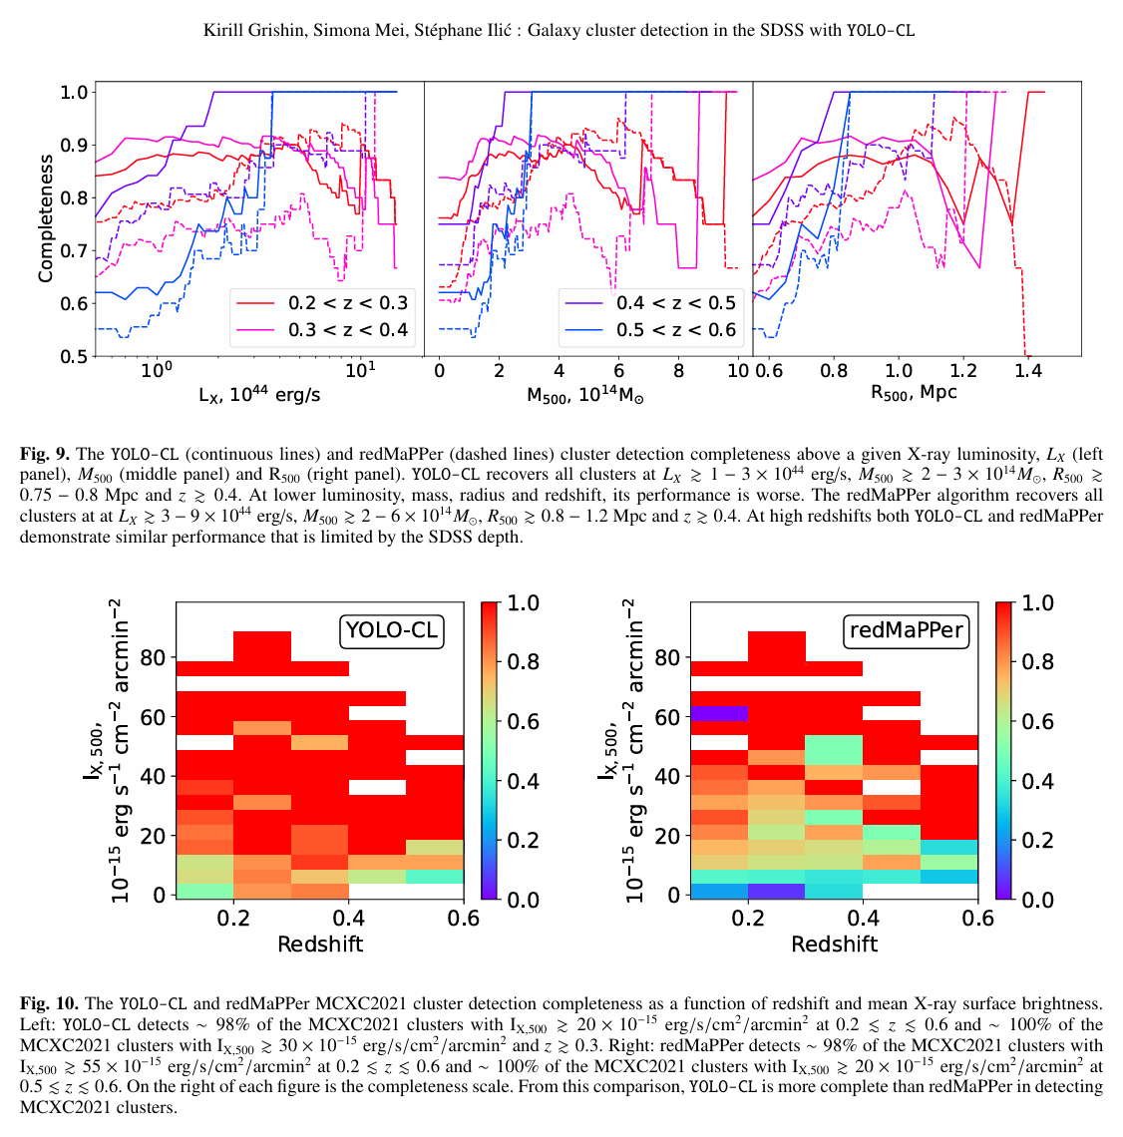
Extra Slides

Slide 16
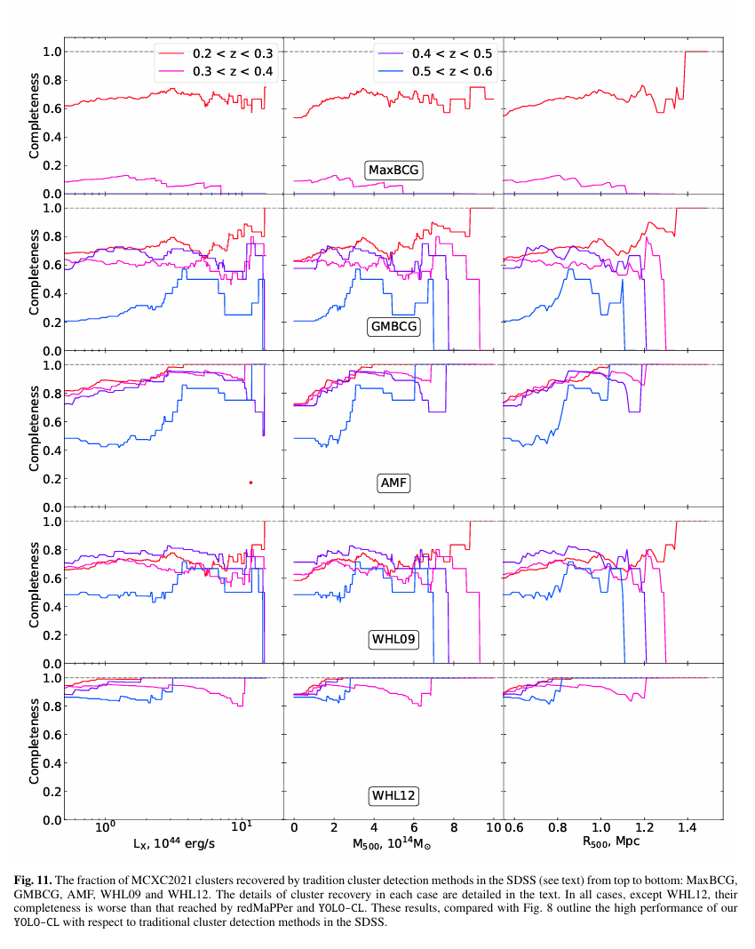
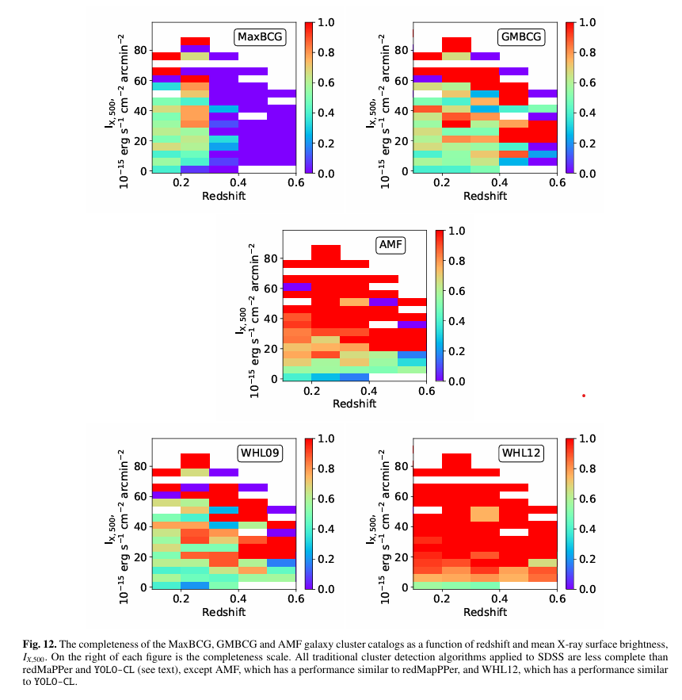

Slide 17
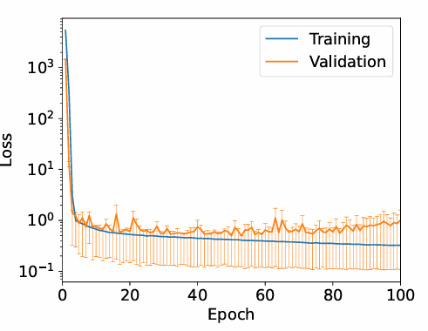

Slide 18
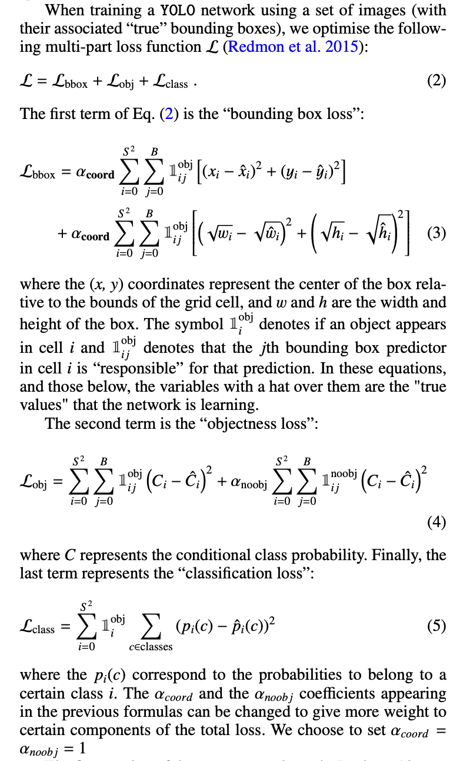

Slide 19
