Slide 1
Friday 6th December 2024 Fatih BELLACHIA
LAr Online S/W Phase II
Working Packages

Slide 2
Software Development Timeline
Milestones
Setting up documentation
First version of requirements
Technical Reference manuals ready
E.g. LATOME
Beta release ready
for EMF test stand
TDAQ release ready
Production release ready
Documentation
Specifications
Refactoring and development
Development
Development
Operation and Maintenance
Development
1
2
3
4
5
6
C++ Coding Style
Python Coding Style
Software project governance
Tools
Functional requirements
E.g. Calibration
Non-functional requirements
Moving from Legacy C++ to Modern C++2x
Base
Third party libraries
IpBus
OPC-UA client/server
OPC-UA/IpBus gateway
Abstract board
LDPB
LTDB*
LATOURNETT
Calib
FEB2
LASP*
LTI*
GUI application
TOML configuration file
Calibration
User plugins
DAQ interface
Controller
Schema and data for Configuration database
Message passing
Error handling
Monitoring plugins
Calibration plugin
Commissioning
Physics
Calibration
Stage 0
Stage 1
Stage 2
Stage 3
Stage 4
Stage 5
Production
* resources must be identified for development/maintenance
Fatih Bellachia

Slide 3
Tasks To Be Performed
LAr Phase II Online Software
Olivier Arnaez / Fatih Bellachia
WP1 Software Configuration Management
Jean Jacquemier
WP2 Refactoring
Fatih Bellachia
WP3 LATS and Front-End boards
Sylvain Lafrasse
WP1.a
Software documentation, policy and rules
WP1.b
AI driven development
GitLab Duo
WP1.c
DevSecOps and CI/CD
WP2.a
Phase 0
Core libraries
WP2.b
Phase I libraries
WP2.c
Run Controller and
OKS database
WP3.a
Generic Board
And Simulator Board
WP3.b
Configuration
And
Monitoring
WP3.c
Calibration
Olivier Arnaez
Marco Delmastro
WP3.b.1
Boards
And
DAQ plugins
WP3.b.2
Measure Performance
OPC-UA server
Ferio Rasambatra
WP3.b.1.1
LATS
WP3.b.1.2
FEB2
WP3.b.1.3
CALIB
Fatih Bellachia

Slide 4
BACKUP
Fatih Bellachia

Slide 5
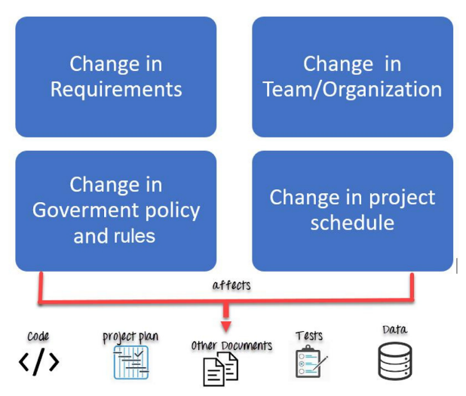
Software Configuration Management (SCM)
WP1 Software Configuration Management
managed
WP1.a
Software documentation, policy and rules
WP1.b
AI driven development
GitLab Duo
WP1.c
DevSecOps and CI/CD
Source: Guru99
By 2027, 70% of professional developers will use AI-powered coding tools, up from less than 10% today.
Source: Gartner
AI
Sec
Fatih Bellachia
Notes:
Le Software Configuration Management (SCM), c’est une discipline du génie logiciel qui gère, organise et contrôle les changements en termes des exigences, de codes et d'autres éléments au cours du cycle de vie du développement logiciel.
Elle englobe:
les pratiques et les procédures d'administration du code source,
de production de versions,
de développement de logiciels,
de contrôle des changements
et de gestion des configurations logicielles.
D'ici 2027, 70 % des développeurs professionnels utiliseront des outils de codage basés sur l'IA, contre moins de 10 % aujourd'hui.
Le service CERN GitLab a le plaisir d'être informé du lancement du projet pilote de solution GitLab Duo AI le vendredi 18 octobre 2024.
Les fonctionnalités de GitLab Duo Enterprise seront disponibles pour un groupe sélectionné d'utilisateurs au cours des 60 prochains jours. À la fin de cette période, les réactions des utilisateurs seront recueillies et analysées.
Pour plus d'informations sur la façon de commencer à utiliser GitLab Duo, veuillez vous référer à https://gitlab.docs.cern.ch/docs/GitLab%20Duo/

Slide 6
Refactoring
26
WP2 Refactoring
WP2.a
Phase 0
Core libraries
WP2.b
Phase I libraries
WP2.c
Run Controller and
OKS database
Fatih Bellachia

Slide 7
Phase-2 LATS and Front-End boards
WP3 LATS and Front-End boards
WP3.a
Generic Board
And Simulator Board
WP3.b
Configuration
And
Monitoring
WP3.c
Calibration
WP3.b.1
Boards
And
DAQ plugins
WP3.b.2
Measure Performance
OPC-UA server
WP3.b.1.1
LATS
WP3.b.1.2
FEB2
WP3.b.1.3
CALIB
Fatih Bellachia

Slide 8
RESEARCH & TECHNOLOGY
at LAPP
Fatih Bellachia

Slide 9
High-Availability Application Server (HAAS)
WP4 High-Availability Application Server
[  ]
systemd
Checkpoint / Restore
Server
Redundancy
Processes
Restore
or
Restart
Checkpoint
or
Dump
Image files
with state
Fatih Bellachia
Notes:
Le serveur OPC-UA est un nœud critique de communication.
Le point de contrôle est une technique qui assure la tolérance aux pannes des applications.
Elle consiste à sauvegarder un snapshot de l'état d'une application, de manière à ce qu'elle puisse redémarrer à partir de ce point en cas de défaillance.
Y compris la possibilité de sauvegarder et de restaurer l'état d'une socket TCP sans interrompre la connexion.

Slide 10
Dynamic Software Update (DSU)
WP5 Dynamic Software Update
WP5.a
Security,
validation chain procedure
and policy
WP5.b
Hot patching
WP5.c
Live feature update
Fatih Bellachia
Notes:
Il s'agit de mettre à jour des programmes en cours d'exécution.
Le hot patching permet de corriger le code en mémoire des processus en cours d'exécution sans avoir à les redémarrer.
Le Live feature update permet d'ajouter des fonctionnalités ou de modifier des fonctionnalités à une application en cours d’exécution sans devoir redémarrer.

Slide 11
Thank
You
For
Your
attention
Fatih Bellachia

Slide 12
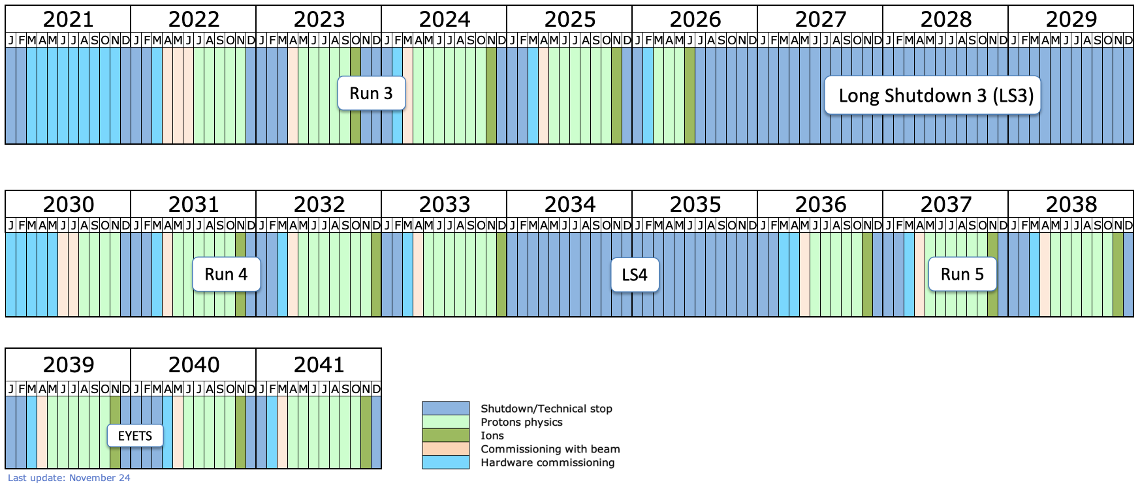
LHC/HL-LHC timeline
Run 3
Long Shutdown 3 (LS3)
Run 4
LS4
Run 5
…
EYETS
Fatih Bellachia

Slide 13
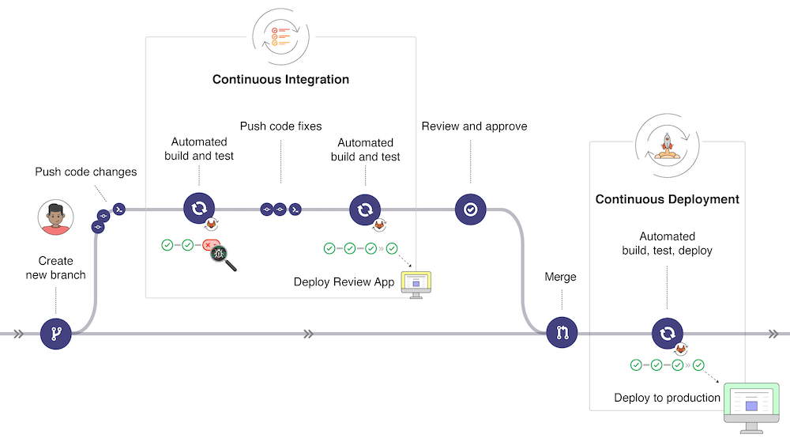
Software Development Methodology
DevOps
Is a culture that promotes collaboration between all participants involved in software development and maintenance
Benefits
Accelerate software delivery
Deliver high quality software
Improve production reliability
GitLab CI/CD workflow
Continuous Integration
Every change that is committed in a remote repository triggers an automated build and test
Checking the compliance of the LAr coding style
Static Code Analysis (i.e. bug hunting)
Unit/Regression Test
Continuous Delivery
Automates the entire software release process. The deployment decision into the production environment is triggered by the developer
Continuous Integration
Continuous Delivery
Workflow from GitLab
Click to
Fatih Bellachia

Slide 14
Expertise Level and Learning
Supported Learning Phase
Guru
An expertise covering dedicated techniques and technologies as well as in-depth knowledge of the LAr Online framework
Expert
Full-stack developer with a solid base in software development and strong knowledge of the LAr Online framework
Developer
Know the best practices and patterns in software development
Novice
He/She has difficulty to follow good development practices and usually implements features by trial and error
Coding Style
Standard C++2x
LAr Online S/W
Features provided
CI/CD
How to write Unit Test?
How to write a plugin?
How to write Integration Test (e.g. mock)?
How to use git?
How to create CMake file?
Best practice
What features do I need to achieve my requirements?
etc…
etc…
Test
Validation of acquired knowledge
Fatih Bellachia

Slide 15
AI In SOFTWARE DEVELOPMENT CYCLE
Fatih Bellachia

Slide 16
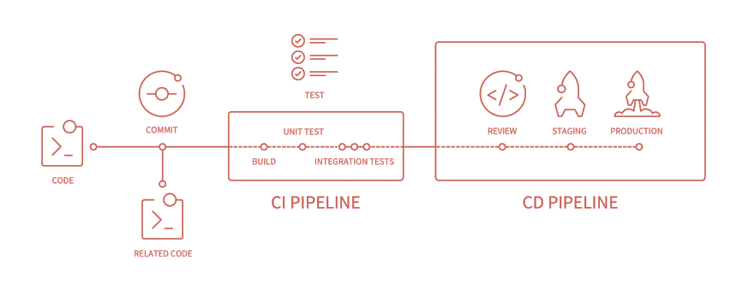
LAr Online Software CI/CD pipeline
Fatih Bellachia

Slide 17
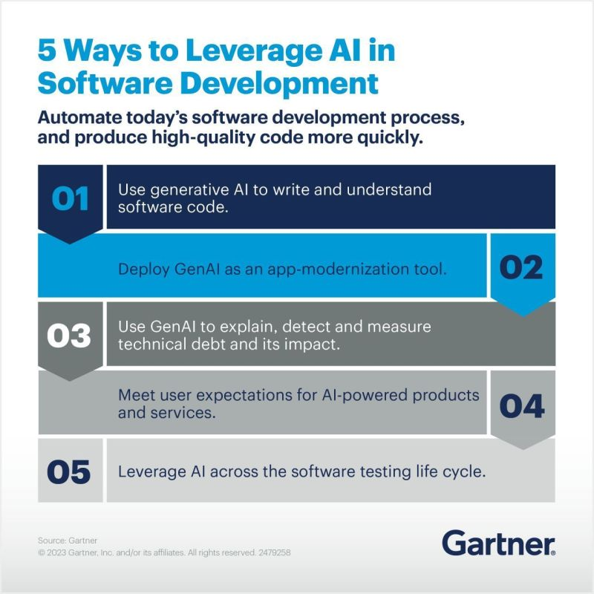
Generative AI
Fatih Bellachia

Slide 18
Meta Build System
Fatih Bellachia

Slide 19
CMake
Directory layout of LAr CMake managment files
<…>/LargOnline/mgmt/lar-cmake
cmake
LArConfig.cmake
LAr Configuration files
LArCommonConfig.cmake
*.in
Template files
modules
LAr*.cmake
Module files
scripts
share
*.*
Scripts and helpers
bin
lar_setup.sh
Bootstrap script
Fatih Bellachia

Slide 20
CMake
Functions and Macros
LAr Online | TDAQ
lar_add_jar(…) | tdaq_add_jar(…)
lar_generate_dal(…) | tdaq_generate_dal(…)
lar_generate_isinfo(…) | tdaq_generate_isiinfo(…)
lar_project(…) | tdaq_project(…)
lar_show_info(…) | tdaq_show_info(…)
lar_add_executable(NO_RPATH …) | tdaq_add_executable(…)
lar_add_library(NO_RPATH …) | tdaq_add_library(…)
lar_package(NO_SOURCES …) | tdaq_package(…)
lar_add_update_database(…)
lar_export_jars(…)
lar_generate_database_file(…)
lar_set_database_jar_info(…)
lar_set_env(…)
lar_set_path(…)
lar_set_variable(…)
lar_show_properties(…)
lar_show_target_properties(…)
Fatih Bellachia

Slide 21
CMake
<…>/workarea
CMakeLists.txt
Top-level (project) configuration file
x86_64-el9-gcc13-dbg
x86_64-el9-gcc13-opt
Super build areas (cache only)
packageA
<vxrypz|x.y.z>
CMakeLists.txt
packageA configuration file
src
packageA
x86_64-el9-gcc13-dbg
Out-of-source build directories
x86_64-el9-gcc13-opt
packages.txt
List of used packages
packageB
bin
lib
CMakeLists.txt
packageB configuration file
src
packageB
Contains current version
VERSION
x86_64-el9-gcc13-dbg
Out-of-source build directories
x86_64-el9-gcc13-opt
Fatih Bellachia

