Slide 1


Investigating
Self-Interacting
Dark Matter using Physicalised
Machine Learning
Bayesian Deep Learning for Cosmology & Time Domain Astrophysics
22/5/2025
Making machine learning trustworthy with interpretable outputs
Ethan Tregidga, David Harvey, Luca Biggio, Felix Vecchi

Slide 2

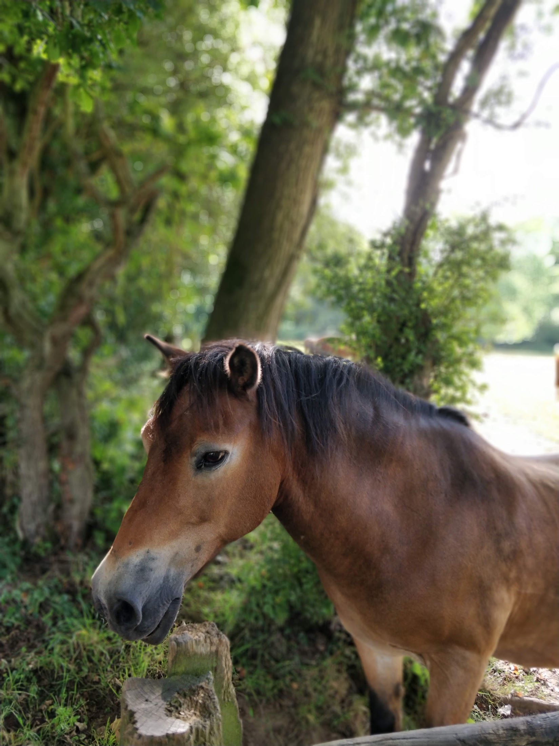
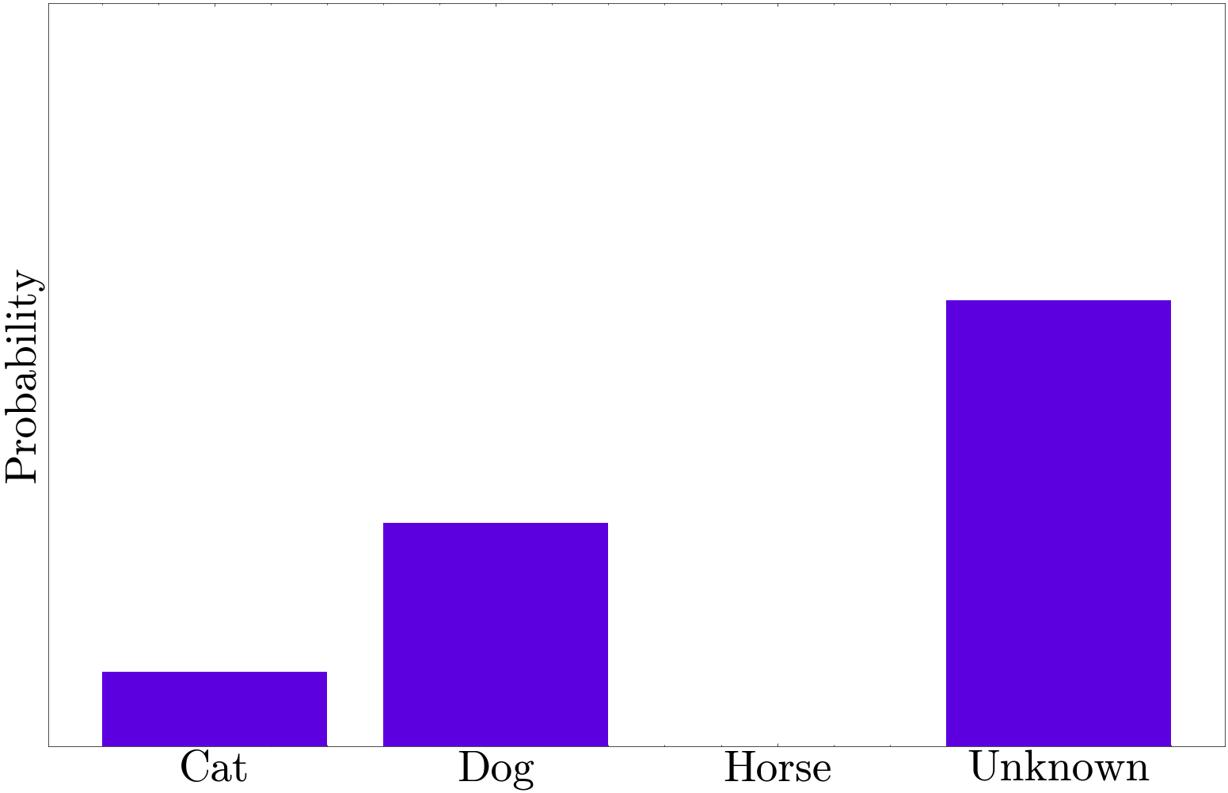
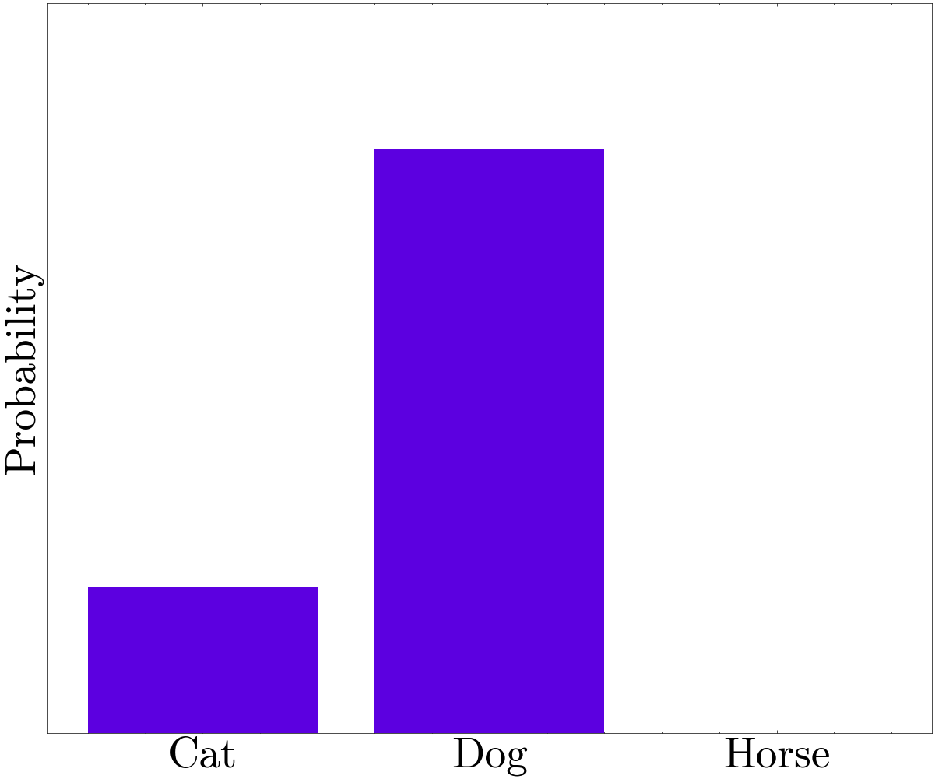
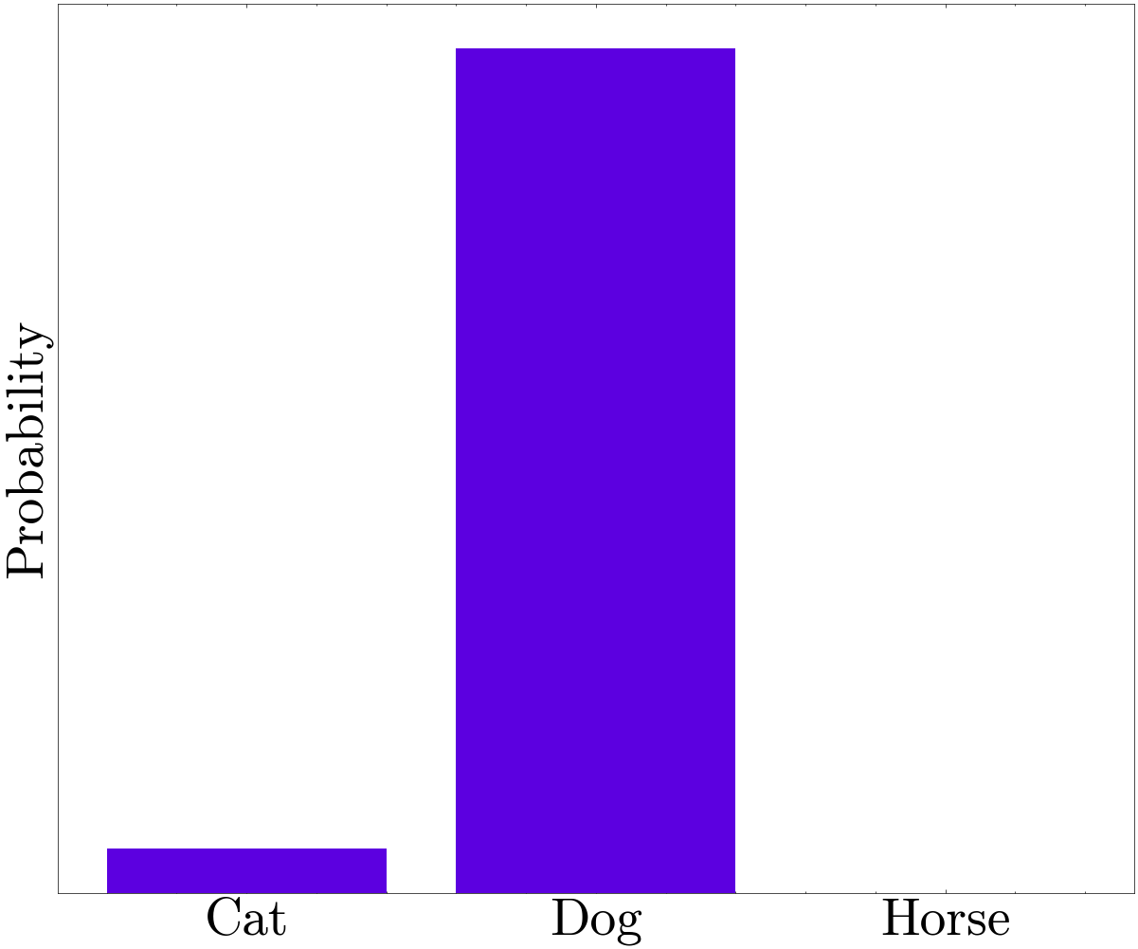
Confidently Wrong
I Don’t Know
Classifier

Slide 3
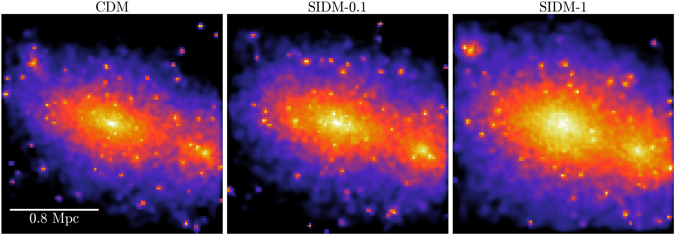
Affect of Self-Interacting Dark Matter

Slide 4

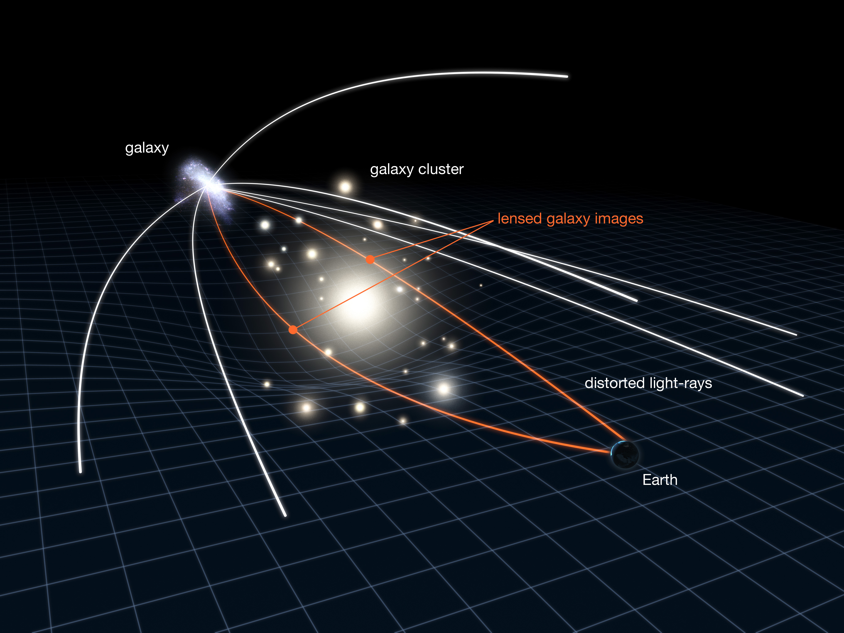
Galaxy Clusters Probe Dark Matter
NASA, ESA & L. Calçada

Slide 5
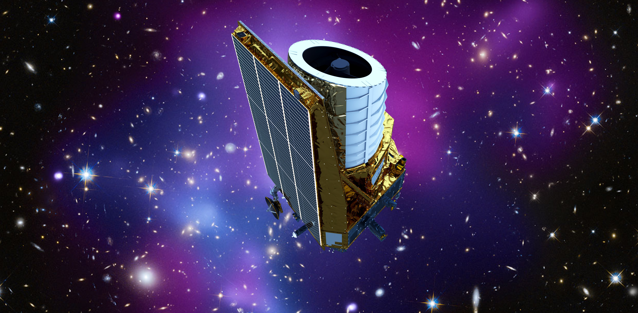
Era of Big Data
Keith Cooper, space.com

Slide 6
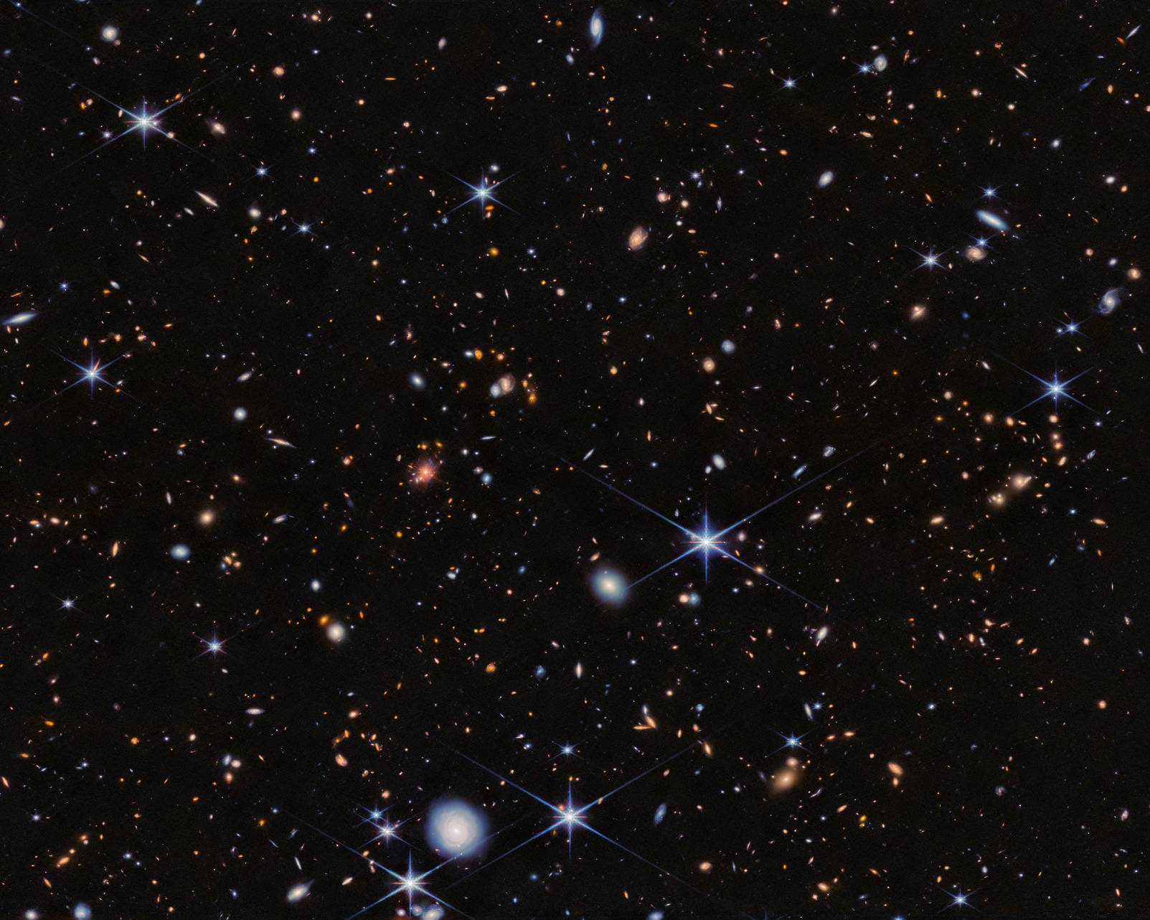
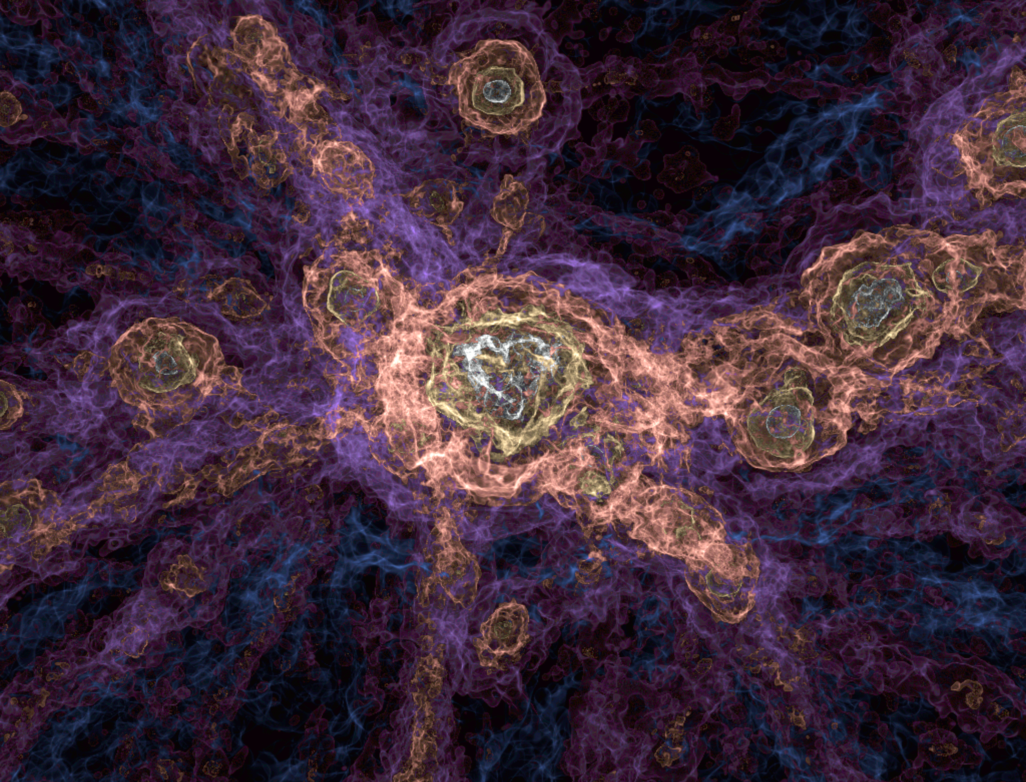
Limitations of Cosmology
ESA/Webb, NASA & CSA, H. Dannerbauer
The FLAMINGO project

Slide 7
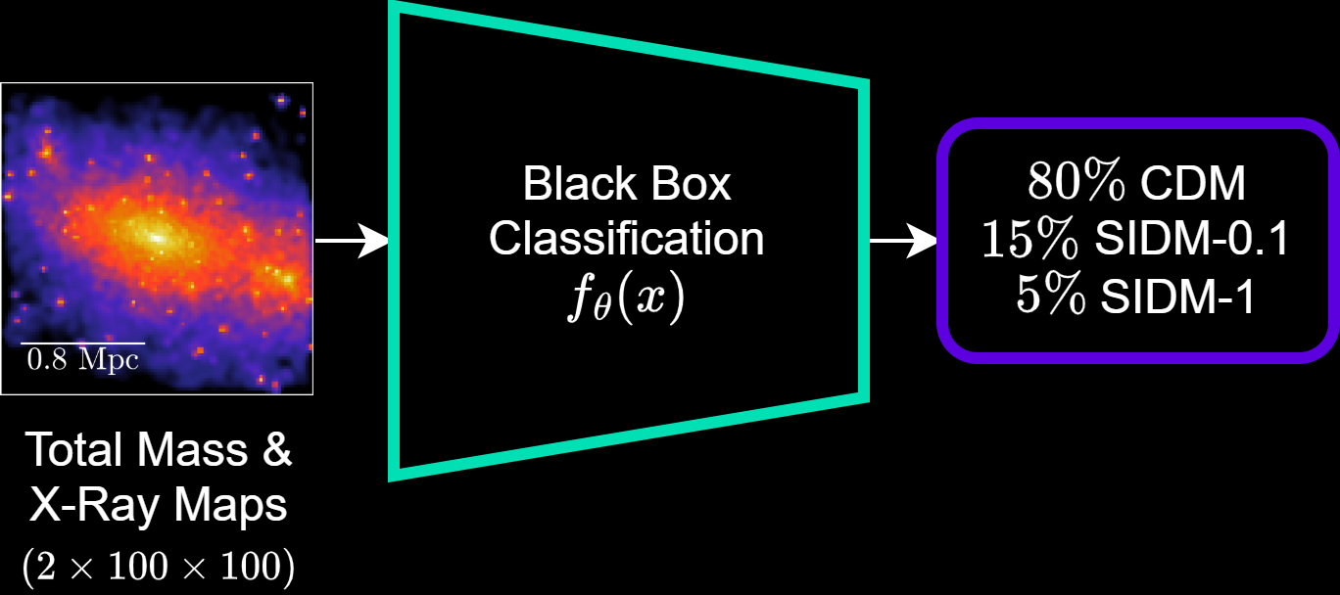
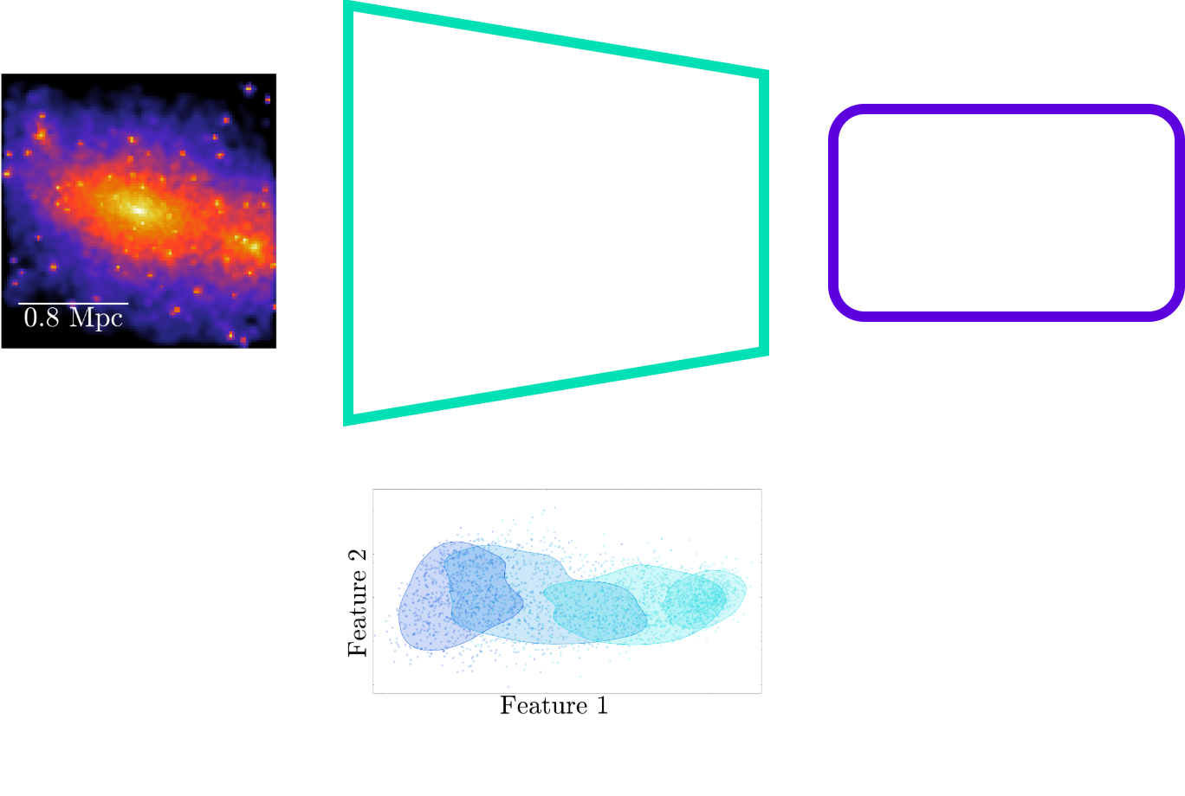
Creating an Interpretable Latent Space

Slide 8
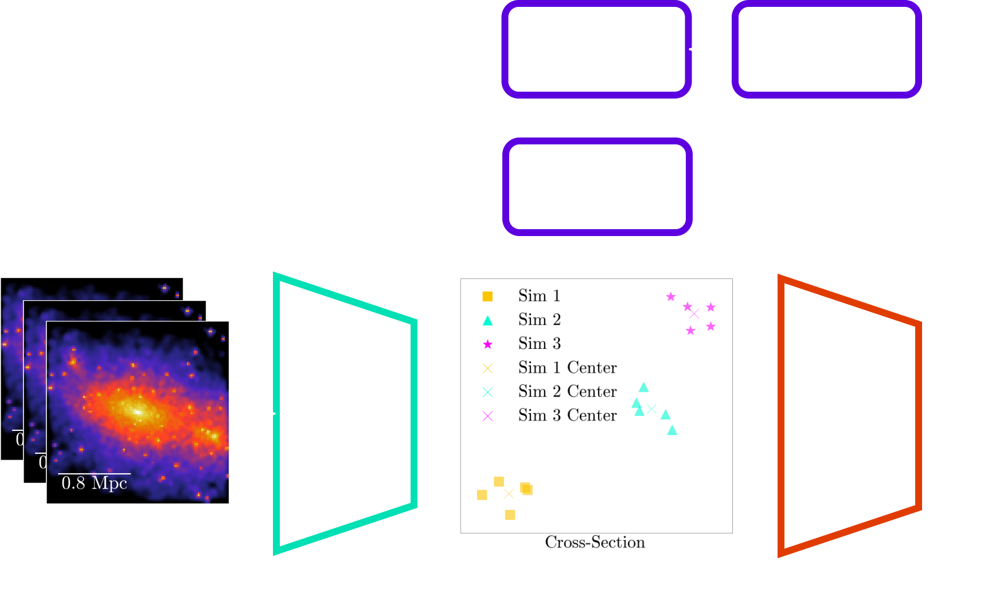

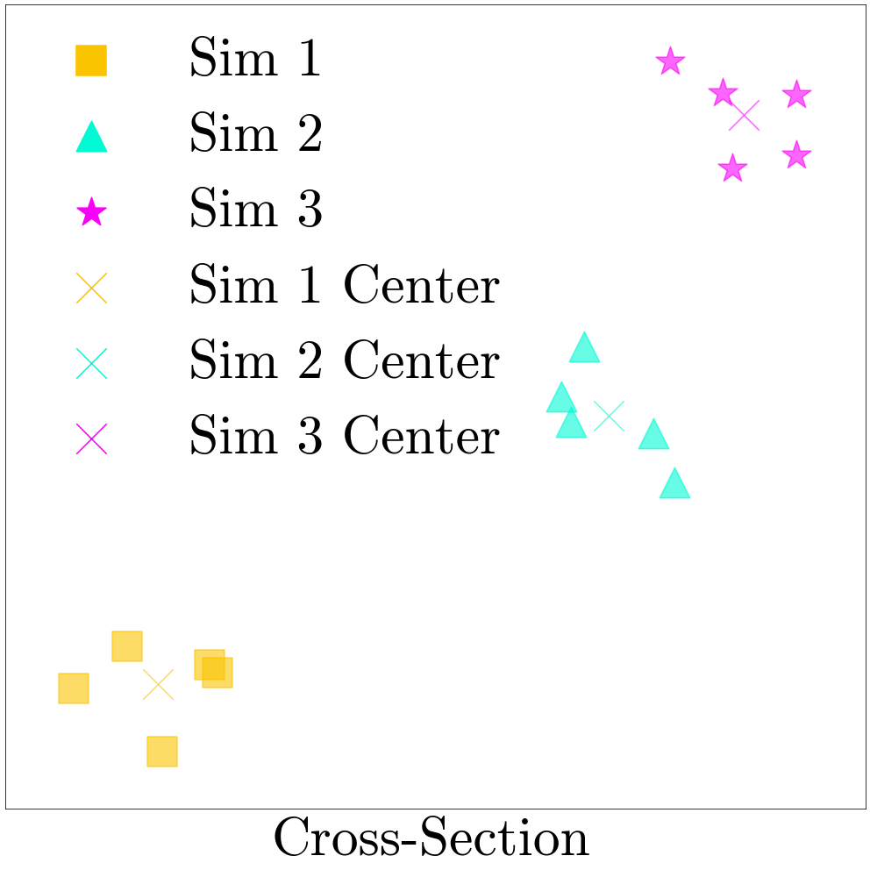
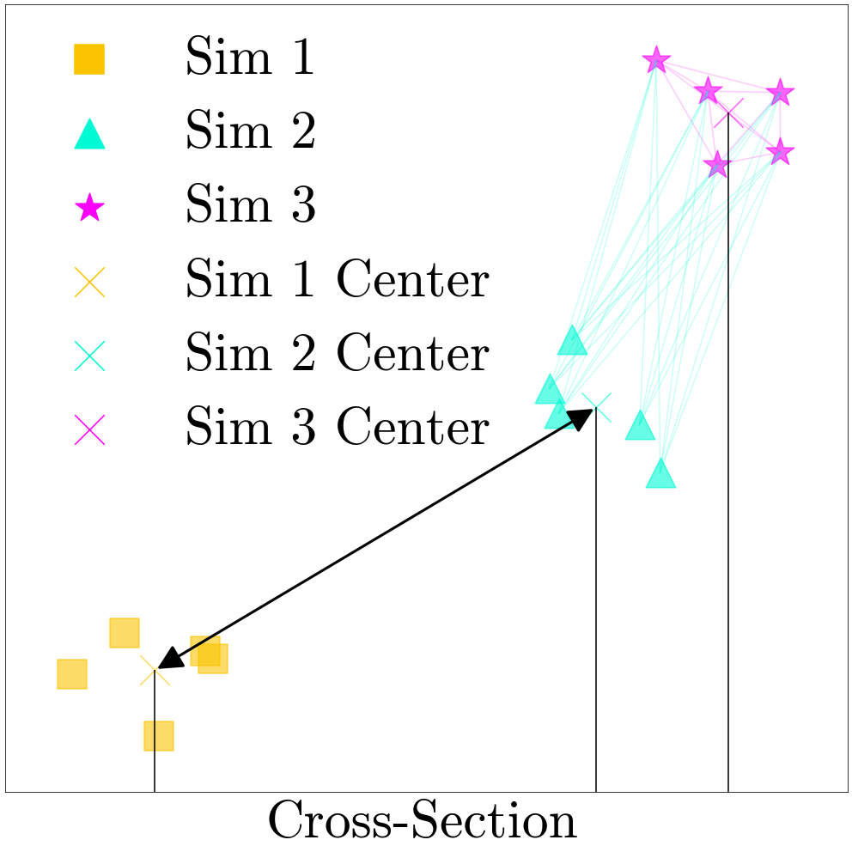
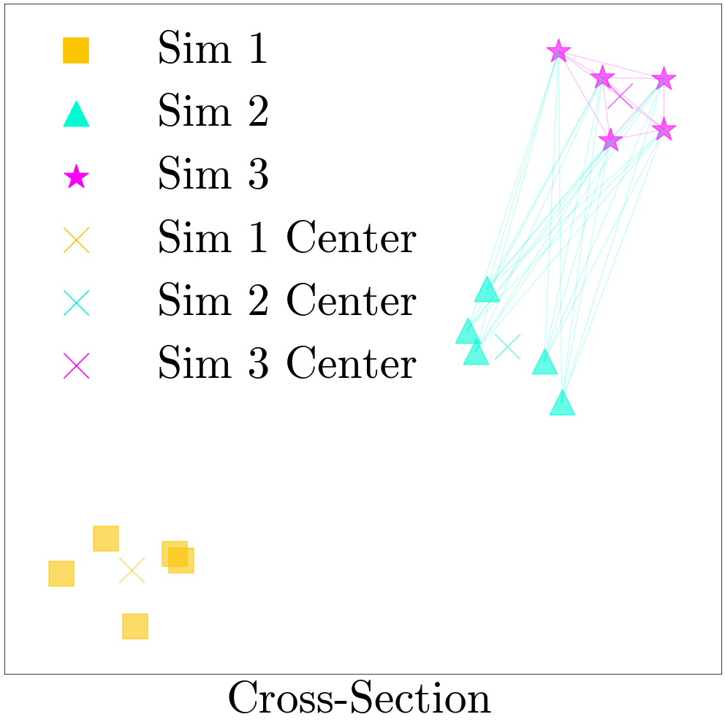
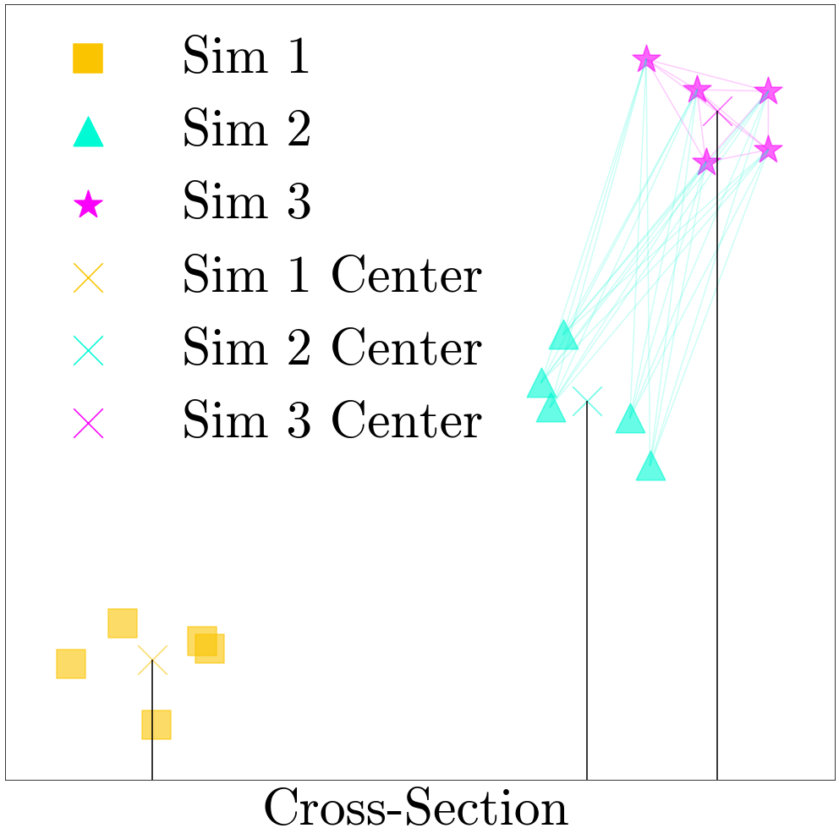
Enforcing Latent Structure

Slide 9
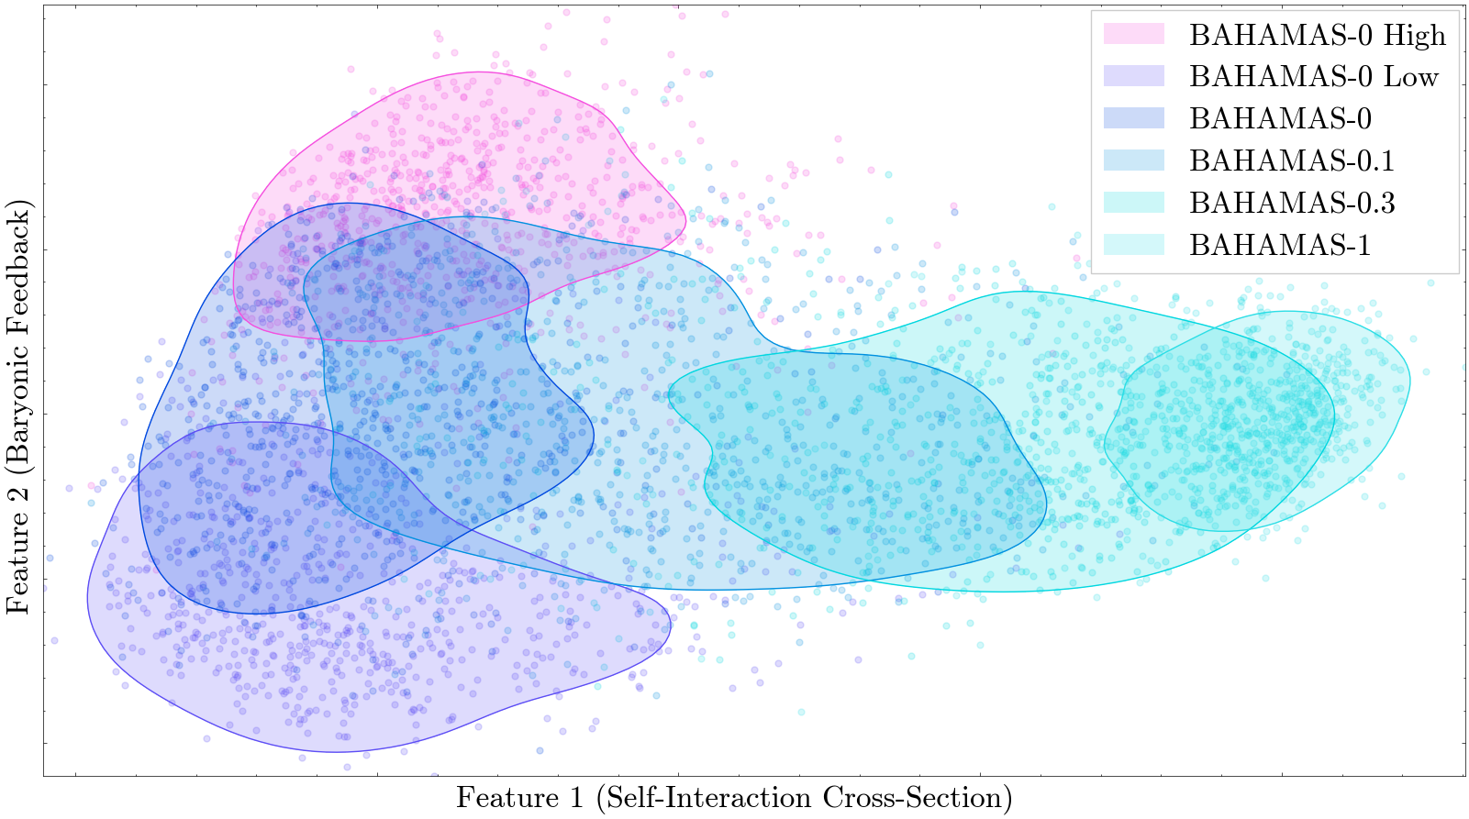
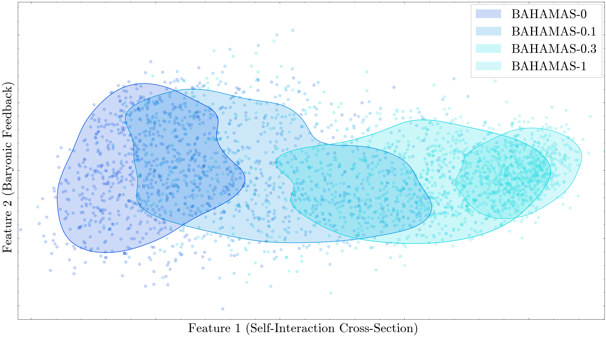
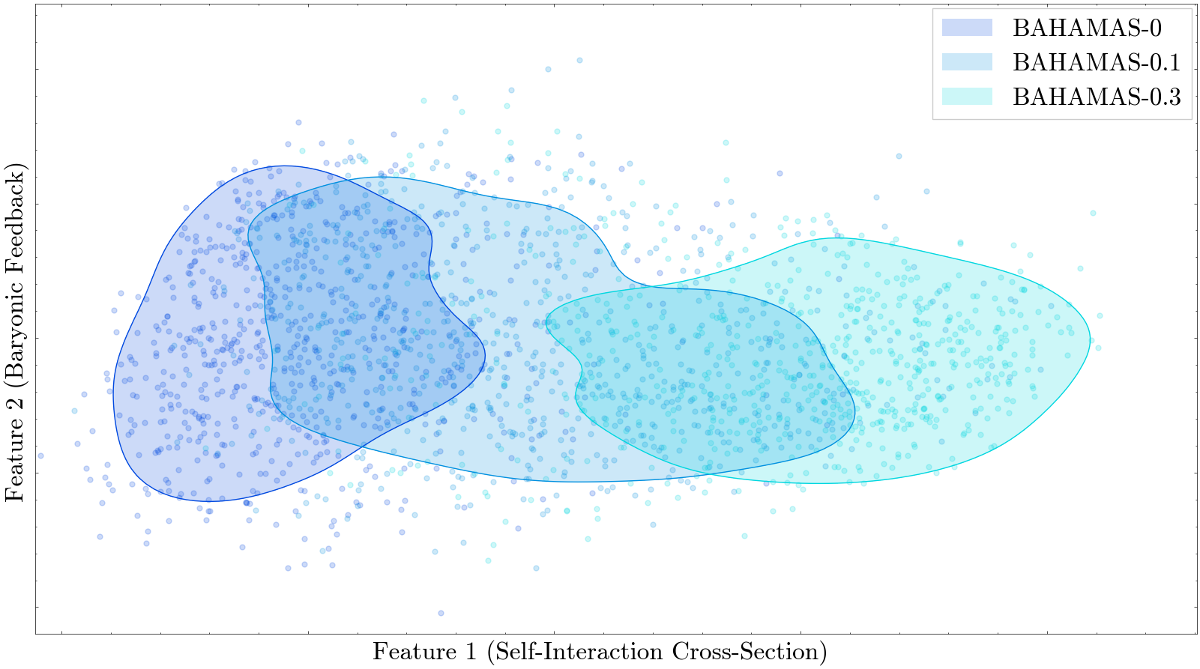
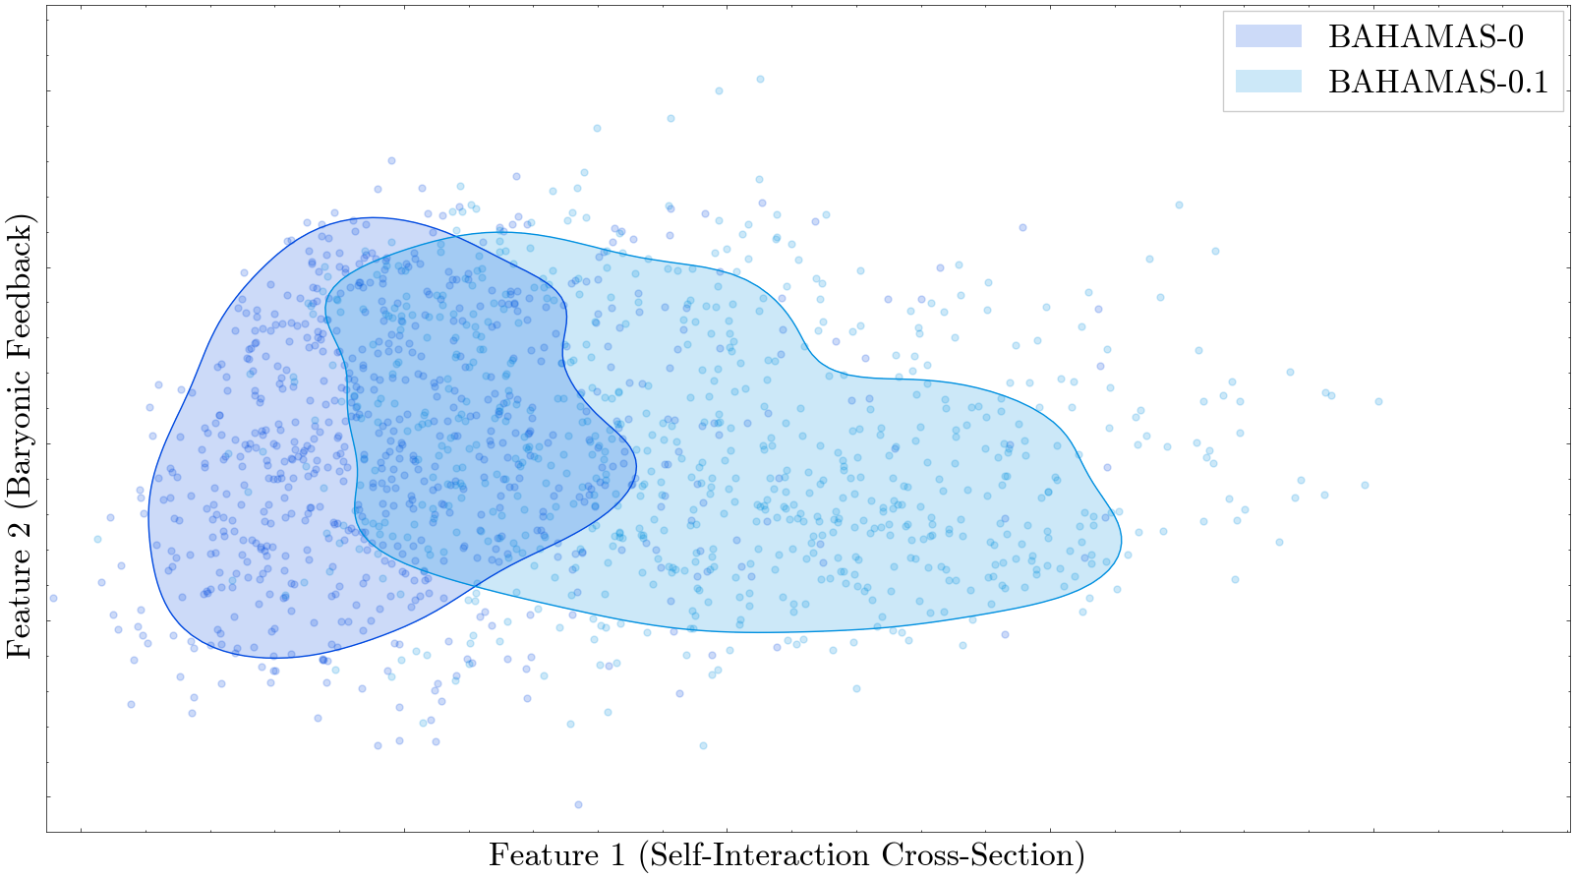
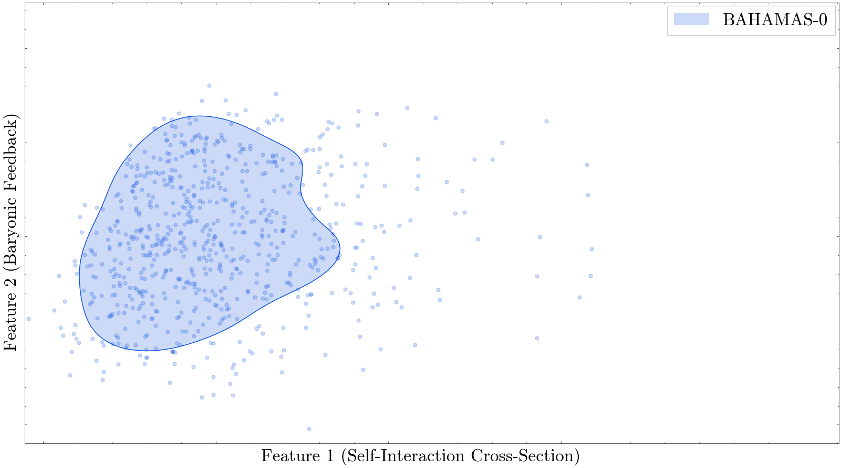
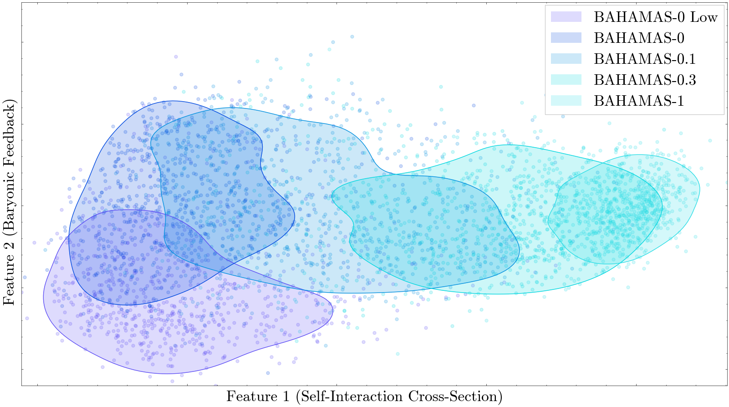
Identification of Unknown Physical Properties

Slide 10
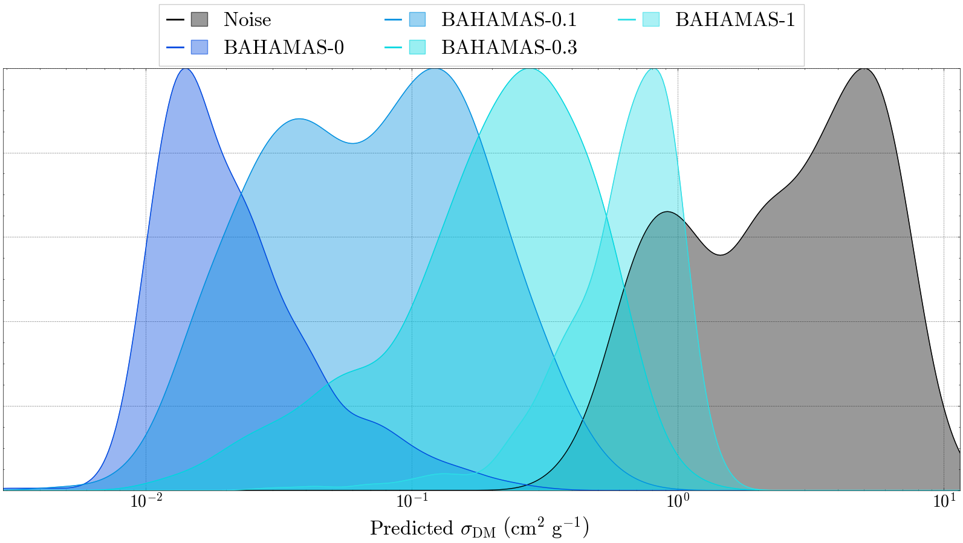
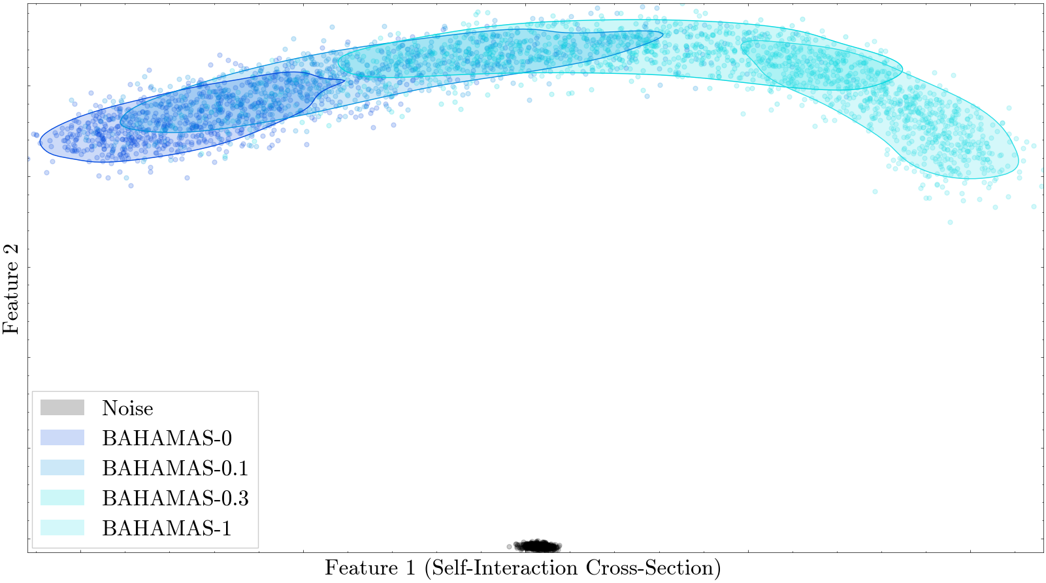
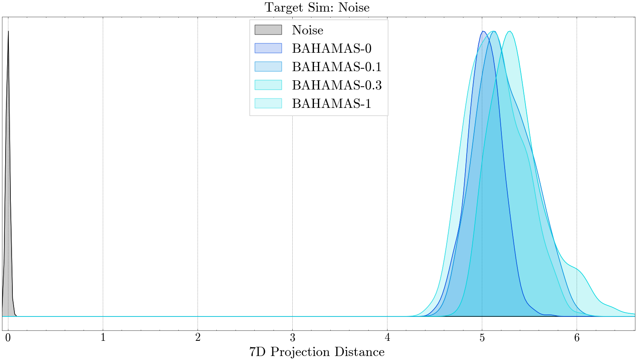
Identifying Unknowns

Slide 11
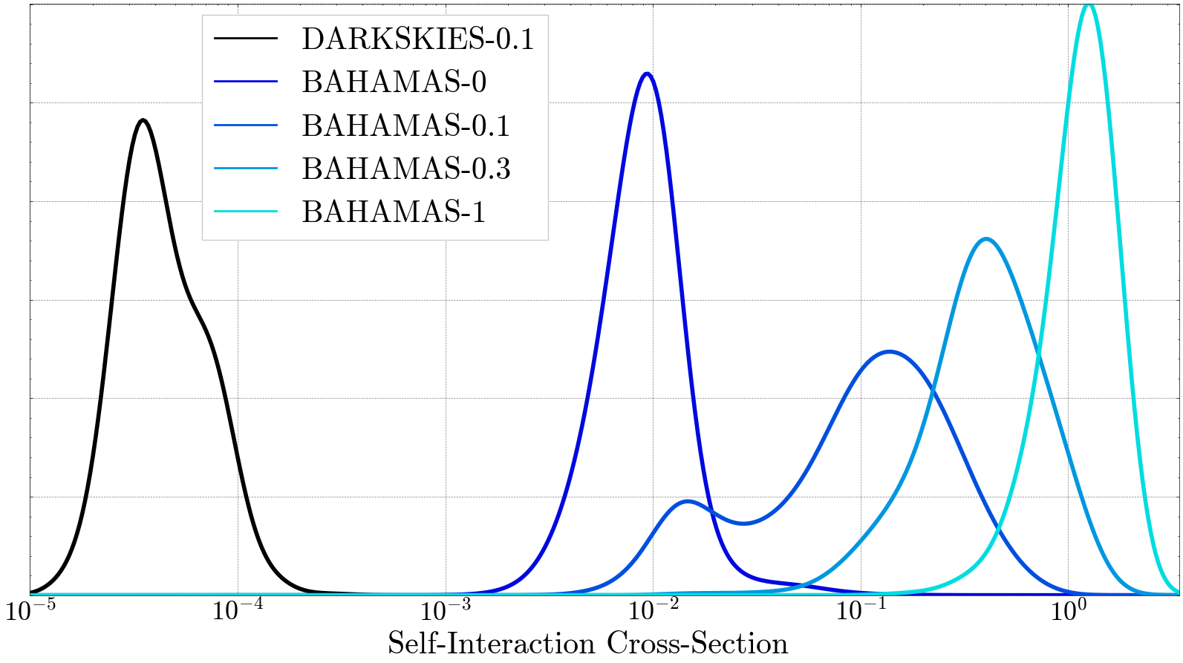
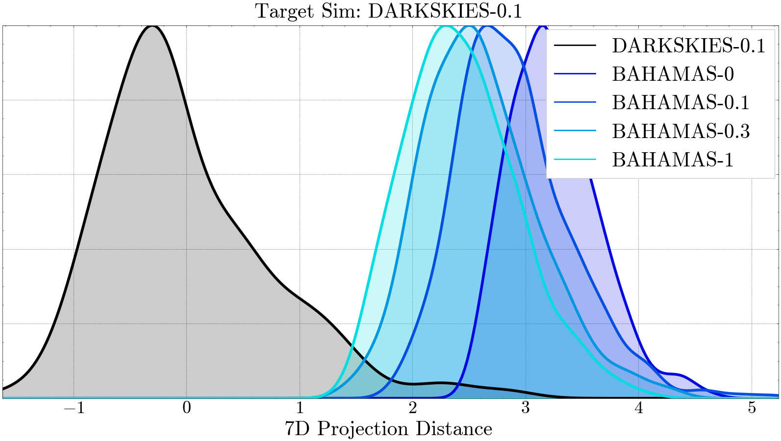
Improving Accuracy with Additional Data

Slide 12
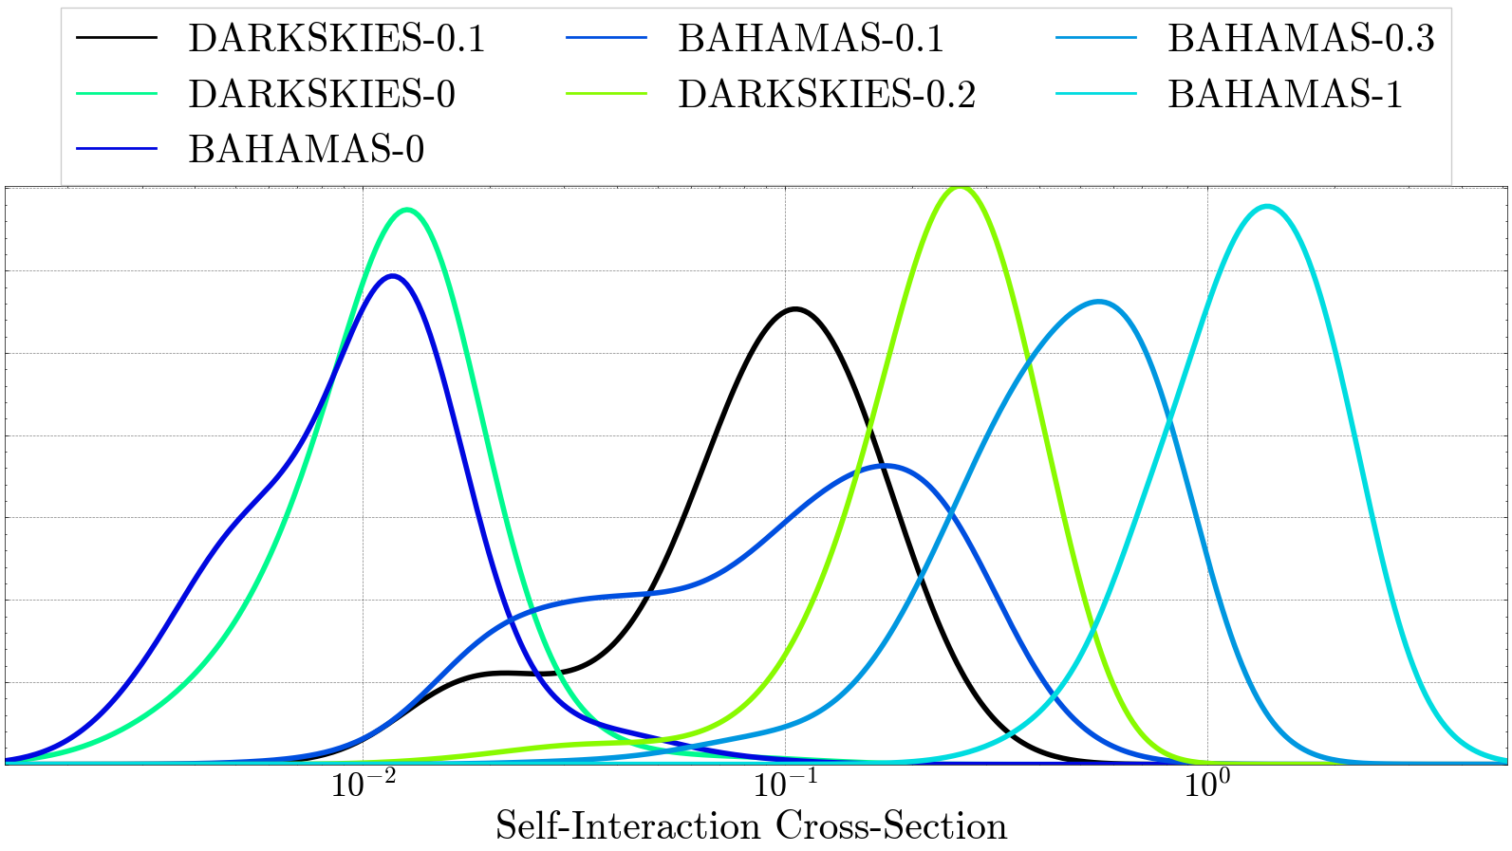
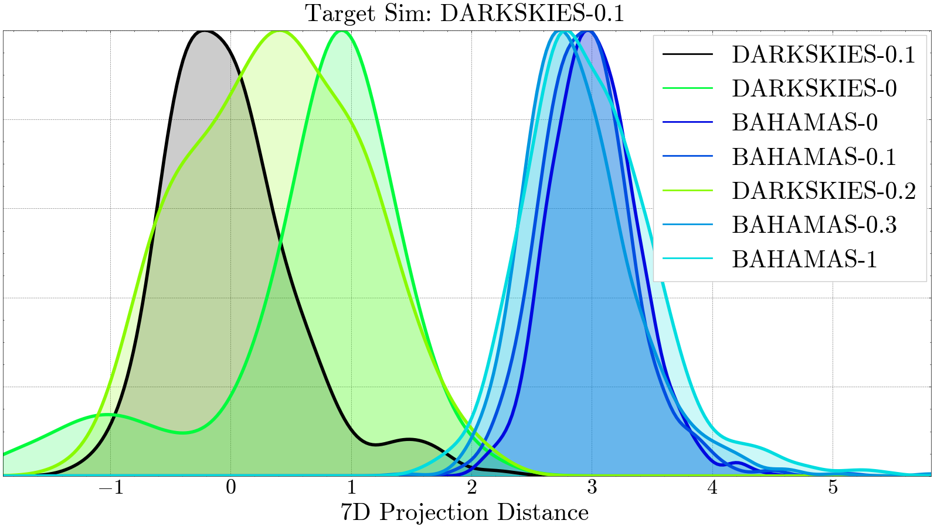
Improving Accuracy with Additional Data

Slide 13
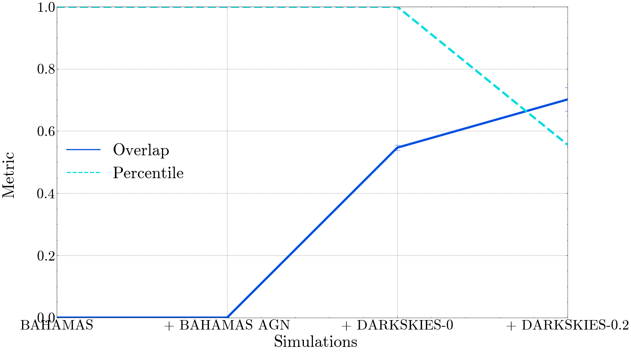
Quantifying When the Unknown Becomes Known

Slide 14
Conclusions
Feature similarity enables machine learning to say “I don’t know”
Exploring the feature space can help quantify the prediction confidence of observations

Slide 15
Conclusions
Galaxy cluster weak lensing probes dark matter
Machine learning is model agnostic, capable of learning new techniques
Machine learning is an unknown black box
Similarity clustering provides a measure of confidence and interpretability

Slide 16
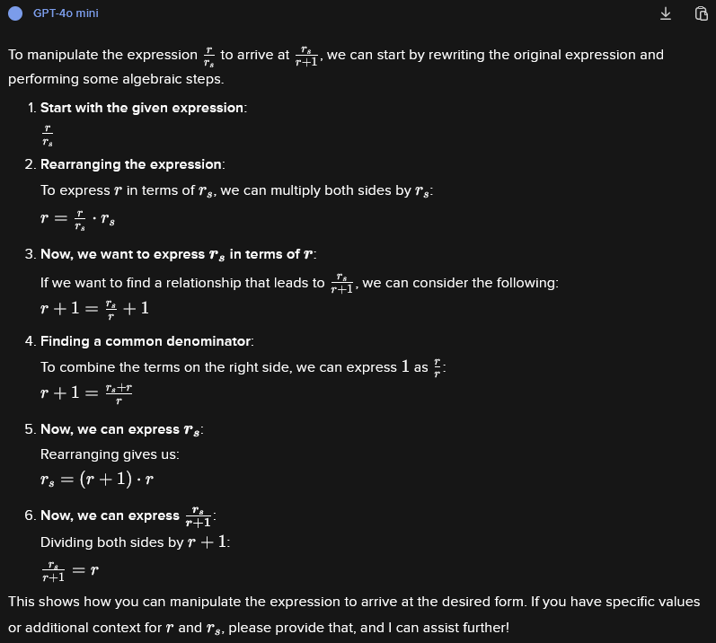
Confidently Wrong

Slide 17
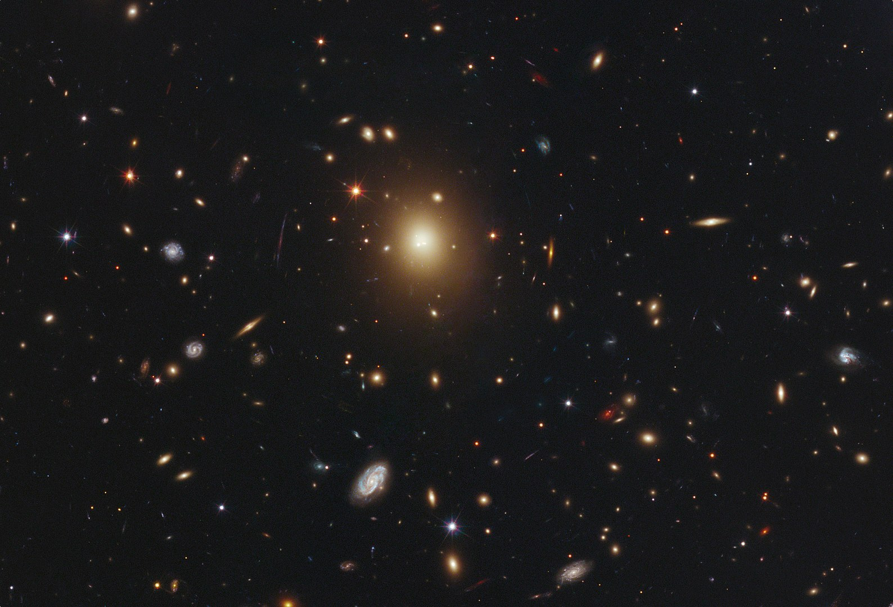
Galaxy Clusters Probe Dark Matter
Brightest Cluster Galaxy (BCG)

Slide 18

Affect of Self-Interacting Dark Matter

Slide 19
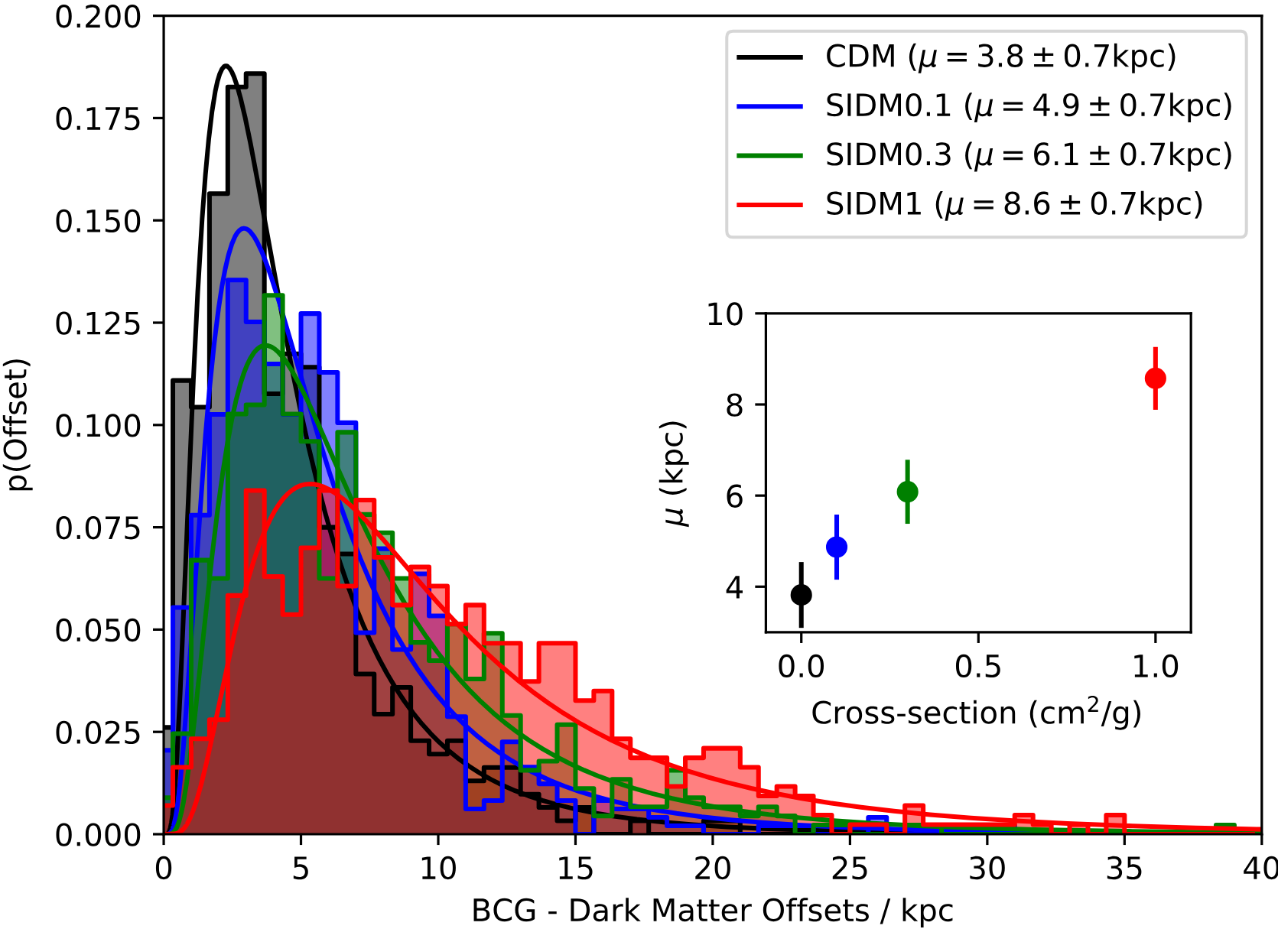
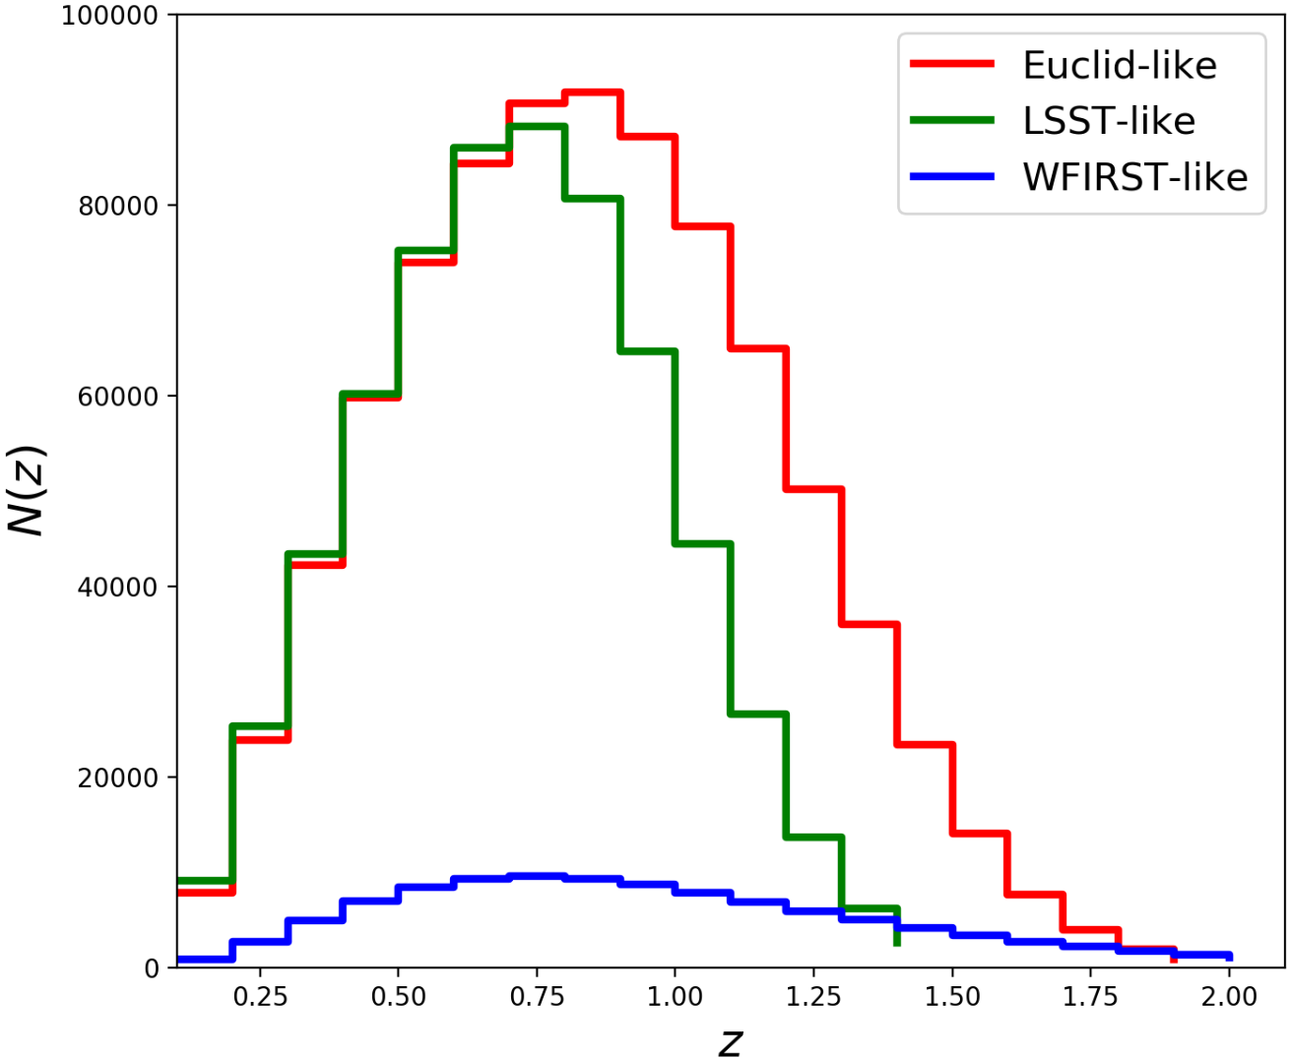
D. Harvey et al. 2019
L. Salvati, M. Douspis, N. Aghanim 2020
Current Methods are Slow

Slide 20
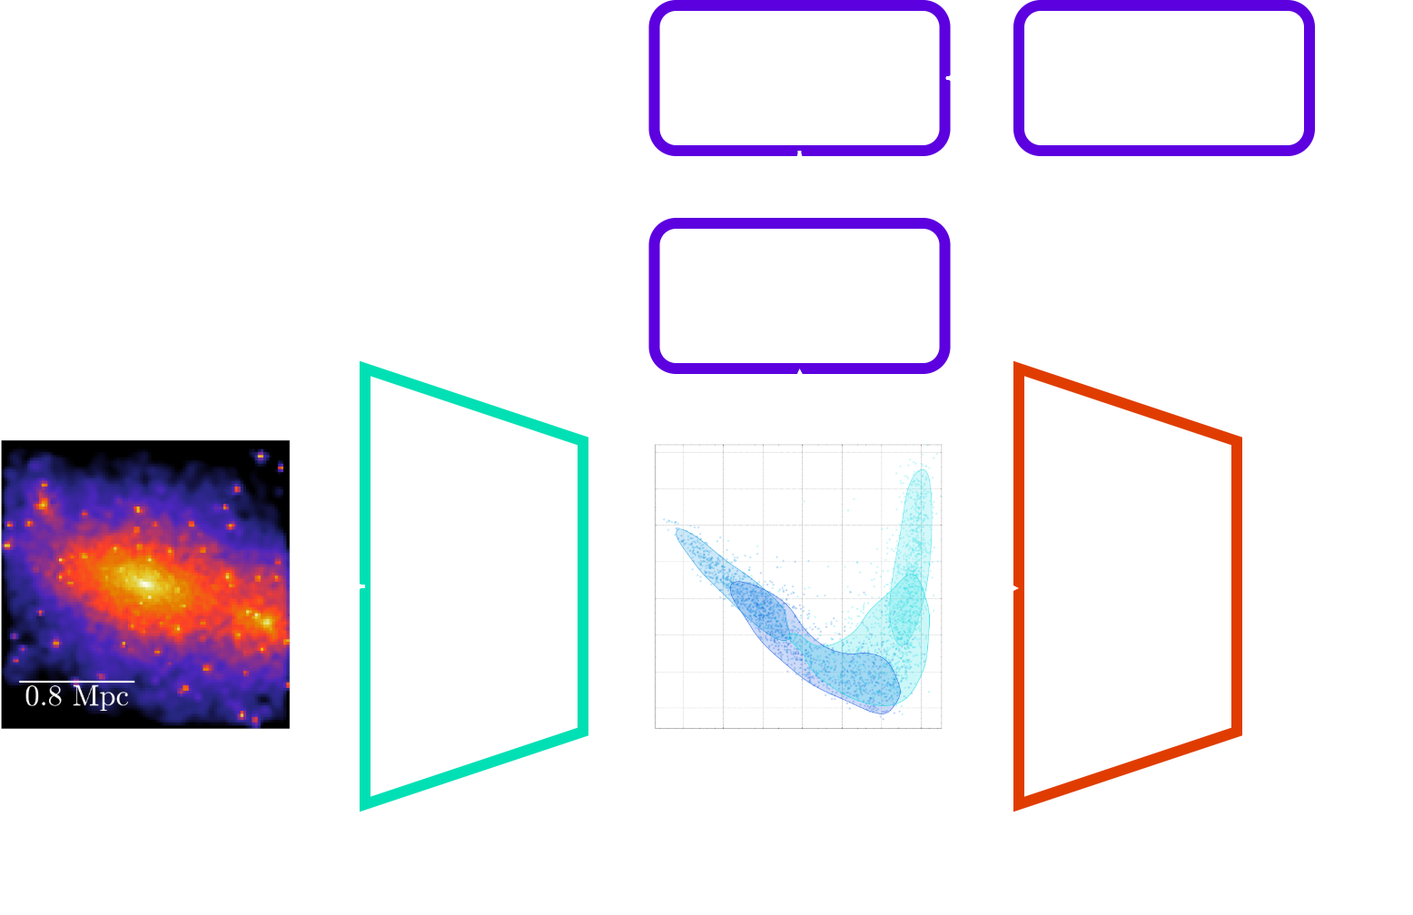
Creating an Interpretable Latent Space

Slide 21
Future Plans
Test TNG-Cluster for a different simulation base
X-ray super-resolution summer collaboration with the Center for Astrophysics | Harvard & Smithsonian
Adapt X-ray super-resolution to “paint” baryons onto large scale DM only simulations
Combine our algorithm and super-resolution to predict a cross-section for the universe using observations from Euclid

Slide 22
Investigating
Dark Matter
Self-Interaction using Physicalised
Machine Learning
PhD Day
7/3/2025
Galaxy cluster weak lensing probes dark matter
Machine learning is fast & model agnostic, but a black box
Similarity clustering makes machine learning interpretable
Ethan Tregidga, David Harvey, Luca Biggio

