Slide 1
Non-Parametric Normalizing Flow Modeling of Binary Black Hole Populations for Unbiased Dark Siren Cosmology
Leonardo Iampieri, Simone Mastrogiovanni
Paris Workshop - 21/05/2025

Slide 2
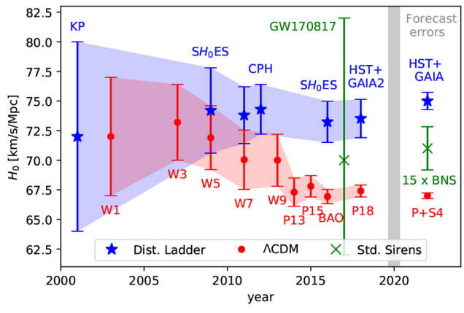
Hubble tension
Discrepancy in the measured values of the Hubble Constant (H0):
Cosmic Microwave Background (early universe) - Planck experiment.
Standard candles (late universe) - SH0ES experiment.
Discrepancy: ~5σ → suggests new physics or unrecognized systematics
Independent probe needed: Gravitational Waves (GWs) offer a ladder-free distance measure.
CMB
[J. Ezquiaga+ Front. Astron. Space Sci., 21 December 2018]
L. Iampieri Paris Workshop - 21/05/2025

Slide 3
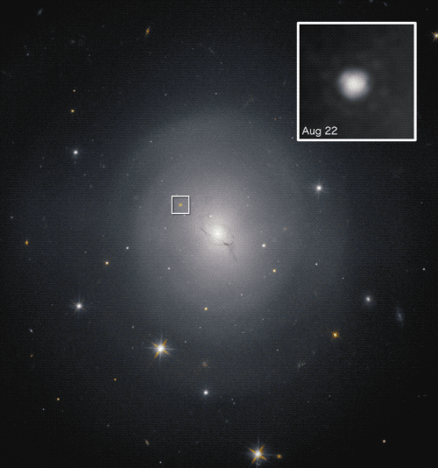
Gravitational Wave Cosmology
GW sources are standard sirens: we can derive the luminosity distance directly from the GW signal.
The luminosity distance is given by:
By identifying the host galaxy, we recover spectroscopic measurement of redshift (example case: GW170817).
In absence of Electromagnetic counterpart, we can infer z statistically from the Binary Black Holes (BBH) population.
NGC4993
Luminosity distance
Hubble constant
[B. P. Abbott et al Nature volume 551 (2017)]
L. Iampieri Paris Workshop - 21/05/2025

Slide 4
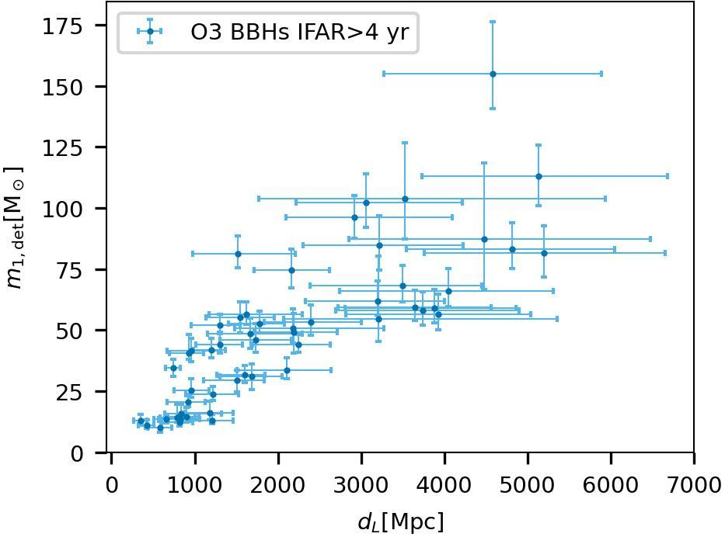
Dark Sirens - Mass Method
Core idea: Infer source redshift z by comparing observed detector-frame BBH masses to the source-frame mass distribution [Mastrogiovanni+, PRD 104 (2021)]
Inference on z, and therefore H₀, is highly sensitive to the choice of source–mass model
Mass-redshift correlation: The source mass distribution may evolve with redshift
Parametric Mass-redshift distributions
can biases H0 inferences when the
assumed functional forms are incorrect [Pierra+, PRD 109 (2024)]
NGC993
[LVK+ 2021 ApJL 913 L7]
L. Iampieri Paris Workshop - 21/05/2025

Slide 5
Normalizing Flow
Objective: represent the mass-redshift distribution with a flexible model: a normalizing flow.
Normalizing Flows (NFs) transform a density using a chain of smooth, invertible mappings such that, .
the parameters represent the source masses and redshift.
We parametrize the chain using a set of weights w. Exploiting invertibility, we can construct the log-likelihood
We optimize the log-likelihood for w using stochastic gradient descent by maximizing the posterior distribution on w.
L. Iampieri Paris Workshop - 21/05/2025

Slide 6
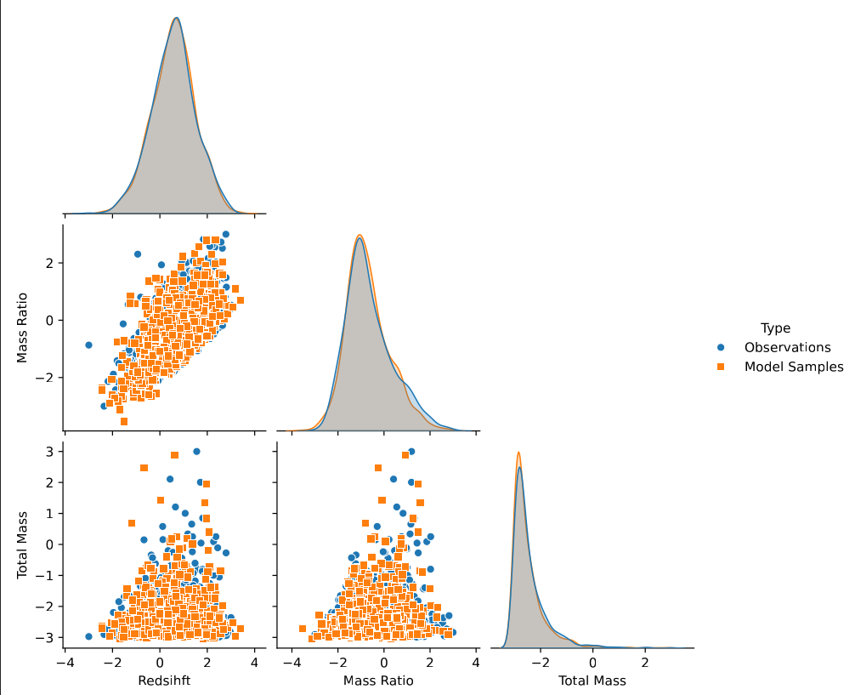
Example Scenario
We generated catalog of 10^3 observations with:
m1 and m2 drawn from a Powerlaw+Peak model
z drawn from a Madau distribution
no measurement uncertainty and selection effects.
Loss function:
NF Architecture: Affine Neural Spline Flow implemented in pytorch [Zuko package]
L. Iampieri Paris Workshop - 21/05/2025

Slide 7
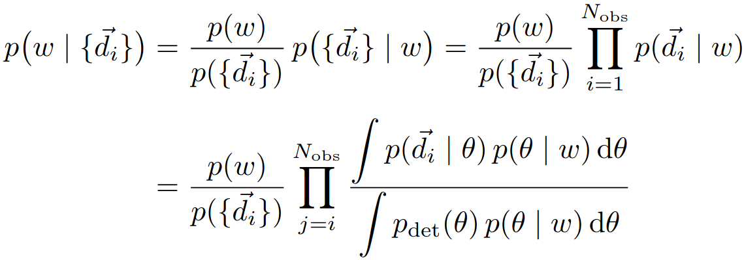
Hierarchical Bayesian Analysis (HBA)
HBA scheme: the posterior on the weights w informed from a catalog of Gravitational Wave (GW) Observations is given by
Number of observed GW events
GW Likelihood
Population Model
Detection Probability
L. Iampieri Paris Workshop - 21/05/2025

Slide 8
Hierarchical Likelihood Evaluation - 1
To evaluate the numerator in the Hierarchical Likelihood (HL) we generate a set of posterior samples
The integral at the numerator is computed through a Monte Carlo integration over the posterior samples
Number of samples
Prior used for Posterior samples
L. Iampieri Paris Workshop - 21/05/2025

Slide 9
Hierarchical Likelihood Evaluation -2
The integral at the denominator of the HL Expression corrects for selection biases.
To compute this integral we use “injections”, i.e. Monte Carlo simulations of injected and detected events.
We computed the integral through Monte Carlo integration over detected injections:
Number of detected events
Number of injections generated (even not detected)
Prior used for injections
L. Iampieri Paris Workshop - 21/05/2025

Slide 10
Loss Function
In the presence of noise uncertainty and selection biases, the loss to minimize becomes
Number of observations
Number of detected injections
Number of PE samples
Prior used for Posterior samples
Number of total injections
Prior used for injections
L. Iampieri Paris Workshop - 21/05/2025

Slide 11
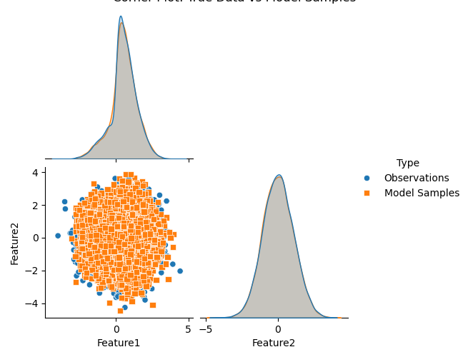
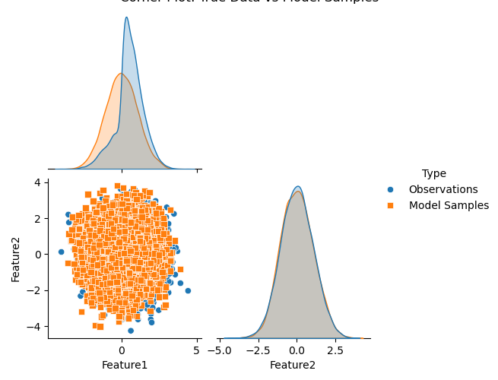
Example: Selection Bias
Correcting for selection biases is necessary for the NF to recover the true distribution.
Example: we generate 10^4 observation from a 2D Gaussian distribution with detection probability
Training cases:
Fig. 1 - Uncorrected Loss
Fig. 2 - Full Loss
Fig. 1
Fig. 2
L. Iampieri Paris Workshop - 21/05/2025

Slide 12
Next Steps & Conclusions
Normalizing Flow flexibly capture complex, multimodal distributions without need to set a fixed functional form
We can define a single hierarchical loss to account for noisy uncertainty and selection biases.
Next steps will involve:
Realistic Simulations:
Incorporate GW posterior samples and detector biases
Valide NF recovery in such scenarios
Real Data Application
Train on O3/O4 BBH Catalogs
Compare resulting distribution with current parametric fits
L. Iampieri Paris Workshop - 21/05/2025

