Slide 1
VIP2B (Sub-reticule I)
Grzegorz Deptuch, Jim Hoff, Alpana Shenai, Tom Zimmerman and Ray Yarema
  A description of the VIP2B (Sub-reticule I)
      Place it in Historical Context
      New Architecture (3 Tiers down to 2)
VIP=Vertically Integrated Pixel

Slide 2
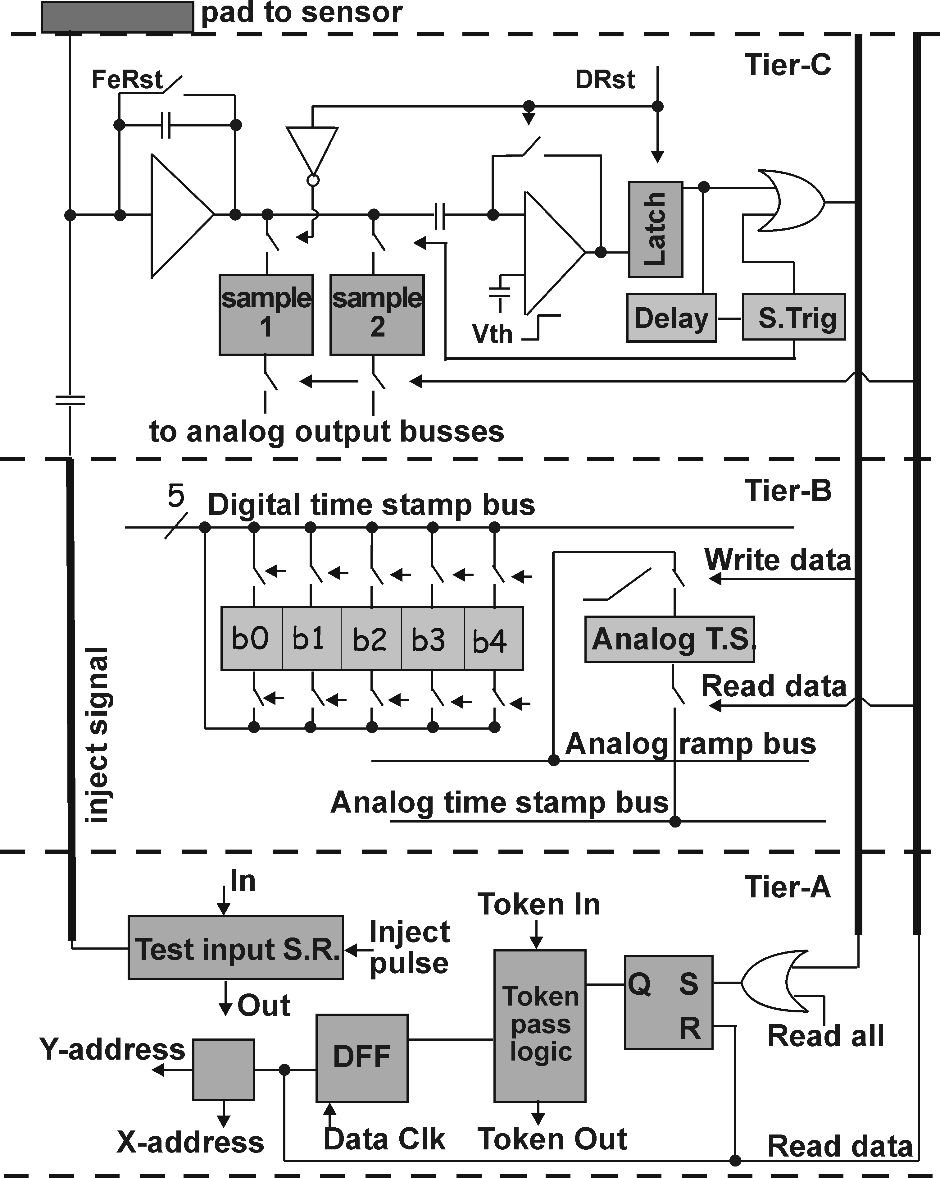
VIP1 (2006): MIT-LL 0.18u SOI process – 3 tiers
(64 X 64 array of 20um square pixels) – vertex detector at the ILC
2 modes of operation: Acquire (accept input signals)
and Readout (read out hit pixel addresses and data serially, and analog samples)
Backside
3D
Analog circuits: integrator, DCS, discriminator. The discriminator firing takes the second sample and forms a hit signal, notifying the digital tier. Analog samples are held until a readout and reset is performed.
Analog tier is on “top” for proximity to detector, and farthest away from digital tier.
Shielded from lower tiers with routing metals.
Positive
input charge
only
Vias
Tier C
analog
Routing Metals
Backside
Tier B
Time
Time-stamping tier, 2 different methods:
Analog time stamp: sampled analog ramp
Digital time stamp: 5-bit counter
Stamp
Tier A
Data
Routing Metals
Routing Metals
sparsification
Digital circuits: record all hit pixels during Acquire mode, then force a readout of all digital and analog data in Readout mode (hit pixels only)
Backside

Slide 3
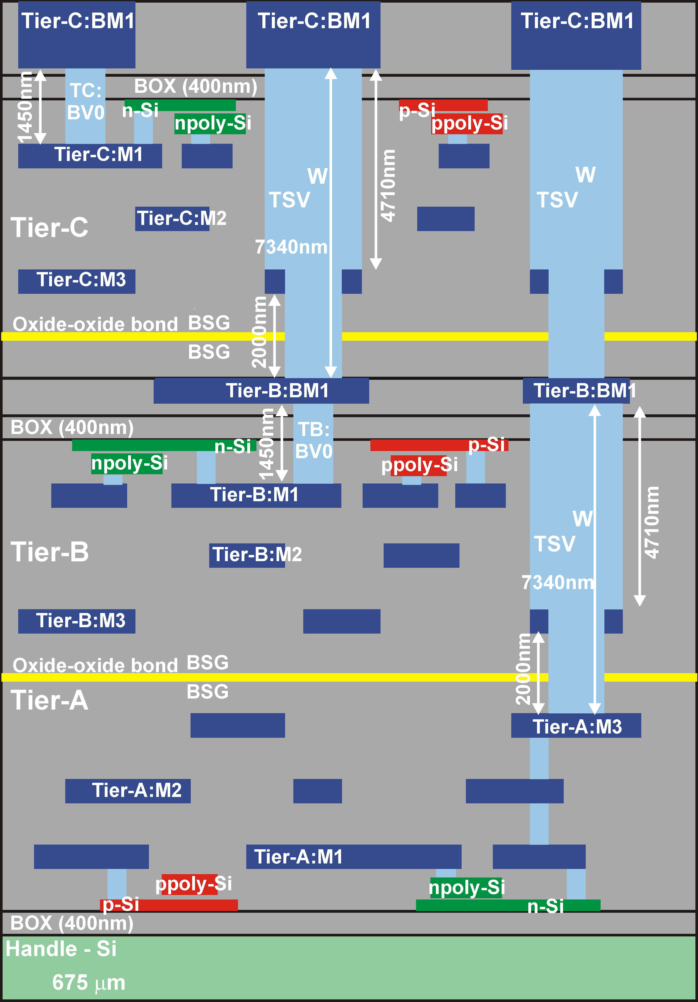
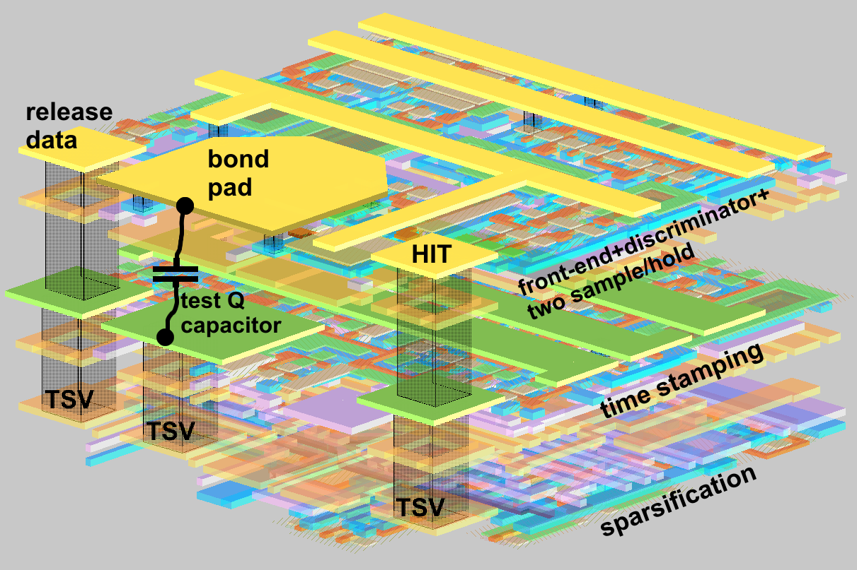
VIP1 (2006): MIT-LL 0.18u SOI process – 3 tiers
via last process (vias added to wafers after bonding and thinning) – excludes large area for local interconnect in TSV location
8.4μm
tier-C
tier-B
tier-A
8.0μm
6.2μm
VIP1 was submitted in 2006 (run 3DM2), VIP2 was submitted in 2008 (run 3DM3) – we are still waitng for delivery of chip to be able to test

Slide 4
VIP1 (2006): MIT-LL 0.18u SOI process – 3 tiers
Example:
VIP1 Test
Result
VIP1 found to be functional, architecture was proven, but:
Problems with VIP1:
Very low yield (many different kinds of problems on different chips)
Flakey performance – “working” chips can exhibit different strange behaviors (high leakage, etc.)
Poor analog matching (e.g., current mirrors) – FDSOI not well suited for precision analog
High leakage for minimum length transistors
Analog output buffers are just source followers – output voltage is influenced by current draw
If a non-hit pixel is mistakenly read out, the readout of the 2nd analog sample has indeterminate value, making it difficult to tell if this pixel was really hit or not
Conclusion: the MIT process is simply not like a good reliable commercial process!

Slide 5
VIP2 (2008): MIT-LL 0.18u SOI process – 3 tiers
Strategy for the 2nd (VIP2) MIT submission (2008):
Devise and use our own set of more conservative design rules (e.g., larger minimum transistor length and larger metal width and pitch) to increase yield (hopefully).
Larger 30u square pixel to accommodate changes – forces a 48 X48 array to keep same area as VIP1.
Pass digital power and ground from the digital tier to the other tiers through inter-tier vias in every pixel (instead of only at the periphery). Makes tighter loops, better referencing.
Use unity-gain buffers on the analog outputs instead of source followers so that output current does not affect output voltage
Modify analog pixel design so that if a non-hit pixel is read out, the 2nd analog sample reads 0V
Use all static logic in the digital tier – more immune to leakage currents
Increase number of bits in digital time stamp from 5 to 7.
Conclusion: The test set-up is ready. Fermilab is still waiting for the delivery of chips.

Slide 6
VIP2B: Submit a redesigned version of the MIT VIP2
to the Tezzaron/Chartered process (2009/10)
Advantages:
1) Chartered is a high-volume commercial process – better models, more predictable and reliable 2) Bulk CMOS process is better for analog
3) Tezzaron’s Through-Silicon-Via density is significantly higher than MIT’s
Major design revision required because:
1) Only 2 tiers available, not 3
2) totally different process – significantly different transistor parameters
3) desired to add a selectable inverting amp after the integrator to allow opposite polarity detectors
New 2-tier configuration: Analog top tier and Digital bottom tier
Eliminate the middle tier of the VIP2 (MIT) design by getting rid of the analog time stamp and incorporating the digital time stamp into the digital tier.

Slide 7
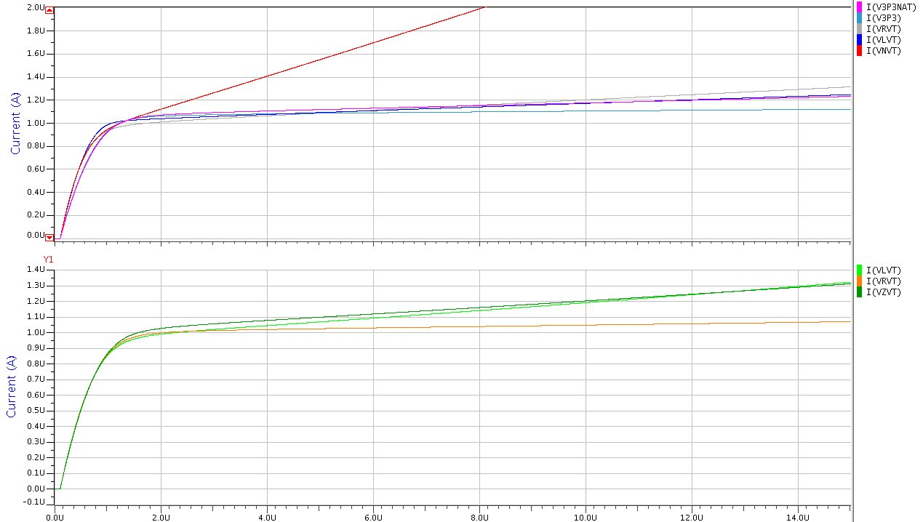
Example simulation of Chartered transistor characteristics
Long channel transistor: NMOS, W/L = 2/2, Id ~ 1uA
1.5V native Vt: Vgs=218mV, gds=1470n
1.5V reg. Vt: Vgs=430mV, gds=230n
3.3V native Vt: Vgs = -90mV, gds=115n
Chartered 0.13u process
(1.5V low power)
1.5V low Vt: Vgs=419mV, gds=158n
3.3V reg. Vt: Vgs=810mV, gds=40n
Ids vs. Vds
A “simple translation” of the analog circuits in the MIT VIP2 circuit to the Chartered process fails miserably, due to very different transistor parameters.
Start over and design the VIP2B analog circuits using the “full palate” of available Chartered transistors:
PMOS_1P5 (1.5V, regular Vt)
PMOS_1P5_LVT (1.5V, low threshold voltage)
PMOS_3P3 (3.3V)
NMOS_1P5 (1.5V, regular Vt)
NMOS_1P5_LVT (1.5V, low Vt)
NMOS_1P5_NAT (1.5V, native Vt)
NMOS_3P3 (3.3V)
NMOS_3P3_NAT (3.3V native Vt)
3.3V transistors have lower gm, lower gds (good for current sources)
Native transistors have low Vt, but large gds
Narrow width effect (lowering of threshold voltage) is very pronounced:
use unit multiples to form ratios in analog design!

Slide 8
gds vs. L (NMOS)
Some examples of simulated transistor parameters from the document “Chartered 0.13 LP Process Transistor Modeling and Performance Issues” (available upon request from Fermilab).
gm vs. L (NMOS and PMOS)
gds vs. L (PMOS)

Slide 9

VIP2B (2009): Tezzaron/Chartered 0.13um 3D-IC process – 2 tiers
VIP2B pixels are 24μm².
Array is 192 X 192 (4608μm²).

Slide 10

VIP2B (2009): Tezzaron/Chartered 0.13um 3D-IC process – 2 tiers

Slide 11
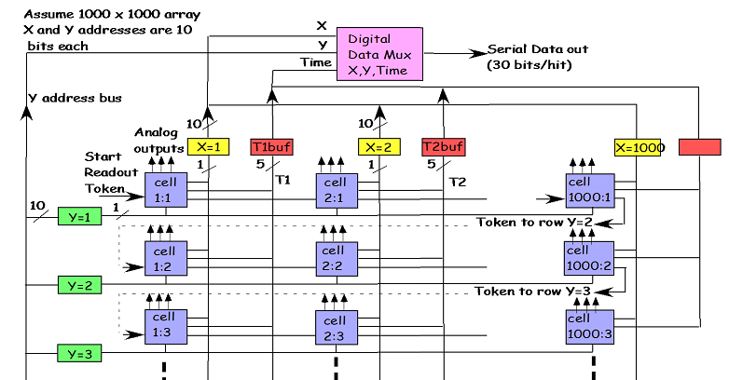
VIP2B (2009): Tezzaron/Chartered 0.13um 3D-IC process – 2 tiers
  How it works:
Adapted from earlier MITLL designs in FDSOI technology
192 × 192 array of 24 μm² pixels
8 bit digital time stamp (Δt=3.9 μs)
Readout between ILC bunch trains of sparsified data
Sparsification based on token passing scheme
Single stage signal integrating front-end with 2 S/H circuits for analog signal output with CDS
Analog information available for improved resolution
Separate test input for every pixel cell
Serial output bus
Polarity switch for collection of e⁻ or h⁺
VIP Functional
block diagram
signals are accumulated and time stamped using global Gray code counter

Slide 12
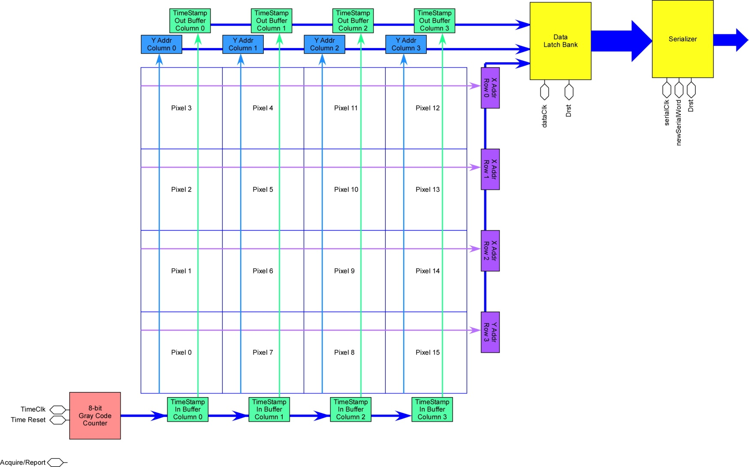
Digital Tier
VIP2B (2009): Tezzaron/Chartered 0.13um 3D-IC process – 2 tiers
  The ILC machine time-structure implies operation with two modes:
ACQUIRE:
- individual pixels gather hits.
- arriving hit are time stamped by latching current state of a gary counter whose values are distributed to all pixels.
- each pixel can stroe signature of a single hit (extending storage to more hits per pixel is not difficult)
REPORT:
- each hit pixel, in turn, releases its location, magnitude and time information to the peripheral circuitry from where the information is sent off chip (serializer and analog buffers)
- sparsification ciruitry, based on token passing, allows selective readout of only hit pixels (reduce avarage readout time)
X/Y addresses are hardcoded
Analog part of a pixel passes ‘hit’ pusle from discriminator down to digital part
Digital part of a pixel passes ‘release data’ request to analog part when it comes to the turn of the readout

Slide 13

VIP2B (2009): Tezzaron/Chartered 0.13um 3D-IC process – 2 tiers
Token races until it finds pixel taht was hit; it stops there and pixels radiates X/Y address selection line; Ttoken stay in a hit pixel until Data_Clk is pulsed (‘[I’m done with radout of you’)

Slide 14
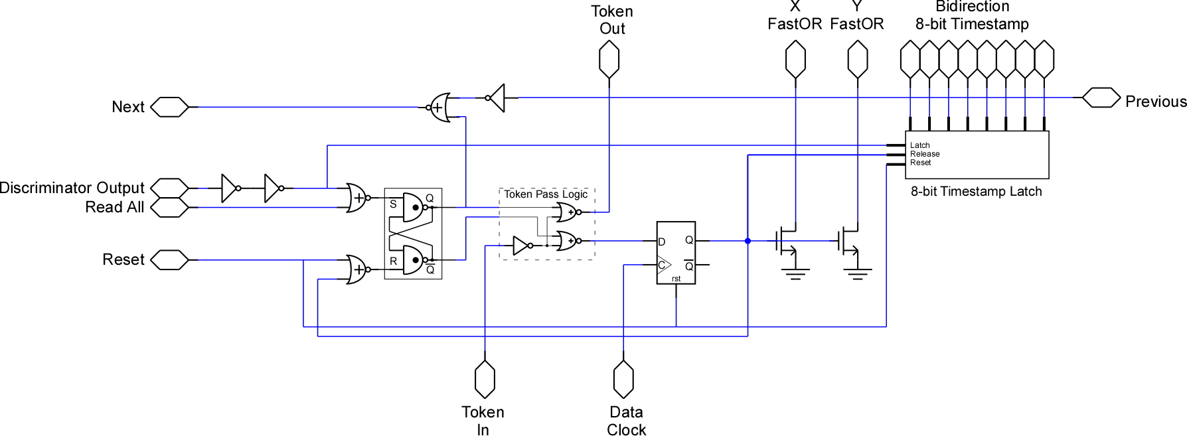
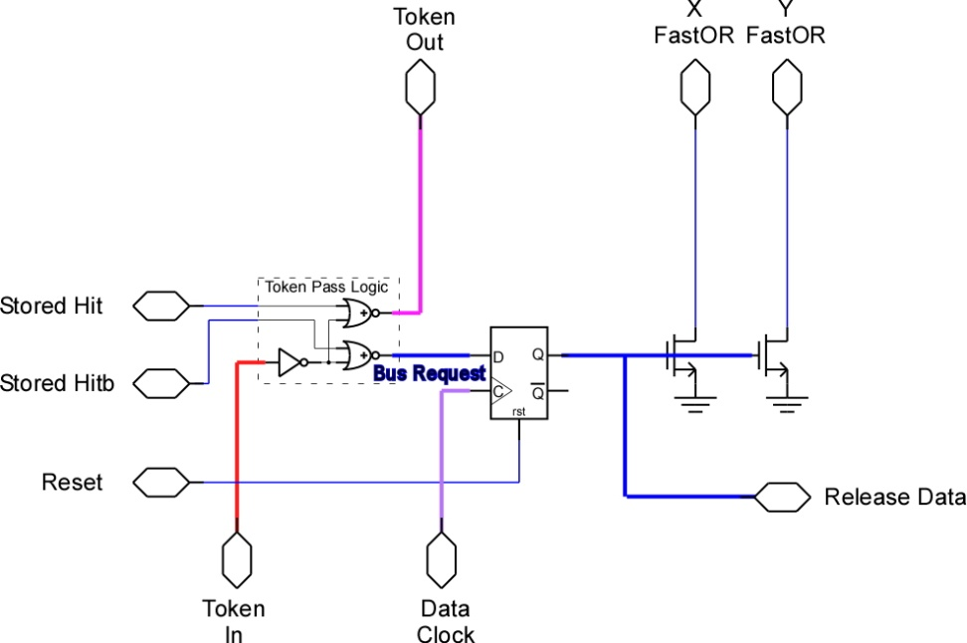
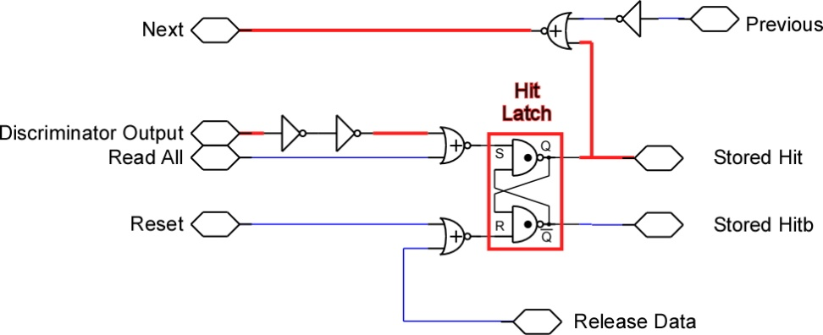
Digital Pixel
VIP2B (2009): Tezzaron/Chartered 0.13um 3D-IC process – 2 tiers
Pixel gets hit
Readout token arrives

Slide 15

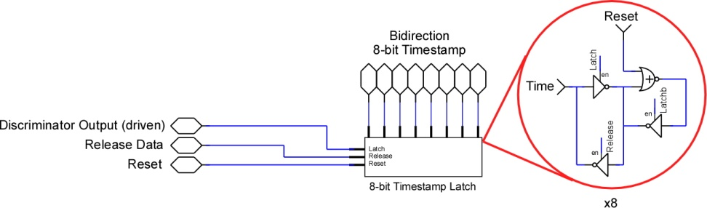
VIP2B (2009): Tezzaron/Chartered 0.13um 3D-IC process – 2 tiers

Slide 16

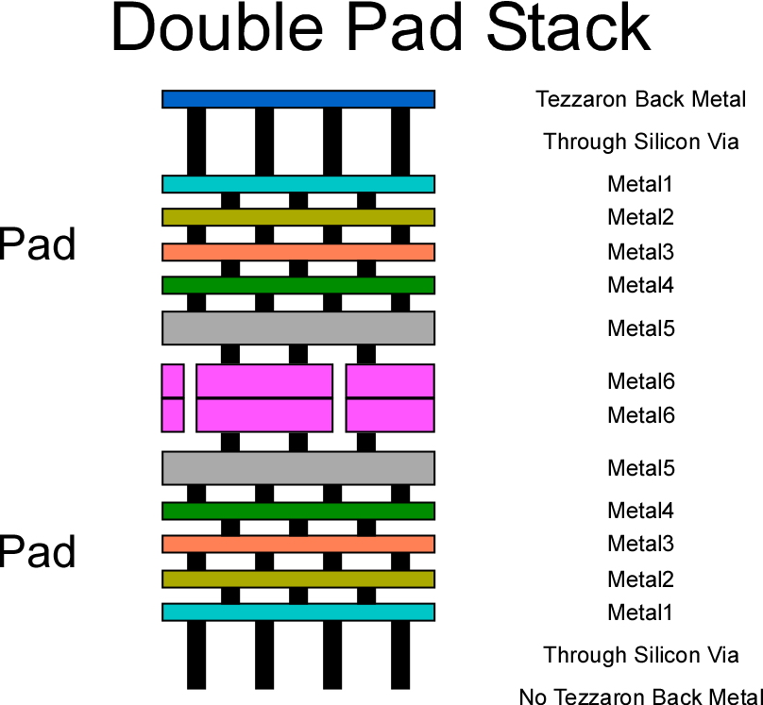
VIP2B (2009): Tezzaron/Chartered 0.13um 3D-IC process – 2 tiers
Pads in each tier in the same (X,Y) location.
Full metal stack in both tiers.
TSV and Back Metal on both tiers (even though no Back Metal will be fabricated on the un-flipped, un-thinned tier)
When designed into a 3D stack, there will be a bondable pad on this (+/-X,Y) location regardless of which chip is on top.

Slide 17
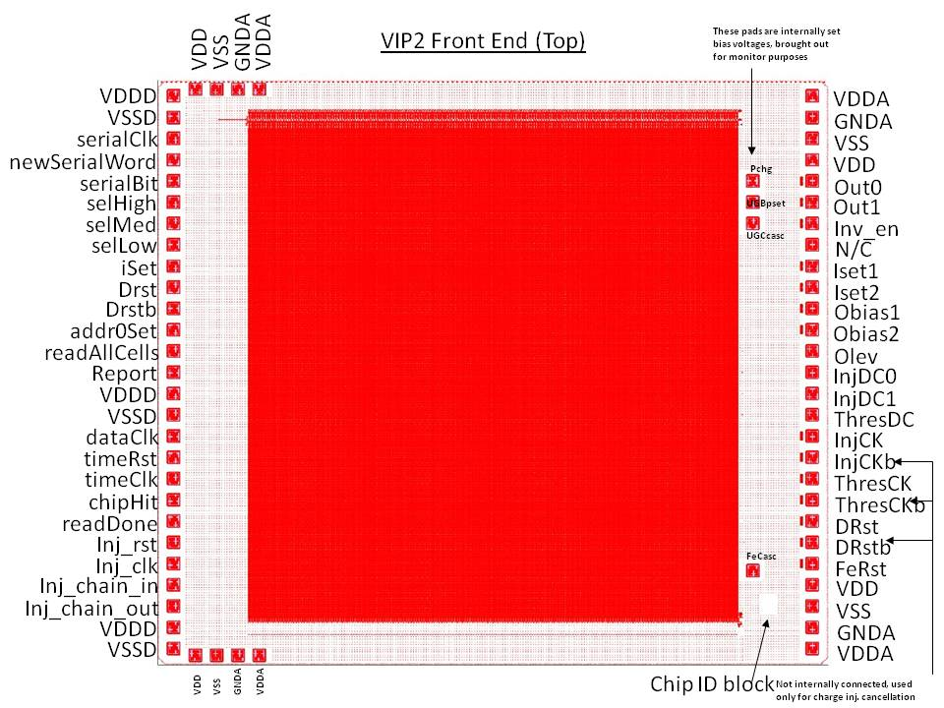
Normal Pad Structure
VIP2B (2009): Tezzaron/Chartered 0.13um 3D-IC process – 2 tiers
Selection of pull-ups strength on X/Y wiredOR lines – lesson from VIP1

Slide 18

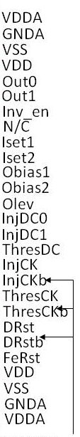
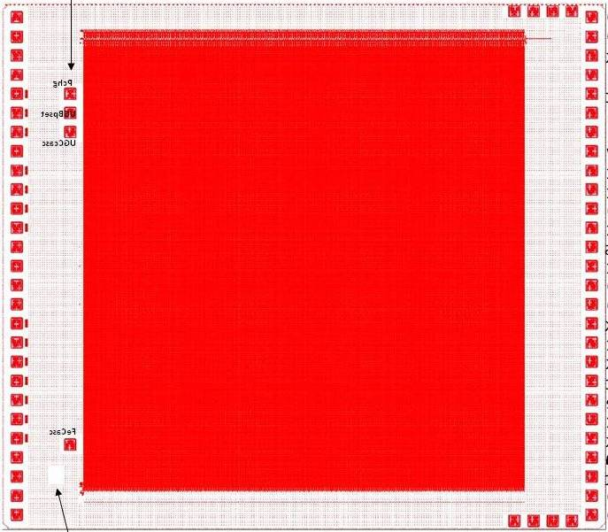


“Inverted” Pad Structure
VIP2B (2009): Tezzaron/Chartered 0.13um 3D-IC process – 2 tiers

Slide 19
VIP2B (2009): Tezzaron/Chartered 0.13um 3D-IC process – 2 tiers
3D-IC detectors
VIP2B w shielding
VIP2B w/o shielding

Slide 20
VIP2B (2009): Tezzaron/Chartered 0.13um 3D-IC process – 2 tiers
VIP2B detectors
Detector for IP2B was designed following 25μm bonding pitch rules from Ziptronix
Only one contact per pixel

Slide 21
VIP2B (2009): Tezzaron/Chartered 0.13um 3D-IC process – 2 tiers
Conclusions
VIP2B is the 3rd generation device from VIP family
VIP2 (MIT-LL) and VIP2B (Tezzaron/Chartered) may arrive almost at the same time
Offered possibility of direct comparison of almost the same chip architecture fabricated in 2 different 3D-IC technologies / fabrication processes
VIP2B features multiple tests structures (single analog channels) allowing tests of performances as a function of input capacitance, dimensions of input devices, etc.

