Slide 1
VICTR
Vertically Integrated CMS TRacker Concept Demonstration ASIC
Jim Hoff
On Behalf of the Fermilab Pixel Development Group

Slide 2
Outline
1. VICTR Motivation
2. Electrical Design
3. Mechanical Design
4. Summary

Slide 3
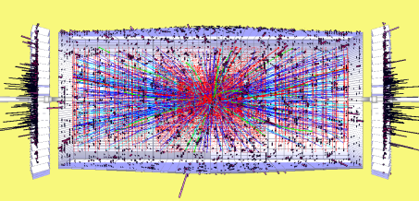
VICTR’s Motivation is Increasing Luminosity
At the expected SLHC Luminosities we are told to anticipate 200-400 int/25 ns crossing
It goes without saying that
All data cannot be read out at the 40MHz beam clock
Standard L1 triggers for CMS will saturate
Some sort of momentum-based track trigger could be used to
identify particles with transverse momenta (Pt) above 2GeV
identify particles with transverse momenta (Pt) above 15GeV
Provide a Z resolution of ~1mm
VICTR is a 3DIC piece of this momentum-based track trigger
10³² cm⁻² s⁻¹
10³³
10³⁴
10³⁵

Slide 4
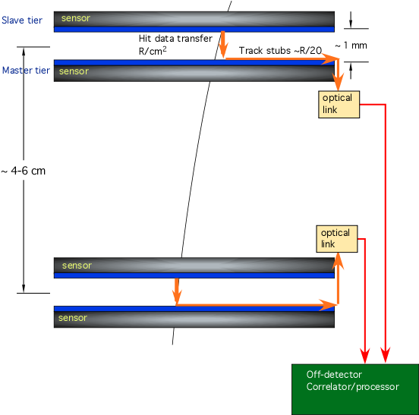
Double-Stack Concept
Two detectors held a fixed distance of 1mm apart could be used to extract tracks caused by particles of Pt>2GeV because at a given distance “R” along the r direction, dφ/dr would be smaller than some definable amount.
Therefore, a high Pt track would be defined on these two rigidly fixed sensors as a pair of coincident hits that are less than or equal to some fixed distance apart along the φ direction.
Two such coincident hits are referred to as a track stub.
Also note that resolution in the z-direction (out of the page in this figure) is also important for multiple track separation.
φ direction
r direction

Slide 5
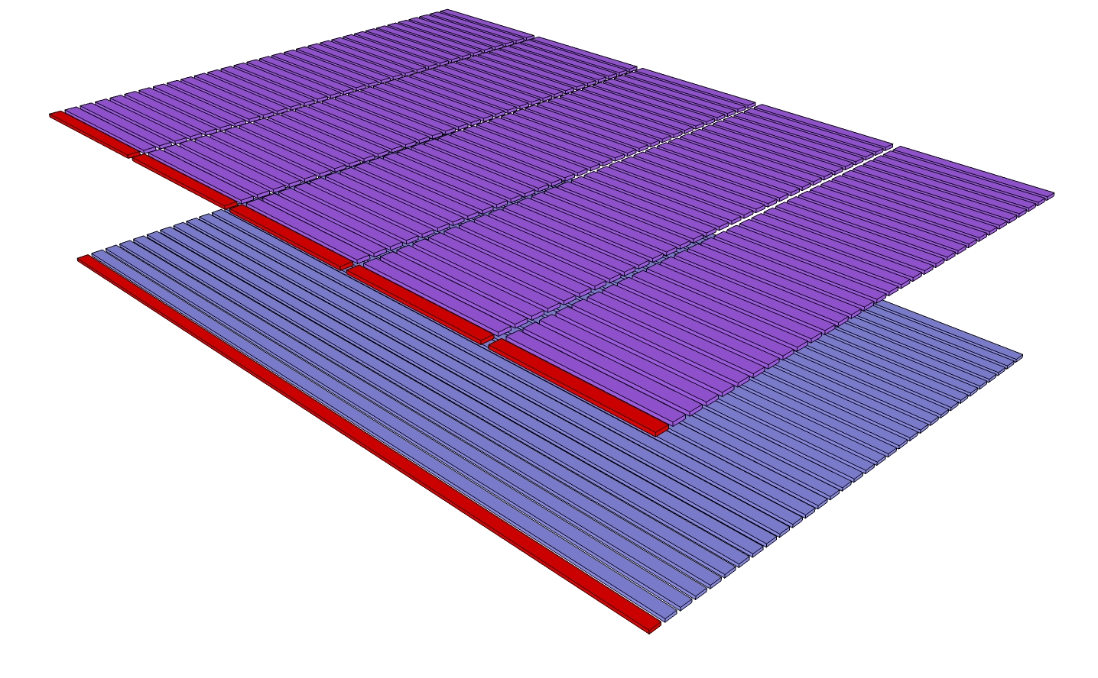
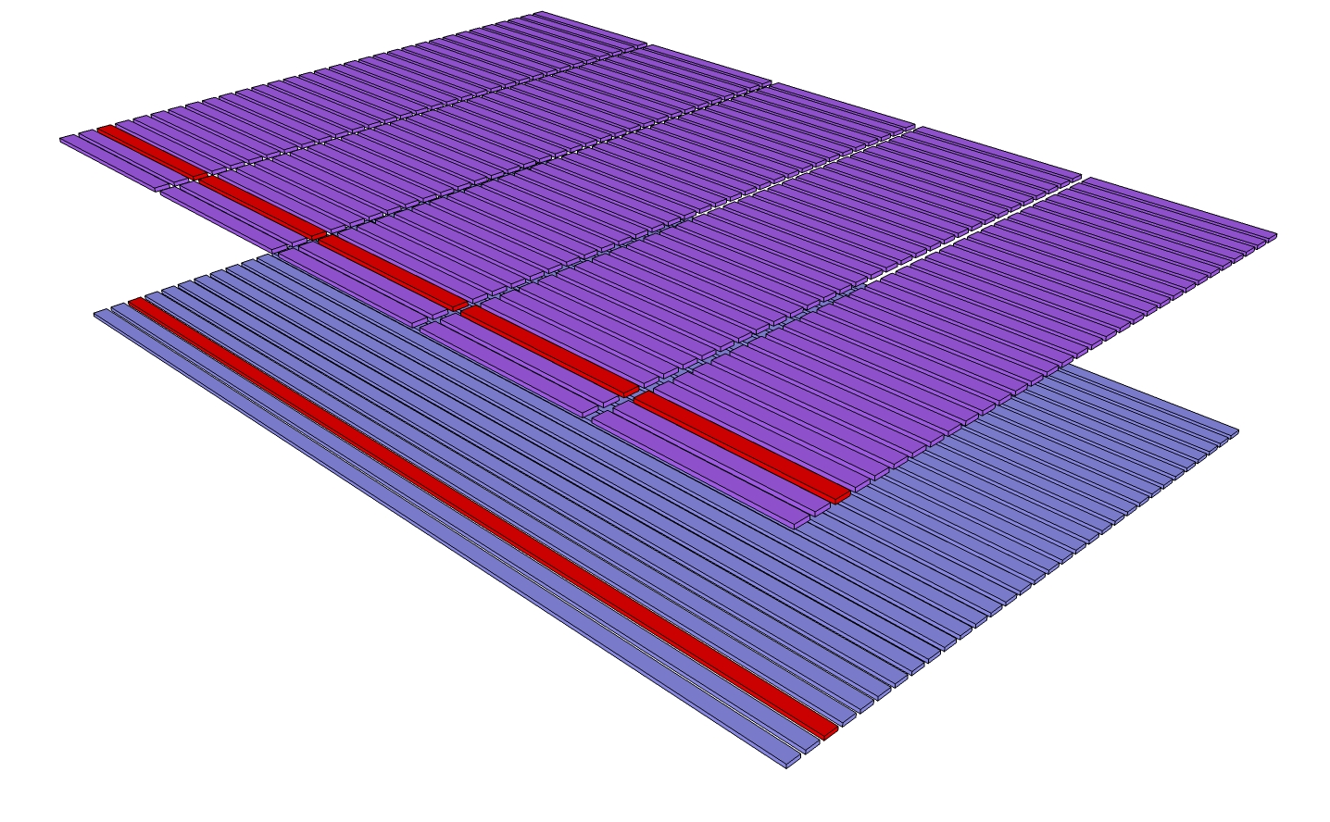
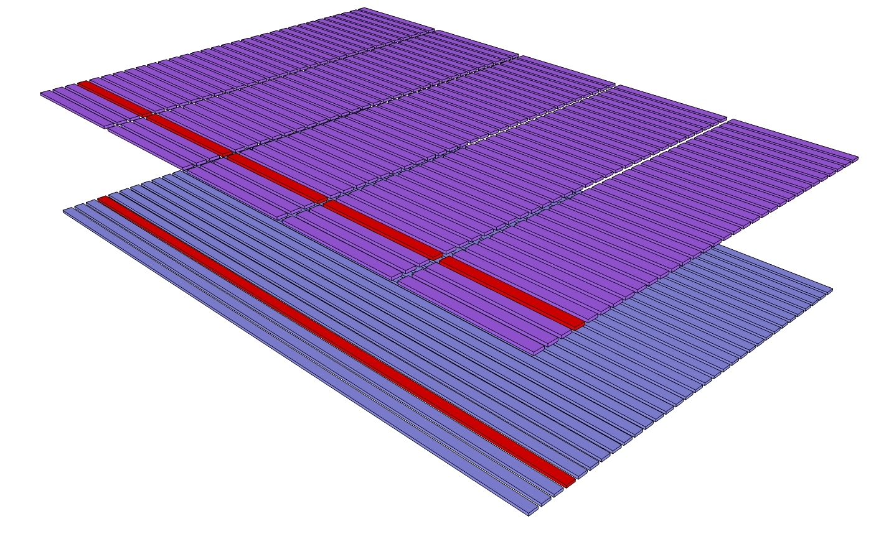
2 Sensors: Short and Long Strips
z direction
r direction
φ direction
The 2 sensors are strip detectors, with the strips in the z direction and the strip plane perpendicular to the r direction. The two strips detectors are held rigidly apart. Z resolution is necessary, but not on both planes. Therefore, one plane has long strips (5mm) and one plane has 5 short strips (1mm each). One long strip and one set of 5 short strips have the same φ value.

Slide 6
Coincident Hits and Stub Formation
Stubs are formed by coincident hits on the two different sensors.
This diagram immediately brings to mind the idea of a 3D integrated implementation

Slide 7
Brainstorming: How might we do this in 3D?
It is easy to see front end amplification, shaping and discrimination occurring separately on each tier for each silicon strip detector (long and short).
Readout on each tier becomes superfluous.
In fact, through the bond interface, we can communicate and generate the coincidences directly.
Unfortunately, even with bump bonding this will not hold the sensors the requisite 1mm apart.
We need an interposer.
Long Strip ASD
Short Strip ASD,
data processing,
and readout

Slide 8
Brainstorming: Adding the Interposer
Clearly, this means that both tiers must be thinned
Logic suggests that the short strips be connected directly to the 3D stack by DBI, simply because its 50um bond pitch is fairly stringent.
This means that the long strips will be on the far side of the interposer connected by bump bonds.

Slide 9
Logic Diagram
Logically, then, this is straightforward. For every strip set…
One ASD sits in the top tier controlling the long strip. The output of its discriminator goes through the bond interface to the bottom tier.
Five ASDs sit on the bottom tier, each controlling one of the short strips.
Each discriminator output is latched for later output.
The five short strip outputs are ORed together making one “bottom tier hit” signal.

Slide 10
Logic Diagram
The top tier hit and bottom tier hit signals are ANDed together with a Schmidt Trigger based timing coincidence circuit. The result becomes the “coincidence hit” signal.
FastOR signals exist flagging any hit on any long strip, any hit on any short strip and any coincidence hit in the chip.
Each strip set produces 8 bits – 1 coincidence hit(C), 1 top hit(T), 5 bottom hits (B), and a sync bit (X)
Output is serialized into one long 64x8=512 bit stream

Slide 11
More on the Logic Diagram
We expect considerable increase in complexity as we move towards the final design. In particular, we anticipate the incorporation of neighbor hits into the coincidence detection circuitry.
For the test beam, there are no fixed data rates. We are not required to meet the 25ns SLHC beam clock yet…

Slide 12
Single Bit Output Stream
As stated previously, each strip set contributes 8-bits to the output stream – 1 coincidence bit, 1 long strip or phi hit, 5 short strip or Z hits, and a Sync Bit. These are concatenated serially and driven off the chip in order as shown below.
Empty | 1000000010000000100000001000000010000000…
Single Φ hit in Strip set 1 | 1000001010000000100000001000000010000000…
Z<2>-Φ coincident hit in Strip set 2 | 1000000010000000100010111000000010000000…

Slide 13
Operating Modes
This output format leads to 2 operating modes, triggered or continuous.
Triggered
Continuous

Slide 14
Consortium Cooperation
In keeping with the front end requirements of the SLHC, we required ASD that responded in the requisite 25ns time period.
We realized we needed an LHC-type front end and it would have been very nice if we could build on the work already done by Atlas.
…so we called Jean Claude Clemens
The we realized that the front ends needed to collect holes to work with our detectors.

Slide 15
Consortium Cooperation
LBNL to the Rescue –
Abder Mekkaoui and Julien Fleury volunteered to modify an existing FEI4 front end.
The polarity was reversed
The gain was changed
Of course, it follows that our control DACs were provided by CPPM (J. C. Clemens, P. Pangaud, S. Godiot)

Slide 16
Final Layouts: Bump Bonding and DBI
DBI Pads
Bump Bond Pads
Long Strip Tier
Short Strip Tier

Slide 17
Final Layouts
Long Strip Tier
Short Strip Tier

Slide 18
How will we build this?
Flip wafer, dice and place on short strip sensor wafer
Tezzaron Wafers

Slide 19
How will we build this?
4 The long strip sensors are bonded to the Interposer making a complete 3D device.
3 Bumps are placed on the long strip sensors
2 The Interposer is bump bonded to the 3DIC
1 Starting from the double thinned VICTR DBI bonded to the short strip sensors, bump bonds are added

Slide 20
Net Result
Long Strip Sensor
Interposer
Interposer Via
VICTR
Chip
Short Strip Sensor

Slide 21
Summary
The logic and electronics on this design, while interesting are straightforward
The real challenge of this design is mechanical.
Can we really grind down both sides of a 3D stack? Will it adversely affect the analog performance of the front ends?
Can we reliably develop the interposer?
Can we fabricate this true 3D detector?

Slide 22
Background Slides

Slide 23
The Daisy Chain(s)
There are 2 daisy chains on the chip
1 on the Phi (Long Strip) Tier, and
1 on the Z (Short Strip) Tier
Each chain can be divided into sections
The first section is the DAC section where voltage and current references are controlled.
The second is in the pixels themselves, where kill, inject and fine tuning are controlled. The pixel section of the chain has one chain but multiple shadow register destinations.

Slide 24
Pad Structure
Like the VIP2B and the test chips, VICTR uses the Double Pad Stack.
The same electrical node is available regardless of whether the Left Tier or the Right Tier is physically on top.
The pad locations in an inverted 3D stack are symmetrically flipped around the vertical axis compared to a normal 3D stack

Slide 25
Pad Structure

Slide 26
Phi (Long Strip) Tier
Programming Interface
A-to-D Converters

Slide 27
Z (Short Strip) Tier
Readout Architectore
Programming Interface
A-to-D Converters
LVDS Drivers

Slide 28
VICTR Motivation

Slide 29
Single Strip Readout Architecture

Slide 30
4 Serial Outputs

