Slide 1


Brief Idea for New Method To Collect Data From Detector
Nguyen Minh Truong, FPT University
on behalf of the COMET collaboration
Viet Nam Flavor Physics, Aug. 17th - 23th 2025

Slide 2
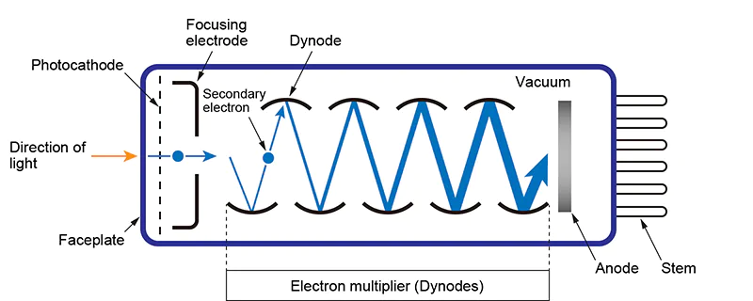
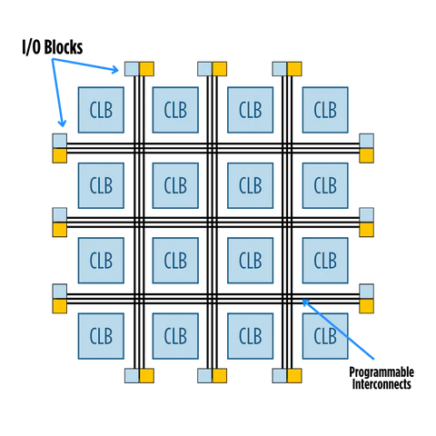
Normal Method
𝛾
Digitizer FPGA
Detector: Scintillator, etc
PMT, SiPM, etc
𝛾, e, 𝜇, p, etc
time
time
time
V
V
V

Slide 3
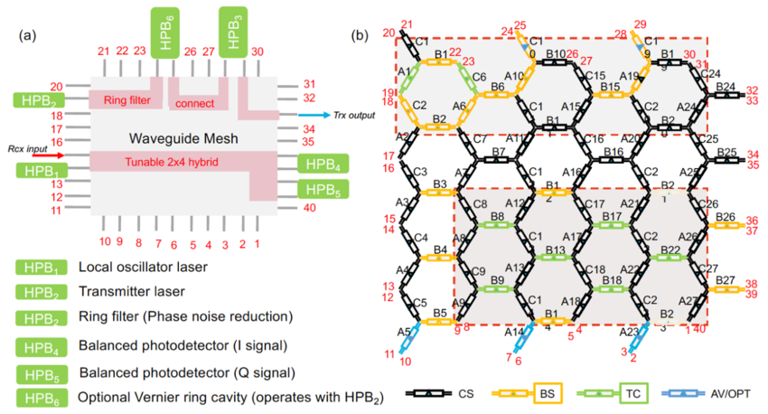
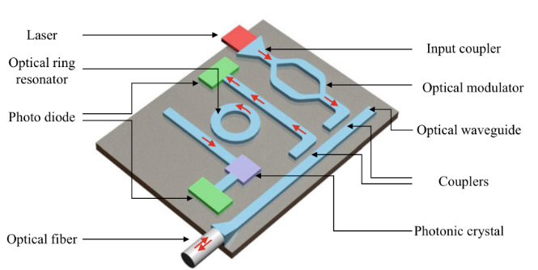
New Normal Method
FPPGA
𝛾
Photonic IC
Advantage:
+ No/low heat
+ High bandwidth
+ …
Photon
Scintillator, etc
Wave length (𝝀)
𝝀
𝝀
time
histogram
Insensitive
https://www.ovaga.com/blog/transistor/photonic-integrated-circuit-definition-disadvantage-fabrication-application
DOI:10.1117/12.2551289

Slide 4
New Normal Method
FPPGA
𝛾1
Photonic IC
𝛾2
Advantage:
+ No/low heat
+ High bandwidth
+ Collect two or more events happen at same time
+ …
Photon
Scintillator, etc
Wave length (𝝀)
𝝀1
𝝀1
𝝀2
time
histogram
Insensitive
𝝀2
histogram

Slide 5
Thank you for your attention
5

