Slide 1
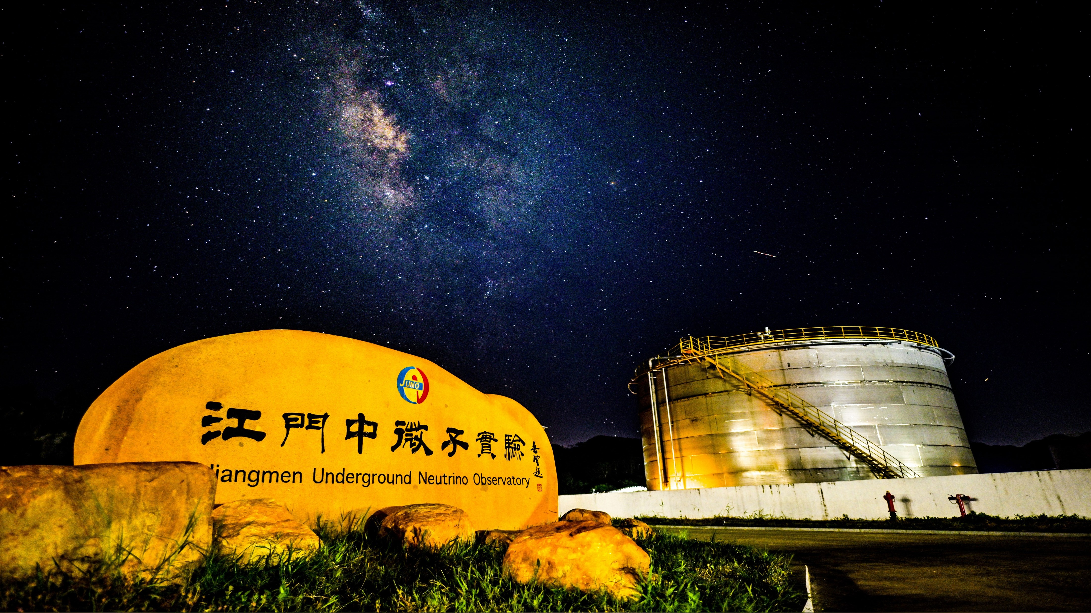
JUNO
status and perspectives
Achim Stahl
RWTH Aachen University
on behalf of the JUNO collaboration
21st Rencontre de Vietnam – Flavour Physics 2025

Slide 2
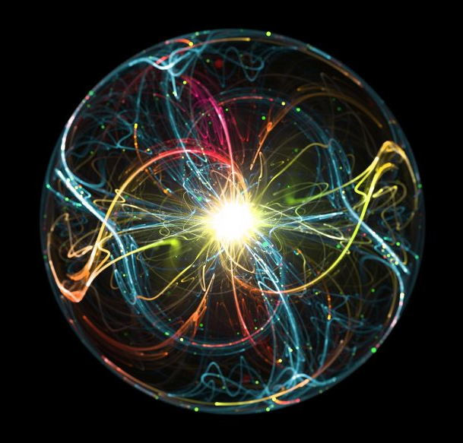
JUNO – a multi-purpose neutrino experiment
+
PPNP 123 (2022)103927 J. Phys. G 43 (2016) 030401
source | rate | energy | science case
Reactor | 47 evts per day | 1.8 … 10 MeV | mass hierarchy, osc. parameters
Atmospheric n | 10 evts per day | 0.1 … 100 GeV | osc. parameters
Solar: ⁸B / ⁷Be | 16 / 490 per day | 0.5 … 12 MeV | solar physics, osc.
Supernova burst | 10⁴ evts @ 10 kpc | 0.1 … 50 MeV | SN mechanism
Diffuse SN bgd | 2 – 4 per year | 10 … 30 MeV | SN rate
Geoneutrinos | 400 per year | 1.8 … 3 MeV | geology of earth
new physics
proton decay
dark matter annihilation
sterile neutrinos
magnetic moment of n

Slide 3
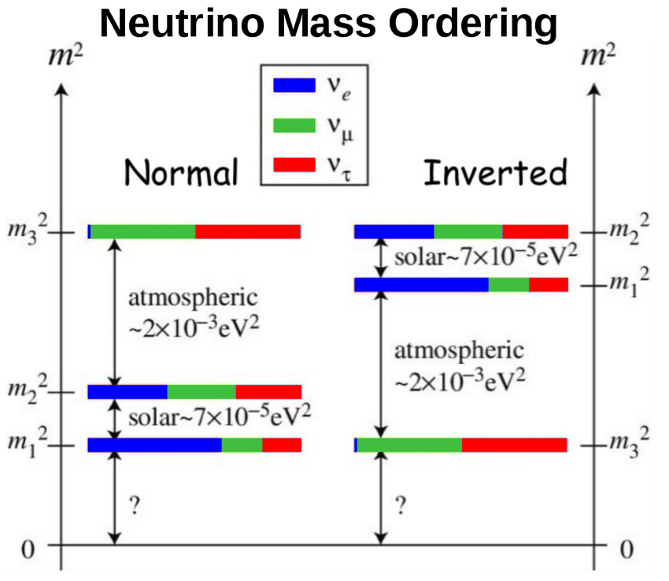
Neutrino Oscillations
Neutrino mass ordering from the interference effect in the reactor neutrino spectrum
Phys Rev D 88 (2013) 013008

Slide 4
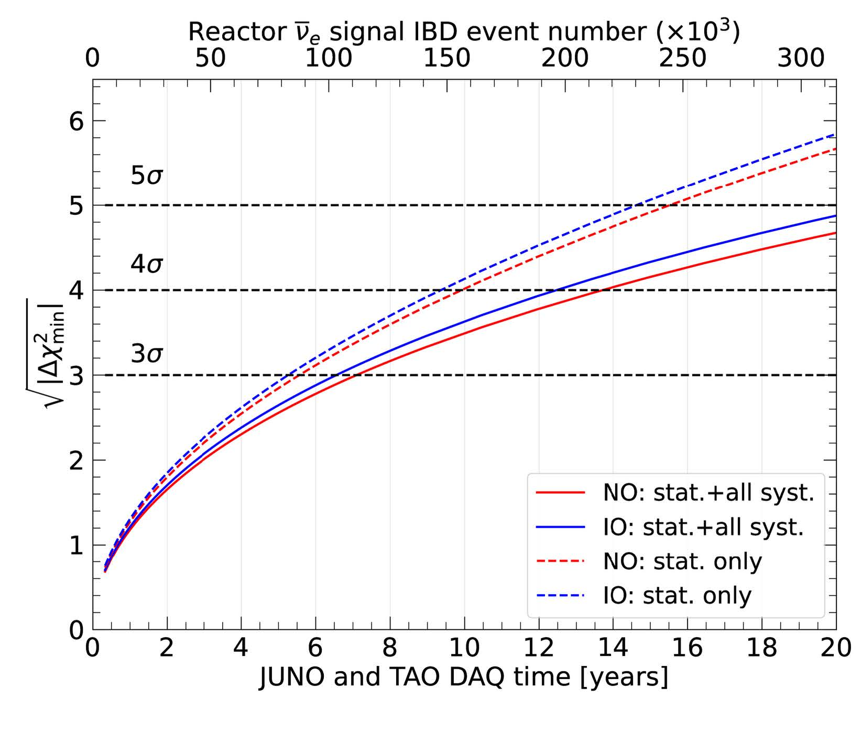
Neutrino Oscillations
Neutrino mass ordering from the interference effect in the reactor neutrino spectrum
Phys Rev D 88 (2013) 013008
Ref: Chinese Phys. C 49 033104)

Slide 5
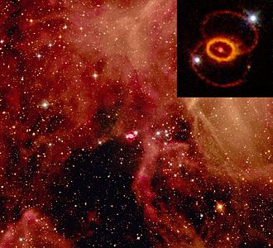
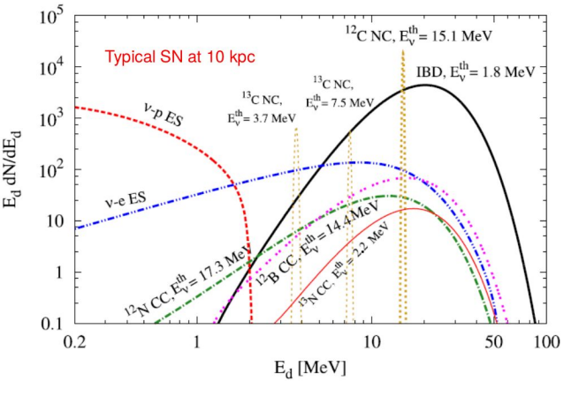
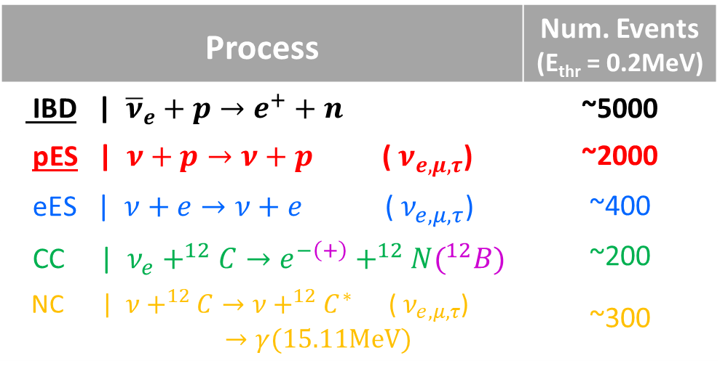
Supernova Burst
SN1987A ©NASA
J. Phys. G: Nucl. Part. Phys. 43 (2016) 030401

Slide 6
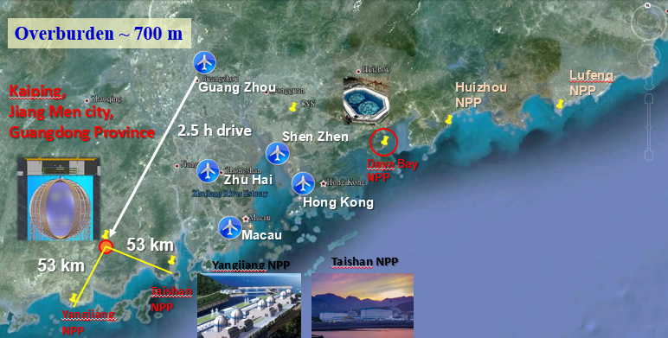


Location
252 km
9.2 GW_{th}
17.4 GW_{th}

Slide 7
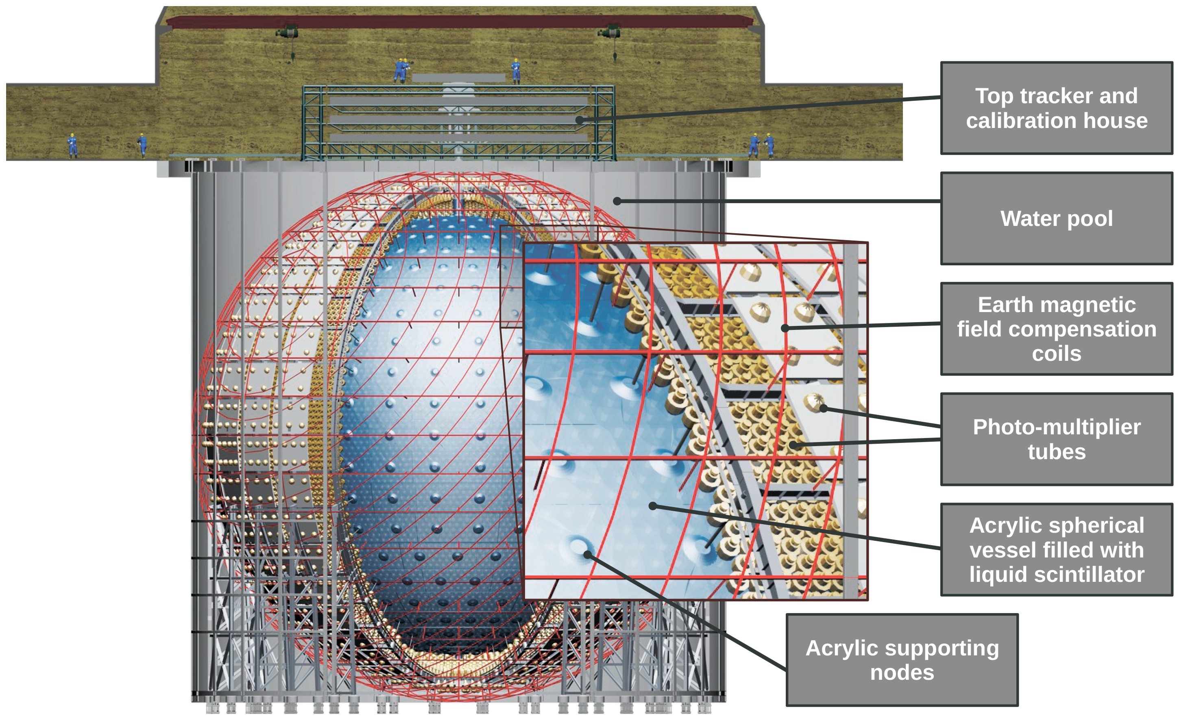
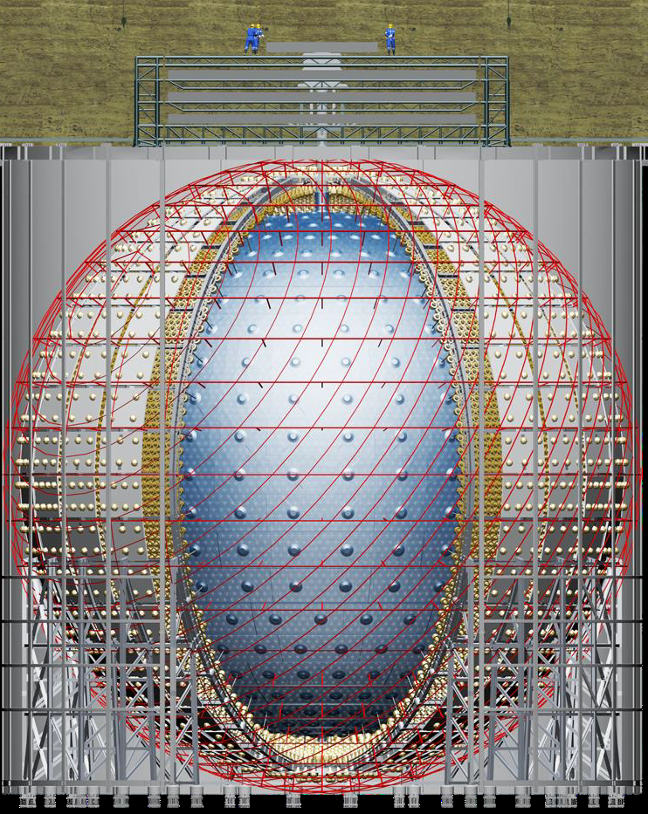
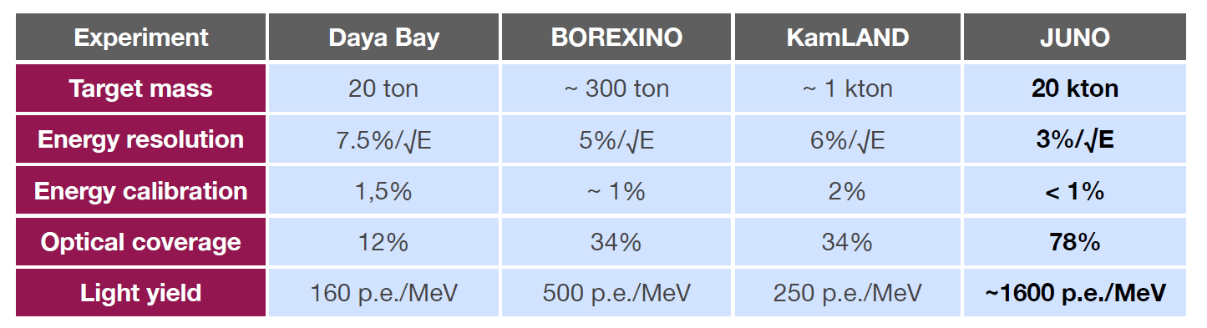
JUNO detector
~650m
overburden
3 layers of
plastic scintillator strips
35 kilotons ultrapure water
>2500 20” PMTs
17,596 20” + 25,600 3”
17.7 m in radius
20 kilotons of liquid scintillator
LAB + 2.5 g/L PPO + 3 mg/L bis-MSB

Slide 8
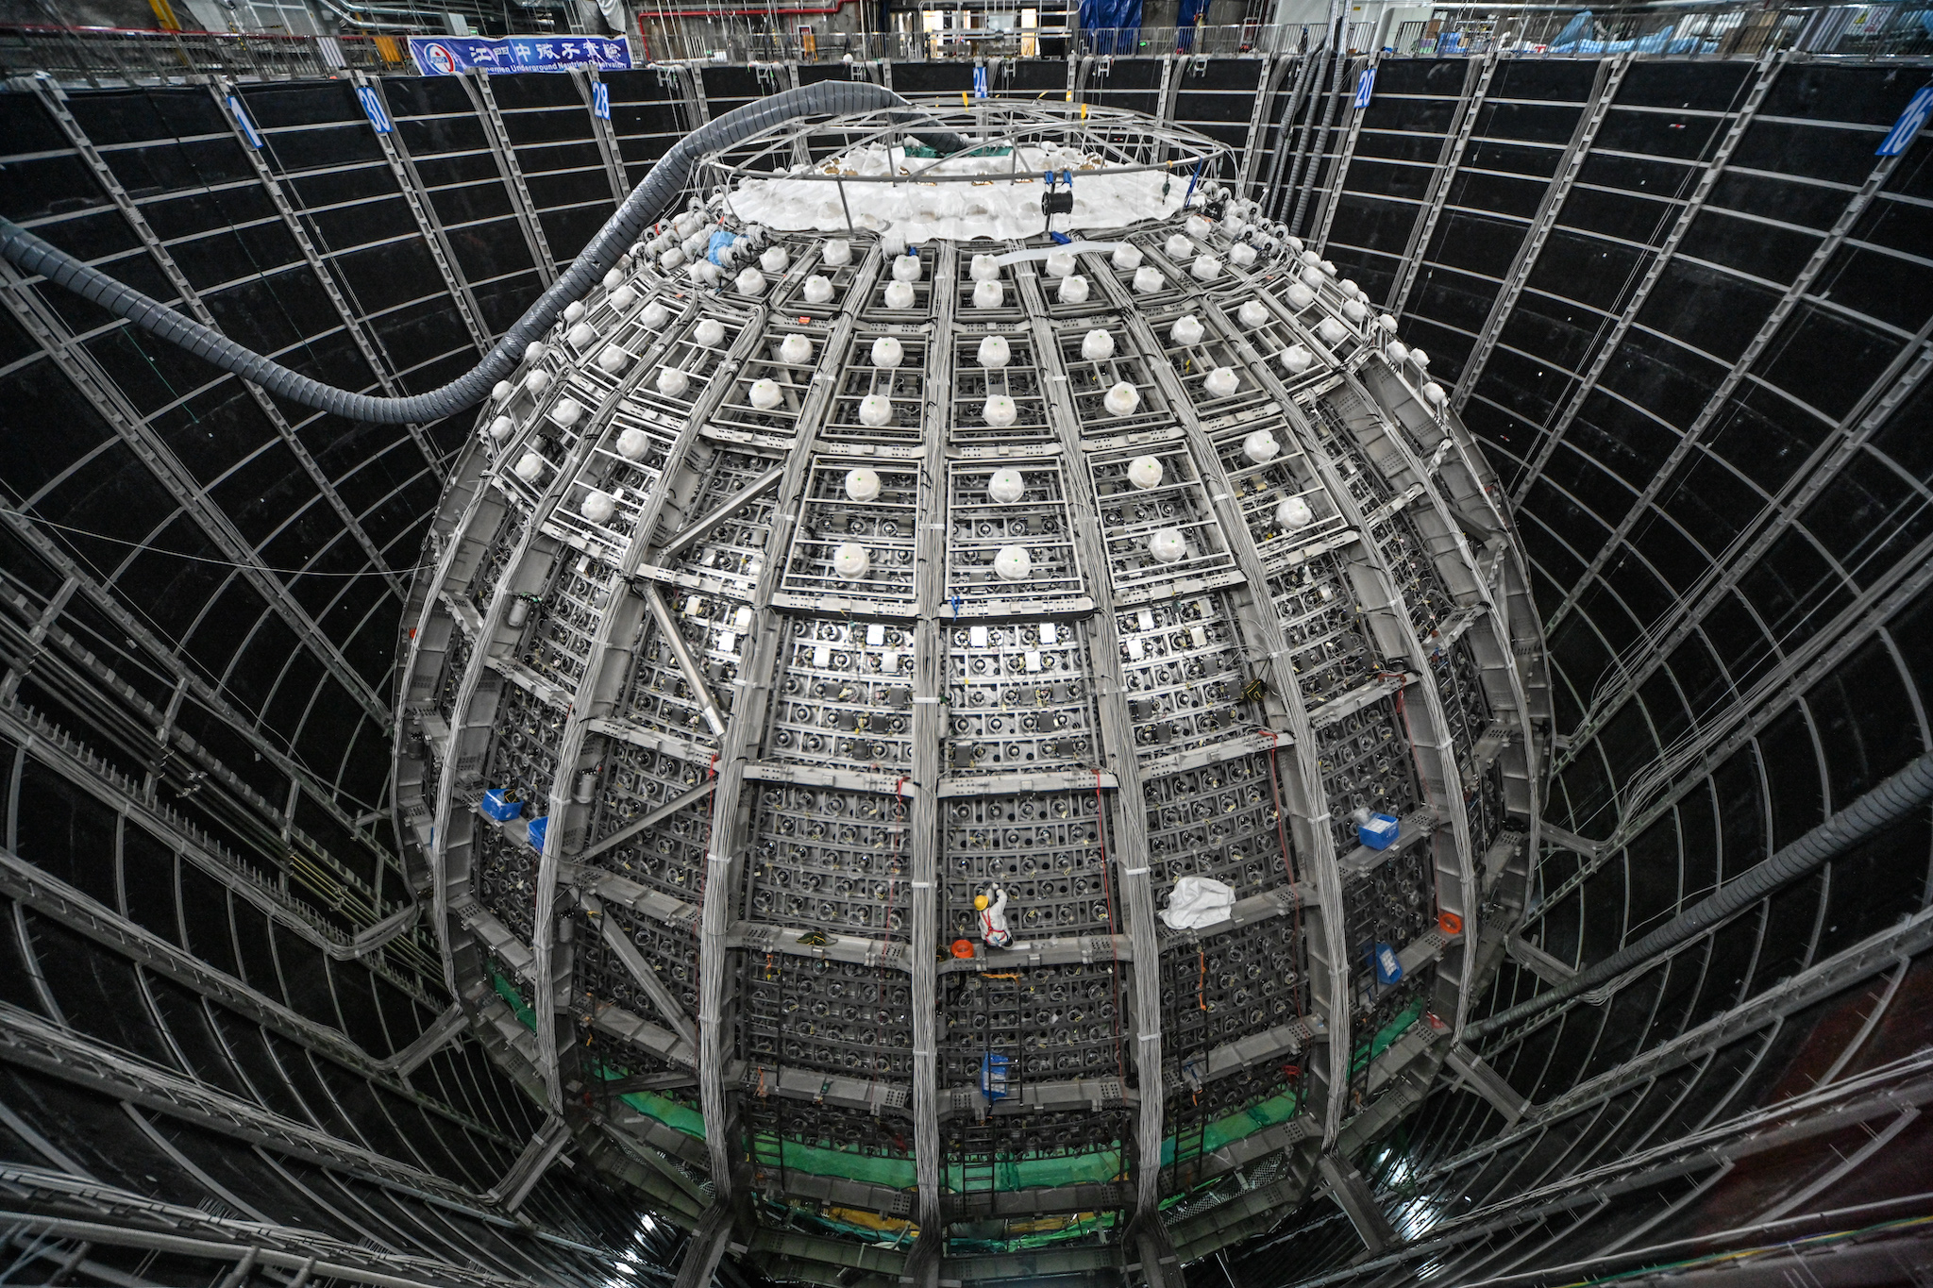
17.7 m radius
20 kt

Slide 9
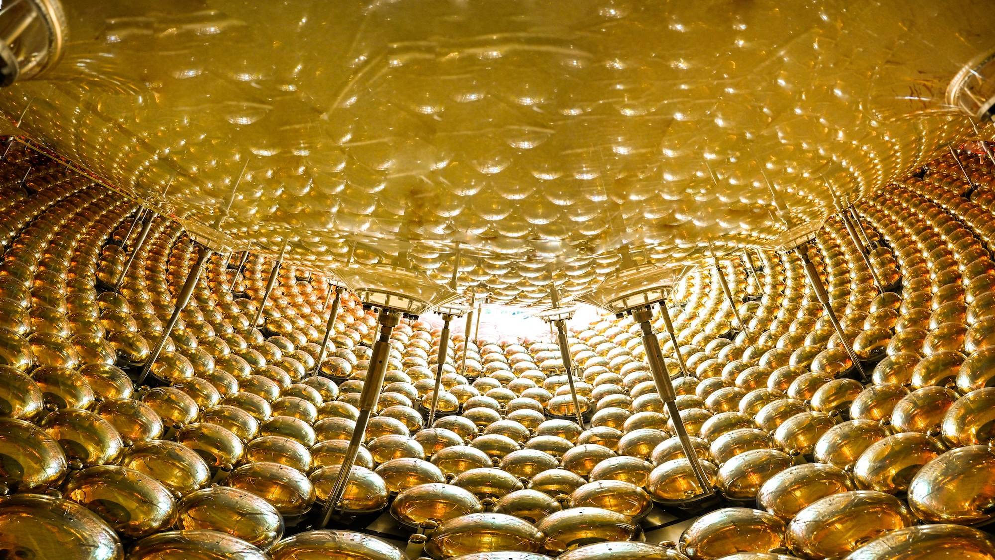
17,596 / 25,600 PMTs
78% coverage

Slide 10
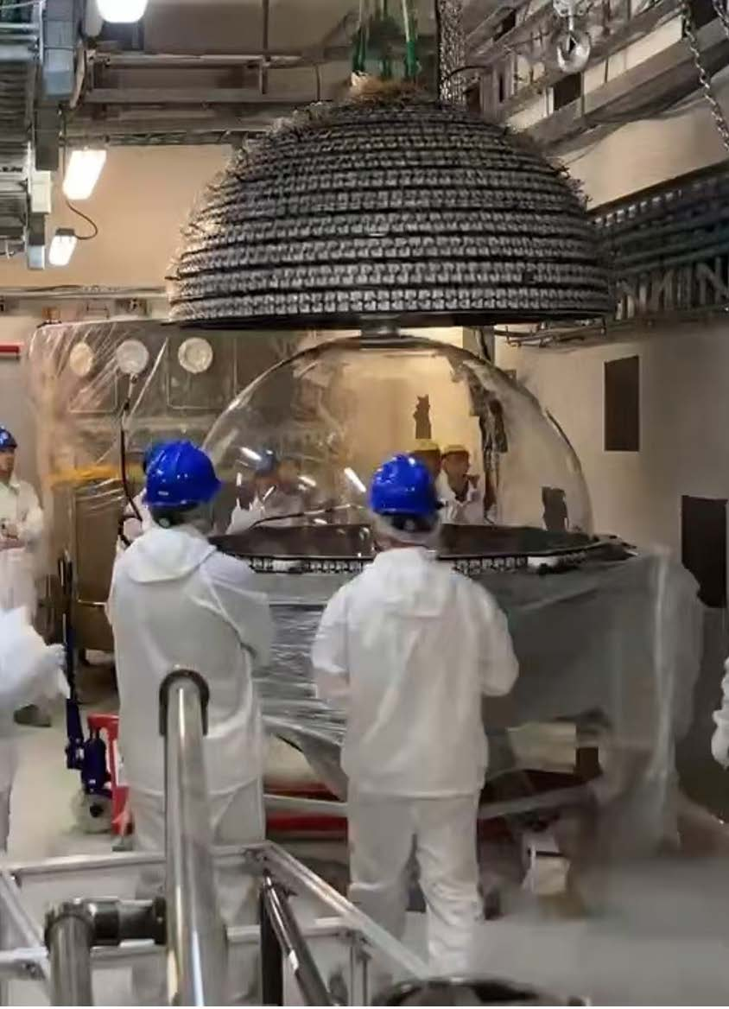
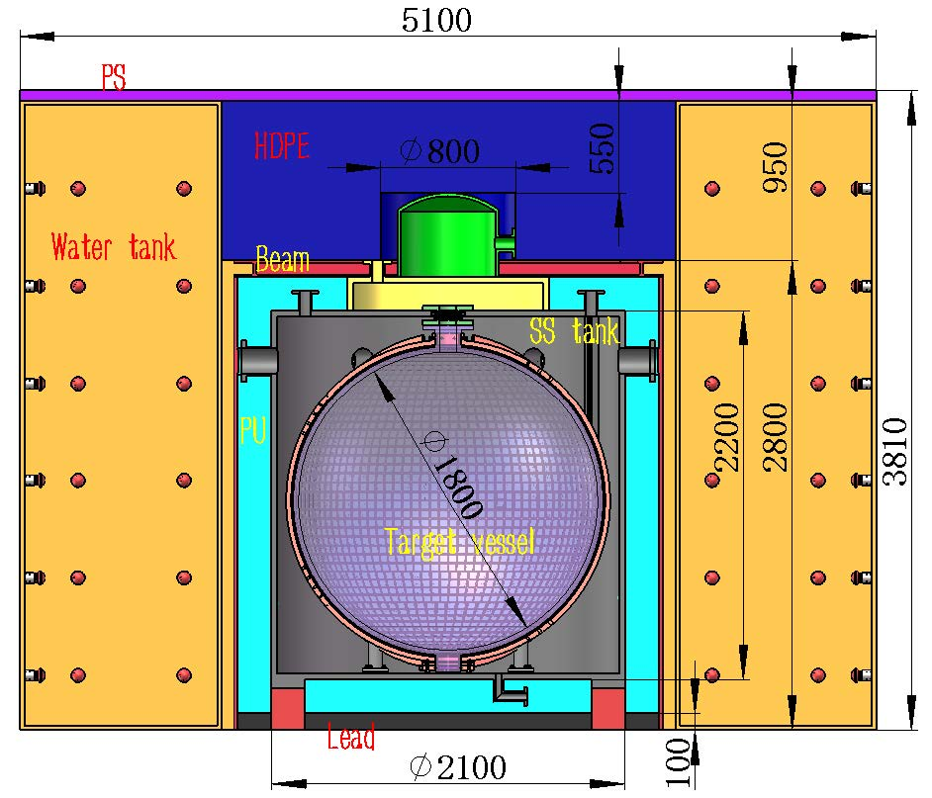
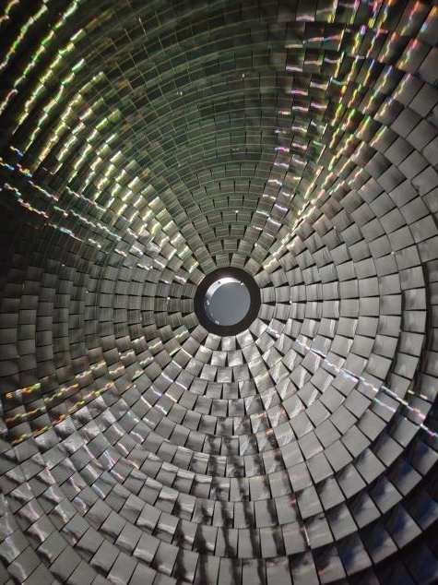
TAO: our near detector
Volume: 1.8 t (1t fiducial)
Baseline: 44 m (unit 1) and 217 m (unit 2)
Scintillator: LAB-based and Gd-doped
Light-detection: SiPMs, coverage ~94%, PDE ~50%
operated at -50° C (dark noise <100 Hz/mm²)
Energy resolution: < 2%/√E (LY: 12,000 photons/MeV
~ 6,000 p.e./MeV)

Slide 11
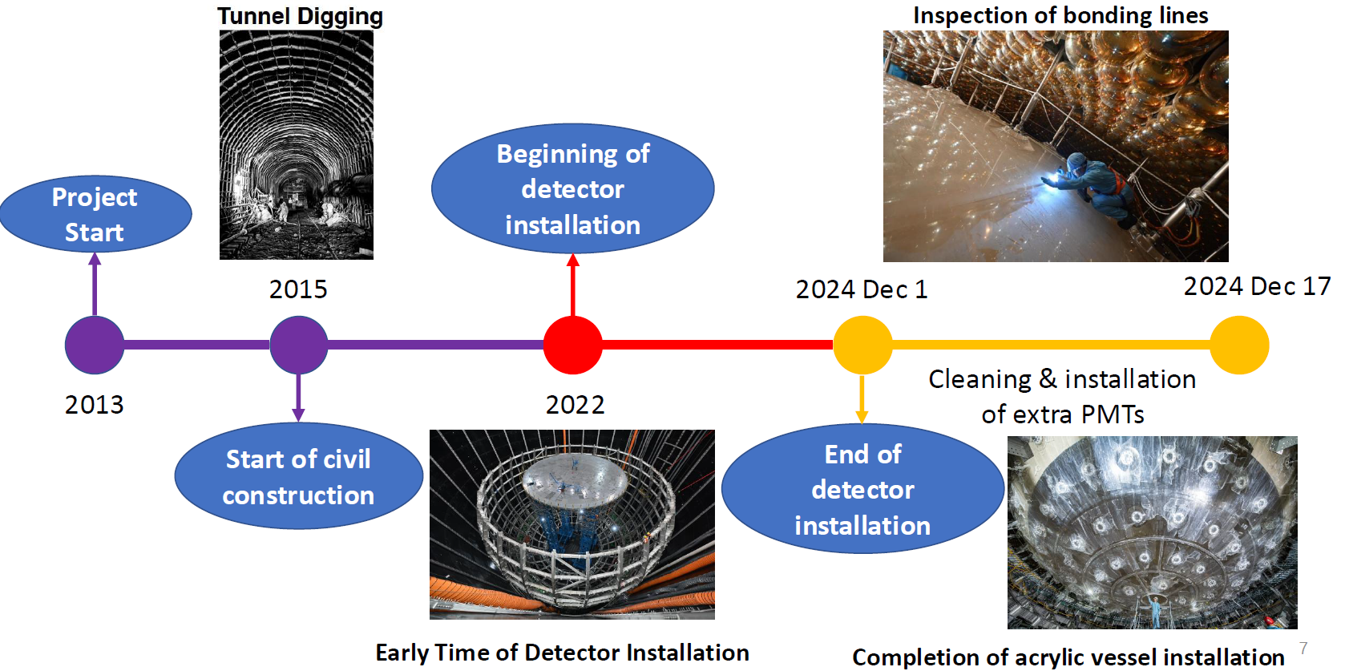
A long journey

Slide 12
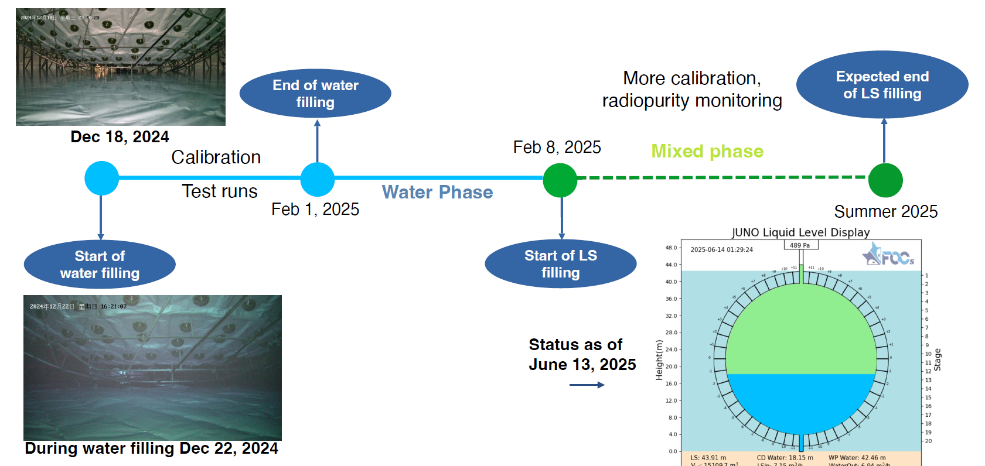
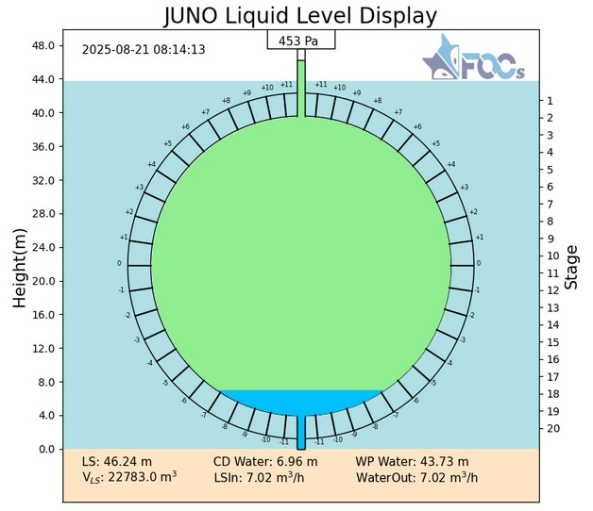
A long journey
Status as of
Aug. 21st, 2025

Slide 13
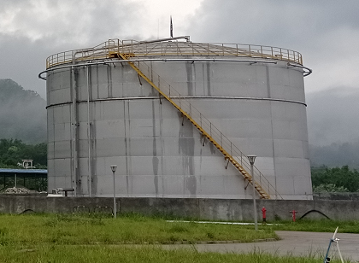
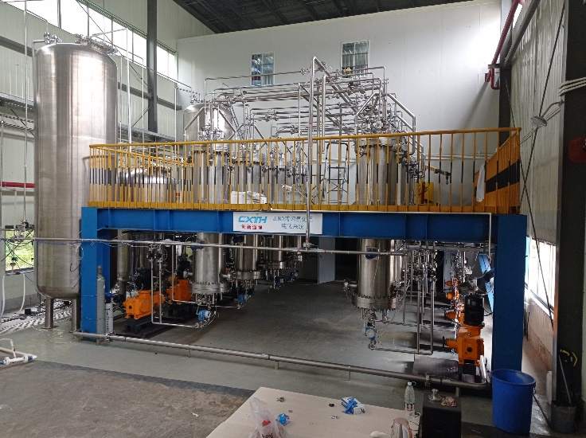
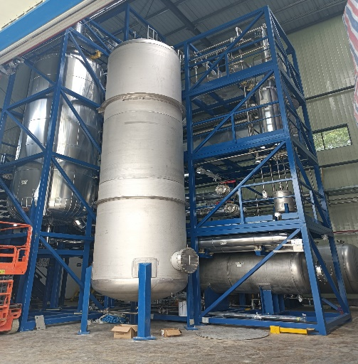
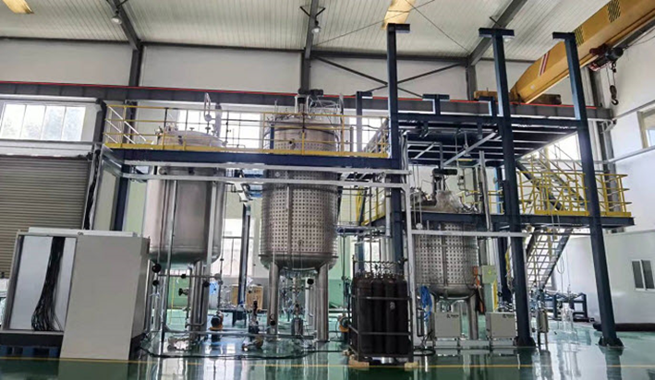
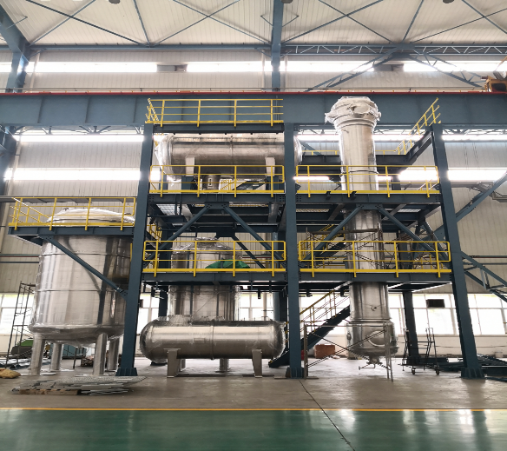
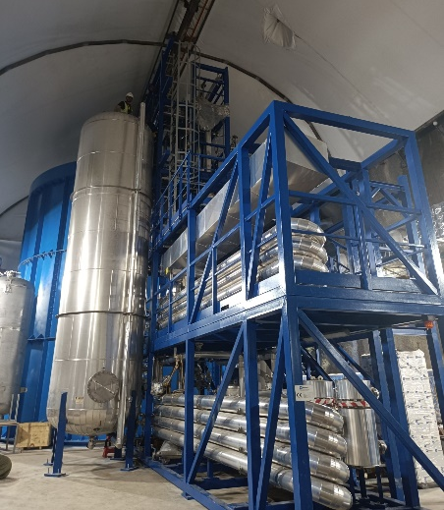
The liquid scintillator
Solvent: LAB
Linear Alkyl-Benzene
88% C + 12% H
Scintillator: Fluor
2.5 g/l PPO
Wave-length shifter
bis-MSB
3 mg/l
Distillation to remove radioactive impurities
5000 m³ LAB tank
Al₂O₃ to remove particles
Mixing (2.5 g/L PPO,3 mg/L bis-MSB)
Experiments | Mass [t] | ²³⁸U [g/g] | ²³²Th [g/g] | ²¹⁰Po [cpd/kt] | Reference
Borexino Phase I | 278 | (1.6±0.1)×10⁻¹⁷ | (6.8±1.5)×10⁻¹⁸ | 8×10⁴ | PRL 101 (2008) 091302
KamLAND | 1000 | (5.0±0.2)×10⁻¹⁸ | (1.3±0.1)×10⁻¹⁷ | 2.4-4.8×10⁵ | PRC, 92:055808, 2015
SNO+ | 780 | (4.7±1.2)×10⁻¹⁷ | (5.3±1.5)×10⁻¹⁷ | 10⁷ | PANIC2021:274, 2022
JUNO reached | 20000 | < 1×10⁻¹⁶ | < 1×10⁻¹⁶ | 5×10⁴
Water extraction to remove radioactive impurities
Gas stripping to remove Rn and O₂
OSIRIS: radio purity check

Slide 14
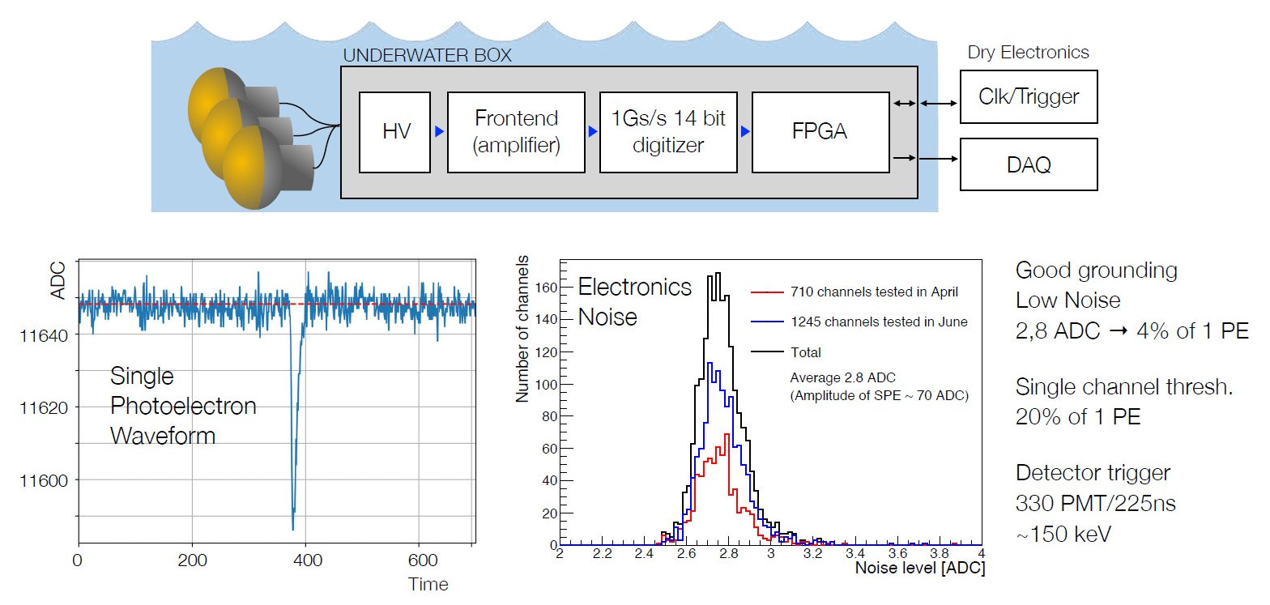
Electronics Performance
Good grounding
Low Noise
2.8 ADC → 4% of 1 p.e.
Single channel threshold:
20% of 1 p.e.
Detector trigger:
350 PMTs in 300 ns
~ 180 keV

Slide 15
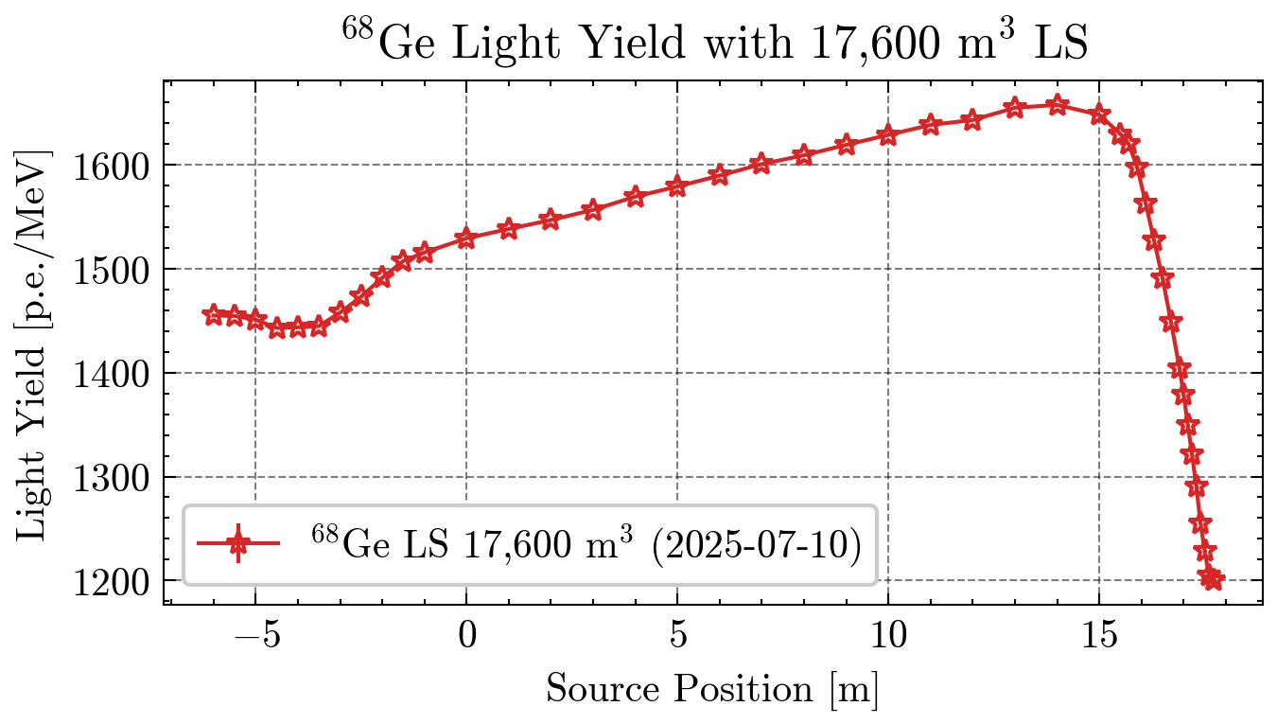
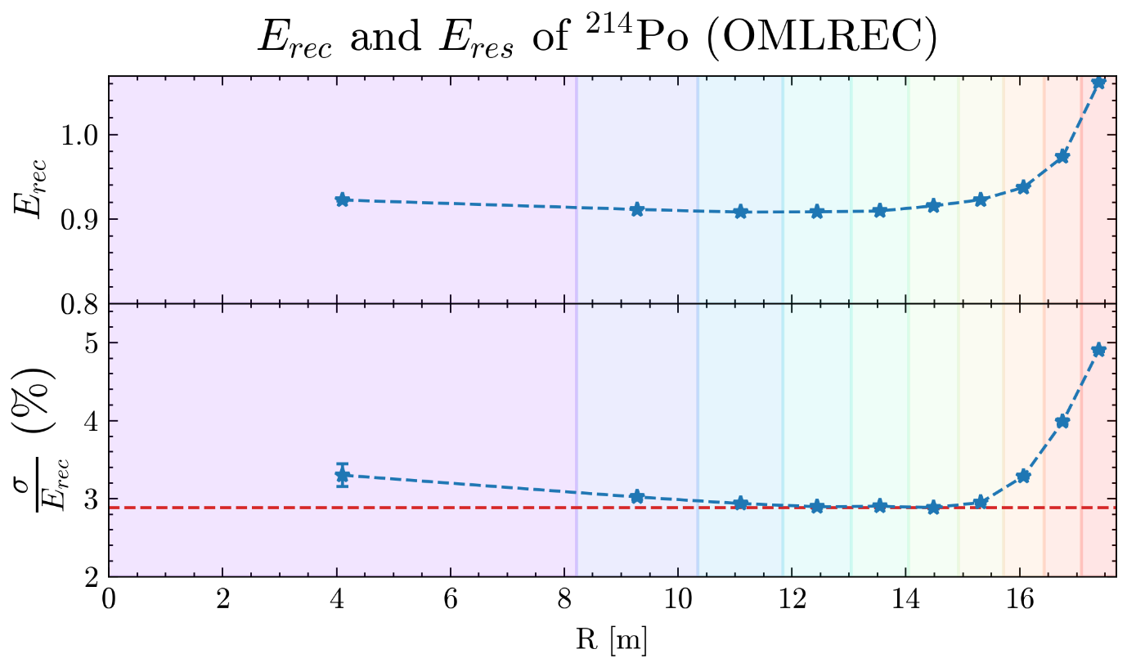
Energy Resolution
(OMILREC)
Light yield along the vertical axis of JUNO
detector partially filled
simulation: 1525 p.e. @ centre
Energy resolution with ²¹⁴Po source
detector partially filled
approx 3% @ 0.92 MeV
uniformity still needs to be improved

Slide 16
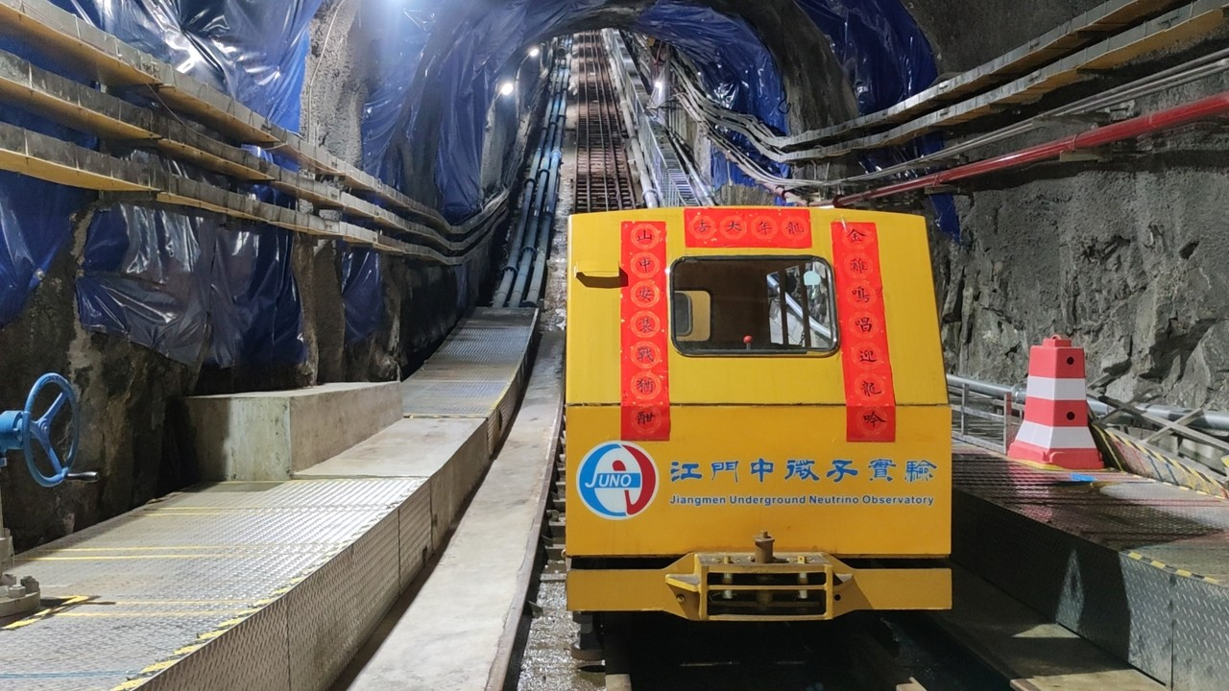

Thanks

Slide 17
Backup Slides

Slide 18
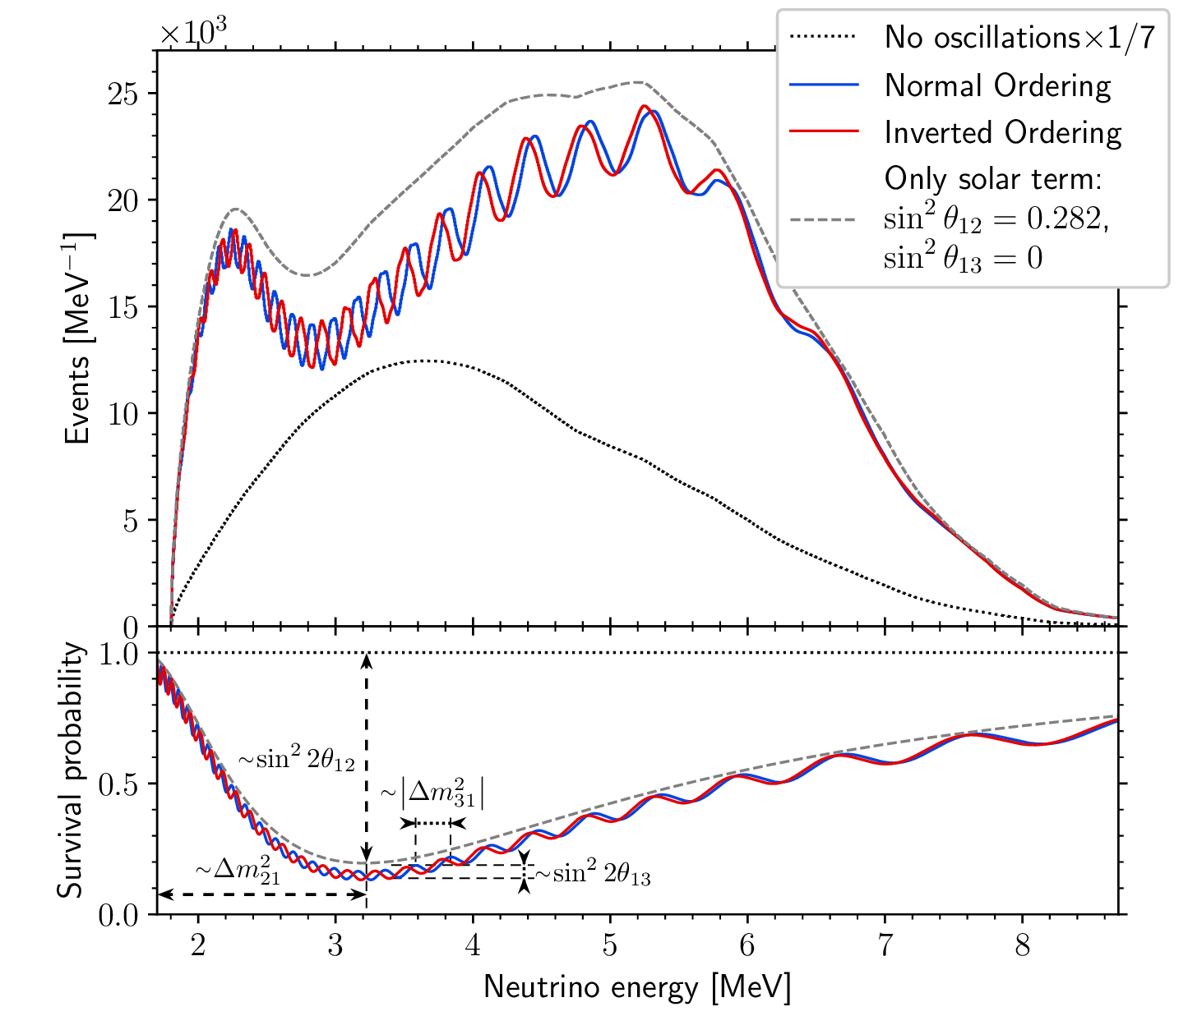
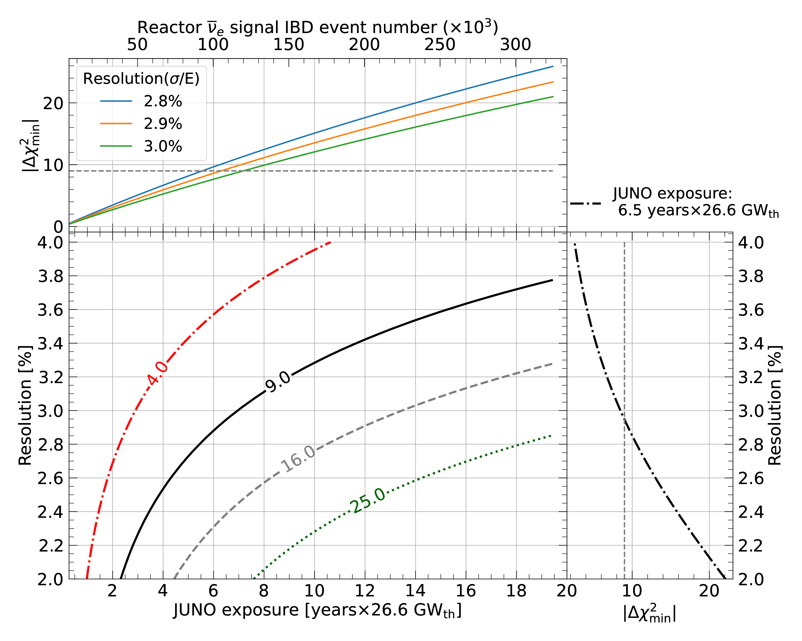
Neutrino Mass Ordering

