Slide 1
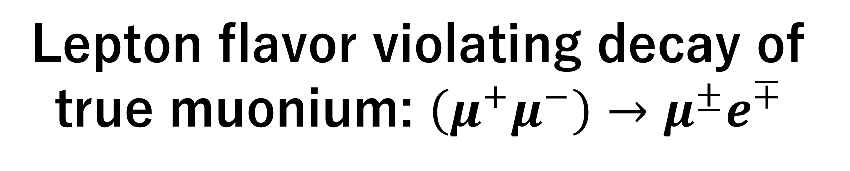
Lepton flavor violating decay of true muonium: $\left(μ^{+}μ^{−}\right)→μ^{±}e^{∓}$
Ryotaro Minato (Yokohama National University)
Collaborators: Akira Sato (Osaka University), Ryosuke Suda (Saitama University), Masato Yamanaka (Hiroshima Institute of Technology)
arXiv:2507.01193
Notes:
Thank you for your introduction.
This presentation is based on the following arXiv preprint.

Slide 2
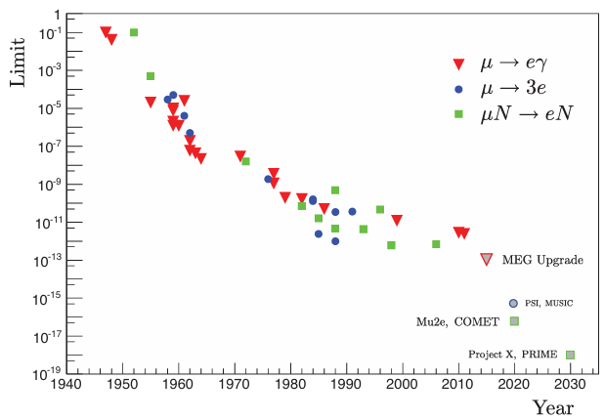
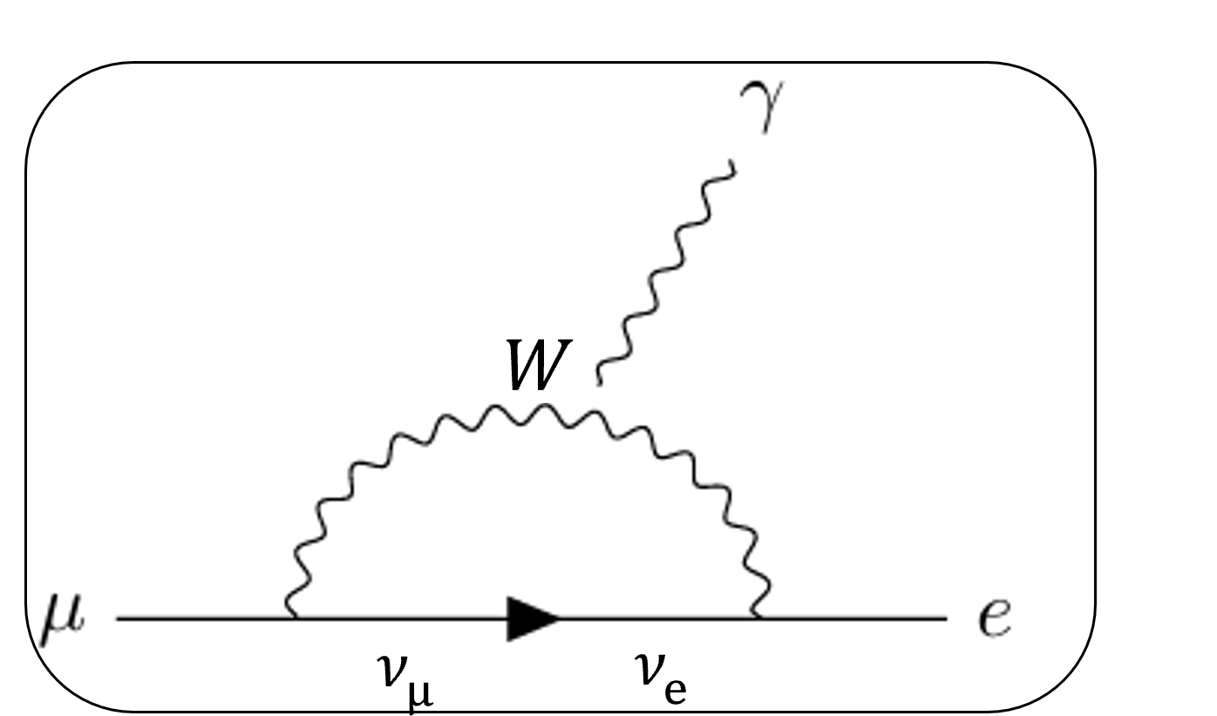

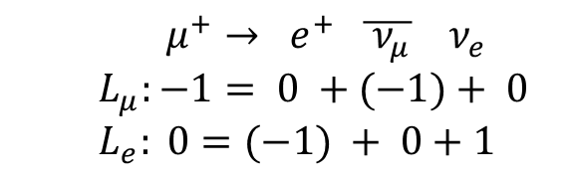

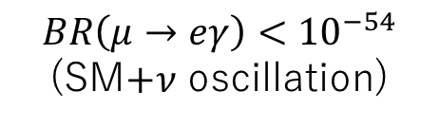

Lepton Flavor Violation
$$μ^{+}→ e^{+} \overline{ ν_{μ}} ν_{e}$$
$L_{μ}:−1= 0 +(−1)+ 0$
$L_{e}: 0=(−1) + 0+1$
Lepton Flavor Violation (LFV)
Standard model: Exact conservation of lepton flavor
→Evidence for BSM (e.g., Neutrino Oscillations).
Charged Lepton Flavor Violation (CLFV)
Haven’t discovered yet, Evidence of New Physics (NP)
$$\overline{ ν_{μ}}→\overline{ ν_{e}}$$
$$L_{μ}:−1≠0$$
$$L_{e}:0≠−1$$
Not conserved
$$μ^{+}→e^{+}γ$$
$$L_{μ}:−1≠0$$
$$L_{e}:0≠−1$$
$$BR\left(μ→eγ\right)<{10}^{−54}$$
(SM$+ν$ oscillation)
BR
・MEG
・COMET
・Mu3e
・Mu2e
…
$${10}^{−15}$$
Extremely small without NP!
Robert H. Bernstein, Peter S. Cooper, Jul 22, 2013
Notes:
The focus of this study is Lepton Flavor Violation (LFV). In the Standard Model, lepton flavor is conserved. For example, this is a process of muon decays which conserves lepton flavor. However, lepton flavor violation was discovered in the neutrino sector by neutrino oscillation. This provided clear evidence of physics beyond the Standard Model (BSM).
In this study, we particularly focus on Charged Lepton Flavor Violation (CLFV). These are simple examples of CLFV process μ→eγ, which is not conserved lepton flavor. CLFV is predicted by neutrino oscillations, its expected branching ratio from the Standard Model and neutrino oscillation is extremely small (O(E-54)). Therefore, if CLFV is observed at current experimental sensitivity(O(E-15)), it would provide direct evidence of the existence of the new physics beyond the Standard Model.
However, CLFV has not been discovered yet, and various experiments are searching for it. As mentioned in the previous talk, the MEG experiments investigate the decay μ→eγ, while the Mu3e experiments study μ→3e. So, muon CLFV is hot topic now.

Slide 3
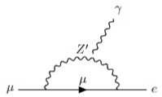
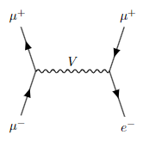
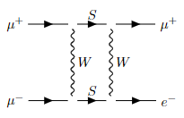
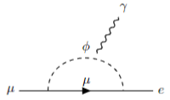
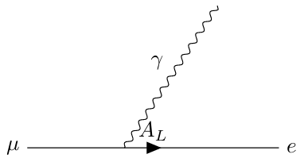
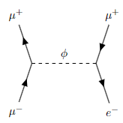
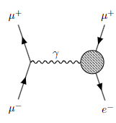
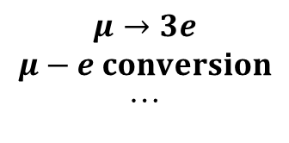



Proposal new CLFV channel
Work: Propose new CLFV channel : $(μ^{+}μ^{−})→μ^{±}e^{∓}$
→Calculation both of $μμμe$ four-fermi operator and dipole operator
Motivation
New particles through intermediate states, don’t appear directly
$$μ→eγ$$
$$(μ^{+}μ^{−})→μ^{±}e^{∓}$$
comparing
$$z′$$
・・・
・・・
$$μ→3e$$
$$μ−e conversion$$
…
・・・
Extract underlying physics by comparing with other channels
→Exploring many CLFV channels complementally is important
Notes:
This is our work propose a new CLFV channel:(μ⁺μ⁻)→μ⁺e⁻ or μ⁻e⁺. There is motivation.
In many models, new CLFV particles are not produced directly. Instead, they appear as virtual particles in intermediate states. This makes it hard to identify the origin of CLFV from just one process.
So, to better understand the underlying physics, we compare different CLFV channels such as: μ → eγ, μ → 3e, μ–e conversion. Each process gives complementary information, because they may have common structure of NP.
The more we compare, the more we can narrow down the possible mediators.
Our new channel, (μ⁺μ⁻)→μe, adds a new way to test CLFV.
It probes both (μμμe) four-fermion operator and dipole operator simultaneously, which has not been calculated before theoretically.
Therefore, exploring many CLFV channels together helps us reveal new physics in a more complete way.

Slide 4
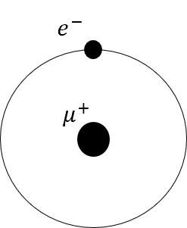
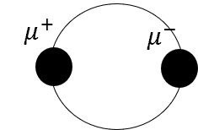
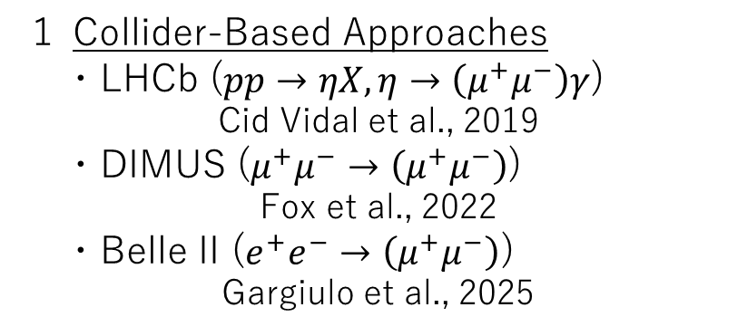
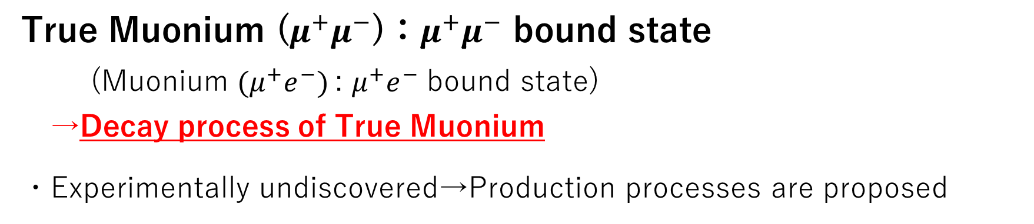


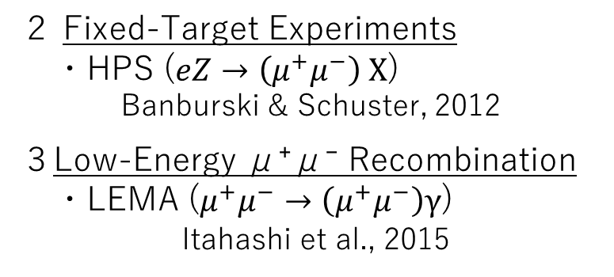
What is True Muonium?
Muonium
True Muonium
True Muonium ($μ^{+}μ^{−}$)：$μ^{+}μ^{−}$ bound state
(Muonium ${(μ}^{+}e^{−})$: $μ^{+}e^{−}$ bound state)
→Decay process of True Muonium
・Experimentally undiscovered→Production processes are proposed
$$0.053 nm$$
$$0.00051 nm$$
Candidates for production processes
１ Collider-Based Approaches
・LHCb ($pp→ηX, η→\left(μ^{+}μ^{−}\right)γ$)
Cid Vidal et al., 2019
・DIMUS ($μ^{+}μ^{−}→\left(μ^{+}μ^{−}\right)$)
Fox et al., 2022
・Belle II ($e^{+}e^{−}→\left(μ^{+}μ^{−}\right)$)
Gargiulo et al., 2025
２ Fixed-Target Experiments
・HPS ($eZ→$ $\left(μ^{+}μ^{−}\right) X$)
Banburski & Schuster, 2012
３Low-Energy μ⁺μ⁻ Recombination
・LEMA ($μ^{+}μ^{−}→\left(μ^{+}μ^{−}\right)γ$)
Itahashi et al., 2015
Notes:
Now, let me introduce True Muonium. It is a bound state of a muon and an anti-muon, written as (μ⁺μ⁻). The parentheses we refer to as bound state. This is similar to Muonium, which is a bound state of an electron and an anti-muon (μ⁺e⁻).
In this study, we are interested in the decay process of True Muonium, involve lepton flavor violation.
True Muonium has not been observed experimentally yet. However, several production methods have been proposed. As shown here, we classify them into three types:
1 Collider-based approaches, such as – LHCb (via η → γ (μ⁺μ⁻)),
Proton collision involve meson decay – DIMUS (a future μ⁺μ⁻ collider), – and Belle II (e⁺e⁻ → μ⁺μ⁻).
2 Fixed-target experiments, for example HPS. An electron beam hits a heavy nucleus and creates True Muonium.
3 Low-energy μ⁺μ⁻ recombination, using slow muon beams to form bound states.
These approaches may lead to the first discovery of True Muonium in the future.

Slide 5

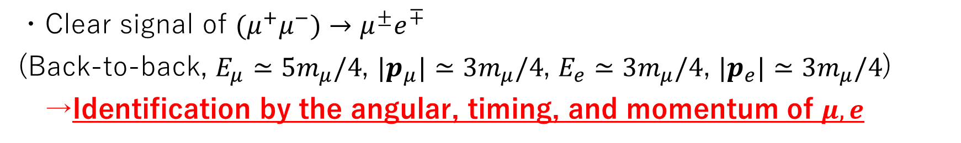



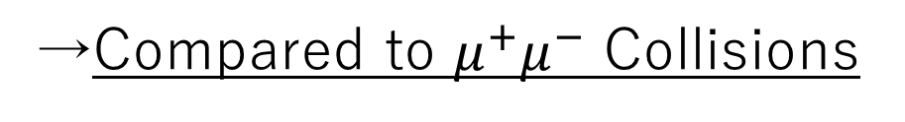


Why True Muonium?
$$p=0$$
→Compared to $μ^{+}μ^{−}$ Collisions
$$μ^{+}$$
$$(μ^{+}μ^{−})$$
$$e^{−}$$
$E_{μ}$, $p_{μ}$
$E_{e}$, $p_{e}$
well-defined energy
・Clear signal of $(μ^{+}μ^{−})→μ^{±}e^{∓}$
(Back-to-back, $E_{μ}≃5m_{μ}/4$, $|p_{μ}|≃3m_{μ}/4$, $E_{e}≃3m_{μ}/4$, $|p_{e}|≃3m_{μ}/4$)
→Identification by the angular, timing, and momentum of $μ,e$
・Early-stage accessible
Can be observed before construction of muon acceleration systems
・Magnetic fields provide unique insights into new physics (future work)
As seen in muonium–antimuonium conversion rate depends on external field.
(K. Horikawa and K. Sasaki, 1996)
Notes:
Then we will explain Why do we use True Muonium Compared to μ⁺μ⁻ collisions, True Muonium offers several advantages for searching for CLFV.
First, the signal is very clear. Assuming the rest frame, the two leptons are emitted back-to-back, with fixed energies and momenta. This makes it easy to identify them using their angular correlation, timing, and momentum.
Second, TM can be studied at an early stage of the muon collider program. It only requires a source of muons and cooling system. We can search for TM decay even before building acceleration systems.
Third, magnetic field studies may reveal new physics. We do not touch in this study.
These features make TM powerful probe for CLFV

Slide 6
・Introduction
・Interaction Lagrangian
・Numerical result
Notes:
Here we explain the theoretical framework used in this study.

Slide 7
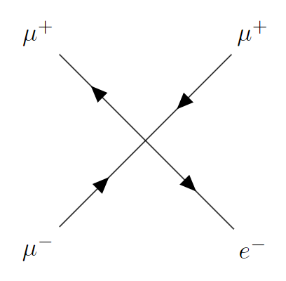
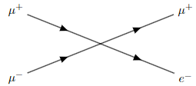






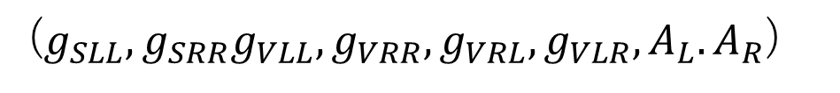





Types of Operator
・Scalar, Vector, Dipole-type operator
Evaluate the BR as a function of $g_{S}, g_{V},A$
$$L_{μ}:0→−1$$
$$L_{e};0→+1$$
CLFV！
(Heavy mediator)
$$μ^{+}$$
$$μ^{+}$$
?
$$g_{S},g_{V}$$
+
$$A$$
$$μ^{−}$$
$$e^{−}$$
SM
Dipole
$$g_{S}$$
$$g_{V}$$
$$e^{+}e^{−}, 2γ$$
(singlet : triplet=1:3)
Scalar
Vector
Chirality (L,R)
($g_{SLL},g_{SRR}g_{VLL},g_{VRR},g_{VRL},g_{VLR},A_{L}.A_{R}$)
Notes:
We consider three types of operator of mediator particles that could significantly contribute to CLFV:
Scalar-type
Vector-type
Dipole-type
If the mediators are heavy, the interaction is described as an effective four-Fermi interaction. In the case of independence, we analyze scalar and vector operators with couplings g_s​ and g_v​, respectively. Additionally, we include a dipole operator involving photon emission, with coupling A.
We then evaluate the branching ratios as functions of these three independent couplings.
Since the process may be sensitive to chirality, we further extend our analysis to include left-right couplings, considering a total of eight independent coupling.

Slide 8
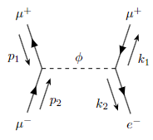
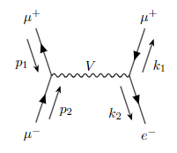
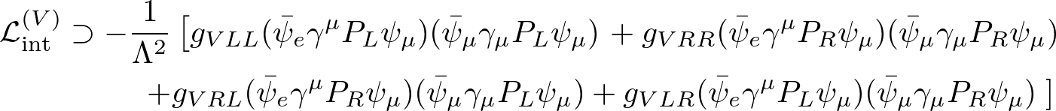




Scalar, Vector-type Operator (Four-Fermi)
Heavy mediator can be treated as contact interactions.
$$q$$
・・・
$$q$$
$$q^{2}≪{m_{φ}}^{2},{m_{V}}^{2}\sim Λ^{2}$$
($Λ$: Scale of NP)
Notes:
Next, we present the Lagrangian for each operator type.
Four-Fermi interactions
・If the mediator is much heavier than the typical momentum scale of the interaction, the process can be approximated by a point-like interaction.
・The scale Λ is interpreted here as the scale of the mediator mass.
・Performing the Fierz transformation, we find that some scalar operator are linearly dependent on vector operators, reducing the number of independent couplings to six.
Corresponding Lagrangian is like that.

Slide 9
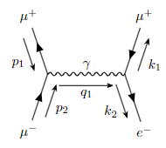
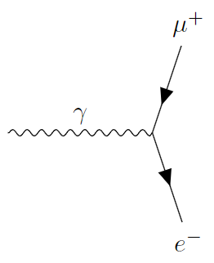

Dipole-type Operator
Dipole-type operator + gauge interaction
・Strong complementarity with $μ→eγ$ searches
Dipole
Notes:
2. Dipole-type interactions
This case involves one dipole operator and one gauge interaction, with a photon as the mediator.
・It has strong complementarity with $μ→eγ$ searches, because this process include $μ→eγ$ dipole structure.
The corresponding Lagrangian is expressed like this.
We evaluate the dependence of CLFV branching ratios on all eight couplings.

Slide 10
・Introduction
・Interaction Lagrangian
・Numerical result
Notes:
Let us move on to our results of the branching ratio.

Slide 11
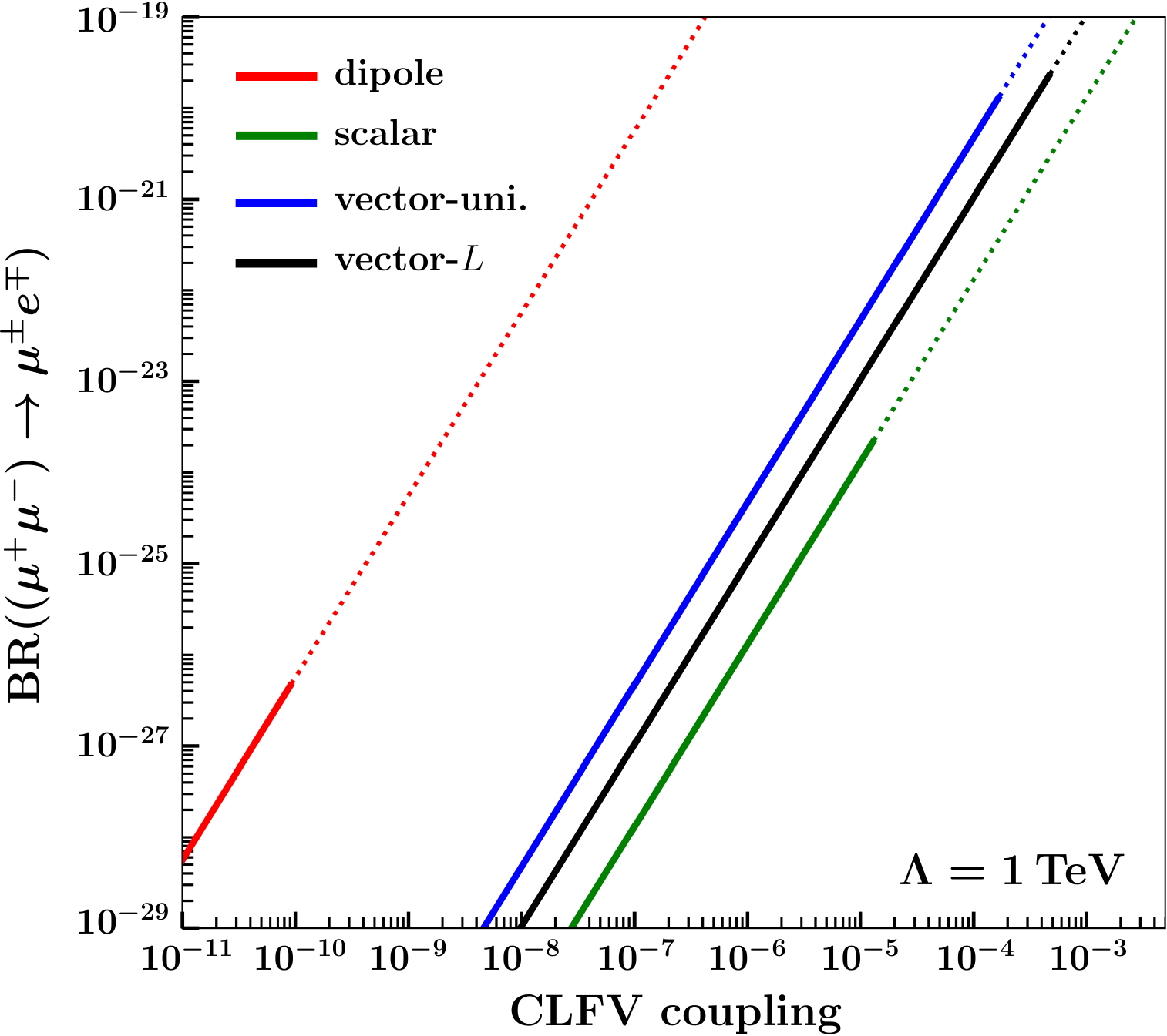

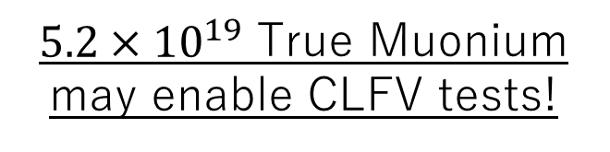
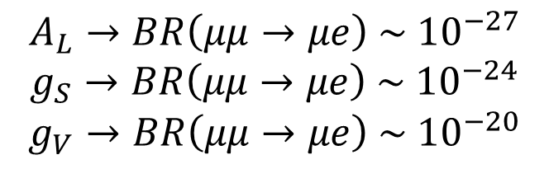
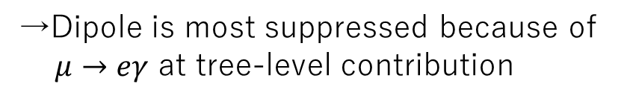


Result (single operator)
Branching Ratio for Each Coupling Constant
Upper Limit of BR
Equal LR
$$g_{VLL}=g_{VRR}=…$$
$$A_{L}→BR\left(μμ→μe\right) \sim {10}^{−27}$$
$$g_{S}→BR\left(μμ→μe\right) \sim {10}^{−24}$$
$$g_{V}→BR\left(μμ→μe\right) \sim {10}^{−20}$$
Only L
$$g_{VLL}≠0,g_{VRR}=…0$$
excluded
${5.2×10}^{19}$ True Muonium
may enable CLFV tests!
Constrains for CLFV coupling by MEG ($μ→eγ$ )
→Dipole is most suppressed because of
$μ→eγ$ at tree-level contribution
The MEGII collaboration .2024
Notes:
Now, let’s look at the branching ratio as a function of each CLFV coupling, assuming a single-operator dominance.
On the horizontal axis, we have the CLFV coupling strength. On the vertical axis, we have the predicted branching ratio for the decay of true muonium into μ±e∓.
The solid lines show our theoretical predictions, while the dotted lines is excluded region by the MEG II bound from μ→eγ.
The different colors in the plot correspond to different types of couplings. For the vector operator, we considered two cases separately: one with equal left- and right-handed couplings, and another with only left-handed coupling.
For example, in the scalar case (green), increasing g_s​ leads to a higher branching ratio, but the experimental limit cuts off the allowed region around 10^{-24}.
We see a similar trend for vector-type operators (blue and black), which give the largest possible branching ratios among the cases we studied.
On the other hand, the dipole-type operator (red) is the most suppressed. This is because it contributes to μ→eγ at tree level. In contrast, scalar and vector operators only contribute via loop processes, allowing for larger branching ratios.
From these results, the most optimistic case requires about 5.2×10^{19} true muonium to test CLFV.

Slide 12
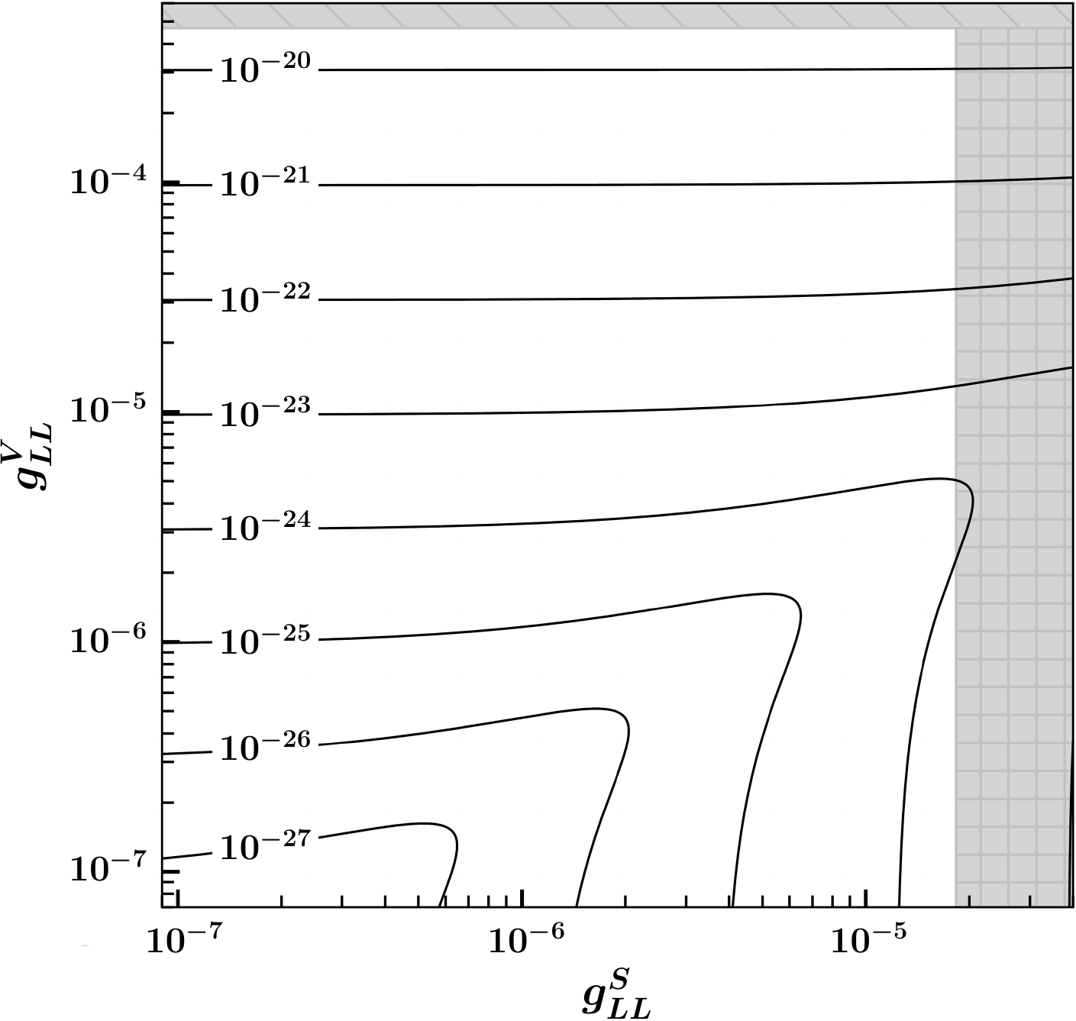
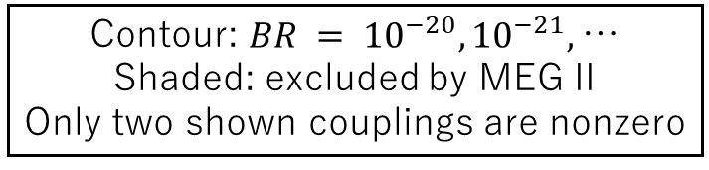
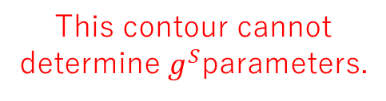


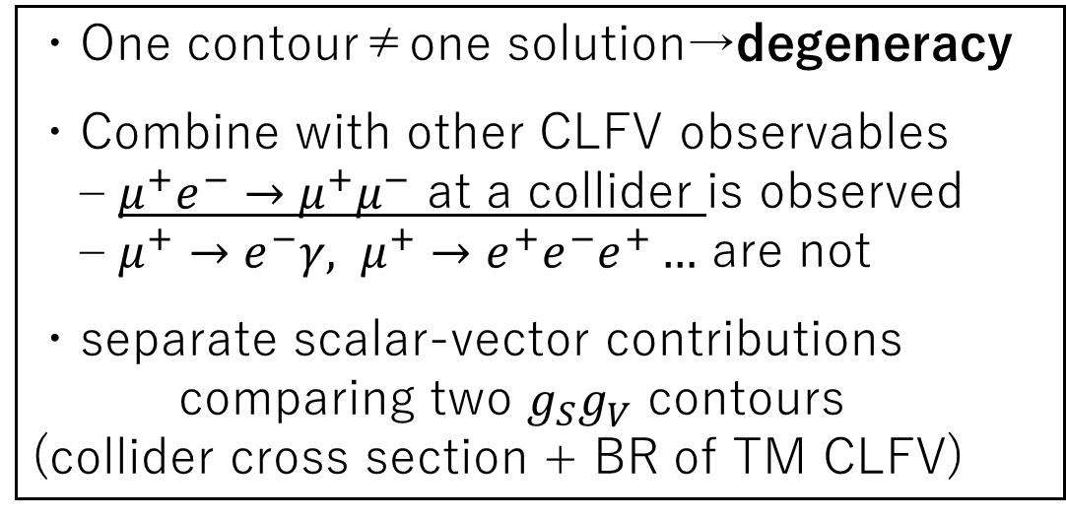
Contour: $BR = {10}^{−20}, {10}^{−21},$…
Shaded: excluded by MEG II
Only two shown couplings are nonzero
Result (multiple operator)
(e.g. scalar-vector interference)
$${BR=10}^{−20}$$
This contour cannot
determine $g^{S}$parameters.
Draw similar $g_{S}−g_{V}^{ }$ contour
・One contour≠one solution→degeneracy
・Combine with other CLFV observables – $μ^{+}e^{−}→μ^{+}μ^{−}$ at a collider is observed – $μ^{+}→e^{−}γ, μ^{+}→e^{+}e^{−}e^{+}…$ are not
・separate scalar-vector contributions comparing two $g_{S}g_{V}^{ }$ contours (collider cross section + BR of TM CLFV)
$→$Break degeneracies and pin down the operator.
Notes:
Here, we extend the analysis to the case where multiple operators contribute simultaneously. As an example, this plot shows the branching ratio of (μ+μ−)→μ±e∓ in the gSLL– gVLL​ plane. We assume only these two couplings are nonzero and real.
The horizontal and vertical axes correspond to gSLL and gVLL ​, respectively.
Each contour represents a fixed branching ratio.
The shaded region is excluded by the MEG II bound from μ→eγ.
Single measurement of the TM branching ratio cannot determine each coupling — we have a degeneracy. In the plot we see at the contour of 10^-21, the vector coupling gv​ can be fixed, whereas the scalar coupling gs​ remains undetermined. To resolve this, we need additional CLFV observables. For example, if the process μ+e−→μ+μ− is observed at a collider while other channels such as μ→eγ or μ→3e remain unobserved, we can also draw similar contour lines from collider data. In this case, it becomes important to disentangle scalar and vector contributions by comparing the contour line from collider cross section with BR of TM CLFV. When combined with complementary CLFV searches, true muonium measurements can break parameter degeneracies and pin down the type of operator responsible for the signal.

Slide 13
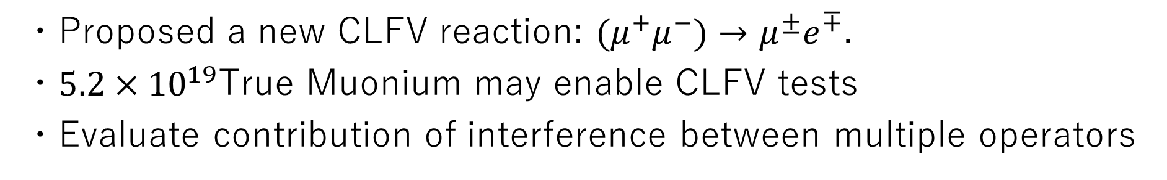
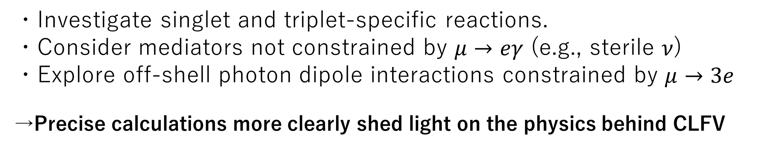
Future Work
Summary
・Proposed a new CLFV reaction: $(μ^{+}μ^{−})→μ^{±}e^{∓}$.
・$5.2×{10}^{19}$True Muonium may enable CLFV tests
・Evaluate contribution of interference between multiple operators
・Investigate singlet and triplet-specific reactions.
・Consider mediators not constrained by $μ→eγ$ (e.g., sterile $ν$)
・Explore off-shell photon dipole interactions constrained by $μ→3e$
→Precise calculations more clearly shed light on the physics behind CLFV
Notes:
Conclusion
I have no time, I will skip summary
We proposed a new LFV reaction: (μ+μ−)→μ+e− from True Muonium decay.
We evaluated three operator types: scalar, vector, and dipole.
Detecting this LFV process would require at least 10^{20} True Muonium events.
Prospects:
Investigate singlet and triplet-specific reactions.
Consider scalar and vector mediators not constrained by μ→eγ(e.g., sterile neutrino).
Explore off-shell photon dipole interactions constrained by μ→3e.
These steps could improve our understanding of mediators and enable LFV searches with fewer True Muonium events, contributing to new physics exploration.

Slide 14



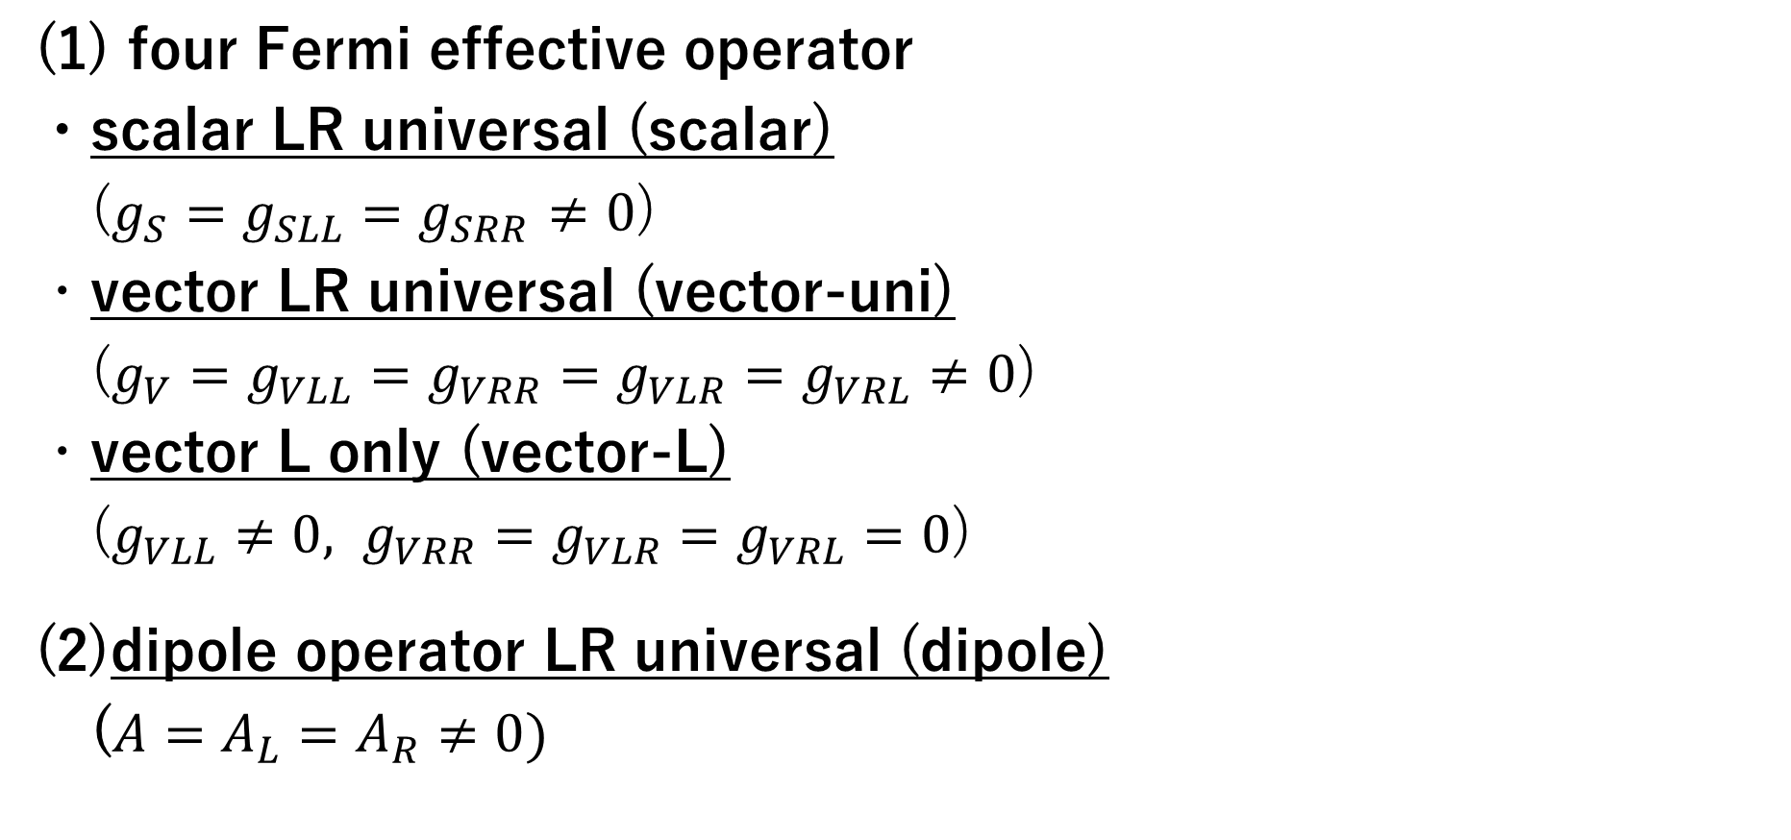










Working Hypothesis
$$L(R)$$
$$L(R)$$
$$g_{S}$$
(1) four Fermi effective operator
・scalar LR universal (scalar)
($g_{S}=g_{SLL}=g_{SRR}$ $≠0$)
・vector LR universal (vector-uni)
($g_{V}=g_{VLL}=g_{VRR}=g_{VLR}=g_{VRL}≠0$)
・vector L only (vector-L)
($g_{VLL}≠0, g_{VRR}=g_{VLR}=g_{VRL}=0$)
(2)dipole operator LR universal (dipole)
($A=A_{L}=A_{R}≠0)$
$$R(L)$$
$$R(L)$$
$$L(R)$$
$$L\left(R\right),R(L)$$
$$g_{V}$$
$$L(R)$$
$$L\left(R\right),R(L)$$
$$L(R)$$
$$A$$
$$R(L)$$
Notes:
To begin with, we consider four representative scenarios as working hypothesis to evaluate the branching ratio. We first focus on the case of four-fermion operators, for which three possibilities are examined.
The first is the case of a scalar mediator, where we assume that it couples equally to left- and right-handed leptons.
Next, we consider a vector mediator, for which there are two distinct coupling patterns:
One where it couples equally to both left- and right-handed leptons, which we refer to as the vector-universal case.
The other where it couples only to left-handed leptons, referred to as the vector-left case.
Finally, we consider the dipole operator, assuming again that it couples equally to both left- and right-handed leptons.

Slide 15
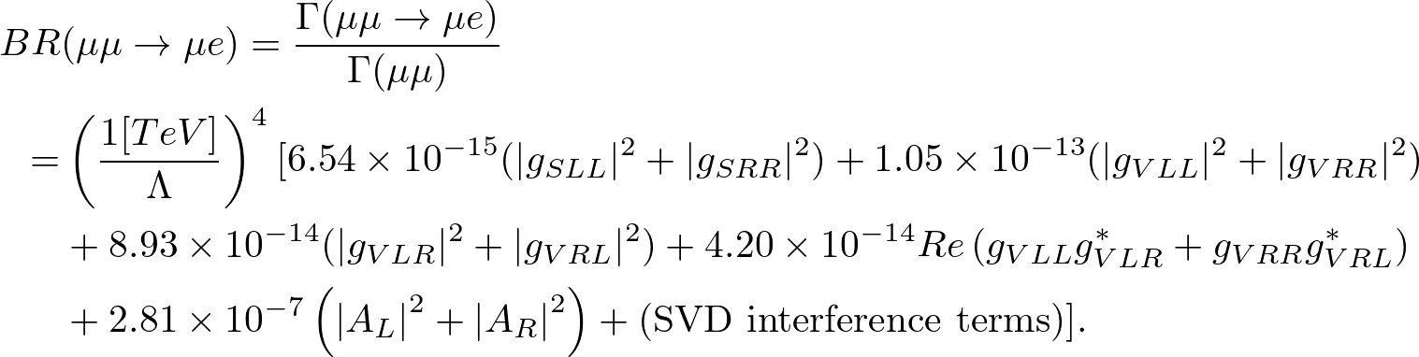

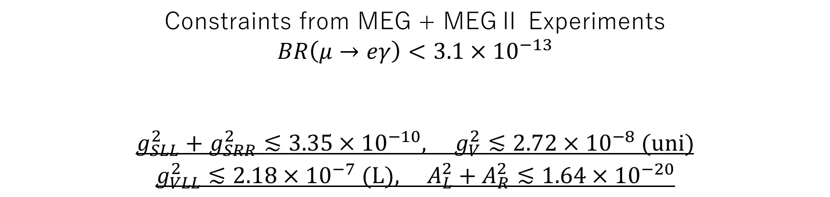
Branching Ratio
Branching ratio($m_{e}\sim 0$)
Constraints from MEG + MEGⅡ Experiments
$$BR\left(μ→eγ\right)<3.1×{10}^{−13}$$
$$g_{SLL}^{2}+g_{SRR}^{2}≲{3.35×10}^{−10}, g_{V}^{2}≲{2.72×10}^{−8}\text{ (}\text{uni}\text{)}$$
$$g_{VLL}^{2}≲{2.18×10}^{−7} \text{(}\text{L}\text{)}, A_{L}^{2}+A_{R}^{2}≲1.64×{10}^{−20}$$
The MEGII collaboration .2024
($Λ\sim 1[TeV]$)
Notes:
Next, we will explain our results.
The obtained branching ratio for (μ+μ−)→μ+e− is presented.
We ignore small electron mass.
The Standard Model contributions (such as e+e− and 2γfinal states) are also included.
We set constraints on our couplings using data from the MEG experiment, which measures μ→eγ.

Slide 16
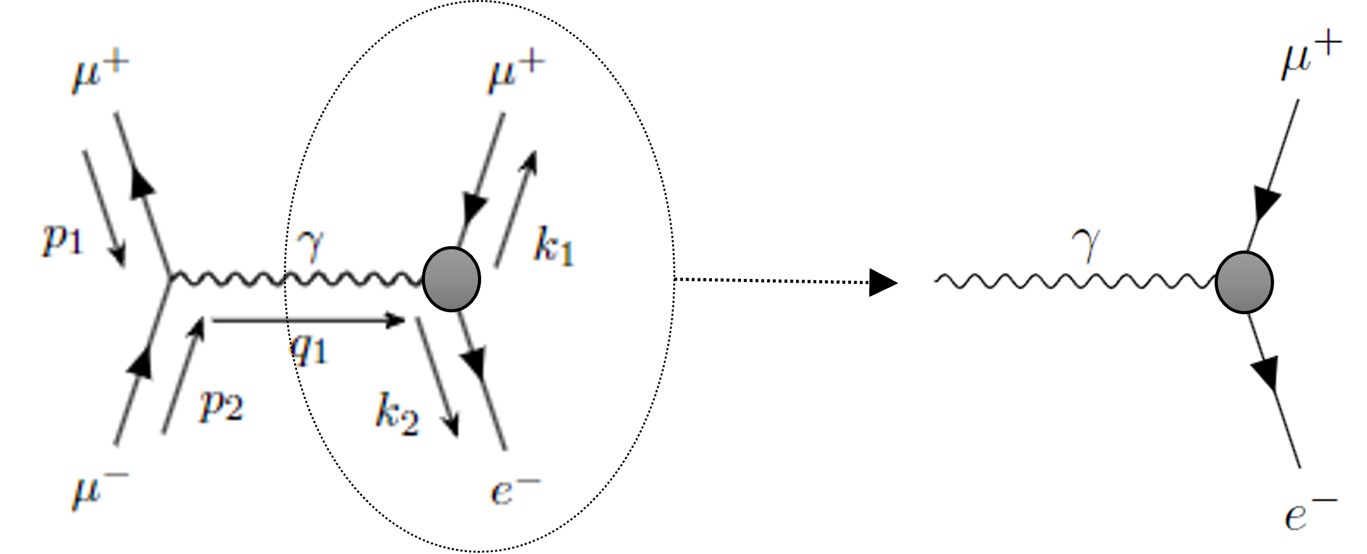


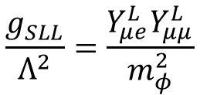
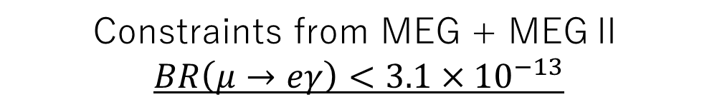



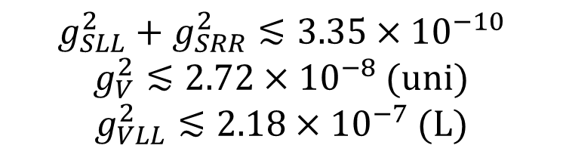





Upper Limit of Coupling Constant
Dipole
Constraints from MEG + MEGⅡ
$$BR\left(μ→eγ\right)<3.1×{10}^{−13}$$
The MEGII collaboration .2024
$$A_{L}^{2}+A_{R}^{2}≲1.64×{10}^{−20}$$
Scalar
Vector
Scalar, Vector
$$g_{S}$$
$$g_{V}$$
$$Y_{μμ}^{L}$$
$$Y_{μe}^{L}$$
$$Q_{μμ}^{L}$$
$$Q_{μe}^{L}$$
$$g_{SLL}^{2}+g_{SRR}^{2}≲{3.35×10}^{−10}$$
$g_{V}^{2}≲{2.72×10}^{−8}$ (uni)
$g_{VLL}^{2}≲{2.18×10}^{−7}$ (L)
(Four-Fermi)
$$\frac{g_{SLL}}{Λ^{2}}=\frac{Y_{μe}^{L}Y_{μμ}^{L}}{m_{φ}^{2}}$$
$$\frac{g_{VLL}}{Λ^{2}}=\frac{Q_{μe}^{L}Q_{μμ}^{L}}{m_{Z^{′}}^{2}}$$
($Λ\sim 1[TeV]$)
Notes:
Then, we discuss experimental constraints on the couplings.
We use data from the MEG experiment, which measures μ→eγ, to set constraints on our couplings.
Scalar and vector operators:
Previous studies have calculated the μ→eγ branching ratio for heavy scalar and vector mediators.
We reinterpret their results using our Lagrangian to obtain upper limits on the couplings, assuming Λ=1 TeV.
Dipole operator:
It is simple. The dipole-type contribution can be directly constrained using μ→eγ data.

Slide 17

Vector-universal vs Vector-left
Vector-universal
Assuming $g_{V}^{\left(vector−uni\right)} = g_{VLL}^{\left(vector−L\right)}$
Vector-left
$$BR\left(vector−uni\right)\sim BR(vector−L)×8$$
→Enhanced around a digit by interference terms
・On the other hand, scalar and dipole are different factor of two simply
Notes:
Because in the case of vector operators there is a non-negligible difference.

Slide 18


Estimated Number of Muons Produced
$3×{10}^{15} μ^{−}/s$, $2×{10}^{15} μ^{+}/s$ are expected produced
at the muon production point of the muon collider
→ ${10}^{22} μ / year$ can produced
C. Accettura et al, 2025
If an efficient method for generating True Muonium,
CLFV decay proposed in this study could be discovered!
Notes:
10^-2以上の効率でTMが作れれば可能、TM効率に依存

