Slide 1


The COMET Experiment
Search for μ - e Conversion at J-PARC
Nguyen Minh Truong, FPT University
on behalf of the COMET collaboration
Viet Nam Flavor Physics, Aug. 17th - 23th 2025

Slide 2
Content
- Introduction μ – e conversion
- μ – e conversion experiment principle
- The COMET experiment at J-PARC
- Current Status
- Summary

Slide 3
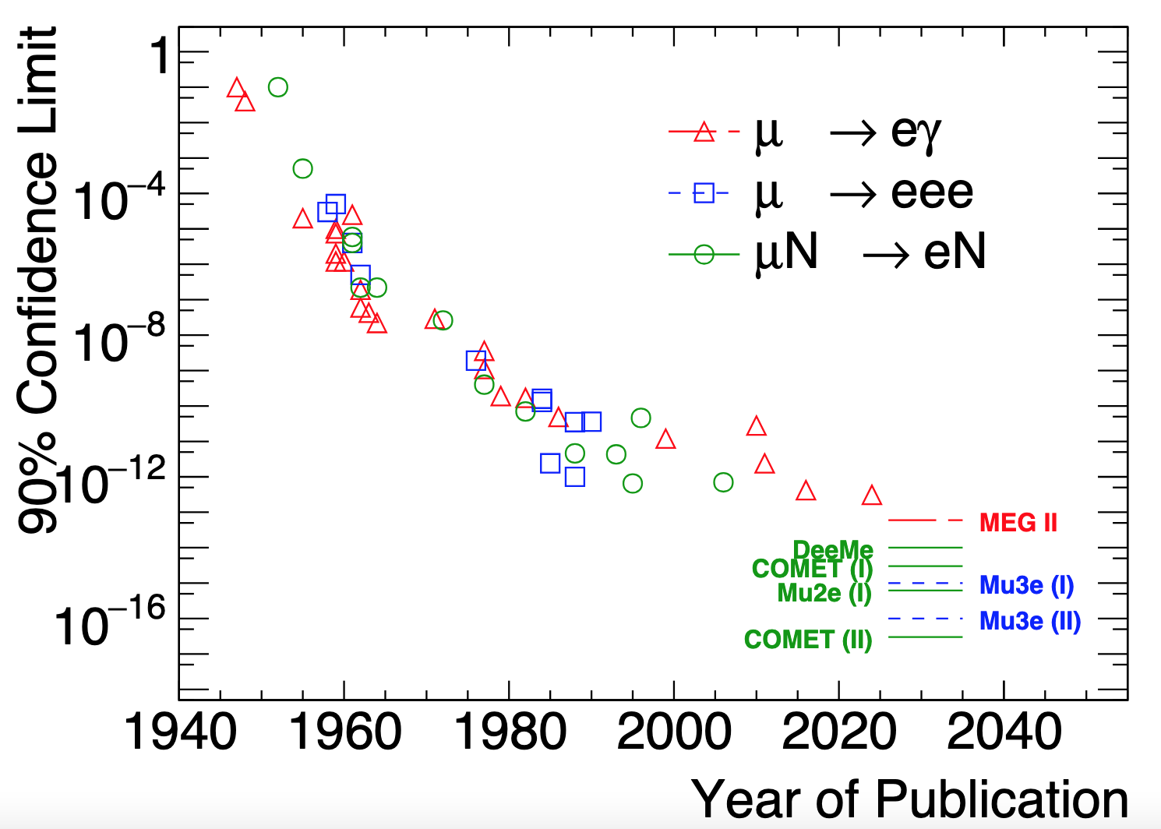
Introduction
Muon-to-Electron Conversion (μ – e conversion) :
- A charged lepton flavor-violating process,
Muon decays to single electron with no neutrino emitted.
- In the SM, the μ – e conversion process is predicted may happen at 𝒪(10⁻⁵⁴) that is too difficult for the current experiment.
- Current upper limit Br(μ + Au → e + Au) < 7x10⁻¹³ by the SINDRUM-II experiment.
- Many appealing new physics models predicted that the μ – e conversion process may happen right-below the current limit.
Nucleus
DIO: μ⁻→ e⁻ 𝜐_{μ} 𝜐_{e}
MC: μ⁻ + (A,Z) → 𝜐_{μ} + (A,Z-1)
𝜇⁻
μ – e conversion: μ⁻ + (A,Z) → e⁻ + (A,Z)

Slide 4
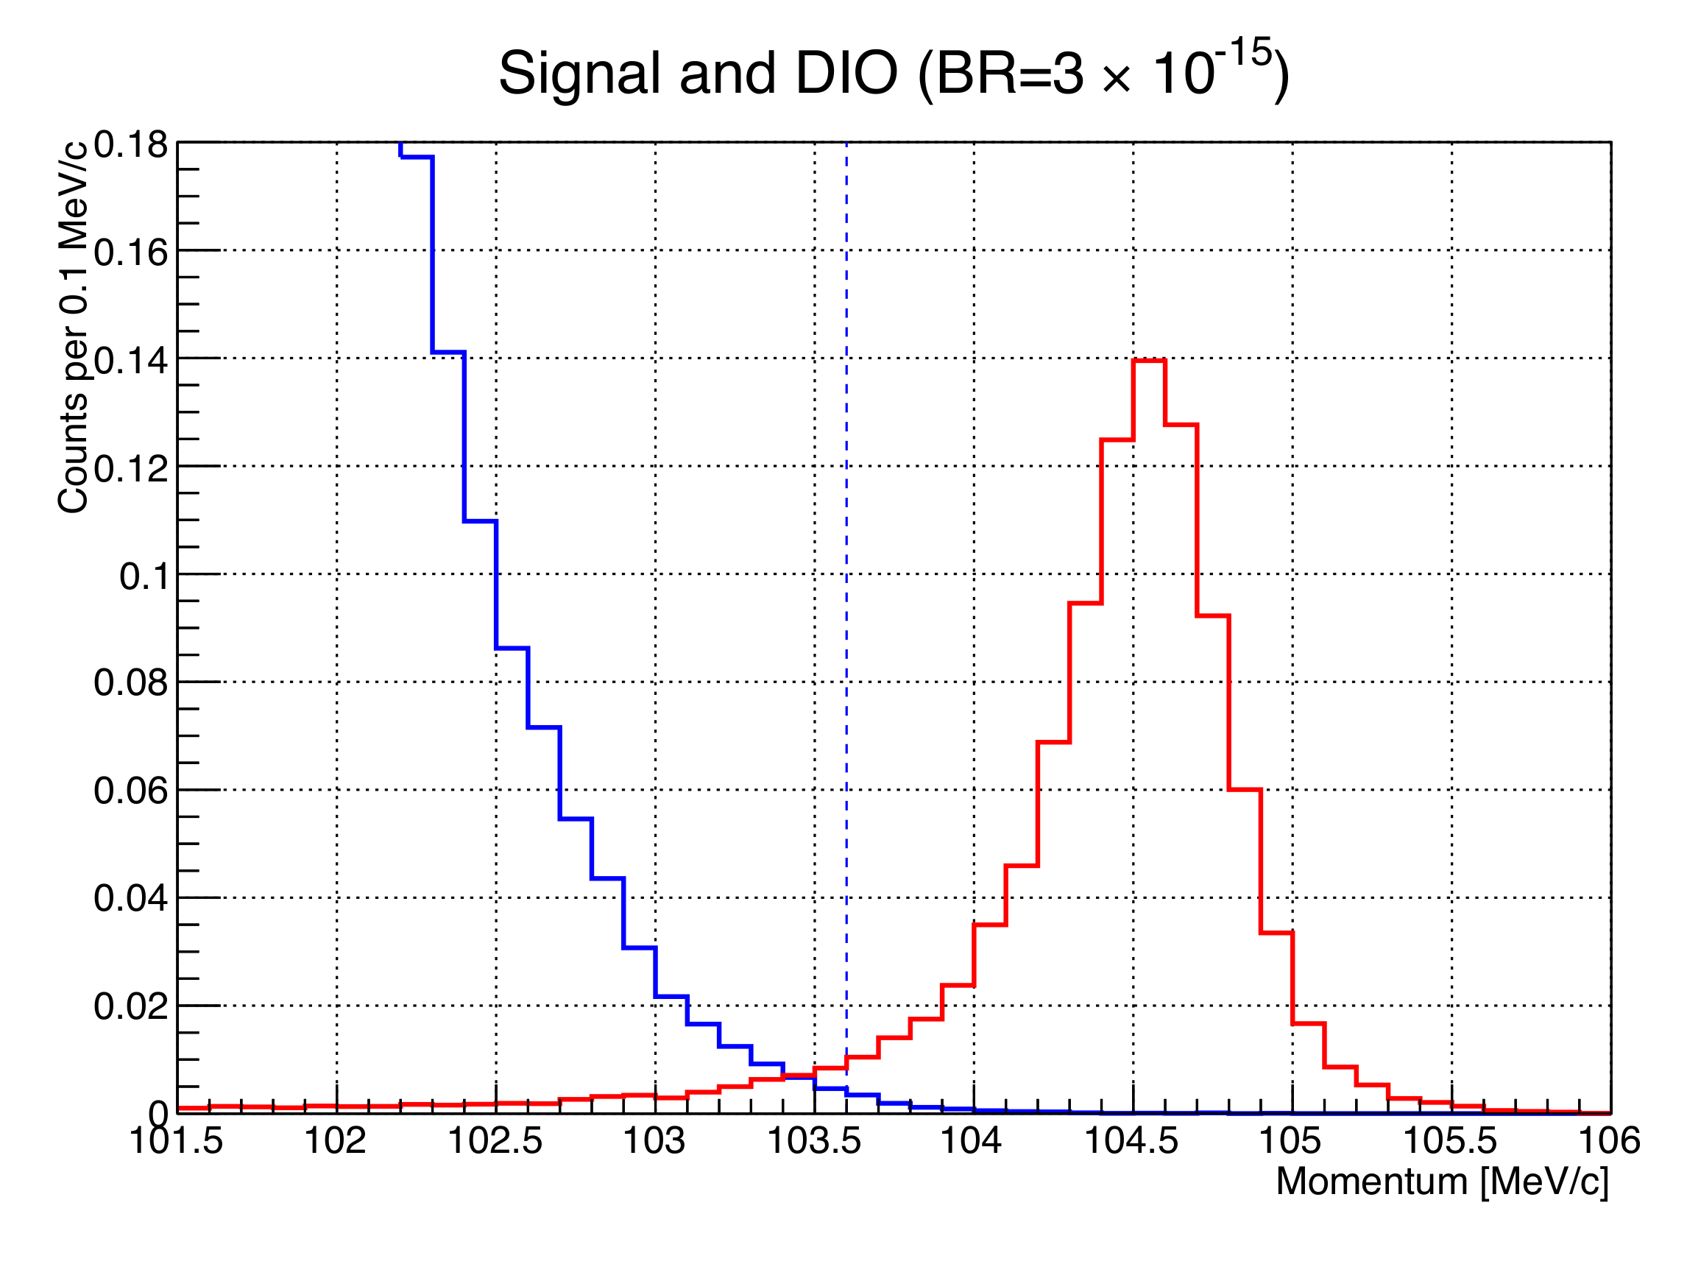
Experimental Principle
Signal and intrinsic backgrounds
+ Signal μ + N → e + N,
monochromatic energy of 104.97 MeV and muonic atom lifetime is 864 ns in Al target
+ Dominant intrinsic backgrounds: decay-in-orbit (DIO)
+ Contaminate the signal region with finite resolution → Momentum resolution < 200 keV/c is required.
Nucleus
DIO: μ⁻→ e⁻ 𝜐_{μ} 𝜐_{e}
MC: μ⁻ + (A,Z) → 𝜐_{μ} + (A,Z-1)
𝜇⁻
μ – e conversion: μ⁻ + (A,Z) → e⁻ + (A,Z)

Slide 5
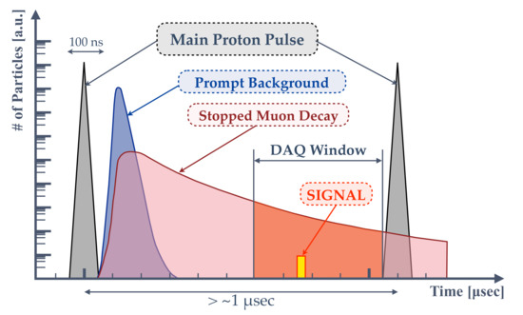
Experimental Principle
High intense muon beam and beam backgrounds
+ Proton beam at J-PARC gain high statistics of muons.
An effective transport line from π to μ is essential
+ Backgrounds arise from the proton and its secondary:
Radiative pion capture, muon decay in flight, etc...
→ Bunched beam structure and delayed timing window for masking the beam BG
+ The fraction of residual protons between the bunches (extinction) <10⁻¹⁰
+ Narrow proton pulse beam in 100ns width
+ DAQ window delay 700ns from pulse beam

Slide 6
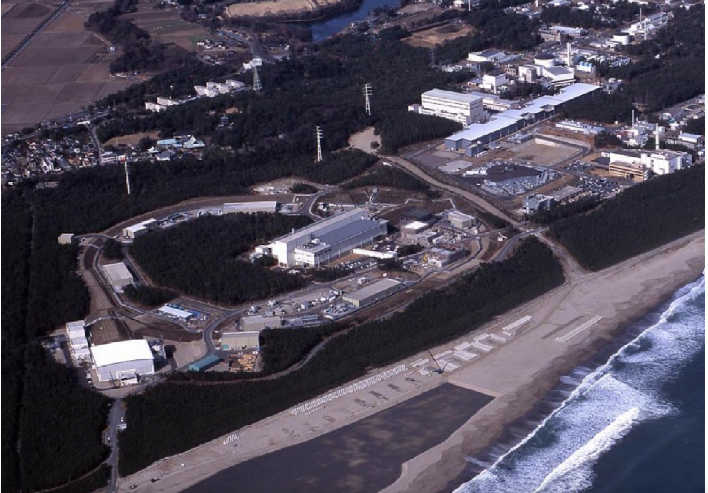
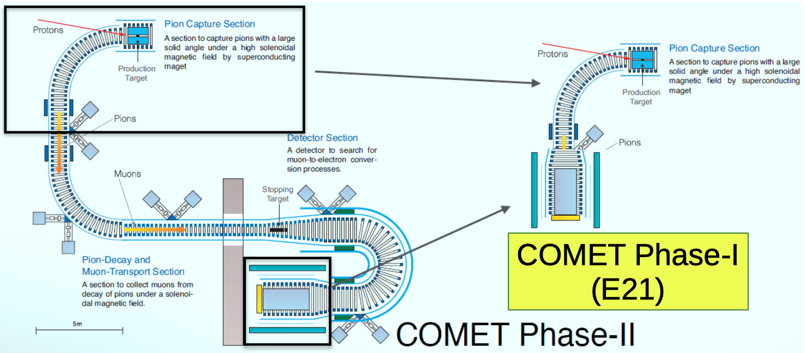
The COMET Experimental at J-PARC
Searching for μ-e conversion at J-PARC The final goal: 𝒪(10⁻¹⁷) sensitivity.
10,000 times improved from the current limit.
Building the facility and muon transport line.
Phase I: Single Event Sensitivity 3 x 10⁻¹⁵
Physics measurement by cylindrical detector
Beam & background measurement by tracker and calorimeter
Phase II: Single Event Sensitivity ~ 10⁻¹⁷
Physics measurement by tracker and calorimeter

Slide 7
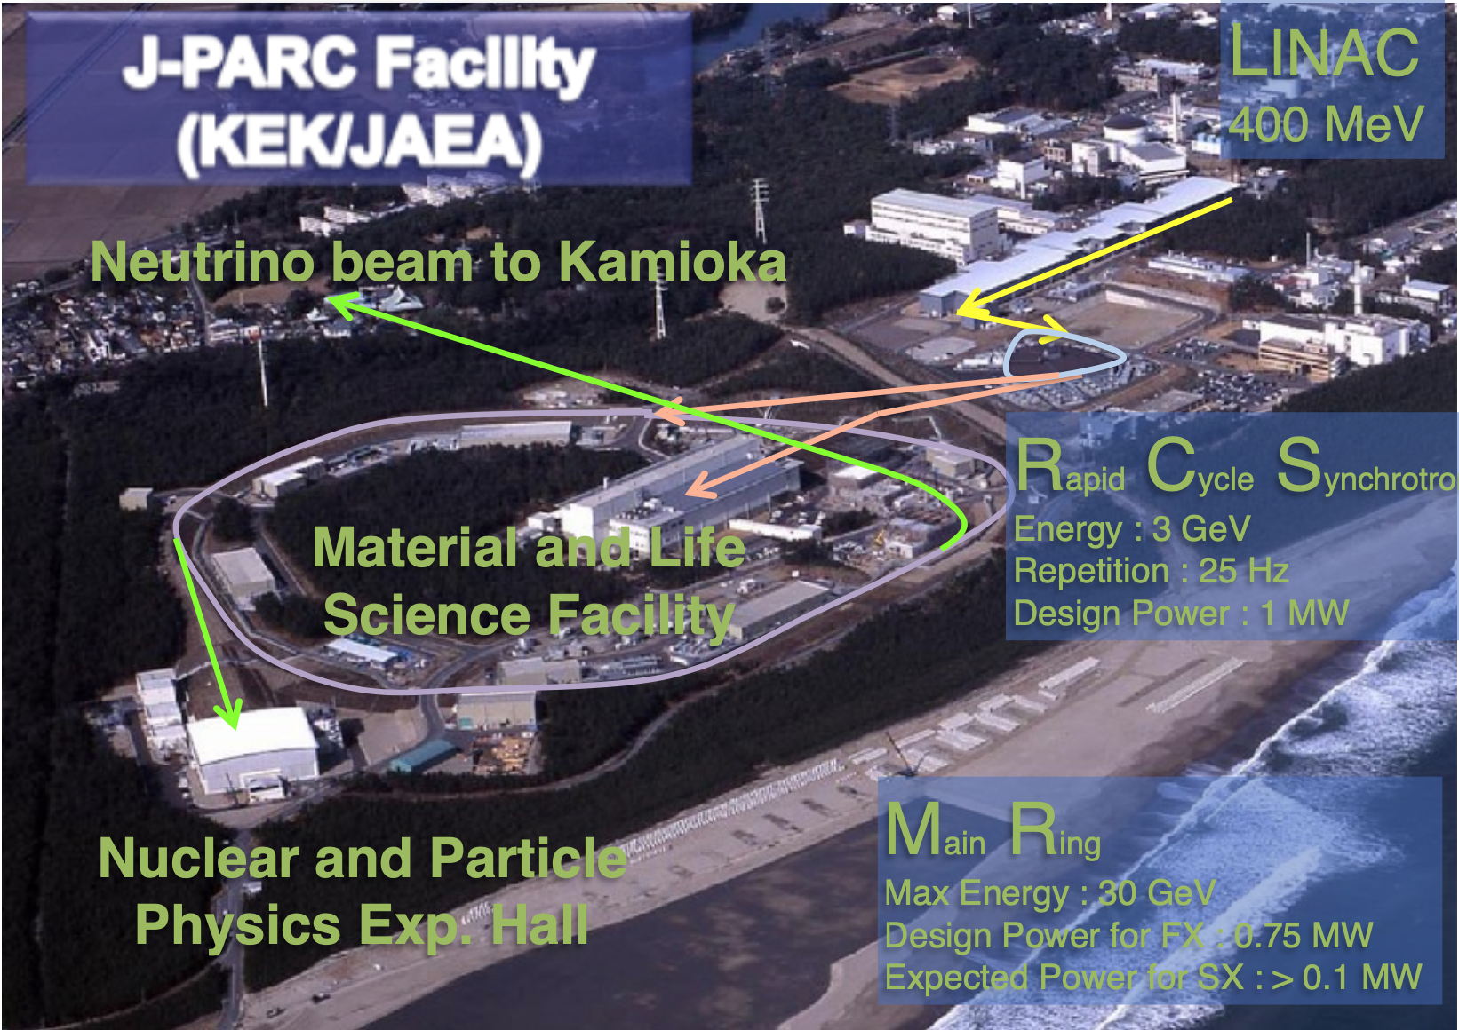
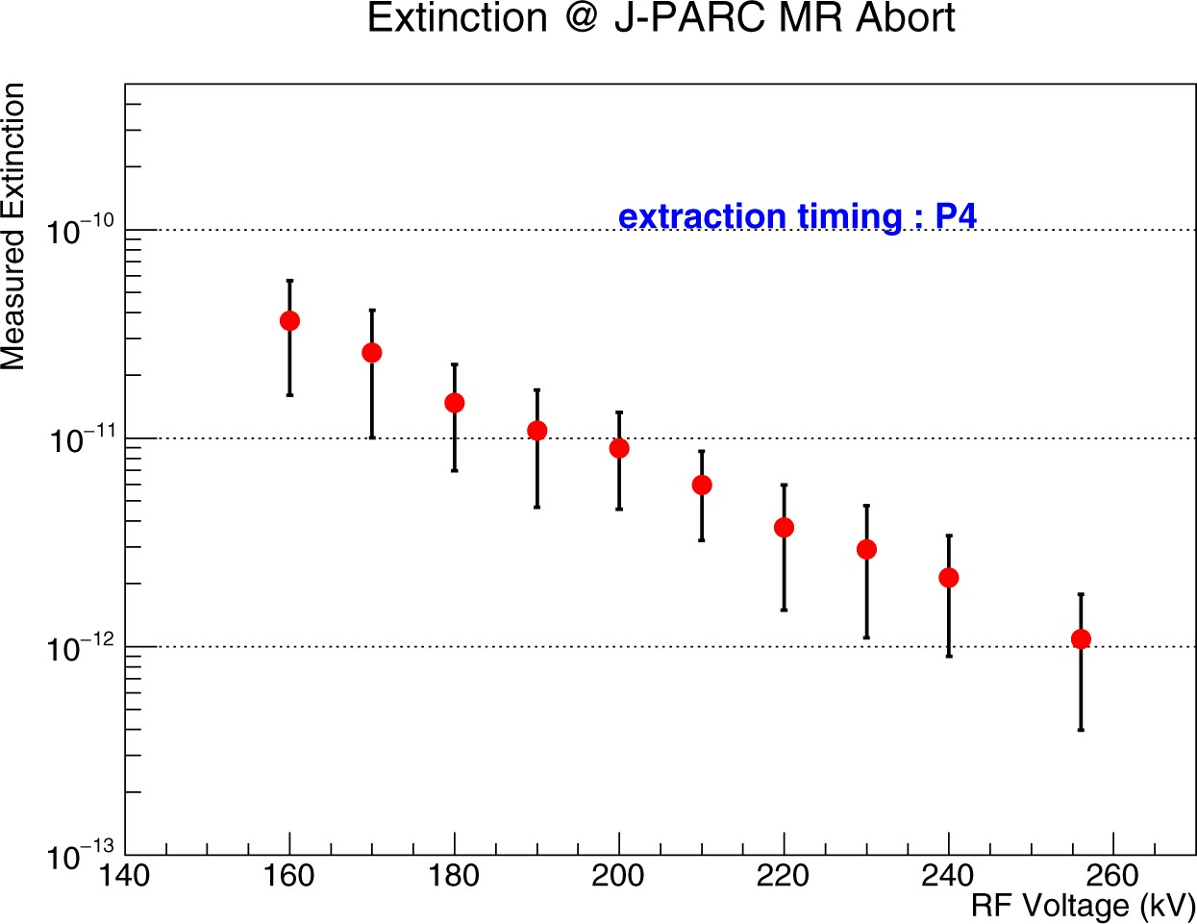
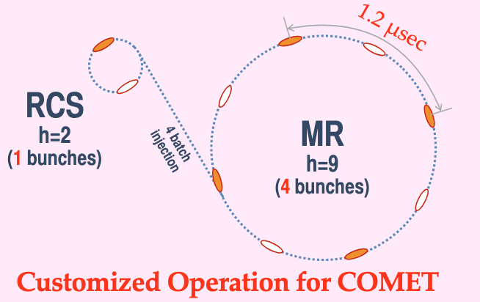
Proton Beam
J-PARC Proton Beam for COMET
+ 3.2 kW for phase I
+ 56kW for phase II
+ Bunched slow extraction for the timing-window measurement
+ Accelerator proton beam 8GeV
Minimize antiproton
+ Extinctions < 10⁻¹⁰ to remove background in signal time window.
The experiment confirm that the extinctions < 10⁻¹⁰ can be achieved.
Exp. Hall
Prog Theor Exp Phys, Volume 2020, Issue 3, March 2020, 033C01, https://doi.org/10.1093/ptep/ptz125

Slide 8
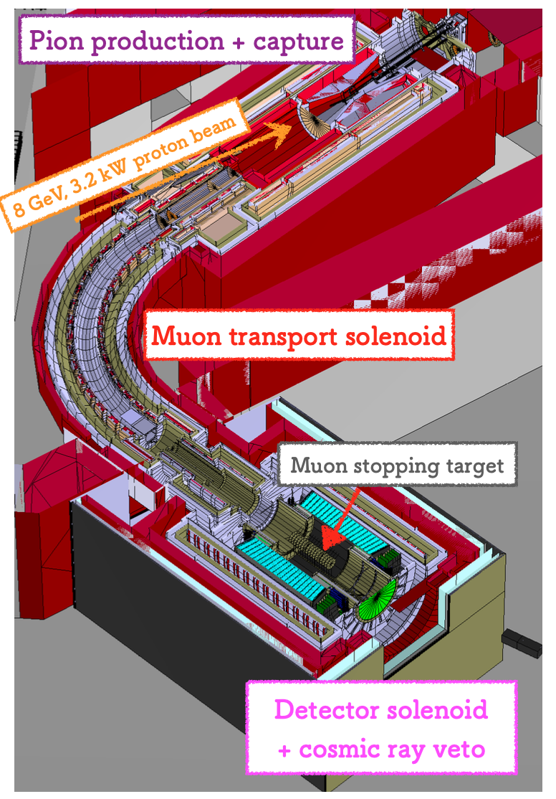
Phase-I
Physics:
An 𝒪(10⁻¹⁵) sensitivity still achievable; 100 times better than the
current upper limit
Several physics channels (e.g., μ-N(A, Z) → e+N’(A, Z-2)) will be studied
+ π→μ in the muon transport solenoid.
+ CyDet combining with the muon stopping targets,
CDC: Cylindrical Drift Chamber (momentum)
CTH: Cylindrical Trigger Hodoscope (time and trigger)
CDC
CTH

Slide 9
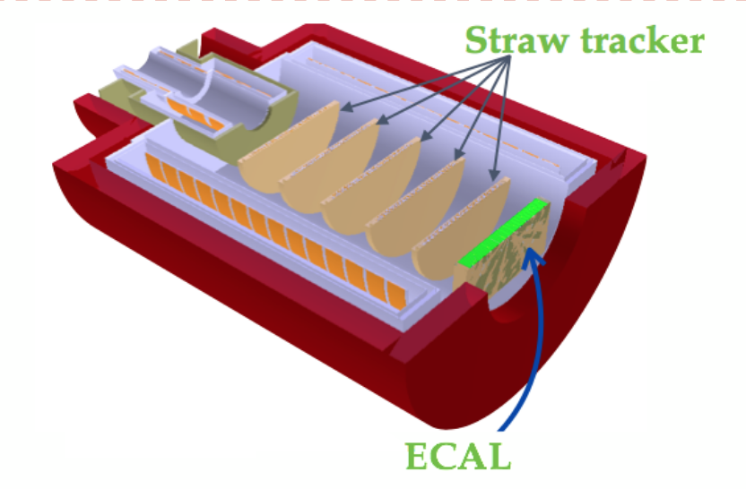
Phase-I
Beam measurement
+ Same concept as phase-II detector
+ Measure all delivered beam induced BG:
● inter-bunch extinction factor
● unwanted secondary particles in the beam line
● background processes: DIO and radiative MC
+ Straw tracker and Electron calorimeter are used

Slide 10
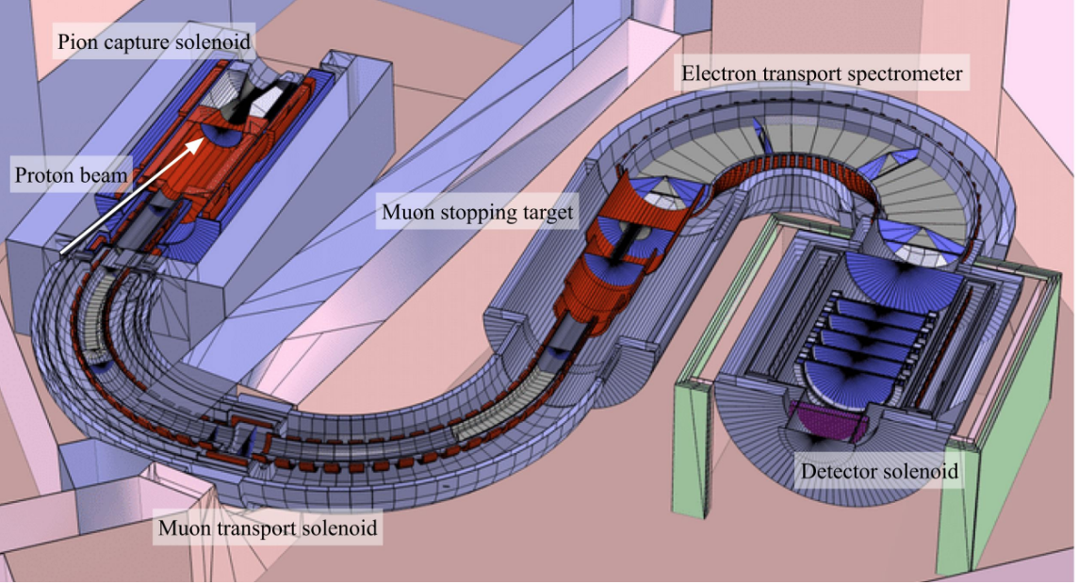
Phase-II
Physics:
+ Sensitivity 𝒪(10⁻¹⁷), 10,000 times better than the current upper limit
How to achieve
+ Additional transport solenoid
+ Electron spectrometer suppress low momentum electron and beam background
+ Straw tube tracker measures momentum
+ Electron calorimeter measure energy

Slide 11
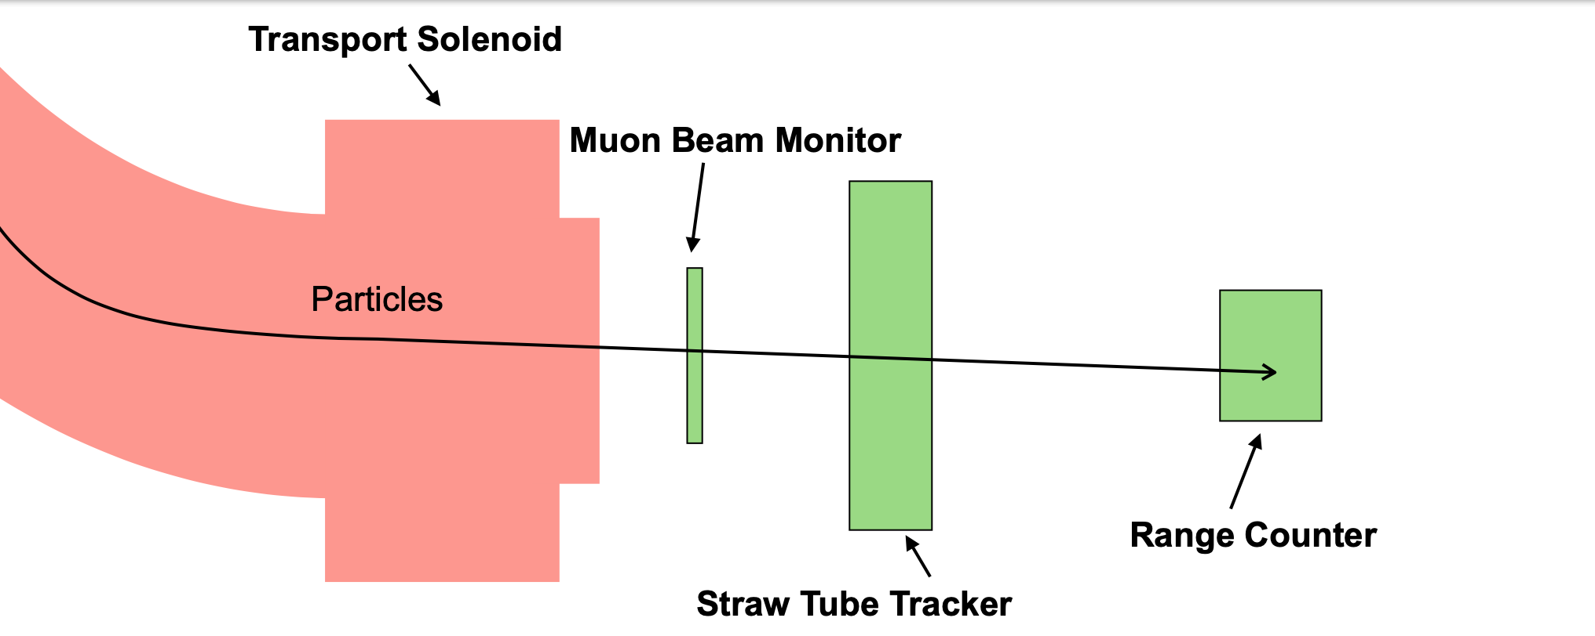
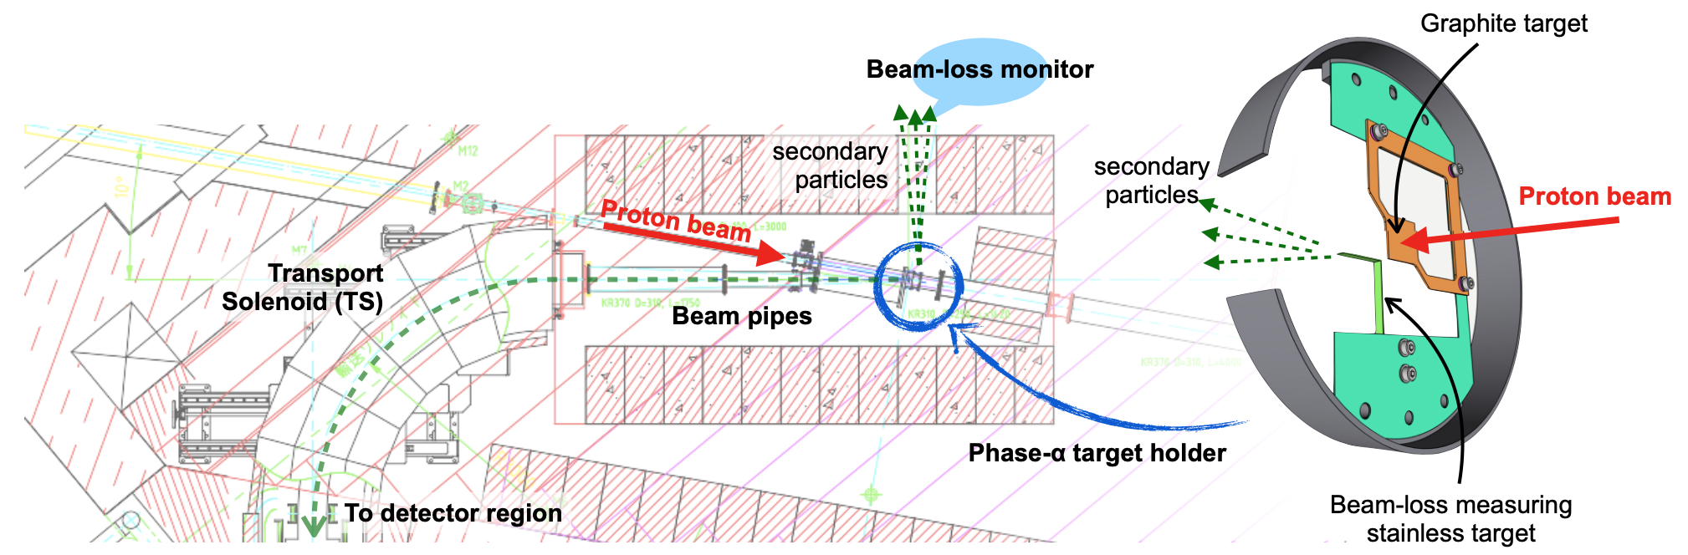
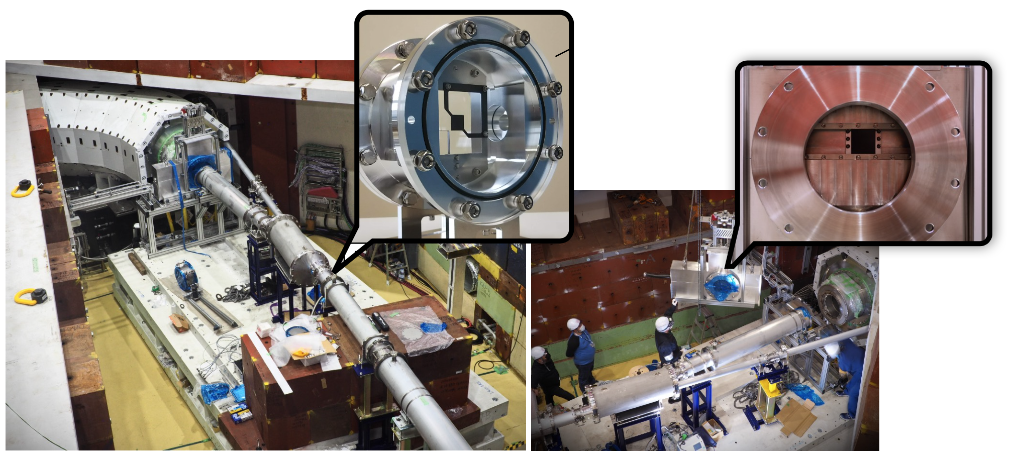
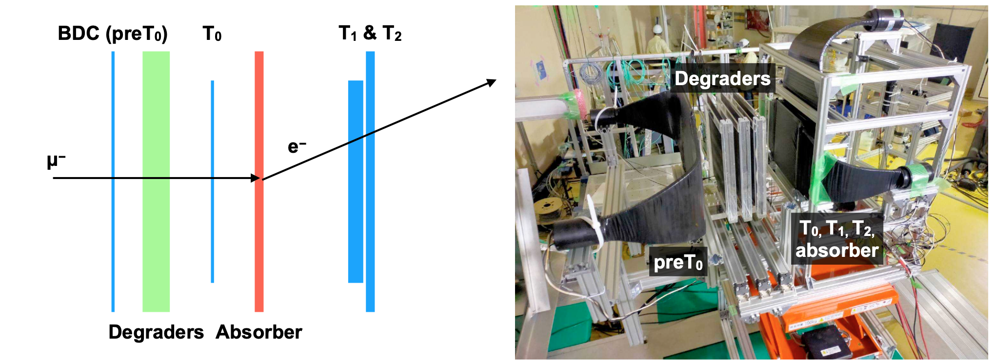
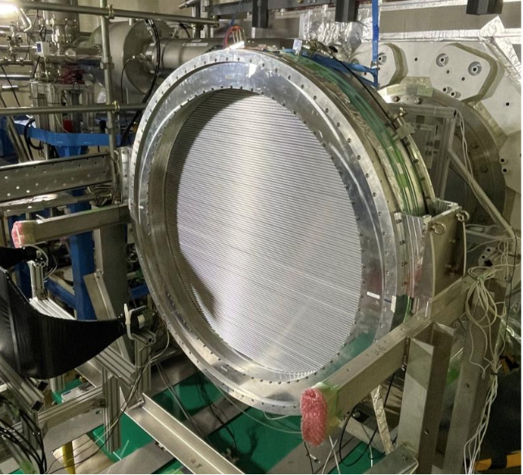
COMET Phase-α
A low beam-intensity run to study the beamline in 2023.
+ Measure the proton beam and the π/μ backward-production yield.
+ Investigation of the secondary beam in the experimental area.
+ Comparison with simulation, and validation of simulation.
+ The analysis is going to be finalized.

Slide 12
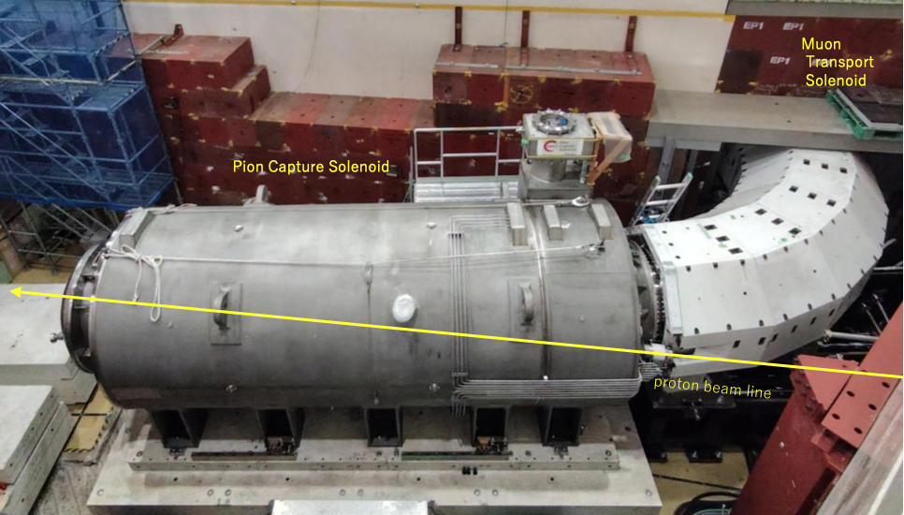
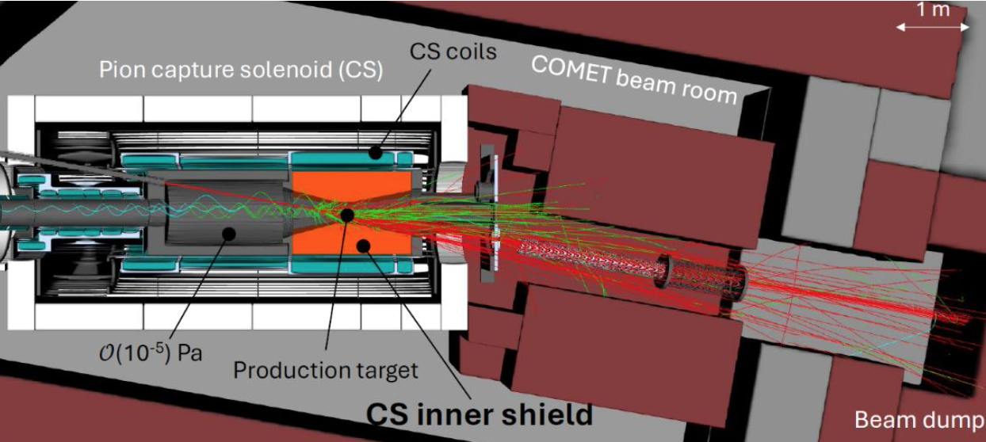
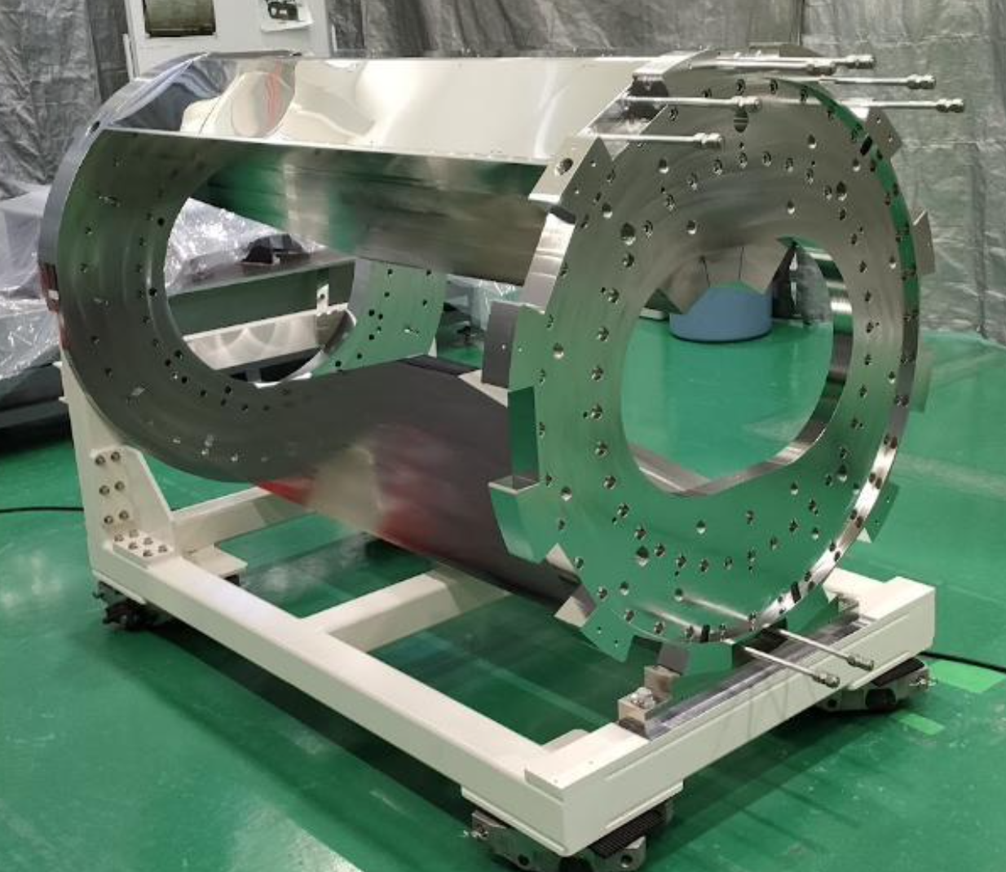
COMET Beam Room
The capture solenoid is installed
Detailed radiation shield design
+ Part of CS inner shield has been manufactured and delivered.

Slide 13
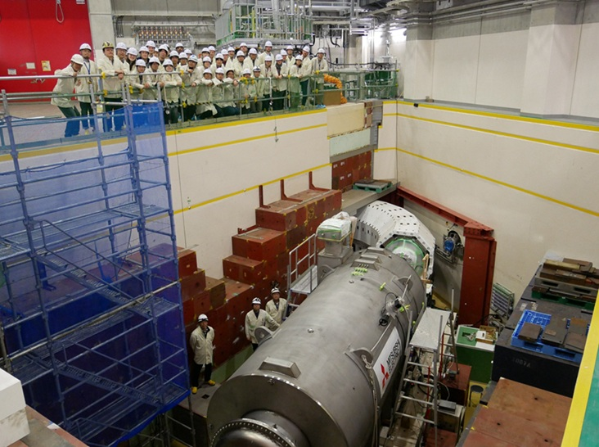
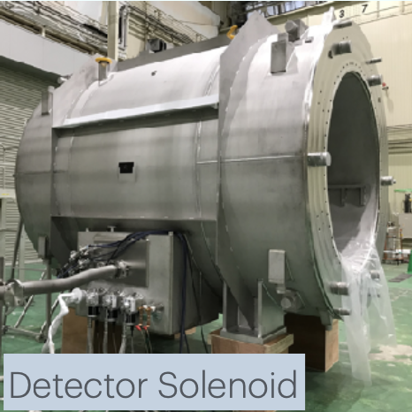
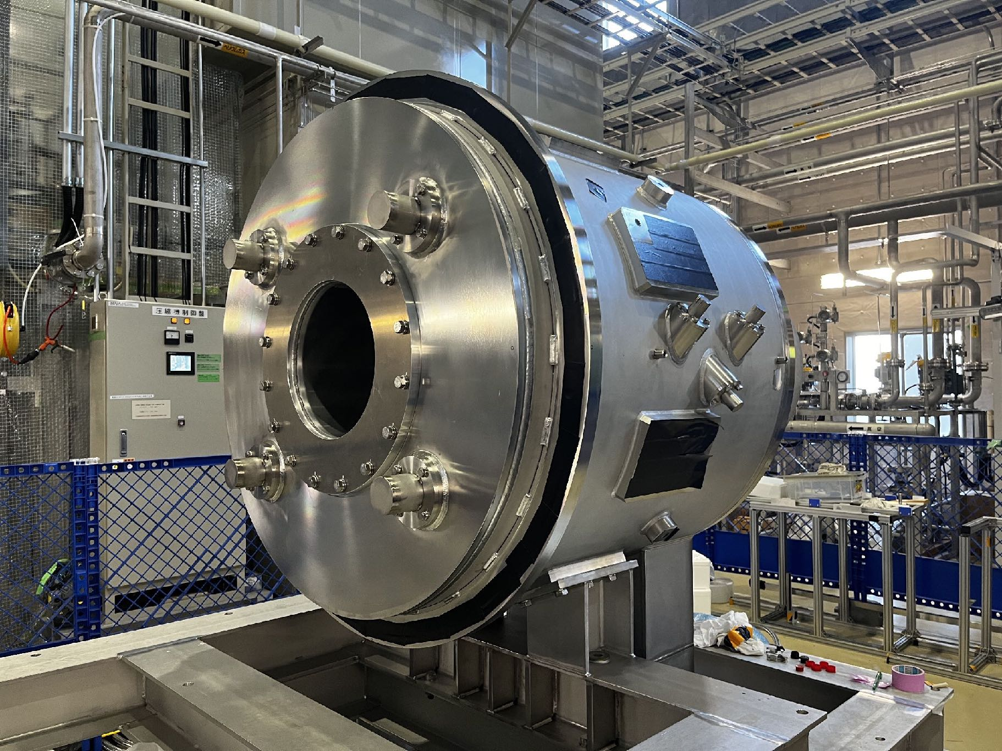
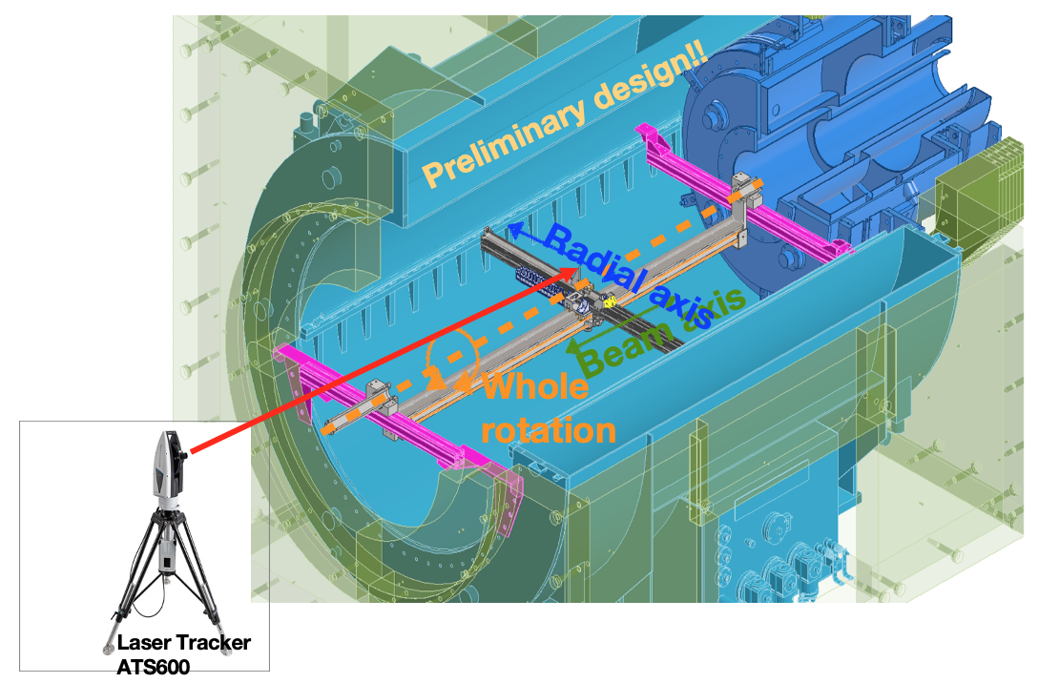
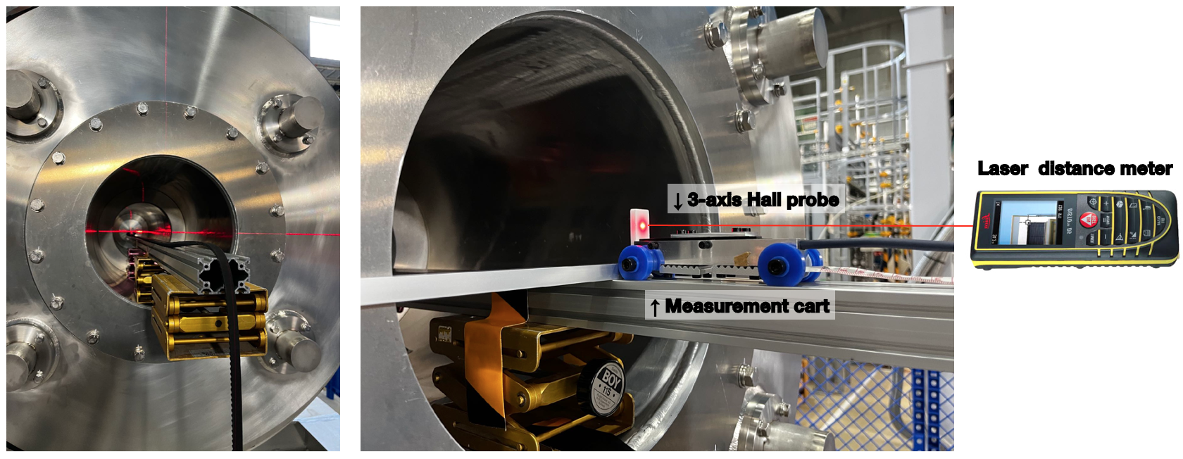
Magnet Fabrication
• Pion Capture Solenoid delivery in October 2024 and installed.
• Muon Transport Solenoid: Ready
• Detector Solenoid
+ Full excitation test was done in 2024, field measurement will be in 2025.
• Bridge Solenoid
+ Full excitation test and field measurement will be done in 2025.
• All magnets are delivered. Testing and installing of the COMET magnet system is ongoing.
Detector Solenoid
Bridge Solenoid

Slide 14
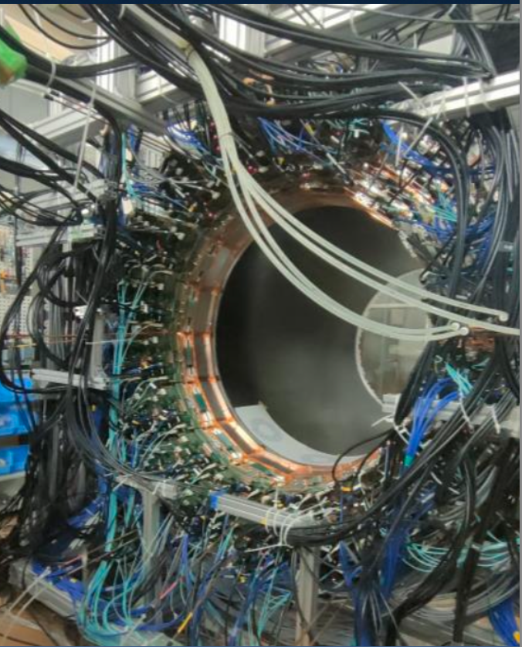
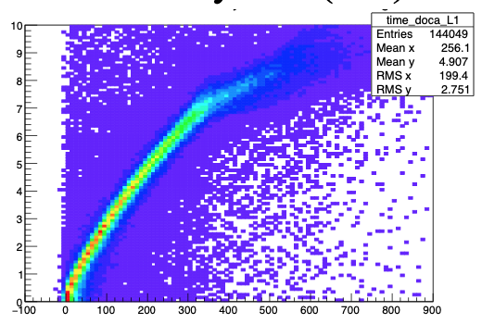
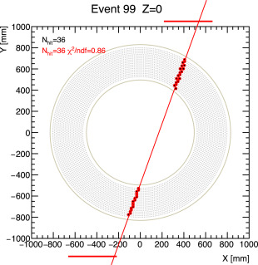
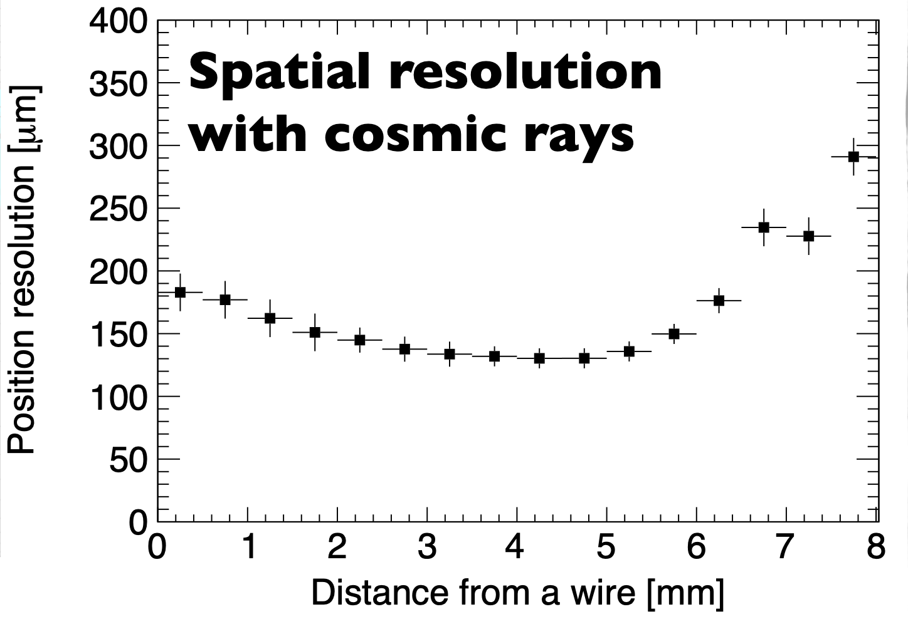
CDC: Cylindrical Drift Chamber
CDC measures the momentum of electrons in COMET Phase-I physical measurements.
The CDC is arranged in 20 concentric sense layers with alternating positive and negative stereo angles.
+ 4,986 sense wires: gold-plated tungsten, 25 μm in diameter, 50 g tension.
+ 14,562 field wires: aluminum, 80 μm in diameter, 80 g tension
+ Chamber gas is He:i-C₄H₁₀ (90:10),
Its construction from 2014. And now, cosmic-ray and other tests are being conducted at J-PARC
Many studied are going for track reconstruction with a high hit occupancy.
A. Sato, et al, “Design and construction of the cylindrical drift chamber for the COMET Phase-I experiment”
https://doi.org/10.1016/j.nima.2024.169926

Slide 15
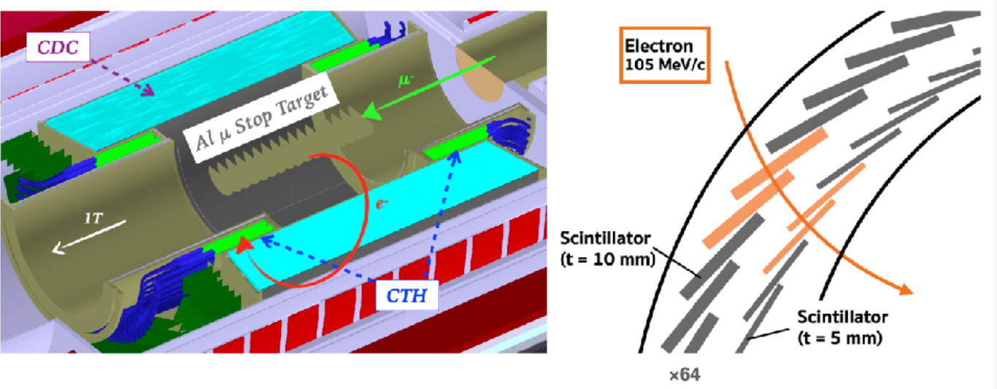
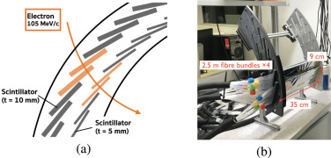
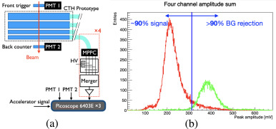
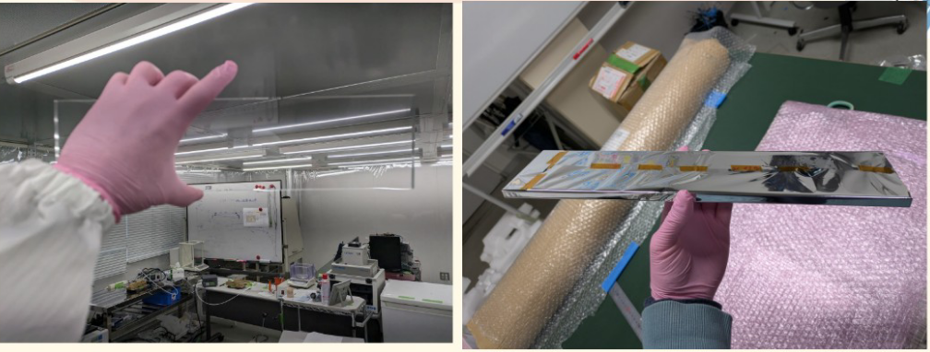
CTH: Cylindrical Trigger Hodoscope
performance test at PSI
Trigger : 4-fold coincidences, T0 measurement for tracking
• R&D items have been finished and are moving towards the construction phase.
• MPPC QC has been completed for 300 MPPCs, and brief analysis indicate all are fine.
• Scintillators are in QC.
• A full scale MPPC cooling prototype has been built and tested
• Front-end electronics being produced and mass production will start soon
Yuki Fujii, et al, Particle identification using plastic scintillators in the COMET Phase-I experiment,
Nucl. Instrum. Methods A https://doi.org/10.1016/j.nima.2024.169665

Slide 16
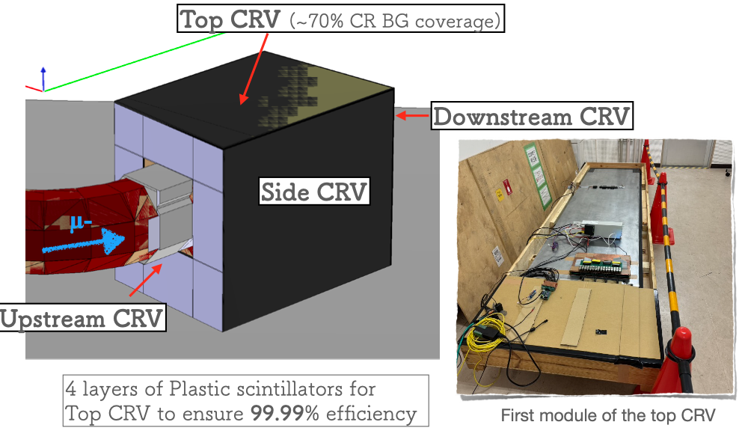
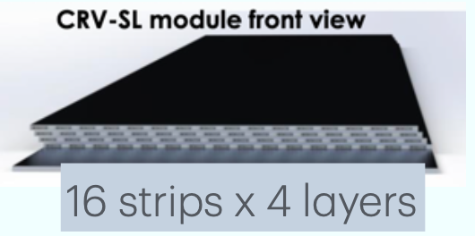
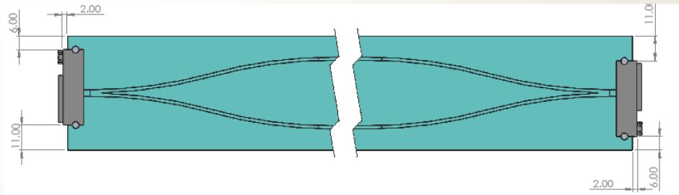
CRV: Cosmic-ray Veto
+ Cosmic ray-induced backgrounds are one of the most important backgrounds.
● cosmic-ray muons that produce an electron which enters the detector.
● cosmic-ray muons which enter the detector and are misidentified as an electron.
→ CRV are used to cancel these cosmic ray -induced backgrounds.
+ Scintillator-CRV module test at J-PARC.
+ Top CRV partial installation with different technologies for Phase-I Low-Intensity by the end of 2026.
+ Left, Right, Upstream, and Downstream CRV for Phase-I by the end of 2027.

Slide 17
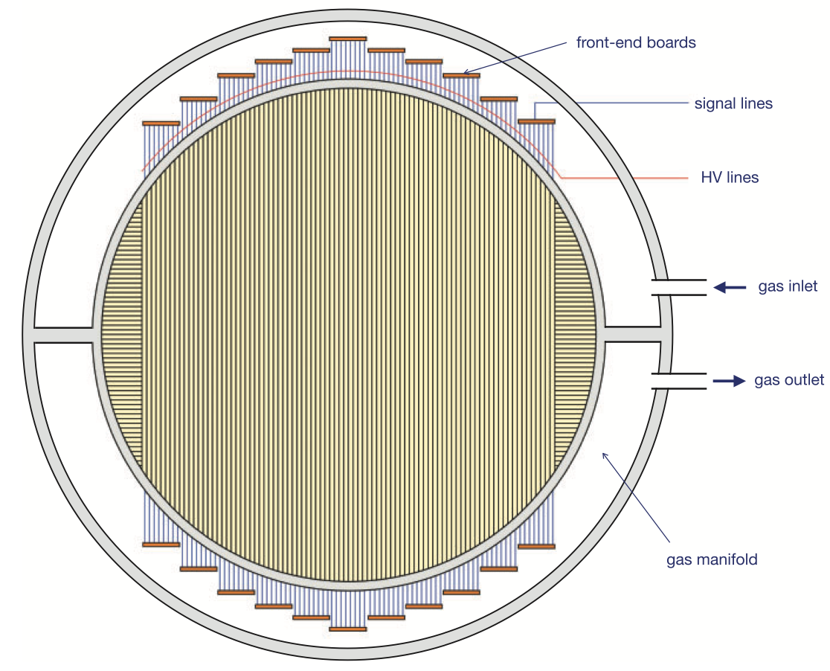
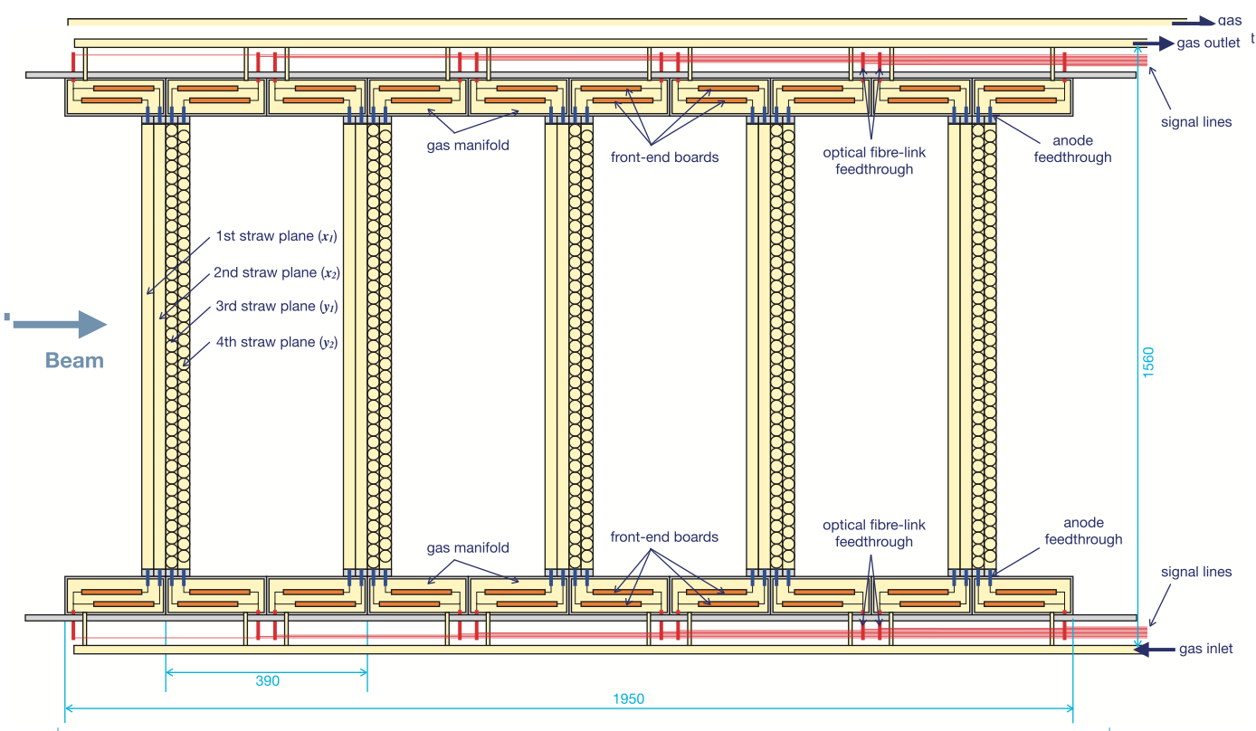
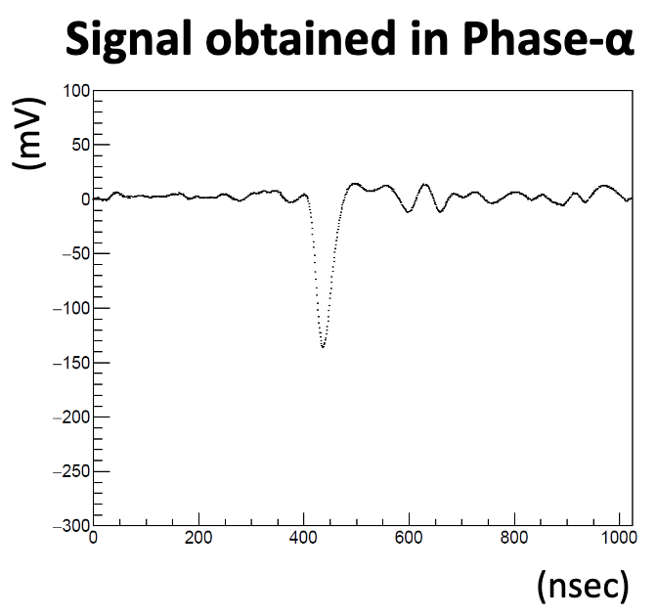
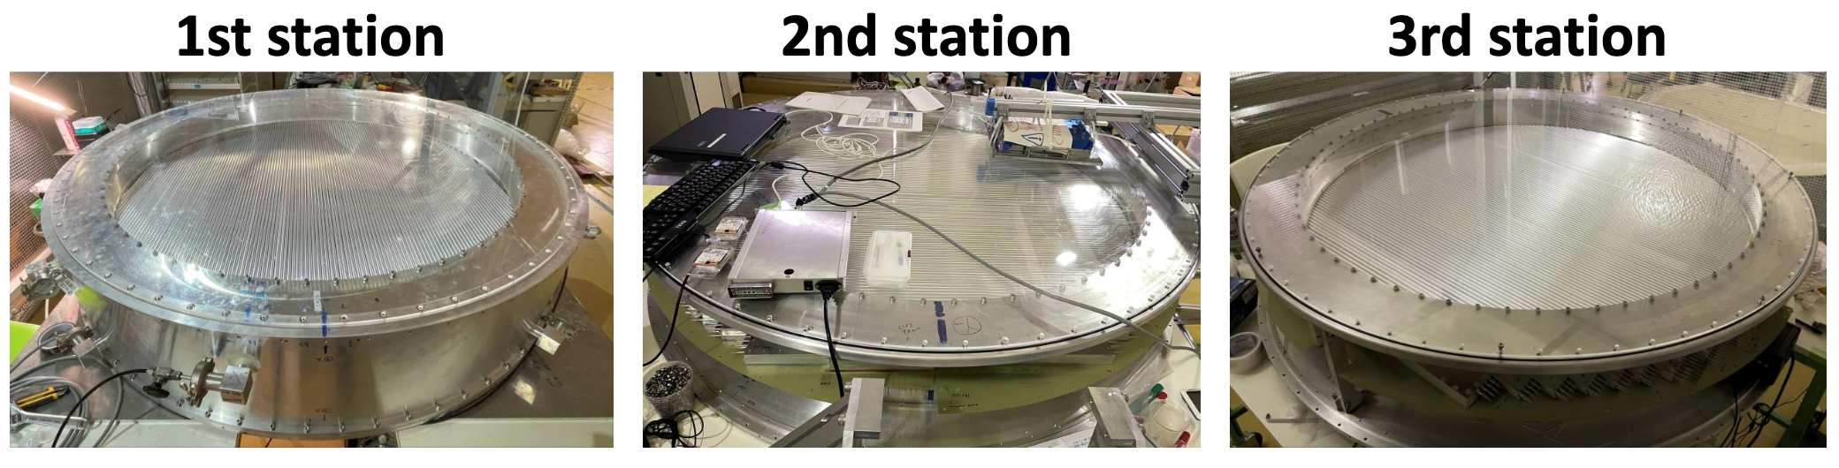
Straw Tracker
The straw tracker will direct measurements of the particles in the muon beam line, the rate of particle production, and other backgrounds
The 1st, 2nd and 3rd station are completely constructed.
The 4th and 5th station will be finish in 2025
The 1st station is used for Phase- α beam

Slide 18
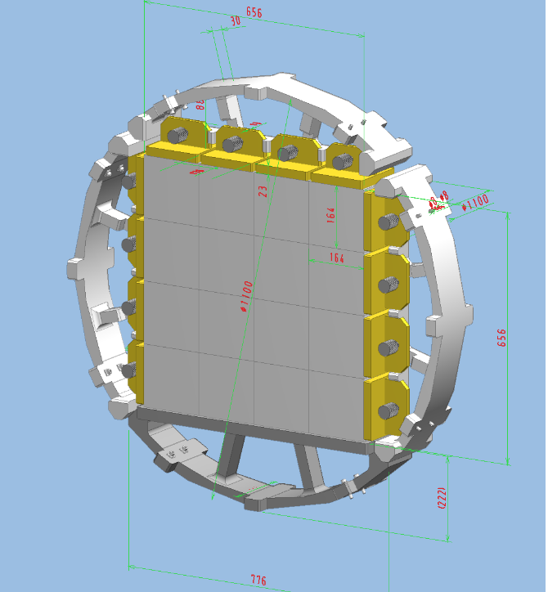
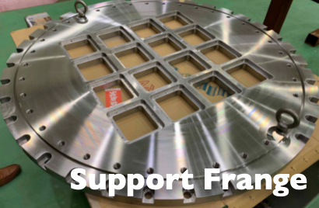
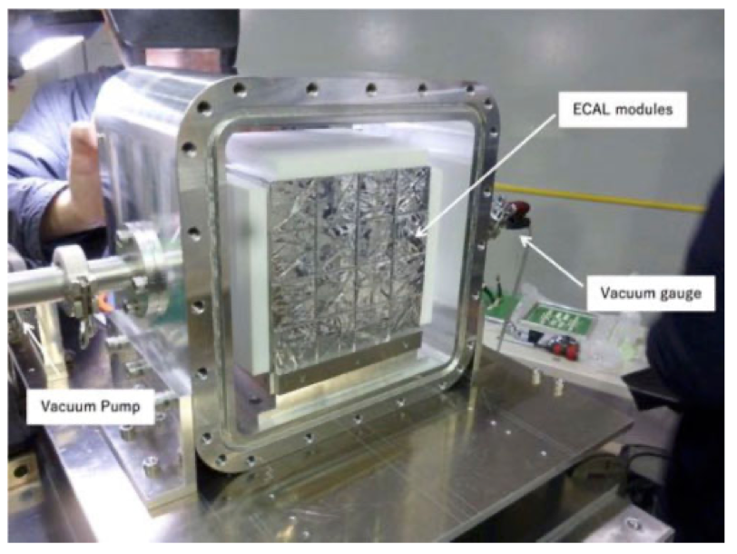
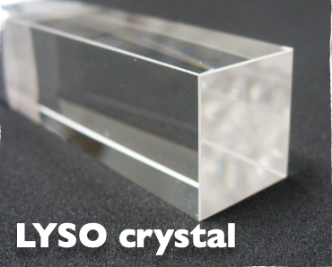
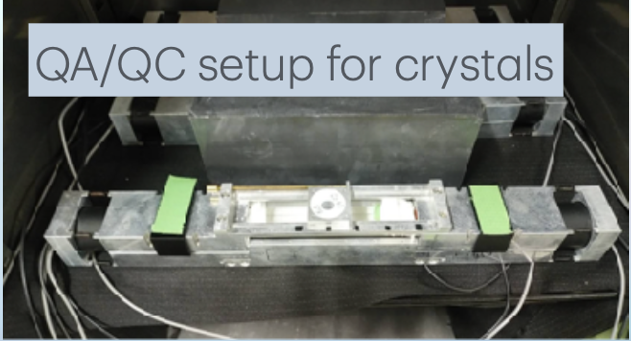
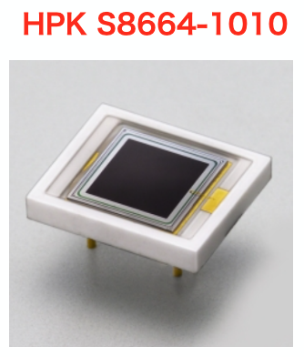
Electron Calorimeter
The electron calorimeter (ECAL) system consists of segmented scintillating crystals
ECAL construction in preparation
• QA/QC setup for crystals
+ 482 crystals in hand (512 in design)
• All APDs were delivered and QA/QC ongoing
Layout of module support frame
Prototype of ECAL

Slide 19
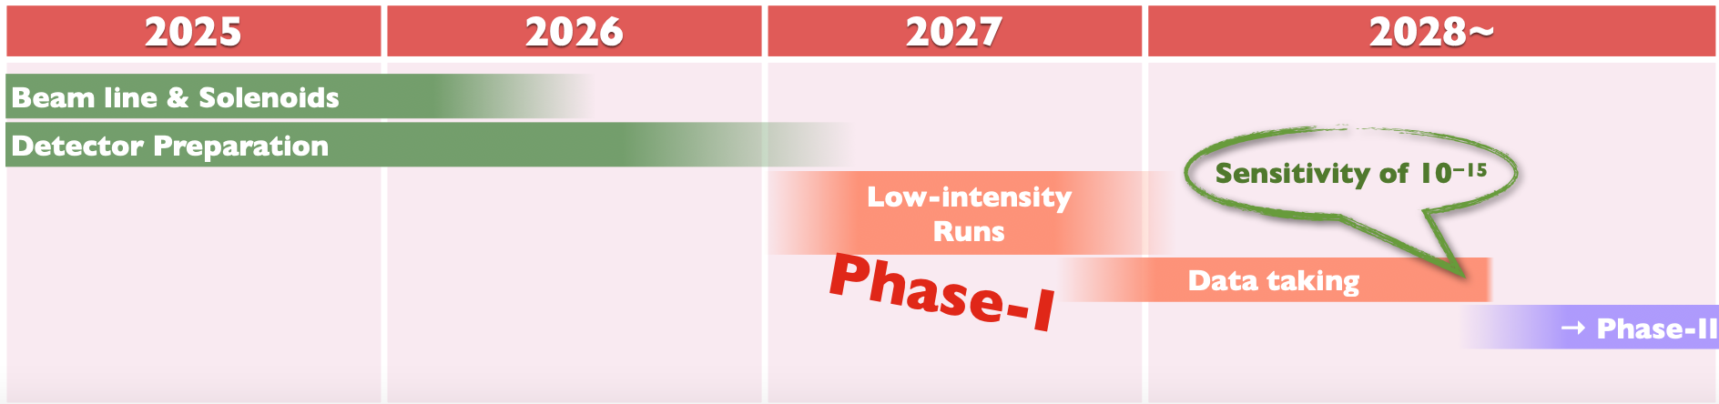
Summary
Muon flavor physics experiment is a good tool to detect the new physics beyond the SM
The COMET experiment plans to search for the μ - e conversion process by improve more 4 order sensitivity of the current upper limit:
  + Phase-I single event sensitivity 3 x 10⁻¹⁵
  + Phase-II single event sensitivity ~ 10⁻¹⁷
Phase α has been done to study the proton beam and the π/μ backward-production yield, the final analysis is ongoing
The Detector Solenoid, Bridge Solenoid was delivered and its magnetic field will be measure for physics data taking.
The physics detector in preparation for Phase-I Low-Intensity runs (~10% power) and Phase-I data taking in 2027.

Slide 20
Thank you for your attention
20

Slide 21
Backup slides
21

Slide 22
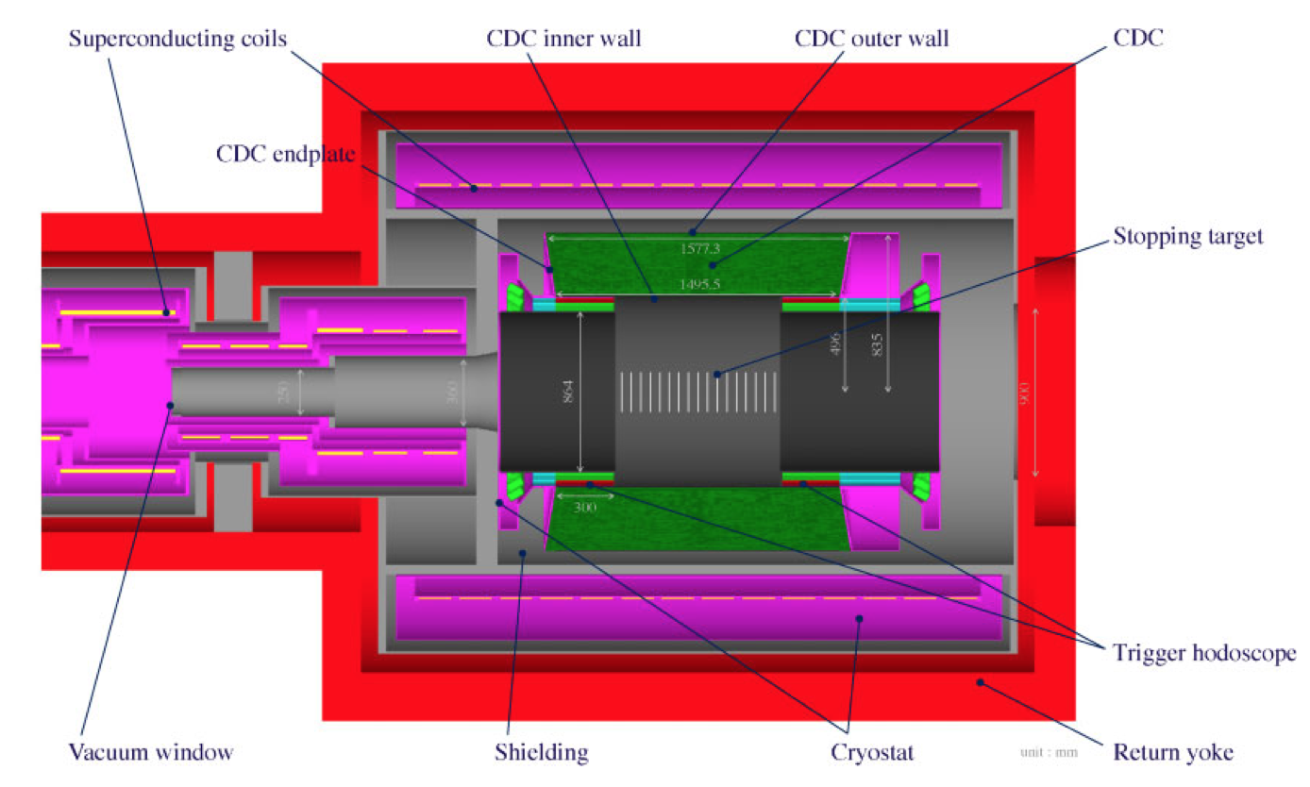
Physics Detector

Slide 23
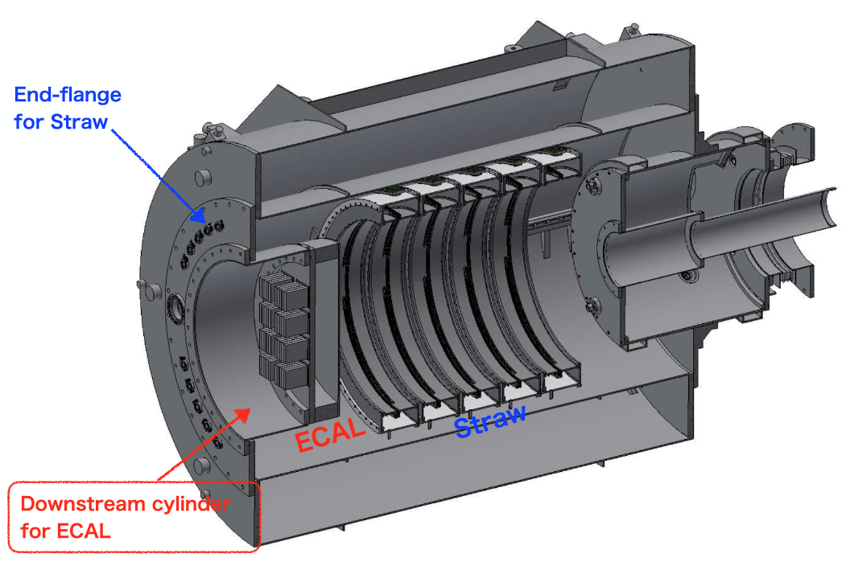
Beam Detector

