Slide 1







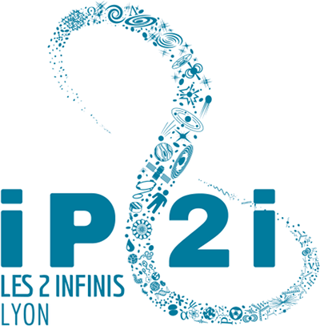




New Approaches in Radiation Therapy
Rachel DELORME on behalf of the community
IN2P3 Scientific Council – 08/07/2025

Slide 2
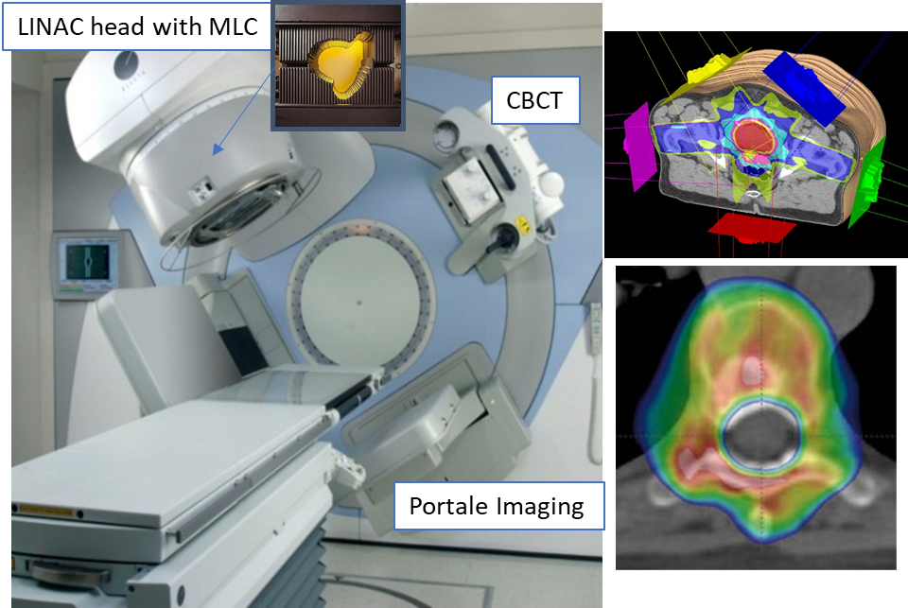
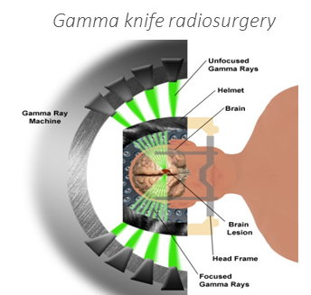
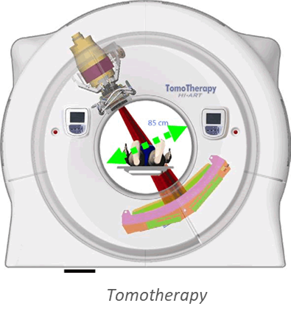
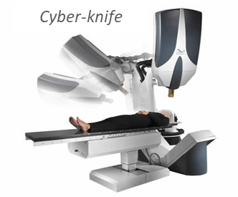
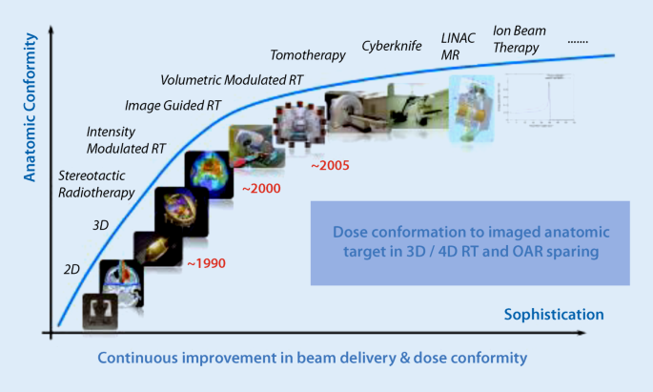
General context
Targeted RT
New dose delivery
Radiobiology & Patient based models
« Conventional » external beam radiotherapy (EBRT)
  The technological evolution of X-rays EBRT improved the dose conformation to the tumor through advanced techniques of radiation intensity modulation (IMRT, VMAT..) and image guidance (IGRT):
Innovative RT strategies inducing differential biological effects
Standard clinical accelerator (IMRT, VMAT) with embedded imaging systems
  Typical treatment characteristics:
  Particles: X-rays 6-25 MV (all tumors), electrons 3-25 MeV (surface)
  Time fractionation: 2 Gy/session, 5 session/week
  Dose: 40-70 Gy
  Dose rate: 30-70 mGy/s (2 Gy/min)
  Field sizes: 2 - 40 cm² (homogeneous dose coverage)
Rachel Delorme
IN2P3 Scientific Council – 08/07/2025
1
Notes:
Idée de montrer ce qu’on considère comme “conventionnel” avec des schémas d’irradiations visant une couverture homogène du faisceau et orders de grandeur dose/dose rate/fractionnement (simplifié), utilisé cliniquement pour la plupart des traitements de RT (~95%?), pour aller vers les “Nouvelles approaches” qui explorent d’autres voies d’irradiation pour traiter des cancers incurables actuellement.
Ouverture thérapies innovantes qui visent à induire un effet différentiel biologique entre tumeur et tissus sains

Slide 3
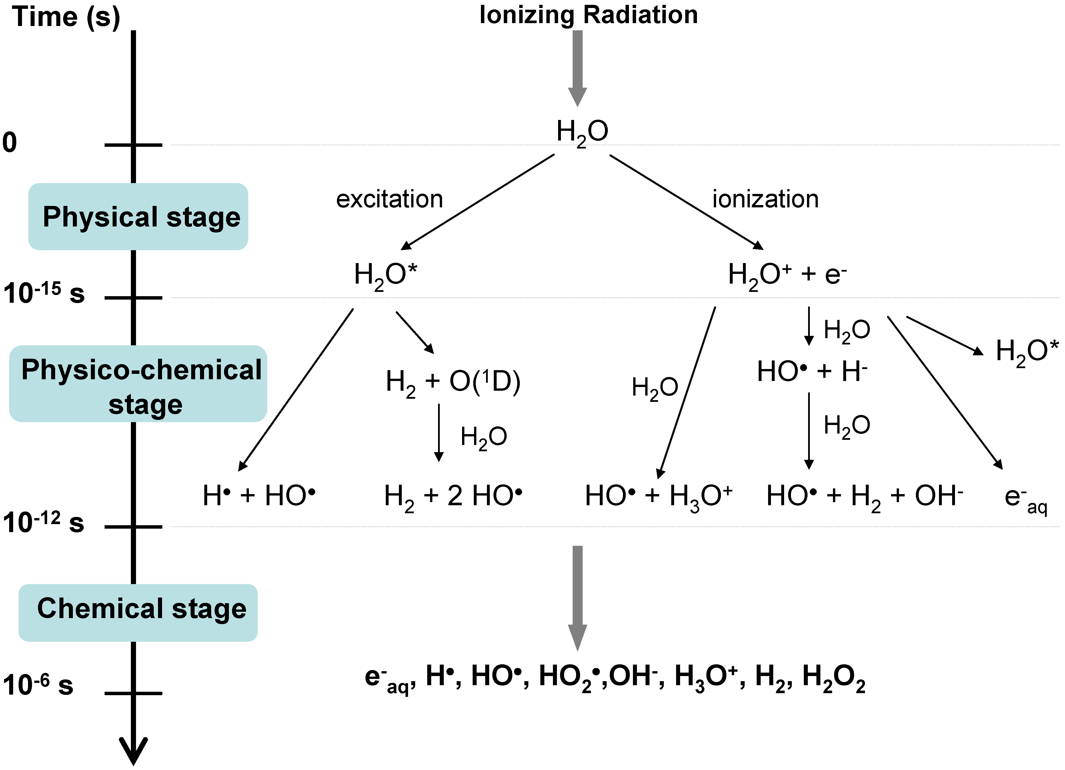
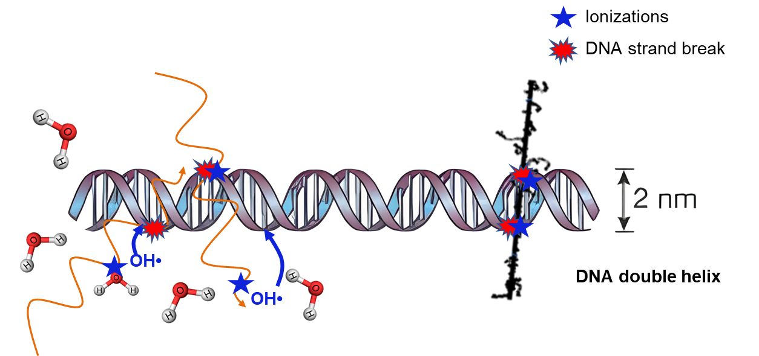
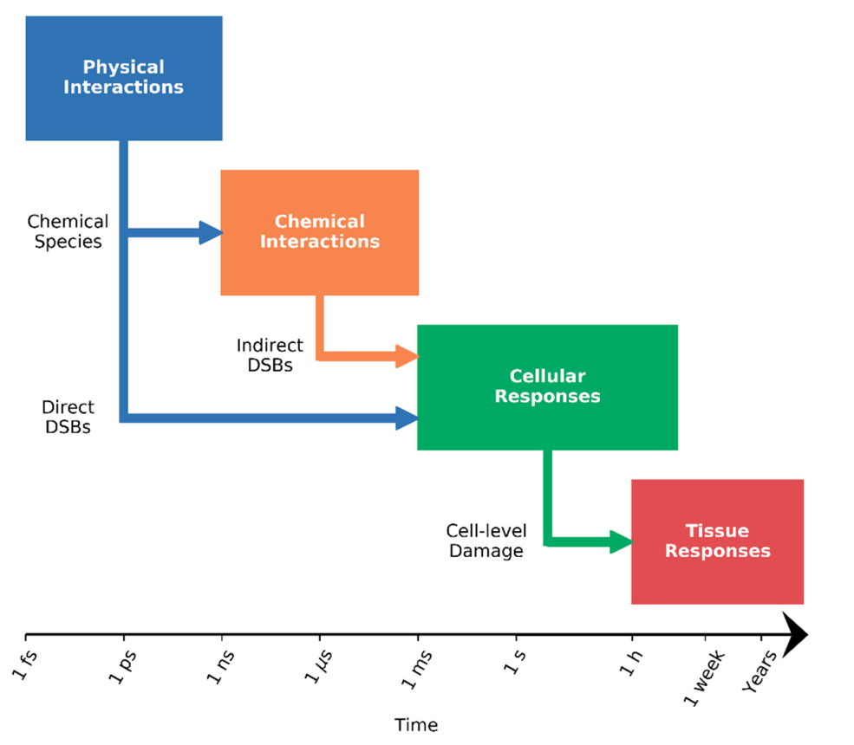
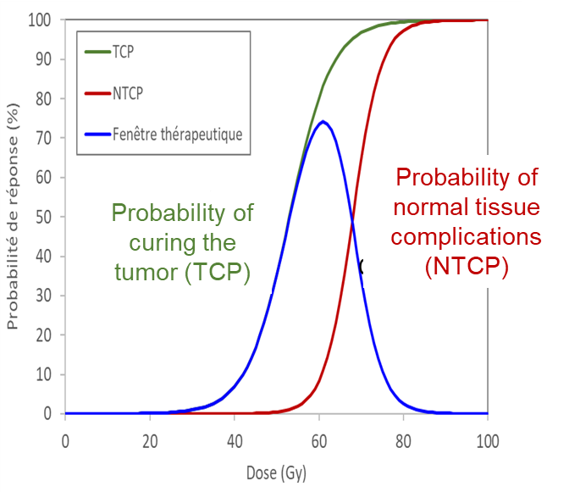
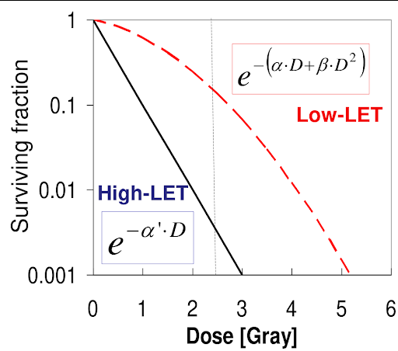
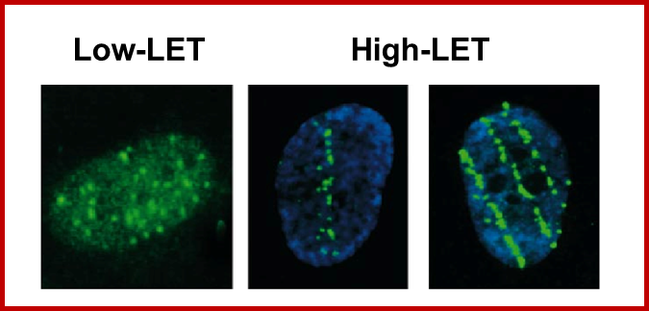
General context
Targeted RT
New dose delivery
Radiobiology & Patient based models
Basic of radiobiology: from physical to biological effects
Direct effect
direct ionization of the molecule
Low-LET
Water radiolysis: creation of reactive chemical species (OH•, H₂O₂, e-_{aq}…) that will interact with organic molecules
High-LET
Indirect effect
+ tumor microenvironnement, immune response…
Biological damage
Tissue Response
at molecular scale
(e.g. DSB)
at cellular scale
RBE
Question of other sub-cellular damage (membrane, mitochondria…)
Rachel Delorme
IN2P3 Scientific Council – 08/07/2025
2
Notes:
Passer rapidement car Maris déjà présenté base de radiobio.
Message principal: From the physical parameter to early or late biological outcome, different time scale and various possible manner to infer on biological response. High complexity of dose-response modeling involving multiple spatial scales and processes.
Accent on “other “radiobiology than simplistic DNA breaks: the role of sub-cellular targets, of distant effects as bystander or absocal effects, and tumor microenvironement (or inflammatory/immune processes) in the efficacy of therapies is unknown and need to be identified and quantified if we want to predict biological responses for a kind of treatment.

Slide 4
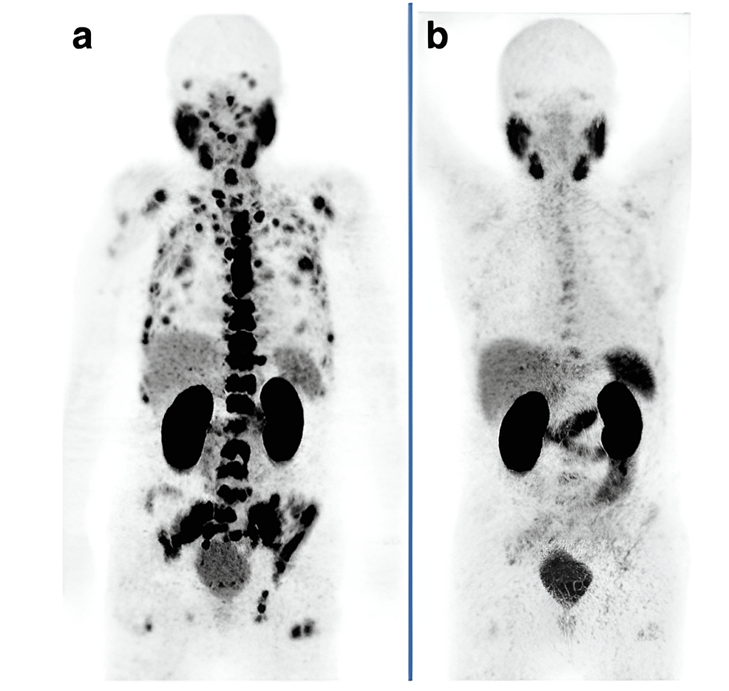
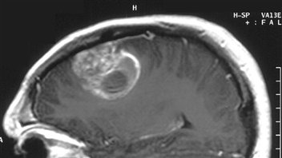
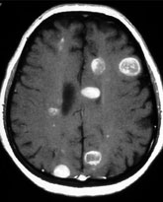
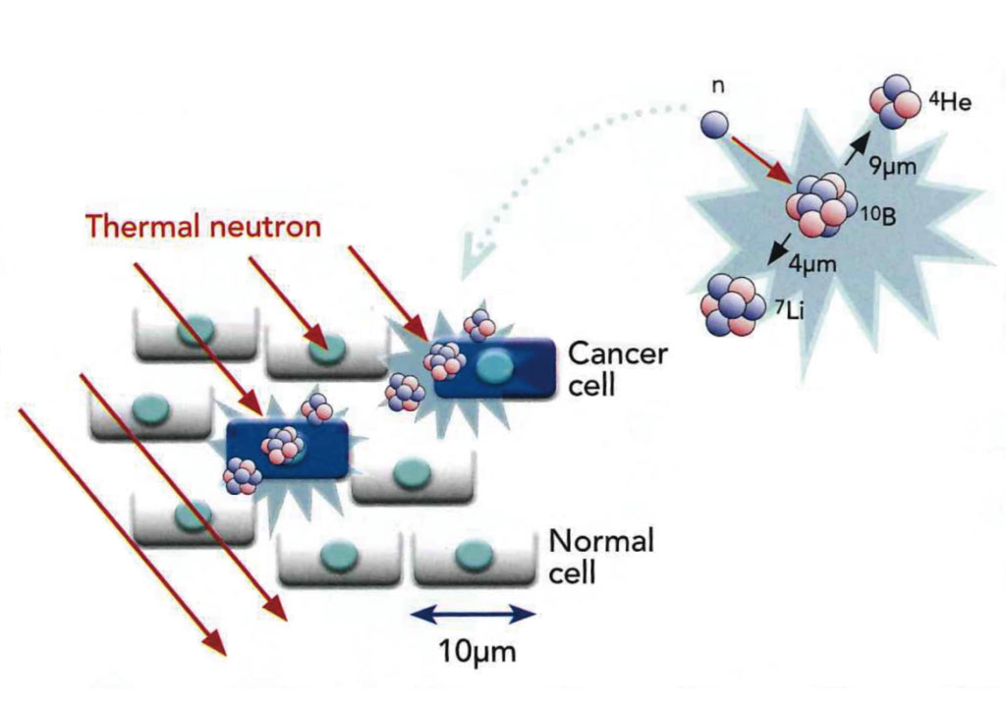
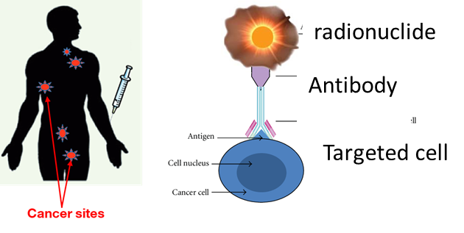
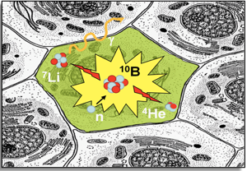
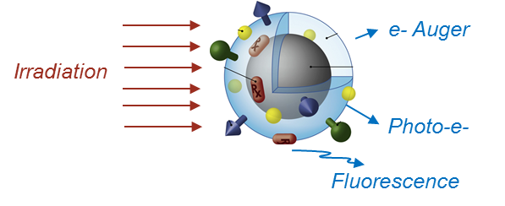
General context
Targeted RT
New dose delivery
Radiobiology & Patient based models
Limitations and other therapeutic strategies
  The toxicity to healthy tissue still limits the dose delivered and the curative use of RT :
              In particular for very radioresistant, bulky and diffuse cancers (e.g. glioblastoma…), and for non-localized tumors (multiple metastasis)
  How to improve the treatment?
              Induce a more efficient tumoral irradiation
    High-LET particles: hadrontherapy (p, α, ¹²C, ions)
    Targeted radiotherapies (using molecular targeting or sensitizers)+high-LET: radionuclide therapy (TRT), BNCT, nanoparticles…
 | α-TRT | BNCT | NP
Radionuclide/particle | ²²³Ra, ²²⁵Ac, ^{212/213}Bi, ²¹¹At, ²¹²Pb… | ¹⁰B/^{11*}B | e- (PE, Auger)
Energies α (et ⁷Li) or e- | 5-9 MeV | 0.8-1.7 MeV | 0-100 keV
Range α (and ⁷Li) or e- | 40 –100 µm (few cells) | 5 –9 µm (<cell) | 0-100 µm
LET (keV/µm) | 60 – 100 | ≥ 200 | 0.5-20
(β,α, Auger)
¹⁰B
⁷Li
α
n
Targeted Radionuclide Therapy (TRT)
BNCT
Nanoparticle-enhanced RT (radiosensitizers)
Rachel Delorme
IN2P3 Scientific Council – 08/07/2025
3
Notes:
Targeted therapies (especially TRT) may be adapted for multimetastatic and non-solid tumors such as leucemia

Slide 5
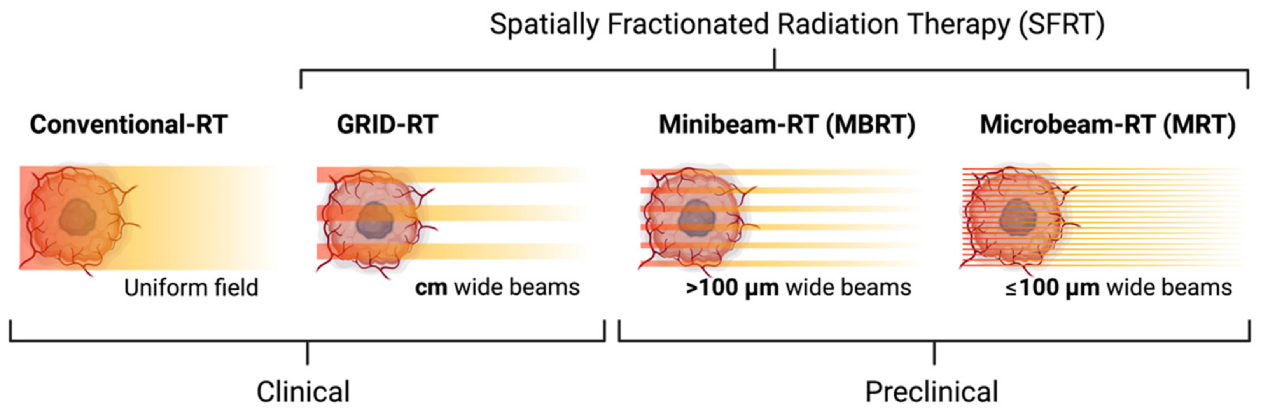
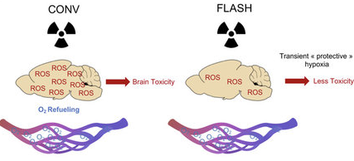
General context
Targeted RT
New dose delivery
Radiobiology & Patient based models
Limitations and other therapeutic strategies
  The toxicity to healthy tissue still limits the dose delivered and the curative use of RT :
              In particular for very radioresistant, bulky and diffuse cancers (e.g. glioblastoma…), and for non-localized tumors (multiple metastasis)
  How to improve the treatment?
              Induce a more efficient tumoral irradiation
    High-LET particles: hadrontherapy (p, α, ¹²C, ions)
    Targeted radiotherapies (using molecular targeting or sensitizers)+high-LET: radionuclide therapy (TRT), BNCT, nanoparticles…
              Preserve the healthy tissues:
    Improve ballistics with different particle/energy/molecular targeting: hadrontherapy, VHEE, TRT (α /Auger)
    Dose delivery mode: spatial fractionation of dose (SFRT) (beam size < mm),
    Ultra-high dose-rate (UHDR, “FLASH” effect)
Rachel Delorme
IN2P3 Scientific Council – 08/07/2025
3

Slide 6
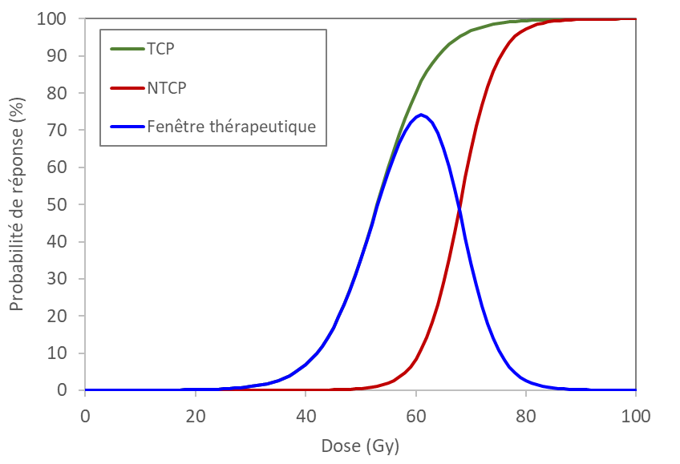

General context
Targeted RT
New dose delivery
Radiobiology & Patient based models
Limitations and other therapeutic strategies
  The toxicity to healthy tissue still limits the dose delivered and the curative use of RT :
              In particular for very radioresistant, bulky and diffuse cancers (e.g. glioblastoma…), and for non-localized tumors (multiple metastasis)
  How to improve the treatment?
              Induce a more efficient tumoral irradiation
    High-LET particles: hadrontherapy (p, α, ¹²C, ions)
    Targeted radiotherapies (using molecular targeting or sensitizers)+high-RBE: radionuclide therapy (TRT), BNCT, nanoparticles…
              Preserve the healthy tissues:
    Improve ballistics with different particle/energy/molecular targeting: hadrontherapy, VHEE, TRT (α /Auger)
    Dose delivery mode: spatial fractionation of dose (SFRT) (beam size < mm),
    Ultra-high dose-rate (UHDR, “FLASH” effect)
Therapeutic window
Probability of normal tissue complications (NTCP)
Probability of curing the tumor (TCP)
Die due to cancer
Damage to critical organs
→ Play on physical parameters to induce a different biological effect
Rachel Delorme
IN2P3 Scientific Council – 08/07/2025
3

Slide 7
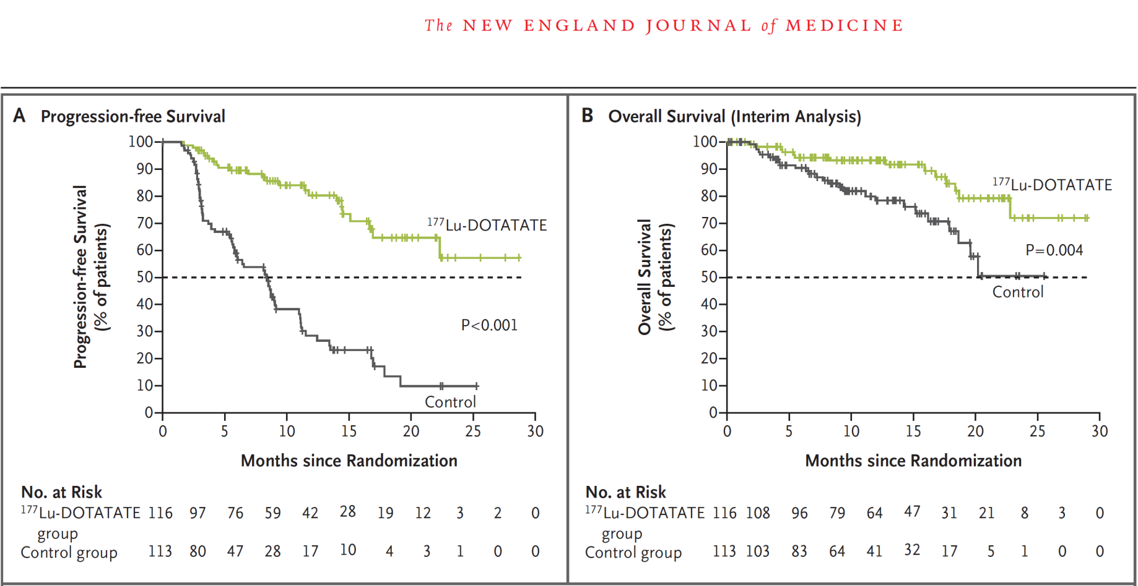
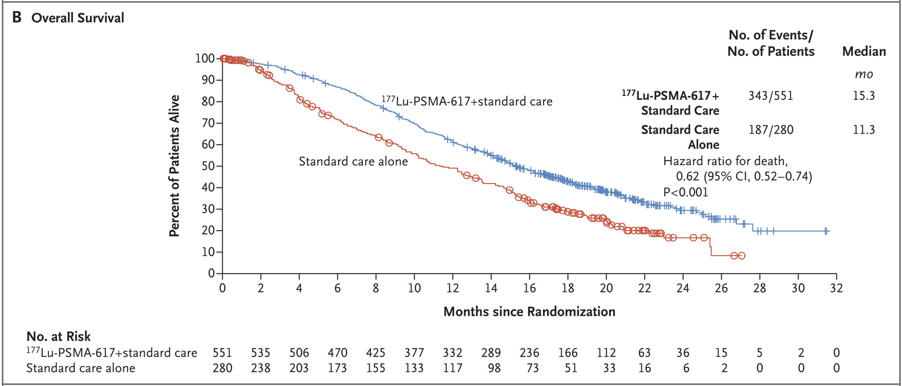
General context
Targeted RT
New dose delivery
Radiobiology & Patient based models
Targeted Radionuclide Therapy (TRT)
  TRT uses unsealed sources for selectively target cancer cells thanks to radiopharmaceuticals (RP).
  Rapid evolution of diagnostics and TRT over the past 20 years :
Dev. ^{99m}Tc imaging with γ cameras
PET imaging with ¹⁸F-FDG. Becomes a gold std
⁶⁸Ga-DOTATATE PET imaging enabling patient selection and dosimetry for 177Lu TRT
Development of theranostic approaches
New era of TRT and theranostics
~1940
~1950-70
1990-2000
2002
2013
2017
2022
FDA approval of ¹⁷⁷Lu-DOTATATE for neuroendocrine tumors & ¹⁷⁷Lu-PSMA for mCRPC
Strosberg et al. Phase 3 Trial of 177Lu-Dotatate for midgut Neuroendocrine tumors, N. Engl. J. Med. 376;2, 2017
Radioiodine therapy ¹³¹I for thyroid. Remains a gold std
FDA approval of ⁹⁰Y-Zevalin® for hematologic cancers
FDA approval of first TAT - ²²³Ra for bone metastasis
Radioimmunotherapy (antibodies)
Peptide receptors RT, small molecules
*PET: Positron Emission Tomography ; FDA: Food and Drug Administration
PSMA: Prostate-Specific Membrane Antigen ; mCRPC: metastatic castration-resistant prostate cancer
Sartor et al.,, ¹⁷⁷Lu-PSMA-617 for metastatic castration resistant prostate cancer, N. Engl. J. Med. 385; 12, 2021
Rachel Delorme
IN2P3 Scientific Council – 08/07/2025
4
Notes:
Ga: emetteur beta+, 1,9 MeV, T1/2: 68min. Lu: beta-, 0,6 MeV, T1/2 6,4 jour

Slide 8
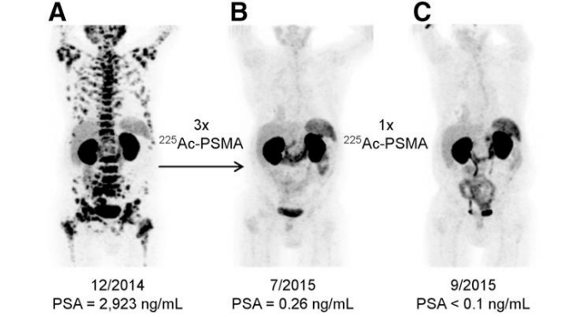
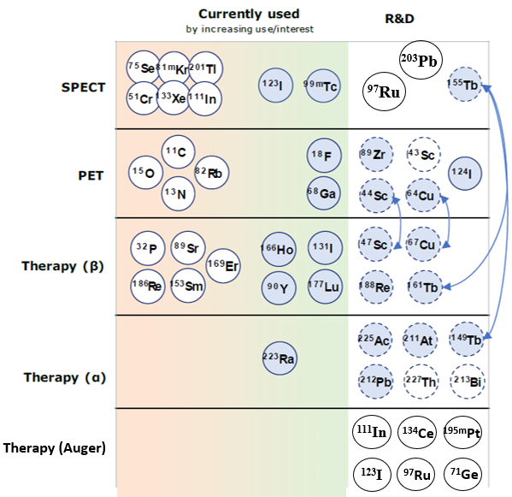
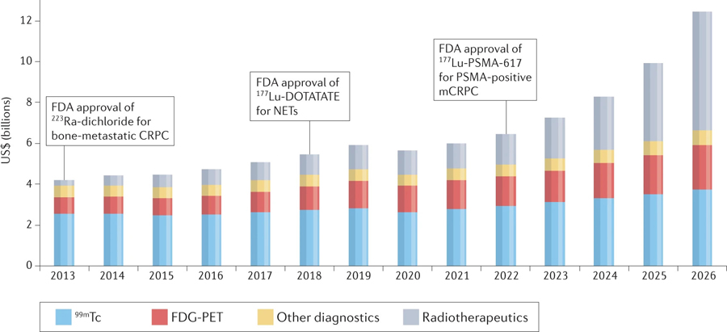
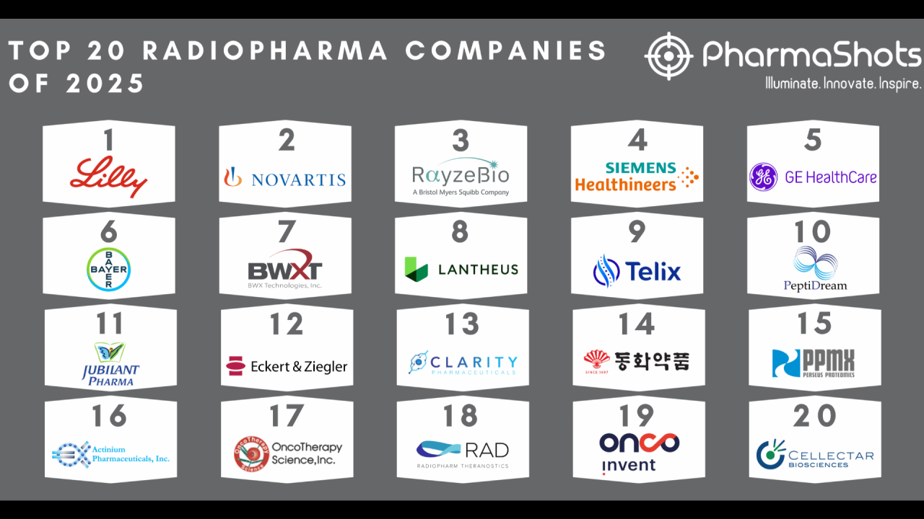
General context
Targeted RT
New dose delivery
Radiobiology & Patient based models
Targeted Radionuclide Therapy (TRT)
  Interest in Targeted Alpha Therapy (TAT) with various emitters (²²⁵Ac, ²¹¹At, ²¹³Bi, ²¹²Pb…) and ligands. ~30 clinical trials ongoing
  Novel targets & ligand development to expand TRT applications with theranostic pairs
  Expension of TRT to earlier treatment indications, and proposition of combined β/α/Auger TRT
      ➔ Increasing demand for new isotopes with reliable production routes
Spectacular response of Metastatic Castration-Resistant Prostate Cancer patient using ²²⁵Ac-PSMA-617 TAT, Imaging performed with ⁶⁸Ga-PSMA. From Kratochwill J. Nucl Med, 57(12), 2016
Adapted from Co-ordinated Approach to the Development and Supply of Radionuclides in the EU - N°ENER/D3/2019-231 - Final Report
The predicted global nuclear medicine market 2013–2026, from Bodei L, et al... Nat Rev Clin Oncol. 2022 Aug;19(8):534-550.
    Financial interest, most pharmaceutical companies launched nuclear medicine programs
Rachel Delorme
IN2P3 Scientific Council – 08/07/2025
5
Notes:
Avec l’avancée de la TRT dans les lignes de traitement (i.e. pris en charge de + en plus tôt) la dosimétrie personalisée deviendra necessaire. Expliquer que pas comme en EBRT, la dosimétrie n’est pas systématique dans la prise en charge clinique. Montrer qu’il a pu être montré un lien fort entre la realization de dosi et réponse patient (lorsque dose > xx) + peut améliorer les schémas d’injection

Slide 9
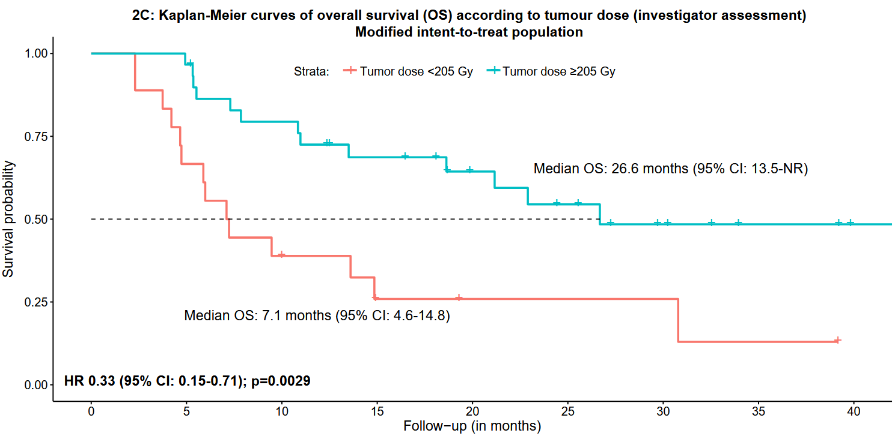
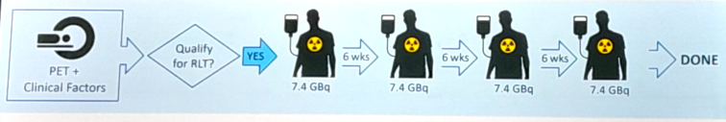
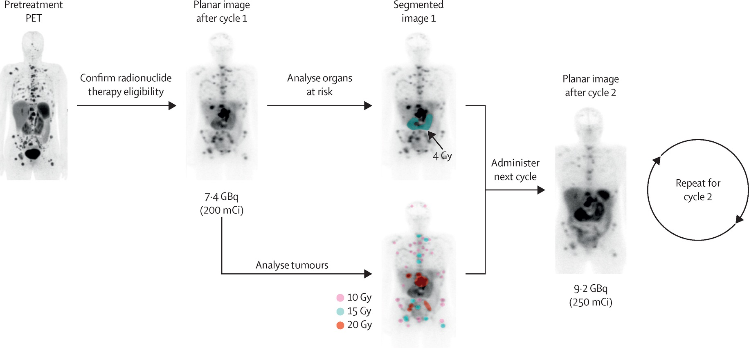
General context
Targeted RT
New dose delivery
Radiobiology & Patient based models
TRT: Theranostic and Dosimetry
Demonstration of personalize dosimetry benefit
  Despite effective palliation of tumor growth, current fixed
  activity is applied, sub-optimal for curative treatment:
Dosimetry may guide personalization to achieve durable
complete response by adapting activity / cycle
Pretreatment PET imaging (≠ time points)
Planar image after cycle 1
Garin et al., SIRT using personalised dosimetry for locally advanced hepatocellular carcinoma (HCC) patients: multicenter randomised phase 2 study (DOSISPHERE-01 trial). Lancet, 6(1),2021
Define the biodistribution and select responsive patient
7,4 GBq
(200mCi)
Analyse tumor and OAR doses
TRT is not systematically performed in clinics due to heavy protocol, additional cost and patient’s discomfort
  Need to simplify dosimetric protocols with the improvement of imaging systems and reconstruction algorithm (e.g. AI-based)
9.2 GBq
(250mCi)
Adapt inj. Activity for next cycle
Dosimetry in radionuclide therapy: the clinical role of measuring radiation dose. Lawhn-Heath C, et al. Lancet Oncol. 2022; 23:e75-e87.
Rachel Delorme
IN2P3 Scientific Council – 08/07/2025
6
Notes:
“The Right Drug to The Right Patient for The Right Disease, at the Right Time with The Right Dosage”
Avec l’avancée de la TRT dans les lignes de traitement (i.e. pris en charge de + en plus tôt) la dosimétrie personalisée deviendra necessaire. Expliquer que pas comme en EBRT, la dosimétrie n’est pas systématique dans la prise en charge clinique. Montrer qu’il a pu être montré un lien fort entre la realization de dosi et réponse patient (lorsque dose > xx) + peut améliorer les schémas d’injection

Slide 10
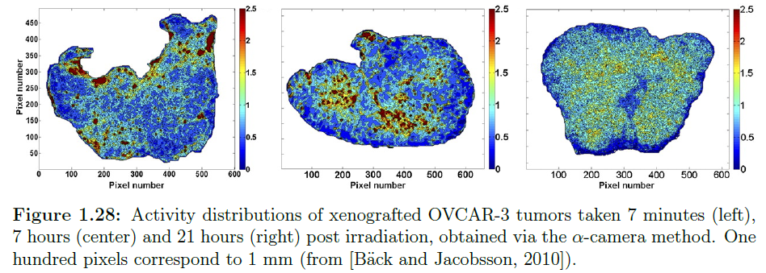
General context
Targeted RT
New dose delivery
Radiobiology & Patient based models
TRT: Theranostic and Dosimetry in TAT
  Additional difficulties with alpha emitters or high-LET/short range emitters:
      Difficulty to observe clear “dose-effect relationship”.
      High heterogeneity at micro/tissue scale
      (range < 100 µm), often unknown
      → homogeneous hypothesis may lead to errors
      High (and variable) RBE
      Complex direct (role of sub-cellular target damage),
      bystander and systemic biological response.
  TAT personalize (bio)dosimetry requires:
      Theranostic radionuclide pairs with alpha emitters
      Gamma camera adapted to high-energy (> 300 keV)
      Multiscale modeling tools to account for heterogeneities in bio-dose prediction and quantify uncertainties
      Dedicated controlled radiobiological experiments (in vitro / in vivo) to characterize complex TAT biological effects
      Identify the relevant metrics to characterize TAT efficacy (beyond absorbed dose)
1mm
Example of heterogeneous activity distribution in tumor after 7min, 7h, and 21h after injection, via alpha-camera method. From Bäck T & Jacobsson L. J Nucl Med. 2010;51(10):1616-23.
Rachel Delorme
IN2P3 Scientific Council – 08/07/2025
7
Notes:
“The Right Drug to The Right Patient for The Right Disease, at the Right Time with The Right Dosage”
Avec l’avancée de la TRT dans les lignes de traitement (i.e. pris en charge de + en plus tôt) la dosimétrie personalisée deviendra necessaire. Expliquer que pas comme en EBRT, la dosimétrie n’est pas systématique dans la prise en charge clinique. Montrer qu’il a pu être montré un lien fort entre la realization de dosi et réponse patient (lorsque dose > xx) + peut améliorer les schémas d’injection

Slide 11
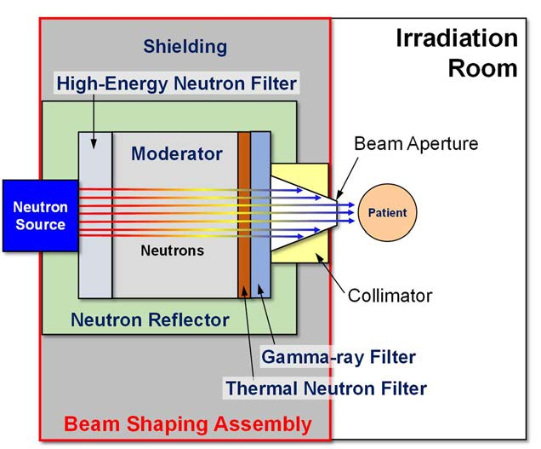
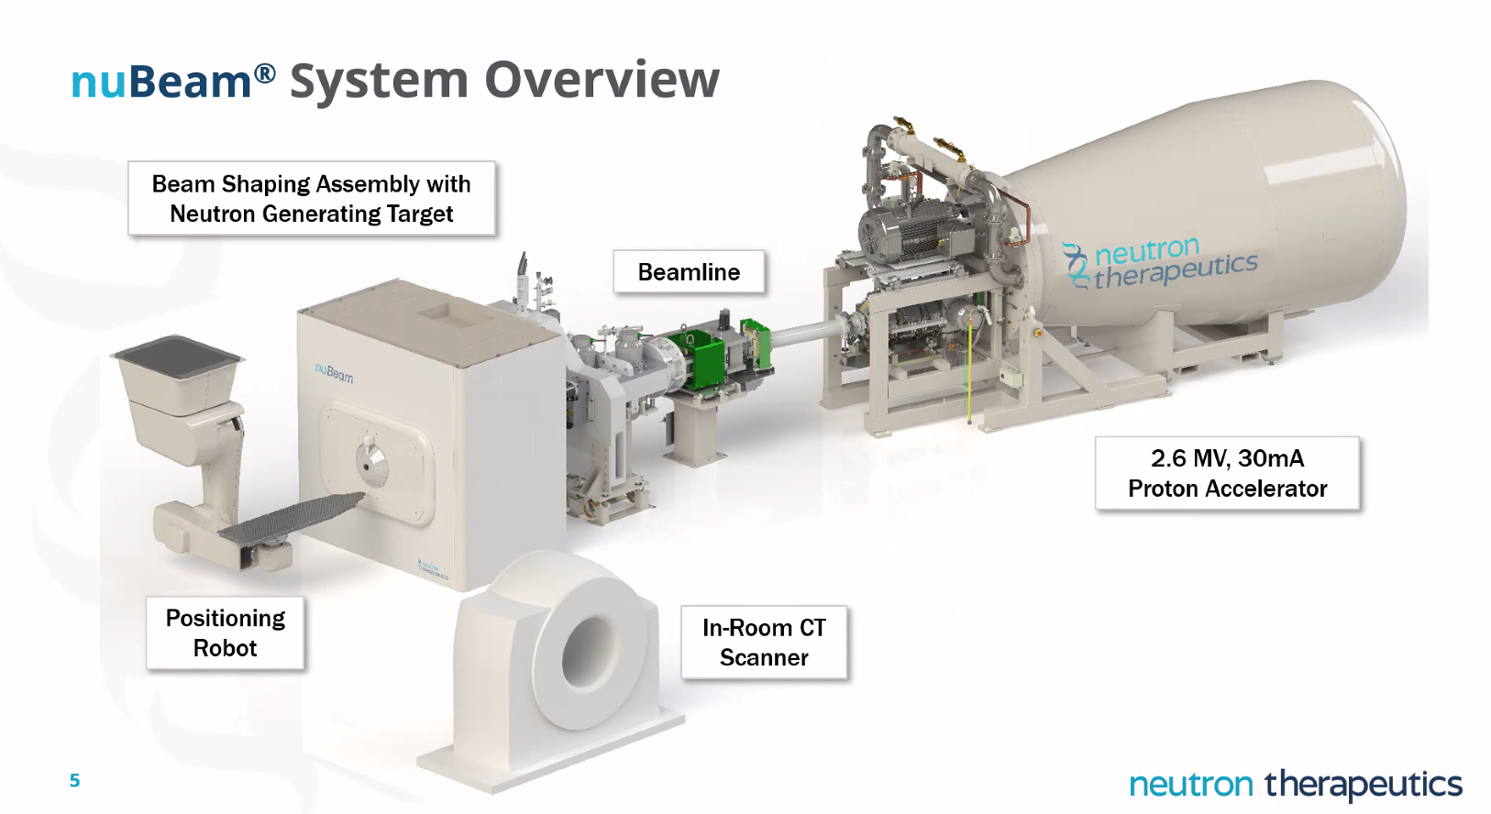
General context
Targeted RT
New dose delivery
Radiobiology & Patient based models
BNCT: combined therapy
  BNCT Principle: combine external epithermal neutron irradiation with injected ¹⁰B-based compound to maximize neutron capture cross section at tumor location → lead to local emission of very high LET-ions (α, ⁷Li³⁺)
Max range ~5-9µm; LET > 200 keV/µm
Enriched boron isotope, delivered in cancerous cells (BPA or BSH)
6 %
⁴He (1,77 MeV) + ⁷Li (1,01 MeV)
¹⁰B + n_{th}(0,025 eV) [¹¹B]*
⁴He (1,47 MeV) + ⁷Li (0,84 MeV) + γ (0,48 MeV)
94 %
  Several clinical trials (Barth et al. 2012; Shen S et al. 2024: promising results for high-grade glioblastoma and recurrent Head & Neck cancers. Historically delivered on nuclear facilities...
  Accelerator-based BNCT: new era for clinical trials as compact accel neutron sources (CANS) allow performing BNCT in hospital.
  About 26 new AB-BNCT facilities world-while, 9 in Japan (IAEA*). Clinical trial started in Finland 2025, BNCT accepted in clinical routine for recurrent H&N cancers in Japan.
  Compagnies proposing integrated systems (e.g. neutron therapeutics, TAE life science…)
NuBeam® system (ex. installed in Finland, Japan, UK…)
*IAEA report 2023 “advances in boron neutron capture therapy”; https://nucleus.iaea.org/sites/accelerators/Pages/default.aspx
Rachel Delorme
IN2P3 Scientific Council – 08/07/2025
8

Slide 12
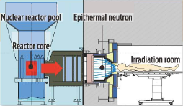
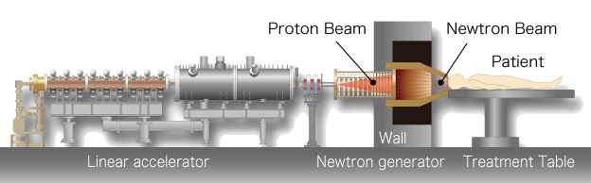
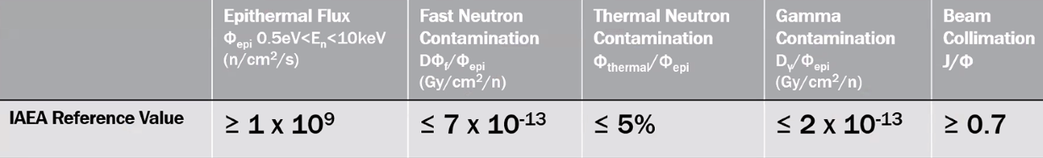
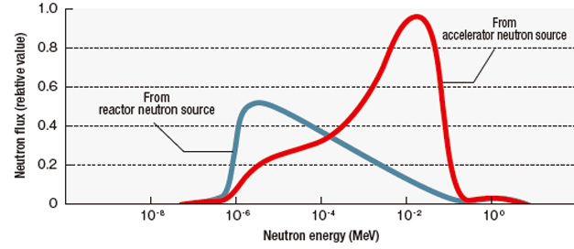
General context
Targeted RT
New dose delivery
Radiobiology & Patient based models
Accelerator-based BNCT
Produced in reactors or accelerators :
  AB-BNCT: improved patient care and beam spectra for
  treating deeper tumors.
IAEA recommandations for neutron beam quality:
Some Challenges:
Production targets: possible reactions ⁷Li(p,n)⁷Be, ⁹Be(p,n)⁹B, ⁹Be(d,n)¹⁰B, ¹³C(d,n)¹⁴N
High power (30-75 kW) degrades targets. Residual radioactivity with ⁷Li, needs frequent change.
→ Design optimal targets.
Online monitoring: need for real time monitoring : target aging (neutron flux ↘) and delivered dose
→ Develop n & γ (480 keV) detectors.
Beam shaping assembly:
→ Find optimal moderation to maximize penetration in tissue with high-enough intensity.
Lack of standardization : complexify treatment comparisons.
→ Neutron field spectral and fluence characterization with adapted detectors.
Neutron energy spectra as a function of the source
Rachel Delorme
IN2P3 Scientific Council – 08/07/2025
9

Slide 13
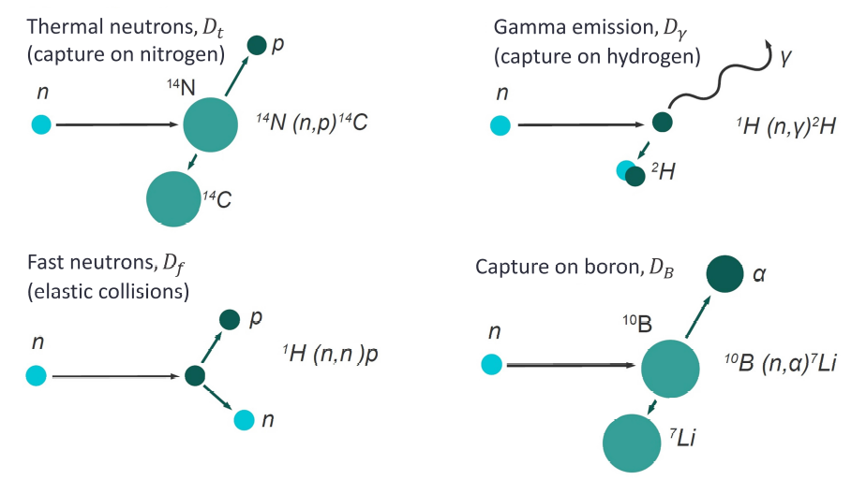

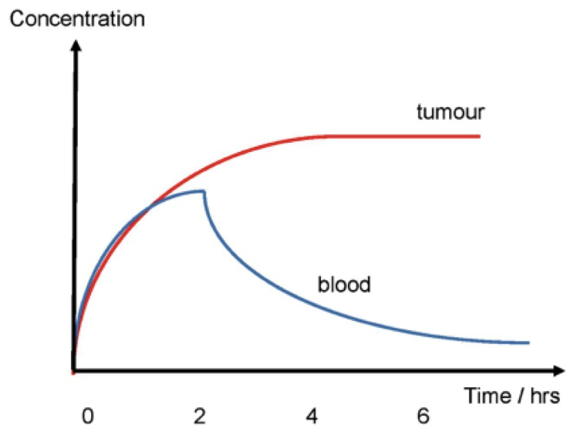
General context
Targeted RT
New dose delivery
Radiobiology & Patient based models
BNCT dosimetry
  BNCT dosimetry: complex cumulation of several components due to neutron thermalization, neutron capture in normal tissue and gamma component (from source and capture) in addition to the desire boron dose → MC based TPS
  Biological dose: based on boron concentration measurement and
  cumulation of weighted components by fix RBE (or CBE) factors.
6 %
⁴He (1,77 MeV) + ⁷Li (1,01 MeV)
Main neutron interaction of interest in BNCT:
¹⁰B + n_{th}(0,025 eV) [¹¹B]*
⁴He (1,47 MeV) + ⁷Li (0,84 MeV) + γ (0,48 MeV)
94 %
σ_{B-capt} ≈ 4000 barns
(vs σ_{H-capt} ≈ 0,3 b & σ_{N-capt} ≈ 1,7 b)
  Insuffiscient: high variation in RBE according to cell line, neutron spectra, particle type and dose, in addition
  to high dose heterogeneity due to compound biodistribution and very low-range/high RBE of He/Li ions.
Minimum required tumor/tissue uptake ratio = 3.5
Rachel Delorme
IN2P3 Scientific Council – 08/07/2025
10

Slide 14
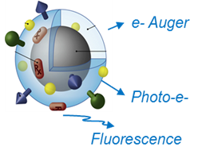
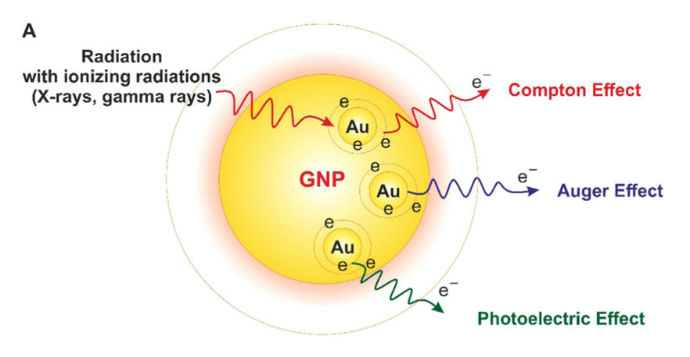
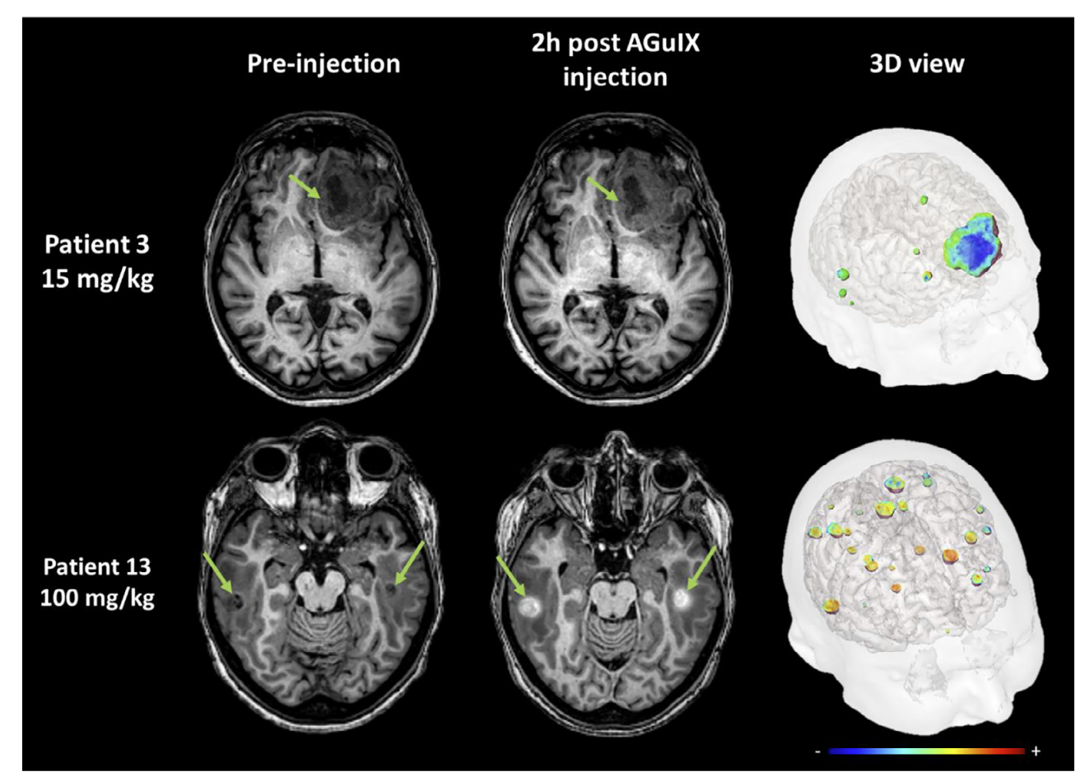
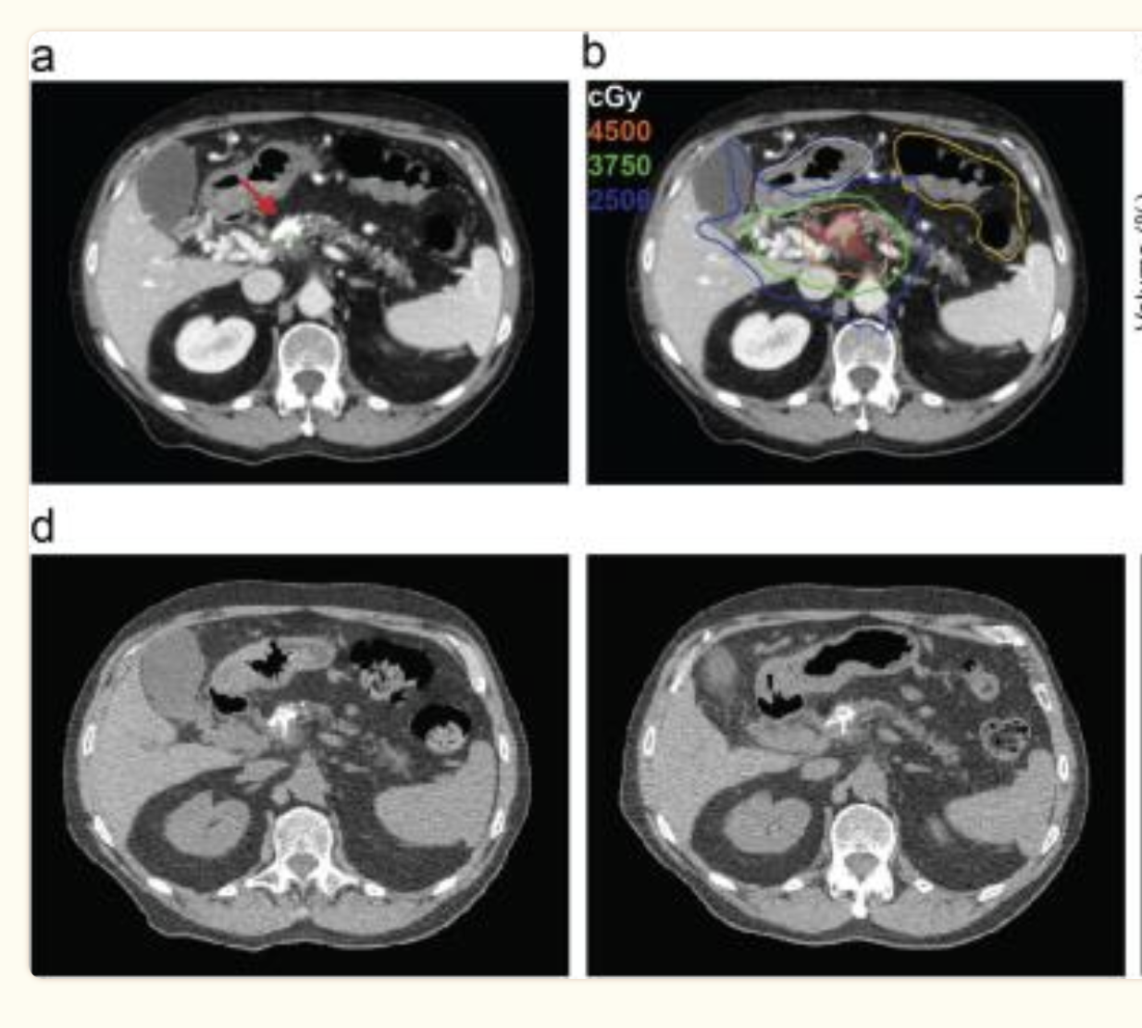
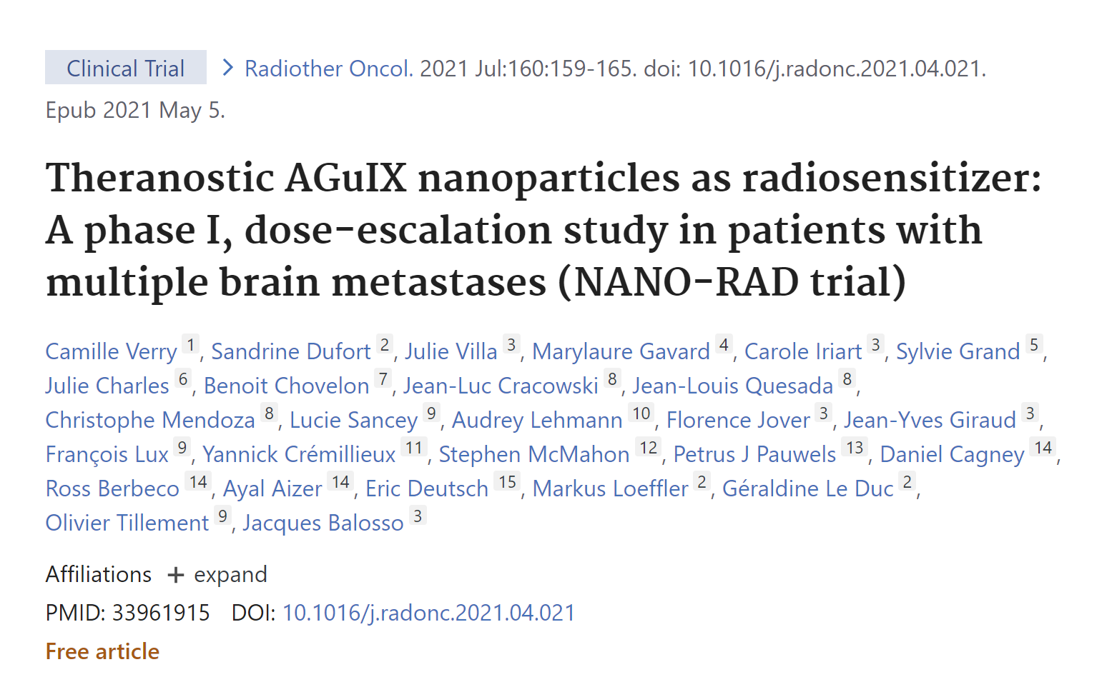
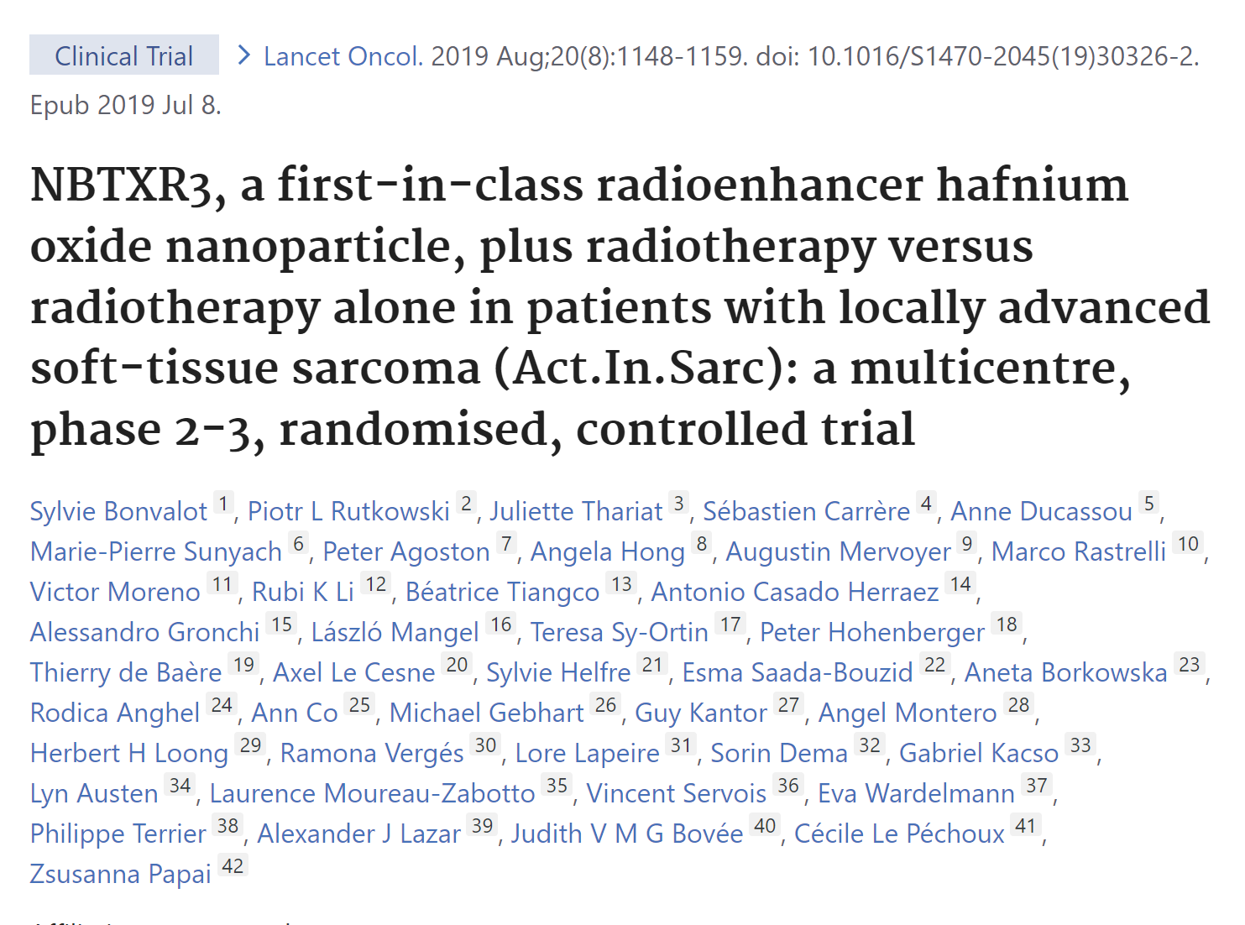
General context
Targeted RT
New dose delivery
Radiobiology & Patient based models
Nanoparticle-enhanced therapy
  Metallic / Oxide NP can enhance radiosensitization of RT: local dose boost due to Auger/PE electron emission cascades.
  First showed by Hainfeld et al. in 2004: Gold NP + RX
  Confirmed in numerous studies with different NP/beams
  2 clinical trials in France: AGuIX® (Gd), NBTXR3® (Hf oxide)
  High complexity to optimize NP-based treatments
  Radiosensitization is cell-line and NP-type dependent: standardization
  Treatment efficacy may depend on tumor targeting and cell-uptake
  Macroscopic dose-enhancement cannot explain alone observed biological effects
Borran et al., 2018. Rad. Phys. Chem.
Verry C. et al., R&O, 2021
Bagley F.B. et al., Clin Transl Radiat Oncol, 2021
  Pancreatic adenocarcinoma
Rachel Delorme
IN2P3 Scientific Council – 08/07/2025
11

Slide 15
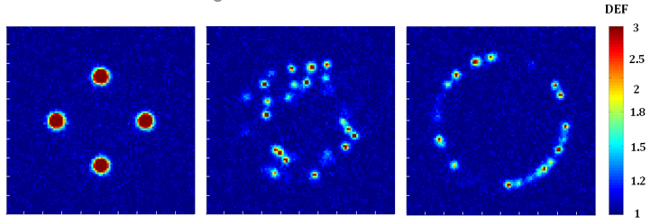
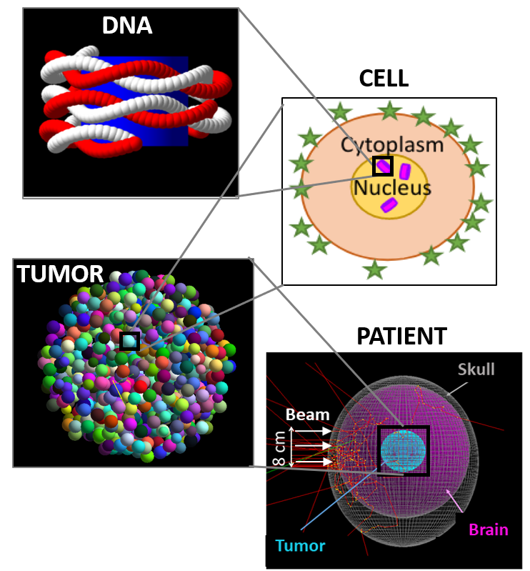
General context
Targeted RT
New dose delivery
Radiobiology & Patient based models
Targeted therapies: dosimetric issues
  Common difficulties in dose calculations and biological response prediction:
  « Local » (cell scale, larger? lower?) dose due to low-range particles of potential high-LET (Auger e-, α, ions)
  Heterogeneity ++ of energy deposition at nano / micro /tumor scale
  Question of the relevant sensitive target at cell scale
  to consider biological damage
  DNA, Cell nucleus, Cytoplasm, Membrane, tumor…? How?
Cell membrane
Cell nucleus
Exemple of heterogeneous dose deposition at cellular scale according to internalization case of Gd-NP (Delorme et al. (2017), Med. Phys. 44 (11):5949)
Physical, chemical and biological mechanisms involved in NP-radiosensitization ?
Lack of precise biological/clinical data of such heterogeneities:
→ But can be simulated to quantify the impact of such « unknown » heterogeneous distributions.
Multiscale modeling tools
Rachel Delorme
IN2P3 Scientific Council – 08/07/2025
12

Slide 16
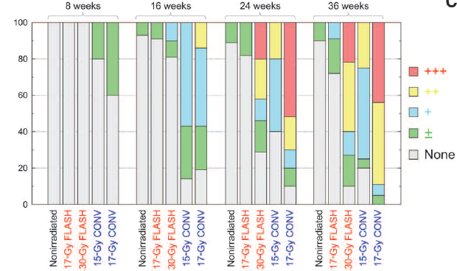
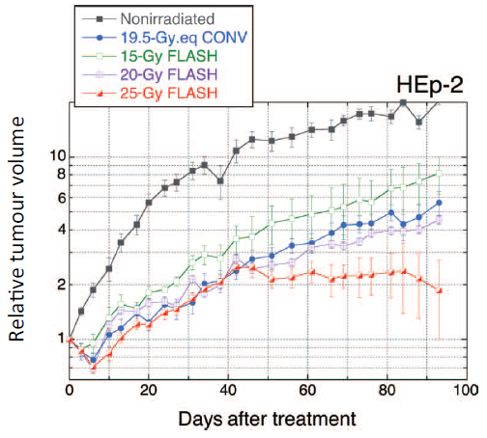



General context
Targeted RT
New dose delivery
Radiobiology & Patient based models
UHDR irradiation: « FLASH » therapy
  Very-high dose rates (> 40 Gy/s) protect normal tissues:
  Pioneer work of Favaudon et al. 2014: observed lower normal tissue toxicity (lung fibrosis) using high-dose rate e- beam (> 40 Gy/s, E~6 MeV) with similar tumor control to conv. (~0.03 Gy/s)
  FLASH-effect confirmed with e-/γ/p beams in several in vivo experiments.
  Recently demonstrated with scattered and PBS proton beam (Diffenderfer et al. 2019).
  First patient treated in Lausanne (Bourhis et al. 2019).
  Several clinical trials planned/started (on electron beam UHDR facilities, < 10 MeV)
  High and fast enthousiasm with FLASH therapy… Sometimes forgeting the basic rules of protection in RT
  ➔ Some negative results in veterinary trials on cats (Vozenin et al.) or dogs (Børresen B. et al., Front Onc 2023) with osteonecrosis
Vozenin et al. 2018
Rohrer-Bley et al. 2022
First demonstration of lung fibrosis reduction (twice more dose) on mice treated with FLASH compared to CONV irradiation, with comparable tumor response (Favaudon et al. 2014).
Memory sparing in mice after whole brain irradiation for dose rates > 100 Gy.s⁻¹ (Montay-Gruel et al. 2017)
Rachel Delorme
IN2P3 Scientific Council – 08/07/2025
27
Notes:
Explorer la GdNCT (157Gd)?

Slide 17



General context
Targeted RT
New dose delivery
Radiobiology & Patient based models
UHDR irradiation: « FLASH » therapy
  What physical parameters are needed to have a “Flash” effect ?
From Wilson et al. (2020), Frontiers in Oncology, volume 9:1563. https://doi.org/10.3389/fonc.2019.01563
Which beams: different time-structures
  Challenges/Questions:
  Limits of physical parameter’s impact on FLASH biology: pulse duration/intensity, mean or instantaneous dose-rate, beam size, total dose…
  Chemical and biological mechanisms of FLASH-effect ?
  Is it observable in vitro ? → need for FLASH-compatible irradiation platforms & multidisciplinary teams
  Need for Adapted dosimetry solutions for very-high dose rates needed
From Schuller et al. (2020), Physica Medica 80 (2020) 134–150. https://doi.org/10.1016/j.ejmp.2020.09.020
Rachel Delorme
IN2P3 Scientific Council – 08/07/2025
28

Slide 18




General context
Targeted RT
New dose delivery
Radiobiology & Patient based models
Spatially Fractionated RT
  SFRT can (also) protect normal tissue, with equivalent tumor control efficiency.
  Combines submillimetric beam sizes with spatial fractionation of the dose
  MRT: Beam < 200 µm (synchrotron) ;
  MBRT: 400-700 µm (accessible compact sources)
  Grid (or Latice): ~0.5-1 cm (used clinically)
  Challenge/questions:
  Explore the terra incognita of influence parameters
  Biological processes induced in normal and cancerous cells/tissues ?
  Reliable dosimetry protocols for very small beam size
+
Dose-Volume effect (Zeman et al. 1959)
Hopewell et al., Radioth. Oncol. (2000)
→ Dose-volume effect = the smaller the beam size, the higher the tolerance dose in healthy tissues.
Heterogeneous dose profiles
Rachel Delorme
IN2P3 Scientific Council – 08/07/2025
29
Notes:
Explorer la GdNCT (157Gd)?

Slide 19
General context
Targeted RT
New dose delivery
Radiobiology & Patient based models
IN2P3 contributions for innovative radiotherapies (RT)
Targeted radiotherapies
New dose delivery modes
TRT
Nanoparticles
FLASH
SFRT
AB-BNCT
Innovations in radionuclide production
Accelerator optimization
Detectors for clinical beam monitoring and dosimetry
Multiscale modeling
Radiochemistry
Imaging systems, reconstruction
Radiobiology
Rachel Delorme
IN2P3 Scientific Council – 08/07/2025
13

Slide 20
General context
Targeted RT: radionuclides
New dose delivery
Radiobiology & Patient based models
IN2P3 contributions in TRT – Radionuclides
Optimal production routes for high-LET and theranostic pairs
Clinical
almost all are for clinical application… mid/long term
Bio-conjugation methods for diverse vectors (antibody, peptides…)
Innovations in radionuclide production
Improve radiolabeling and vectorization
EUROPA
REPARE
PRALINE
Targetry: explore projectiles/materials, high power…
PRALINE
REPARE
Nuclear data cross section
Multimodal & multi-isotope imaging systems
Develop selective, fast and robust chemical processes
Advance separation chemistry, ligands
XEMIS
Preclinical and clinical imaging evaluation
SMILES
PET/SPECT
CLEARMIND
PRALINE
THIDOS
Explore novel ligands, radiolysis impact
PRALINE
Preclinical evaluation of radiopharmaceuticals
Rachel Delorme
IN2P3 Scientific Council – 08/07/2025
14

Slide 21










General context
Targeted RT: Radionuclides
New dose delivery
Radiobiology & Patient based models
Radionuclide production @ - PRISMA
Permanent IN2P3 FTE ~11
2020 – 2025 highlights: develop non-conventional methods for producing radionuclide with high purity
Numerous cross-section meas. (~20y exp), especially based on d (and α) beams: ²¹¹At(α), ⁶⁴Cu(γ)/⁶⁷Cu(β), ^{117m}Sn(CE), ¹⁸⁶Re(β), ¹⁶¹Tb(β)…
Used for nuclear code constraints.
Develop innovative targets
resistant to high current (~150 µA):
enriched vs natural. E.g. co-deposition
methods of Gd on Ni
Advance separation: SMILES project (2023-*):
Mass separation devices using electrostatic or magnetic fields coupled to laser ionization. 3 phases:
Charged particle optics simulations (SIMIONS): achieved setup optimization.
Analytical mass separator development: construction of a TOF system coupled with Laser/thermal ionization sources (1st exp 2025)
Magnetic mass separation: completion ~2028
Understanding chemical speciation: radiolysis study on astatine (Ghalei et al. 2022)
5-year prospects:
Collecting new nuclear data (5y): monitor reactions (⁶¹Cu, …), contaminants (^{177m}Lu, …), alpha route..
Optimizing production (5y): focus on Auger emitters (^{197m}Hg with d, ⁷¹Ge with p, d and α …)
Developing new targets : molecular plating (2y), molten salts techniques (5y). Pelletizing (2y)
Collecting fundamental chemistry data (5y): speciation studies on Pa, Ru and Rh
Explore alternative method for purification and acceleration of particles: launched of SMILES facility (2y) and operations (5y), Laser Plasma Acceleration (5y) → EUROPA (European call) project launched in 2025 to demonstrate feasibility of RI production for medicine.
⁶⁷Cu production σ meas. ; Stacked foils for reaction monitoring
TOF-L desorption-ionization source ; Thermal source design
Ni-Gd Co-deposition
Main articles
Cross section
Nigron E. et al (2023), ARI, vol. 200, 110927
Collaborations
Targetry
Bigourdan T. et al (2023), doi:10.1051
Local: CRCI²NA, LS²N, CHU Nantes, ICO, radiochemistry subatech
IN2P3: IPHC, IJCLab, GANIL
International: INFN Milano, INFN Legnaro, Univ. Granada, Oslo university, VUB, LARISSA (DE)
Industry: AI4R, ORANO
Theranostics
Sounalet T. et al (2024), ARI, Vol. 205, 111190
Mass separation
Formento R et al (2020), NIM B, 463: 468-471
Speciation studies
Ghalei M. et al (2022) , Rad.Phy.Che 198 110224
Rachel Delorme
IN2P3 Scientific Council – 08/07/2025
15
Notes:
Speciation: état d’oxidation des isotopes lors de leur production, intervient dans méthodes d’extraction/séparation…
TENDL nuclear data library for various projectile types and for isotope production of T1/2 > 1s
Sn: Etain (tin) → émetteur gamma pour SPECT + conversion electron emitter → range from 220-290 µm!
Internal conversion = deexcitation of nucleus, lead to atomic electron emission
PRISMAP: collab européenne (?) qui regroupe les principaux producteurs de RN académique → pour la fourniture en RN jusqu’aux essais cliniques.
Perspective Q: Can we produce Lu-177 using deuteron beam? What production route for what purity for Tb-155?
SMILES: different kinds of source will be used to desorb neutral species from their backing before laser ionization and mass separation

Slide 22


General context
Targeted RT: Radionuclides
New dose delivery
Radiobiology & Patient based models
REPARE@
Permanent IN2P3 FTE ~1
(15 persons in collab)
2020 – 2025 highlights: REPARE ANR (2019-2024): R&D for Production of innovAtive RadioElements
5-year prospects:
Project focused on the production of ²¹¹At, as a pilot study. Aims to develop innovative technologies, later being adapted to industrial production.
Innovative targets: main achievements:
    Conception of a high-power target based on solid Bismuth.
    → Built and tested (2023/2024) at the Neutron for
    Science (NFS) facility at GANIL.
    →Two Bi targets of ~1 GBq, irradiated with ⁴He²⁺ beams of
    28 MeV, shipped to ARRONAX.
    Investigation of liquid bismuth target: no go for prototype.
Cross-section measurements of ^{210,211}At:
Measurement of the ²¹¹At production cross section, and this of ²¹⁰At
in the alpha+²⁰⁹Bi reaction at threshold energies, a contaminant
for ²¹¹At production that is important to characterize.
Conception of a ²¹¹Rn/²¹¹At generator with regional partners (GANIL, CERMN, IMOGERE). Work on Rn cage molecules:
Repeated production of ²¹¹At: 1 or 2 irradiations per month on SPIRAL2 beam (within PRISMAP+ network)
Investigation of new alpha and Auger emitter production.
SIMS station pre-project install @GANIL
The REPARE target station installed in the converter room of the NFS facility at GANIL
Collaborations
Funds
Main article
IN2P3: GANIL, Subatech, ARRONAX
Local: CYCERON, CERMN, IMOGERE
International: CERN
Ansari-Chaveau et al. 2025, Optimizing 211At production cross section by studying the rise of 210At cross section: First measurement using Linac SPIRAL2, submitted
Rachel Delorme
IN2P3 Scientific Council – 08/07/2025
16

Slide 23





General context
Targeted RT: Radionuclides
New dose delivery
Radiobiology & Patient based models
PRALINE : Production de Radionucléides et Ligands pour la dosimétrie et l’Imagerie NucléairE
Permanent IN2P3 FTE ~5
(~9 persons in collab)
2020 – 2025 highlights: new methodology for theranostic pair radioisotope developments
3-year prospects:
ANR TTRIP (2021-2025): Tools for Tb RadioIsotope Production for nuclear medicine :
Target production:
    co-electrodeposition technique for Gd target
    pure ¹⁵⁵Gd (> 99.9%) target production by implantation
    on SIDONIE electromagnetic separator of IJCLab.
Cross section measurements:
    pure ¹⁵⁵Gd(p,n)¹⁵⁵Tb (Auger + SPECT)
    and Tb contaminants [1]
Complexation studies, radiolabeling :
    new chelator compatible with Tb and antibody;
    ¹⁶¹Tb (β⁻, Auger) biolabeling with antibody [2]
Preclinical & clinical imaging evaluation:
  Impact study of ¹⁵⁶Tb pollution on ¹⁵⁵Tb SPECT
  image quality [3]
  Clinical validation of THIDOS camera (¹³¹I therapy, 365 keV) [4]
New production/chelation solutions for use of theranostic Sc (43-PET, 47-β⁻) and Tb pairs:
Exploration of other Tb isotope production (¹⁴⁹Tb (α) and ¹⁵²Tb (PET)).
Production of ⁴³Sc (minimizing ⁴⁴Sc contaminant). Sc(III) complexation
Imaging :
Study 3γ imaging possibilities with ⁴⁴Sc
γ camera (THIDOS evolution) for imaging isotopes (Eg ≲ 250 keV)
[1]
[2]
[4]
[3]
Main articles
Wang et al. ARI, 2022, 186, pp.1102
Wang et al., ARI, 2023, 201, pp.110996
Bouteculet et al., ARI, 2024, 213, pp.111485
Bossis et al., IEEE TRPMS, 2024, vol. 8, no. 5, pp. 556-570
Bossis, et al., NIM A 2023, 1048 : 167907.
3 PhD: M.Bouteculet & S.Lam (defense: fall 2025), M.Hussein (2nd year).
Collaborations
IN2P3: IJCLab, Subatech, ARRONAX, GANIL
Funds
National: ICMub (Dijon), IC-UNISTRA (Strasbourg), ASNR, ICR (Toulouse)
Clinique: ICR (Toulouse), CHU Lausanne, Bordeaux
International: NPI-CAS (Czek republic), Catholic Uni. KAERIS (south korea)
Rachel Delorme
IN2P3 Scientific Council – 08/07/2025
17

Slide 24





General context
Targeted RT: Radionuclides
New dose delivery
Radiobiology & Patient based models
Instruments and methods for preclinical theranostic @ -IMR
Permanent IN2P3 FTE ~ 8
2020 – 2025 highlights:
5-year prospects:
[1]
Instrumental development for preclinical imaging:
Past decade: several design of PET and SPECT imaging systems,
especially in collab with Inviscan company (FPGA dev, PET design…).
→ evaluate possible transfer with SATT & CNRS innov.
Primate imaging, pharmacokinetics: Performance evaluation of the IRIS XL-220 PET/CT
new camera dedicated to non-human primates. (Boisson et al. 2022). [1]
Preclinical imaging studies :
investigate tumor characterization at both molecular and functional levels.
Macroscopic radiobiology rpPET INCA project: Comparison
of the [18F]-FDG and [18F]-FLT PET tracers in the evaluation
of the preclinical proton therapy response in hepatocellular
carcinoma. (Brasse et al. 21) [2]
Radiomarker for breast cancer: ⁶⁴CuCl₂ PET imaging of
4T1-related allograft of triple-negative breast cancer in mice.
(Latgé et al. 2023) [3]
The ⁶⁴CuCl₂ is produced at Cyrcé.
Instrumental & methods developments:
Dose delivery optimization (hypofractionation, flash) with protons → TEL & dose rate biol impact
Dedicated preclinical instrumentation: Whole-body &Brain mouse PET, High-efficiency SPECT
Dedicated reconstruction and quantification algorithms (AI based)
Innovative combination therapies and companion trials (glioblastoma, pancreatic cancer)
Proton beam irradiation + activation molecules: chemotherapy (1y), or nanoparticles (3y)
TRT + activation molecules (chimio, nanoparticles): first with ⁶⁷Cu (β) (1y), then with theranostic pairs (Cu, Tb) (3-5y)
[2]
[3]
Main articles
Latgé, A., et al. (2023). ⁶⁴CuCl₂ PET imaging of 4T1-related allograft of triple-negative breast cancer in mice. Molecules 2022, 27, 4869.
Brasse, D. et al. (2021) Molecular Imaging and Biology. 2021 Oct;23(5):724-732
Boisson et al. (2022), EJNMMI Physics 9, 10.
Collaborations
Funds
Industry: Inviscan SA
IN2P3: IPHC (DSA, DEPE, Cyrcé), LPC Caen, Arronax
National: CINAM, LATIM
Clinical: CLCC Paul Strauss, ITI Institut du Médicament de Strasbourg
IMS
CPER
Rachel Delorme
IN2P3 Scientific Council – 08/07/2025
18

Slide 25





General context
Targeted RT: Radionuclides
New dose delivery
Radiobiology & Patient based models
Imaging systems
→ See Etienne Testa talk for details
2020 – 2025 highlights: several imaging systems for theranostic applications developed in IN2P3 labs, that can have an important role in the development of personalized dosimetry in TRT
XEMIS:
Compton camera based on
liquid Xe detection material → fast and sensitive,
allowing very low injected activity imaging,
+ possible meas. of 3 γ emissions (↗resolution).
1st Preclinical prototype installed at the Nantes University Hospital, for diag.
CLEARMIND:
“scintronic” detector
concept with TOF <100ps
to improve PET
imaging sensitivity and
resolution (to ~1 mm).
THIDOS:
New portable gamma camera
to control the dose delivered during radioactive iodine treatment for thyroid diseases.
Adaptation to high-energy emitters to apply TAT dosi
CCP: Compton collimated probe
intraoperative probe for radio-guided surgery.
Valo “Déclic” ongoing
Livrable: Preclinically
testable probe
prototype (pork)
Rachel Delorme
IN2P3 Scientific Council – 08/07/2025
19

Slide 26
General context
Targeted RT: dose/modeling
New dose delivery
Radiobiology & Patient based models
IN2P3 contributions in « Targeted RT » (MP)
Innovative production targets
Clinical
Modeling at sub-cell, cell and multicell (2D/3D) scales
Accelerator optimization & field characterization in BNCT
(BSA, target, design, meas…)
Multiscale modeling of physical dose and biological response
Neutron beam characterization
Optimal moderation
(?)
Preclinical (in vivo) and clinical (patient) modeling/dosimetry
Experimental microdosimetry
Sub-cell (nucleus, mitochondria, membrane…), cell and multicell (immunogenicity…) biological responses
For in vitro/in vivo radiobiological studies
Monitoring of dose delivery
BIOALTO
Understanding the biological mechanisms
THIDOS
XEMIS
AIDER
For clinical dose monitoring (TRT, BNCT)
Vector (or NP)/irradiation combination
Rachel Delorme
IN2P3 Scientific Council – 08/07/2025
20

Slide 27




General context
Targeted RT: dose/modeling
New dose delivery
Radiobiology & Patient based models
Accelerator Based-BNCT @
Permanent IN2P3 FTE ~1.6
(~9 persons in collab)
2020 – 2025 highlights: Master projet AB-nCT (2024-2027)
3-year prospects:
Project aims at proposing an optimal set of accelerator-based BNCT systems, including:
Innovative targets for intense epithermal neutron:
  Develop a rotating target on a graphite wheel + ⁹Be (or ¹³C) deposit [1]
  Design of a recycling liquid ⁷Li-based target (patent ghetta 2020)
  Development of an e- thermal test beamline (3 kW/cm²)
  → graphite whell held up to 500°C
Neutron field detection: develop 2 detector types.
NFM[2] : Gas detector (Ar/CO2) with ¹⁰B-coated foil for field monitoring
MIMAC-FastN[3]: used as neutron spectrometer in epithermal and fast ranges
or as microdosimeter, meas. 3D ion tracks
after ¹⁰B capture in tissue-equivalent gaz.
Design of optimal moderator (BSA) [4]:
inverse topological optimization algorithm.
Optimal BSA design for BNCT, reach treatment
depth up to ~10cm (std ref ~7.6cm).
All dev aims at proposing an optimal AB-BNCT facility based on Argentina Deuteron accel design (reflexion in the frame of BNCT-GLOBAL)
Targets: demonstrator of the ¹³C target deposited on the graphite wheel by sputtering method. (with Argentina collab)
Detectors: neutron angular distrution + NFM neutron meas. @ GANIL + TANDAR
Microdosimetry: validate µdosi meas. With tissue-eq. Gaz + compare Geant4 ionization
Moderator: design and construct the moderator for the metrological epithermal neutron beamline at LMDN. + TANDAR
[1]
Main article/patents
[4]
[3]
[2]
N. Sauzet, D. Santos et al., NIMA 2020, arXiv: 1906.03878
M. Hervé et al. Phys. Medica 88 (2021) 148–15
S. Chabod et al., Phys. Med. Biol 67(2022) 105009 .
C. Beaufort et al., 2024 JINST 19 P05052.
S. Chabod et al., Phys Med Biol. 2025 70(3).
Patents “Fast neutron detector and spectrometer”, Santos et al.. 2021, FR GB DE 36525633 ; “Liquid target for the production of nuclear particles” Ghetta et al. FR 1906353
Collaborations
IN2P3: IP2I
Funds
National: LMDN-ASNR, IAB
International: TANDAR (CNEA, Argentina), BNCT-GLOBAL (Germany)
MITI-CHEMINS
Rachel Delorme
IN2P3 Scientific Council – 08/07/2025
21

Slide 28








General context
Targeted RT: dose/modeling
New dose delivery
Radiobiology & Patient based models
Multiscale modeling in TAT and BNCT
Permanent IN2P3 FTE ~2-3
(+10 persons in collab)
*see E. Testa presentation
2020 – 2025 highlights: PICTURE PCSI (2021-25) + MP BioALTO (2024-2027) + MITI AlphaBioDose
5-year prospects:
Project aims at developing flexible multi-scale models , based on Geant4-based MC codes and NanOx*, for biological dose prediction in TAT & BNCT considering source heterogeneity, RBE and cell geometry.
TAT: - CPOP-Geant4-NanOx calculation chain in spheroid geometries evaluate impact
of intra-cell and intra-tumor source heterogeneities on cell Survival and TCP. [1]
- Analysis and CPOP code on github (CPOP will be in GATE soon).
BNCT: - preliminar TCP calculation showing huge impact
of boron internalization (factor 5-6 on D_{TCP=0,5})
- Collab with Univ.of Granada to compare on ILL experiments.
Experiments:
- instrumentation of the BioALTO* beamline (MP) for low-energy ion
radiobiology - LPSC diamond monitor.
- MITI collab (GANIL, ISTCT, LITO) to perform in vitro dose-controlled
cell survival with α-emitters + alpha@Silab.
- with LIRIS: 3D cell microscopy images →
Objective to characterize and quantify cellular lethal mechanisms (DNA and
other cytoplasm or membrane targets…) to constraint models.
TAT:
Benchmark TAT cell survival + study impact of cell geometry + scale-up to in vivo biological-dose maps.
Include in NanOx extra-nuclear cell damage. Fit on BioALTO + α emitters experiments. (+µbeams?)
Create digital database of various cell lines
BNCT:
Confirm heterogeneity impact on TCP.
Extend multi-scale approach including full BNCT dose components. IAB collab to constraint BNCT model and study cell-biological mechanisms
Collab Univ. Granada → BNCT dose formalism comparison & inclusion in TPS.
Availabiliy in open-source codes G4-DNA/GATE: TAT/BNCT BioDose actor in GATE, BioALTO digital twin
Extend modeling to tumor response models
[1]
Main articles
Collaborations
Funds
Levrague et al., 2025, Med. Phys., in proof
Alcocer-avila et al., 2024, Med. Phys. 51(12):9358-9371.
Levrague et al. 2024, ⟨hal-04775893⟩ ⟨hal-04775900⟩
Github: https://github.com/lpc-umr6533/cpop.git ; https://github.com/VictorLevrague/py_nanox_package.git
IN2P3: IP2I , LPCA, GANIL, IJCLab
National: LIRIS, ISTCT, LITO, IAB, Baclesse
International: Univ. Granada, AMA/NASA, Argentina
Rachel Delorme
IN2P3 Scientific Council – 08/07/2025
22

Slide 29






General context
Targeted RT: dose/modeling
New dose delivery
Radiobiology & Patient based models
Dose control in radiobiology
Permanent IN2P3 FTE ~1
(~4 in2p3 persons)
2020 – 2025 highlights: complementary solutions for dose-control in biology exp
5-year prospects:
TAT dosimetry:
Started 2018
4-Si detector [1] develop for TAT dosimetry, to qualify the dose delivered in 2D in vitro irradiation experiments with dedicated cell supports [2]. Part of a program that studies multiscale biological effects for the treatment
of brain metastasis.
New deconvolution method developed
for alpha energy spectra reconstruction
(Doudard et al.)
From 2024: collab with LPSC/IP2I and
LITO (MITI AlphaBioDose) to provide exp.
Data constraining the models.
+ preclinical in vivo dosimetry with
multimodal-imaging data to evaluate
treatment efficiency and toxicity.
Microscintillator for TRT:
Objective:
Preclinical liquid source microdosimetry from isotope production to biodistribution studies:
- meas. activity at a micrometer scale
- Detecting low activity levels
Implantation near (in vitro) or within structures of interest (in vivo)
Results:
Efficacy and energy measurement with sealed α-sources.
TAT Dosemeter @ GANIL objectives:
Short-term: - Dose-effect relationships in TAT (survival and DNA break) on metastatic breast cancer cells irradiated with ²²³Ra (or available α emitters)
- Benchmark biological effect models (collab LPSC/LITO)
Medium/long-term : In vitro dosimetry at the cellular level. Joint measurements of α particle interactions… →Microscopy + Scintillator…
and the rate of DSB
at the cellular level
µscintillator @ LPC:
  Short-term: test various organic scintillators.
  Control reproducibility of detector sizes and shapes. Study response as function of β/α
  Delivrable 3-4 y: functional and dose-calibrated detector
[1]
[2]
Main articles
Collaborations
Funds
A. Doudard* et al.. Med. Phys. 2023; https://doi.org/10.1002/mp.16279
A. Corroyer-Dulmont et al. Front. Oncol. 2021; https://doi.org/10.3389/fonc.2021.714514
Frelin-Labalme A-M et al. Med. Phys. 2019; https://doi.org/10.1002/mp.13969
Corroyer-Dulmont A et al.. Neuro-Oncology 2019; https://doi.org/10.1093/neuonc/noz169
IN2P3: LPSC, IP2I, IPHC
National: ISTCT, LITO, Baclesse, CINAM
Rachel Delorme
IN2P3 Scientific Council – 08/07/2025
23

Slide 30




General context
Targeted RT: dose/modeling
New dose delivery
Radiobiology & Patient based models
Preclinical and clinical dosimetry of TRT
Permanent IN2P3 FTE ~1.6
(~9 persons in collab)
2020 – 2025 highlights: Over 15 years of partnership IMOST- Jean Perrin cancer center
5-year prospects:
Several projects, studying the dosimetric and microdosimetric impact of innovative targeted radionuclide radiotherapy treatments or radiopharmaceuticals dedicated to SPECT or PET imaging using the GATE simulation platform.
Demand from medical centers & INSERM lab to perform
the dosimetry to accompagny Radiopharmaceutical
developement and clinical transfert.
General:
LPCA will continue dosimetry studies for preclinical and clinical treatments to support the market introduction of innovative radiopharmaceuticals.
Development & validation of GATE 10 simulation platform and Geant4-DNA.
ANR IRHydroBRAIN (2025-2028) :
Strategy for intraoperative TRT in glioblastome with radiolabeled hydrogel with ⁹⁰Y or ¹⁷⁷Lu.
Apply to TAT : FANTαSTIC
Development and testing
of new biophysical models
for biological dose predictions.
Clinical transfert phase I MELRIV - CARSPECT
1h
3h
6h
16h
3D reconstruction (spheroid, mouse, rabbit and human) from microscopic or CT imaging. Definition of ROIs
Biodistribution study of radiopharmaceuticals by SPECT, PET imaging and dosimetric calculation
²²⁵Ac, ²¹²Pb, ²¹¹At
Main articles
Collaborations
Industry: NanoH
Funds
1. Thivat E et al. BMC Cancer. 2022;22(1):417. doi:10.1186/s12885-022-09495-3
2. Jouberton E et al.. Med Phys. Published online 2018. doi:10.1002/mp.13165
3. Chanchou M et al. Méd. Nucl. - IFM. 2021;45(4):175. doi:10.1016/j.mednuc.2021.06.008
4. Fois GR et al. Med Phys. 2020. doi:10.1002/mp.14603
5. Thivat E et al. Front Med. 2022;9:993151. doi:10.3389/fmed.2022.993151
Local: IMOST, CLCC Jean Perrin
National: CRAN
International: OpenGate Collab
Rachel Delorme
IN2P3 Scientific Council – 08/07/2025
24

Slide 31

General context
Targeted RT: dose/modeling
New dose delivery
Radiobiology & Patient based models
Clinical dose control systems
Permanent IN2P3 FTE ~10
(++ persons in collab)
→ see E. Testa presentation
2020 – 2025 highlights:
5-year prospects:
THIDOS:
New portable γ camera of 10x10cm field
of view, to control the dose delivered
during ¹³¹I (β 364 keV) treatment for thyroid diseases.
Evaluate accuracy and robustness of the quantification protocol.
XEMIS:
Medium (4-5y) : apply for TRT dosimetry planification for preclinical appy
Long (>5y): patient-scale prototype.
Complementary Compton camera solutions to guide TRT dosimetry:
THIDOS → 2025: test in 3 clinical centers: IUCTO, Baclesse, Cochin for thyroid.
2025-27: adapt to ¹²³I (160 keV) for plan dose + exploit possible applications for ¹⁷⁷Lu (
>2026… Develop a DL-enhanced Compton camera to allow dosimetric monitoring of TAT (Eg ≳ 400 keV). ¹⁴⁹Tb, ²¹³Bi, ²²⁵Ac or ²¹²Pb
AIDER
European-horizon 25-29: develop Compton cameras for radiopharmaceutical dose control.
→ In charge of optimizing the CC prototype by MC simulation and image reconstruction
Collaborations
Funds
Main articles
IN2P3: IJCLab, Subatech, IP2I
Clinical/national: IUCTO, Baclesse, Cochin, CREATIS
International: Korea (thidos) + European (AIDER)
Bossis et al., IEEE TRPMS, 2024, vol. 8, no. 5, pp. 556-570
Bossis, et al., NIM A 2023, 1048 : 167907.
Lequertier, V. et al.. PMB, 70:045001.
Lainé et al.. Sensors, 2024, 24 (17), pp.5826.
Rachel Delorme
IN2P3 Scientific Council – 08/07/2025
25

Slide 32










General context
Targeted RT: dose/modeling
New dose delivery
Radiobiology & Patient based models
Nanoparticles and radiosensitization
Permanent IN2P3 FTE ~2.7
2020 – 2025 highlights: explores radiobiology with an emphasis on radiosensitization (NP)
5-year prospects:
Development of mitochondria-targeted
gold NP
The team develop since several years innovative NP specifically targeting the cell mitochondria.
Despite effective targeting, no significant radiosensitizing effect was observed on prostate tumor cells. →abandon
Investigate radioprotective effect :
Key molecular pathways highlighted in mitochondria DNA mechanisms involved in radioprotective effect in hibernation thanks to advanced instrumentation & analysis developments.
Other NP studies @ in2p3:
NP radiobio: IP2I C. Rodriguez’s team have 15 y experience in NP research, especially with AGuIX® NP and radiosensitization mechanisms implying extra-nuclear cell organelles.
LP2IB – IRIBIO: radiosensitization quantification studies performed on metallic/oxide NP with AIFIRA µbeam & analysis tools
NP modeling: IP2I Beuve’s team (F. Poignant PhD) + R. Delorme:
Innovative approaches and metabolism impact
Dose enhancement using nanoparticles
2025-2028 : Mitochondrial / metabolism impact of dose enhancement of well characterized metal nanoparticles.
Complementary analyses from IP2I partner
Hibernation: a bio-inspired approach to radiosensitize human cells
2025-2027: Deciphering specific mechanisms involved in radiosentization
2026-2028: Characterization of bear serum specific compounds
Follow-up of irradiation impact on cells
Dev of prototype of an epifluorescence microscope
coupled with a mini-irradiator (X-rays)
Development of related dosimetry
Main articles
Collaborations
Funds
Debar L et al.(2023). Mitochondrion., 71:93-103.
Martucci M et al. (2023). Methods Mol Biol., 2615:121-137.
Martucci M et al. (2024). Nucleic Acids Res., 52(10):5912-5927.
Mehmedović M et al. (2022). Biochim Biophys Acta Mol Basis Dis.,1868(10):166467.
IN2P3: IPHC, IP2I
National: UNH, LNHB, CRCI2NA
International:
Rachel Delorme
IN2P3 Scientific Council – 08/07/2025
26

Slide 33


General context
Targeted RT
New dose delivery
Radiobiology & Patient based models
IN2P3 contributions in « FLASH therapy » (MP)
WP1
Physics
WP2
Chemistry
WP3
Biology
WP4
Digital twins
- Beam monitoring Instrumentation
- Dosimetry
FLASH
- Beam Line Simulation
- Simulation of radiolysis under different conditions: O2, pH, time, dose rate, etc.
- GATE10 implementation
Radiolysis
H₂O₂, e-_{aq}, HO°, O2°⁻
O₂, pH, dose-rate, biomolecules
- Cell Radiobiology
- ROS measurements
- Damage measurements
Rachel Delorme
IN2P3 Scientific Council – 08/07/2025
30

Slide 34






General context
Targeted RT
New dose delivery
Radiobiology & Patient based models
Understanding mechanisms of FLASH therapy
Permanent IN2P3 FTE ~10
*see E. Testa presentation
2020 – 2025 highlights: FLASHMOD & beyond…
5-year prospects:
FLASHMOD aimed to develop a comprehensive environment around the ARRONAX proton beam to study the FLASH effect [0,1 Gy/s – 300 kGy/s].
Arronax FLASH beamline adaptation: developed pulsed
irradiation modes allowing $\dot{D}=$ 1 mGy/s to 1 MGy/s
+ innovative beam monitoring instrumentation:
Beamline modeling with GATE* (digital twin) and
dosi validation.
Radiochemistry studies: Measurements of
production yields of several ROS in CONV and
UHDR, including H2O2 and e⁻_{aq}
Modeling of radiolysis in GATE*, validate Geant4-DNA models
against experiments.
Biological zebrafish embryos and endothelial cells
experiments. New small animal holder.
Fruitful & interdisciplinary collab within IN2P3 (LPCA, Subatech, Arronax, LP2IB) →being continue within next “FLASH MP” + AAP:
Measurement of ROS in cellular environments (until now pure water).
LPCA will continue validation of G4-DNA + implementation in GATE* (Chemistry Actor)
Subatech investigate exp. chemistry of FLASH, targeting LET influence, time structure effect and superoxide species.
FLASHDANZE project submitted to PIANOFORTE call (with ASNR)
Main articles
Fois GR, et al. Med Phys. Published online 2024. doi:10.1002/MP.17281
Evin M et al. (2024), Physica Medica, 120, 103332
Ghannam Y et al. Radiother Oncol. 2023 Oct;187:109820.
Terfas et al. (2025) J.of Physical Chemistry A, DOI: 10.1021/acs.jpca.5c00629
Collaborations
Funds
IN2P3: Subatech, LPCA, LP2I, soon IPHC
National: CLCC, ICO Nantes, INSERM US2B, CIMAP/GANIL
International: Dredse Flash team (Germany)
PCSI FLASHMOD
Rachel Delorme
IN2P3 Scientific Council – 08/07/2025
31

Slide 35

General context
Targeted RT
New dose delivery
Radiobiology & Patient based models
Radiolysis of Biomolecules for FLASH irradiation
Permanent IN2P3 FTE ~1.5
2020 – 2025 highlights:
5-year prospects:
This project aims at developing a systematic study, at the molecular scale, of
the radiolysis of protein biomolecules by accelerated ions studying LET, Ph
and the dose-rate effect on radiolytic yields.
Other Objective: to deliver robust experimental data for simulation codes Geant4-DNA).
Results: - In water: radiolytic yields of ·OH and e–_{aq} remain unaffected by dose rate under 24 MeV proton from dose rates (0.1 Gy/s) up to 200 Gy/s (300ns), but decreased above several kGy/s.
- In biomolecules: 2,5-DOPA and aspartame analog
yields increased clearly with D.
Another applied project:
Dev of thin dosimetry films for skin dose measurement
during treatment →CNRS Prématuration,
Q. Raffy, 2023–2025 → continues with SATT.
Study dose-rate effects on radiolysis of water and biomolecules under electron and X-ray (Aerial-CRT), UHDR µpulses H+ @ ARRONAX and at HIMAC (Japan).
Study of the impact of O2 concentration on dose-rate effects in biomolecule radiolysis.
Study more complex peptides to identify potential intramolecular radical–radical transfer processes that may occur in proteins.
Investigation of the evolution of radicals formed in proteins under irradiation, using low-temperature (26 K) irradiation conditions.
Collaborations
Funds
IN2P3: Subatech, Arronax
National: Icube, the platform Acacia, G4-DNA collab , G. Baldacchino.
International: NIRS-QST (Japan) and CNAO (Italy), ICANS, Aerial-CRT (Illkirch) platform
2 PCSI plan cancer projects
PHC Sakura Project (2021-23)
Rachel Delorme
IN2P3 Scientific Council – 08/07/2025
32

Slide 36








General context
Targeted RT
New dose delivery
Radiobiology & Patient based models
Dose monitoring for FLASH &microbeams
Permanent IN2P3 FTE ~2.6
2020 – 2025 highlights: Find solutions to monitor ion beams at UHDR [1-1MGy/s] … and SFRT
DIAMONI:
Diamond detector for MRT
PEPITES:
MRT is progressing toward clinical application. At ESRF synchrotron, a veterinary trial has started, very promising for resistant/diffuse tumors.
→ LPSC developed a stripped diamond detector to monitor the irradiation.
*see E. Testa presentation
Irradiation platforms
CYRCé
BioALTO
Dose monitoring for FLASH beam is a hot topic: UHDPulse (2019-2023) European project from metrological labs dedicated to FLASH detector development to support the FLASH clinical transfer challenge
ARRONAX
→Transfer on Australian synchrotron and other compact sources.
Rachel Delorme
IN2P3 Scientific Council – 08/07/2025
33

Slide 37








General context
Targeted RT
New dose delivery
Radiobiology & Patient based models
Radiobiology & Patient based models
Permanent IN2P3 FTE ~
2020 – 2025 highlights:
Correlation of RADiomic and RADiobiological parameters to predict tumor response of oral cavity and oropharyngeal cancers to RADiotherapy
Numerical tool developments for patient-based modeling (PMRT program), analysis and treatment choice
Validation of the mouse model, calibration of MRI images and tumor sections
librairie logicielle R
https://CRAN.R-project.org/package=espadon
Information sur https://espadon.cnrs.fr
Correlation of radiobiological datas and radiomics parameters
  Study of comparative toxicity with Xrays or proton treatments at CLCC Baclesse
Clinical collaborations
Rachel Delorme
IN2P3 Scientific Council – 08/07/2025
35

Slide 38

General context
Targeted RT
New dose delivery
Summary
Summary – FLASH MP perspective (in construction)
WP1 - Contrôle qualité et dosimétrie des lignes faisceaux UHDR H⁺, He²⁺ , C, e⁻, RX (Resp: Charbel Koumeir, Ziad El Bitar)
TASK 1 – Contrôle de la structure temporelle du faisceau
TASK 2 - Développement instrumental spécifique UHDR
TASK 3 - Protocole dosimétrique ions et validation
TASK 4 – Protocole dosimétrique électrons et validation
WP2 – Effet du débit de dose sur la radiolyse de l’eau expérimentale (Resp: Quentin Raffy, Guillaume Blain)
TASK 1 – Effet du débit de dose en fonction du TEL
TASK 2 – Effet de la structure temporelle des faisceaux
TASK 3 – Influence du pH et de O₂
TASK 4 – Radiolyse de biomolécules
WP3 - Irradiations de populations cellulaires (Resp: François Chevalier, Claire Rodriguez-Lafrasse)
TASK 1 – Effet du débit de dose en fonction du TEL
TASK 2 – Effet de la structure temporelle des faisceaux
TASK 3 – Influence du pH et de l’O₂
WP4 – Jumeaux numériques multi-échelles (Resp: Lydia Maigne, Nicolas Arbor)
TASK 1 – Simulations des lignes/faisceaux d’irradiation avec GATE 10
TASK 2 – Simulations de la chimie de la radiolyse avec Geant4-DNA
TASK 3 – Simulations des dommages biologiques (modèles biophysiques)
TASK 4 – Création d’une base de données ouverte
Rachel Delorme
IN2P3 Scientific Council – 08/07/2025
34

Slide 39

General context
Targeted RT
New dose delivery
Summary
Summary – FLASH MP perspective (in construction)
WP1 – Quality control & dosimetry
WP2 – Radiolysis in FLASH
WP2 – Cell irradiations
WP3 – Simulations
Total FTE – in2p3:
6.25 researchers,
7.2 technical staff
10 PhD defended
7 PhD ongoing
5 CDD researchers
1,5 CDD techn. staff
Total articles: 40
Total funds:
185 K€ in2p3,
818 K€ non-in2p3
Scientific Objectives of the MP :
Better understand the fundamental mechanisms in FLASH by studying the FLASH phenomenon
on different types of beams (ions and e-)
Combine UHDR and TEL / pH / biological model → Multidisciplinary approach
Dosimetry and implementation of UHDR ion beams
Understanding chemical mechanisms
Understanding biological mechanisms
Developing innovative predictive digital twins
Rachel Delorme
IN2P3 Scientific Council – 08/07/2025
35

Slide 40


General context
Targeted RT
New dose delivery
Summary
Summary – Targeted RT MP perspective (in construction)
WP1 – Multiscale modeling of physical dose and biological response
WP2 – Optimization and control of dose delivery
WP3 – understanding the biological mechanisms
Task 2.1: Optimization and characterization of neutron fields in BNCT
Task 2.2: Dose delivery control in in vitro and preclinical radiobiology
Task 2.3: Clinical dose delivery control in internal radiotherapy (personalized dosimetry)
Task 3.1: Studies of subcellular (nucleus, mitochondria, membrane...), cellular, and multicellular (immunogenic…) responses
Task 3.2: Vector (or NP) /irradiation combination studies
Task 1.1: Modeling at the subcellular, cellular, and multicellular scales (2D and 3D)
Task 1.2: Preclinical and clinical modeling
(in vivo, patient)
Total FTE – in2p3:
10.3 researchers,
11.4 technical staff
12 PhD defended
4 PhD ongoing
6 CDD
Total articles: 25
Total funds:
162 k€ in2p3,
1.44 M€ non-in2p3
Scientific Objectives of the MP :
Optimize therapeutic efficacy, improve personalized dosimetry
Optimize dose delivery and radiation control
Determine the physical dose delivered and predict a biological response to treatment.
Understand the mechanisms involved in therapeutic efficacy and how to quantify them
Necessary multidisciplinary collaborations (physical, biological, chemical and clinical)
Rachel Delorme
IN2P3 Scientific Council – 08/07/2025
36

Slide 41


General context
Targeted RT
New dose delivery
Summary
Summary – Radionuclide MP perspective (in construction)
WP1 – High-LET particles
WP2 – Theranostic approaches
WP3 – Innovative radionuclide production
WP4 – Separation and formulation chemistry
WP5 – Vectorization, radiolabeling
WP6 – Imaging & Dosimetry
Designing effective theranostic pairs.
→Lanthanides, transition metals, biological and chemical compatibility
Optimizing the therapeutic use of alpha and Auger emitters.
Exploring laser-plasma acceleration and mass separation
Developing rapid and selective chemical processes
Efficiently coupling radionuclides and biological vectors
Evaluating the spatiotemporal distribution of radiopharmaceuticals
Total FTE – in2p3:
15.5 researchers,
10.1 technical staff
13 PhD defended
+11 PhD ongoing
5.2 CDD
Total articles: 69
Total funds:
152 kEuros in2p3,
1.3 MEuros non-in2p3
Scientific Objectives of the MP Project:
Innovate in the production of radionuclides
Master chemical and biological transformation
Evaluate, visualize, and optimize clinical efficacy
Rachel Delorme
IN2P3 Scientific Council – 08/07/2025
37

Slide 42

General context
Targeted RT
New dose delivery
Summary
Conclusion
  Highly dynamic activity in the very interdisciplinary field of “innovative therapies” :
  Some fundamental researches : understanding/modeling biological or chemical effects, technological breakthrough in instrumentation, cross section measurements…
  Others pushed up to clinics / valorization → importance of large variety of profiles and projects. Offer flexibility
  Significant number of peer-reviewed publications and successful calls for proposals attest to the relevance of the research conducted.
  Structuration:
  Strong local collab with numerous INSERM/clinical and other academic partners (Labex…)
  National with consolidated intra-in2p3 and inter-institute (INSERM, ASNR, CNRS, CEA…) collab, notably thanks to the MI2B GdR, MITI programs, “IN2P3” platform activities, scientific networks (FLI, PRISMA…) and project call opportunities.
  International through important scientific and technical collabs (e.g. Radionuclide PRISMAP, BNCT, CNAO, major role within the GATE and Geant4DNA collaborations…)
  Next 4 (?) in2p3 MP construction to come in fall 2025…
Rachel Delorme
IN2P3 Scientific Council – 08/07/2025
38
Notes:
Highly dynamic activity in the field of innovative therapies, which make a wide variety of contributions to health, with interdisciplinary depth (accelerator physics, instrumentation, modeling/analysis, computer science, imaging, biology, chemistry, etc.) and the flexibility necessary to adapt to rapidly evolving clinical needs. The significant number of peer-reviewed publications and successful calls for proposals attest to the relevance of the research conducted there.
The teams have a strong local structure through numerous clinical and academic partners (Labex role, etc.), national structure through intra-in2p3 and inter-institute scientific connections (INSERM, ASNR, CNRS, CEA, etc.), notably thanks to the GdRMi2B, scientific networks (France Life Imaging, PRISMA, etc.), and in2p3 platforms, as well as a visible international position (e.g., major role within the GATE and Geant4DNA collaborations).

Slide 43
Thank you
Rachel DELORME on behalf of the community
IN2P3 Scientific Council – 08/07/2025

Slide 44
Appendix
Marie VANSTALLE
IN2P3 Scientific Council – 08/07/2025
40

Slide 45





























C. & J.M. Fontbonne
∿350 /mois en 2024
https://CRAN.R-project.org/package=espadon
Information sur https://espadon.cnrs.fr
Collaborations
librairie logicielle R
lecture fichiers DICOM
pseudonymisation
contrôle qualité : représentation 2D-3D, lien entre les données
calcul de métriques usuelles + nouvelles
automatisation des analyses et des études cliniques
exploration
Thèse de Nathan Azémar
Etude des corrélations dose / dermites radiques & œdèmes.
scanner initial
scanners de repositionnement….
ARPHYCO
Comparaison multicentrique d’un traitement du cancer du sein
Histogrammes dose - volume
Cœur
poumon g.
Représentations 2D/3D,
Changement de repère
morpho-mathématique, clusterisation
Gy
Gy
Comparaison des délinéations automatiques des OAR TPS / délinéations manuelles de référence.
Critères de qualité des traitements
Comparaison des CT et synthetic CT (←IRM),
+ conséquence sur la dosimétrie.
Développement d’outils pour le calcul de la dosimétrie en cas de ré-irradiations (cancer secondaire).
Notes:
Outil développé pour la gestion unifiée des données patients et faciliter leur analyse → aujourd’hui utilisé partout dans le monde (cf. 350 download/mois) + nombreuses collabs en appli clinique (petits cœurs)
Cadre du projet PMRT-Caen = Plateforme de Modélisation des effets de la RadioThérapie.

Slide 46



Spécification du Parcours Médical (SPaM)
J.Hommet, D.Cussol
Formalisme permettant la spécification des pratiques médicales et la description des parcours médicaux.
Implantation en langage ADA
Utilisations de SpaM
  Etude des toxicités comparées de traitements avec des RX et des protons au CLCC Baclesse
    PREFERANCE (J.Balosso) : Irradation des tumeurs de l’encéphale
    PIOTOX (J.Thariat, J.M.Fontbonne, N.Azémar) : toxicités oculaires
    MOPROS (C.Laurent, A.Corroyer-Dulmont) : toxicités cutanées
  Utilisation d’ESPADON (C.Fontbonne, J.M.Fontbonne, N.Azémar) pour la lecture et la manipulation des images
➔ Présentation Thao PHAM à 11h30
Exemple de spécification d’un parcours médical
Tableau Comparatif des NTCPs
ROI/NTCP RX Dosimetry Proton Dosimetry
Brain
Mental Disorder : 0.01 % ( 1.09643E-04) 0.02 % ( 2.35200E-04)
Mental Trouble : 23.43 % ( 2.34299E-01) 37.17 % ( 3.71662E-01)
Necrosis/Infarction : 0.00 % ( 1.19209E-07) 0.00 % ( 1.78814E-07)
Chiasma
Altered view : 35.55 % ( 3.55547E-01) 60.20 % ( 6.02040E-01)
Blindness : 0.71 % ( 7.05943E-03) 2.18 % ( 2.17566E-02)
Eye L
Altered view : 1.71 % ( 1.71446E-02) 0.55 % ( 5.48735E-03)
Blindness : 0.10 % ( 1.01840E-03) 0.04 % ( 3.62009E-04)
Dryness : 65.56 % ( 6.55623E-01) 35.65 % ( 3.56519E-01)
Eye R
Altered view : 1.81 % ( 1.81056E-02) 0.45 % ( 4.53568E-03)
Blindness : 0.11 % ( 1.07208E-03) 0.03 % ( 3.06368E-04)
Dryness : 67.02 % ( 6.70154E-01) 31.34 % ( 3.13374E-01)
Lens L
Cataract requiring intervention : 45.98 % ( 4.59847E-01) 0.68 % ( 6.77693E-03)
Lens R
Cataract requiring intervention : 56.35 % ( 5.63454E-01) 1.54 % ( 1.53589E-02)
Optic Nerve L
Altered view : 9.00 % ( 9.00496E-02) 3.28 % ( 3.27869E-02)
Blindness : 0.09 % ( 8.86589E-04) 0.03 % ( 2.57760E-04)
Pain : 62.45 % ( 6.24523E-01) 37.20 % ( 3.71984E-01)
Optic Nerve R
Altered view : 18.37 % ( 1.83733E-01) 11.93 % ( 1.19270E-01)
Blindness : 0.24 % ( 2.38827E-03) 0.13 % ( 1.29005E-03)
Pain : 81.11 % ( 8.11137E-01) 70.04 % ( 7.00353E-01)

Slide 47
Radionuclides
Rachel Delorme
IN2P3 Scientific Council – 08/07/2025
23

Slide 48


FTE in the radionucleides Master-project of in2p3
FTE by project
FTE by team
Total FTE in radionucleides MP: 15.46 researchers, 10.10 technical staff

Slide 49


FTE in the radionucleides Master-project of in2p3
PhD by project (2020-2025)
CDD by project (2020-2025)
Total PhD in RN MP: 13 defended, 11 on-going
Total CDD in RN MP: 3 FTE researchers, 2.2 FTE technical staff

Slide 50


Publications & fundings in the radionucleides Master-project of in2p3
Publications by project (2020-2025)
Fundings by project (2020-2025)
Total publications in FLASH MP: 69
Total fundings in FLASH MP: 152 kEuros in2p3, 1267 kEuros non-in2p3

Slide 51








Les radionucléides sont au Cœur des activités de Médecine Nucléaire
Identify clinical need
Identify the (best) candidate radionuclides
Determine
the optimal production path
Targetry
Extraction
&
Purification
Chemistry/Physics
High current
Applications:
Alpha Thérapie
Auger Thérapie
Théranostic
RIV
µ-dosimetrie
Radiolyse
Radiobiologie
Towards
preclinical and clinical use
radiopharmaceuticals
Nuclear data
Cross section
Fundamental chemistry Radiochemistry
Collaboration with Physicians
Contour de Master Projet “Radionuclides”

Slide 52





Radionuclide production scheme
Nuclear reactor
ILL
Arronax
radiopharmaceutical
Particle accelerator
Extraction/Purification
Radiolabeling
production
Identification and evaluation of production routes
Production cross section measurements for radionuclide of interest and contaminants
Target preparation (thin and thick targets, enriched targets)
High power targetry (10kW or more)
Fundamental chemistry on radionuclides
Dry and wet extraction and purification methods
Impact of radiolysis on the chemistry (speciation)
Automation
Impact of radiolysis on radiolabelling
Impact of radiolysis on the stability of radiolabelled molecules

Slide 53
For the next 5 years
Production routes and cross section measurements for
  radionuclide production using deutrons and alpha particles
  Auger emitters (⁹⁷Ru, ^{197m}Hg, ⁷¹Ge …), lanthanides (¹⁵⁵Tb, ¹⁵²Tb, ¹³⁴La, ¹³⁴Ce …),
  Theranostic imaging radionuclides (²⁰³Pb, …)
Better understanding of ²¹¹At production using high power targetry
  Internal target at Arronax
  10 kW targetry at GANIL
Studies of generators
  Development of a ⁴⁴Ti/⁴⁴Sc for PET and 3 photons imaging
  ¹⁰³Ru/^{103m}Rh
  ²³⁰U/²²⁶Th
Study of radiolysis effect on radionuclides
  Speciation of Ruthenium and Rhodium
  Stability of ²¹¹At in different solution

Slide 54



Dosimetry
Current procedure in targeted therapies:
Despite effective palliation of tumour growth, current fixed activity is not curative
Dosimetry may guide personalization to achieve durable complete response
Dosimetry may allow to adapt activity/cycles to enhance efficacy while ensuring safety
¹³¹I therapy for NHS
( Dewaraja et al, J.Nuc. MED. 2014)
Dose to the tumour is different among cycles
Dewaraja et al, SNMMI 2025

Slide 55


Slide 56
Targeted RT
Rachel Delorme
IN2P3 Scientific Council – 08/07/2025
23

Slide 57
General context
Targeted RT
New dose delivery
Radiobiology & Patient based models
TRT: main challenges in2p3 can adress
  Innovate in the production of RN and radiopharmaceuticals(RP) to expand TRT applications:
      Identify and produce high-LET emitters of interest (alpha: ²²⁵Ac, ²¹¹At, ²¹²Pb…, Auger: ¹¹¹In, ¹²³I, ⁹⁷Ce…) and theranostic pairs (e.g. ⁶⁴Cu/⁶⁷Cu, ⁴⁴Sc/⁴⁷Sc, ¹⁵⁵Tb/¹⁴⁹Tb(α)/¹⁶¹Tb(β)…) with optimal and alternative production routes.
      Scale-up production addressing high-power target issues
      Contribute in nuclear metrology (cross section measurements, model validations…)
      Advanced extraction, separation and characterization techniques for off trace-level radionuclides
  Understanding and optimizing vector biodistribution:
      Bio-chemistry: develop innovative ligands with enhanced stability and kinetics, radiolabeling strategies and radiolysis impact on it, site-specific bioconjugation
      Dedicated in vitro and preclinical studies to characterize microscopic biodistribution of RPh
  Developing advance imaging (PET/SPECT) to track RP and gamma cameras for personalized patient dosimetry
  Understand and model radiobiological mechanisms specific to TRT (especially α, Auger):
      Instrumental development to control/measure the delivered dose in radiobiological experiments with unsealed sources
      Produce quantified biological data to evaluate the role of sub-cellular or multicellular structures
      Develop multiscale methodology and modeling to evaluate TAT biological dose distribution in vivo.
Rachel Delorme
IN2P3 Scientific Council – 08/07/2025
5

Slide 58


FTE in the targeted radiotherapies Master-project of in2p3
FTE by team
WP1 – Multiscale modeling of physical dose and biological response
FTE by project
WP3 – understanding the biological mechanisms
WP2 –Optimization and control of dose delivery
Total FTE in targeted radiotherapies MP: 10.3 researchers, 11.35 technical staff

Slide 59


FTE in the targeted radiotherapies Master-project of in2p3
WP1 – Multiscale modeling of physical dose and biological response
PhD by project (2020-2025)
WP1 – Multiscale modeling of physical dose and biological response
CDD by project (2020-2025)
WP3 – understanding the biological mechanisms
WP3 – understanding the biological mechanisms
WP2 –Optimization and control of dose delivery
WP2 –Optimization and control of dose delivery
Total PhD in Targeted radiotherapies MP: 12 defended, 4 on-going
Total CDD in Targeted radiotherapies MP: 5.7 FTE researchers, 0.2 FTE technical staff

Slide 60


Publications & fundings in the targeted radiotherapies Master-project of in2p3
Publications by project (2020-2025)
Fundings by project (2020-2025)
Total publications in FLASH MP: 25
Total fundings in FLASH MP: 152 kEuros in2p3, 1267 kEuros non-in2p3

Slide 61
FLASH/SFRT
Rachel Delorme
IN2P3 Scientific Council – 08/07/2025
23

Slide 62


FTE in the FLASH Master-project of in2p3
FTE by team
FTE by project
WP1 – Quality control & dosimetry
WP2 – Radiolysis in FLASH
WP3 – Cell irradiations
WP4 – Simulations
Total FTE in FLASH MP: 14.13 researchers, 19.70 technical staff

Slide 63


FTE in the FLASH Master-project of in2p3
PhD by project (2020-2025)
WP4 – Simulations
CDD by project (2020-2025)
WP4 – Simulations
WP1 – Quality control & dosimetry
WP2 – Radiolysis in FLASH
WP3 – Cell irradiations
WP1 – Quality control & dosimetry
WP2 – Radiolysis in FLASH
WP3 – Cell irradiations
Total PhD in FLASH MP: 6 defended, 6 on-going
Total CDD in FLASH MP: 5 FTE researchers, 1.5 FTE technical staff

Slide 64


Publications & fundings in the FLASH Master-project of in2p3
Publications by project (2020-2025)
Fundings by project (2020-2025)
Total publications in FLASH MP: 40
Total fundings in FLASH MP: 185 kEuros in2p3, 818 kEuros non-in2p3

Slide 65
General
Rachel Delorme
IN2P3 Scientific Council – 08/07/2025
23

Slide 66





Biological effects – quantification at cell scale
Cell survival: To compare irradiation protocols and RT approaches, we can use clonogenic cell survival which quantify biological effects at cell level (elementary constituent of living matter)
Curve linking dose to cell survival: Linear Quadratic Model
Radiobiological parameters:
α (Gy⁻¹)
β (Gy⁻²)
$$S\left(D\right)=e^{−(αD+βD^{2})}$$
« Macroscopic" description using mathematical models
Linear (lethal) component
Quadratic (sublethal) component
RBE depend on many parameters (cell line, oxygenation, % survival considered…)
Cell survival fraction (%)
10% cell survival at 8 Gy
Notes:
A description/quantification of these effects is needed to define RT irradiation protocols.
To do this, we use cell survival curves obtained by irradiating cell lines at different doses.
The survival curve is non-linear, and contains a certain amount of information that can be interpreted using mathematical models.
Note that the RBE depends on the biological effect under consideration. It's not the same if you look at survival at 1%, for example.
RBE is strongly correlated with radiation type
(...)
But also other parameters such as the type of cells irradiated.
Overkill effect: An optimum
exists between the likelihood to hit the biological targets and the ionizing density. At a
fixed dose, the higher the LET the lower the number of ion tracks. Less ion tracks means a
lower probability to hit the biological targets.

Slide 67




Different particles: VHEE (50-250 MeV)
Advantages vs MV photons
  Flatter depth dose profile: deep tumors
  Relative insensitivity to heterogeneities
  Magnetic collimation
  “Flash” dose rate accessible
Advantages vs protons
  Potential reduced cost, compactness
  and beam shaping
Current challenges:
  Radiobiology of VHEE and pulsed-regime unknown
  Reliable VHEE dosimetry protocols (potential ultra-short pulses, high-dose rates)
Clinical case VHEE compared to VMAT → Better protection of OAR (prostate, Lung, brain, H&N…) Schuler et al. 2017
Notes:
Potential use for new dose-delivery approaches ?

