Slide 1
Overview of Health-related activities at IN2P3
(CNRS- Nucléaire & Particules)
ML Gallin-Martel LPSC Grenoble
Lyon, July 8, 2025 Conseil Scientifique IN2P3

Slide 2
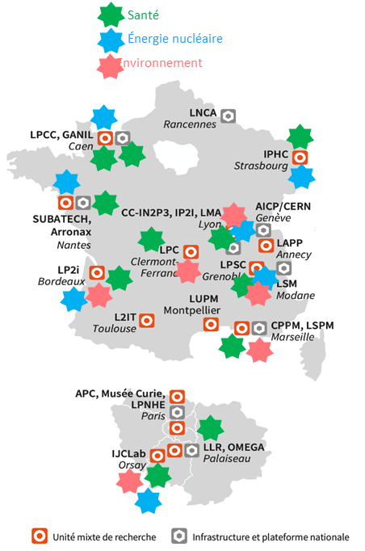

IN2P3 : Interdisciplinary Research for Health
Key Figures (2015–2024):
  11 (+1 CIMAP) IN2P3 laboratories
  ~75 permanent researchers
  ~60 PhDs & postdocs

Slide 3
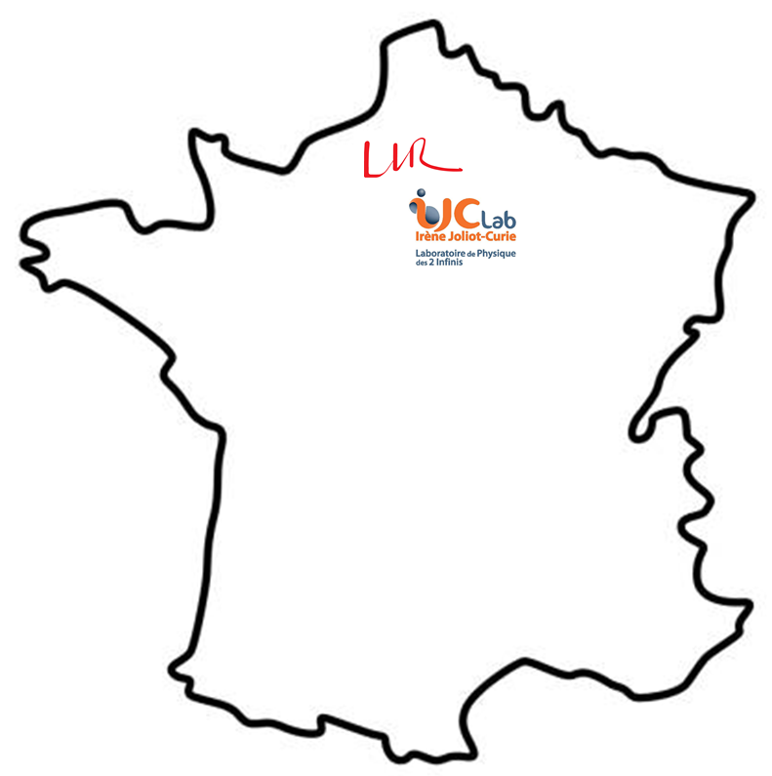

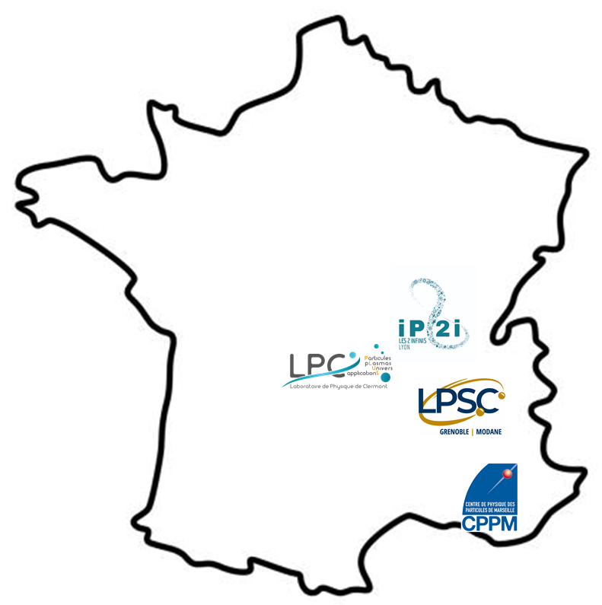

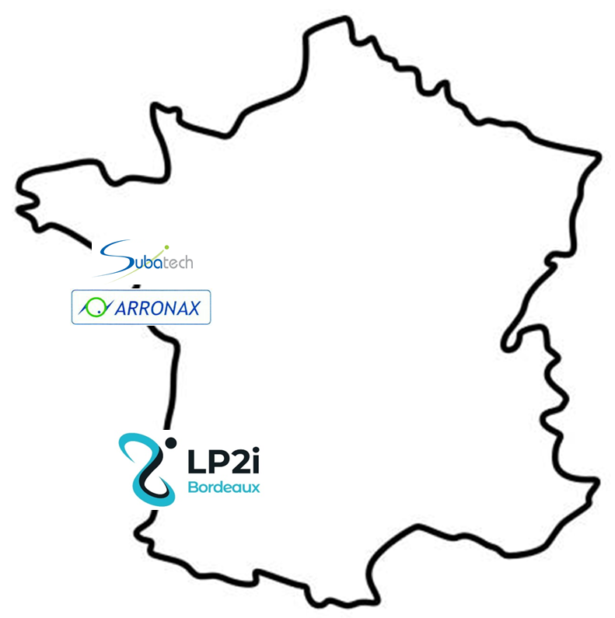
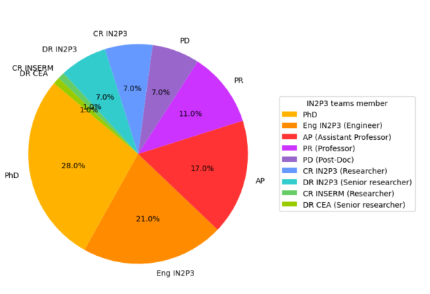
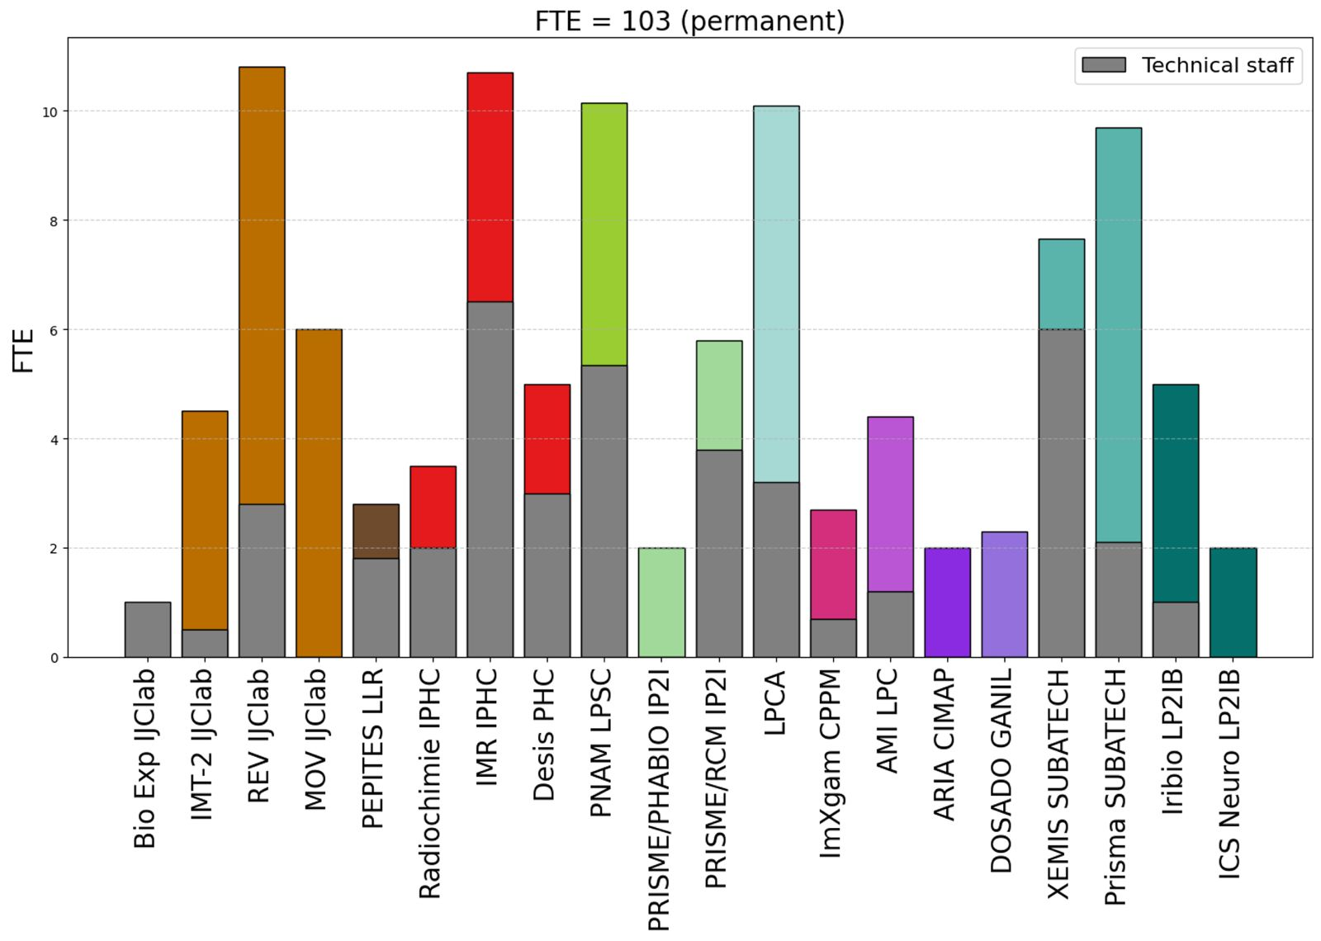

Human resources
~108 FTE (permanent) distributed among 11 + 1 laboratories (CIMAP)
High proportion of non-permanent staff, including engineers on fixed-term contracts, and “teacher-researchers”
Technical staff
Researchers

Slide 4
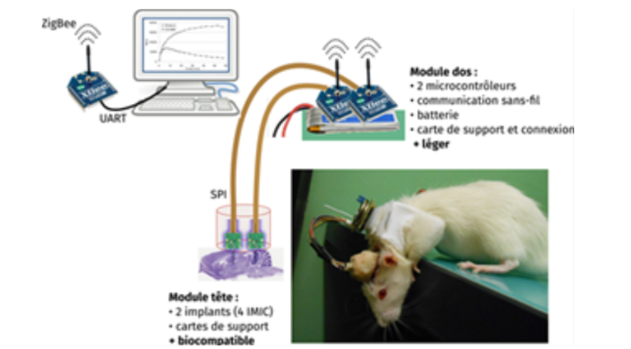
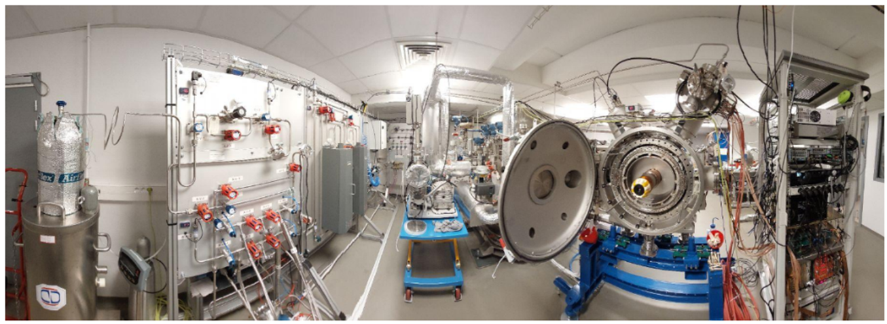
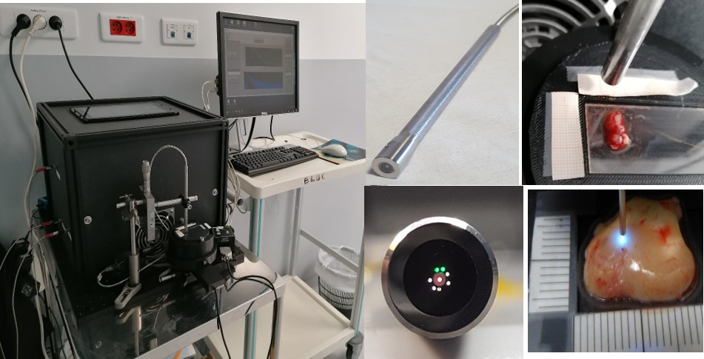
IN2P3 : Interdisciplinary Research for Health
Imaging
Main Research Axes:
  Imaging
MAPSSIC
Pre-clinical
XEMIS2, CHU Nantes
pre-clinical
High sensitivity multimodal diagnostic imaging:
  PET, ToF-PET (e.g. ClearMind), PET/CT and PET/MRI,
  X-ray Photon-Counting CT
  3-gamma imaging (e.g. XEMIS2)
Preclinical imaging:
  Demonstrators (e.g. PIXSCAN)
  Intracranial probes for imaging in awake animals (e.g. MAPSSIC)
Clinical imaging: image-guided therapy
  Intraoperative imaging in surgery (e.g. OPALIS)
ClearMind - clinical
Intraoperative endomicroscope OPALIS - clinical

Slide 5
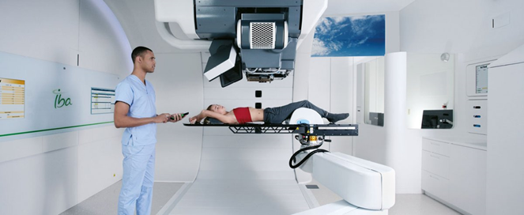
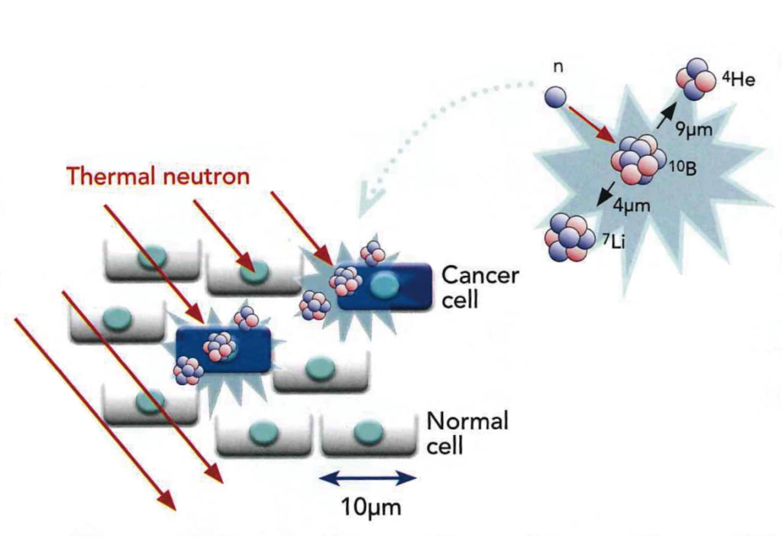

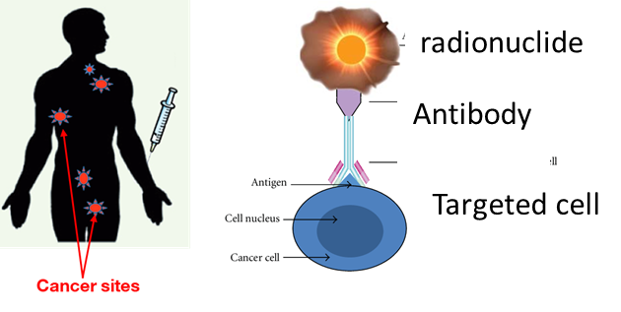
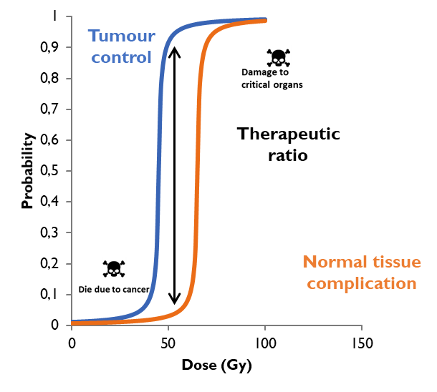
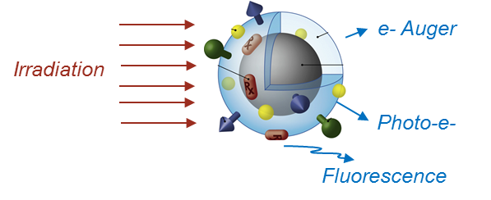
IN2P3 : Interdisciplinary Research for Health
Radiotherapies
Main Research Axes:
  Imaging
  Radiotherapy
X rays / Hadrontherapy
-> RadiotherapIES
Targeted Radionuclide Radiotherapy
BNCT
One of the main objectives is to widen this therapeutic window to increase the differential response between tumor tissues / healthy tissues
Nanoparticles
The dose unit is Gy = 1 J/kg

Slide 6
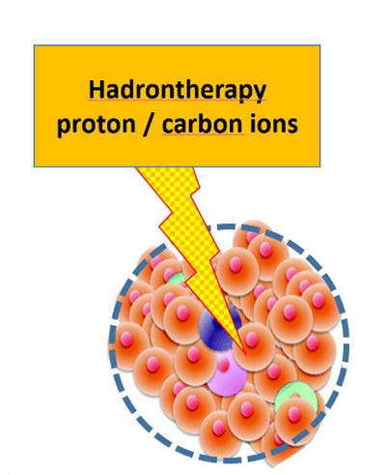
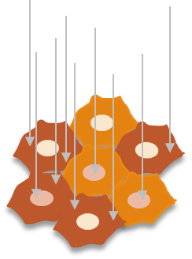
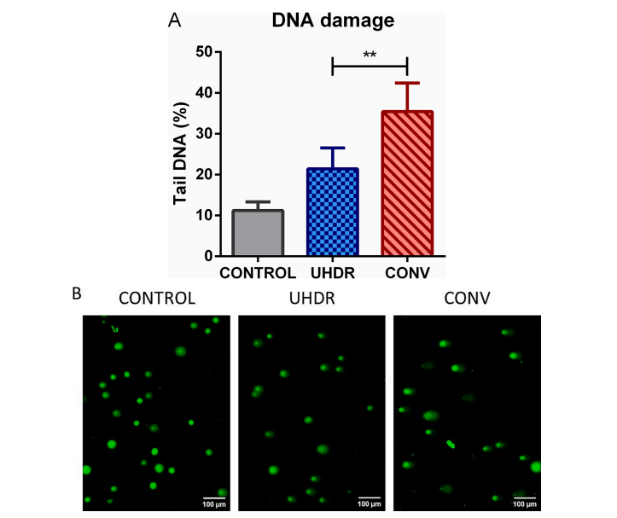
IN2P3 : Interdisciplinary Research for Health
Main Research Axes:
  Imaging
  Radiotherapy
  Radiobiology
Radiobiology
Radiation beam
cells
Radio-resistant tumor models / normal cells: in vitro studies with cell lines / organoids / eggs/animals
Innovative combinations: use of targeted radio-sensitizers
Interest of carbon ions?
Interest of Ultra High Dose Rate (UHDR) = FLASH?
Basic biol/chem mechanisms of therapeutic efficacy…

Slide 7
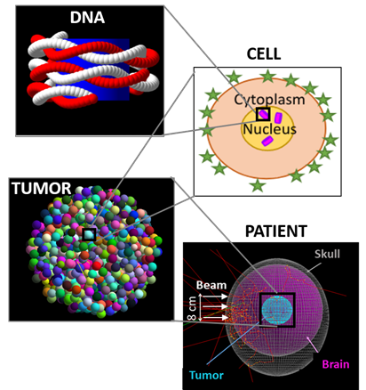
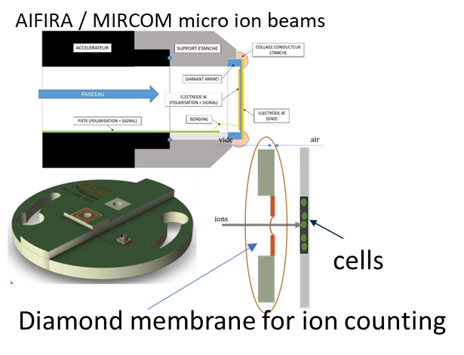
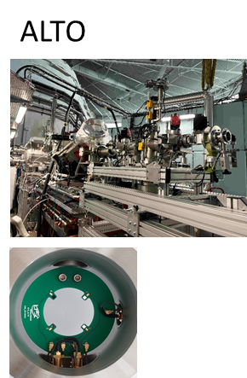
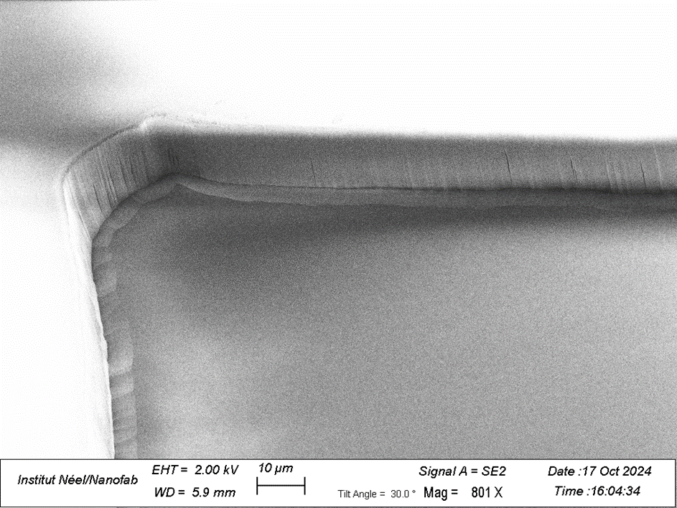
IN2P3 : Interdisciplinary Research for Health
Physics for Radiobiology
Radiobiology
Radiation beam
Multi scale Modeling Tools
Beam monitor instrumentation
cells
Diamond beam monitor

Slide 8
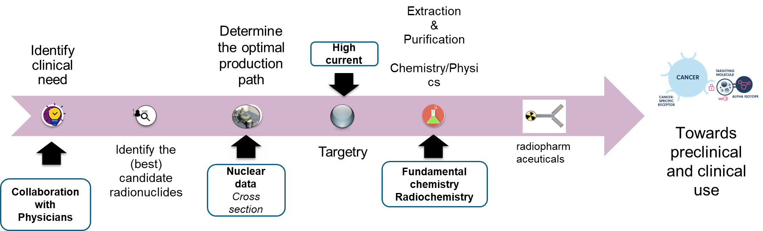
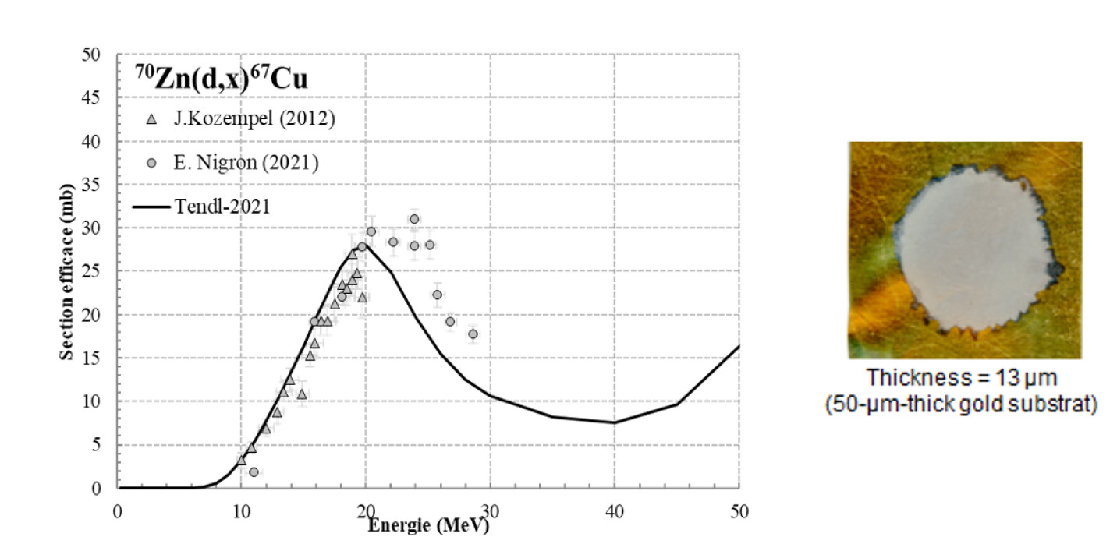
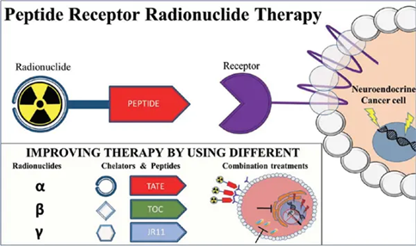
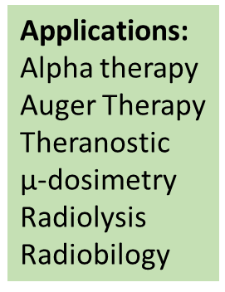
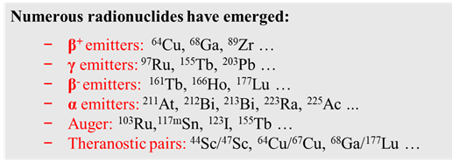
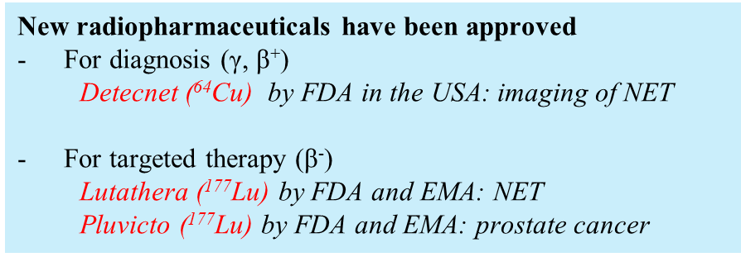
IN2P3 : Interdisciplinary Research for Health
Main Research Axes:
  Imaging
  Radiotherapy
  Radiobiology
  Radionuclides
Radionuclides
Production issues:
quantitative: beams, targets,
qualitative: purity, separation.
Key parameters:
Radiation type → depends on application (Imaging vs Therapy)
Half-life → to match biodistribution time
Chemical properties → to ensure stable attachment to vector molecule
Radiobiology

Slide 9
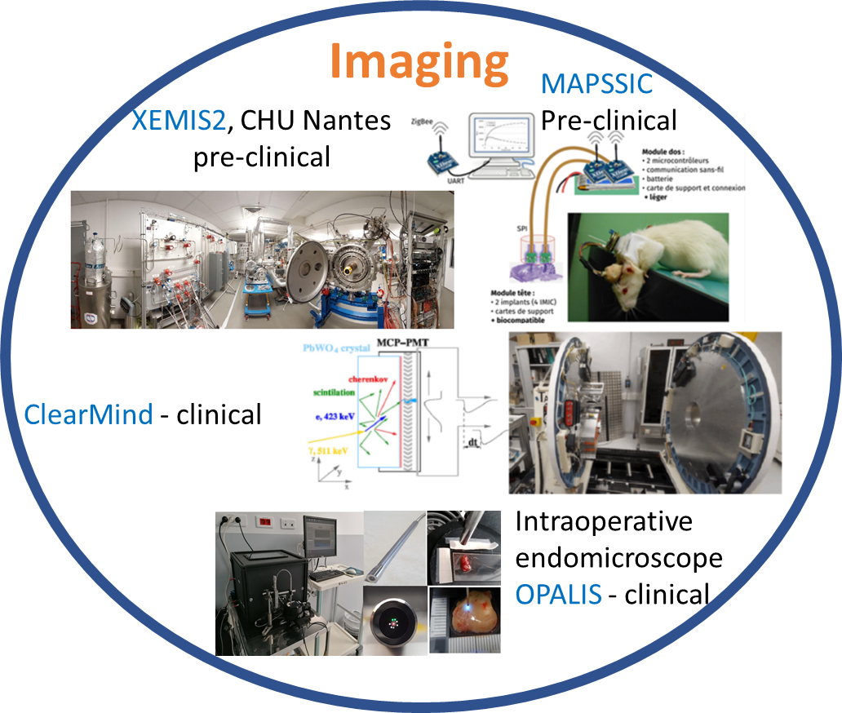
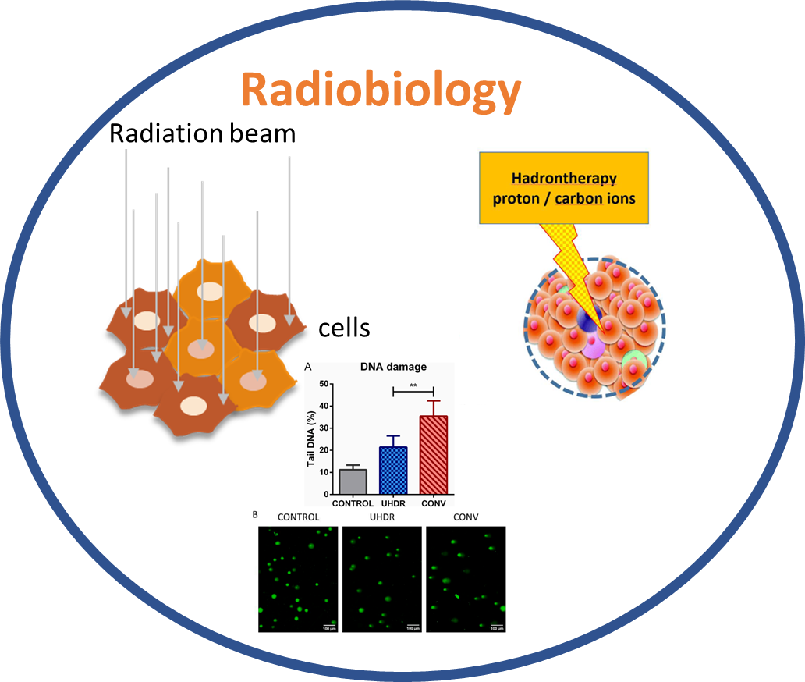
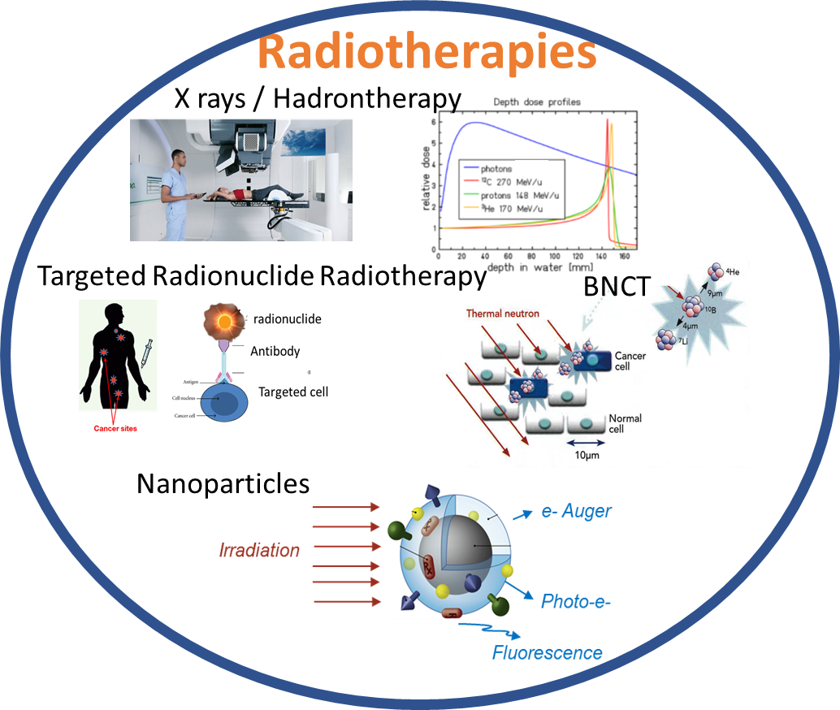
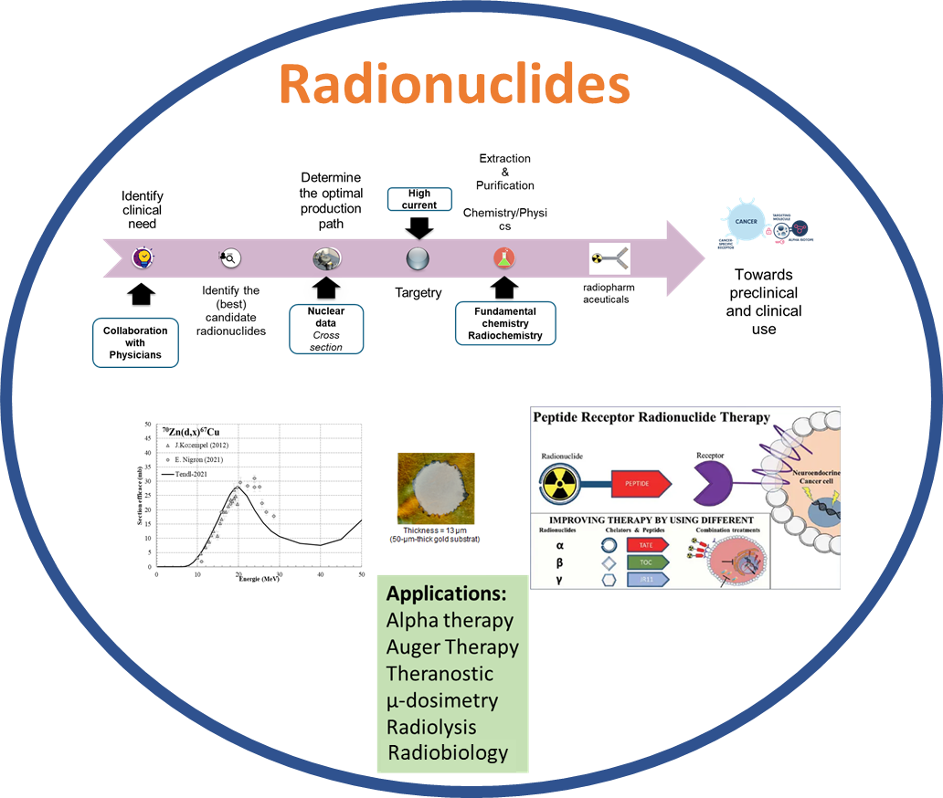
IN2P3 : Interdisciplinary Research for Health
Scientific Objectives
  Using ionizing radiation to understand their effect on living matter and participate to the development of therapeutic applications against cancer.
RadiationS for Health

Slide 10
Expertise areas
In relation with nuclear physics, radiochemistry, detector development, Monte-Carlo simulation tools, mastering complex experiments, accelerators:
  Multi-scale simulation tools (GATE, Geant4-DNA, NanOx)
  Innovative imaging (ToF-PET, SPECT, X-ray Photon Counting CT, Compton imaging, proton radiography, non linear optical imaging)
  Innovative radiotherapies: Hadrontherapy, FLASH, Micro Beams, Targeted Therapies, …
    irradiation beamline developments
    online beam monitoring,
    dosimetry
    secondary particle imaging
  Radionuclides production
  Physics developments (modeling and beam instrumentation) to support research in radiobiology

Slide 11
Positioning
Expertise in modeling: leadership in highly-used open-source code
Expertise in instrumentation => developments with the objective of delivering:
    demonstrators supporting the emergence of disruptive technologies,
    as part of a strategic technological watch,
    finalized applications.
Unique irradiation platform network (RESPLANDIR) to carry out research activities
Research
Clinical transfer

Slide 12
National and local collaborations
Biologists & clinicians integrated in IN2P3 labs (e.g. LP2IB, IP2I Lyon, IJClab, LPCA, IPHC)
Partnerships:
  Existing: IN2P3 – CAL (Hadrontherapy Center Antoine Lacassagne in Nice), IN2P3-ASNR (formerly IRSN), IN2P3-Inserm
  Other under discussion: IN2P3 – CYCLADE (ARCHADE Advanced Resource Centre for Hadrontherapy In Europe program) hadrontherapy center in Caen
Local collaboration: CHU and with cancer treatment centers (e.g in Orsay Institut Curie, Institut Gustave Roussy, …)
GDR MI2B created by IN2P3 (in 2004 G Montarou LPCA IN2P3 and P. Mangeot DAPNIA CEA), now a CNRS-wide initiative
  Involves CNRS (Biology, Physics, Engineering, Computer Science), Inserm, …
  Partnerships with SFPM, SFBR, and national platforms (e.g. ALTO, AIFIRA, ARRONAX, GANIL, CYRCé)

Slide 13
International collaborations
  Multi-scale simulation tools (GATE, Geant4-DNA, NanOx)
  Innovative imaging (ToF-PET, SPECT, Compton imaging, proton radiography)
  Innovative radiotherapies: Hadrontherapy, FLASH, Micro Beams, targeted therapies, …
    irradiation beamlines development
    online beam monitoring,
    dosimetry
    secondary particle imaging
  Particle and radionuclide production
  Radiobiology
Country Institution Topic
EU PRISMAP, EURADOS Radionuclide production, dosimetry
Italy INFN FOOT-Xn (FOOT collaboration), radionuclide production CNAO FOOT-Xn, ANR CLINM, carbon radiobiology Switzerland CERN, CERN MEDICIS imXgam: R&D detector, radionuclide production Spain University of Seville Radionuclide production University of Granada BNCT modeling CSIC Valencia R&D Compton camera Belgium Univ. Leuven Proton FLASH UK Imperial College Lhara: laser acceleration for medical use Germany GSI Hadrontherapy monitoring with CMOS sensors Poland IFJ PAN Radiobiology, dosimetry Argentina University of Rosario Atomic and molecular theoretical physics CNEA Buenos Aires BNCT Australia Ansto Microbeam radiotherapy Japan NIRS Radiobiology AIST, Tsukuba Diamond detectors South Korea Cath. Univ. Of Korea Compton Imaging Korea Atomic En. Res. Inst. USA NASA IEA project: DNA break modeling for space research

Slide 14

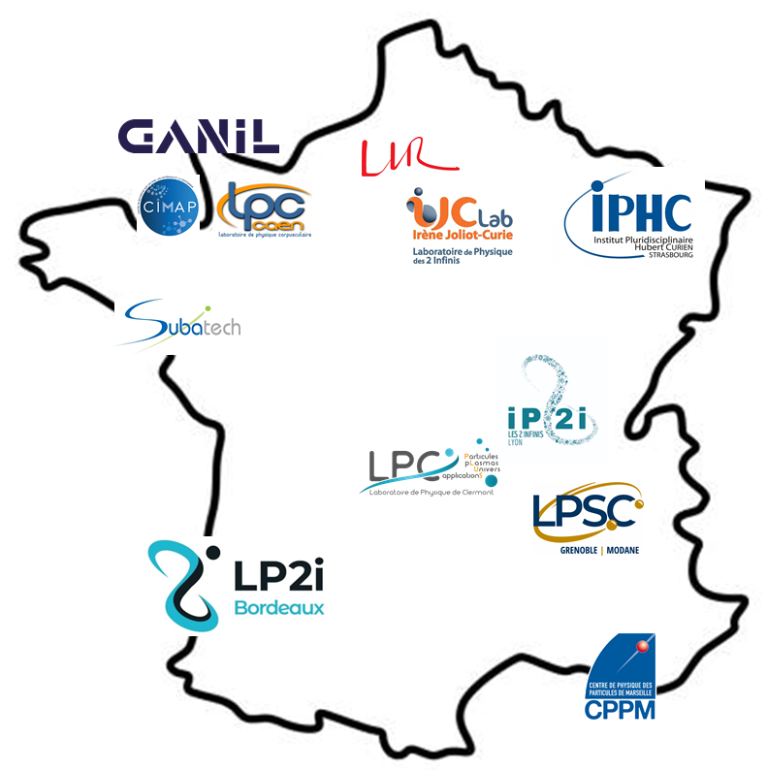

The budget
ANR
Others (Europe, ….)
INCA- PCSI
CNRS-MITI
LABEX
Region
University (IDEX,…)

Slide 15
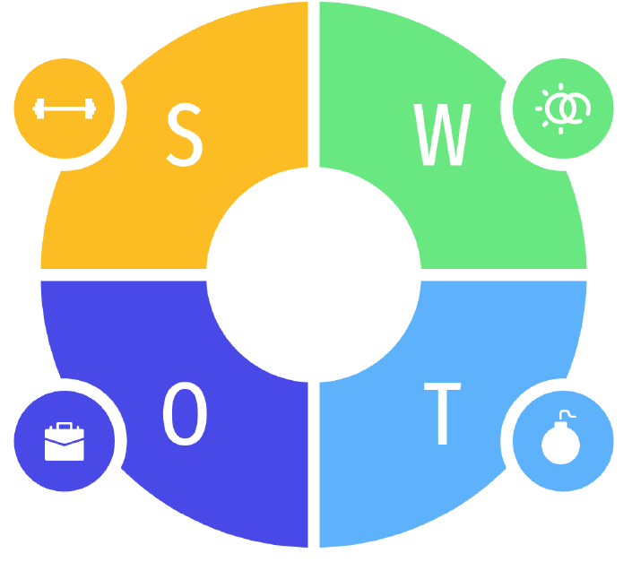
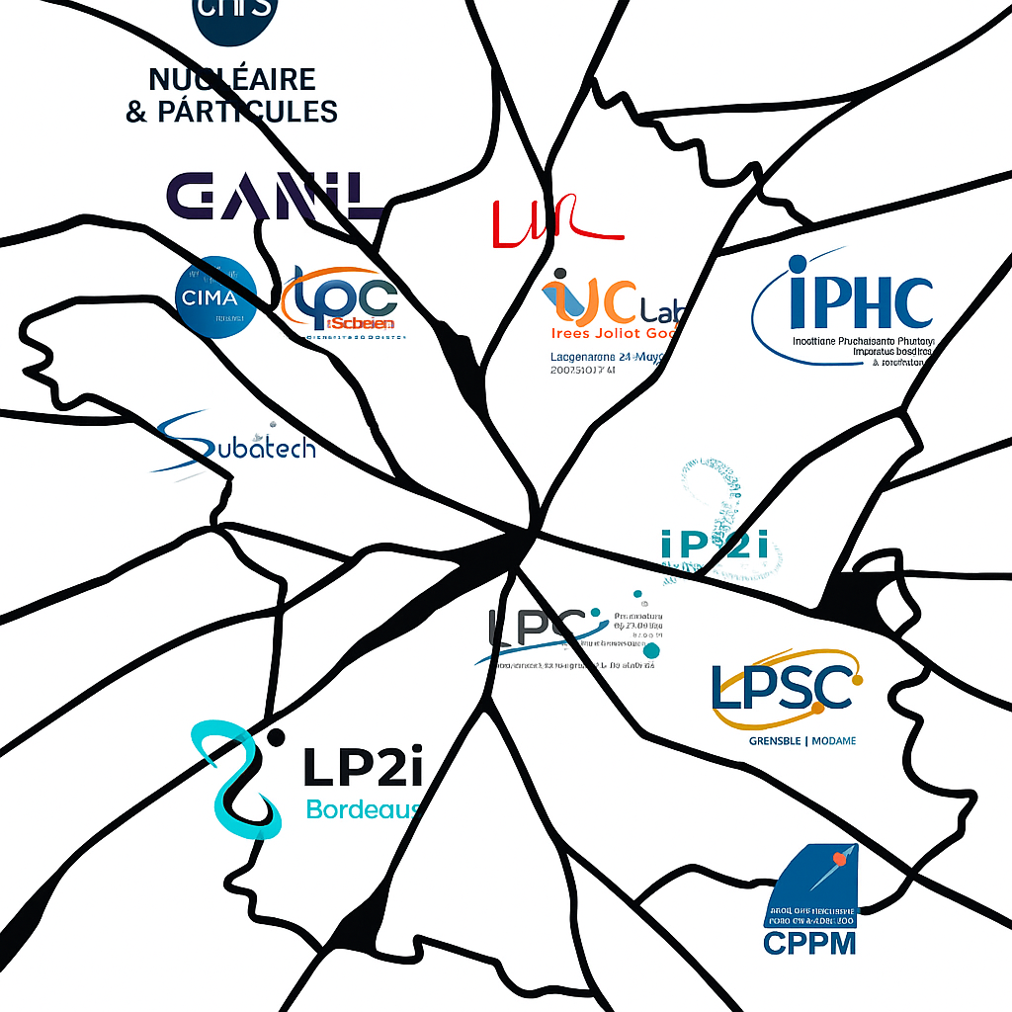
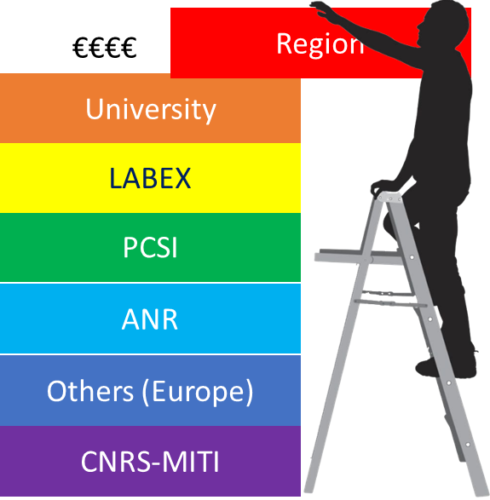
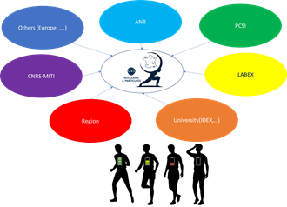
Project-based structuring

Slide 16
GDR MI2B
The GDR MI2B: a scientific coordination research group
Open to CNRS- Biology teams (deputy management), but also to CNRS Engineering, CNRS Physics, CNRS Computer Sciences, Inserm, ASNR, …
36 partner teams, including:
  12 IN2P3 (CNRS Nuclear & Particle Physics)
    + platforms:
    AIFIRA (Bordeaux) – CYRCÉ (Strasbourg) – ALTO (Orsay) – Arronax (Nantes) – GANIL (Caen)
  11 CNRS Biology
  => ~280 subscribers to the mailing list

Slide 17
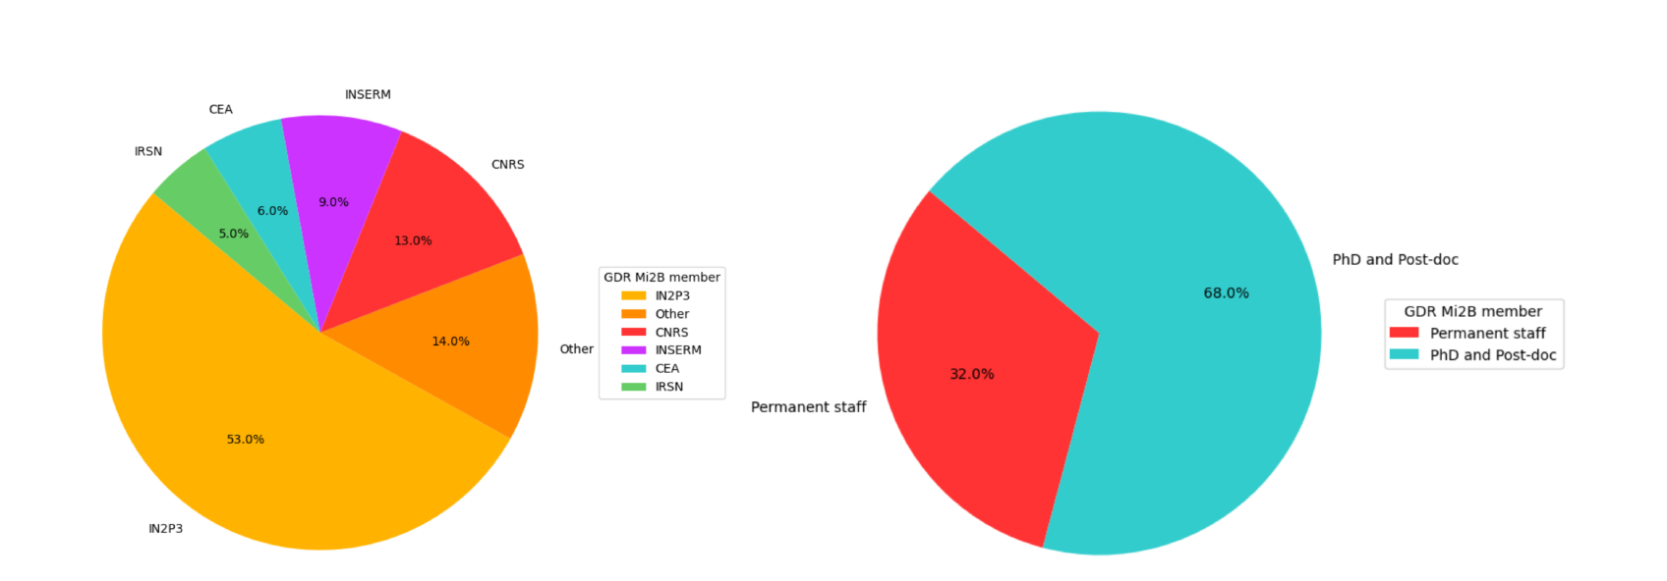
GDR MI2B members
Largely open to other institutes working in the field of health, with a majority from IN2P3 which initiated its creation

Slide 18
Research Areas and Cross-cutting Themes
4 Key Research Areas or Domains
Methods and Instruments in Biomedical Imaging
Tools and Physical Methods for Innovative Radiotherapies
Effects of Radiation on Living Organisms
Radionuclides for Imaging and Therapy

Slide 19
Research Areas and Cross-cutting Themes
Methods and Instruments in Biomedical Imaging
High-sensitivity multimodal diagnostic imaging (PET, PET/CT and PET/MRI, X-ray PC-CT, 3-gamma imaging, …) Treatment planning (proton tomography) Image-guided therapy (prompt gamma imaging for dose delivery monitoring in hadron therapy, intraoperative imaging in surgery) Preclinical imaging (demonstrators, multimodal platforms, simultaneous hybrid imaging, intracranial probes for imaging in awake animals)

Slide 20
Research Areas and Cross-cutting Themes
Tools and Physical Methods for Innovative Radiotherapies
Improving the therapeutic index of radiation treatments
⇒ Increase the probability of tumor control without increasing complications to healthy tissues.
Quality control of treatment delivery
Innovative dose delivery methods (energy, position, timing)
Optimization of treatment planning

Slide 21
Research Areas and Cross-cutting Themes
Effects of Radiation on Living Organisms
Understanding the mechanisms involved in low-dose exposure
Contributing to the challenges of modeling living systems and associated predictive models
Studying radiolysis of water and biomolecules
Assessing changes at different scales (molecular, cellular, whole body)
Understanding the mechanisms involved in therapeutic exposures
Optimizing conventional radiotherapy protocols and developing innovative therapies
Estimating radiation risk associated with each modality

Slide 22
Research Areas and Cross-cutting Themes
Radionuclides for imaging and therapy
The challenge is to stimulate research related to innovative radionuclides in a theranostic approach (combining imaging and therapy). The main questions addressed in this context are: Which innovative radionuclides should be promoted? Which biological agents are suitable for selective delivery? How can we produce these radionuclides with suitable purity and quantity for medical applications How can the radionuclide be stably attached to the biological vector?

Slide 23
Research Areas and Cross-cutting Themes
4 Key Research Areas or Domains
Methods and Instruments in Biomedical Imaging
Tools and Physical Methods for Innovative Radiotherapies
Effects of Radiation on Living Organisms
Radionuclides for imaging and therapy
Understanding the mechanisms involved in low-dose exposure Contributing to the challenges of modeling living systems and associated predictive models Assessing changes at different scales (molecular, cellular, whole body) Understanding the mechanisms involved in therapeutic exposures Optimizing conventional radiotherapy protocols and developing innovative therapies Estimating radiation risk associated with each modality
Improving the therapeutic index of radiation treatments
⇒ Increase the probability of tumor control without increasing complications to healthy tissues.
Quality control of treatment delivery
Innovative dose delivery methods (energy, position, timing)
Optimization of treatment planning
The challenge is to stimulate research related to innovative radionuclides in a theranostic approach (combining imaging and therapy). The main questions addressed in this context are: Which innovative radionuclides should be promoted? Which biological agents are suitable for selective delivery? How can we produce these radionuclides with suitable purity and quantity for medical applications? How can the radionuclide be stably attached to the biological vector?
High-sensitivity multimodal diagnostic imaging (PET, PET/CT and PET/MRI, X-ray PC-CT, 3-gamma imaging, …) Treatment planning (proton tomography) Image-guided therapy (prompt gamma imaging for dose delivery monitoring in hadron therapy, intraoperative imaging in surgery) Preclinical imaging (demonstrators, multimodal platforms, simultaneous hybrid imaging, intracranial probes for imaging in awake animals)
Biology
Clinical Application
5 crossing themes
Computing & Monte Carlo Modeling
Instrumentation
Irradiation Platforms

Slide 24
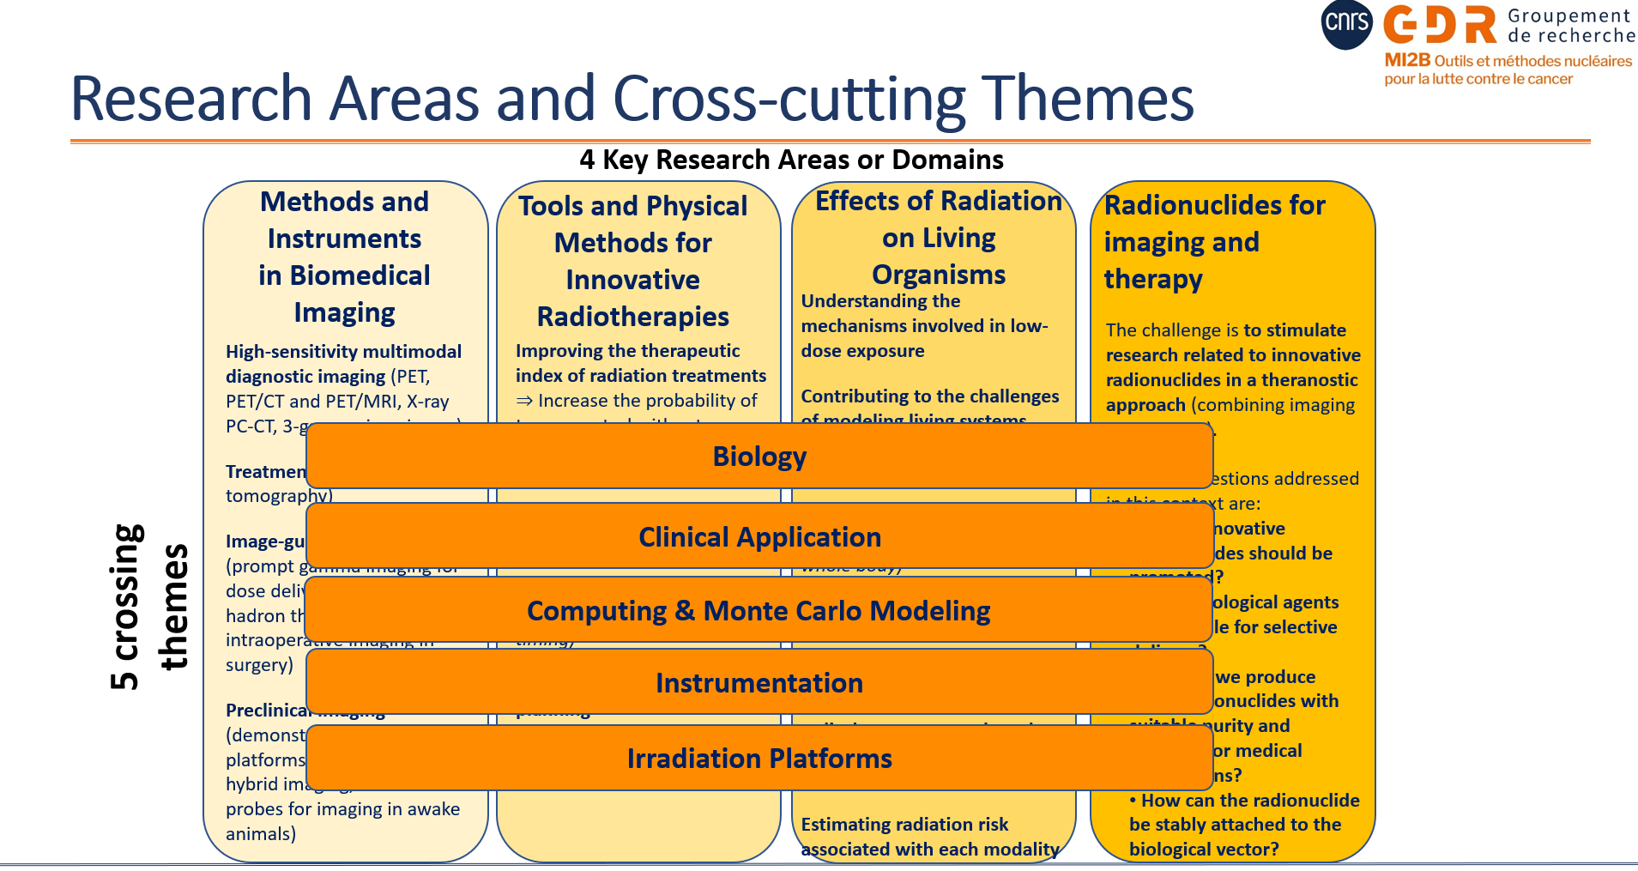
GDR MI2B Governance
Direction
Marie-Laure Gallin-Martel
(LPSC – IN2P3)
Lucie Sancey
(IAB – CNRS Biology)
Division Heads
Imaging
Marc-Antoine Verdier (IJClab- IN2P3)
Mathieu Dupont (CPPM – IN2P3)
Radiotherapies
Rachel Delorme (LPSC-IN2P3)
Jean-Michel Letang (CREATIS CNRS-Engineering)
Radiation Effects
Mathilde Badoual (IJClab – IN2P3), Michael Beuve (IP2I Lyon – IN2P3), Patrick Vernet (LPCA-IN2P3), Lucie Sancey (IAB – CNRS Biology)
Radionucleides
Ferid haddad (SUBATECH-IN2P3 / GIP ARRONAX)
Ali Ouadi (IPHC – IN2P3)
Cross-cutting Themes
Biology
Lucie Sancey (IAB- CNRS Biology), François Paris (Inserm)
Clinical Applications
Juliette Thariat (LPC-IN2P3/CHB Caen)
Computing
Lydia Maigne (LPCA – IN2P3), Jean-Michel Letang (CREATIS- CNRS Engineering)
Instrumentation
Mathieu Dupont (CPPM-IN2P3)
Irradiation Platform
Charbel Koumeir (GIP ARRONAX)
External Relations
SFPM SFBR Inserm
Ludovic Ferrer Julie Costanzo Jean-François Paris

Slide 25
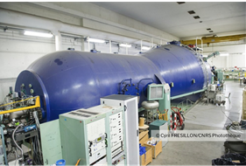
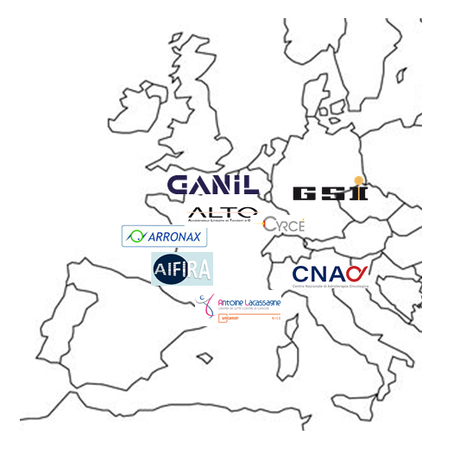
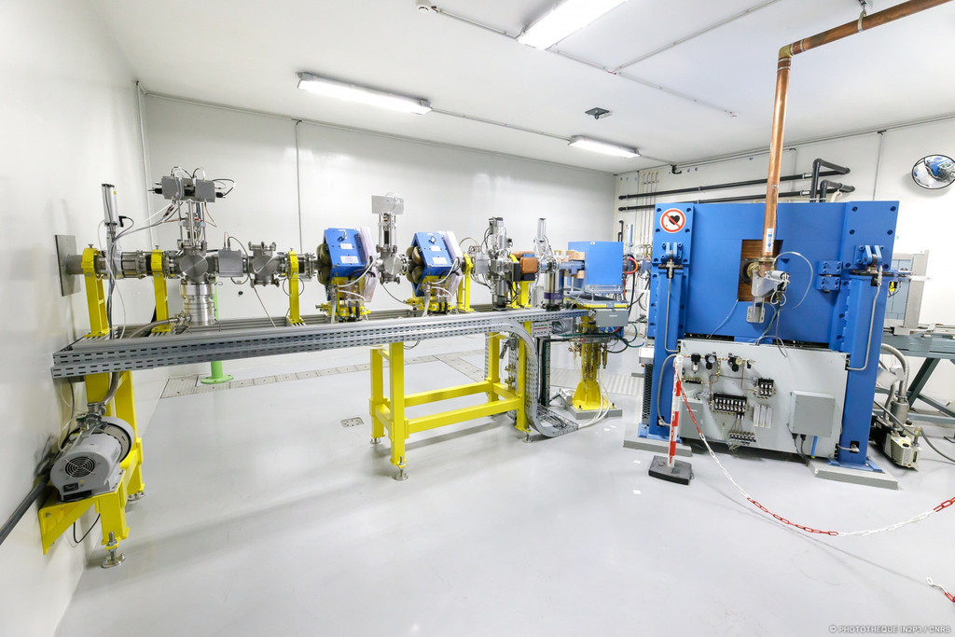
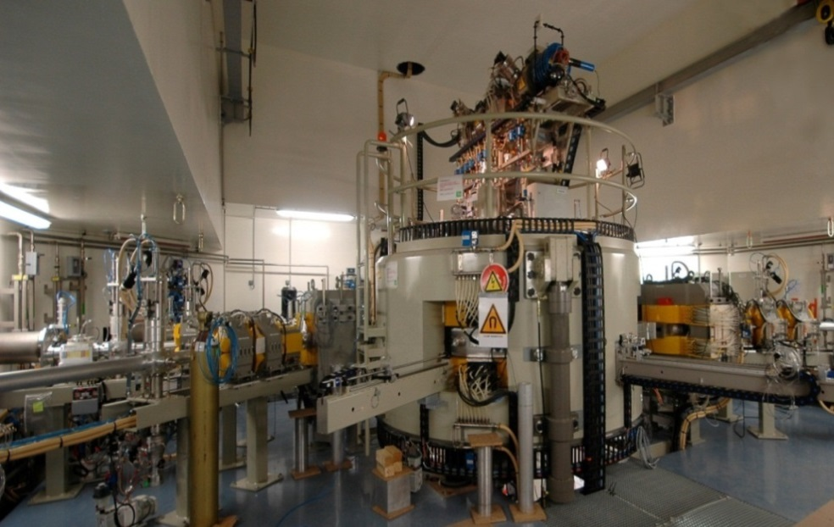
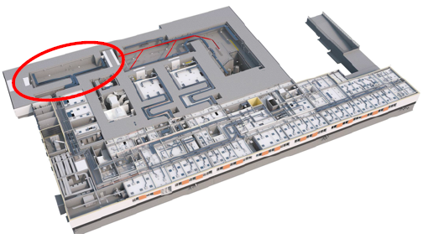
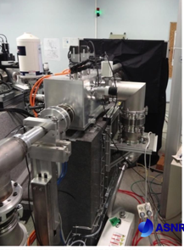
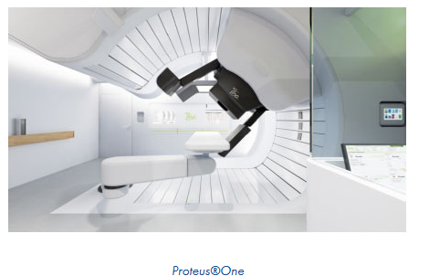
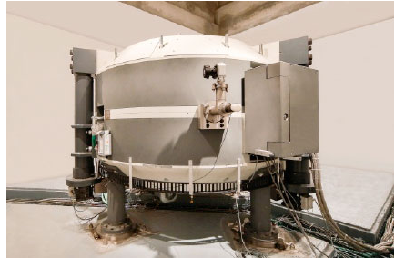
Irradiation platforms
GANIL
ALTO
CYRCé
ARRONAX
C400, carbon beams
With dedicated « research rooms »
= on-going discussion with IN2P3 and others partners!
CNAO
AIFIRA
CAL, Nice

Slide 26
GDR MI2B members
Predominant role played by non-permanent staff – mainly Young Scientists
Role of GDR: education and training
Young researchers present at AGs (oral/poster)
Thematic schools:
  “Physics for Radiobiologists” (Aussois 2024) is to be repeated every two years starting in 2026.
  Alternating with a similar initiative: “Radiobiology for Physicists”, inspired by the 2024 Joliot-Curie school in Oléron (potential partners: RADIOTRANSNET, SFBR, …).

Slide 27
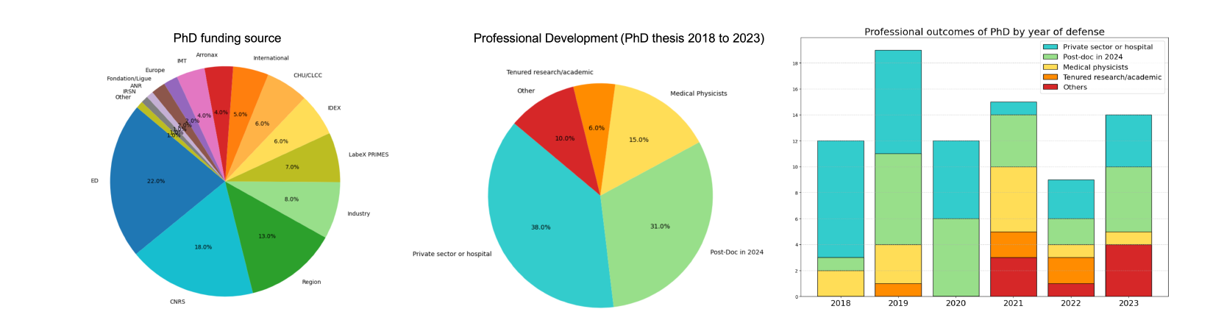
Young Scientists
Results of a survey conducted in 2024 through the GDR MI2B among all its members.
We can be glad that our PhD students find professional opportunities and are not left behind, but the proportion of them who go on to renew our workforce remains sadly too low to ensure the long-term sustainability of our teams
27

Slide 28

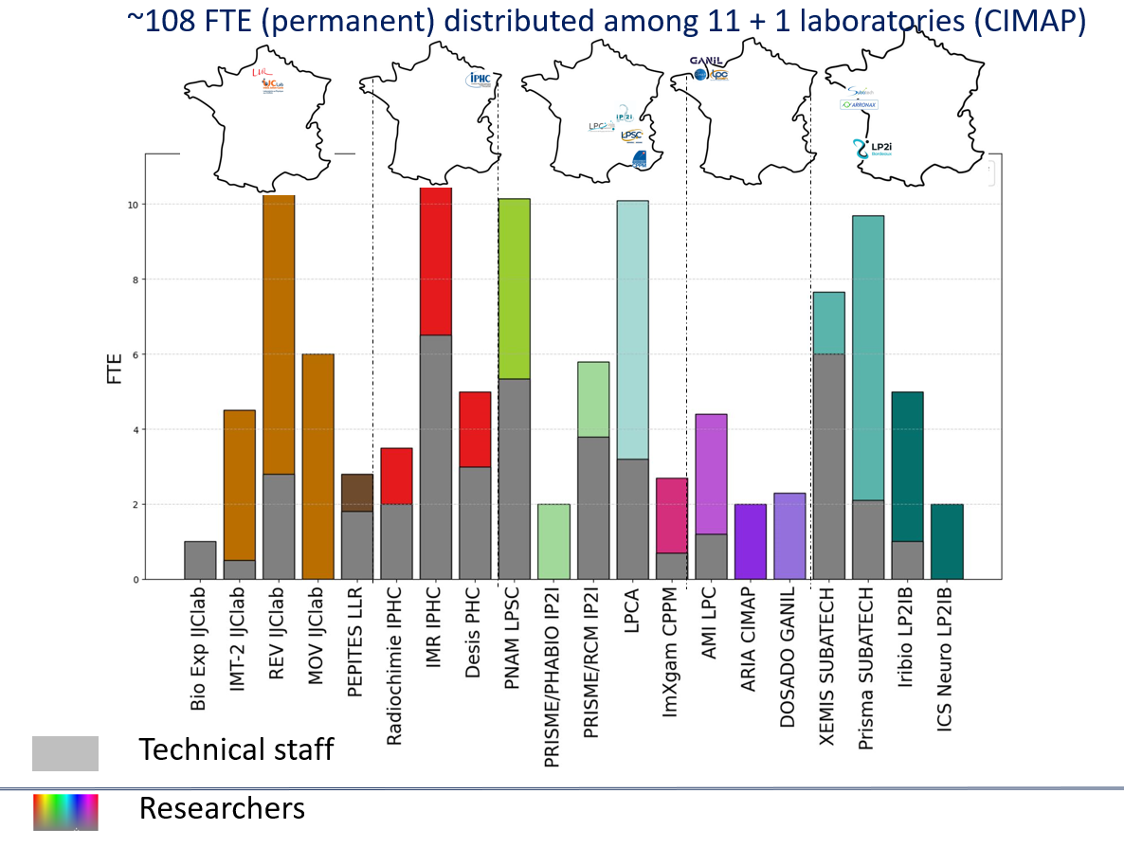


What about the future ?
2025
2025
Tenured research / academic
Researchers

Slide 29
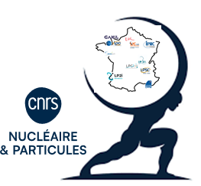
5 years perspectives
Towards a new organization in 4 Master Projects
New in 2025

Slide 30
Status of therapeutic approaches
External therapies using different ion types in hadron therapy: protons, helium, carbon, ...
External therapies (e.g., X-rays or hadron therapy) with spatial (micro- or mini-beams) and/or temporal fragmentation (FLASH).
Internal radiotherapy within the theranostic approach
Combined external (X-ray or hadron therapy) and internal therapies (e.g. radionuclide therapy, BNCT...).
With the following scientific objectives:
Significantly improving the effectiveness of treatments for cancers that are radioresistant, recurrent, therapeutically unresponsive, metastatic or diffuse by combining particles with low and high LET.
Enabling dose hypofractionation to achieve effective tumor volume reduction while minimizing damage to surrounding healthy tissues => improving treatment tolerance for patients.
Moving toward personalized medical practices through theranostic approaches that combine therapy and diagnostics

Slide 31
Towards a new organization in Master Project
Radionuclides for therapy and diagnosis
Hadrontherapy
FLASH
Targeted Radiotherapies

Slide 32

Towards a new organization in Master Project
Radionuclides for therapy and diagnosis
Hadrontherapy
FLASH
Targeted Radiotherapies
WP
With a matrix structure thanks to the definition of a serie of Work Packages (WP) specific to each MP but based on our reconized expertise in :
modeling,
imaging,
instrumentation,
….
WP
WP
WP
With 5 Years objectives and delivrables (currently under discussion)

Slide 33
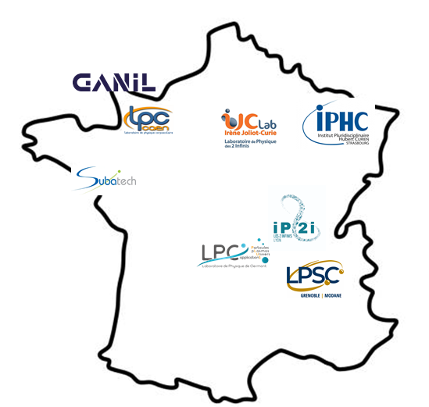


Towards a new organization in Master Project
Radionuclides for therapy and diagnosis
Hadrontherapy
FLASH
Targeted Radiotherapies
FTE = 15,3 Researchers
19,6 Technical staff
FTE = 6,3 Researchers
7,2 Technical staff
FTE = 10,3 Researchers
11,4 Technical staff
FTE = 15,5 Researchers
10,1 Technical staff

Slide 34
Conclusion 1/2
This talk was aimed to give you a broad landscape of Health-related research at IN2P3
…. Focussing:
interdisciplinary developments in radiation physics, imaging, radiobiology, and radiotherapy.
…. Highlighted:
the structuring role of the GDR MI2B in coordinating these activities
…. Fostering:
local, national and international collaborations
… Outlining:
new organizational perspectives within IN2P3 with the construction of Master Projects (started in March 2025)

Slide 35

CONCLUSION 2/2
Strengths
Weaknesses
Difficulty securing external funding for long-term projects
Human Resources
Dependence on external irradiation facilities
High dependence on radionuclide availability slowing-down TRT research
Highly interdisciplinary projects
Unique set of irradiation platforms
Access to clinical facilities (CNAO, CAL)
Strong partnerships (CNAO, INFN, GSI, GANIL…)
High succes with funding agencies
Expertise in instrumentation and modeling (leadership in highly-used open-source code)
Strong links with Inserm, CHU and Cancer centers
Threats
Opportunities
Collaborative works with many national institutions (INSERM, CNES, clinical facilities) and regional structures
Possible transfer to industry or clinical routine (e.g., online monitoring)
Commissioning of the C-400
New accelerators techniques (e.g. laser)
Strong competition for fundings
Risk of project slow-down due to staff turnover or lack of recruitment
Constraints associated with international beam time access
Uncertainty in long-term institutional or political support for interdisciplinary research
Lack of attractiveness due to low amount of permanent academic positions
Cost of access to clinical beam

Slide 36
Thanks for your attention

Slide 37
Back-up

Slide 38


FTE in the Hadrontherapy Master-project of in2p3
FTE by team
FTE by project
WP2 – Nuclear and chemical data
WP1 – Dose modeling
WP3 – Dose delivery control
WP4 – Biological effects
Total FTE in Hadrontherapy MP: 15.33 researchers, 19.60 technical staff

Slide 39


FTE in the Hadrontherapy Master-project of in2p3
PhD by project (2020-2025)
CDD by project (2020-2025)
WP2 – Nuclear and chemical data
WP2 – Nuclear and chemical data
WP1 – Dose modeling
WP3 – Dose delivery control
WP4 – Biological effects
WP1 – Dose modeling
WP3 – Dose delivery control
WP4 – Biological effects
Total PhD in Hadrontherapy MP: 27 defended, 20 on-going
Total CDD in Hadrontherapy MP: 11.20 FTE researchers, 9 FTE technical staff

Slide 40


Publications & fundings in the Hadrontherapy Master-project of in2p3
Publications by project (2020-2025)
Fundings by project (2020-2025)
Total publications in Hadrontherapy MP: 111
Total fundings in Hadrontherapy MP: 1039 kEuros in2p3, 4058 kEuros non-in2p3

Slide 41


FTE in the FLASH Master-project of in2p3
FTE by team
FTE by project
WP1 – Quality control & dosimetry
WP2 – Radiolysis in FLASH
WP3 – Cell irradiations
WP4 – Simulations
Total FTE in FLASH MP: 6.25 researchers, 7.20 technical staff

Slide 42


FTE in the FLASH Master-project of in2p3
PhD by project (2020-2025)
WP4 – Simulations
CDD by project (2020-2025)
WP4 – Simulations
WP1 – Quality control & dosimetry
WP2 – Radiolysis in FLASH
WP3 – Cell irradiations
WP1 – Quality control & dosimetry
WP2 – Radiolysis in FLASH
WP3 – Cell irradiations
Total PhD in FLASH MP: 10 defended, 7 on-going
Total CDD in FLASH MP: 5 FTE researchers, 1.5 FTE technical staff

Slide 43


Publications & fundings in the FLASH Master-project of in2p3
Publications by project (2020-2025)
Fundings by project (2020-2025)
Total publications in FLASH MP: 40
Total fundings in FLASH MP: 185 kEuros in2p3, 818 kEuros non-in2p3

Slide 44


FTE in the targeted therapies Master-project of in2p3
FTE by team
WP1 – Multiscale modeling of physical dose and biological response
FTE by project
WP3 – understanding the biological mechanisms
WP2 –Optimization and control of dose delivery
Total FTE in targeted therapies MP: 10.3 researchers, 11.35 technical staff

Slide 45


FTE in the targeted therapies Master-project of in2p3
WP1 – Multiscale modeling of physical dose and biological response
PhD by project (2020-2025)
WP1 – Multiscale modeling of physical dose and biological response
CDD by project (2020-2025)
WP3 – understanding the biological mechanisms
WP3 – understanding the biological mechanisms
WP2 –Optimization and control of dose delivery
WP2 –Optimization and control of dose delivery
Total PhD in Targeted therapies MP: 12 defended, 4 on-going
Total CDD in Targeted therapies MP: 5.7 FTE researchers, 0.2 FTE technical staff

Slide 46


Publications & fundings in the targeted therapies Master-project of in2p3
Publications by project (2020-2025)
Fundings by project (2020-2025)
Total publications in targeted therapies MP: 34
Total fundings in targeted therapies MP: 152 kEuros in2p3, 1267 kEuros non-in2p3

Slide 47


FTE in the radionucleides Master-project of in2p3
FTE by project
FTE by team
Total FTE in RN MP: 15.46 researchers, 10.10 technical staff

Slide 48


FTE in the radionucleides Master-project of in2p3
PhD by project (2020-2025)
CDD by project (2020-2025)
Total PhD in RN MP: 13 defended, 11 on-going
Total CDD in RN MP: 3 FTE researchers, 2.2 FTE technical staff

Slide 49


Publications & fundings in the radionucleides Master-project of in2p3
Publications by project (2020-2025)
Fundings by project (2020-2025)
Total publications in RN MP: 69
Total fundings in RN MP: 152 kEuros in2p3, 1267 kEuros non-in2p3

