Slide 1




Study of point-like absorbing defects in large mirrors for gravitational wave detectors
Maxime LE JEAN
Laboratoire des Matériaux Avancés
(LMA)
Supervisor : Jérôme DEGALLAIX

Slide 2
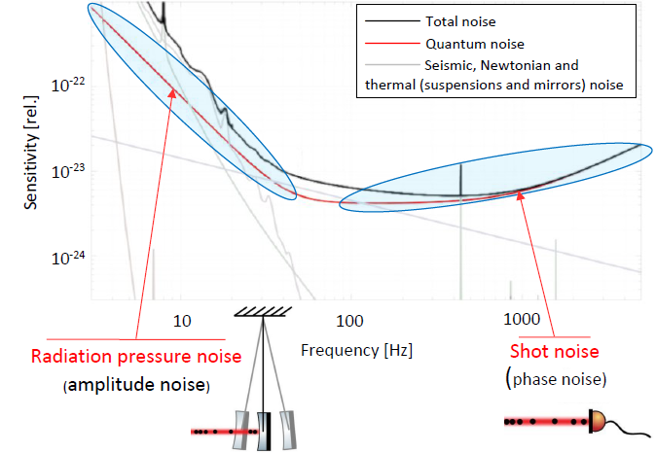
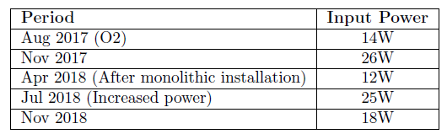
Increasing the circulating power
Direct way to decrease shot noise
Comes with drawback :
  Wavefront distortion
  Radiation pressure
We have possibilities to counterbalance the drawback
- Quantum Squeezing
- Thermal compensation systems
Virgo Attempts
Still problematic until now
Increase of power attempts at O4
not completely succesfull

Slide 3
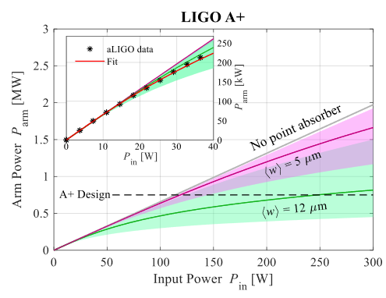
Point absorbers (PA)
A punctual site of excess absorption
Wide range of diameters [10 – 500] µm
Wide range of local absorption expected
There can be several PA’s per mirrors
  (2018 : LHO ITMY → « Constellation of PAs »)
Generally of metallic nature (Al)
The more power is in the ITF, the more problematic the PAs become -> limits improvements of the detectors
Critical for arm cavity mirrors

Slide 4
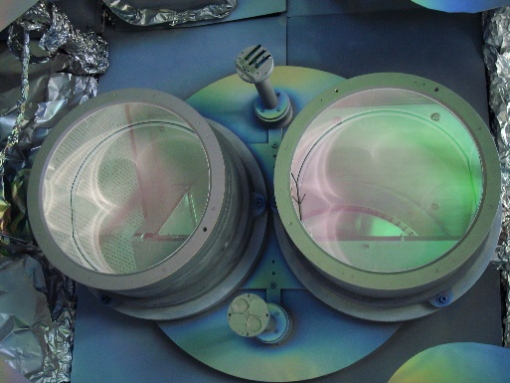
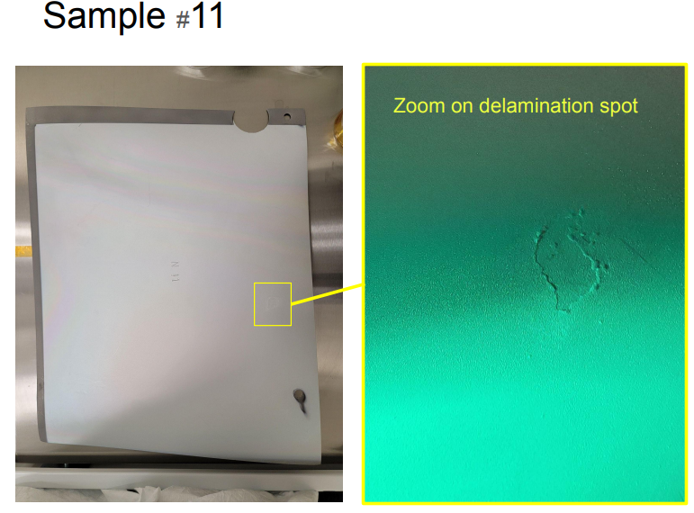
Detecting them at LMA
Originate from deposition process
- Embedded in the coating
- Small particules from mounts, walls, protective sheets
Detecting them before their installation in the ITF. (Corrective treatments, preparing compensations …)
Virgo cannot detect PAs before mirror installation
A joint study LIGO/LMA has already allowed to reduce the population of PA’s
Benefitial for other projects high optical power experiments

Slide 5
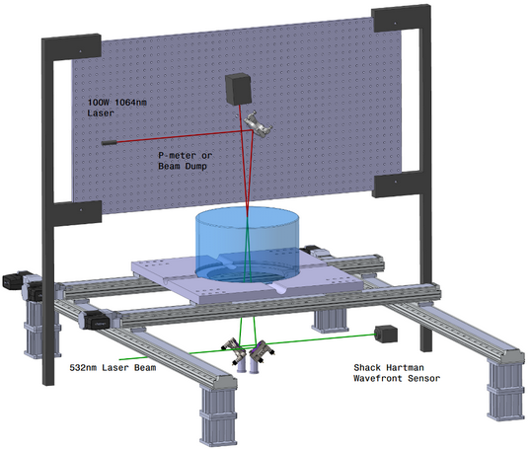
Construction of caracterization bench
Expanding the Caltech bench (TM-HPAD) Test mass Hartman PA Diagnostic
CW laser at 1064 nm (200 W)
Will be able to holds 62 cm diameter and > 300kg test masses
Same power density than in AdV ~3kW/cm²
Shack-Hartman wavefront sensitivity
→ (λ/100)
Bonus :
Scattering measurement with CCD camera

Slide 6
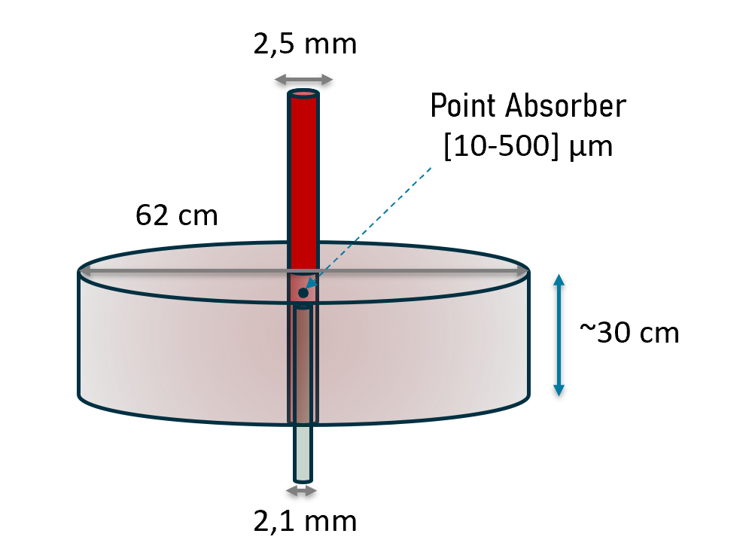


Principle scheme of measurement
P
t [s]
t0
t1
T
(near PA)
$$T_{hot}$$
t [s]
$$θ_{amb}$$
t0
t1
tf

Slide 7

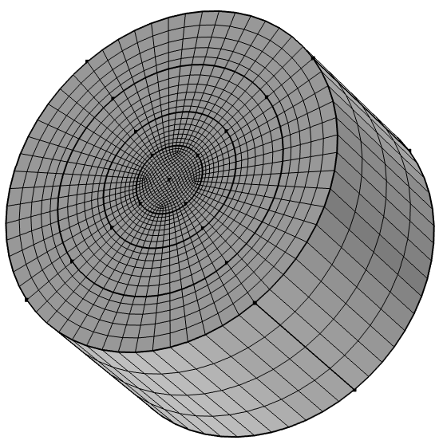
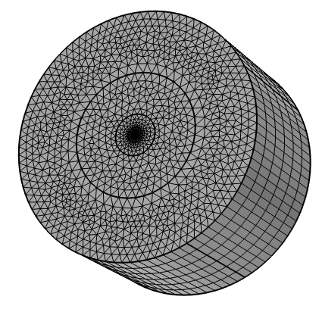
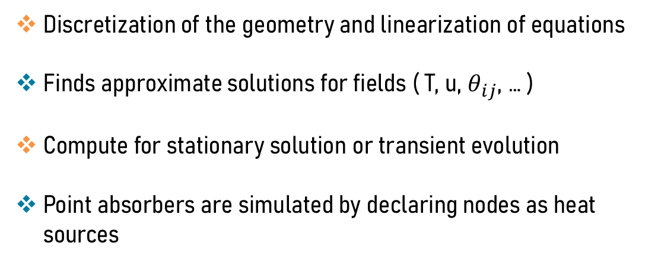
Numerical simulations
Finite element simulation (FEM)
Discretization of the geometry and linearization of equations
Finds approximate solutions for fields ( T, u, $θ_{ij}$, … )
Compute for stationary solution or transient evolution
Point absorbers are simulated by declaring nodes as heat sources
→ Simulation of an AdV test mass in the ITF configuration

Slide 8
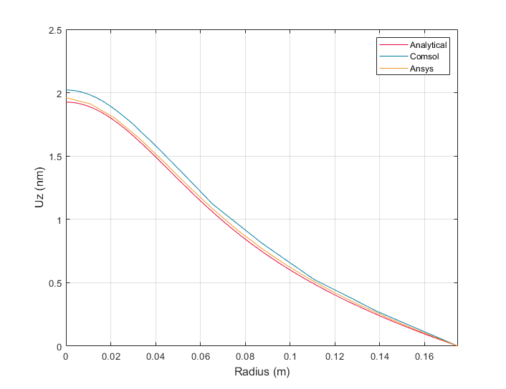
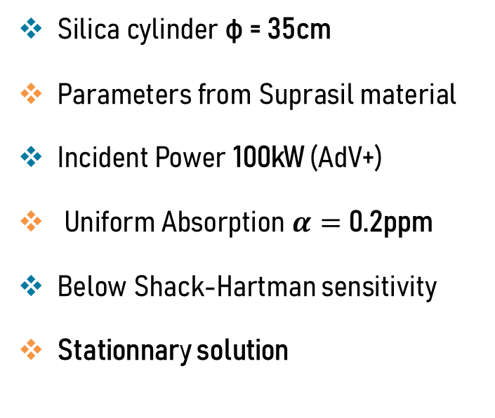
Absorption Uniforme
Silica cylinder φ = 35cm
Parameters from Suprasil material
Incident Power 100kW (AdV+)
Uniform Absorption $α=$ 0.2ppm
Below Shack-Hartman sensitivity
Stationnary solution
Results on uniform absorption are convincing enough to
use COMSOL model to simulate point absorbers

Slide 9
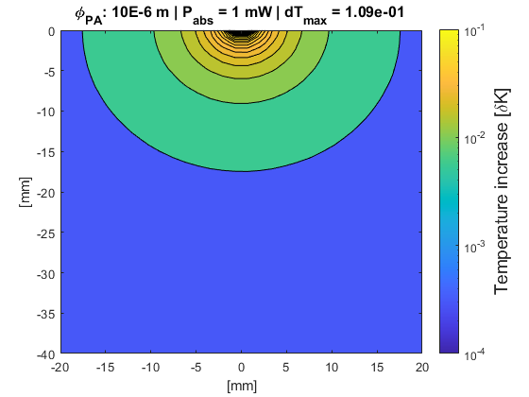
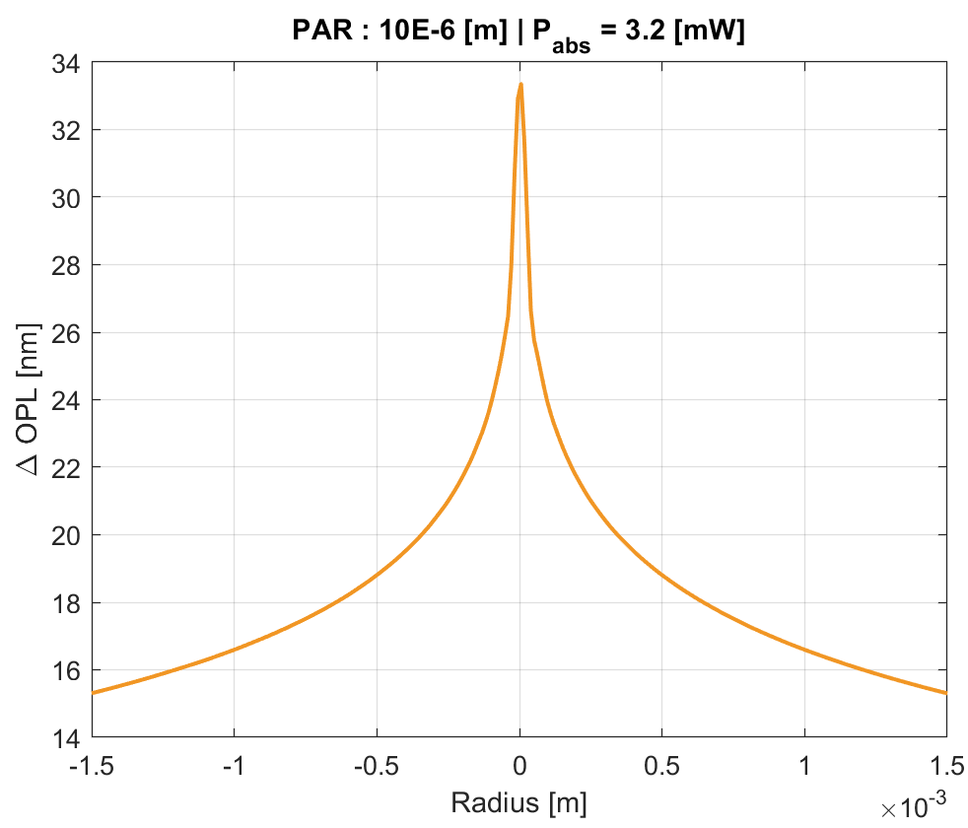

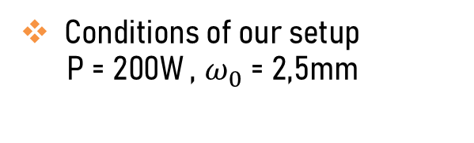
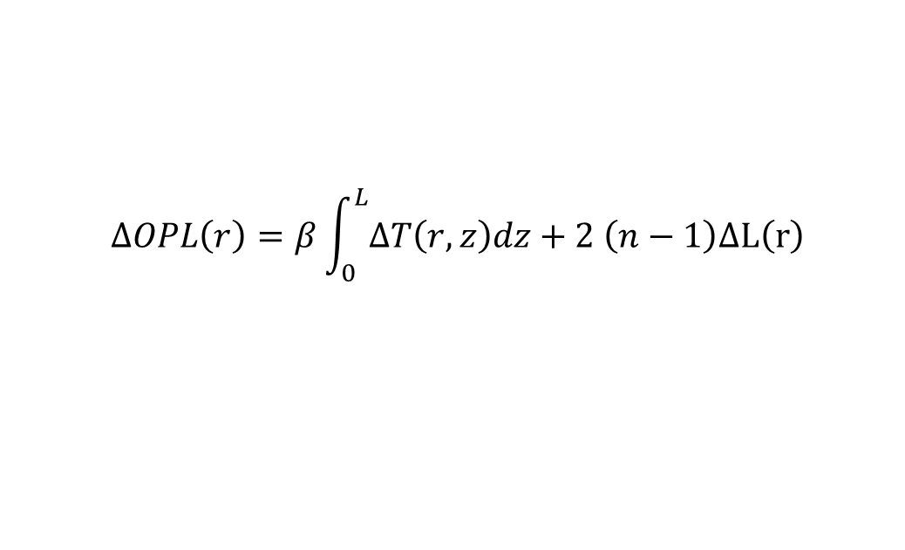
Point absorbers
Conditions of our setup
P = 200W , $ω_{0}$ = 2,5mm
PA properties :
Radius : 10 $μ$m, Abs = 1 mW
$$ΔOPL\left(r\right)=β\int_{0}^{L}{ΔT\left(r,z\right)dz+2 \left(n−1\right)ΔL\left(r\right)}$$
Few comparable ressources for point absorption

Slide 10
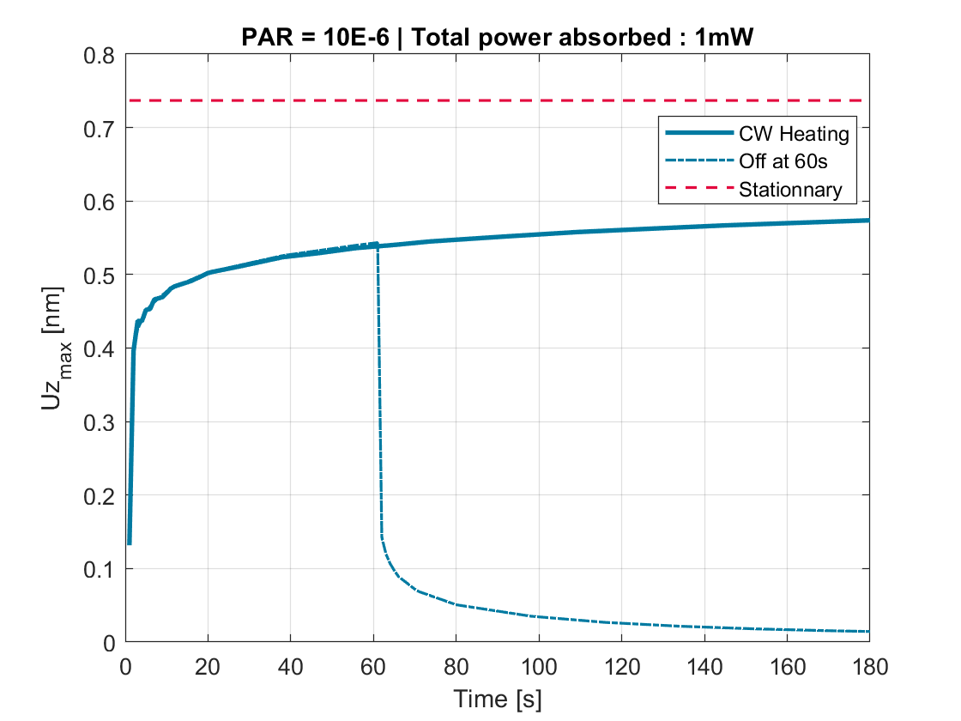
Transient evolution
We observe a convergence of the transient evolution to the stationary value
For point absorbers we expect to have more than 70% of the effects after 20s of pump time duration
The cooling dynamics could also be used to improve the detection accuracy

Slide 11
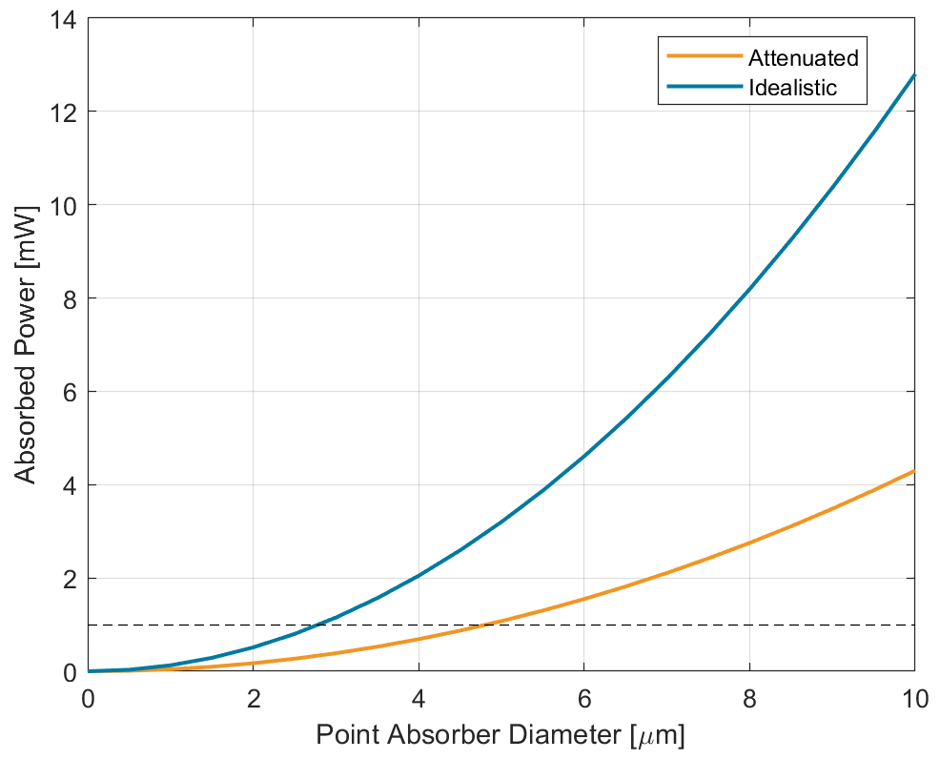
Theoretical capabilities of our setup
A size limit we could choose is one dictated by the dark field microscope
Even in defavorable cases we’ll be able to detects Pas of larger size
May be improved by a deeper analysis of the wavefront or the dynamical evolutions
Similar to Caltech’s bench sensitivity

Slide 12
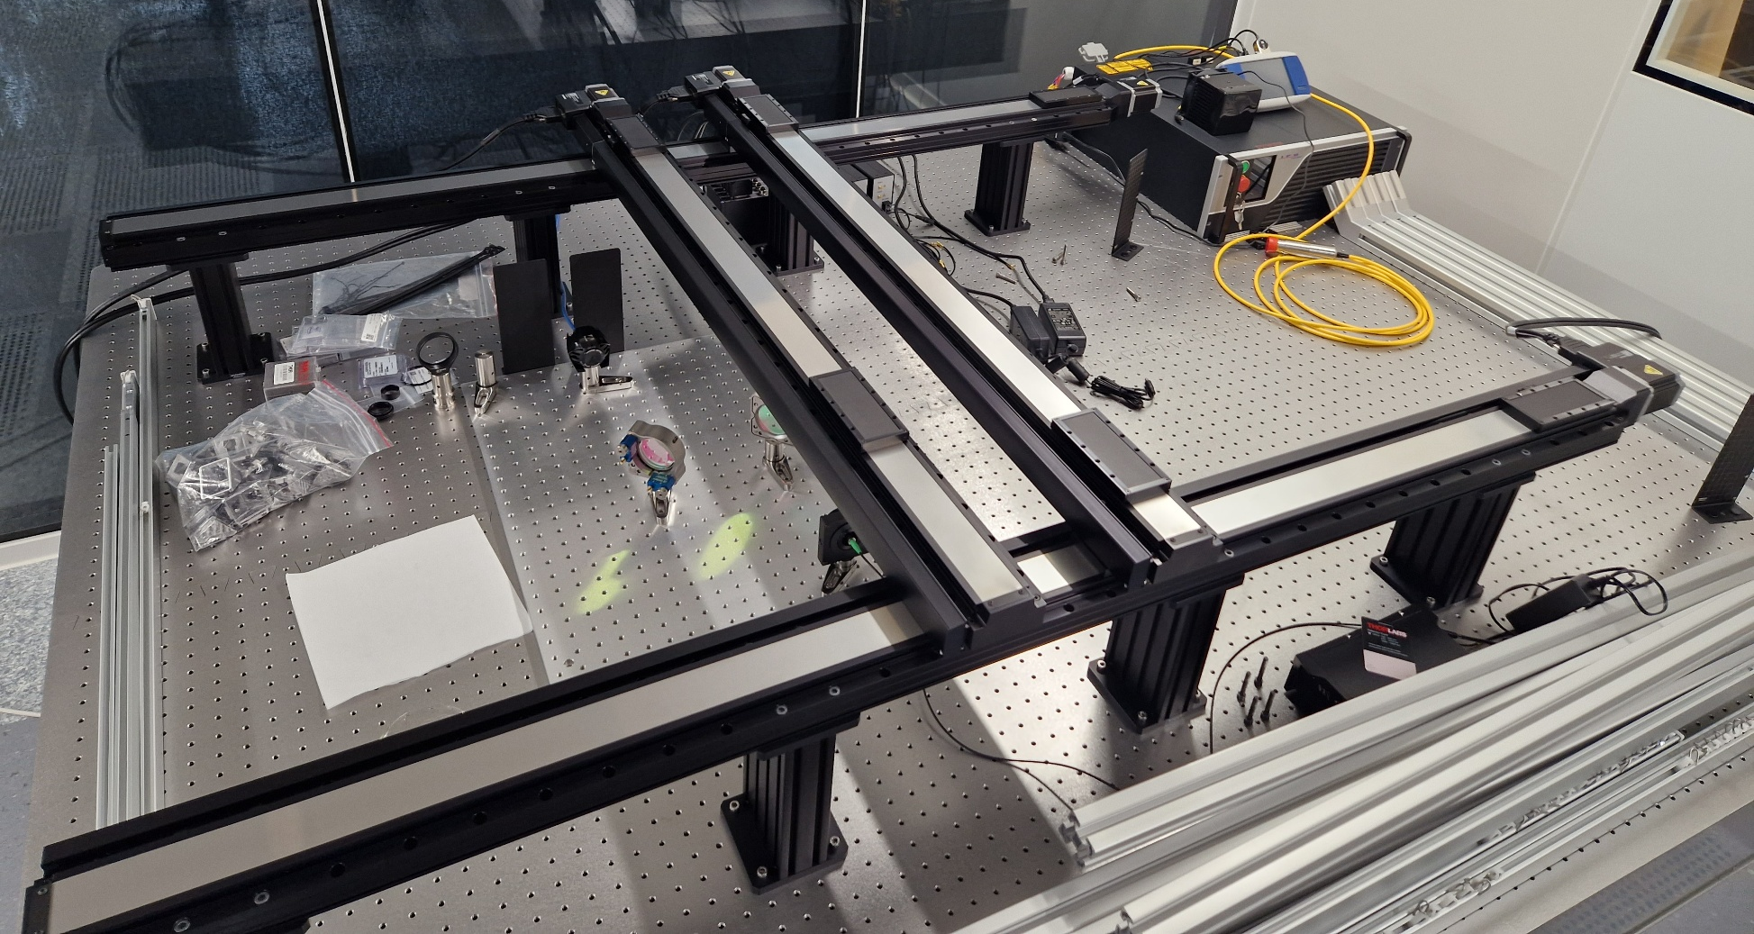
Status of the setup
( Installed in the cleanroom )

Slide 13
Upcoming work
Automatise callibrations / data acquisition / logs and error handling/…
Enhancing the sensivity by reducing vibrations, optimizing optical alignment
Design of the large mount and adaptations
Collecting datas over test samples
(relatively long scan time, provide feedback for coating R&D processes)
Develop an analysis pipeline for theses datas
Testing Virgo test masses ?
Remote-Controlled Elements :
- Laser 200W - Power-meter
- 2x Piezo-mounts - Wavefront sensor
- 4x Linear Stages

Slide 14
Experimental study of point-like absorbing defects in large mirrors for gravitational wave detectors
Maxime LE JEAN
Laboratoire des Matériaux Avancés
(LMA)
Supervisor : Jérôme DEGALLAIX

Slide 15
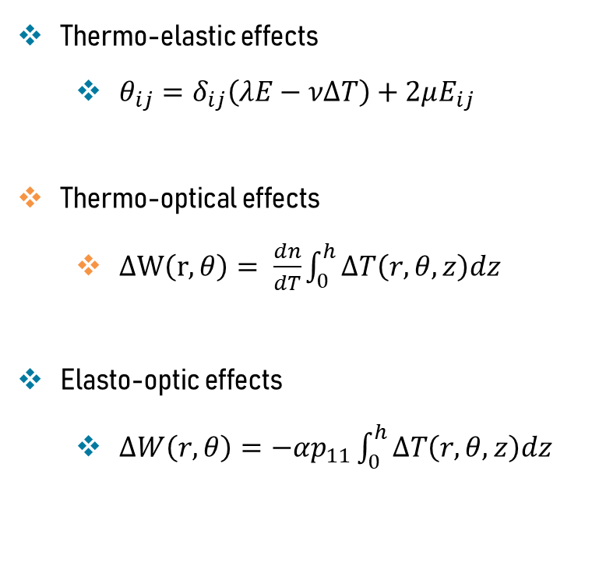
Computation details
Thermo-elastic effects
  $θ_{ij}=δ_{ij}\left(λE−νΔT\right)+2μE_{ij}$
Thermo-optical effects
  $ΔW\left(r,θ\right)= \frac{dn}{dT}\int_{0}^{h}{ΔT\left(r,θ,z\right)dz}$
Elasto-optic effects
  $ΔW\left(r,θ\right)=−αp_{11}\int_{0}^{h}{ΔT\left(r,θ,z\right)dz}$

Slide 16
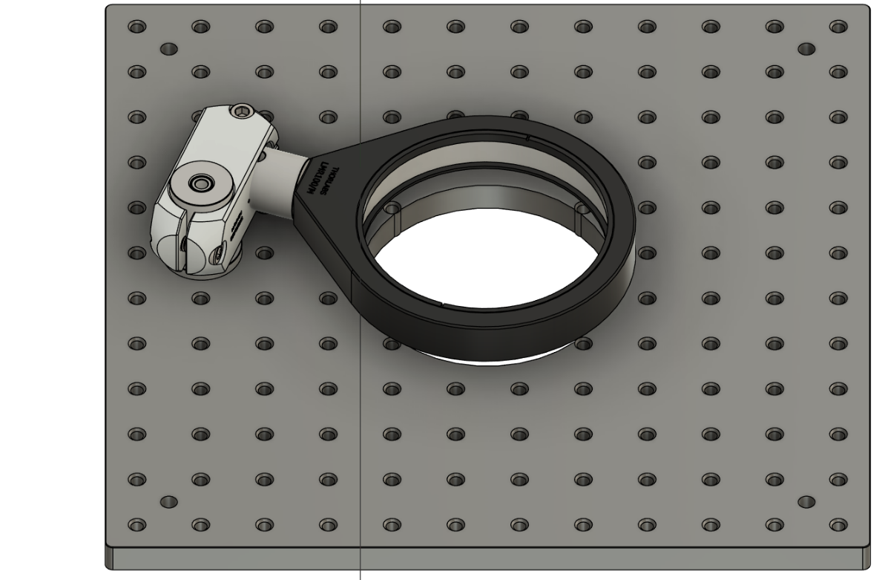
Small mounts
The large mount takes time to design and manufacture so I ordered a solution to scan smaller mirrors
100 diameter samples :
30 min scan time duration

Slide 17
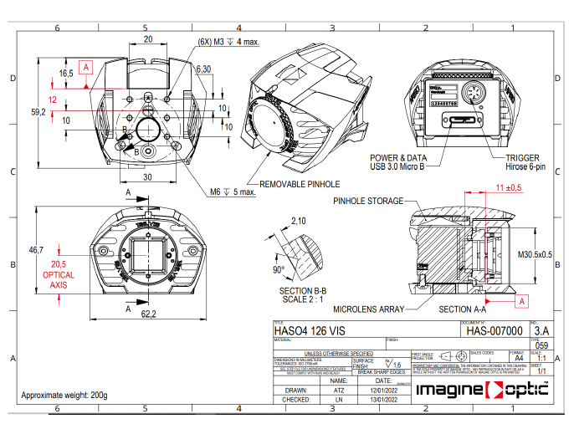
SHWFS HASO 4

Slide 18
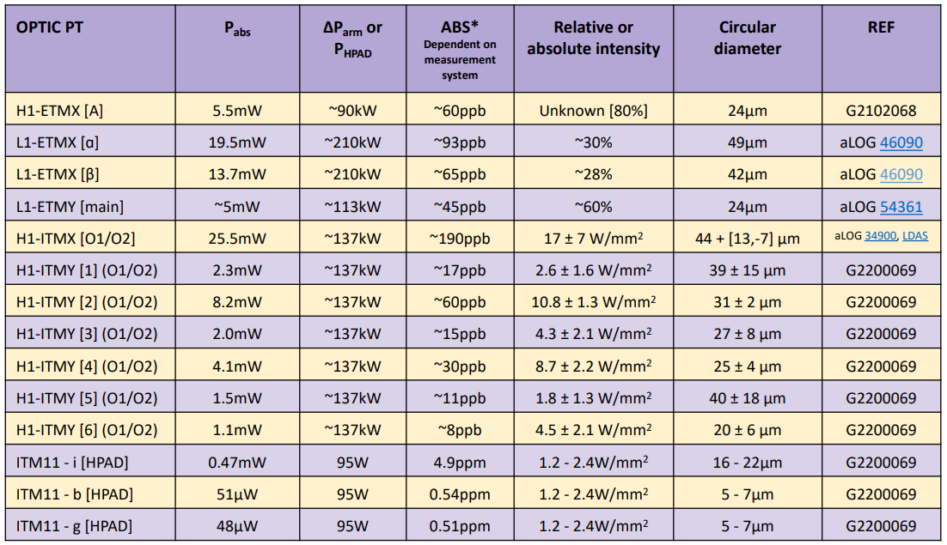
Resume of PA in LIGO test masses

