Slide 1
Electroweak Precision Measurements
and Neutrinos et FCC-ee
1. Circular colliders as «Higgs Factories» (or, better, nurseries)
Feasibility study successful → report out on 31 March 2025 (soon)
2 the present physics landscape, what is the best tool to deal with it.
3. Neutrinos
4. Precision measurements at the Z and W
conclusions

Slide 2
We have gone a long way!
2010-11-12 : ideas, wishes, basic concepts, (VHE-LHC, LEP3, TLEP), Higgs discovery
grassroots studies in EU context; «Higgs factory» in LHC, first, then in new 100km tunnel
LEP3 and TLEP submitted to ESPP2012 {TLEP + VHE-LHC ~FCC}
2013 ESPP2013 wants «ambitious post-LHC accelerator projet »
2014-02 Kick-off meeting of FCC design study FCC ee-ep-hh
ESPP contributions and CDR submitted
➔ FCC can be done! Starting with the e+ e- collider
-2020 ESPP2020 long term vision: a 100 TeV pp collider
shorter term priority ‘Higgs Factory’
recommends Feasibility study of 100km facity
Many new physics opportunities discovered esp. for O(10¹³) Z factory!
Great complementarity between
ee and pp programmes
Europe, together with its international partners, should investigate the technical and financial feasibility
of a future hadron collider at CERN with a centre-of-mass energy of at least 100 TeV and
with an electron-positron Higgs and electroweak factory as a possible first stage.
Such a feasibility study of the colliders and related infrastructure should be established as a global endeavour
and be completed on the timescale of the next Strategy update.

Slide 3
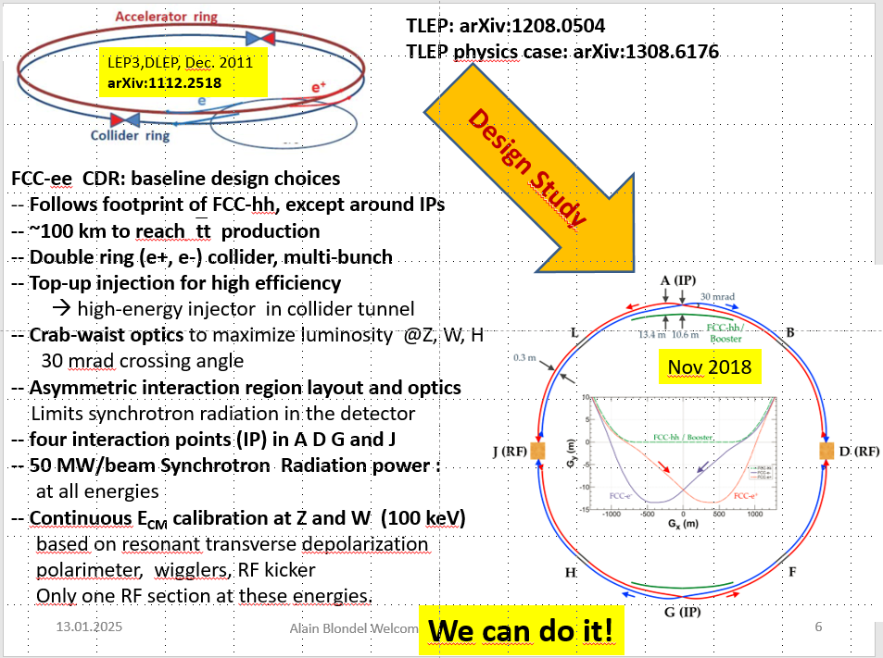
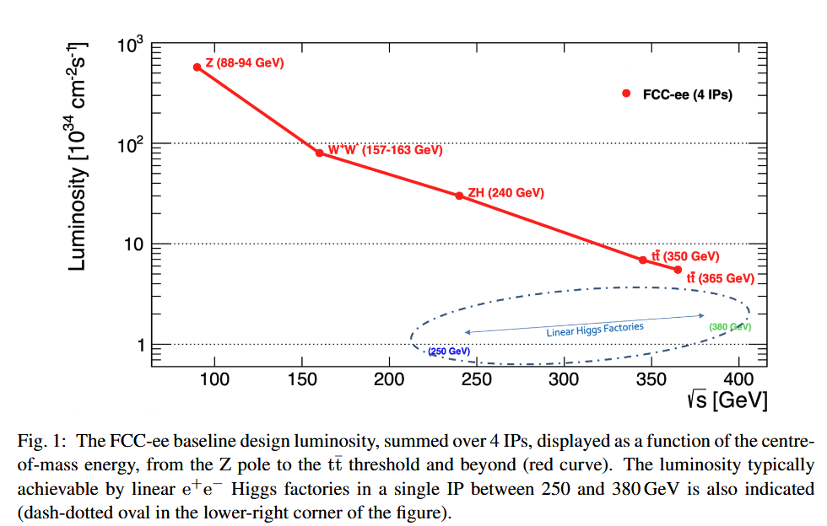
Feasibility Study
Event statistics :
E_{CM} errors:
Z peak E_{cm} : 91 GeV 6 10¹² e+e- → Z
WW threshold E_{cm} : 161 GeV 2.5 10⁸ e+e- → WW
ZH threshold E_{cm} : 240 GeV 2.4 10⁶ e+e- → ZH
‾tt threshold E_{cm} : >350 GeV 2 10⁶ e+e- →‾tt
LEP x 3 10⁵
LEP x 2.10³
Never done
Never done
110/20 ptp keV
300 keV
<1 MeV
<2 MeV
Great energy range for the heavy particles of the Standard Model.

Slide 4





Future Circular Collider Feasibility Study
LHC
HL-LHC
PS
SPS
FCC
http://cern.ch/fcc
Work supported by the European Commission under the HORIZON 2020 projects EuroCirCol, grant agreement 654305; EASITrain, grant agreement no. 764879; ARIES, grant agreement 730871; and E-JADE, contract no. 645479
photo: J. Wenninger
photo: J. Wenninger

Slide 5
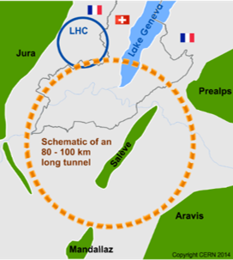
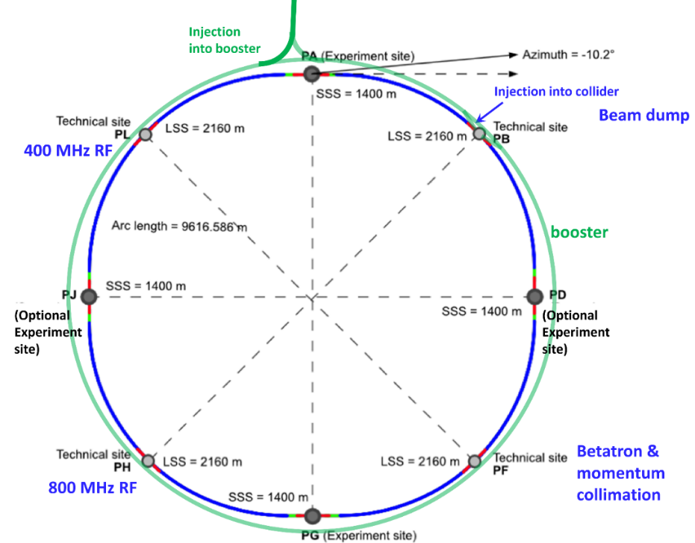
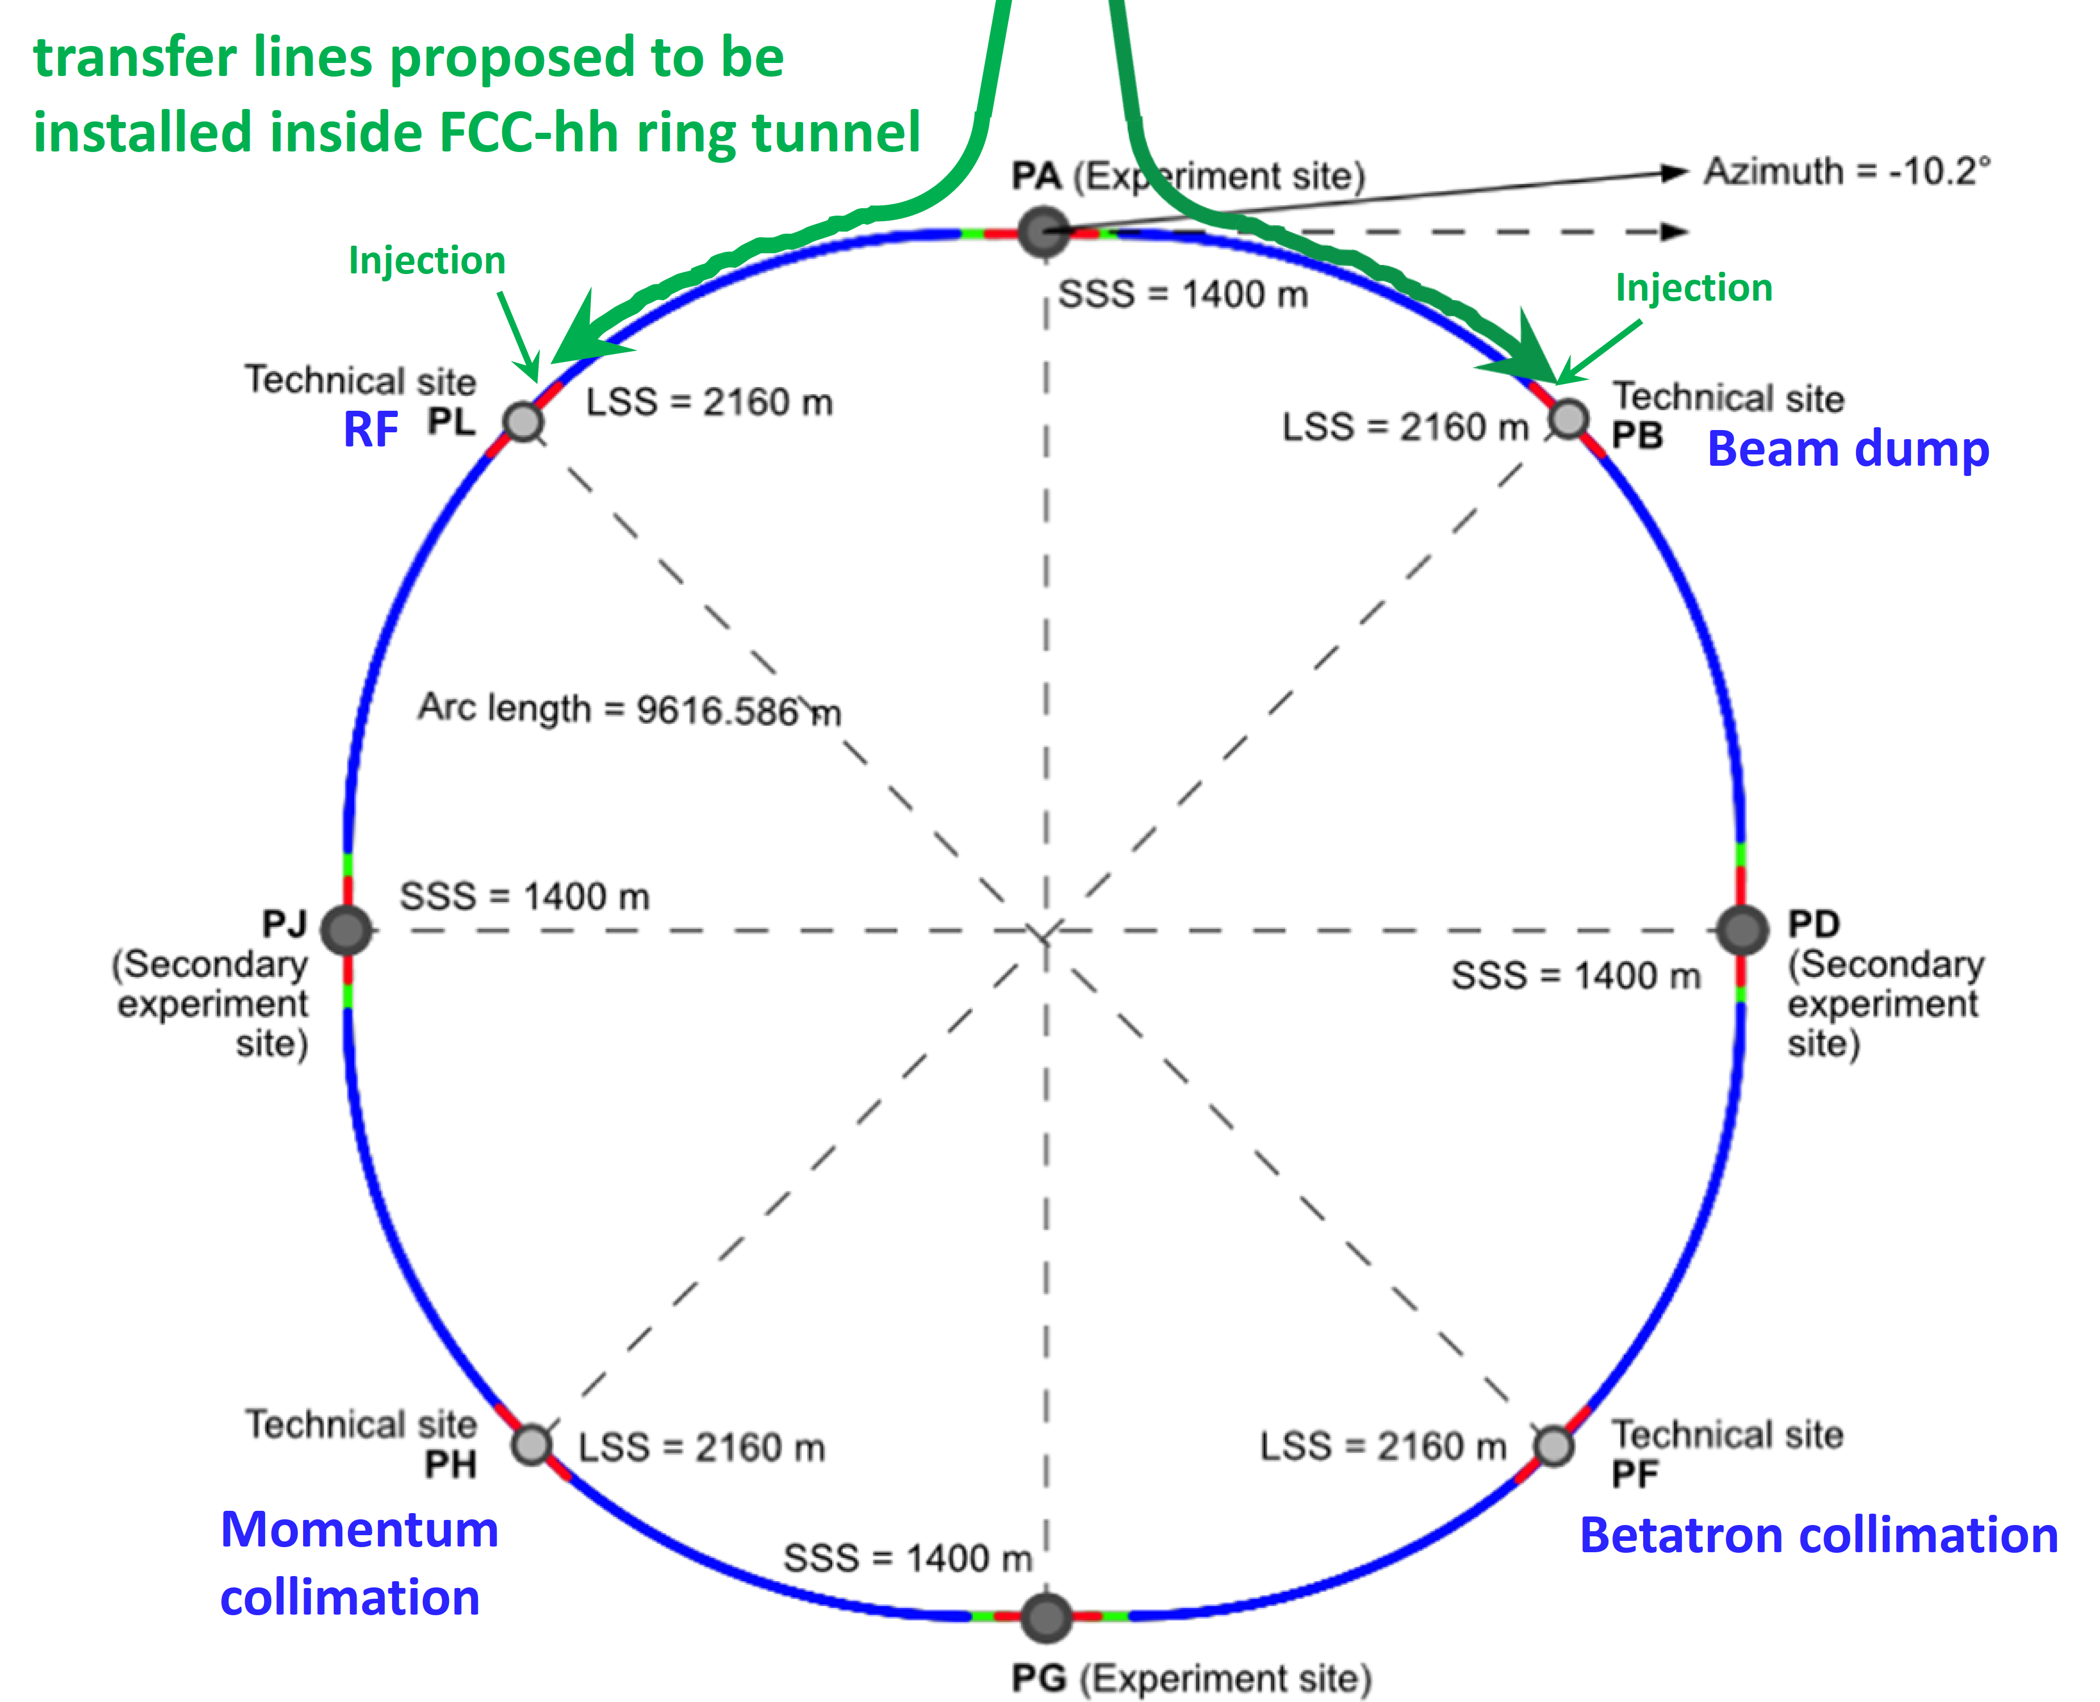
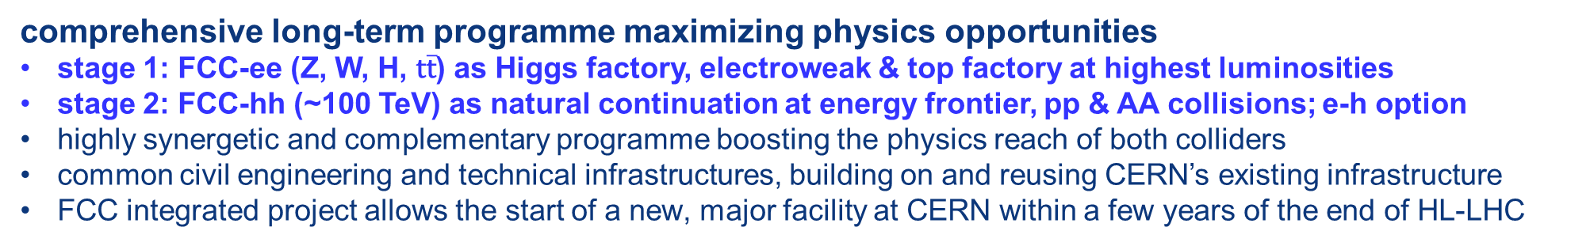
FCC integrated programme
comprehensive long-term programme maximizing physics opportunities
stage 1: FCC-ee (Z, W, H, $\text{t}\overline{\text{t}}$) as Higgs factory, electroweak & top factory at highest luminosities
stage 2: FCC-hh (~100 TeV) as natural continuation at energy frontier, pp & AA collisions; e-h option
highly synergetic and complementary programme boosting the physics reach of both colliders
common civil engineering and technical infrastructures, building on and reusing CERN’s existing infrastructure
FCC integrated project allows the start of a new, major facility at CERN within a few years of the end of HL-LHC
FCC-ee
FCC-hh
2020 - 2045
2045 - 2065
2070 -
a similar two-stage project CEPC/SppC is under study in China

Slide 6
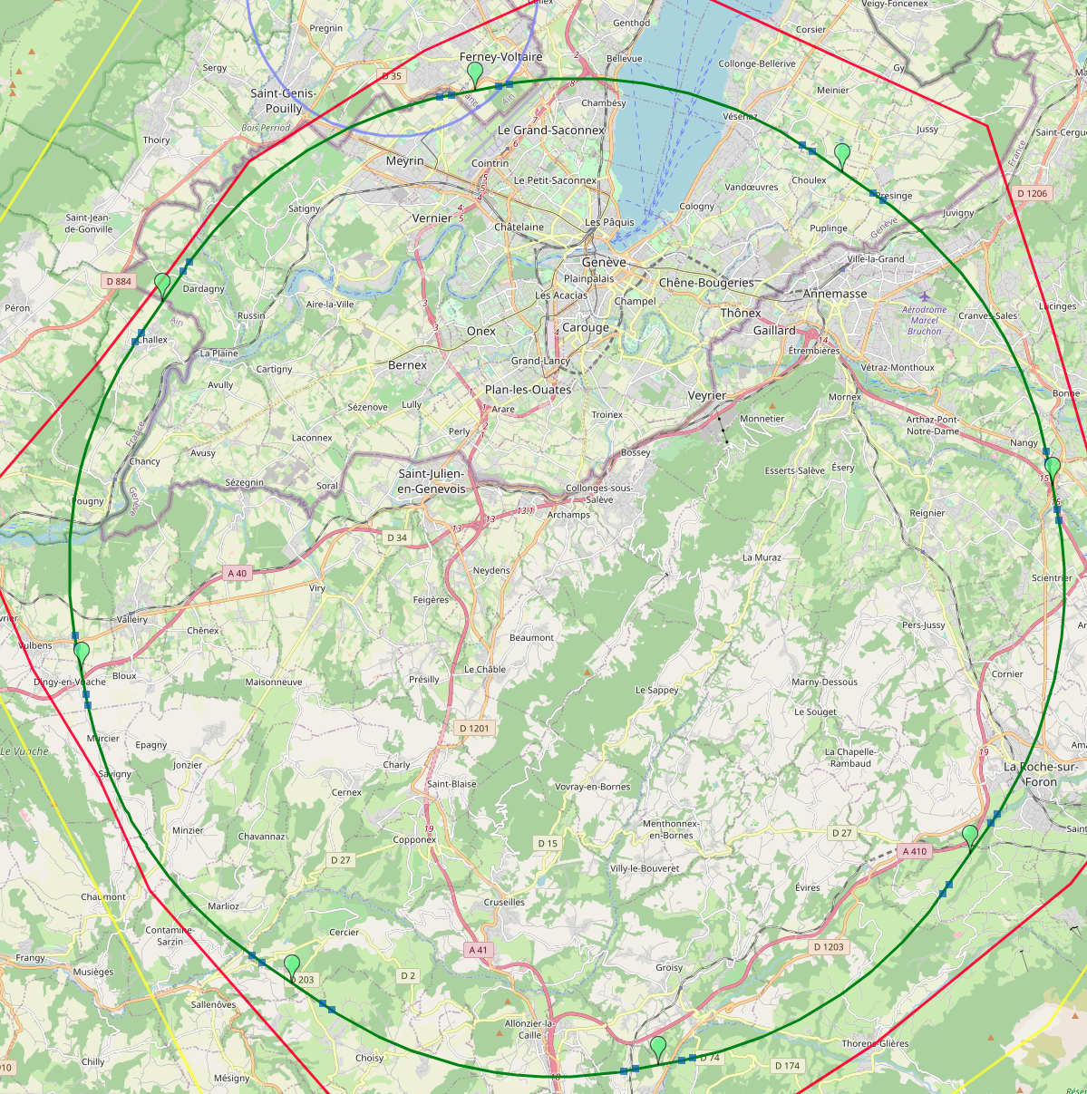
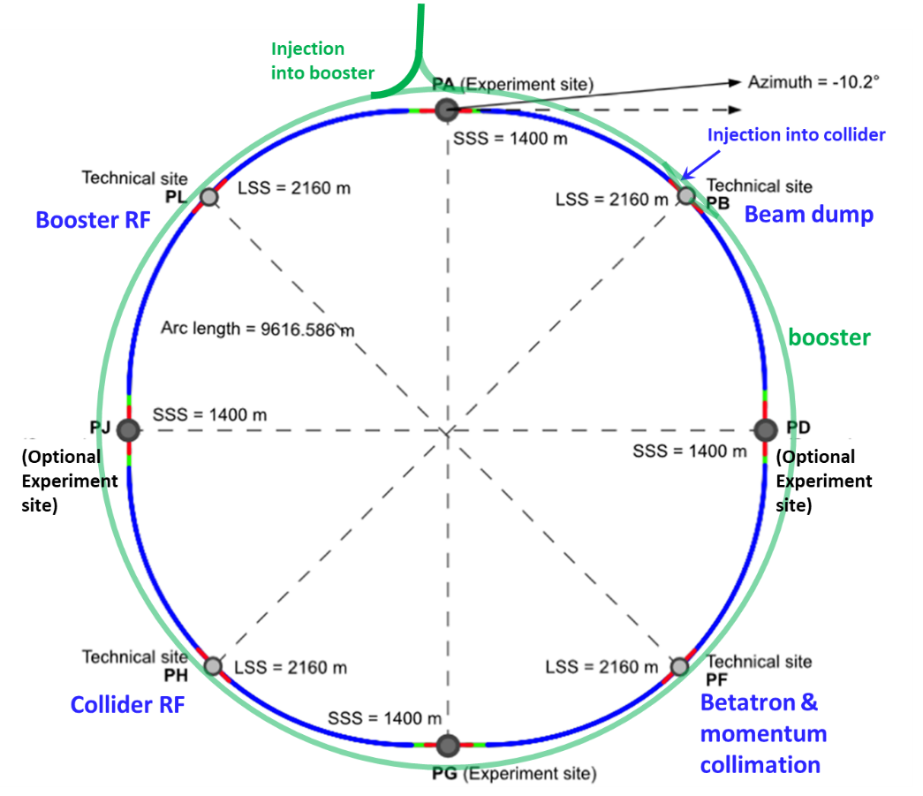
Reference layout and implementation: PA31 - 91.3 km
V. Mertens,
J. Gutleber
Layout chosen out of ~ 100 initial variants, based on geology and
surface constraints (land availability, access to roads, etc.), environment, (protected zones), infrastructure (water, electricity, transport), machine performance etc.
“Avoid-reduce-compensate” principle of EU and French regulations
PA: Experiment
PB: technical
PL: technical
Overall lowest-risk baseline: 91.3 km ring, 8 surface points,
4-fold symmetry
Number of surface sites | 8
Surface requirements | ~40 ha
LSS@IP (PA, PD, PG, PJ) | 1400 m
LSS@TECH (PB, PF, PH, PL) | 2032 m
Arc length | 9.6 km
Sum of arc lengths | 76.9 m
Total length | 91.3 km
PD: experiment
PJ: experiment
PF: technical
PH: technical
6
PG: experiment

Slide 7
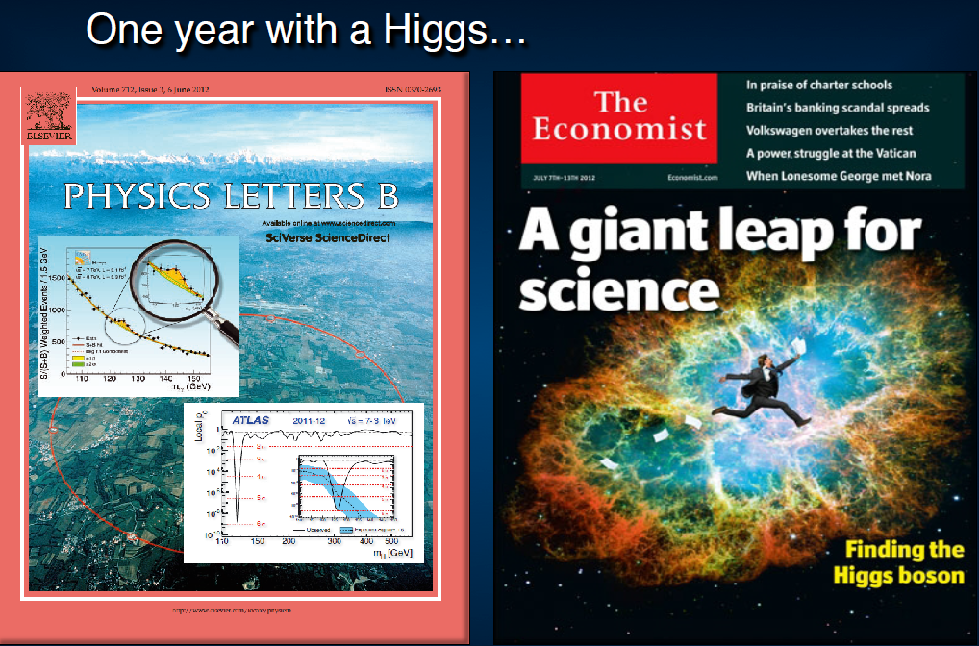
13 YEARS AGO ALREADY

Slide 8
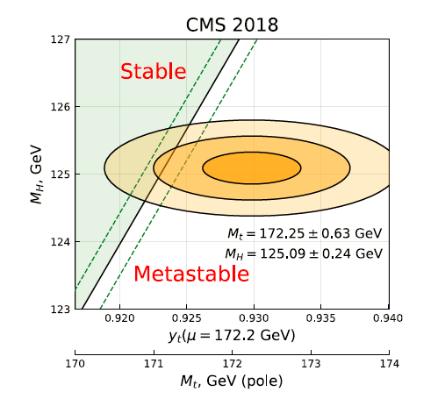
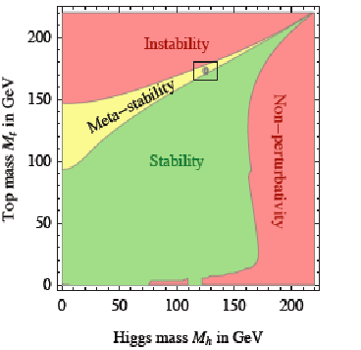
The Standard Model is a very consistent and complete theory.
It explains all known collider phenomena and almost all particle physics (except neutrinos)
– this was beautifully verified at LEP, SLC, Tevatron and the LHC.
-- the EWPO radiative corrections predicted top and Higgs masses
assuming SM and nothing else -- NO MORE FREE PARAMETERS NOW
we can even extrapolate the Standard Model all the way to the the Plank scale :
FCC 2048

Slide 9
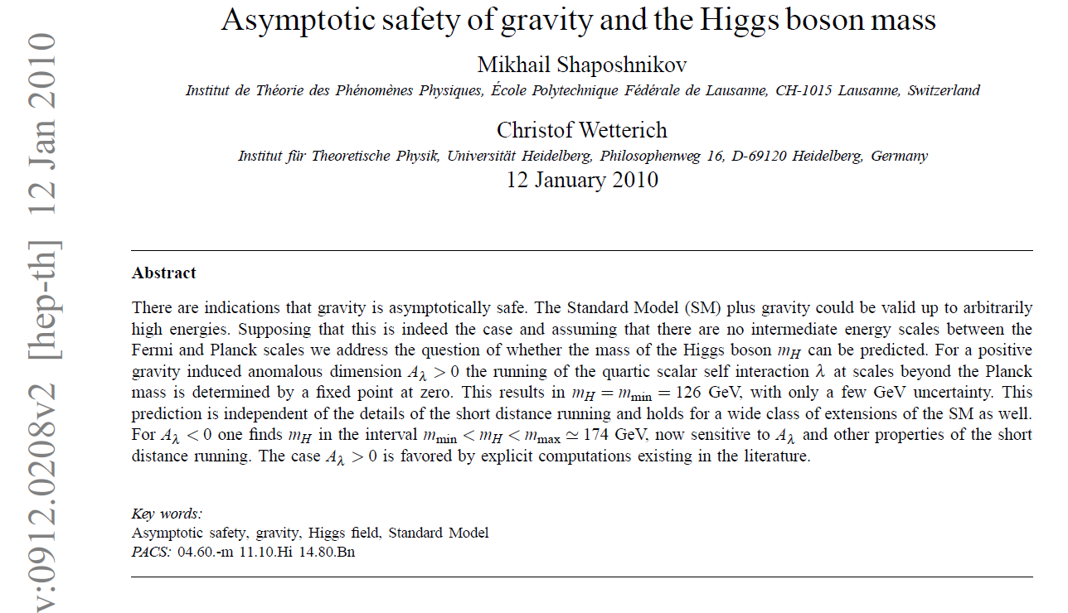
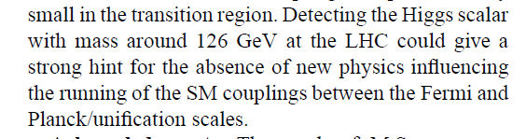
Is it the end?
Is it the end?

Slide 10
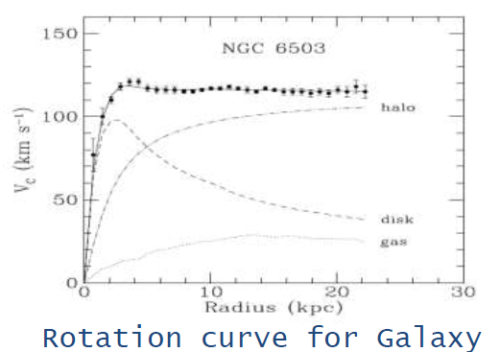
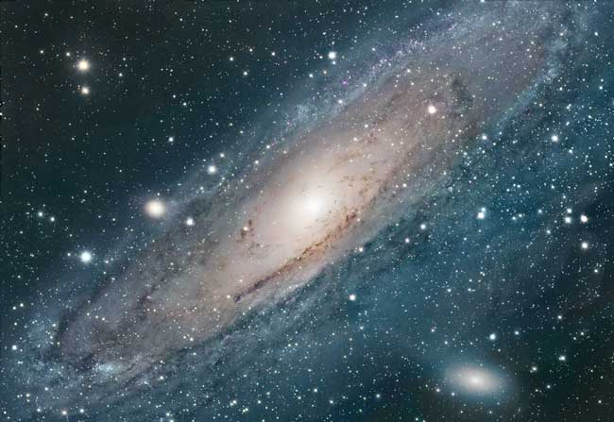
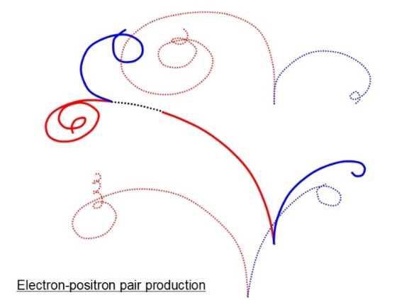
We cannot explain:
Dark matter
Standard Model particles constitute only 5% of the energy in the Universe
Were is antimatter gone?
What makes neutrino masses?
Not a unique solution in the SM --
Dirac masses (why so small?)
Majorana masses (why not Dirac?)
Both (the preferred scenarios, see-saw...) ?
➔ heavy right handed neutrinos?

Slide 11
Is it the end?
Certainly not!
-- Dark matter
-- Baryon Asymmetry in Universe
-- Neutrino masses
are experimental proofs that there is more to understand.
We must continue our quest, but HOW?
Direct observation of new particles (but not only!)
New phenomena (ex: Neutral currents, neutrino oscillations, CP violation.. )
Deviations from precise predictions
(ref. Uranus to Neptune, Mercury’s perihelion,
top and Higgs predictions from LEP/SLC/Tevatron/B factories, g-2, etc…)
To which, one can add many theoretical questions on the SM
these facts may or do require
particle physics explanations.

Slide 12
The Physics Landscape
We are in a fascinating situation: where to look and what will we find?
For the first time since Fermi theory, WE HAVE NO SCALE
The next facility must be versatile with as broad and powerful reach as possible,
as there is no precise target
➔ more Sensitivity, more Precision, more Energy
FCC , thanks to synergies and complementarities, offers
the most versatile and adapted response to today’s physics landscape,

Slide 13
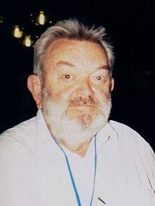
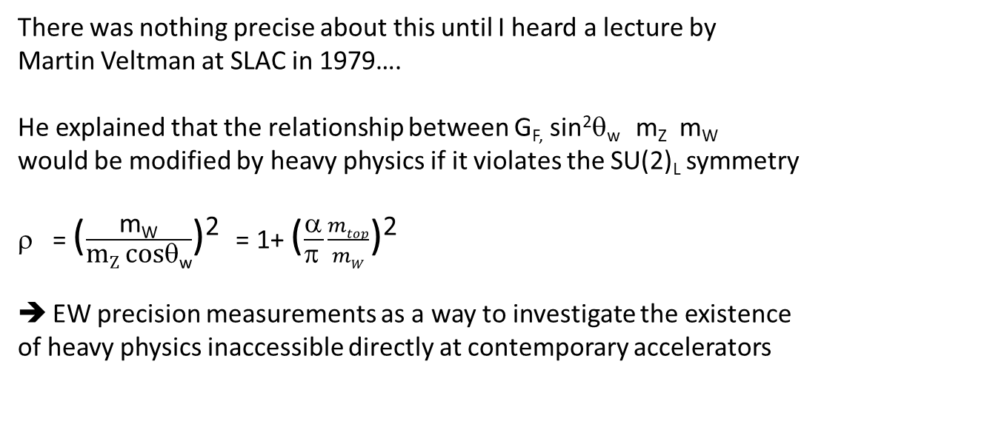
There was nothing precise about this until I heard a lecture by
Martin Veltman at SLAC in 1979….
He explained that the relationship between G_{F,} sin²θ_{w} m_{Z} m_{W}
would be modified by heavy physics if it violates the SU(2)_{L} symmetry
= ($\frac{\text{m}\text{W}}{\text{m}\text{Z} \text{cos}\text{θ}\text{w}}$)² = 1+ ($\frac{α}{π }\frac{mtop}{mW}$)²
EW precision measurements as a way to investigate the existence
of heavy physics inaccessible directly at contemporary accelerators
NB This is not why the 26.7 km circumference LEP was built.
Veltman lui-même who was part of the committee, insisted that it should be large enough to
verify that W pair production was not divergent.
The construction of LEP was decided by CERN council in 1981, before the W and Z
were observed at the proton-antiproton collider! Construction started in 1983.
A big scare of the time was the number of neutrinos

Slide 14
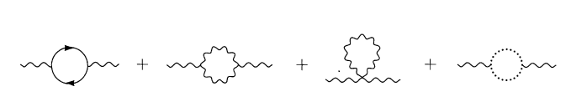
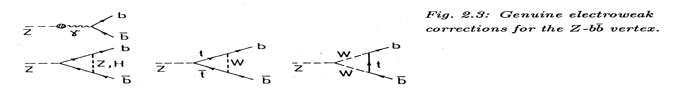
Some examples of diagrams in which EW precision measurements are sensitive to heavy physics
(a practical view)
, Z, W self-energies
➔ universal
t
t
γ
γ
γ
Z
W
W
Z
Z
Δα_{QED} (evolution of α with √s)
T (difference between W and Z)
S (difference between γ and Z)
vs.
vs.
vs.
b
α/π . m_{t}²/m_{W}²
t
Vertex diagrams: flavour specific
Ex Δ_{b}
Γ_{b} /Γ_{d} ∝ α/π . m_{t}²/m_{W}²
Also m _{(s-top, s-W )} etc.
Z
Z’
ν
N
x
x
Mixing with heavy particle
Any reaction invoving (here) Z or ν
Is affected
A heavy Z, W, Higgs
A heavy neutrino ∝ |θ|² see later

Slide 15
Motivation for the precision measurements *and* precision calculations
1. Given that the minimal SM is complete with the Higgs discovery, how do we find out:
-- if the Higgs boson is exactly what is foreseen by the standard model? (→ Higgs Factory)
-- where/what are the new physics phenomena that must be present to explain:
baryon asymmetry
dark matter,
neutrino masses (and other mysteries we don’t understand) (→ EW/top factory)
2. A powerful and broadly efficient method is to perform precision EW measurements
-- many observables contain sensitivity to new phenomena, either by loops, direct long distance propagator effects, or mixing with SM coupled particles.
➔ are there any more weakly coupled particles?
The top quark effect at LEP was 10σ! (➔ there is *not* another t-b quark system)
any custodial SU(2)-violating effect appears regardless of mass scale
-- is there mixing ? in particular active-sterile neutrino mixing
-- high mass SM-coupled and custodial SU(2)-respecting → (ex: Z’ or degenerate SuSy)
Emphasis on different observables depending on the question asked.
Veltman: Δρ =ΔT.α=
α/π . (m²_{top}-m²_{b})/m²_{W}
«T»
not to forget:
QCD
Lepton-quark
lepton and quark family
Universality
«ν»
«S»

Slide 16
Higgs, EWPOs and flavours are complementary
Precision Natural SUSY at CEPC, FCC-ee, and ILC, JJ Fan, M. Rees and Liantao Wang
arXiv:1412.3107v2 figure 5 (top row)
availability of Higgs, EWPO and flavour will provide redundancy,
possible guidance on the nature of new effect if observed
more and more specific exclusions if no effect is found.
“ also, b→ sγ could be useful”

Slide 17
Huge statistics will help with systematics....
but detectors must be designed for this!
Imagine an astronomer whose aperture increases X500!
With statistics 300 000 times those of LEP ➔ statistical precision improves by 500
even more for b, tau and charm observables because of improvement of vertex detector and smaller beam pipe
Target: improve systematics to the level of the statistical precision
Examples(all work in progress, or to be done)
-- monitor luminosity with γγ events in addition to low angle Bhabha.
→ 1.5 10⁻⁵ precision provided fiducial volume limit (10-20 degrees) can be known to 10 microns at 2.5m.
-- Then, acceptance for lepton pairs known to 2 10⁻⁶
-- perform beam energy calibration continuously with pilot polarized bunches RDP
-- use several tags (inclusive double tag, exclusive B decay modes tag, etc. etc.) for b,c,s-jet efficiency for R_{b,c,s}
-- use huge samples of muon pairs (1.5 10¹¹) to perform exquisite detector alignment (for tau life time, luminosity etc...
--- etc etc
Success requires to be proactive and design detectors with these precision targets in mind.
➔ a new era of detector design!
➔ Considerable opportunities in physics studies in preparation to collaborations for detectors!

Slide 18
Juan Alcaraz

Slide 19
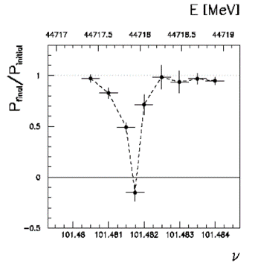
Beam Polarization can provide two main ingredients to Physics Measurements
Transverse beam polarization provides beam energy calibration
by resonant depolarization
→ low level of polarization is required (~10% is sufficient)
→ at Z & W pair threshold comes naturally σ_{E} ∝ E²/√ρ
→ at Z use of asymmetric wigglers at beginning of fills
since polarization time is otherwise very long (250h→ ~1h)
→ should be used also at ee → H(126)
→ use ‘single’ non-colliding bunches and calibrate continuously
during physics fills to avoid issues encountered at LEP
→ Compton polarimeter for both e+ and e-
→ should calibrate at energies corresponding to half-integer spin tune
→ must be complemented by analysis of «average E_beam-to-E_CM» relationship
For beam energies higher than ~90 GeV can use ee → Z γ or ee → WW events
to calibrate E_{CM} at ±1-5 MeV level: m_{H} (5 MeV) and m_{top} (20 MeV) measts

Slide 20
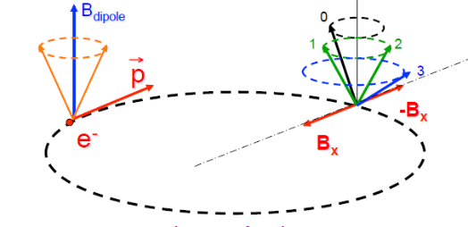
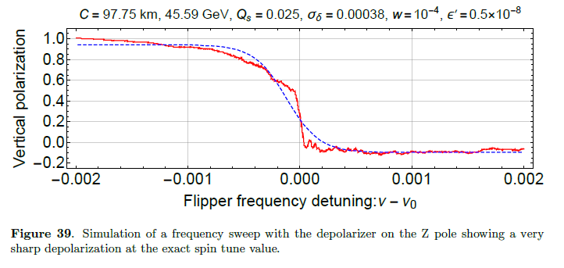
RESONANT DEPOLARIZATION
Once the beams are polarized,
an RF kicker at the spin precession frequencv
will provoke a spin flip and complete
depolarization
Simulation of FCC-ee by I. Kopp:
spin precession (ν is the spin tune)
δθ_{spin} = (g-2)/2 . E/m δθ_{trajectory}
= ν . δθ_{trajectory}
ν = E_{beam} / 0.4406486
= 103.5 at the Z peak

Slide 21
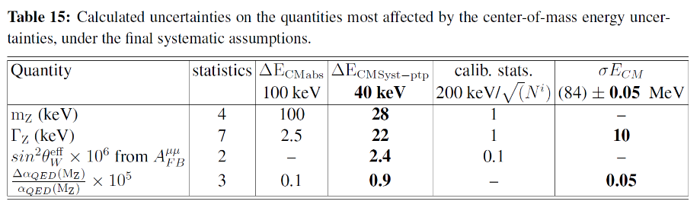
results obtained in the FCC Design Study:
Polarization and Centre-of-mass Energy Calibration at FCC-ee, arXiv:1909.12245
stat/present
500
400
75
15 (qualitiative!)
40
20 keV
14
11
1.2
0.45
4
4
2
3
Next challenges for the feasibility study:
-- Ascertain the above with integrated simulations (simulation of polarization and depolarization on real machine)
-- Match systematic errors with statistics.
most relevant targets : the point-to-point systematics, improve the calibration at WW energy
– these are effects that would lead to a deviation from relation between
-- the spin tune as measured by resonant depolarization
-- and the center-of-mass energy.
-- examples: 1. interference between depolarizing resonances and the induced depolarizing resonance
because the spin tune varies with energy.
2. effects due to collision offsets folded by opposite sign dispersion
-- designevaluate performance and cost the polarimeter at conceptual level
-- finalize implementation in the realistic machine, study operational aspects

Slide 22
Progress in FCC-ee energy calibration
From FCC week 2022 and FCC EPOL workshop:
-- Resonant depolarization measures energy every 15 minutes
at < 50 keV/beam level at Z, 100 keV/beam at W
syst will be reduced to < 100keV on m_{W}
at Z point to point uncertainties remain to be understood
-- Only one RF station around the ring, + the energy losses of the
two beams are strongly constrained from the direct measurement
of boost at the IPs O(5 keV level) every 8hrs shift in 2/4 experiments
-- beam-beam deflection measurement is extremely sensitive to
beam beam offset and local opposite-sign dispersion
(previously large point-to-point error):
still lots to do but O(20 keV) per measurement every 3second
➔ targeting to match or go below statistical errors
Z pole
WW threshold

Slide 23
COLLISION OFFSET
4.2 μm
2. offset by δ_{y} = 0.1σ_{y} (=3.5nm)
opposite kick by 4μrad
(Shatilov) in opposite directions for e+ and e-
movement in the BPMs by
± 2 μrad x 2.1m = ±4.2 μm
(x1000 demagnification due to optics)
with a very specific pattern of movements
4μrad
Vertical beam size at the IP: ∼35 nm (at Z pole). Vertical offset of 0.1σ_{y} leads to additional orbit angles about ±2 μrad for the nominal bunch population 2.5E+11. (D. Shatilov, simulation)

Slide 24
EW Precision - Conclusions
The Electroweak programme at the Future Higgs/Electroweak/top factories is stunningly precise and effective search for
the existence of new particles with SM couplings or mixing with SM (esp neutrinos) at the level of 10⁻⁵
any new significant signal will be discovery.
Precision = discovery potential!
-- from 1 to 3 orders of magnitude improvements in experimental precision, over a large number of observables.
-- the full exploitation of these capabilities will require creativity for detector design and accelerator operations,
and a coordinated campaign of measurements (noise parameters, ancillary measaurements)
-- Matching the mind-boggling statistical precision with experimental systematics and theoretical accuracy will require
a large number of clever tricks and careful methodology
-- a great opportunity for early carrier scientists (acc. exp. and th. alike) to
-- have fun!
-- make a name for themselves and produde or contribute to original contributions.

Slide 25
RECENT RESULTS
1. Direct determination of α_{QED} (m_{Z}) (Unique to circular machines, since it requires 10¹² Z and line shape scan)
1.1 was so far determined from the slope of A_{FB}^{μμ} vs √s → ±3 10⁻⁵ (P. Janot)
1.2 recent paper by M. Riembau uses both s and t- channel e+e- → e+e- and μ+μ- at the Z pole ±0.6 10⁻⁵
Di-lepton distributions limited
by statistics
requirements on tracker to be
spelled out but double tag essential.

Slide 26
Detector – related EOIs for the strategy
can be found here:
https://indico.cern.ch/event/1511773/

Slide 27
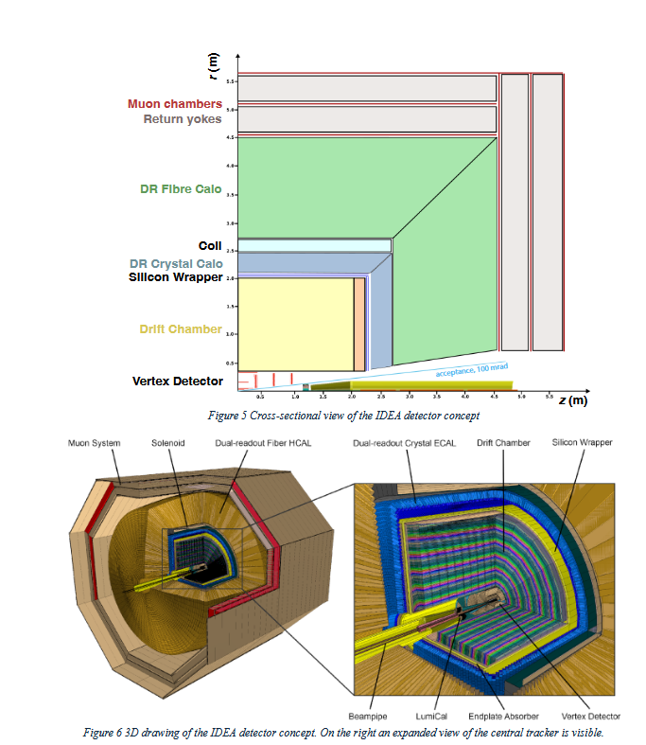
The IDEA detector
EOI to be submitted to the ESPP25

Slide 28
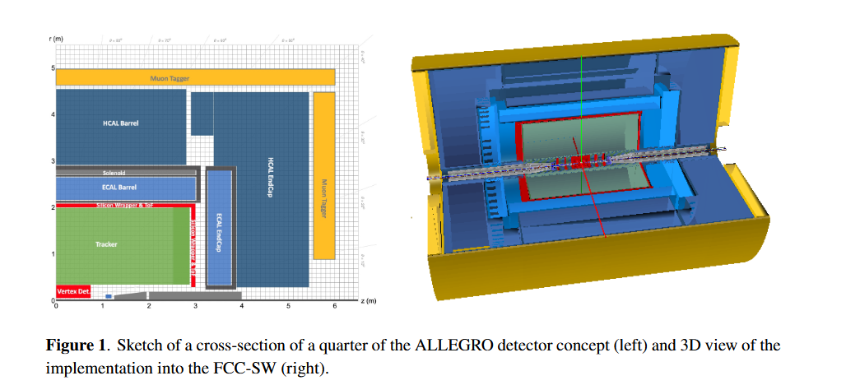
ALLEGRO DETECTOR
Also ILD (ILC base) and CLD (CLIC base)

Slide 29
RECENT RESULTS
2. Flavour tagging
in IDEA arXiv:2202.03285v1
Jet Flavour Tagging for Future Colliders with Fast Simulation
IDEA has a drift chamber tracker (dE/dx)
silicon vertex detector and wrapper
uses the Vertex detector and wrapper as TOF with resolution O(30ps)
achieve e.g. b tagging with 75% efficiency for 10⁻³ charm contamination (single jet)
c 60% 2 10⁻⁴ b contamination
s 10% efficiency 2 10⁻³ u,d contamination
This is a huge breakthrough w.r.t. LEP where efficiencies of 10-15% and contamination of 15% was the best achieved for b-tagging
➔ High precision of b,c,s branching frations and jet charge asymmeries.

Slide 30
Single Jet tagging efficiencies
arXiv:2202.03285v1
Jet Flavour Tagging for Future Colliders with Fast Simulation
F Bedeschi , L Gouskos, M Selvaggi
It is possible to achieve high purity (99%) for s quarks with an efficiency of more than 10%
THIS IS STILL 1.5 10¹² X 0.22 X 0.2 =
6 10¹⁰ single tag events and
3 10⁹ double tag ss events
(5 orders of magnitude better than
ALEPH bb analysis )
All of this is much more precise than the
ALEPH bb analysis by factor sqrt(10⁵)
and 15 times less impurity.

Slide 32
Systematics due to point to point errors
Systematics due to lepton cut acceptance
Syst. Due to tagging efficiency
Syst. Due to jet charges

Slide 33
Overview of EW relationships and examples of new physics effects
Z scan
WW at & above threshold
α_{QED}, m_{Z}, G_{F}
Δα_{QED}
m_{top}
S,T, NP
m_{top}
m_{top}
α_{s}
S,T,ν, NP
sin²θ^{eff}_{W}
m_{W}
ν
T,ν, NP
asymmetries
from Parity violating couplings
A_{FB}^{f}
P(τ), A_{FB}^{pol(f)}
(initial of final state)
A_{LR}
α_{s} Vcs, Vcb
σ_{had} (m_{Z})
Γ_{Z}
α_{s}
δ_{vb}
τ
(mass)
BR,
lifetime
ratios of partial Z widths
R_{lept (e,μ,τ)}
R_{b}
R_{c}
Γ_{W}
_{part. widths}
FCC TeraZ
statistics,
precise ECM
ILC GigaZ long. Pol.
FCC 210¹¹taus
partial widths, (g_{A}² +g_{V}²)(f), N_{v}
(g_{V}/g_{A})(f)

Slide 34
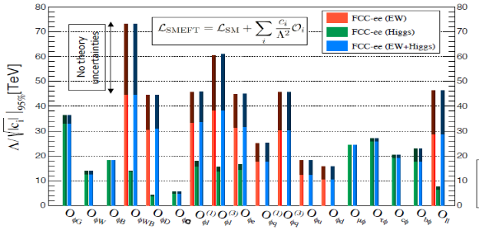
Precision EW measurements @ FCC is the SM complete?
NP Sensitivity by oblique/vertex loops or mixing
Higgs + EWPO (+ flavours) are complementary
top quark mass and couplings essential
the 91km circumference is broadly optimal for this
preliminary systematics (book-keeping)
aim at reducing to the level of statistics
many observables still to be added (flavours)
complemented by high energy FCC-hh
Theory work is critical and initiated 1809.01830
see also recent physics workshop session.

Slide 35
NEUTRINOS
The fact that neutrinos have mass is THE observed BSM phenomenon there is in particle physics
It is intimately a Higgs Physics question:
➔ what are the couplings of the H(125) (Nobel 2013) to massive neutrinos (Nobel 2015)?

Slide 36
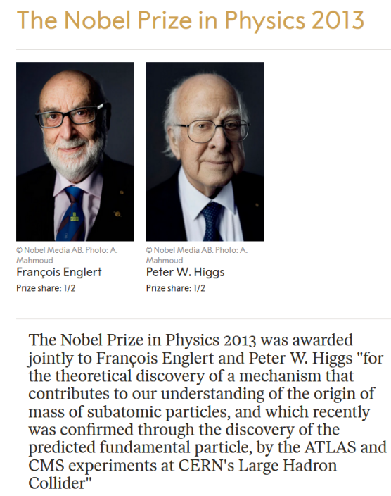


Slide 37
Heavy Neutral Leptons and Fermion number violation
courtesy
Panos Charitos

Slide 38
fermion number violation is the first Sakharov condition for the
Baryon Asymmetry of the Universe
Baryogenesis or Leptogenesis + sphalerons
Also requires
-- CP violation and
-- out of equilibrium universe (Big Bang OK
Fermion number conservation
Is *not* in itself a law or a symmetry of the Standard Model
For charged fermions (e/mu/tau and the quarks) it is not possible to transform a fermion into an antifermion because of charge conservation
For neutrinos, which are neutral, the SM assumes they are massless.
neutrino is left-handed (identical if massless to negative helicity)
and the antineutrino has positive helicity
neutrino <-> antineutrino transition is forbidden by angular momentum conservation
This results in practice in apparent conservation of fermion number
The existence of massive neutrinos allows for spin flip and thus in principle a neutrino-antineutrino transition.
since a left handed field has a component of the opposite helicity (and vice versa)
ν_{L} ≈ ν₋ + ν₊ m/E (mass is what allows to flip the helicity)
for very small mass and light neutrinos this is very, very small: for m=50meV and P =30 MeV ➔ (m/E)² = 10⁻¹⁸
This can be observed in neutrino less double beta decay or by searching directly for the right-handed neutrinos!

Slide 39
Motivation and Communication
A matter of name:
Sterile neutrinos ``ν₄ “ ( and *NO* it is *not* a fourth family of neutrino!)
Heavy Neutral Leptons
Right-Handed Neutrinos
Heavy Majorana neutrinos
are all the same!
Generically we are talking of the new degree of freedom that arises for each family of light neutrinos that is massive. Massive neutrino → two helicity states, which can be projected on
Electroweak Left-handed (ν_{L}= ν₋ +m/E ν₊ ) and Right-Handed (ν_{R}= ν₊ +m/E ν₋ ) states.
At least two are needed to account for observed three family neutrino oscillations, three more ‘natural’
Most models of neutrino mass generation, and certainly the simplest and most natural ones,
involve right-handed neutrinos
Of course it is possible to generate heavy neutral leptons in different, ad-hoc ways.

Slide 40
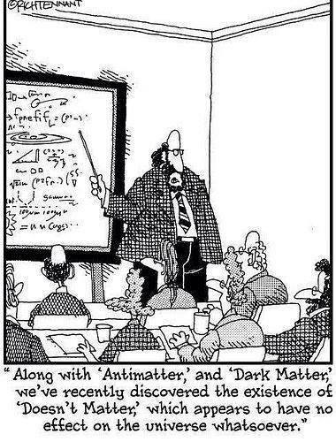









my SM training in 1976
Electroweak eigenstates
$$\left({e \atop v_{e}}\right)$$
$$\left({ \atop v_{μ}}\right)$$
$$\left({ \atop v_{τ}}\right)$$
$$\left(e\right)$$
$$\left(\right)$$
$$\left(\right)$$
Q= -1
R
R
R
L
L
L
$$\left(_{e}\right)$$
$$\left(_{μ}\right)$$
$$\left(_{τ}\right)$$
Q= 0
R
R
R
I = 1/2
I = 0
Right handed neutrinos
are singlets
no weak interaction
no EM interaction
no strong interaction
can’t produce them
can’t detect them
-- so why bother? –
Also called ‘sterile’
NB unlike for v_{L} , nothing distinguishes the particle and antiparticle of v_{R} which is a singlet (no ‘charge’)
→ naturally a Majorana particle

Slide 41

Neutrino masses occur via processes which are intimately related to the Higgs boson
➔ what are the couplings of the H(125) to neutrinos?
Adding neutrino masses to the Standard model 'simply' by adding a Dirac mass ➔ right-handed neutrino
m_{D} is the Higgs Yukawa coupling (like everybody else). Then the right handed neutrinos are perfectly sterile, (except that they couple to both the Higgs boson and gravitation).
Things become more interesting: a Majorana mass term arises. So-called Weinberg Operator (only Dim5 operator in EFT) and involves the Higgs boson and the neutrino Yukawa coupling
Majorana mass term is extremely interesting as this is the
particle-to-antiparticle transition that we want
in order to explain
the Baryon asymmetry of the Universe
(+ CP violation in e.g. neutrinos)
M_{R}
Pilar Hernandez,
Granada 2019-05

Slide 43
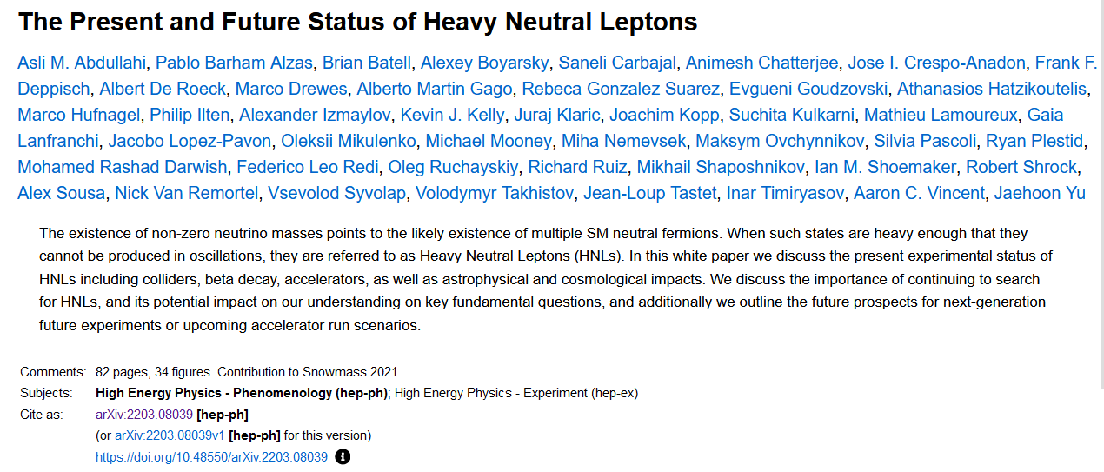
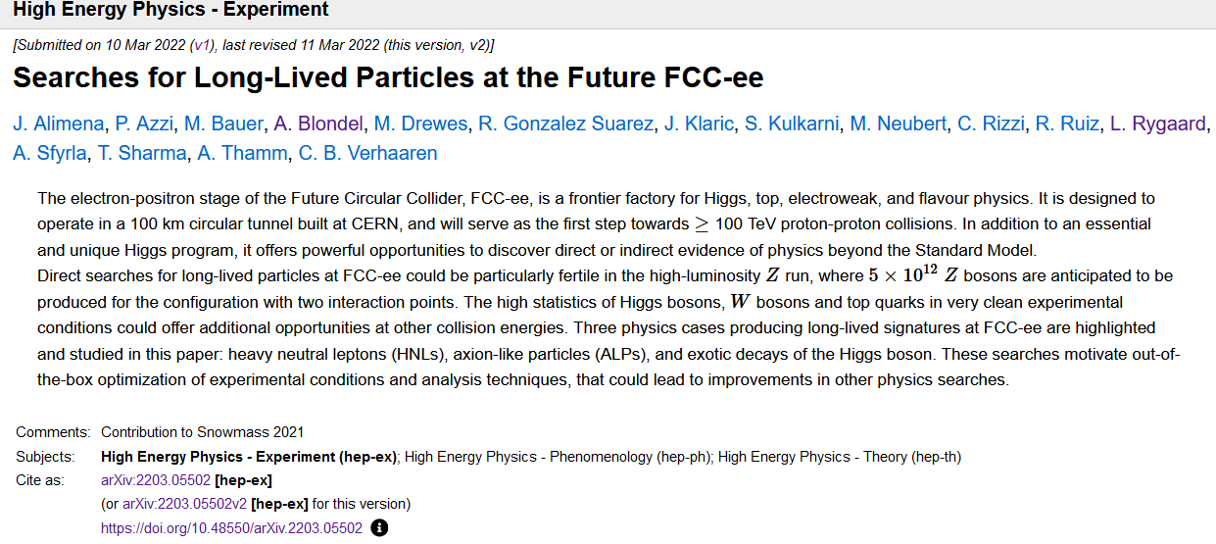
Heavy Neutral Leptons -- recent litterature
777 references!

Slide 44
The minimal neutrino Standard Model
is type I see-saw (just complete with RH ν’s)

Slide 45

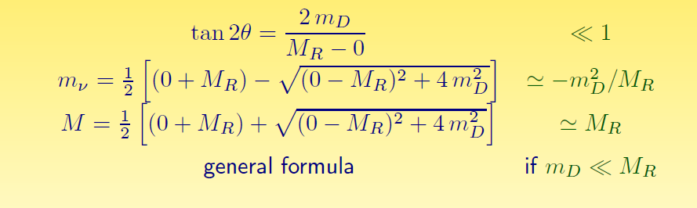
Mass eigenstates
See-saw type I :
M_{R} ≠ 0
m_{D} ≠ 0
Dirac + Majorana
mass terms
see-saw
M_{R} = 0
m_{D} ≠ 0
Dirac only, (like e- vs e+):
ν_{L} ν_{R} ‾ν_{L} ‾ν_{R}
½ 0 ½ 0
4 states of equal masses
M_{R} ≠ 0
m_{D} = 0
Majorana only
ν_{L} ‾ν_{R}
½ ½
2 states of equal masses
M_{R} > m_{D} ≠ 0
Dirac + Majorana
ν N ‾ν N
½ 0 ½ 0
4 states , 2 mass levels
m
m
m
I_{weak}=
dominantly:
I_{weak}=
I_{weak}=
Some have I=1/2 (active)
Some have I=0 (sterile)
All have I=1/2 (active)
m₁ have ~I=1/2 (~active)
m₂ have ~I=0 (~sterile)

Slide 46
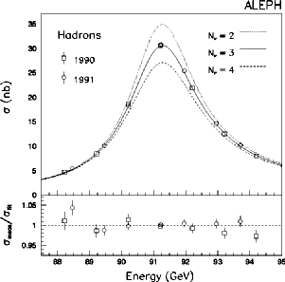


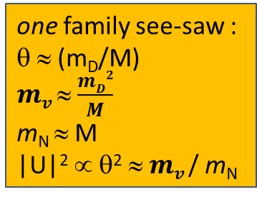
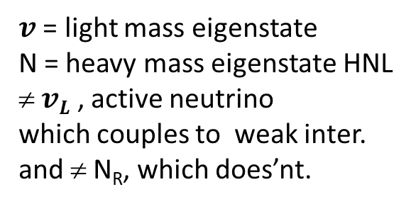

Manifestations of right handed neutrinos (HNL)
$v$ = light mass eigenstate
N = heavy mass eigenstate HNL
≠ $vL$ , active neutrino
which couples to weak inter.
and ≠ N_{R}, which does’nt.
one family see-saw :
θ ≈ (m_{D}/M)
$mv$ ≈ $\frac{mD2}{M}$
m_{N} ≈ M
|U|² ∝ θ² ≈ $mv$/ m_{N}
ν = ν_{L} cosθ - ${Nc}_{R }^{} sin$θ
$N=N_{R}^{} \text{cos}\text{θ}+ vL$ ^{c} sinθ
what is produced in W, Z decays is:
$vL= v$ cosθ + $N_{ }^{}sin$θ
-- mixing with active neutrinos leads to various observable consequences in High Energy experiments
If N is not too heavy it will decay in the detector ➔ POTENTIAL FOR DIRECT DISCOVERY
If it is too heavy to be produced
➔ PMNS matrix unitarity violation and deficit in Z «invisible» width
➔ violation of unitarity and lepton universality in Z, W or τ decays
➔ EW observables that contain neutrinos are modified, G_{F} in particular μ→ e ν_{e} ν_{μ}
➔ affect prediction of both {α G_{F} m_{Z}} → sin²θ_{W}^{eff}, m_{W} and all that follows
➔ tau life time
➔ N_{v} < 3
-- missing neutrino rate is proportional to sin²θ_{mix} regardless of HN mass.
Antusch, vdBeij...

Slide 47
POTENTIAL FOR DIRECT DISCOVERY of HEAVY NEUTRINOS

Slide 48
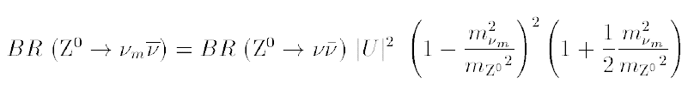
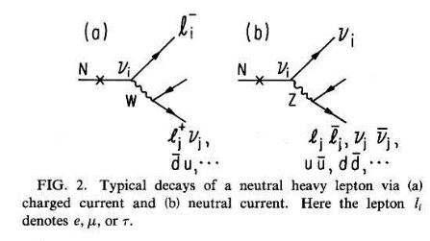

HNL
RH neutrino production in Z decays
Production:
multiply by 2 for antineutrino and add contributions of 3 neutrino species (➔ Σ_{λ=e,μ,τ} |U_{λ} |² )
Decay
Decay length:
cm
NB CC decay always leads to
≥ 2 charged tracks
Backgrounds : four fermion: e+e- → W*⁺ W*⁻ e+e- → Z*(vv) + (Z/γ)*
Long life time → detached vertex for ~<M_{Z}

Slide 49
Production of HNL in Z decays
We begin experimentally by assuming HNL production one at a time.
This is an approximation of the more favored situation where two or three almost degenerate HNLs are produced,
possibly generating a phenomenology akin to e.g. K_{L} and K_{S} or (K <->‾K) system with oscillations and other lifetime effects.
This is extraordinarily interesting ... see S. Antusch
In the simplified, one-N-at-a-time assumption the particle has one mass, one cross-section and one decay width/life time.
and four decay modes N→ eW*, μW*, τW* (CC decays) and N→ vZ* (NC decay)-- two or more charged tracks except N->vvv
0.6
0.5
0.4
0.3
0.2
0.1
0.0
Tanishq Sharma
N→ λ W*→ qq
N→ v Z* → qq
N→ λ⁺λ^{(‘)-} v
N→ λ W*→λ’v and
N→ v Z*→ λ λ)
N→ ν νν
BRANCHING
RATIO
10 20 30 40 50 60 70 80
HNL Mass (GeV/c²)

Slide 50
50 GeV HNL with a mixing angle of 10⁻¹⁰, decaying 50cm from the collision point into
N→ e- {W*→ hadrons}.

Slide 51
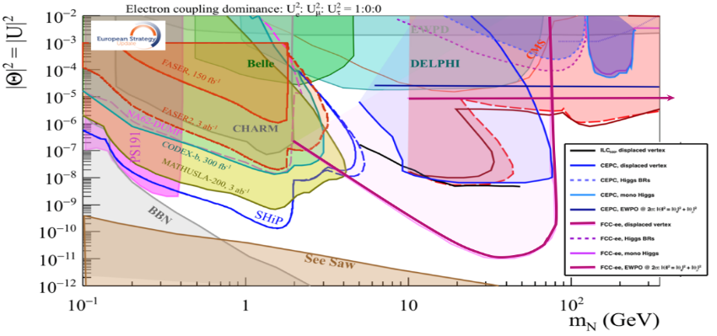
This picture from the ESPP BB is relevant to Neutrino, Dark sectors and High Energy Frontiers.
FCC-ee (Z) compared to the other machines for right-handed (sterile) neutrinos
How close can we get to the ‘see-saw limit’?
-- the purple line shows the 95% CL limit if no HNL is observed. (here for 10¹² Z),
-- the horizontal line represents the sensitivity to mixing of neutrinos to the dark sector,
using EWPOs (G_{F} vs sin²θ_{W}^{eff} and m_{Z}, m_{W}, tau decays) which extends sensitivity from 10⁻³ (now)
to 10⁻⁵ (FCC) mixing all the way to very high HNL masses (500-1000 TeV at least). arxiv:2011.04725

Slide 52
Dirac vs Majorana(I)
It has been emphasized by Matthew Mccullough that there exist ways to create models of Dirac HNL-like particles
and that the discovery of a RHv requires the observation of the Majorana nature of the particle.
In any case Fermion number violation is of the greatest interest.
At a hadron or ep collider the HNL can appear in W decay W(*)→ λ⁺N → λ’± W*⁺ . The charge of the final vs initial lepton is a test of fermion number violation which arises if HNL are Majorana particles.
At the Z the process Z→ Nv does not make it very easy.
Several methods
Forward-backward asymmetry relic of the Z parity violating couplings. Dirac keeps it, Majorana washes it out.
➔ uses N→ λqq decay and requires lepton charge reconstruction.
Polarization (also relic of Z parity violation) of HNL leads to harder lepton spectrum for Dirac than for Majorana
➔ uses N→ λqq and requires lepton momentum reconstruction (but not the charge)
NB analysis sensitive to detail W* mass distribution, esp. for small masse W* (in tau & D mass region and below)
W/Z diagram interference (Petcov) for N→ λλv Very elegant but less statistics and less easy
These methods work for the prompt analysis as well as for the LLP analysis within presumably a smaller radius.

Slide 54
Dirac vs Majorana(II)
in addition the lifetime is reduced by a factor 2 for a Majorana vs Dirac particle
C_{MD}= 1(Dirac), 2(Majorana)
At the Z the production cross-section and the decay rate depend on the same combination of mixing angles!
CAVEATs!!
Of course this can only be used if we can measure the lifetime,
and can be falsified if e.g two dirac neutrinos are produced with similar masses in the experiment.
The other methods (polarization and asymmetry) can be always used – 400 events are needed for 2σ separation

Slide 55
Drewes, ICHEP

Slide 56
Increasing the detection efficiency with large detectors

Slide 57
CLD detector
12m high
5m radius,
assume some
muon chambers outside

Slide 58
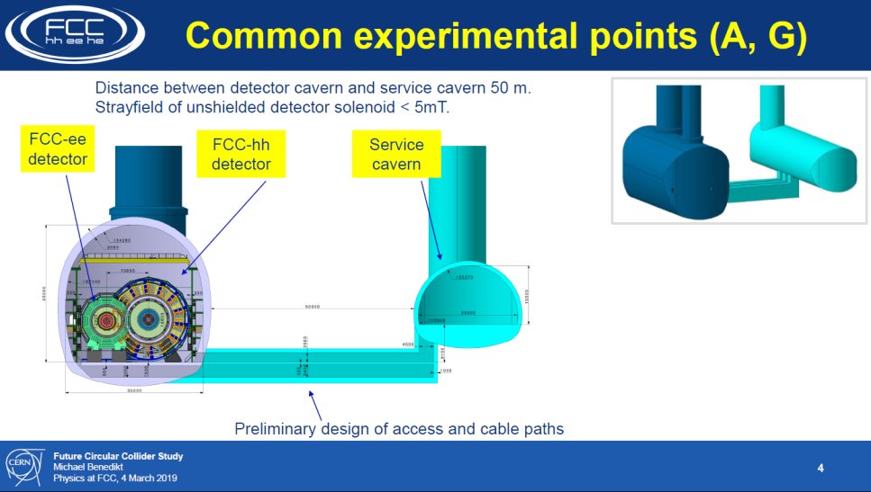
HECATE DETECTOR TO FILL THE WHOLE CAVERN
with e.g. RPC or Scintillator modules.

Slide 59
4 event lines for LLP signature (Exclusion if you do the search and find nothing!) 5 10¹² events

Slide 60
Full legend of previous plot
see Alimena et al,
arXiv:2203.05502v3

Slide 61
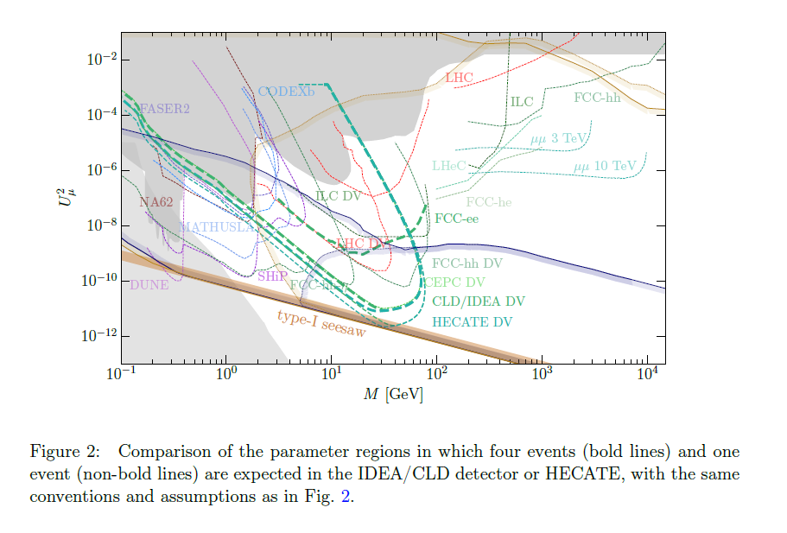

Slide 62
Electroweak precision measurements and neutrinos

Slide 64
Here the uncertainty is clearly
detector dependent. Detectors with
highly granular EM calorimeter
and efficient tracker (TPCs)
(ALEPH and DELPHI) fared better that
drift chamber + cristal/leadglass blocks.
this measurement is extremely important
and should have heavy impact on detector
design especially the EM calorimeter
(granular rather than high energy resolution.
Δsin²θ^{eff} → ±2 10⁻⁶ (abs)

Slide 65
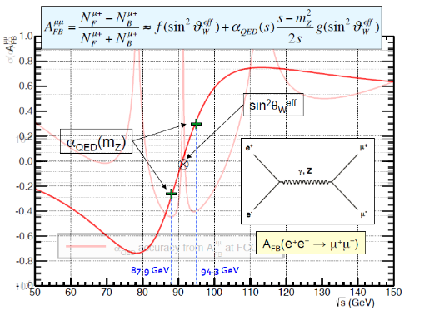
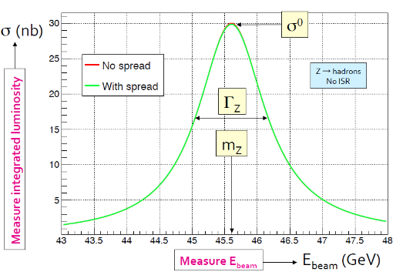
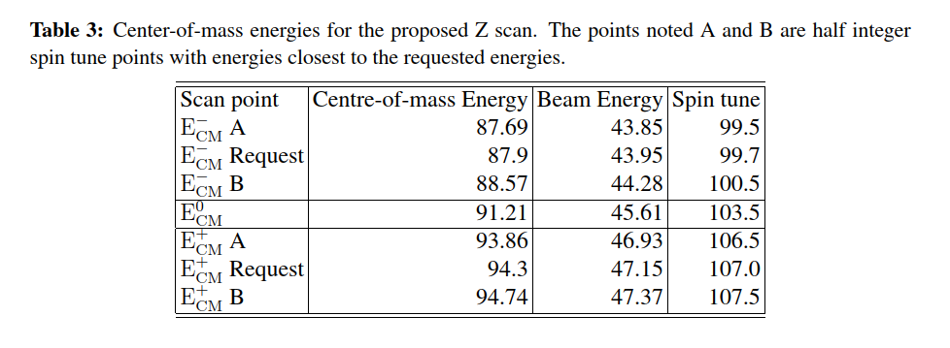
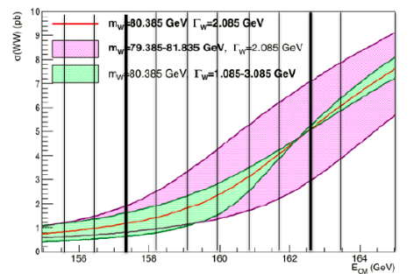
FCC scan points for m_{Z} and m_{W}
30 ab-1
90 ab-1
30 ab-1

Slide 66
Electroweak measurements:
preliminary systematics (book-keeping) have been given
NEXT: aim at reducing systematics to the level of statistics
arXiv:2106.13885
FCC Ongoing:
-- dedicated EPOL group to improve ECM calibration using resonant depolarization:
targets: -- reduction of point to point uncertainties 40→ 5 keV ➔ 4 keV Z width precision
-- reduction of uncertainty at W mass
-- understand fundamental errors between spin resonance frequency and beam energy.
-- improve running scheme accordingly.
big steps achieved already.
-- assess possibility to reduce systematics on dilepton and diphoton selections to statistical level
-- requires uncertainty on the cut on low angle acceptance at the level of 2.5 microradians (6 microns)
→ two methods proposed (complementary): detector construction and in-situ calibration
-- target reduce error on R_{lept} = Γ_{had}/Γ_{lept} relative: from (LEP 1.2 10⁻³) → CDR 5 10⁻⁵ → stat 2.10⁻⁶
reduce luminosity determination uncertainty using ee→ γγ events to 10-5 absolute
-- improve flavour tagging and uncertainties to reduce Rb= = Γ_{b}/Γ_{had} uncertainty
(LEP 0.2163±0.000600) → CDR 0.000060 → stat 0.0000003 (reduction wrt LEP by factor 2000! )
-- τ lifetime (discussing 2 10⁻⁵ on G_{τ} see M. Dam for the challenge)
-- include all leptons in determination of α_{QED} (m_{Z}) 3 10⁻⁵ → anther factor 2?

Slide 67
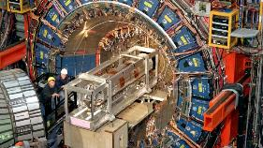
About Precision Measurements...
Recent CDF: m_{W} (MeV)= 80’433.5 ± 6.4 _{stat} ± 6.9_{syst} (10⁻⁴ precision)
-- « could hint at new physics » and surely created a buzz!
-- precision measurements as broad exploration of new physics in quantum corrections, or mixing (SUSY, Heavy neutrinos, etc..)
(-- questions because inconsistent with previous measurements)
CDF measurement is remarkable in several ways:
(after 10 years of work)
systematic errors similar to statistical precision
relies for the precise calibration on J/ψ, ϒ, Z masses
all measured in e+e- colliders...
using resonant depolarization!
3. emphasizes the need for more than one experiment
Resonant depolarization is the cornerstone of the precision programme of FCC-ee
➔ Improvement by factor 10-1000 on a long list of precision measurements.
e.g. W mass down to ±250 keV, Z mass and width ±4 keV, sin²θ_{W} ^{eff} ± 2.10⁻⁶ etc..
➔ explore new physics at 10-100 TeV scale, or 10⁻⁵ mixing with known particles.
~40 times more
precise than CDF
factor 500 more
precise than LEP

Slide 68
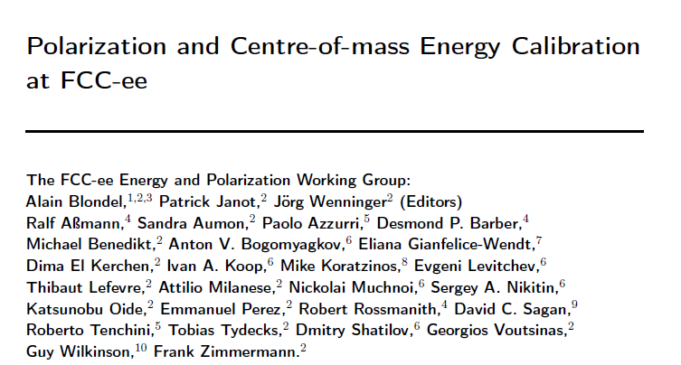
FCC-ee beam polarization and
centre-of-mass energy calibration
arXiv:1909.12245

Slide 69
Beam Polarization can provide two main ingredients to Physics Measurements
Transverse beam polarization provides beam energy calibration
by resonant depolarization
→ low level of polarization is required (~10% is sufficient)
→ at Z & W pair threshold comes naturally σ_{E} ∝ E²/√ρ
→ at Z use of asymmetric wigglers at beginning of fills
since polarization time is otherwise very long (250h→ ~1h)
→ should be used also at ee → H(126)
→ use ‘single’ non-colliding bunches and calibrate continuously
during physics fills to avoid issues encountered at LEP
→ Compton polarimeter for both e+ and e-
→ should calibrate at energies corresponding to half-integer spin tune
→ must be complemented by analysis of «average E_beam-to-E_CM» relationship
For beam energies higher than ~90 GeV can use ee → Z γ or ee → WW events
to calibrate E_{CM} at ±1-5 MeV level: m_{H} (5 MeV) and m_{top} (20 MeV) measts

Slide 70
Beam Polarization can provide two main ingredients to Physics Measurements
2. Longitudinal beam polarization provides chiral e+e- system
-- High level of polarization is required (>40% )
-- Must compare with natural e+e- polarization due to chiral couplings of electrons (15%)
or with final state polarization analysis for CC weak decays (100% polarized) (tau and top)
-- Physics case for Z peak is very well studied and motivated:
A_{LR} = A_{e} , A_{FB}^{Pol}(f) etc… (CERN Y.R. 88-06)
figure of merit is L.P² --> must not lose more than a factor ~10 in lumi.
self calibrating polarization measurement requires controlled e+ and e- polarization
at high statistics A_{FB}^{Pol} = A_{e} plays the role of A_{LR} (Tenchini)
-- enhance Higgs cross section (by up to ~30%)
top quark couplings? final state analysis does as well (Janot arXiv:1503.01325)
enhance signal, subtract/monitor backgrounds, for ee→WW , ee →H
-- requires High polarization level and often both e- and e+ polarization
➔ not interesting If loss of luminosity is too high
-- Obtaining high level of polarization in high luminosity collisions is delicate in top-up mode
DECIDED to FOCUS ON TRANSERSE POLARIZATION FOR ENERGY CALIBRATION
As far as we could check, there is no physics that can be done with longitudinal polarization
that cannot be done without, given enough luminosity

Slide 71
RESONANT DEPOLARIZATION
Once the beams are polarized,
an RF kicker at the spin precession frequencv
will provoke a spin flip and complete
depolarization
Simulation of FCC-ee by I. Kopp:
spin precession (ν is the spin tune)
δθ_{spin} = (g-2)/2 . E/m δθ_{trajectory}
= ν . δθ_{trajectory}
ν = E_{beam} / 0.4406486
= 103.5 at the Z peak

Slide 72
First set of results obtained in the FCC Design Study:
Polarization and Centre-of-mass Energy Calibration at FCC-ee, arXiv:1909.12245
stat/present
500
400
75
15 (qualitiative!)
40
4
4
2
3
m_{W}(MeV) 0.250 -- 0.300 --
Next challenges for the feasibility study:
-- Ascertain the above with integrated simulations (simulation of polarization and depolarization on real machine)
-- Match systematic errors with statistics.
most relevant targets : the point-to-point systematics, improve the calibration at WW energy
– these are effects that would lead to a deviation from relation between
-- the spin tune as measured by resonant depolarization
-- and the center-of-mass energy.
-- examples: 1. interference between depolarizing resonances and the induced depolarizing resonance
because the spin tune varies with energy.
2. effects due to collision offsets folded by opposite sign dispersion
-- designevaluate performance and cost the polarimeter at conceptual level
-- finalize implementation in the realistic machine, study operational aspects

Slide 73
Progress in FCC-ee energy calibration
From FCC week 2022 and FCC EPOL workshop:
-- Resonant depolarization measures energy every 15 minutes
at < 50 keV/beam level at Z, 100 keV/beam at W
syst will be reduced to < 100keV on m_{W}
at Z point to point uncertainties remain to be understood
Can be verified using e+e- →μ+μ- (invariant mass) to ~+-20 keV
-- Only one RF station around the ring, + the energy losses of the
two beams are strongly constrained from the direct measurement
of boost at the IPs O(5 keV level) every 8hrs shift in 2/4 experiments
-- beam-beam deflection measurement is extremely sensitive to
beam beam offset and local opposite-sign dispersion
(previously large point-to-point error):
still lots to do but O(20 keV) per measurement every 3second
➔ targeting to match or go below statistical errors
Z pole
WW threshold

Slide 74
COLLISION OFFSET
4.2 μm
2. offset by δ_{y} = 0.1σ_{y} (=3.5nm)
opposite kick by 4μrad
(Shatilov) in opposite directions for e+ and e-
movement in the BPMs by
± 2 μrad x 2.1m = ±4.2 μm
(x1000 demagnification due to optics)
with a very specific pattern of movements
4μrad
Verify colliding bunches vs
Non-colliding (pilot) bunches
Vertical beam size at the IP: ∼35 nm (at Z pole). Vertical offset of 0.1σ_{y} leads to additional orbit angles about ±2 μrad for the nominal bunch population 2.5E+11. (D. Shatilov, simulation)

Slide 75
EW Precision - Conclusions
The Electroweak programme at the Future Higgs/Electroweak/top factories is stunningly precise and effective search for
the existence of new particles with SM couplings or mixing with SM (esp neutrinos) at the level of 10⁻⁵
any new significant signal will be discovery.
Precision = discovery potential!
-- from 1 to 3 orders of magnitude improvements in experimental precision, over a large number of observables.
-- the full exploitation of these capabilities will require creativity for detector design and accelerator operations,
and a coordinated campaign of measurements (noise parameters, ancillary measaurements)
-- Matching the mind-boggling statistical precision with experimental systematics and theoretical accuracy will require
a large number of clever tricks and careful methodology
-- a great opportunity for early carrier scientists (acc. exp. and th. alike) to
-- have fun!
-- make a name for themselves and produde or contribute to original contributions.

Slide 76
NEUTRINOS -- conclusions
The impact of the neutrinos having masses is (in the simplest see-saw type I) is either or both
-- a very rare process : e.g. if light neutrino masses are ~50 meV, a HNL of 50 GeV has a mixing of 10⁻¹²
expect only very few events in an TeraZ exposure of FCC (9 10¹² Z produced)
-- or small effects: the experiments today are sensitive at the 10⁻³level. With the improved measurements at FCC the limits will be improved to 10⁻⁵ for ν_{e} ν_{μ} and, thanks to the tau lifetime measurement, ν_{τ}
Mixing angles can be somewhat larger, see S. Antuschs talk, and statistics of up to 10⁶ HNLs cannot be excluded.
Other more complicated schemes can be built to increase the chances of observation (but less ‘natural’)
-- the neutrinos are the only fermions for which the Yukawa coupling is not the mass
The Dirac mass in the case of a 50 GeV HNL is typically 1/10 of the electron mass.
This also implies that the process H→vN which proceeds by the Yukawa coupling, is very small
The possibility – albeit small – of such a discovery is an exciting motivation for the TeraZ run of FCC.

Slide 77
MANY SPARES

Slide 78
Juan Alcaraz

Slide 79
statistical precision 3 10⁻⁶ for each of l = e, μ, τ
test of universality in NC
test of quark-lepton universality
leads to determination of α_{QCD}(m_{Z}) with 10⁻⁴ precision (better?)
at LEP main systematic came from lepton acceptance
(a cosθ cut at 0.95 leads to ~10% event loss for leptons
only 1-2% for hadrons)
Event rotation technique used for hadron successfully at LEP (leptons?)
we have requested a low angle limit of 100 mrad
for the accelerator elements (final focus, solenoid compensation)
a clean design of the low angle detector fiducials
(similar to lumi monitor) probably necessary.
level of detail in lepton event generator etc...

Slide 80
see later...

Slide 81
For the width the two-gamma background
(non resonant) should be studied.
Also event shapes might be slightly
affected by the varying ISR across the
peak.
Fo the absolute cross-section luminosity
is dominant.

Slide 82
this is an easier measurement as many
experimental uncertainties vanish
Peak asymmetry measures
A_{FB}^{μμ} = ¾ A_{e} A_{μ}
where
A_{l} ≡ (g_{Ll}² - g_{Rl}²)/(g_{Ll}² + g_{Rl}²)
= 2 g_{Vl} g_{Al} / (g_{Vl}² +g_{Al}²)
and
sin²θ_{W}^{eff} ≡ ¼ (1- g_{Vl} /g_{Al} )
this is *not* 1-m_{W}²/m_{Z}² (should better not be used by experiments, just use m_{W} as relation is sensitive to new physics)
refer to analysis by P. Janot for the extraction of α_{QED}(m_{Z}²) arxiv:1512.05544
importance of QED effects on asymmetry and event generator
analysis of asymmetry for e and τ final states of great interest – can we improve precision?

Slide 83
R_{b} ≡ Γ( Z →‾bb)/Γ( Z →hadrons)
Of all HF/EW/top factory measurements this is where the largest relative improvement wrt LEP is expected.
FCC-ee -- factor 500 in statistical precision x a factor 5 in tagging efficiency (85% @ <1% background)
In addition R_{b} is sensitive to new physics via the vertex correction involving top and thus to e.g. supersymmetry
in a different way than the usual self-energy corrections (see next slide)
With 7 10¹¹ Z →‾bb events a relative statistical precision of O(1.5 10⁻⁶ ) is expected (WOW!)
There is a great synergy with the b,c,g tagging undertaken for the Higgs decays by Selvaggi et al. The Z decay
should also be used as a calibration.
The measurement is affected by gluon splitting to‾bb in hadronic events, but a lot of information should
exist in the data to eliminate uncertainties on tagging efficiency, hemisphere correlations, gluon production
and many more. How far can we go?
Also of interest R_{c}, R_{s}, etc... where strange particle ID might be more important.

Slide 84
Precision Natural SUSY at CEPC, FCC-ee, and ILC, JJ Fan, M. Rees and Liantao Wang
arXiv:1412.3107v2 figure 5 (top row)
«Higgs and EWPOs are complementary»
“ also, b→ sγ could be useful”

Slide 85
this measurement allows
-- in combination with Ae from Pτ^{FB}
to extract Ab.
-- or directly to be used as an EWPO
sensitive to similar effects as sin²θ_{W}^{eff}
– some buzz due to present difference with A_{LR}
-- sensitive to gluon emission which
dilutes the forward backward asymmetry.
-- requires charge tagging
-- jet charge was the best charge indicator
at the end of LEP
J. Alcaraz showed that, similarly to R_{b}, lots of
information can be retrieved from the data

Slide 87
W mass, width and branching ratios
-- W mass is the most sensitive quantity when compared with G_{F} m_{Z} and α_{QED}(m_{Z}) but sensitive to errors in the latter.
direct comparison with sin²θ_{W}^{eff} has no sensitivity to error in α_{QED}(m_{Z}).
Two techniques
-- total WW cross-section around threshold – Paolo Azzurri)
-- invariant mass reconstruction using constrained kinematic
fit for WW threshold or higher energies. (M. Beguin thesis)
-- possibility of measurement of width from mass reco?
-- precision of resonant depolarization at WW threshold
to be improved.
-- measurement of hadronic/leptonic branching ratio
provide
-- independent measurement of α_{QCD}(m_{W})
-- further verifications of charged current interactions
direct measurements of Vcs, Vbc and Vbu
<0.10
<0.10

Slide 88
Conclusions
The Electroweak programme at the Future Higgs/Electroweak/top factories is stunningly precise and effective search for
the existence of new particles with SM couplings. any new significant signal will be discovery.
Precision = discovery potential!
and a factor 5 in precision does matter!
-- from 1 to 3 orders of magnitude improvements in experimental precision, over a large number of observables.
-- the full exploitation of these capabilities will require creativity for detector design and accelerator operations,
and a coordinated campaign of measurements (noise parameters, ancillary measaurements)
-- Matching the mind-boggling statistical precision with experimental systematics and theoretical accuracy will require
a large number of clever tricks and careful methodology
-- a great opportunity for early carrier scientists (acc. exp. and th. alike) to
-- have fun!
-- make a name for themselves and contribute to original contributions.

Slide 89
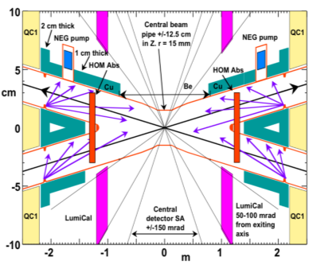
FCC-ee experimental conditions
By design of the accelerator, low background
conditions in the experiments, ~1cm radius beam pipe
High luminosity → DAQ rate 100kHz @Z, pile-up O(10⁻³)
No trigger necessary (important for LLP searches)
low angle upper limit of accelerator elements 100mrad
beam pipe radius at IP : 10mm
3. High precision E_{CM} calibration O(10-100 keV)
--@ Z (+WW unlike LEP) resonant depolarization
-- at higher energies relies on ee→ Zγ , WW
4. Moderate beamstrahlung →measurable, ~Gaussian energy spread
5. New design compatible with 4 IP for FCC-ee → improve total Luminosity (and physics/MW)
to match the multiple detector requirements

Slide 90
FCC-ee beam polarization and
centre-of-mass energy calibration
arXiv:1909.12245

Slide 91
Some references (not a complete set!):
B. Montague, Phys.Rept. 113 (1984) 1-96;
Polarization at LEP, CERN Yellow Report 88-02;
Beam Polarization in e+e-, AB, CERN-PPE-93-125 Adv.Ser.Direct.High Energy Phys. 14 (1995) 277-324;
L. Arnaudon et al., Accurate Determination of the LEP Beam Energy by resonant depolarization,
Z. Phys. C 66, 45-62 (1995).
Spin Dynamics in LEP http://dx.doi.org/10.1063/1.1384062
Precision EW Measts on the Z Phys.Rept.427:257-454,2006 arXiv:0509008v3
D.P. Barber and G. Ripken ``Handbook of Accelerator Physics and Engineering” World Scientific (2006), (2013)
D.P. Barber and G. Ripken, Radiative Polarization, Computer Algorithms and Spin Matching in Electron Storage Rings arXiv:physics/9907034
for FCC-ee:
First look at the physics case of TLEP arXiv:1308.6176, JHEP 1401 (2014) 164 DOI: 10.1007/JHEP01(2014)164
M. Koratzinos FCC-ee: Energy calibration IPAC'15 arXiv:1506.00933
E. Gianfelice-Wendt: Investigation of beam self-polarization in the FCC-ee arXiv:1705.03003
October 2017 EPOL workshop: https://indico.cern.ch/event/669194/
AB, P. Janot, J. Wenninger et al Polarization & Centre-of-mass Energy Calibration @ FCC-ee _{arXiv:1909.12245}

Slide 92
Beam Polarization can provide two main ingredients to Physics Measurements
Transverse beam polarization provides beam energy calibration
by resonant depolarization
→ low level of polarization is required (~10% is sufficient)
→ at Z & W pair threshold comes naturally σ_{E} ∝ E²/√ρ
→ at Z use of asymmetric wigglers at beginning of fills
since polarization time is otherwise very long (250h→ ~1h)
→ should be used also at ee → H(126)
→ use ‘single’ non-colliding bunches and calibrate continuously
during physics fills to avoid issues encountered at LEP
→ Compton polarimeter for both e+ and e-
→ should calibrate at energies corresponding to half-integer spin tune
→ must be complemented by analysis of «average E_beam-to-E_CM» relationship
For beam energies higher than ~90 GeV can use ee → Z γ or ee → WW events
to calibrate E_{CM} at ±1-5 MeV level: m_{H} (5 MeV) and m_{top} (20 MeV) measts

Slide 93
Beam Polarization can provide two main ingredients to Physics Measurements
2. Longitudinal beam polarization provides chiral e+e- system
-- High level of polarization is required (>40% )
-- Must compare with natural e+e- polarization due to chiral couplings of electrons (15%)
or with final state polarization analysis for CC weak decays (100% polarized) (tau and top)
-- Physics case for Z peak is very well studied and motivated:
A_{LR} = A_{e} , A_{FB}^{Pol}(f) etc… (CERN Y.R. 88-06)
figure of merit is L.P² --> must not lose more than a factor ~10 in lumi.
self calibrating polarization measurement requires controlled e+ and e- polarization
at high statistics A_{FB}^{Pol} = A_{e} plays the role of A_{LR} (Tenchini)
-- enhance Higgs cross section (by up to ~30%)
top quark couplings? final state analysis does as well (Janot arXiv:1503.01325)
enhance signal, subtract/monitor backgrounds, for ee→WW , ee →H
-- requires High polarization level and often both e- and e+ polarization
➔ not interesting If loss of luminosity is too high
-- Obtaining high level of polarization in high luminosity collisions is delicate in top-up mode
DECIDED to FOCUS ON TRANSERSE POLARIZATION FOR ENERGY CALIBRATION
As far as we could check, there is no physics that can be done with longitudinal polarization
that cannot be done without, given enough luminosity

Slide 94

Requirements from physics
Center-of-mass energy determination with precision of << ± 100 keV around the Z peak
Center-of-mass energy determination with precision of < ± 200 keV at W pair threshold
3. For the Z peak-cross-section and width, require energy spread uncertainty Δσ_{E}/σ_{E} =0.2%
NB: at 2.3 10³⁶/cm²/s/IP : full LEP statistics 10⁶ μμ 2.10⁷ qq in 6 minutes in each expt
-- use resonant depolarization as main measuring method
-- use pilot bunches to calibrate during physics data taking: 100 calibrations per day each 10⁻⁶ rel.
-- long lifetime at Z requires the use of wigglers at beginning of fills
take data at points where self polarization is expected
ν_{s} =$\frac{g−2}{2}\frac{Eb}{me}= \frac{Eb}{0.4406486(1)} ≈ N+\left(0.5±0.1\right)$E_{CM} = $\left(N+\left(0.5±0.1\right)\right)$ x 0.8812972 GeV
Given the Z and W widths of 2 GeV, this is easy to accommodate with little loss of statistics.
It might be more difficult for the Higgs 125.09+-0.2 corresponds to v_{s} = 141.94+-022

Slide 95



Simulations of self-polarization level with SITROS
orbit and emittance corrections needed
for the FCC-ee luminosity seem sufficient to
ensure useful levels of polarization
2. HOWEVER: same simulation does not
produce luminosity and polarization,
effect of simultaneous optimization
could not be simulated
E. Gianfelice
at the W
at the Z
Excellent level of polarization at the Z (even with wigglers) and sufficient at the W σ_{E} ∝ E²/ρ

Slide 96
RESONANT DEPOLARIZATION
Once the beams are polarized,
an RF kicker at the spin precession frequencv
will provoke a spin flip and complete
depolarization
Simulation of FCC-ee by I. Kopp:
spin precession (ν is the spin tune)
δθ_{spin} = (g-2)/2 . E/m δθ_{trajectory}
= ν . δθ_{trajectory}
ν = E_{beam} / 0.4406486
= 103.5 at the Z peak

Slide 97




LEP
long sweep works well at the Z. Several depolarizations needed: eliminate Qs side band and 0.5 ambiguity
Less well at the W: the Qs side bands are much more excited because of energy spread, need iterations with
smaller and smaller sweeps – work in progress. see I. Koop presentations at FCC weeks.
← Fourier analysis shows the
side band situation at W.
FCC-W
spectrometer ±1σ/s
First attempt at ‘LEP’
multiple sweep
technique →

Slide 98
scan points for m_{Z} and m_{W}

Slide 99

statistical precision at the Z
Three categories:
Absolute dominate for Z and W mass
ptp Point-to-point dominate for Γ_{Z} & A_{FB}^{μμ} (peak and off-peak)
Due to sampling – turns out to be negligible for 1meast /(15 min= 1000s) → 10⁴ measts

Slide 100

4

Slide 101
From beam energy to E_{CM}
IP1
α=30 mrad
≈ E⁺_{b} + E⁻_{b}
Δ_{SRe}
Energy gain (RF) = losses in the storage ring
Synchrotron radiation (SR)
beamstrahlung (BS)
Δ_{SRi}
E+ = E₀⁺ + 0.5Δ_{RF} -2Δ_{SRi} - Δ_{SRe} – 1.5Δ_{BS}
E⁻ = E₀⁻ - 0.5Δ_{RF} - Δ_{SRi} – 0.5Δ_{BS}
➔ E⁺ + E⁻ = E₀⁻+ E₀ (+ Δ_{SRe} - Δ_{SRi} )
Δ_{RF} = 2Δ_{SRi} + 2Δ_{SRe} + 2Δ_{BS}
at the Z (O of mag.):
Δ_{SR} = 2Δ_{SRi} + 2Δ_{SRe} =36 MeV
Δ_{SRe} - Δ_{SRi} ≈ α/2π Δ_{SR} = 0.17 MeV
Δ_{BS} = 0 up to 0.62 MeV
the average energies E₀ around the ring
are determined by the magnetic fields
➔same for colliding or non-colliding beams
-- measured by resonant depolarization
-- can be different for e⁺ and e⁻
Δ_{RF}
←E₀ at half RF
single RF system ➔ E⁺ + E⁻ constant
if e+, e- energy losses are the same
(mod higher order corrections)
cross-checks: E⁺ - E⁻ (boost of CM),
+ measured Z masses!
IP2

Slide 103

arXiv:1909.12245

Slide 104



FCC-ee Beam Polarization and Energy Calibration
3. From spin tune measurement to center-of-mass determination ν_{s} = $\frac{g−2}{2}\frac{Eb}{me }= \frac{Eb}{0.4406486(1)}$
  3.1 Synchrotron Radiation energy loss (9 MeV @Z in 4 ‘arcs’) calculable to < permil accuracy
  3.3 Beamstrahlung energy loss (0.62 MeV per beam at Z pole), compensated by RF (Shatilov)
  3.4 layout of accelerator with IPs between two arcs well separated from single RF section
3.5 E_{b}⁺ vs E_{b}⁻ asymmetries and energy spread can be measured/monitored in expt:
e+e- → μ+ μ- longitudinal momentum shift and spread (Janot)
D. Shatilov:
beam energy
spectrum
without/with
beamstrahlung
z boost
P. Janot: 5 min/exp @Z ➔ 10⁶ μ+ μ- /expt →
50 keV meast both on σ_{ECM} and E⁺ - E⁻
and beam crossing angle α (error negl.)
also monitor relative ECM (p-t-p!)

Slide 105

Hardware requirements: wigglers
Given the long polarization time at Z, wigglers will be necessary.
An agreement was reached on a set of 8 wiggler units per beam
Polarization wigglers
8 units per beam, as specified by Eliana Gianfelice
B+=0.7 T L+ = 43cm L-/L+ = B+/B- = 6
at Eb= 45.6 GeV and B+= 0.67 T
=> P=10% in 1.8H σ_{Eb} = 60 MeV E_{crit}=902 keV
placed e.g. in dispersion-free straight section H and/or F

Slide 106

First single pole magnetic concept, keeps some of the ideas of the LEP design, in particular the “floating” poles
narrower (200 mm) lateral poles
central main coils
beam
side trim coils
wider (300 mm) central pole
mass ≈ 4 tons
A. Milanese

Slide 107


Hardware requirements: polarimeters
2 Polarimeters, one for each beam
Backscattered Compton γ +e → γ + e 532 nm (2.33 eV) laser; detection of photon and electron.
Change upon flip of laser circular polarization → beam Polarization ±0.01 per second
End point of recoil electron → beam energy monitoring ± 4 MeV per second
e’
e
laser
γ
install photon-electron IP on inner ring
in points H and F (Oide)
Munchnoy

Slide 108
polarimeter-spectrometer situated 100m from end of dipole.
Using the dispersion suppressor dipole with a lever-arm of 100m from the end of the dipole, one finds
-- minimum compton scattering energy at 45.6 GeV is 17.354 GeV
-- distance from photon recoil to Emin electron is 0.628m
 | laser (eV) | beam (GeV) | mc2(MeV) | B field | R | LM | theta | L | true beam
 | 2.33 | 45.6 | 0.511 | 0.013451 | 11300 | 24.119 | 0.002134 | 100 | 45.60005
nominal kappa = 4. E_laser.Ebeam_nom/mc2 | 1.627567296
true kappa = 4. E_laser.Ebeam_true/mc2 | 1.627568924
nominal Emin | 17.35445561
true Emin | 17.35446221
position of photons | 0
nominal position of beam (m) | 0.239182573
true position of beam (m) | 0.239182334 | 2.39182E-07
nominal position of min (m) | 0.628468308
true position of min (m) | 0.628468069 | 2.39182E-07
mouvement of beam and end point
are the same:
0.24microns for δEb/Eb=10⁻⁶ (δEb=45keV)
628mm
239mm
0
± 1mm
70mm
FCC-ee plane
end point
elliptic distribution
of scattered electrons
beam spot
and BPM
recoil photon
spot
A.Blondel

Slide 109

±1mm
350mm
Munchnoi

Slide 110

Compton Polarimeter: Rates

Slide 111

Depolarization
This is not-so trivial in FCC-ee!
16700 bunches circulate
time-between-bunches = 19ns,
depolarize one-and-only-one
of them.
Kicker must have fast (<9ns) rise.
The LHC TF system works essentially on a bunch by bunch basis for 25ns.
They would provide a transverse kick of up to ~20 mrad at the Z peak with ~10 MHz bandwidth. This is 10x more than what we may need-
a priori OK !

Slide 112
From resonant depolarization to Center-of-mass energy
-- 1. from spin tune to beam energy--
The spin tune may not be en exact measurement of the average of the beam energy
along the magnetic trajectory of particles. Additional spin rotations may bias the issue.
Anton Bogomyagkov and Eliana Gianfelice have made many estimates.
synchrotron oscillations ΔE/E -2 10⁻¹⁴
Energy dependent momentum compaction ΔE/E 10⁻⁷
Solenoid compensation 2 10⁻¹¹
Horizontal betatron oscillations ΔE/E 2.5 10⁻⁷
Horizontal correctors*) ΔE/E 2.5 10⁻⁷
Vertical betatron oscillations **) ΔE/E 2.5 10⁻⁷
Uncertainty in chromaticity correction O(10⁻⁶ ) ΔE/E 5 10⁻⁸
invariant mass shift due to beam potential 4 10⁻¹⁰
*) 2.5 10⁻⁶ if horizontal orbit change by >0.8mm between calibration is unnoticed
or if quadrupole stability worse than 5 microns over that time. consider that 0.2 mm orbit will be noticed
**) 2.5 10⁻⁶ for vertical excursion of 1mm. Consider orbit can be corrected better than 0.3 mm.

Slide 113








From resonant depolarization to Center-of-mass energy
2. from beam energy to E_{CM}
opposite sign dispersion
$$E_{e^{−}}$$
Experience from LEP – Vernier scans
No effect. ${ECM=(E}_{e^{+}}+E_{e^{−}})$
NB energy spread is reduced.
Van Der Meer today
Relative position of beams measured to 80 nanometers from one scan
$$E_{e^{+}}$$
$$E_{e^{−}}$$
ECM lower than ${(E}_{e^{+}}+E_{e^{−}})$
$$E_{e^{+}}$$

Slide 114


For FCC-ee at the Z we have in vertical direction:
Parasitic dispersion of e+ and e- beams at IP 10um
the difference is $∆D_{y}^{∗}=14μm$.
Sigma_y is 28nm
Sigma_E is 0.132%*45000MeV=60MeV
Delta_ECM is therefore 1.4MeV for a 1nm offset
Note that we cannot perform Vernier scans like at LEP, we can only displace the two beams by ~10%sigma_y
Assume each Vernier scan is accurate to 1% sigma_y,
we get a precision of 400 keV.
the process should be simulated
we need 100 beams scans to get an E_{CM} accuracy of 40keV – suggestion: vernier scan every hour or more.
It is likely that Vernier scans will be performed regularly at least once per hour or more. (→100 per week) we end up with an uncertainty of ~10keV over the whole running period.
The dispersion must be measured as well; this can be done by using the vernier scans with offset RF frequency
critical effect is in the vertical plane, but horizontal plane should be investigated as well

Slide 115

with the improved systematic error evaluation
the point-to-point uncertainty estimate is O(10 keV) (M.K.) It can be controlled in two ways
1. compare the momentum as measured with the polarimter spectrometer between different
energies (monitored constantly at each energy)
➔ Magnet must be very precisely monitored (<10-6) and dedicated monitoring of the main beam after the collision and magnet should be discussed.
this requires dedicated design of polarimeter
2. use the e+e- → μ+μ- events in the detectors to measure ECM for each of the energies.
➔ monitor experimental magnet to (<10-6) precision + QED issues etc..

Slide 116
Conclusions
We had a first look at the determination of centre of mass energy and energy spread in FCC-ee
Results are promising of extraordinary, historical measurements.
This must be improved and secured further towards the TDR
EPOL indico thread

Slide 118
C. Paus
G. Wilson
Physics groups define benchmark measurements
to be picked up by case studies ...
leading to performance evaluation and detector requirements

Slide 119

FCC-ee Detectors
Detectors can be done and work for the FCC-ee, but physics optimization remains to be done.
Two integration, performance and cost estimates:
-- Linear Collider Detector group at CERN has undertaken the adaption of
CLIC-SID detector for FCC-ee
-- IDEA, detector specifically designed for FCC-ee (and CEPC)
MAPS
SiD at ILC, CLD at FCC-ee IDEA at FCC-ee & CEPC
Many challenges to come, mainly because of the Z run.

Slide 120
New from the FCC ‘Liverpool’ physics workshop
implementation of Noble Liquid Calorimeter in FCCSW
→ intention to develop an entire detector concept around this key element.

Slide 122
SPARES

Slide 123
Our marching orders from ESPP 2020:
“Europe, together with its international partners, should investigate the technical and financial feasibility of a future hadron collider at CERN with a centre-of-mass energy of at least 100 TeV, and with an electron-positron Higgs and electroweak factory as a possible first stage. Such a feasibility study of the colliders and related infrastructure should be established as a global endeavour and be completed on the timescale of the next Strategy update.”
Feasibility of the colliders (ee and hh) and related infrastructure.
→ FCC is the highest priority after HL-LHC for Europe and its international partners (Plan A)

Slide 124
Physics at FCC-ee
HIGGS FACTORY
Higgs provides a very good reason why we need e+e- collider
2. ELECTROWEAK PRECISION ( 10⁻³ today → 10⁻⁵)
Z + WW + top required!
Test of the completeness of the SM
Are there further particles with SM couplings?
3. Z FACTORY
(5 10¹² Z i.e. 1.5 10¹¹ ee, μμ, ττ ; ~0.7 10¹² uu,dd,ss,cc,bb ; 10¹² νν)
High statistics for Heavy Flavours, QCD
Search for Feebly Coupled Particles
The place for ‘direct discovery’
+ comments on the synergy and complementarity of FCC-ee hh and eh

Slide 125
Status of FCC
-- June 2021 The FCC Feasibility Study (2021-2025) organization was proposed to CERN council, approved unanimously
-- Council documents :
-- Financial study: “ The focus will be on the tunnel and the first-stage collider (FCC-ee)”
-- Design of FCC-ee and FCC-hh, and their injectors, key technologies, technical infrastructure
-- MDI and Ecm calibration for FCC-ee
-- The physics case and detector concepts will be consolidated for both colliders (FCC-ee and FCC-hh).
-- intermediate review mid 2023, delivery of Feasibility Study Report (FSR) end 2025, (first collisions >2040)
-- Stress the importance of communication towards
scientific community, governments and funding agencies, industries and general public
-- work has started on placement in Geneva area (France and Switzerland)
→ reduce number of surface points to 8
→ layout consistent with later choice of 2 or 4IP for the e+e- collider
-- in parallel, high field magnet R&D for FCC-hh will be carried out with high priority
These events bring both FCC-ee and FCC-hh one step closer to reality
MTP: 100MCHF/5yrs
- Organisational structure of the FCC feasibility study
http://cds.cern.ch/record/2774006/files/English.pdf
- Main deliverables and timeline of the FCC feasibility study
http://cds.cern.ch/record/2774007/files/English.pdf
+120MCHF/6yrs

Slide 126
More on TeraZ
The Flavour Factory
Progress in flavour physics wrt SuperKEKb/BELLEII requires > 10¹¹ b pair events,
FCC-ee(Z): will provide ~10¹² b pairs. “Want at least 5 10¹² Z…”
-- precision of CKM matrix elements
-- Push forward searches for FCNC, CP violation and mixing
-- Study rare penguin EW transitions such as b ➝s 𝜏+ 𝜏− , σπεχτροσχοπψ (προδυχε β−βαρψονσ, Β_{σ} …)
-- Test lepton universality with 10¹¹ 𝜏 decays (with 𝜏 lifetime, mass, BRs) at 10⁻⁵ level, LFV to 10⁻¹⁰
-- all very important to constrain / (provide hints of) new BSM physics.
need special detectors (PID); a story to be written!
The 3.5 × 10¹² hadronic Z decay also provide precious input for QCD studies
High-precision measurement of αs(mZ) with Rℓ in Z and W decay, jet rates, 𝜏 decays, etc. : 10 ⁻⁻ ³ ➝10 ⁻⁻ ⁴
huge √s lever-arm between 30 GeV and 365 GeV, fragmentation, baryon production ….
Testing running of αs to excellent precision with hadron production from low energy (γ*/Z* +γ )
to 365 GeV
And... H→gg is a pure gluon factory (100’000 events)

Slide 127





Centre of mass Energy Calibration: the cornerstone of the precision programme
Large ring→transverse polarization of e± up to E_{beam} > 80 GeV σ_{E} ∝ E²/√ρ
Resonant depolarization provides high precision E_{beam} ν_{s} =$\frac{g−2}{2}\frac{Eb}{me}= \frac{Eb}{0.4406486(1)}$
Unique to circular machines (ee and μμ)
Improve over LEP by using pilot bunches + e- and e+ polarimeter
Relationship between ν_{s} and E_{CM}
➔ CM boost, σ_{ECM}, α_{coll} determined from 10⁶ μμ /5min
➔ Beamstahlung monitor under study etc...
First round of studies (arxiv 1909.12245)
m_{Z}, Γ_{Z} , sin²θ_{W}^{eff} , α_{QED}(m_{Z}), m_{W}
next target: bring syst. closer to stat. errors.
E. Gianfelice
LEP
FCC-ee simulation of
resonant depolarization
Alain Blondel Physics at the FCCs
127
At our luminosity level, longitudinal polarization brings
nothing that cannot be done otherwise.

Slide 128


Higgs Physics
e+e- : Z – tagging by missing mass
→ must do physics with ratios
THE LHC is a Higgs Factory…BUT
e⁻
H
total rate ∝ g_{HZZ}²
ZZZ final state ∝ g_{HZZ}⁴/ Γ_{H}
measure total width Γ_{H}
g_{HZZ} to ±0.2%
empty recoil = invisible width
‘funny recoil’ = exotic Higgs decay
σ_{i→f} ^{observed} ∝ σ_{prod} (g_{Hi} )²(g_{Hf})²
Γ_{H}
Z*
?
e⁺
Z

Slide 129


Circular vs linear complementarity
plots from Briefing Book
Luminosity
Luminosity/Power → Energy efficiency
cross-over ~350 GeV
Luminosity vs Energy circular below 365GeV linear above 365 GeV
Efficiency : 9 (5) GJ/Higgs at FCC-ee with 2(4)IP 50GJ/Higgs for ILC250 (first 15 years)
Beam polarization: circular: transverse → ppm beam energy calibration
linear: longitudinal : e- ±80% easy, (e+ ±30% difficult) → additional d.o.f
Monochromatization for e+e- → H (125 GeV)
Long term energy upgrade circular: pp, AA, e-h linear: High energy lepton collisions
Interaction points circular: 2-4 linear: 1 IP (at a time)
Run limited in time by arrival of hadron collider Run is open ended

Slide 130
The Standard Model is a very consistent and complete theory.
It explains all known collider phenomena and almost all particle physics (except ν’s)
– this was beautifully verified at LEP, SLC, Tevatron and the LHC.
-- the EWPO radiative corrections predicted top and Higgs masses
assuming SM and nothing else
we can even extrapolate the Standard Model all the way to the the Plank scale :
FCC 2048

Slide 131
Is it the end?
Is it the end?

Slide 132

Higgs Production
LEP
10⁶ e+e- → ZH events with 5 ab-1
● Target : few per-mil precision, statistics-limited.
● Complemented with 200k events at √s = 350 – 365 GeV
Of which 30% in the WW fusion channel (useful for the Γ_{H} precision)

Slide 133

table from ESPP briefing book

Slide 134


High energy Higgs factories: ILC500, CLIC3000, FCC-hh.
FCC-ee + FCC-hh is very competitive
}
ee
}
hh
±3(stat)±~1.4(syst)
ee
hh
ee
FCC-hh > 10¹⁰ H produced, +
FCC-ee measurement of g_{HZZ}
g_{HHH} , g_{Hγγ} , g_{HZγ} , g_{Hμμ} , BR_{inv}
(*)see M. Selvaggi, 3d FCC physics workshop,
9% precision in 3 years of FCC-hh running, 2004.03505v1

Slide 135
FCC-ee at the intensity frontier
TeraZ offers four additional pillars to the FCC-ee physics programme
Flavour physics programme
Enormous statistics 10¹² bb, cc
Clean environment, favourable kinematics (boost)
Small beam pipe radius (vertexing)
Flavour EWPOs (R_{b}, A_{FB}^{b,c}) : large improvements wrt LEP
CKM matrix, CP violation in neutral B mesons
Flavour anomalies in, e.g., b ➝ sττ
QCD programme
Enormous statistics with Z ➝𝓁𝓁, qq(g)
Complemented by 100,000 H ➝ gg
α_{S}(m_{Z}) with per-mil accuracy
Quark and gluon fragmentation studies
Clean non-perturbative QCD studies
Often statistics-limited
5. 10¹² Z is a minimum
Tau physics programme
Enormous statistics: 1.7 10¹¹ ττ events
Clean environment, boost, vertexing
Much improved measurement of mass, lifetime, BR’s
τ-based EWPOs (R_{τ}, A_{FB}^{pol}, P_{τ})
Lepton universality violation tests
PMNS matrix unitarity
Light-heavy neutrino mixing
Rare/BSM processes, e.g. Feebly Coupled Particles
Intensity frontier offers the opportunity to directly
observe new feebly interacting particles below m_{Z}
Signature: long lifetimes (LLP’s)
Other ultra-rare Z (and W) decays
Axion-like particles
Dark photons
Heavy Neutral Leptons

Slide 136
FCC-ee at the intensity frontier
… which in turn provide specific detector requirements
Flavour physics programme
Formidable vertexing ability; b, c, s tagging
Superb electromagnetic energy resolution
Hadron identification covering the momentum
range expected at the Z resonance
QCD + EW programme
Particle-Flow reconstruction
Lepton and jet angular and energy resolution ; Lepton ID
More case studies will lead to
more detector requirements
Tau physics programme
Momentum resolution
  Mass measurement, LFV search
Precise knowledge of vertex detector dimensions
  Lifetime measurement
Tracker and ECAL granularity and e/μ/π separation
  BR measurements, EWPOs, spectral functions
Rare/BSM processes, e.g. Feebly Coupled Particles
Sensitivity to far-detached vertices (mm ➝ m)
  Tracking: more layers, continuous tracking
  Calorimetry: granularity, tracking capability
Larger decay lengths ⇒ extended detector volume
Full acceptance ⇒ Detector hermeticity
If all these constraints are met, Higgs and top programme probably OK (tbc)

