Slide 1
Robotisation of clean room assembly
Julien Drant (CEA/IRFU)
On behalf of the KEK and CEA robotics collaboration
FJPPN-A_RD_27
The 14th Joint Workshop of FKPPN and TYL/FJPPN, 2025 May 13th-16th at Subatech, Nantes, France

Slide 2
Outline
Motivation
Project overview
KEK and CEA teams activity during FY2024
KEK and CEA teams activity foreseen for FY2025
Exchange between CEA and KEK teams
Summary

Slide 3
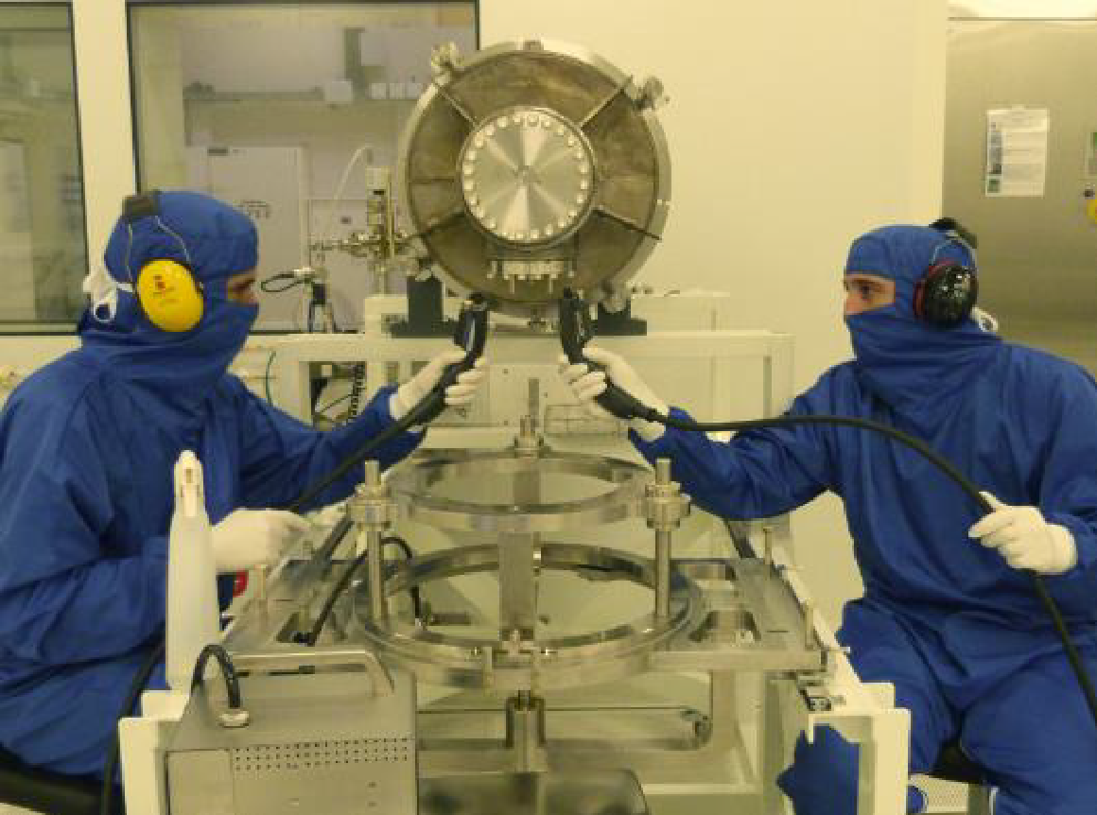
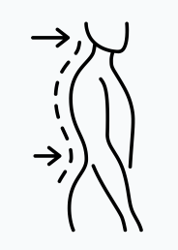
Why using Cobot ? Let’s get starting
Cavity string assembly in the clean room is a tedious work that has noisy and painful steps such as cleaning the taped holes of a part.
It is recognized that humans are the biggest source of particulate contamination during assembly operations on sensitive components in cleanrooms.
A COllaborative roBOT (COBOT) can work anytime with or without any operators especially work overnight, reducing painful work and assembly duration by some hours

Slide 4
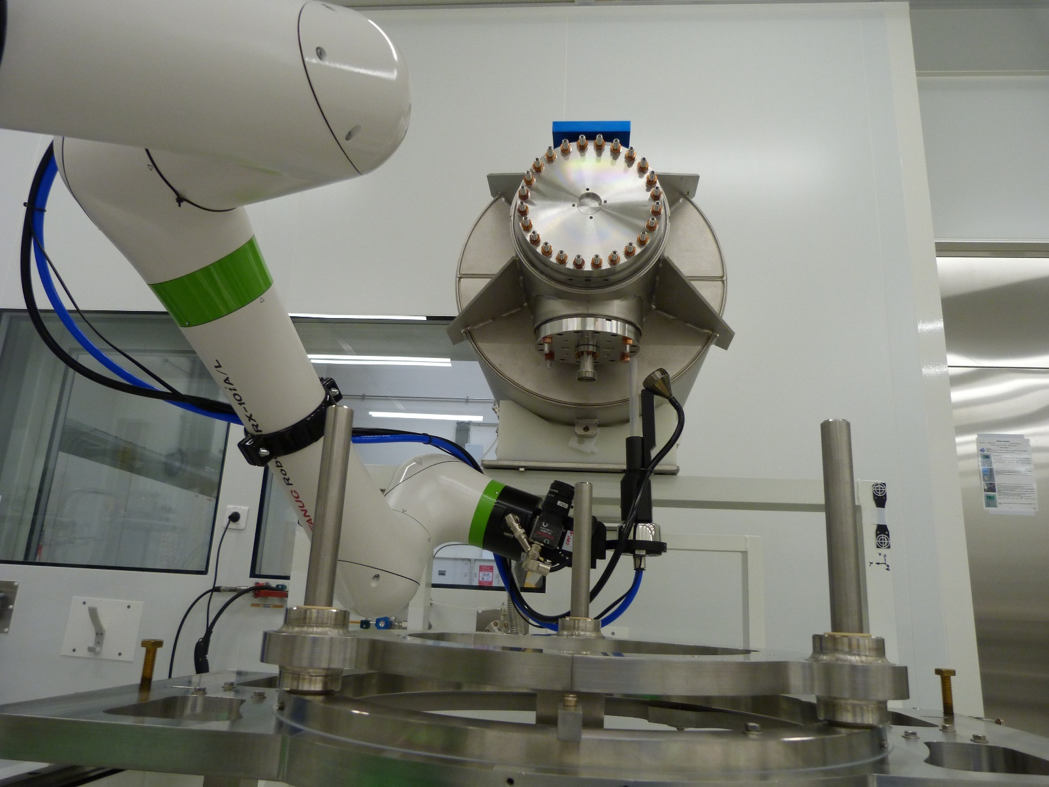
Why using Cobot ? Let’s get starting
The use of cobot is also motivated by the fact that cavity string component are well defined, immobile and the assembly phase remains quite identical during the production.
The repeatability is an issue for operators, whereas it is an important advantage and objective for a cobot
The quality of cleanroom operations could be improved by limiting the inherent variability of human operators

Slide 5
Joint Project Overview
Members:
 | CEA-IRFU | KEK
PIs | Stephane Berry | Tomohiro Yamada
Members | Julien Drant | Hayato Ito
 | Christophe Servouin | Takeshi Dohmae
 | Ambre Gonzalez-Moreau | Yasuchika Yamamoto
 | Enrico Cenni | Rishabh Bajpai
Common objective: To reduce human intervention in the clean room as much as possible during the critical phases when the RF surface is open.
Envision tasks for the cobot: Cleaning of components environment (flanges, fasteners, …). Assembly of flanges, power couplers, inter-cavity bellows, etc…

Slide 6
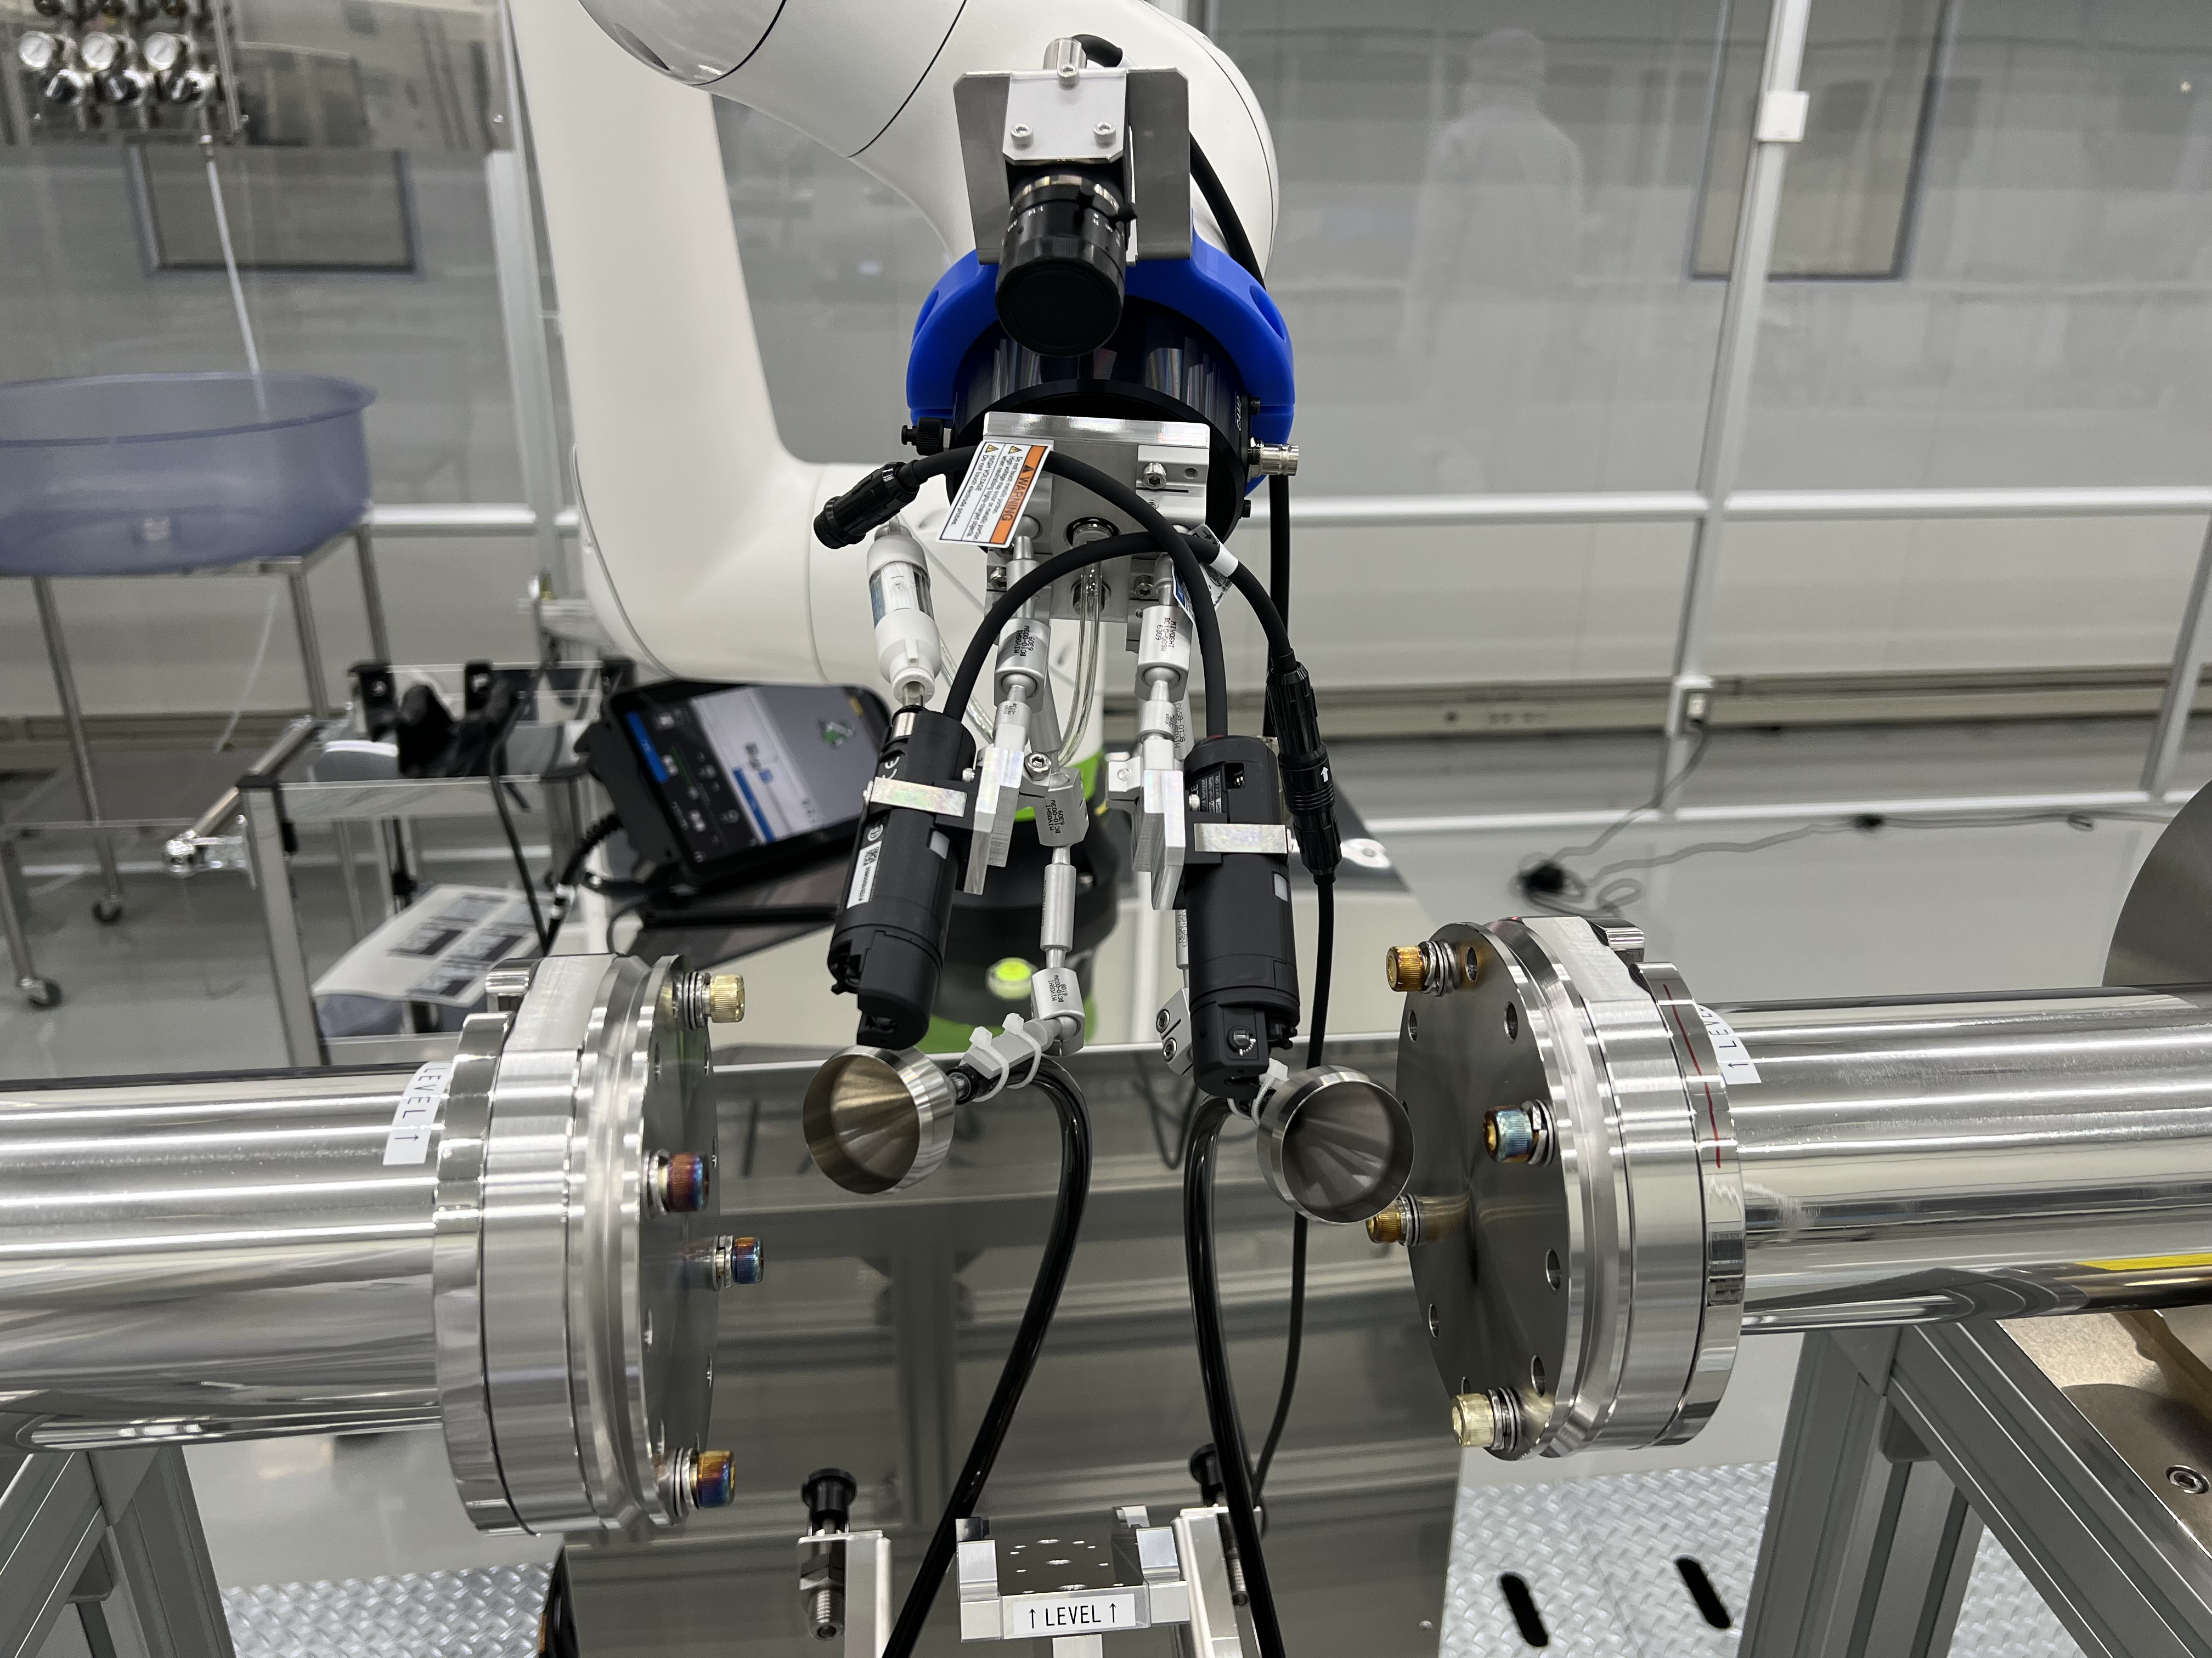
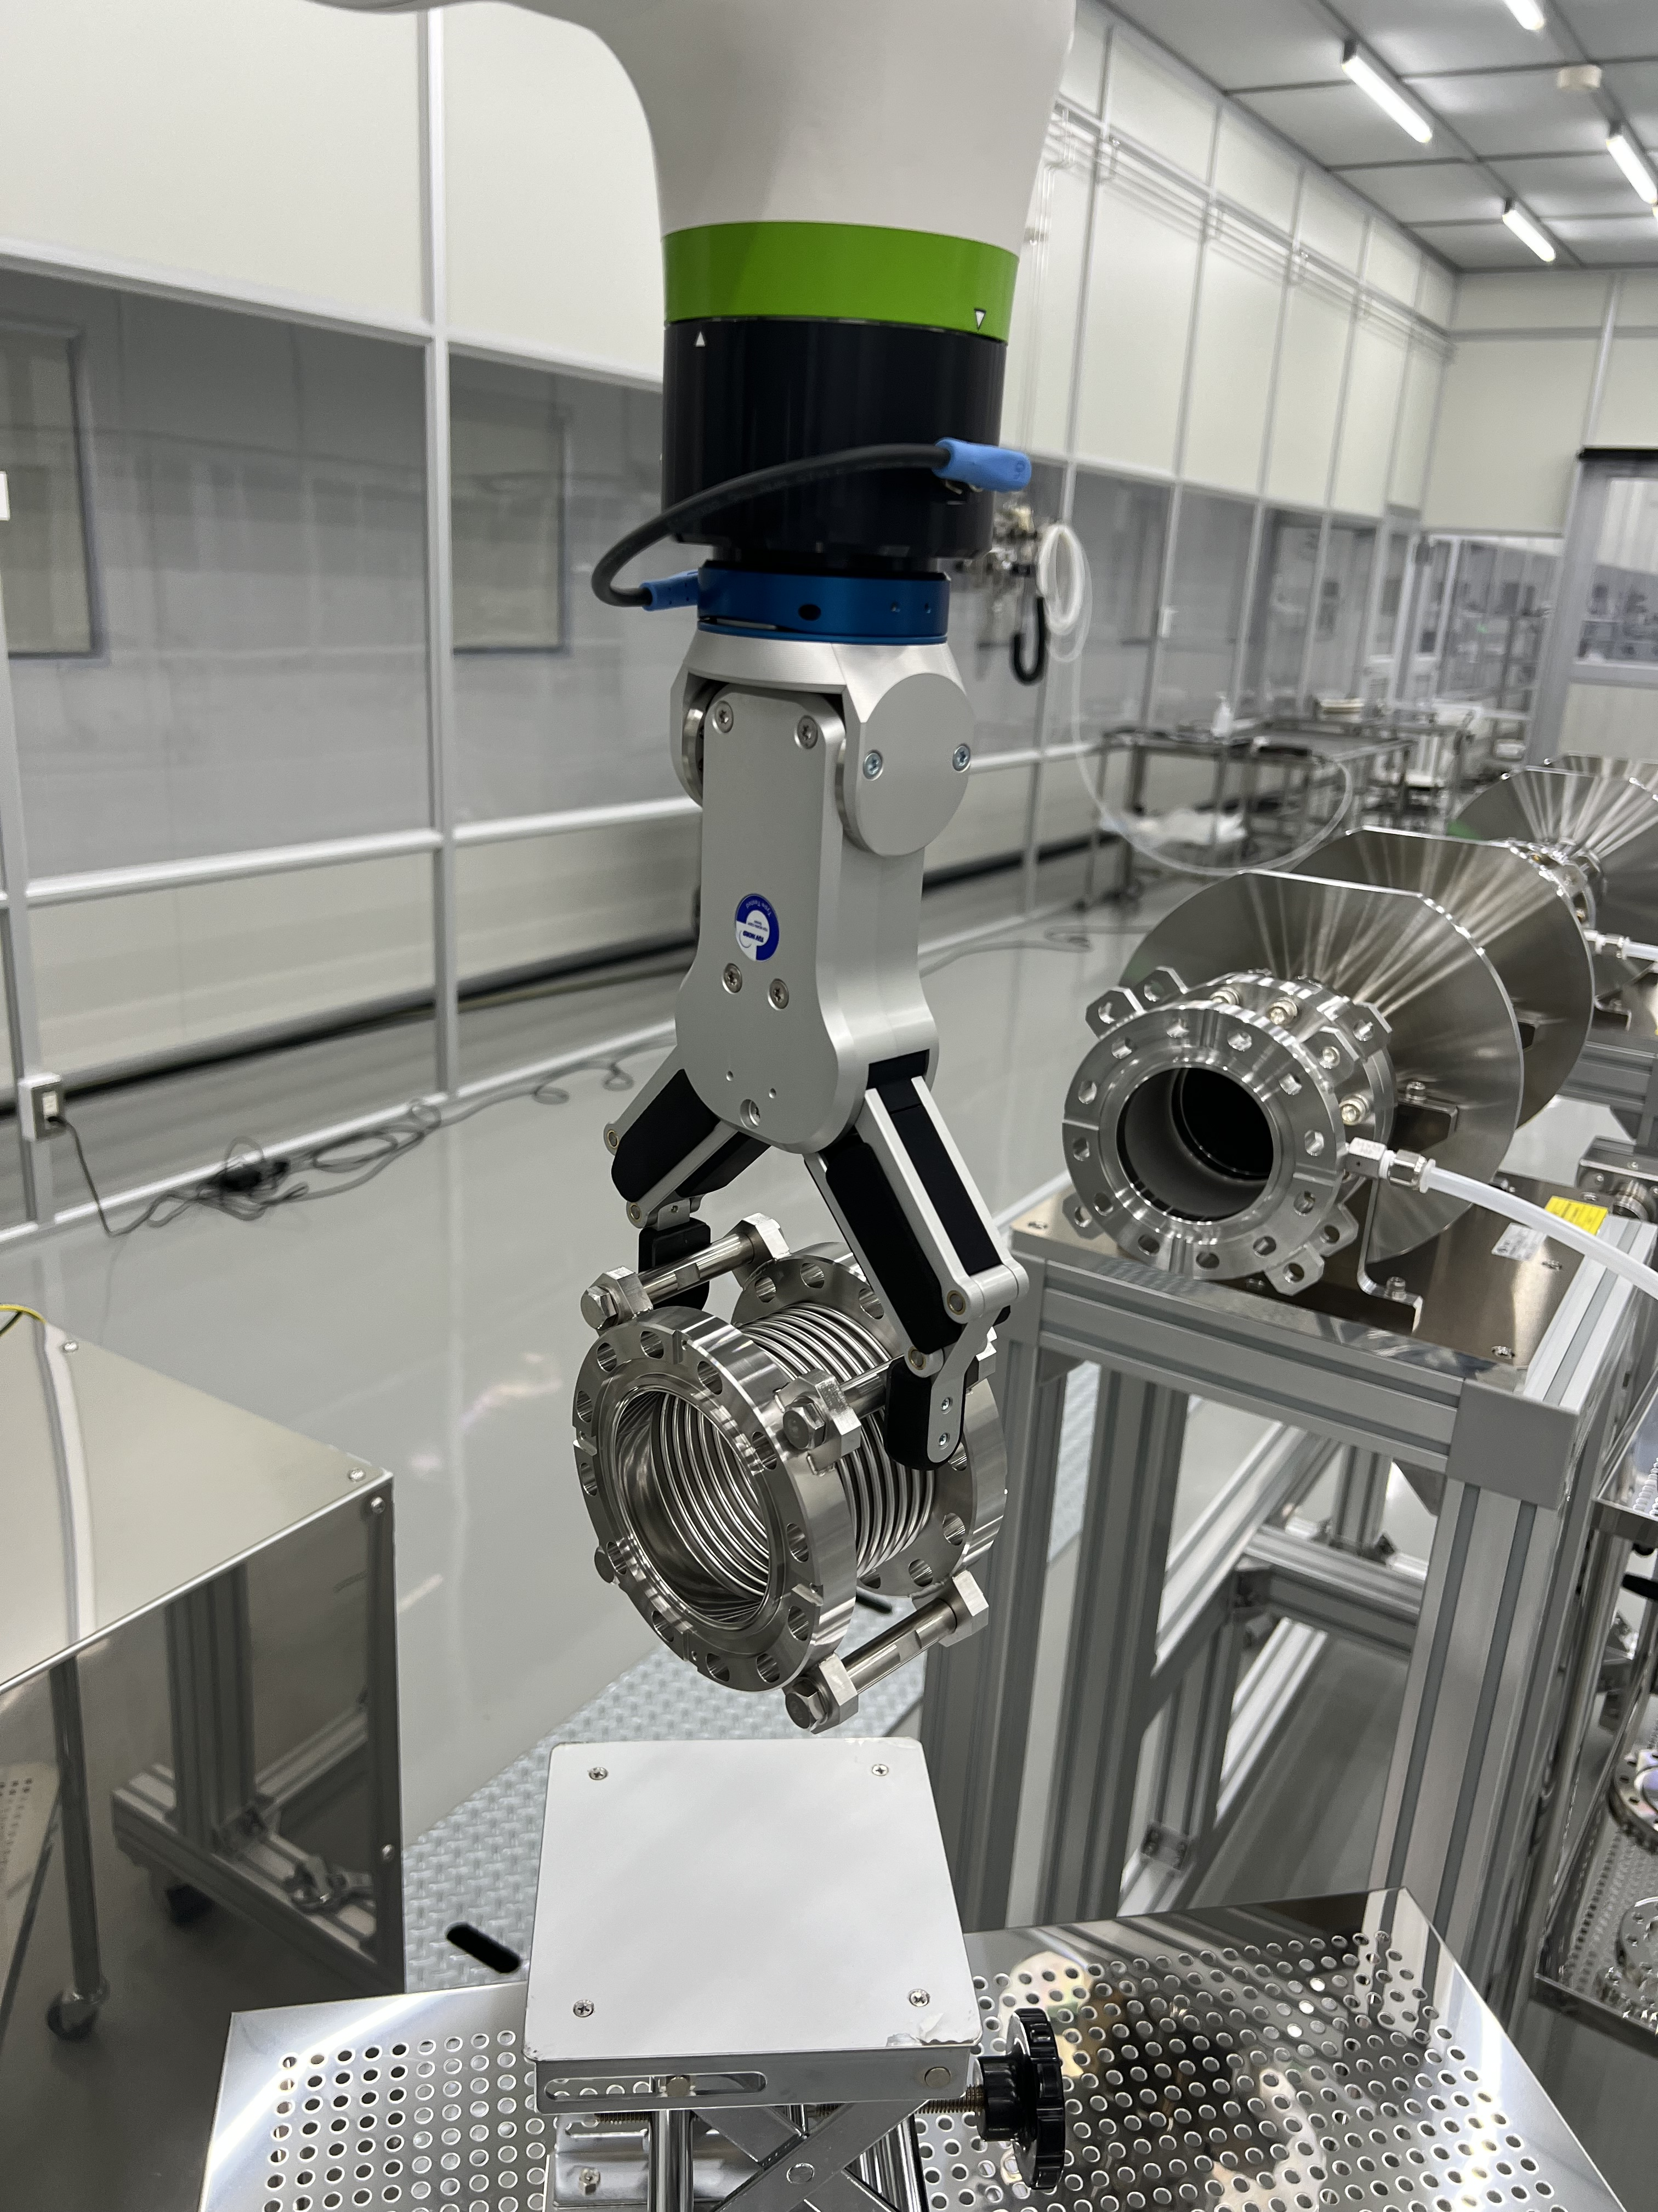
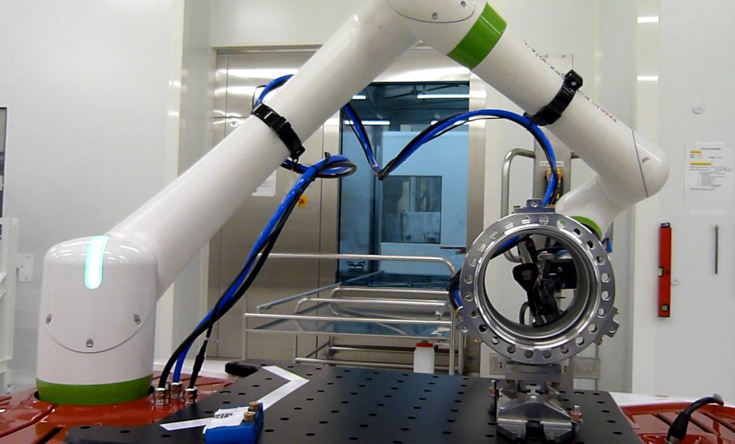
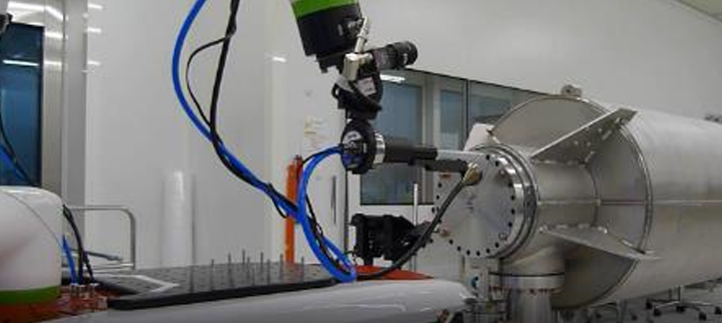
Overall research plan
Main interests for each institute
CEA-IRFU
A lot of experiences for various cavities for E-XFEL, ESS and PIP-II projects. Strong interests on 1.3 GHz cavity assembly by the cobot.
KEK
Rapid and effective R&D of cobot use for MEXT* 5 years project: Fabrication of one 1.3 GHz ILC-type cryomodule by JFY2027.
Development of cobotization at CEA since 2017 for cavity string assembly
Use on ESS project cavity string assembly for some cleaning phases
Development of assembly steps to complete the role of cobot
Development of cobotization at KEK since 2022
Focus on cavity string assembly for cleaning and assembly phases
*MEXT: Ministry of Education, Culture, Sports, Science and Technology

Slide 7
Use of cobot for cavity string assembly
Our global objective of the use of cobot in cleanroom is the assembly of cavity strings.
This objective can be detailed in 2 sub-objectives :
These objectives require several steps of modeling and programming.
Cleaning of components
Assembly of components
Paths programming
Vision-based localization
Paths adaptation
Cobot actions (Cleaning/handling/assembly...)

Slide 8
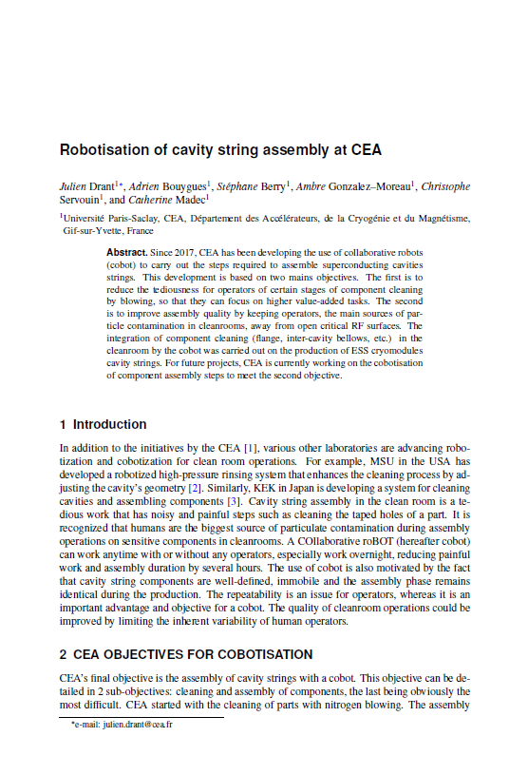
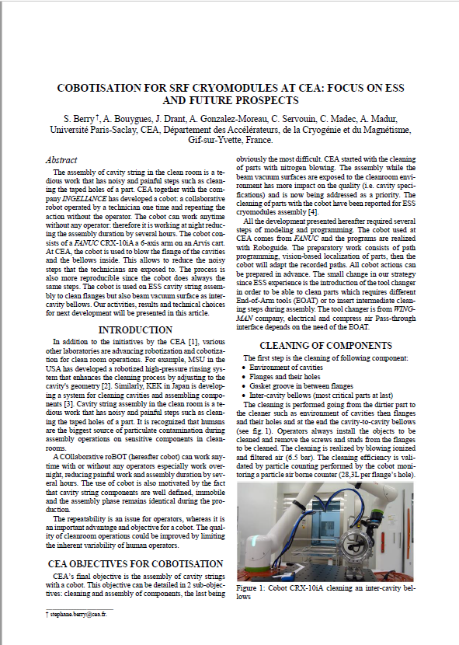
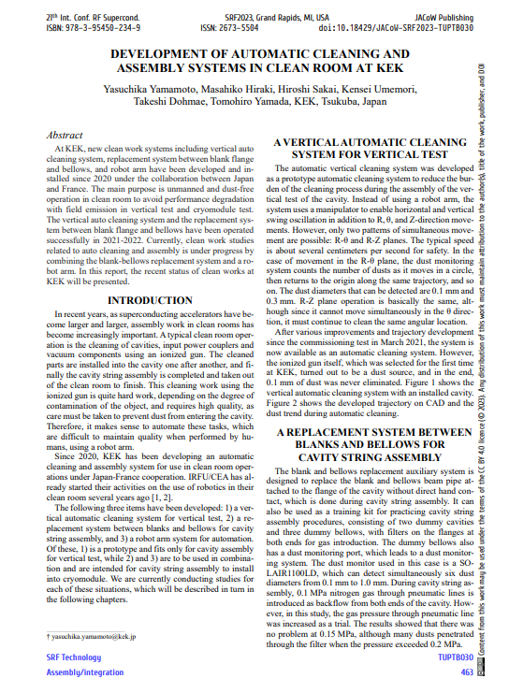
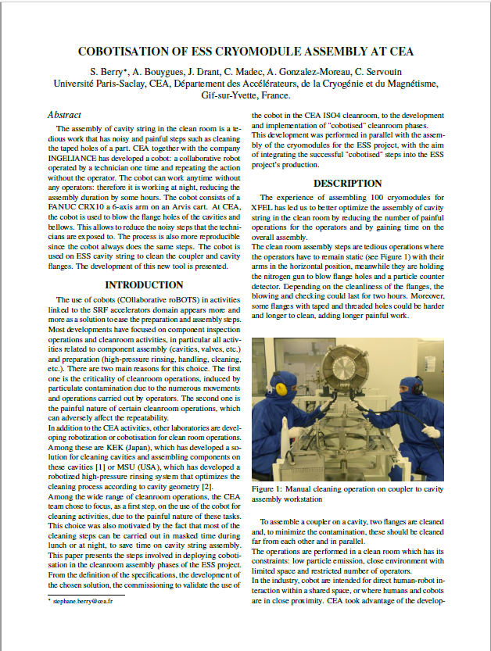
Overall research plan
Many recent contributions from both laboratories with proceedings and conference talks
Y.Yamamoto et al., “Development of automatic cleaning and assembly systems in clean room at KEK”, SRF2023, Grand Rapids, MI, USA
S.Berry et al., “Cobotisation of ESS Cryomodule Assembly at CEA”, SRF2023, Grand Rapids, MI, USA
S.Berry et al., “COBOTISATION FOR SRF CRYOMODULES AT CEA: FOCUS ON ESS AND FUTURE PROSPECTS”, LINAC2024 proceedings, DOI: 10.18429/JACoW-LINAC2024-THPB011
J.Drant et al., “Robotisation of cavity string assembly at CEA”, LCWS 2024 Proceedings https://doi.org/10.1051/epjconf/202431502010
*MEXT: Ministry of Education, Culture, Sports, Science and Technology

Slide 9
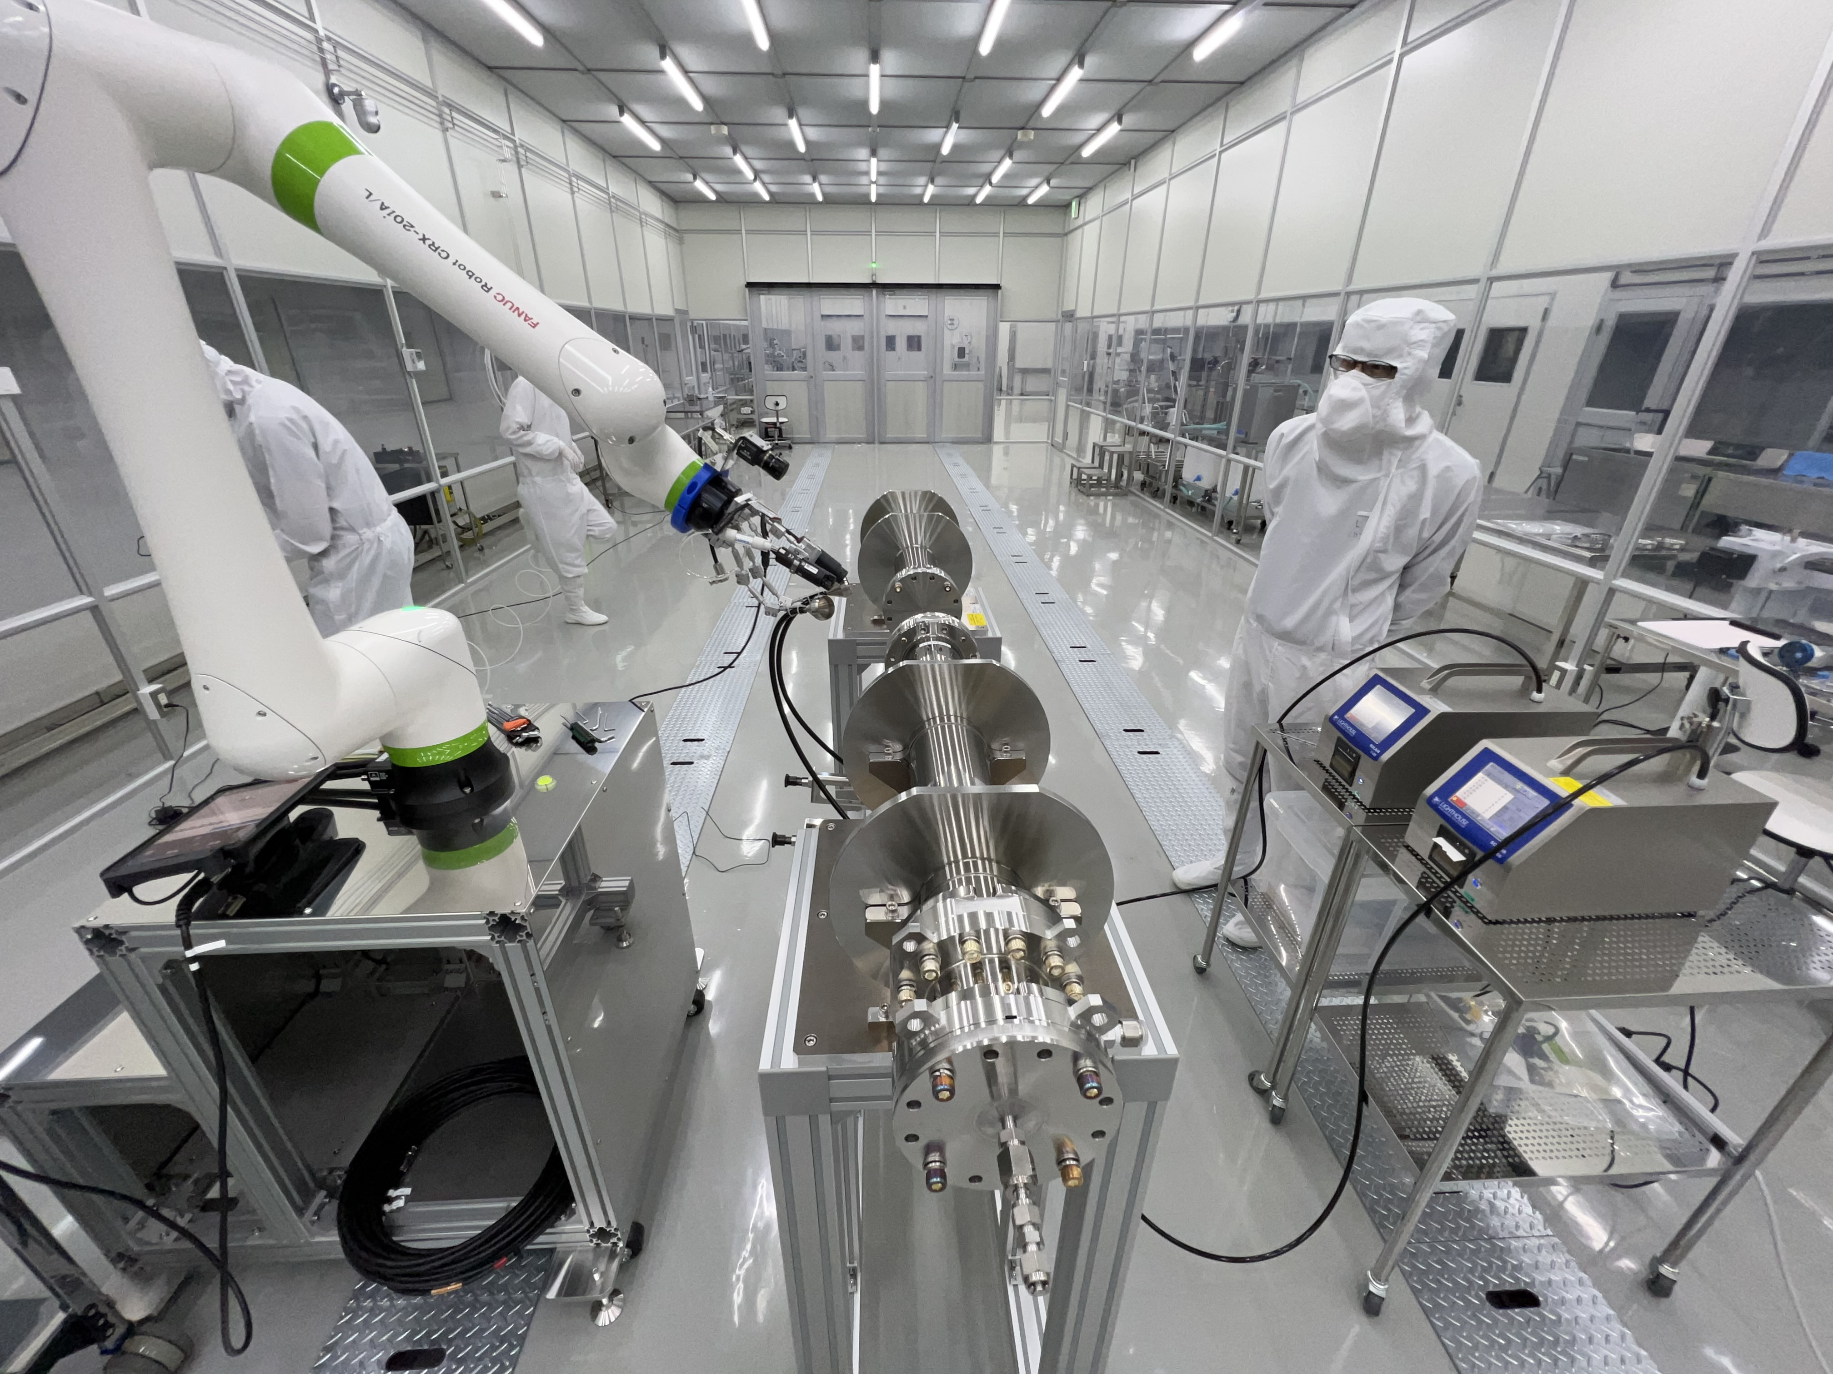
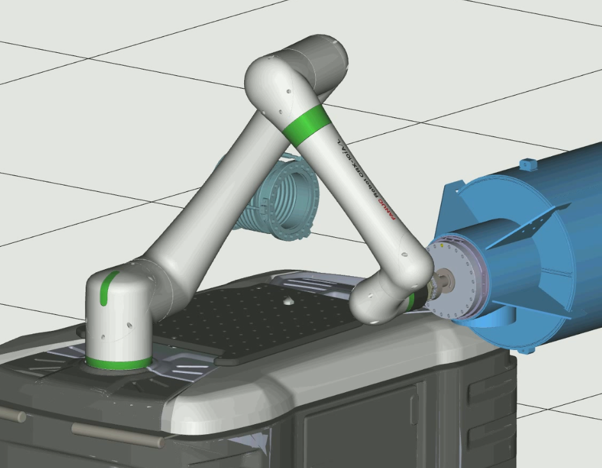
KEK activities in JFY2024
Development of use of cobot during 3 phases :
Cavity performance test (vertical test),
Helium tank welding on cavity
Cavity string assembly
Preparation of future development
Fabrication of a mock-up RF coupler
Purchase of ROBOGUIDE software

Slide 10
KEK activities in JFY2024
Visit of T.Yamada from KEK at CEA in February, 2025
Presentation of CEA cobot infrastructure (New cobot, Roboguide sotfware, ...)
Short tutorial from CEA staffs on cobot paths programming
Demonstration of several actions performed by the cobot
Cavity flanges removal and installation
Paths correction by using vision
Handling of power coupler and antenna cleaning
Use of safety zones
A lot of exchanges between T. Yamada and the CEA cobotic teams

Slide 11
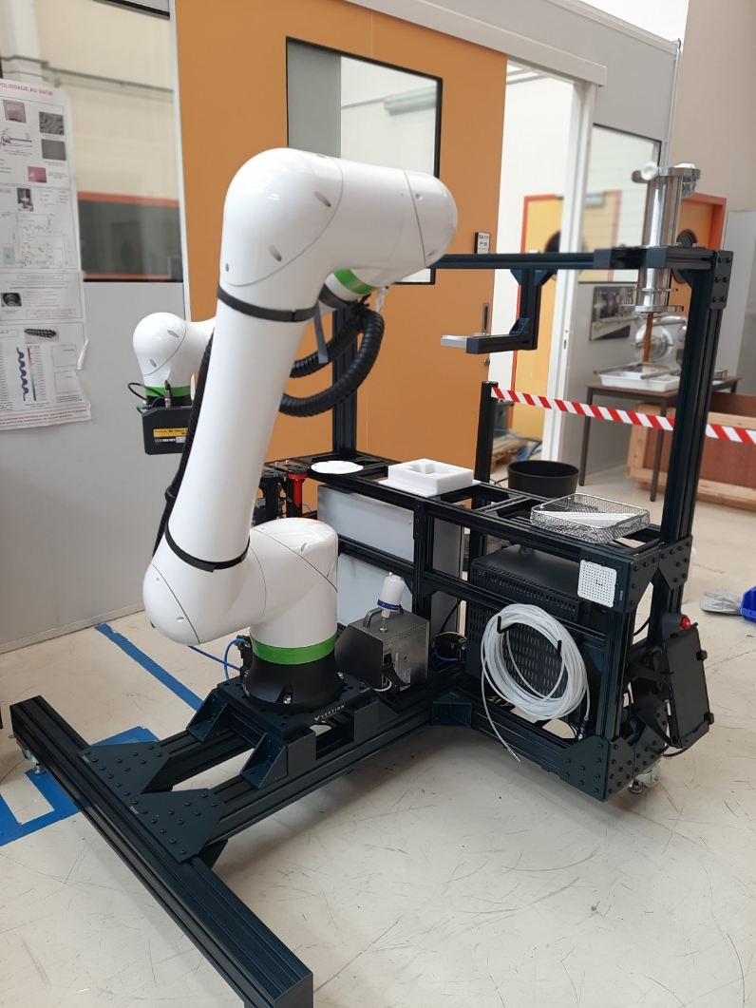
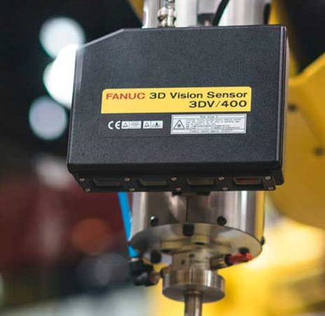
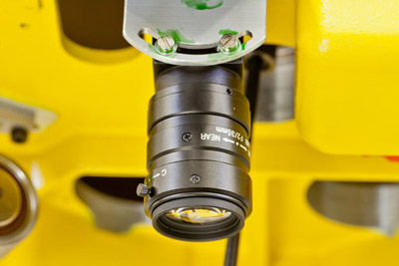
CEA activities in JFY2024
Acquisition of a new robot (old one :CRX-10iA, new one CRX-25iA) commissioned for cleanroom
Higher payload, larger area of action
Improvement of vision system (old one : 2D camera, new one : 3D camera)
Greater precision, easier component location

Slide 12
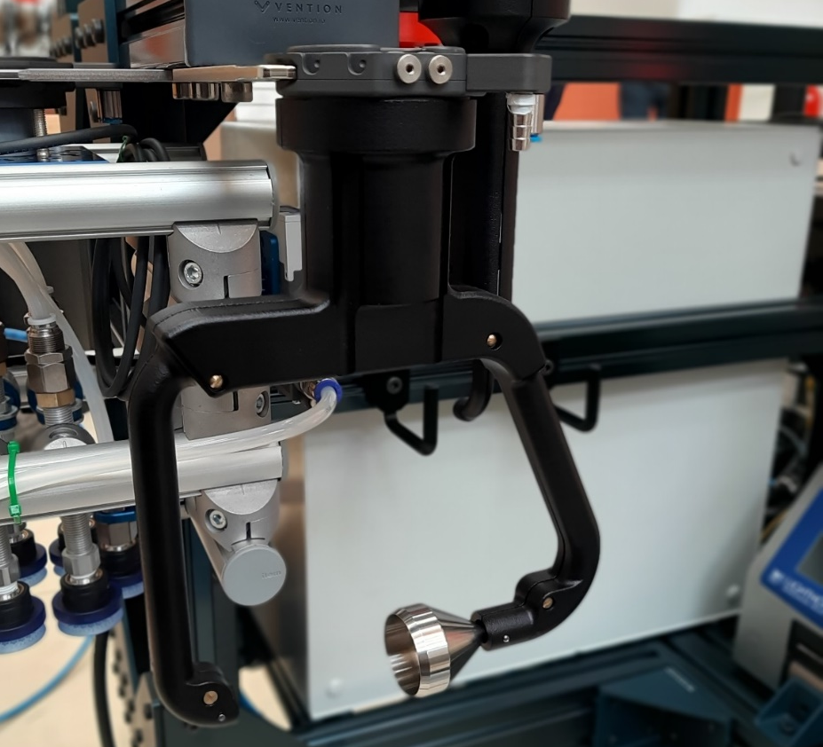
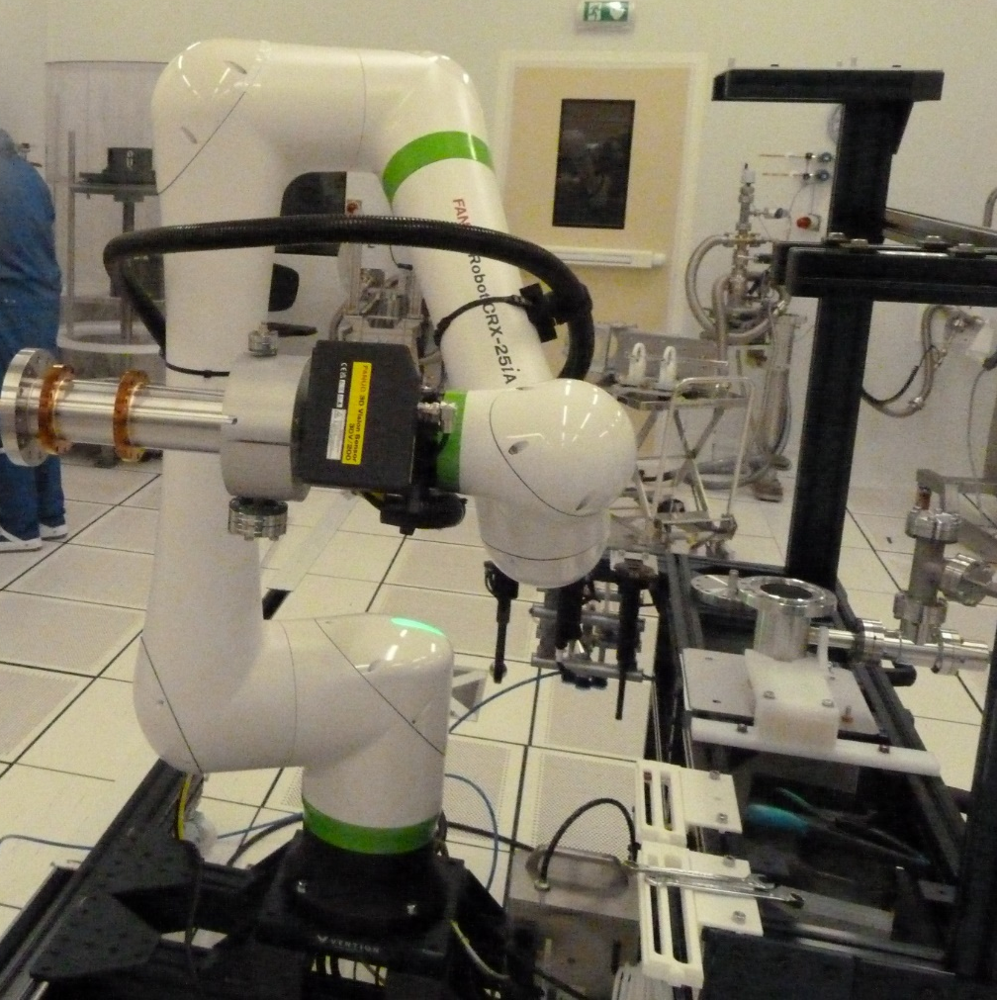
CEA activities in JFY2024
Purchase of versatile gripper (technology by suction) which can be adapted to a large range of component (flanges,…)
Design of versatile or on purpose tooling to blow-clean component
Design of on purpose tooling to handle critical component (power coupler, inter cavity bellows)

Slide 13
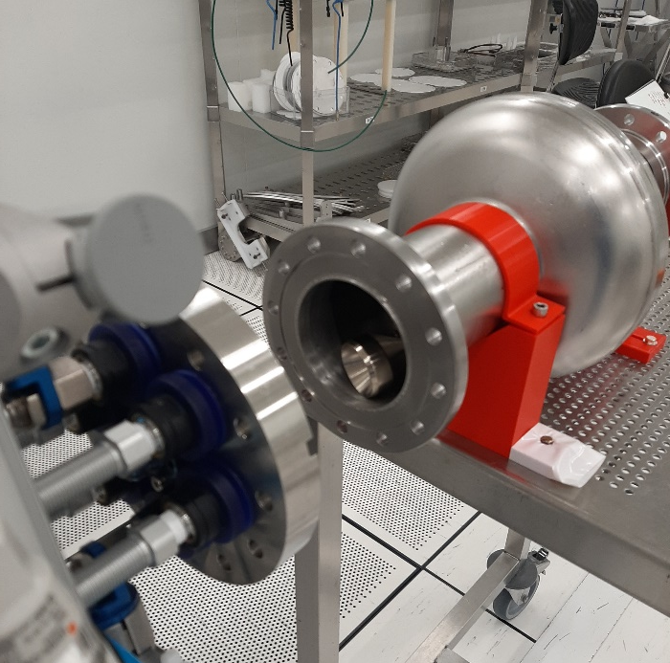
CEA activities in JFY2024
Development of flange assembly on a 1,3 GHz cavity with the cobot
Use of a dummy cavity to validate the paths and the cleanliness of actions (0.1µm particles counter inside the cavity)
Particles counter inside dummy cavity
Flange removal with no particles inside
Flange assembly with no particles inside

Slide 14
CEA activities in JFY2024
Assembly of a blank flange on a 1.3GHz cavity in ISO4 cleanroom for a cold RF test with potential bias.
Previous test flange removal and installation of clean blank flange by human operator
Clean blank flange removal and re-installation by cobot
Blank flange removal and installation of new clean test flange by human operator
 | Eacc at quench | Rad at quench
2022 test results | 48 MV/m | 30µSv/h
2025 test results | 33 MV/m | 32µSv/h
Difficulty to separate the effect of multiple removal/assembly operations from the effect of the cobot or the human in test performance.
Need to repeat this type of experiment with better-controlled parameters

Slide 15
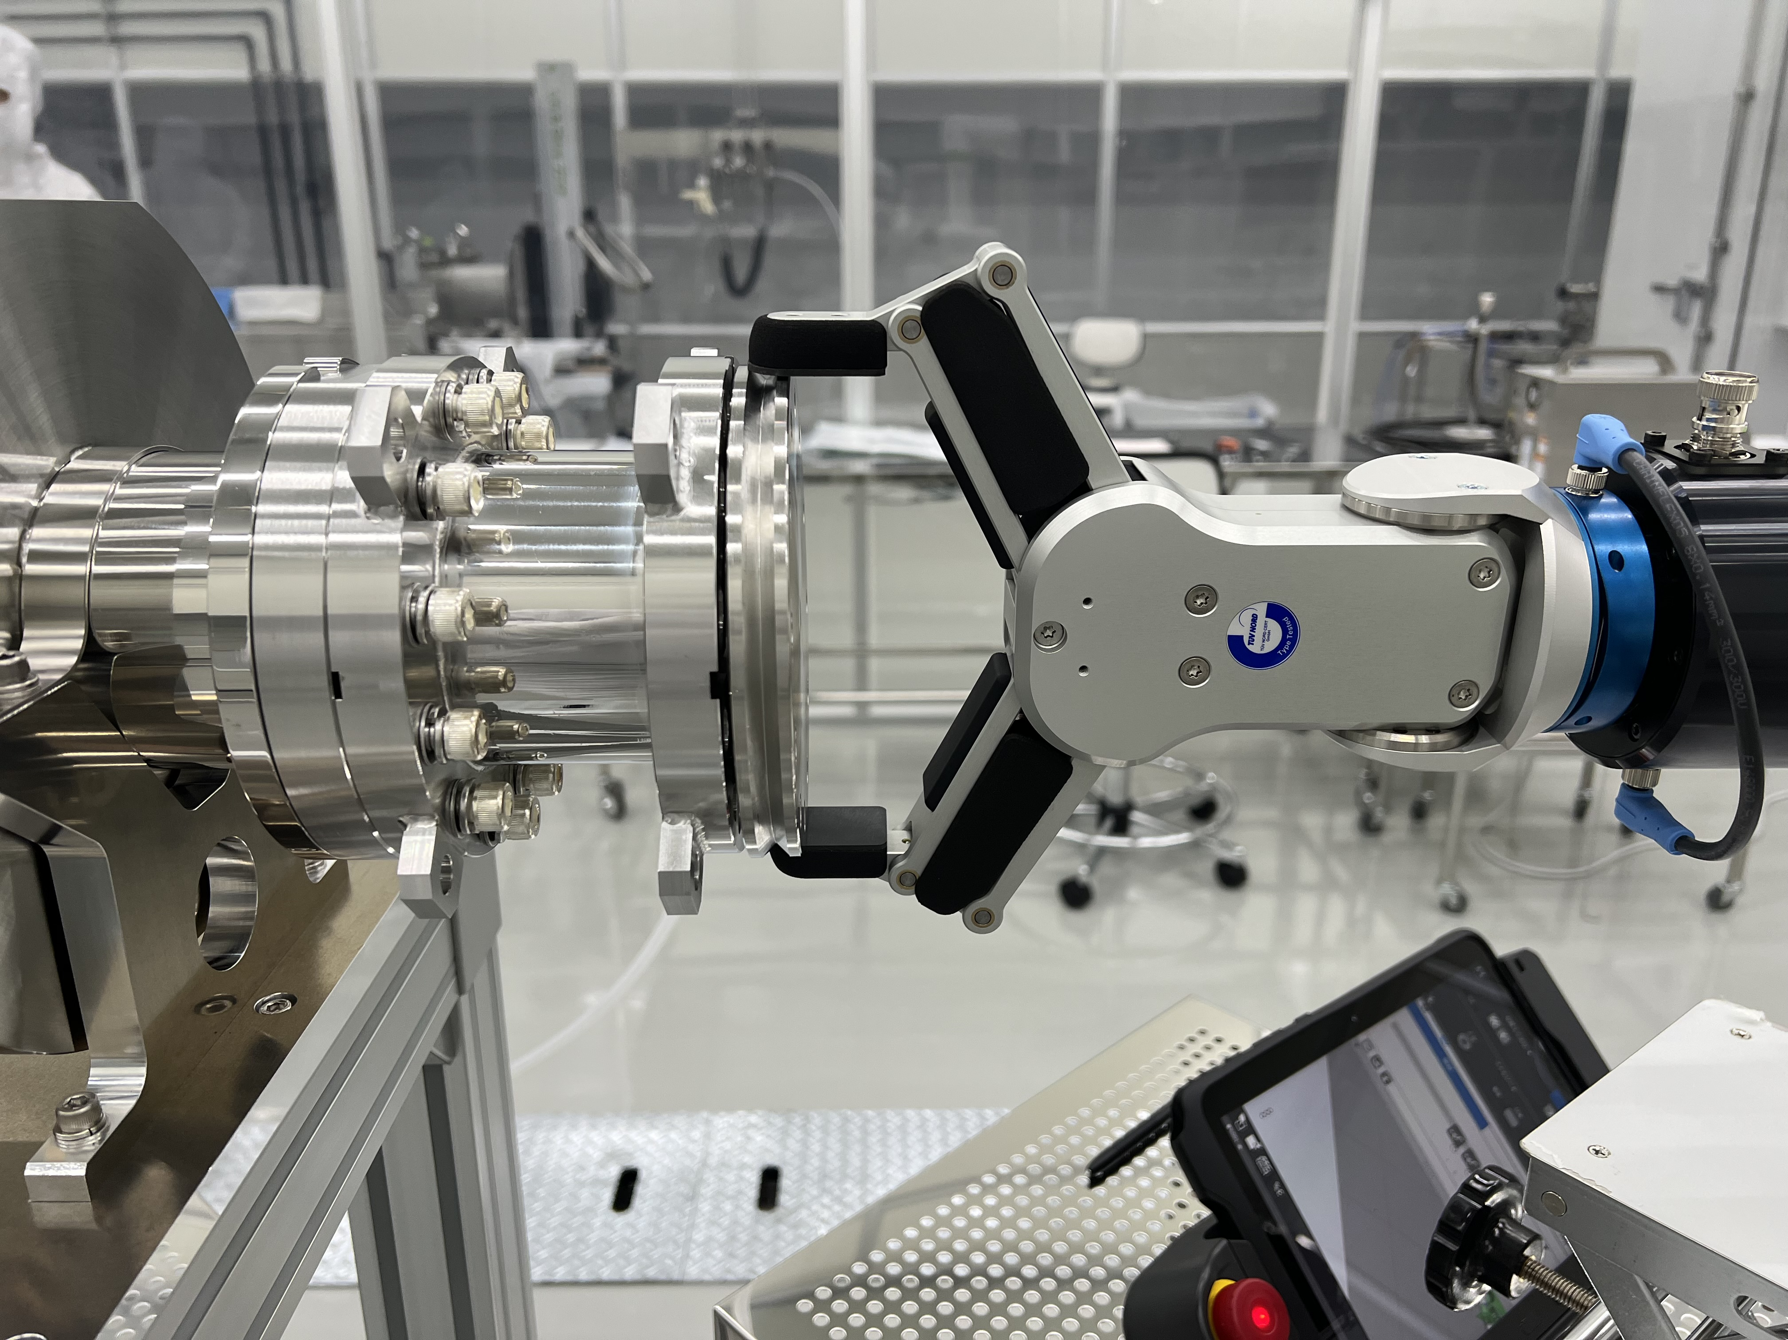
Foreseen KEK activities in JFY2025
Develop the path programming by using Roboguide software
Work outside of cleanroom
Easier path validation/optimization
Design of end-effectors of the cobot
Cleaning/particle counting
Handling/assembly
Perform assembly with cobot in cleanroom
Air-blowing of the cavity end-group,
Flange removal
Assembly of a new clean flange
Validation with cold RF test (field emission verification, …)

Slide 16
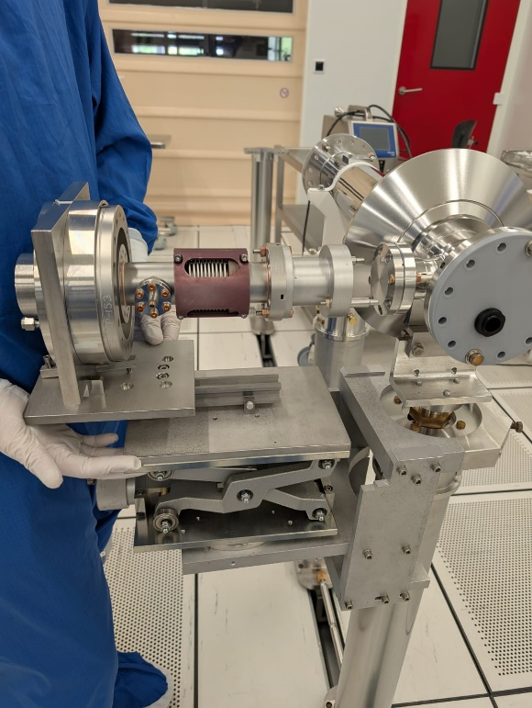
Foreseen CEA activities in JFY2025
Comparison of cleanliness of coupler on mock-up cavity assembly between :
Manual assembly by an human
Cobot assisted assembly
New assembly of blank flange on cavity validated by a cold RF test (with no disturbance of human contribution)
Good opportunity to compare results between KEK and CEA cobot assembly

Slide 17
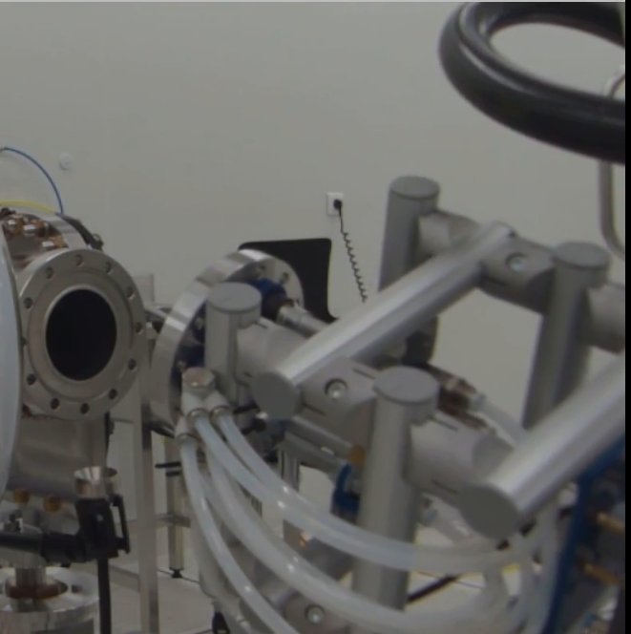
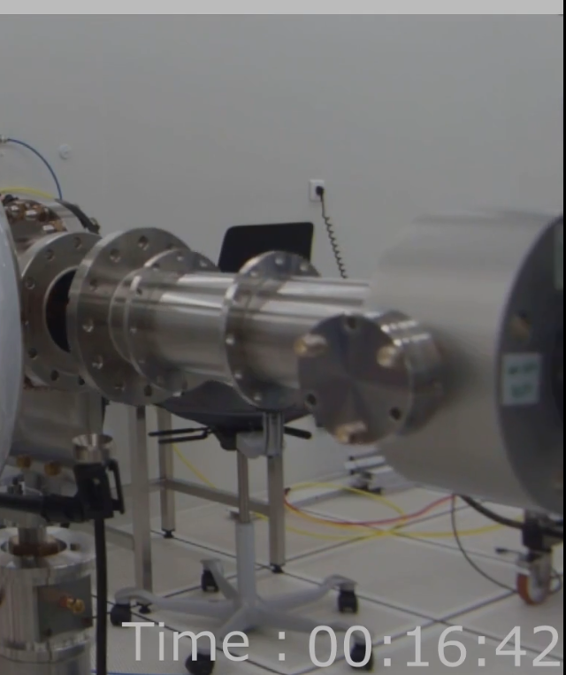
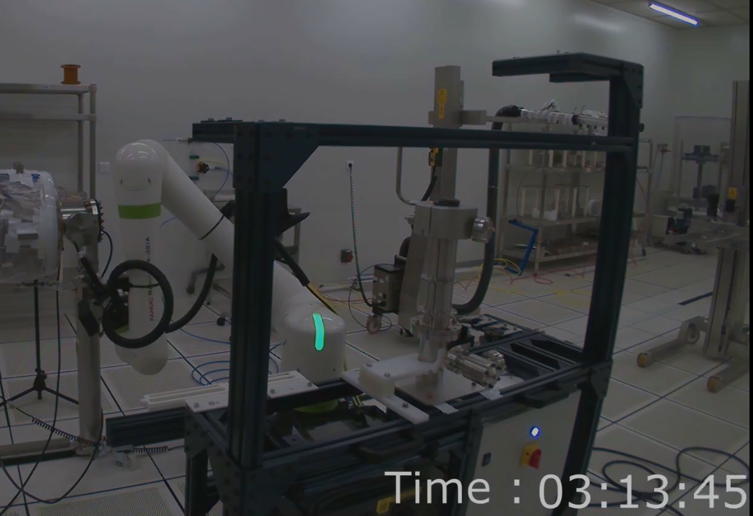
Foreseen CEA activities in JFY2025
Continue work developing cobotisation of coupler/bellow assembly and cleaning in production
On 1.3GHz cavity (ILC project type) as a good comparison with KEK team
On 650MHz cavity (PIP-II project), to develop/deploy cobotisation in a production infrastructure
Cleaning of components
Removal of flange
Assembly of coupler

Slide 18
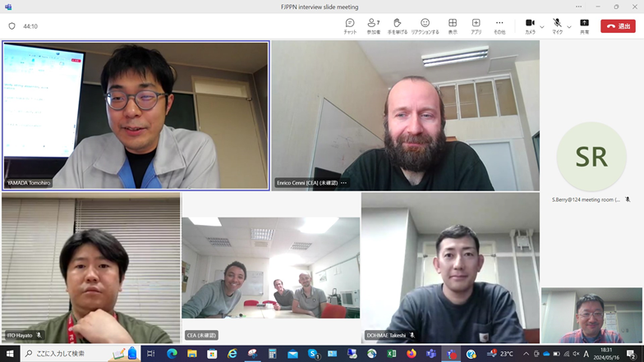
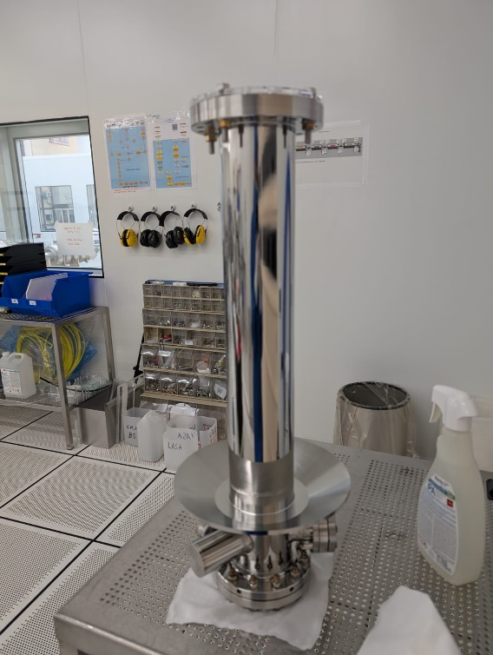
Exchange between KEK and CEA
Regular collaboration meetings to exchange on advancement on project.
Exchange of components for comparison of work processes and cleanliness results
CEA will visit KEK for observation of cobot methods and continue joint development of cobot use method

Slide 19
Summary
Cobotisation keeps human operators away from critical RF surfaces during assembly tasks
Cobotisation reduces the tediousness of certain cavity string assembly preparation tasks.
The ability to work outside normal working hours can be a useful productivity booster for future large-scale particle accelerator.
The goal of cobotisation remains to keep operators in the cleanroom to perform/support very high value-added tasks.
As cobotisation in our field is still in its early stage, the collaboration presented will enable us to implement new ideas and accelerate its validation in our area of work.
Thanks to my colleagues at CEA and KEK for the information provided.
We look forward to continuing to collaborate on this exciting and essential topic for the future of SRF cavity string assembly.

