Slide 1


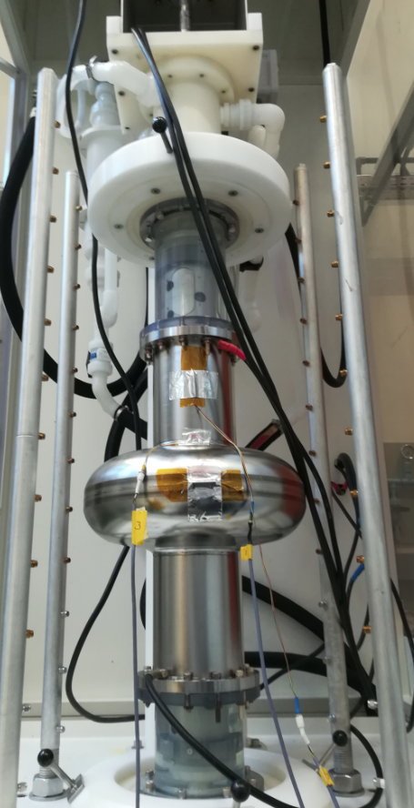
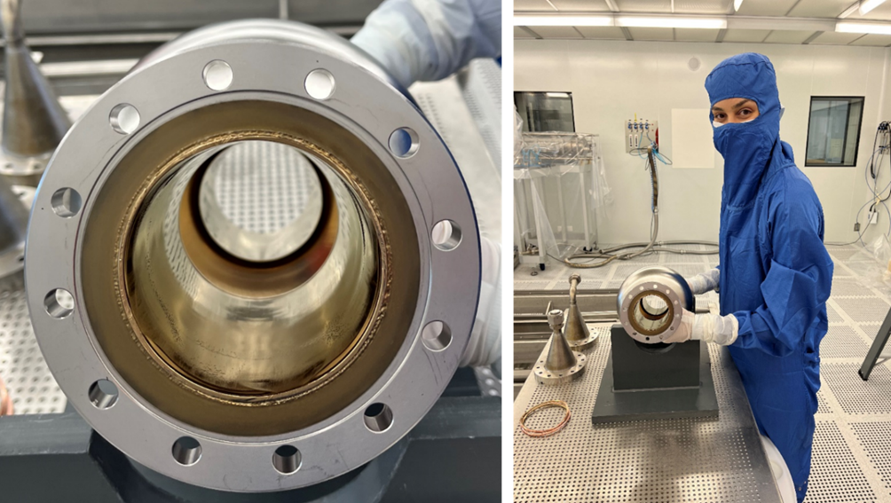
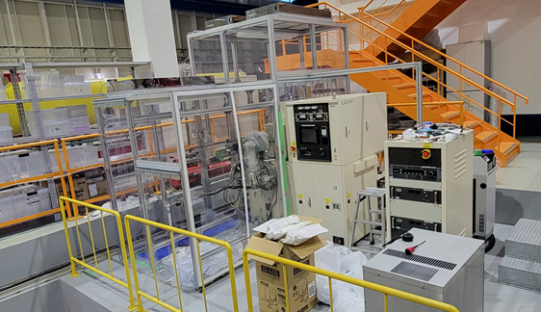
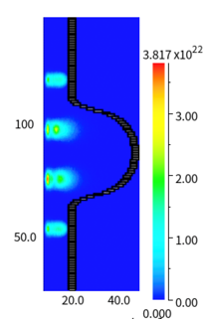
A_RD_25:
Continued Effort Towards Ultimate Performance for Accelerator Cavities
2025 FKPPN - FJPPN joint Workshop,
Nantes 14-16 May 2025

Slide 2
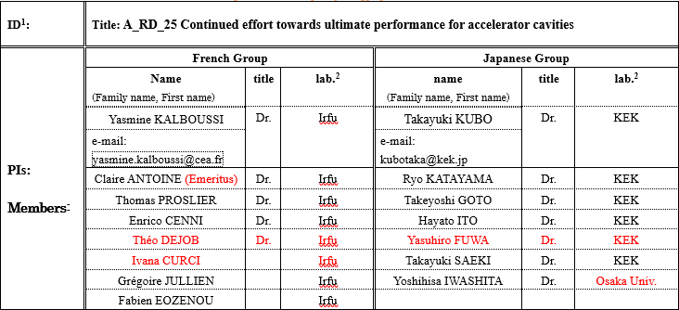
COMPOSITION OF TEAMS
FY 2024 Exchange program:
- KEK side: Visit of R. KATAYAMA in September 2024
- Irfu side: Visit of C. ANTOINE & G. JULLIEN in January 2025
FY 2025 Exchange plans:
- KEK side: Visit of Y. FUWA and/or T. GOTO in September 2025
- Irfu side: Visiting candidate under discussion

Slide 3
Continued Effort Towards Ultimate Performance for Accelerator Cavities
Japan Part
Progress in theory T. Kubo
Experimental effort for TF R. Katayama
3GHz cavity Y. Fuwa
Vertical & HF free EP T. Goto

Slide 4

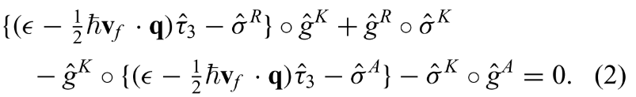

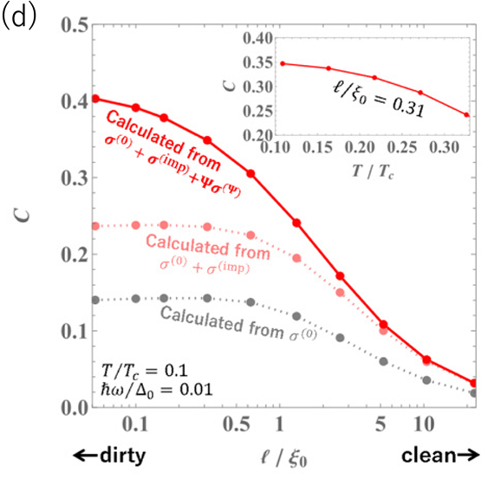
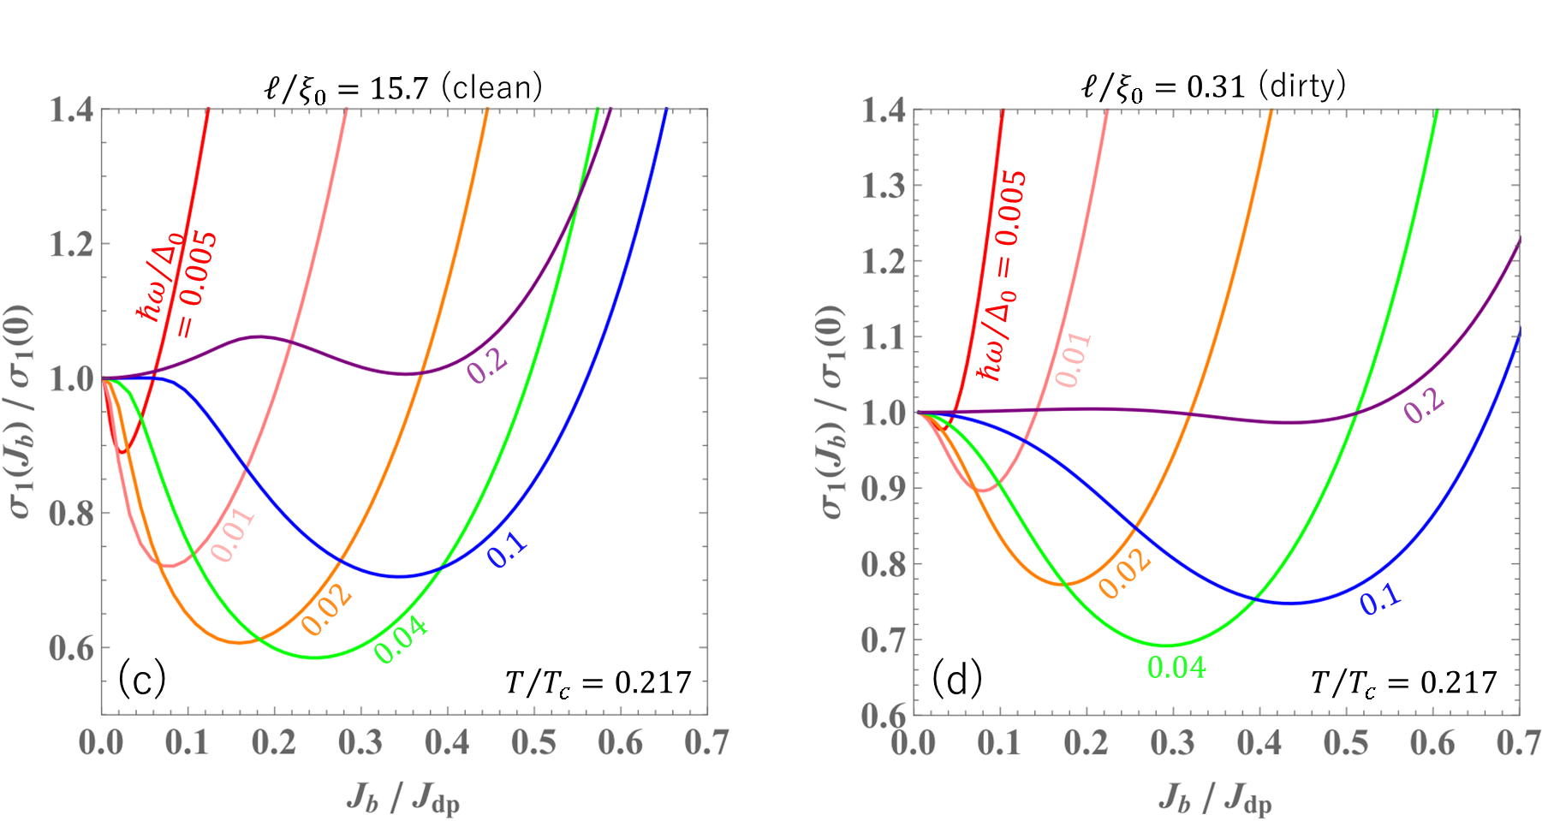

Electromagnetic response to a weak rf superposed on a dc bias:
tackle the problem head-on using the Keldysh-Eilenberger theory of nonequilibrium superconductivity
This long-standing and tough problem—belong to nonequilibrium superconductivity and relevant to many superconducting devices, including the Q-slope in SRF cavities—had not been solved correctly.
Theory of nonequilibrium superconductivity
Moyal product
The dc bias–induced Q-slope grows stronger with frequency
—mirroring the ac-driven Q-slope well known in SRF cavities.
Established the theory of kinetic inductance under dc bias
$$L_{k}\left(J_{b}\right)=$$
$$L_{k}(0)\left\{1+C{\left(\frac{J_{b}}{J_{dp}}\right)}^{2}+…\right\}$$
T. Kubo, Physical Review Applied 22, 044042 (2024)

Slide 5
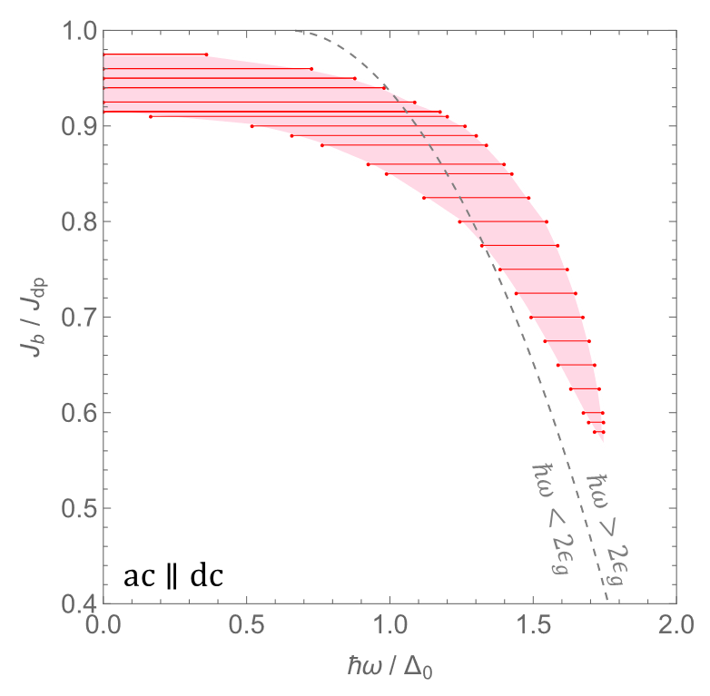
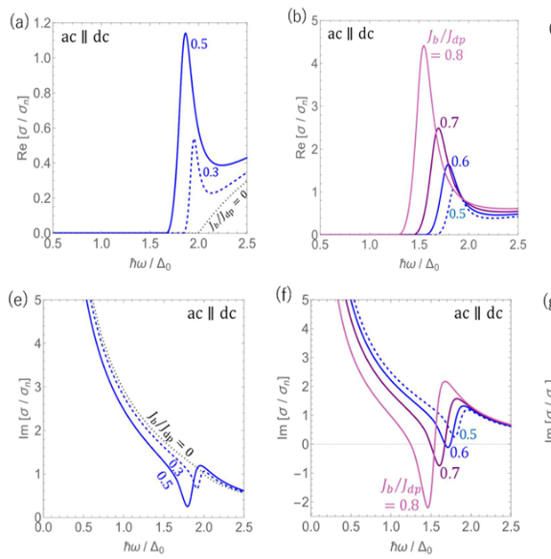


Plan of 2025
Apply the Keldysh-Eilenberger (or Keldysh-Usadel) theory of nonequilibrium superconductivity to superconducting devices—including SRF cavities—to gain deeper insights beyond what has been achieved so far.
Some new findings have already been obtained.
In dirty superconductors under combined dc and ac fields, there exists a frequency range where the superconducting Higgs mode drives the imaginary part of the conductivity (i.e., the superfluid density) negative, leading to instability.
$$Reσ$$
Higgs mode
Instability domain
$$Imσ$$
Higgs mode
Negative!!!
arXiv:2502.05914
To be published soon in Phys. Rev. Applied

Slide 6
Continued Effort Towards Ultimate Performance for Accelerator Cavities
Japan Part
Progress in theory T. Kubo
Experimental effort for TF R. Katayama
3GHz cavity Y. Fuwa
Vertical & HF free EP T. Goto

Slide 7
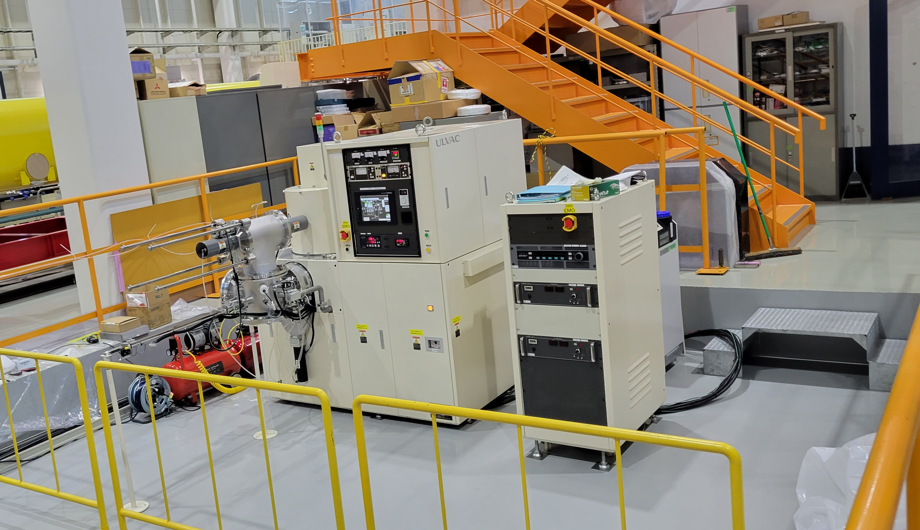
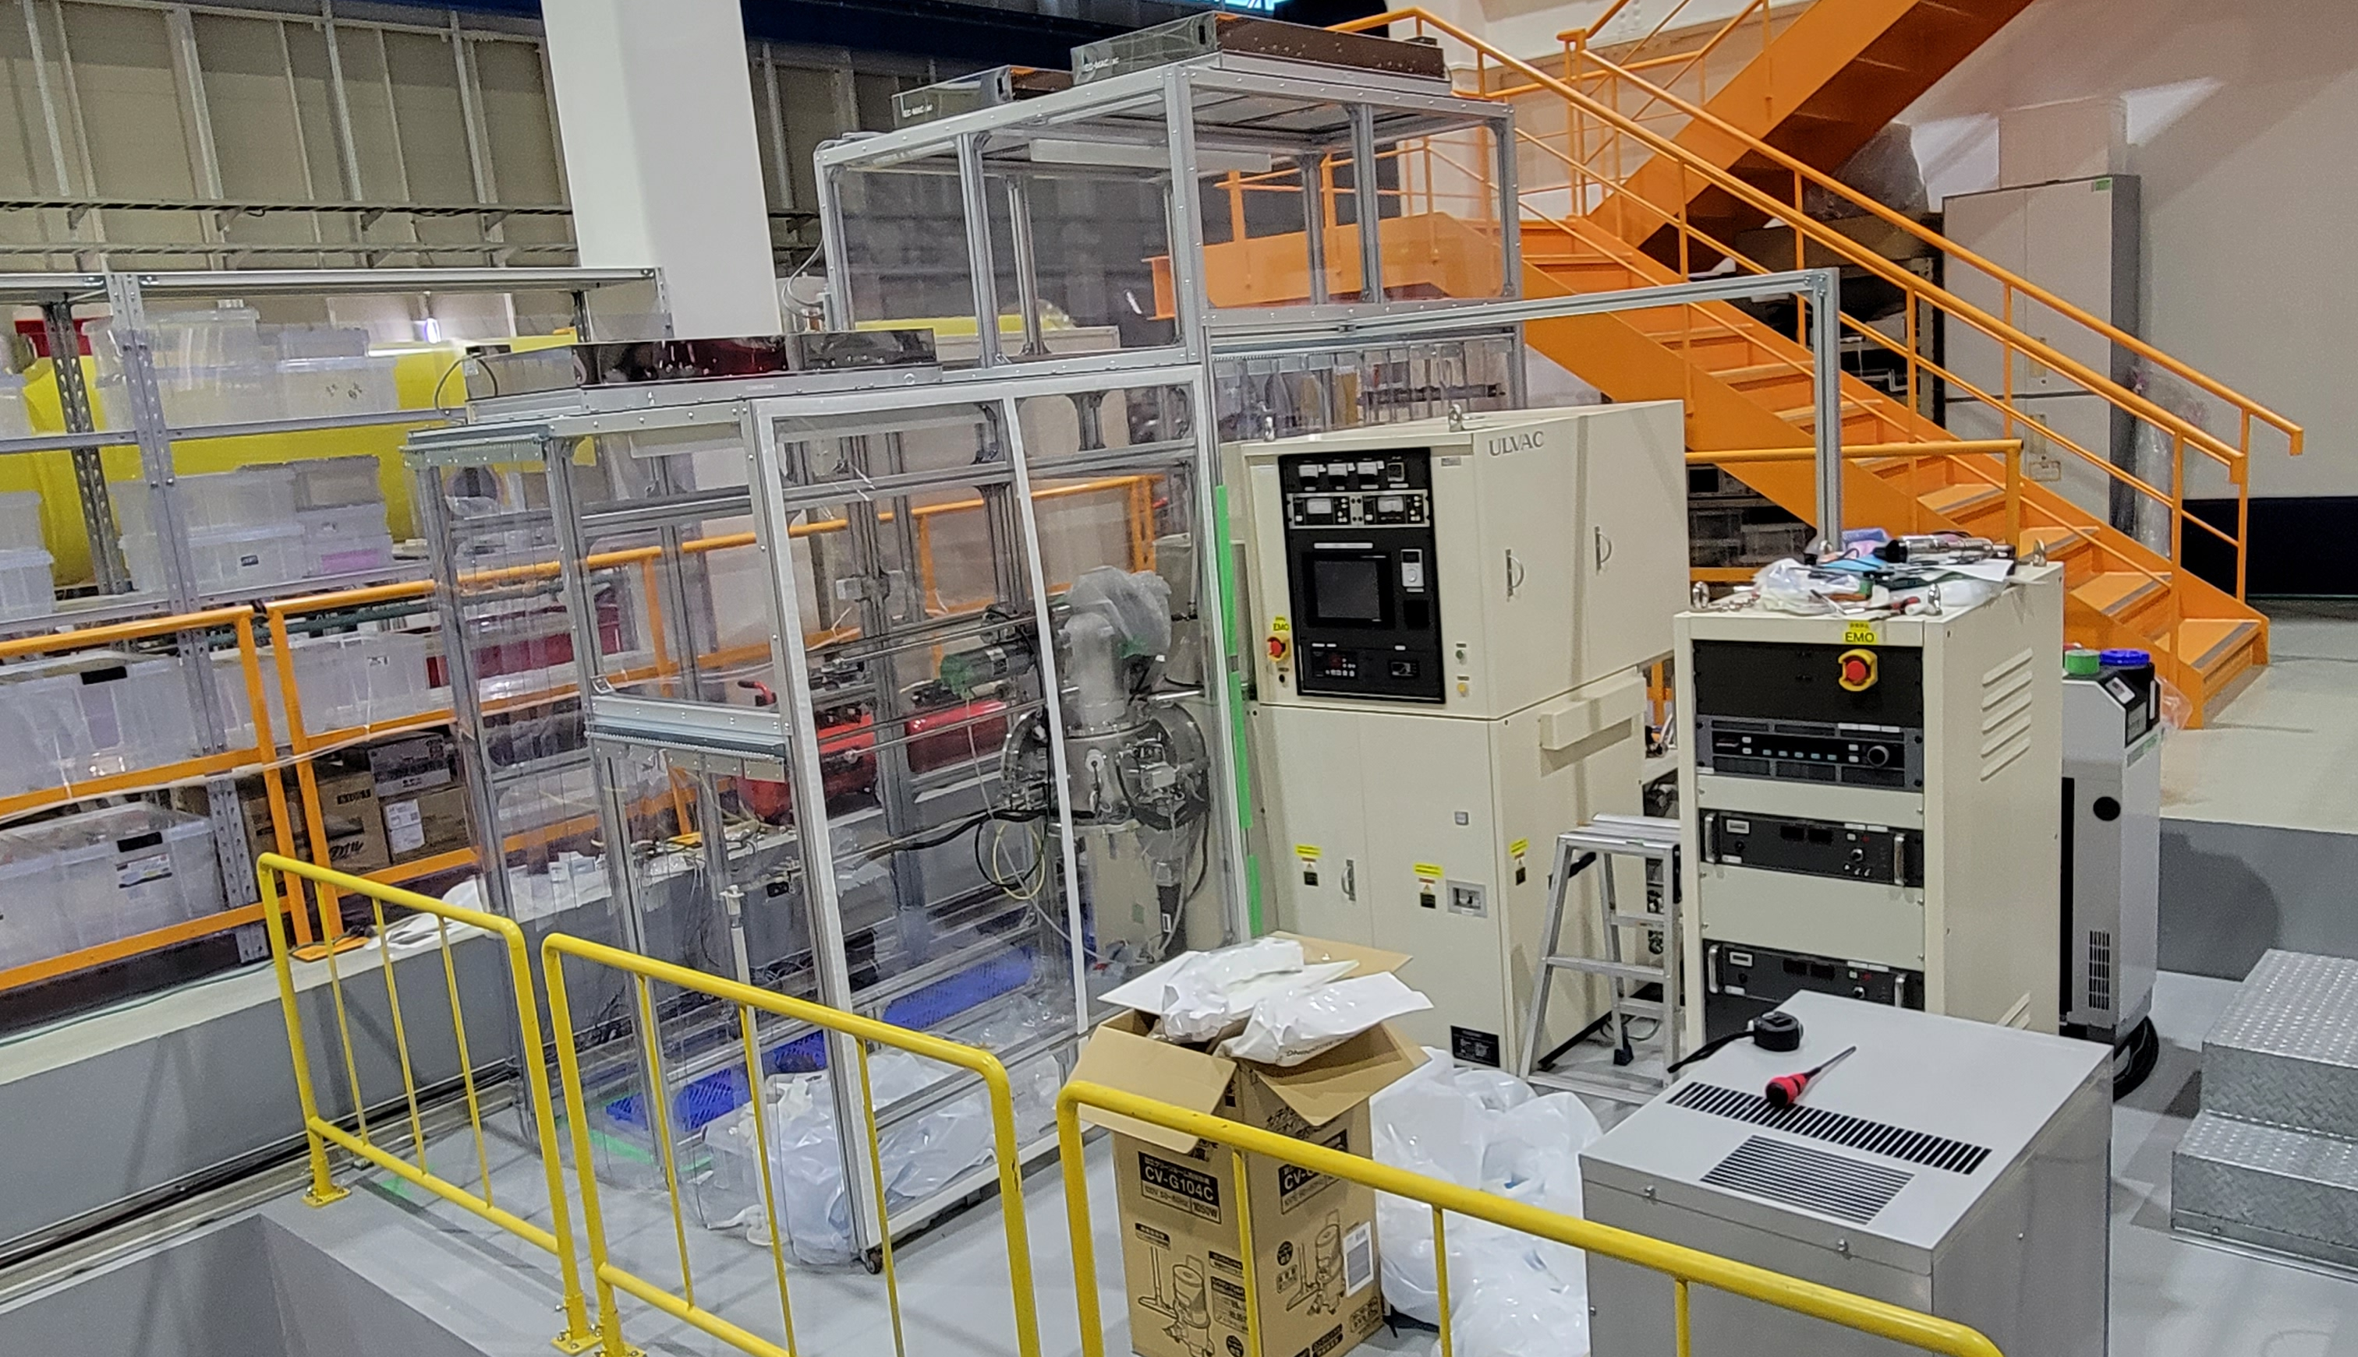
Clean-booth for Sputtering System
View of 2024.03
A DC magnetron sputtering apparatus was installed on March 19, 2024 at KEK COI building.
This Fiscal year, we constructed a clean booth surrounding the sputtering system.
We evaluated the cleanliness of the clean booth by measuring the number of particles, which was found to be 20 particles per 28.3 liters of air.
View of 2025.05

Slide 8
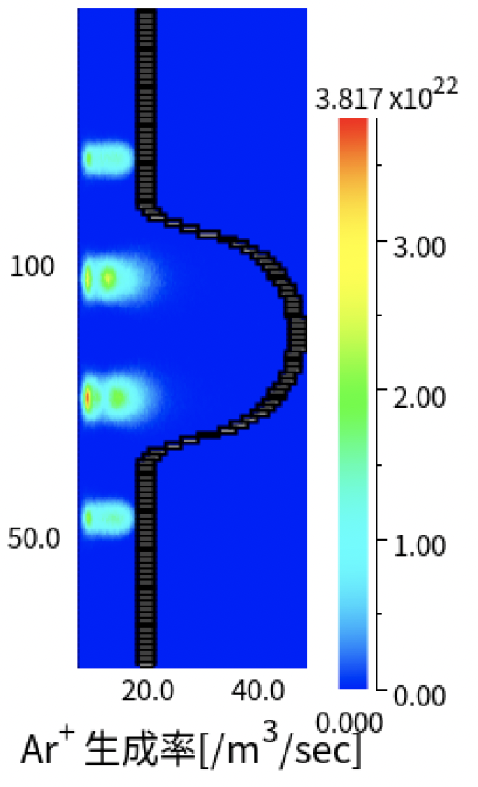
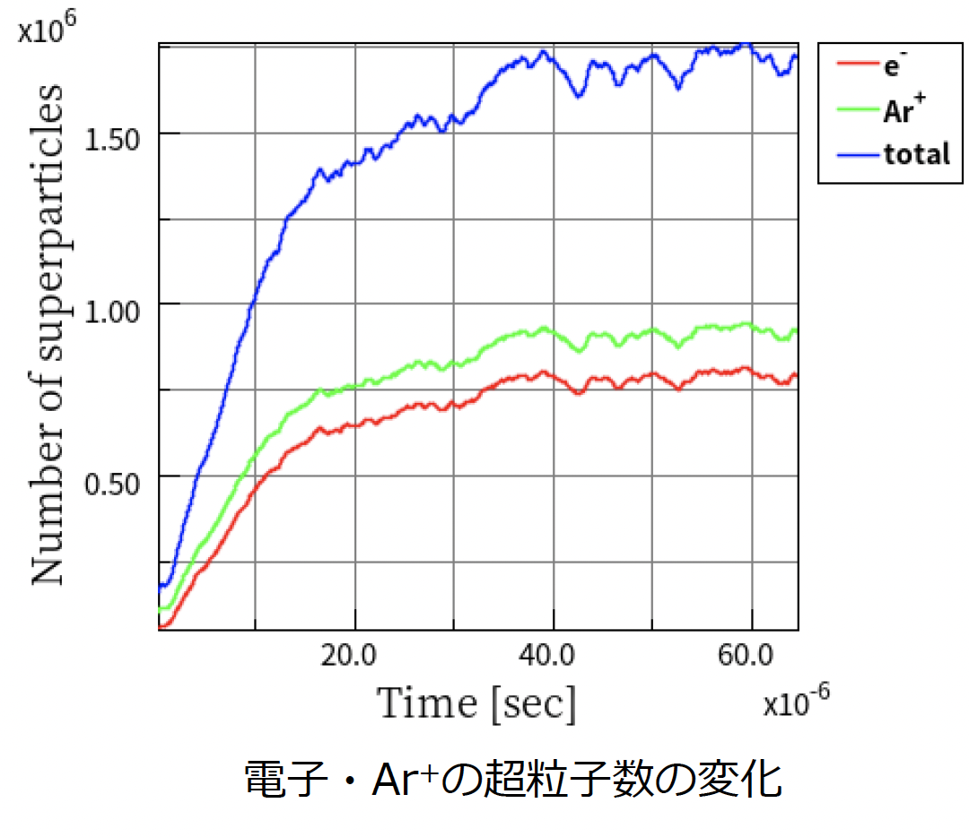
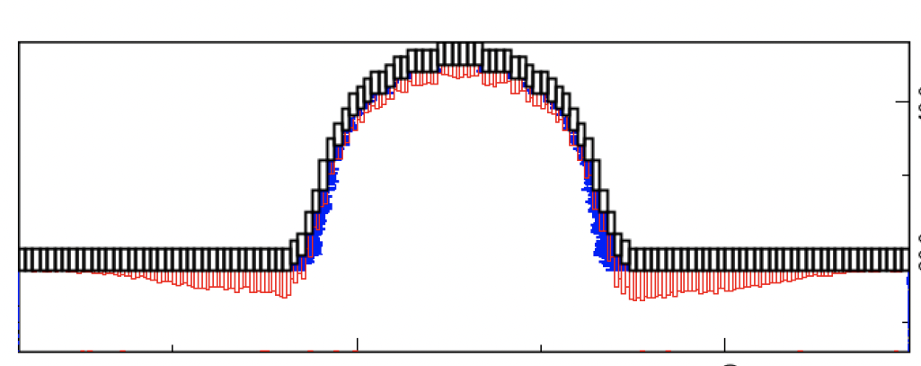
Simulation Study
By T.Sasakii
Sputtering simulation was performed to understand what film formation condition is optimal especially for Nb3Sn coating method.
We used the software modules developed by PEGASAS software inc., in order to perform the sputtering simulation.
Current status of simulation study:
  Ar+ generation rate, number of super-particles of e- and Ar+, DC magnetron sputtering can be simulated.
  Uniformity of films looks not ideal.
The simulation study is ongoing for optimization.
Ar+ generation rate [/m3/sec]
Film thickness distribution on the surface

Slide 9
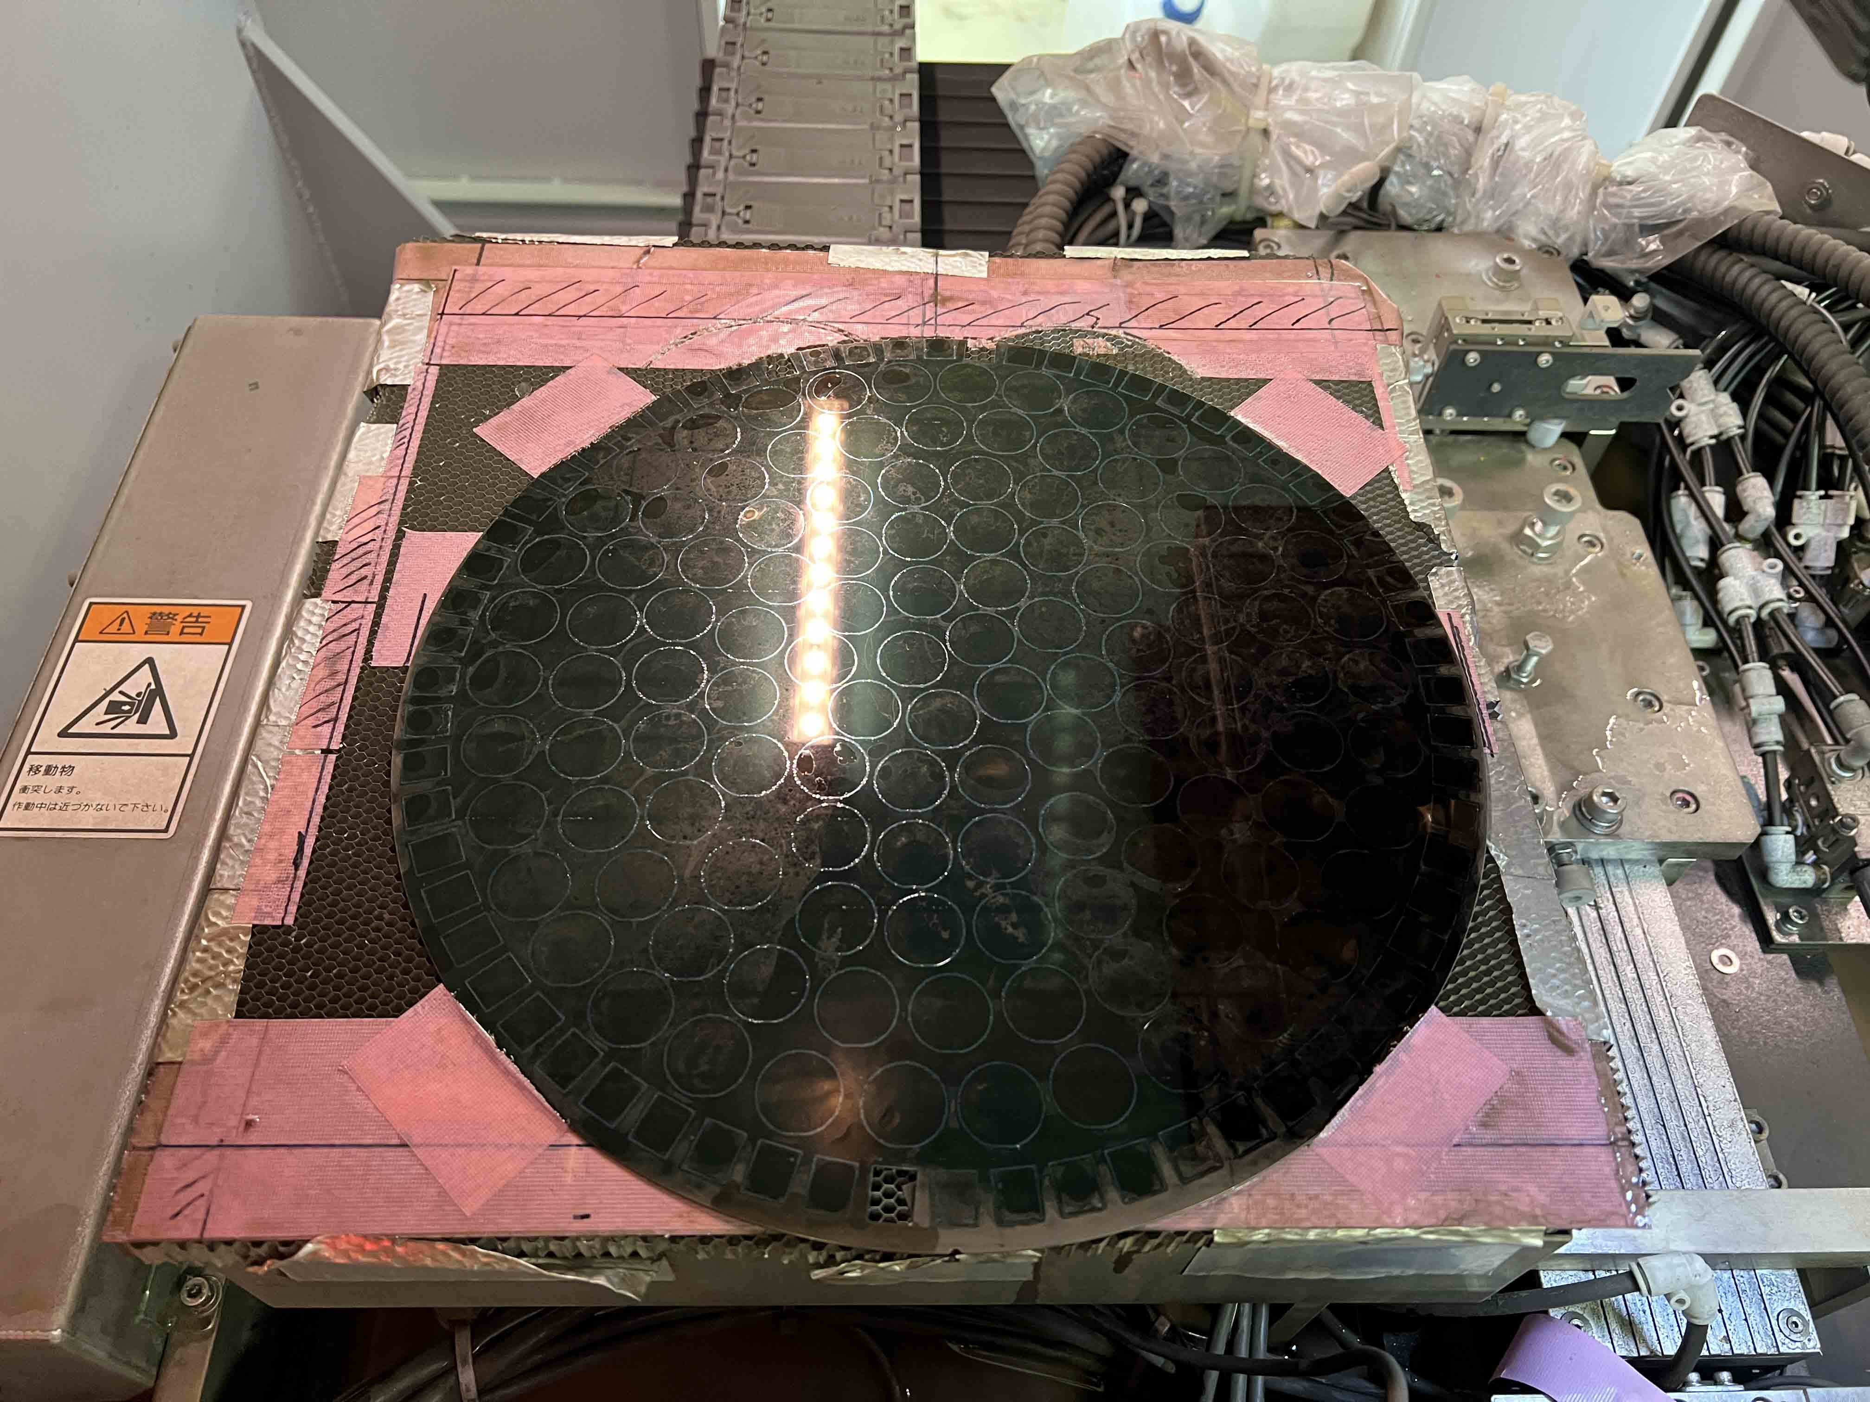
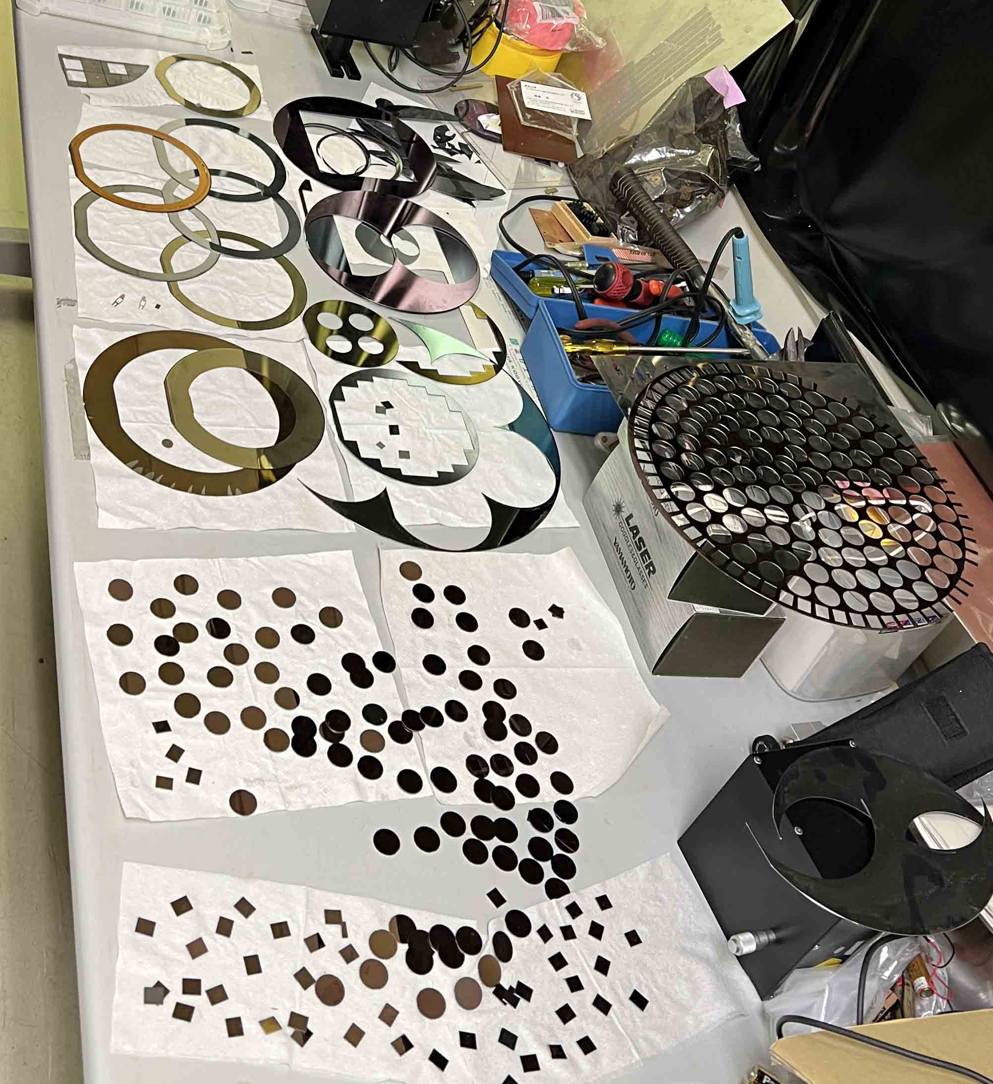
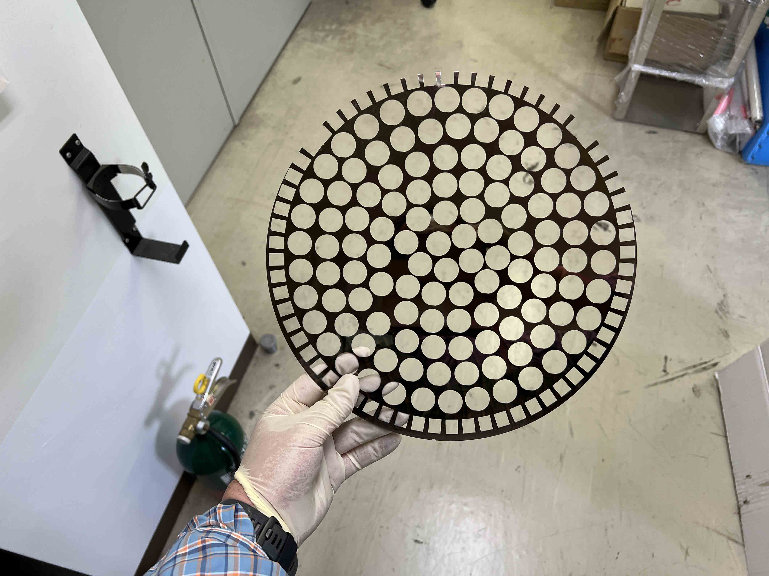
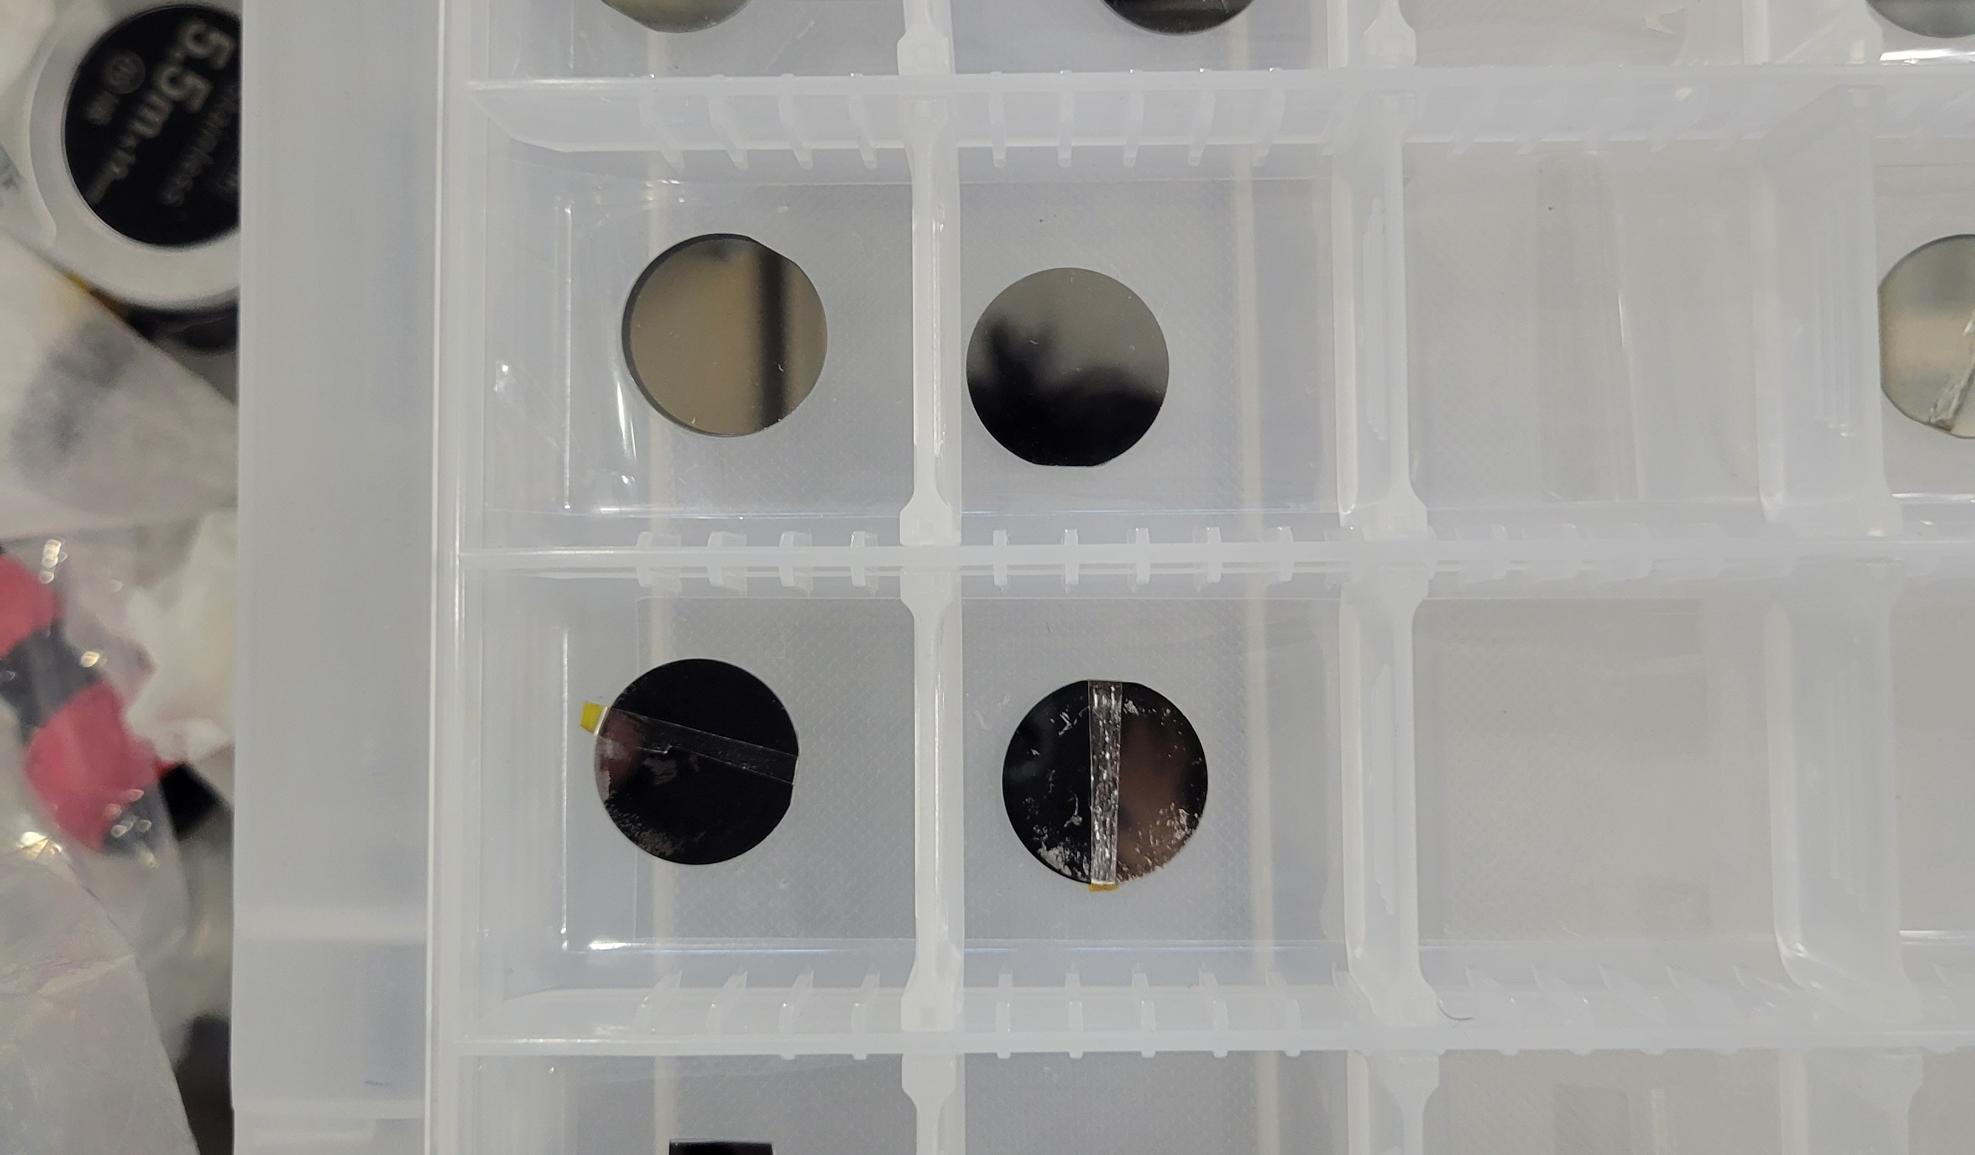
Flat samples preparations
We have prepared more than 100 silicon substrates for the thin-film study.
The φ20 mm silicon substrates were cut from a φ300 mm silicon wafer coated with a protective resist layer.
At present, we have successfully performed DC magnetron sputtering on these substrates.

Slide 10
Plan for 2025
We are creating Nb3Sn and AlN thin films on silicon substrates and evaluating the superconducting properties of these samples.
More detailed sputtering simulations will be conducted.
Sputtering will also be applied to a 3 GHz coupon cavity and a 3 GHz cavity.

Slide 11
Continued Effort Towards Ultimate Performance for Accelerator Cavities
Japan Part
Progress in Theory T. Kubo
Experimental effort for TF R. Katayama
3GHz cavity Y. Fuwa
Vertical & HF free EP T. Goto

Slide 12
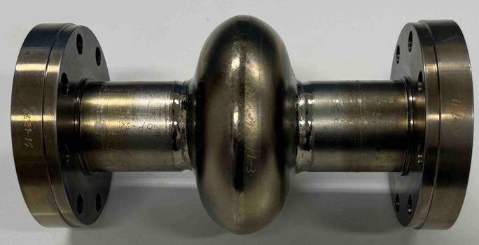
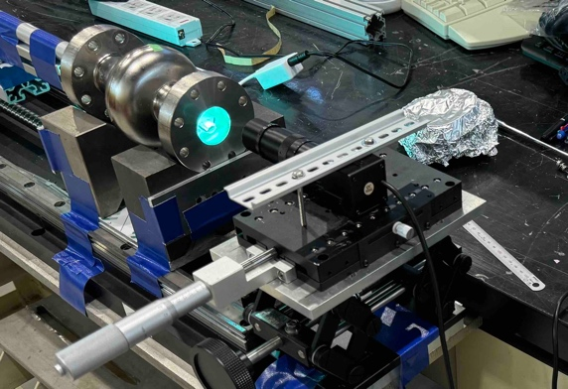
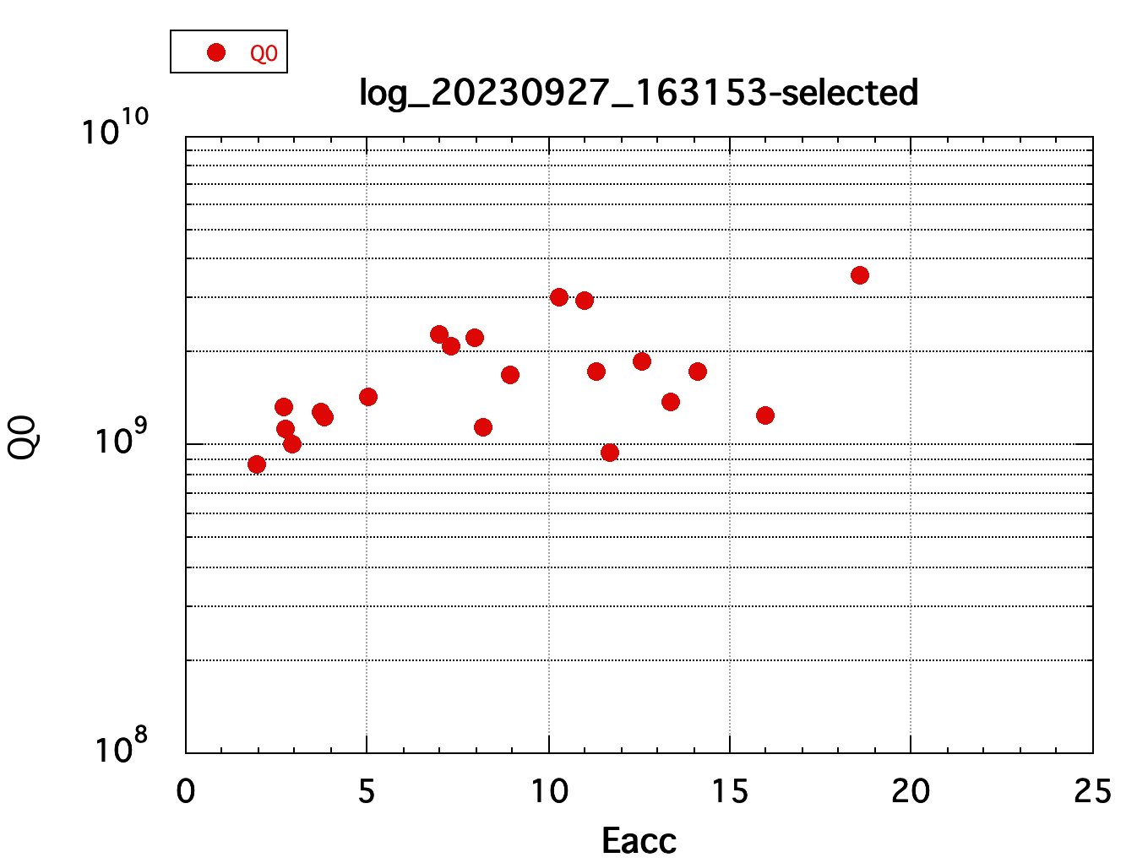
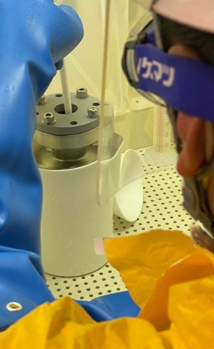
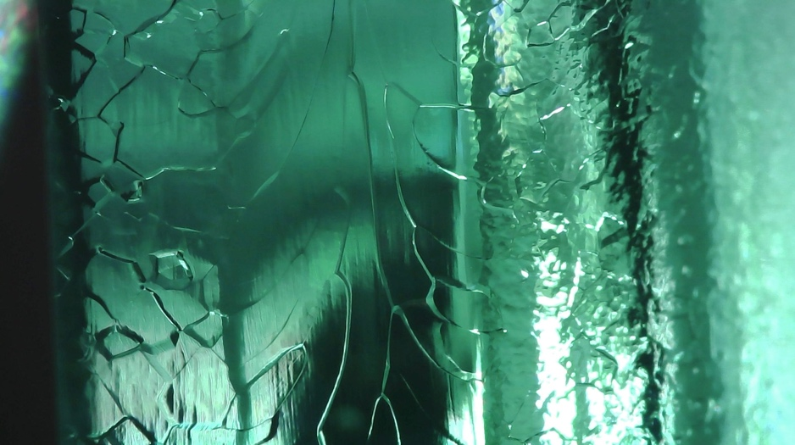
3GHz Cavity preparation
Previous treatment applied on cavity #1 (see 2024 Meeting): BCP treatment
Nb-flange with pure-AL hexagon seal, 158 µm BCP, no-EP, no-anneal, with 120degreeC baking
Cavity observation
Eacc=18.6MV/m, Q0=2.8E9 at 2K
heating at 90 degree equator
f=2.992172GHz at 2K
Inner surface 85 degree equator
close to the heating point 90degree.
No defect found.
BCP (158µm)

Slide 13
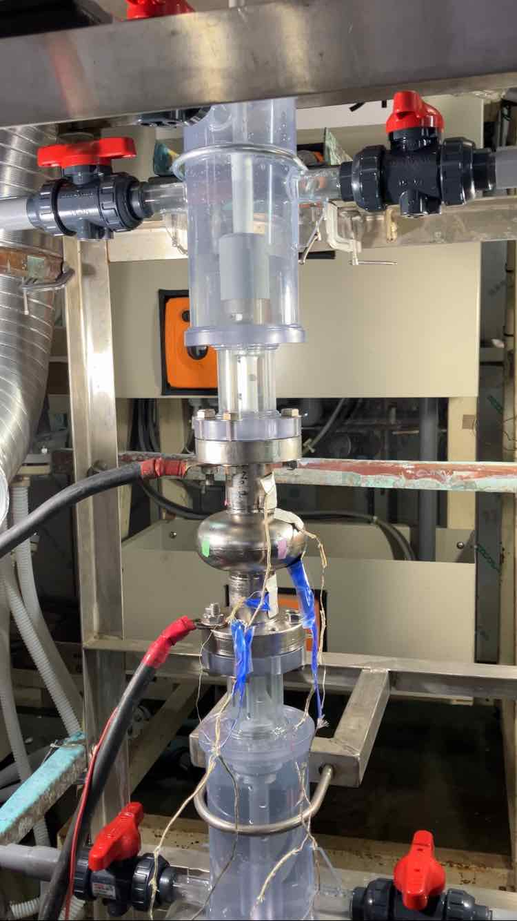
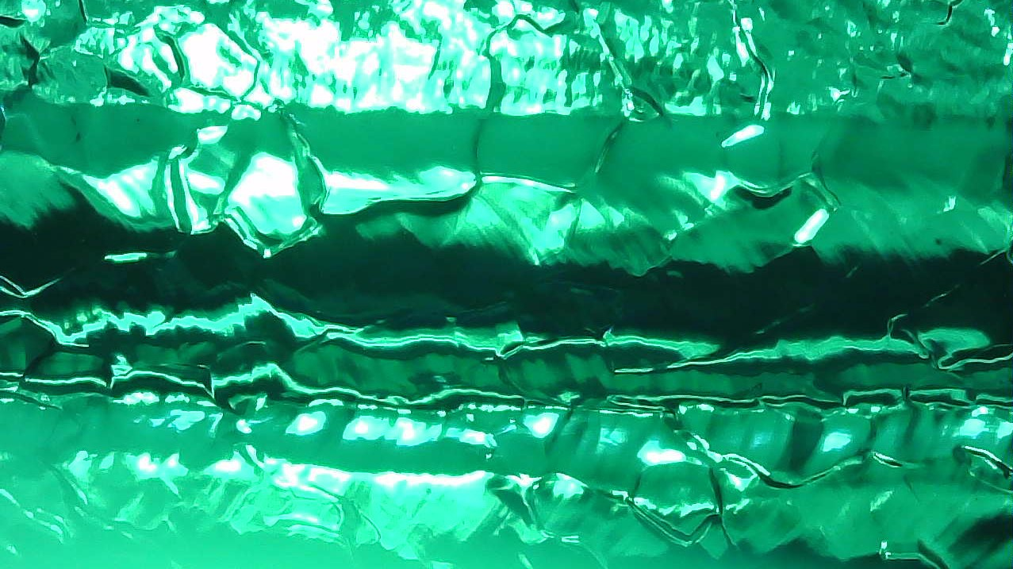
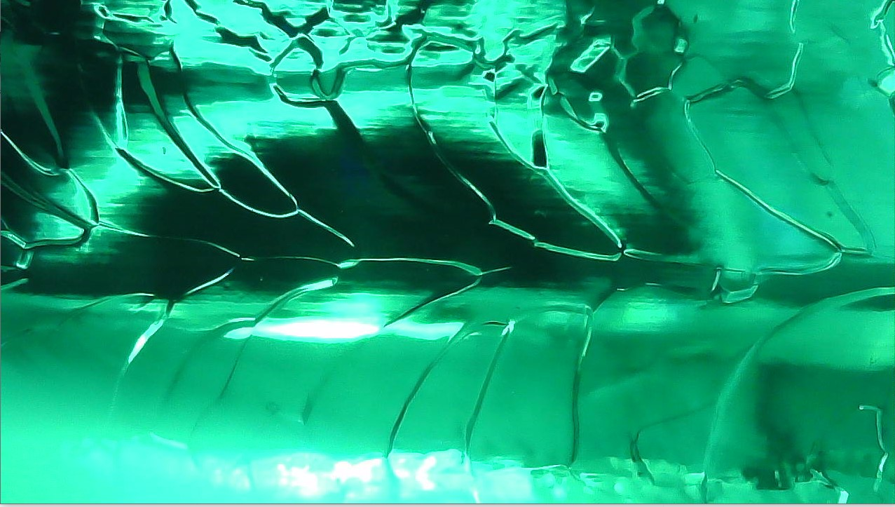
EP processing for 3GHz elliptical cavities (FY2024)
In FY2024, EP (electropolishing) process for 3GHz single-cell elliptical cavity was performed.
For EP process, a vertical EP setup dedicated to 3 GHz cavities was used.
EP treatment was performed in two stages:
- EP1 (100 µm) with the cavity temperature below 50°C (increased removal rate)
- (annealing at 900°C was performed for 3 hours)
- EP2 (30 µm) with the cavity temperature below 20°C
Inner surface after EP (left: equator region, right: iris region)

Slide 14
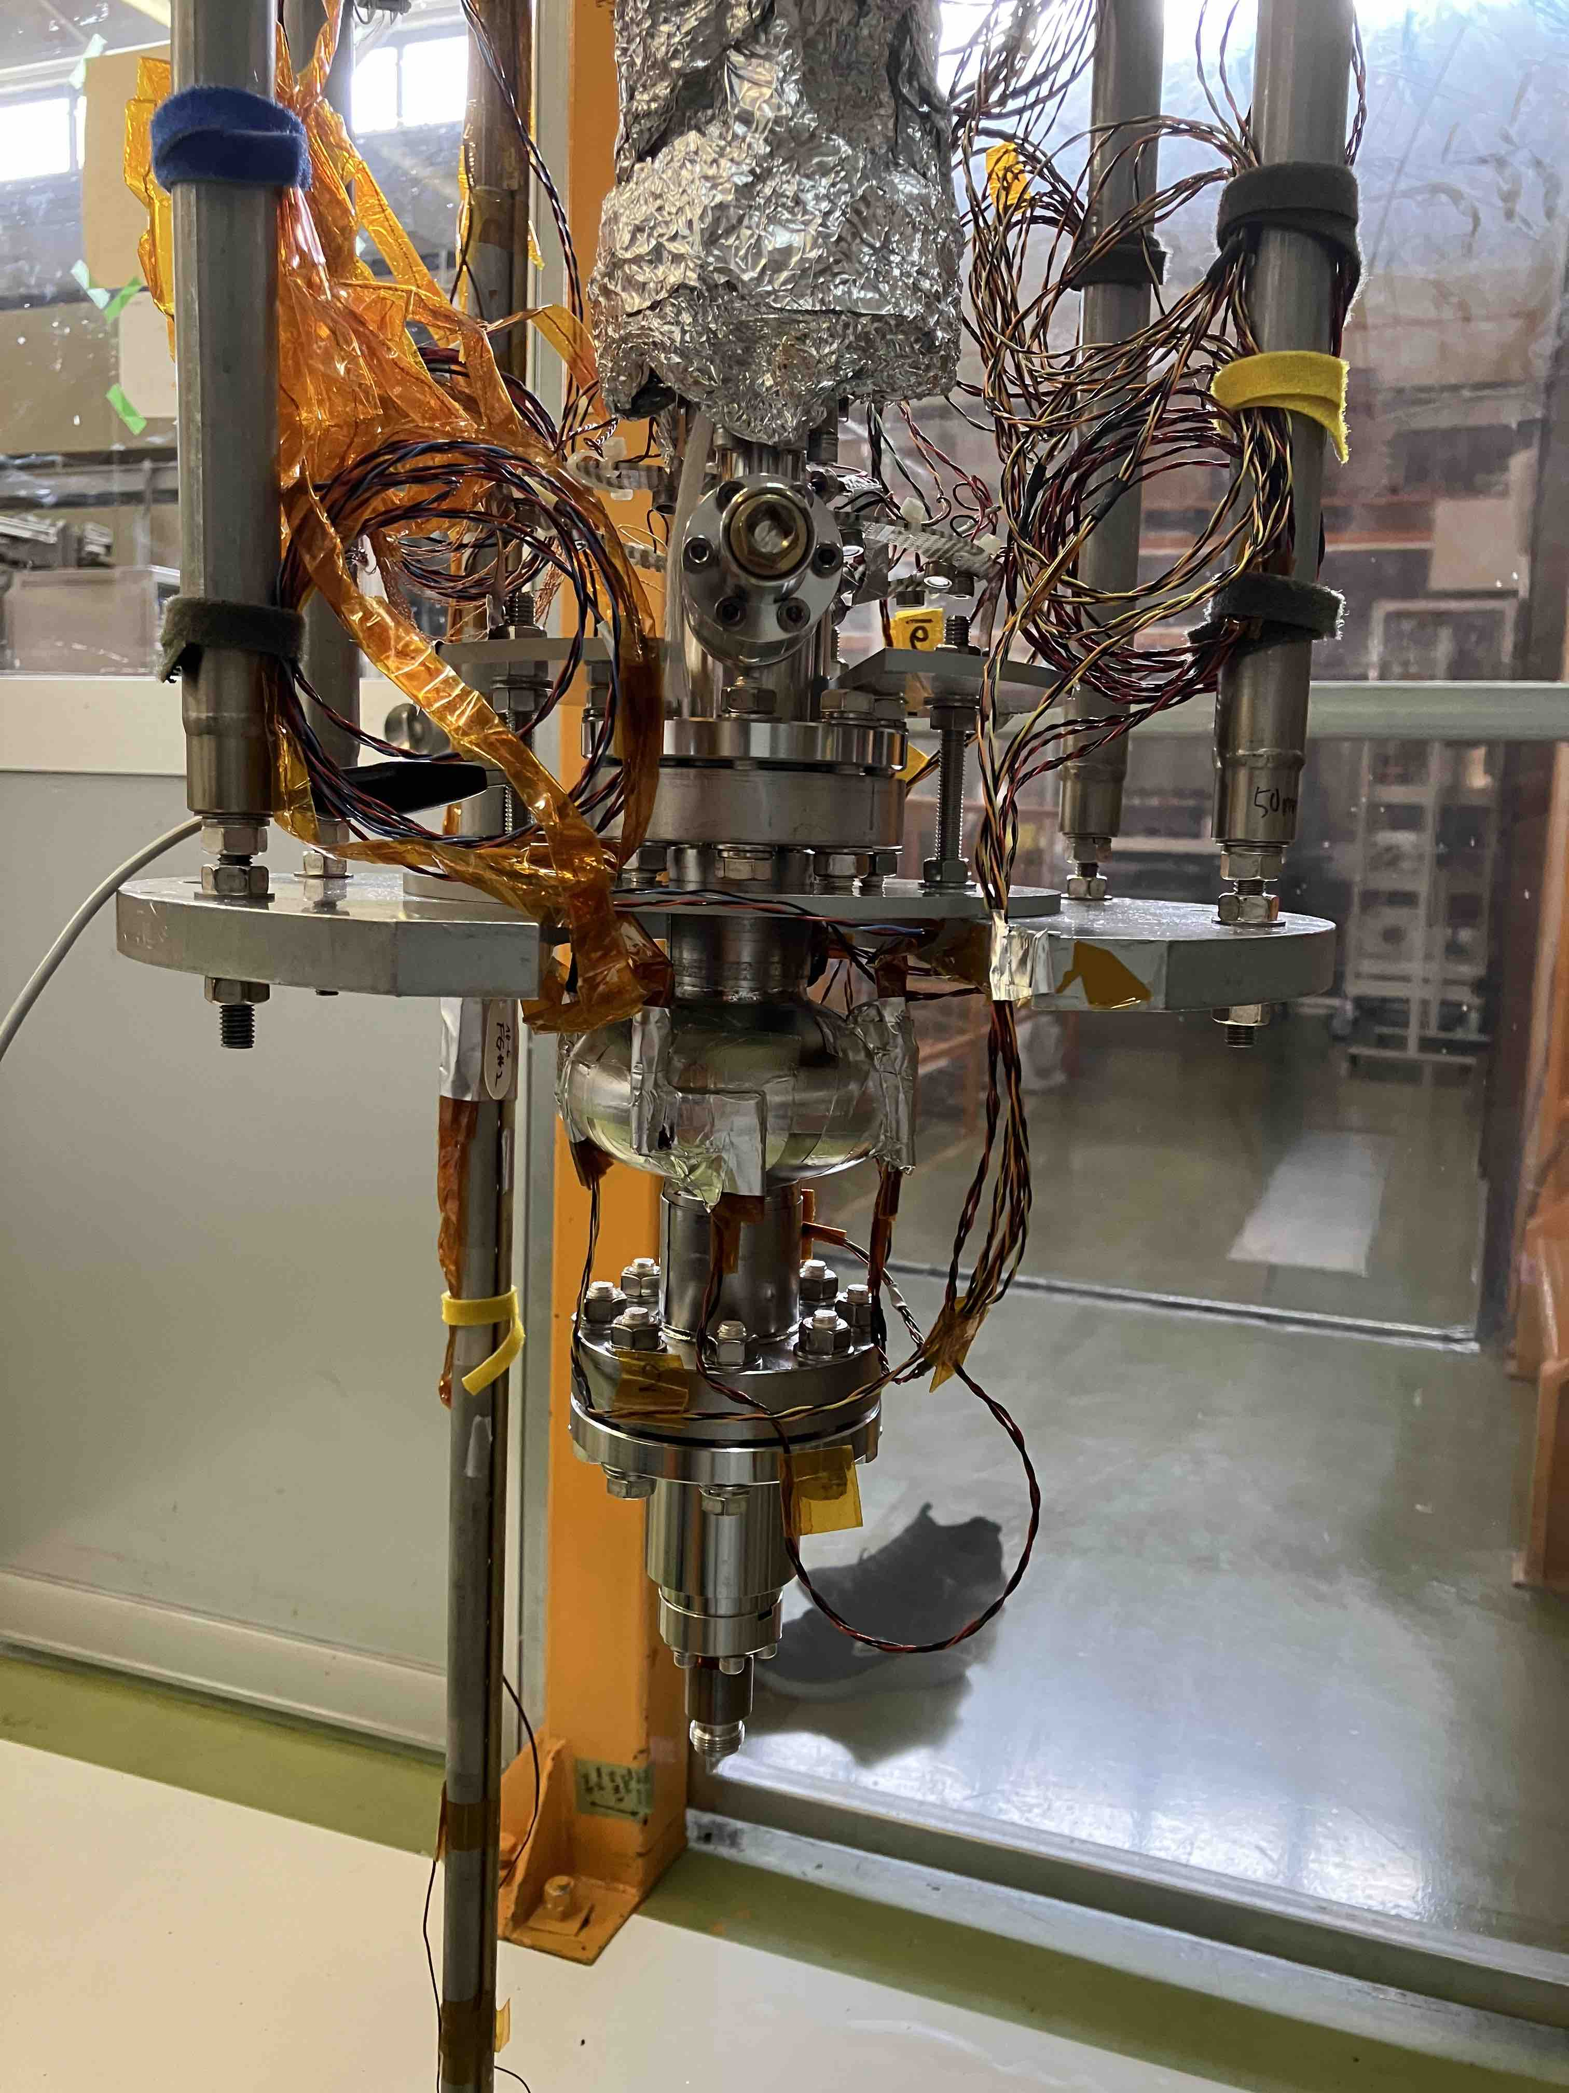
Vertical test of 3GHz elliptical cavities (FY2025)
Vertical test (VT) will be performed to measure RF performance of 3 GHz cavities at KEK-STF.
Preliminary test result of VT in April 2025
For a 3GHz cavity after EP2 process
- E_{acc} ~ 22 MV/m
- Q₀ > 1 x 10⁹ (@ 2K)
Established measurement system for 3 GHz cavities
will be tuned in order to measure the performance of
cavities with various treatments in the future:
thin-film coating, mid-T baking, etc…

Slide 15
Continued Effort Towards Ultimate Performance for Accelerator Cavities
Japan Part
Progress in Theory T. Kubo
Experimental effort for TF R. Katayama
3GHz cavity Y. Fuwa
Vertical & HF free EP T. Goto

Slide 16
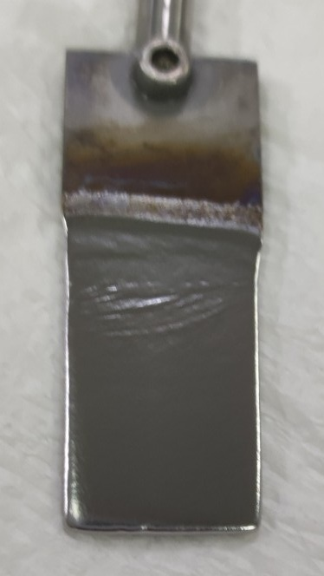
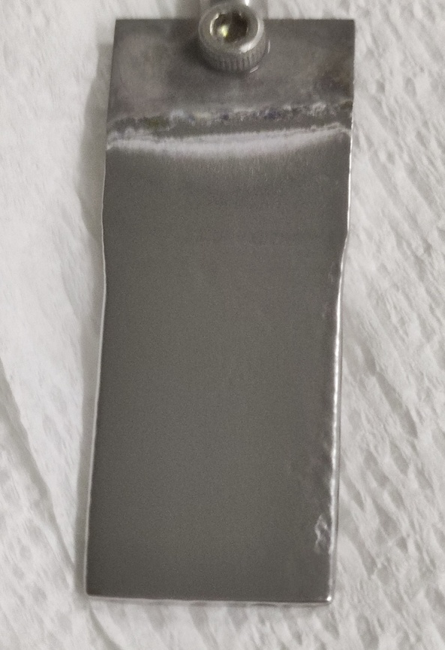
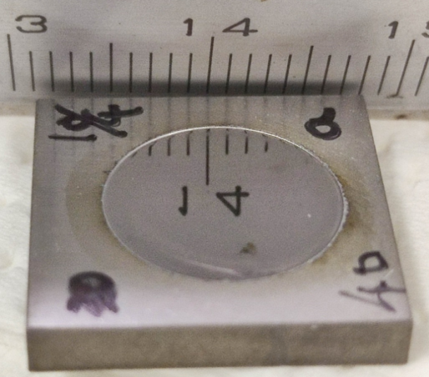
Development of HF free EP of Nb with organic solvents (Report FY2024)
- Hydrofluoric acid (+ sulfuric acid) is very dangerous as gas and liquid. >> high cost of EP process
- In the EP reaction, hydrogen atoms derived from water molecules in the electrolyte are absorbed into Nb.
>> Nb-H is formed in Nb, and the SRF performance of the cavity is very limited (especially, E_{acc}).
>> These problems can be solved by developing an EP process that uses organic solvents containing less water molecules in the electrolyte.
2023: sample area 1 cm²
- 1 M NH₄F in ethylene glycol
2024: ~10 cm²
For a larger sample area, the reaction conditions were optimized.
The conditions under which the difference between the front and back of the substrate becomes small were investigated.

Slide 17
Development of HF free EP of Nb with organic solvents (Plan FY2025)
- 1 M NH₄F in ethylene glycol
2025: ~1000 cm²
(assuming EP treatment of cavity)
2024: ~10 cm²
Large samples (~1000 cm²) will be tested.
The effect of small cathode area relative to anode will be examined
The effect of increasing the distance between electrodes will be examined.
For a larger sample area, the reaction conditions will be more optimized.
In 2025, the suitable conditions for larger sample area (~1000 cm²) will be investigated.

Slide 18
Continued Effort Towards Ultimate Performance for Accelerator Cavities
French Part
Vertical electropolishing F. Eozénou
Multilayers Y. Kalboussi

Slide 19

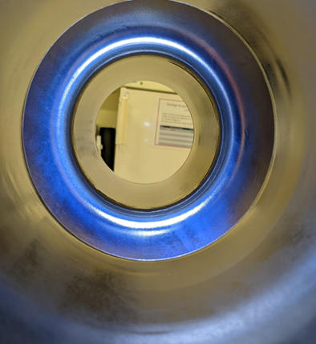
ELECTROLYTE INVESTIGATION
HF concentration 0.5% vs 3% for standard EP process
Effect of depleted HF concentration on performance?
Thicker oxyde might act as a barrier for Hydrogen?
Benefits of decreased HF concentration:
Toxicity lowered compared to standard mixture (skin contact H310 Vs H311)
No storage limitation constraint at Saclay
Blueish color obtained after VEP
on ESS 704 MHz single cell cavity
A new acid will be tested with theoretical HF concentration divided by 2: ‘SF10-1’
The acid has been purchased and received
The efficiency of the acid will be tested on single cell 1300MHz cavity

Slide 20
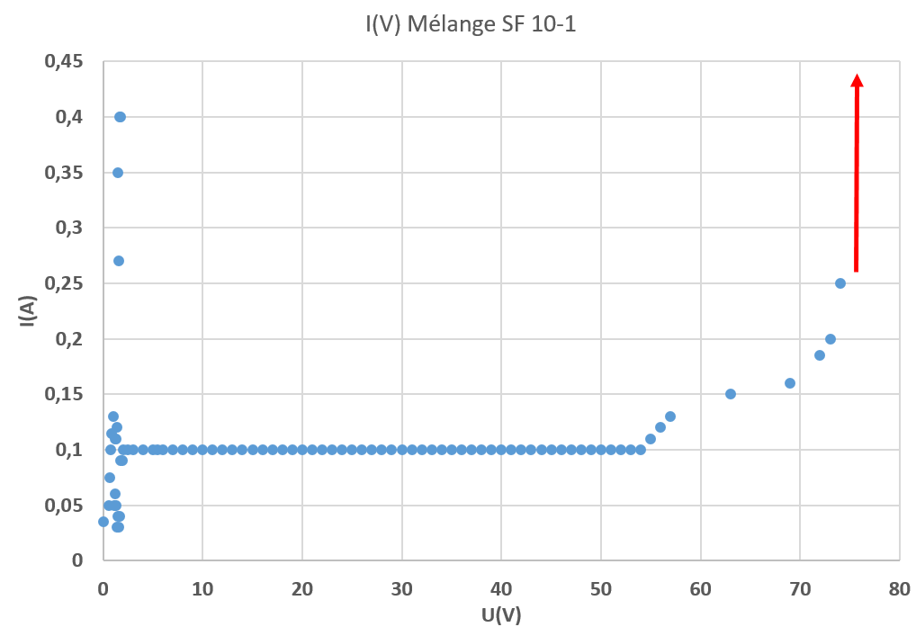
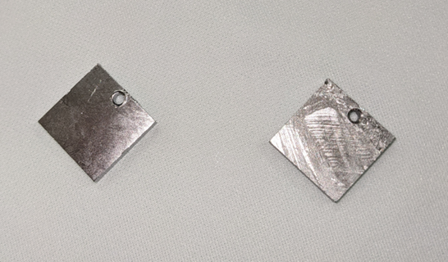
INVESTIGATION WITH ‘SF 10-1’ ON SAMPLES
    Investigation on samples: I(V) plot
    A clear ‘plateau’ is noticed for a wide range of potentials
    Sudden Intesity rise for U>70 V
    A dedicated 500V power supply will be used to investigate U>70V. Similar to Plasma ElectroPolishing ?

Slide 21
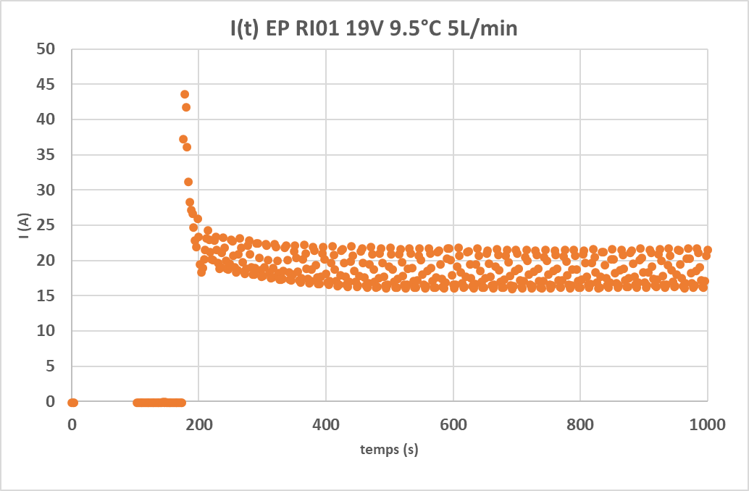
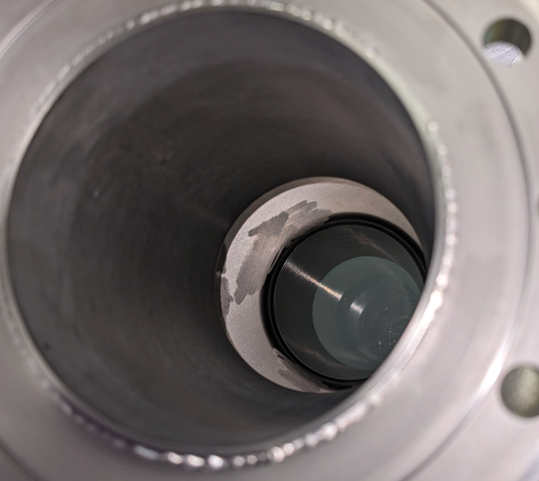
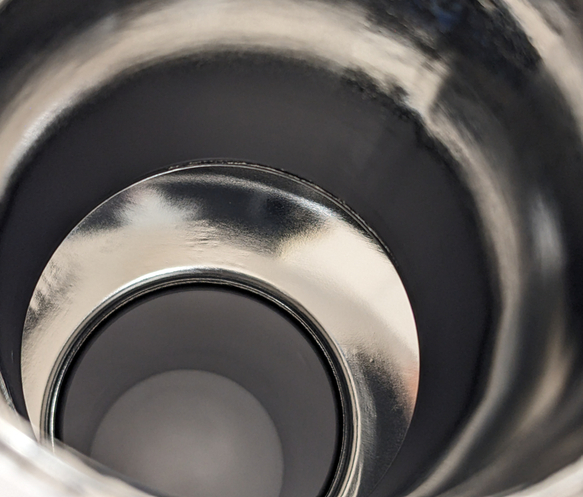
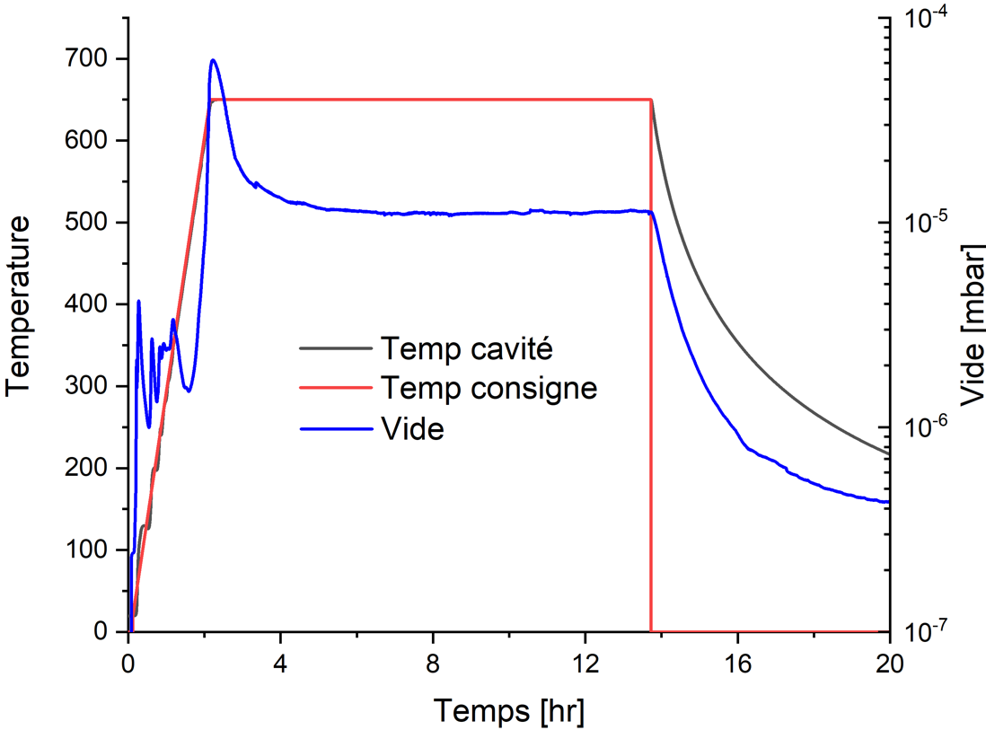
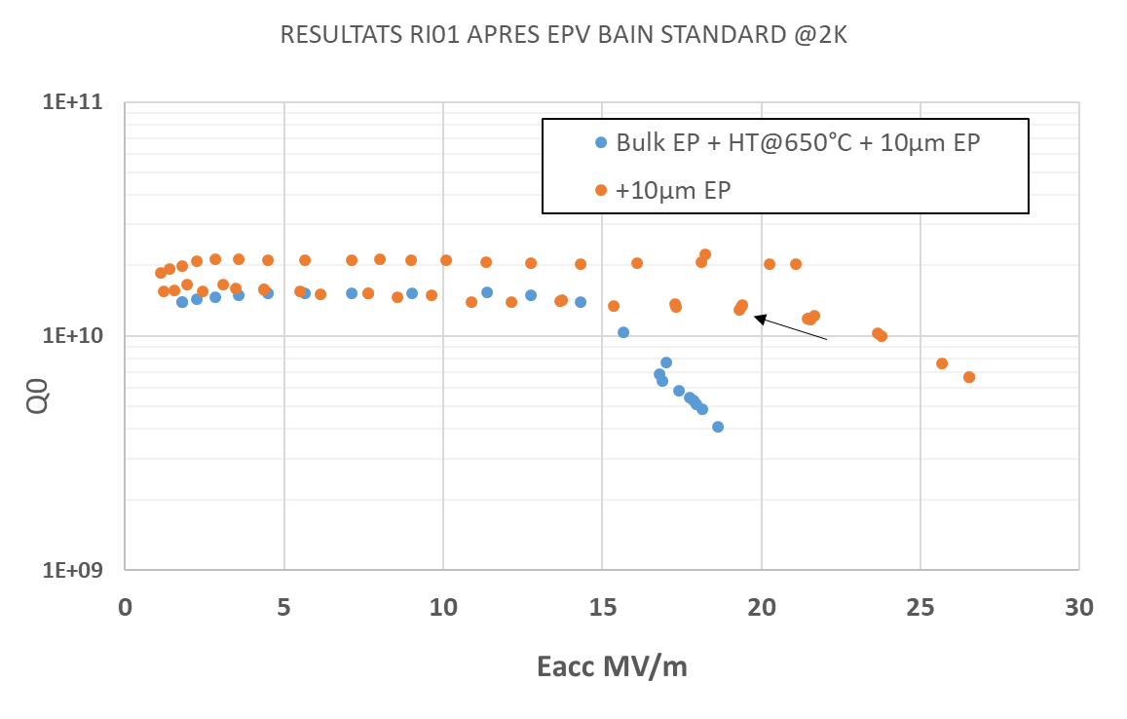
NEXT STEP: APPLICATION ON SINGLE CELL CAVITY
The cavity RI01 has been purchased
Test with ‘standard’ recipe for reference test
⁓240 µm bulk EP (0.15µm/min)
Typical current oscillations during standard VEP
Strong degassing during HT after standard recipe
RI01 tested twice with standard recipe: Field emission
Performance of RI01 limited by Field Emission (presence of a large defect at the surface?)
Addition 50 µm have been removed with standard recipe/parameters prior to VT

Slide 22
Continued Effort Towards Ultimate Performance for Accelerator Cavities
French Part
Vertical electropolishing F. Eozénou
Multilayers Y. Kalboussi

Slide 23
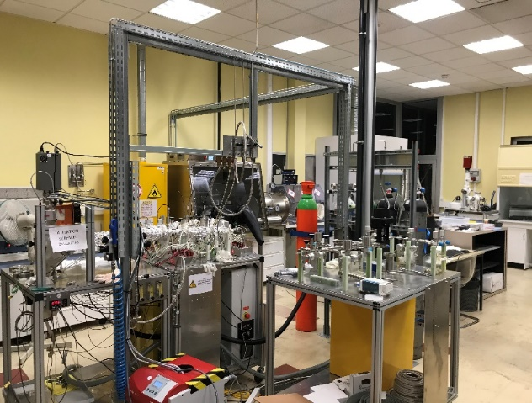
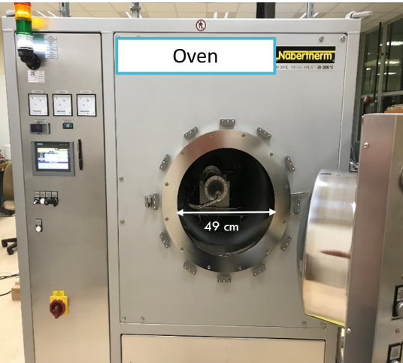
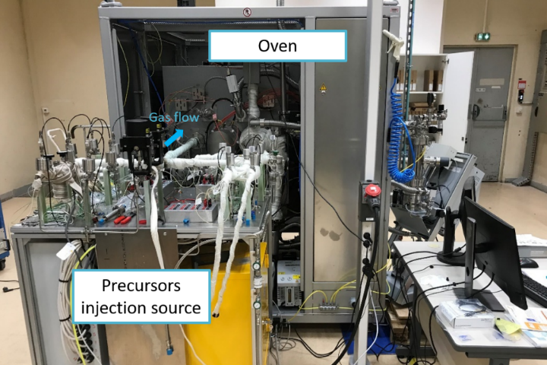
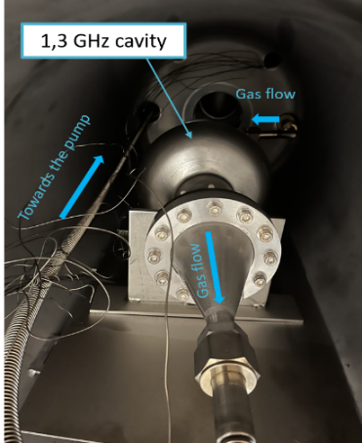
The lab – Deposition Lab
Two ALD deposition systems:
  Research scale: small samples (Φ = 5 cm , L = 40 cm) - New chemistries
  Development scale: Macroscopic objects (Φ = 49 cm , L = 110 cm). 1.3, 0.7 GHz cavities
  Future:
    HIPIMS deposition system for A15 on 1.3 GHz cavities and large coupons.
    Thematic:
      Superconductors (cavities, QuBits), multipacting, Corrosion, Filtration…

Slide 24
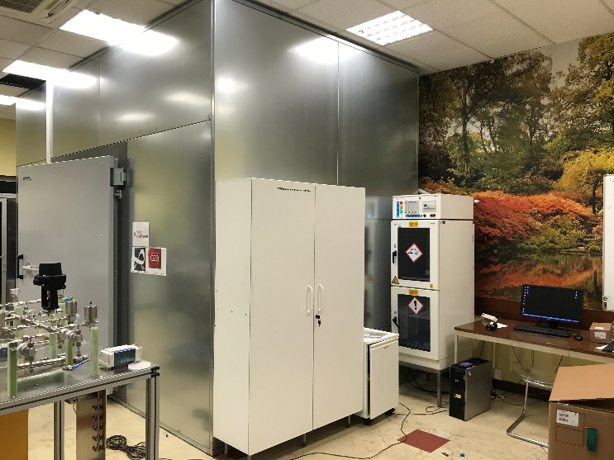
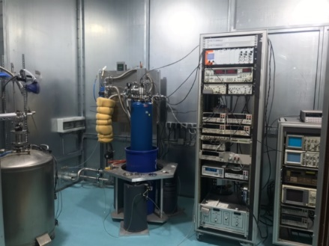
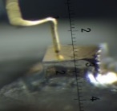
The Lab - Characterization
Tunneling spectroscopy (Superconducting properties: gap, local Tc, Mapping – 1,5 K – 1x1 cm²)
Transport measurements (Tc, RRR)
  Projects:
    Collaboration USA (thesis, measurements)
    Collaboration with CERN (Nb₃Sn/Cu…)
    Research area:
      Qubits, cavities, ALD…

Slide 25
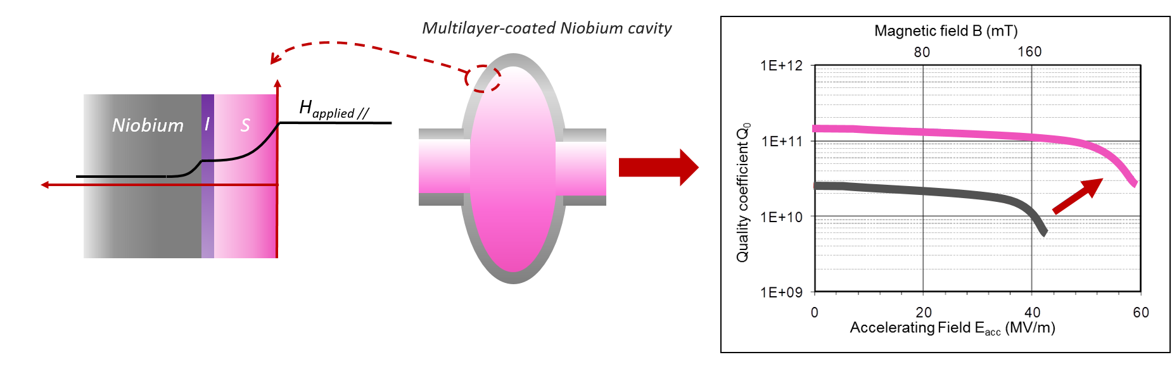
Multilayers
A theoretical approach proposed by A. Gurevich (2006) to improve RF cavities through depositing a superconducting multilayer to screen the magnetic field.
The thickness of the superconductor must be lower than its penetration depth.
The superconducting layer must have higher T_{c} than Nb.
25

Slide 26


Multilayers: NbTiN
To enhance the superconducting performances of NbTiN films, several thermal treatments have been tested. The best results on Nb coated samples were obtained with:
A first ramp of 6 °C/ minute up to 800°C
A second ramp of 18°C/minute up to 900°C
NbTiN (45 nm) –AlN (10 nm) – Niobium
NbTiN (45 nm) –AlN (10 nm) – Sapphire
Plateforme MPBT
T_{c} is similar on Niobium and Sapphire substrate.

Slide 27



ALD on SRF cavities and multilayers
The Niobium ellipsoid was coated and annealed with the optimized NbTiN-AlN bilayer recipe.
NbTiN
AlN
Nb
T. SAEKI, TFSRF21: Overview of thin-film studies at KEK and Kyoto University, (2021).
Enhancement of first penetration field demonstrated.
Thicker layer (~ 200 nm) to determine ξ and the predicted optimal thickness

Slide 28

NbTiN-AlN Multilayer on 1,3 GHz cavity
The Niobium cavity was coated with the optimized AlN- NbTiN bilayer recipe .
Coating had a bright golden and uniform colour.
The cavity was annealed @ 900°C.
Vacuum degradation during the annealing step on the first test.
( P>10⁻⁵ mbar )
Observed delamination in the beam tubes after annealing.

Slide 29







Delamination studies
- Leak detected and fixed.
- Upscaling of the samples with tubes and curve plate
BSE
50 µm
Height : 30 mm
Diameter : 37 mm
Annealed at 900°C
InLens
200 nm
55 by 22 mm
InLens
200 nm
Tc ~ 14.5 - 15 K (42 nm)
New multilayer diffusion barrier.
Presence of film confirmed by XRD, EDS, MEB
No delamination observed
29
Notes:
Outlook for FJPPN : pursue studies on multi-layers and perform cavity tests

Slide 30
Pursue the effort towards ultimate gradients and quality factors for SRF cavities.
 | CEA Saclay | KEK
VEP | VEP with a depleted HF concentration (<0.5%) with Ninja cathode: ongoing - Single-cell 1300MHz cavities prior to ALD deposition - 704MHz activities | New VEP facility for 1.3GHz 9-cell cavity, in addition to HEP facility. The Ninja cathode dedicated for the VEP process for cavity Hydrofluoric acid-free EP process Plasma electrolytic polishing (PEP)
Thin-film | A multilayer Nb/AlN/NbTiN ALD layers deposition on 3000MHz Cu and Nb cavities. | AlN-NbN thin-film: coupon analysis AlN-NbN thin-film grown on single-cell 3000MHz Nb cavities. The cavities will be tested at 4K and 2K. Theoretical study of multilayer structure.

Slide 31
THANK YOU FOR YOUR ATTENTION

