Slide 1




Measurement and simulation of injection losses and
resulting detector backgrounds at SuperKEKB
FJPPN- A_RD_30
IJCLab, Orsay, France
P. Bambade*
M. Li
S. Wallon
KEK, Tsukuba, Japan
N. Iida*, Y. Funakoshi, H. Kaji
T. Koga, Y. Ohnishi, K. Uno
S. Uehara , H. Nakayama
2025 Joint workshop of FKPPN and TYL/FJPPN, 14-16 May, 2025

Slide 2
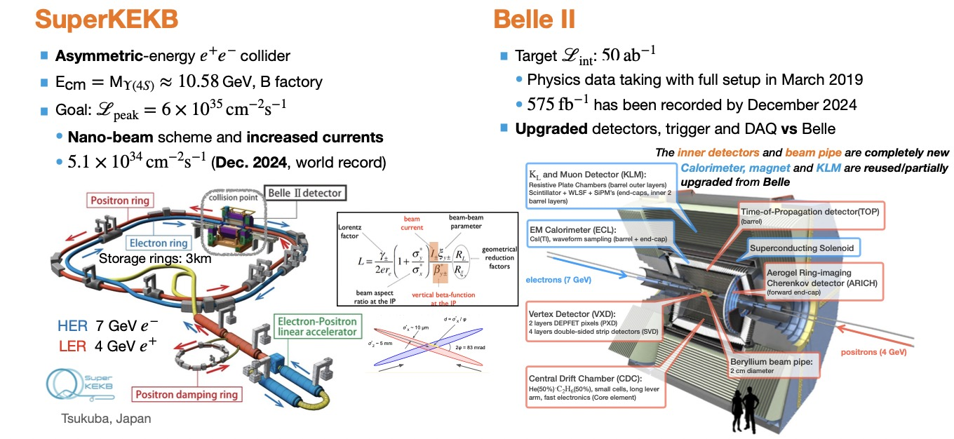
SuperKEKB/Belle II project
2
Achieving the target design luminosity remains a major challenge.

Slide 3
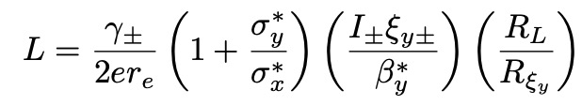
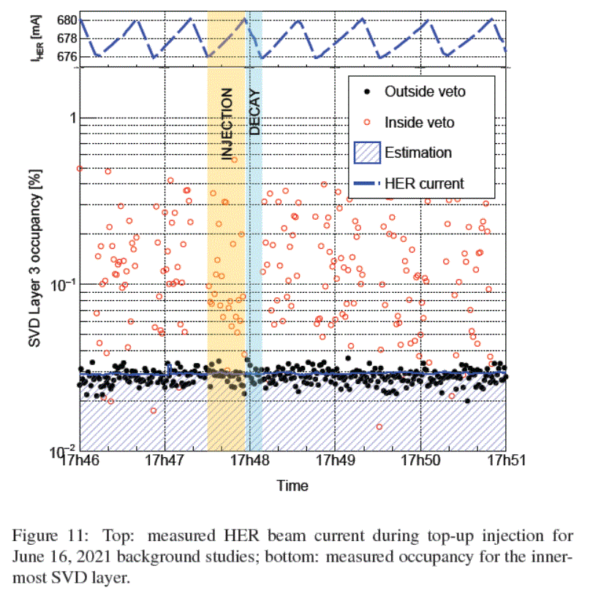
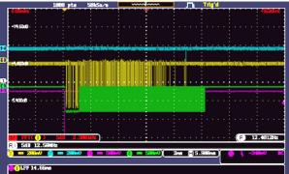
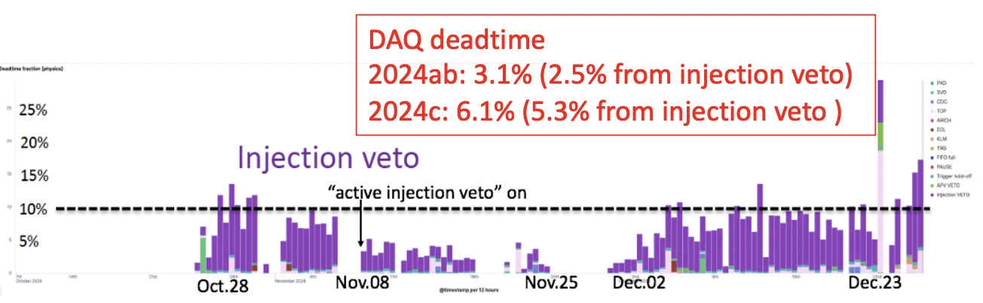
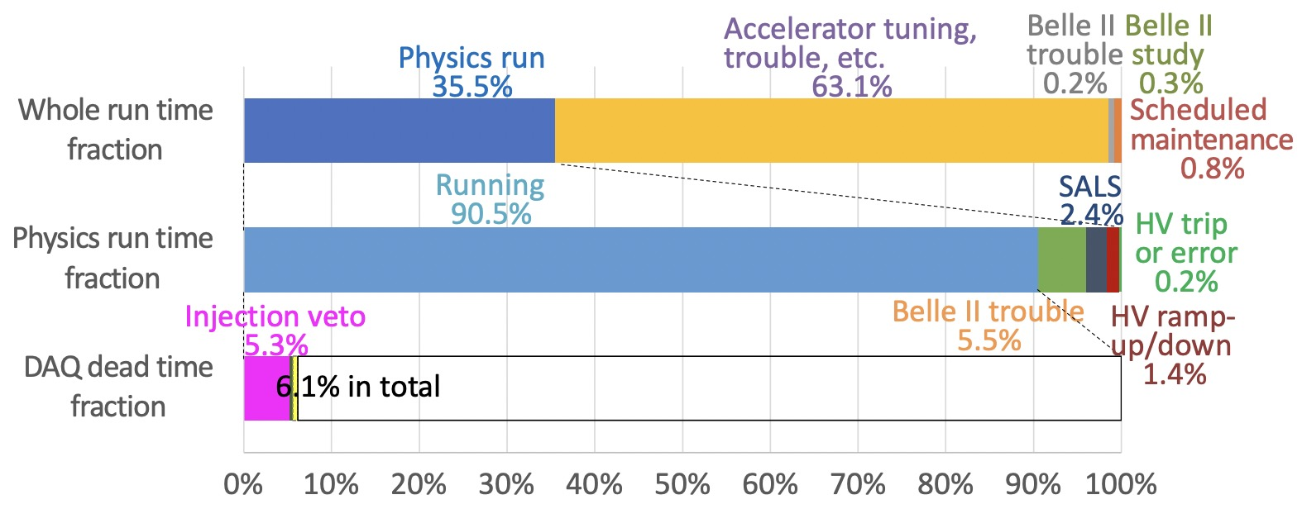


SuperKEKB/Belle II project
3
Injection strongly limit higher luminosity during recent operation
high currents → reduced lifetimes → tried during 2024c run
$$×$$
Small $β_{y}^{∗}$ → reduced DA → tried 0.8mm during 2022ab run
$$×$$
Achieved injection efficiency during physics run almost lower than half of the required -> limit beam current
Huge background appear just after beam injection and continues more than 10ms -> limit data taking efficiency
-Belle II trigger is vetoed for a while after injection ->large DAQ deadtime of 5~15%
Injection-related issues are expected to become more severe for higher luminosity -> serious issue for target luminosity
Detailed injection-related beam loss and background simulation is essential for improving injection efficiency and BG
-ECLBG –Injection Veto
～10ms
SVD first layer occupancy
ECLTRG injectionBG duration

Slide 4
FJPPN- A_RD_30
4
Title | Measurement and simulation of injection losses and resulting detector backgrounds at SuperKEKB
Subject | LumiBelle2 fast luminosity monitor at SuperKEKB -> high peak and integrated luminosity Injection-related beam loss and backgrounds at SuperKEKB ->necessary for high luminosity&data taking efficiency
Member | IJCLab, Orsay, France P. Bambade* M. Li (PhD) S. Wallon | KEK, Tsukuba, Japan N. Iida*, Y. Funakoshi, H. Kaji T. Koga, Y. Ohnishi, K. Uno S. Uehara , H. Nakayama
Activities | France->Japan: improve injection simulation; conduct injection validation experiment; join LumiBelle2 operation 2024.02.14-03.15(M. Li, supported by EAJADE) 2024.02.24-03.07(P. Bambade, supported by JENNIFER2) 2024.05.12-07.11(M. Li , supported by TYL and EAJADE) 2024.11.10-12.28(M. Li, supported by TYL and IHEP) 2025.02.24-03.08(M. Li, supported by TYL and EAJADE) Japan->France: disscuss project progress and plan 2024.09.20-09.28(H. Kaji, supported by FJPPN) 2024.10.30-11.01(H. Kaji, supported by FJPPN)
Articles, conference talks | “Status and Performance of LumiBelle2 in the 2024 Beam Operation of SuperKEKB“, by Meng LI et al., presented at the IBIC 2024, Beijing, China (THP16) “Investigation on injection-related beam loss at SuperKEKB”, by Meng LI et al., Invited talk at eeFAC2025, Tsukuba, Japan (TUA14) …

Slide 5
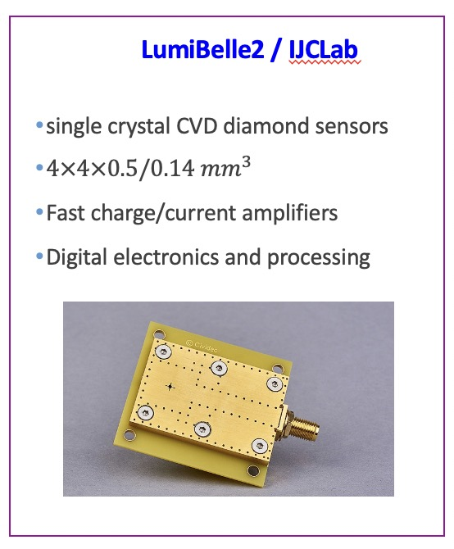
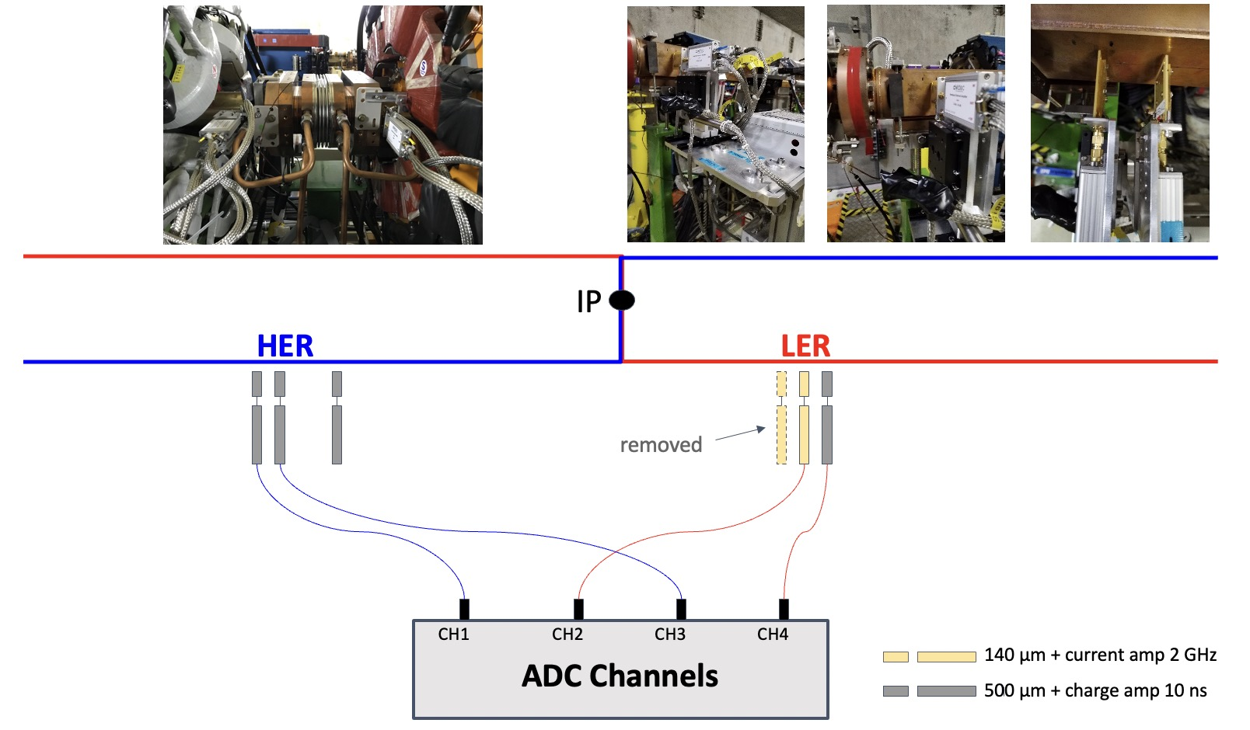
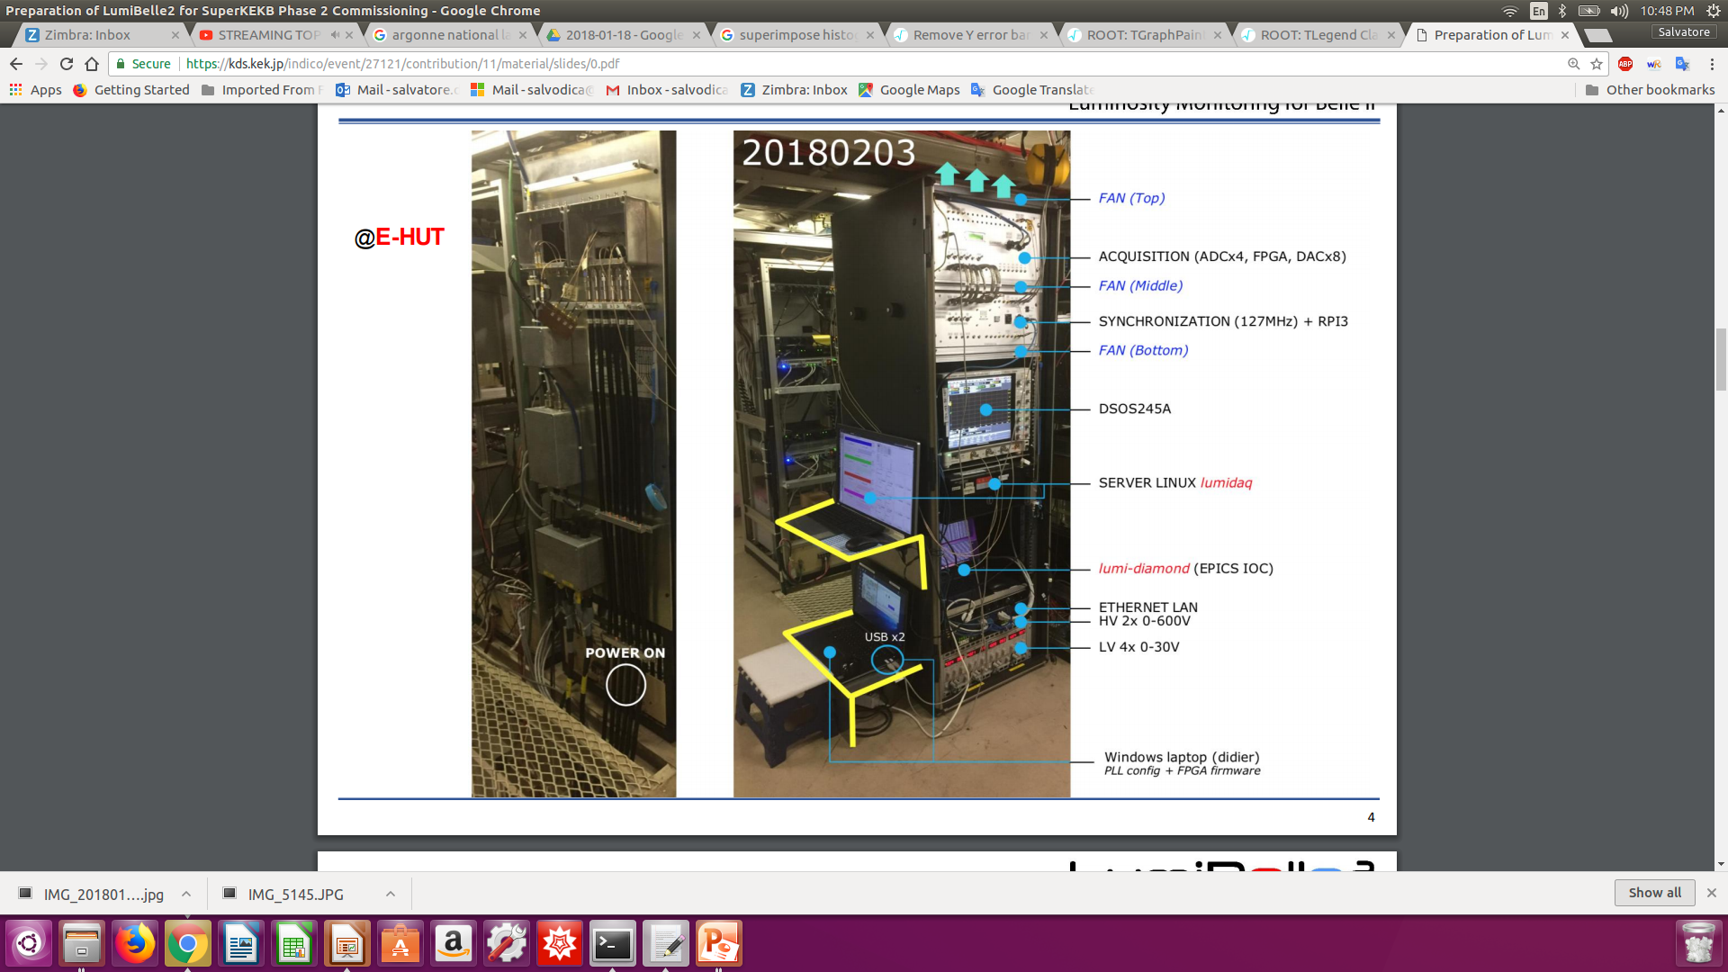
IJCLab–KEK Collaboration within FJPPN-TYL
5
Since 2012:
Collaboration on fast luminosity monitor at SuperKEKB(LumiBelle2)
-> Developed a fast luminosity monitor LumiBelle2 based on sCVD diamond detectors
-> Fast luminosity measurement and feedback(1% relative precision@1kHz )
-> Bunch by bunch luminosity diagnostic(1% relative precision@1Hz)
-> IP vertical beam size measurement + tuning at very low currents
-> Maintain optimum collision conditions & maximize luminosity

Slide 6
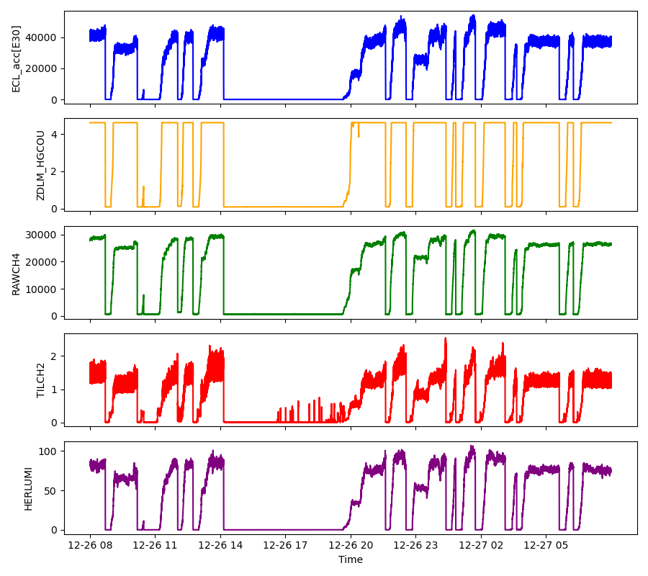
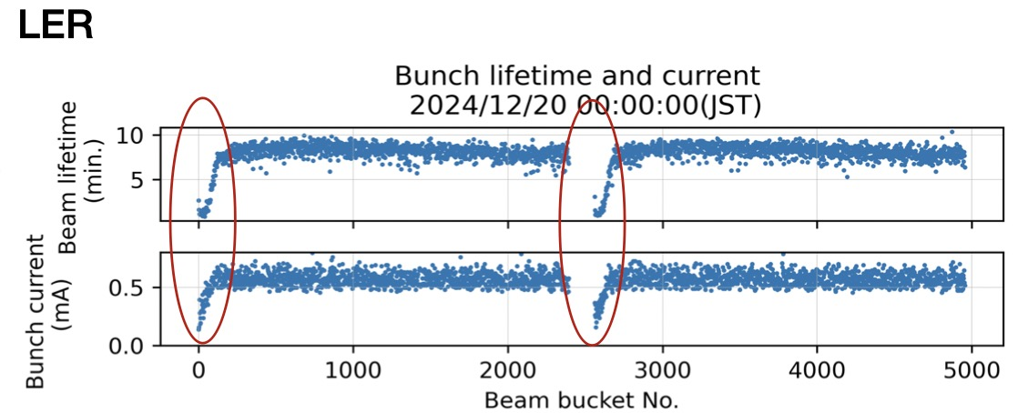
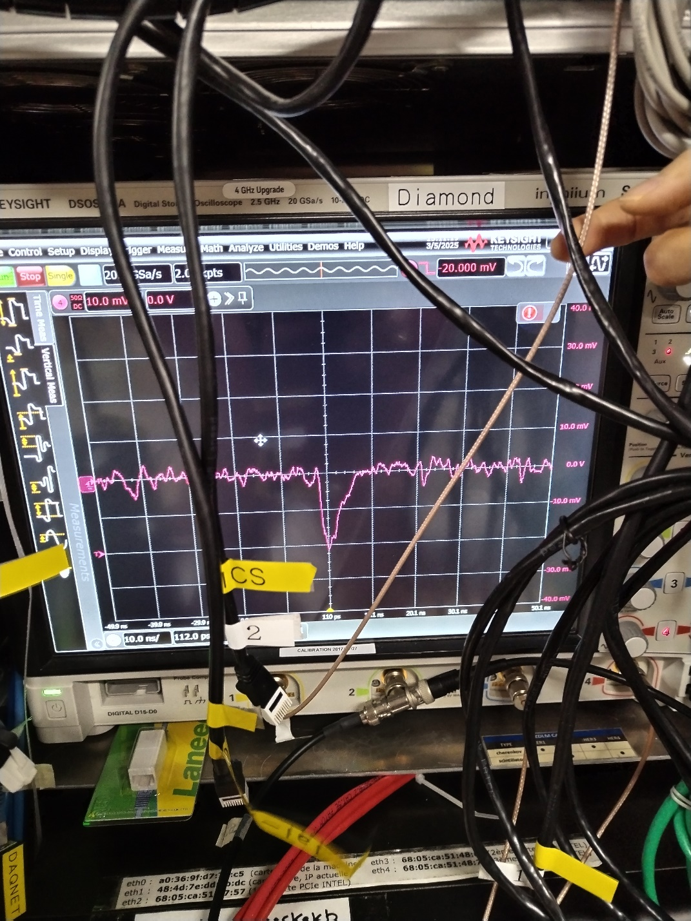
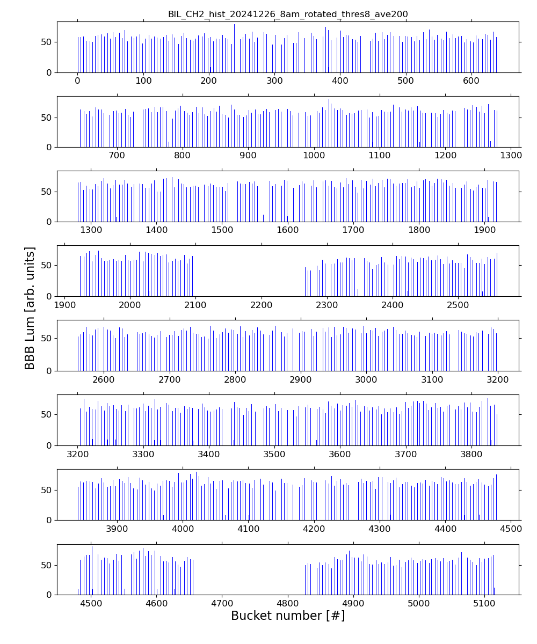
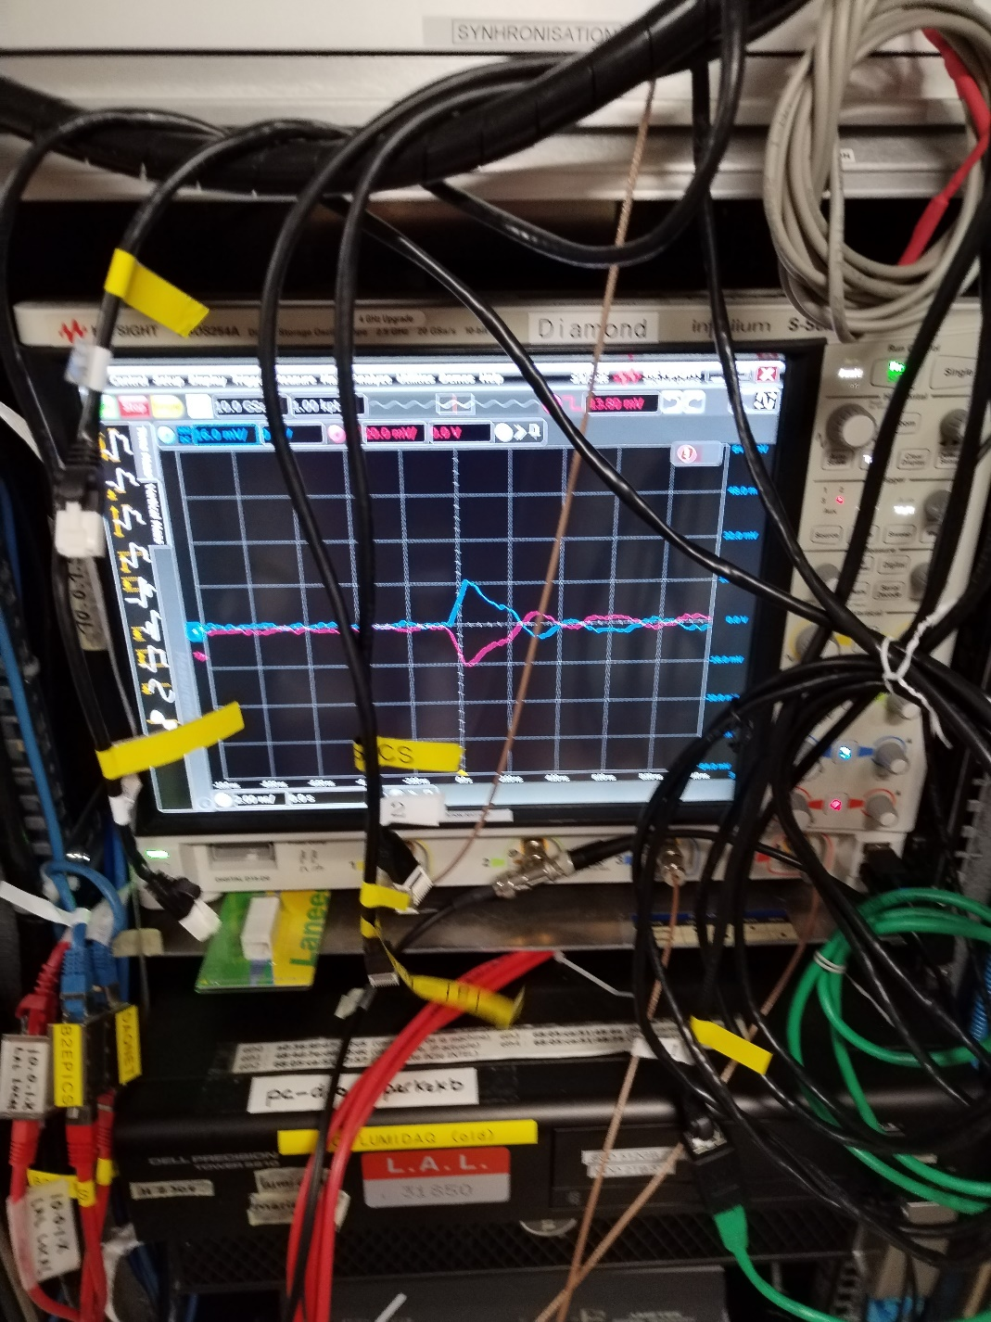
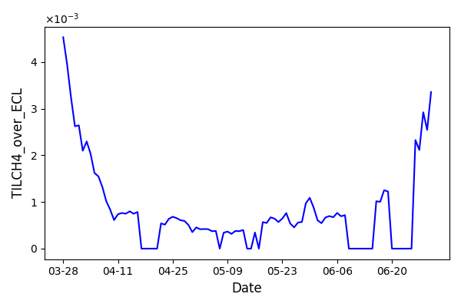
LumiBelle2 fast luminosity monitor at SuperKEKB
6
In 2024, the LumiBelle2 was operated successfully at KEK
Conducted data analysis based on 2024 run to estimate the performance of Diamond sensors
- Internal data handling/archiving software instability
- Sensor sensitivity drift in one diamond detector
Observed variation of B-by-B lifetimes -> B-by-B luminosity data for machine tuning required by SuperKEKB group
Install LGAD sensors in LumiBelle2 -> radiation hardened version from IHEP-Beijing used in Atlas
500μm diamond herd42 with C2HV0235
Trigger level -20mV
sensitivity@500um diamond
LGAD sensor from IHEP with C2HV0235 and RF splitter / inverter
Trigger level 13.8mV

Slide 7
IJCLab–KEK Collaboration within FJPPN-TYL
7
Since 2024:
Extended the collaboration ➔ injection-related beam losses at SuperKEKB
-> reliable injection simulation for accelerator operation
-> Improve injection performance and reduce injection BG
-> Achieve high luminosity & data taking efficiency
Progress
A detailed simulation of injected beam losses and related backgrounds was developed
-Injection errors mainly affect injection efficiency
-Beam-beam effect, cancel coil error have a large effect on injection-related background
-Beam loss in IR can be suppressed by minor collimator aperture adjustment
Validation experiments conducted in collaboration with SuperKEKB, MDI, and Belle II groups
-New CLAWS loss monitor installed for dedicated measurements
-CsI & EMT monitors and Belle II ECL sub-detectors reconfigured with 1 Hz injection trigger
The results show good qualitative agreement between the simulations and measurements

Slide 8
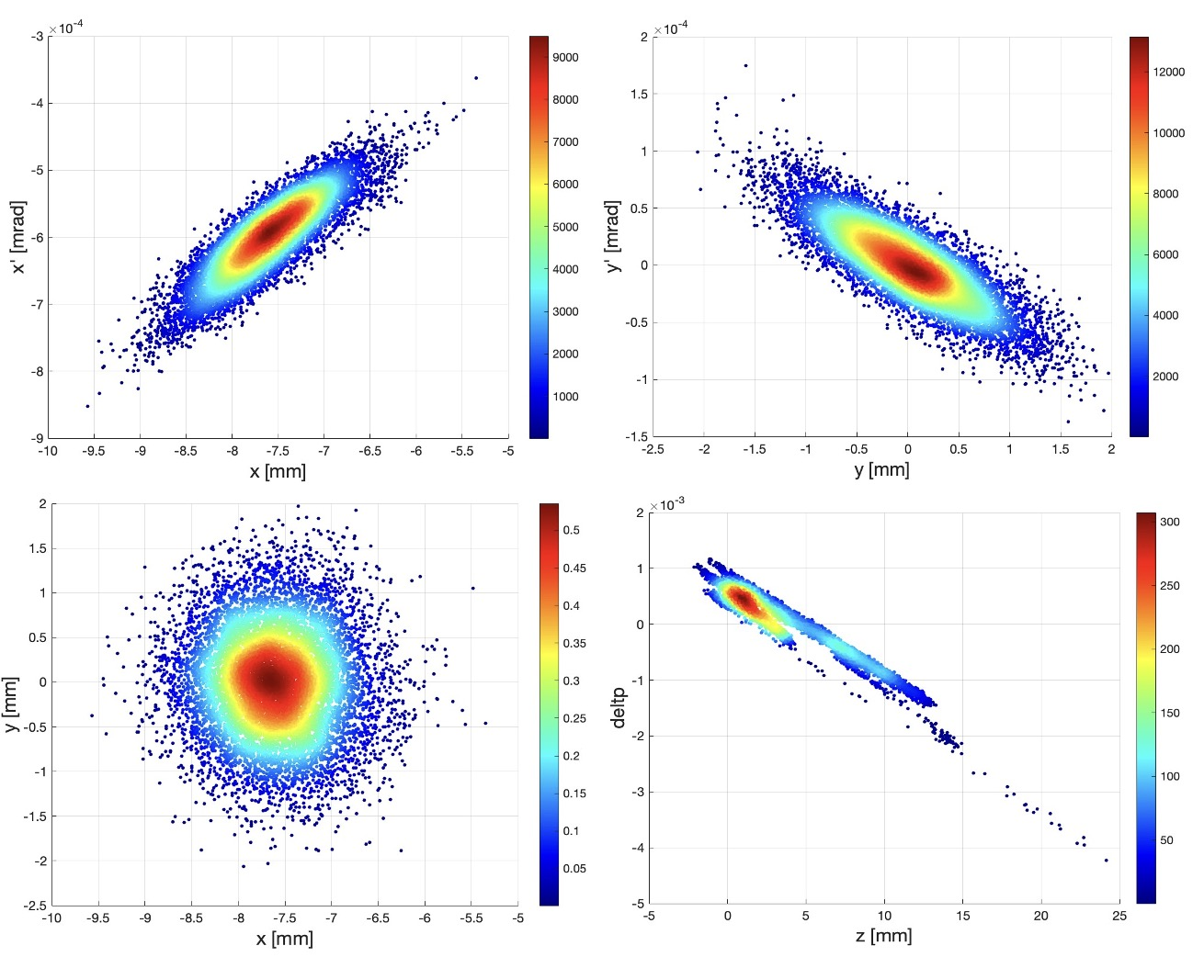
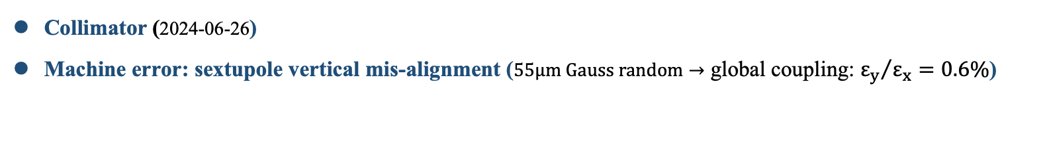
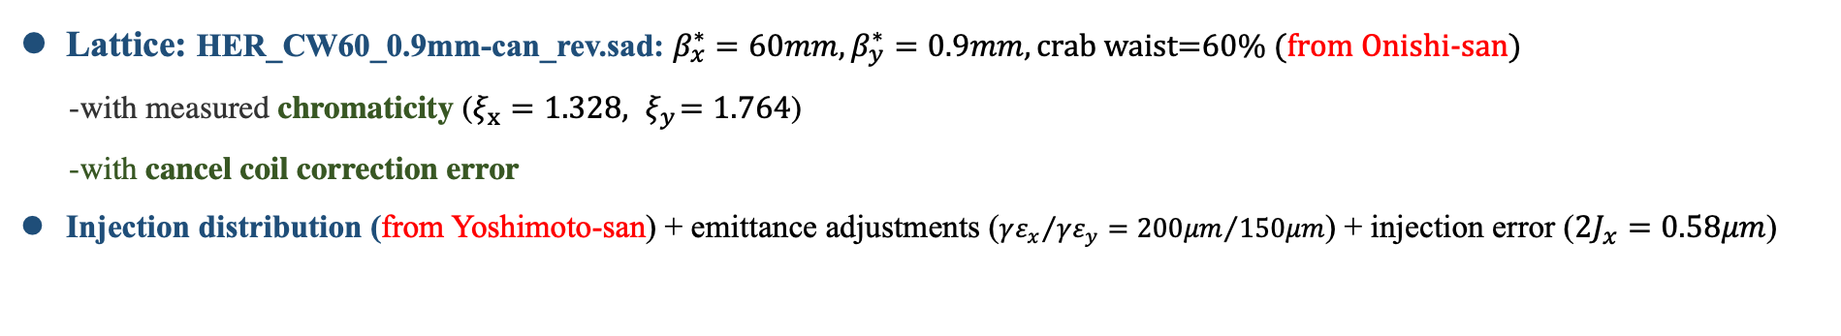
Injection simulation based on realistic operation settings
8
Lattice: HER_CW60_0.9mm-can_rev.sad: $β_{x}^{∗}=60mm, β_{y}^{∗}=0.9mm, \text{crab} \text{waist}\text{=60\%}$ (from Onishi-san)
-with measured chromaticity ($ξ_{x}=1.328,{ ξ}_{y}=1.764$)
-with cancel coil correction error
Injection distribution (from Yoshimoto-san) + emittance adjustments (${γε_{x}}/{γε_{y}={200μm}/{150μm}}$) + injection error (${2J}_{x}=0.58μm$)
Beam-beam(weak-strong model)
$N_{p}=3.31×{10}^{10}→I_{b}=0.5mA→ξ_{y}=0.017, ξ_{x}=0.010$ (based on 2024-6-27 operation emittance and bunch current)
Collimator (2024-06-26)
Machine error: sextupole vertical mis-alignment ($55μm Gauss random→$ global coupling: ${ε_{y}}/{ε_{x}=0.6\%}$)
Bunch-by-bunch feedback(damping time=0.5ms) $→$ Gaussian stored beam also included

Slide 9
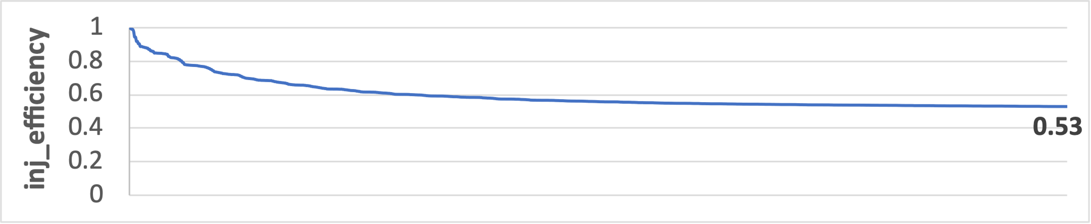
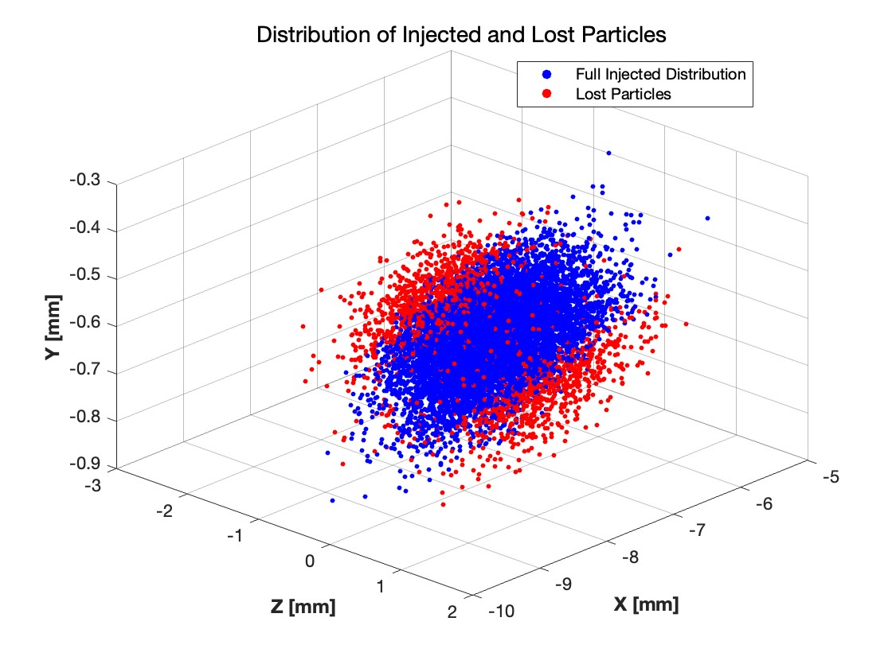
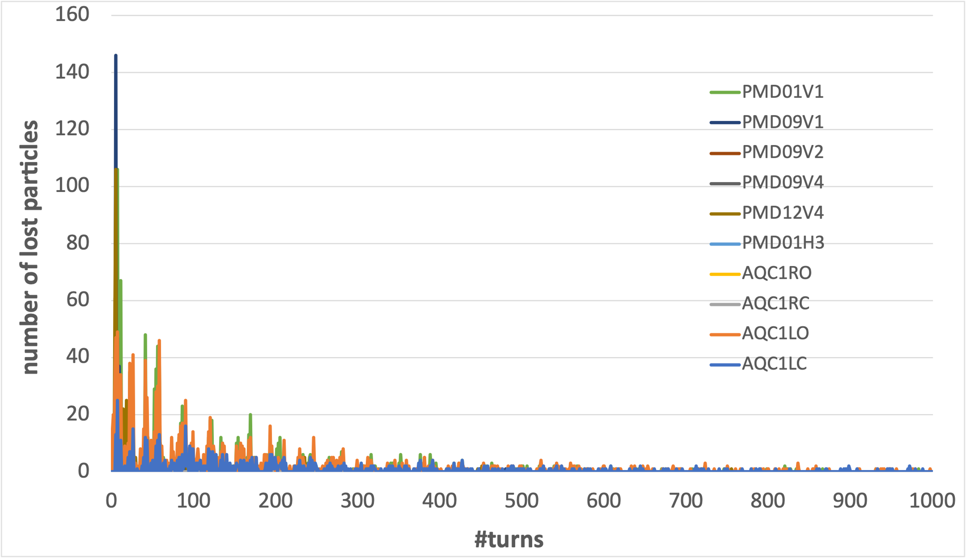
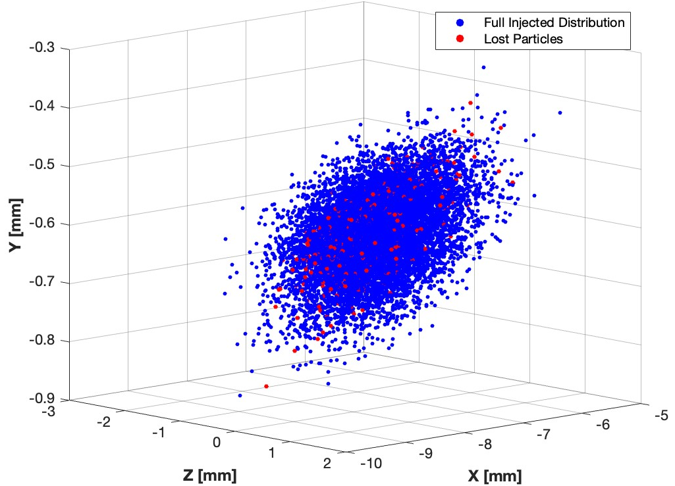
Injection efficiency and beam loss
9
A: Large rapid beam loss
A: Large rapid beam loss
originate from the edge of bunch
B: Small continuous beam loss
B: Small continuous beam loss
There are 2 different types of beam loss:
1) large and fast beam loss in the first 100 turns(30%) →injection efficiency
2) small and continuous beam loss until 1000 turns(10%) →injection BG duration
originate from the beam core

Slide 10
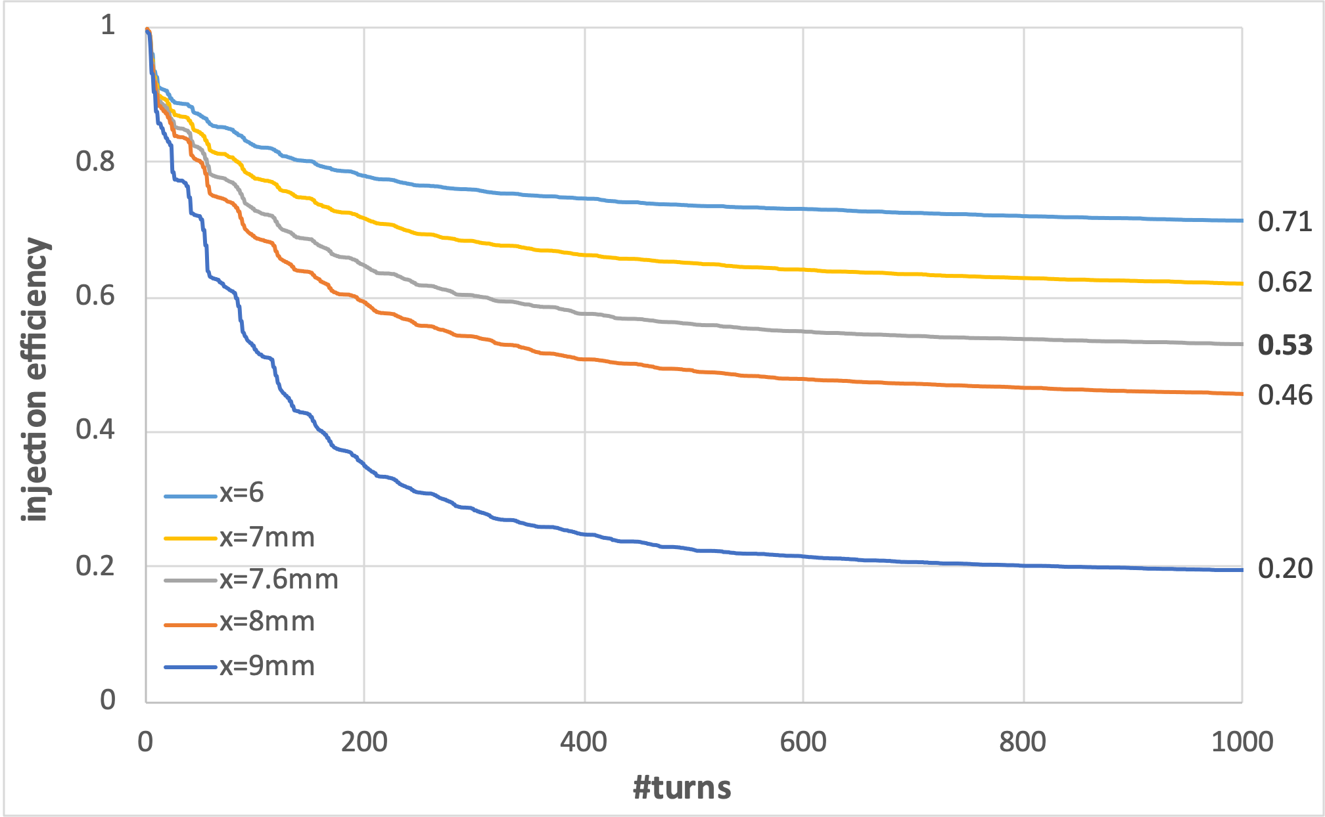
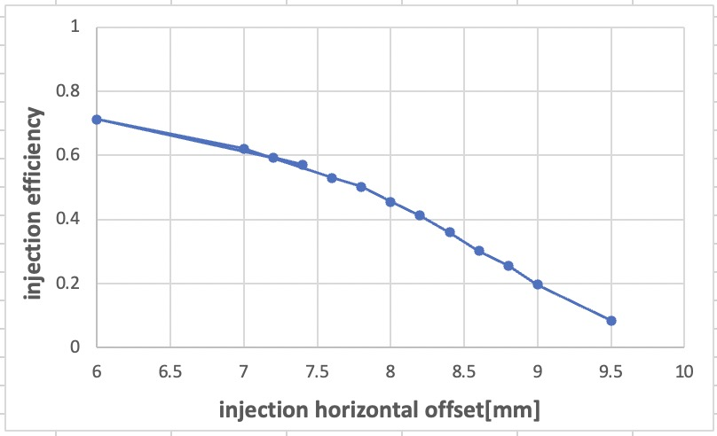
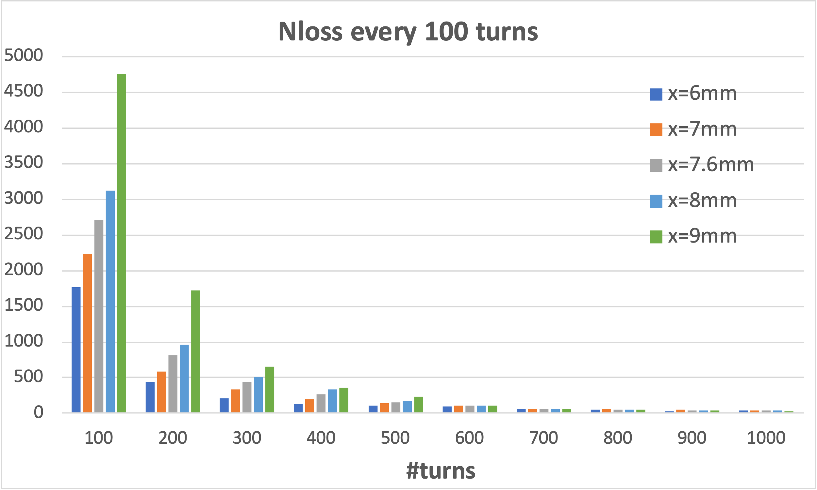
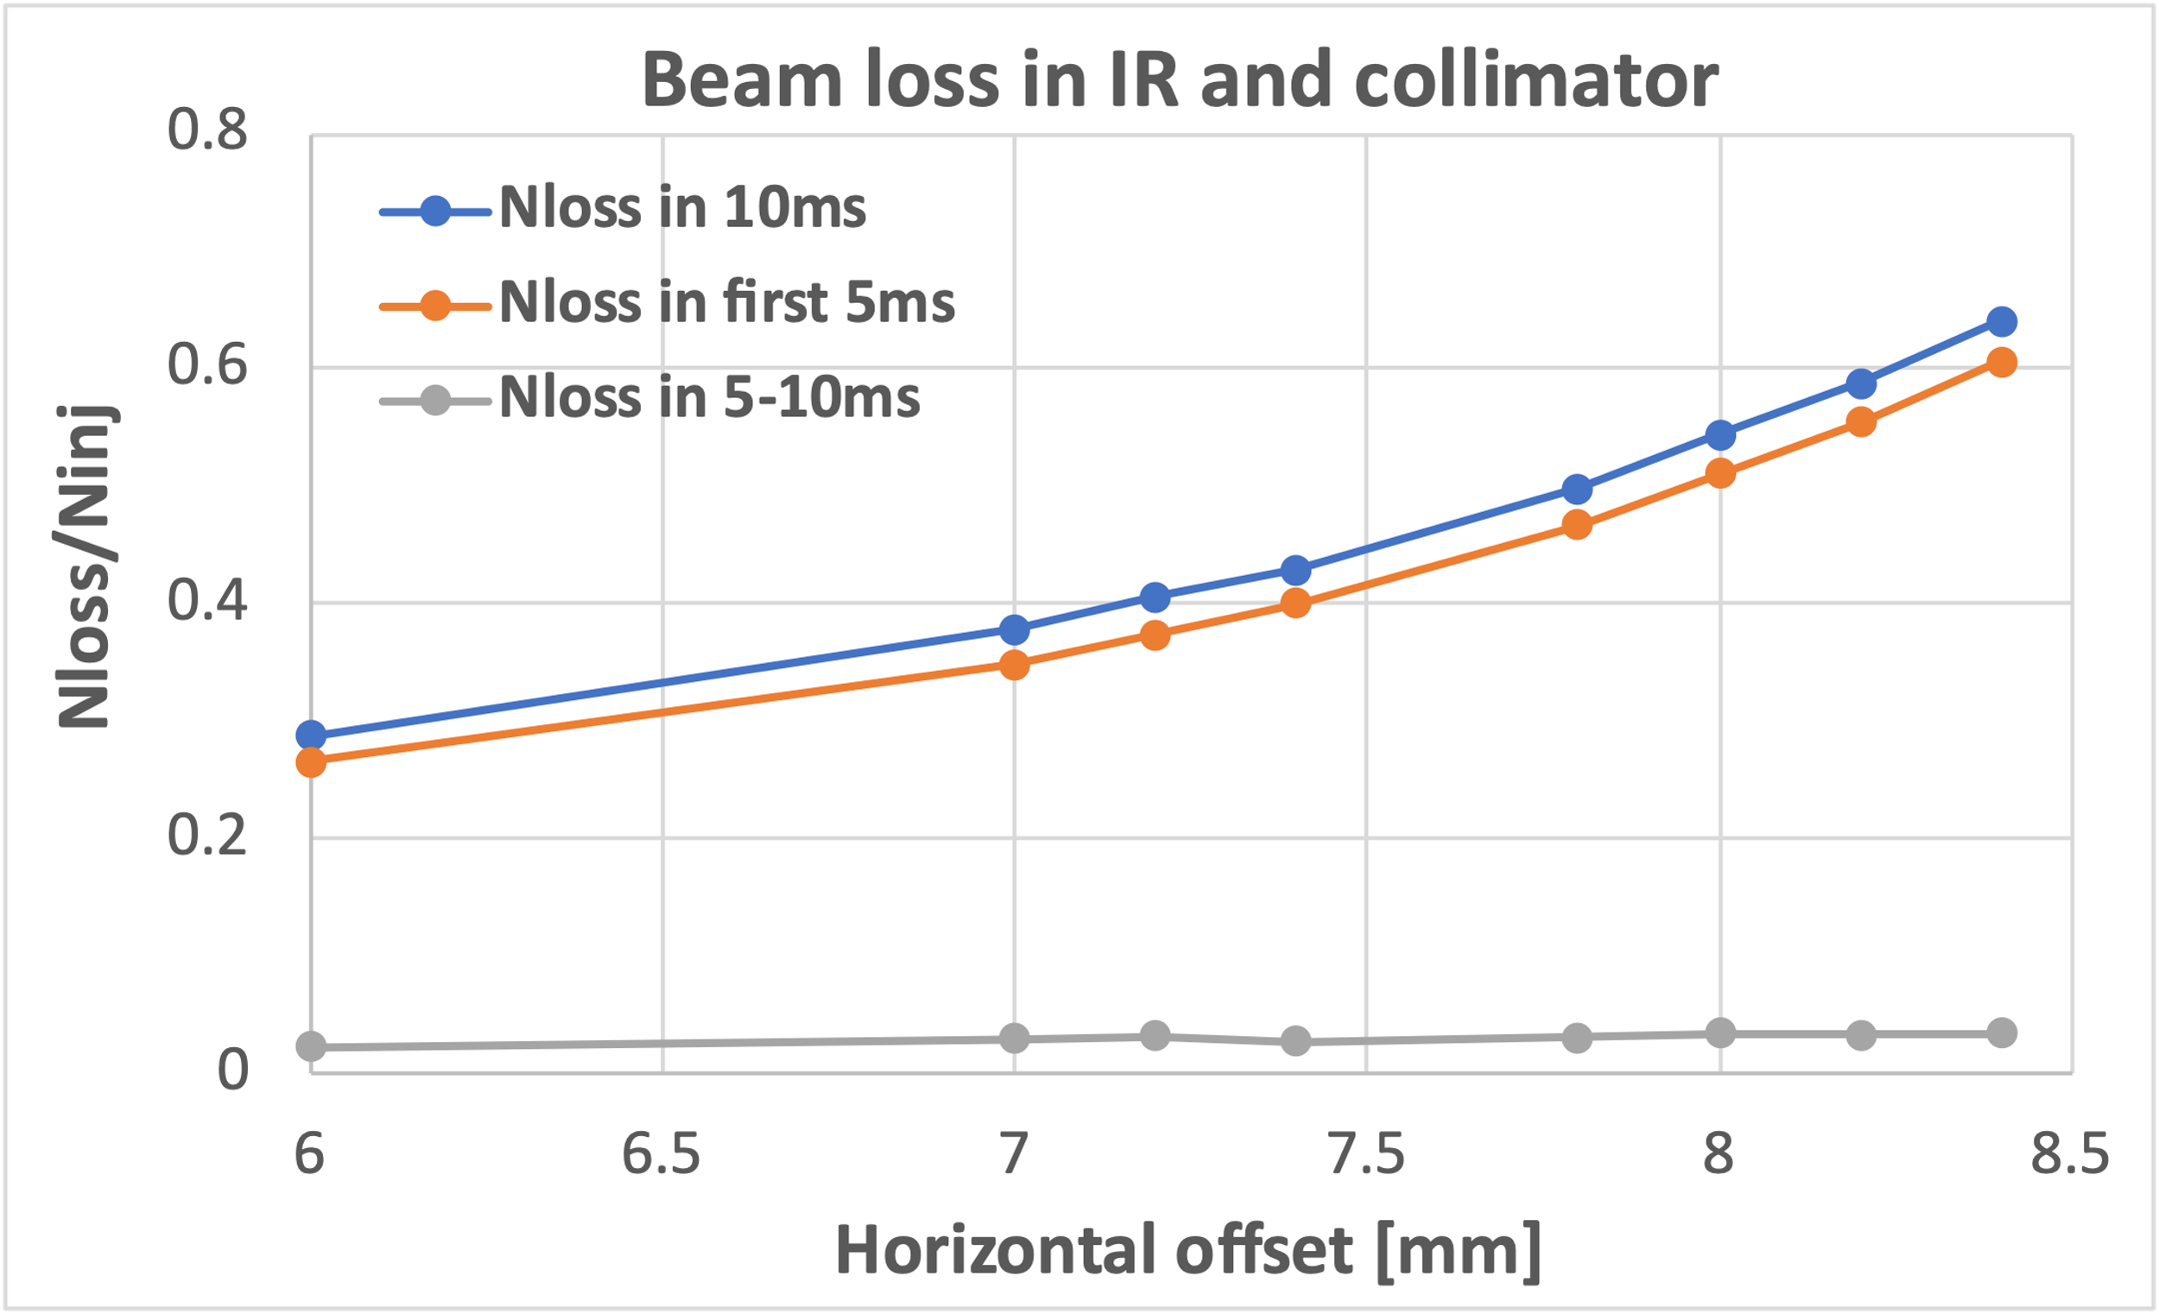
Finding1: Injection errors mainly affect injection efficiency
10
Injection horizontal offset

Slide 11
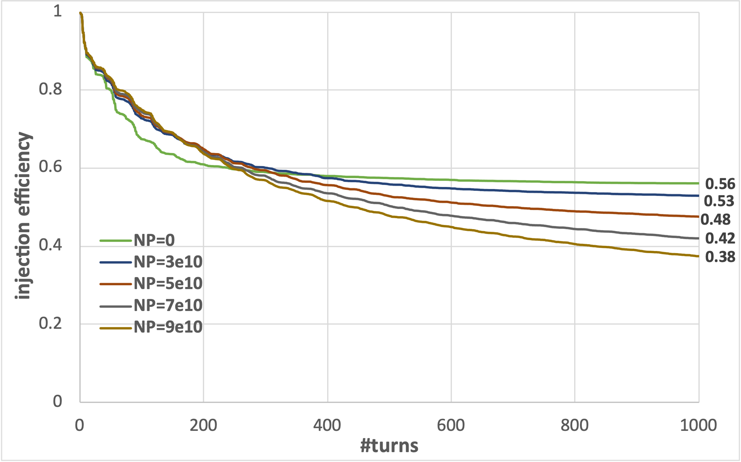
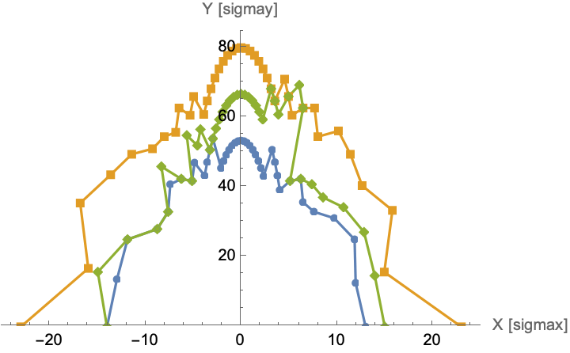
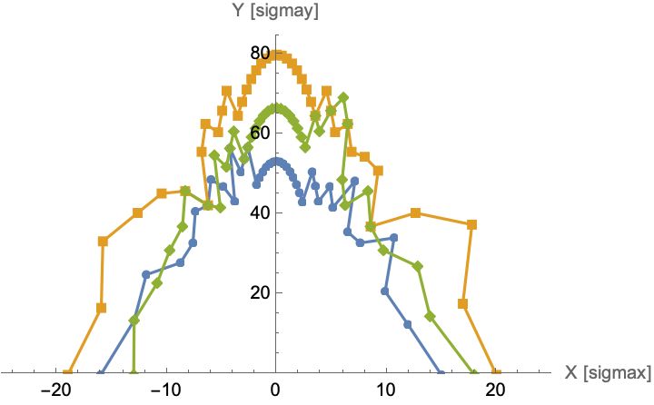
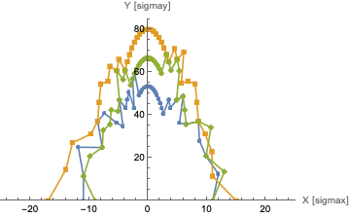
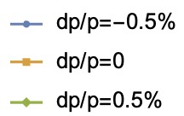
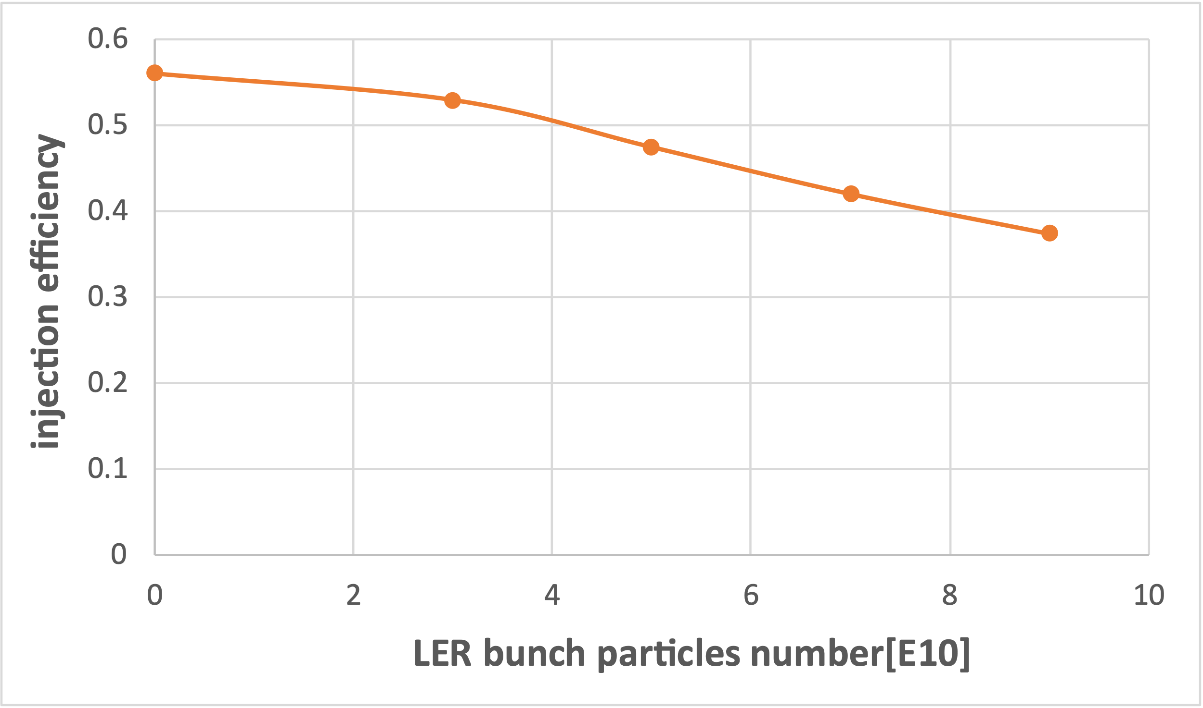
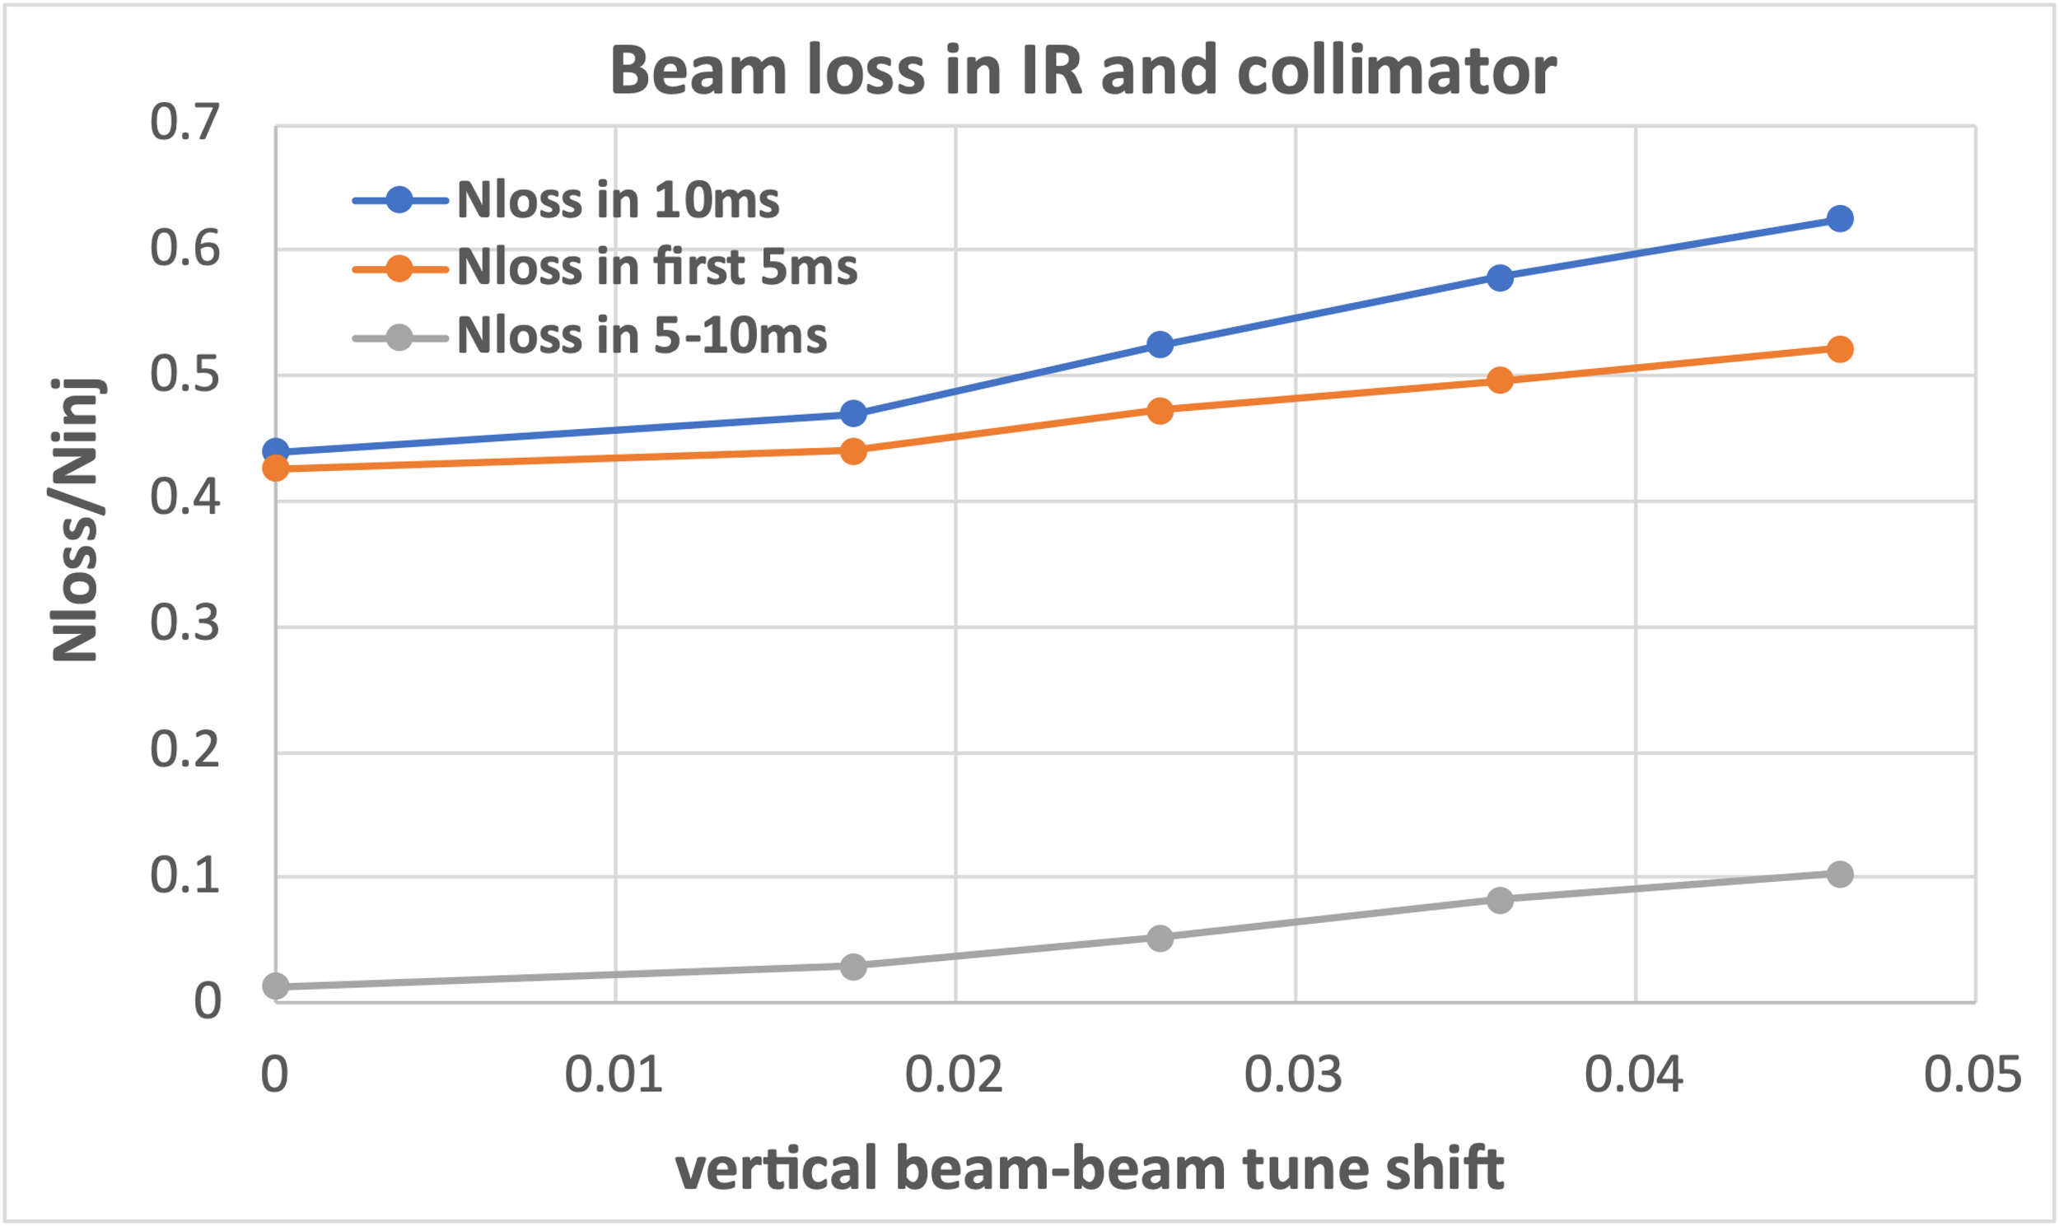
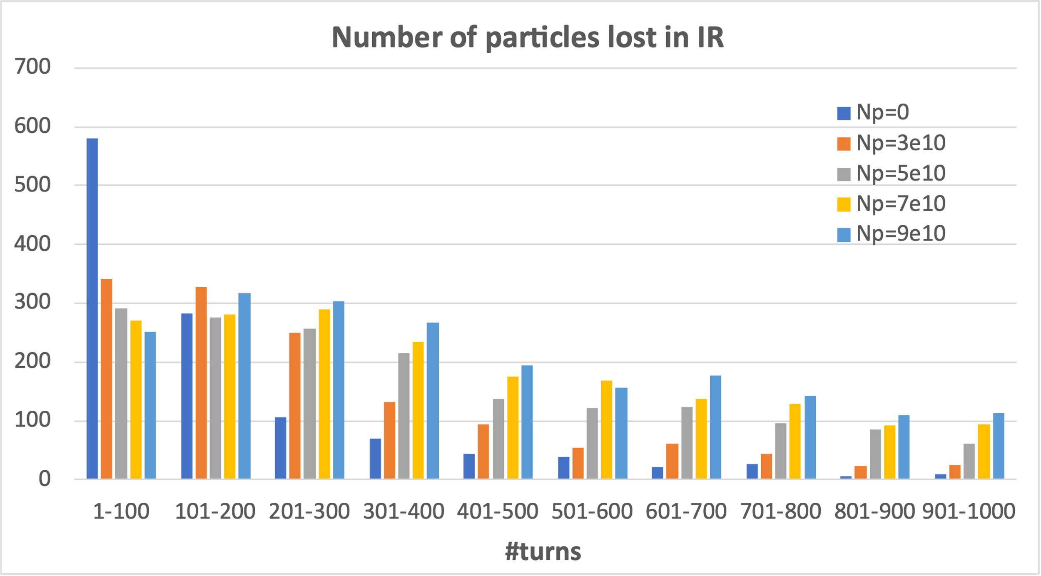



Finding2: Non-linearity in HER lattice affect both efficiency and background
11
Beam-beam interatcion
Beam-beam interaction can reduce the beam loss rate in the first 100 turns but increase the loss rate after 100 turns.
Strengthening the beam-beam interaction decreases DA, lowers injection efficiency, and increases injection background-related beam loss.
$$N_{p}=0→ξ_{y}=0→23σ_{x}$$
$$N_{p}=3.3×{10}^{10}→ξ_{y}=0.017→19σ_{x}$$
$N_{p}=18×{10}^{10}→ξ_{y}=0.092$ $→15σ_{x}$

Slide 12
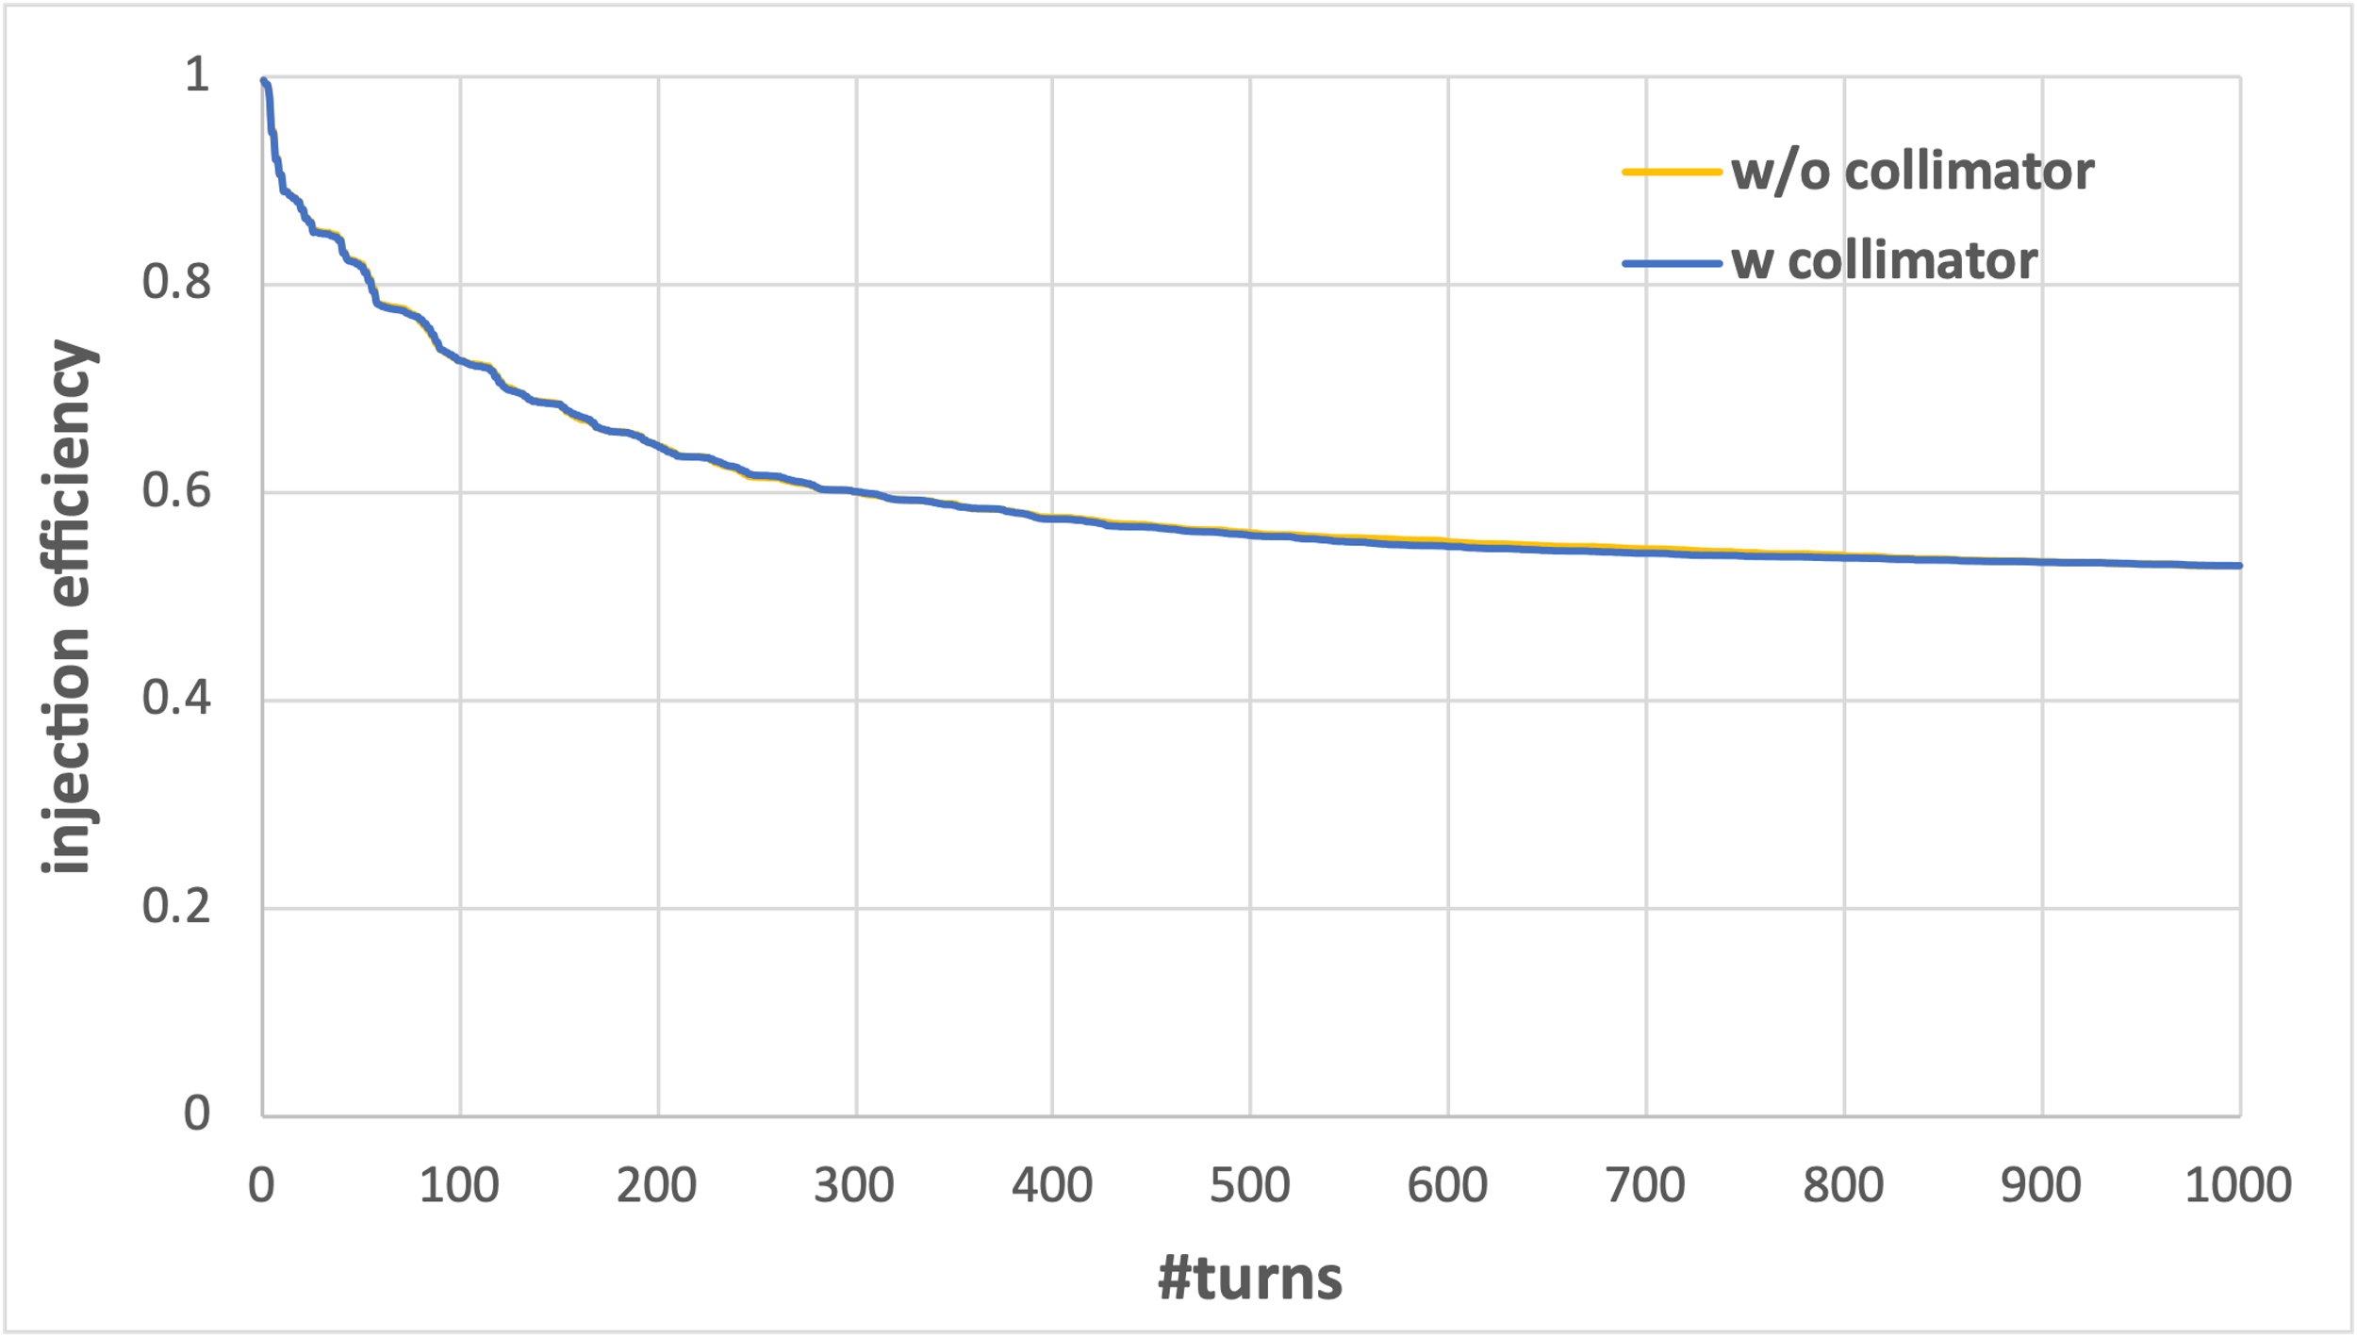
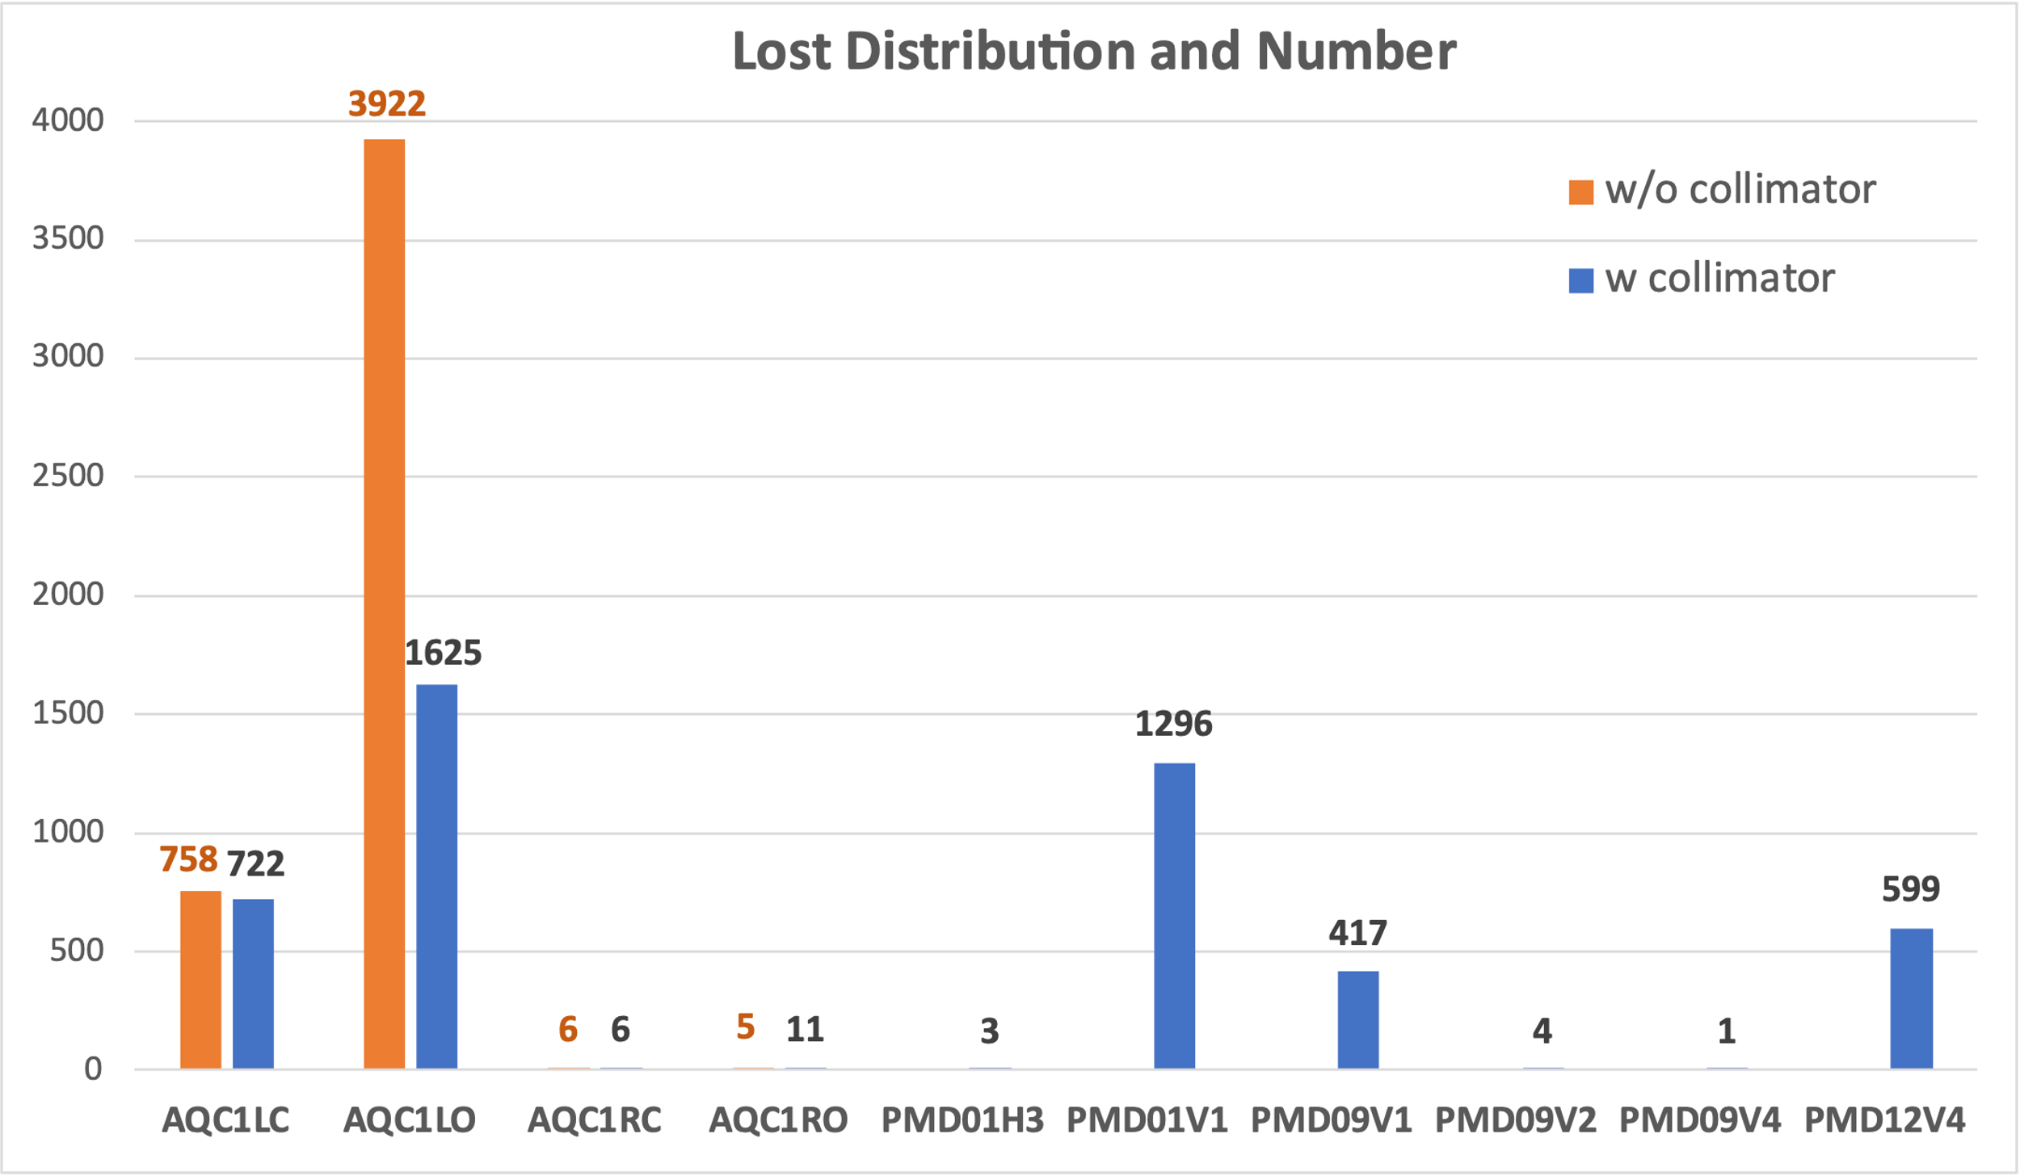
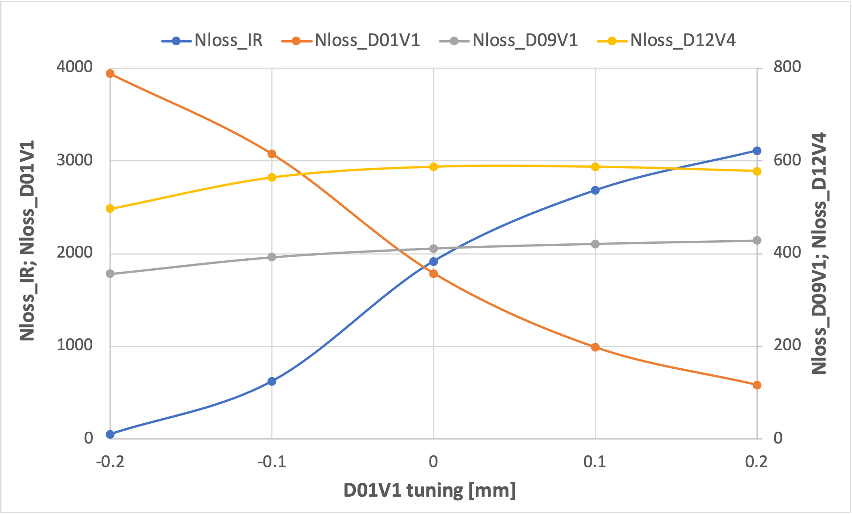
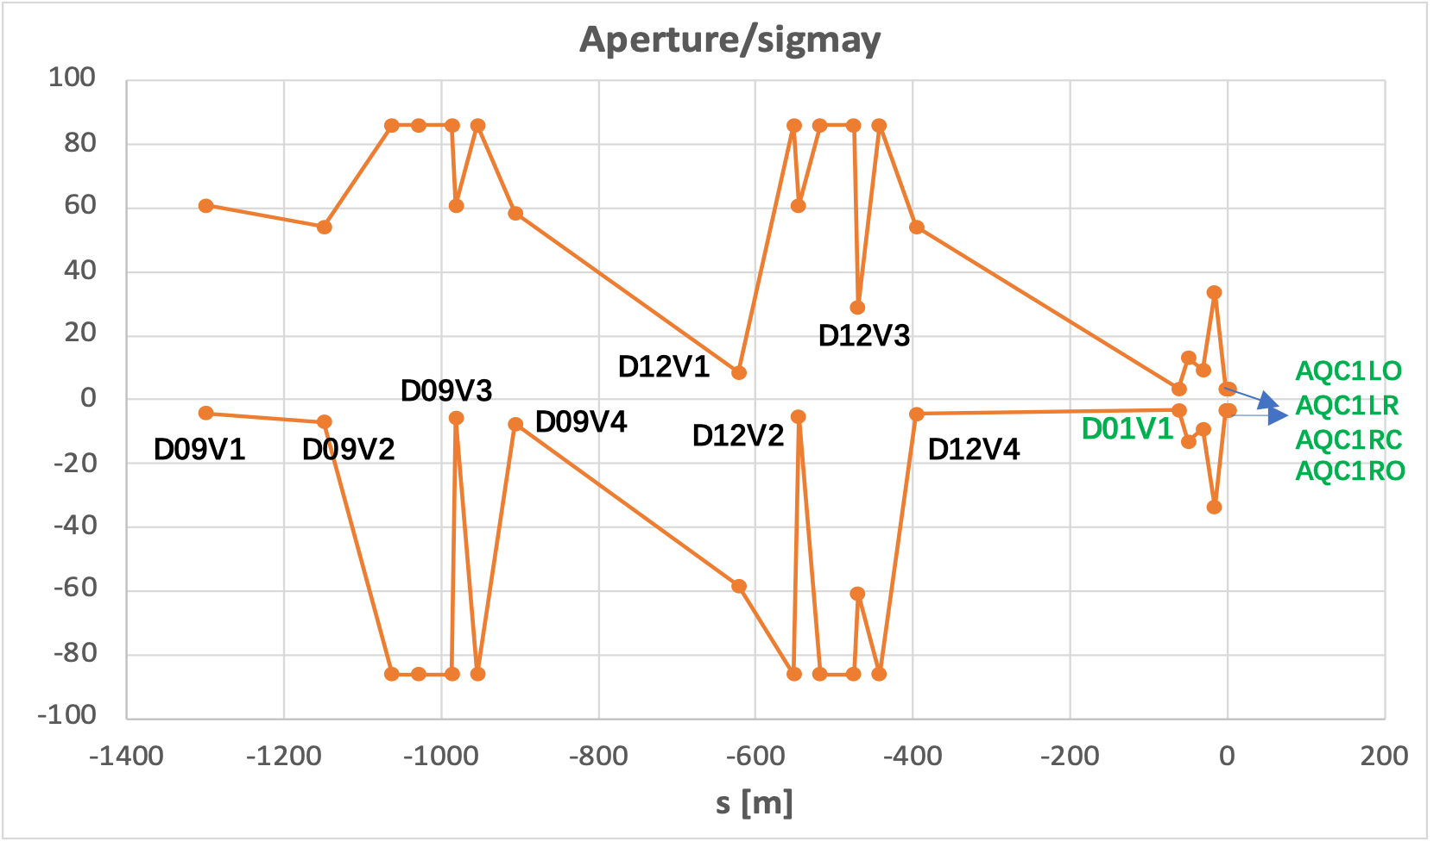
Finding3: IR Beam loss can be suppressed by minor collimator aperture adjustment
12
Current collimator settings are effective in protecting the IR region, but IR losses remain.
D01V1 plays a major role in this suppression
-relative aperture to the injection beam size of D01V1 is almost the same as that of the IR beam pipe

Slide 13
Main findings from simulation
13
Injection errors mainly affect injection efficiency
-> injection offset; injection angle; injected emittance; injection phase; x-y coupling
Beam-beam effect, cancel coil error have a large effect on injection-related background.
Beam loss in IR can be suppressed by minor collimator aperture adjustment
-> When closing all the vertical collimators by 0.1mm, the beam loss in IR can be significantly suppressed
-> D01V1 plays a major role
Based on the findings obtained from simulations, we conducted corresponding validation experiments:
-> Injection tolerance measurement ( with Iida-san, Onishi-san)
-> Beam-beam study related to injection BG (with Kaji-san, Koga-san, Bela-san, Funakoshi-san)
-> Collimator study related to injection BG (with Uno-san, Ueki-san, Kaji-san, Koga-san, Bela-san)
The results showed good qualitative agreement between the simulations and measurements.

Slide 14
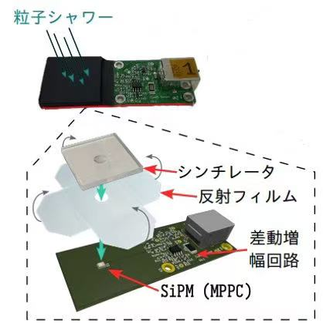
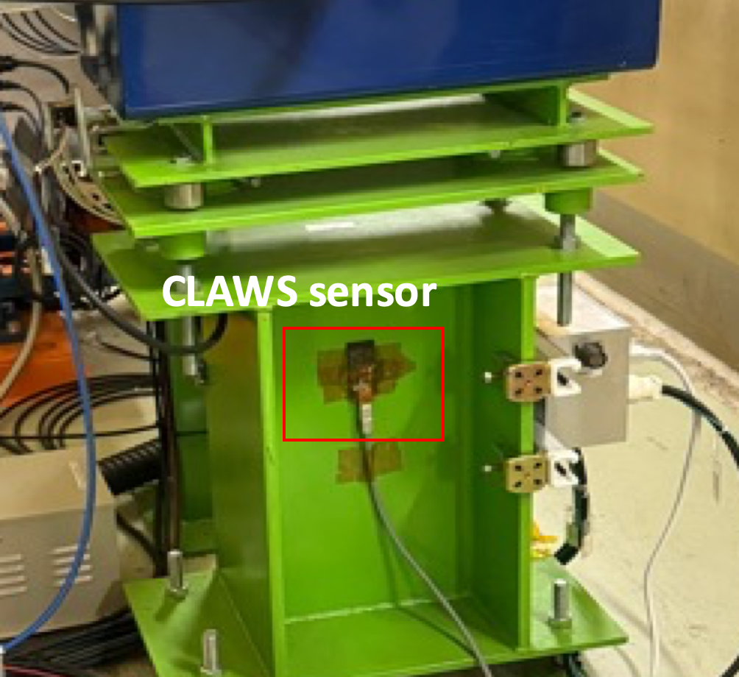
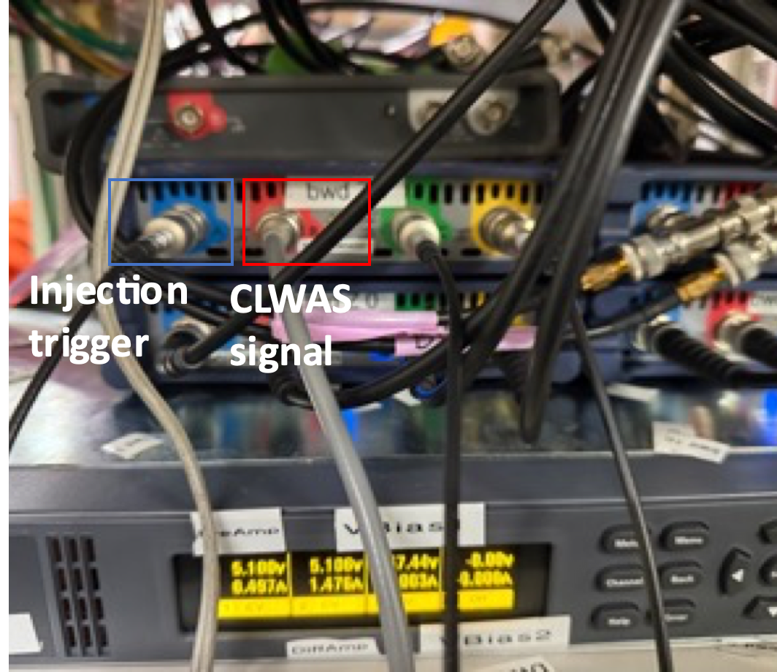
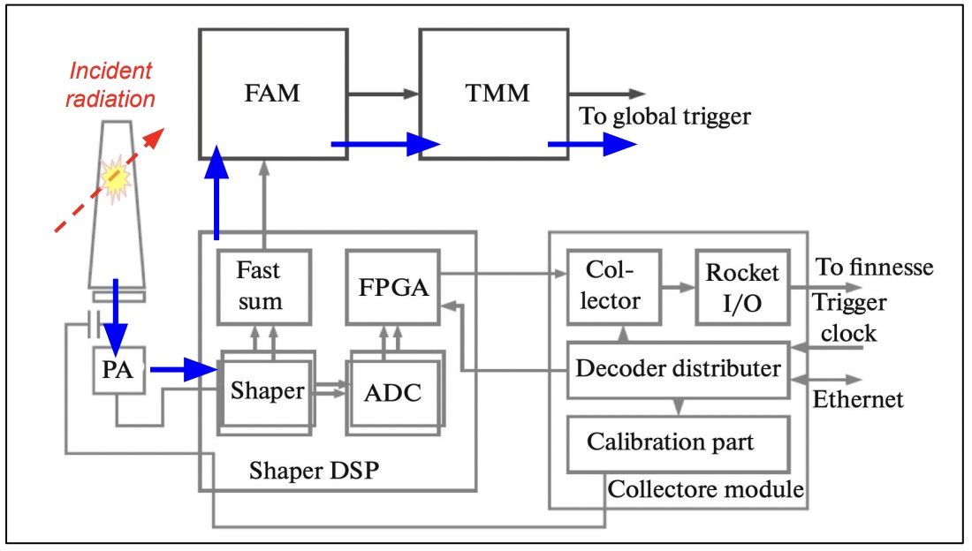
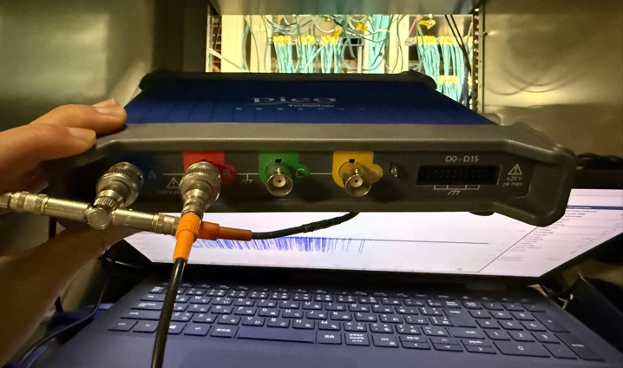
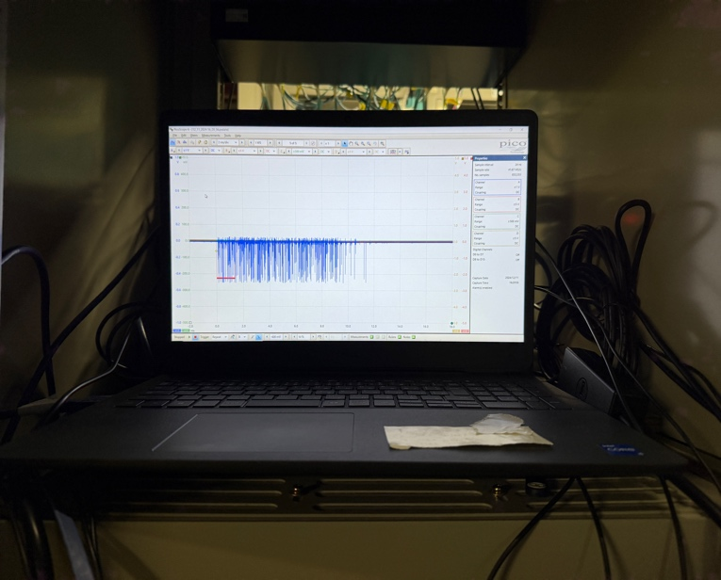
Loss monitor and Belle II detector for injection BG measurement
14
“CsI scintillator + PMT”, “EMT” loss monitor installed near the collimator and injection point
A dedicated CLAWS scintillator for injection background study newly installed near the collimator D01V1.
-they have good time resolution
-record spatial and temporal loss pattern during several ms
-fast beam loss monitor, consist of the plastic scintillator and SiPM
-sensitive small beam loss, record time structure of injection BG
EMT
Belle II subdetector ECLTRG record the injection BG duration signal shot by shot injection.
1Hz Inj trigger
Oscilloscope
ECL trigger signal
Injection trigger
E > 100 MeV; #cluster>6
These three types of loss monitors and TbT monitors are triggered by a 1Hz injection trigger, record the injection efficiency, beam loss patten and injection BG duration.

Slide 15
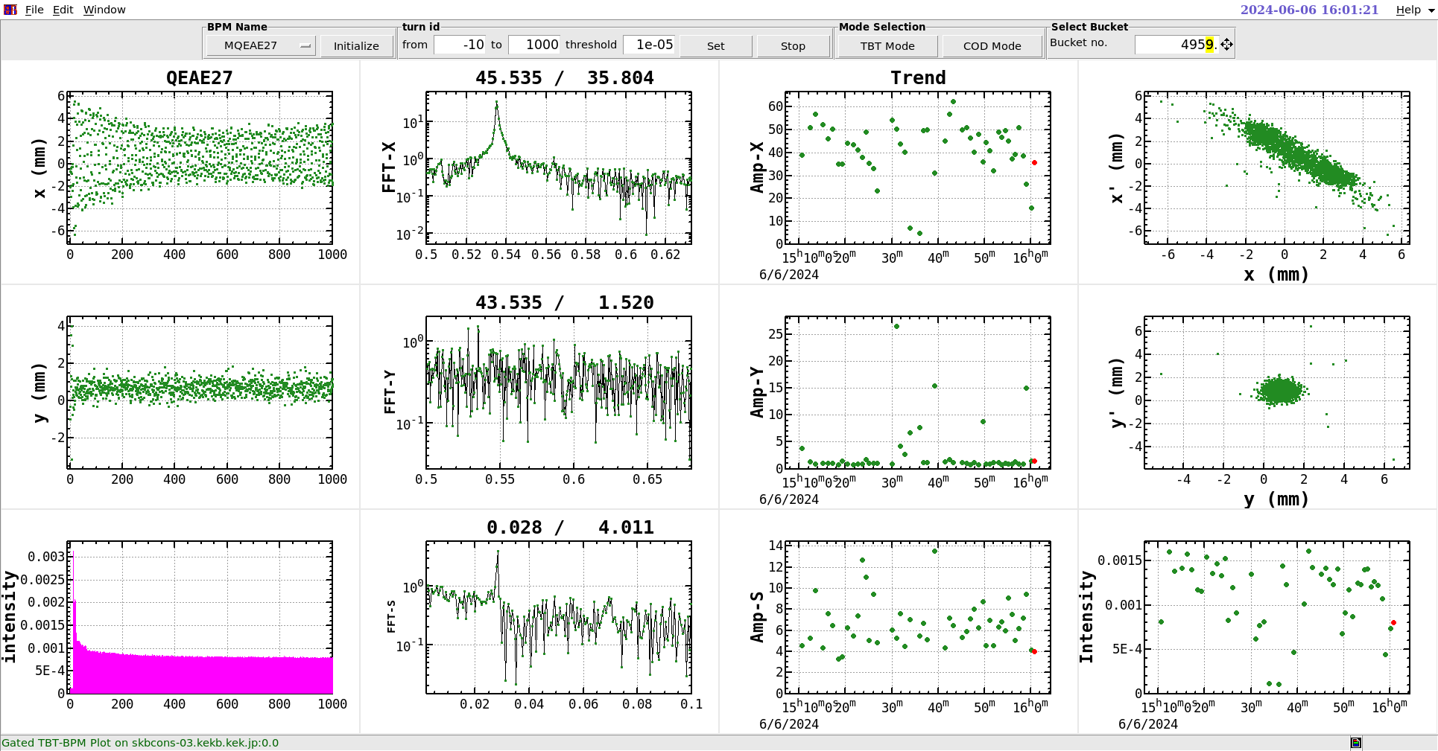
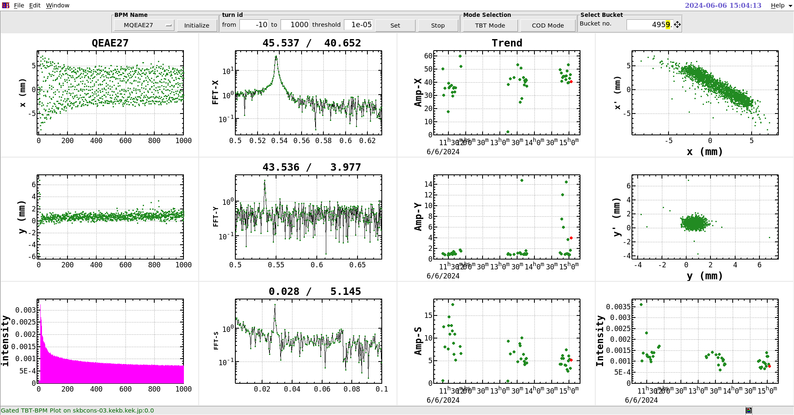
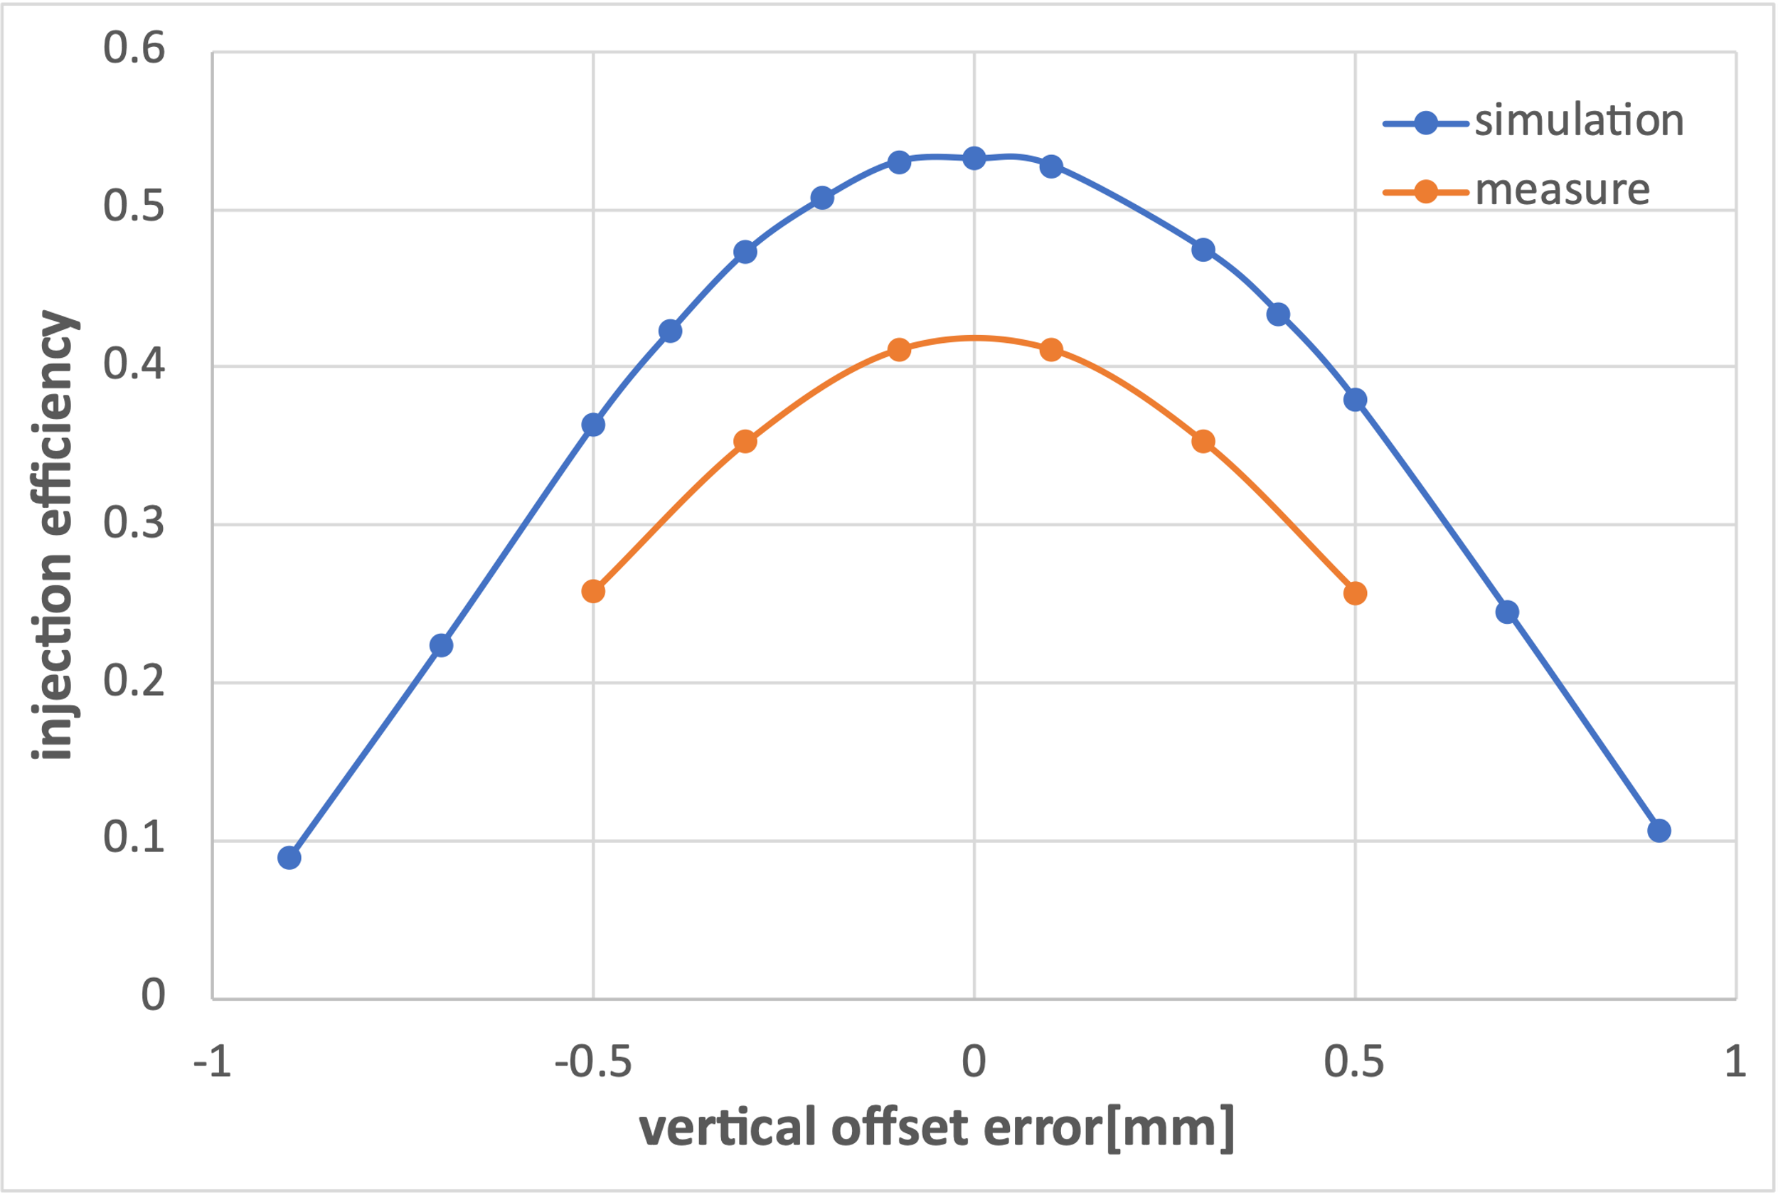
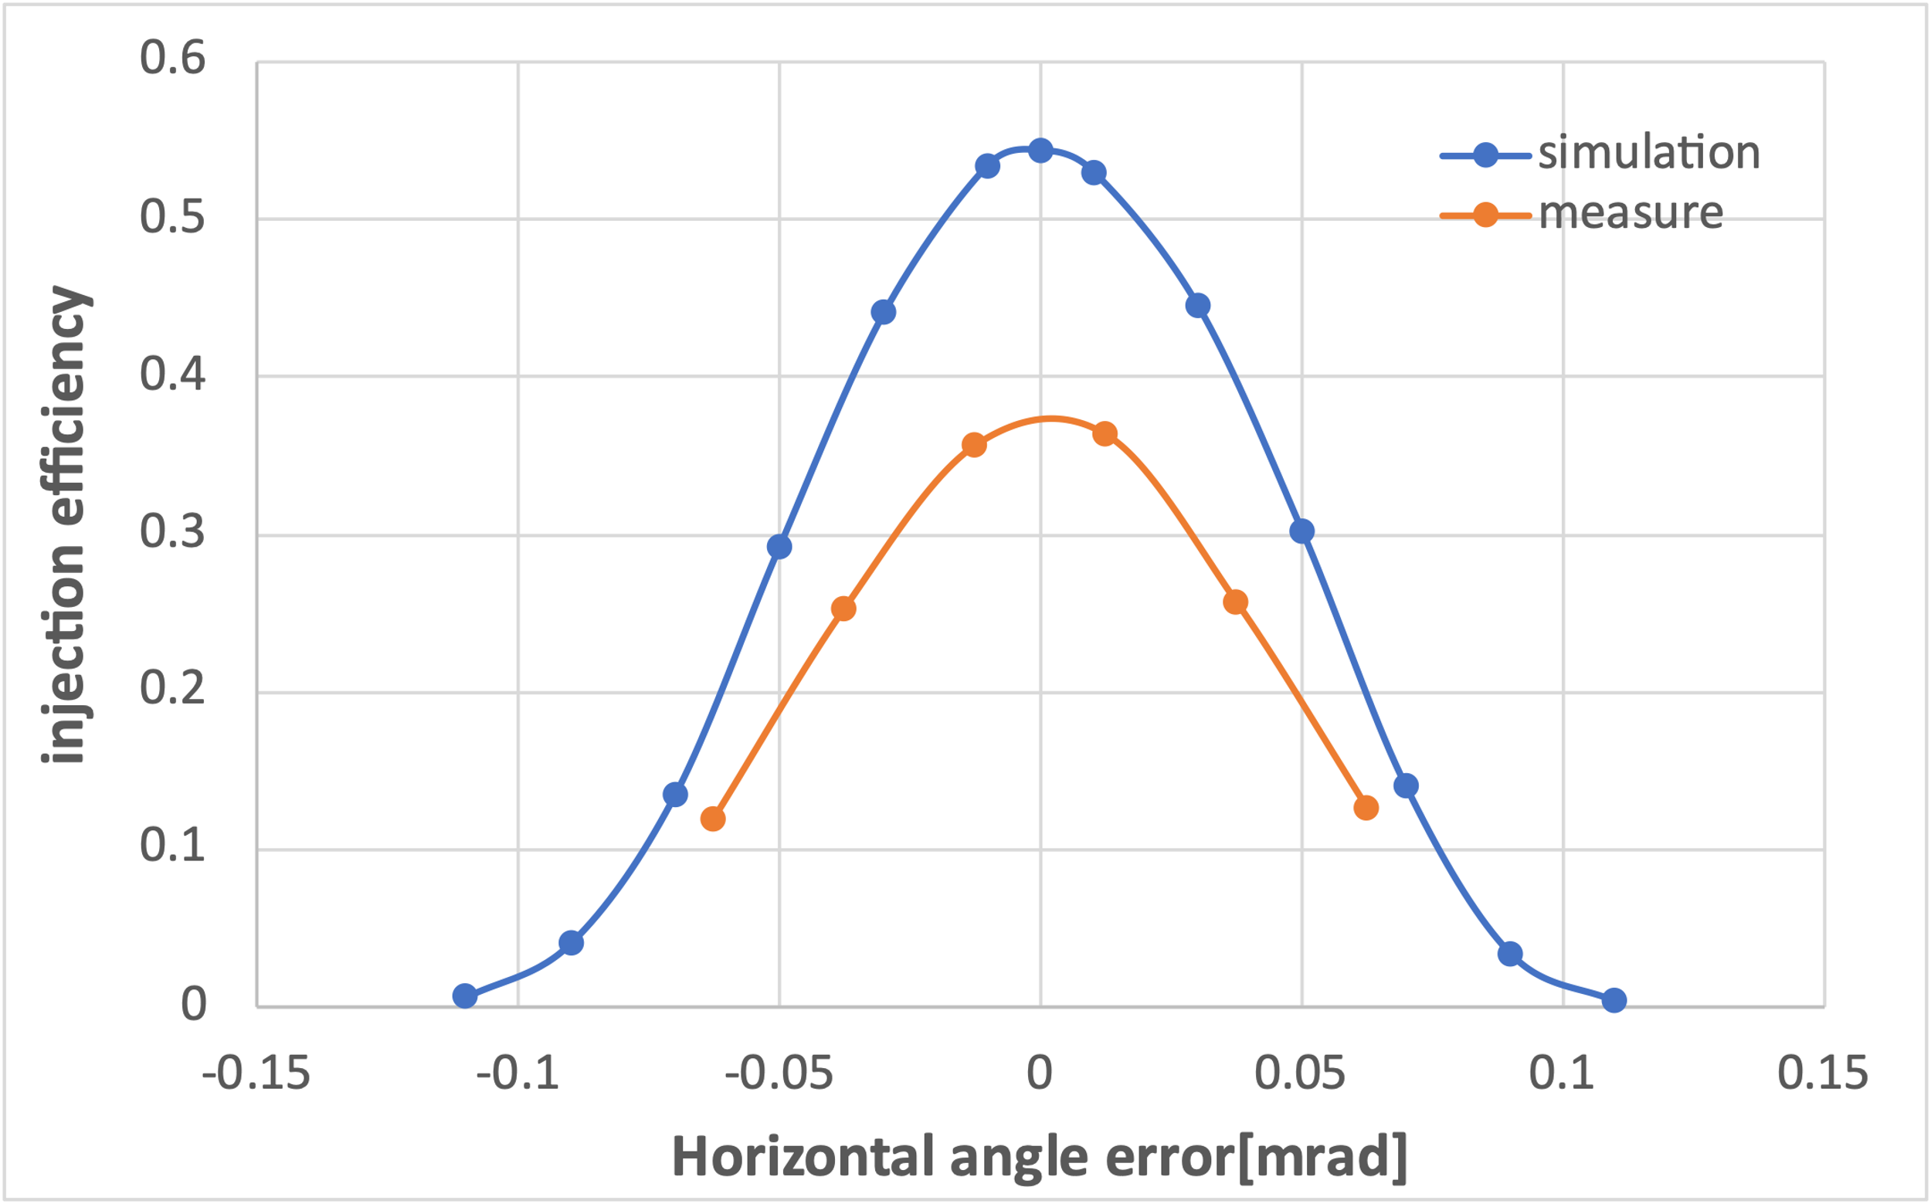
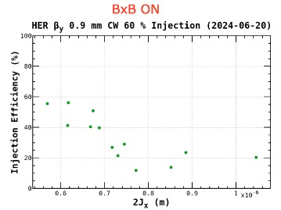
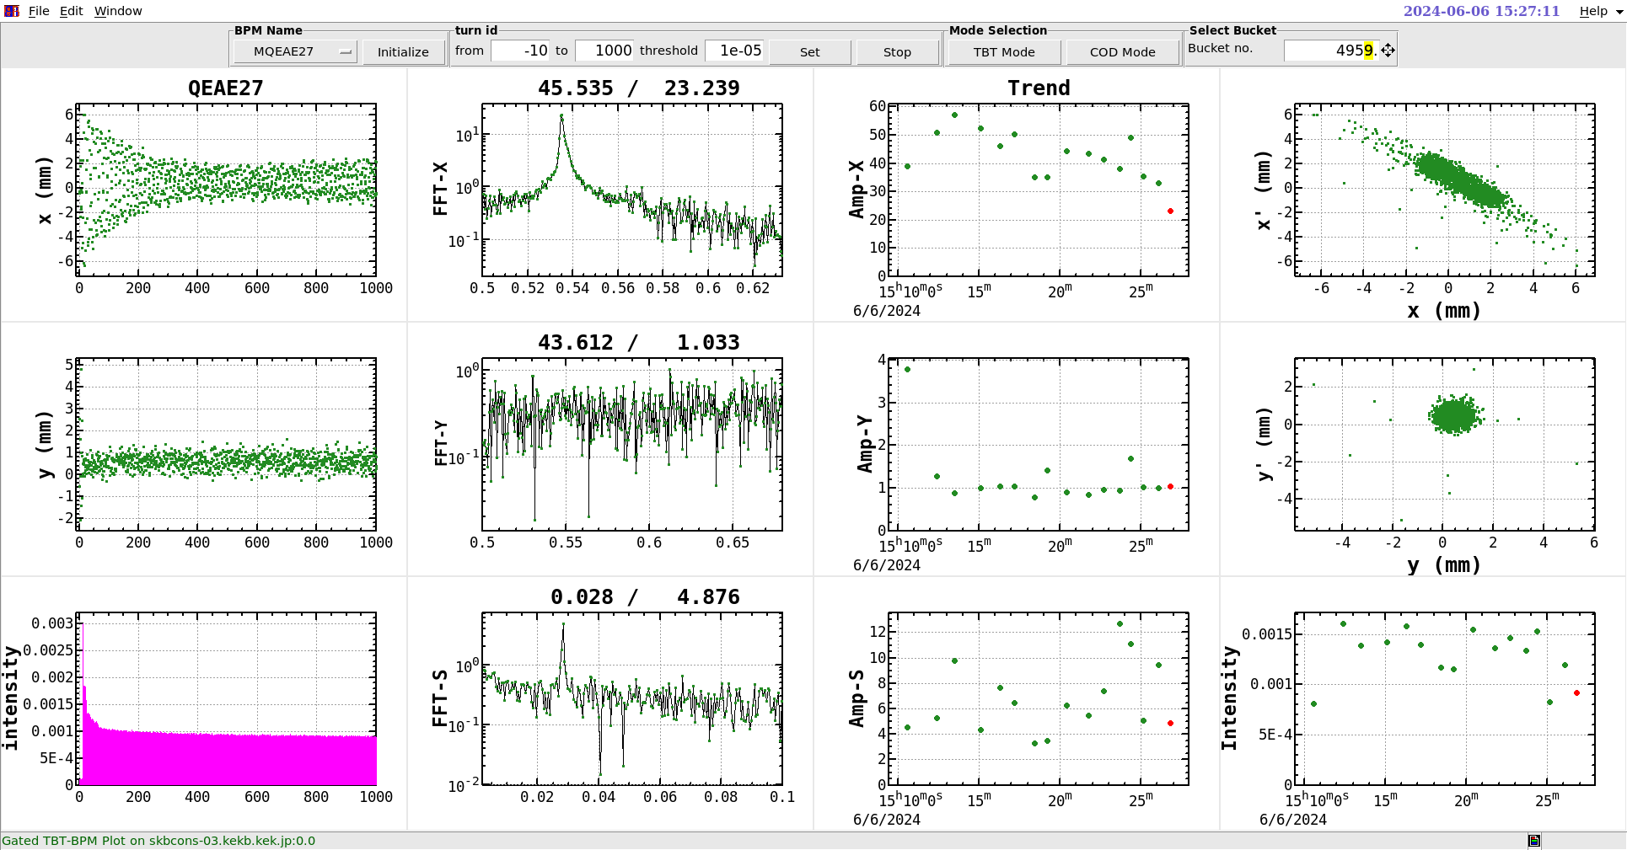


Injection tolerance measurement (2024-06-06)
15
Vertical Position Scan[mm]:$−0.06→−1.06$
Septum Angle Scan[mrad]:$2.94→3.06$
Septum Position Scan[mm]:$45.1→46.1$
Vertical Angle Scan[mrad]: $0.014→−0.054$
from Onishi-san
The trend of injection efficiency with respect to the variation in error is consistent, but the simulated absolute values are higher than the measured values.

Slide 16


Collimator D01V1 and beam-beam measurement
16
The injection BG is very sensitive to collimator D01V1 aperture
( close 200um )
( close 100um )
Experiment setting
( open 100um )
( open 200um )

Slide 17

The injection BG increases as the beam intensity (beam-beam strength) increases.
17
( close 200um )
( close 100um )
Experiment setting
( open 100um )
( open 200um )

Slide 18




18
Detailed data analysis
Compare with simulation
Measured injectionBG duration increases with stronger beam–beam interaction ->qualitative agreement with simulation
Measured injectionBG duration sensitive to collimator D01V1 settings -> qualitative agreement with simulation

Slide 19
Conclusions and Prospects
  A more realistic simulation mechanism for injection-related beam loss has been developed.
  Verification experiments have been conducted based on its main findings.
  The simulation results are qualitatively consistent with the experimental observations.
  Further investigation of injection-related beam loss and background
  Tune scan study (betatron-synchrotron resonance,…)
  Further nonlinearity including fully implemented crab-waist collision
  More realistic IR beam pipe and collimator model including tip-scattering
  Assessment for higher luminosity in 2025 and beyond
  More validation experiments (CLAWS at D01V1, ECLTRG,…)
LumiBelle2
  Bunch by bunch luminosity online monitor
  Compare LGAD and CVD diamond sensors (radiation hardness)

Slide 20
Back up

Slide 21


Comparison between simulation and measurement on collimator
18

Slide 22





16
Positive linear correlation between beam loss at D01V1 and ECLTRG duration, under fixed D01V1 aperture settings.
22.64ms
6.11ms
4.98ms
R² = 0.81
R² = 0.84
R² = 0.29
Stronger beam-beam interaction
(higher luminosity)
higher beam loss at D01V1,
increases IR beam loss
longer injection BG duration
Closing the D01V1 aperture
reduce the average level of injection BG duration
mitigates the impact of injection fluctuation on IR beam loss

Slide 23




Reconstruction CLAWS data waveform
15
noise, baseline, shift
Integration=d01v1*sampling_interval

Slide 24
Injected beam
stored beam
her-initial-particles_1.dat(9972)
Gaussion distribution(9972*2)
beamI0={1,{xi,pxi,yi,pyi,zi,deli,flgi}};
Initial total center of gravity
beamR0={1,{xs,pxs,ys,pys,zs,dels,flgs}};
Initial gravity center of x, px : Gxi0, Ggxi0
Gx0; Gpx0
Initial gravity center of x, px : Gxr0, Ggxr0
start loop
deltGx[1]= -0.02*Gx0;
deltGpx[1]=-0.02*Gpx0;
start loop
beamItrack[n]=TrackParticles[beamI[n-1],start,1];
beamRtrack[n]=TrackParticles[beamR[n-1],start,1];
remove lost particles
Remove lost particles
applied in the next turn
beamI[n]
beamR[n]
add feedback
feedback kick calculated based on beam position from last turn:
deltGx[n+1]=-0.02*Gx[n];
deltGpx[n+1]=-0.02*Gpx[n];
add feedback
beamI[n][2,1]+deltGx[n];
beamI[n][2,2]+deltGpx[n]
beamR[n][2,1]+deltGx[n]; beamR[n][2,2]+deltGpx[n]
beamI[n]
beamR[n]
Gxi[n]; Gpxi[n]
total center of gravity
Gx[n]; Gpx[n]
Gxr[n]; Gpxr[n]
track the injection beam and storage beam at the same time turn by turn, calculate the center of gravity of injected and stored beam, and feedback kick, update the horizontal coordinates of the particles turn by turn.

