Slide 1




A_RD_24
Study of laser-beam arrival time synchronisation towards sub picosecond level
A. Aryshev (KEK) and A. Martens (IJCLab) on behalf of
KEK (Kaji, Popov)
IJCLab (Back, Charlet, Esnault, Johora⁺, Zomer)
The research leading to these results has received funding from the European Union's Horizon Europe MSCA under grant agreement no. 101086276
⁺: non-permanent contract

Slide 2
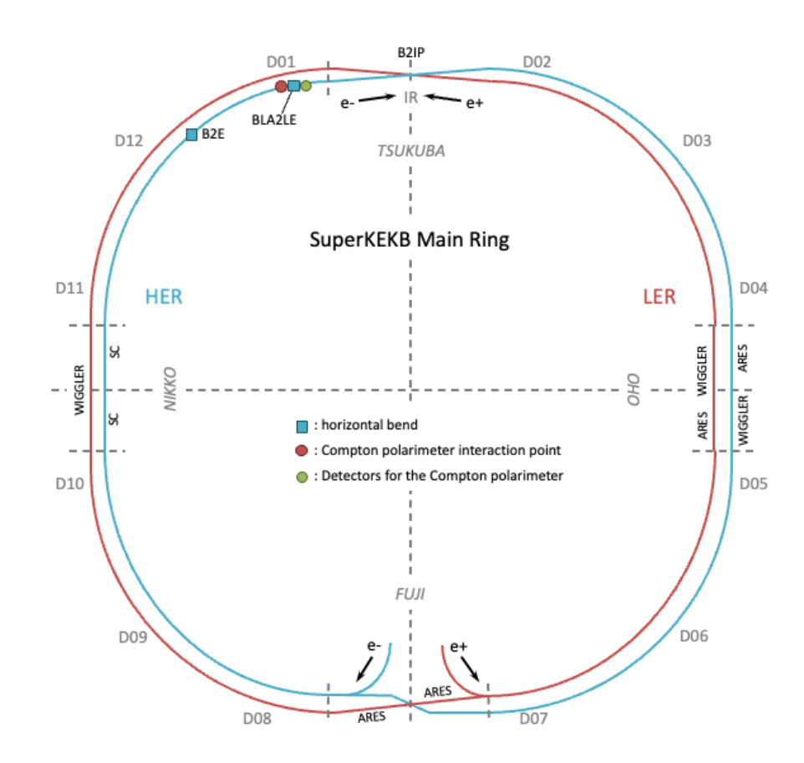
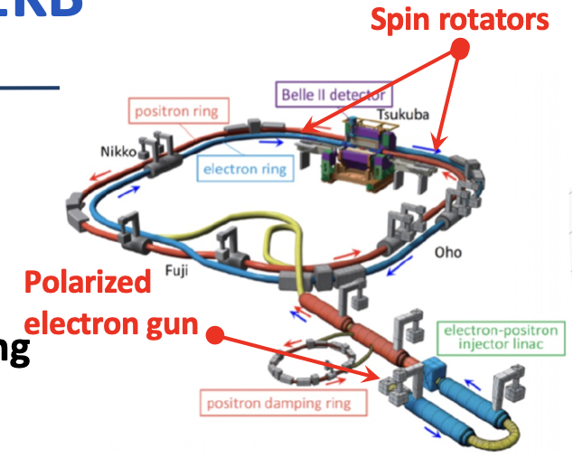
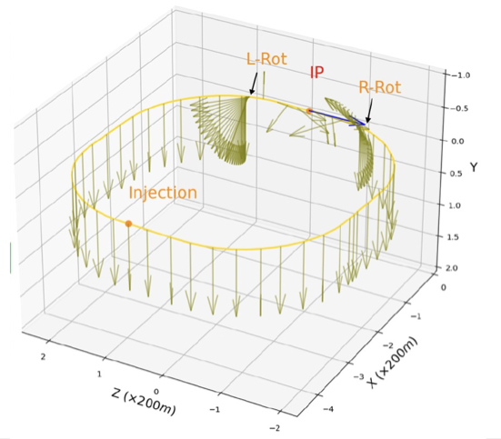
SuperKEKB polarization upgrade
Compton polarimeter
See Belle II upgrade framework CDR arXiv:2406.19421; M. Roney talk at ICJHEP 2024
Only for electrons
Beam transport of polarized beam
Top-up injection at nominal energy
Spin rotators (combined function magnets from BNL)
Preservation of polarization

Slide 3
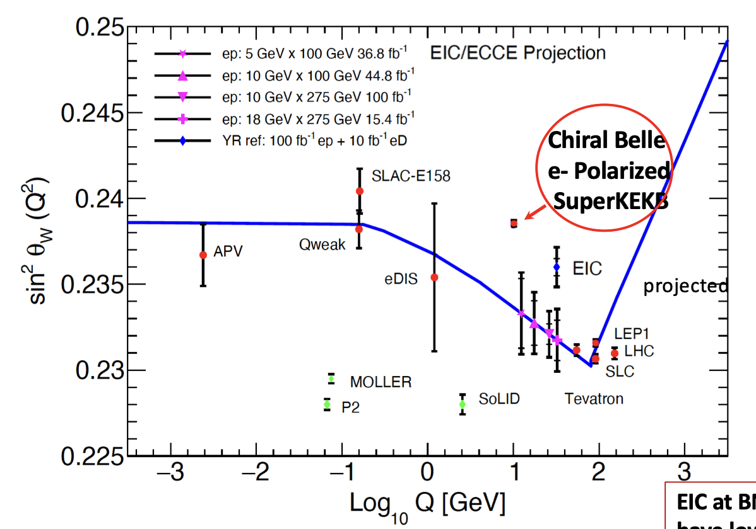
Potential of polarization upgrade
Just an example of measurement of interest
See Belle II upgrade framework CDR arXiv:2406.19421; M. Roney talk at ICJHEP 2024

Slide 4
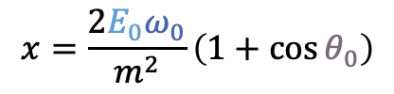


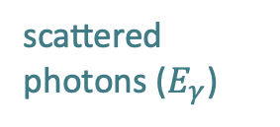

Compton polarimeter
laser (E_{λ})
scattered photons ($E_{γ}$)
Initial electron energy (7 GeV)
Initial photon energy (2.4eV at 515nm)
Crossing angle of beams
Emitted photon energy
$$θ_{0}$$
θ
e⁻ beam $Ee$
$$x=\frac{2E_{0}ω_{0}}{m^{2}}\left(1+\cos{θ_{0}}\right)$$
$$y=\frac{E_{γ}}{E_{0}}$$
D. Charlet et al., JINST 18 (2023) P10014
Differential cross-section
Transverse laser polarisation: nuisance parameter to minimize and keep under control
Transverse electron beam polarisation: intervenes as an asymmetry in the transverse plane
$$\frac{dσ}{dydφ_{obs}}\left(x,y\right)=\frac{dσ_{0}}{dy}\left(x,y\right)+\frac{dσ_{⊥}}{dy}\left(x,y\right)\cos\left(2\left(φ_{obs}−φ_{las}\right)\right)𝒫_{lin}^{las}+\frac{dσ_{∥}}{dy}\left(x,y\right)𝒫_{C}^{las}(P_{T}f_{T}\left(x,y\right)\cos\left(φ_{obs}−φ_{elec}\right)+P_{L}f_{L}(x,y))$$
Electron beam polarization independent
Electron beam polarization dependent
⚠️ Transverse e-beam polarimetry implies measuring geometrical asymmetries in the detection plane
Notoriously difficult task due to a narrow cone for scattered particles along e-beam direction
For integration ease, concentrate on photon detection and longitudinal polarization

Slide 5
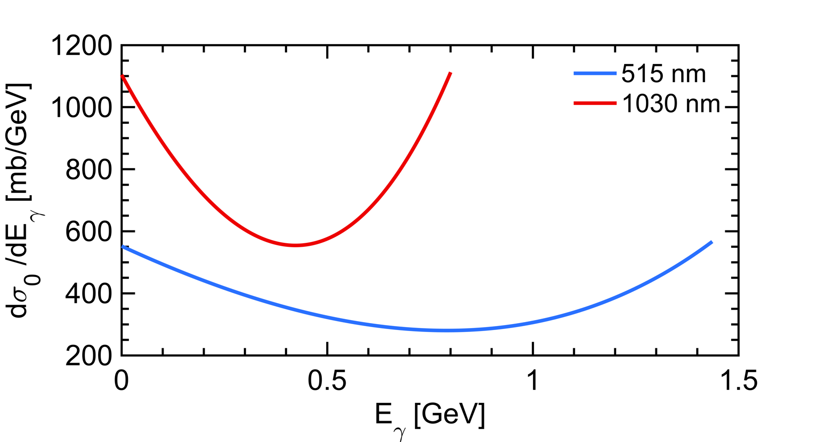
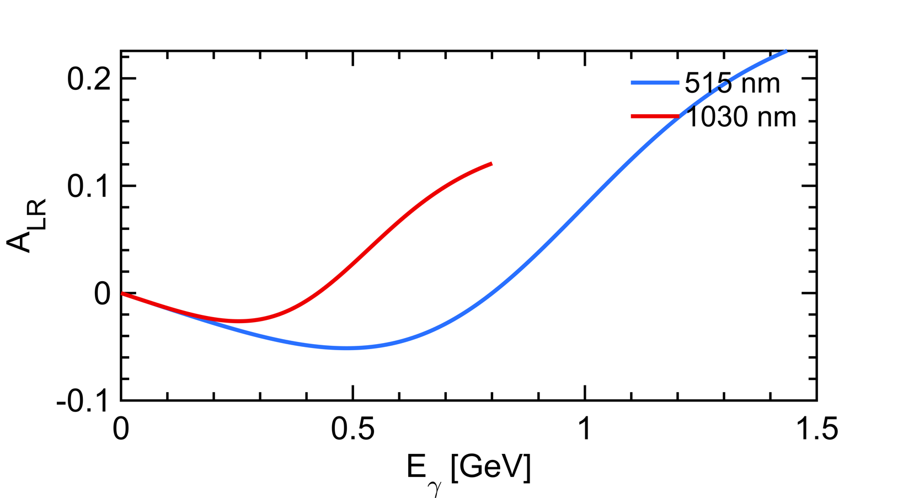
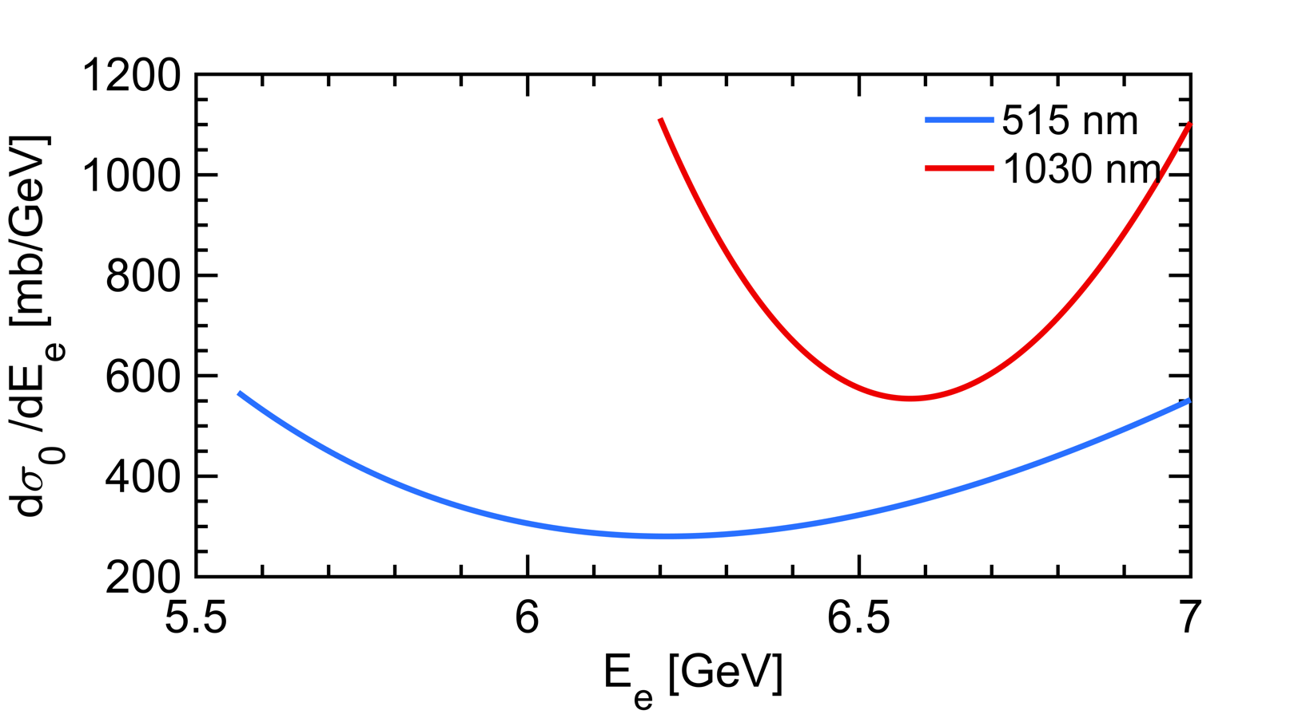
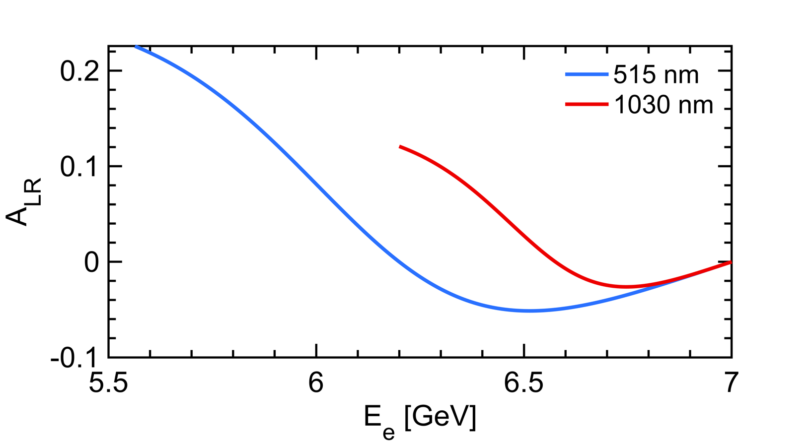

Longitudinal Compton polarimetry
$$\frac{dσ}{dy}(x,y)≅\frac{dσ_{0}}{dy}\left(1+{𝒫_{z}λA}_{LR}\right)$$
Polarization dependent term generates a left-right asymmetry function of $E_{γ}$
Landau-Lifshitz QED book paragaphs 86 and 87
that reflects also as a function of the energy of the emitted electron
Using a 515nm laser provides higher sensitivity

Slide 6
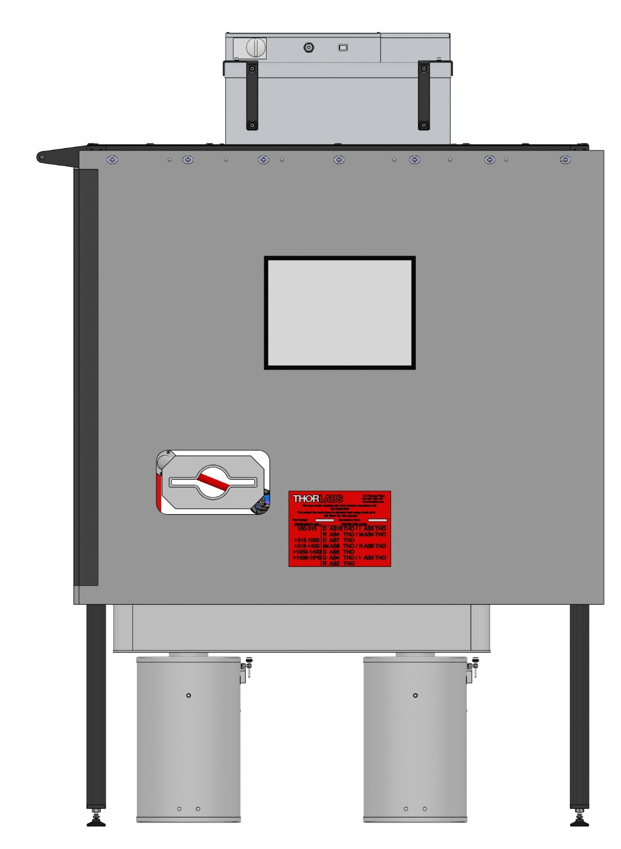
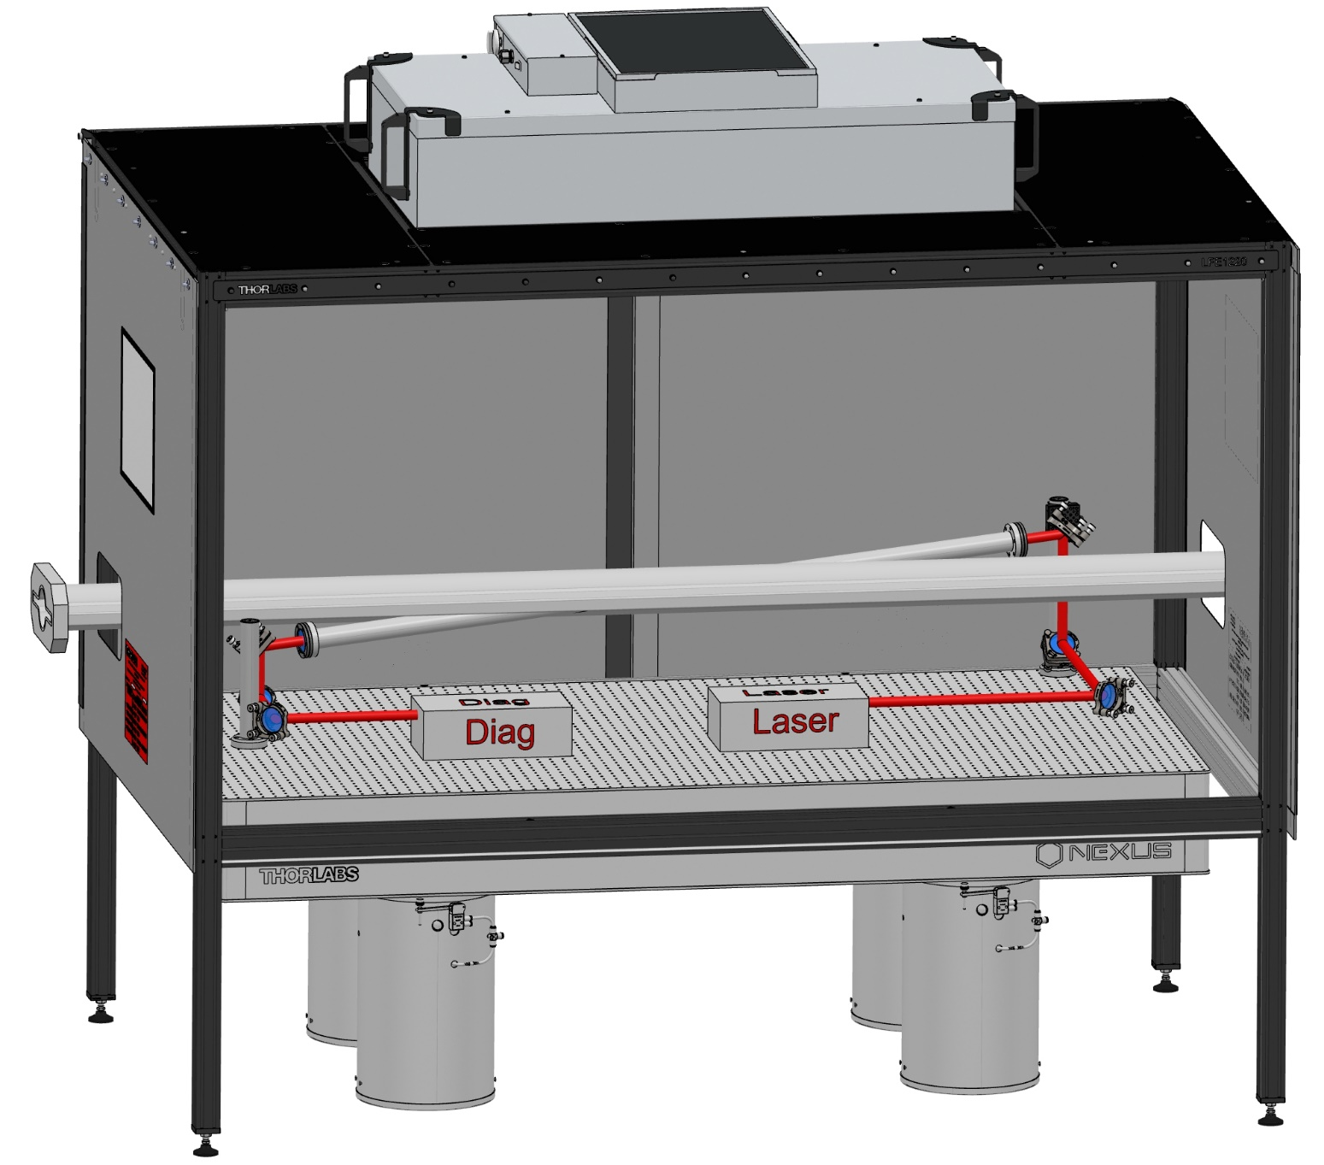
Mechanical system integration
D. Charlet et al., 2023 JINST 18 P10014
e- beam
910 mm
450 mm
Crossing Angle Horizontal : 8 deg
Crossing Angle Vertical : 4 deg
+ some neutron + lead shielding around electronics to be located below the table
+ some lead shielding around the table to protect the laser

Slide 7
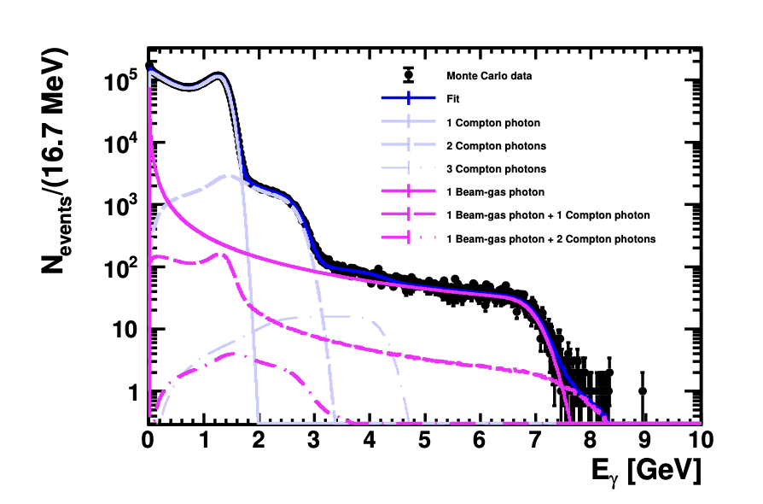
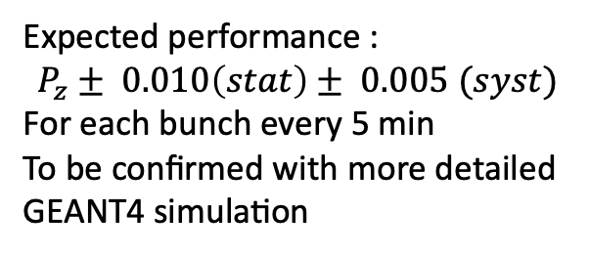
Expected performance
Expected performance :
$$P_{z}± 0.010\left(stat\right)± 0.005 (syst)$$
For each bunch every 5 min
To be confirmed with more detailed GEANT4 simulation
D. Charlet et al., 2023 JINST 18 P10014
Now in a Technical Design phase
Requirement: fast, radiation tolerant, calorimetry of scattered photons every 4 ns
R&D with BaF₂ detector
Precise and low cost electron/laser beam and DAQ synchronisation (bunches are ~3ps long)

Slide 8
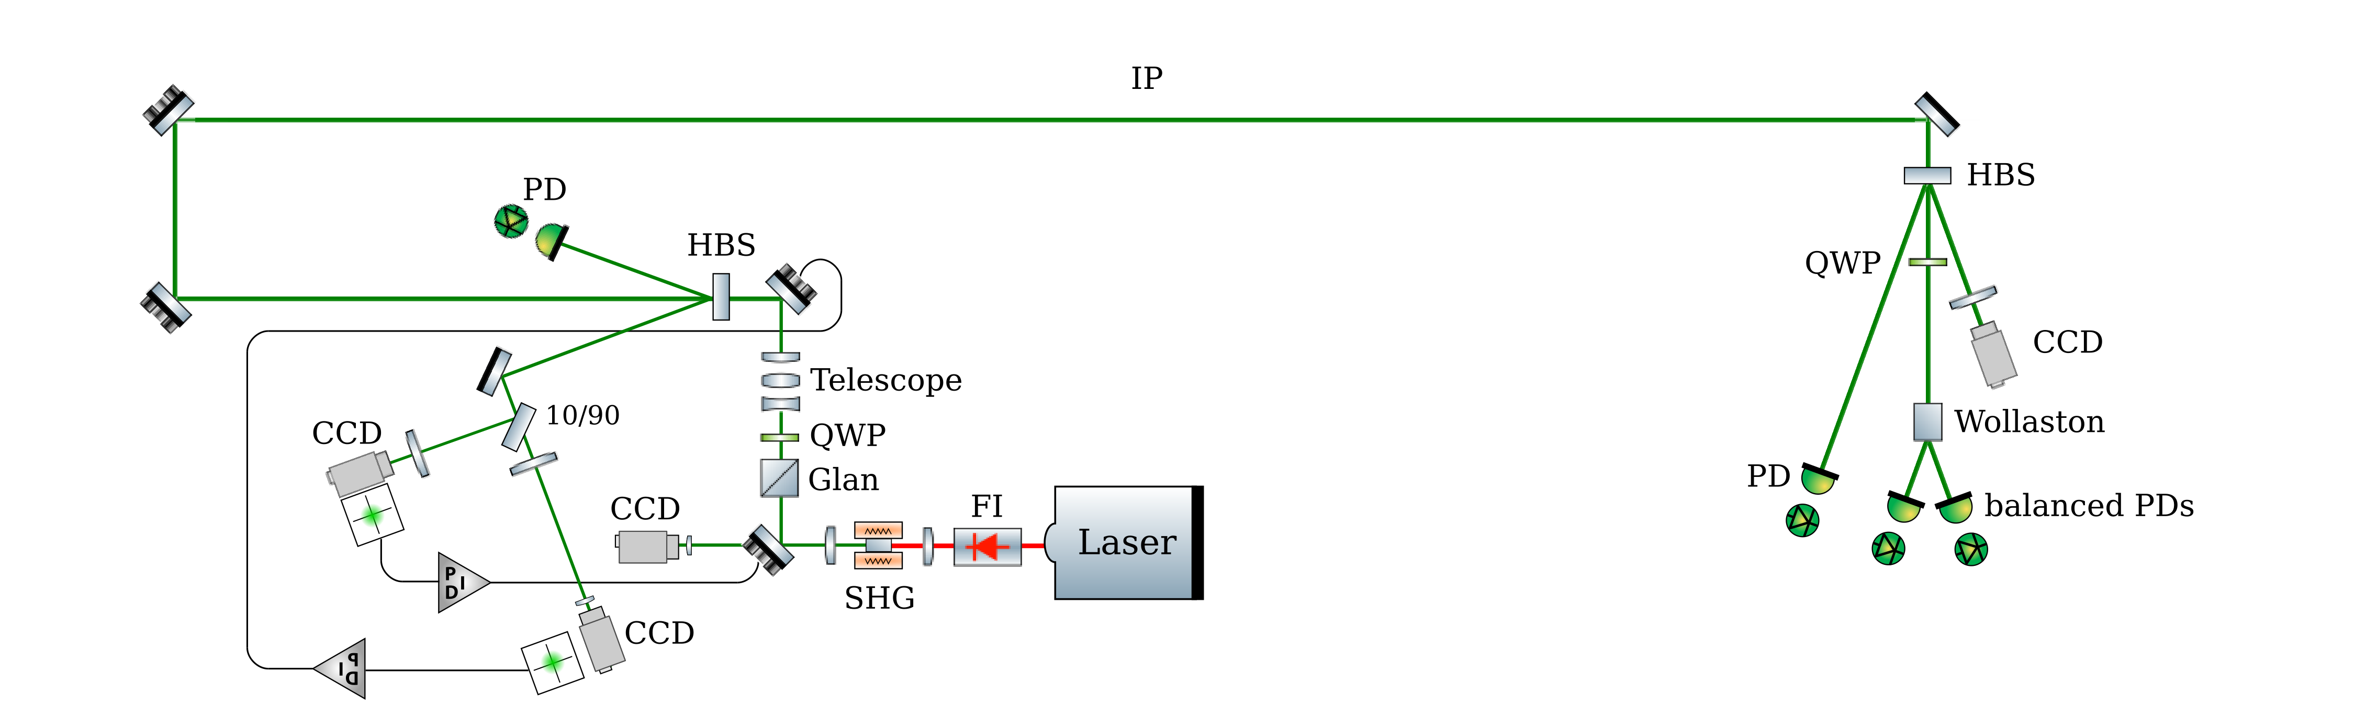
Laser system
Possibility to insert mirror for laser polarization calibration
250MHz
D. Charlet et al., 2023 JINST 18 P10014
Box with rough temperature control
Box with rough temperature control
Typical picosecond pulse duration
Elliptic beam can be delivered with cylindrical lenses/mirrors (not planned for a first step)
Key aspect: remote operation of the system that will be located in the tunnel

Slide 9
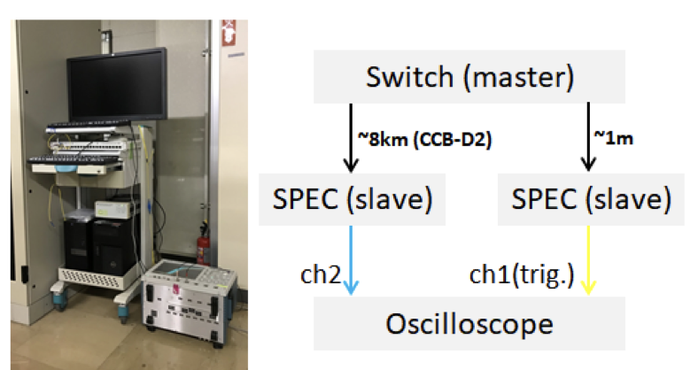
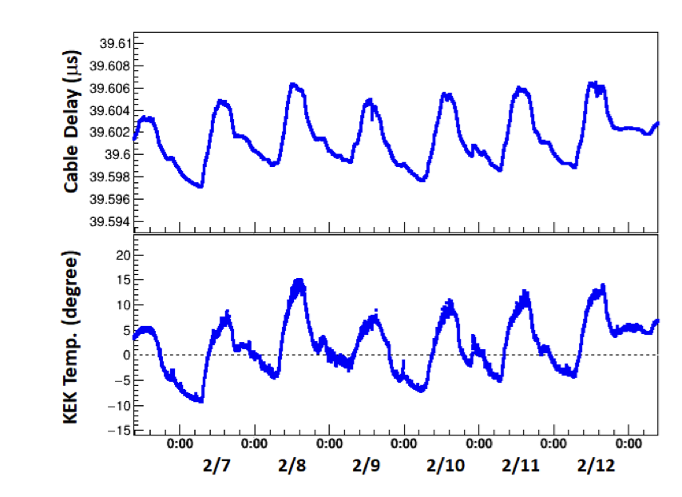
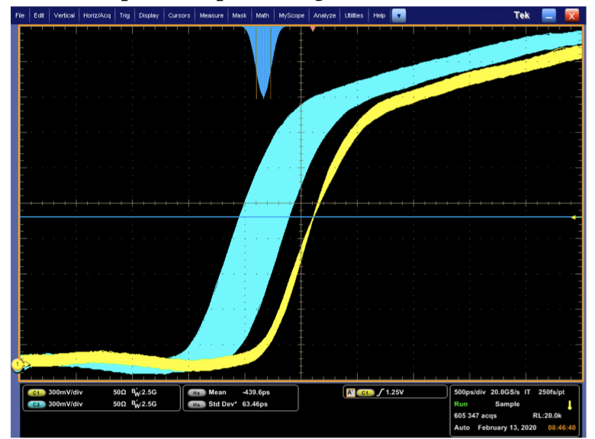
Clock distribution issue
Time propagation delay in optical fiber over time
H. Kaji, PASJ2020 WEOT09
Typical residual jitters are in the range of hundreds of picosecond due to thermal drifts over kilometric fibres
→ Very expansive optical measurement and compensation systems
Possibility to synchronize the laser on the RF clock of the accelerator using the WhiteRabbit technology and improvements implemented in IDROGEN board of IJCLab

Slide 10
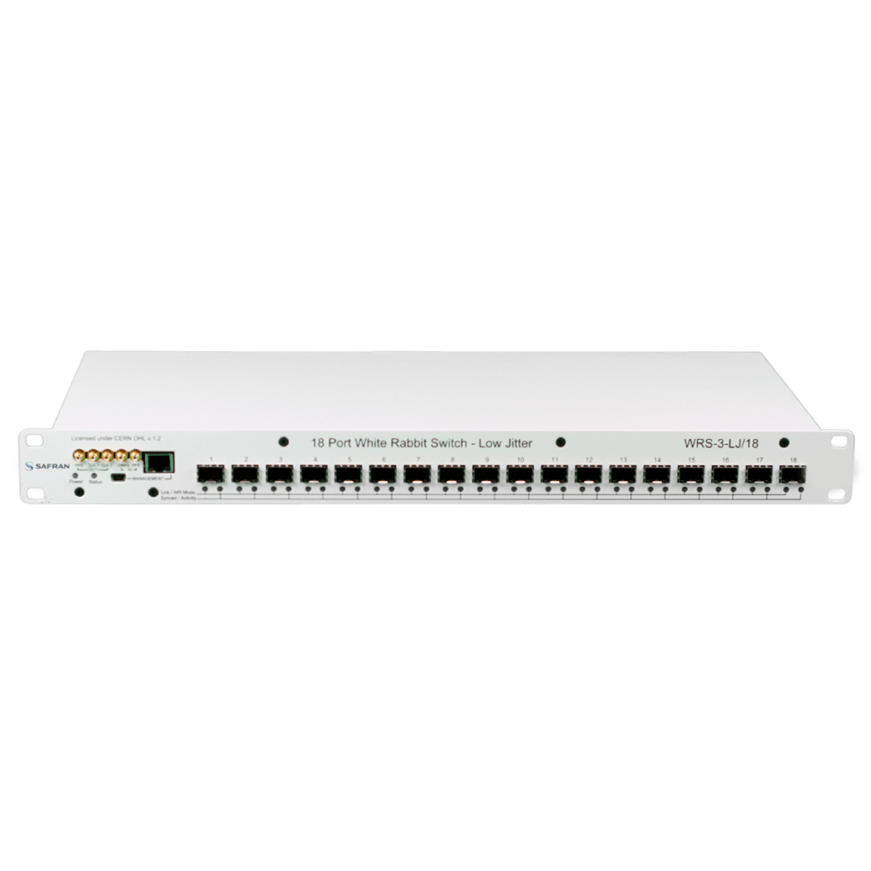
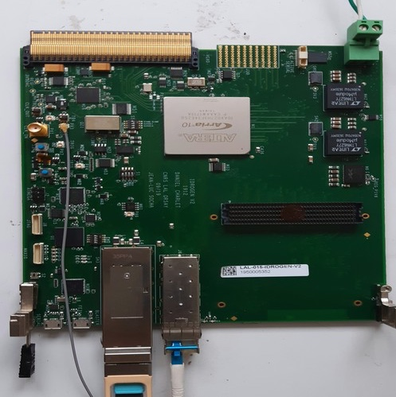
Laser synchronisation – concept
Master Oscillator (510MHz/51)
IDROGEN board
tailored for low noise with WR node
FPGA mezzanine card with high speed ADC
WhiteRabbit switch
WhiteRabbit (CERN) :
IEEE protocols over ethernet (SyncE, PTP)
State of the art digital technics to recover clocks
D. Charlet et al., https://cds.cern.ch/record/2893372?ln=en
4km fibre link
IDROGEN Board initially thought for radio-astronomy experiments
WhiteRabbit allows to minimize implementation cost and meet performance ?
A simple fibre to bring to the laser
No expensive/complicated fibre length compensation system to implement
Possibility to embed DAQ for the calorimeter
High interest in ATF team for investigating possibility of simplifyin ATF clock distribution
Expected to be used in the next accelerator being implemented at IJCLab (PERLE)

Slide 11
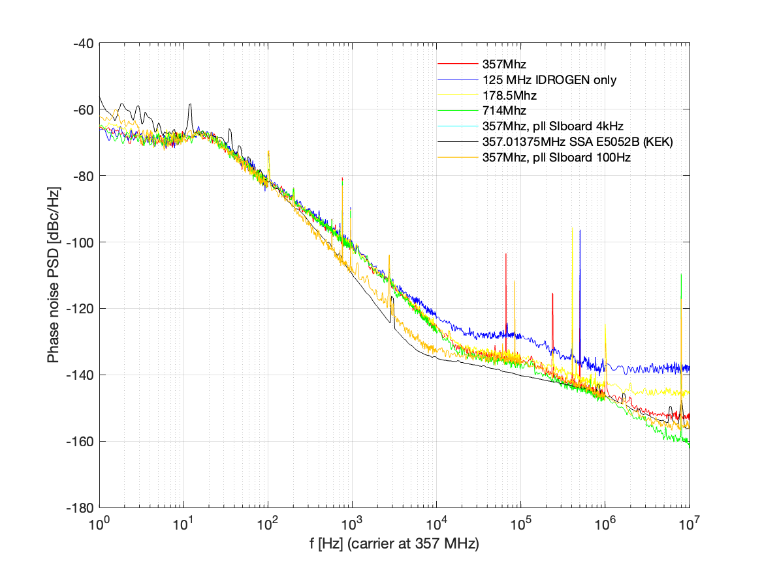

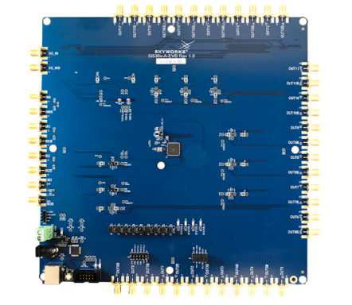
Arbitrary frequency generation
Orsay team at KEK June and Oct ‘24
Rubidium
RF
Same configuration but two totally different qualification schemes
fibre link
Identical phase noise for various different output frequencies
Arbitrary frequency
Precision of 1 Hz, accuracy excellent (no drift over several hours)
Consistency of KEK and IJCLab measurements.

Slide 12
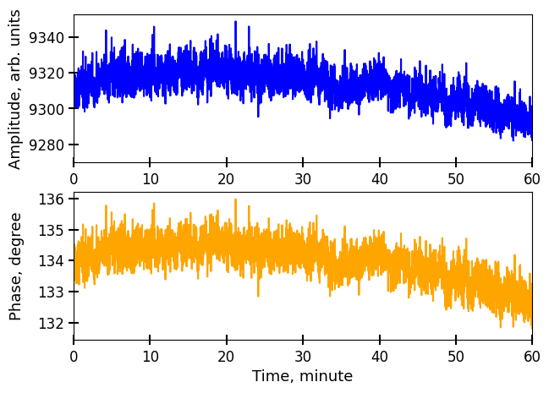
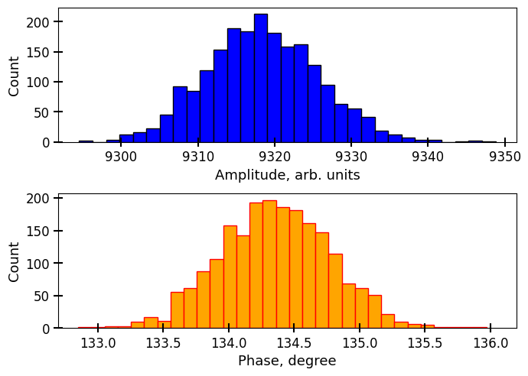





Long term drift
ATF team visit at IJCLab (Jan’25)
Generated freq.
X
Low Pass
$$KA\sin{φ}$$
split 50:50
$$A\cos{(ωt+φ)}$$
$$\cos{(ωt)}$$
Reference freq.
split 50:50
$$φ$$
X
Low Pass
$$KA\cos{φ}$$
~0.3degree RMS phase jitter (at 357MHz) i.e. 2.3ps RMS (below 1Hz)
NB: measurements made in a regular office, no thermal stabilization

Slide 13
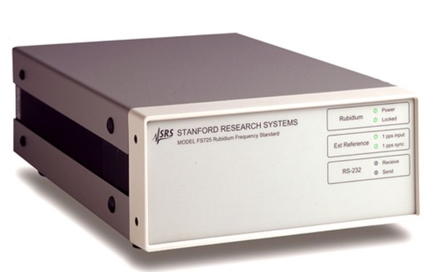

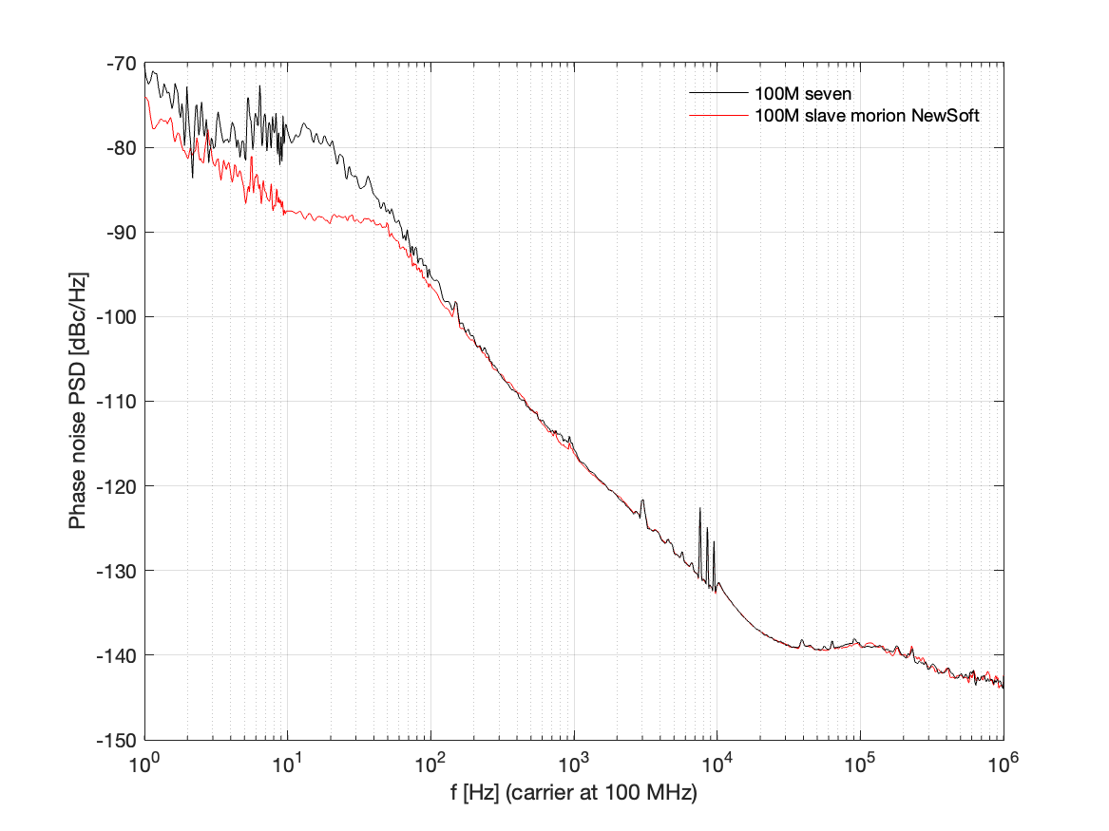
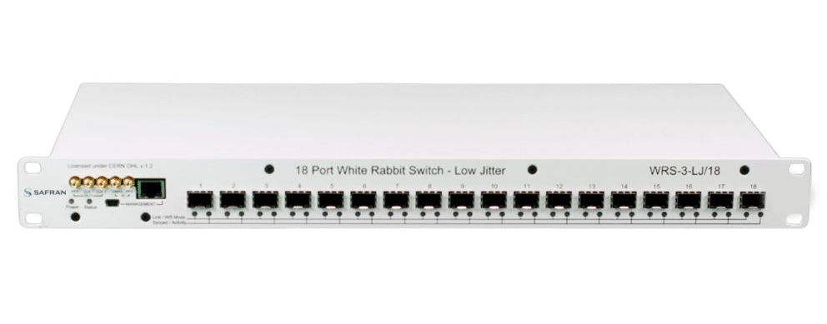
Last results at Orsay (March’25)
Rubidium
WR_LJ switch
IDROGEN slave
Rubidium
Phase noise comparison
Subtantial phase noise improvement
Obtain down to <0.9ps RMS (1hz, 10MHz)
Good enough for direct lazer synchronization
IDROGEN master
IDROGEN slave

Slide 14
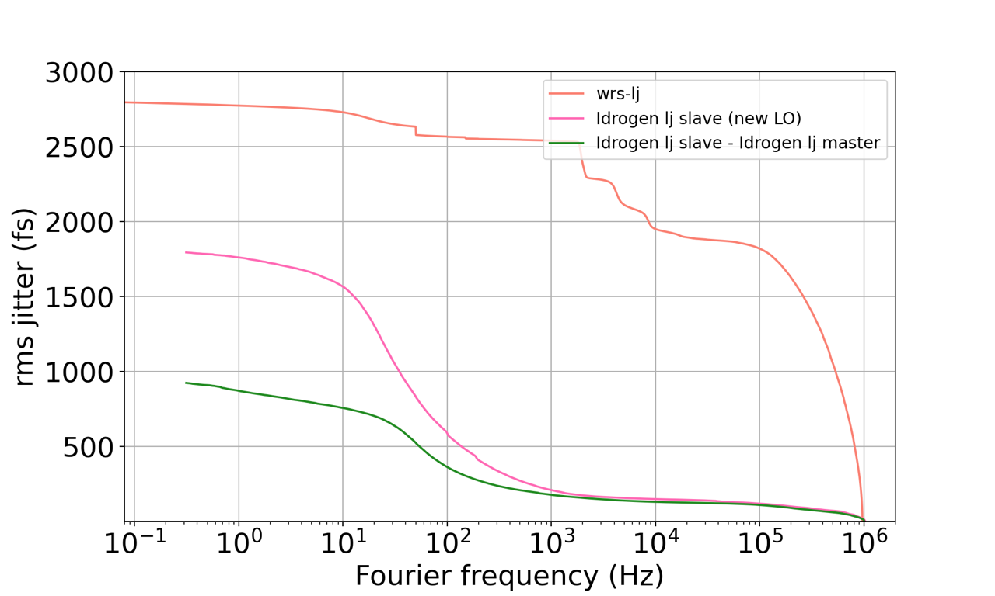
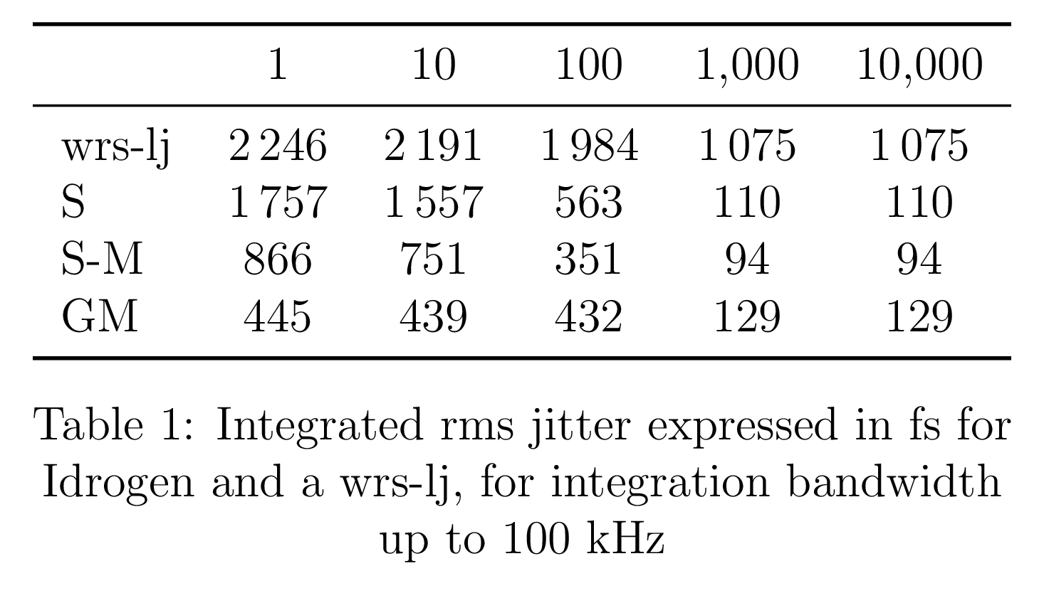
Integrated time jitter
Also in collaboration with LTE
(P.-E. Potie, M. Lours)
Integrated jitter according to integration window
IDROGENDROGEN BOARD: 2x better than Switch Low Jitter from Safran/Seven Solution

Slide 15
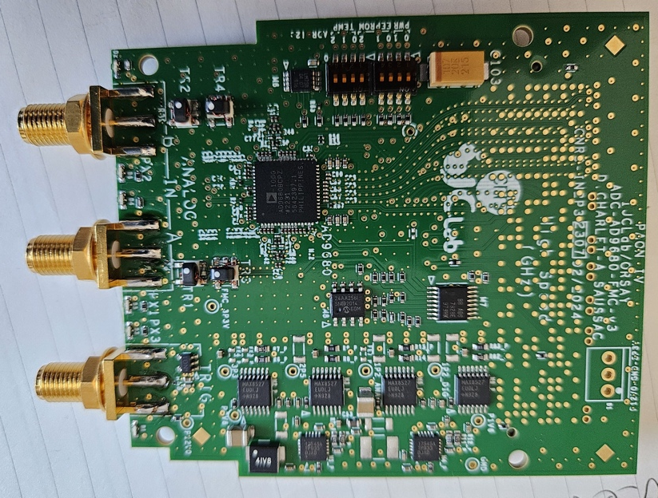
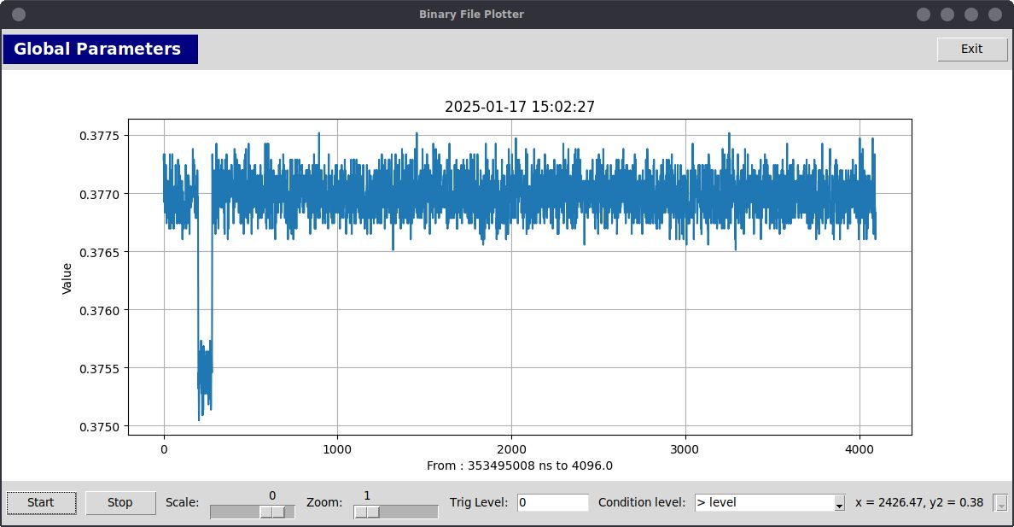
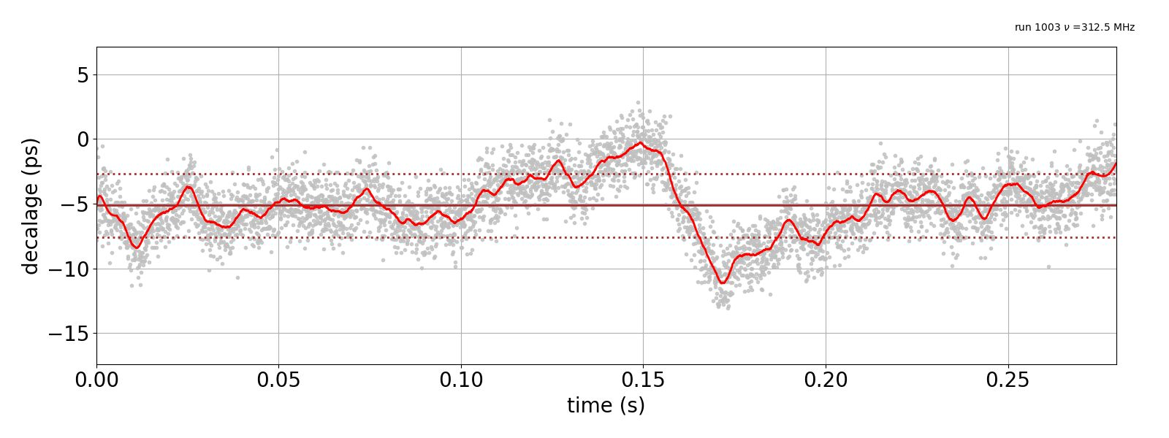
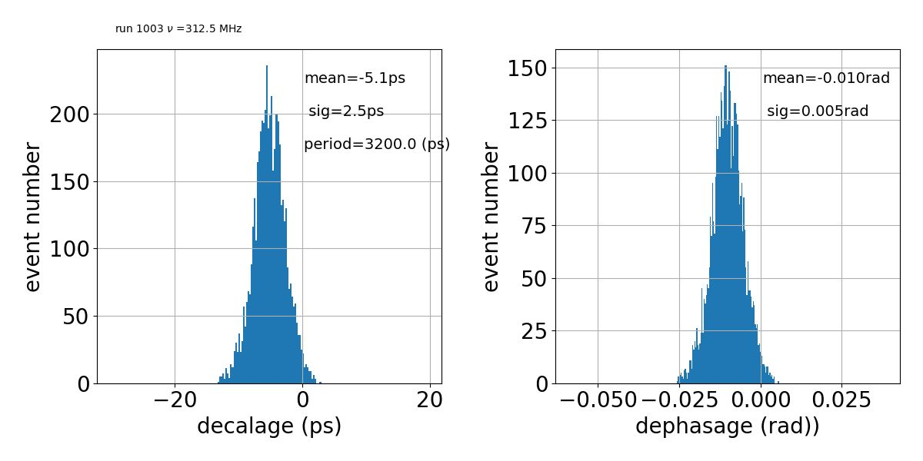
ADC capabilities
The motivation of the development of a new mezzanine :
  includes its own PLL & External ADC clock source
Mezzanine main features :
  VITA57.1 (FMC), ADC 9680, 2 channels 1GSPS 14 bits
  ADC acquisition JESD204B protocol,
  2GHz analog bandwidth
  External trigger in
Bandwidth 500 MHz to 1.5GHz
Synchro & timing by WR
Data transfer 40G Ethernet (currently 2x 10Gbs)
Configuration by IPBus 10G
1.250GSPS capability
5ns pulse & 10mv dynamic
System time resolution : 2.5 ps

Slide 16
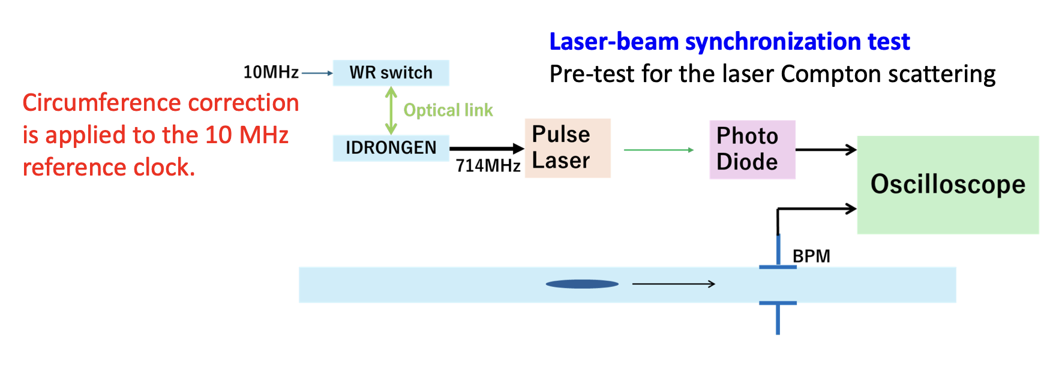
Planned activities at KEK this year
178.5MHz
Performance demonstration
Long term phase stability in representative accelerator conditions
NB: extended interest to use the IDROGEN board for instance to diagnose early beam oscillations and fasten aborts before occurrence of sudden beam losses. Cf Yun-Tsung Lai presentation
Several publications in preparation, triggered by the support of FJPPN

Slide 17
Conclusion & prospects
SuperKEKB polarization upgrade motivates development
of new synchronisation scheme for laser and e-beam
Exploits IJCLab know-how developed initially for Astrophysics projects now expanded into TimeD IN2P3 R&T
KEK know-how in accelerator synchronisation and time distribution
High-potential for a revisited way to synchronise accelerator components
arbitrary fibre length can be used (on accelerator scales)
Works already well with commercial WhiteRabbit switch
better with IDROGEN master : <0.9ps RMS jitter can be reached
Planned tests at KEK Accelerator Test Facility to make convincing demonstration
FJPPN support for travels to help achieving this experiment
Exchanges funded by FJPPN:
2-3 visits a year at KEK cofounded with EAJADE
Visit of KEK colleagues at Orsay + long term 1 month visit funded by KEK

Slide 19
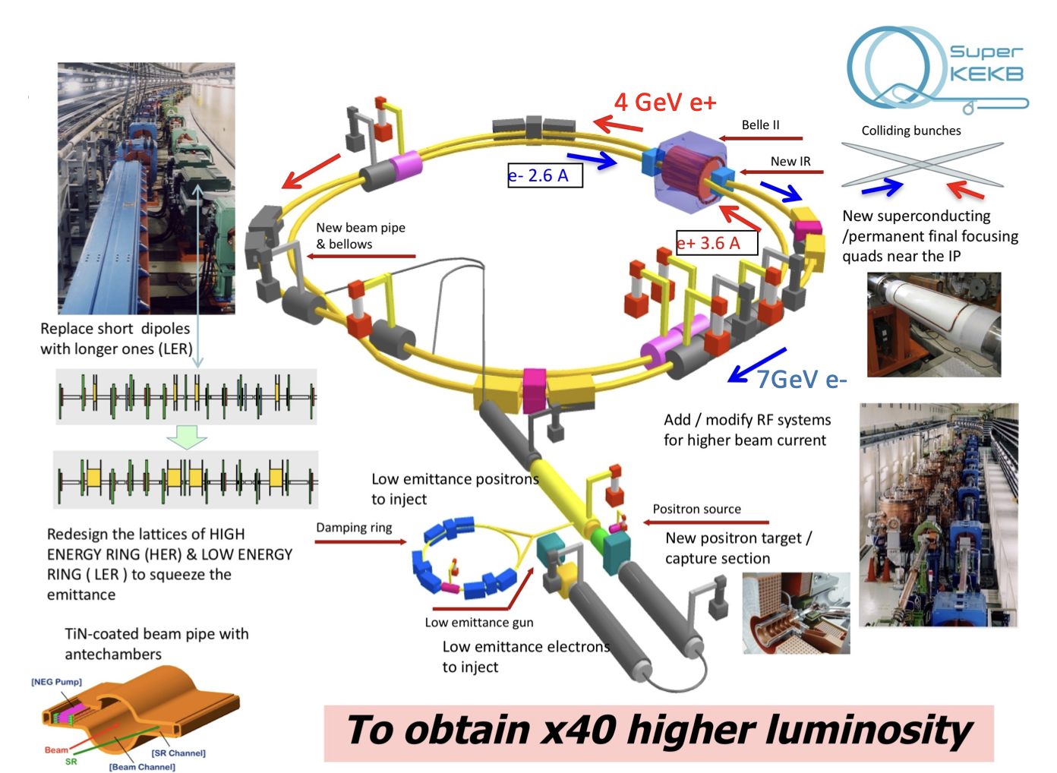
SuperKEKB

Slide 20
Luminosity projection
Today
Additional possibility being considered: e- beam polarization upgrade
Goal : transparent upgrade for accelerator --> negligible luminosity loss, possibility to operate w/ and w/o polarization

Slide 21
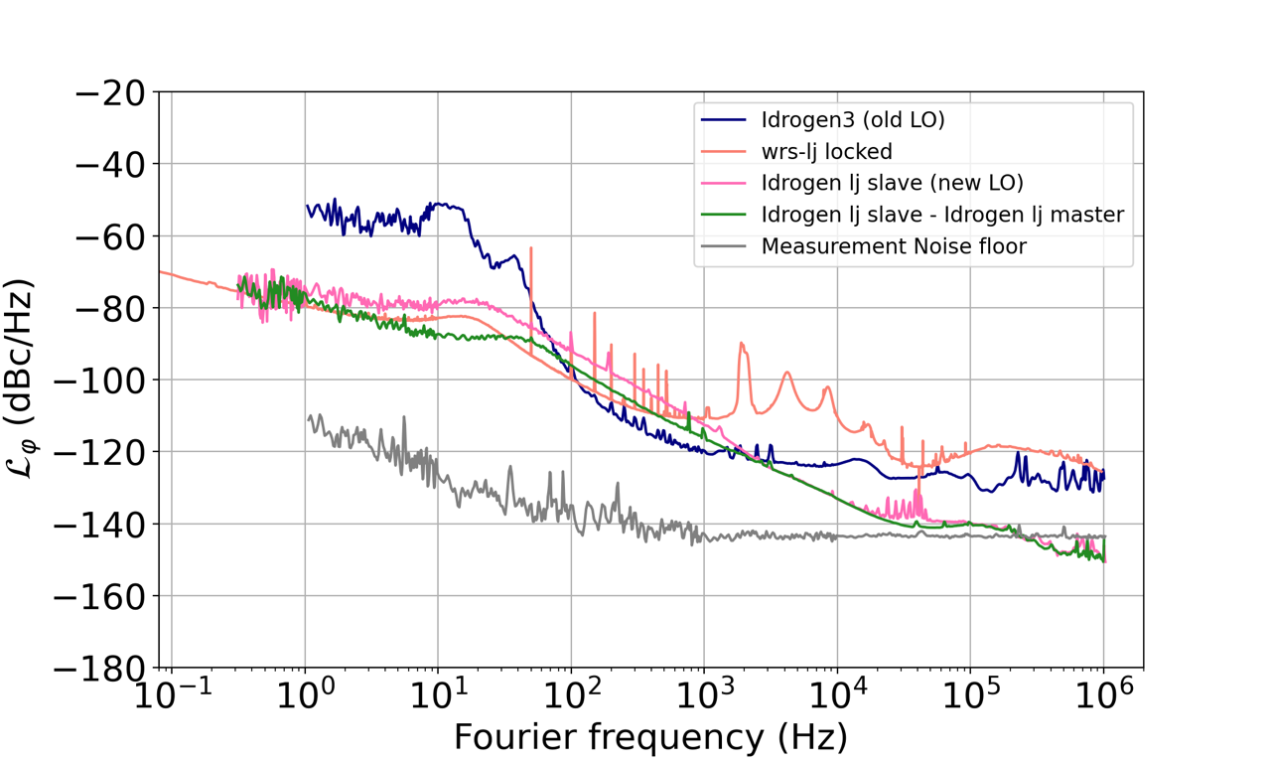
IDROGEN board performances
Phase noise measurement
Phase noise measurement
Integrated jitter according to integration window
IDROGEN BOARD: 4x better than Switch Low Jitter from Safran/Seven Solution
Measurements made at LTE (P.-E. Pottie)

Slide 22
2 channels 1GSPS 14b ADC FMC board
The motivation of the development of a new mezzanine instead of an off-the-shelf ADC mezzanine :
  includes its own PLL;
  ADC clock source : External clock
Mezzanine main features :
  VITA57.1 (FMC), ADC 9680, 2 channels 1GSPS 14 bits
  ADC acquisition JESD204B protocol,
  2GHz analog bandwidth
  External trigger in
Bandwidth 500 MHz to 1.5GHz
Synchro & timing by WR
Data transfer 40G Ethernet (currently 2x 10Gbs)
Configuration by IPBus 10G
1.250GSPS capability
5ns pulse & 10mv dynamic

Slide 23
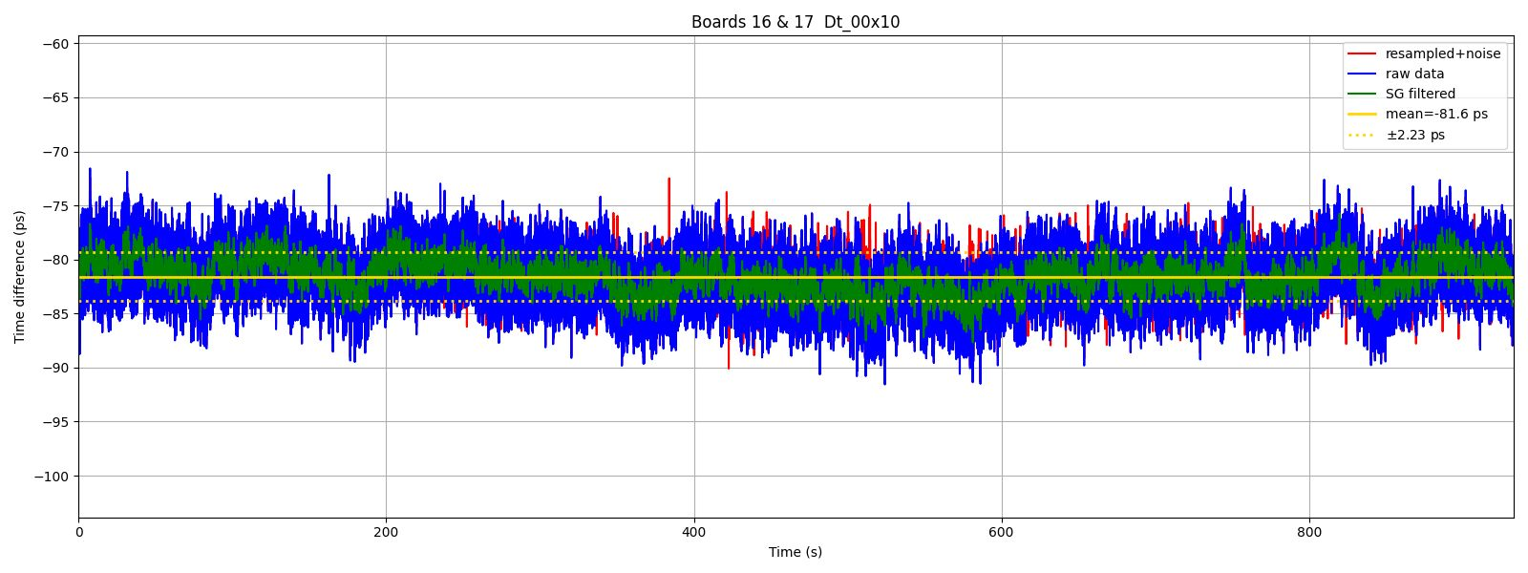
FMC ADC_9680: Synchronization
ps
2 IDROGEN boards synchronize by WR
Same RF signal (312.5MHz) split on boards
FFT 8K point
Cross correlation
System time resolution : 2.2ps
s
Notes:
Plot du haut
Temps acquisition en ~minutes
Moyenne de moyenne 2+180 fs de dispersion
Plot du bas c’est vue “instantané” echelle temps courte

Slide 24
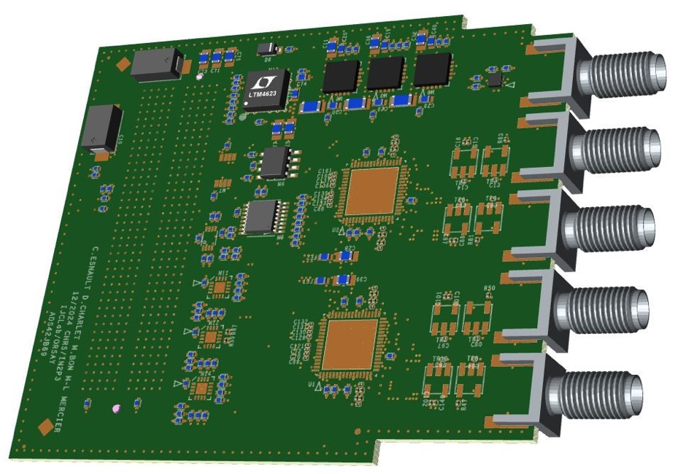
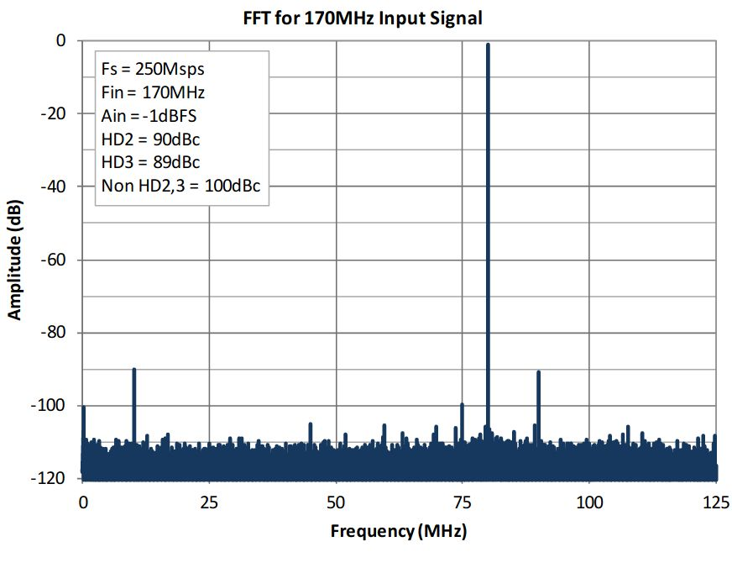
4 channels 250MSPS 16b ADC FMC board
The motivation to develop the FMC-ADS42JB69
  ADC Clock directly from IDROGEN FMC connector
4 channels 250MSPS 16bits
One external trigger
  Interface JESD204B
  Analog input 900MHz
  2.5v input voltages

Slide 25
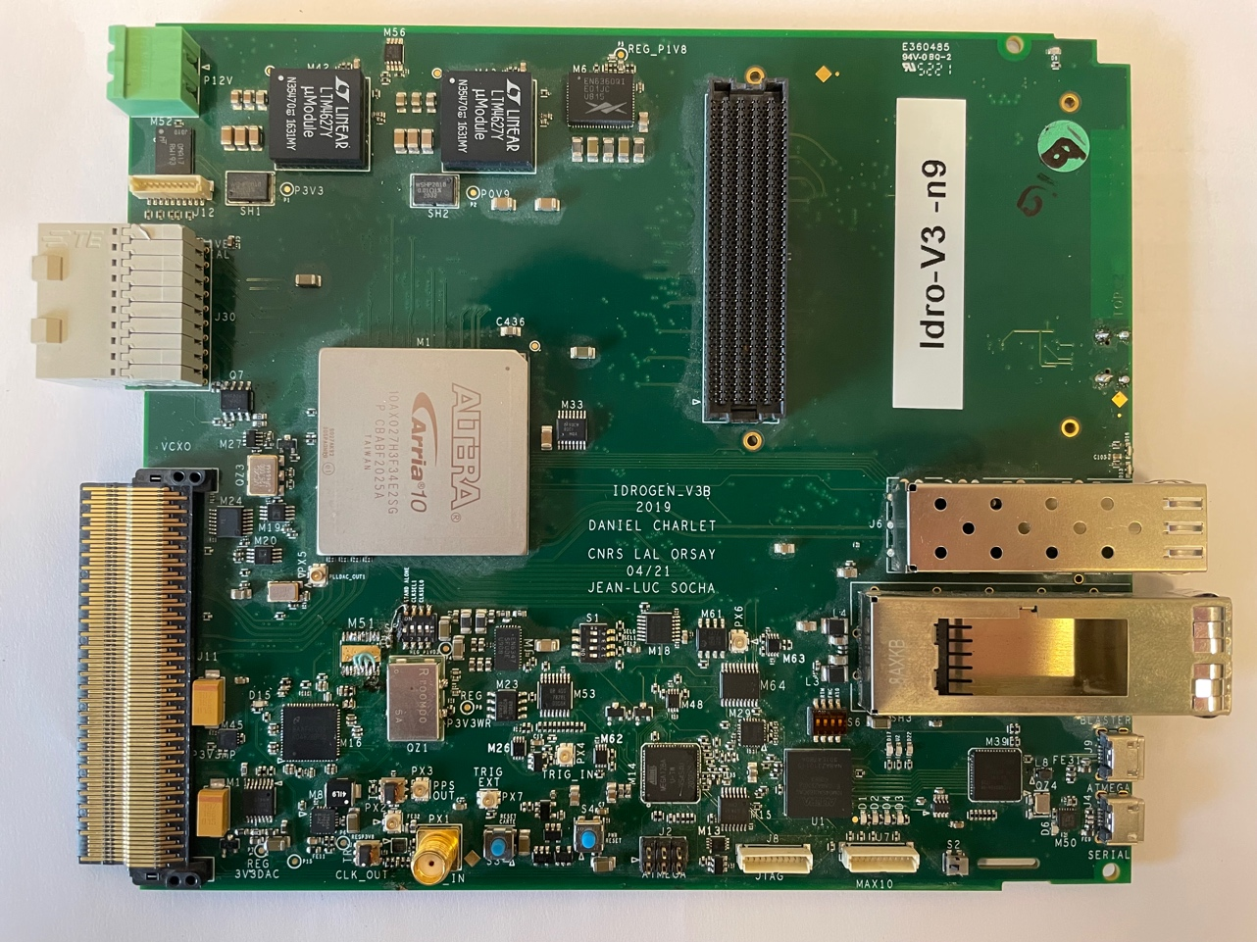
IDROGEN board v3
High speed data acquisition & Low phase noise WR node
White Rabbit Design & development done by IJCLab (based on CERN schematic): Component upgrade and EMC design rules compliant → High stability timing distribution
xTCA4.0 form factor board → Modularity
Base on ARRIA 10 FPGA → High data rate transfer
Standalone capability
FMC Slot (ADC, DAC, clock synthesis, ...)
RTM Connector
SFP+ connector for WR
µTCA connector
1Gb Ethernet
PCIe (8GT/s)
QSFP connector for data transfer (Ethernet, GBT, ...)

Slide 26
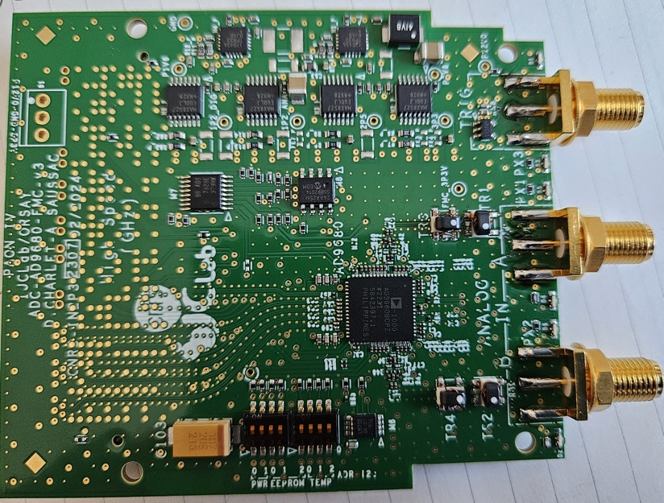
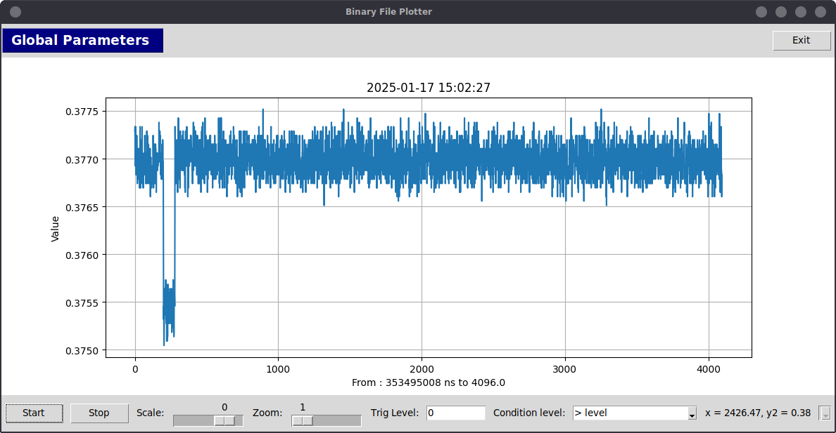
2 channels 1GSPS 14b ADC FMC board
The motivation of the development of a new mezzanine instead of an off-the-shelf ADC mezzanine :
  includes its own PLL;
  ADC clock source : External clock
Mezzanine main features :
  VITA57.1 (FMC), ADC 9680, 2 channels 1GSPS 14 bits
  ADC acquisition JESD204B protocol,
  2GHz analog bandwidth
  External trigger in
Bandwidth 500 MHz to 1.5GHz
Synchro & timing by WR
Data transfer 40G Ethernet (currently 2x 10Gbs)
Configuration by IPBus 10G
1.250GSPS capability
5ns pulse & 10mv dynamic

Slide 27
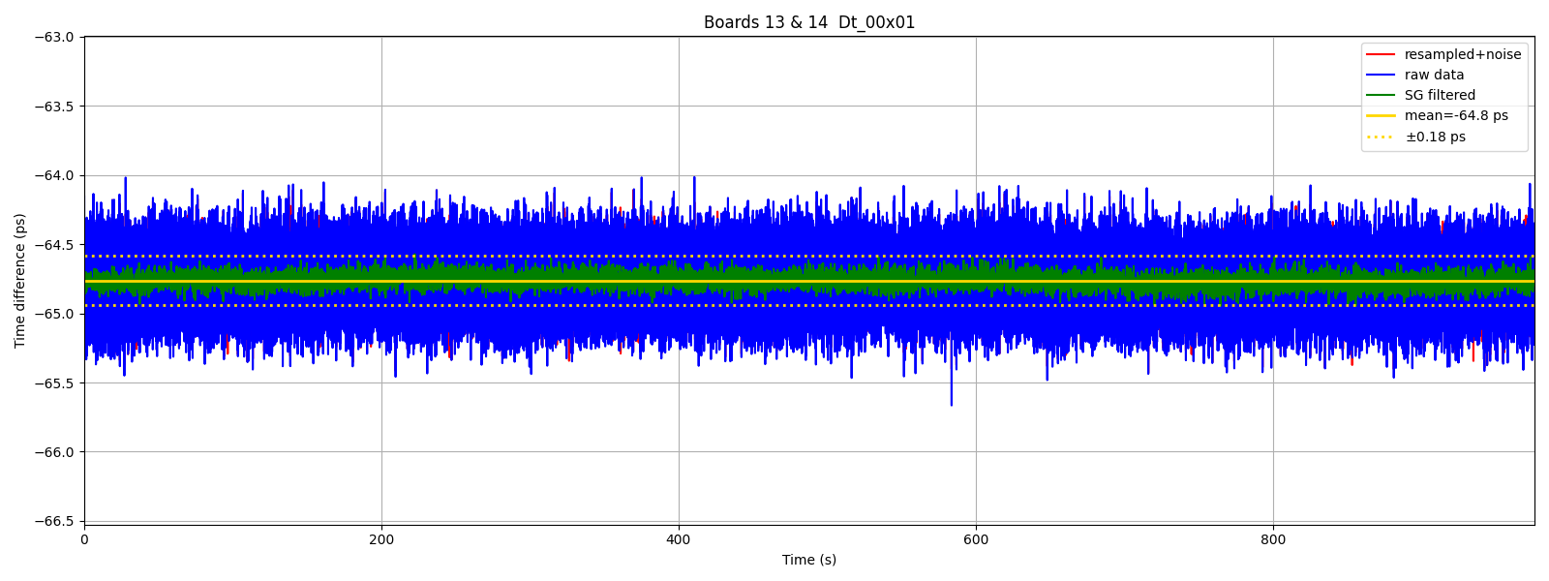
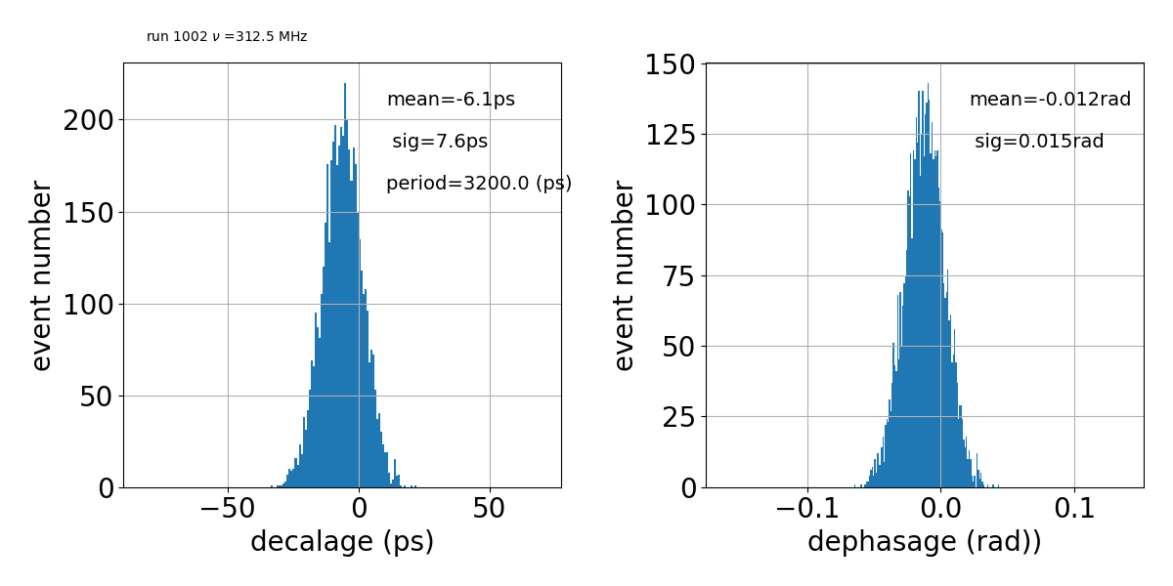
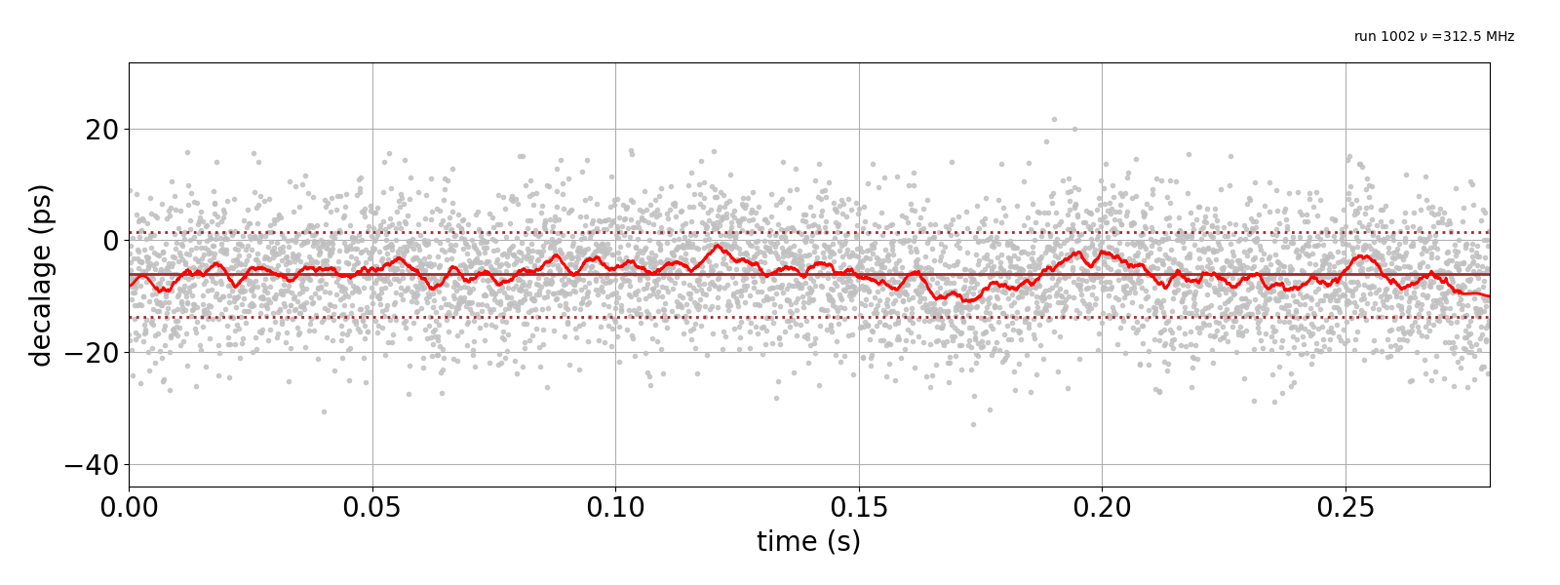
FMC ADC_9680: Synchronization
2 IDROGEN boards synchronize by WR
Same RF signal (312.5MHz) split on boards
FFT 16K point
Cross correlation

Slide 28
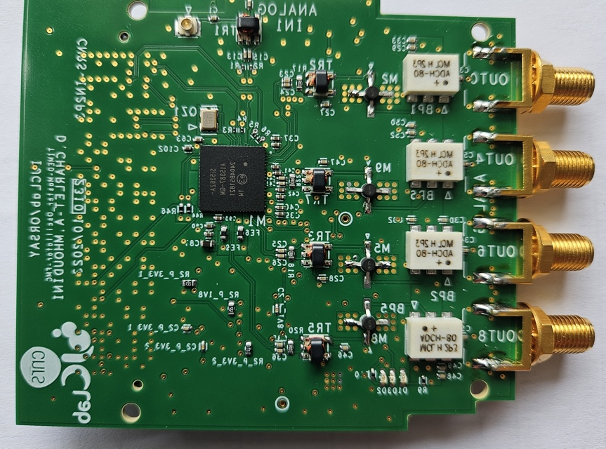
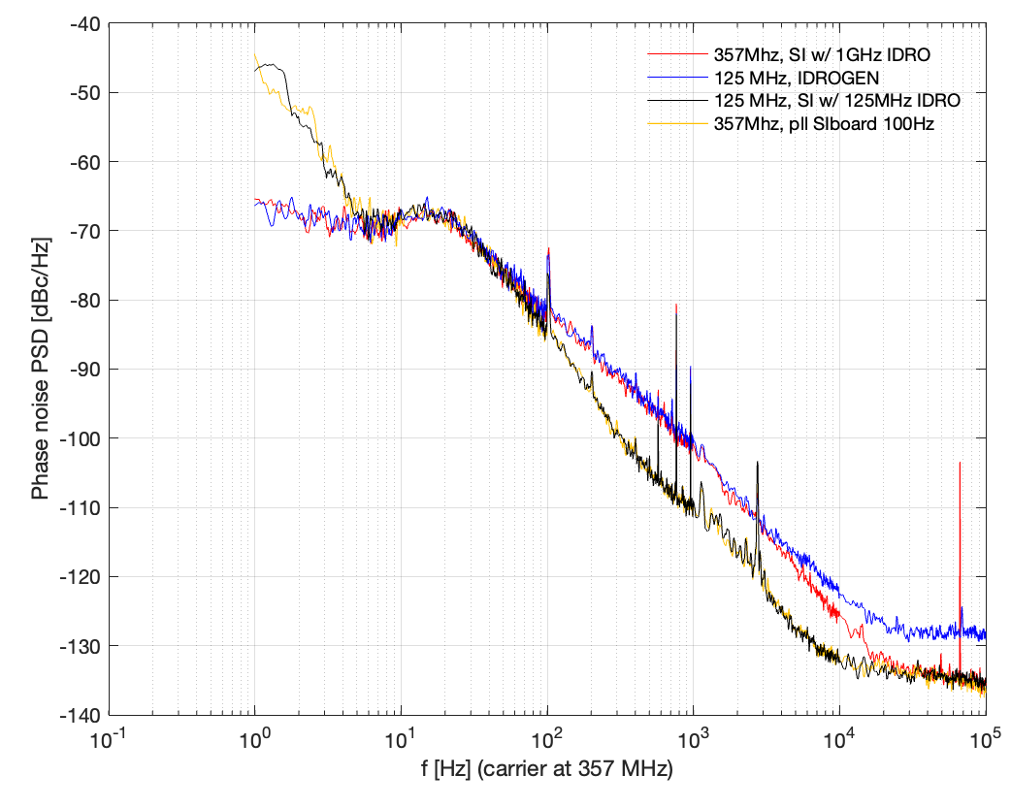
FMC clock synthesizer
The motivation to develop the Fractionnal PLL (FPLL) FMC
  Generate any frequency disciplined by WR clock
  Replace very expensive system with recent component
Fractional PLL SI5362
  Ultra-high-performance jitter attenuator
  Ultra-low phase jitter (<55 fs typ)
  18 outputs 10KHz to 2.75GHz
FMC_SI536X
  4 single ended independent outputs clock
  Configuration by PCIe or IPbus
  Currently in cabling
Measurement of phase
jitter with SI5361

