Slide 1




Linear Collider Facility
Roman Pöschl
Many slides taken from Jenny List
See also https://agenda.linearcollider.org/event/10624/program
IRN Terascale Meeting – Strasbourg May 2025

Slide 2
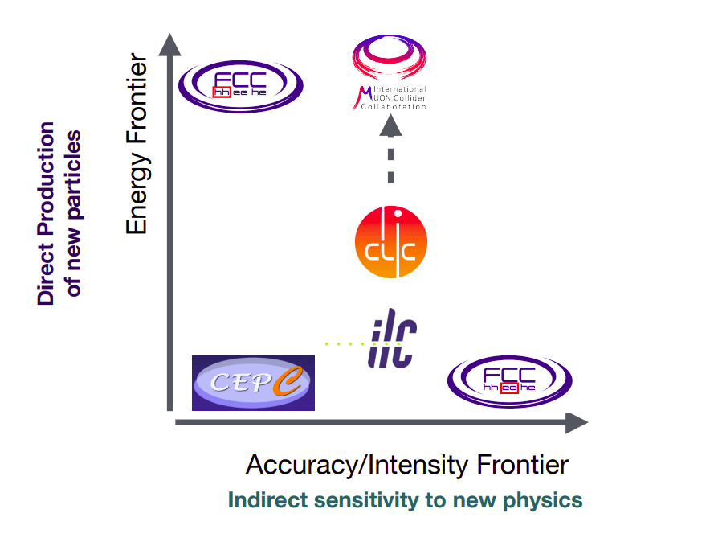
Future Projects – “The Frontiers”
Cartoon J. de Blas, ICEPP Tokyo, Dec. 2023

Slide 3
e+e- Physics program
New Physics
ee->ZH
ee->ZHH
Higgs via W-fusion
mZ
2xmW
tt-threshold
tth-threshold
LHC discovery?
1 TeV
...
Energy reach of LCF
Energy reach of CC
All Standard Model particles within reach of planned e+e- colliders
High precision tests of Standard Model over wide range to detect onset of New Physics
Machine settings can be “tailored” for specific processes
  Centre-of-Mass energy
  Beam polarisation (straightforward at linear colliders)
Drastic reduction of background through beam polarisation → facilitates BSM searches
the full Higgs / top / electroweak program requires polarised beams & ECM up to at least 1 TeV

Slide 4
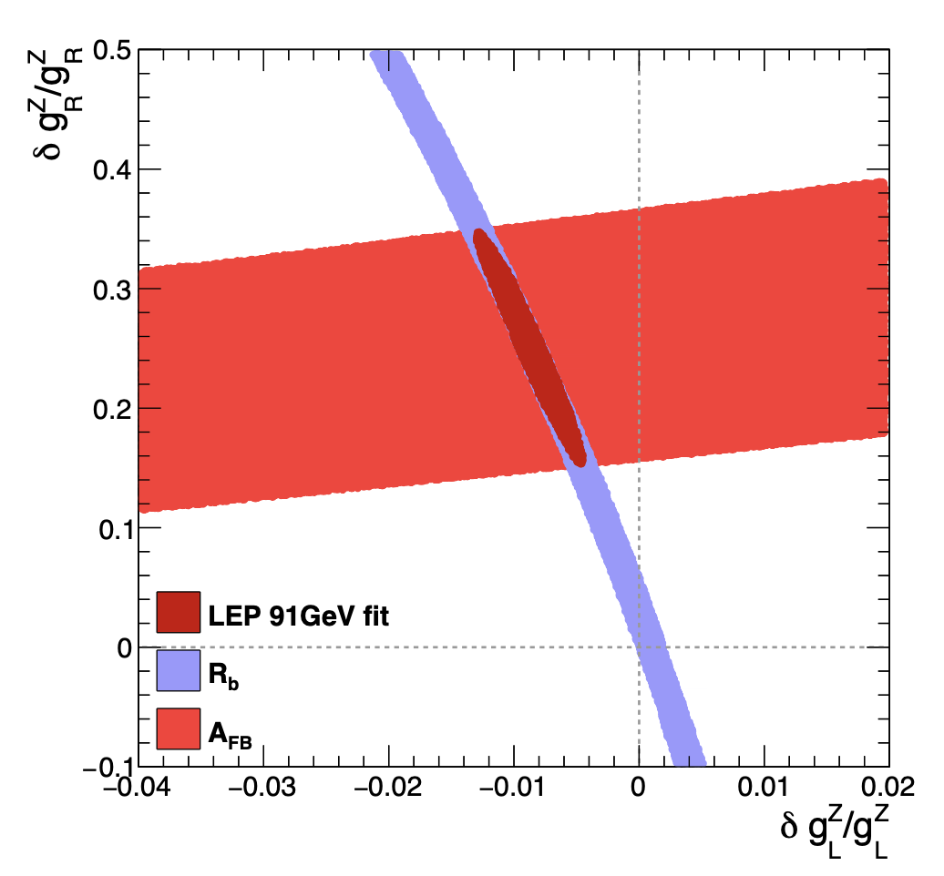
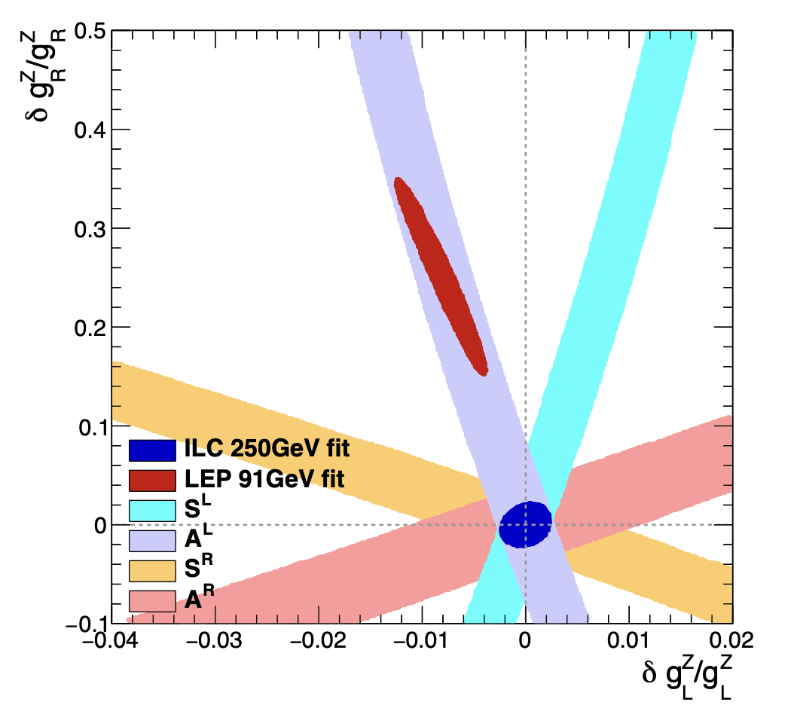
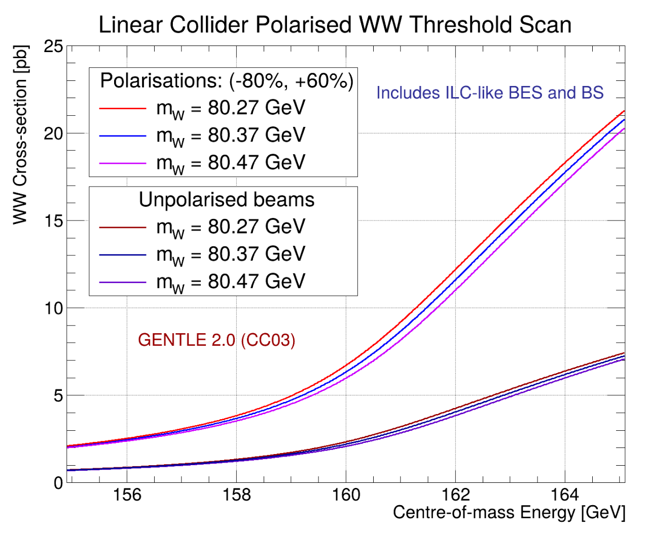
Beam Polarisation
Example electroweak couplings
  More observables for constraints
  “Four machines in one”
Example WW threshold
  Much sharper rise at threshold
  Enhanced sensitivity to W mass

Slide 5



Future Projects – Linear Colliders
HALHF and PWA
Linear Collider Facility - LCF
Linear Colliders would cover in a staged approach centre-of-mass energies between the Z-pole until multi-TeV
Polarised beams
Documents for all proposals see backup

Slide 6
LCVision – A Unified approach
LCWS2024: Linear Colliders teaming up in view of the upcoming EPSSU
all linear colliders share the same scientific goals:
  formulate a coherent physics program
  define energy stages etc science-driven
beyond an individual technology:
  design a linear collider facility
  infrastructure compatible with various technologies
  plus beam-dump / fixed-target exp’s / R&D facilities
study the Higgs now - but maintain flexibility for the future:
  start now with an affordable project
    maintain scientific diversity
    strengthen accelerator R&D towards 10 TeV pCoM collider
  decide on upgrades / new projects based on future developments - or even break-throughs:
    scientifically: HL-LHC could still discover new particles
    technologically: higher gradients / muon cooling / high-field magnets

Slide 7
LCVision and the ESPPU
from the remit of the European Strategy Group
The aim of the Strategy update should be
  to develop a visionary and concrete plan
  that greatly advances human knowledge in fundamental physics
  through the realisation of the next flagship project at CERN.
The Strategy update should include
  the preferred option for the next collider at CERN
  and prioritised alternative options to be pursued if the chosen preferred plan turns out not to be feasible or competitive.
In order to receive full attention for the LCVision idea:
complement a generic, site-independent concept with
a concrete proposal for a
Linear Collider Facility (LCF) @ CERN

Slide 8
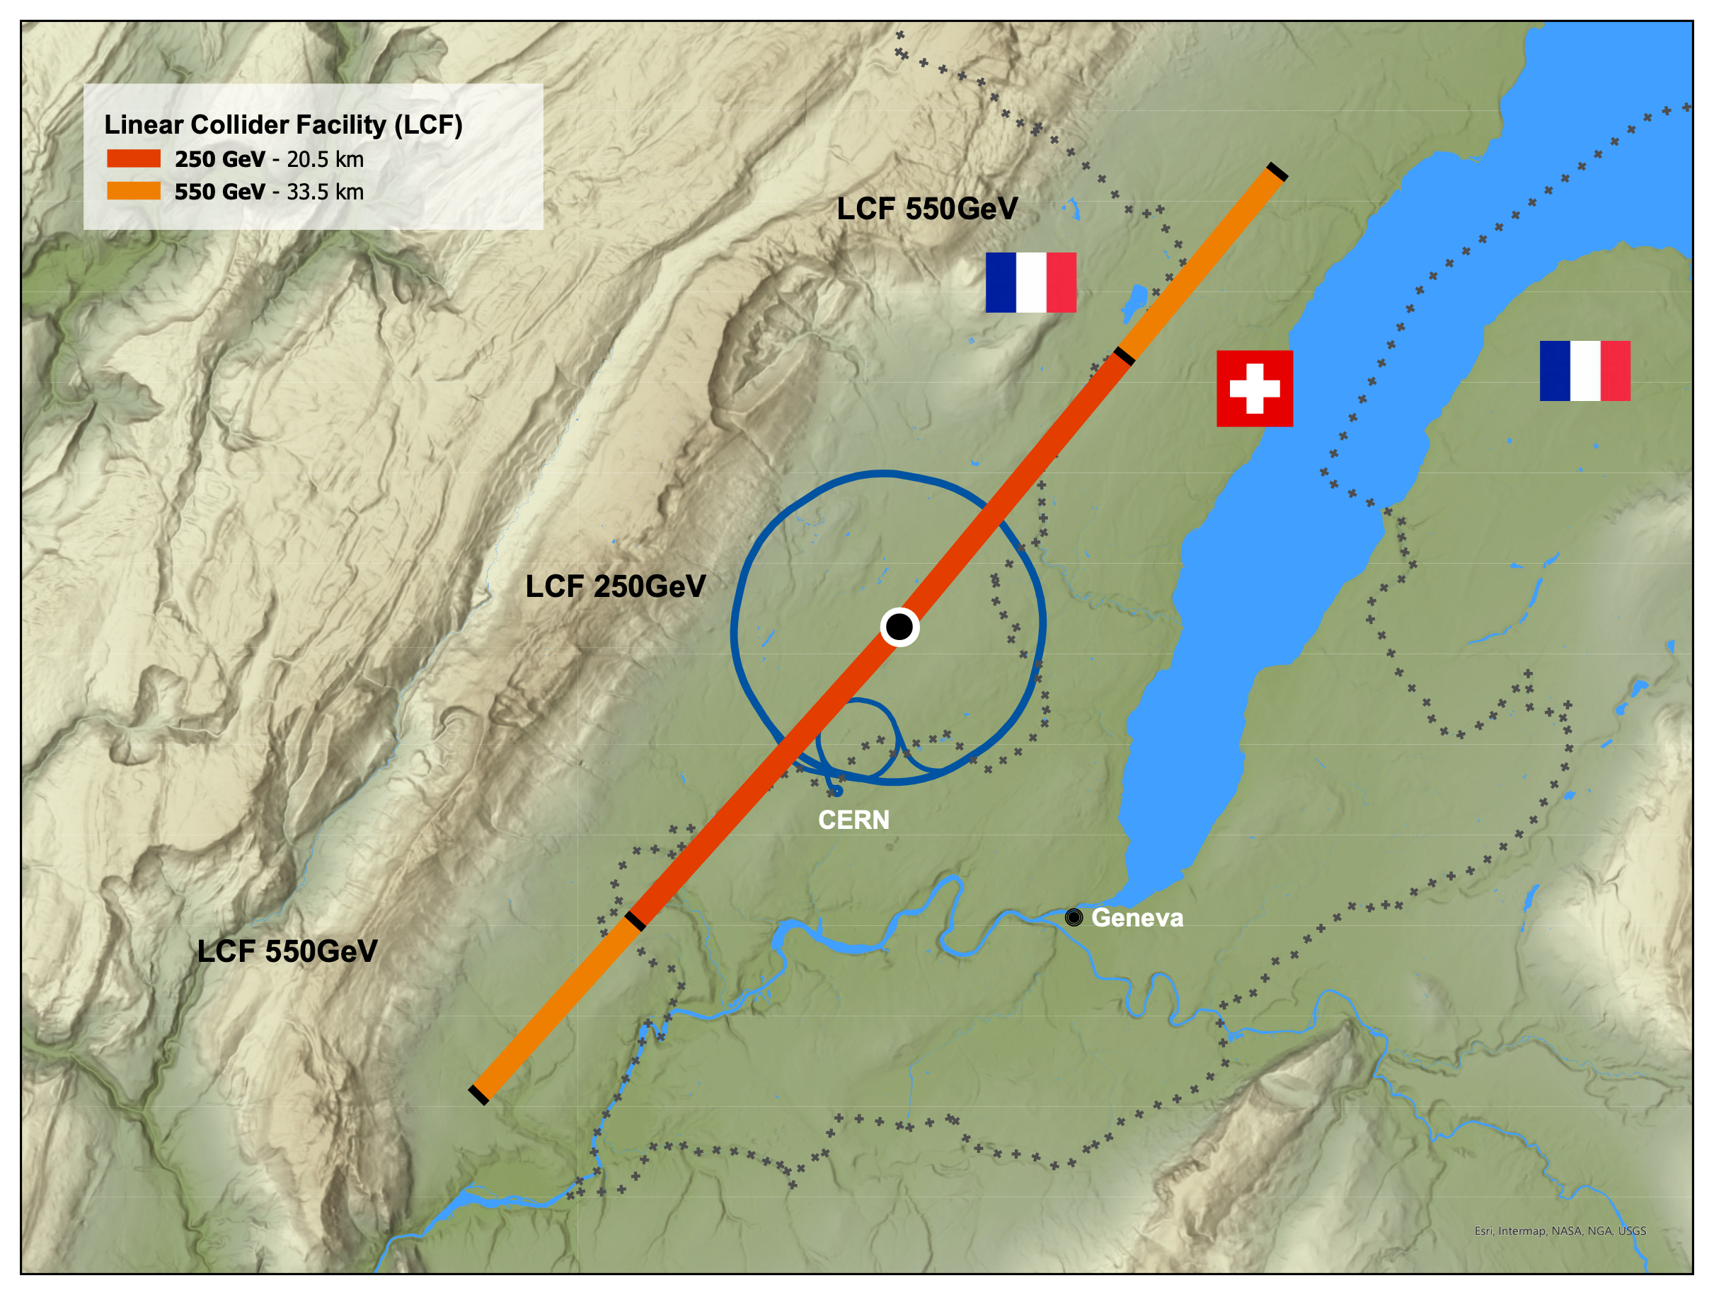
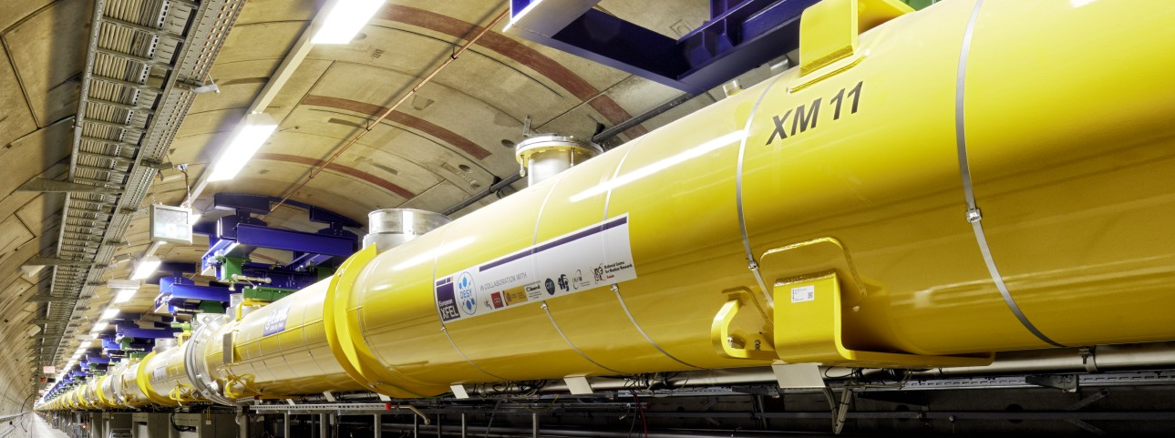
General Considerations
for the LCF@CERN
Philosophy:
  leverage all the excellent work done for ILC & CLIC in the past
    reliable costing etc
    “ready to build”
  gently modernize to turn into true flagship project for CERN
Superconducting RF technology (like ILC)
  successful construction & operation of Eu.XFEL, LCLS-II…
  => no large-scale demonstrator step needed
  lab experience and production capacities in industry globally
  => opportunity to take burden off CERN’s shoulders
  choice for fastest implementation
Scope project to be a flagship project for CERN
  2 interaction regions
  higher luminosity than ILC (possible due to Q0=2E10)
  add-on facilities (Beyond Collider, R&D / irradiation facilities)
  attaractive upgrade perspectives with advanced technologies
  but stay affordable, wrt to CERN budget
The LCF in 2025 is NOT the ILC as planned in Japan in 2016
LCF spec
ILC spec

Slide 9
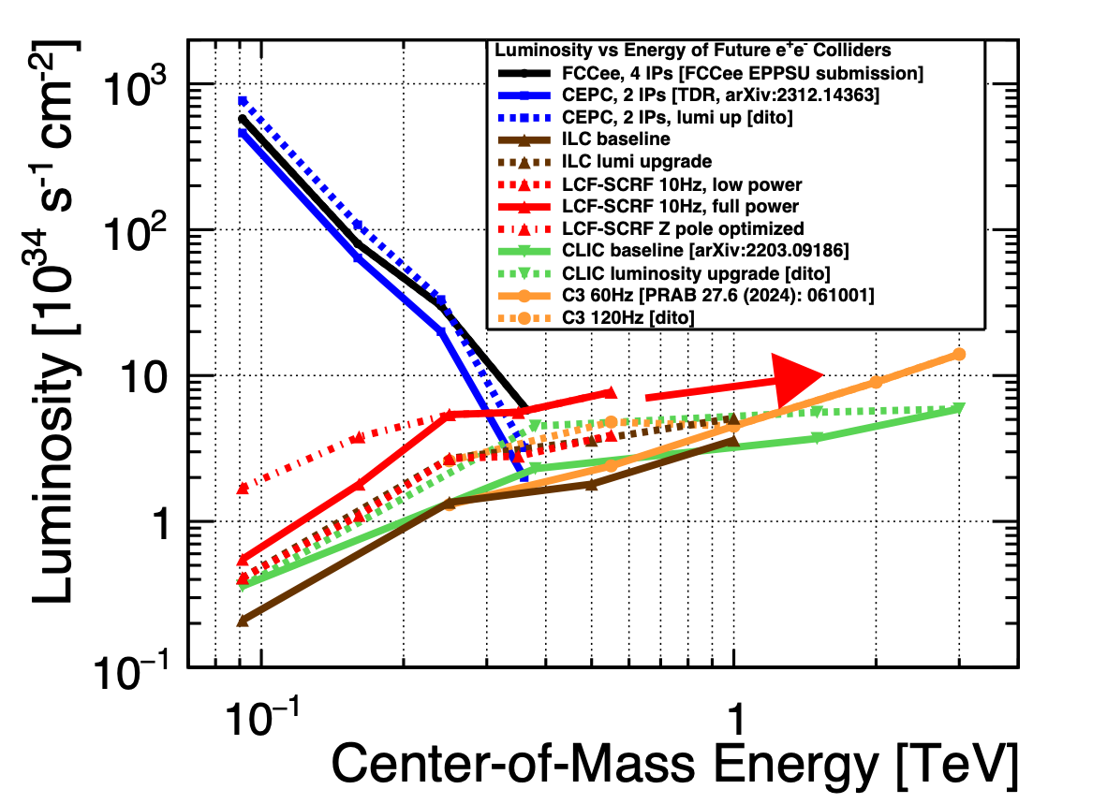
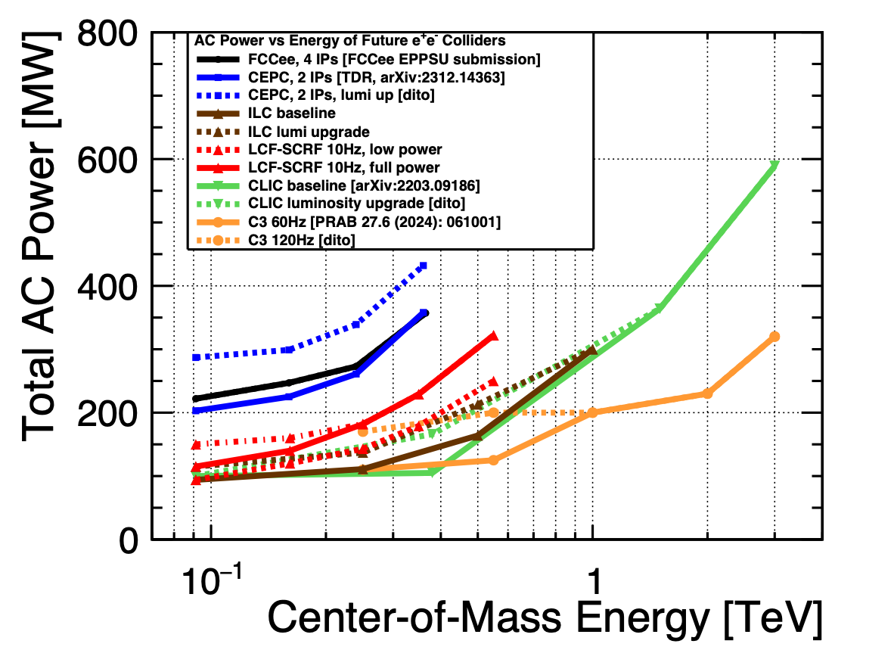
Luminosity and Power Consumption
For LCF-SCRF and other e+e- colliders

Slide 10
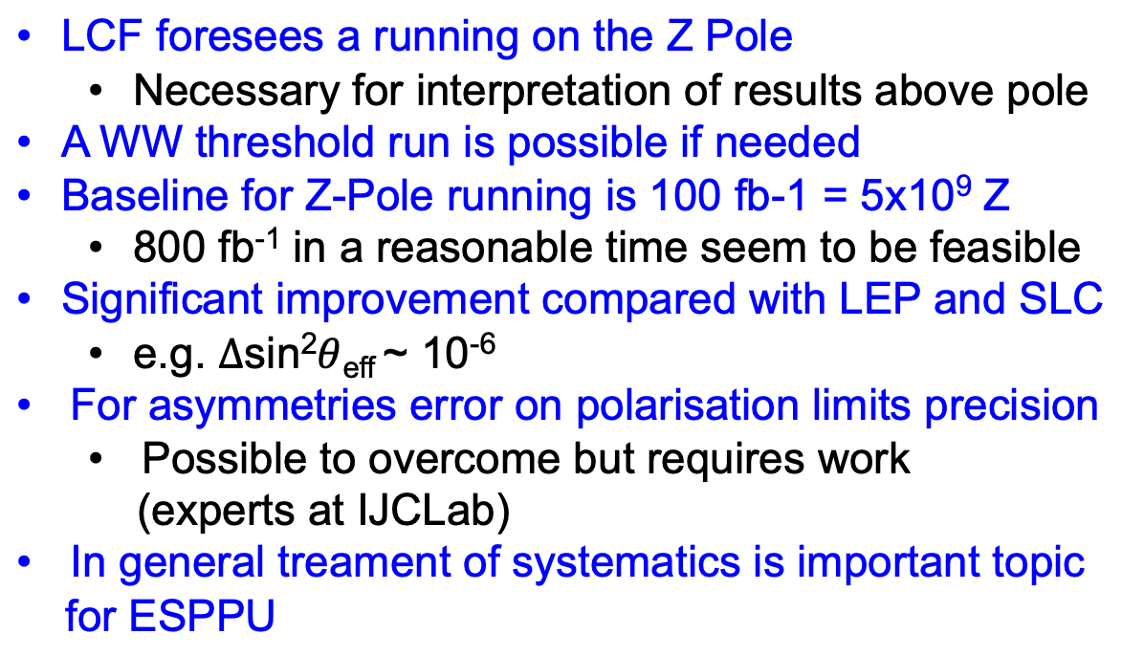
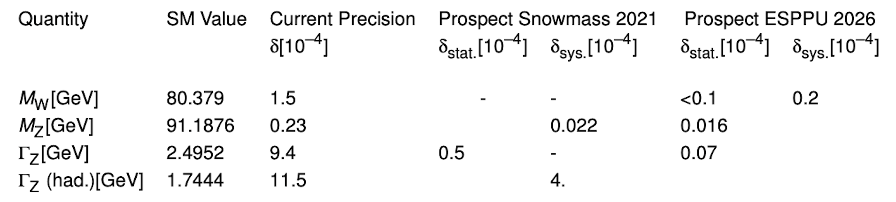
Electroweak Precision Observables

Slide 11
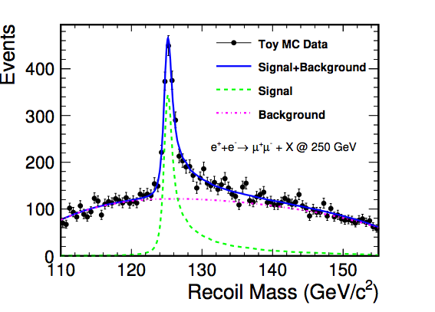
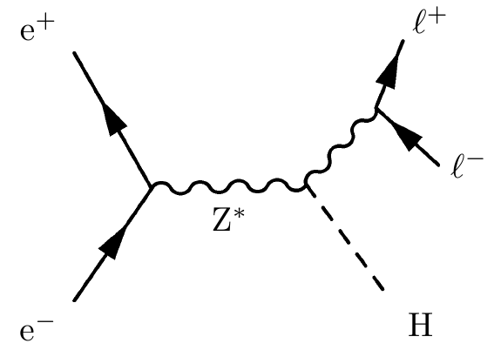

Higgs-strahlung at lepton colliders
Powerful channel for unbiased tagging of Higgs Events
Absolute normalisation of Higgs couplings
Sensitivity to invisible Higgs decays
Well measurable
decay leptons from Z
μ Pairs, e pairs
No assumption on Higgs
decay modes
Higgs Recoil Mass:
$$M_{h}^{2}=M_{recoil}^{2}=s+M_{Z}^{2}−2E_{Z}\sqrt{s}$$
Clean and sharp peak in Z recoil spectrum
Illustrates precision that can be expected
from e+e- colliders

Slide 12
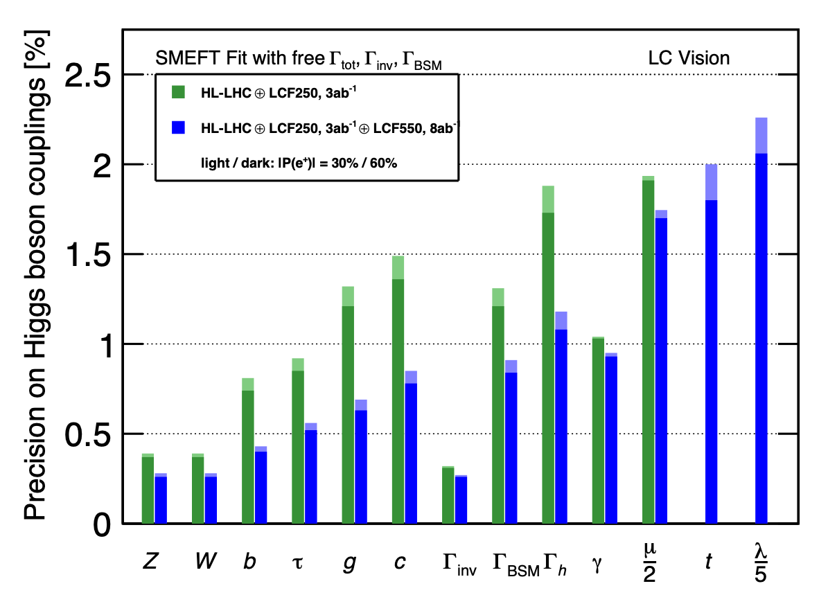
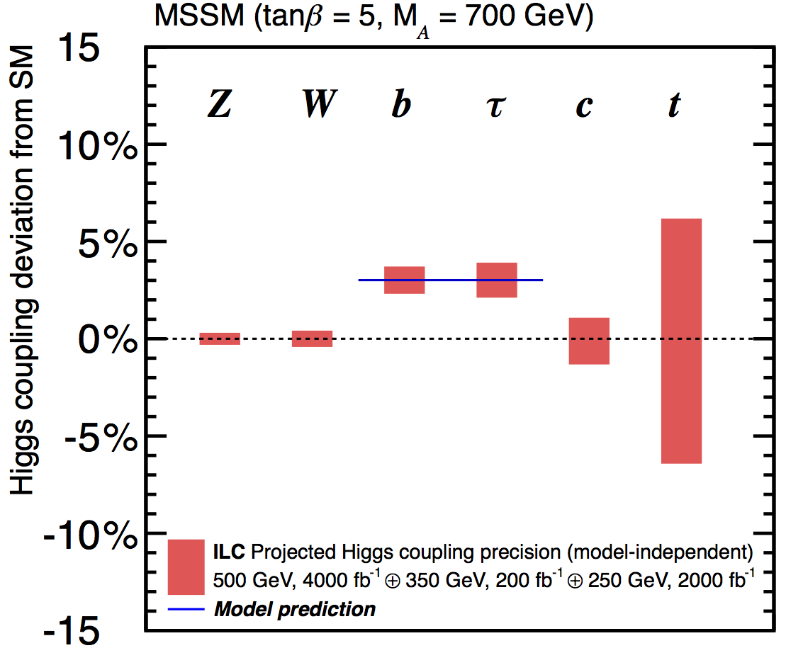
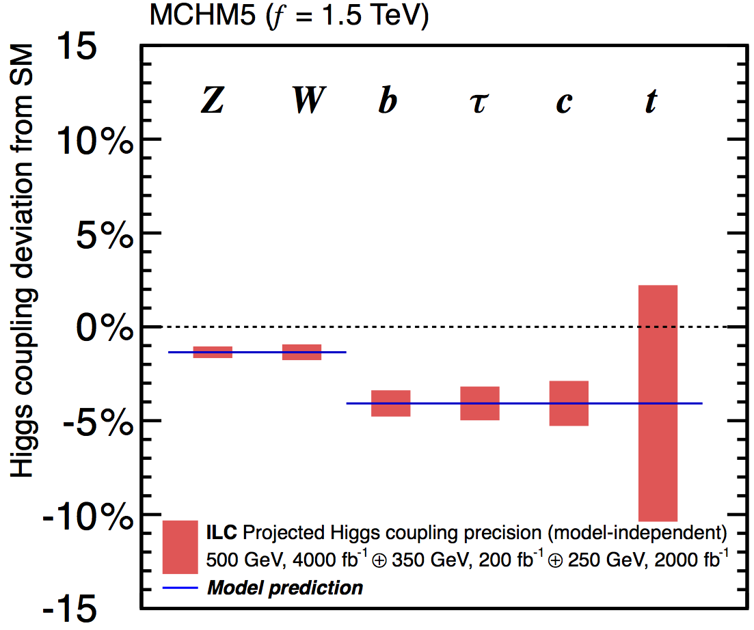
Precision matters ...
Example for illustration: Coupling precision after full LCF programme
Composite Higgs
Supersymmetry
Different new physics models lead to different patterns

Slide 13
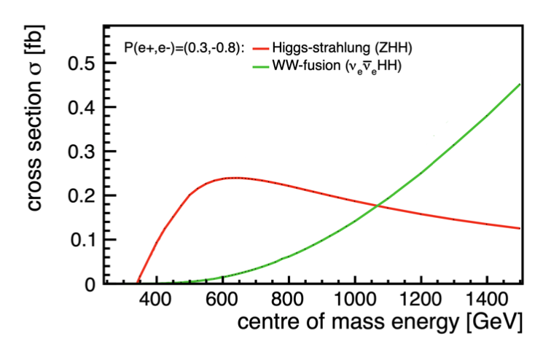
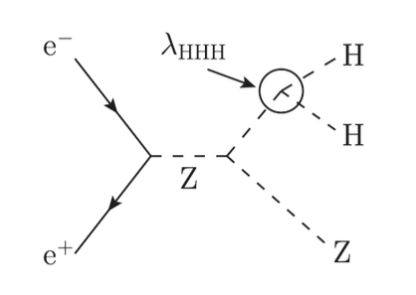
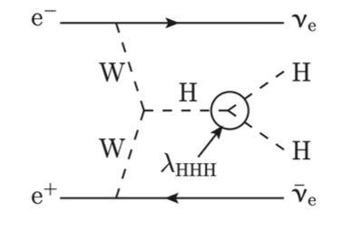
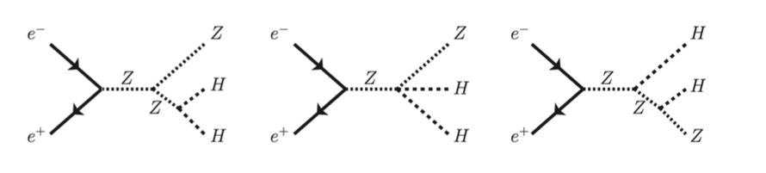
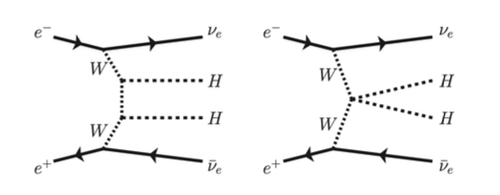
Higgs Self Coupling measurement - Ingredients to cross section
Di-Higgsstrahlung
WW Fusion
Dominates below 1 TeV
Dominates above 1 TeV
Constructive Interference
Destructive Interference
Slide from Julie Munch Torndal

Slide 14
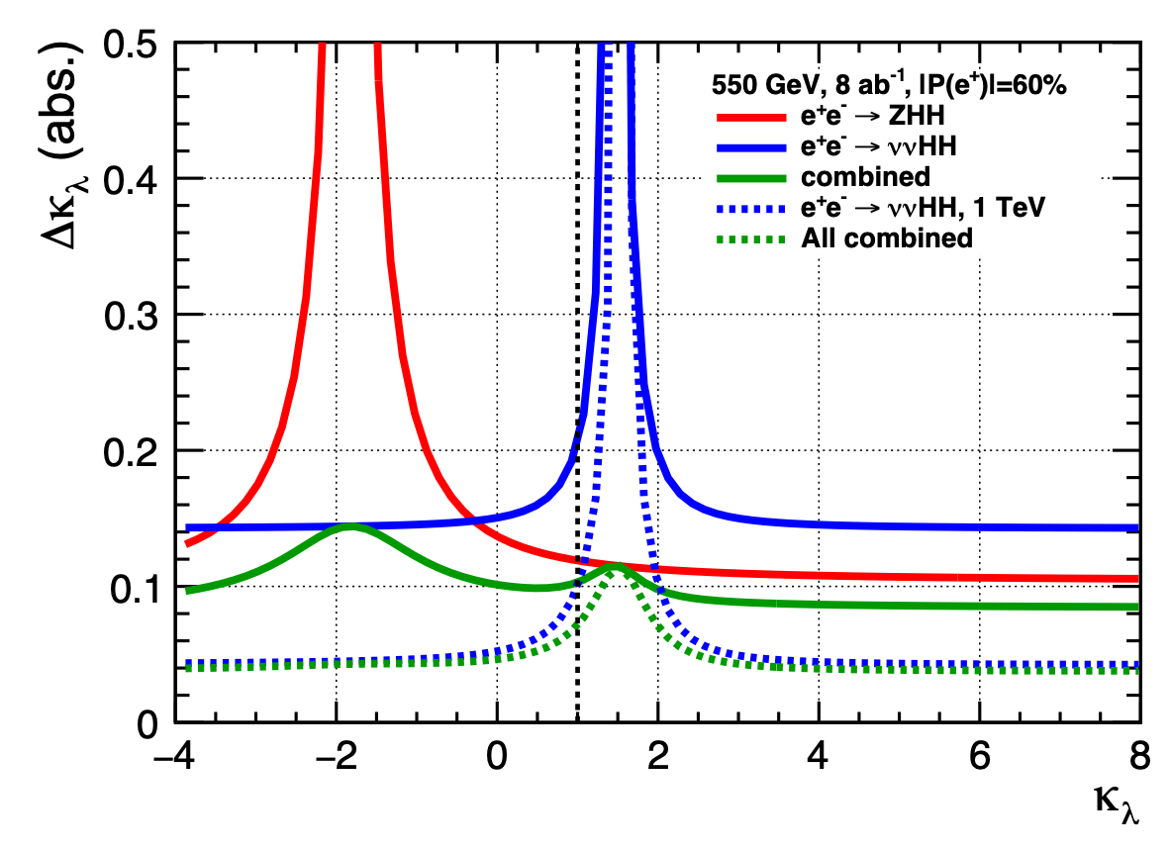
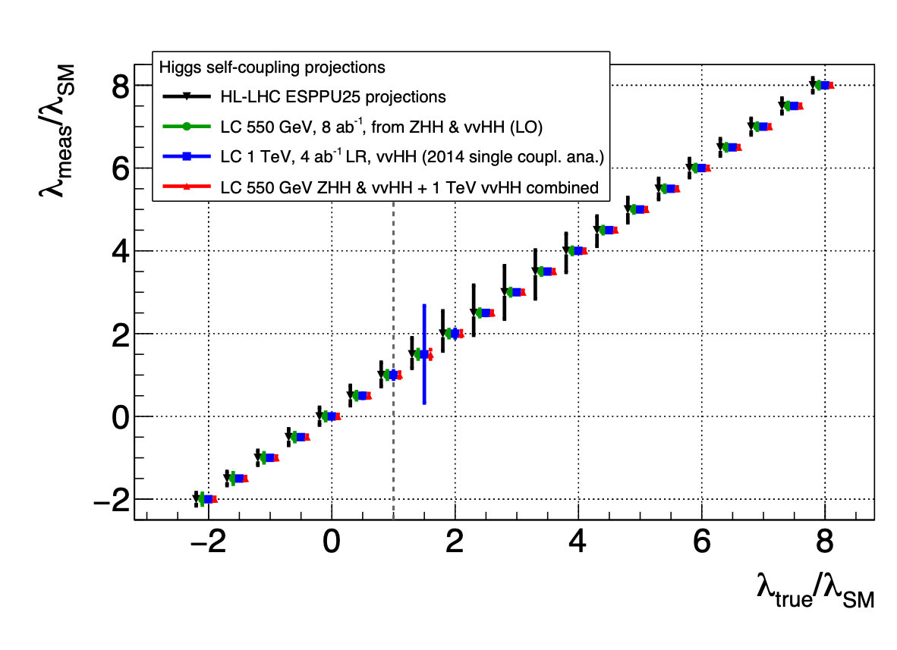
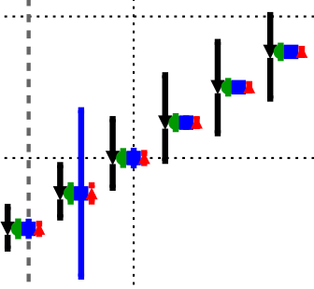
Di Higgs Production
tree-level access to self-coupling
550 GeV
  ~ peak of ZHH cross-section
  vvHH becomes just about visible
  together for SM case:
  ∆𝝹𝜆 = 11% (15%) for 8ab⁻¹ (4ab⁻¹)
dependence on 𝜆:
  ZHH: constructive interference
  vvHH: destructive interference
  together: ~const absolute precision
  as function of 𝜆
1-3 TeV: vvHH becoming dominant
  ∆𝝹𝜆 = 0.04 (8ab-1) over wide range of 𝝹𝜆
  (except 𝝹𝜆 ~ 1.5)
quantitative improvement and qualitatively new information wrt HL-LHC
550

Slide 15
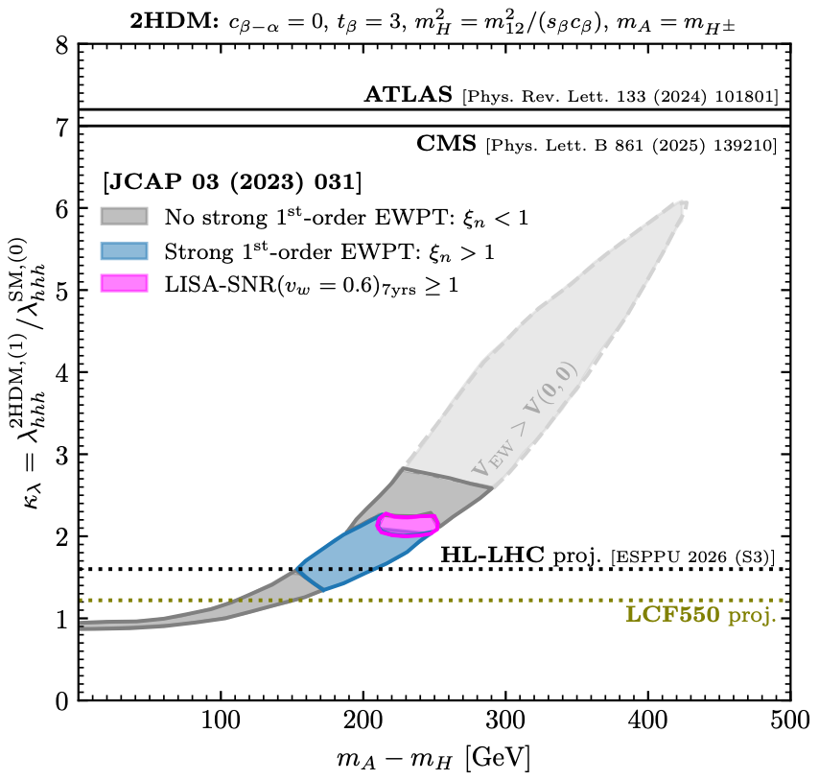
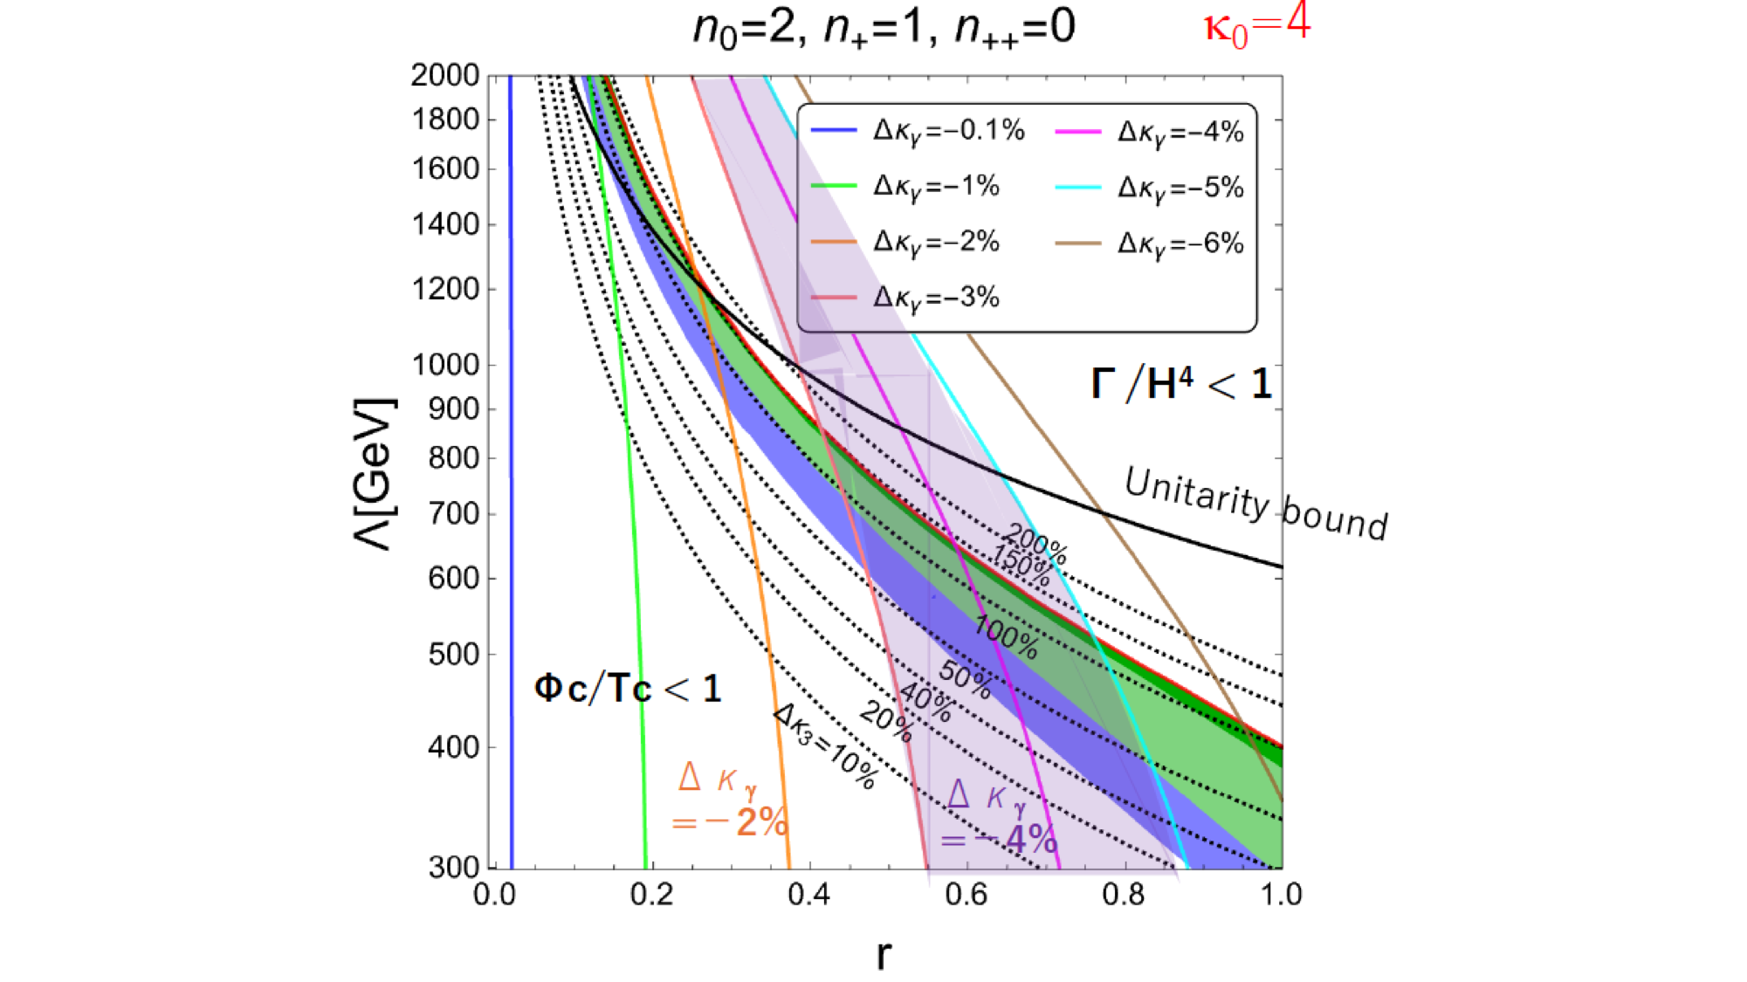
Interplay with gravitational waves
aligned Higgs EFT
area above dashed
lines expected to be
excluded if SM true
primordial
black
hole
search
DECIGO/
LISA
Phys.Lett.B 856 (2024) 138940
FOEWPT only
testable via
Higgs

Slide 16
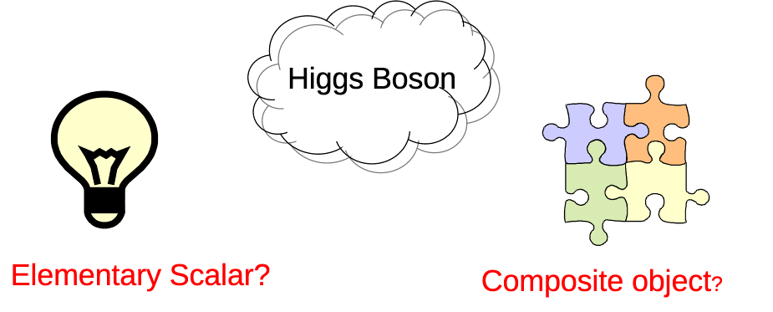
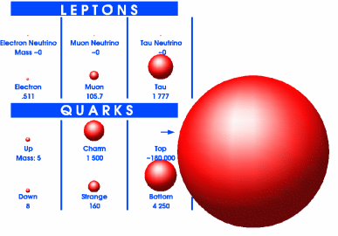
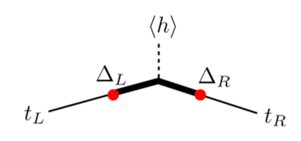
An enigmatic couple
Top quark
- Higgs and top quark are intimately coupled!
Top Yukawa coupling O(1) !
=> Top mass important SM Parameter (-> backup)
- New physics by compositeness?
Higgs and top composite objects?
- Future colliders perfectly suited to decipher both particles
Courtesy of S. Rychkov

Slide 17
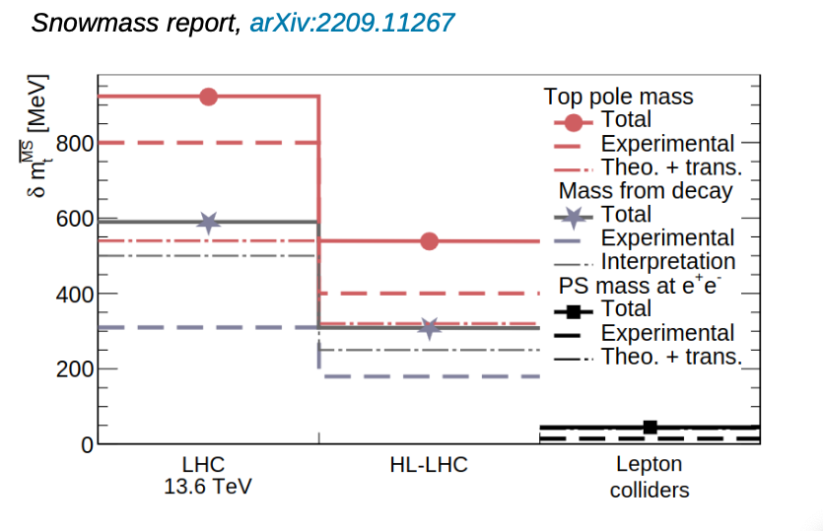
Top Mass Summary
All future lepton (e+e- colliders) will improve considerably the precision on mtop
Marcel Vos@Top23

Slide 18
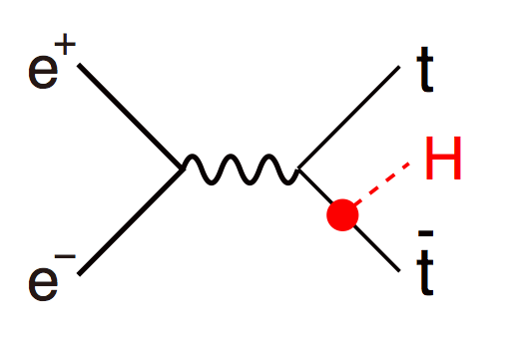
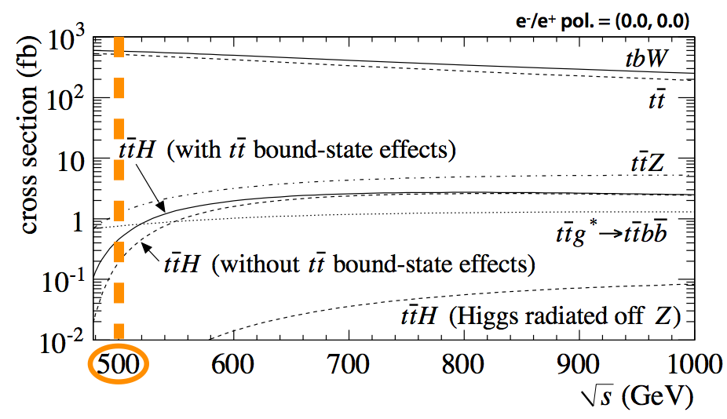
Top Yukawa Coupling – e+e-
- Coupling of Higgs to
heaviest particle known today
- Up to eight final state jets
√s[GeV] | 550 | 1000 | 1400
L[ab-1] | 4 | 8 | 2
δyt/yt[%] | 2.8 | 1.0 | 2.7

Slide 19
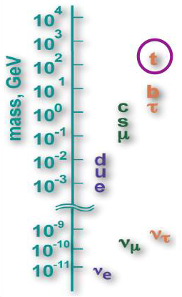
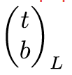
Fermion Hierarchy
- SM does not provides no explanation
for mass spectrum of fermions (and gauge bosons)
- Fermion mass generation closely related
to the origin electroweak symmetry breaking
- Expect residual effects for particles with
masses closest to symmetry breaking scale
- Heavy quark effect or effect on all fermions?
Strong motivation to study chiral structure
of (heavy) quark vertices

Slide 20
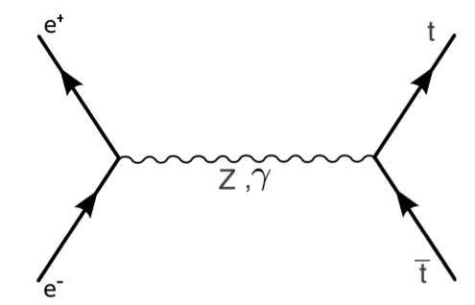
Two fermion processes
f
f
*add term ~sin²θ in case of non-relativistic fermions e.g. top close to threshold
ΣIJ are helicity amplitudes that contain couplings gL, gR (or FV, FA)
ΣIJ ≠ ΣI'J' => (characteristic) asymmetries for each fermion
Forward-backward in angle, general left-right in cross section
All four helicity amplitudes for all fermions only available with polarised beams
LC would be four colliders in one!

Slide 21
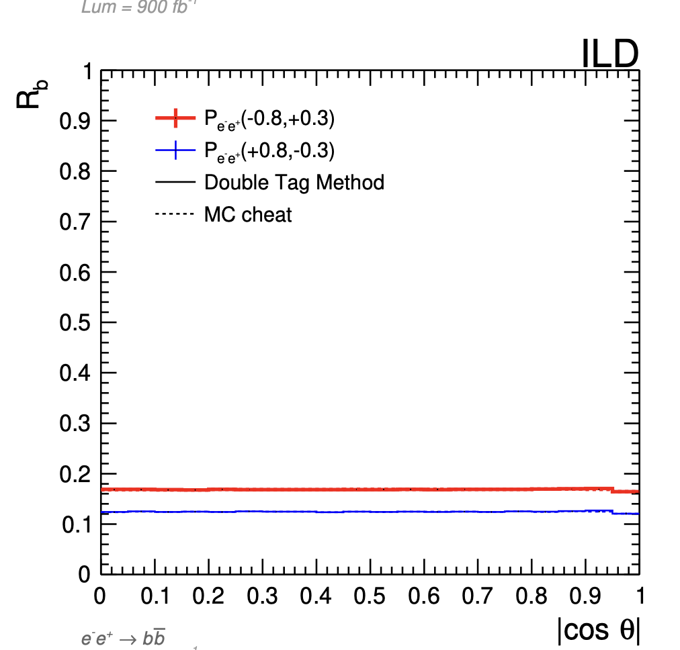
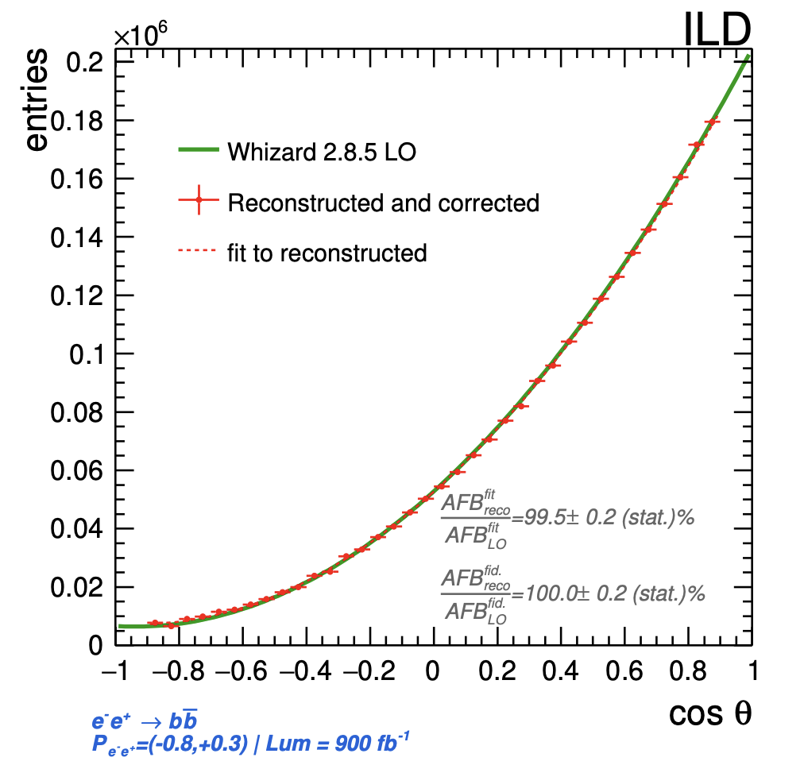
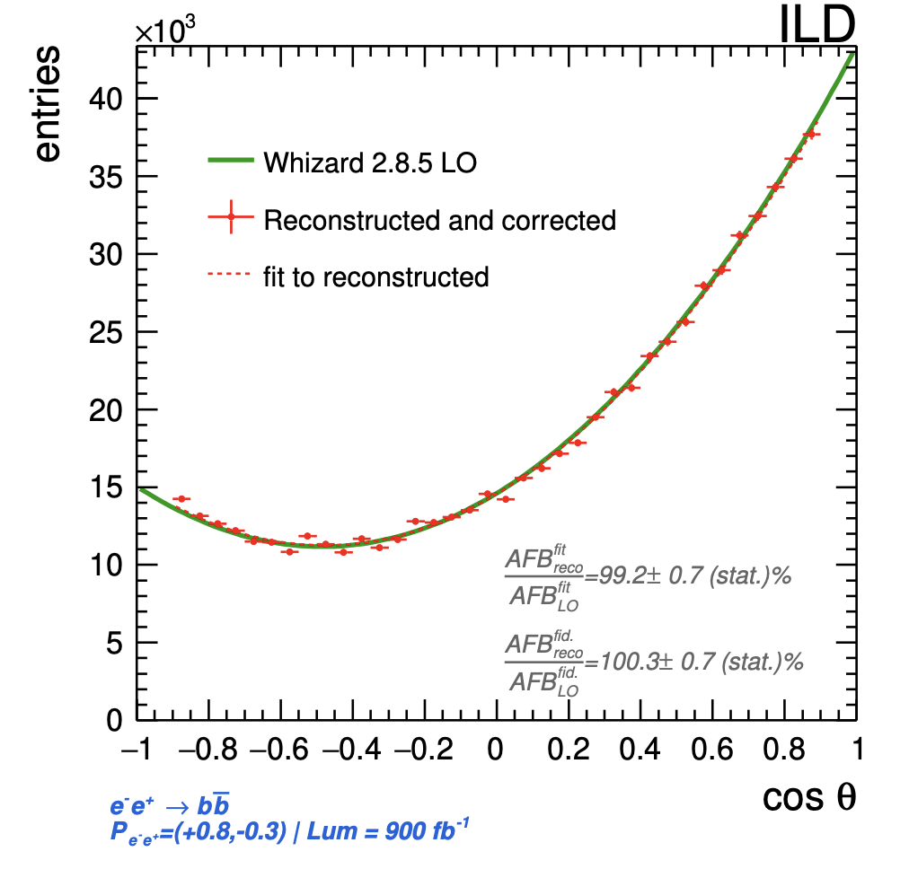
ee→bb at 250 GeV
Powerful tool to study onset and amplification of new physics effects
Full simulation study at 250 GeV is solid basis for estimations on Z pole (Ab, Rb)
Interpretation in terms of new physics (Z’ up to 19 TeV in case of GHU) require precise input from Z pole
Study has been extended to 500 GeV, 1 TeV
A. Irles et al.
https://arxiv.org/pdf/2306.11413

Slide 22
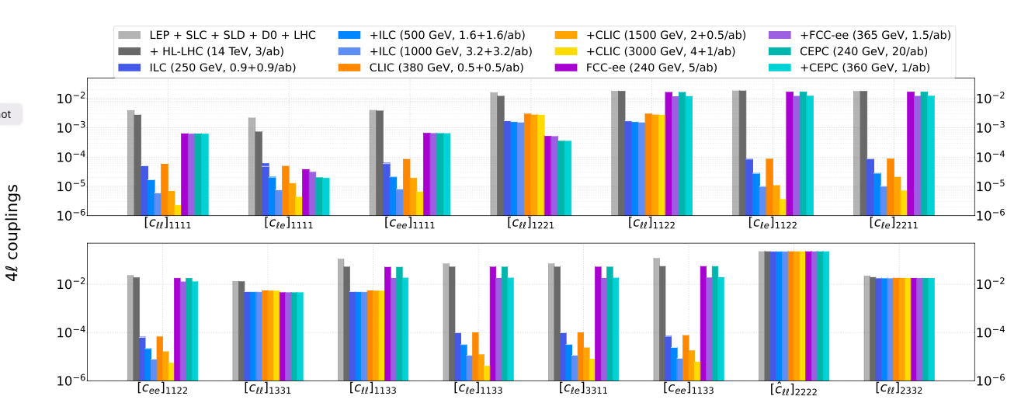
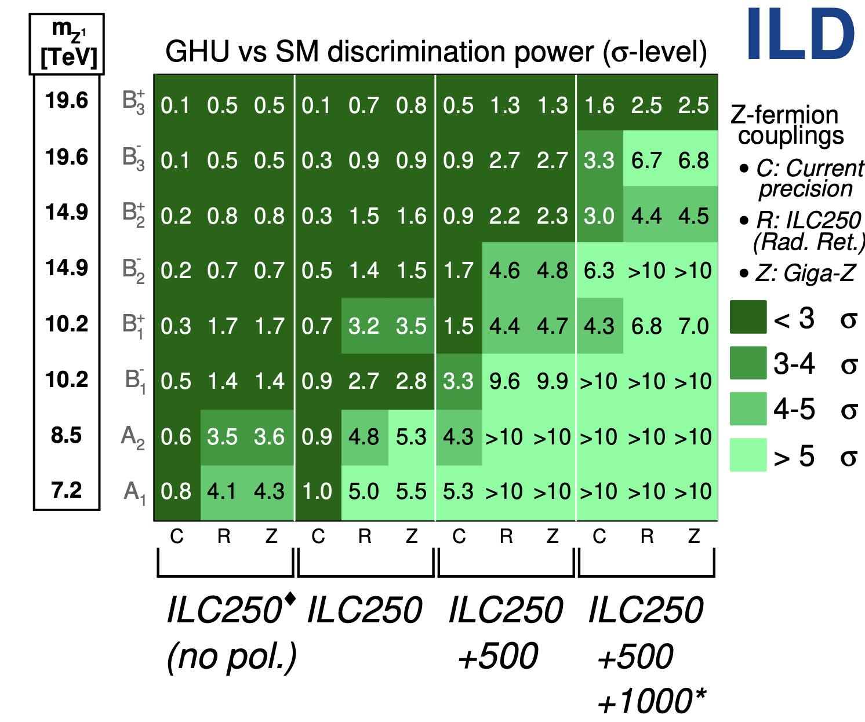
Interpretation of two fermion processes
4-fermion operators in EFT (arxiv:2209.08078)
Separation power in GHU Models
J. P. Marquez et al. (arxiv:2403.09144)
Interpretation of 2f results bears discovery potential
  Will benefit from polarisation and higher energies
Has to be vetted regularly against (HL-)LHC results
Probed mass scale: 9-25 TeV

Slide 23
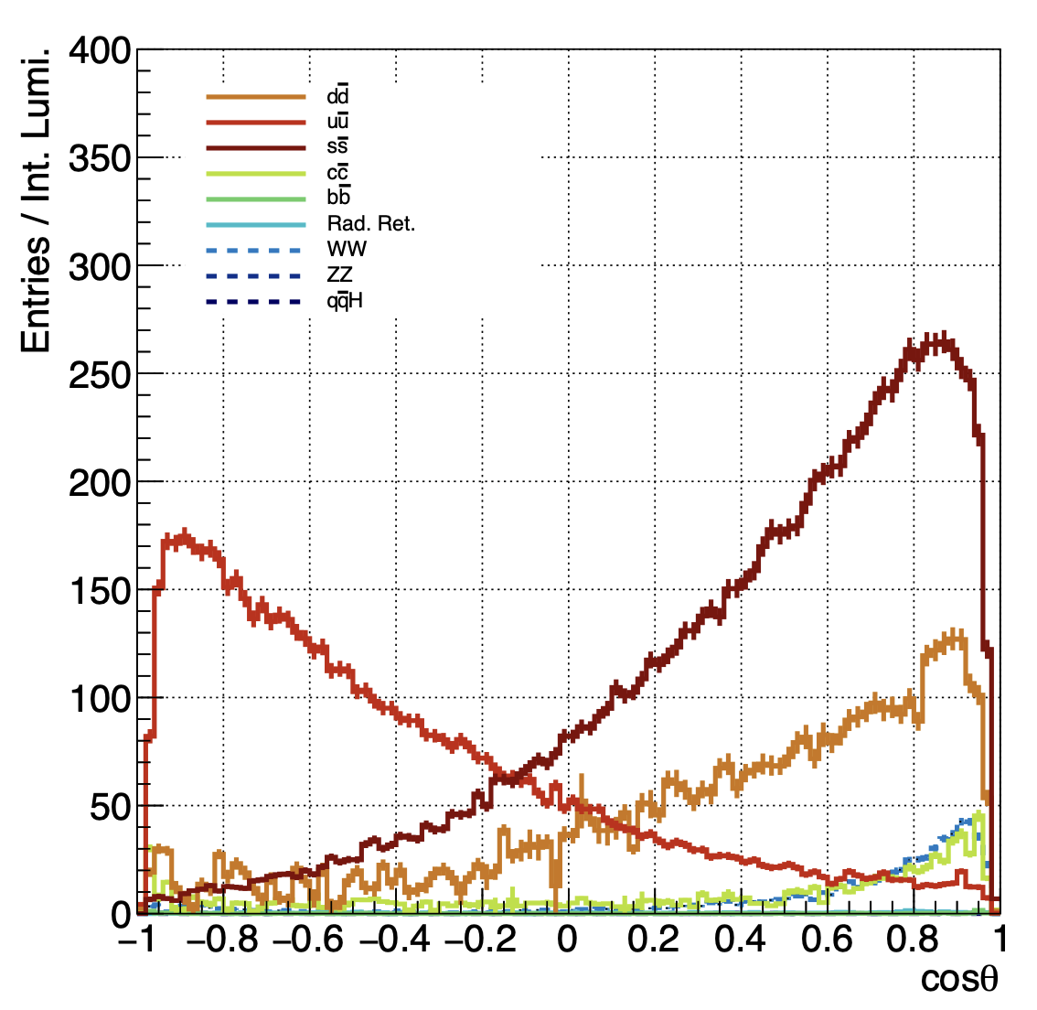

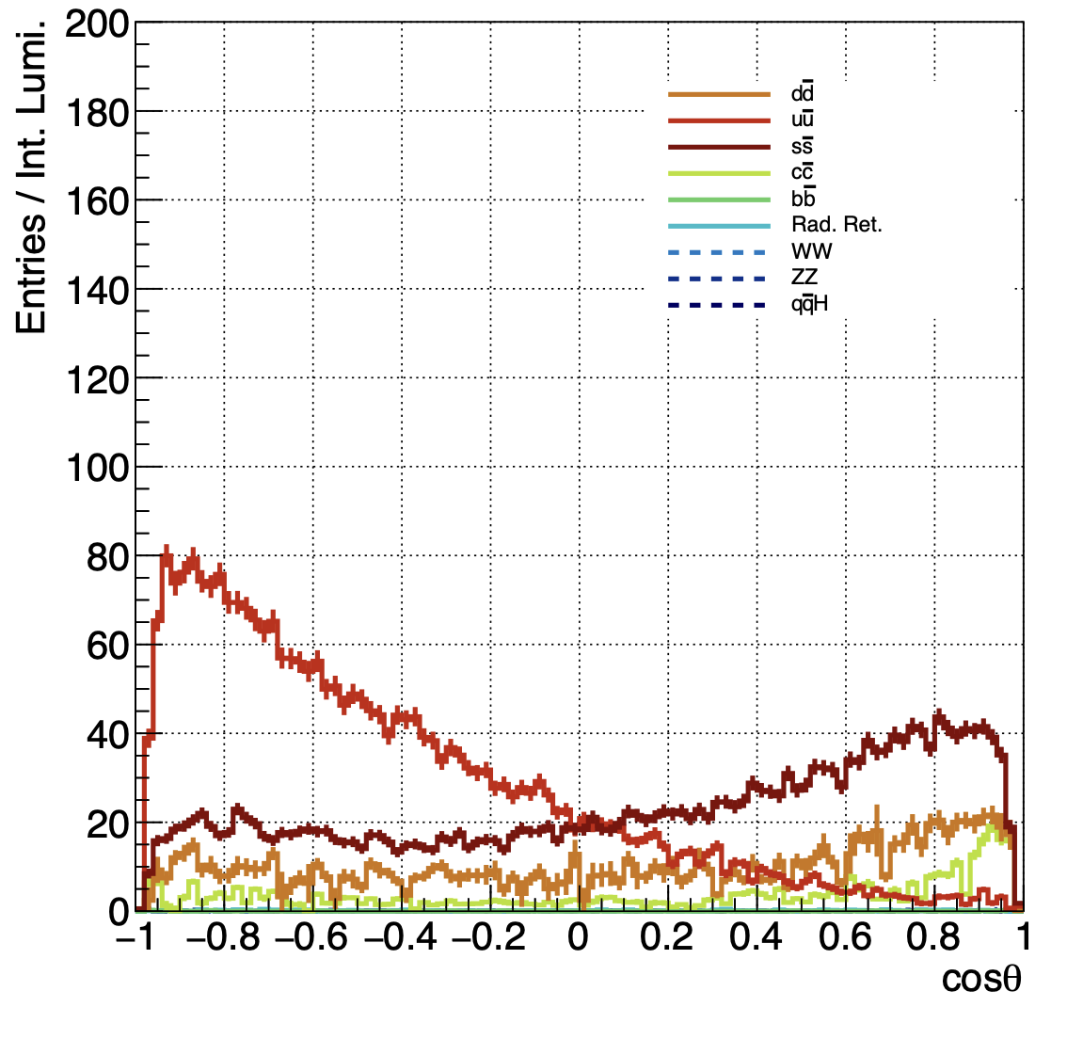

Interpretation of two fermion processes
PhD thesis of Yuichi Okugawa (IJCLab/Tohoku U, 2021-2024)
  Polarisation (-80,+30): ΔRs = 0.9%, ΔAfb,s = 0.9%
  Polarisation (+80,-30): ΔRs = 1.6%, ΔAfb,s = 5.9%
  Statistical error only
  Systematic error sensitive to knowledge of background
Analysis based on leading particle
  “hand made cuts” to understand effect of potential selection criteria
  Some cuts are very harsh
  Therefore selection effiency is low (0.6%) and S/B ~ 1
    u,d final states with Kaons cannot be well suppressed
Analysis needs revision

Slide 24
Interpretation of two fermion processes
Considerable progress in flavor tagging in recent years ...
Mouthwatering opportunities for light quarks
e.g. Background down to 10⁻² at 10% efficiency
For this working point statistical error would go down to
  Polarisation (-80,+30): ΔRs = 0.22%, ΔAfb,s = 0.22%
  Polarisation (+80,-30): ΔRs = 0.4%, ΔAfb,s = 1.5%
Systematics due to background could be ~statistical error
Remains to be shown, other systematics may set in -> TYL/FJPPN project!
T. Suehara

Slide 25
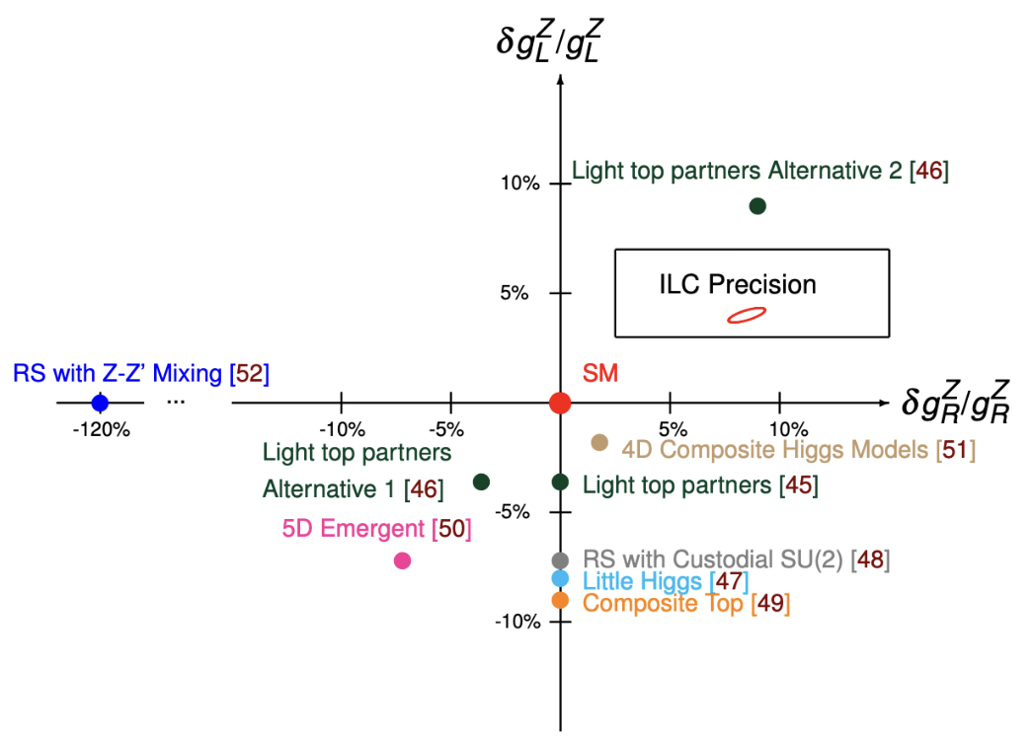
Top quark and new physics
assuming only
4ab⁻¹ at 500 GeV
Couplings of the Top quark to the Z boson:
essential for NLO interpretation of Higgs measurements
tremendous BSM sensitivity in its own right
Displayed Models take LHC Constraints into account
arxiv:2503.19983

Slide 26
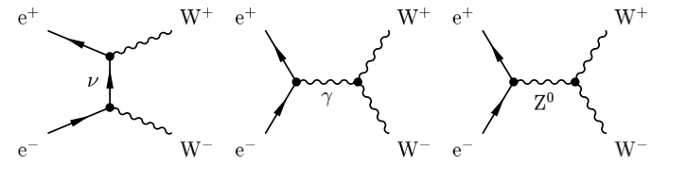
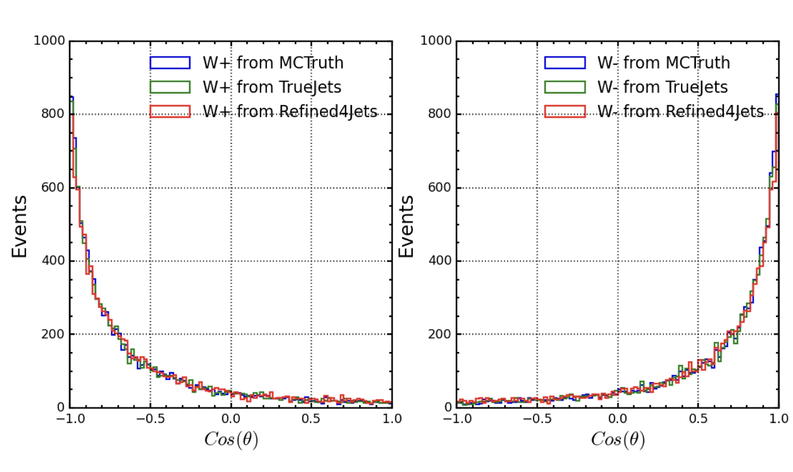
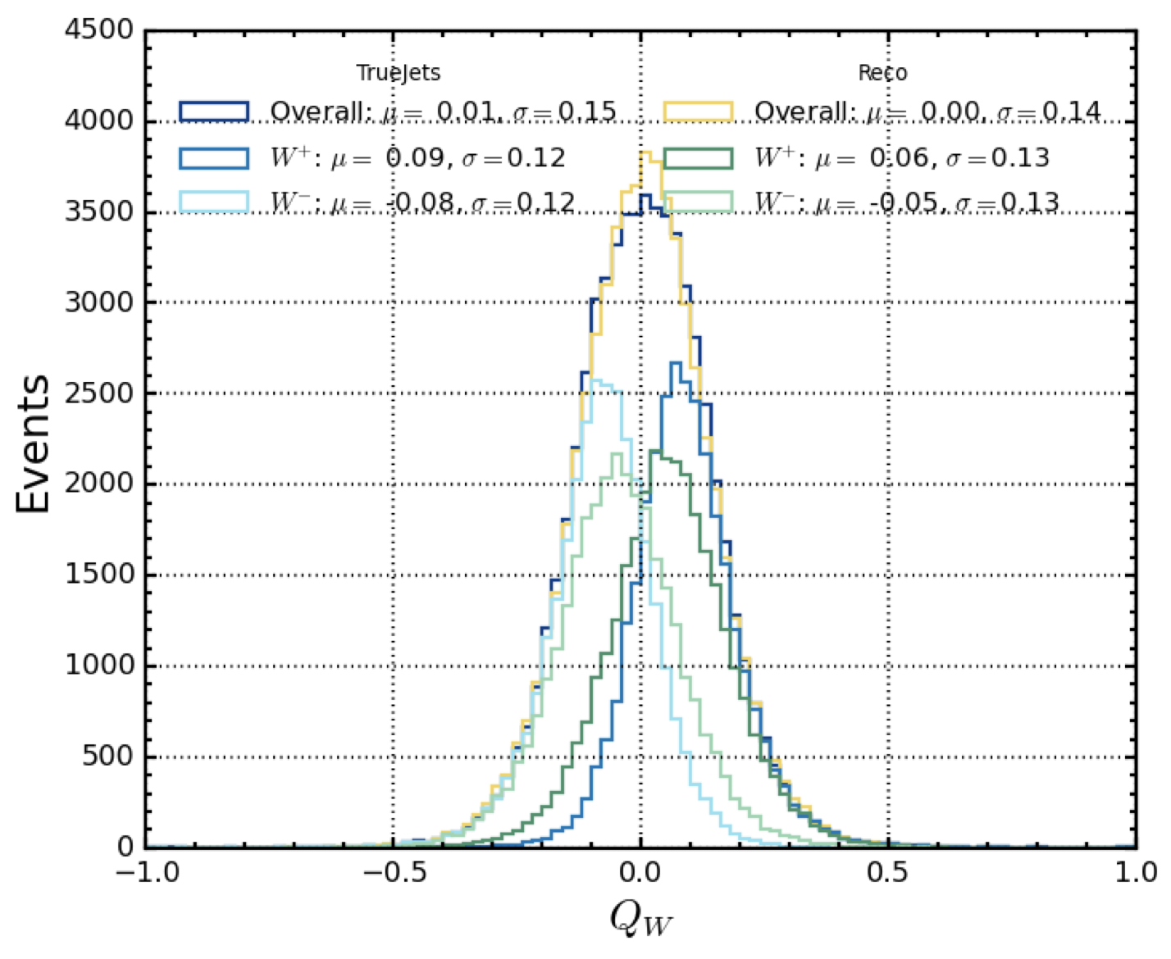
WW Production at 250 GeV (and above)?
Sensitivity to triple and quartic gauge Boson couplings (TGC and QGC)
Observables depend strongly on beam polarisation
=> Enrich different helicity modes of W
=> Disentangling of couplings to Z and γ
=> in situ measurement of beam polarisation (and luminosity)
Analysis of fully hadronic final state (first steps)
W charges (true jets and measured)
The goal
Overlap leads to
charge flips
Correction compromised
by correlation introduced
by jet algorithm
Improvement by
Machine learning?
X. Xia, PhD Student
26
N. Walker, ILC School 2013

Slide 27
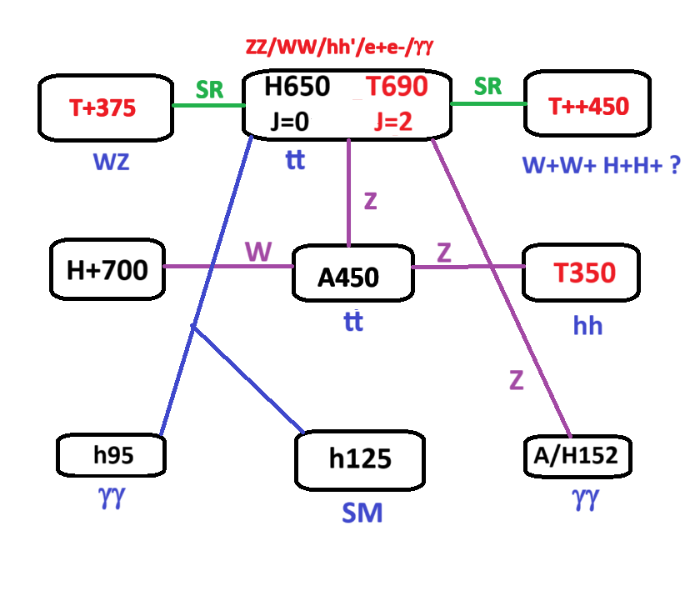
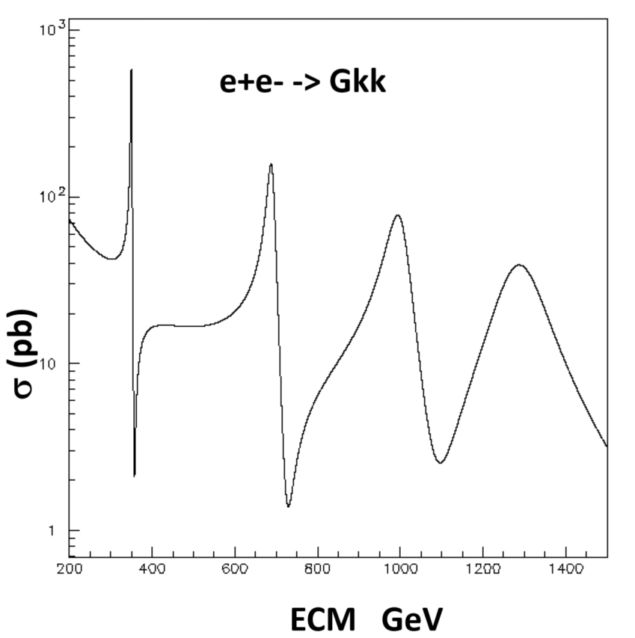
What if … LHC makes a discovery I?
>> 5 sd Narrow resonance seen in top pairs by CMS
Candidates: A(365), CP-odd toponium, KK graviton T(350) seen in hh
T(690) a narrow resonance, 20 GeV wide, seen in ZZ/WW/h125h95/γγ/e+e- which could also be a KK graviton
Combined significance > 5 sd
A(450) indicated in ttZ, tt and T(350)Z->hhZ
RUN3 data should confirm/dismiss these indications
Series of KK resonances at LCF?
Slide provided by F. Richard
27
N. Walker, ILC School 2013

Slide 28

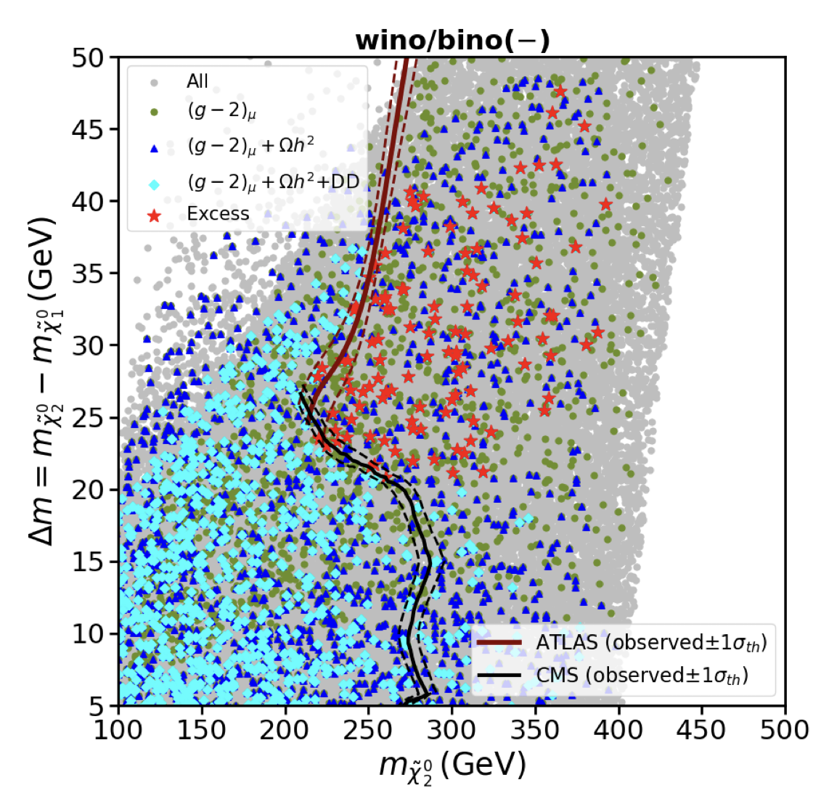
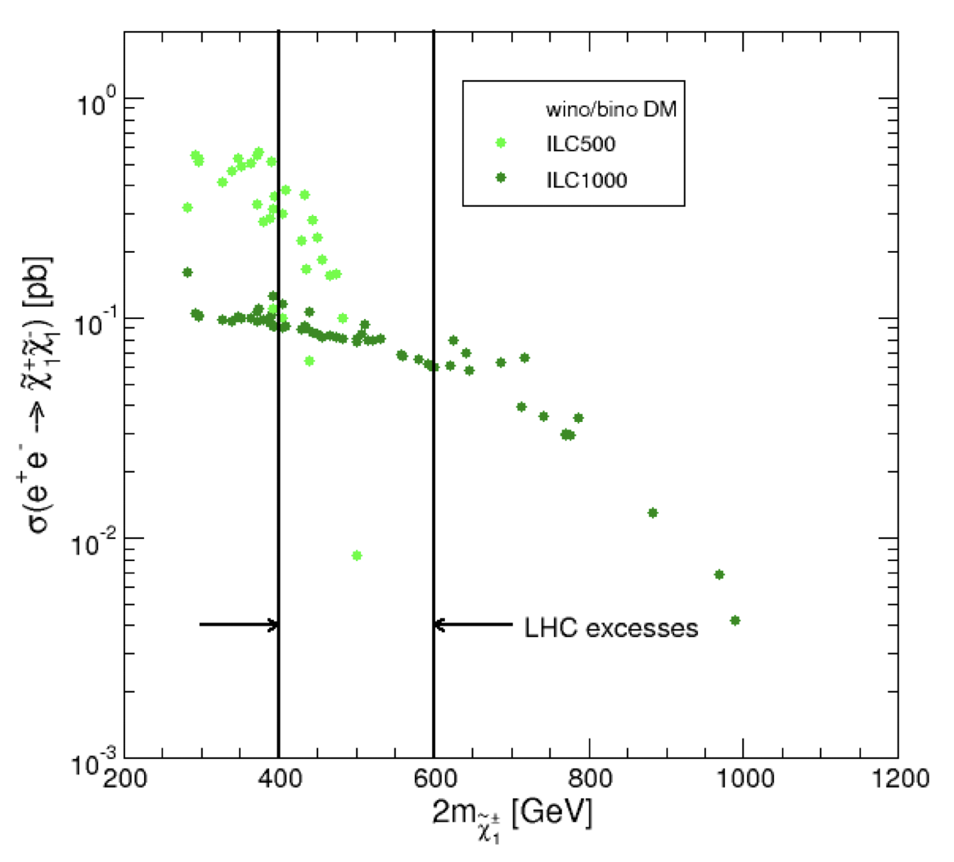

What if … LHC makes a discovery II?
Some excesses in “golden” EWino Channel at LHC
Parameter scan for Wino/Bino DM scenario
e⁺e⁻ cross section for EWino production
LCF would cover phase space of excesses
would be dark matter candidate
28
N. Walker, ILC School 2013

Slide 29
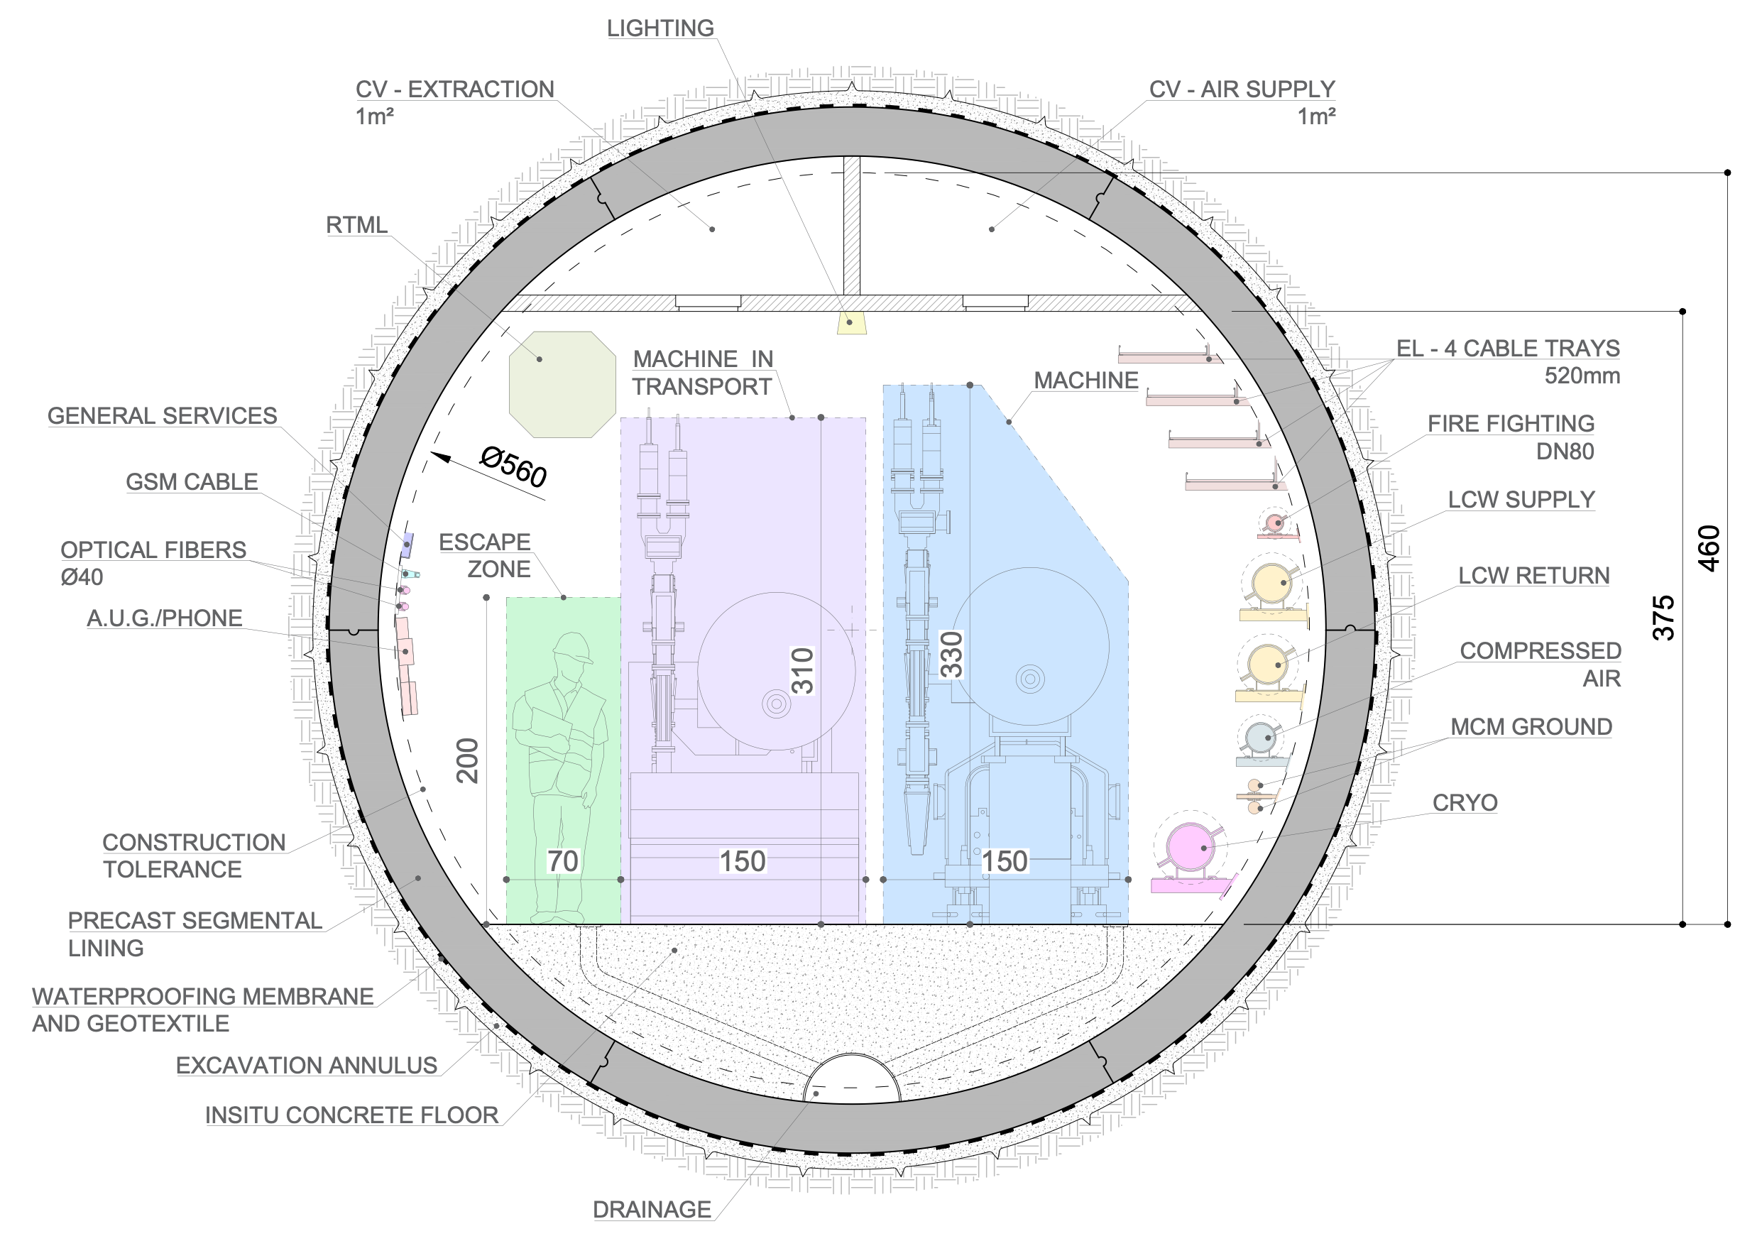

Staging I
250 GeV incl Z pole - facility
33.5km long tunnel => reach 550 GeV with 31.5 MV/m SCRF
∅ 5.6m, two IPs
equipped with SCRF for 250 GeV
10Hz trains of 1312 bunches => L = 2.7 x 10³⁴ / cm² / s
construction cost: 8.29 BCHF
AC power: 143 MW
optionally: beam-dump / fixed-target
upgrade: double luminosity 2625 bunches / train:
+0.77 BCHF + 39MW
both beams polarised:
  e-: 80%
  e+: 30%
3ab-1 @ 250 GeV
operation at Z pole (eg 100fb⁻¹)
WW theshold (eg 500fb⁻¹) as needed

Slide 30
Staging II
250 GeV incl Z pole - facility
550 GeV incl ttbar theshold
33.5km long tunnel => reach 550 GeV with 31.5 MV/m SCRF
∅ 5.6m, two IPs
equipped with SCRF for 250 GeV
10Hz trains of 1312 bunches => L = 2.7 x 10³⁴ / cm² / s
construction cost: 8.29 BCHF
AC power: 143 MW
optionally: beam-dump / fixed-target
upgrade: double luminosity 2625 bunches / train:
+0.77 BCHF + 39MW
both beams polarised:
  e-: 80%
  e+: 30%
3ab-1 @ 250 GeV
operation at Z pole (eg 100fb⁻¹)
WW theshold (eg 500fb⁻¹) as needed
Upgrade
  equipping the additional tunnel with SCRF
  + 5.46 BCHF
  10 Hz trains of 2625 bunches => 7.7 x 10³⁴ / cm² / s
  AC power 322 MW
  target 8 ab⁻¹

Slide 31


Running Scenarios up to 550 GeV
baseline
start immediately with full power

Slide 32


Running Scenarios starting at 550 GeV
take some polarised data at lower energies
or go more quickly to TeV range
An LCF gives flexibility to decide exact program based on scientific and technological progress / break-thoughs

Slide 33
Summary and Conclusion
e+e- colliders are indispensable tools to understand and/or discover the nature of new physics
  Precision on Higgs couplings at or below 1% level
  Indrect and direct discovery potential at all centre-of-mass energies
  Light scalars or vector bosons with different gauge symmetry
Full exploitation of physics potential requires large energy coverage and polarised beams
  Effects at HZ threshold and below are expected to become more prominent at higher energies
  New physics signals and relevant operators depend on chiral state of initial and final state fermions
  (“Early”) direct measurement of the Higgs-selfcoupling
  Sufficient lever arm to react to HL-LHC results
    Remember also the “LEP disaster”, Higgs missed by 30 GeV in centre-of-mass
A clear pattern of anomalies would be an excellent (and maybe the only)
motivation for a large hadron machine
Linear Collider Facility based on SCRF is close at hand
  Attractive options for innovative accelerator (and detector) concepts
  LCVision effort to coordinate the different proposals
  Require close collaboration between Physics and Detector and Accelerator Experts!
33

Slide 34
Backup

Slide 35


The Standard Model is complete
We know that there exists at least one fundamental scalar with a non-vanishing expectation value
We don't know what shapes the potential and whether the potential is the footprint of a larger mass scale
35

Slide 36

Science Driver Higgs Boson

Slide 37




The Higgs Potential
“Today”, T=0
t=0, T>>0
Perfect (electroweak) symmetry
and massless particles
Broken (electroweak) symmetry
and massive particles
Two questions:
Shape of “today's” Higgs Potential?
Transition from symmetric, unbroken to broken phase?
=> Triple Higgs-self coupling

Slide 38

LCVision EPPSU documents
ILC in Japan (IDT)
arxiv:2504.XXX
… and relation to other inputs
CLIC at CERN
arxiv:2503.24168
arxiv:2503.21857
C³
arxiv:2503.20829
Technologies and upgrades
arxiv:2503.19983
LC Physics Case & long-term vision
HALHF
arxiv paper &
EPPSU submission
arxiv:2503.23489
arxiv:2503.19880
LCF @ CERN
arxiv:2503.24049
10 TeV Wakefield
EPPSU submission & back-up document
arxiv:2503.20214
arxiv:2504.01434
Beyond Collider
https://cds.cern.ch/record/2927631

Slide 39

Open questions
?
?
(✓)
?
?
?
?
?
39

Slide 40


Higgs – Discovery by precision
arxiv: 1710.07621v4
Already large discriminative power at 250 GeV
Full discovery potential developed at higher energies (e.g. 500 GeV)
Observed “Anomalies” could be followed up by future hadron or muon colliders

Slide 41


Entanglement SMEFT NLO
NLO Contributions to ee->HZ
Correlation Cf to tt-Vertices arxiv:2409.11466
~Cf
Cf
Cf
One important contribution is eett Vertex
Cfu=f(Ztt)
Clq=f(eett)
NLO SMEFT introduces sensitivity to and constrains Cf and operators involving top vertices
Disentangling of constraints using beam polarisation
Final word would come from higher energy measurements
Note that Clq is strongly energy dependent (-> would benefit from higher energies)

Slide 42


Mass reaches of future colliders (from Snowmass EF Report)
Generic Z’ Model
Dark Matter 2σ exclusion limits
Z’ are expected for in compositeness models or in
(dual) models with extra dimensions
Example for light Higgsino search in backup
High centre-of-mass energy helps (here)
Don’t forget light states (see backup)
42
N. Walker, ILC School 2013

Slide 43
Two fermion processes
f
Differential cross sections for (relativistic) di-fermion production*:
f
*add term ~sin²θ in case of non-relativistic fermions e.g. top close to threshold
ΣIJ are helicity amplitudes that contain couplings gL, gR (or FV, FA)
ΣIJ ≠ ΣI'J' => (characteristic) asymmetries for each fermion
Forward-backward in angle, general left-right in cross section
All four helicity amplitudes for all fermions only available with polarised beams
tt production see above

Slide 44


e+e- - Top quark production at threshold
Small size of ttbar “bound state” at threshold ideal premise for precision physics
Cross section around threshold is
affected by several properties
of the top quark and by QCD
Top mass, width Yukawa coupling
Strong coupling constant
Effects of some parameters are correlated:
Dependence on Yukawa coupling rather weak,
Precise external αs helps
F. Simon, Top@LC15 Valencia

Slide 45
Top Mass Summary
All future lepton (e+e- colliders) will improve considerably the precision on mtop
Marcel Vos@Top23

Slide 46


Vacuum Stability and Top Quark Mass
Uncertainty on (pole) top quark mass determines uncertainty on stability conditions

Slide 47


Precision on electroweak form factors and couplings
Marcel Vos@ECFA WS 2024
e+e- collider way superior to LHC (√s = 14 TeV)
  True for both, analysis in terms of Form Factors and Wilson Coefficients
Polarised beams at ILC, final state analysis at FCCee
  Final stat analysis also possible at LC => Redundancy
  should be checked again (see arxiv 1503.04247)
:500 GeV is nicely away from QCD matching regime (see backup)
    Less systematic uncertainties
Axial form factors are ~β and benefit therefore from higher energies
The 250 GeV run provides some information (interplay bottom-top)
Top production at an e+e- collider yields dramatic improvement
The fit benefits from a 2nd top run at high energy (2-vs-4 fermion operators)

Slide 48


Uncertainty driver αs
See talk by Francesco Giuli LCF2022
  https://indico.ectstar.eu/event/149/contributions
  /3058/attachments/1919/2513/FCC_LFC_FGiuli_2022.pdf
Best prospects from e+e- collisions
  Δα/α ~0.1% for FCCee hadronic Z-decays
    Comparable with QCD Lattice Results
  Status for ILC Δα/α ~0.6% (arXiv:1512.05194)
    Worth another look ?!

Slide 49

Higgs production at e+e- colliders
Associated and t-channel production

Slide 50

Expected precision at future lepton colliders
Arxiv: 2206.08326
All planned e+e- machines will deliver O(1%) precision on Higgs couplings
  Beam polarisation at LC catches up for smaller luminosity
Muon Collider makes excellent job on trilinear couplings and Hμμ coupling

Slide 51



Higgs Selfcoupling measurement in e+e- (µ+µ-)
Indirect access
  Through loop order corrections in EFT fits
  Single Higgs measurements in e+e-
  at or better than 1%
  Large number of independent observables
  Running at two different centre-of-mass
  energies
Direct access
  Through double-Higgs Production
  Cross section measurement
Details see M. Peskin, 12/1/23
Slide from Julie Munch Torndal

Slide 52


e+e- Colliders – Uncertainties and their drivers
0.5
0.2
0.1
0.1
0.03
0.2
Theory requires 3-loop
calculations
FCCee: 2203.06520
ILC: 2203.07622
Experimental uncertainty drivers:
  MZ, ΓZ: Beam energy, detector calibration and acceptance
    Would require a reduction of a factor 20-25 to match FCCee statistics w.r.t current estimates
  :Beam energy (FCCee, CEPC), beam polarisation (ILC)
  Rb: Detector acceptance, QCD (gluon radiation?)
    Difficult to judge on “the error source”, it's rather a sum of many
  Rl: Detector acceptance

Slide 53

Probing New Physics with the trilinear Higgs Coupling
J. Braathen, IDT-WG3 Physics Meeting
53
N. Walker, ILC School 2013

Slide 54


New physics?
EFT: Two distinct observations
Observables at fixed mass m
(e.g. Z pole of Higgs decays)
High energy tails of distributions
(e.g. Drell-Yan Productions)
Increasing UV scales probed in EFT
achieved solely by increasing the
measurement precision
c6 ~ (g*)²
Typical experimental precision 0.1-1%
Increasing UV scales probed in EFT
achieved solely by increasing the
energy scale of measurement precision
Typical experimental precision 10%
A. Falkowski, Journée Grands Accél., LAL
54

Slide 55


Top Yukawa Coupling and New Physics
Top-Higgs couplings in “presence” of heavy particles
arxiv: 1408.4456
arxiv: 1408.4456
20%
arxiv: 1408.4456
Heavy particles, e.g. (Kaluza Klein) “duplicas” of SM particles provoke sizable effects
Sensitivity to CP Violation !?
Caveat: R.P. did not check against current LHC constraints!

Slide 56


Anomalous Triple Gauge Couplings
Sensitivity to triple and quartic gauge Boson couplings (TGC and QGC)
Observables depend strongly on beam polarisation
=> Enrich different helicity modes of W
=> Disentangling of couplings to Z and γ
=> in situ measurement of beam polarisation (and luminosity)
Limits on Triple Gauge Couplings@250 GeV
For reference: Comparison with other results

Slide 57

Light Higgsinons- Event Display
Clear signal => ILC covers important corner of phase space for SUSY Searches

Slide 58

Direct Searches for New Particles - SUSY
f
f
Hadron Colliders have a great potential to discover supersymmetric particles
Hadron Colliders cannot exclude low mass SUSY with light neutralinos and charginos
  … that are degenerated in mass

Slide 59

Light Higgsinons- Event Display
f
f
J. Yan, LCWS2016

Slide 60

Experimental challenges - Flavor tagging and charge measurement
Flavor tagging
  Indispensable for analyses with final state quarks
Quark charge measurement
  Important for top quark studies,
  indispensable for ee->bb, cc, ss, ...
Control of migrations:
  Correct measurement of vertex charge
  Kaon identification by dE/dx (and more)
Future detectors can base the entire measurements on
double Tagging and vertex charge
  LEP/SLC had to include single tags and
  Semi-leptonic events
PhD thesis: S. Bilokin
A. Irles

Slide 61
Top pair production at threshold
Small size of ttbar “bound state” at threshold ideal premise for precision physics
Cross section around threshold is
affected by several properties
of the top quark and by QCD
Top mass, width Yukawa coupling
Strong coupling constant
Effects of some parameters are correlated:
Dependence on Yukawa coupling rather weak,
Precise external αs helps
F. Simon, Top@LC15 Valencia

Slide 62

Top pair production at threshold
“Bound states” at tt threshold
Hydrogen atom of strong interaction
- Size O(10⁻¹⁷m), smallest non-elementary object known in particle physics
Small scale => Free of confinement effects => Ideal premise for precision calculations
Measurement of (a hypothetical) 1³S1 State
- Decay of top quark smears out resonances in a well defined way

Slide 63
Top threshold scans at different e+e- colliders
ILC
Fit uncertainty:
28.5 MeV (18 MeV stat)
CLIC
Fit uncertainty:
31 MeV (21 MeV stat)
FCC-ee
Fit uncertainty:
27 MeV (15 MeV stat)
63
N. Walker, ILC School 2013

Slide 64


Sensitivity and error breakdown
Numbers for ILC/CLIC, some numbers get better for FCCee
  e.g. Beam energy uncertainty < 3 [MeV]
Uncertainty driver αs
  Δm ~ 2.6 per 10⁻⁴ in αs

Slide 65


Top quark polar angle spectrum at 500 GeV
ILD-Note-2019-007
Semi-leptonic
channel
Integrated Luminosity 4 fb⁻¹
Exact reproduction of generated spectra
Statistical precision on cross section: ~0.1%
Statistical precision on AFB: ~0.5%
  Can expect that systematic errors will match statistical precision (but needs to be shown)

Slide 66




New physics below tt threshold? - Example b quark couplings
~3σ in heavy quark observable
ee->bb@250 GeV
Is tension due to underestimation of errors or
due to new physics?
High precision e+e- collider will give final word on anomaly
In case it will persist polarised beams will allow for discrimination between effects on left and right handed couplings
Randall Sundrum Models generate basically automatically a symmetry group of type SU(2)R
Randall Sundrum Models Djouadi/Richard '06

Slide 67


Decomposing ee->bb – Differential cross section
Full simulation study within ILD Concept allows for educated guess on uncertainties on Z-Pole
Arxiv:1709.04289, ILD Paper in progress
A. Irles, SUSY2021
Excellent agreement between predicted and reconstructed distributions
Gap between red dots and green histogram = acceptance drop.
Blue dots = corrected acceptance
The fit is restricted to |costheta|<0.8
  Minimal impact of the corrections
Left Pol
Right Pol
Preliminary
Preliminary
Systematic uncertainties under scrutiny:
  Selection and background rejection
  quark tagging/mistagging (modelisation, QCD, correlations)
  Luminosity
  Polarisation
Additional complication in continuum: Rejection of ISR events – Uncertainty ~5x10⁻⁴ (doesn't apply on Z-pole)

Slide 68



Precision on electroweak form factors and couplings
Arxiv:1709.04289, ILD Paper in progress
Couplings are order of magnitude better than at LEP
e+e- collider way superior to LHC (√s = 14 TeV)
Final state analysis at FCCee
  Also possible at LC => Redundancy
Two remarks:
  500 GeV is nicely away from QCD Matching regime
    Less systematic uncertainties
  Axial form factors are ~β and benefit therefore from higher energies
Full disentangling of helicity structure for all fermions only possible with polarised beams!!

Slide 69


QCD uncertainties on ee->tt cross section
Linear Colliders
FCC
Marching non-relativistic calculations in threshold region with tt-continuum is theoretical challenge
QCD uncertainties shrink as energy increases
Non resonant contributions are important (i.e. ee->tt --> ee->WbWb)
J. Reuter, FCCee-France Workshop, Annecy and arXiv: 1609.03390

Slide 70





Effects at higher energies
Development of EFT Operators
GUT Inspired GHU Model (Hosotani et al.)
arxiv:1807.02121
Effects amplified at
higher energies
Different patterns for
different beam polarisations
(L, U, R)
Different patterns
for different fermions
Increased sensitivity to operators
representing four-fermion interactions

Slide 71
How can the Z-pole help?
On the Z-pole
Above the Z-pole
f
f
Z'/
Z',Z'/
γ'
f
f
ILC/GigaZ with ~10⁹ Z
Sensitivity to Z/Z' mixing
Sensitivity to vector (and tensor)
couplings of the Z
  the photon does not “disturb”
Sensitivity to interference effects of Z and photon!!
Measured couplings of photon and Z can be influenced
by new physics effects
Interpretation of result is greatly supported by precise input
from Z pole

Slide 72



Linear Electron Positron Colliders - ILC
Energy: 0.1 - 1 TeV
Electron (and positron)
polarisation
TDR in 2013
+ DBD for detectors
Footprint 31 km
Initial Energy 250 GeV – Footprint ~20km
Under discussion in Japanese Gouvernment and inernational community
Recently: Budget request by Japanese Government of for ILC related accelerator studies (10 Oku Yen = doubling of budget)
ILC Nine-Cell SRF Cavity
Since 2020 ILC Development is organised within
International Development Team
https://linearcollider.org/team/
Design Gradient: 31,5 MV/m

Slide 73

Phase Transition in Standard Model
Electroweak Baryogenesis requires 1st Order PT
Drawings by Y. Nir
MH < 70 GeV
MH > 70 GeV
- Coexistence Two minima at 0 and vc at TC
=> 1st order phase transition
and development into “today's” shape at T=0
- No coexistence of two minima at 0 and vc
=> Cross over into “today's” shape at T=0
The discovered Higgs is too heavy to provoke a 1st order phase transition
=> New physics needed

Slide 74

Linear Electron-Positron Colliders
Energy: 0.1 - 1 TeV
Electron (and positron)
polarisation
TDR in 2013
+ DBD for detectors
Footprint 31 km
Initial Energy 250 GeV – Footprint ~20km
Japanese Gouvernment expressed its interest in project in March 2019
Energy: 0.4 - 3 TeV
CDR in 2012
Footprint 48km
Initial Energy 380 GeV
Possible future project at CERN

Slide 75

Linear Electron Positron Colliders
Energy: 0.4 - 3 TeV
CDR in 2012
Update 2016
Footprint 48km
Initial Energy 380 GeV
Possible future project of CERN
Cool Copper Collider
Based on new RF Technology
Operation at Cryogenic temperature (LN2 ~ 80K)
Aiming at gradients of 120 MV/m

Slide 76

New physics?
M. Perelstein: AWLC2017
76

Slide 77


EFT Framework and beam polarisation
EFT adds additional spin structure to ZH
production cross section (see backup)
Precision for 2ab-1 polarised = 5ab-1 unpolarised
ALR(ZH) projects out cWW
Polarisation dependent

Slide 78
Science drivers
Higgs Boson
Top quark
Elementary Scalar?
Composite object?
- Higgs and top quark are intimately coupled!
Top Yukawa coupling O(1) !
=> Top mass important SM Parameter
- New physics by compositeness?
Higgs and top composite objects?
- e+e- collider perfectly suited to decipher both particles
Courtesy of S. Rychkov

Slide 79


Light scalar study in ILD
Light scalar may be missing piece to trigger first order 1st transition and/or the being the radion in extra dimension theories
New resonances cleanly dinstiguishable for large range of masses
Sensitivity to mixing angle θh down to 10⁻² (taking all relevant backgrounds into account)
^{L}new scalar would count as “Feebly interacting Particle” (FIPS)

Slide 80


Feebly interacting particles – A summary
Light scalar may be missing piece to trigger first order 1st phase transition and/or being the radion in extra dimension theories
Courtesy J. List
e+e- colliders extend limits considerably w.r.t. LHC
  Statistics helps at lowest masses
CEPC, FCCee (>Z pole) limits order of magnitude
better than ILC
  Backgrounds taken correctly into account?
  Similar at stable particle level
Courtesy M. Peskin

Slide 81

New particles – Extended Higgs Sector
Deviations
of λ from
SM Value
Heavy
Higgs
Mass
arxiv: 1305.1563
- New (bosonic) particle may modify λ and enable 1st order phase transition
- Impact on measurements and achievable precisions of λ ?

Slide 82


Electroweak top couplings and discovery reach
New physics reach for typical BSM scenarios with composite Higgs/Top and/or extra dimensions
Based on phenomenology described in Pomerol et al. arXiv:0806.3247
95% Exclusion Limit
5σ discovery
ILC@500 has discovery potential up to 10 TeV for typical BSM scenario
More cms e.g. at CLIC would of course help a great deal (also for disentangling effects)
\

Slide 83


Precision on Z-pole and interplay with measurements above pole
Example: b couplings and helicity amplitudes
Don't forget: Electroweak observables
arxiv: 1905.00220
Spectacular sensitivity to new physics in RS Models
  Complete tests only possible at LC
  Discovery reach O(10 TeV)@250 GeV and O(20 TeV)@500 GeV
Pole measurements critical input
  Only poorly constrained by LEP
Pole measurements will (most likely) influence
also top electroweak precision program
  (t,b) doublet
Precise measurement of
  Ten times better than LEP/SLD
  Polarisation compensates for ~30 times luminosity
  ... and ALR at LC can benefit from hadronic Z decays
  No assumption on lepton universality at LC
Complete test of lepton universality
  Precisions of order 0.05%
Excellent control of beam polarisation(dP/P ~ 5x10⁻⁴)
and beam energy (~MeV or better) required
83
N. Walker, ILC School 2013

Slide 84

Elements of top quark reconstruction
Three different final states:
1) Fully hadronic (46.2%) → 6 jets
2) Semi leptonic (43.5%) → 4 jets + 1 charged lepton and a neutrino
3) Fully leptonic (10.3%) → 2 jets + 4 leptons
Final state reconstruction uses all detector aspects
Results shown in the following are based on full simulation of LC Detectors

Slide 85


Electroweak top couplings EFT-operators
arxiv:2203.07622
Updated from arxiv:1907.10619
Mapping between FF and EFT Coefficients
arxiv:1807.02121
Translation of results into EFT language confirm superiority of e+e- w.r.t. LHC
Several operators benefit already from 250 GeV running
Top specific operators constrained by running at 500 GeV

Slide 86


Higgs self-coupling – Experimental issues
ILD Event Display
Up to six jets in final state
  Excellent jet and particle separation and
  (nearly) 4pi hermeticity required
Four b-quarks
  Excellent flavor tagging
  Results shown in the following profit from
  recent improvements
Julie Munch Torndal and DESY-THESIS-2016-027

Slide 87


High Order Electroweak Corrections
arxiv:1503.04247
arxiv:1503.04247
- Electroweak corrections manifest themselves differently for different beam polarisations
Beam polarisation important asset to disentangle SM and effects of new physics
Configuration seems to lead to “simpler” corrections

Slide 88


Higgs Quantum Number – CP via tth
Direct coupling of top quark to CP odd and CP even scalar
Cross section
Top quark polarisation
Dramatic differences for
CP odd and CP even scalar
Sensitivity to CP odd admixture b
Merit of beam polarisation
Determination of CP nature of scalar boson in an unambiguous way
Godbole et al., LCWS07

Slide 89

Electroweak Precision Observables
Copied from deBlas, Higgs-Hunting 2016
Precise measurements of W&Z properties taken at e+e- colliders
and in part also at Tevatron/LHC
Tevatron/LHC but in future also from e+e- colliders
W-observables
LEP2
0.02 - O(1%)
0.02-O(1%)
0.4%
0.2%

Slide 90


Running Scenarios – Shortening 550 GeV in favor of 1 TeV
Tech upgrade after 550 GeV
Tech upgrade after 250 GeV

