Slide 1
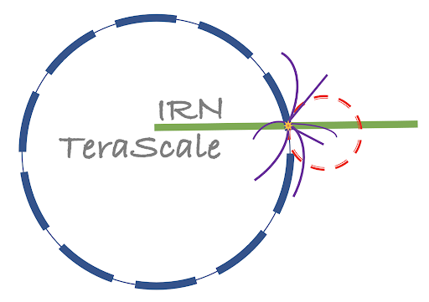
Baryogenesis via bubble collisions
Kristjan Müürsepp, in collaboration with
Martina Cataldi (UHH,DESY) and Miguel Vanvlasselaer (Brussels U,IIHE)
Laboratori Nazionali di Frascati (INFN - LNF), Frascati, Italy
Keemilise-Bioloogilise Füüsika Instituut (KBFI), Tallinn, Estonia
IRN Terascale meeting,
Institut Pluridisciplinaire Hubert Curien (IPHC), Strasbourg
19.05.2025

Slide 2
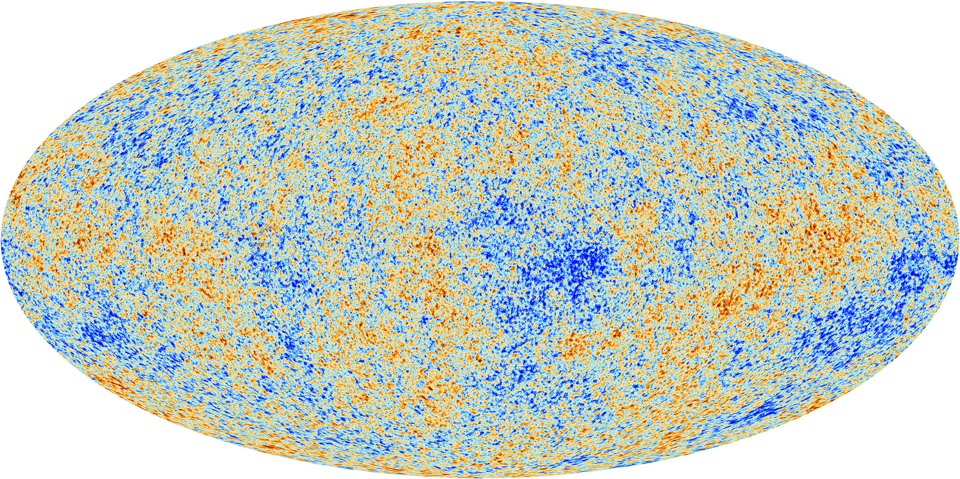
The unbearably (finely tuned) baryon asymmetry
The Universe contains more matter the antimatter as evidenced by the structure around us.
This can be observed in two equivalent ways:
These values are inferred independently from
1. Enhancement of the odd peaks in CMB
2. Abundances of D, 3He during BBN
Credit: Wikipedia
Credit: ESA

Slide 3
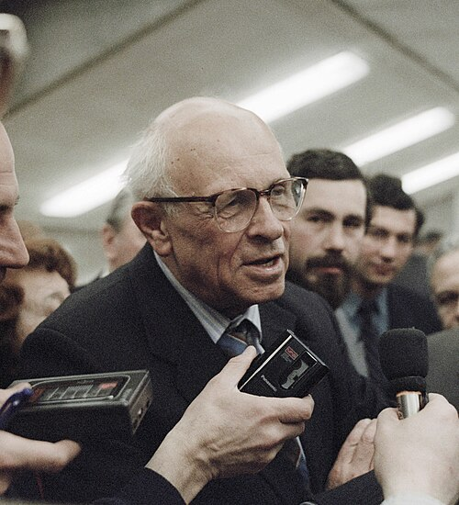
Sakharov conditions
The observed baryon asymmetry should be created dynamically after inflation:
This can be achieved by the 3 Sakharov conditions:
Baryon number violation
C- and CP- violation
Departure from thermal equilibrium
Credit: Wikipedia

Slide 4
Asymmetrizing within the SM
Can we satisfy Sakharov conditions in the SM…? Not really!
1. Sphalerons conserve B-L but violate B+L
with unsuppressed decay rate at high temperatures. OK!
2.1 Weak interactions violate C maximally. OK!
2.2 The CP-violation from the CKM matrix however is ~ ${10}^{−20}.$ NOT ENOUGH!
3. EWSB does not give a first order phase transition – Higgs is too heavy! NOT OK!
Look for explanation in connection with other unsolved problems of the SM.

Slide 5
Neutrinos to the rescue
Baryogenesis can be nicely connected with an explanation of neutrino masses.
1. Light neutrino masses from a heavy right-handed neutrino -> seesaw mechanism
2. CP violating decays of RHN are out of equilibrium and produce ΔL
3. ΔL is converted into ΔB by sphalerons.
Shortcomings of this simple scenario of LEPTOGENESIS:
RHN has to be very heavy mN> ${10}^{9}$ GeV => High reheating temperatures needed
Around T~ ${10}^{13}$ GeV strong washout
Heavy new physics not very easily testable
We use the mechanism first introduced in
M.Cataldi and B.Shakya, JCAP 11 (2024) 047
Artwork by Sandbox Studio, Chicago with Ana Kova

Slide 6
The boiling Universe
The key observables that we are interested in:
Energy released by the PT $α=\frac{ΔV}{ρ_{rad}}$
Inverse duration of the PT $β/H$
Lorentz boost factor of the bubble $γ=\sqrt{1−v_{w}^{2}}$
Bubble wall thickness $l_{w}\sim O(v)$
Bubble radius at nucleation $R_{∗}\sim O(T_{n}^{−1})$
FOPT often feature gravitational wave signals!
b

Slide 7
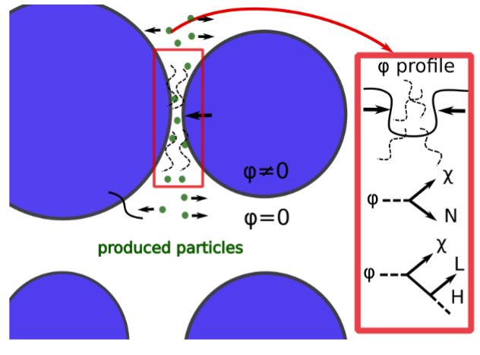
From bubbles to particles
For that runaway bubbles are needed.
We need to limit the friction on the bubble walls
Maximum energy for particle production E ~ γ v
Compared to bubble – plasma collision : vev does not have to be related to the heavy particle mass!

Slide 8
Zooming in on the bubble collisions
The number of particles produced per unit area: The imaginary part of the 1PI 2-point Green function
A. Falkowski, J.M.No JHEP 02 (2013) 034 R. Watkins and L. M. Widrow, Nuc. Phys B 02 (1992) 347
The Fourier transform has been computed numerically:
Number of particles produced
H. Mansour, B.Shakya. Phys.Rev.D 111 (2025) 2
For very heavy particles only the first part is important

Slide 9
Introducing the heavyweights
We consider the simplified Lagrangian with the hierarchy
The yield of the heavy particles produced is given by which is much less than the yield of light species
To avoid backreaction one needs which gives a rough constraint

Slide 10
Boosted light(ning) fast particles
Boosted SM particles can also be produced directly via off-shell N
The production is always dominated by the mN resonance!
Backreactions can be avoided in all cases.

Slide 11
CP-violation in the production
We generalize the Lagrangian to include flavours
Equal and opposite asymmetries produced, but SEPARATED into two sectors
N talks to the SM => transmits its asymmetry to the SM
χ talks to a light dark sector => its asymmetry is secluded from the SM.

Slide 12
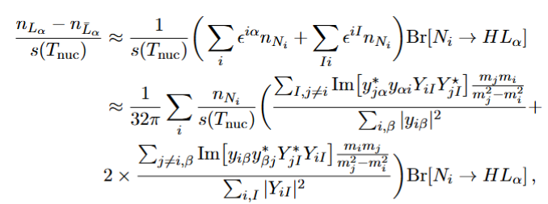
Combining CP violation from production and decay
← CP-violation from the production of N
← Fraction of asymmetry transferred to SM
↑
CP violation from the decay of N
Bubble wall plasma contribution subdominant due to

Slide 13
Production via off-shell N
The rate of production of the asymmetry
The asymmetry produced as a result:

Slide 14
Two special cases of the off-shell production
We focus on 2 generations of N, and assume m1<< m2 and m2>> $γv$
a. When $γv≫$m1:
1. N1 resonance dominates the 1->3 production
2. We recover the CP-violation from the production and decay of an on-shell N1.
b. When $γv<$m1:
1. CP-violation can still occur via off-shell production
Complicated to compute numerically
Excellent analytic approximation:

Slide 15
The danger of equilibriation 1
The main danger is the reaction HL → ϕχ. This can happen in two ways
1. Non-thermal interactions (boosted H,L)
a. Can produce N on-shell with the rate
Another way to understand
b. Thermalisation rate via t-channel scatterings nL<< neq!
So the H,L thermalize much before creating appreciable amount of on-shell N.

Slide 16
The danger of equilibration 2
Thus the main process is:
2. Thermal equilibration via off-shell N (we assume massless limit for SM particles)
We consider separately two regimes:
1. Relativistic equilibration 2. Non – relativistic equilibration
resulting in exponential suppression numerically insignificant
due to the exponential suppression
in the Boltzmann equation!

Slide 17
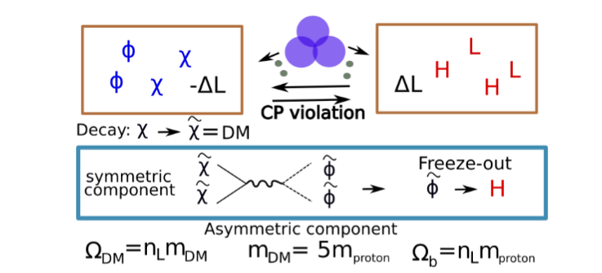
Two birds with one stone : a tale of cogenesis
To explain the coincidence problem we slightly extend the Lagrangian
Only connection to the SM
↓
Sizeable Higgs portal
↓
Avoids washout from DS decays to SM

Slide 18
Light from heavy: inverse seesaw mechanism
Introduce lepton number violating terms
This results in the effective Weinberg operator Resulting in the neutrino mass matrix
Giving a mass to the heaviest light neutrino
↓

Slide 19
Other wash-out channels
which decouples for
To avoid strong washout we thus require
In our construction we can easily avoid this bound since we usually have v<< mN.
→ → exponentially suppressed production of N.

Slide 20
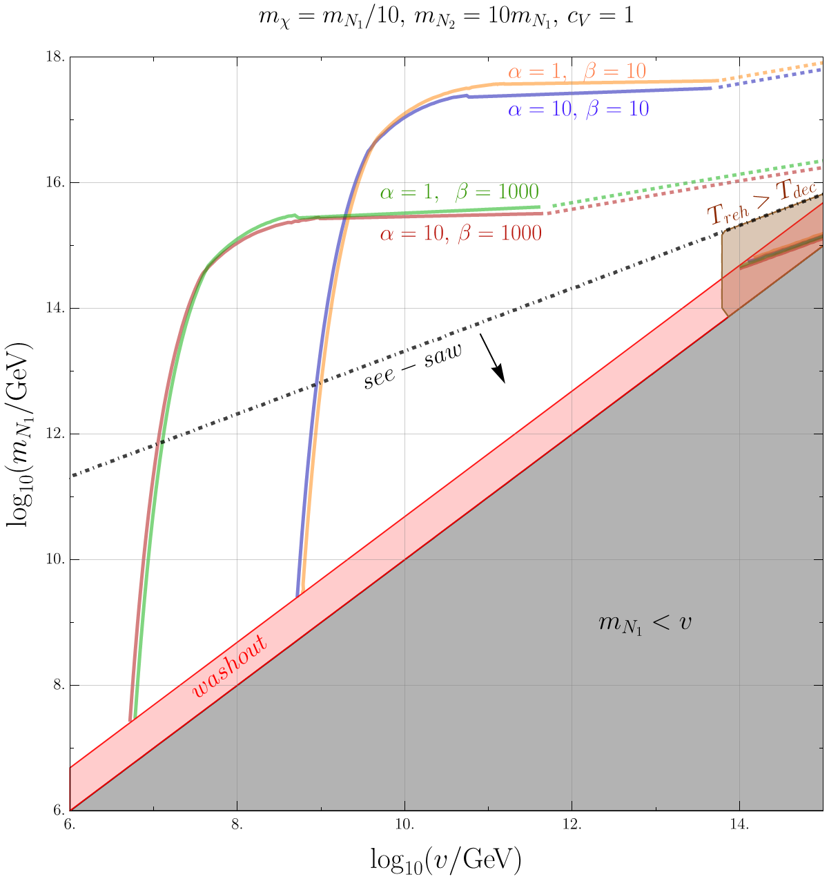
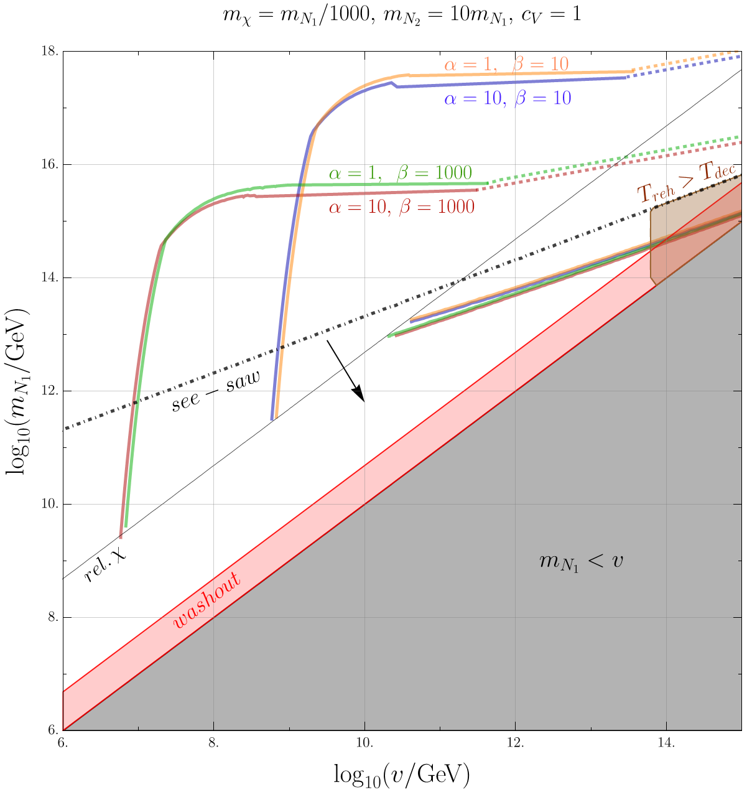
Parameter space for on-shell and off-shell production

Slide 21
Gravitational wave signal
Since we have γ >> 1, we will use bulk flow model, T.Konstandin, JCAP 03 (2018) 047
energy mostly in the sound waves
The energy density and the peak frequency are given by
An IR cut-off f < H($T_{reh}$)/(2 π) imposed by causality.

Slide 22
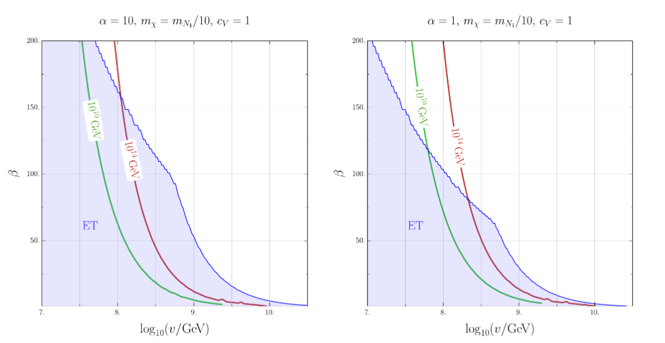
Gravitational wave signals for the Einstein telescope

Slide 23
Conclusions
Bubble collisions from phase transitions allow to create very heavy particles
The same mechanism can also entail CP violation in the production
We have applied this observation to a concrete realization of baryogenesis
We computed CP violation both from the on-shell and off-shell production
We start with zero asymmetry =|> the asymmetry is separated into two different sectors.
Consequently, we also attempt to explain the DM abundance via cogenesis.
Adding lepton violating terms can be used to also explain the neutrino masses
Thank you for attention!

