Slide 1
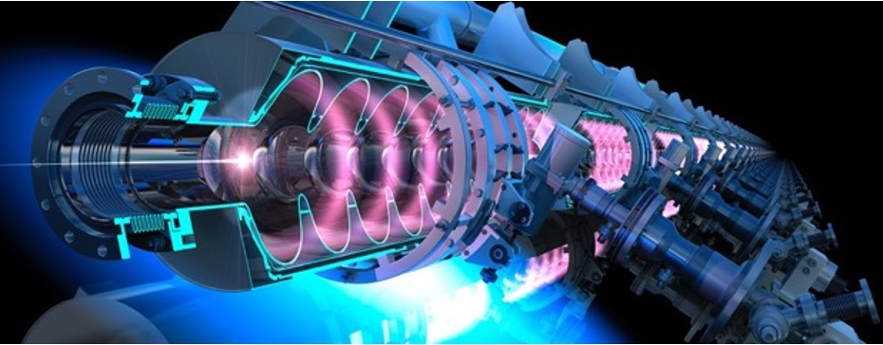
PERLE: Powerful Energy Recovery Linac for Experiments
Walid Kaabi (IJCLab-CNRS)
Lyon, March 19th 2025

Slide 2
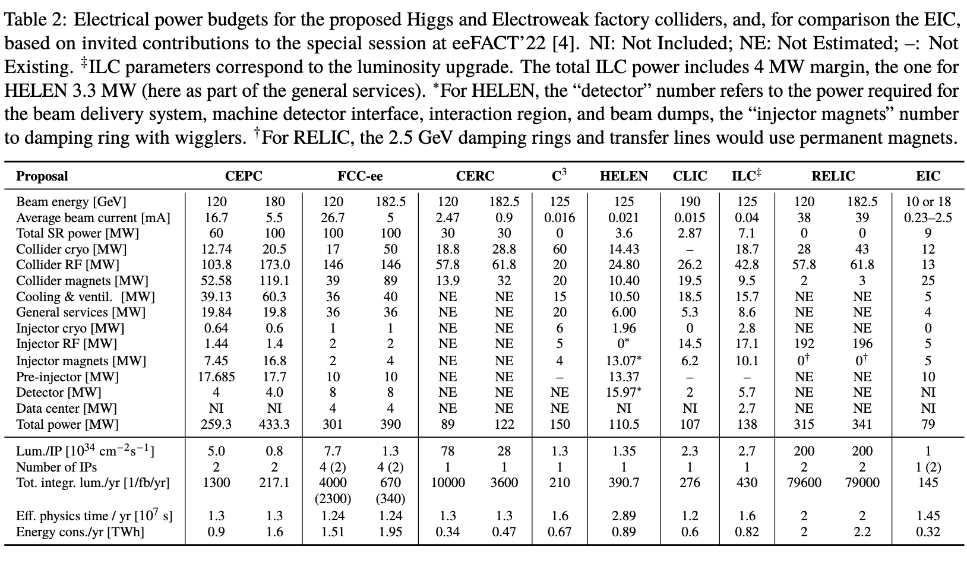
Introduction: Average power needs for future HEP projects
This table is the result of dedicated discussion session on Power budget and performance considerations for future Higgs factories held during eeFACT2022 workshop in Frascati.
https://accelconf.web.cern.ch/eefact2022/papers/frxas0101.pdf

Slide 3
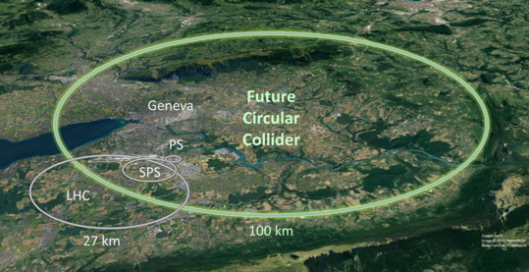
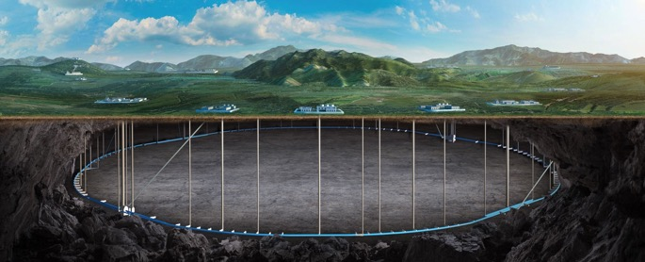
Introduction: Average power needs for future HEP projects
Example 1: FCC-ee (ZH mode)
Example 2: CEPC in Higgs factory mode
The total power consumption for a e+ e- Higgs factory is 300 MW. The power breakdown is as the following:
  RF for beam acceleration 51 % (145 MW)
  Cryogenic cooling 5 % (14 MW)
  Magnets 9 % (26 MW)
  Others 35 % (98 MW)
The total power consumption is 340 MW for the operation on Higgs mode, assuming a SR power of 50 MW/beam. The power breakdown is as the following:
  RF for beam acceleration 52 % ( 177 MW)
  Cryogenic cooling 3,2 % ( 11 MW)
  Magnets 17 % ( 58 MW)
  Others 27,3 % ( 93 MW)
FCC Conceptual Design Report, Eur. Phys. J. Special Topics 228, 261–623 (2019)
CEPC Technical Design Report, December 2024 (page 967)
* “Others” includes vacuum system, instrumentation, radio protection, control system, experimental devices, utilities, general services…

Slide 4
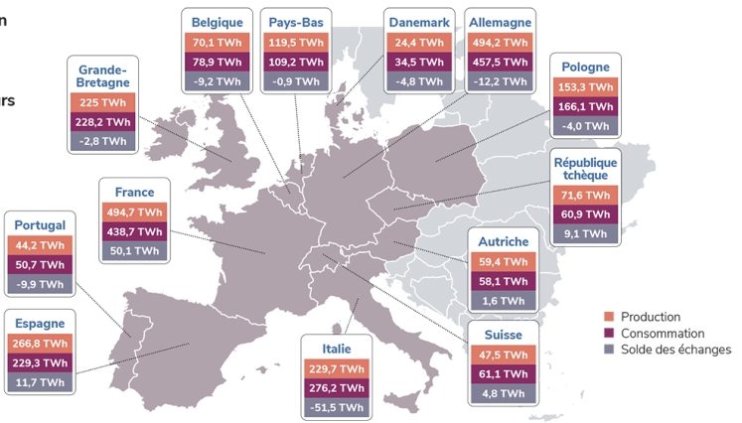
Introduction: Average power needs for future HEP projects
From these two examples of Higgs factory, the total power consumption (300-340 MW) represent an estimated annual energy consumption of nearly 2 TWh for a typical yearly operating cycle.
It represent 1 to 6% of the yearly consumption of some middle size European countries
Half of this consumption is for RF power, to accelerate the beam and compensate SR.
Efficiency enhancement of future large-scale facilities is becoming an obligation toward:
Societal acceptability
Political commitments of the hosted country toward reaching carbon neutrality in upcoming years.
Production, Consumption and Exchange of the electrical power in some European countries (2023 data, updated in February 2024)
https://analysesetdonnees.rte-france.com/bilan-electrique-2023/europe#Introduction
R&D on high Q₀ SRF
High efficient klystrons development
Permanent magnets + Dual aperture magnets with common coils.
Efficient cryoplant design

Slide 5
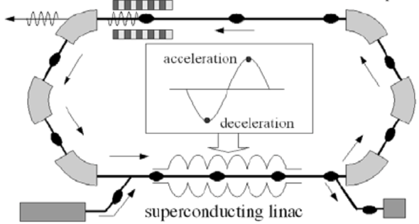
Introduction- ERL Concept
Acceleration:
RF power provided to cavities
The idea:
ERL Loop
(1’)
(1)
New beam injected in ERL loop
Acceleration to the top energy
(2’)…
(2)
acceleration
deceleration
ERL Loop
Kinetic energy of used beam recycled to re-excite cavities
Superconducting Linac
(4)
Beam used in IP
(3)
Injector
Beam dump
The benefits:
Reduce RF power consumption
Dumping the beam at injection power
Fresh beam in IP with the same characteristics
Deceleration:
180° RF Phase shift
More advantages:
Linac-like beam quality with extremely flexible time structure
High operating efficiency
Multi-pass configuration: High current carrying capability (no RF power limit) + High beam power in a compact machine
Notes:
By recovering the Energy of accelerated beams, Energy Recovery Linacs (ERLs) make large beam powers possible that would otherwise be prohibitively expensive.
Linacs produce high beam qualities for scientific experiments and for industrial applications, but their beam power is limited by the available electrical power.
ERLs surpass this power limit: much larger beam currents and beam powers become available because the beam energy is recaptured.
How do ERLs compare to other accelerators?
high currents, like storage rings, because the energy is recovered,
high beam quality (low emittance, bunch length, and energy spread) like linacs, because each bunch traverses it only once,
tolerates beam disruption as each bunch is used only once before it’s discarded.

Slide 6
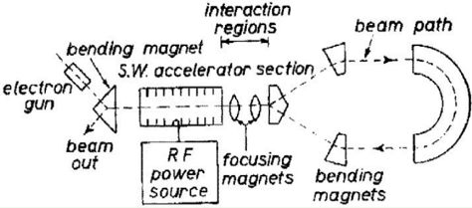
ERL History and achievements
1987 Los Alamos
FEL-operation, nc,
coupled acc/dec cavities
1987 High Energy Physics Lab
Stanford University
SRF cavities, proof of principal experiment
1965 M. Tigner
“A possible apparatus for electron clashing-beam experiments”
2000
Jefferson Lab
“Front End Test”
SRF, first CW
recovery
2017 Darmstadt Univ, Germany
“S-DALINAC”, SRF, single pass 22.5MeV,
2021
2 pass demonstration
2002 JEARI, Japan
FEL, SRF, 700kW beam power
2005 Daresbury Lab, GB
“Alice”, SRF, 26MeV, versatile
10-year user program
2002
Jefferson Lab
“IR-Demo”
SRF, 5mA, 48MeV,
2.1kW beam power IR
2003
CEBAF, 1 GeV, single turn
2007 Upgrade:
9mA, 150MeV
1.1MW beam power with ~300kW total power
under construction:
MESA, Germany
Particle physics application
PERLE, France
Technology test facility (LHeC/FCC-eh) + ICS & eRIB test facility
bERLinPro, Germany
SRF/ERL technology test facility
2004 BINP, Russia
FEL-operation
normal conducting RF,
30 mA
2007: 4-passes
2013 KEK, Japan
“cERL”, prototype
ERL light source
Industrial applications
2020, Cornell/BNL
cbeta, FFA-arc
4-pass ERL
(80mA injector, e = 0.3mm mrad)
Courtesy to Bettina Kuske

Slide 7
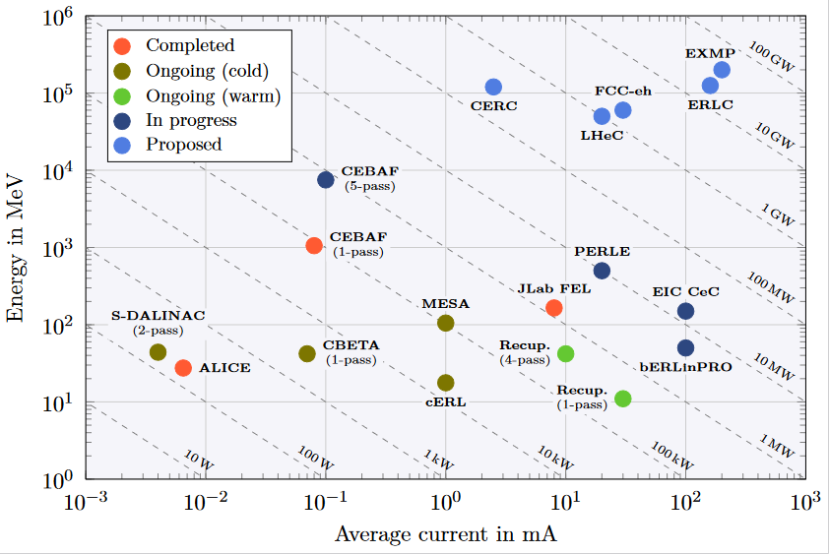
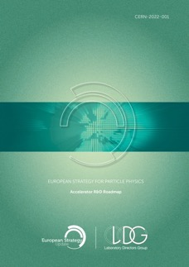
ERL - The global landscape
ERLs were recognized as one of the five main axis of accelerators R&D in support of the ESPP:
  High-field magnets
  High-gradient RF structures & systems
  High-gradient plasma laser accelerators
  Bright muon beams and muon colliders
  Energy Recovery Linacs
Two projects: PERLE & bERLinPro were recognized as "essential pillars of the ERL development," with milestones to be achieved by the next ESPP in 2026.
Funding Limited
Technology Limited
ESPP R&D Accelerator Roadmap: https://arxiv.org/ftp/arxiv/papers/2201/2201.07895.pdf

Slide 8
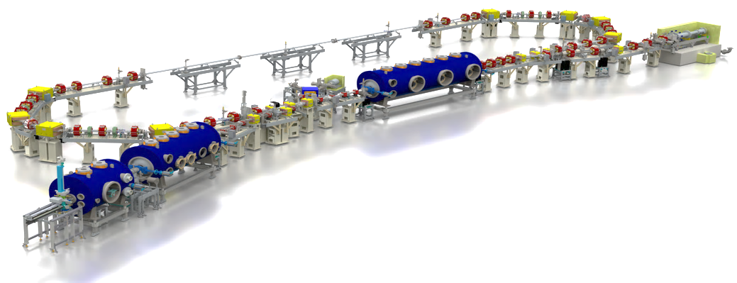
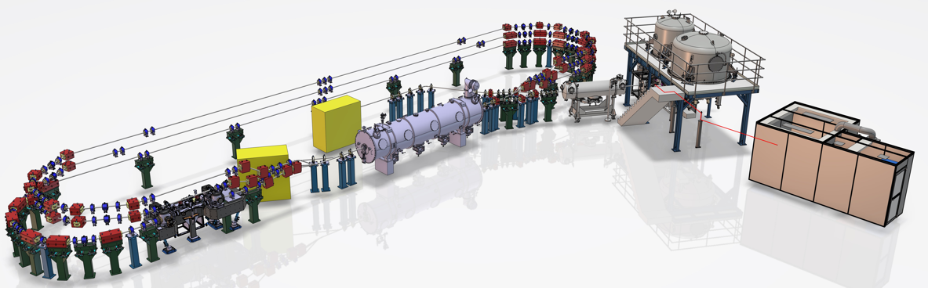
ERLs in the European Accelerator R&D Roadmap
beam dump
6.5 MeV, 100 mA
= 650 kW
linac module
3 x 7 cell SRF cavities @1.3 GHz
44 MeV
merger
dogleg
Booster
3 x 2-cell SRF cavities @1.3 GHz
4.5 MeV
bERLinPro: High current (100 mA), CW, single turn ERL
SRF-gun
1.4 cell SRF cavities
1.5-2.3 MeV, single SC solenoid,
DC-gun
350 keV, 500 pc @ 40MHz
Beam dump
7 MeV, 20 mA
= 140 kW
Laser room
3 stacked isochronous circulation arcs
for 3 different energy beams
Merger
Booster
4 single cell SRF cavity @800 MHz, 7 MeV
Linac module
4 x 5-cell SRF cavity @800 MHz, 82 MeV
PERLE (250 MeV version): high current (20mA), CW, 3 turns ERL

Slide 9
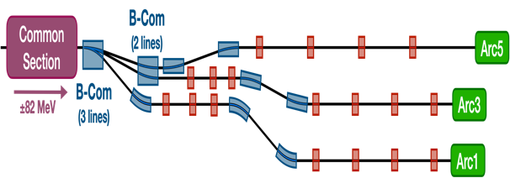
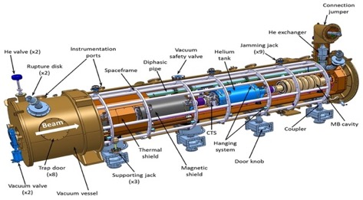
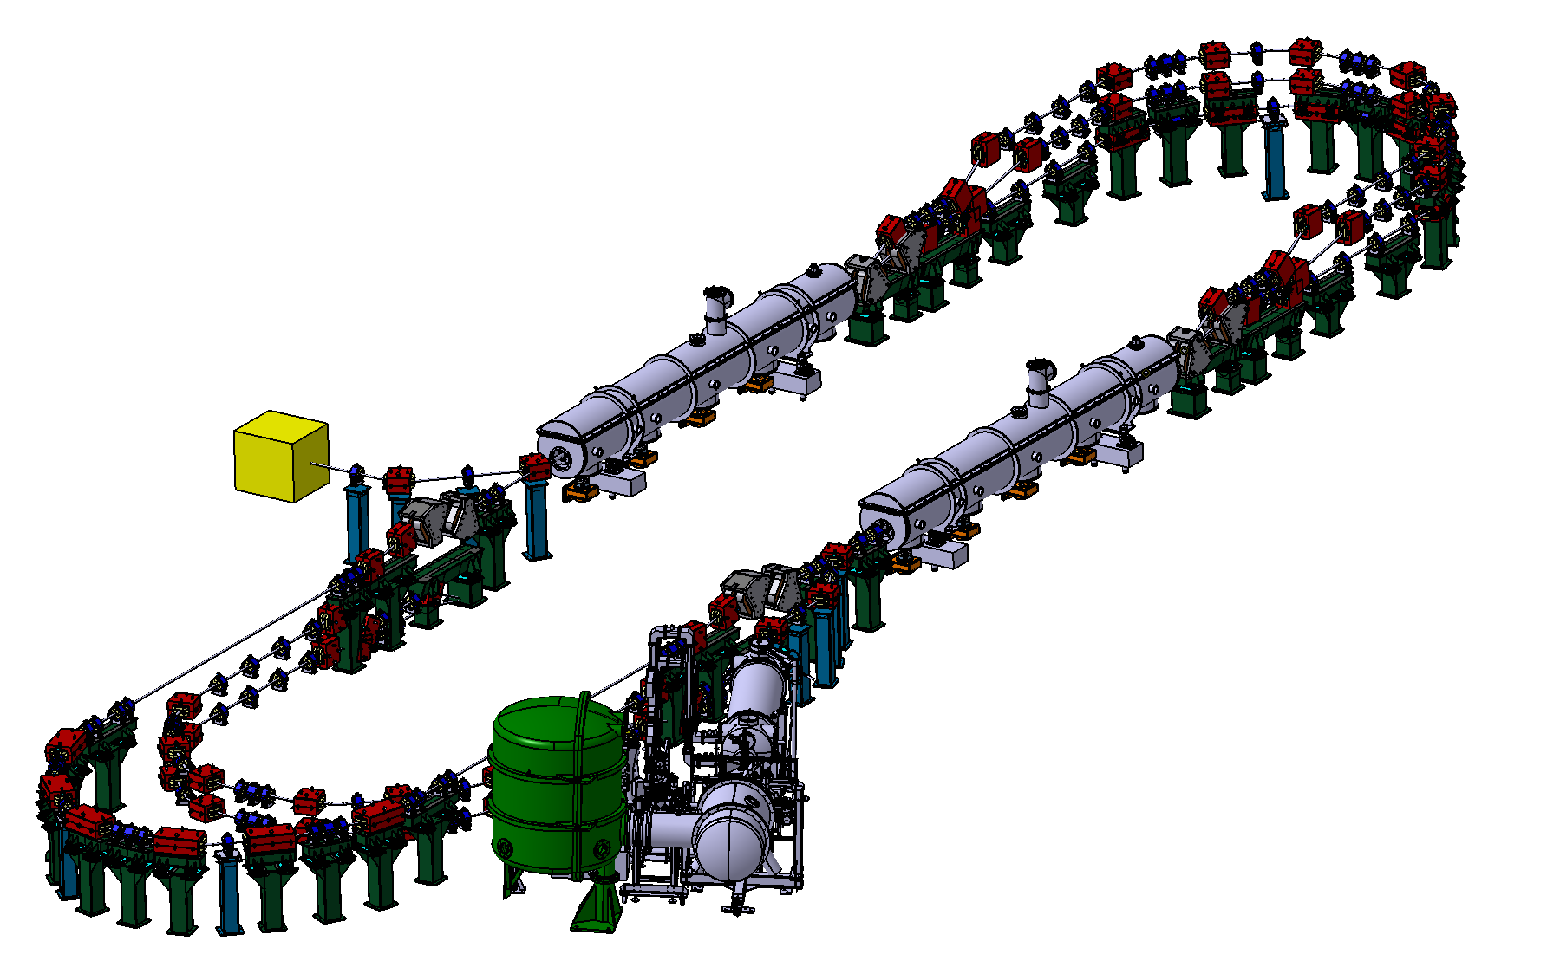
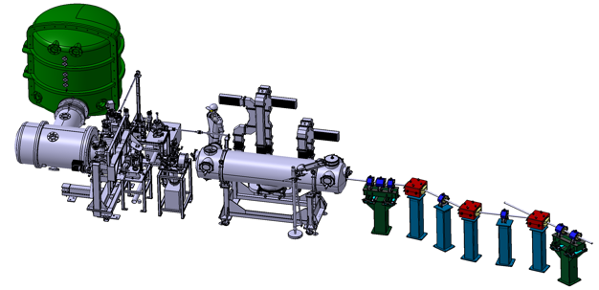








PERLE: Powerful Energy Recovery Linac for Experiments
PERLE: first multi-turn ERL, based on SRF technology, designed to operate at 10MW (20 mA, 500 MeV) power regime
→ A hub to explore a broad range of accelerator phenomena and to validate technical choices improving accelerators efficiency in an unexplored operational power regime on the pathway of the ERL technology development for future energy and intensity frontier machines.
Cryomodule with 4 five-Cell cavities
Total gradient 82 MeV
3 acc & 3 decc beams at different energies travelling in the CM.
Switchyard: vertical separation/recombination of beams at different energies
Target Parameter | Unit | Value
Injection energy | MeV | 7
Electron beam energy | MeV | 500
Normalised Emittance γε_{x,y} | mm mrad | 6
Average beam current | mA | 20
Bunch charge | pC | 500
Bunch length | mm | 3
Bunch spacing | ns | 25
RF frequency | MHz | 801.58
Duty factor |  | CW
Beam dump
3 staked isochronous recirculation arcs for beams at different energies (Arcs 1, 3, 5).
Interaction Points
HV tank
Photocathodes loading chamber (Sb-based photocathodes)
Buncher
350-500 kV
DC gun
Merger
3 staked (& inversed) isochronous recirculation arcs for beams at different energies (Arcs 2, 4, 6)
Light box
Green laser 40 MHz
Booster: 5 single-cell cavities (802MHz) individually powered
Injection line delivering 500pC bunches at 7 MeV.

Slide 10

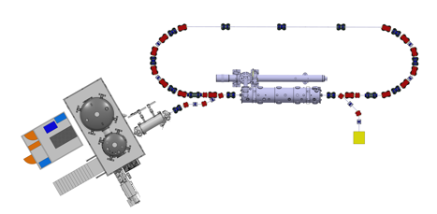

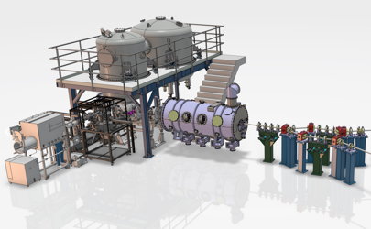
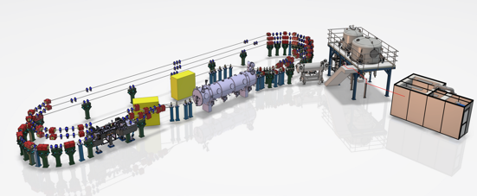
PERLE Timeline (macroscopic view)
“Partially”
TDR and prototyping
CM funded by EU Program iSAS + Matching funds (IN2P3)
Phase 2: PERLE 1 tour
Phase 1: Injection line
Phase 3: PERLE 250 MeV
Extra funding needed for 6 arcs configuration
By CNRS National Program RI2
2022
2023
2024
2025
2026
2027
2028
2029
2030
2031
Phase 4: PERLE 500 MeV

Slide 11
Challenges toward new generation of efficient ERL
ERL specificity
Undesired effect
Technical Challenges
Proposed solutions
1. Short lifetime photocathodes, space charge dominant effect
2. High dynamic losses
3. High HOM excitation
4. Increase beam instabilities
5. Microphonics detuning & mechanical stability
6. Beam load variation, Mismatch between acc/decc bunches
1. High charge @ high rep. rate, high cathode field, high vacuum, high QE & robust photocathodes
2. High Q₀ cavity
3. Efficient HOMs extraction
4. The highest BBU threshold
5. Fast tuning, prevent external vibrations
6. Fast feedback and perfect phase synchronisation
1. Development of DC gun & multi-alkali photocathodes (Cs-K-Sb or Na-K-Sb)
2. Cavity treatment with optimised recipe (EP, Doping, infusion, Mid T-baking…)
3. Act on cavity design + optimized HOM couplers and BLA
4. Optimized Filling pattern and HOM extraction & damping scheme
5. Development of FE-FRT
6. Development of a digital AI-assisted field and detuning control, smart amplifier control
1. High current e⁻ source
2. CW operation (RF)
3. High current operation
4. Multi-pass/multi-bunch operation
5. Efficient use of RF power
6. Efficient beam energy recuperation

Slide 12
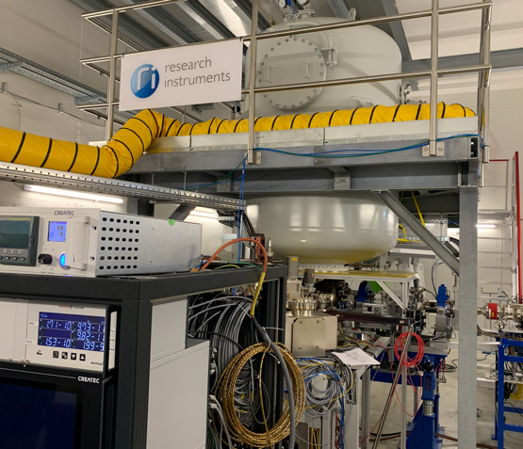
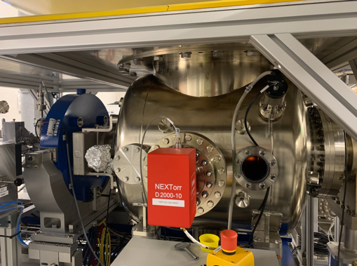
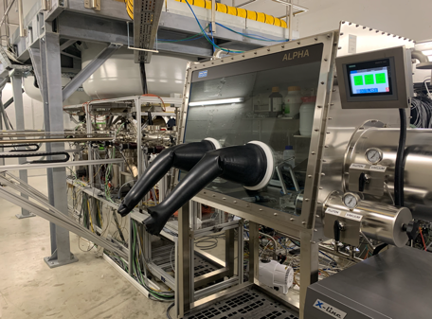
Challenge #1: High Current Electron Source
Collaboration IJCLab-LPSC & RI GmbH
Within a Collaboration Agreement for photoinjector R&D between IJCLab (IN2P3) and Research Instruments GmbH (RI), Hardware of lighthouse project (terminated) transferred to IJCLab for PERLE. The gun was commissioned and tested at high rep rate, at a limited bunch charge. It includes:
A DC Gun, Cornell design (400 pC, 50 MHz demonstrated), fully equipped (all pumps) in load-lock version
A Photocathode Preparation Facility (PPF)
HV power supply suited for high bunch charge (designed for 40 mA, 450 kV)

Slide 13
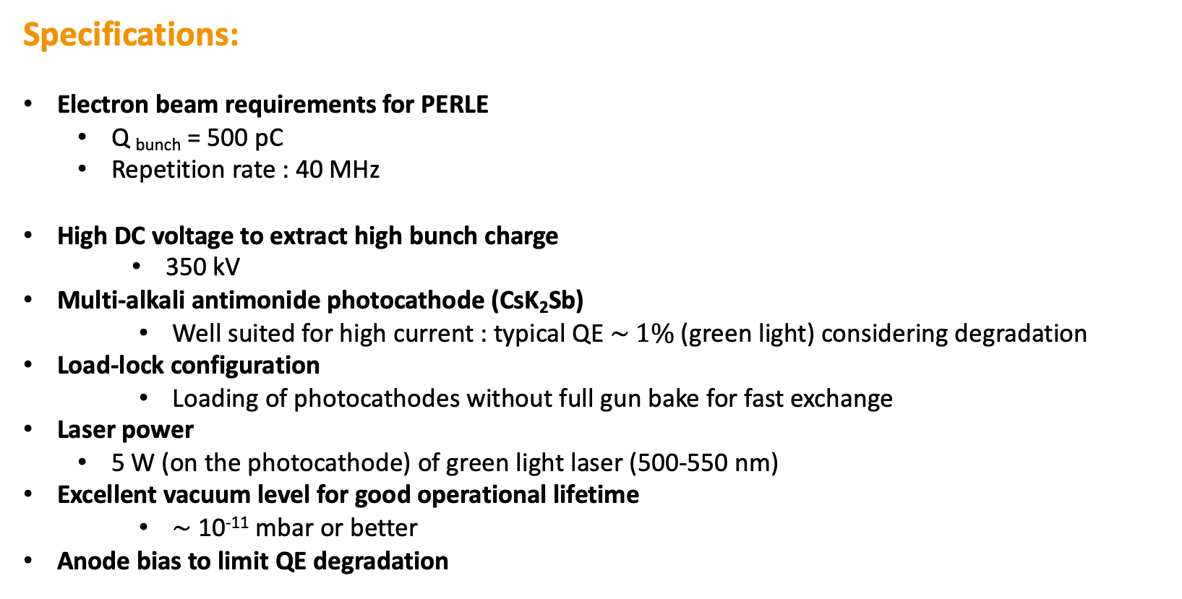
Challenge #1: High Current Electron Source
Specifications:
Electron beam requirements for PERLE
  Q _{bunch} = 500 pC
  Repetition rate : 40 MHz
  High DC voltage to extract high bunch charge
    350 kV
  Multi-alkali antimonide photocathode (CsK₂Sb)
    Well suited for high current : typical QE $\sim 1\%$(green light) considering degradation
  Load-lock configuration
    Loading of photocathodes without full gun bake for fast exchange
Laser power
  5 W (on the photocathode) of green light laser (500-550 nm)
  Excellent vacuum level for good operational lifetime
    $\sim$10⁻¹¹ mbar or better
  Anode bias to limit QE degradation
  I= 20 mA

Slide 14
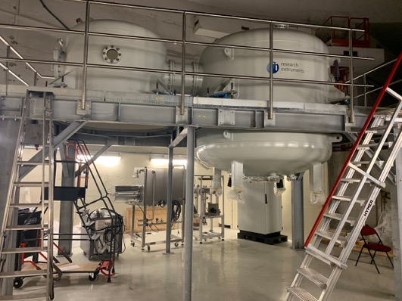
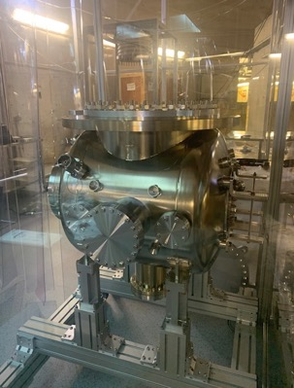
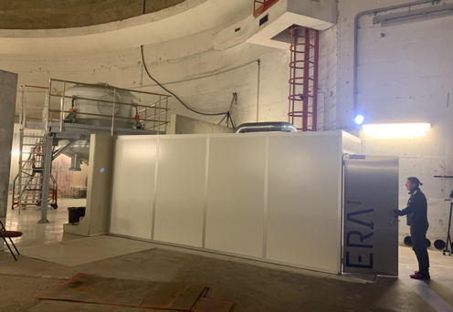
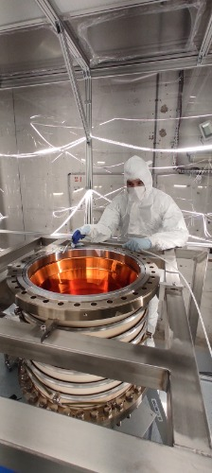
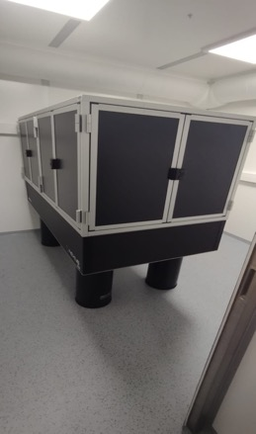
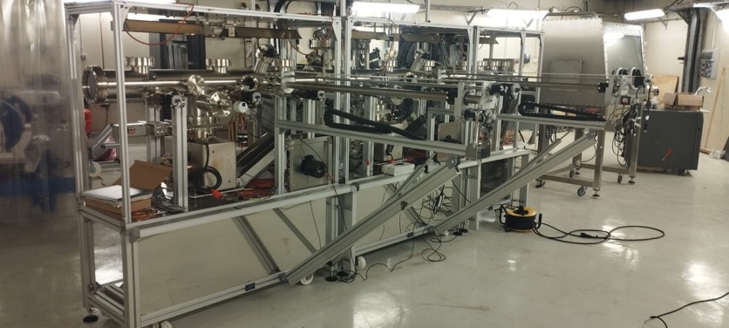
Challenge #1: High Current Electron Source
Laser room
HV tanks
Gun chamber
Ceramic isolator
Photocathode Preparation Facility
Laser setup

Slide 15
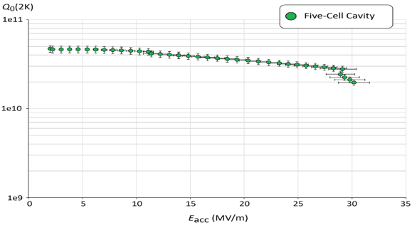
Challenge #2: High Q₀ cavity
CERN-JLab-IJCLab collaboration
A 5-Cell 802 MHz Nb cavity was designed according to PERLE requirements, prototyped and tested in vertical cryostat:
Q₀ (2k) = 3 e10 @ ~27 MV/m
PERLE requirements
Quench @ E_{acc} ~ 30 MV/m
First Nb 802 MHz 5-Cell cavity fabricated @ JLAB
→ In order to maintain the high cavity performance once Jacketed and the end group equipped, an R&D program within a large collabotration (Coll. IJCLab, Jlab, Fermilab, CERN and KEK) is ongoing to optimise the cavity post-treatment recipe (EP, BCP, N₂ diffusion, low T double step treatment, Mid-T baking…)
F. Marhauser et al. “802 MHz ERL cavity design and development”- IPAC2018 (Vancouver, BC, Canada)- doi:10.18429/JACoW-IPAC2018-THPAL146

Slide 16
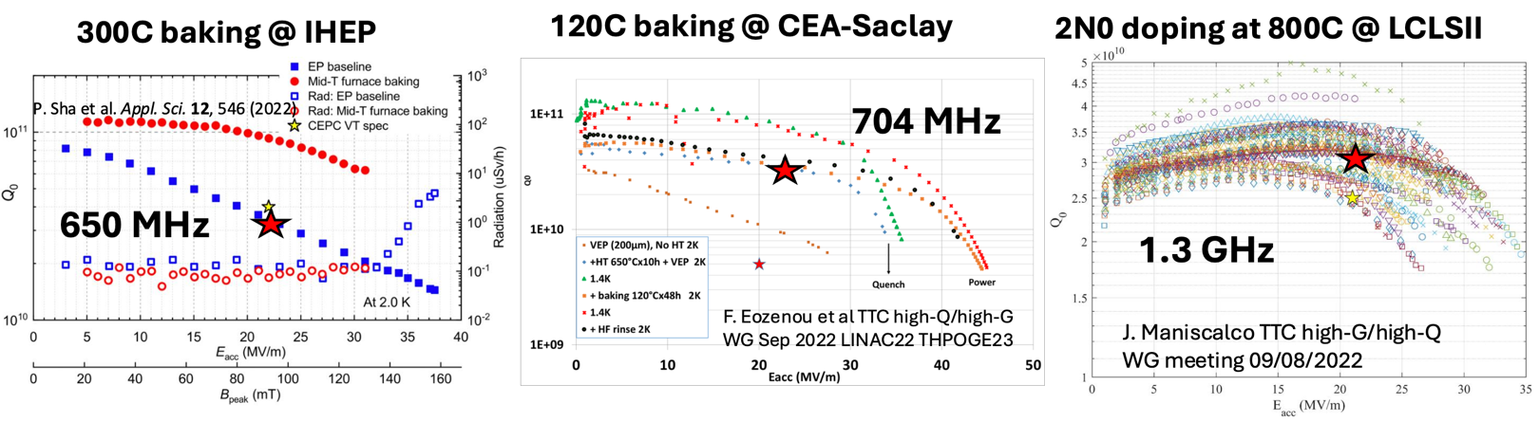
Challenge #2: High Q₀ cavity
Courtesy to Akira Miyazaki
Mid-T baking and N-doping are very interesting processes to enhance Q₀ and gradient.
Mid-T baking is a relatively new approach that shown several advantages:
  Provide higher Q₀ compared to N-doping (and a factor 5 compared to EP).
  Need less EP
  A more simple and robust process (easily implementable and reproducible)

Slide 17
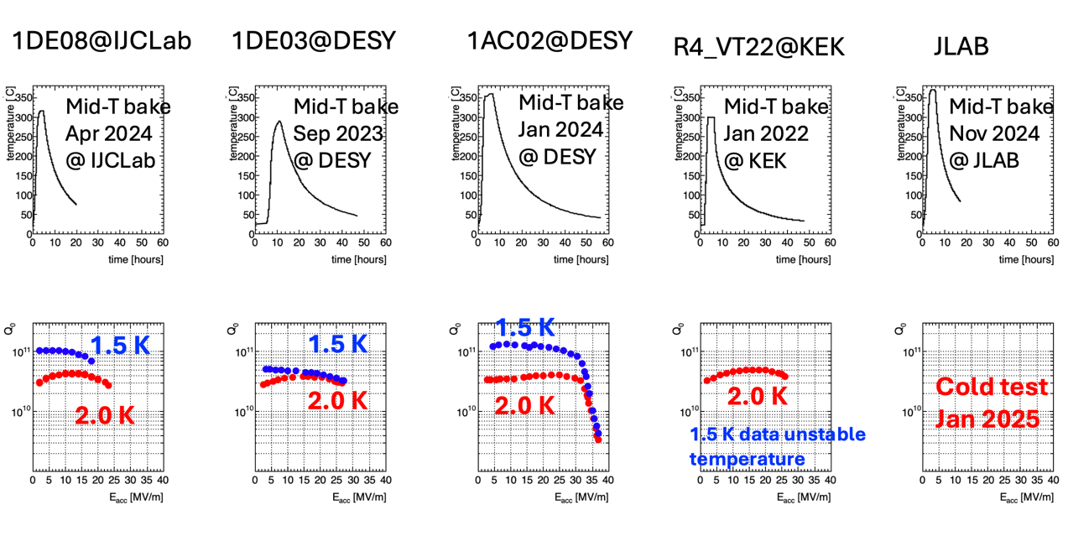
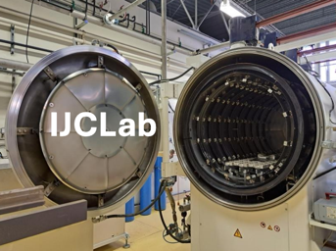
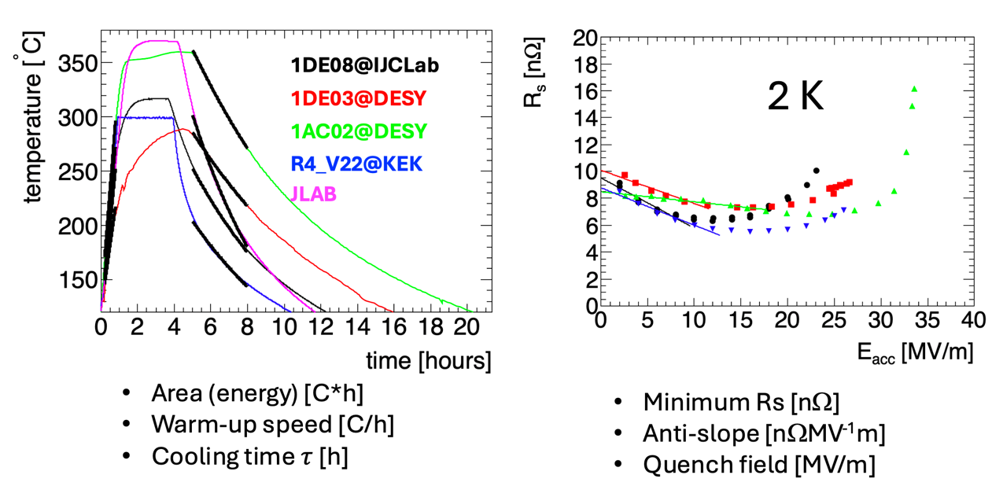
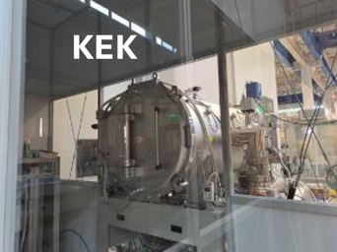
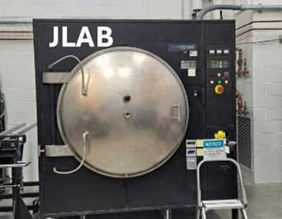
Challenge #2: High Q₀ cavity
Possibility to compare the recipes and results between labs, find correlations and explanations to progress toward an optimized recipe.

Slide 18
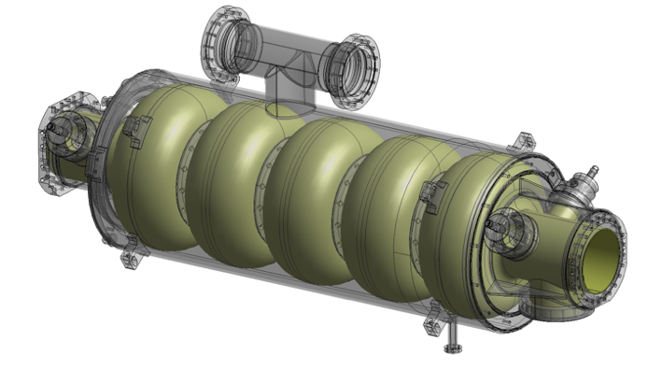
Challenge #3: Efficient HOMs extraction
CERN-JLab-IJCLab collaboration
ERL cavity design considerations:
Low frequency choice (<1GHz) → Resulted from cost optimization models & in consideration of potential beam breakup instabilities (BBU)
Large iris aperture → allowing strong cell to cell coupling
Few cells for a given gradient → to avoid strongly confined HOMs as prerequisite for adequate broadband HOM-damping
Optimized end-cell design → to facilitate HOM extraction & damping
  The dressed cavity is equipped with:
  A helium jacket made of Titanium (including the beam pipes)
  A “classical” tuning system as the one developed for the ESS Spoke cavities
  4 HOM couplers and the fundamental power coupler to the end-groups
  A BLA (very preliminary design) between cavities

Slide 19
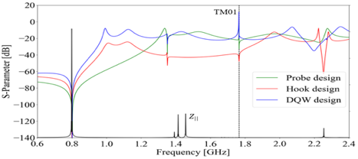
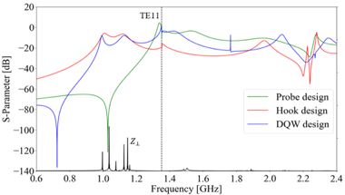

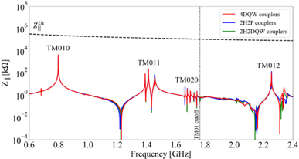
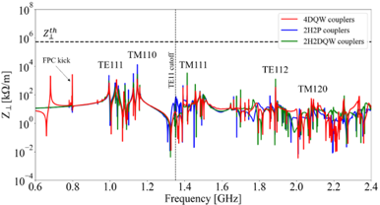

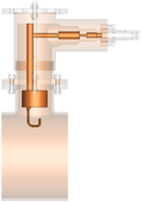
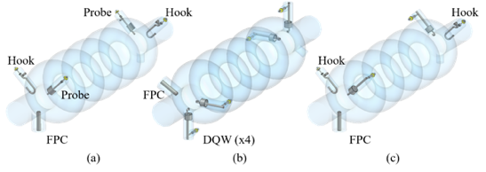
Challenge #3: Efficient HOMs extraction
For PERLE (3 turn ERL), The total current carried by cavities is 6 x 20mA= 120mA (3 passes up + 3 passes down)
Efficient extraction of dangerous HOMs requires the combination use of optimized HOM couplers + the use of Beam Line Absorber (BLA).
Within the PERLE collaboration (IJCLab, JLab and CERN):
A complete study of High Order Modes of the 800 MHz cavity was performed.
3 HOM coupler designs (Hook, Probe, Double Quarter Wave (DQW) were investigated and mechanically optimized for efficient HOMs extraction.
Different damping scheme at the end group were numerically simulated
Monopole transmission
Dipole transmission
TM010
Optimized region
Optimized region
TM011
TM012
Longitudinal impedance spectra of the cavity
Transverse impedance spectra of the cavity
Probe Coupler
Hook Coupler
DQW Coupler
beam

Slide 20
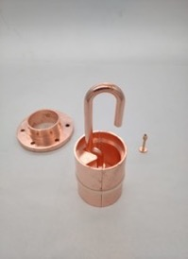
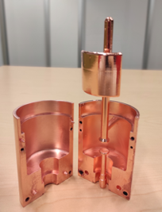
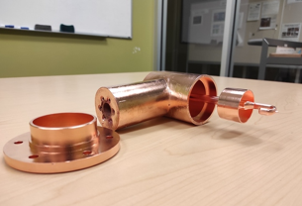
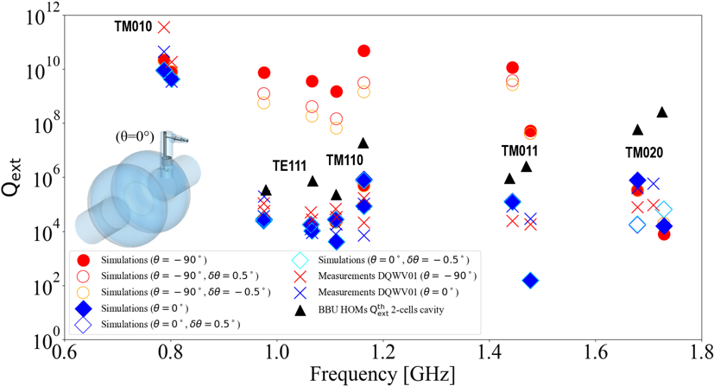
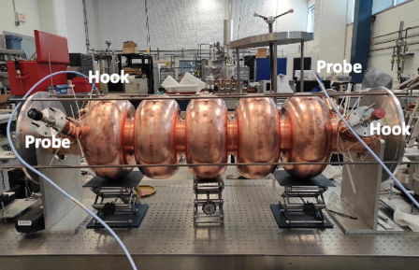
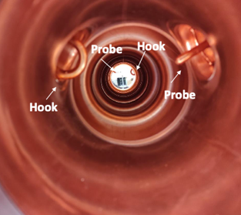
Challenge #3: Efficient HOMs extraction
From RF design to performance measurements: Successful collaborative effort between IJCLab, Jefferson Lab & CERN
Probe coupler
DQW coupler
Hook coupler
3D-printed prototype (Epoxy Accura 48) copper-coated @CERN
Courtesy to Carmelo Barbagallo
A 5-Cell copper cavity was fabricated @Jlab (same design as the Nb 5-cell cavity fabricated in 2017) to allow end group optimisation & test several HOM couplers combinations to assess the best HOM damping scheme.
C. Barbagallo et al., “First RF measurements of coaxial HOM coupler prototypes in a copper cavity for the PERLE project”, proceedings IPAC’23, 10.18429/JACoW-IPAC2023-MOPA025

Slide 21
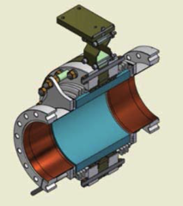
Challenge #3: Efficient HOMs extraction
HOM couplers for PERLE cryomodule:
  The low-level measurements agreed pretty much with the simulations [1]
  The mechanical design of HOM couplers is under finalization.
  The HOM couplers will be cooled at 2 K in the PERLE cryomodule
We aim now to produce Nb HOM couplers with optimized design and to install them on a new Nb 5-cell PERLE cavity with the optimized end-group.
The Production of 4 cavity scheduled within ISAS European Program.
Beam Loss Absorbers:
  We still need additional absorbers to capture and dissipate HOMs as they propagate along the beamline.
  Technology demonstrated at CBETA-Cornell University [2], cERL- KEK [3] & EU-XFEL [4]
  Adaptation to PERLE requirements to be performed
  Power absorbed ~100 W per BLA
  Installation between two cavities could be feasible (study ongoing)→ He-cooling and thermal intercept needed at 50 K
SiC BLA used in CBETA Linac [2]
[1] C. Barbagallo, PhD thesis manuscript, « Design and Optimization of Higher Order Mode Couplers for the Superconducting Cavities of the PERLE Energy Recovery Linac »
[2] R. Eichhorn et al., « Higher order mode absorbers for high current ERL applications », proceedings SRF2015
[3] M. Sawamura et al., « ERL HOM ABSORBER DEVELOPMENT IN JAPAN », proceedings ERL’09
[4] J. Sekutowicz et al., « Beam tests of HOM absorber at FLASH », proceedings IPAC’10

Slide 22
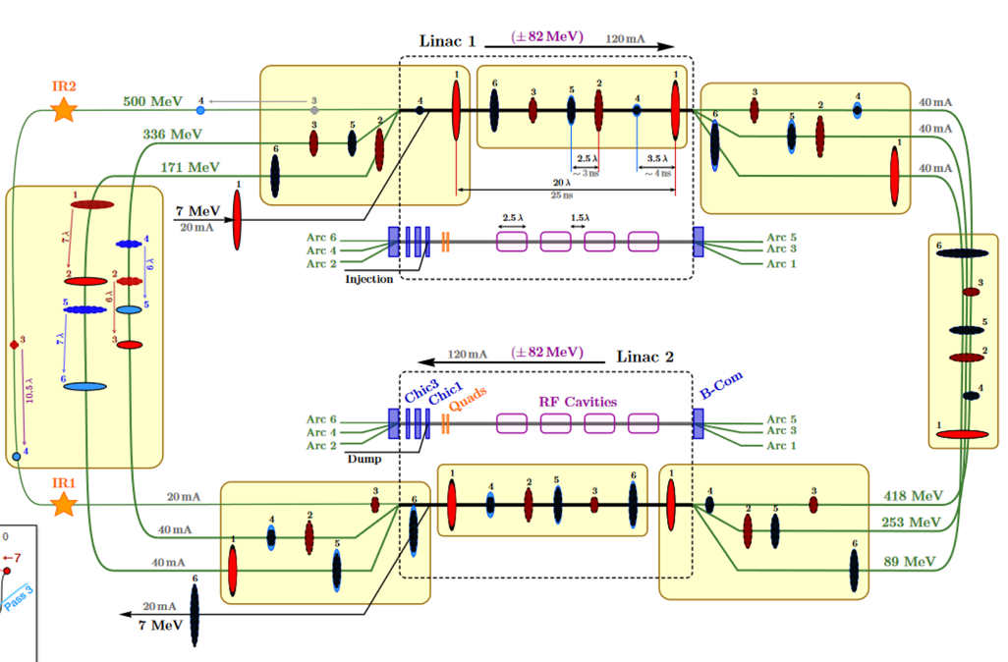


Challenge #4: High BBU threshold
Courtesy to Alex Fomin
Bunch Filling Pattern studies:
Pass 1
Pass 1-2
Pass 1-6
In the injection line:
500 pC e- bunchs generated at f_{inj}= 40 MHz
  time spacing between bunches: 25 ns
  average current: 20 mA
Bunches accelerated to 7 MeV in the injector then injected into the ERL loop
ERL Loop:
Cavity frequency: f_{RF}= 801,58 MHz (λ_{RF}= 34.7 cm)
f_{RF}/f_{inj =} 20
Length spacing between bunches: 20 λ_{RF}
During the 1st Pass:
Linac 1 → Arc 1 → Linac 2 → Arc2
7 → 89 MeV 89 → 171 MeV
1st Pass length= 167 λ_{RF}
8 bunchs injected in the 1st pass.
The 9th bunch Injected is followed by the 1st accelerated bunch in pass 1 that start pass 2 (spaced by 7 λ_{RF}).

Slide 23


Challenge #4: High BBU threshold
Bunch Filling Pattern 250 MeV Vs. 500 MeV version
S. A. Bogacz et al., Beam dynamics driven design of powerful energy recovery linac for experiments, Phys. Rev. Accel. Beams 27, 031603 (2024).

Slide 24



Challenge #5: Fast compensation of cavity detuning
Courtesy to Nick Shipman
Ferro-Electric Fast Reactive Tuner (FE-FRT): How it acts?
FE-FRT is a shorted co-axial structure containing a ferro-electric
RF power flows into the FE-FRT and is reflected back to the cavity
Voltage applied to the ferro-electric changes its permittivity
Permittivity change → Phase change of the reflected power → Cavity frequency change
FE-FRT operates outside cryomodule at room temperature and tunes cavity without mechanical deformation
Tuning speed measured at less than 600ns, limited by HV circuit
Ideal for microphonics suppression:
For low beam loading machines (As ERLs) cavity frequency shift is dominated by microphonics
The effect of microphonics can be reduced passively or actively (stiffening of cavity, isolation of noise sources, active feedback e.g. piezo tuners…)
Residual microphonics require over-coupled FPC, but typically, RF power required is still many times larger than for critical coupling case

Slide 25



Challenge #6: Fast feedback & perfect phase synchronisation
Bandwidth and Resonance control:
Operating at higher Q_{ext} (narrower bandwidth: Q_{ext}= f₀/△f)
reduces the power needs if resonance control can be guaranteed.
makes resonance control extremely challenging
4 kW
3.3 kW
2 kW
1.3 kW
1 kW
Under development within iSAS program:
The schematic overview to compensate detuning with new ferro-electric fast reactive tuners (FE-FRT) avoiding large power overhead and to compensate with AI-smart control loop countermeasures via the low level radio frequency (LLRF) steering of the RF amplifier the disturbances in SRF cavities that impact field stability

Slide 26

Developpment of injection line systems:
HV system
Funded by the national program RI2 (CNRS)
Booster
DC Photogun
Merger
Buncher
Photocathode Preparation Facility (PPF)
Diagnostics line

Slide 27





Buncher cavity design
Collaboration IJCLab-ESS Bilbao
PERLE buncher cERL-type design
(some summary highlights...)
Important progress in the RF design, thermal and beam dynamics simulations of a buncher cavity for PERLE by colleagues from ESS-Bilbao.

Slide 28


Booster specifications and possible design investigation
The booster design is ongoing, the specifications are:
Bring the beam energy up 7 MeV:
  x4 single cell SRF cavities, Qo > 3E+10 @ 10 MV/m
  T= 2K (dynamic losses < 5W /cavity)
  F = 801.58 MHz
  RF Power/cavity~40kW
  No HOM couplers but absorbers needed
Adapt as much as possible the Linac cryomodule design to the booster requirements:
  Same vacuum vessel type (same diameter, alignment supports, openings for accessibility, end-caps...)
  Same cryogenic interface (jumper connection)
  Same interface to the RF network
  Same tuning systems
Cryo interface
RF interfaces

Slide 29



Booster single cell cavity
More in Raphael Roux Poster
We tried to standardize its design as much as possible w.r to the 5 cell cavity design:
  RF design from the 5-cell cavity
  Helium vessel made also of Titanium
  Same flanges
  Same coupler port aperture
  Same bellows
  Same tuning system
  ... no HOM coupler ports!
To be compatible with our vertical cryostat configuration for testing at 2K
Simulations & Injector design optimization studies were performed with different codes (OPAL and Astra)
More in Connor Monaghan talk and Raphael Roux Poster

Slide 30




Linac cryomodule design
PERLE 1st cryomodule is adapted from ESS design and will be optimised for efficient high current ERL operation. It will integrate the RF systems (SRF Cavities, HOM couplers & absorbers, Fundamental Power Couplers) optimized and developed within the European project ISAS.
As In-kind contribution of ESS to iSAS, the 1st cryomodule of the linac will reuse ESS medium beta prototype components:
Vacuum vessel
ESS, CEA, CERN and INFN-LASA
are involved in this work
Spaceframe
Thermal shield
And will host new optimized components developed within the iSAS project
  Cavity string (SRF cavities, RF couplers, Tuning systems, Beam Line Absorbers, HOM couplers...)
  Magnetic shield
  Cryogenics circuit...

Slide 31


Further development toward improving ERL efficiency
R&D on Nb3Sn cavities:
The most developed alternative Nb SRF superconductor is Nb3Sn. SRF Nb3Sn cavities have a potential to be a game changer, operating at higher cryogenic efficiency: Nb3Sn has higher 𝑇𝑐 of 18.3 K, compared to the 9.2 K of Nb.
Nb cavities must operate at 2 K to have 𝑄₀ > 1 × 1010. 2 K cryogenic systems are inefficient. Nb3Sn can have similar 𝑄₀ but at 4.2 K where the cryogenic efficiency ~3 times better.
Limitation today is the accelerating gradients that remain ≤ 24 MV/m and non producible at industrial scale.
The most progress to date has been made with the vapor diffusion process. Other processes of making Nb3Sn are under investigation: electroplating, CVD deposition, magnetron sputtering... As these techniques mature, we should expect further progress.
As ERLs operate at relatively low gradient, it is very likely to see in the near future ERL cryomodules equipped with Nb3Sn cavities.

Slide 32

Innovation for Sustainable Accelerating Systems (iSAS)
More about iSAS: https://indico.ijclab.in2p3.fr/event/9521/
iSAS Collaboration

Slide 33





Summary slide for applications on PERLE
We are considering hosting 2 R&D set-up at PERLE:
An inverse Campton scattering source (ICS) at IP1
An electron scattering on online produced radioactive ion experiment at IP2.
ELECTRON bunches
(few tens of MeV)
θ ~ 10 mrad
θ
on-axis photons: most energetic
X-RAYS
(few tens of keV)
Low beta (β=30cm) at regions for experiments

Slide 34






Ions trap
Spectrometer for e- scattering
X-LINE in X-HUTCH
Fabry-Perot Cavity
X-LINE elements inside bunker

Slide 35









Summary:
Courtesy to Jorgen D’Hondt
Potential impact of ERL technology
enables the ultimate upgrade of the
LHC/FCC programs
2070’ies
ERL FCC-eh
demonstrate
multi-turn high-power ERL
2040-2050’ies
ERL for H/HH Factories
reuse ERL
2020’ies
iSAS
2030-2040’ies
2 ERL beams
2030’ies
high-power ERL for
e⁺e⁻ Higgs Factories
(Z/W/H/top/HH program)
PERLE
EIC
1 ERL beam
high-power ERL
e⁻ beam in collision
(ep/eA @ LHC program)
bERLinPro
increases the performance of the next major colliders
high-power ERL
demonstrated
ERL application
electron cooling

Slide 36
Thank you for your attention!

Slide 37

Innovation for Sustainable Accelerating Systems (iSAS*)
* iSAS: project supported by Horizon Europe

Slide 38



Inverse Campton scattering source @ PERLE
X-LINE in X-HUTCH
Fabry-Perot Cavity
X-LINE elements inside bunker

Slide 39


Implementation of DESTIN @ PERLE:
Spectrometer
Ion target location
RIB factory
50 MeV e- Linac

Slide 40



LHeC/FCC-eh: High energy & high luminosity electron-proton collisions
From HERA to LHeC:
3 order in magnitude in luminosity
1 order in magnitude in energy
→ LHeC a 1 GW beam power facility
With the planned R&D on ERLs, we will prepare the path for a 1 GW electron machine with only 100 MW power needed.
A Mutli-turn ERL (3+3 passes), 50 GeV, RF Frequency: 801.52 MHz, 20 mA beam current (6x20 = 120 mA load in the cavities)

Slide 41


ERLC: A re-imagining of the ILC as an ERL
Schematic plot showing the concept of ERLC:
Schematic plot showing the concept of ReLiC:

Slide 42

ERLC: A re-imagining of the ILC as an ERL
Compared to ILC, Luminosities at CoM 250GeV and 500GeV for equivalent wall plug powers of 120 MW and 150 MW respectively are found to be between one and two orders of magnitude greater, depending on the duty factor chosen.
However: The duty factor approach of 1/3 is a limitation for such machine for cryogenics efficiency. Without a vigorous R&D on 4K SRF operation (Q₀ at 10¹¹) and extraction of higher-order modes to high temperature, the build cost would be more than twice ILC.
V. Telnov/BINP, LCWS2021, https://indico.cern.ch/event/995633/contributions/4275159/
Preprint paper https://arxiv.org/pdf/2105.11015.pdf

