Slide 1
Nature of Upper Crust and Magma Reservoir from Seismic Full Waveform Inversion of Ultra-long Offset Multi-channel Seismic Reflection Data at the Axial Volcano in the Pacific Ocean
Wenxin Xie, Satish Singh, Hélène Carton
Marine Geosciences Team
Université Paris Cité, Institut de Physique du Globe de Paris, CNRS, Paris, France
Notes:
I'm happy to share my work here

Slide 2
Table of Contents
Study Area and Data
Scientific Objective
Method
Results
Discussion and Conclusion
Notes:
My presentation is divided into the following sections:

Slide 3
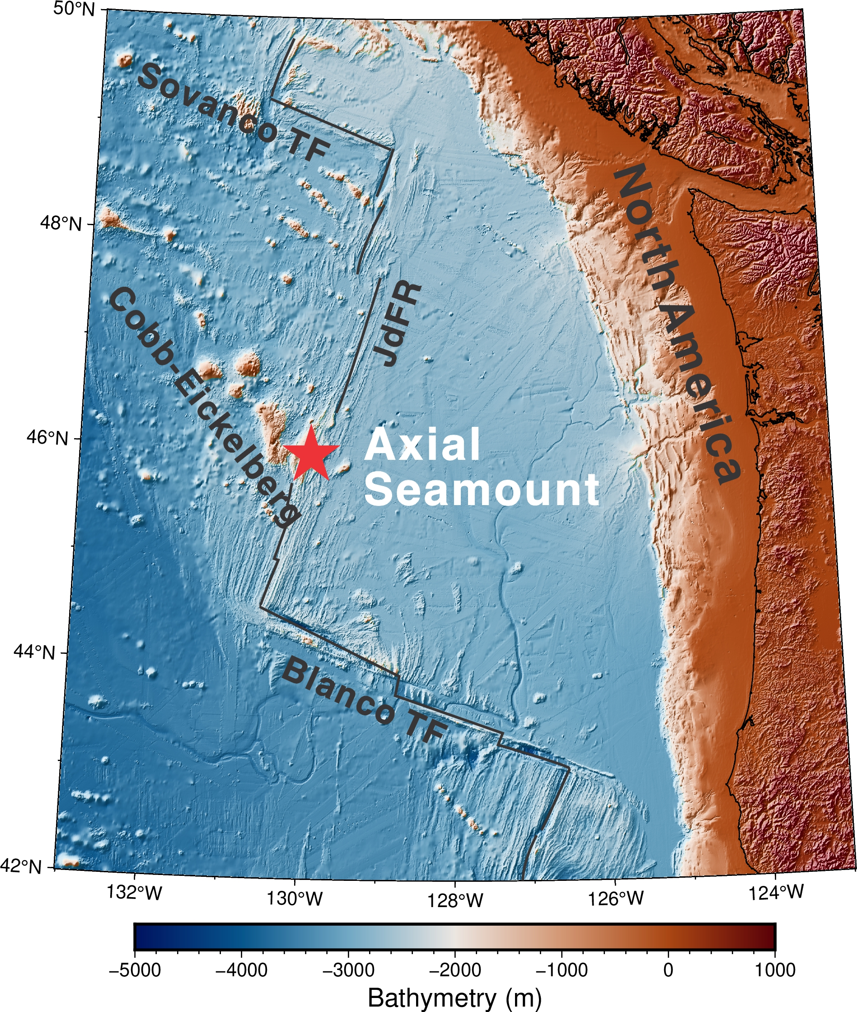
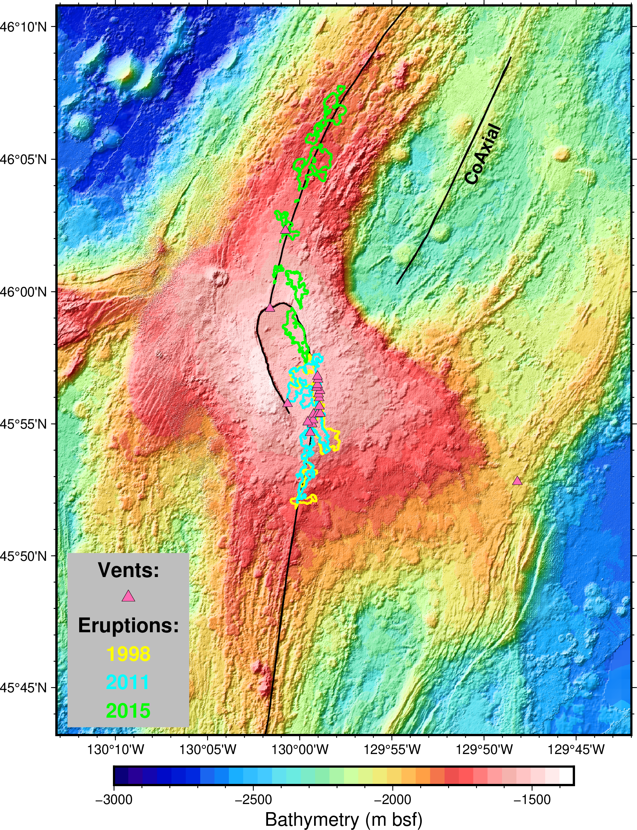
Study Area: Axial Seamount
Formed by interacting with the intermediate-spreading Juan de Fuca Ridge and the Cobb hotspot in the last ~ 0.5 Ma
Erupted three times (1998, 2011, and 2015)
Like a mini Iceland
North rift zone
Caldera
Sorth rift zone
Study Area and Data Scientific Objective Method Results Discussion and Conclusion
Notes:
Axial Volcano in the Eastern Pacific Ocean. It is one of the largest active submarine volcanoes, like a mini-Iceland, formed by the interaction between the intermediate-spreading Juan de Fuca Ridge (JdFR) and the Cobb hotspot.
If we zoom in, we can see that its summit features a horseshoe-shaped caldera. The volcano has two major rift zones extending north and south. Besides, it hosts many hydrothermal vent fields and has erupted three times in recent years.

Slide 4
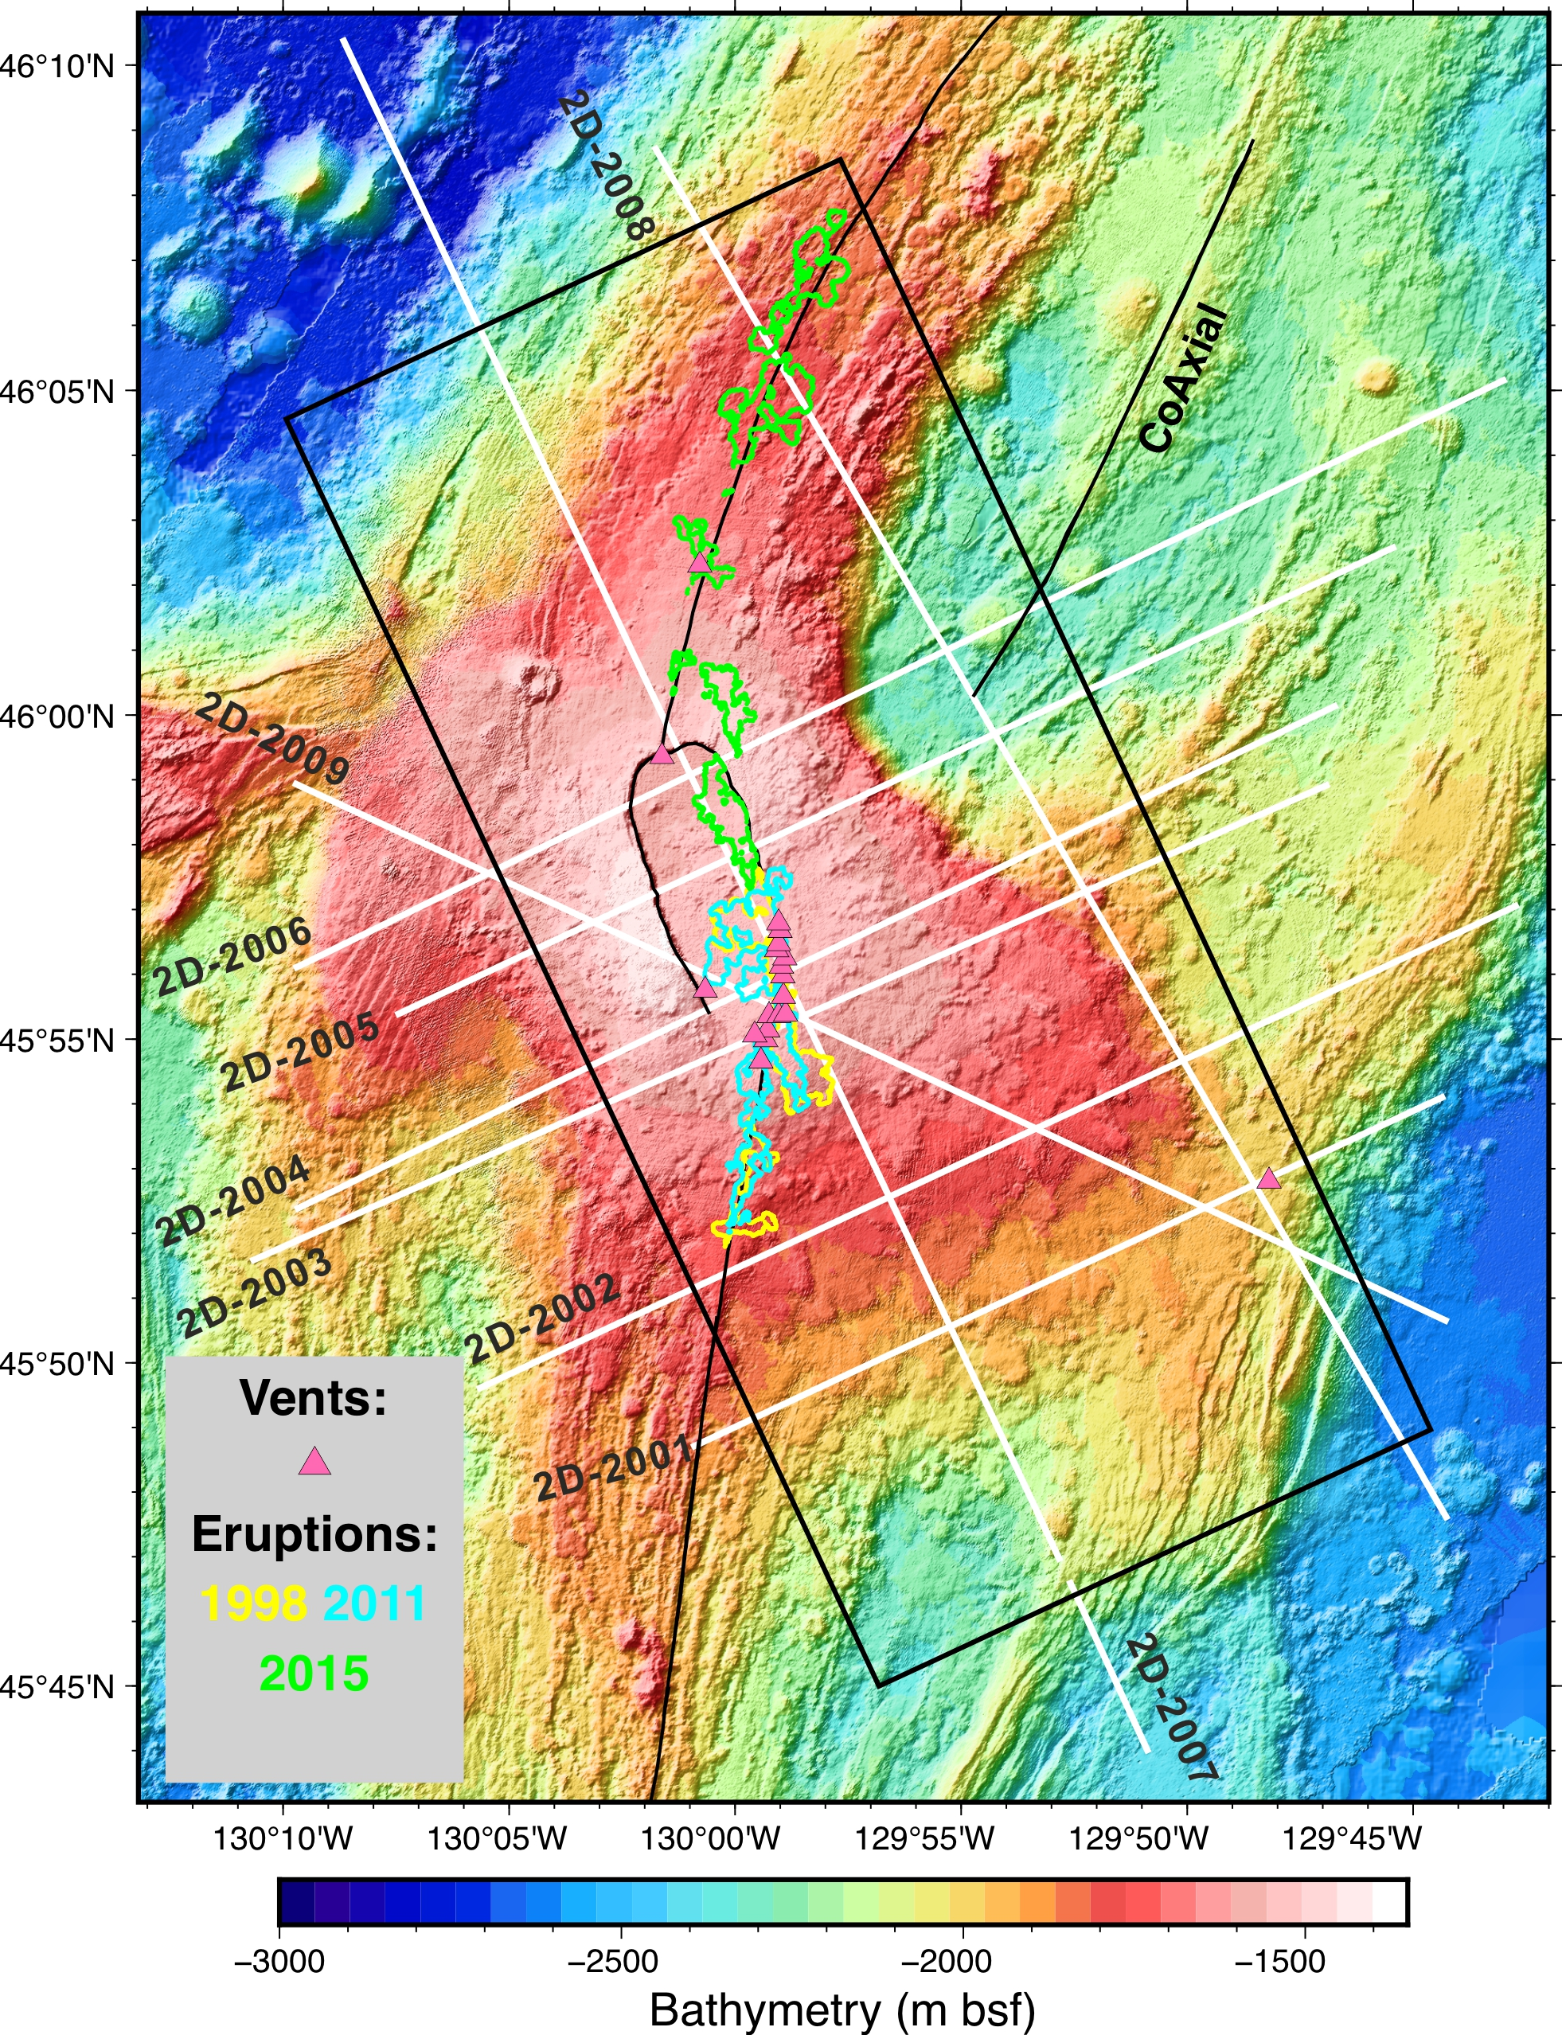
Data: Geophysical Experiments
2019 US R/V Langseth MGL1905
North rift zone
3D multi-channel seismic data covered a 40 km by 16.3 km area
Conventional time stacking and migration image
(Kent et al., 2025)
2D 12 km offset streamer data
Tomography
Full waveform inversion
（in this study)
Caldera
Sorth rift zone
Study Area and Data Scientific Objective Method Results Discussion and Conclusion
Notes:
2019, US research ships conducted geophysical experiments here and collected the 3D… (black box)besides,
Besides, it also obtained 9 2D 12km offset streamer data (white line)

Slide 5
Scientific Objective:
Time domain
Detailed structure above (upper crust) and below (magma reservoir) the LAB?
3D seismic data stacking and migration image
The lithosphere–asthenosphere boundary (LAB) beneath the Axial Volcano
North rift zone
Caldera
Sorth rift zone
Kent et al., 2025
Study Area and Data Scientific Objective Method Results Discussion and Conclusion
Notes:
Recently, scientists used conventional time stacking and migration images to show that LAB beneath Axial volcano.
2D ultra-long offset data to characterize the detailed nature of the magma reservoir, including its internal structures

Slide 6
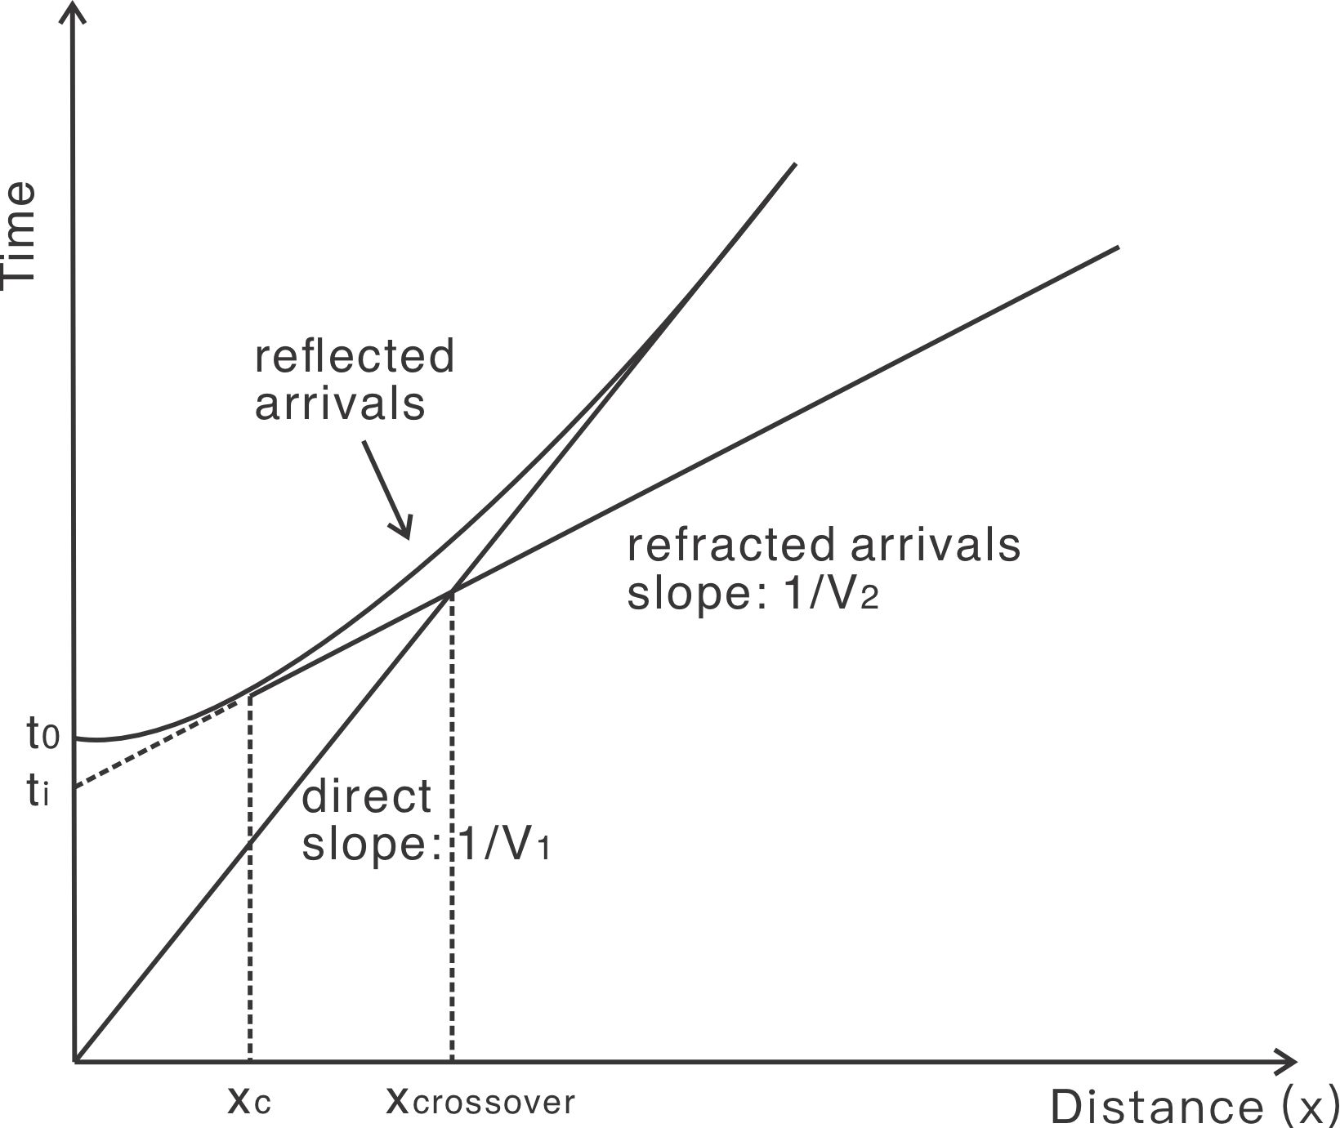
Scientific Objective
Line 2003 - Shot gathers at different locations
SW
Shot 1400
Shot 1280
NE
Shooting direction
triplication effect
Study Area and Data Scientific Objective Method Results Discussion and Conclusion
Notes:
There are two examples of shot gathers in different locations of 2D line.
The top is the topography and bathymetry the this 2D line.
We can see the 12 km streamer data contain enriched information. Like the shadow zone, it means seismic rays cross the magma reservoir.
Three different wave paths arrive at the same or very similar times, leading to a travel-time curve that bends back and then forward in slope. By stacking the retrograde branch of a triplication

Slide 7
Scientific Objective
Seafloor
Layer 2A event:
a high gradient in the uppermost crust, roughly lava (basalt) /dike boundary in the young crust
Carbotte et al., 2021
Axial melt lens (AML):
a nearly flat and thin layer at the top of magma reservoirs
Kent et al., 1990
Seafloor
layered lava flows in (b), which are absent in (a).
Study Area and Data Scientific Objective Method Results Discussion and Conclusion
Notes:
By stacking the retrograde branch of a triplication
There is a sharp reflective interface called layer 2A events
disappeared.
Dipping lava toward the magma reservoir
What’s important here is…

Slide 8
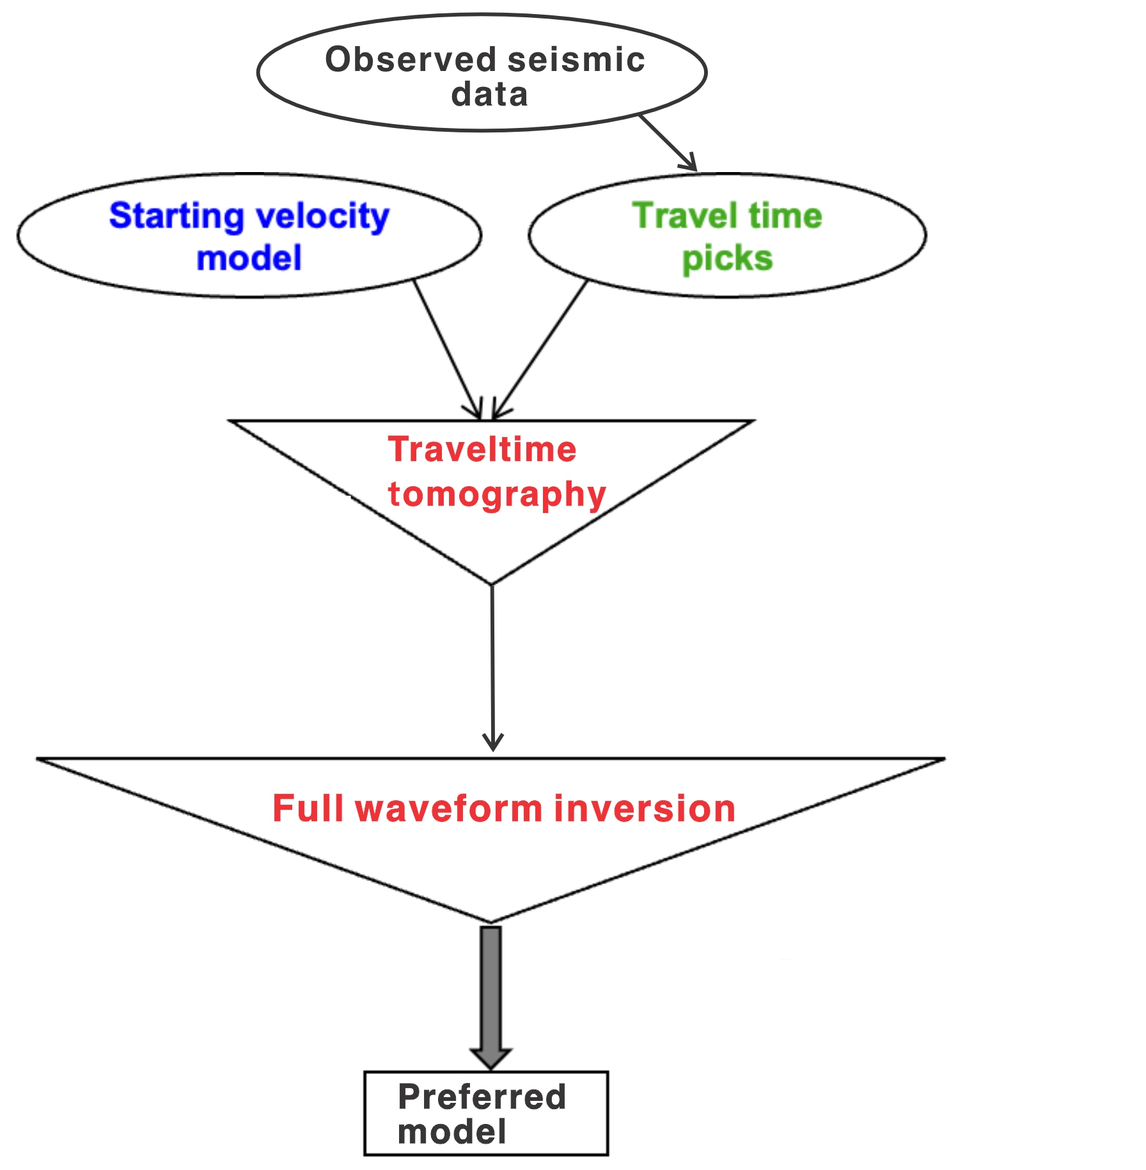
Method: Tomography and Full Waveform Inversion (FWI)
Long wavelength
Travel time misfit
(Van Avendonk et al., 2004)
Short wavelength
FWI misfit function
(Shipp & Singh, 2002)
Study Area and Data Scientific Objective Method Results Discussion and Conclusion
Notes:
decipher
TT Minimize the misfit of the first arrival time between the predicted and picked
To provide a background velocity for FWI
FWI: Minimize the misfit of the waveform between the synthetic data and observed data to get a high-resolution velocity model
OK, let’s see the results

Slide 9
Traveltime Tomography
Initial model
Final model
Velocity perturbation
Study Area and Data Scientific Objective Method Results Discussion and Conclusion
Notes:
We start from a homogeneous 1D model, after tomography we can see

Slide 10
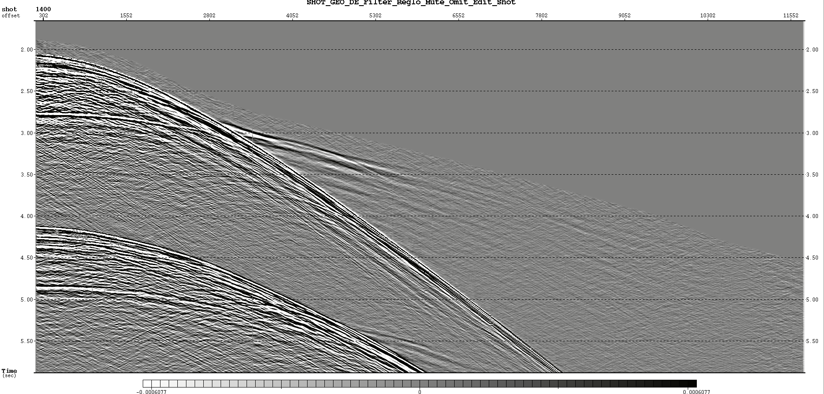
Full waveform inversion
Step 1: FWI of wide-angle data starting from the traveltime inversion result.
Step 2: FWI of near offset reflection data.
Step 3: Sequential inversion data between 3-6 Hz, 3-9 Hz, and 3-12 Hz
AML
Step 2
Step 1
Study Area and Data Scientific Objective Method Results Discussion and Conclusion

Slide 11
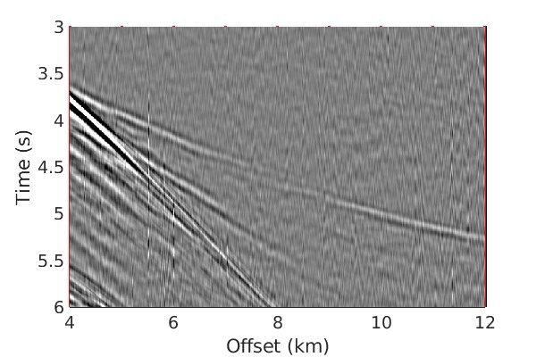
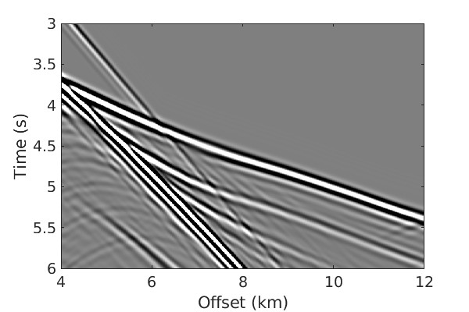
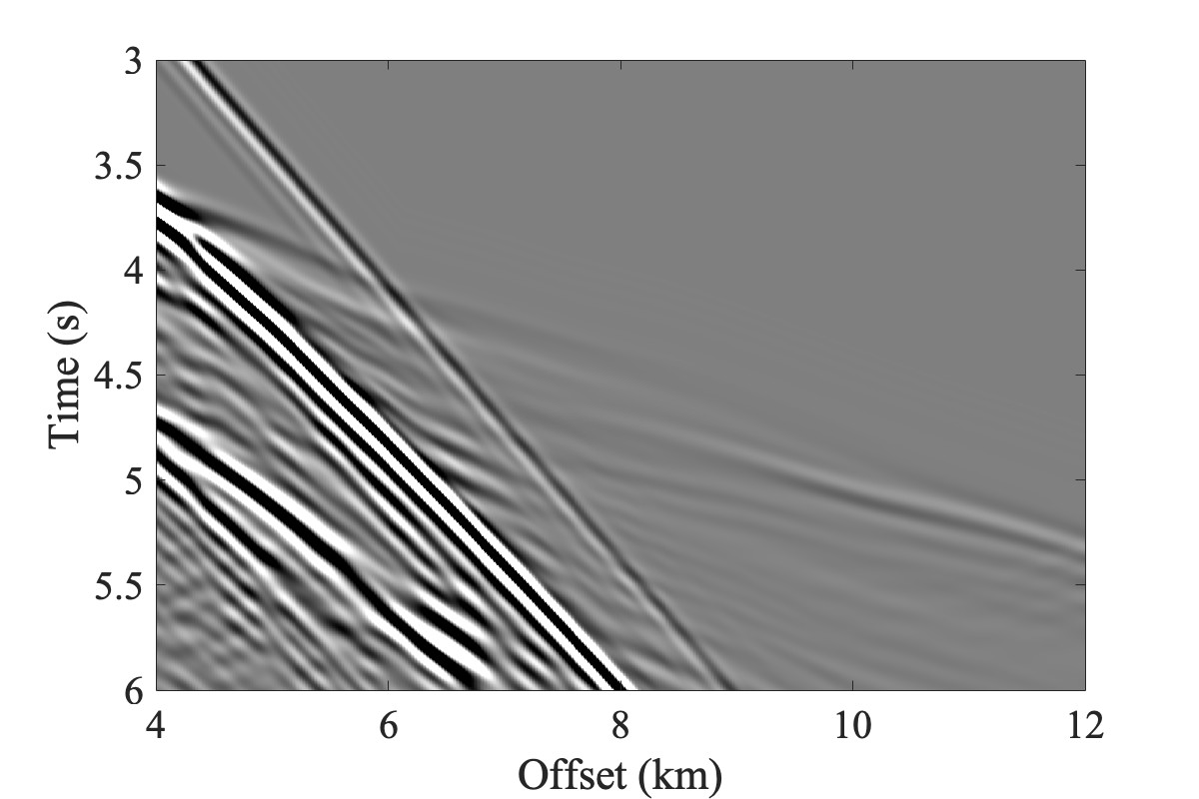
Step 1: FWI of wide-angle data
Observed data
Initial synthetic data
Final synthetic data
Amplitude varies with offset
Big residuals between the initial synthetic data and the observed data
Consistent with observed data
Study Area and Data Scientific Objective Method Results Discussion and Conclusion
Notes:
Let’s now look at
That means we got a reliable

Slide 12
Step 1: FWI of wide-angle data
Traveltime tomography model
FWI after step1
Velocity gradient
Study Area and Data Scientific Objective Method Results Discussion and Conclusion
Notes:
There is no sharp contrast in the final velocity model, but when we look at the velocity gradient, there is a high gradient velocity at 1.5 km below the seafloor. showing the deep blue, above that is low velocity below is high velocity.

Slide 13
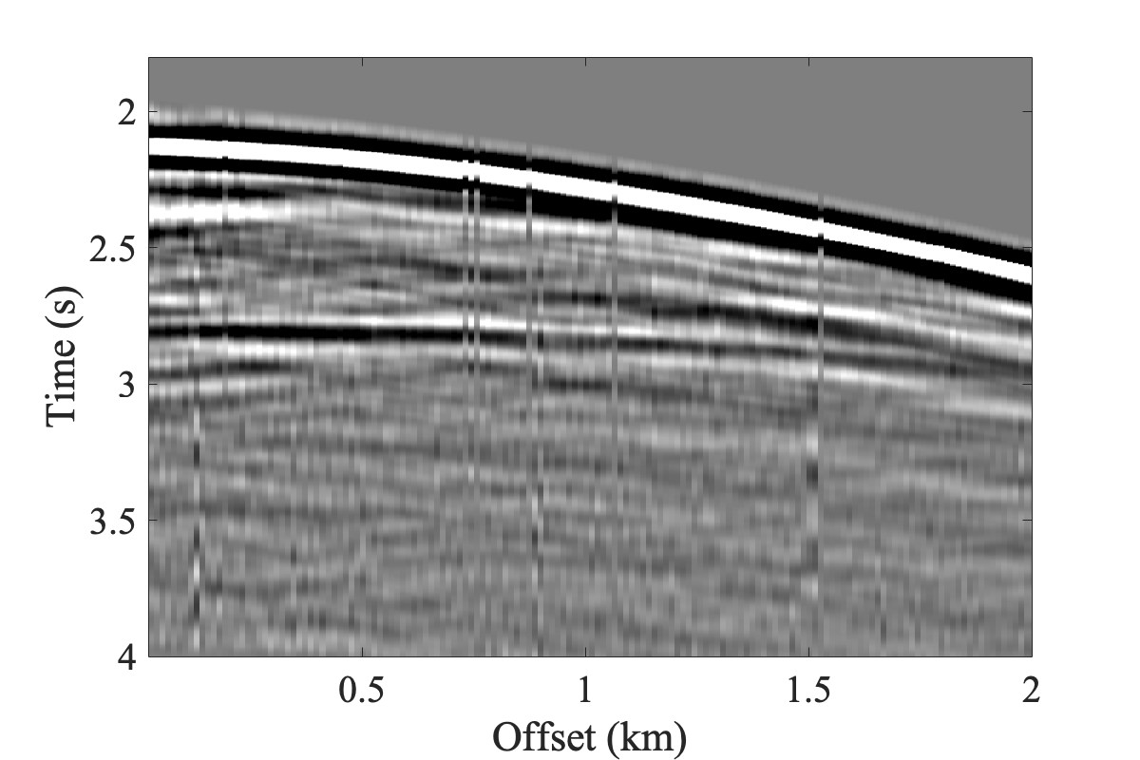
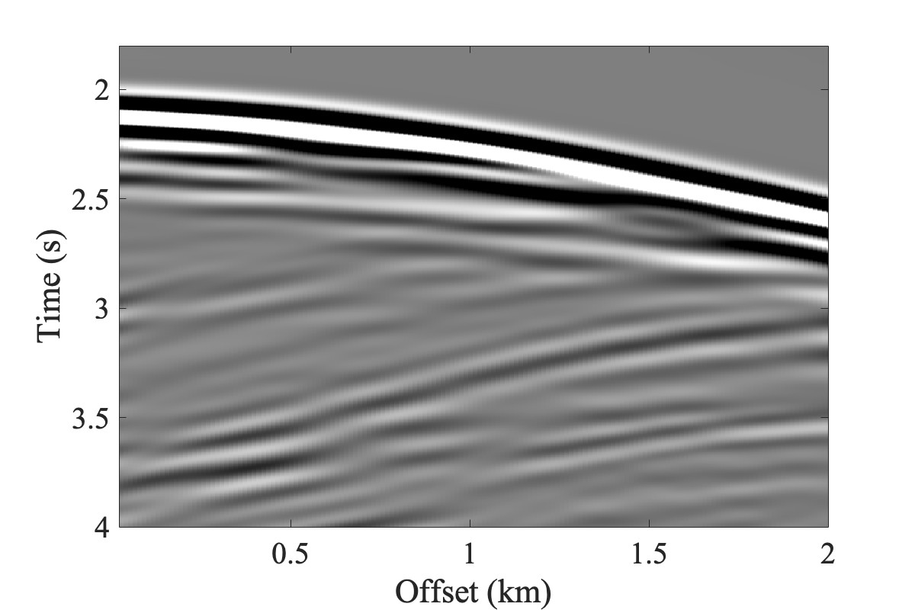
Step 2: FWI of near offset reflection data
Observed data
Initial synthetic data
AML signals
Initial waveform fitting
seafloor
AML signals
Study Area and Data Scientific Objective Method Results Discussion and Conclusion
Notes:
Next, we go on to do step 2 FWI， AML in data, but not in synthetic data

Slide 14
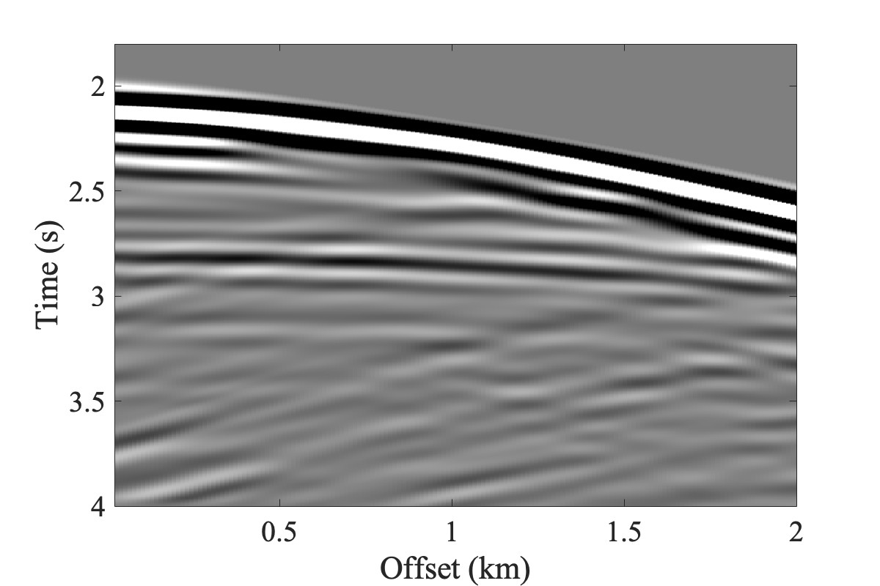
Step 2: FWI of near offset reflection data
Observed data
Initial synthetic data
Final synthetic data
AML signals
AML signals
Final waveform fitting
seafloor
AML signals
Study Area and Data Scientific Objective Method Results Discussion and Conclusion
Notes:
Appeared
Not only but also

Slide 15
Step 2: FWI of near offset reflection data
FWI step 1 result (equal to the starting of step 2)
FWI step 2 result
AML
The center 10 km of the volcano.
A low-velocity (3.2-4.5 km/s) thin layer (< 100 m) located at 3 km.
Stacked layers beneath the axial melt lens
Next: increase the offset of reflections
Study Area and Data Scientific Objective Method Results Discussion and Conclusion
Notes:
Let’s see how the velocity changed
We start from the FWI step 1 model and apply the shots which has the AML signals, thanks to we fitting…

Slide 16
Hydrated/dehydrated Lava Flow at the Layer 2A/2B Boundary
FWI velocity model
FWI velocity gradient
Layer 2A/2B boundary
Layer 2A/2B boundary
The Layer 2A event observed on the conventional image corresponds to the base of the high-velocity gradient layer obtained by FWI.
Study Area and Data Scientific Objective Method Results Discussion and Conclusion
Notes:
We can base on the results so far to discuss
Firstly, overlap
The base of this high-velocity gradient layer (Layer 2A) represents the boundary between hydrated lava flows above and dehydrated (altered/metamorphosed) lava flows below.

Slide 17
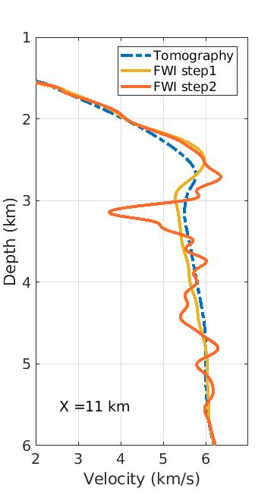
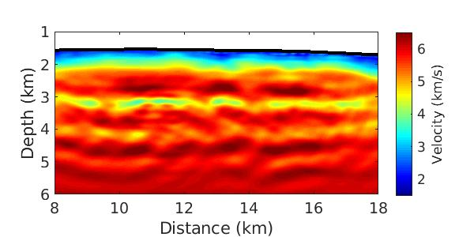
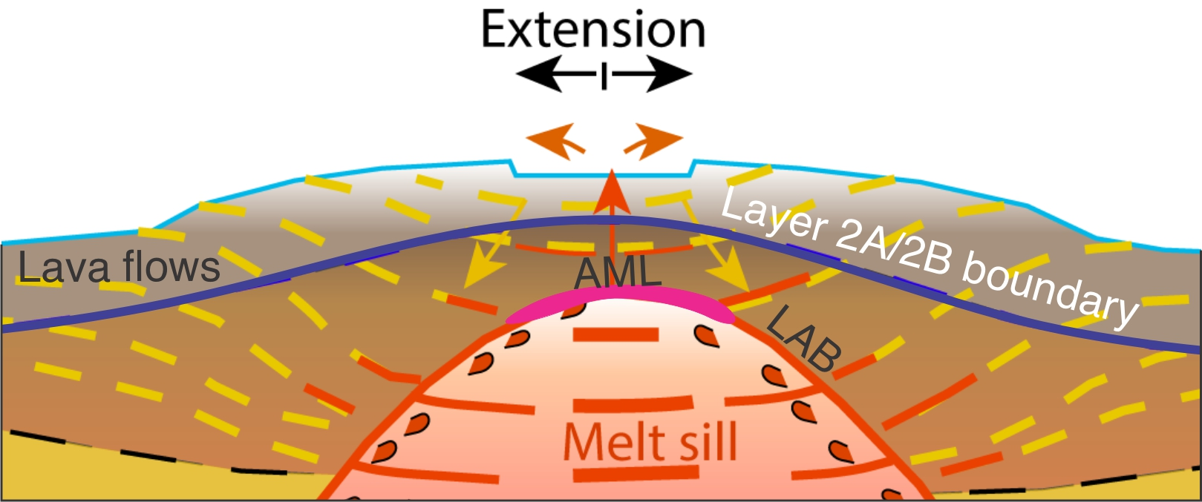
Nature of Magma Reservoir
1D velocity profile
AML
High velocity gradient layer
High velocity
layer
AML
Magma domain
Schematic model of the magmatic system below the Axial Seamount
Study Area and Data Scientific Objective Method Results Discussion and Conclusion
Notes:
If we analyze the 1D velocity profile, which is the white dashed line in the velocity model, at 2 km…
Very steep slope

Slide 18
Conclusion
Nature of the upper crust
Layering below the seafloor visible in the anomaly and gradient images is due to stacked lava flows.
The Layer 2A event observed on the conventional image corresponds to the base of the high-velocity gradient layer obtained by FWI.
The base of this high-velocity gradient layer (Layer 2A) represents the boundary between hydrated lava flows above and dehydrated (altered/metamorphosed) lava flows below.
Nature of the magma reservoir
The axial melt lens (AML) is a thin layer with low velocity at the top of the magma domain. Above the AML is a high-velocity layer.
Beneath the AML and inside the magma domain, there are stacked sills.
Study Area and Data Scientific Objective Method Results Discussion and Conclusion
Notes:
At the end to summarize this work

Slide 19
Thank You for Your Attention

