Slide 1
Study of the impact of sources of variability on soil mineralogical characterization using hyperspectral imaging
22 May 2025
Corentin Feray
Director: Stéphane Jacquemoud (IPGP/U. Paris Cité)
Co-director: Rodolphe Marion (CEA)
2 years funded by CEA and the Académie Spatiale d’Île de France

Slide 2
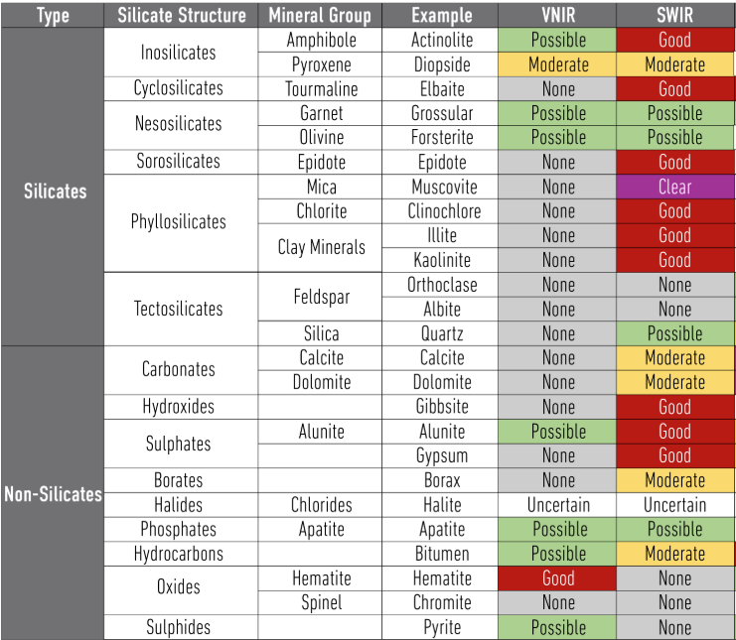
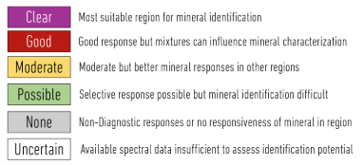
What am I looking for?
About 10 minerals of interest presenting absorptions features in the solar domains (VNIR/SWIR)
Source : Terracore
22/05/2025
Corentin Feray

Slide 3
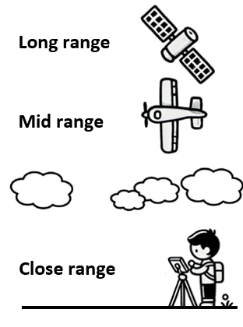
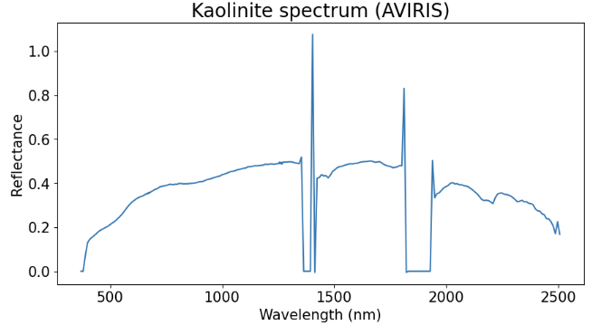
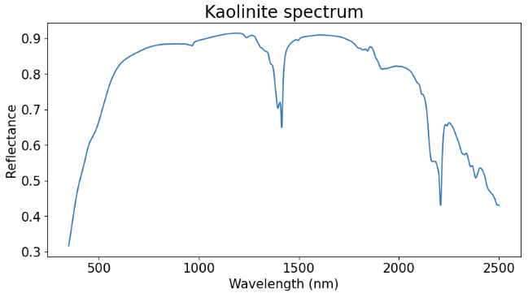
Spectroscopic data
Example of kaolinite
Absorption bands = Chemical effects
Continuum = Physical effects
22/05/2025
Corentin Feray

Slide 4
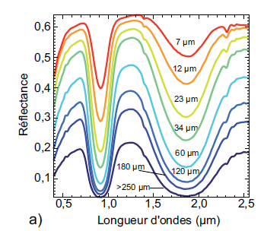
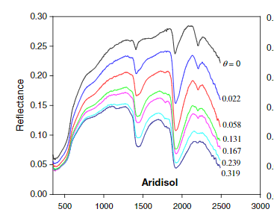
Factors affecting reflectance spectra
Acquisition chain: acquisition parameters, camera calibration …
Environmental conditions: lighting (direct/diffuse), acquisition geometry, atmosphere, shadows…
Physical properties: grain size and shape, porosity, compaction …
Chemical properties : mineralogical composition, water content, organic matter content, pollutant content …
Average grain size [1]
Water content [2]
Wavelength (µm)
Wavelength (nm)
[1] Verpoorter (2009)
[2] Sadeghi et al. (2015)
22/05/2025
Corentin Feray

Slide 5
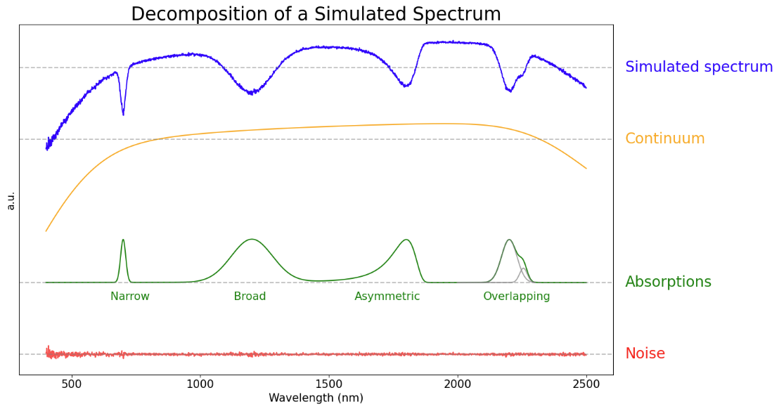
Spectral deconvolution
Objectives: reduce data dimensionality, the impact of noise, correlations between parameters, and improve parameter interpretability.
Logarithm of a reflectance spectrum:
22/05/2025

Slide 6
Spectral deconvolution
Continuum :
Chosen absorption model: EGO (Asymmetric Gaussian) [3]
4 parameters:
Amplitude s
Position μ
Width σ
Asymmetry k
~1000 wavelengths → A few dozen parameters
8 + 4N parameters
(8 for the continuum, 4N for the absorptions)
[3] Pompilio et al. (2009)
22/05/2025

Slide 7
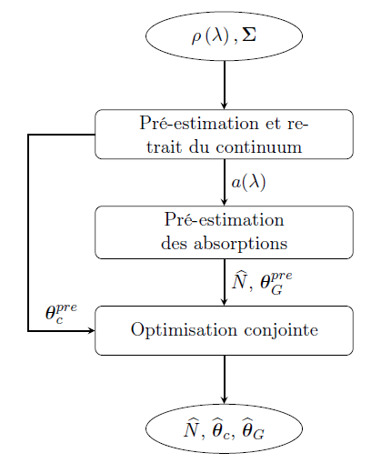
Deconvolution procedure
Based on the work from Ronan Rialland’s PhD thesis (2021) [4]
reflectance spectrum
associated noise covariance matrix
Continuum pre-estimation and removal
Absorption pre-estimation
pre-estimated absorption parameters
pre-estimated continuum parameters
Joint optimization
22/05/2025

Slide 8
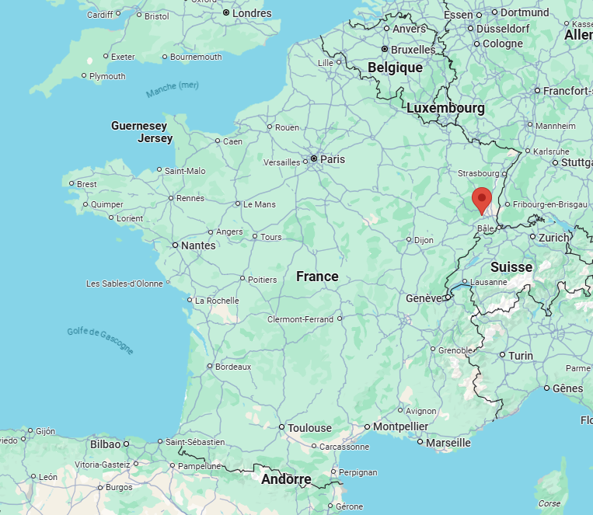
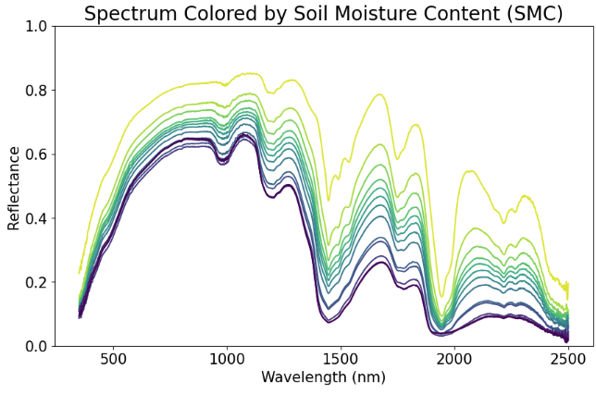
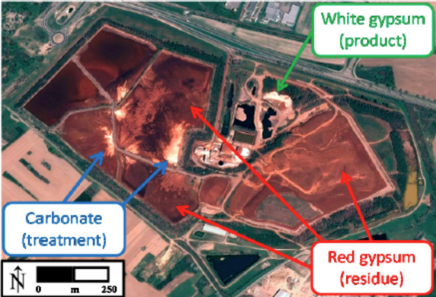
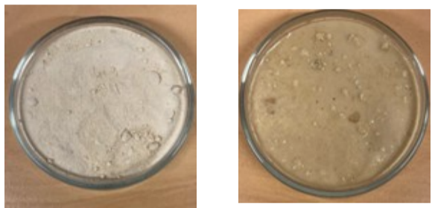
Dataset
Soils from Thann mainly composed of gypsum
Reflectance spectrum acquired using an ASD spectrometer
13 moisture content levels
[5] Uccellatori (2023)
Dry
Wet
22/05/2025

Slide 9
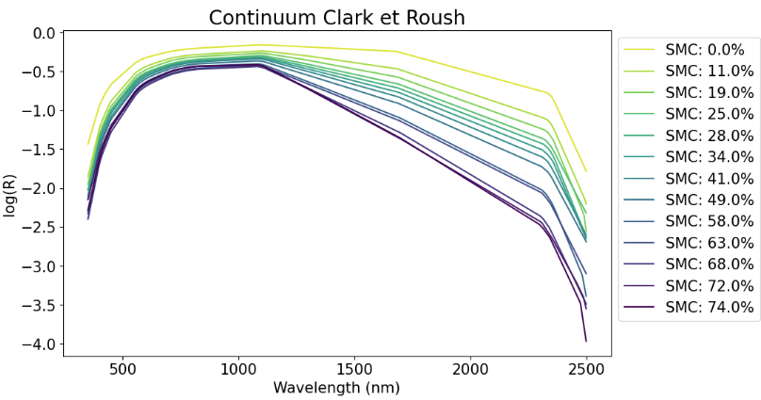
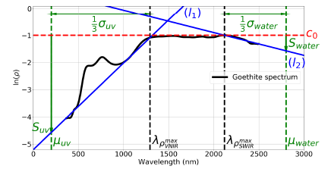
Continuum pre-estimation
Continuum extraction (mathematical)
Geometric initialization [4]
[4] Rialland (2021)
22/05/2025

Slide 10
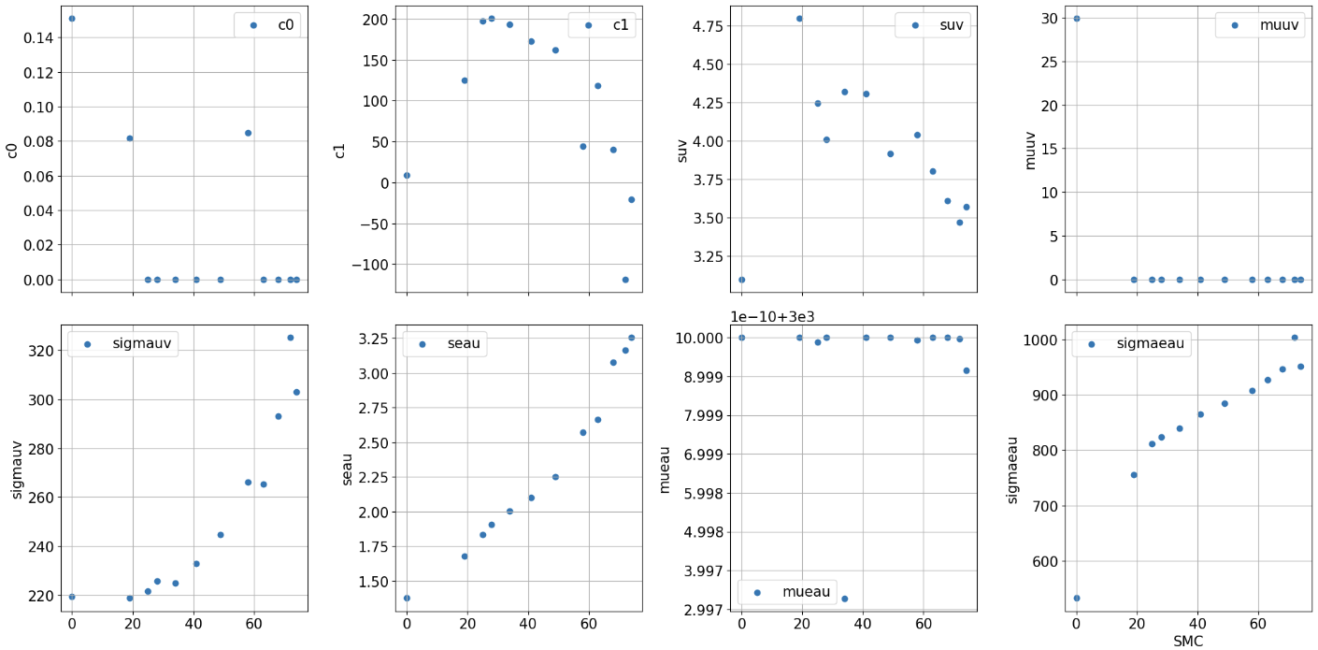
Continuum pre-estimation
22/05/2025

Slide 11
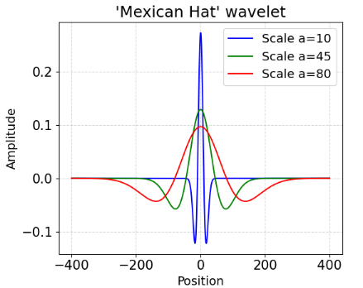
Wavelet transform
2D matrix of wavelet coefficients
Scaled and translated wavelet
Mother wavelet: Mexican Hat
f(t): signal; a: scale factor; b: translation; w(t): mother wavelet
Convolution of the wavelet and the signal
Wavelet coefficients
Intensity
Wavelength (nm)
Wavelength (nm)
22/05/2025

Slide 12
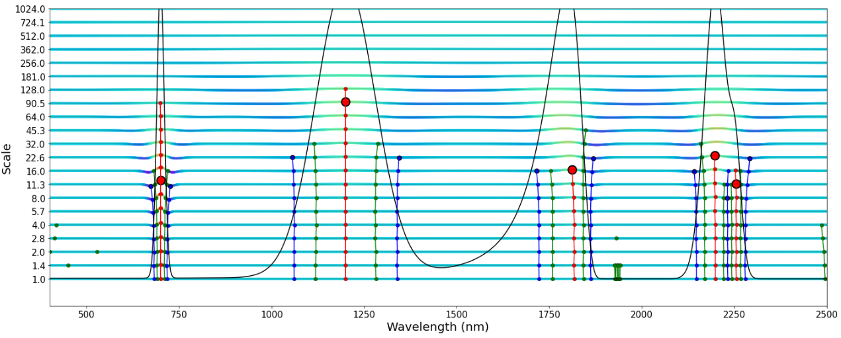
Ridge detection
Computation of ridge lines, trough lines and zero-crossing lines
Position: position of the ridge line at the smallest scales
Width: scale where the ridge line reaches its maximum value
Amplitude: maximum value of the ridge line
Asymmetry: angle between the ridge line and a vertical line
22/05/2025

Slide 13
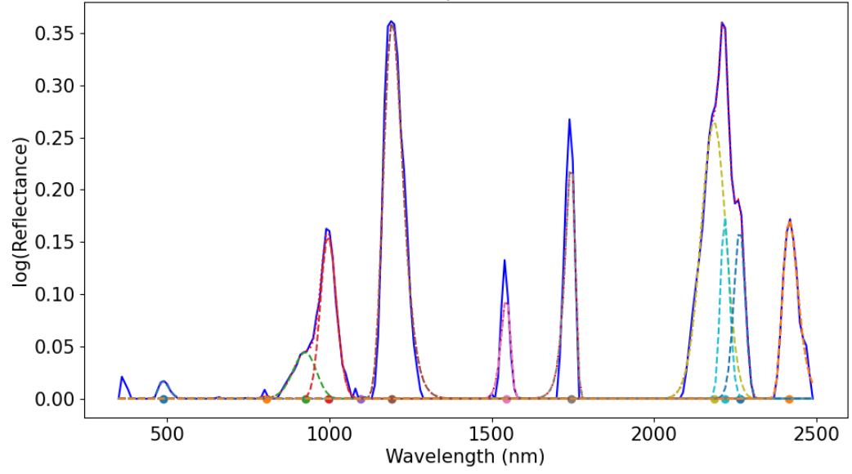
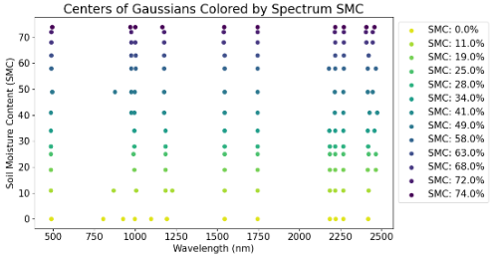
Absorption parameter analysis
Fit result on the spectrum corresponding to dry soil
Centers of the different Gaussians
22/05/2025

Slide 14
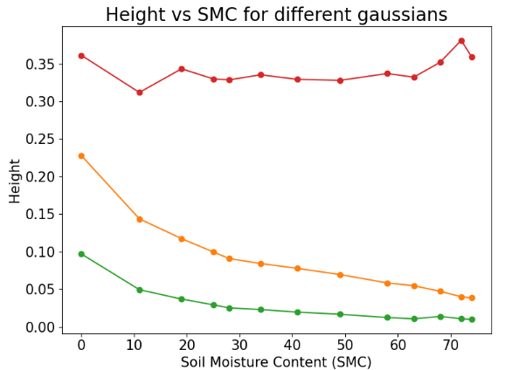
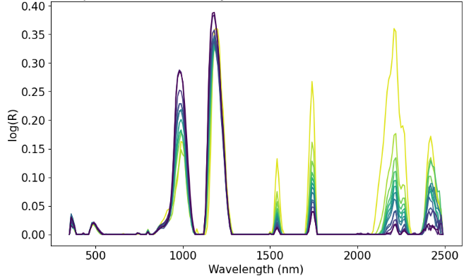
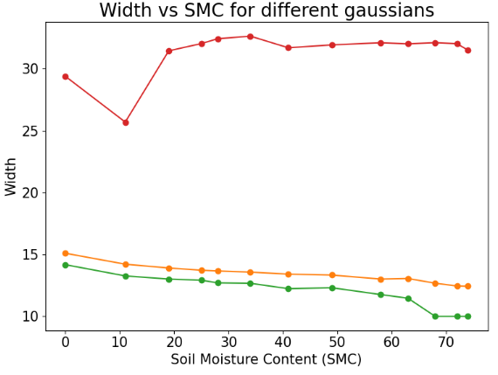
Absorption parameter analysis
Absorption spectra
22/05/2025

Slide 15
Conclusion and perspectives
Conclusion:
Algorithm applicable to different types of data
Noise taken into account
Good estimation of the number of Gaussians
Limitations: difficult initialization in case of overlapping
Perspectives:
Improve Gaussian initialization for overlapping cases
Integration with machine learning methods
Understand and quantify the impact of moisture content on model parameters (detection limits)
Develop robust models to these effects for mineral quantification
22/05/2025

Slide 16
Bibliography
[1] Verpoorter, C. (2009). Télédétection hyperspectrale et cartographie des faciès sédimentaires en zone intertidale: application à la Baie de Bourgneuf (Doctoral dissertation, Université de Nantes).
[2] Sadeghi, M., Jones, S. B., & Philpot, W. D. (2015). A linear physically-based model for remote sensing of soil moisture using short wave infrared bands. Remote Sensing of Environment, 164, 66-76.
[3] Pompilio, L., Pedrazzi, G., Cloutis, E. A., Craig, M. A., & Roush, T. L. (2010). Exponential Gaussian approach for spectral modelling: The EGO algorithm II. Band asymmetry. Icarus, 208(2), 811-823.
[4] Rialland, R. (2021). Télédétection hyperspectrale pour l’identification et la caractérisation de minéraux industriels (Doctoral dissertation, Université Paris-Saclay).
[5] Erica, U. (2023) Impact of surface humidity on the spectral signature of industrial and mining minerals and implications for their detection by hyperspectral imaging (Master's thesis, University of Pavia)
22/05/2025

