Slide 1
Synthetic earthquakes in a 3D numerical sandbox
Photo credit: Jiannan Meng
Adélaïde Allemand¹, Yann Klinger², Luc Scholtès³
¹Institut de Physique du Globe de Paris - Université Paris Cité
²Institut de Physique du Globe de Paris - CNRS
³Laboratoire Magmas et Volcans - Université Clermont Auvergne

Slide 2
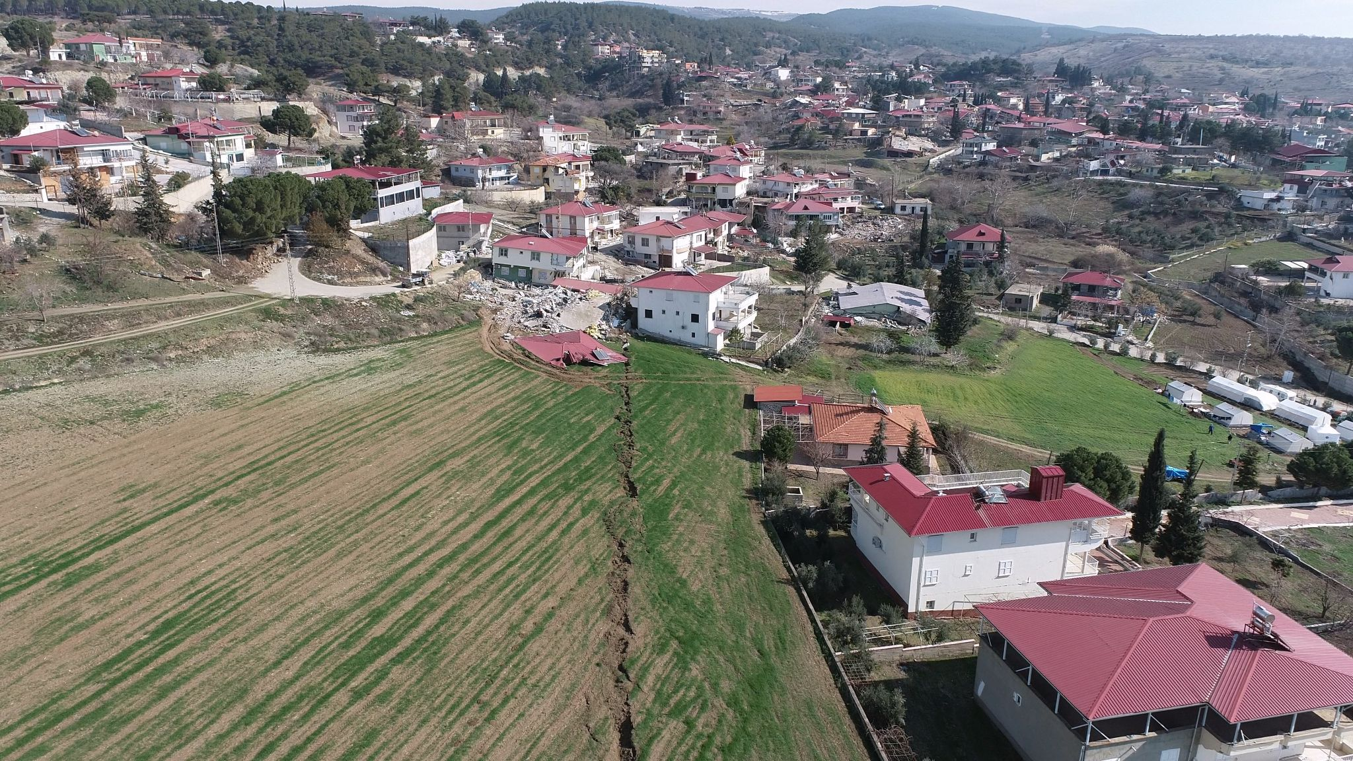
Introduction
Surface rupture after the 2023 Kahramanmaraş earthquakes (Turkey)
Photo credit: Jiannan Meng

Slide 3
Introduction
Surface rupture after the 2023 Kahramanmaraş earthquakes (Turkey)
Photo credit: Jiannan Meng

Slide 4
Introduction
Surface rupture after the 2023 Kahramanmaraş earthquakes (Turkey)
Context: continental strike-slip faults
Photo credit: Jiannan Meng

Slide 5
Objective
Introduction
Model a continental strike-slip fault and the mutual interaction between fault geometry and earthquake rupturing

Slide 6
This approach
Introduction
Development of a mature fault zone

Slide 7
This approach
Introduction
Development of a mature fault zone
Earthquake cycles

Slide 8
This approach
Introduction
Development of a mature fault zone
Earthquake cycles
Seismic cycles on an evolving strike-slip fault

Slide 9
This approach: Discrete Element Modelling (DEM)
Introduction
Development of a mature fault zone
Earthquake cycles
Seismic cycles on an evolving strike-slip fault

Slide 10
Principles of the DEM
Method
Nature

Slide 11
Principles of the DEM
Method
Nature
Strike-slip fault

Slide 12
Principles of the DEM
Method
Nature
Sub-volume
Strike-slip fault

Slide 13
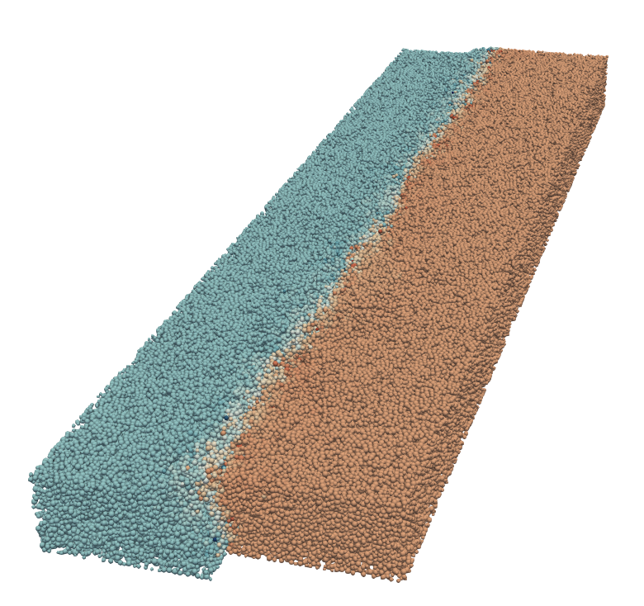
Principles of the DEM
Method
Packing of
spherical particles
Nature
Sub-volume
Strike-slip fault

Slide 14
Principles of the DEM
Method
Contact law between particles
k_{n}
F_{n}
x_{n}
k_{s}
F_{s}
x_{s}

Slide 15
Principles of the DEM
Method
Iteration loop
Contact law between particles
Contact law
k_{n}
F_{n}
Positions
Forces
x_{n}
k_{s}
F_{s}
Newton’s law
Integration scheme
x_{s}

Slide 16
Model setup
Method
Boundary conditions
Dimensions
Radius distribution
R
Y
v
Z
X

Slide 17
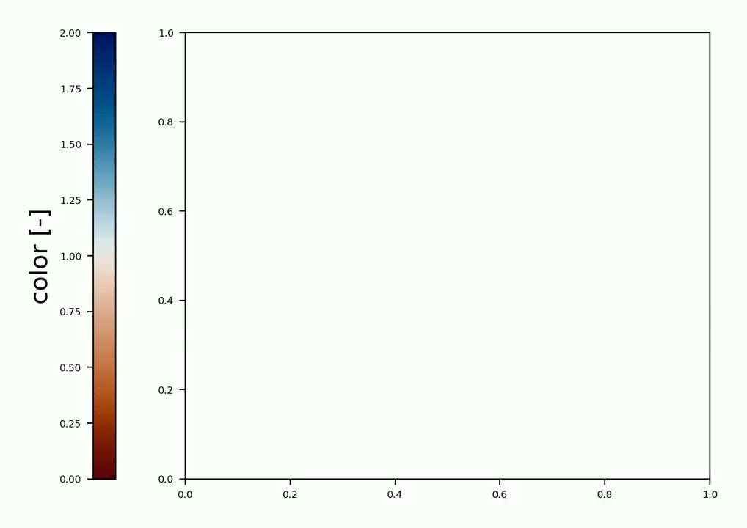
Model setup
Method
👁
Boundary conditions
Dimensions
Radius distribution
R
Y
v
Z
X

Slide 18
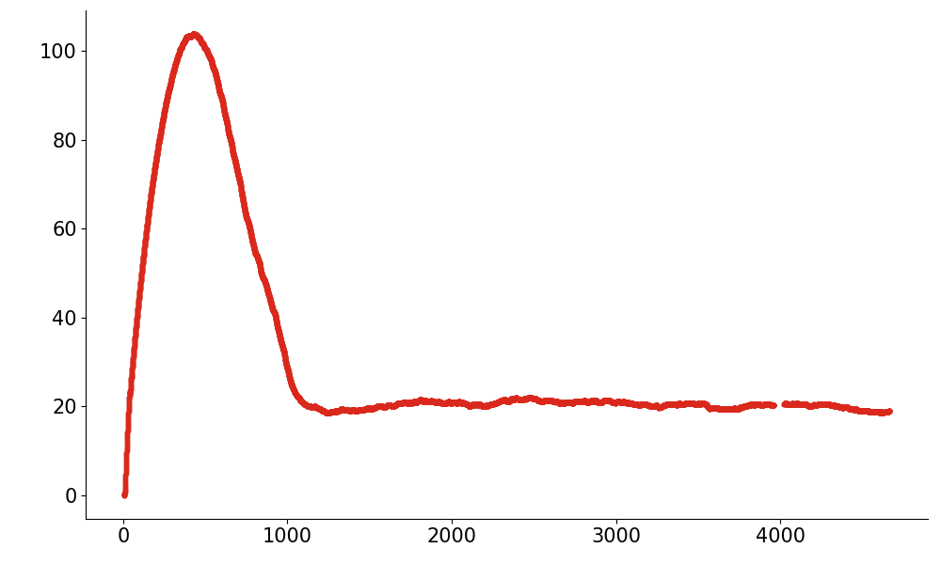
Long term fault evolution
Results
Shear stress (MPa)
Fault cumulated displacement (m) (⇔ Elapsed time)

Slide 19
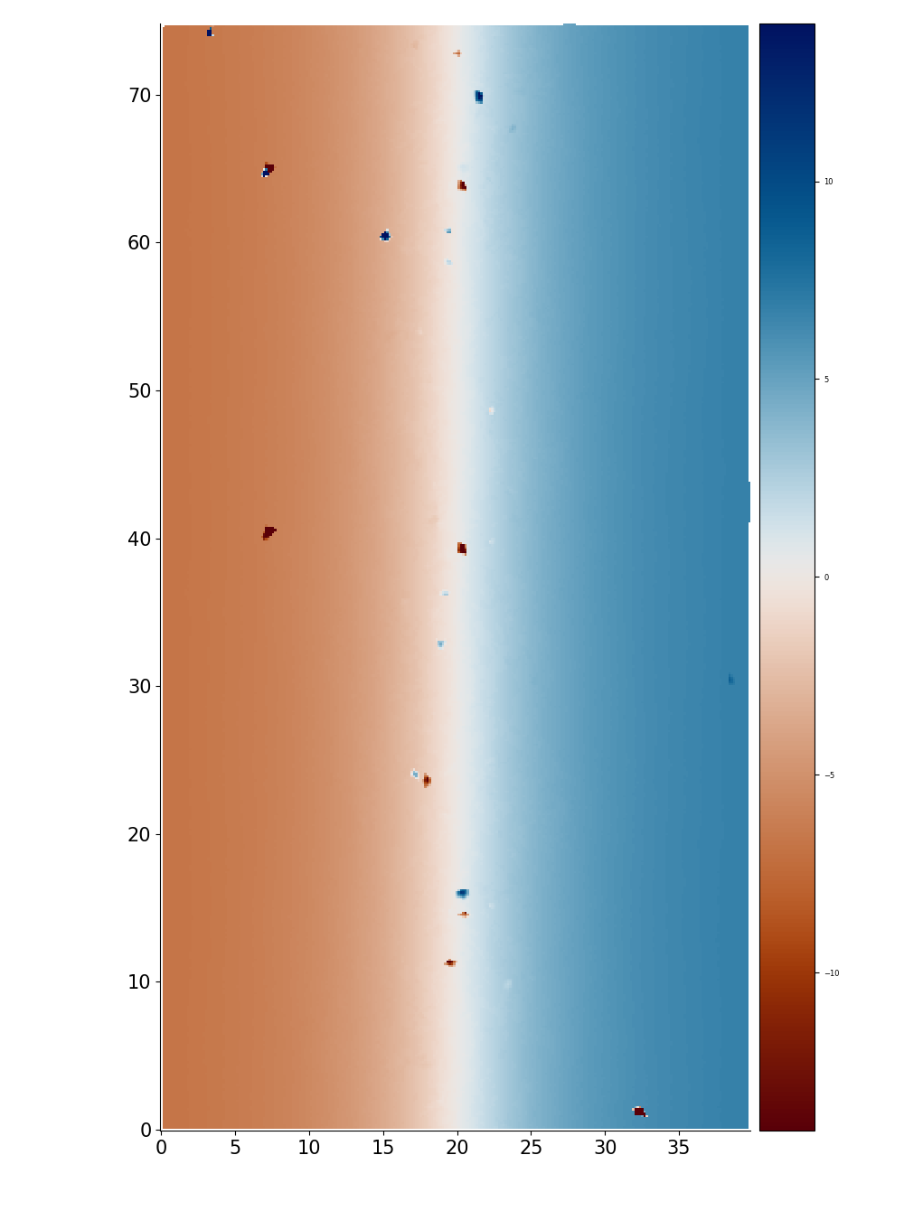
Long term fault evolution
Results
Shear stress (MPa)
14 m
75 km
Distance along the fault (km)
Displacement parallel to the fault (m)
0 km
40 km
-14 m
Fault cumulated displacement (m) (⇔ Elapsed time)
Distance across the fault (km)

Slide 20
Long term fault evolution
Results
Shear stress (MPa)
Basal fault
14 m
75 km
Distance along the fault (km)
Displacement parallel to the fault (m)
0 km
40 km
-14 m
Fault cumulated displacement (m) (⇔ Elapsed time)
Distance across the fault (km)

Slide 21
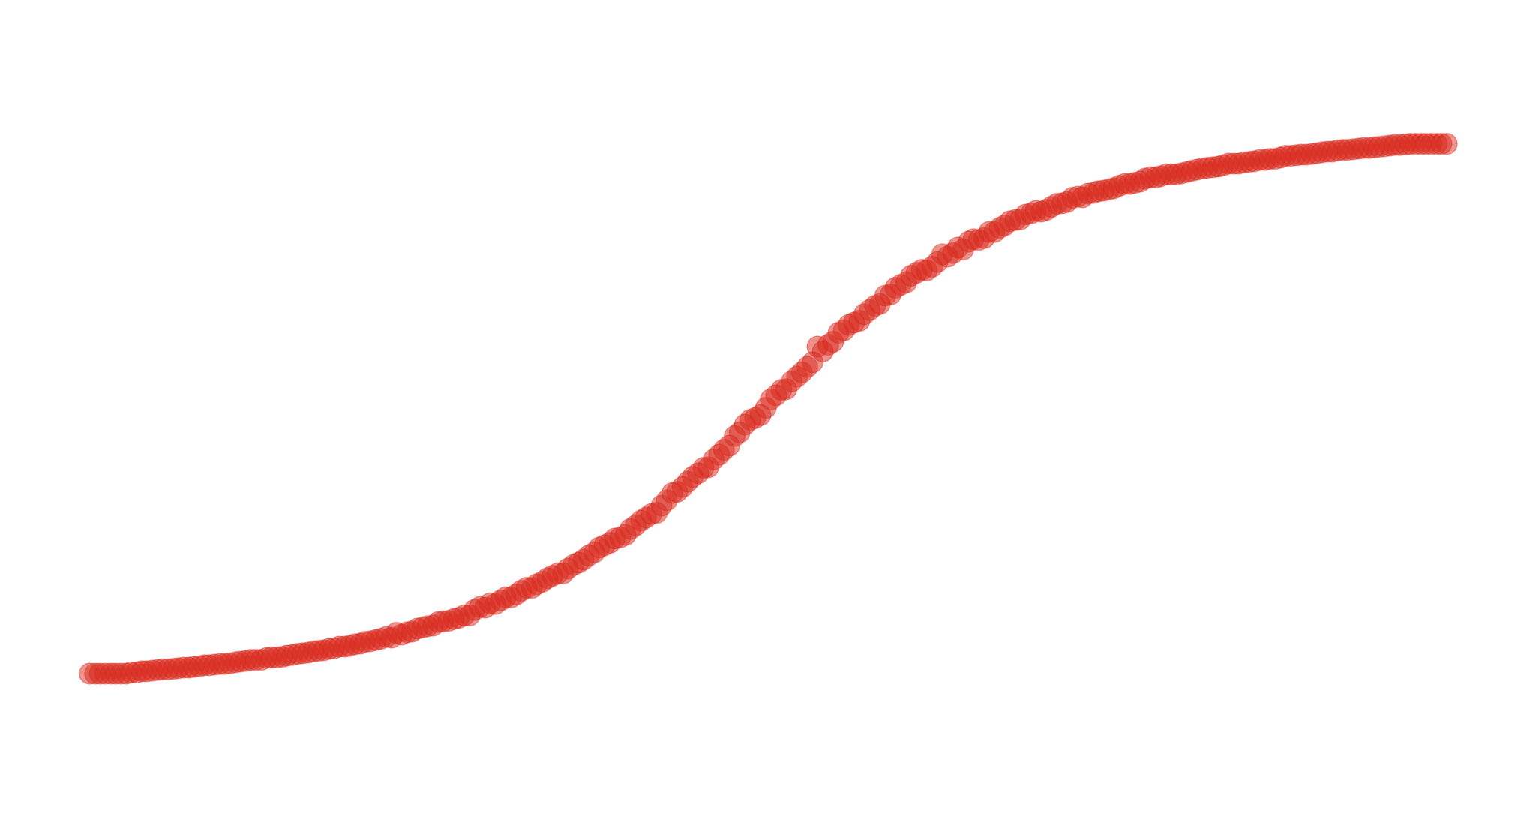
Long term fault evolution
Results
Displacement parallel
to the fault (m)
Shear stress (MPa)
14 m
75 km
Distance along the fault (km)
Displacement parallel to the fault (m)
0 km
40 km
-14 m
Fault cumulated displacement (m) (⇔ Elapsed time)
Distance across the fault (km)

Slide 22
Long term fault evolution
Results
Displacement parallel
to the fault (m)
Shear stress (MPa)
14 m
75 km
Distance along the fault (km)
Displacement parallel to the fault (m)
Diffuse deformation
0 km
40 km
-14 m
Fault cumulated displacement (m) (⇔ Elapsed time)
Distance across the fault (km)

Slide 23
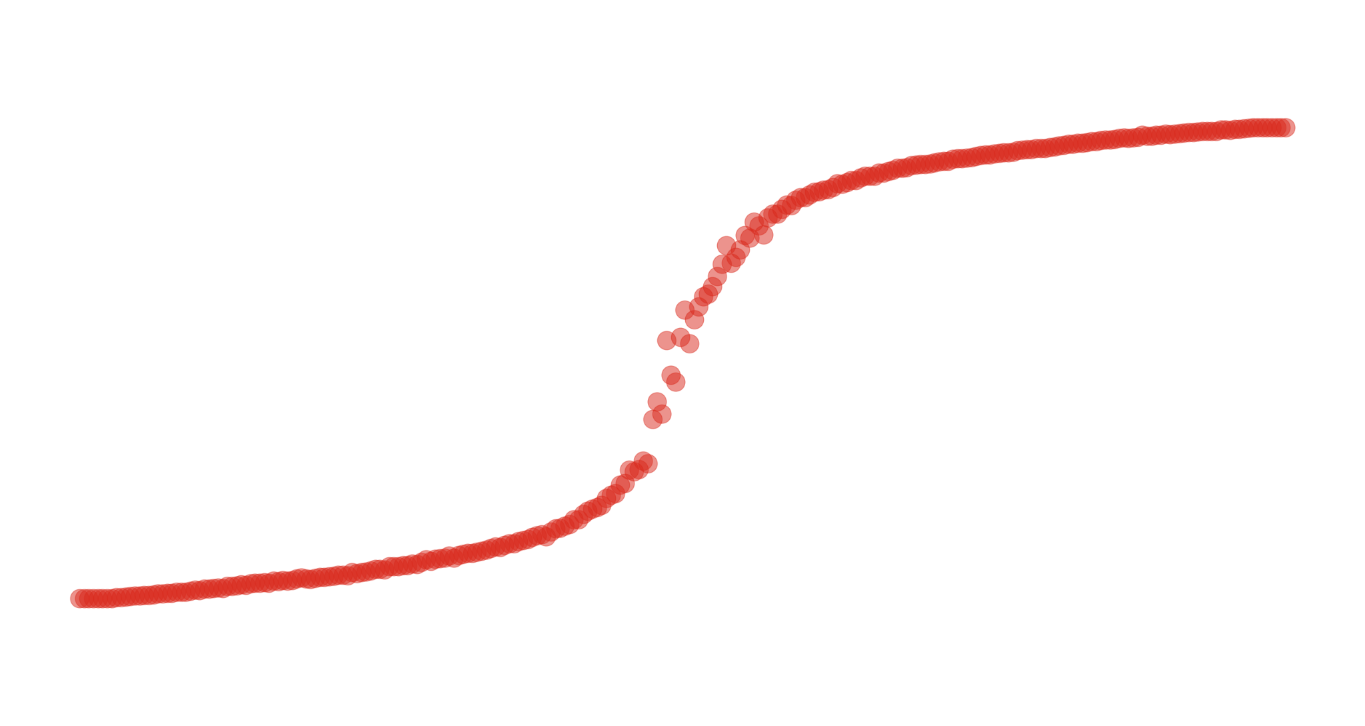
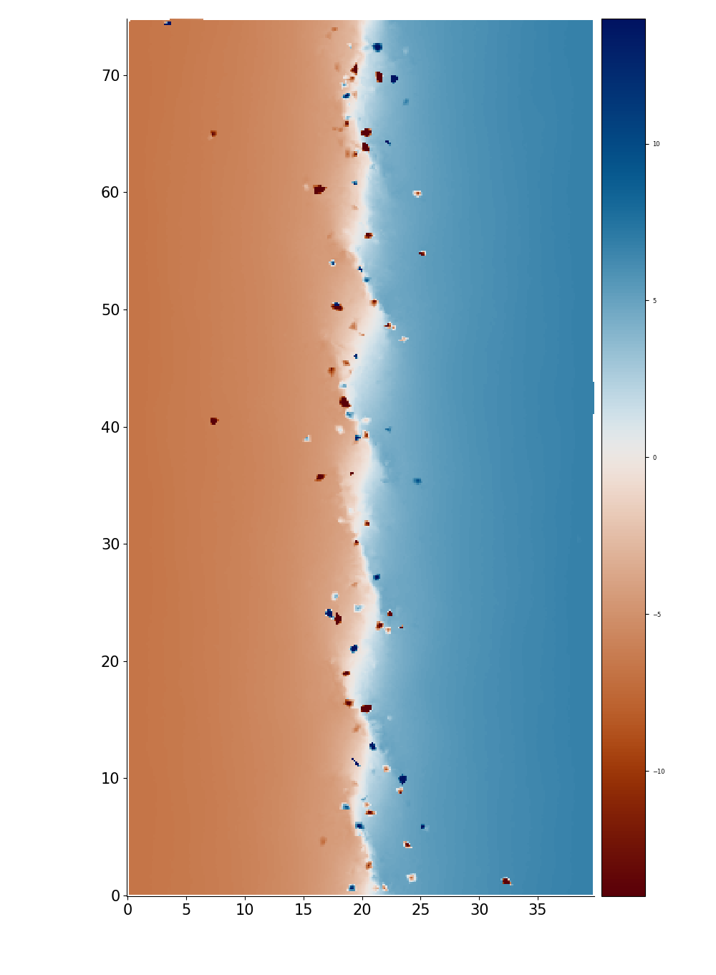
Long term fault evolution
Results
Displacement parallel
to the fault (m)
Shear stress (MPa)
14 m
75 km
Distance along the fault (km)
Displacement parallel to the fault (m)
0 km
40 km
-14 m
Fault cumulated displacement (m) (⇔ Elapsed time)
Distance across the fault (km)

Slide 24
Long term fault evolution
Results
Displacement parallel
to the fault (m)
Shear stress (MPa)
14 m
75 km
Distance along the fault (km)
Displacement parallel to the fault (m)
Riedel shears
0 km
40 km
-14 m
Fault cumulated displacement (m) (⇔ Elapsed time)
Distance across the fault (km)

Slide 25
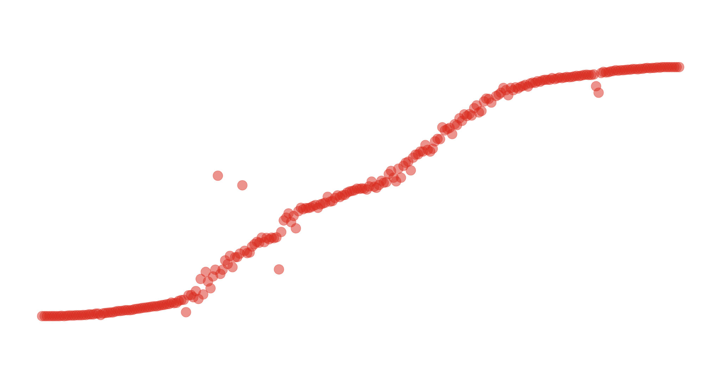
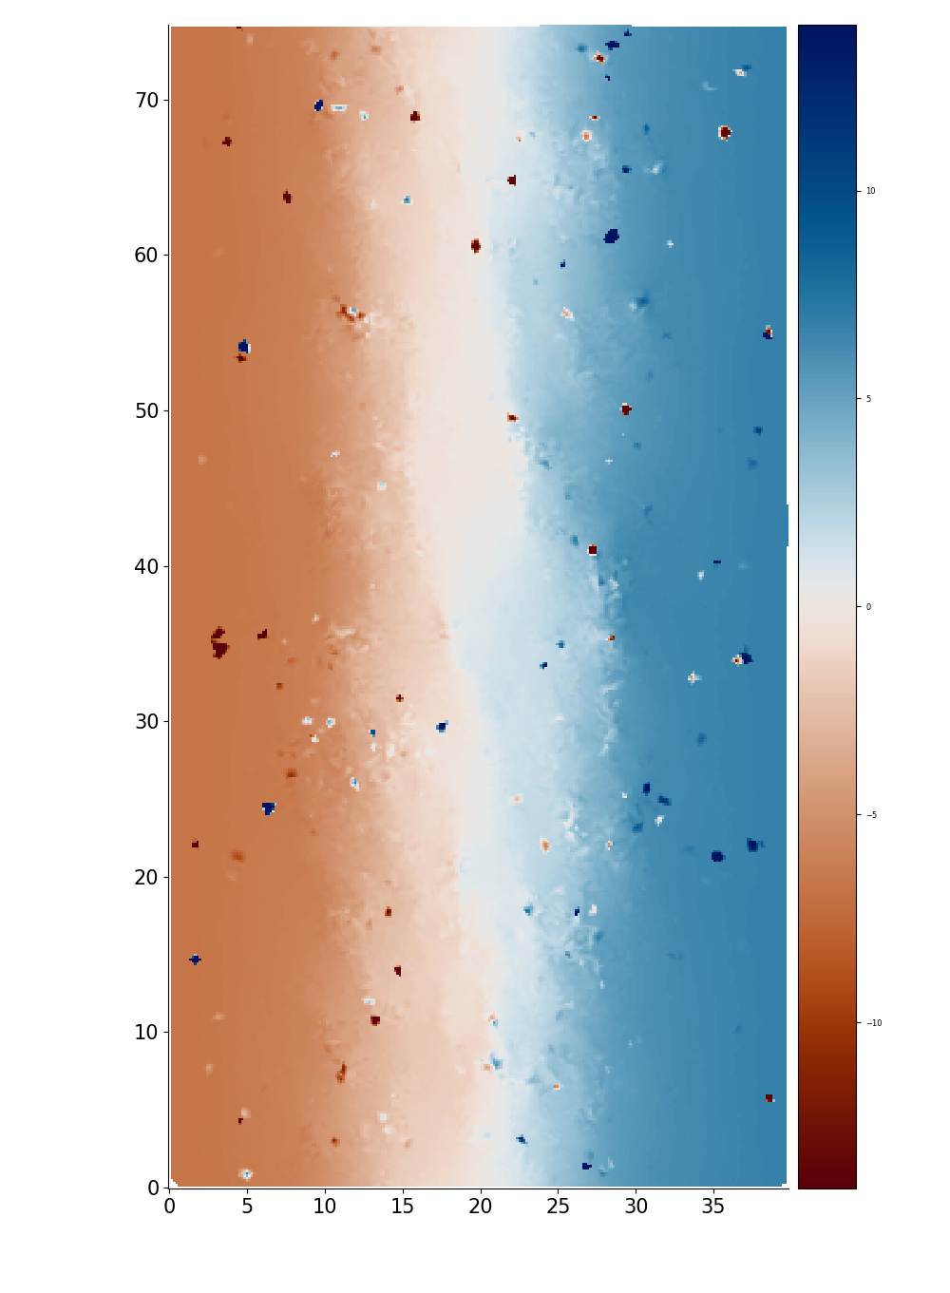
Long term fault evolution
Results
Displacement parallel
to the fault (m)
Shear stress (MPa)
14 m
75 km
Distance along the fault (km)
Displacement parallel to the fault (m)
0 km
40 km
-14 m
Fault cumulated displacement (m) (⇔ Elapsed time)
Distance across the fault (km)

Slide 26
Long term fault evolution
Results
Displacement parallel
to the fault (m)
Shear stress (MPa)
14 m
75 km
Interaction between Riedel shears
Distance along the fault (km)
Displacement parallel to the fault (m)
0 km
40 km
-14 m
Fault cumulated displacement (m) (⇔ Elapsed time)
Distance across the fault (km)

Slide 27
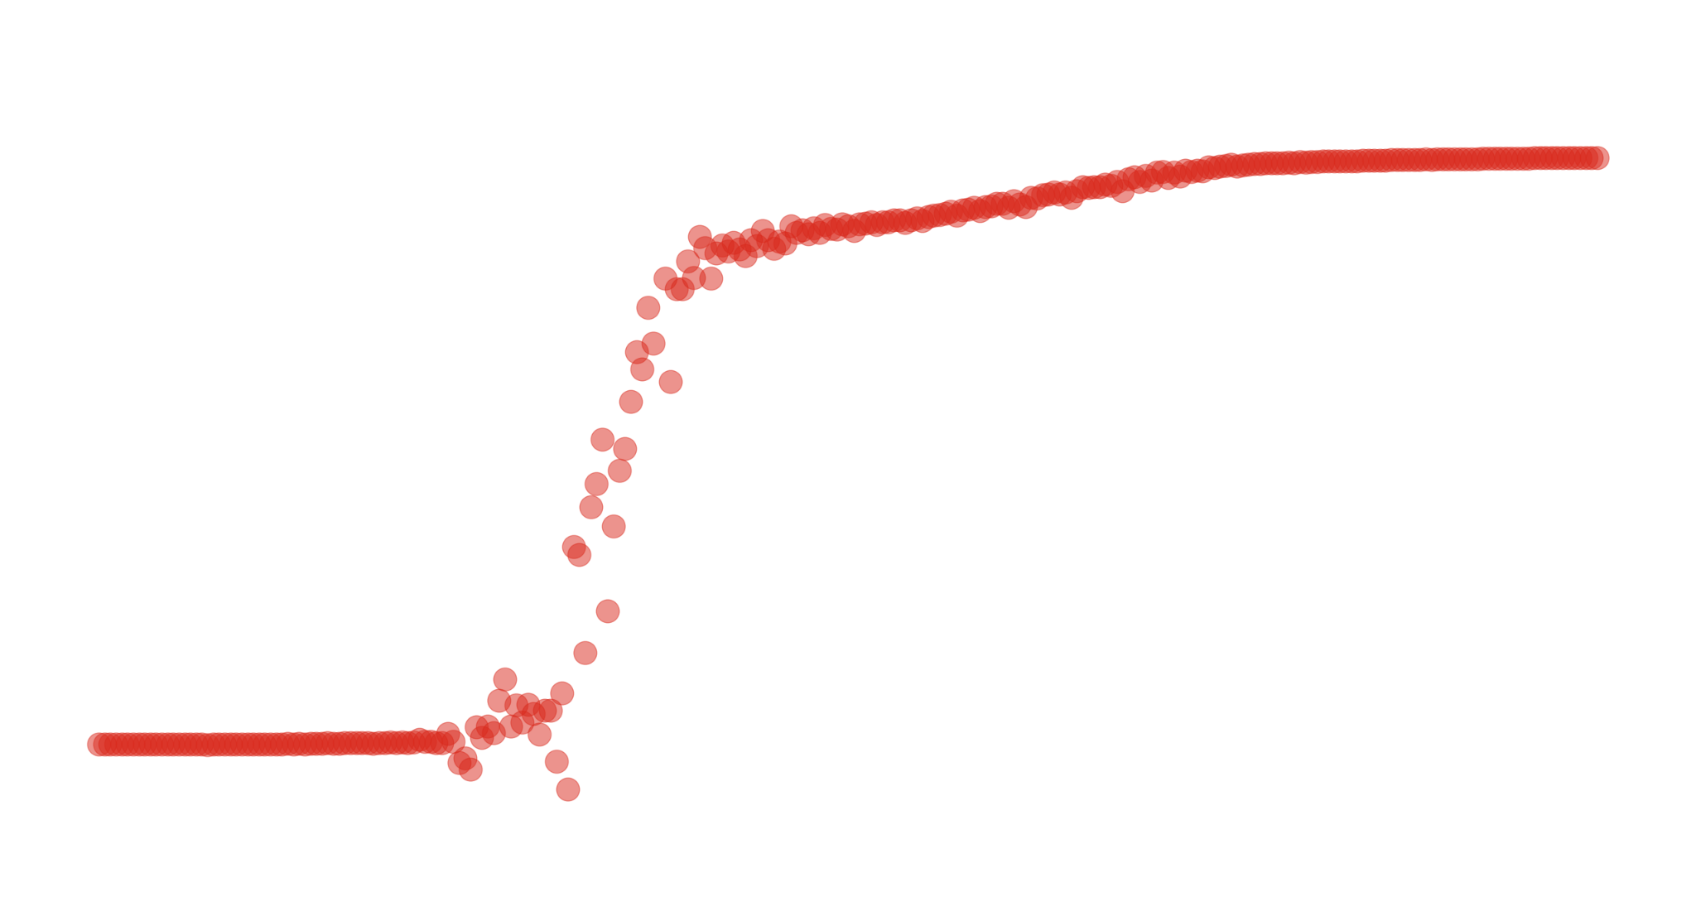
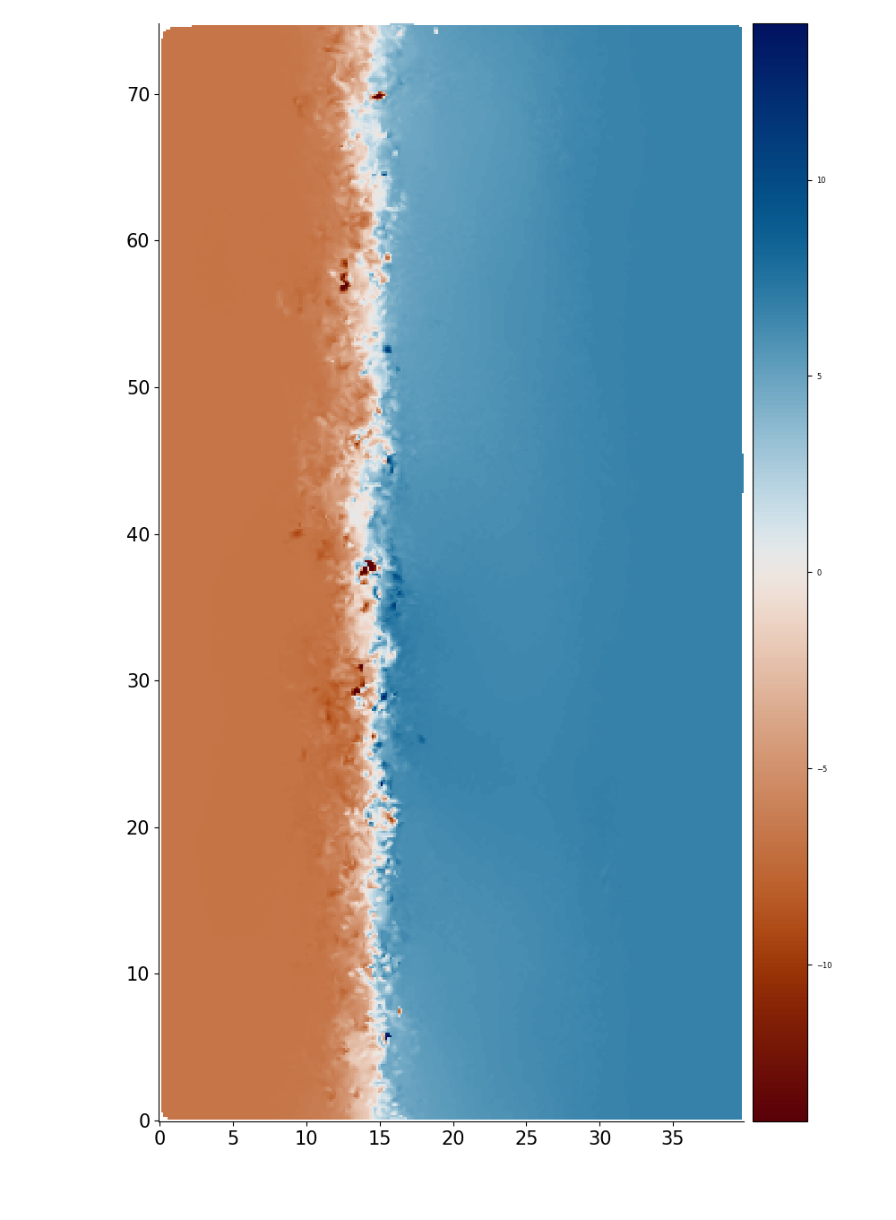
Long term fault evolution
Results
Displacement parallel
to the fault (m)
Shear stress (MPa)
14 m
75 km
Distance along the fault (km)
Displacement parallel to the fault (m)
0 km
40 km
-14 m
Fault cumulated displacement (m) (⇔ Elapsed time)
Distance across the fault (km)

Slide 28
Long term fault evolution
Results
Displacement parallel
to the fault (m)
Shear stress (MPa)
14 m
75 km
Mature strike-slip fault
Distance along the fault (km)
Displacement parallel to the fault (m)
0 km
40 km
-14 m
Fault cumulated displacement (m) (⇔ Elapsed time)
Distance across the fault (km)

Slide 29
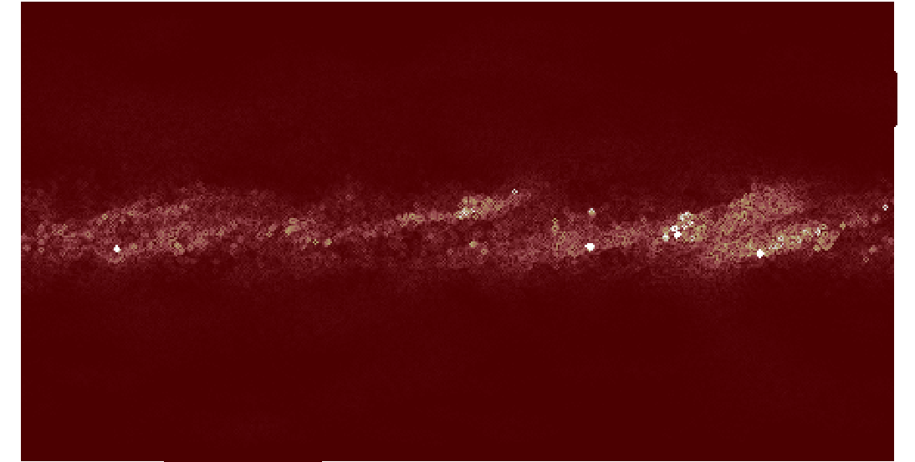
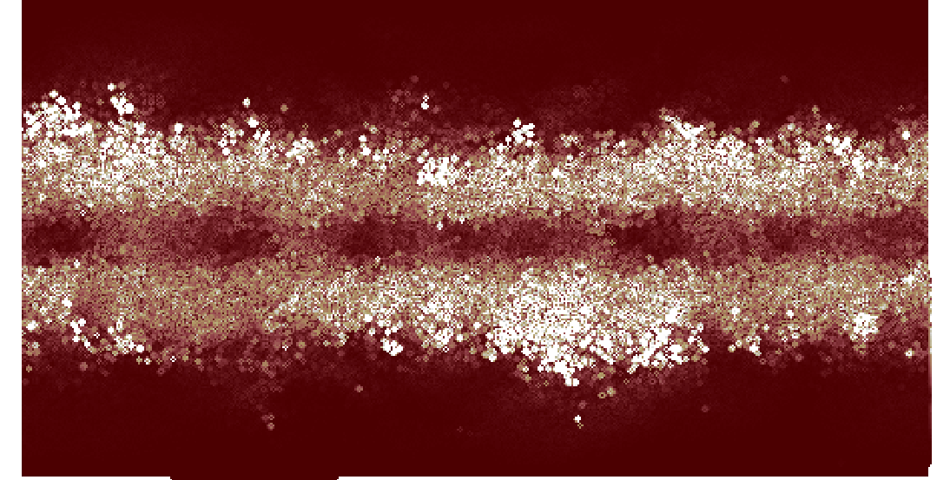
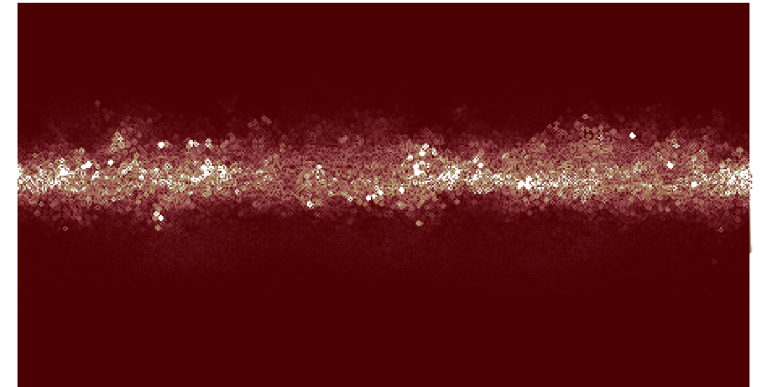
Long term fault evolution
Results
Gradient of displacement in the direction perpendicular to the fault
Comparison with
analogue experiments
Low gradient
High gradient

Slide 30
Long term fault evolution
Results
Gradient of displacement in the direction perpendicular to the fault
Comparison with
analogue experiments
Riedel shears
Low gradient
High gradient
Linear fault

Slide 31
Long term fault evolution
Results
Gradient of displacement in the direction perpendicular to the fault
Comparison with
analogue experiments
Diffuse deformation
Riedel shears
Localised deformation
Low gradient
Wide deformation zone
High gradient
Linear fault
Localised deformation

Slide 32
Long term fault evolution
Results
Gradient of displacement in the direction perpendicular to the fault
Visage et al. (2016)
Comparison with
analogue experiments
Diffuse deformation stage
Diffuse deformation
Riedel stage
Riedel shears
Localised deformation
Low gradient
Interaction stage
Wide deformation zone
High gradient
Mature fault stage
Linear fault
Localised deformation

Slide 33
Long term fault evolution
Results
Gradient of displacement in the direction perpendicular to the fault
Visage et al. (2016)
Comparison with
analogue experiments
Diffuse deformation stage
Diffuse deformation
Riedel stage
Riedel shears
Localised deformation
Low gradient
Interaction stage
Wide deformation zone
High gradient
Mature fault stage
Linear fault
Localised deformation

Slide 34
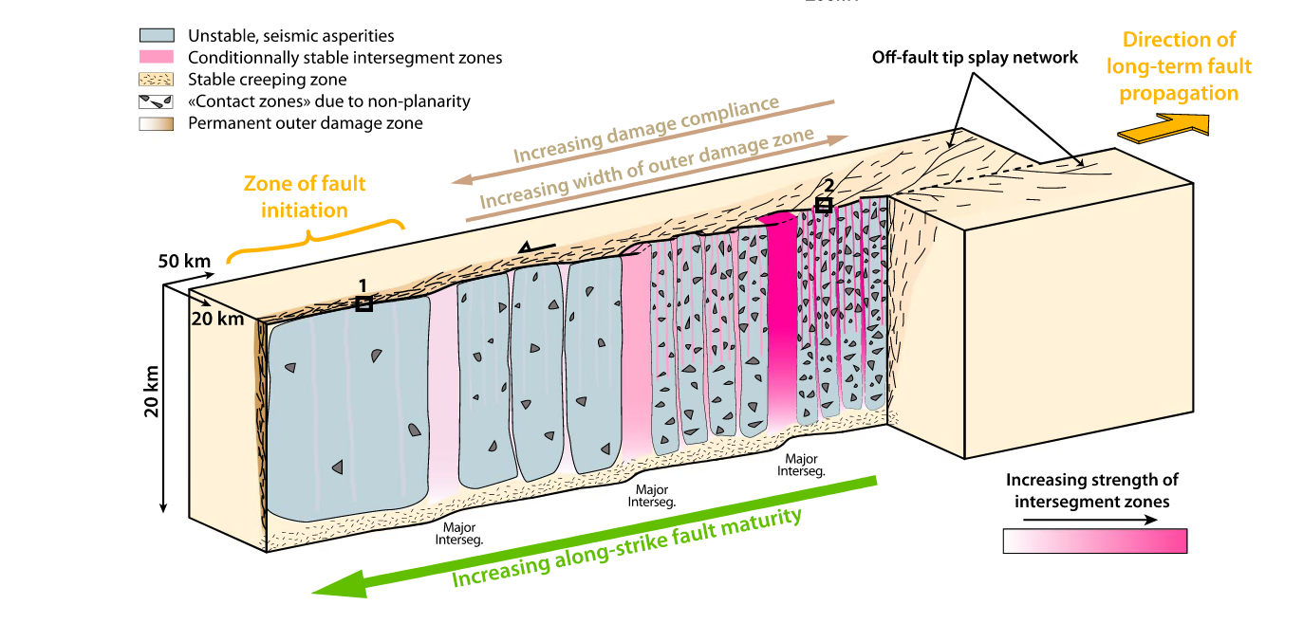
Long term fault evolution
Results
Perrin et al. (2016)

Slide 35
Long term fault evolution
Results
Simulation time
Perrin et al. (2016)

Slide 36
Seismic cycling
Results
Shear stress (MPa)
Fault cumulated displacement (m) (⇔ Elapsed time)

Slide 37
Seismic cycling
Results
Shear stress (MPa)
Fault cumulated displacement (m) (⇔ Elapsed time)

Slide 38
Seismic cycling
Results
Shear stress (MPa)
Fault cumulated displacement (m) (⇔ Elapsed time)

Slide 39
Seismic cycling
Results
Shear stress (MPa)
Distance along the fault
Fault cumulated displacement (m) (⇔ Elapsed time)

Slide 40
Seismic cycling
Results
Shear stress (MPa)
Distance along the fault
Fault cumulated displacement (m) (⇔ Elapsed time)

Slide 41
Seismic cycling
Results
Shear stress (MPa)
Fault cumulated displacement (m) (⇔ Elapsed time)

Slide 42
Seismic cycling
Results
Shear stress (MPa)
Fault cumulated displacement (m) (⇔ Elapsed time)

Slide 43
Seismic cycling
Results
Shear stress (MPa)
Fault cumulated displacement (m) (⇔ Elapsed time)

Slide 44
Seismic cycling
Results
Shear stress (MPa)
Fault cumulated displacement (m) (⇔ Elapsed time)

Slide 45
Seismic cycling
Results
Shear stress (MPa)
Fault cumulated displacement (m) (⇔ Elapsed time)

Slide 46
Seismic cycling
Results
Shear stress (MPa)
Fault cumulated displacement (m) (⇔ Elapsed time)

Slide 47
Seismic cycling
Results
Shear stress (MPa)
…
Fault cumulated displacement (m) (⇔ Elapsed time)

Slide 48
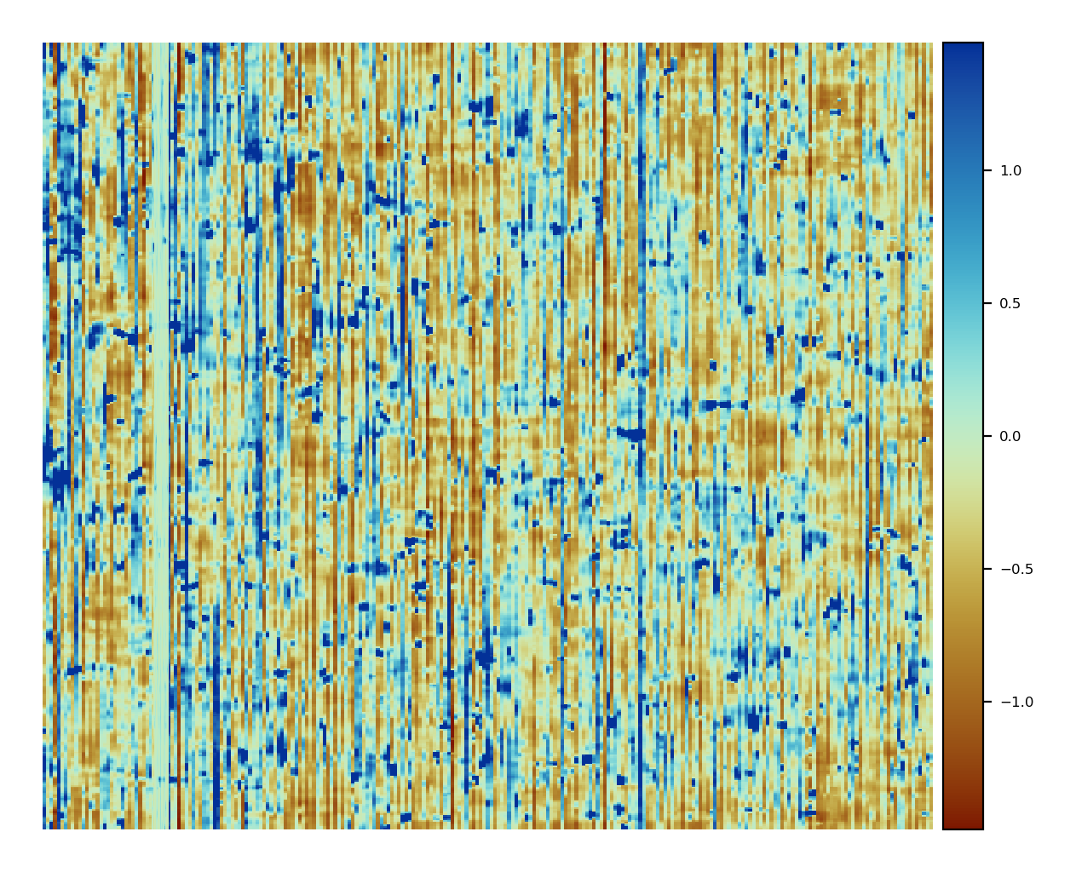
Seismic cycling
Results
75
1.4
Distance along the fault (km)
Displacement on the fault (m)
0
-1.4
0
4.5
Cumulated displacement of the fault (km)

Slide 49
Seismic cycling
Results
75
1.4
Seismic events
Distance along the fault (km)
Displacement on the fault (m)
0
-1.4
0
4.5
Cumulated displacement of the fault (km)

Slide 50
Seismic cycling
Results
75
1.4
Seismic events
Distance along the fault (km)
Displacement on the fault (m)
0
-1.4
0
4.5
Cumulated displacement of the fault (km)

Slide 51
Seismic cycling
Results
75
1.4
Seismic events
Distance along the fault (km)
Displacement on the fault (m)
0
-1.4
0
4.5
Cumulated displacement of the fault (km)

Slide 52
Seismic cycling
Results
75
1.4
Seismic events
Distance along the fault (km)
Displacement on the fault (m)
Locking / creeping phase
0
-1.4
0
4.5
Cumulated displacement of the fault (km)

Slide 53
Seismic cycling
Results
75
1.4
Seismic events
Distance along the fault (km)
Displacement on the fault (m)
Locking / creeping phase
0
-1.4
0
4.5
Cumulated displacement of the fault (km)

Slide 54
Seismic cycling
Results
Displacement parallel
to the fault (m)
14 m
75
1.4
75 km
Seismic events
Distance along the fault (km)
Distance along the fault (km)
Displacement parallel to the fault (m)
Displacement on the fault (m)
0 km
40 km
0
-1.4
-14 m
0
4.5
Distance across the fault (km)
Cumulated displacement of the fault (km)

Slide 55
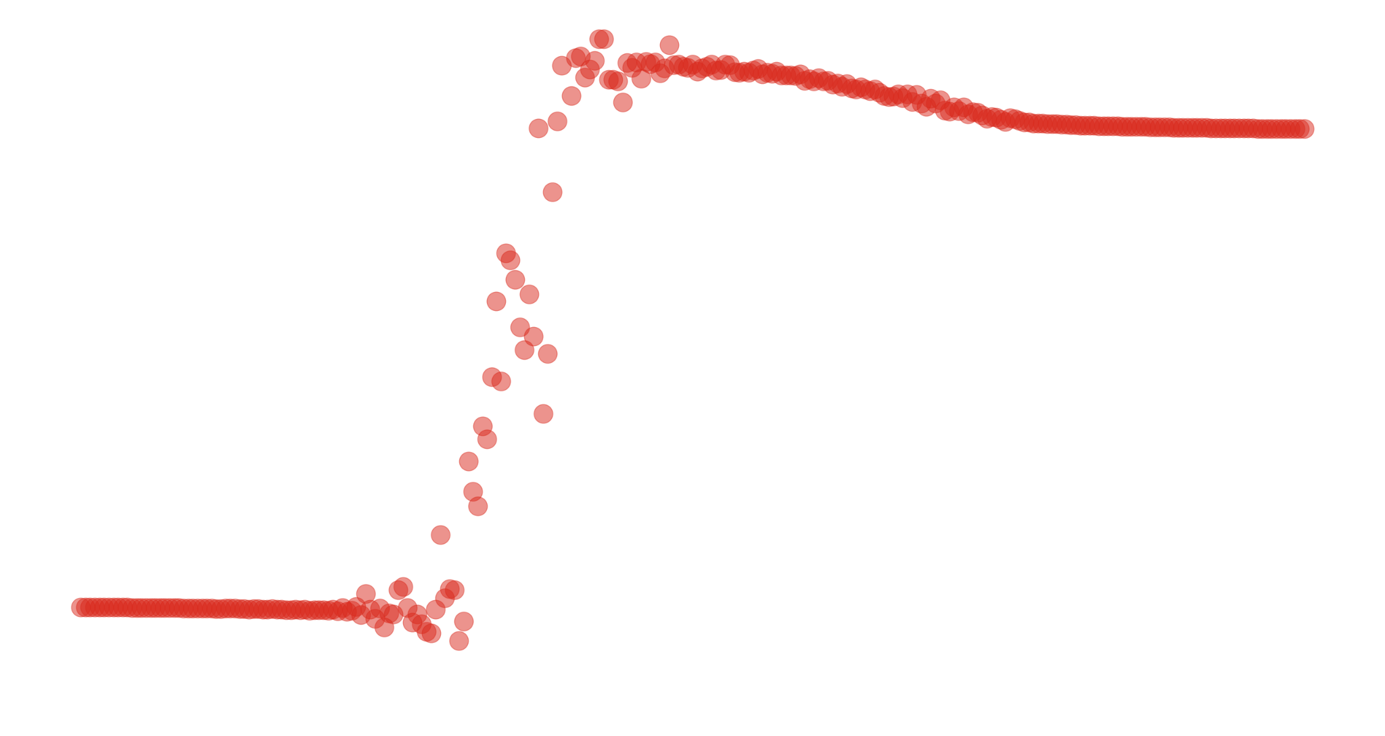
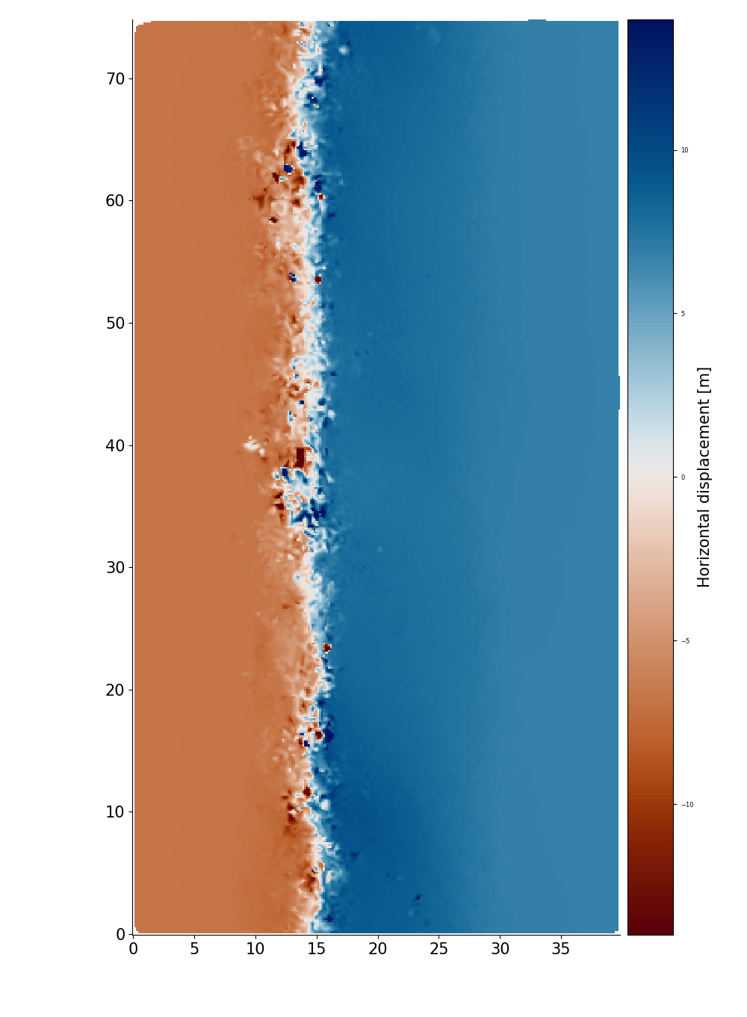
Seismic cycling
Results
Displacement parallel
to the fault (m)
14 m
75
1.4
75 km
Seismic events
Distance along the fault (km)
Distance along the fault (km)
Displacement parallel to the fault (m)
Displacement on the fault (m)
0 km
40 km
0
-1.4
-14 m
0
4.5
Distance across the fault (km)
Cumulated displacement of the fault (km)

Slide 56
Seismic cycling
Results
75
1.4
Alternation between seismic and interseismic phases
Distance along the fault (km)
Displacement on the fault (m)
0
-1.4
0
4.5
Cumulated displacement of the fault (km)

Slide 57
Seismic cycling
Results
75
1.4
Alternation between seismic and interseismic phases
Variations among the rupture lengths
Distance along the fault (km)
Displacement on the fault (m)
0
-1.4
0
4.5
Cumulated displacement of the fault (km)

Slide 58
Seismic cycling
Results
75
1.4
Alternation between seismic and interseismic phases
Variations among the rupture lengths
Variations in the amount of slip released
Distance along the fault (km)
Displacement on the fault (m)
0
-1.4
0
4.5
Cumulated displacement of the fault (km)

Slide 59
Seismic cycling
Results
75
1.4
Alternation between seismic and interseismic phases
Variations among the rupture lengths
Variations in the amount of slip released
Variations in the duration of interseismic periods
Distance along the fault (km)
Displacement on the fault (m)
0
-1.4
0
4.5
Cumulated displacement of the fault (km)

Slide 60
Seismic cycling
Results
75
1.4
Alternation between seismic and interseismic phases
Variations among the rupture lengths
Variations in the amount of slip released
Variations in the duration of interseismic periods
Distance along the fault (km)
Displacement on the fault (m)
⇒ Variations in the magnitude of events
0
-1.4
0
4.5
Cumulated displacement of the fault (km)

Slide 61
Magnitude distribution
Results
Look at the displacement in one time interval
1
2
3
Clustering algorithm
4
Distance along the fault (km)
Horizontal displacement
Distance across the fault (km)

Slide 62
Magnitude distribution
Results
Look at the displacement in one time interval
Filter out the particles below a given displacement threshold
1
2
3
Clustering algorithm
4
Distance along the fault (km)
Horizontal displacement
Distance across the fault (km)

Slide 63
Magnitude distribution
Results
Look at the displacement in one time interval
Filter out the particles below a given displacement threshold
Spatially cluster the particles
1
2
3
Clustering algorithm
4
Distance along the fault (km)
Horizontal displacement
Distance across the fault (km)

Slide 64
Magnitude distribution
Results
Look at the displacement in one time interval
Filter out the particles below a given displacement threshold
Spatially cluster the particles
Compute the magnitude of each cluster
1
2
3
Clustering algorithm
4
Distance along the fault (km)
Horizontal displacement
Distance across the fault (km)

Slide 65
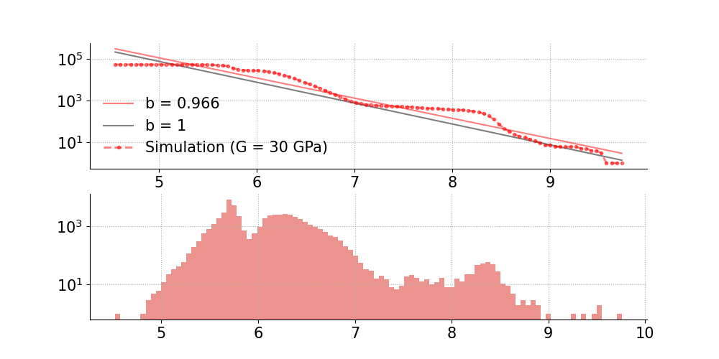
Magnitude distribution
Results
Number N of occurrences
Magnitude M

Slide 66
Magnitude distribution
Results
Log(N≥M)
Number N of occurrences
Magnitude M

Slide 67
Magnitude distribution
Results
Gutenberg Richter
Log(N≥M)
Number N of occurrences
Magnitude M

Slide 68
Conclusion
Conclusion
Development of a mature fault zone
Earthquake cycles
Seismic cycles on an evolving strike-slip fault
✓

Slide 69
Conclusion
Conclusion
Development of a mature fault zone
Earthquake cycles
Seismic cycles on an evolving strike-slip fault
✓
✓

Slide 70
Conclusion
Conclusion
Development of a mature fault zone
Earthquake cycles
Seismic cycles on an evolving strike-slip fault
✓
✓
Study the 3D deformation pattern during interseismic and coseismic periods

Slide 71
Conclusion
Conclusion
Development of a mature fault zone
Earthquake cycles
Seismic cycles on an evolving strike-slip fault
✓
✓
Study the 3D deformation pattern during interseismic and coseismic periods
Increase the time resolution during coseismic phase

Slide 72
Conclusion
Conclusion
Development of a mature fault zone
Earthquake cycles
Seismic cycles on an evolving strike-slip fault
✓
✓
Study the 3D deformation pattern during interseismic and coseismic periods
Increase the time resolution during coseismic phase
Thank you!

Slide 73
Supplementary slides

Slide 74
Classical modelling approaches: numerical modelling
Introduction
Main limitations:
Zielke, Olaf & Mai, M.. (2023)

Slide 75
Classical modelling approaches: numerical modelling
Introduction
Main limitations:
Fixed fault geometry, size and strength
Zielke, Olaf & Mai, M.. (2023)

Slide 76
Classical modelling approaches: numerical modelling
Introduction
Main limitations:
Fixed fault geometry, size and strength
Need of the stress history
Zielke, Olaf & Mai, M.. (2023)

Slide 77
Classical modelling approaches: numerical modelling
Introduction
Main limitations:
Fixed fault geometry, size and strength
Need of the stress history
Constitutive law of the modeled rock / Artificial nucleation of earthquake
Zielke, Olaf & Mai, M.. (2023)

Slide 78
Classical modelling approaches: numerical modelling
Introduction
Main limitations:
Fixed fault geometry, size and strength
Need of the stress history
Constitutive law of the modeled rock / Artificial nucleation of earthquake
⇒ Non-evolving fault
Zielke, Olaf & Mai, M.. (2023)

Slide 79
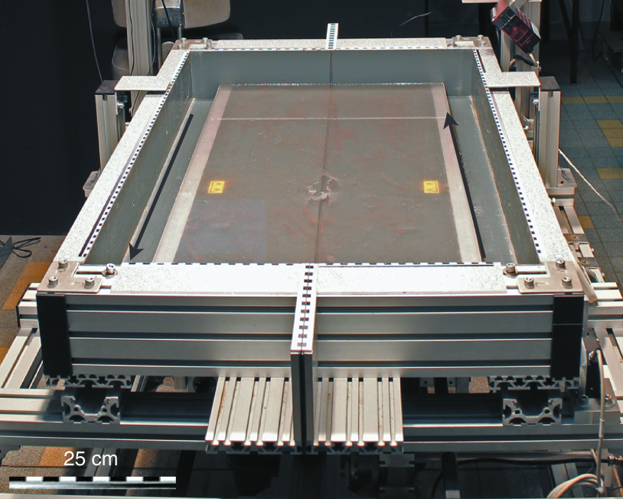
Classical modelling approaches: analogue modelling
Introduction
Preuss, S. (2020) and Caniven et al. (2015)

Slide 80
Classical modelling approaches: analogue modelling
Introduction
Need for scaling laws
Preuss, S. (2020) and Caniven et al. (2015)

Slide 81
Classical modelling approaches: analogue modelling
Introduction
Need for scaling laws
Physical limitations
Preuss, S. (2020) and Caniven et al. (2015)

Slide 82
Classical modelling approaches: analogue modelling
Introduction
Need for scaling laws
Physical limitations
No 3D observations
Preuss, S. (2020) and Caniven et al. (2015)

