Slide 1
SIMULATION OF TRIPLE COINCIDENCES ON A DUAL-RING LONG AXIAL PET USING GATE
D. Calamani and D. Thanasas
National and Kapodistrian University of Athens
Gate Scientific Meeting 2025
NCSR DEMOKRITOS

Slide 2
SCOPE OF THE STUDY
The scope of the study is to develop a full custom-based algorithm that can retrieve the Cartesian coordinates of a point source utilizing triple-coincidence events in a dual-ring PET geometry.
Triple-coincidence events occur throughout the decay of a non-pure positron emitter. Such events were simulated utilizing the ExtendedVSource extension (pPs decay along with a de-excitation prompt gamma of 1157 keV, as the Scandium-44 isotope).
Based solely on triple-coincidence data, the spatial resolution can be calculated through the FWHM of the Point Spread Function (PSF).

Slide 3
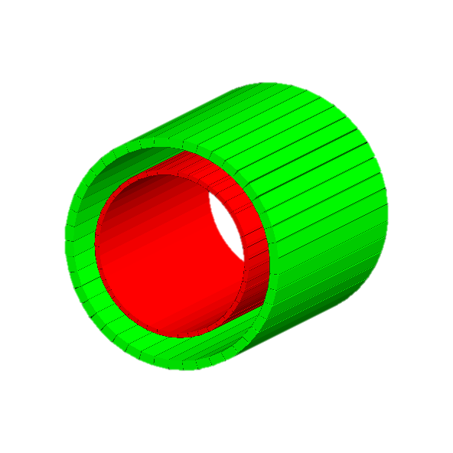
DUAL-RING LONG-AXIAL PET GEOMETRY
Outer Ring-Absorber
4×6.4×102.4 cm³ LSO crystal
45 blocks
Thickness: 4 cm
Initial Geometry:
Inner radius 46 cm
Outer radius 50 cm
Inner Ring-Scatterer
Monolithic Si crystal
Axial Width 102.4 cm
Initial Geometry:
Inner radius 34 cm
Outer radius 36 cm
Thickness: 2 cm

Slide 4
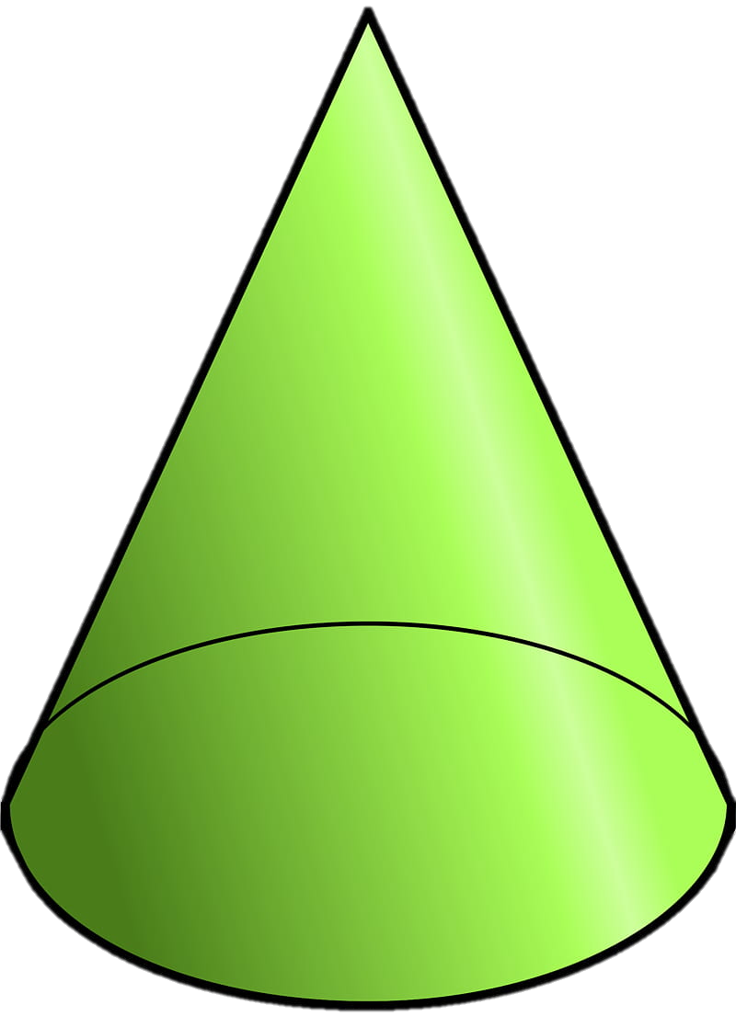
TRIPLE COINCIDENCES
The simulated source emits two back-to-back photons and a high-energetic prompt photon per decay.
The two back-to-back 511 keV photons are detected in the absorber, defining a Line-Of-Response (LOR).
The prompt gamma is Compton-Scattered in the scatterer and absorbed in the absorber.
The Compton kinematics defines a Compton Cone with the prompt gamma scattering point as the tip of the cone and its aperture angle $θ_{c}$ is given by the equation:
$$θ_{c}=\arccos{[1+ m_{e}c^{2}}(\frac{1}{E_{initial}}−\frac{1}{E_{scattered}})]$$
The Compton Cone intersects the LOR at two points (at most), where one of them is the annihilation point.

Slide 5
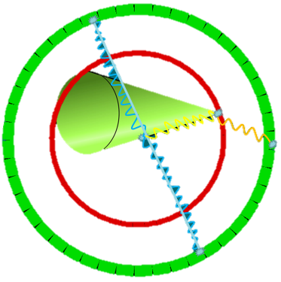
TRIPLE COINCIDENCES
Prompt gamma scattering point
Intersection points
Compton Cone
Line-Of-Response (LOR)
Acceptance of one of the two intersection points is achieved through Time-Of-Flight (TOF) Technique, where the intersection point closer to the TOF point is finally selected.

Slide 6
GATE SIMULATION
Version 9.3
ECAT System (Three hierarchical levels)
45 Blocks
Energy Resolution 9%
LSO Dead Time 40 ns
Point source inside a 0.5 cm radius water sphere
ExtendedVsource simulating the Sc-44 decay

Slide 7
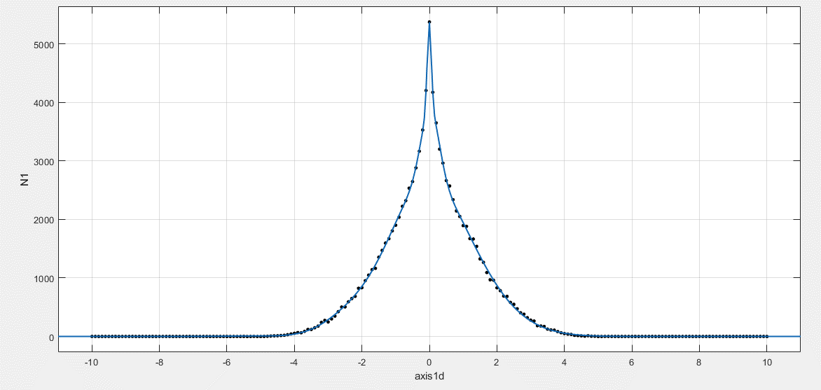
GATE SIMULATION – SPATIAL BLURRING
Spatial Blurring 1.7 mm
$$\sqrt{{(1.3)}^{2}+{(1.0)}^{2}}=1.7 mm$$
Sc-44 positron range blurring in water.
Diffusion of light in LSO crystal
γ-ray
FWHM
LSO
light

Slide 8
THE CUSTOM-MADE ALGORITHM
Energy windows:
Back-to-Back photons 469-553 keV
Prompt gamma 1094-1220 keV (Scattered + Absorbed)
The total energy of photons is derived from Singles.
Defining energy windows
Finding any coincidences among both back-to-back photons along with the prompt gamma
From Singles data
The photons must be absorbed within a time window of 5 ns.
The radius of the absorption must be within the absorber.
Filtering the coincidences where the prompt gamma is Compton Scattered in the scatterer
From Hits data
The prompt gamma must also interact through Compton Scattering within the scatterer. The deposited energy of the prompt gamma in the scatterer is also stored.

Slide 9
THE CUSTOM-MADE ALGORITHM
Defining the Compton Cone
From Singles and Hits data
The scattering point coordinates is the tip of the Compton cone. Its aperture angle is calculated using the initial and the scattered energy of the promt gamma.
Defining the LOR, and the intersection points
From Singles and Hits data
Two back-to-back absorbed points define the LOR. The intersection points between the LOR and Compton cone are calculated.
From Singles data
The TOF point is calculated using the time interval between the two LOR endpoints. The intersection point that is closer to the TOF point is considered as the annihilation point indicating the position of the source.
Calculating the TOF point and identifying the annihilation point

Slide 10
THE CUSTOM-MADE ALGORITHM
Gate simulation
Defining energy windows
Finding any coincidences among both back-to-back photons along with the prompt gamma
Importing Hits and Singles
Calculating the TOF point and its distance between each intersection point
Defining the Compton Cone, the LOR and their intersection points
Filtering the coincidences where the prompt gamma is Compton Scattered in the scatterer
TOF technique
Triple Coincidences
The annihilation point is the intersection point closer to the TOF point.
FINAL OUTPUT!

Slide 11
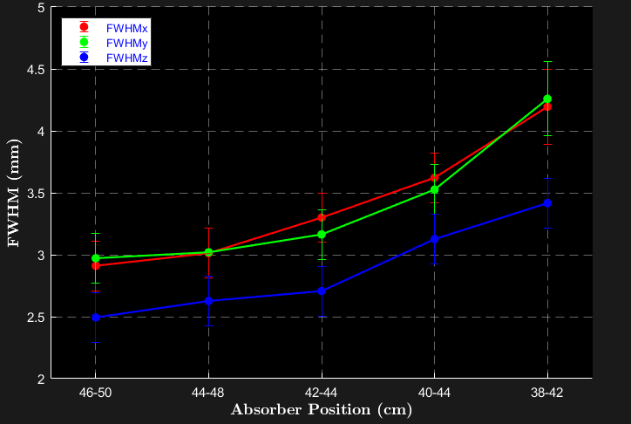
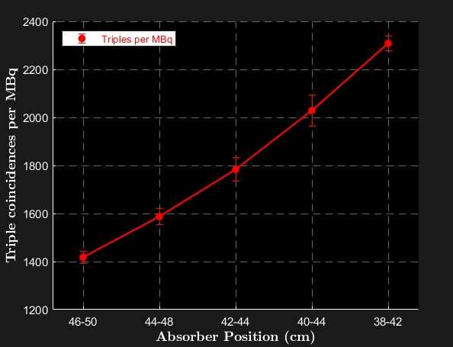
METHODS - RESULTS
Multiple simulations have been implemented using various arrangements for both rings, in order to study variations of the FWHM and the number of triple coincidences per MBq.
Changing the position of the absorber (scatterer position at 34-36 cm).
Absorber position (cm) | FWHMx (mm) | FWHMy (mm) | FWHMz (mm)
46-50 | 2.9(2) | 3.0(2) | 2.5(2)
44-48 | 3.0(2) | 3.0(2) | 2.6(2)
42-46 | 3.3(2) | 3.2(2) | 2.7(2)
40-44 | 3.6(2) | 3.5(2) | 3.1(2)
38-42 | 4.2(3) | 4.3(3) | 3.4(2)

Slide 12
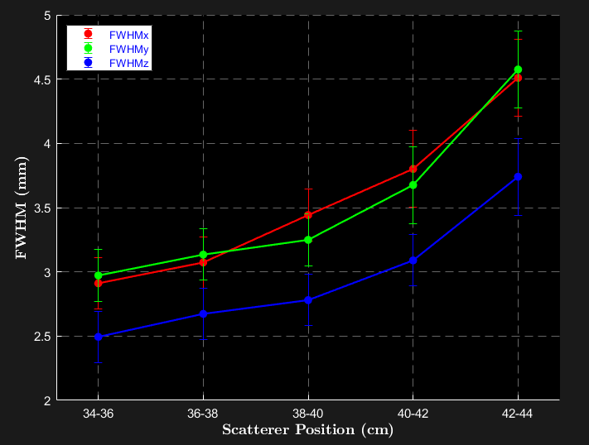
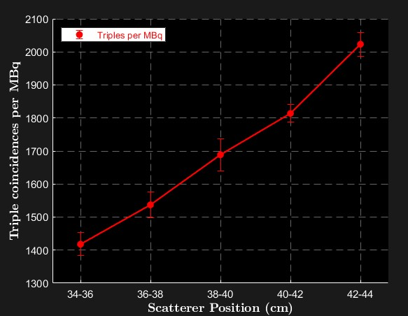
RESULTS
Changing the position of the scatterer (absorber position at 46-50 cm).
Scatterer position (cm) | FWHMx (mm) | FWHMy (mm) | FWHMz (mm)
34-36 | 2.9(2) | 3.0(2) | 2.5(2)
36-38 | 3.1(2) | 3.1(2) | 2.7(2)
38-40 | 3.4(2) | 3.2(2) | 2.8(2)
40-42 | 3.8(2) | 3.7(2) | 3.1(2)
42-44 | 4.5(3) | 4.6(3) | 3.7(2)

Slide 13
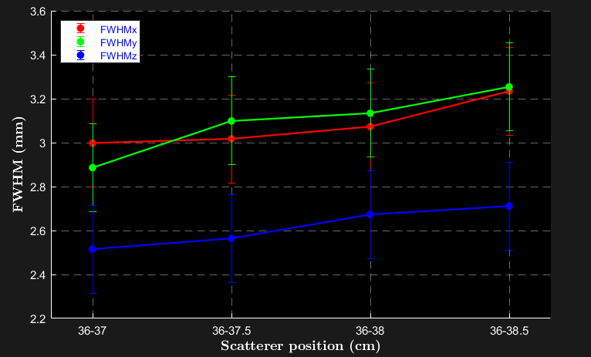
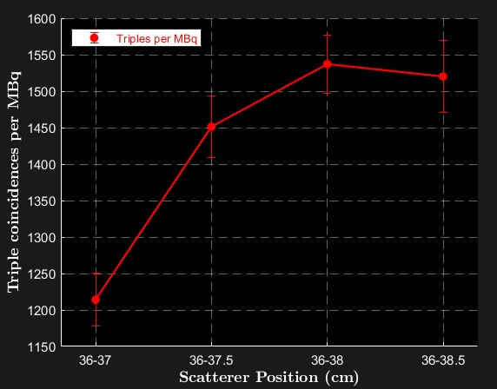
RESULTS
Changing the thickness of the scatterer (absorber position at 46-50 cm).
Scatterer position (cm) | FWHMx (mm) | FWHMy (mm) | FWHMz (mm)
36-37 | 3.0(2) | 2.9(2) | 2.5(2)
36-37.5 | 3.0(2) | 3.1(2) | 2.6(2)
36-38 | 3.1(2) | 3.1(2) | 2.7(2)
36-38.5 | 3.2(2) | 3.2(2) | 2.7(2)

Slide 14
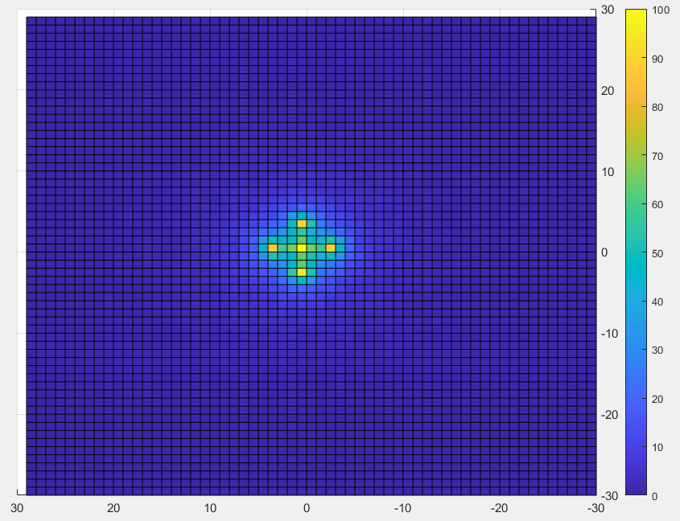
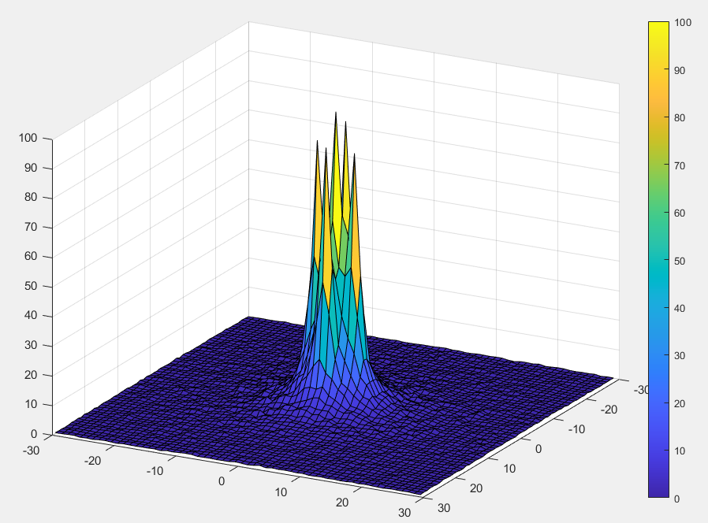
RESULTS
Using the Initial geometry:
Five Point Sources:
0. 0. 0. mm
3. 0. 0. mm
0. 3. 0. mm
-3. 0. 0. mm
0. -3. 0. mm
~250000 counts
Pixel width: 1 mm
The point sources are clearly distinguished!

Slide 15
CONCLUSIONS
The FWHM is inversely proportional to the distance between the two rings.
The FWHM slightly increases with the thickness of the scatterer.
The number of triple coincidences per MBq increases as the scatterer-absorber distance decreases.
The number of triple coincidences per MBq increases with the scatterer thickness up to 2 cm but declines for greater thicknesses.
Point sources spaced 3 mm apart along the x- and y- axis are clearly distinguished.

Slide 16
FUTURE WORK
Implementation of the triple-coincidence technique for various non-pure isotopes and scatterer materials.
Imaging of simulated phantoms (e.g. Derenzo phantom).
Further refinement of the custom-made algorithm.

Slide 17
THANK YOU FOR YOUR ATTENTION!

