Slide 1
OpenGATE for helium commissioning
H. Fuchs, Medical University of Vienna

Slide 2
MedAustron ion therapy center
Synchrotron facility
Protons: 60-252 MeV (3-38 cm)
Carbon Ions: 120-402 MeV/u (3-27 cm)
3 clinical rooms
1 Dedicated research room – IR1
For research users of Austrian universities
Dedicated beam time
Helium ions becoming available

Slide 3
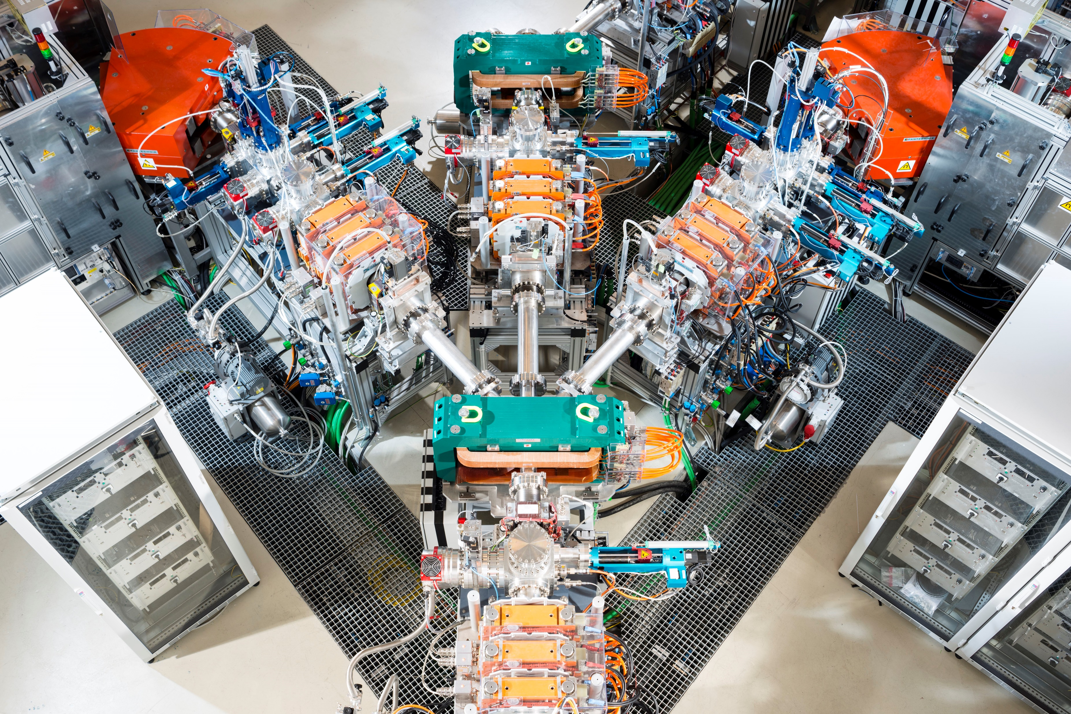
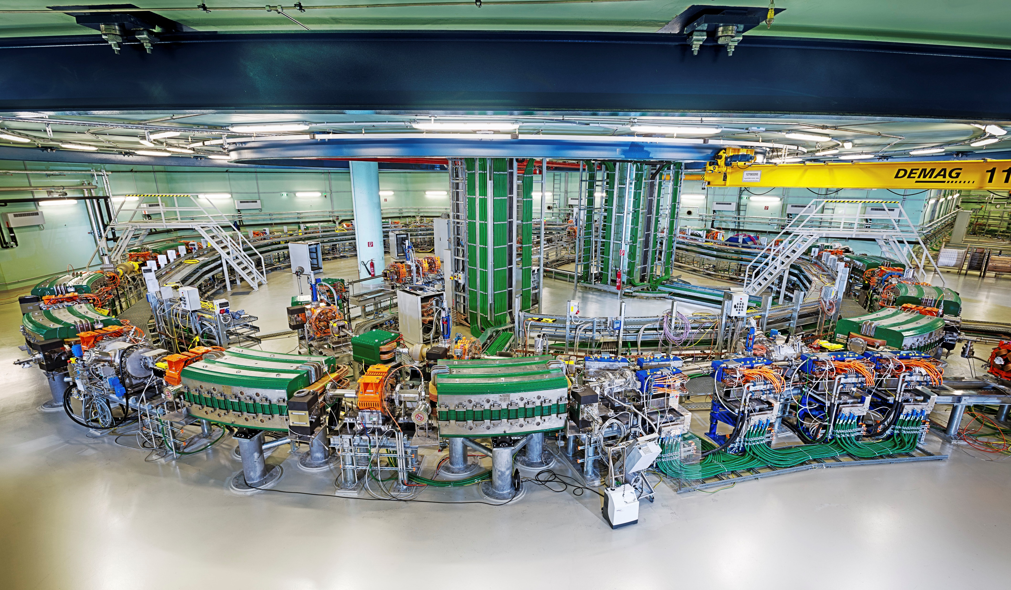
Helium ion
Accelerator commissioning for Helium ions finished
2020-2024
Common tuning and acceptance phase
Accelerator physicists and research users
Tuning in room beam parameters
Ensure specifications met
Beam data measurements
© Thomas Kästenbauer

Slide 4
Helium ion
Target parameters
Ranges in water 1-80 cm
Spot sizes comparable to clinical C12 beam
~7 mm FWHM
Calibration in number of particles
© Thomas Kästenbauer

Slide 5
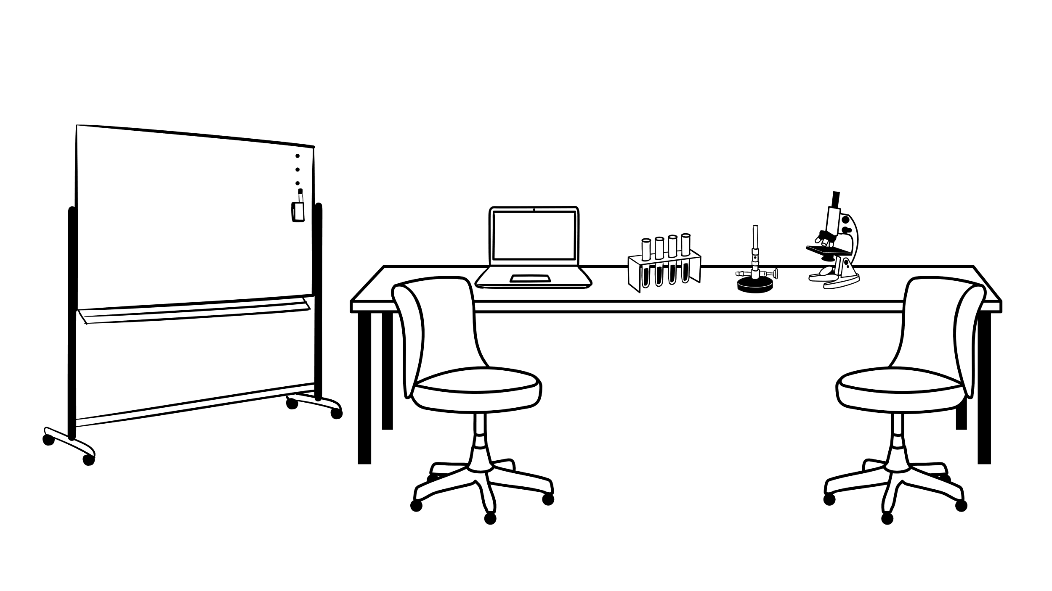
Tasks
Range tuning
Optics tuning
Absolute dose calibration
Base data measurements
Full IDD
Ranges
Spot sizes / Lateral fall off
Only ~50 h beamtime for acceptance & commissioning

Slide 6
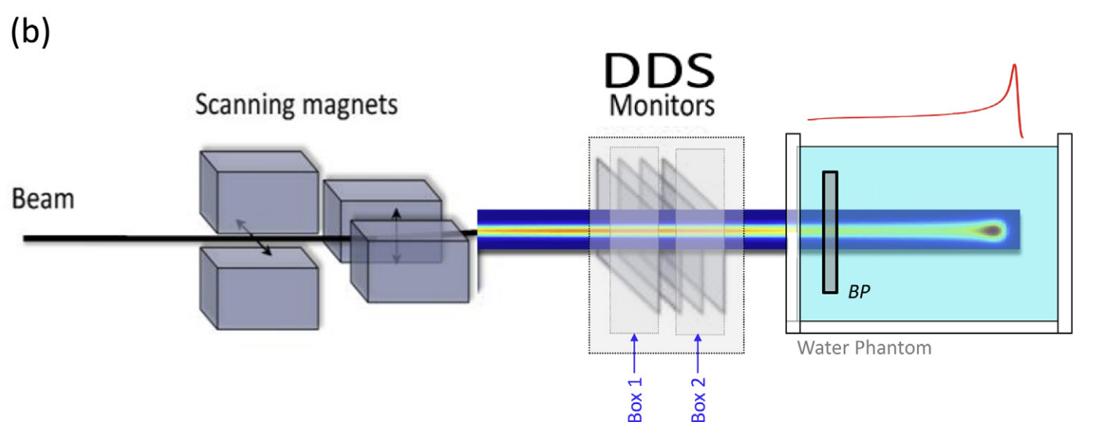
Preparatory work - GATE
Monte Carlo modell of MedAustron nozzle
Existing for Gate 9
Migrated to OpenGATE 10
About 2 days (incl. validation)
OpenGATE provides flexibility
Necessary due to recent beam delivery hardware changes
Changes ~ 1 day

Slide 7
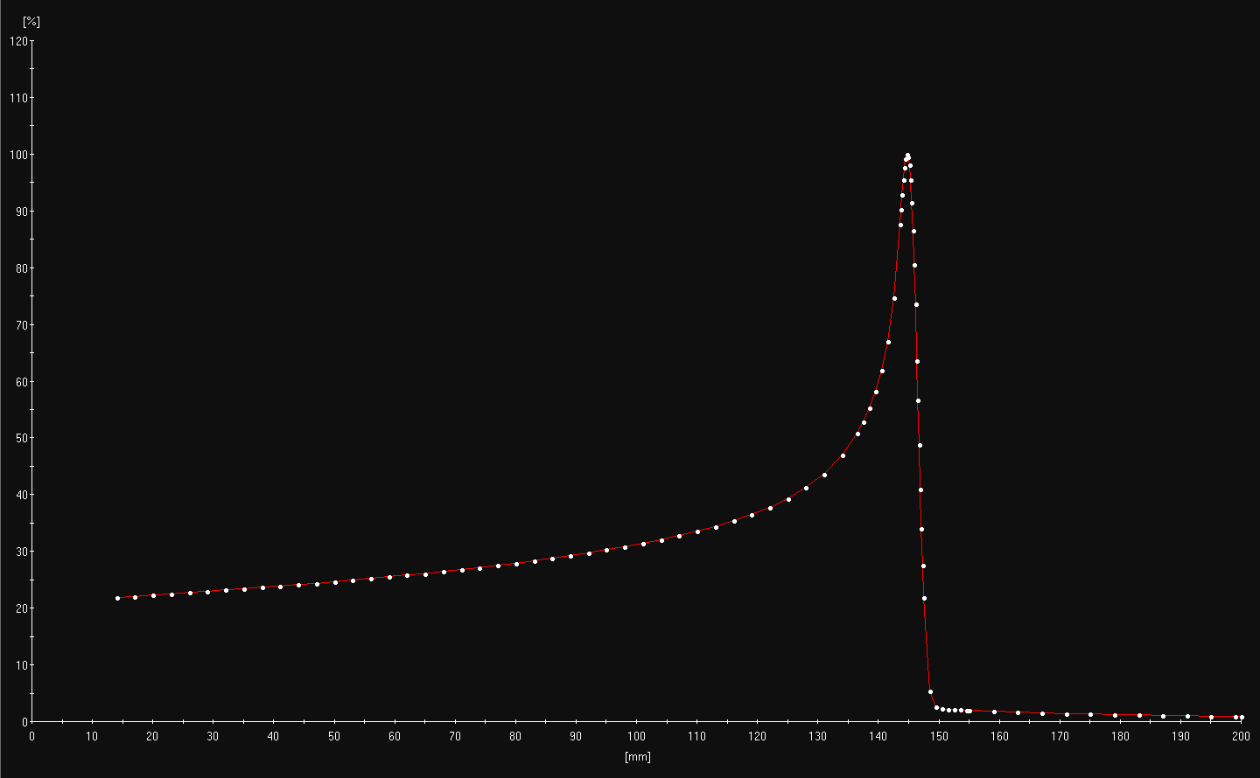
Range tuning
First He beam measured
Ideally energies with ranges in mm steps
Using GATE
Prediction of suitable energies
Initial measurements
16 IDD measured

Slide 8
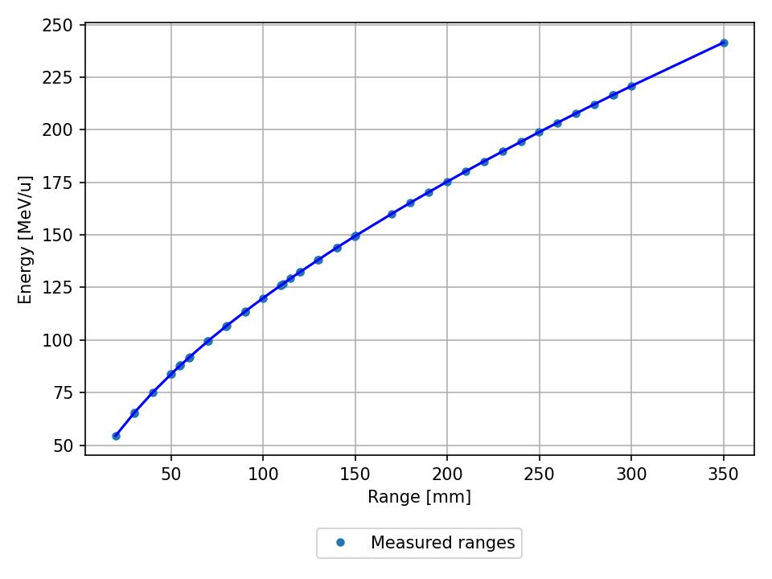
Range tuning
First He beam measured
GATE
Initial energies for calibration
Fine tuning of energies
Creation of full energy list
~350 energies available
1-30 cm in mm steps
Beyond in cm resolution
Experimental verification
38 energies verified
Energies within 0.1 mm of target range

Slide 9
Absolute dose calibration
Calibration in terms of number of particles not MU
Measurement of dose area product
Using stopping power conversion to number of particles
Experimental measurement of dose area product
Stopping power calculation
Monte Carlo simulation
Fixed measurement depth: 14 mm

Slide 10
Absolute dose calibration
Calculation of calibration curve
Experimental verification
Verified 35 energies
Agreement
Within 1.5 %
Average agreement 0.07%
From 1 – 80 cm

Slide 11
Summary & Outlook

Slide 12
Summary
Helium beam time very restricted
2 shifts for range tuning
2 shifts for absolute dose calibration and verification
Optic measurements still ongoing
Extremely efficient use of time
Only possible with Monte Carlo simulations
Gate 10 makes changing geometries substantially easier

