Slide 1
Validation of GateRBEActor for carbon ion pencil beam therapy
Yihan Jia, Favaretto Martina, Andreas F Resch, Markus Stock, Loïc Grevillot
01/04/2025

Slide 2
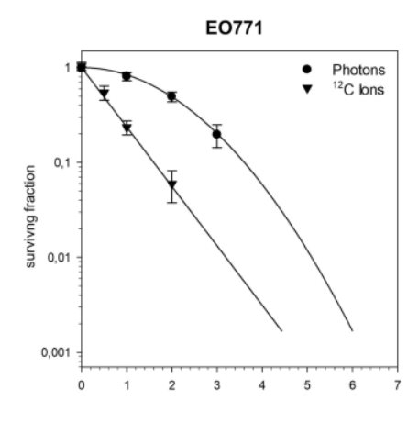
Why relative biological effectiveness (RBE)?
In vitro, in vivo
Dose
Radiation quality (LETd)
Cell line (radiosensitivity)
Endpoint (survival fraction, tumor control probability …)
…
[2] Hartmann L, et al., Scientific reports (2020)
Notes:
1. A factor that characterizes the biological effectiveness of a radiation
Murine tumor cell line

Slide 3
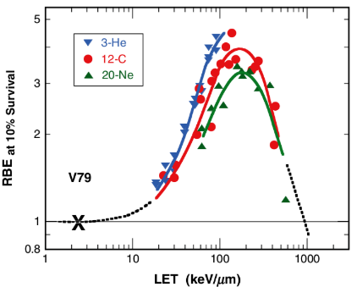
Why relative biological effectiveness (RBE)?
In vitro, in vivo
Dose
Radiation quality (LETd)
Cell line (radiosensitivity)
Endpoint (survival fraction, tumor control probability …)
…
[1] Ridolfi, R (2018)
[2] Hartmann L, et al., Scientific reports (2020)
Notes:
1. A factor that characterizes the biological effectiveness of a radiation
Murine tumor cell line

Slide 4
Why relative biological effectiveness (RBE)?
In vitro, in vivo
Dose
Radiation quality (LETd)
Cell line (radiosensitivity)
Endpoint (survival fraction, tumor control probability …)
…
[1] Ridolfi, R (2018)
[2] Hartmann L, et al., Scientific reports (2020)
Notes:
1. A factor that characterizes the biological effectiveness of a radiation
Murine tumor cell line

Slide 5
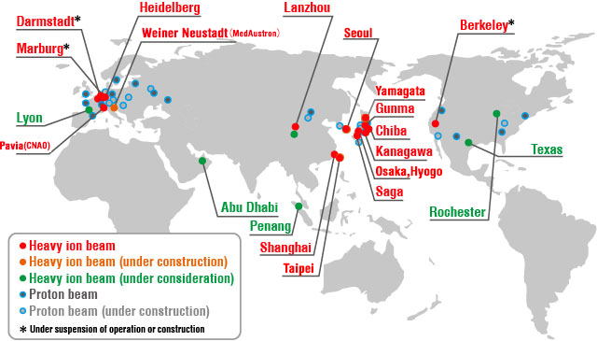
Why relative biological effectiveness (RBE)?
Predictive models: phenomenological, mechanistic
Clinically used models
Local Effect Model I (LEM1)
Modified Microdosimetric Kinetic Model (mMKM)
Clinical experience based on RBE-weighted dose
Prescription, fractionation
Constraints for organs at risk
In vitro, in vivo
clinical outcome
Caen(ARCHADE)
[1] Ridolfi, R (2018)
[3] modified based on Japanese P-RAP
Notes:
GSI pilot project: 1997-2008
NIRS: 1994-

Slide 6
How does RBEActor work?
You can read the User Guideline doc
Here’s the scientific rationale:

Slide 7
How does RBEActor work?
mMKM
Linear Quadratic model
[2] Hartmann L, et al., Scientific reports (2020)
LEM1lda

Slide 8
How does RBEActor work?
mMKM
Linear Quadratic model
[2] Hartmann L, et al., Scientific reports (2020)
LEM1lda

Slide 9
How does RBEActor work?
mMKM
Linear Quadratic model
Linear Quadratic – linear model
[2] Hartmann L, et al., Scientific reports (2020)
LEM1lda

Slide 10
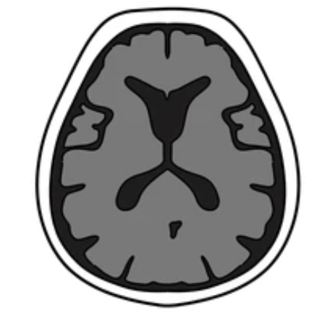
How does RBEActor work?
mMKM
DoseActor
GetTotalEnergyDeposit
LEM1lda

Slide 11
How does RBEActor work?
mMKM
DoseActor
GetTotalEnergyDeposit
SteppingAction
constant
GateBeamQualityActor
Mixed field radiation
[5]
Saturation-corrected dose-averaged specific energy
Microdosimetric quantity
Sub-nucleus domain
LEM1lda
[5] Zeider & Rossi (1980)

Slide 12
How does RBEActor work?
mMKM
DoseActor
GetTotalEnergyDeposit
SteppingAction
constant
GateBeamQualityActor
Mixed field radiation
GetCurrentDEDX
Initial slope of cell survival function
Radiobiological quantity
LEM1lda

Slide 13
How does RBEActor work?
mMKM
Linear Quadratic model
EndSimulationAction
LEM1lda
Linear Quadratic – linear model

Slide 14
How does RBEActor work?
mMKM
Linear Quadratic model
EndSimulationAction
LEM1lda
Linear Quadratic – linear model

Slide 15
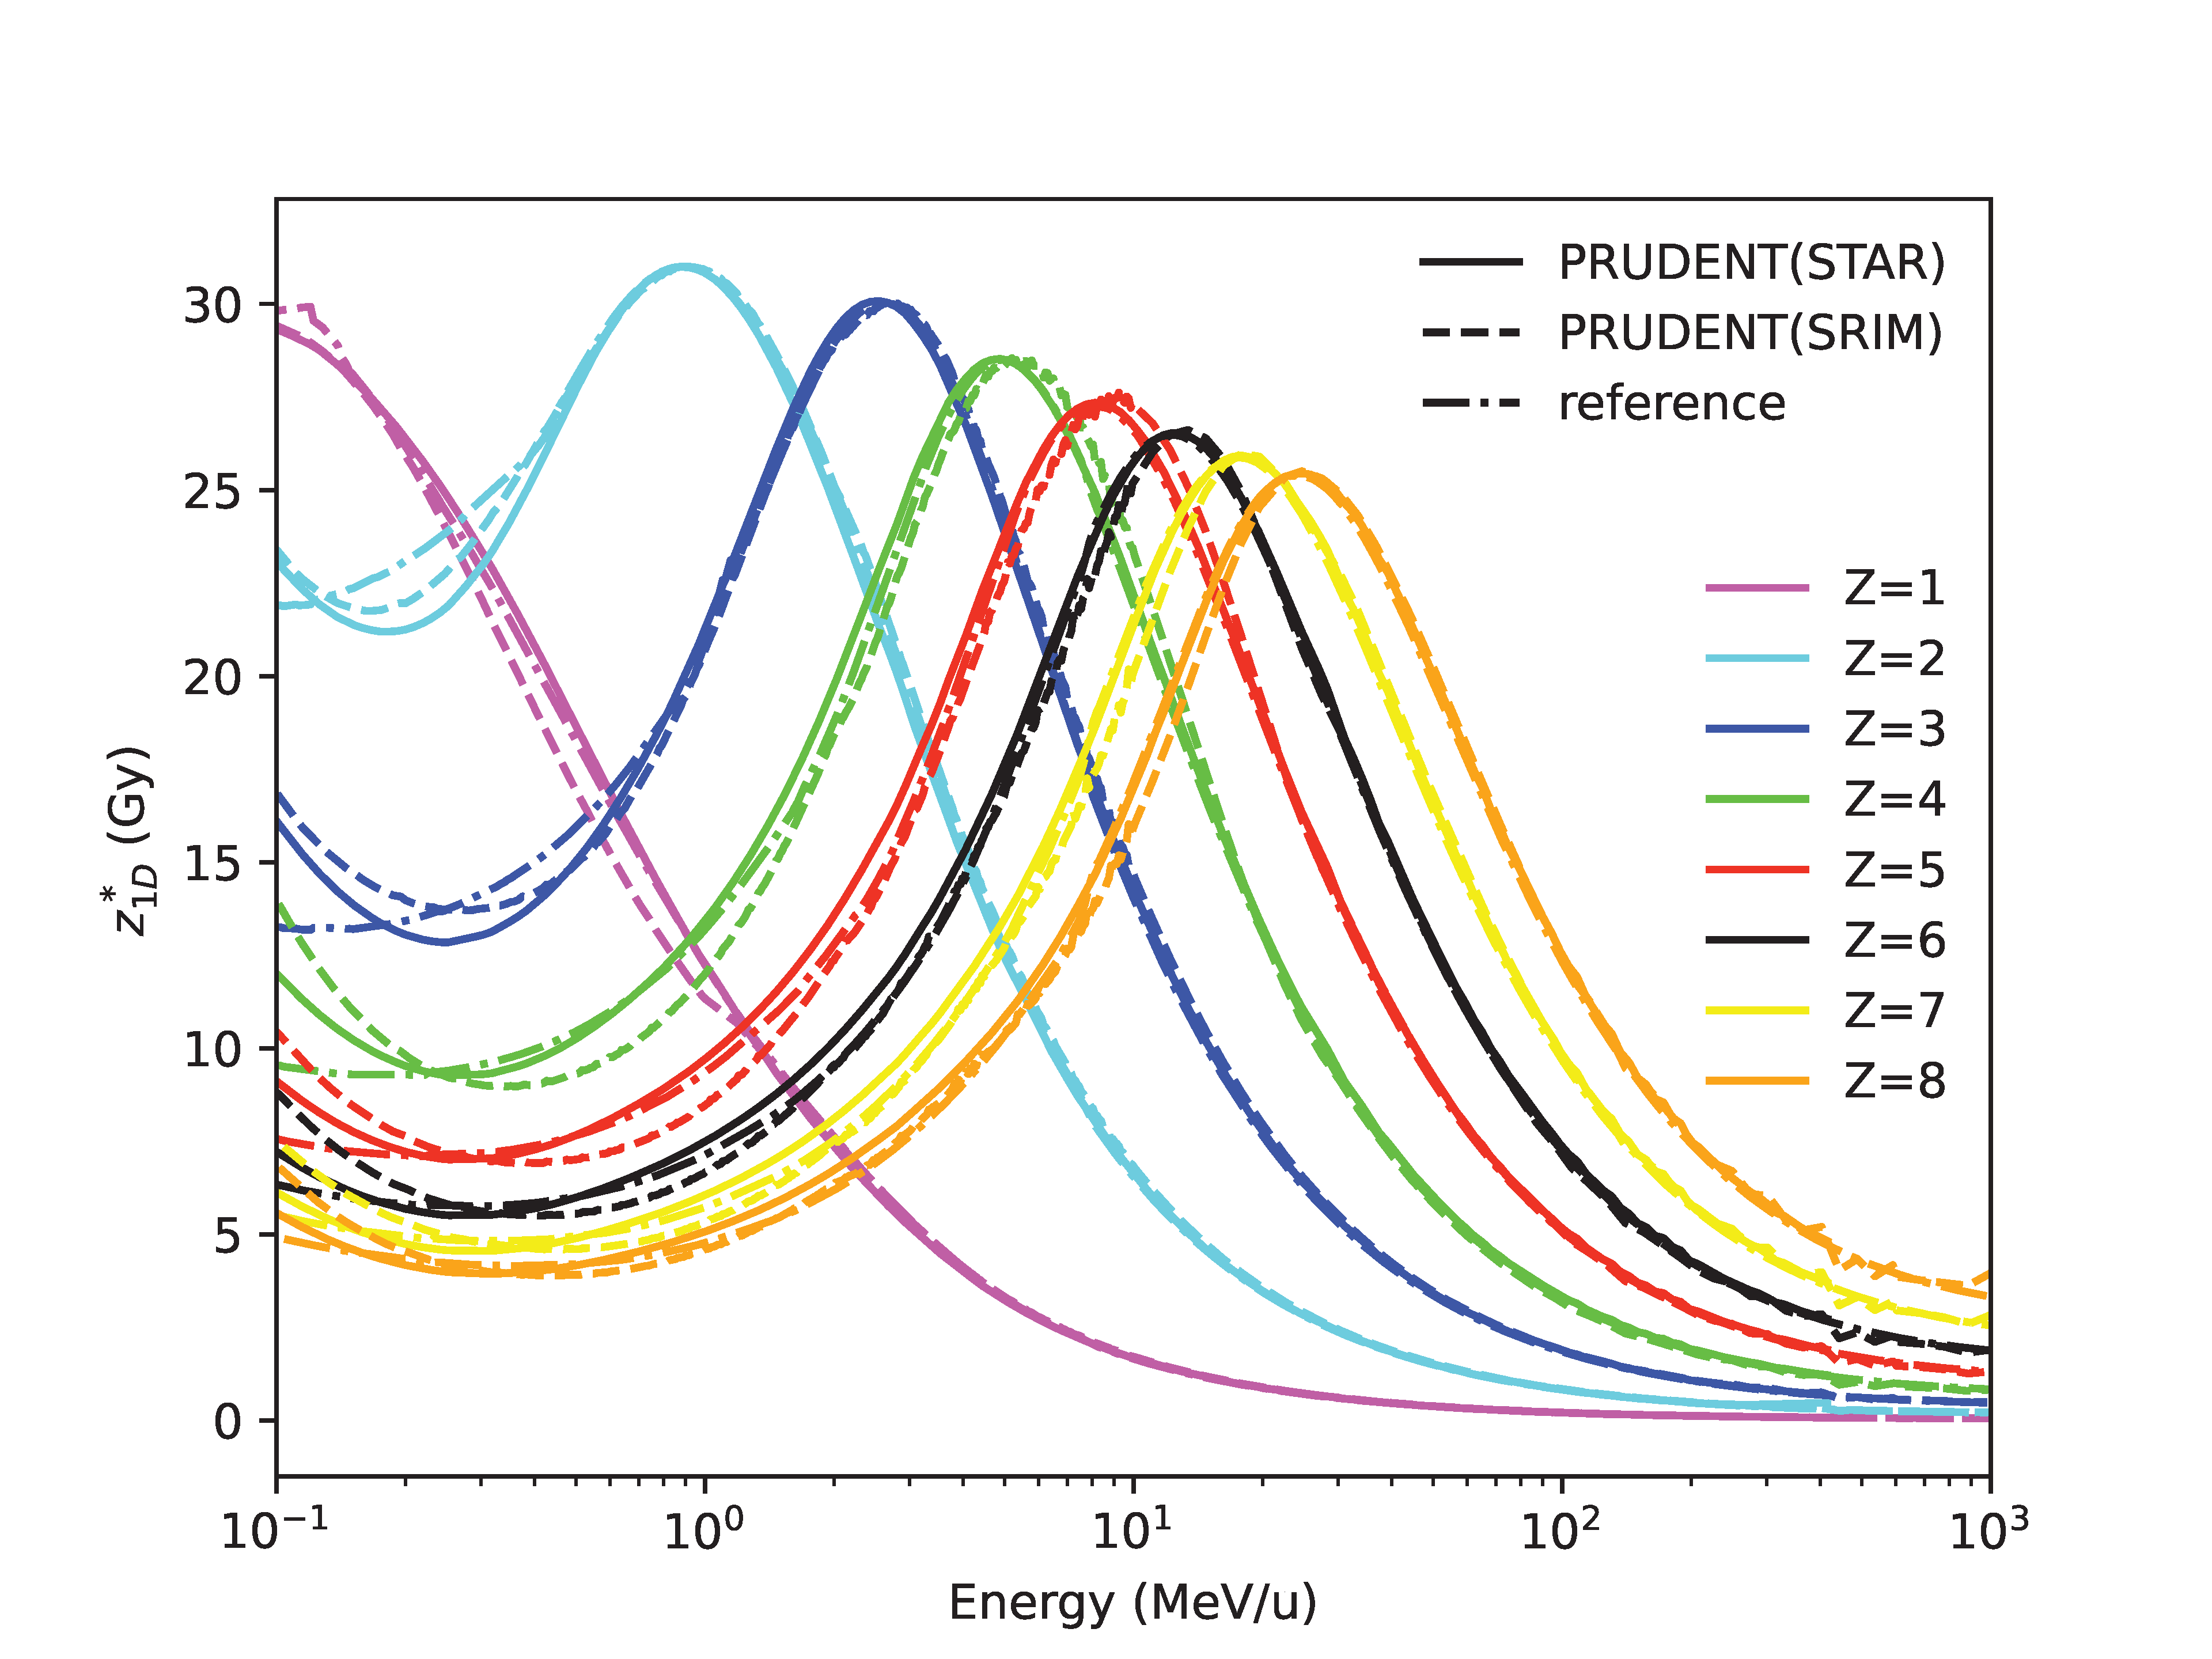
Generation of RBEActor input tables
PRUDENT: PRojectile μ-Dosimetric Effect in Nucleus evaluation Tool
Calculates the table of mMKM and table of LEM1lda
mMKM
constant

Slide 16
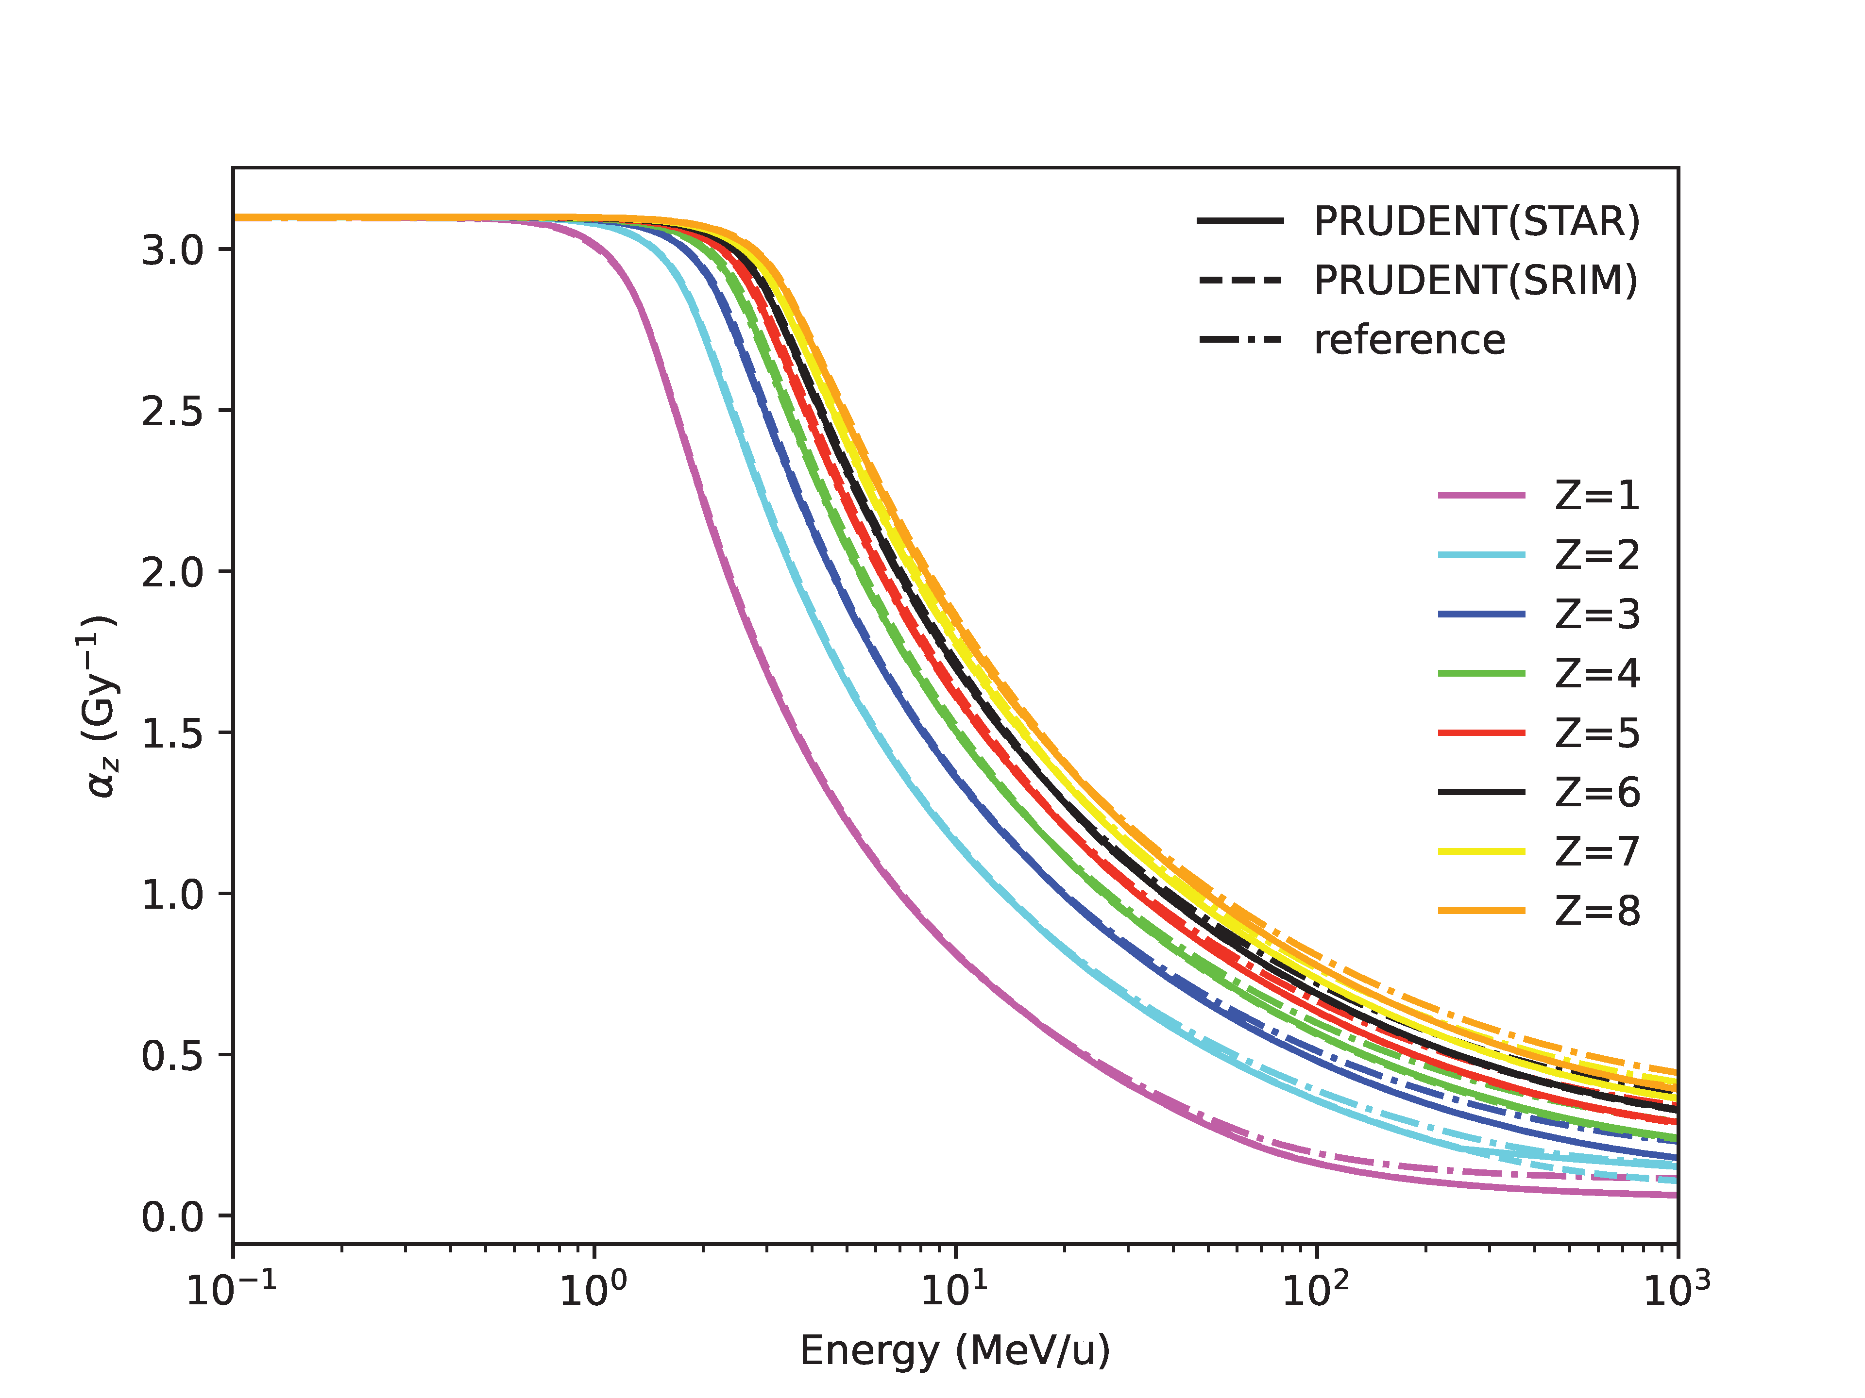
Generation of RBEActor input tables
PRUDENT: PRojectile μ-Dosimetric Effect in Nucleus evaluation Tool
Calculates the table of mMKM and table of LEM1lda
LEM1lda

Slide 17
Comparison of central RBE profile against TPS
Treatment planning system (TPS)
Dose engine: Pencil Beam Algorithm V7.0
RBE model: mMKM, LEM1 classic, LEM1 low dose approximation

Slide 18
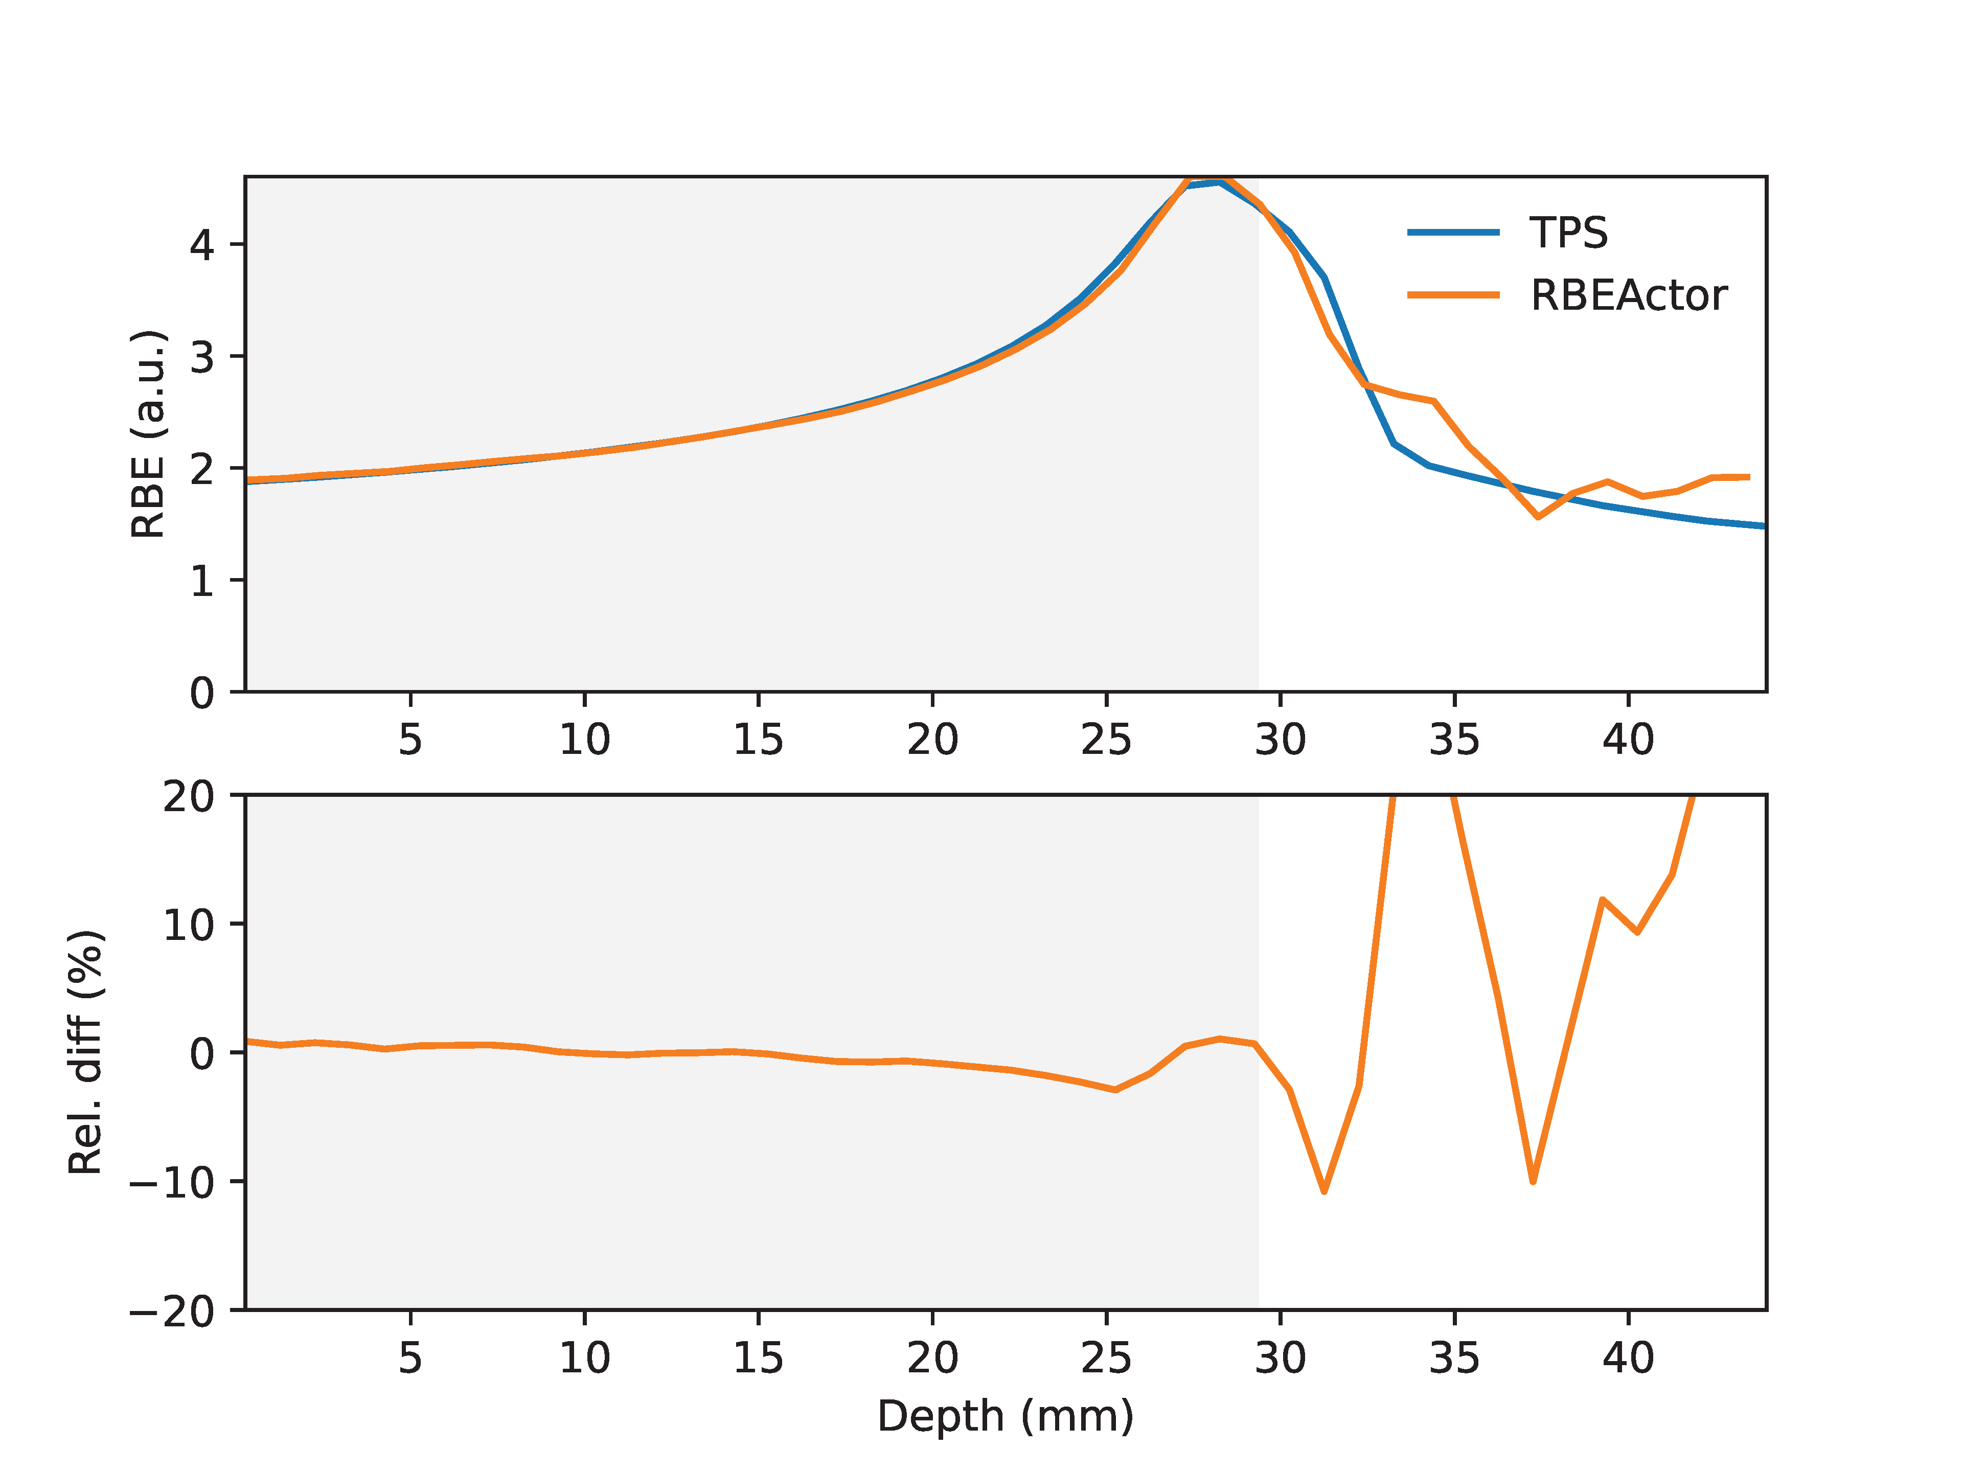
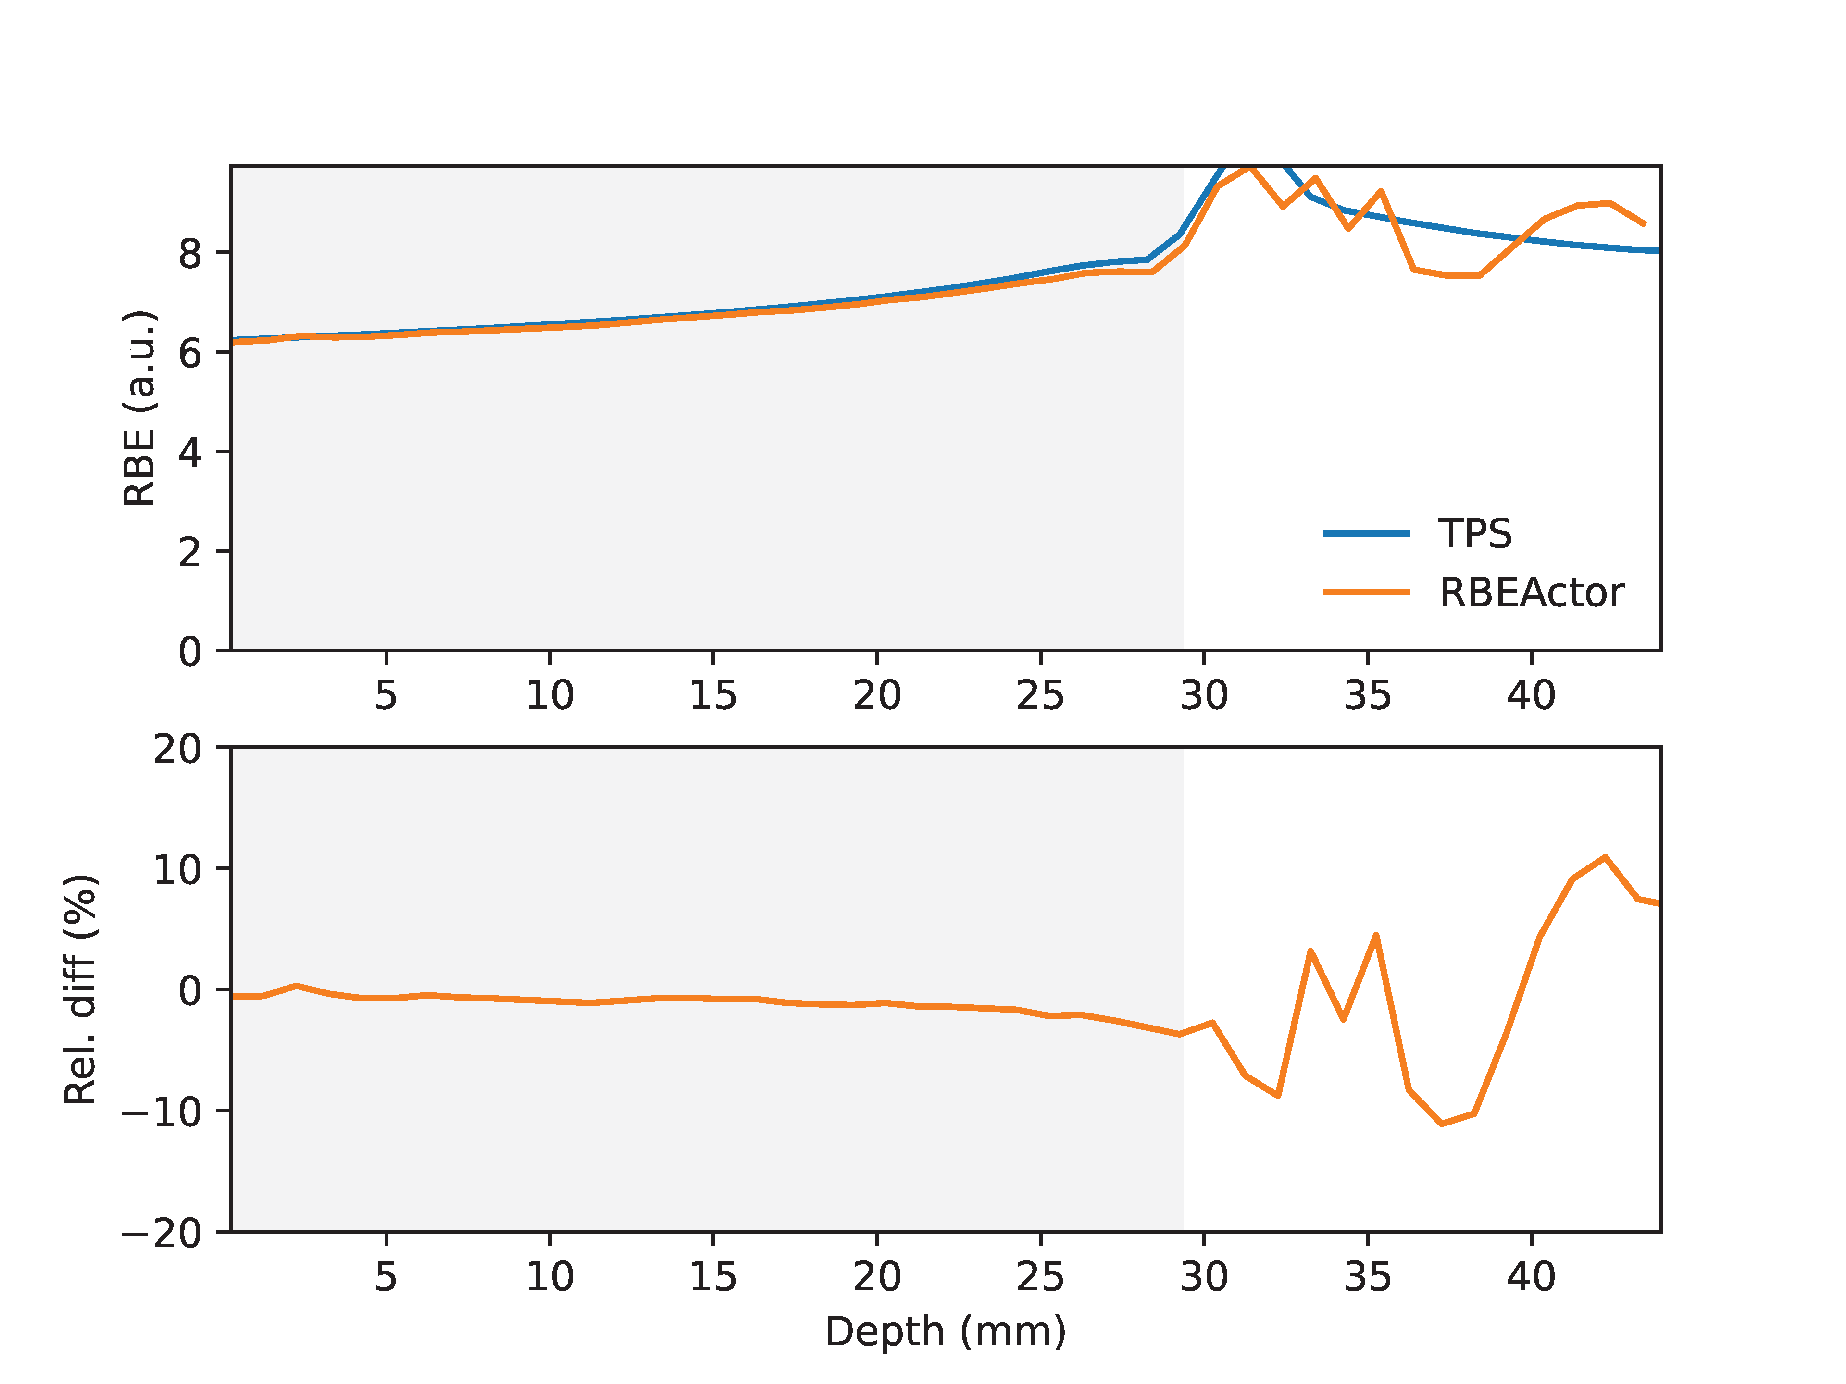
Comparison of central RBE profile against TPS
Treatment planning system (TPS)
Dose engine: Pencil Beam Algorithm V7.0
RBE model: mMKM, LEM1 classic, LEM1 low dose approximation
120.0 MeV/u pencil beam: rel. diff. < 3% until R₈₀-1 mm
Simulation settings:
G4_WATER
QGSP_BIC_HP_EMZ
reference input tables
1E5 primaries
mMKM
LEM1lda

Slide 19
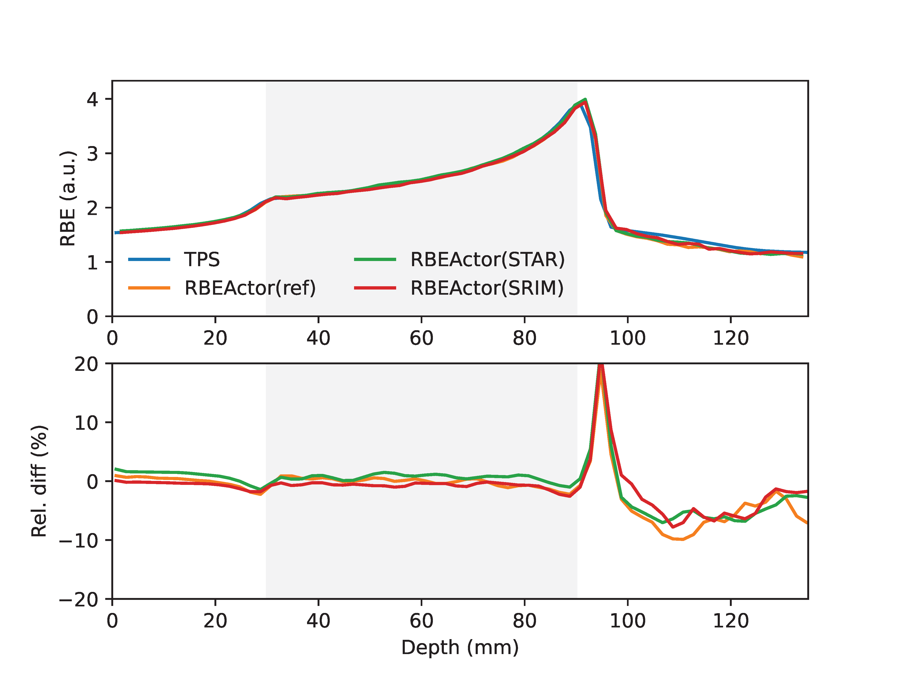
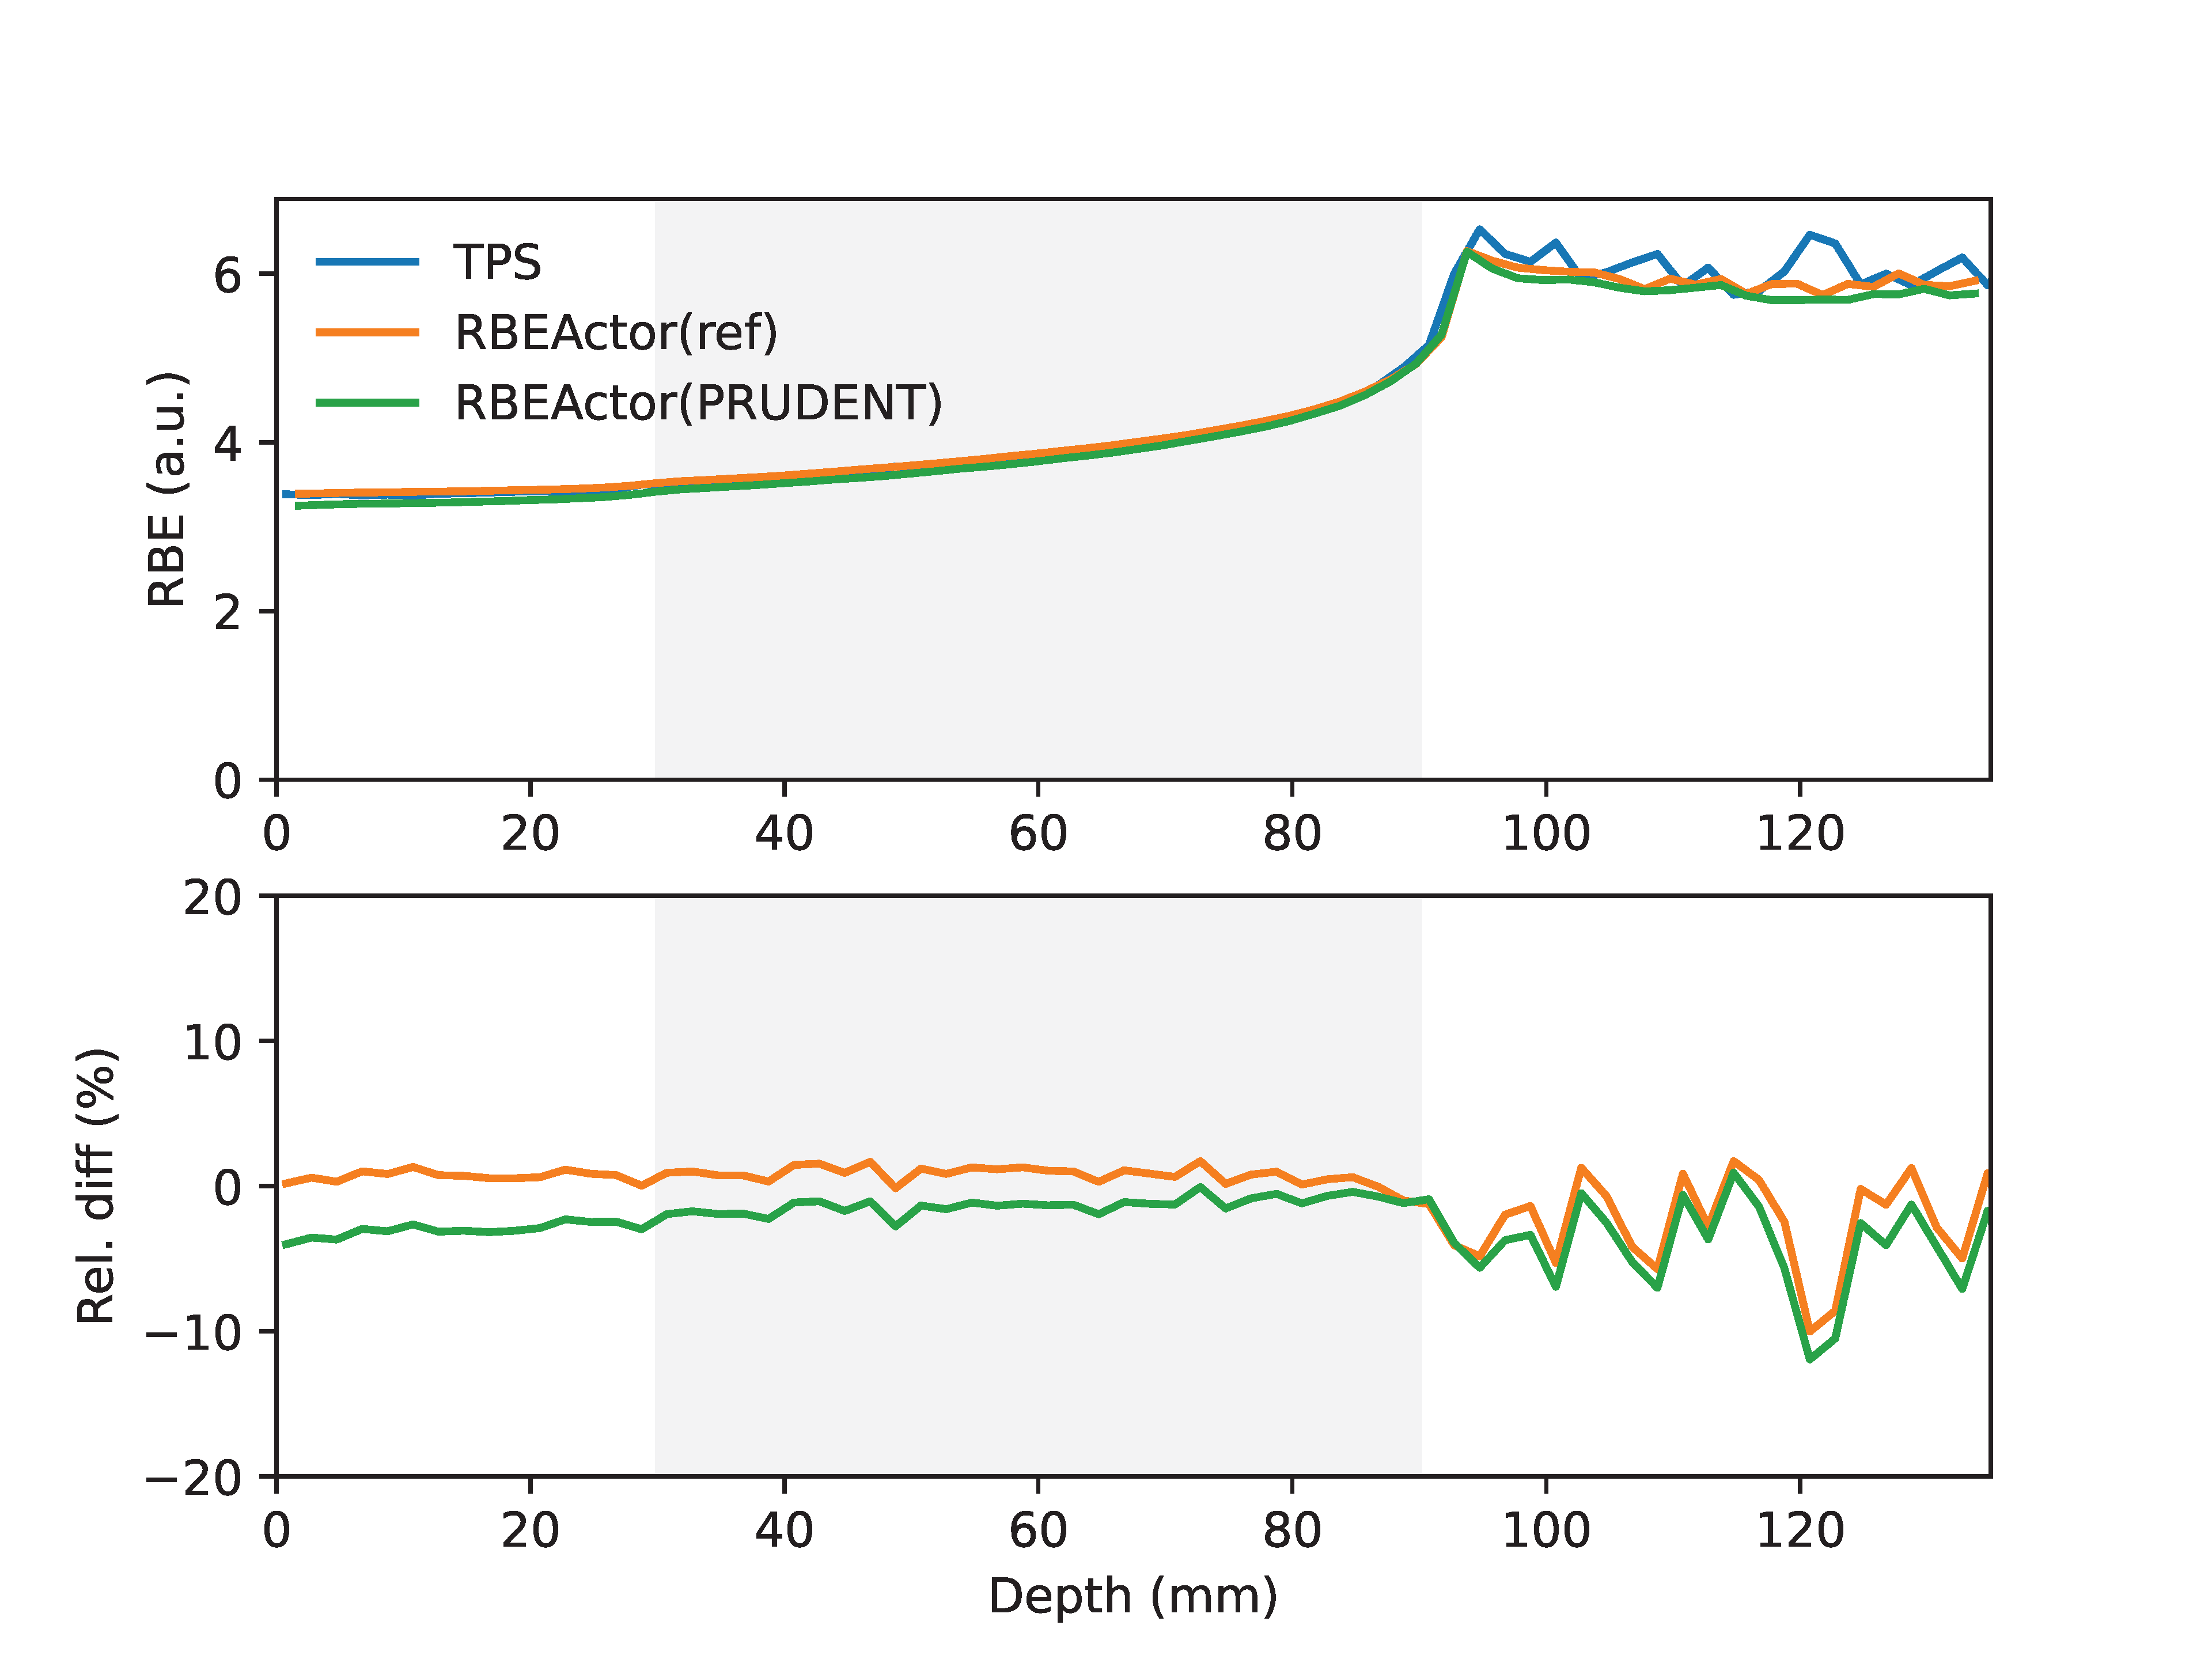
Comparison of central RBE profile against TPS
Energy modulated scanned beams:
field size 6 cm X 6 cm, modulation length 6 cm
depth of field center 6 cm
Uniform LEM1-RBE-weighted dose 2.3 Gy
Agreement with TPS profile better than 2% (reference table) and 3% (PRUDENT) within target region
LEM1 classic
mMKM
Simulation settings:
G4_WATER
QGSP_BIC_HP_EMZ
2% statistical uncertainty goal
mMKM
LEM1lda

Slide 20
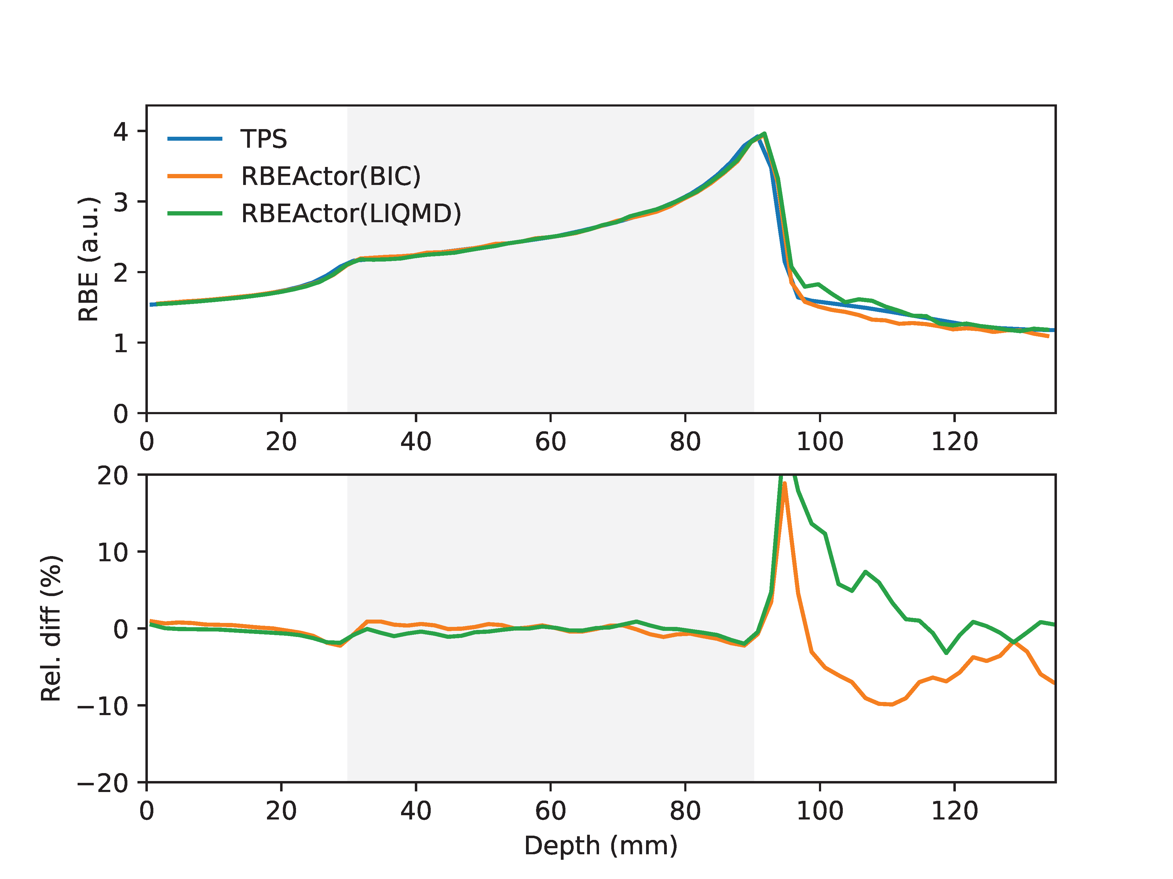
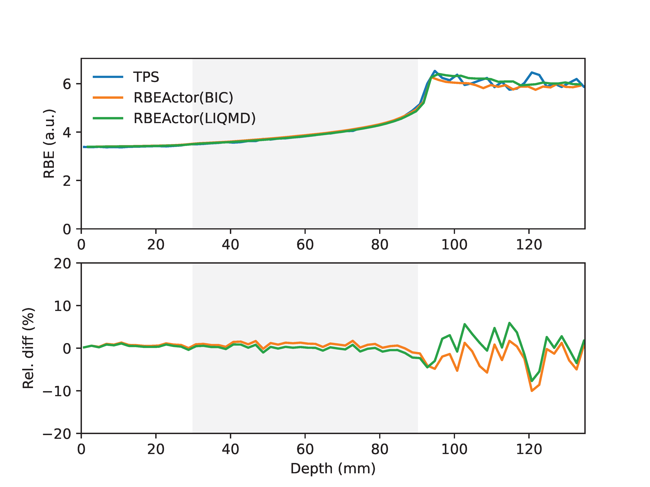
Comparison of central RBE profile against TPS
Physics lists: QGSP_BIC_HP_EMZ, ShieldingLIQMD_EMZ
Impact of nuclear interaction modelling:
agreement with TPS profile better than 3% within target region
Larger divergence in the fragmentation tail for mMKM, compared to LEM1lda
Simulation settings:
G4_WATER
Reference table
2% statistical uncertainty goal
mMKM
LEM1lda

Slide 21
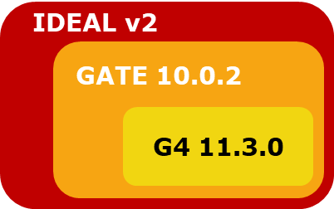
Conclusion
GateRBEActor supports the two clinically used RBE models, modified Microdosimetric Kinetic Model (mMKM) and Local Effect Model I (LEM1)
GateRBEActor is primarily benchmarked against clinical TPS RayStation 2024A
Further benchmarking will involve additional fields in water and fields in patient geometry
GateRBEActor is available in GATE 10.0.2 / GATE-RTiON V2!
Opengate documentation
Courtesy of M. Favaretto, “GateRTion v2: a reference GATE 10 version for ion beam therapy”

Slide 22
Acknowledgement
Medical Physics team, MedAustron
Michael Dutter and Patrick Simons, MedAustron
Giuseppe Magro, PhD, CNAO
Mansure Schafasand, PhD, MedAustron
The financial support from the “Niederösterreichischen Wirtschafts- und Tourismusfonds” and European union in form of the EFRE fonds is gratefully acknowledged.

Slide 23
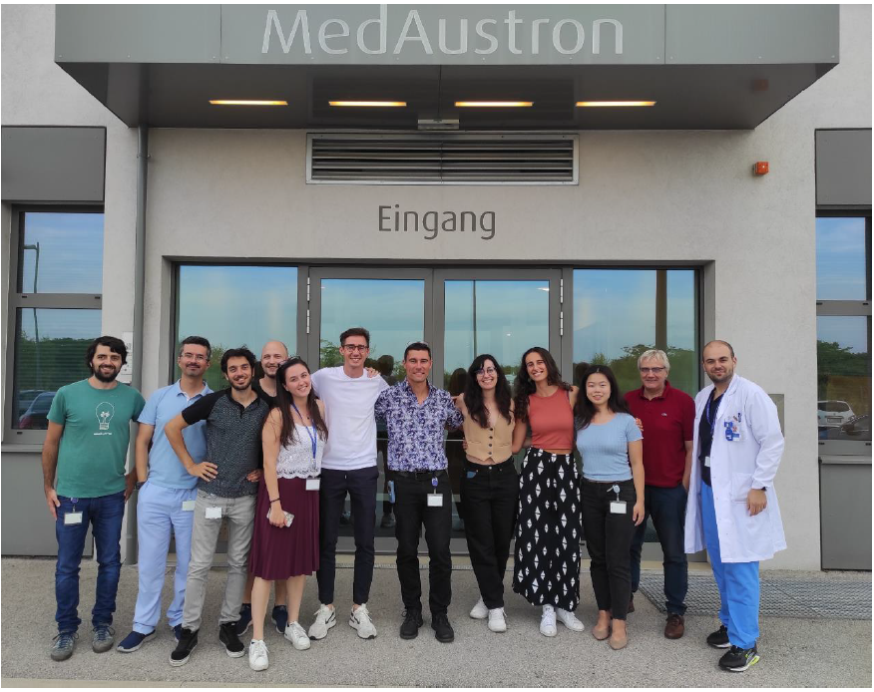
Thank you for your attention!

Slide 24
References
[1] Ridolfi, Riccardo. "Study of the track reconstruction in the FOOT experiment for Hadrontherapy." (2018).
[2] Hartmann, Laura, et al. "Photon versus carbon ion irradiation: immunomodulatory effects exerted on murine tumor cell lines." Scientific reports 10.1 (2020): 21517.
[3] R&D status in various countries. https://www.particle.or.jp/hirtjapan/en/medical/current/world.html Accessed date: 22/03/2025.
[4] Vector illustration by sasami018/ AC-illust on Page 10-14
[5] Zaider, M., and H. H. Rossi. "The synergistic effects of different radiations." Radiation research (1980): 732-739.

Slide 25
Electronic stopping power in water (G4_WATER)

Slide 26
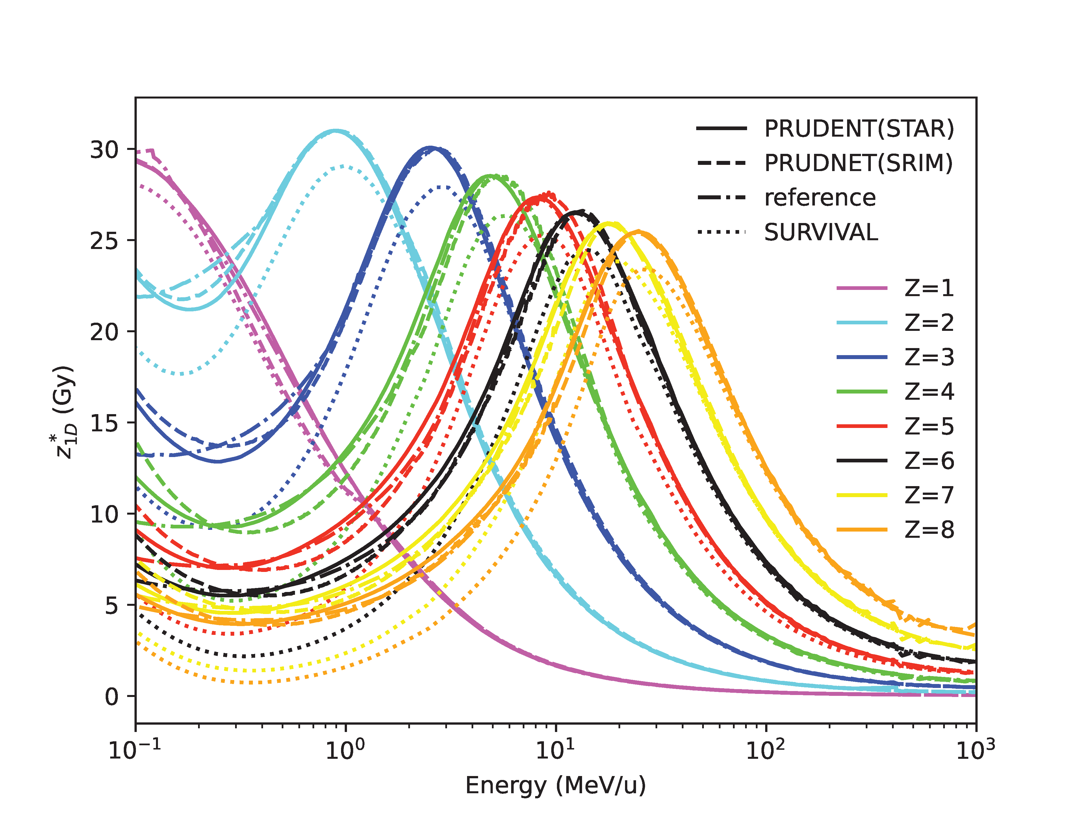
SURVIVAL z*1D table

