Slide 1




GATE Activity @ DeSIs-IPHC
L. V. Garcia Garcia (lucia-victoria.garcia-Garcia@iphc.cnrs.fr)
GATE Scientific Meeting 2025
Athens – 1st April 2025
Notes:
My name
PhD and group
GATE activity at DeSIs group in the IPHC

Slide 2


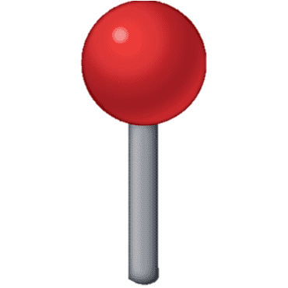

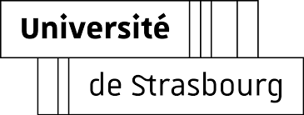
GATE @ DeSIs-IPHC
DeSIs = Dosimetry Simulation and Instrumentation
Members : 4 lecturers, 3 engineers-technicians, 2 Post-Doc, 3 PhD
Applied nuclear physics:
  Radiation protection
  Nuclear measurements
Notes:
Where are we?
DeSIs stands for Dosimetry Simulation and Instrumentation
DeSIs group activaties are mainly Applied nuclear physics --> MC softwares intercomparison and benchmarkin + radiation protection and dosimetry + nuclear measurements

Slide 3
GATE @ DeSIs-IPHC
  Nuclear data and MC softwares
    Charged and neutral secondary particles in hadrontherapy
    Neutron activation around particle accelerator
  Radiation protection & dosimetry
    Skin dose calculation in breast radiotherapy
    In/Out-of-field dose calculation in hadrontherapy
    Patient and staff dosimetry in interventional radiology
  Nuclear measurements
    Neutron field mapping
    Machine learning algorithm for gamma spectrometry
Notes:
MC softwares intercomparison and benchmarkin
Neutron production in hadrontherapy
Neutron activation around particle accelerator
Radiation protection and dosimetry
Skin dose calculation in breast radiotherapy
In/Out-of-field dose calculation in hadrontherapy
Patient and staff dosimetry in interventional radiology
Nuclear measurements
Neutron field mapping
Machine learning algorithm for gamma spectrometry

Slide 4
Index
Active Neutron Detection (80 Prime CNRS PhD project)
  Main goal
  Why using GATE?
  1st Results
  Next steps
Neutron nuclear models (SIMBAD, EURADOS)
GATE10 Isotope definition
Notes:
Three main GATE activities at DeSIs at the moment
- Active neutron detection →my PhD project
- Neutron nuclear models (SIMBAD, EURADOS)
- GATE10 Isotope definition

Slide 5
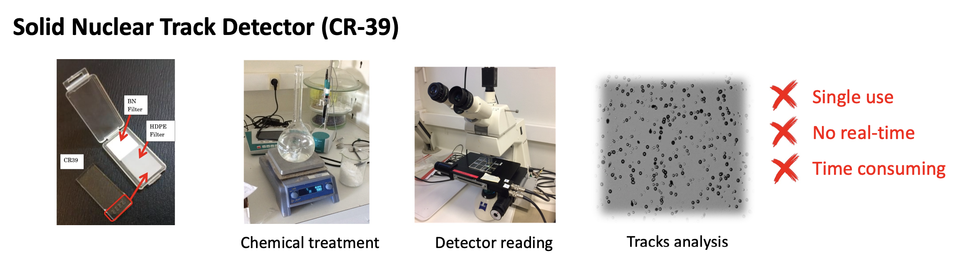
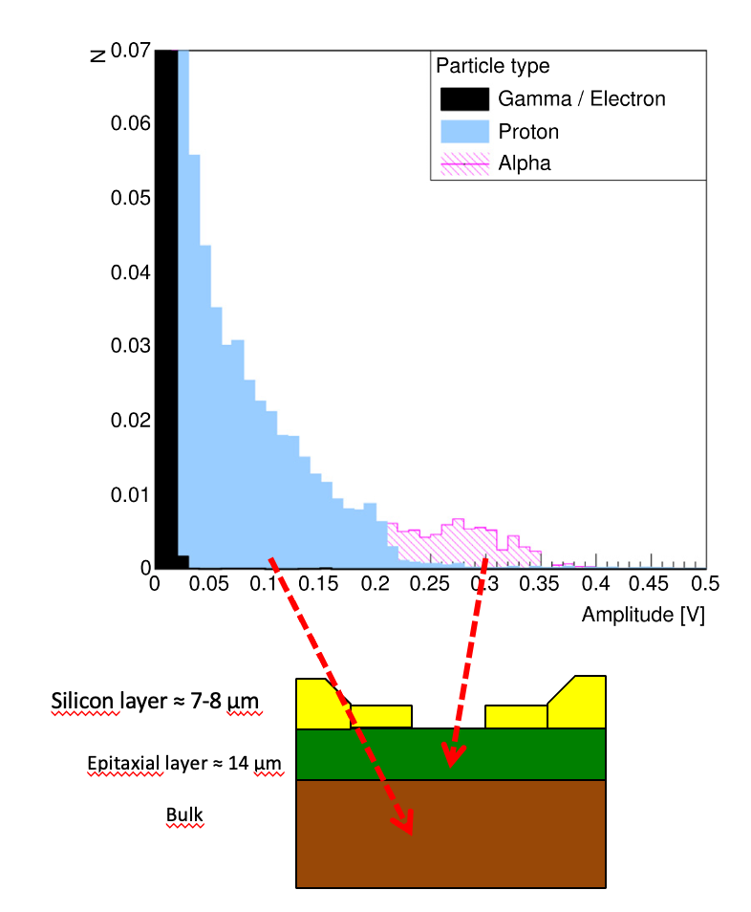
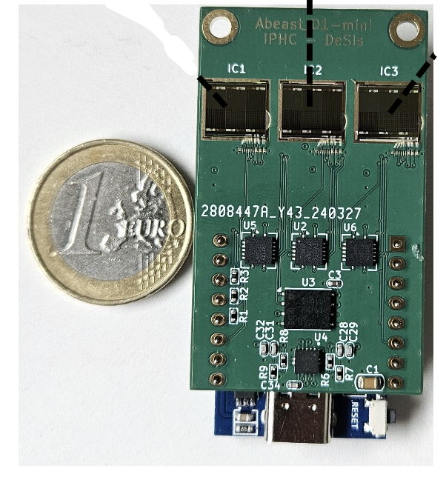
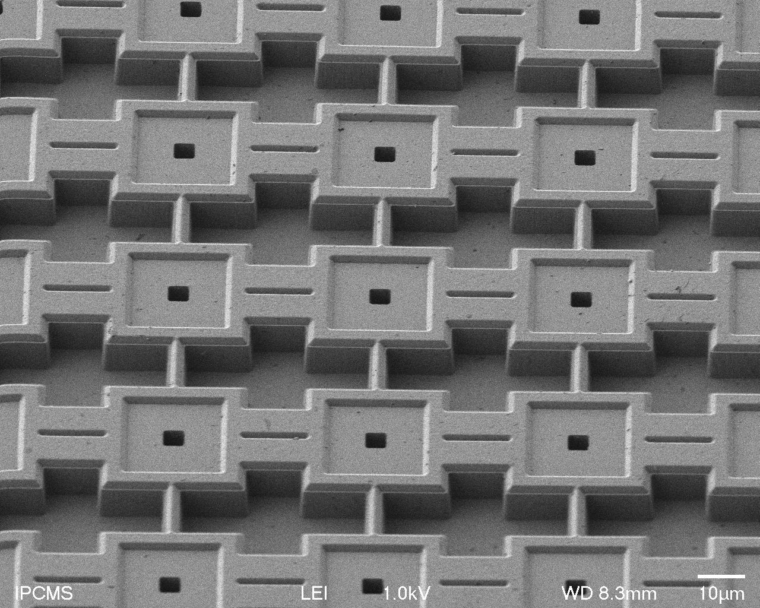
PhD Project
Neutrons are the main secondary particle for particle accelerator and space radiation protection
Most current neutron detectors are based on passive methods
AlphaBeast project @ IPHC:
  We aim to develop a CMOS sensor capable to detect Thermal
  and Fast neutrons on real-time
  4D monitoring
sensor network (3D - space)
real-time monitoring (1D - time)
Notes:
To understand my PhD project is important to know a bit about neutrons dosimetry
- Neutrons are the main secondary particle in particle accelerators and space radiation
- Due to neutrons nature → it’s difficult to detect → passive methods
- Main detector currently is CR-39
- Plastic piece with neutron converter on top + after some time chemical treatment and calculation of neutron fluence → neutron tracks counts
- We aim to develop an active Neutron detector called ALPHABEAST
- CMOS sensor → able to detect thermal and fast neutron
- capable of special +time monitoring
- Explain how does it work
- FN → PE → can transverse up to the bulk of the CMOS
- TN →10B → deposit mainly on the Silicon oxide of the CMOS (open region)

Slide 6

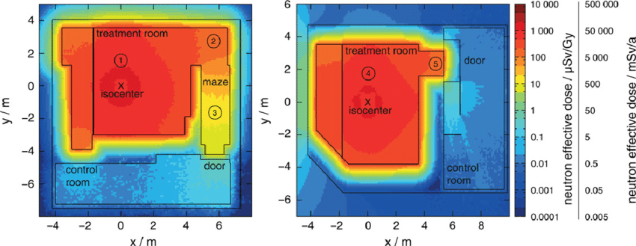
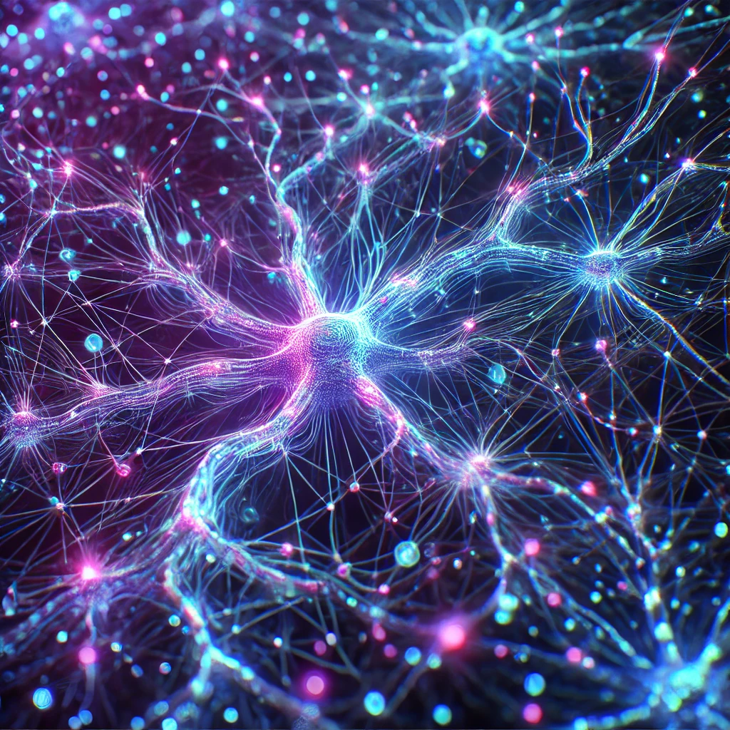
PhD Project
Develop a hybrid neutron mapping system that couple AlphaBeast sensors and AI algorithm
  AI model trained on Monte Carlo neutron maps (GATE)
  Model predictions based on a finite number of AlphaBeast measurements
Treatment room
1
2
MC simulation
Radiotherapy
device
Maze
3
Door
Control room
Neural network
Horst, F., Fehrenbacher, G., & Zink, K. (2017).
Notes:
The final goal of the PhD project
Develop a hybrid neutron mapping system → ALPHABEAST + AI algorithm
AI trained with MC neutron maps → GATE mainly
The prediction based on a finite number of AlpgaBeast measurements

Slide 7
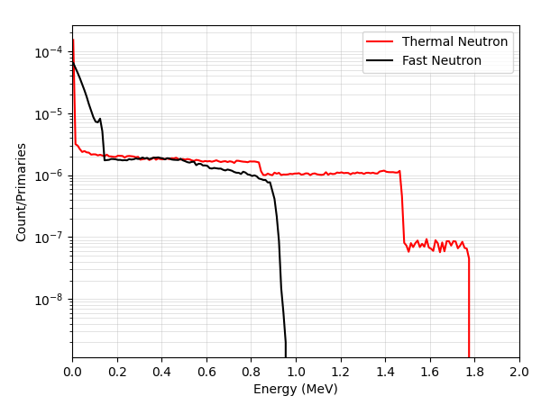
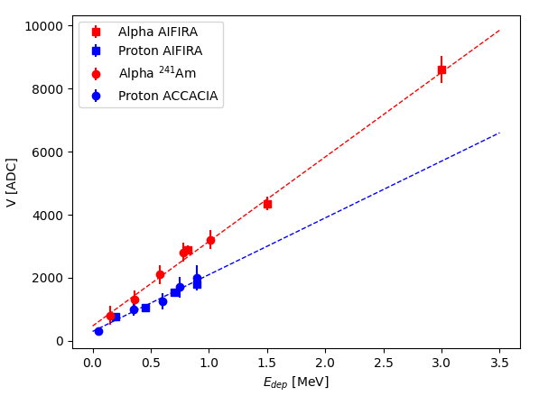
Why using GATE?
We (will) use GATE:
  To determine the expected alpha/proton energy deposition on the sensor
  To determine the type of particle interacting with the sensor (background)
  To compute the energy calibration
  To train our neural network (neutron maps)
Notes:
For what we will be using ?
Determine the type of particles that will be interacting with the sensor when using the converter and when nop
Predict the energy deposited by this particles
Obtain the energy calibration (third graph) → conversion between ADC signal coming from the sensor to go to energy spectrum
And the final stages → train AI algorithm

Slide 8

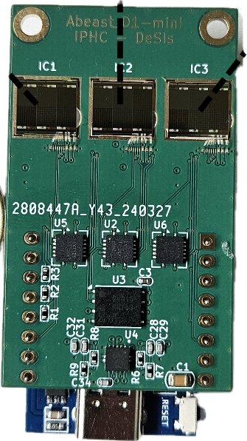
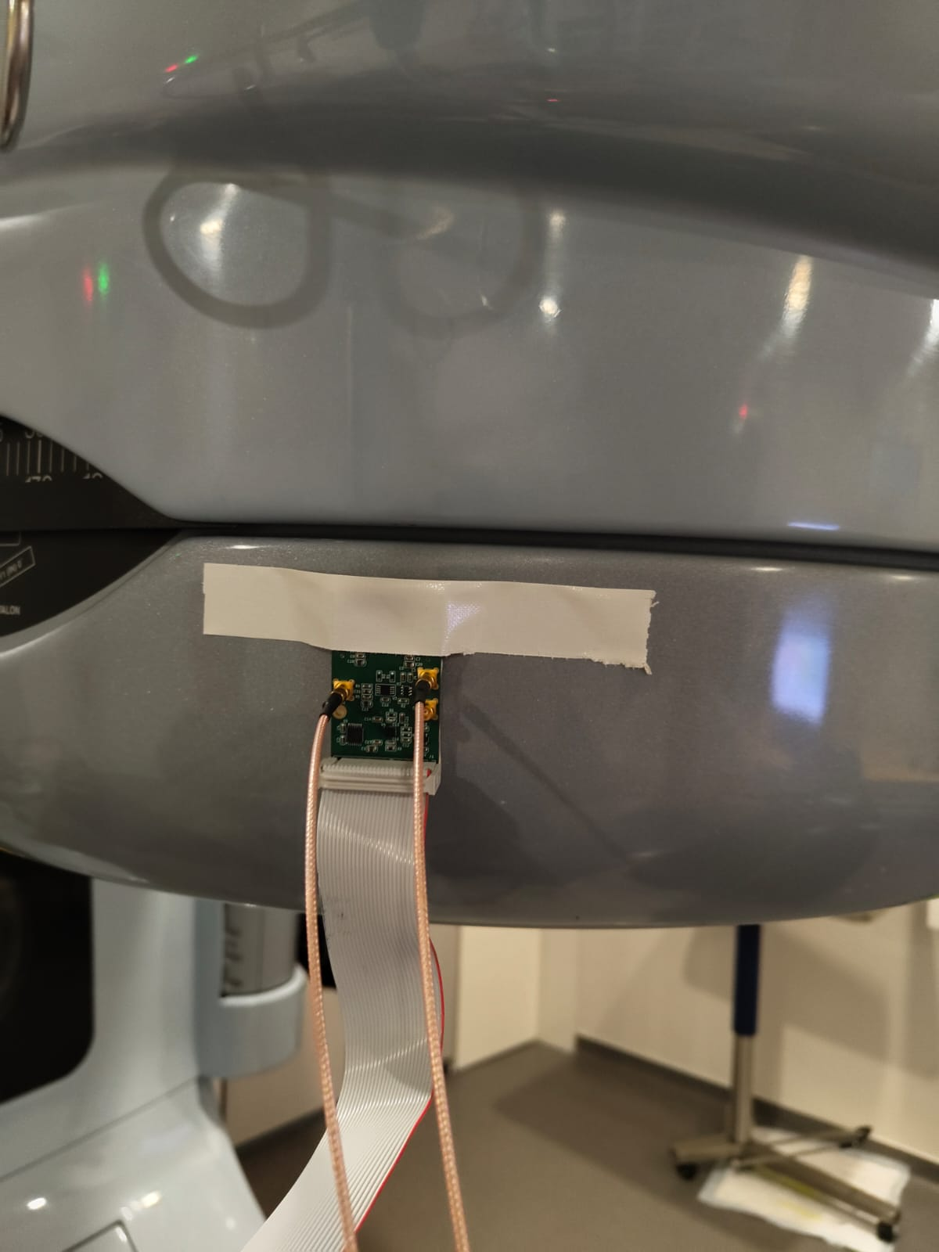
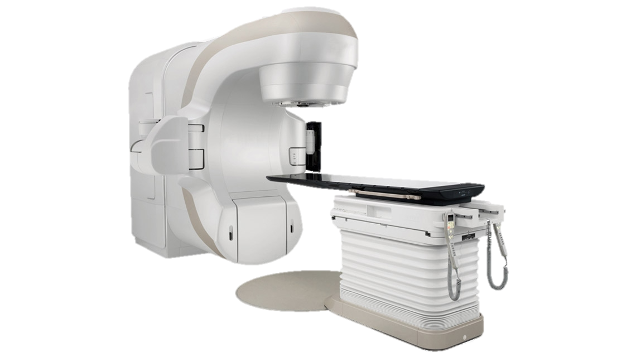
Experimental data acquisition set up
1st experiment
Photo-neutron production with 15MV radiation therapy Linac
AlphaBeast
Notes:
- We run a first experiment at the ICAN a Cancer treatment facility in Strasbourg
- We placed the sensor of the linac to take measurements

Slide 9
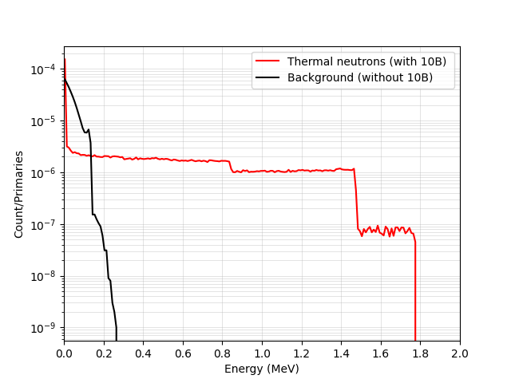
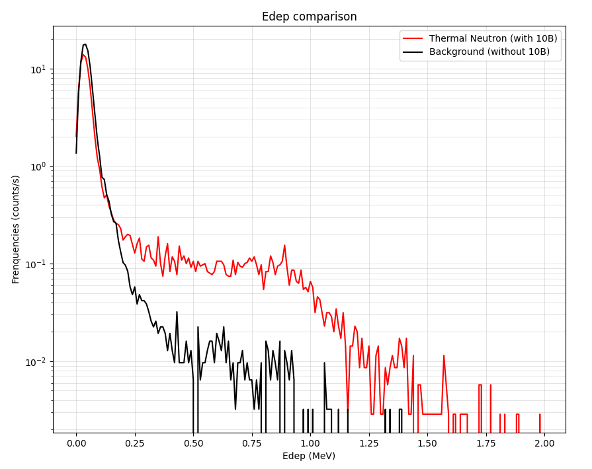
Experimental data comparison
1st experiment
GATE simulations
Experimental data
1 MeV neutrons
We can clearly distinguish thermal neutron signals from background
Background signal is a bit larger in experiments due to “unknown” neutron spectrum
Notes:
We compared the experimental measurements to GATE simulations for Thermal neutrons converted with 10B
We can observe that the background signal in the experiments is larger than for the simulation → this could most probably be because of a unknown neutron spectrum in the radiotherapy room → that is why we need to perform some more experiments in this facility to understand better this unknown neutron spectrum
Still, we can still tell apart the thermal neutrons from the background signal → what we wanted

Slide 10
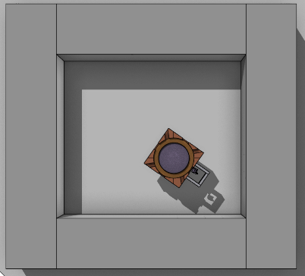
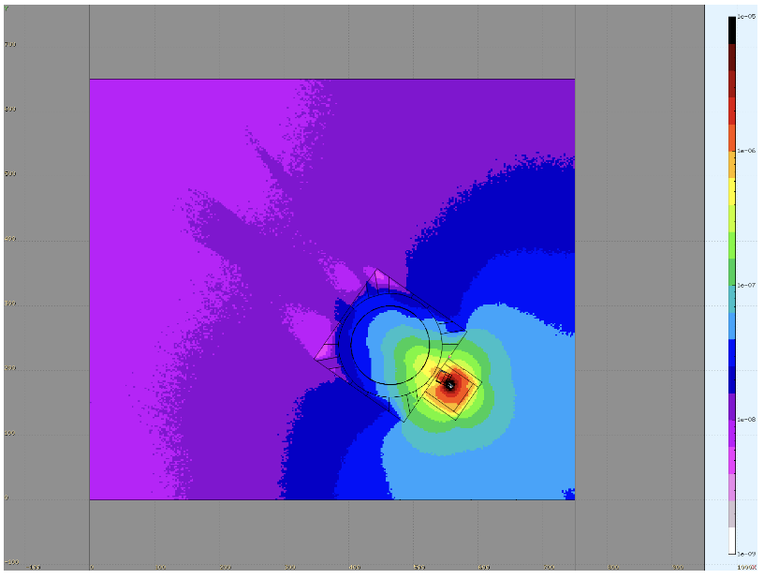
Next steps?
Run experiments at CYRCE – 25MeV cyclotron facility @ IPHC
Measurement of secondary neutrons in the cyclotron room
Comparison with:
- MC simulation
- CR39 measurements
- activation foil measurements
Simulation of the Cyclotron room (FLUKA)
Neutron Fluence in the cyclotron room
Horodynski, J.-M., Oster, D., & Foehrenbacher, T.
Notes:
What will be our next steps in this project?
We will run some measurements at the cyclotron platform @ IPHC, CYRCE, with energy up to 25MeV
We will measurmen secondary neutrons in the cyclotron room
Afterwards we will compare these measurements with state of the art sensor CR39 and active foil measurements and MC simulations (example of fluka fluence calculation)

Slide 11


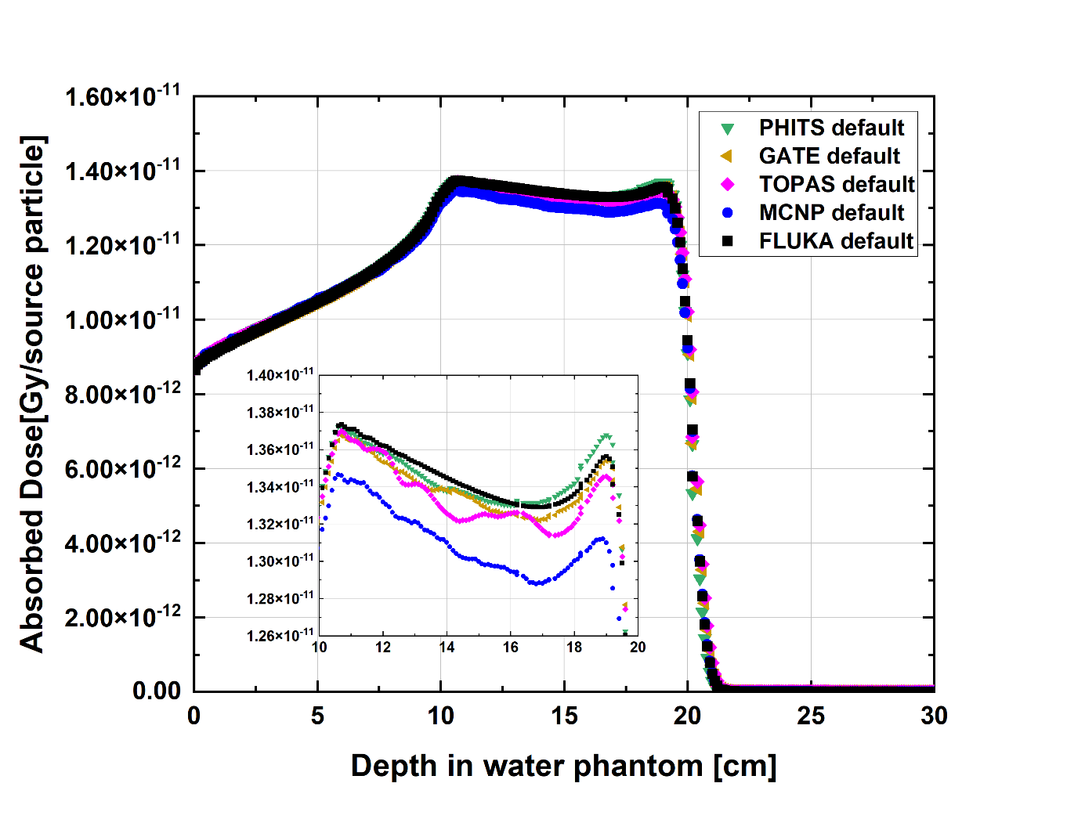
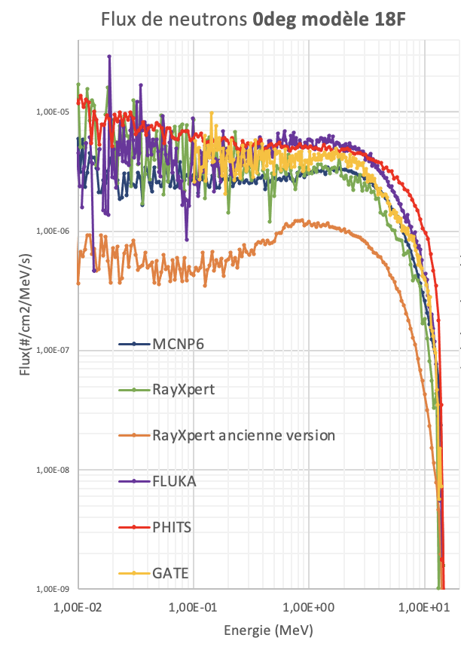

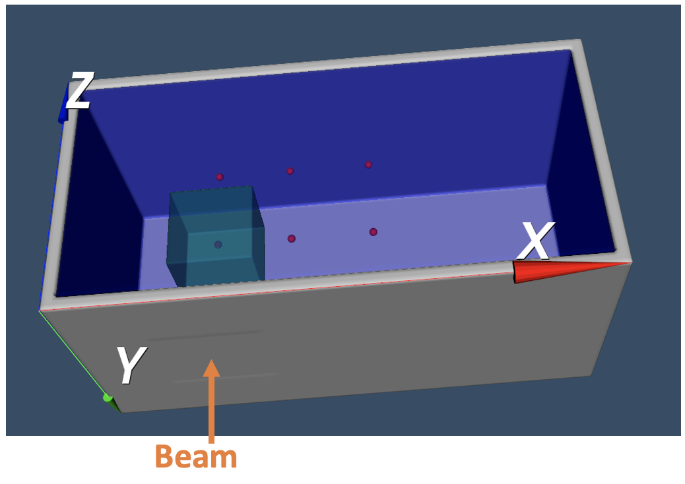
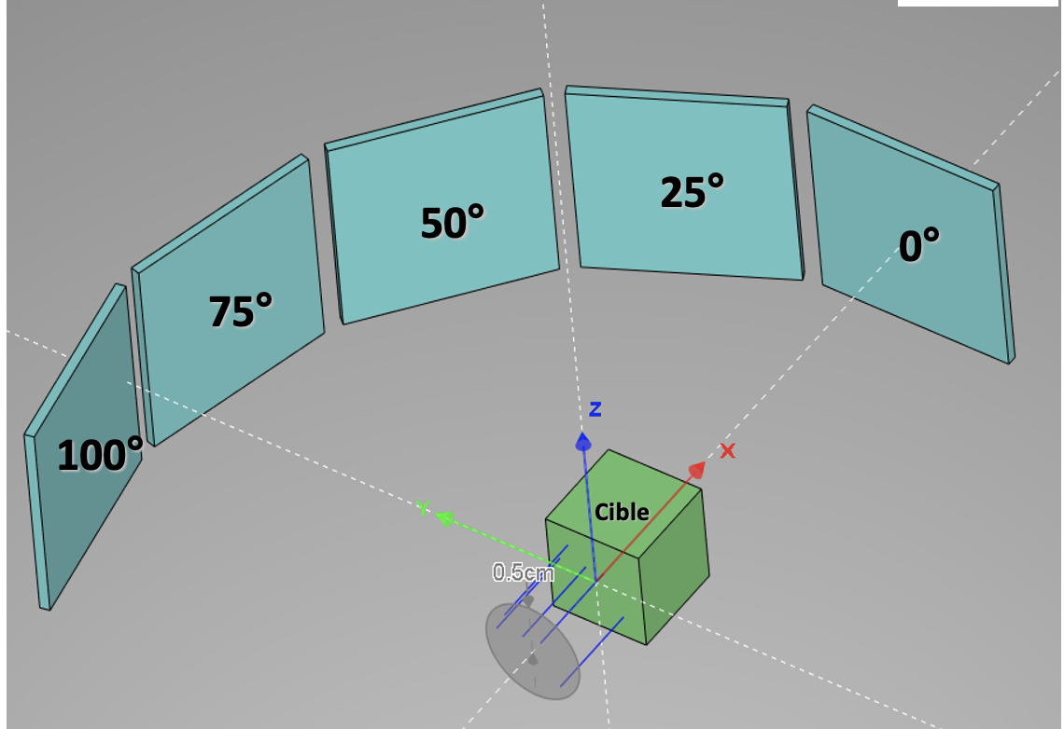
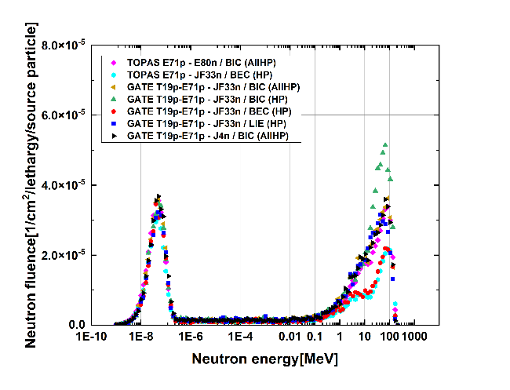




Nuclear models for secondary neutron
DeSIs team is involved in several collaborative projects to benchmark Geant4/GATE nuclear models
EURADOS (WG9 – hadrontherapy)
SIM-𝛽AD (BPI-ANDRA)
Target volume
Water phantom (PMMA walls)
Notes:
Since we will be comparing our measurements with MC simulation (GATE) → we collaborate in different project to benchmark Geant4/GATE nuclear models with other MC simulation
Eurados → hadrontherapy oriented (100MeV) → comparison MC simulations of primary dose from protons and secondary neutron dose → take same treatment plan and analyze the discrepancies between different MC software (FLUKA, MCNP, TOPAS, GATE and PHITS)
For the neutron fluence they used different nuclear models in GATE to analyze the differences
Simbad → particle accelerator neutron production (not same energy 20MeV)
RAYEXPER → gEANT4 → INDUSTRAIL APP + USER FRIENDLY (don’t use GEANT4 directly)

Slide 12
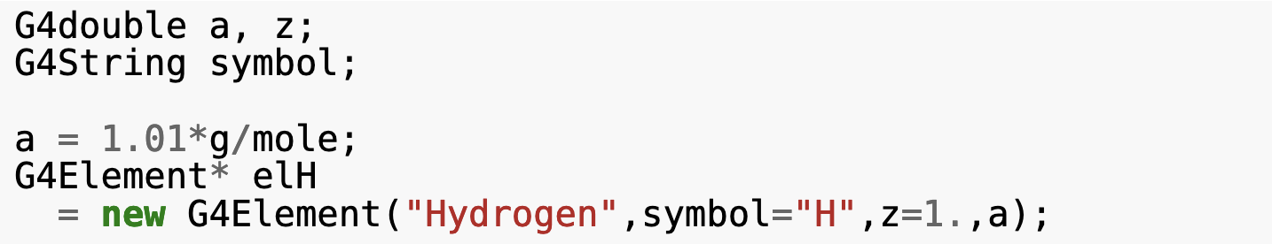
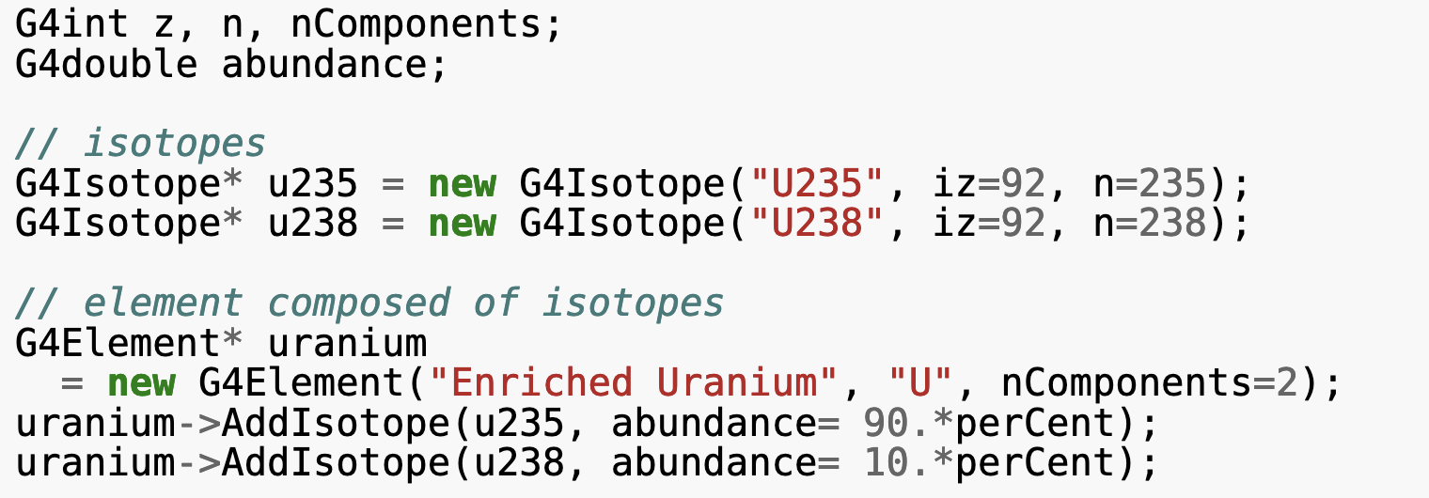

GATE10: Isotope materials
G4Elements can be defined with or without specifying the isotope composition
* In this case natural isotope composition is used by default
GATE10 offers the possibility to create isotope materials
Thanks to David, Thomas
and Nils for their help !!
[Isotopes]
H2: Z=1 ; N=2 ; A= 2.01568 g/mole
[Elements]
Hydrogen: S= H ; Z= 1. ; A= 1.01 g/mole
H2: n=1 ; S= H2
+iso: name=auto ; f=1
[Materials]
Hydrogen: d=1.00 g/cm3; n=1 ; state=liquid
+el: name=Hydrogen ; n=1
Deuterium: d=1.0 g/cm3 ; n=1 ; state=liquid
+el: name=H2; n=1
natural isotope composition
100% deuterium (²H) composition
Notes:
In Geant4 we can define an element/material with and without actually defining the isotopes in their composition → both option available ( if not specified it will use the natural isotope)
Isotope definition needs to be included the number of protons and n, the number of n nucleons
However in GATE we do need it → for GATE10 it was not yet ready → it was implemented in GATE10 just last week (thanks to David, Thomas and Nils)
First define the Isotopes,
Then the element H2
And finally you can define the material including the composition percentage of the isotope/element

Slide 13
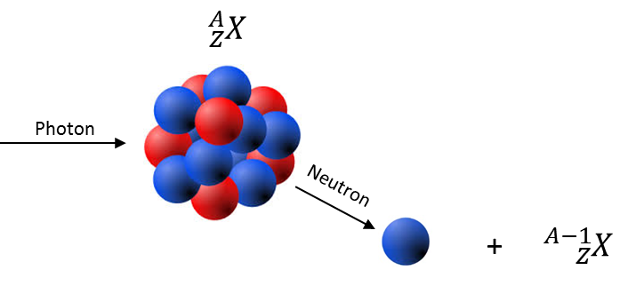

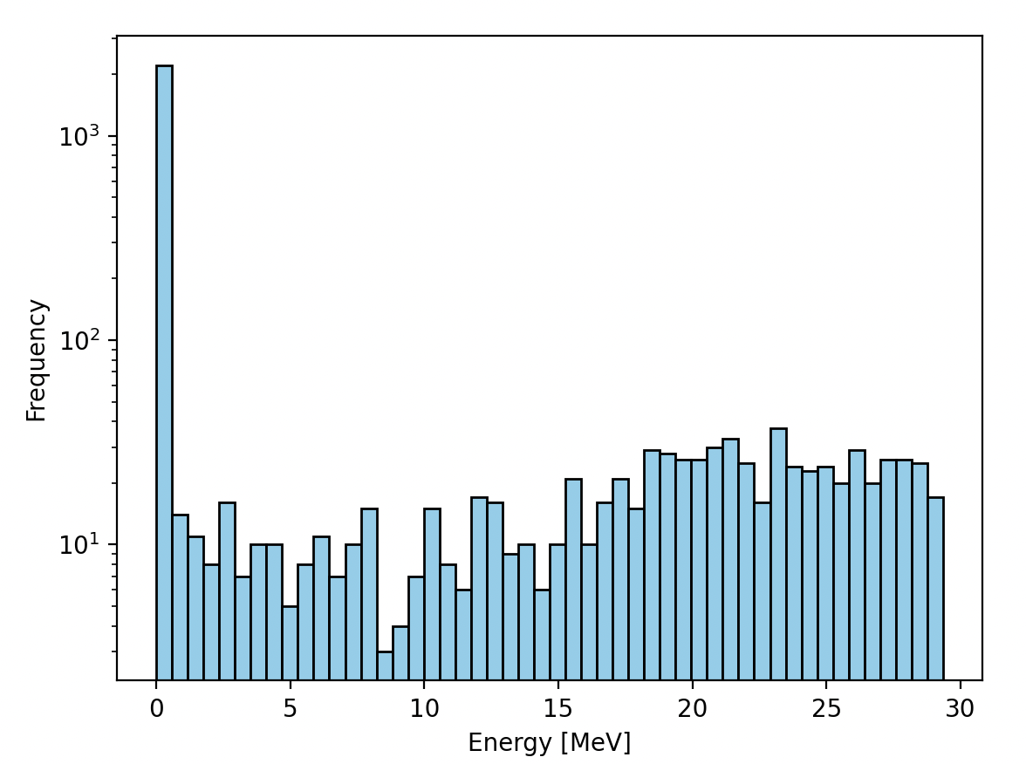
GATE10: Isotope materials
Some basic test: photo-neutrons production with Hydrogen and Deuterium target
For n = 10⁶ photons:
Hydrogen target: no neutron
Deuterium target: ≈ 3000 neutrons
Hydrogen: ¹H (99.99%), ²H (0.01%)
Deuterium: ²H (100%)
50 MeV photons
Notes:
Here we have basics test with Hydrogen
- when applying photon a H1 hydrogen → no neutrons are obtained in this case
- when applying same photon beam to deuterium → we obtain neutrons with this spectrum

