Slide 1
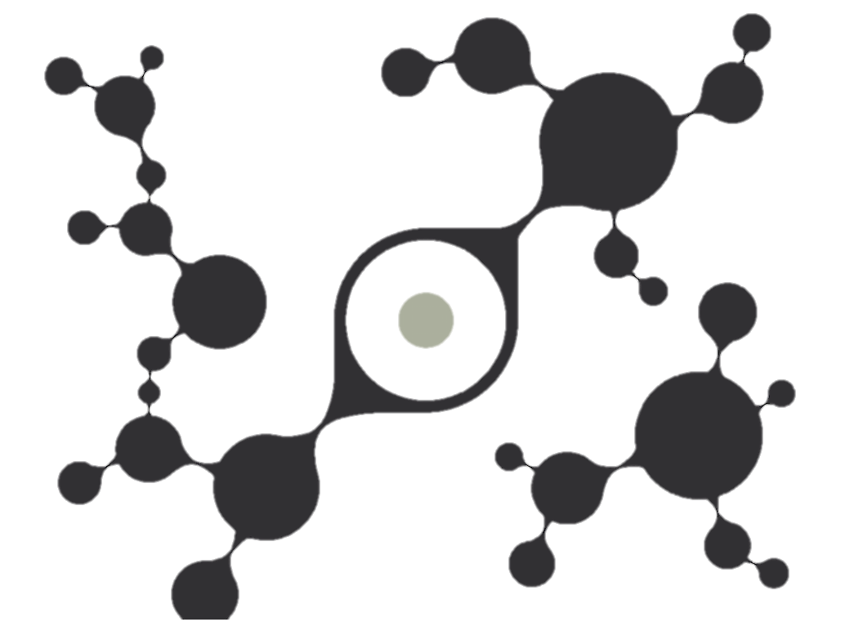
Panagiotis Papadimitroulas Associate Prof. Biomedical Informatics Head of Software & Co-Founder panpap@bioemtech.com www.bioemtech.com
GATE activities @ BIOEMTECH
1 April 2025
Athens, Greece
BIOEMTECH▸ ATHENS, GREECE ▸ +210 6548192 ▸info@bioemtech.com

Slide 2
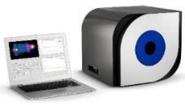
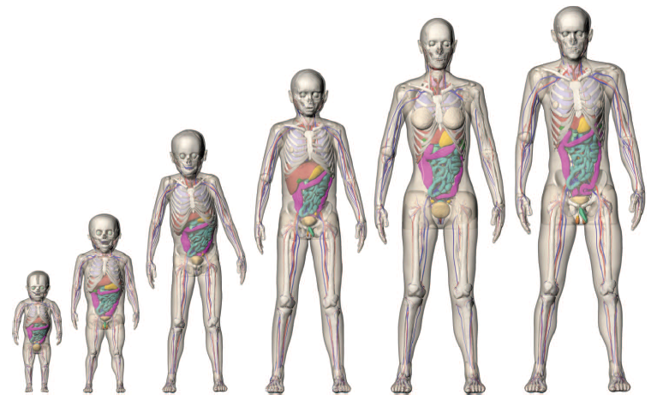
About BIOEMTECH
BIOEMTECH develops and offers innovative solutions in pharmaceutical and medical physics and biotechnology research
We focus on molecular imaging, dosimetry & biomedical engineering:
Design and construction of screening imaging systems, the eyesTM
Preclinical CRO for testing new radiolabelled compounds
Computational tools for medical imaging and dosimetry
Courtesy of BIOEMTECH

Slide 3
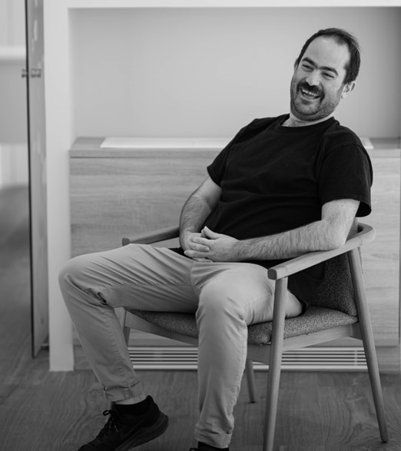
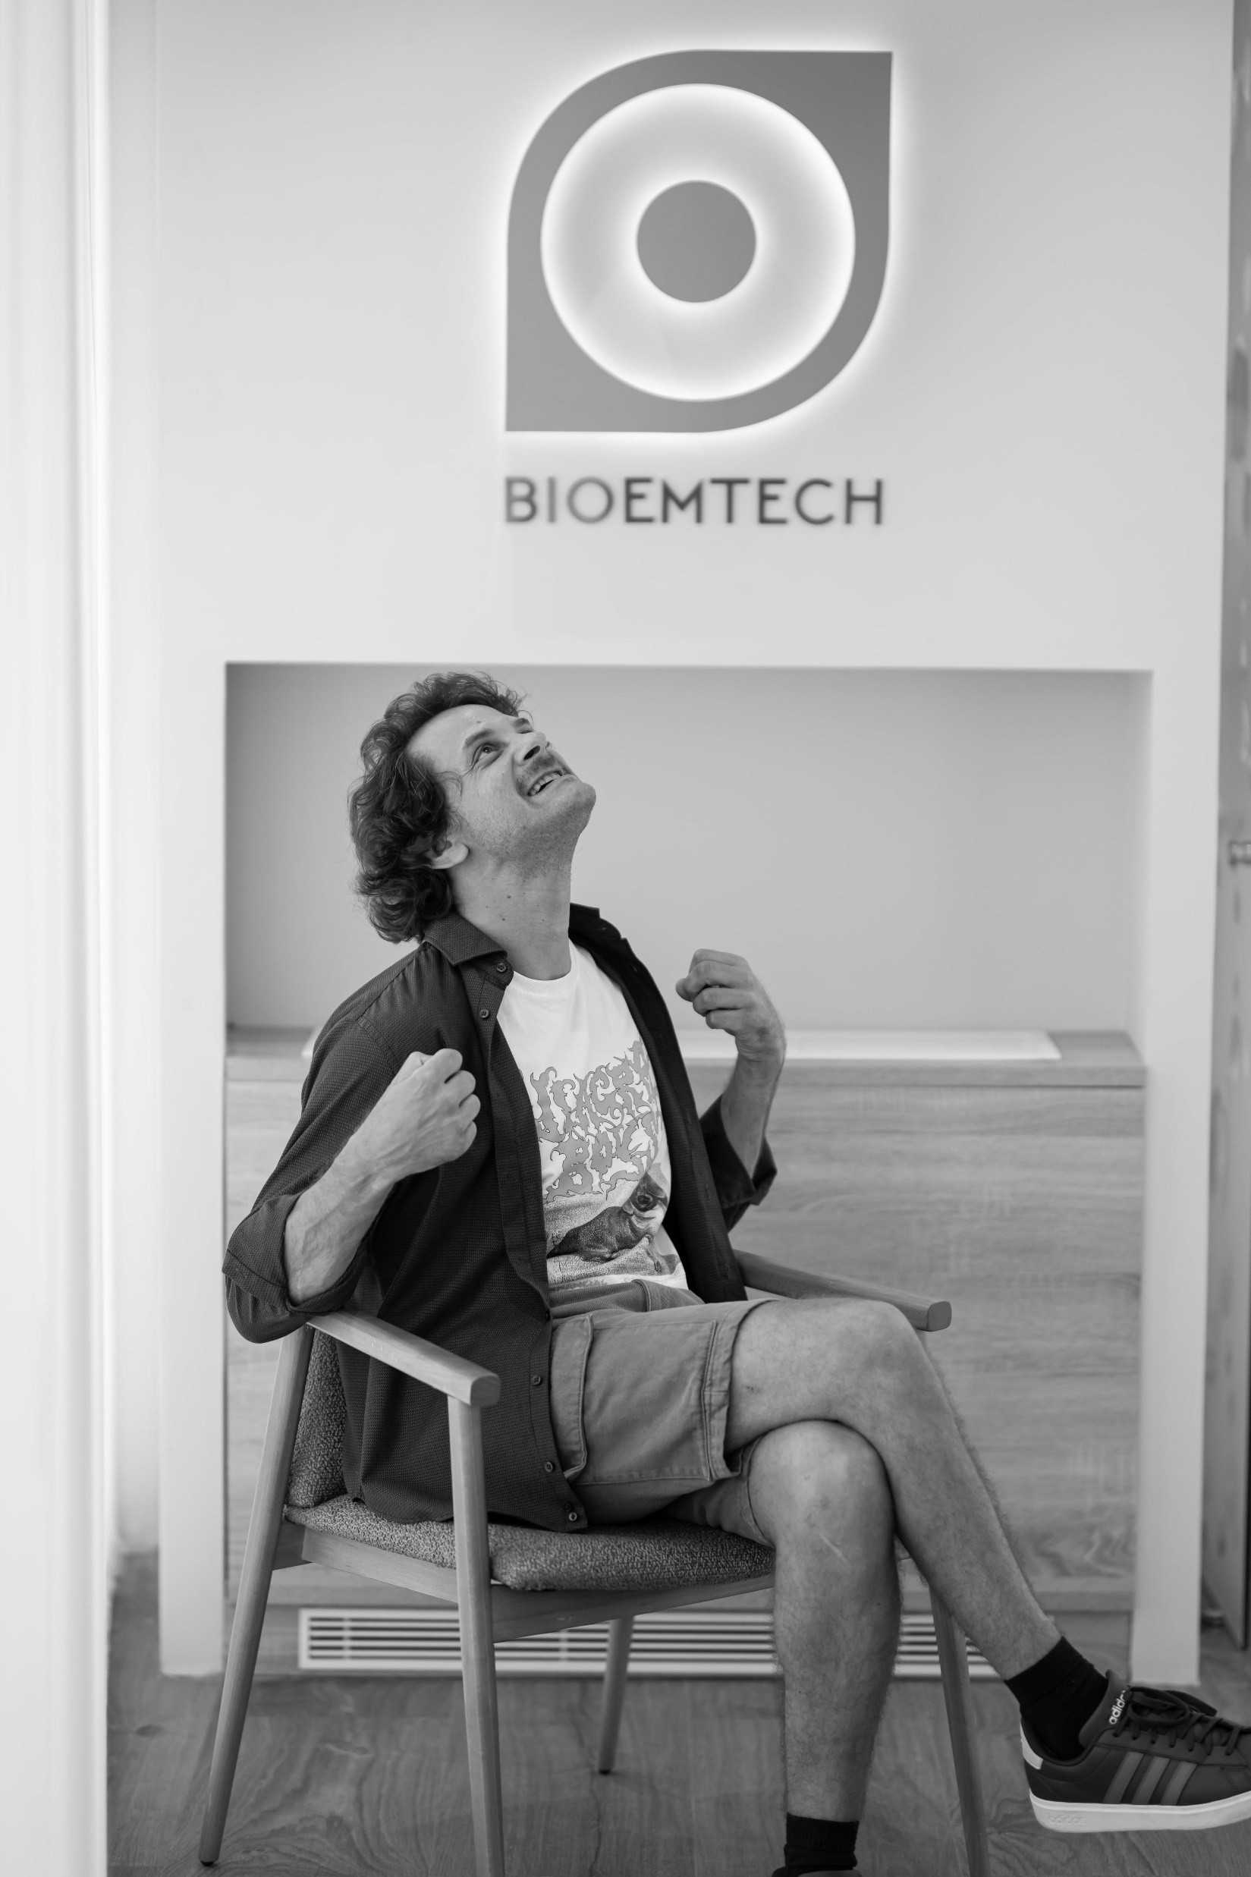
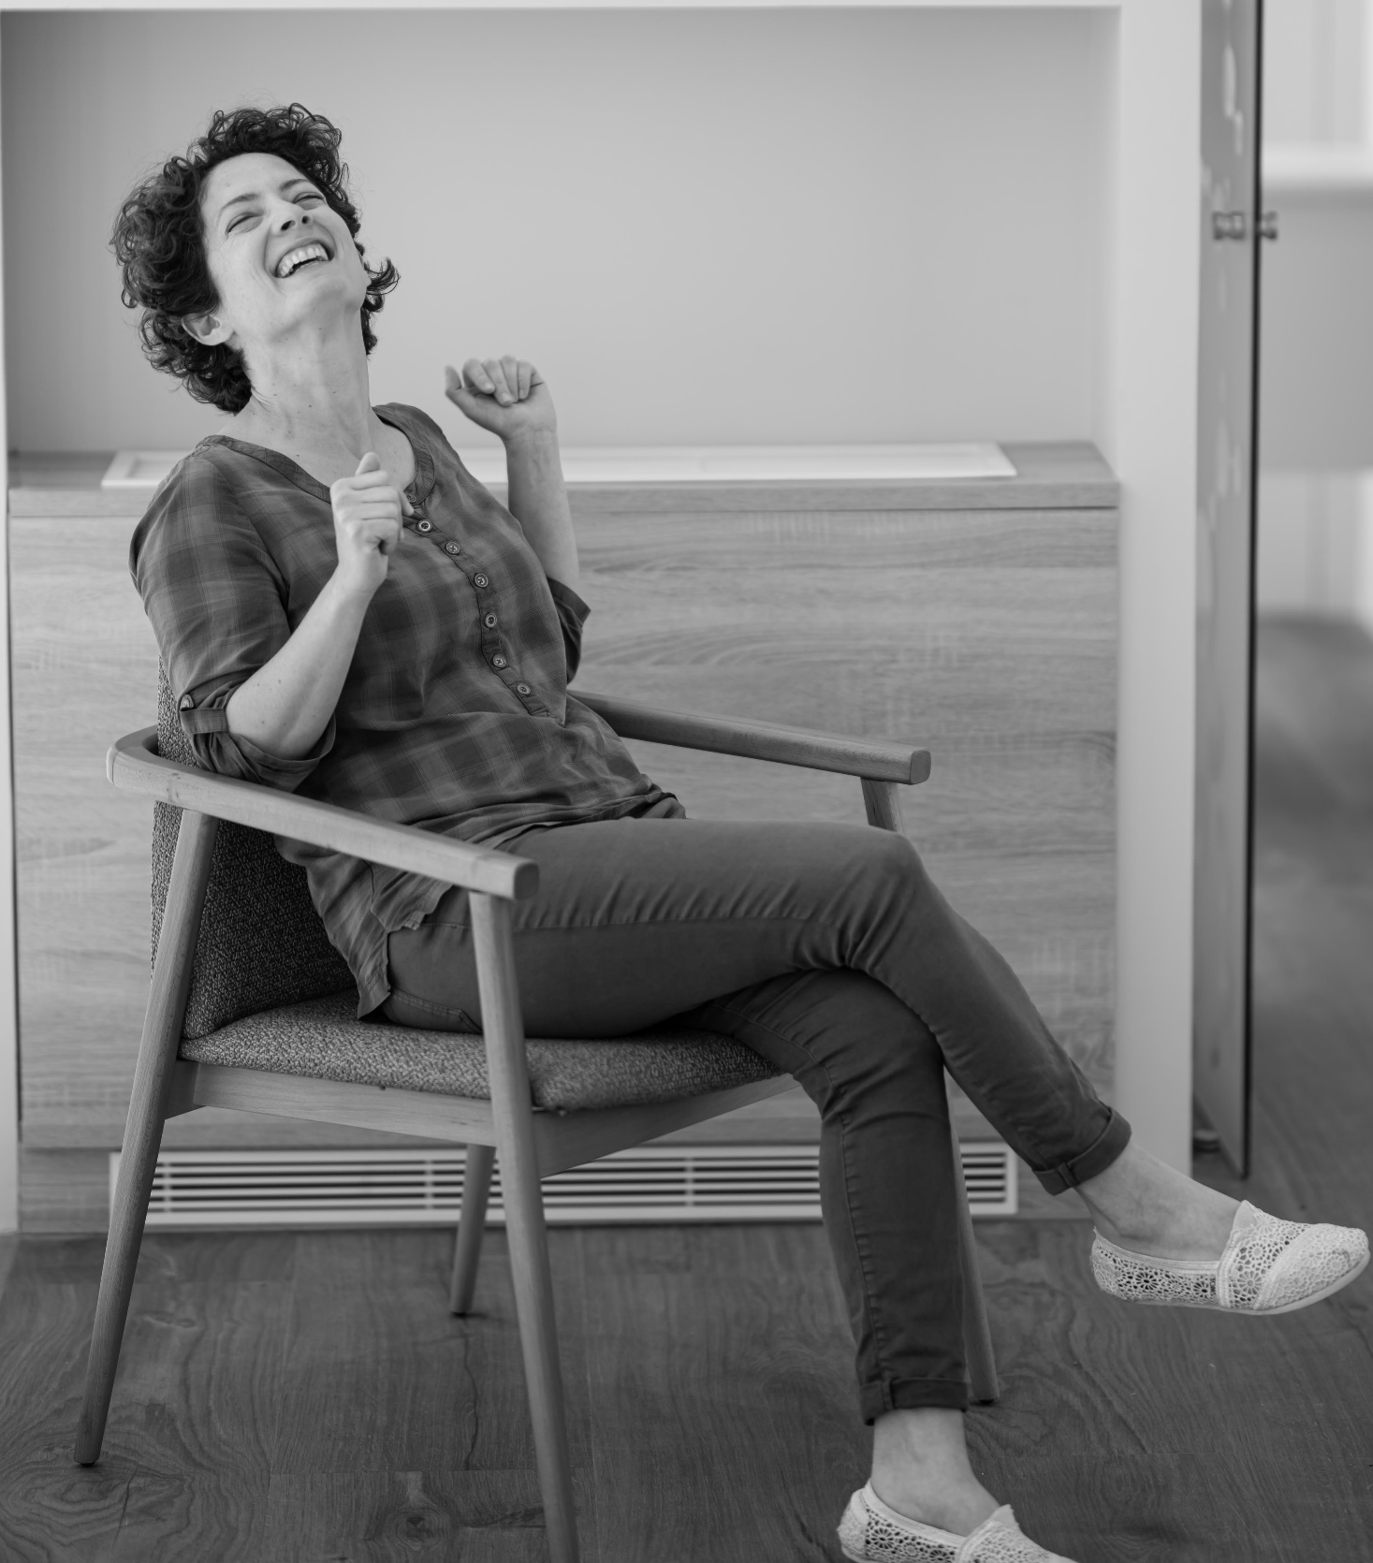
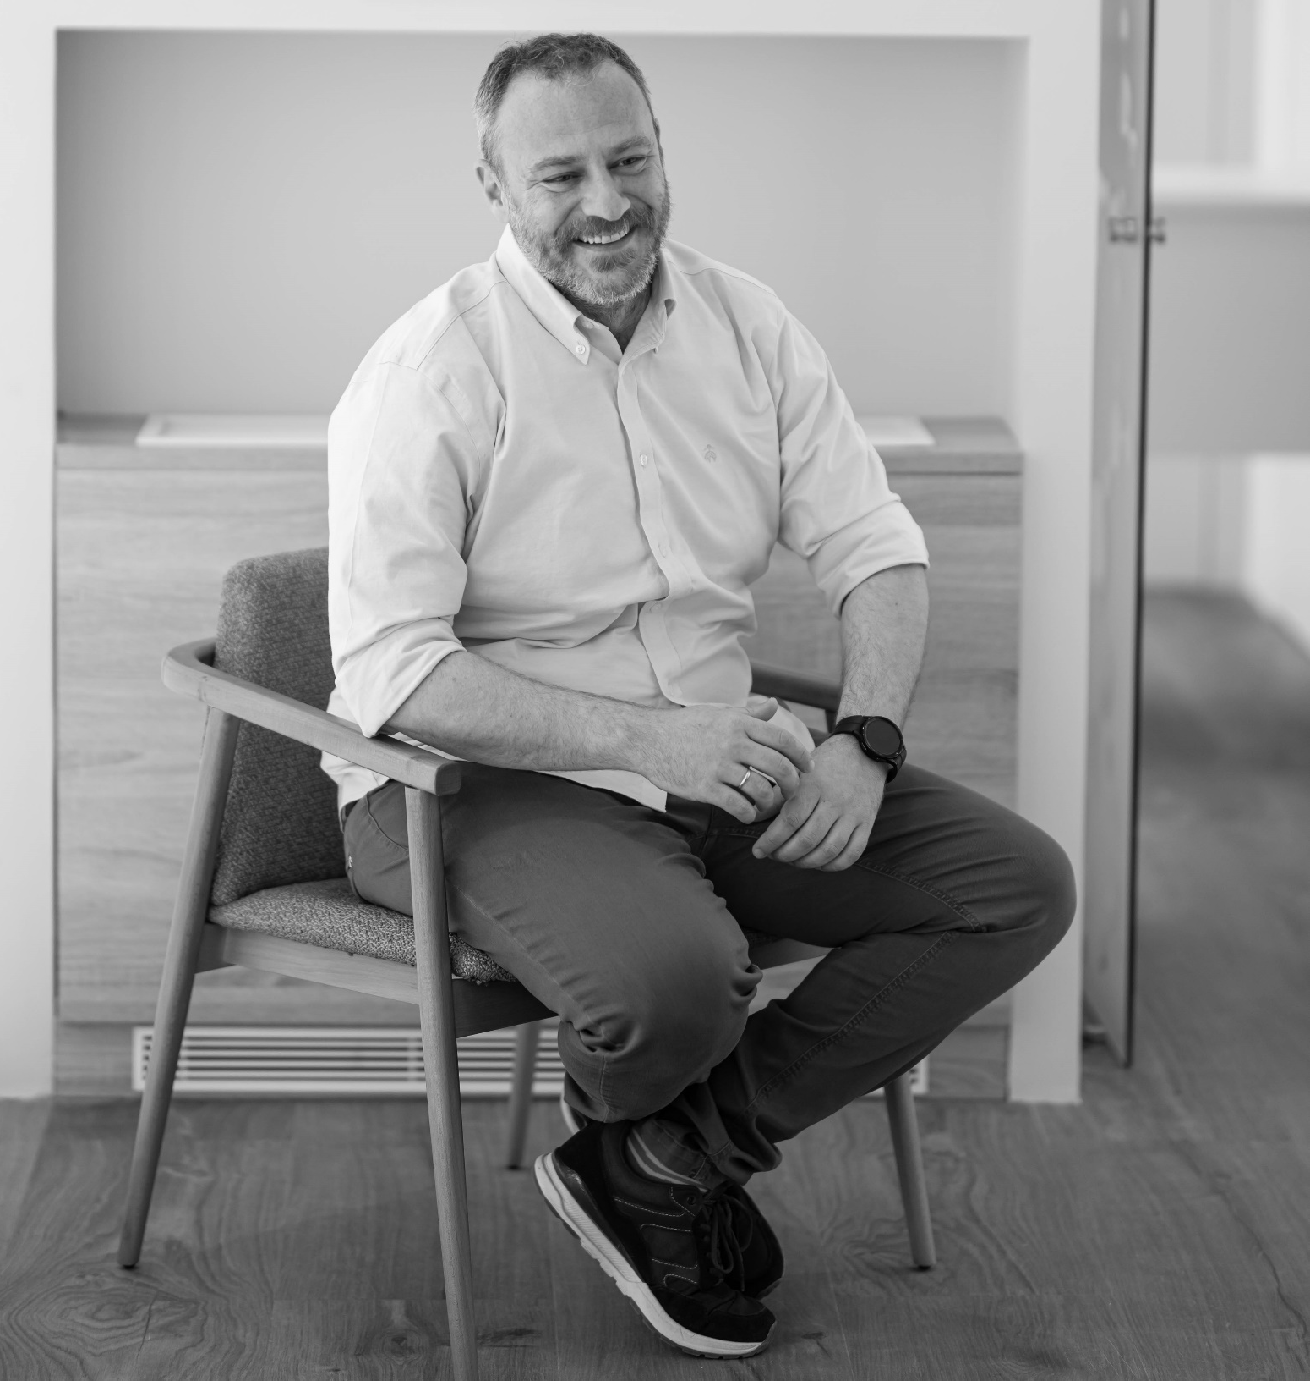
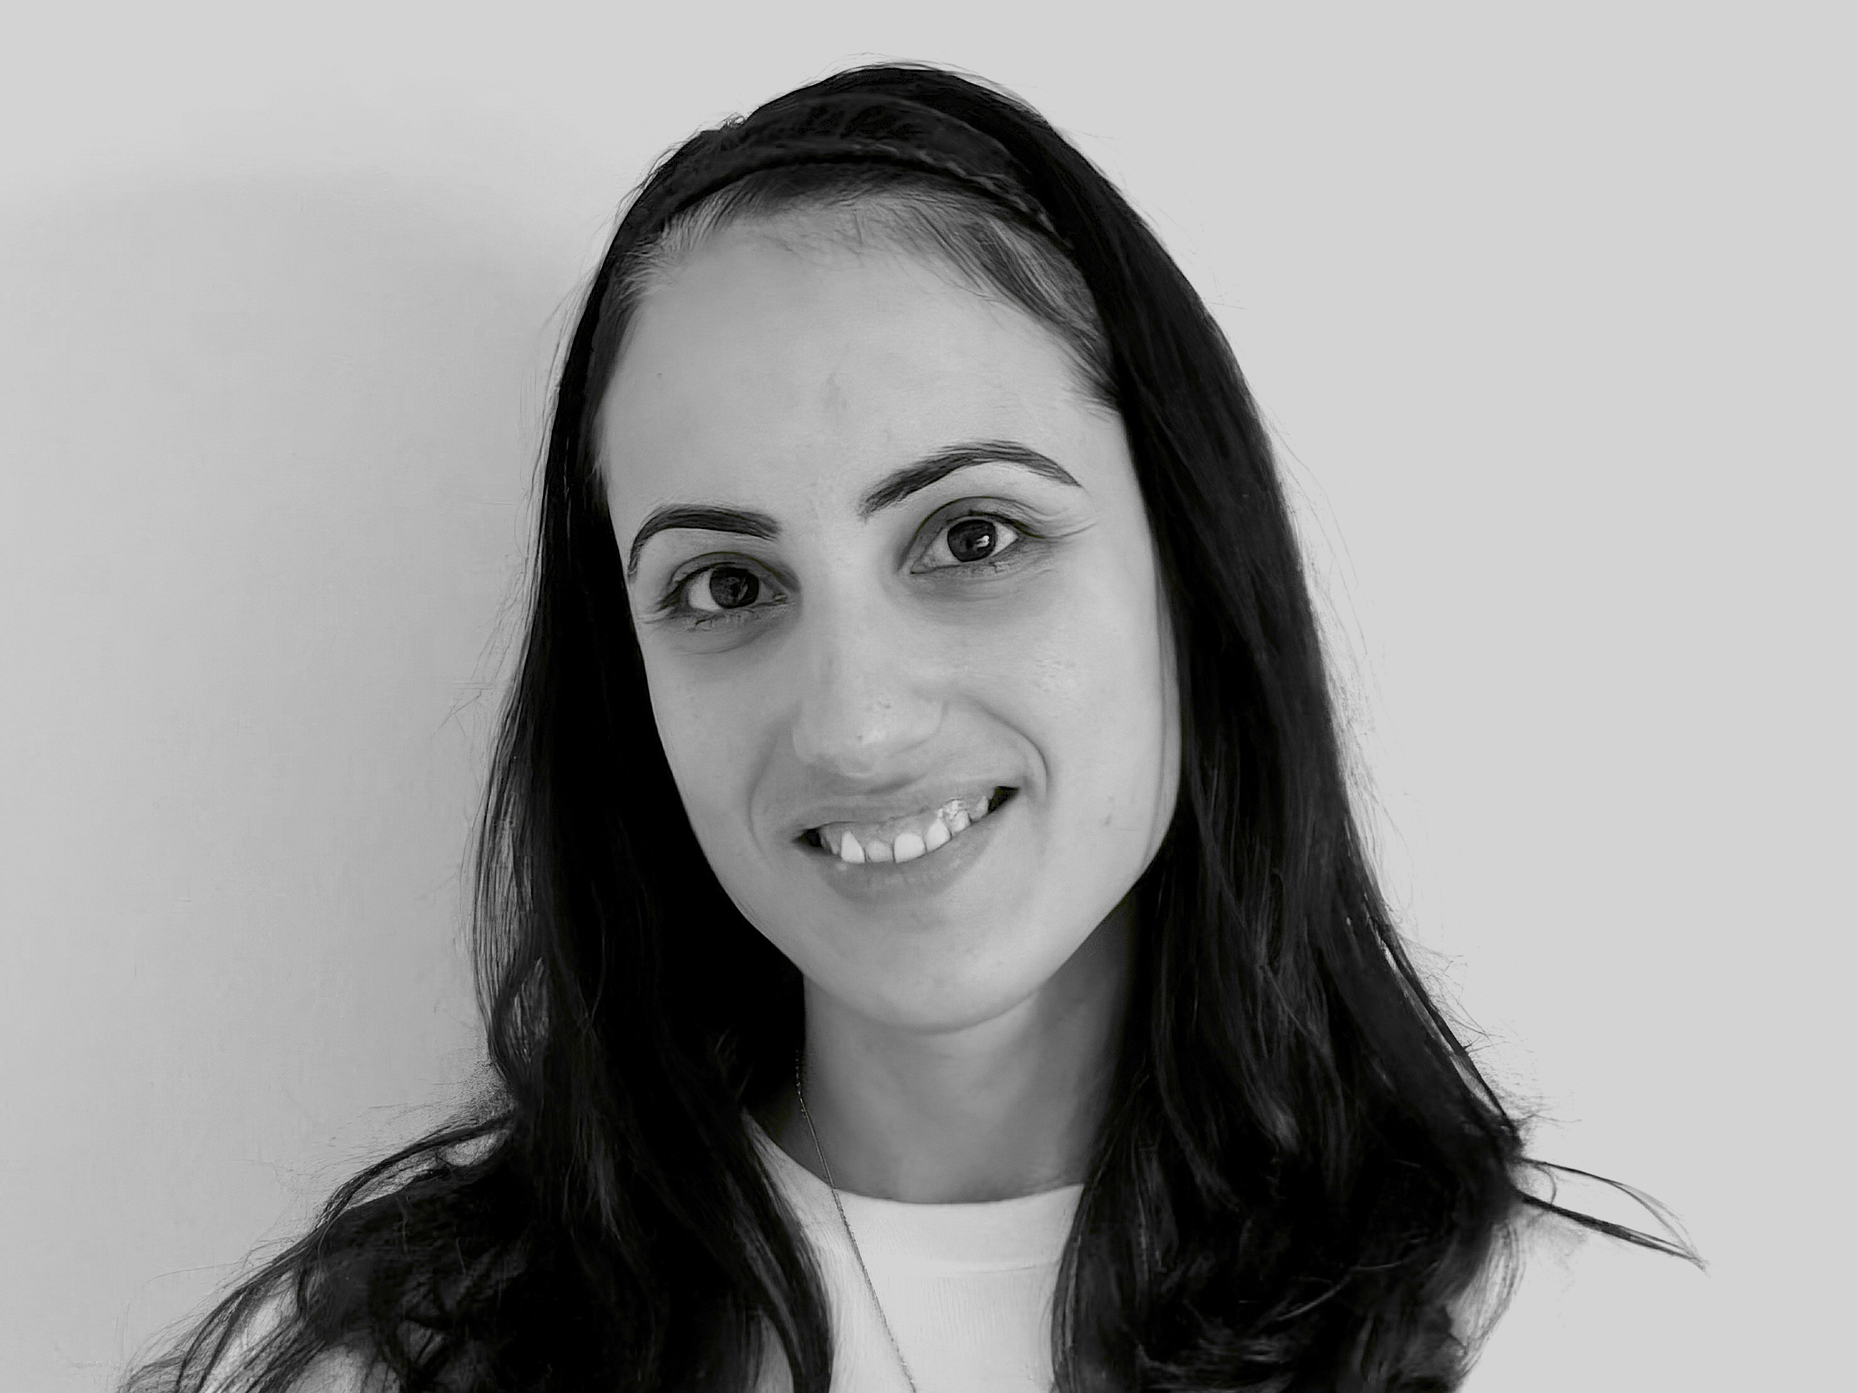
New Entry
SW Unit
…who we are…
Panagiotis Papadimitroulas: Head of Software – Medical Physicist
Valentina Paneta: Senior Data Scientist – Project Manager
Vasilis Eleftheriadis: Software Engineer – AI Expert
Giorgos Savvidis: Medical Physicist – MC Expert
Varvara Lagaki: Physicist – Data processing

Slide 4
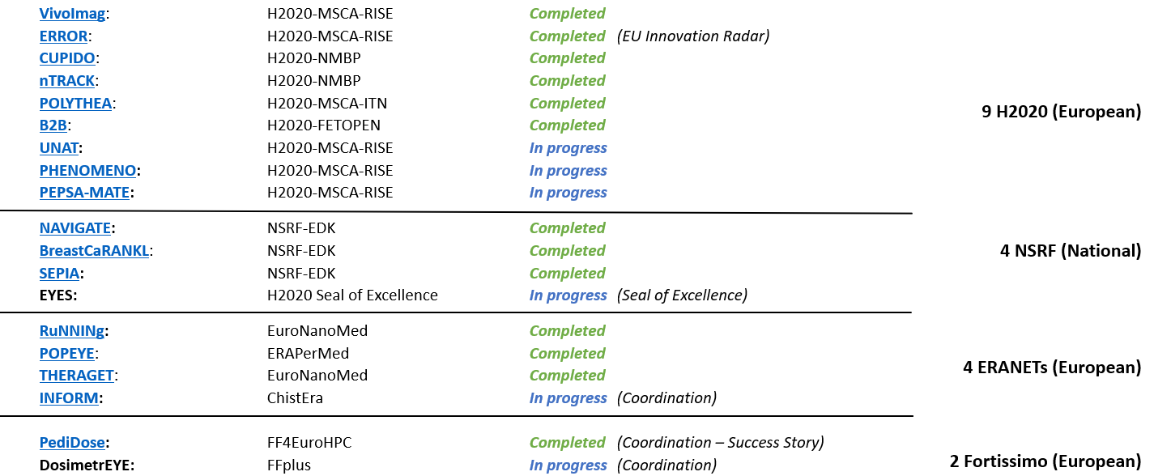
RESEARCH PROJECTS
BIOEMTECH | www.bioemtech.com | info@bioemtech.com

Slide 5
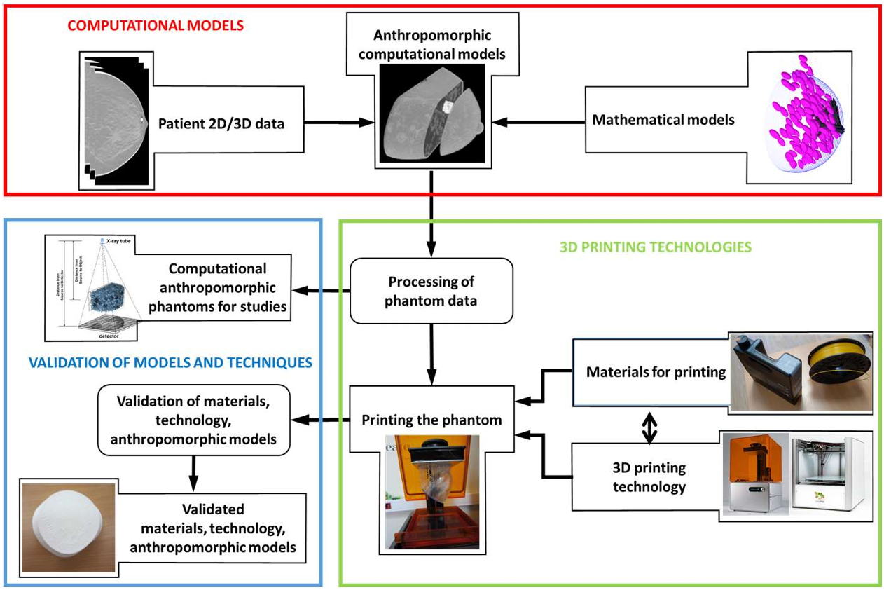
PHENOMENO – concept
H2020 MSCA-RISE project (2021-2025) https://phenomeno.eu/
Physical Breast Anthropomorphic Models and Technology for their Production
The main objective is to develop a complete technology for producing of high-quality physical breast phantoms derived from novel computational breast phantoms and manufactured with novel prototyping techniques.

Slide 6
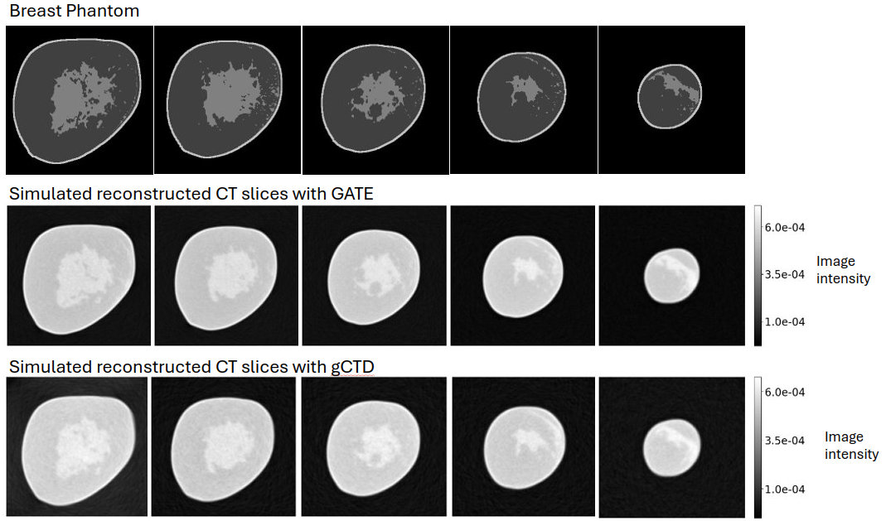
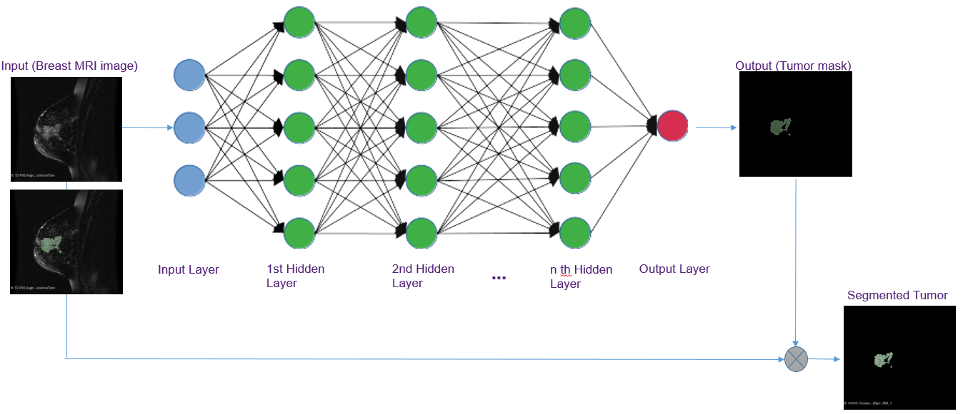
PHENOMENO – breast segmentation & simulations
Role I: Validate GATE Monte Carlo toolkit for in silico X-ray/CT imaging in breast cancer studies and evaluate their accuracy compared to clinical data and similar simulated.
Role II: AI-based automated breast tumor segmentation on clinical MRI data.

Slide 7
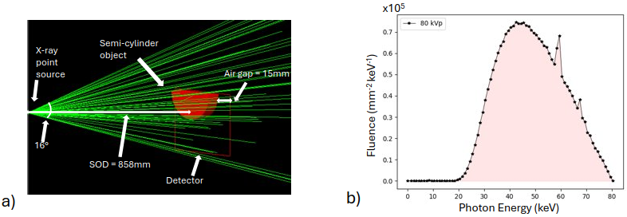
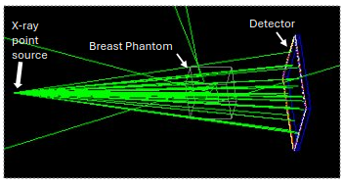
PHENOMENO
Breast CT simulations - setup
In silico study for standardization and evaluation of breast CT imaging and dosimetry using GATE and gCTD Monte Carlo codes
Clinical X-ray spectrum 80kVp
GATE v9.1
Digital 3D breast phantoms (Zenodo)
Perform both imaging & dosimetry: flat field – Semi Cylinder – Breast phantoms

Slide 8
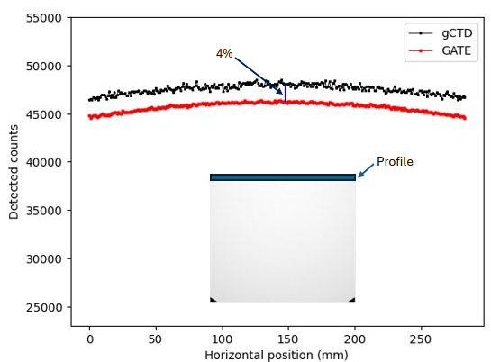
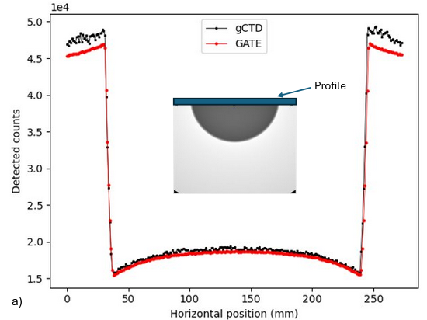
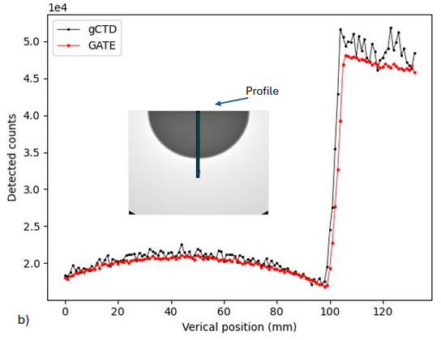
PHENOMENO – imaging simulations
Imaging breast CT simulations
Detector → 290 x 230 mm²
Flat field irradiation → 10¹⁰
Semi-Cylinder → homogeneous glandular tissue 1.04g/cm³ (10¹⁰ )
<4% difference in flat field profile
2.0% & 2.2% difference in the horizontal and vertical profile accordingly.

Slide 9
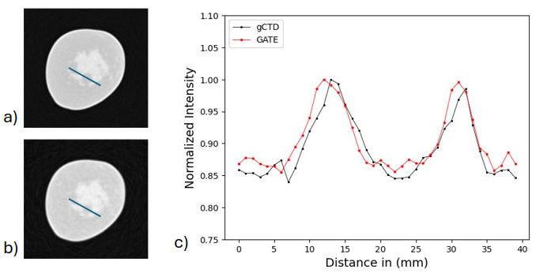
PHENOMENO – imaging simulations
Imaging breast CT simulations
Image size: 376 x 376 x 269 (pix.) & Voxel size: 0.37 x 0.37 x 0.24 mm³
360 projections (1º step) with 10⁸/ projection → 3.6 x 10¹⁰ primaries
CASToR reconstruction (MLEM 100 iterations)

Slide 10
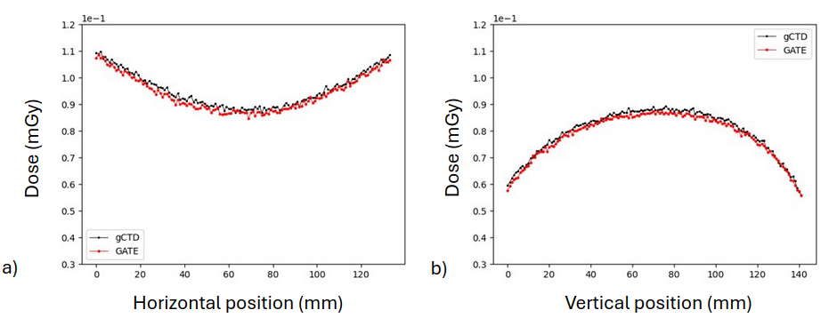
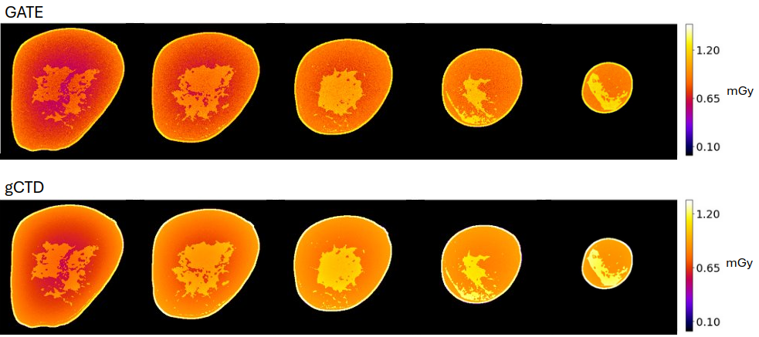
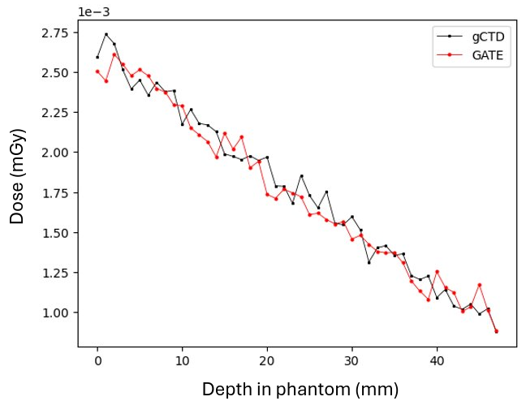
PHENOMENO – dosimetry simulations
Dosimetry CT simulations – (results submitted in Physica Medica)
Semi-cylinder irradiation – Dose actor 1 x 1 x 1 mm³ → 10¹¹
Homogeneous-Cylinder 0.9819g/cm³ → 360 projections10⁹
Breast phantom → 360 projections10⁹
~1% & 1.6% difference for the semi-cylinder & cylinder
~1% difference on the mean dose values for each organ

Slide 11
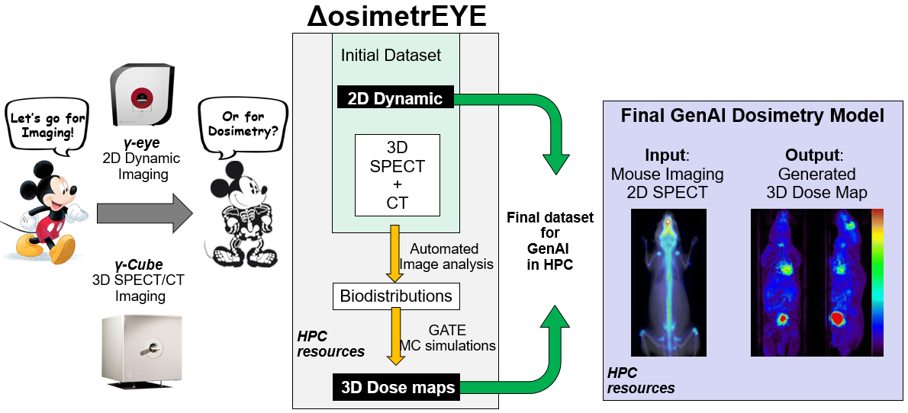
ΔosimetrEYE – concept
Ffplus Innovation Study (2025) https://www.ffplus-project.eu/
A GenAI-based tool for 3D preclinical dosimetry from 2D dynamic imaging
The goal is to utilize the ground truth dosimetry (MC simulations) with GenAI and HPC resources to develop a prediction tool for 3D dose assessment based on 2D preclinical imaging.

Slide 12
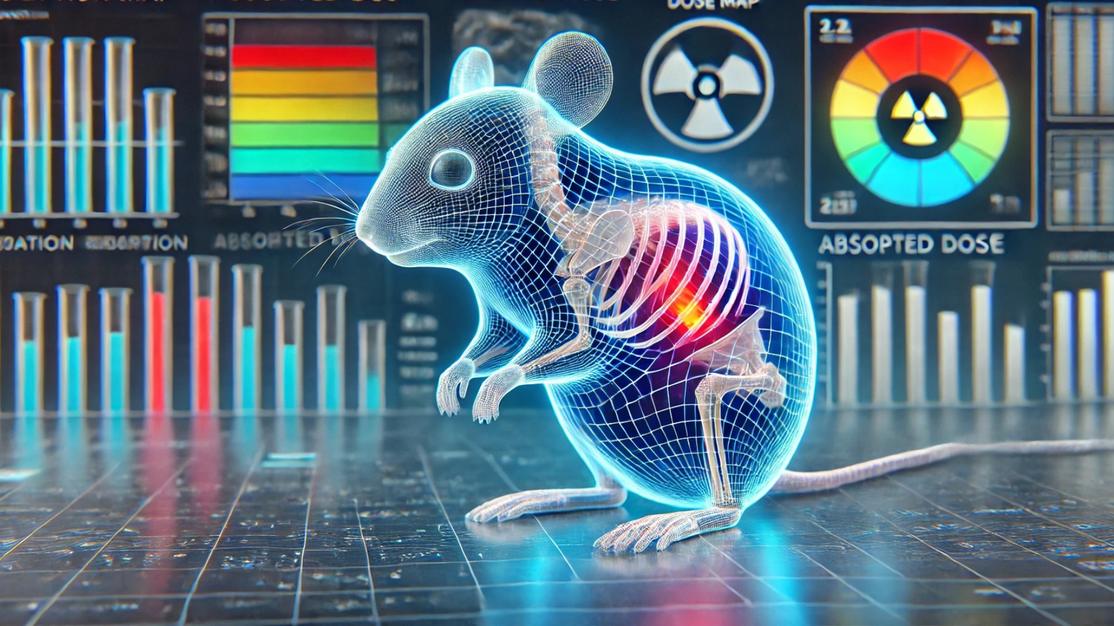
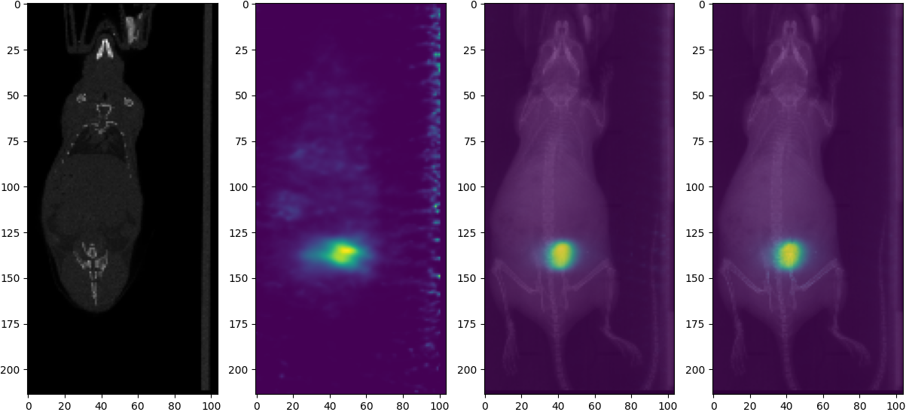
ΔosimetrEYE – concept
METHODOLOGY
Install GATE v10 in HPC “LEONARDO CINECA”
Collect preclinical imaging triplets of data (CT – SPECT – 2D) for In-111
Simulate SPECT/CT and create 3D dose maps. (~1000) Utilize different biodistributions | Aligned datasets
Create a NEW dataset 2D imaging & 3D simulated dose maps (~1000)
Apply pix-to-vox GenAI techniques.
Currently we have collected 380 imaging triplets & standardized the GATE acquisition in HPC

Slide 13
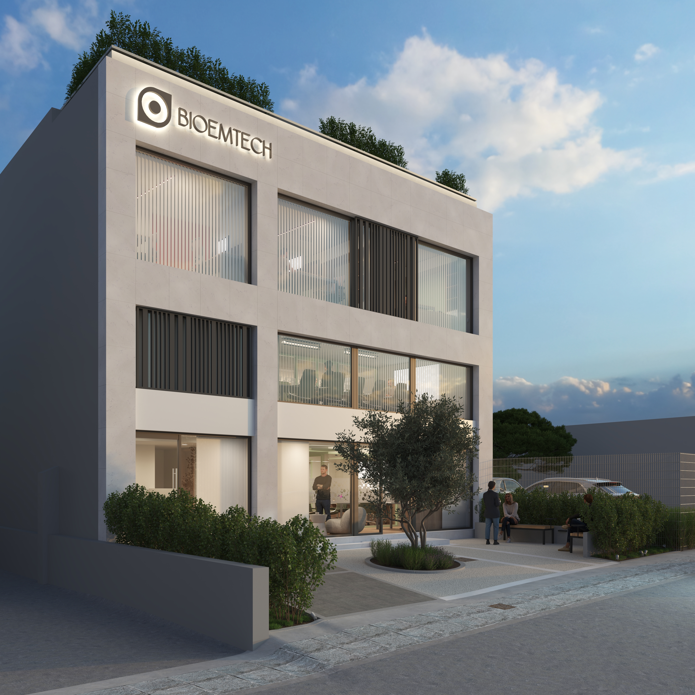
Panagiotis Papadimitroulas Associate Prof. Biomedical Informatics Head of Software & Co-Founder panpap@bioemtech.com www.bioemtech.com
Thank you!
BIOEMTECH▸ ATHENS, GREECE ▸ +210 6548192 ▸info@bioemtech.com

