Slide 1
GateRTion v2: a reference GATE 10 version for ion beam therapy
M. Favaretto¹, Y. Jia^{1,2}, A. F. Resch¹, M. Stock^{1,3} , L. Grevillot¹
¹MedAustron Ion Therapy Centre, Wiener Neustadt, Austria
²Medical University of Vienna, Vienna, Austria
³Karl Landsteiner University of Health Sciences, Wiener Neustadt, Austria

Slide 2
Content
GateRTion v1
GATE 10.0.2 as candidate for GateRTion v2
Physics comparison: GateRTion v1 vs GATE 10.0.2
Preliminary evaluation of GATE 10.0.2 beam model

Slide 3
GateRTion v1

Slide 4
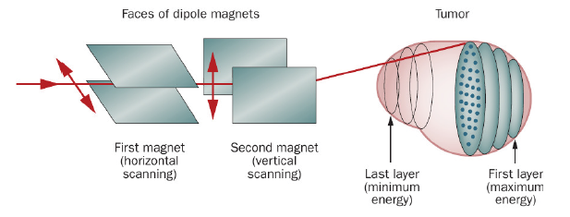
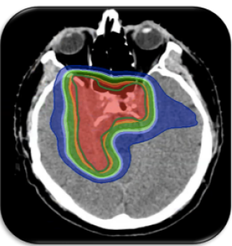
The idea behind the project
Light Ion Beam Therapy (LIBT): cancer treatment technique consisting in scanning a small pencil beam laterally across the tumor volume, while adjusting the beam energy to ensure the distal conformation.
MC code in LIBT centers: Simulation of treatment plans in complex patient geometries
  Independent dose calculation (IDC) -> Replacement of patient specific measurements in water
  Investigation of dosimetric quantities in tumor and healthy tissues (LET, neutrons dose ...)
[1]
GateRTion: provides a validated GATE release for clinical applications in LIBT
  Well-defined Geant4 version → physics can be extensively validated
  Includes features to simulate scanned ion beam therapy treatments
Significant validation effort → long release cycle (~ 5 years)
[2]
[1] M. Durante and J. S. Loeffler. “Charged particles in radiation oncology”
[2] courtesy of MedAustron

Slide 5


GateRTion v1
Release: 2018
Geant4 version: 10.3.3
GateRTion v1 is now 7 years old
Major Geant4 improvements since v10.3.3
GATE 10.0.2 candidate for a GateRTion v2 release
Validation:
  well validated: >9 publications using the same version
Currently used:
  The Christie, Manchester
    AutoMC software for protons IDC and treatment planning (research only).
    Varian Cyclotron.
  CAL, Nice
    simulations with ProteusOne IBA Synchro-Cyclotron.
  MedAustron, Wiener Neustadt
    IDEAL software for IDC with carbon ions and protons.
    MAPTA synchrotron.
  Others
myQAion:
Clinical software for IDC with proton (MCsquare) and carbon ions (IDEAL)
CE marked for protons, soon for carbons

Slide 6
GATE 10.0.2 as candidate for GateRTion v2
Outlook of GATE 10 ion beam therapy features

Slide 7

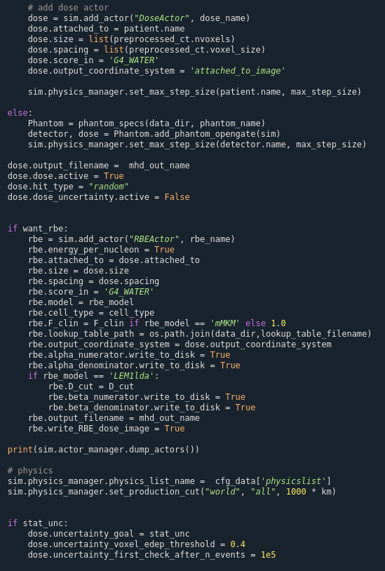
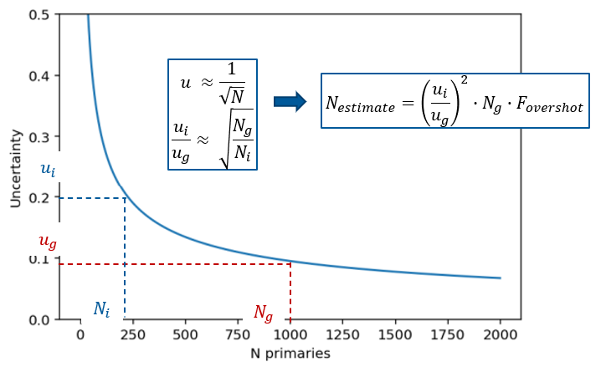
GATE 10.0.2 ion beam therapy features
Treatment Plan Pencil Beam Source
  Reference: user guide sources, presentation gate meeting 2023
  New: read DICOM plans on top of .txt plans
Dose Actor
  New: stop on dose calculation uncertainty goal
    Calculate uncertainty of the dose calculation after the first N events (user input), on the voxel that have edep > max_edep*voxel_edep_threshold
    Estimate Ni to reach goal uncertainty. Next check on uncertainty is performed when N events > Ni .
    Repeat until uncertainty <= uncertainty goal
    Send stop signal to all sources
RBE Actor
  LEM1 low dose approximation
  mMKM
  See presentation of Yihan Jia
  [Today, 3 pm]
$$N_{i}$$

Slide 8
Physics comparison: GateRTion v1 vs GATE 10.0.2
Using IDEAL software

Slide 9
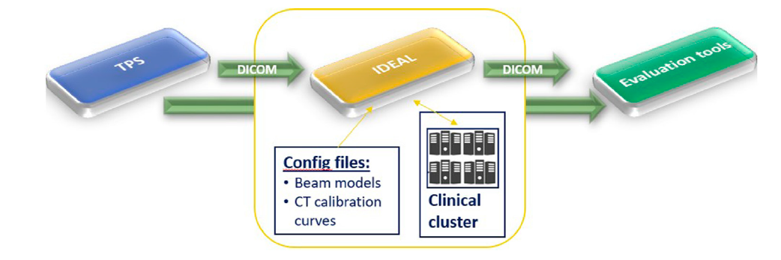
Evaluation setup: IDEAL
Independent DosE CAlculation System for Light Ion Beam Therapy
  DICOM in / DICOM out
    CT (HU map, Scanning protocol)
    Structure (External to crop CT, organ material overwrite)
    Plan (Patient position, gantry angle, beam positions and intensities, beamline)
    Dose (Dose grid size and position)
  Configuration files
    Beamline settings (geometry, beam model)
    HU material conversion for each scanning protocol
  Create mac files, start simulations (HTCondor queuing system)
  Combine simulations, DICOM out
  Open source: https://github.com/OpenGATE/IDEAL
[3]
IDEAL v1.1
MedAustron nozzle geometry
Optimized beam model: v1.1
Commissioned at MedAustron for carbon ions, against measurements
  Preliminary results showed in A. Resch, Gate meeting 2023
IDEAL v2
MedAustron nozzle geometry
beam model: v1.1
Beta version: github link
GateRTion v1
GATE 10.0.2
G4 10.3.3
G4 11.3.0
[3] Grevillot et al. 2021

Slide 10
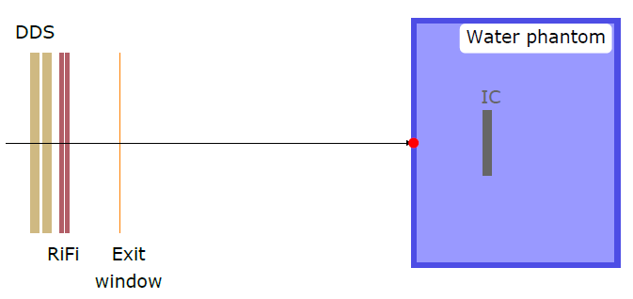
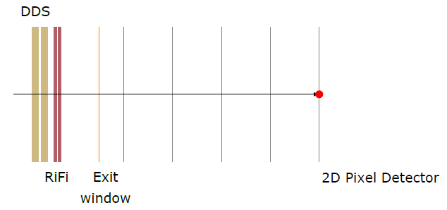
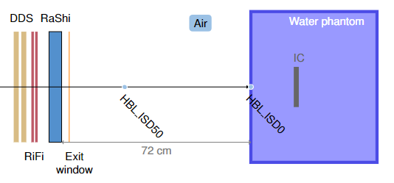
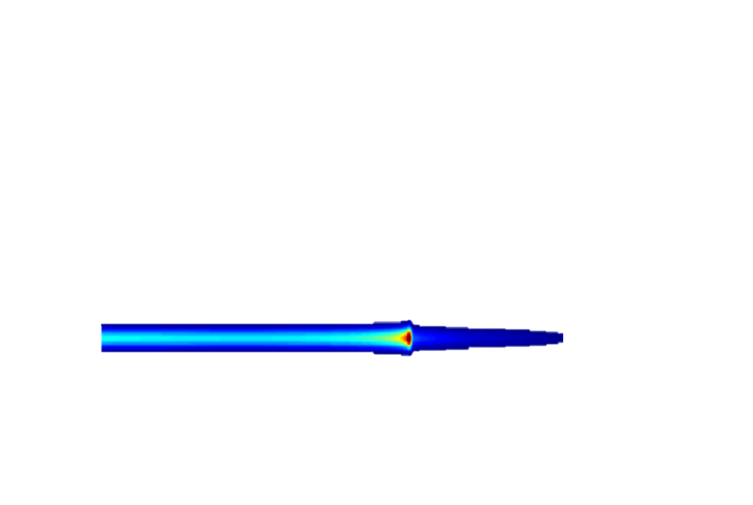
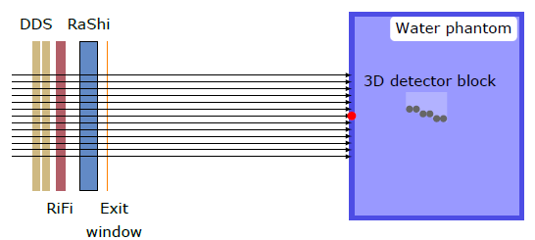
Physics comparison
Depth-dose profiles in water:
Delivery of monoenergetic beams in water
5 energies
GATE 10.0.2 vs GateRTion v1
Spot sizes in air:
Delivery of single energy 5x5 spots map
Evaluation at different air gaps
5 energies
Setting | Beam model v1.1
Energy mean model | V1.1
Energy spread model | V1.1
Optics model | V1.1
Physics list | QGSP_BIC_HP_EMZ
Nozzle geometry | MA full nozzle
Transversal profiles in water:
3 monoenergetic beams in water
Transversal profiles evaluated at 6 depths
Dose in SOBPs in water:
Delivery of 5 cubic fields of different sizes and depths
Point dose evaluation

Slide 11
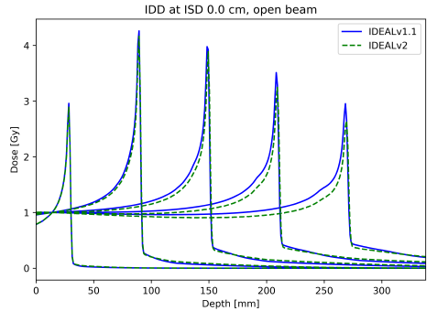
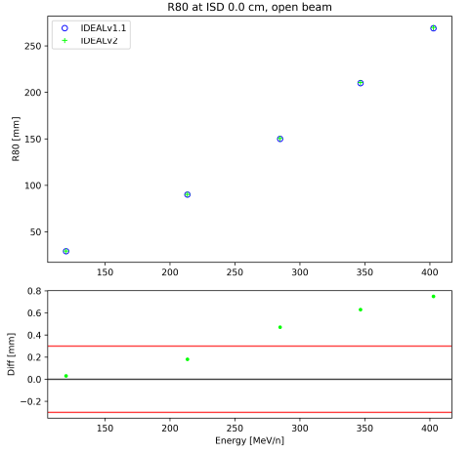
Results: GATE 10 vs GateRTion v1
Depth-dose profiles
Setting | IDEAL v1.1 | IDEAL v2
Beam model | V1.1 | V1.1
Gate version | GateRTion v1 | Gate 10
Physics list | QGSP_BIC_HP_EMZ | QGSP_BIC_HP_EMZ

Slide 12

Results: GATE 10 vs GateRTion v1
Depth-dose profiles
Different Bragg peak shape
Hp: change in BIC nuclear interaction models
Setting | IDEAL v1.1 | IDEAL v2
Beam model | V1.1 | V1.1
Gate version | GateRTion v1 | Gate 10
Physics list | QGSP_BIC_HP_EMZ | QGSP_BIC_HP_EMZ

Slide 13
Results: GATE 10 vs GateRTion v1
Depth-dose profiles
Energy dependent range deviation
Hp:
change in electromagnetic models
change in materials stopping power
 | G4 10.3.3 | G4 11.3.0
EM model | G4IonParametrisedLossModel | G4LindhardSorendenIonModel (since 11.1.0)
MSP dataset | ICRU73 | ICRU90/73
Setting | IDEAL v1.1 | IDEAL v2
Beam model | V1.1 | V1.1
Gate version | GateRTion v1 | Gate 10
Physics list | QGSP_BIC_HP_EMZ | QGSP_BIC_HP_EMZ
Changed EM model for Generic Ion in G4 emstandard_opt4

Slide 14
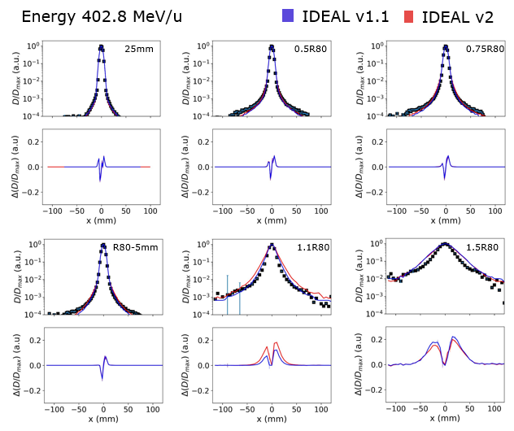
Results: GATE 10 vs GateRTion v1
Transversal profiles in water
Differences in the halo region
  Halo dose comes from secondary particles
→ Change in BIC nuclear interaction model
Minor differences in the core region
  Core dose comes from scattering of primary ions
No difference in the spot size in air
MCS model didn’t change in G4 11.3.0 (G4hMultipleScattering)
Setting | IDEAL v1.1 | IDEAL v2
Beam model | V1.1 | V1.1
Gate version | GateRTion v1 | Gate 10
Physics list | QGSP_BIC_HP_EMZ | QGSP_BIC_HP_EMZ

Slide 15
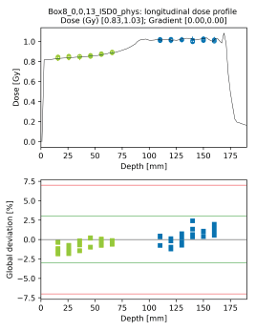
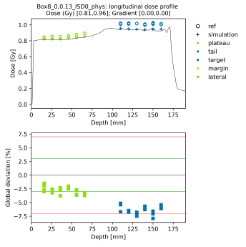
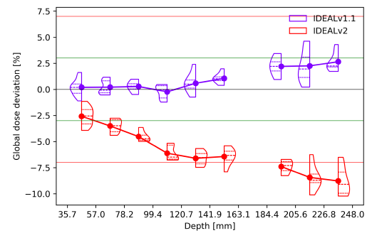
Results: GATE 10 vs GateRTion v1 vs measurements
Dose in SOBPs in water
IDEAL v1.1
IDEAL v2
Dose deviation from measurements increases for deeper targets in both G4 version
Opposite trends
Further proof of change in BIC nuclear interaction model
Setting | IDEAL v1.1 | IDEAL v2
Beam model | V1.1 | V1.1
Gate version | GateRTion v1 | Gate 10
Physics list | QGSP_BIC_HP_EMZ | QGSP_BIC_HP_EMZ

Slide 16
Preliminary evaluation of GATE 10.0.2 beam model
Using IDEAL software

Slide 17
Gate 10 beam model
Changed EM model for GenericIon in EMZ → re-optimization of energy mean beam model
No change in optics physics → same optics beam model used for GateRTion v1
Validation focused on depth-dose profiles and SOBPs dose
Setting | Beam model v1.1 | Beam model v2
Energy mean model | V1.1 | V2
Energy spread model | V1.1 | V1.1
Optics model | V1.1 | V1.1
Physics list | QGSP_BIC_HP_EMZ | QGSP_BIC_HP_EMZ
Nozzle geometry | MA full nozzle | MA full nozzle

Slide 18
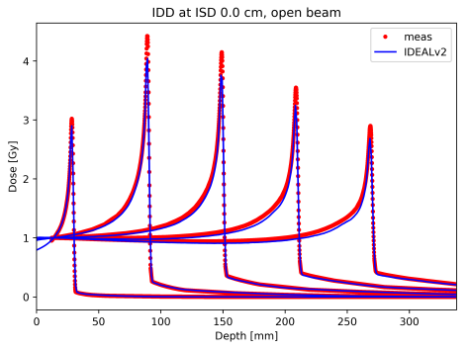
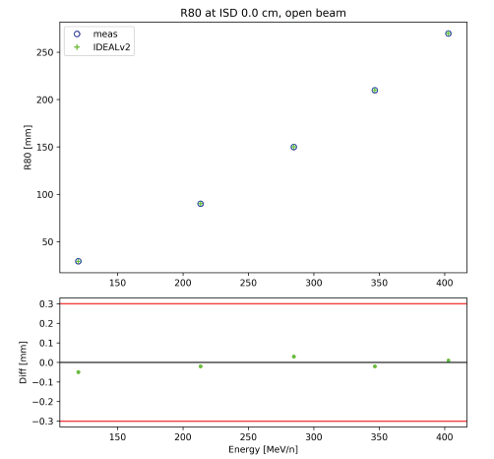
Results: GATE 10 vs measurements
Depth-dose profiles
Beam model v2 yields ranges well within thresholds
Simulated curve remains lower than measured one
Setting | IDEAL v1.1 | IDEAL v2
Beam model | V1.1 | V2
Gate version | GateRTion v1 | Gate 10
Physics list | QGSP_BIC_HP_EMZ | QGSP_BIC_HP_EMZ

Slide 19
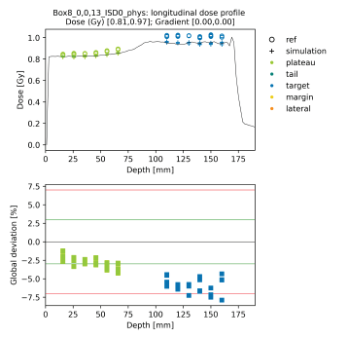
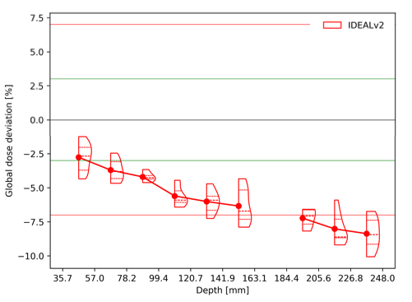
Results: GATE 10 vs measurements
Dose in SOBPs in water
Dose deviation outside thresholds for deep targets
Further investigation of BIC nuclear interaction model required
Possible approaches:
  Dose correction factor could be applied to improve the results
  Different physics lists can be explored
Setting | IDEAL v1.1 | IDEAL v2
Beam model | V1.1 | V2
Gate version | GateRTion v1 | Gate 10
Physics list | QGSP_BIC_HP_EMZ | QGSP_BIC_HP_EMZ

Slide 20
Conclusions and next steps
Conclusions:
GATE 10 provides enhanced features for ion beam therapy
  Treatment Plan source with DICOM
  Stop calculation on statistical uncertainty
  RBE actor
Preliminary evaluation of the physics, for QGSP_BIC_HP_EMZ revealed:
  Changes in Geant4 EMZ EM model and MSP database.
  MCS model remains unchanged.
  BIC nuclear interaction model changed in G4 11.3.0.
 | G4 10.3.3 | G4 11.3.0
EM model | G4IonParametrisedLossModel | G4LindhardSorendenIonModel (since 11.1.0)
MSP dataset | ICRU73 | ICRU90/73
MCS model | G4hMultipleScattering | G4hMultipleScattering
Next steps:
More extensive validation at MA, in collaboration with other facilities
  In place collaboration with The Christie for protons validation (Adam)
Release of IDEAL v2, with GateRTion v2
GATE 10.0.2 is a valid candidate for GateRTion v2
Optics and energy spread beam models developed for GateRTion can be translated to GATE 10.
Only mean energy beam models might need to be revised.
Nuclear interaction models in G4 11.3.0 should be further evaluated.

Slide 21
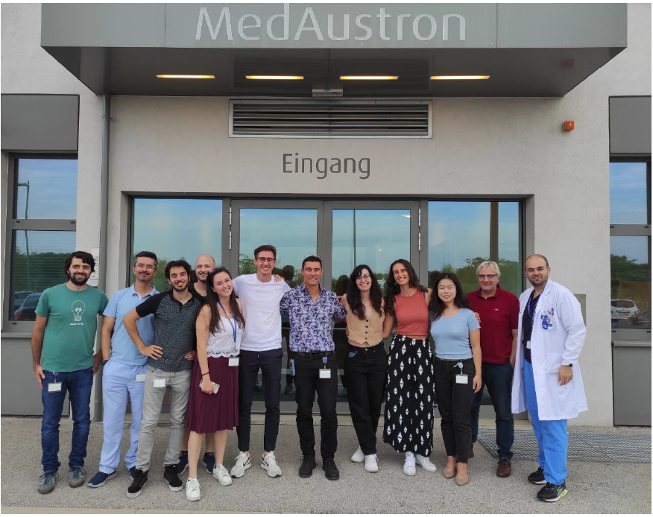



Thank you for your attention!
Acknowledgments:
Scientific contribution: Yihan Jia, Loic Grevillot
Code: Andreas Resch, David Sarrut, Nils Krah, Thomas Baudier
All the others
Contact:
martina.favaretto@medaustron.at
The financial support from the “Niederösterreichischen Wirtschafts- und Tourismusfonds” and European union in form of the EFRE fonds.

Slide 22
Backup slides

Slide 23
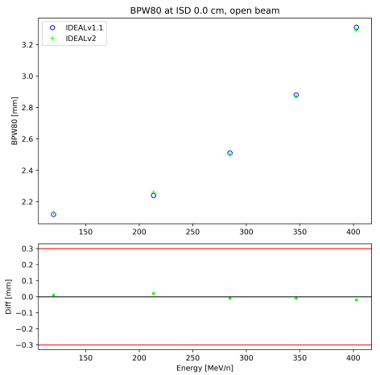
Results: GATE 10 vs GateRTion v1
Brag peak width

Slide 24
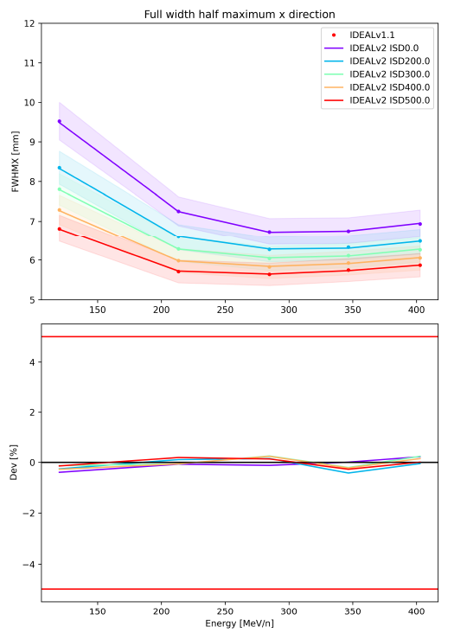
Results: GATE 10 vs GateRTion v1
Spot size in air
No relevant difference between G4 11.3 and G4 10.3
Confirmed same MCS model in EMZ
Setting | IDEAL v1.1 | IDEAL v2
Beam model | V1.1 | V1.1
Gate version | GateRTion v1 | Gate 10
Physics list | QGSP_BIC_HP_EMZ | QGSP_BIC_HP_EMZ

Slide 25
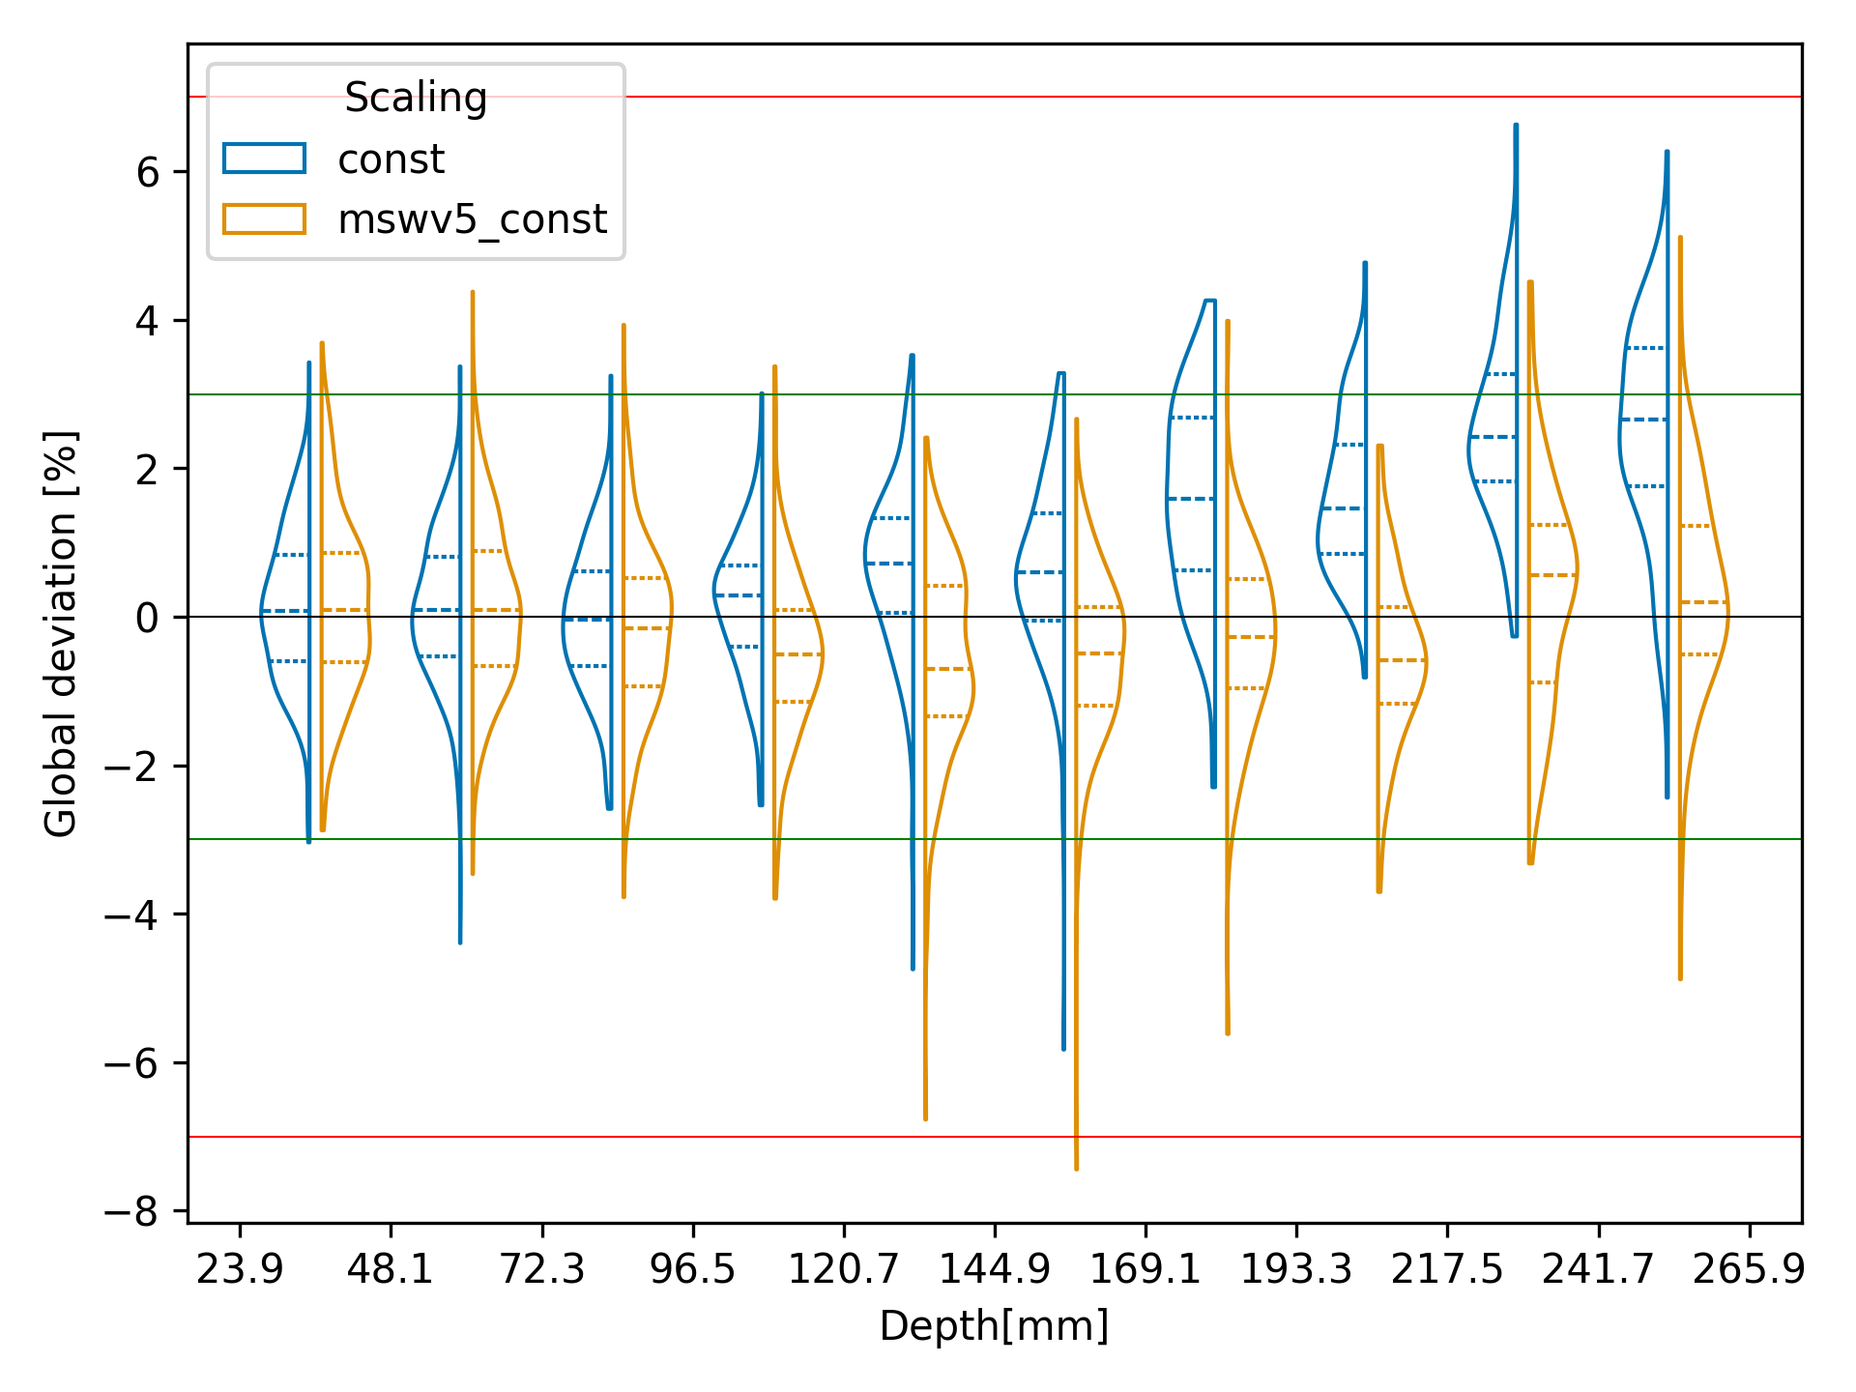
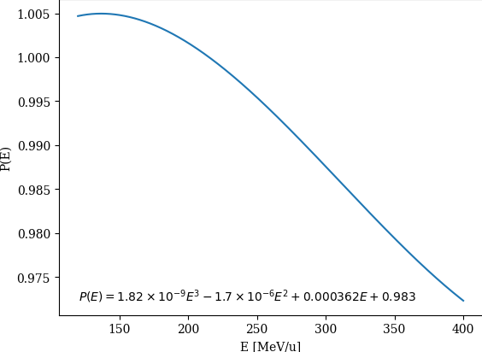
Compensation of depth dependent accuracy
Energy-dependent number-of-primaries/Monitor Unit conversion factor p(E)
Without
With
Slide courtesy of Yihan Jia and Andreas Resch

Slide 26
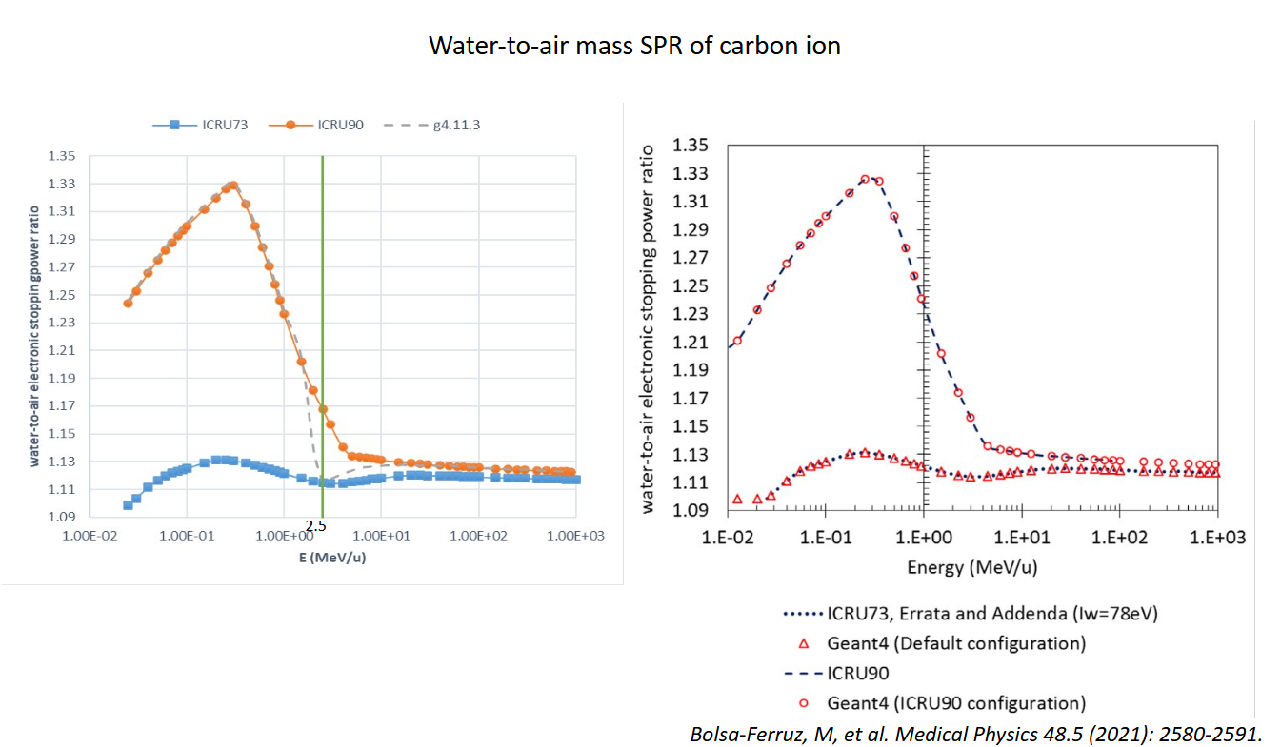
Slide courtesy of Yihan Jia

Slide 27
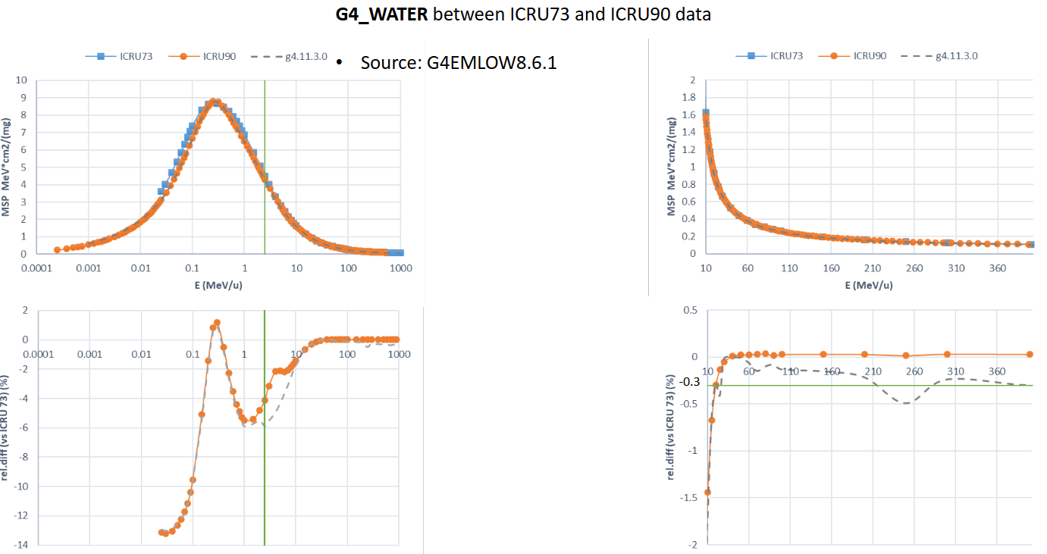
Slide courtesy of Yihan Jia

Slide 28
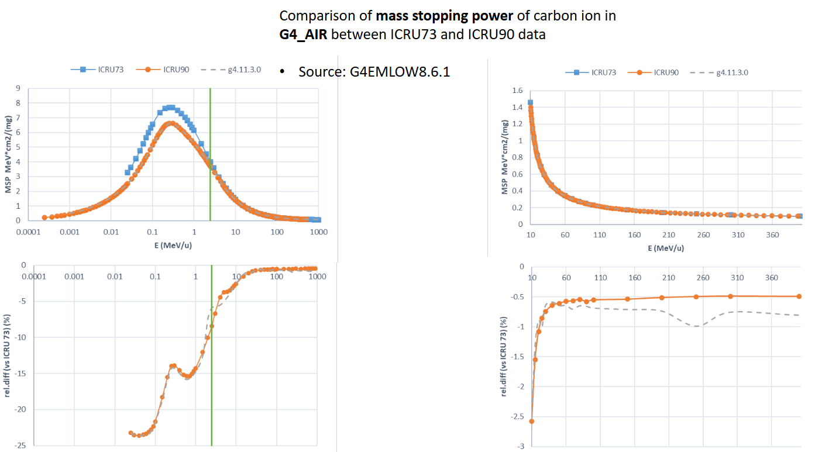
Slide courtesy of Yihan Jia

Slide 29
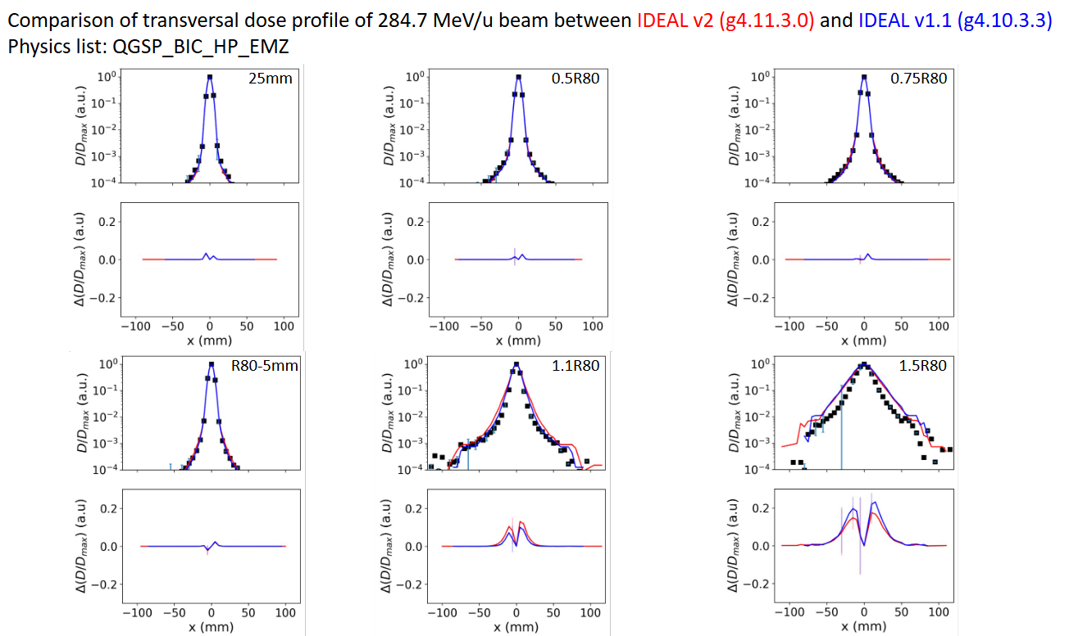
Slide courtesy of Yihan Jia

Slide 30
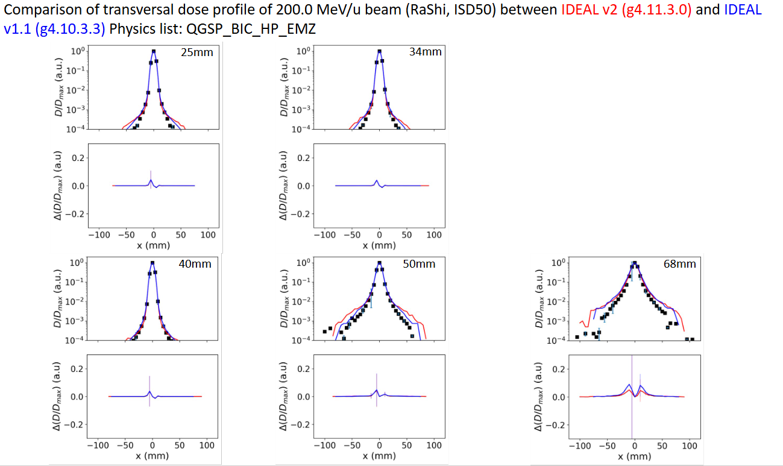
Slide courtesy of Yihan Jia

