Slide 1
Status of GATE
David Sarrut
CNRS - University of Lyon
CREATIS, CNRS UMR5220, Inserm U1044, INSA-Lyon, Université Lyon 1, France
On behalf of the OpenGate collaboration

Slide 2
Recent (r)evolution
GATE version 10 in Novembre 2024
Deep code restructuring
modifying the codebase to enhance
performance, readability, and maintainability
Most visible change for users:
Python instead of macros
Multithreading
From software to toolkit

Slide 3
Switch to …

Slide 4
GATE 10
Current is 10.0.2
With Geant4 11.3
On Linux, Mac (Intel + Silicon), Windows*
Windows: WSL advised (native has issues)
WIP: arm64 (“Surface” laptop)
With Python 3.8, 3.9, 3.10, 3.11, 3.12, (3.13)

Slide 5
Installation
pip install opengate
Take care of architectures (linux, osx, win) and python versions
Install: GEANT4, ITK, QT, UPROOT, etc
Ready in few minutes
Download Geant4 data (10-15 min)
Download data for the tests (5 min)
!! 230 tests !!

Slide 6
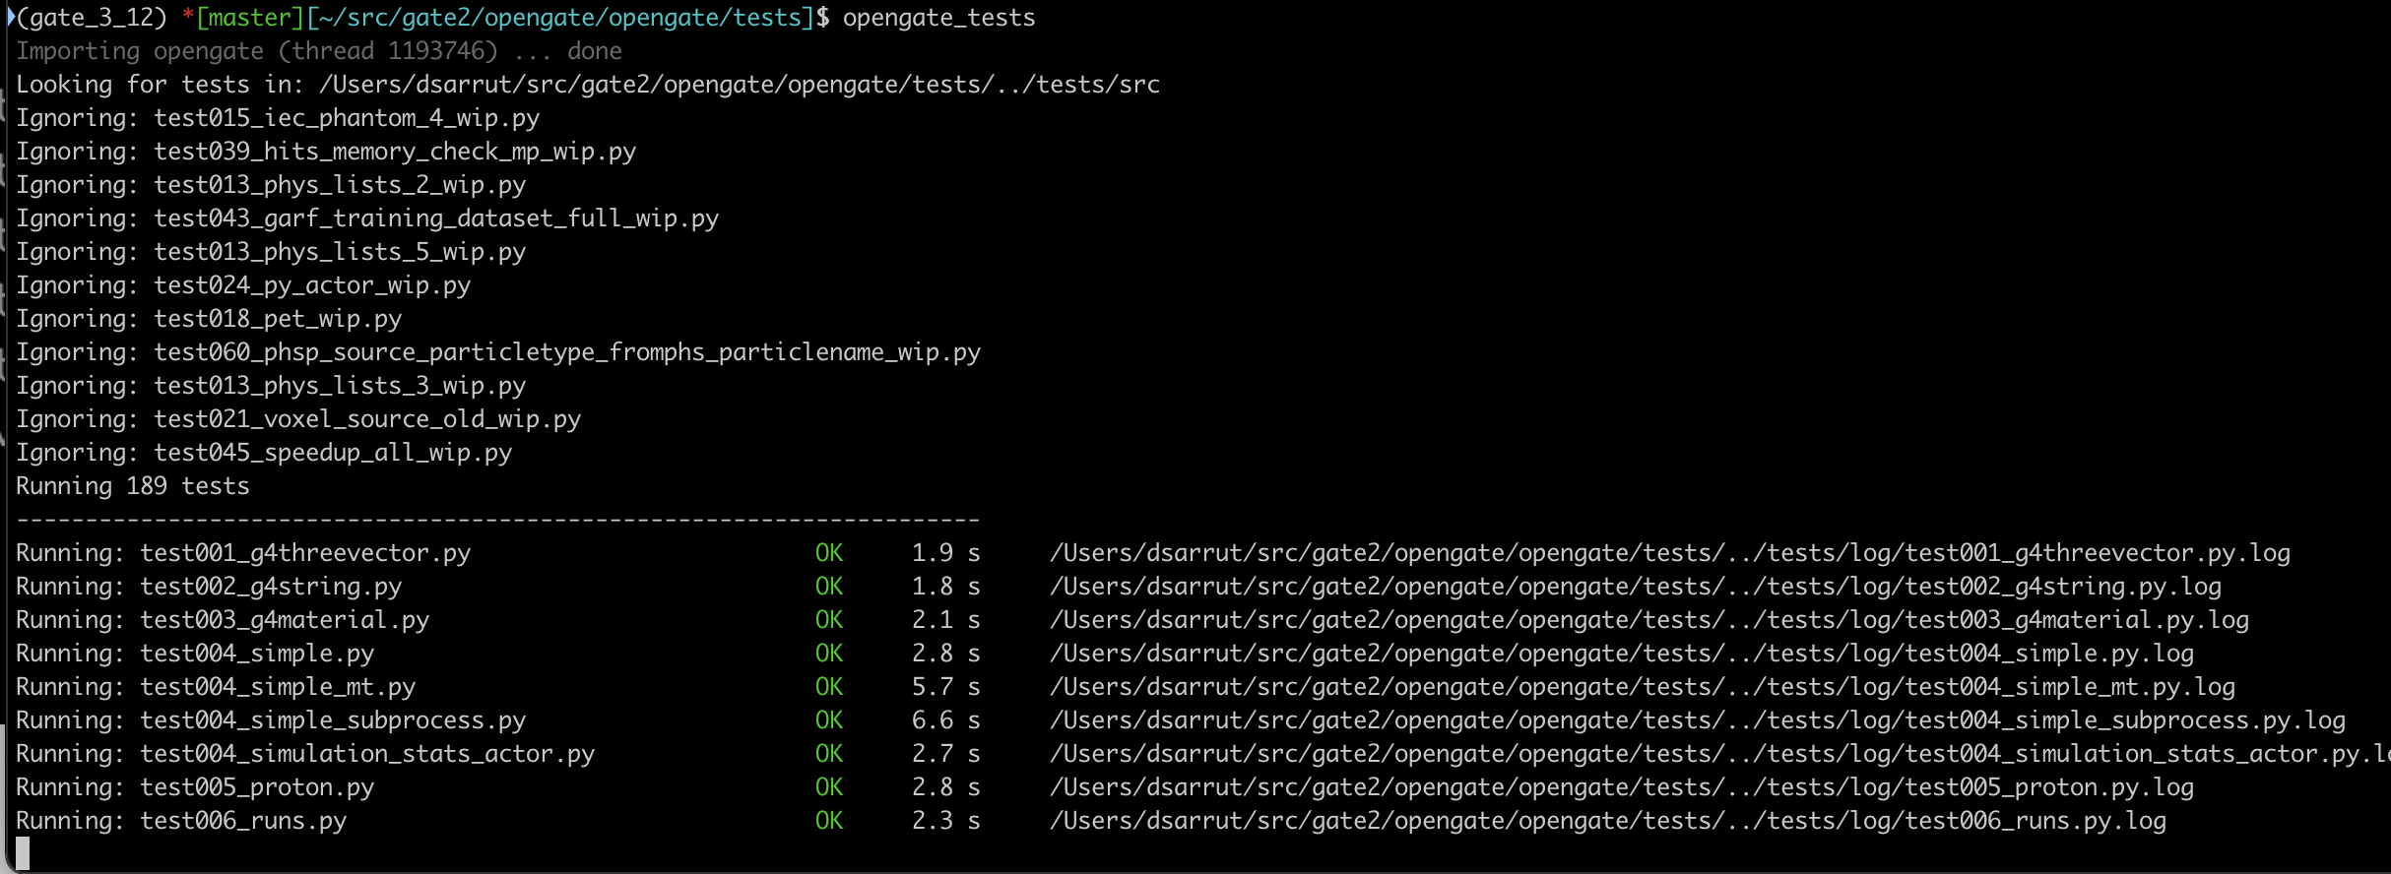
opengate_tests
!! 230 tests !!

Slide 7
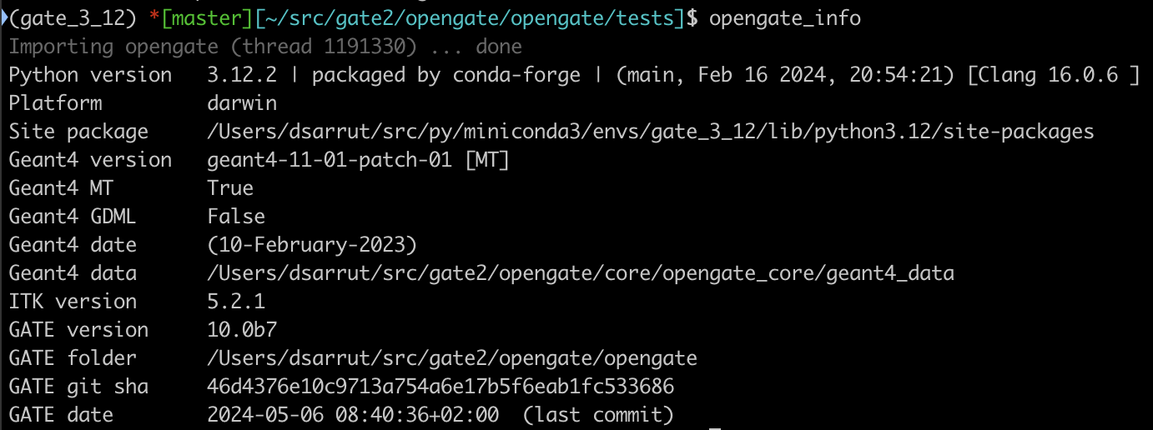
opengate_info

Slide 8
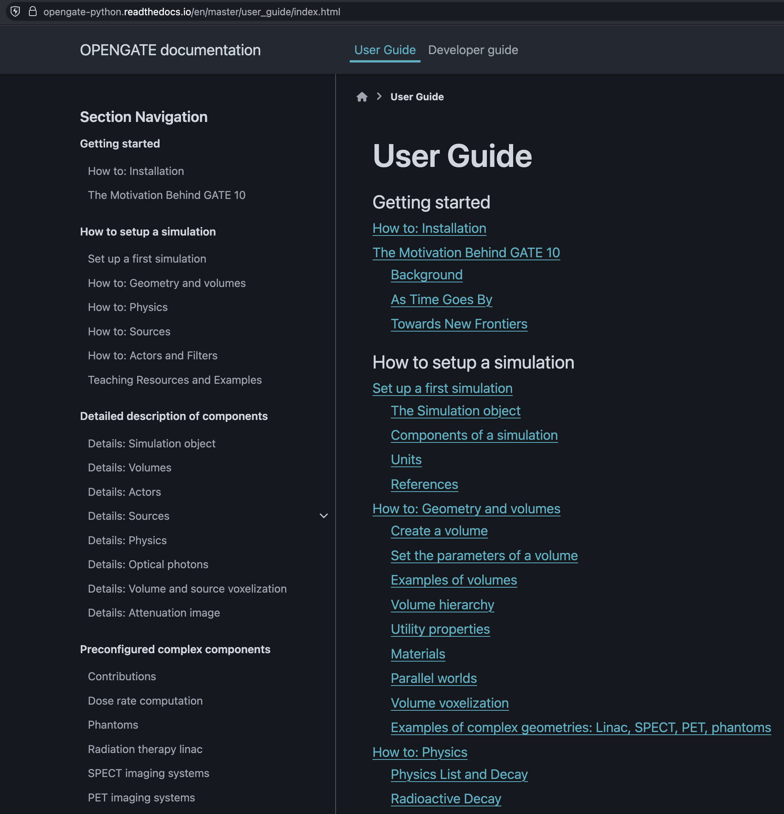
Documentation
https://opengate-python.readthedocs.io
80% complete
Versionning
Community editing
Still: remains non-documented options/features
e..g Phase space source

Slide 9
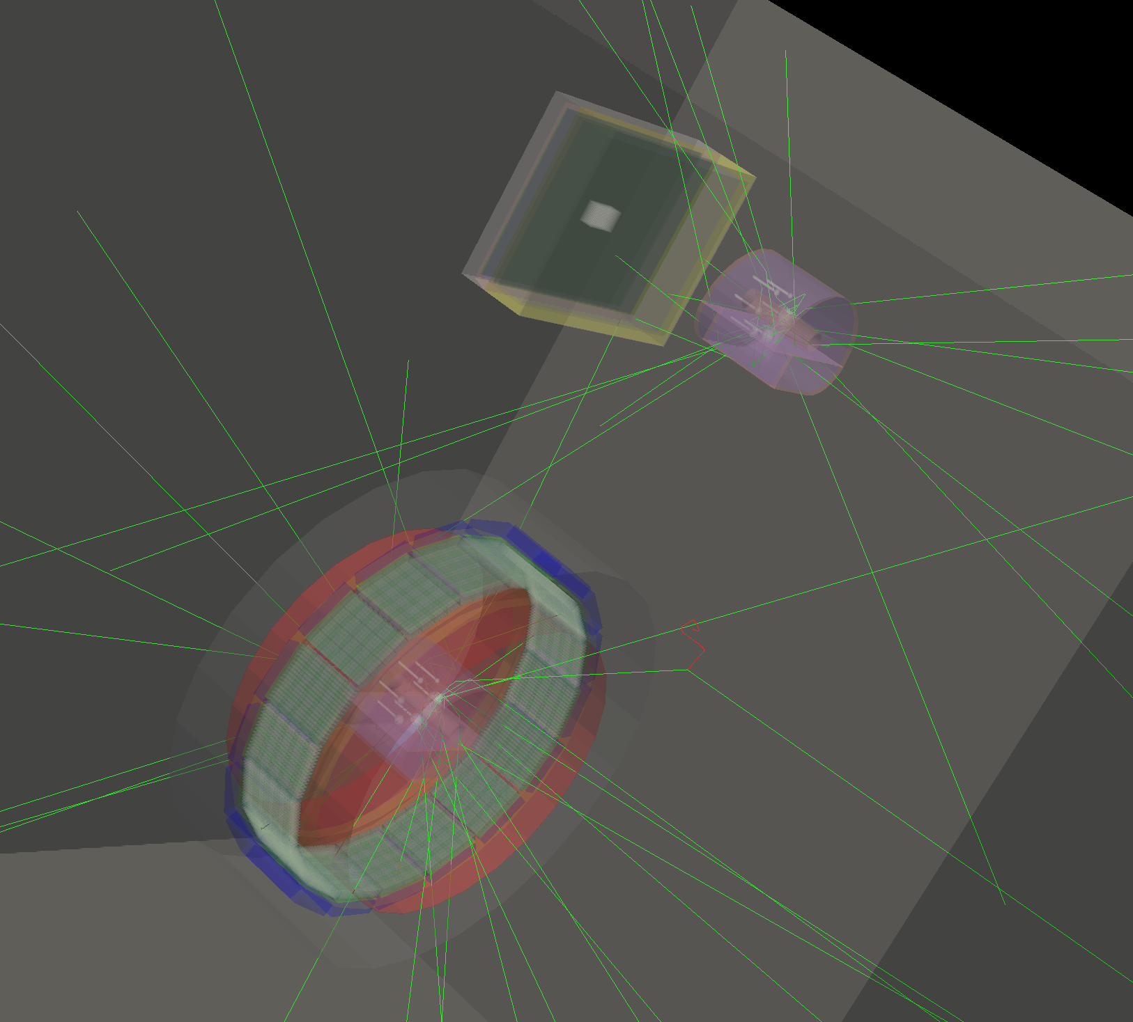
Visualisation
sim.visu = True sim.visu_type = "gdml" sim.visu_filename = ”my_visu.gdml"
Several engines:
VRML: with pyvista
GDML: with pyg4ometry
Both work but slow for complex scenes
QT:
QT5 ? QT6?
CT slices: WIP
Hackathon !
sim.visu = True sim.visu_type = ”vrml" sim.visu_filename = ”my_visu.vrml"
Window Scientific Linux
 | Linux | Mac osx | Windows | WSL
Developer | QT5: OK* | OK | ? | cf linux
pip install | QT5: NO | QT6 only | ? | cf linux

Slide 10
Annoying issue on linux
“cannot allocate memory in static TLS block”
Workaround 1:
Workaround 2:
Automatic set during import, restart the Python process
Not reliable
Workaround 3:
Compile Geant4 with a specific option but slower 15%
export G4L=~/src/geant4-v11.3.0/BuildProducts/lib64
export LD_PRELOAD=${LD_PRELOAD}:${G4L}/libG4geometry.so
export LD_PRELOAD=${LD_PRELOAD}:${G4L}/libG4processes.so

Slide 11
Some useful tools/features

Slide 12
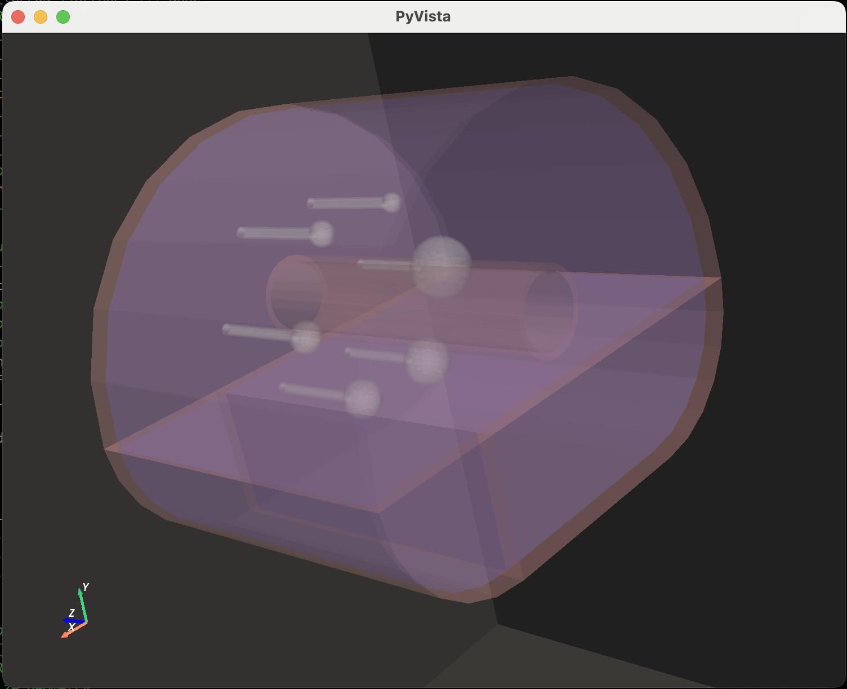
Contrib folder
Contains helpers python functions for various systems
phantoms IEC 6 spheres, empty Jaszack
pet Philips Vereos, Siemens Biograph
spect GE NM 670, Siemens Intevo
linacs Elekta Synergy, Elekta Versa
beamlines, tps ion beam therapy
carm siemens cios alpha
optical: optigan
dose: dose_rate, photon attenuation

Slide 13
Voxelization
# add some volumes
box = sim.add_volume(”Box", name=”mybox") box.size = [50*cm, 50*cm, 50*cm] iec = gate_iec.add_iec_phantom(sim)
iec.mother = box sphere = sim.add_volume("Sphere", name="extra_sphere") sphere.rmax = 2 * cm sphere.translation = [40 * cm, 40 * cm, 40 * cm]
sphere.mother=box # voxelize the geometry with 3x3x3 mm spacing labels, itk_image = sim.voxelize_geometry( box, spacing=2, 2, 2), margin=1, filename=”my_box" )
# write : my_box.mhd and my_box.json
Consider any volume
Run “voxelize”
Voxel spacing
Margin
Output:
3D image of labels
JSON file with material-labels

Slide 14
Attenuation image
Input
Image
Energy
Labels and materials
Output
Attenuation image
In g.cm-1
As a function or a command line
from opengate.contrib.dose.photon_attenuation_image_helpers import ( create_photon_attenuation_image, )
# compute attenuation map image = create_photon_attenuation_image( image_ input_filename, labels_filename, # json file with label to material mapping energy=140 * g4_units.keV, material_database=material_database, # optional .db database=”NIST", # or “EPDL” )
opengate_photon_attenuation_image -h

Slide 15
MultiThreading
sim.number_of_threads = 42
Warning:
Not all scorers support MT
Efficiency varies (nb of threads, memory, tasks)
Wait for threads at each run (slower when motion)
Under the hoods
Geant4 core mecanism
Need adapted lock procedure for each actors
Several choices (memory / speed tradeoff)
Future: improved version for DoseActor
Developers :
Need specific work for MT (lock, atomic)
Guarding mecanism: monoT by default

Slide 16
MultiProcessing
Work in progress (do not work yet)
Goal:
First version on local computer only
Second version to adapt to cluster job submssion (qsub etc)
Interest:
Linear speedup expected
Adapted to clusters
sim.run(nb_proc = 12, ”my_run.json")
sim = Simulation()
sim.merge_run(”my_run.json” )

Slide 17
Next steps, perspectives
Consolidation
Multiprocessing
Digitizer modules: dead time, pileup, noise, etc (still offline first)
Integration with reconstruction software
CASTOR, OpenRTK, PyTomography
Siemens root2listmode fpr e7Tools (not open)
Future Emission Tomography Standardization Initiative (ETS) https://etsinitiative.org
« old school » VRT :
Last Vertex Splitting (cf Maxime)
Free Flight for fast SPECT

Slide 18
Releases cycle
1 major release a year, following Geant4 (10.1, 10.2)
Several minor releases (10.0.1, 10.0.2 etc)
On user demand when an important feature is merged
Not too frequent. Expect 3-4 a year

Slide 19
Contributions
You got a new idea ? Great !!!
Roadmap:
Code it + inform us
Do a PR (Pull Request) on github
With code + test + doc + data
Once all tests passed, we merge into main branch
Enjoy
We can help !

Slide 20
Under the hoods
Folder g4_bindings Geant4 binding from C++ to Python
(expose functions, classes) ; pybind11
Folder opengate_lib Core classes (running): scorers, etc. (run)
Folder opengate User Interface UI (initialisation)

Slide 21
Publications
Collaborative publication in Phys Med Biol
Focus Collection in Phys Med Biol
Any GATE-related papers
Classical review process, published as soon as accepted
Then “grouped” in the FC
Examples of proposals:
Optical GAN, Roncalli et al.
MultiThread/MultiProc, Krah et al.
Last Vertex Splitting, Jacquet et al.
Gate RT ION, Medaustron et al.
Gate for radiation protection, Arbor et al.
Preclinical dosimetry, HPC infrastructures and AI models for dosimetry prediction, Papadimitroulas et al.
Modeling the anode heel effect in X-ray imaging on Gate10, Bert et al.
Low-Count 89Zr Imaging Using Vision/Quadra and effect of LSO background, Mohr et al.
…

Slide 22
Conclusion
GATE 10
Hopefully a better GATE, ready for new MC usages
From software to toolkit
Still, consolidation todo
New features welcome
Open-source, community based
Contributions welcome! opengate-dev-l@in2p3.fr

