Slide 1
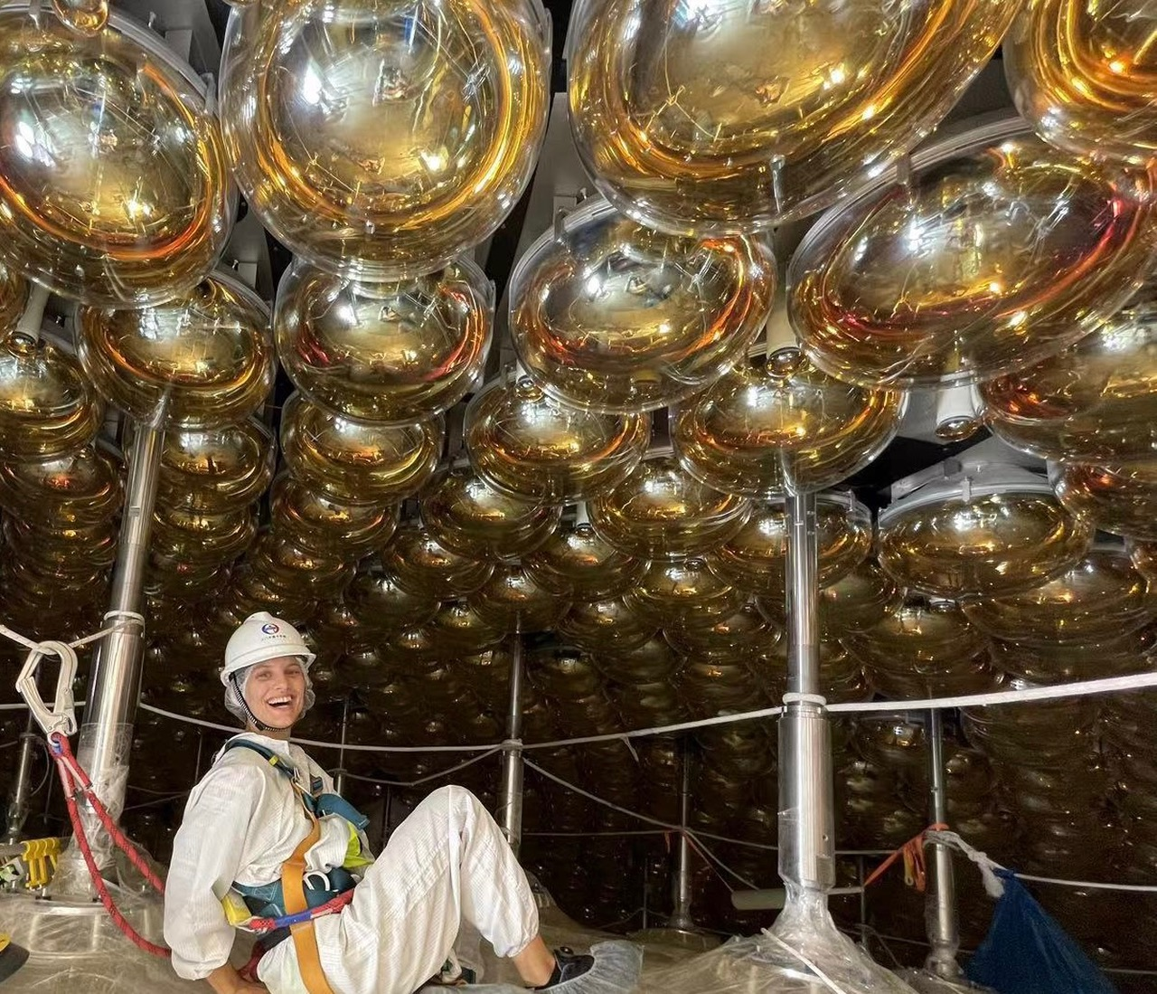
Neutrino Oscillations
Caren Hagner
Universität Hamburg
Strasbourg Summer School,
1st July 2025

Slide 2
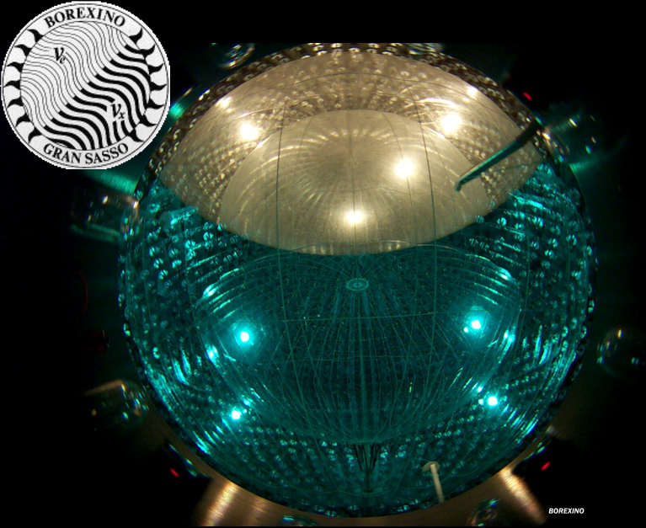
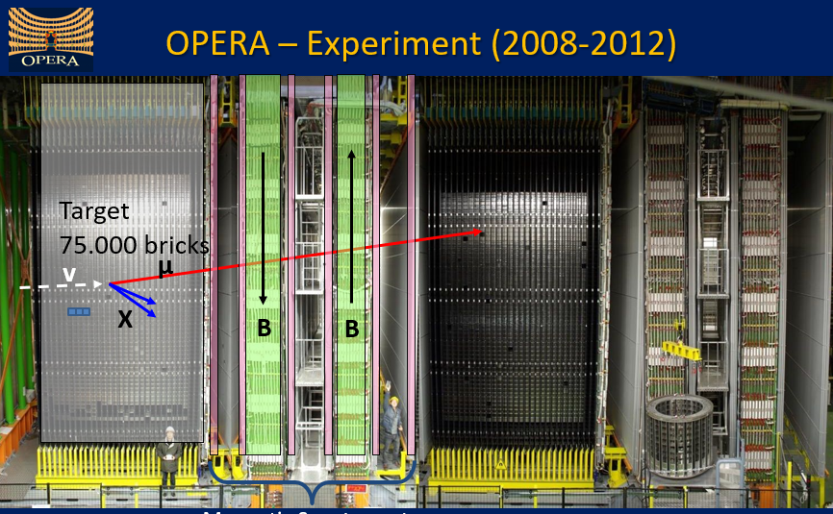
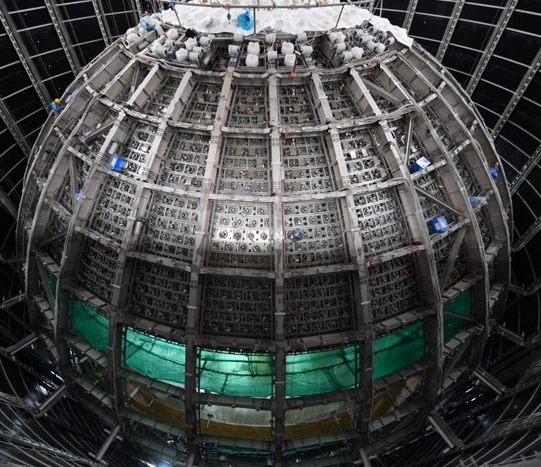
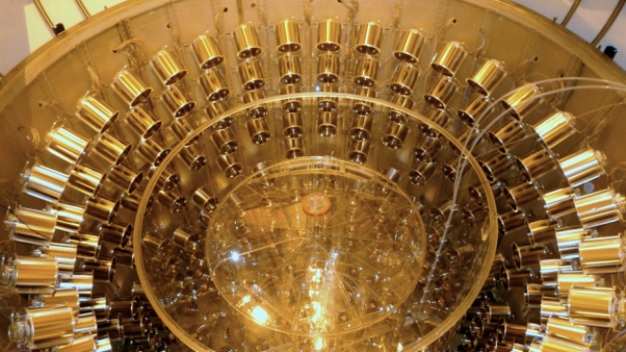

my personal neutrino experience
(Some experiments I participated)
BOREXINO (2007-2021)
Double-Chooz (2011-2017)
JUNO (starting 2025)

Slide 3
Todays Topics:
Some Basic Facts on Neutrinos
Basic Oscillation Mechanism
The Pioneers & Discovery
Why Matter matters, even for Neutrinos
The third Mixing Angle – towards Precision
Into the Unknown
Summary and Outlook

Slide 4
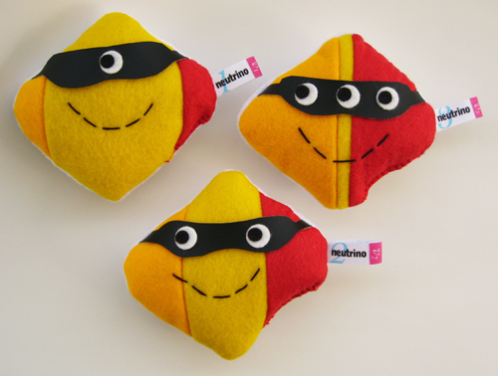
Neutrino Basics

Slide 5


Neutrinos in the Standard Model
Neutrinos interact only via weak interaction
SM: Neutrinos are massless
Neutrinos are left handed,
Antineutrinos are right handed,
Neutrinos are stable
Neutrino Oscillations
Extension of SM: Neutrinos have masses
Do right handed neutrinos exist?
Majorana neutrinos:
Neutrinos can decay

Slide 6
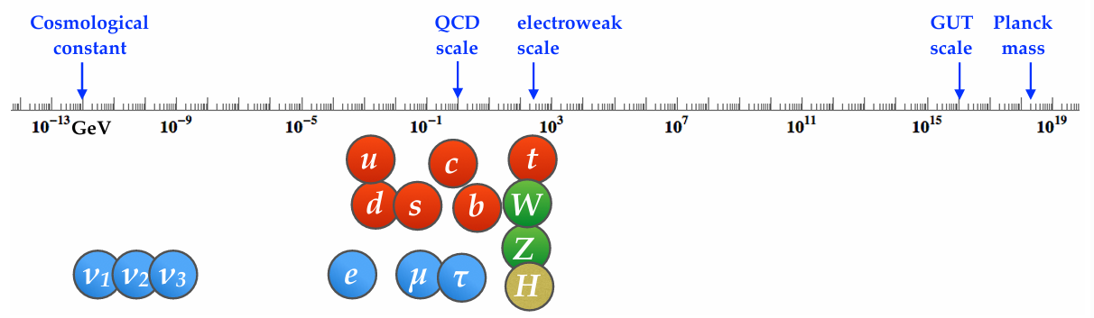
Why are neutrino masses so much smaller?
Why?
0.1 eV
10⁶ eV
KATRIN: m < 0.45 eV
Neutrino Oscillations: m(heaviest neutrino) > 0.05 eV

Slide 7
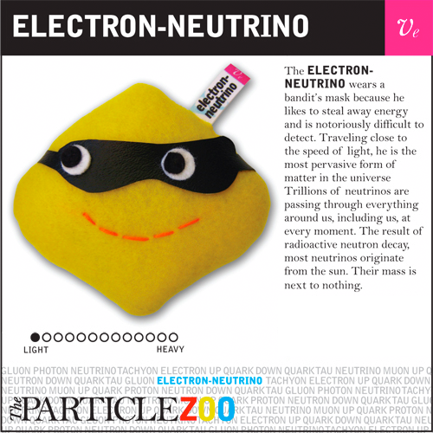
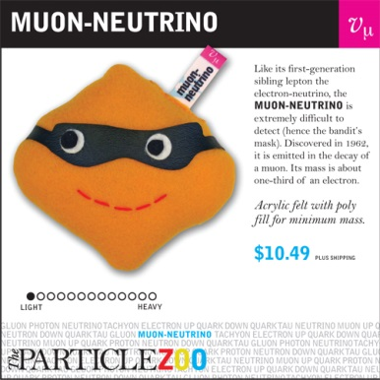
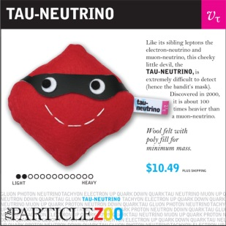
Neutrino Mixing
Flavor-Eigenstates
Mass-Eigenstates
ν₁
ν_{e}
ν₃
20%
20%
49%
49%
60%
ν_{μ}
2%
33%
33%
ν₂
33%
ν_{τ}

Slide 8
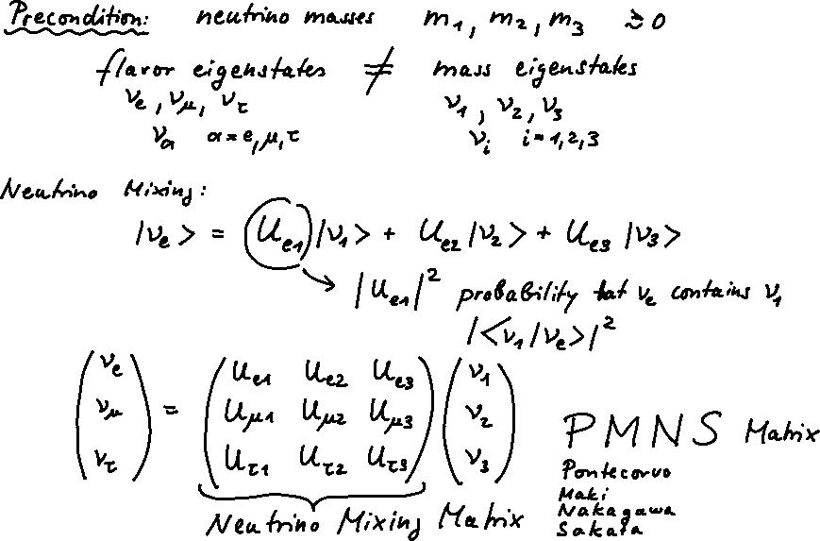
Neutrino Mass and Mixing

Slide 9
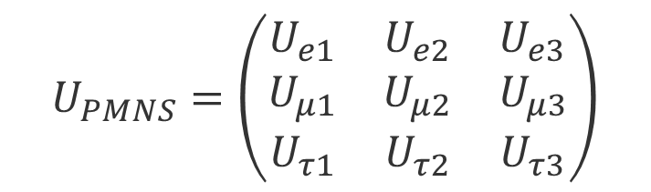
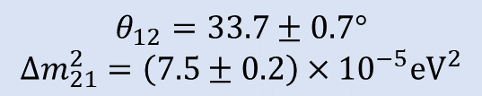
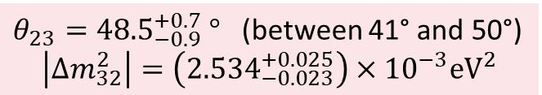
9 complex elements:
+ conditions for unitarity of U
+ if neutrinos are Dirac: can rotate away 2 global phases
4 parameters to describe U (Dirac case)
$$U_{PMNS}=\left(\begin{matrix}U_{e1} & U_{e2} & U_{e3} \\ U_{μ1} & U_{μ2} & U_{μ3} \\ U_{τ1} & U_{τ2} & U_{τ3}\end{matrix}\right)$$
Most popular parametrization: 3 mixing angles θ₁₂, θ₁₃, θ₂₃ and 1 phase δ
$U_{PMNS}=\left(\begin{matrix}1 & 0 & 0 \\ 0 & \cos{θ_{23}} & \sin{θ_{23}} \\ 0 & −sin{θ_{23}} & \cos{θ_{23}}\end{matrix}\right)$ $\left(\begin{matrix}\cos{θ_{13}} & 0 & \sin{θ_{13}e^{−iδ}} \\ 0 & 1 & 0 \\ −sin{θ_{13}e^{+iδ}} & 0 & \cos{θ_{13}}\end{matrix}\right)$ $\left(\begin{matrix}\cos{θ_{12}} & \sin{θ_{12}} & 0 \\ −sin{θ_{12}} & \cos{θ_{12}} & 0 \\ 0 & 0 & 1\end{matrix}\right)$
$θ_{23}={48.5}_{−0.9}^{+0.7} °$ (between 41° and 50°)
$$\left|∆m_{32}^{2}\right|=\left({2.534}_{−0.023}^{+0.025}\right)×{10}^{−3}{\text{eV}}^{2}$$
Θ₁₃ = (8.5 ± 0.5)º
$$θ_{12}=33.7±0.7°$$
$$∆m_{21}^{2}=\left(7.5±0.2\right)×{10}^{−5}{\text{eV}}^{2}$$
What is δ?
Mass ordering?
Octant problem: Is θ₂₃ < 45° or > 45° ?

Slide 10
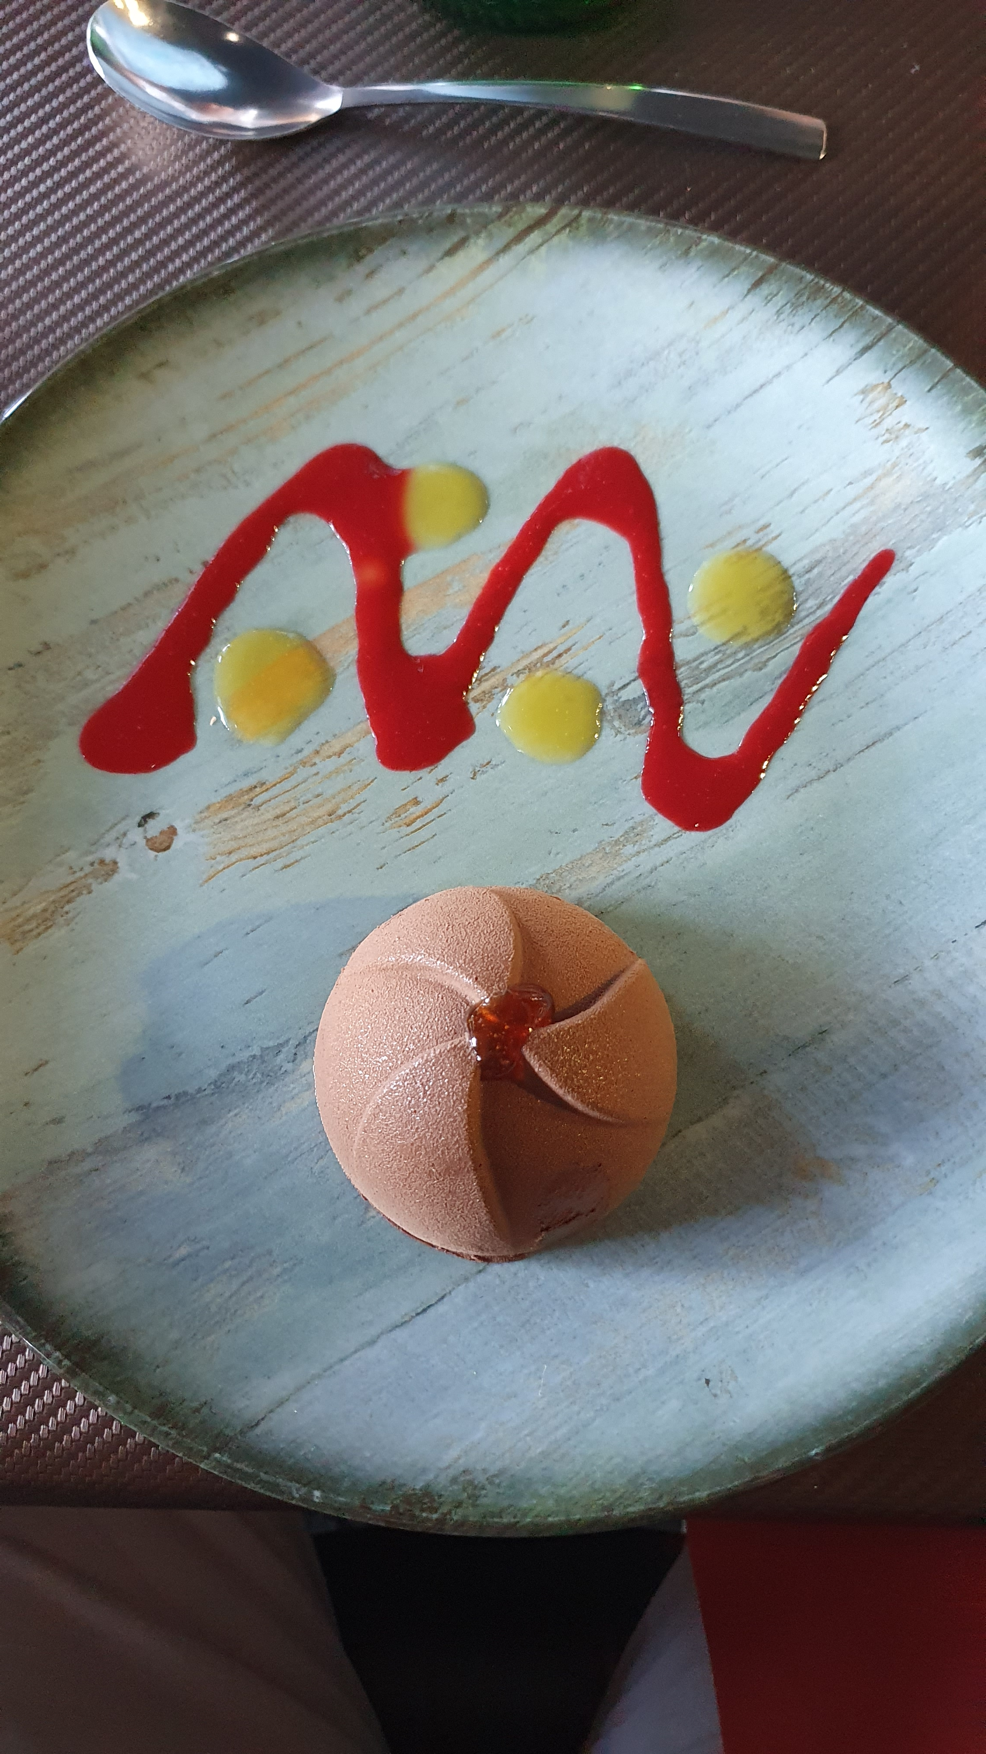
Basic Oscillation Mechanism
2
Wonderful example of
flavour oscillations,
served today at lunch
at Neutrino Summer School

Slide 11
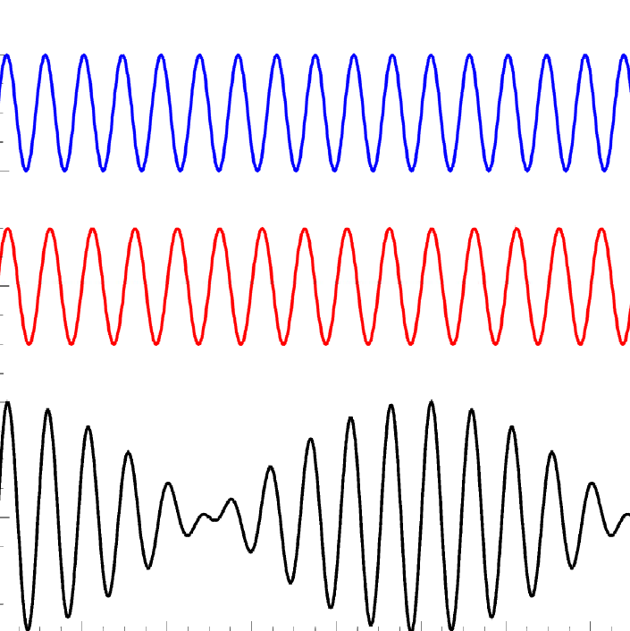
Neutrino Oscillations (simplified)
For Θ ≈ 45º
Flavor Eigenstates
v_{μ}, v_{τ}
Mass Eigenstates
v₂,v₃ with m₂, m₃
Source produces
Flavor-Eigenstates
Propagation in vacuum:
Mass-Eigenstates
Detection process:
Flavor-Eigenstates
v₂
v_{τ}
v_{μ}
v_{τ}
τ
v_{τ}
v_{μ}
v₃
W
W
μ
p,n
hadrons

Slide 12
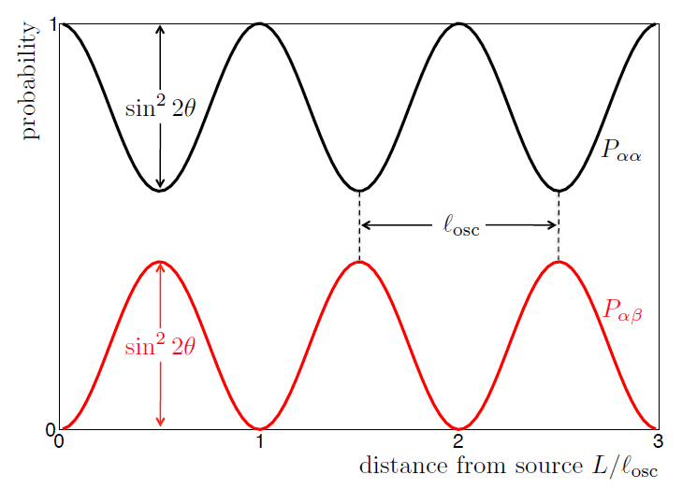
Neutrino Oscillations (2 Flavors)
disappearence
Example:
for Δm² = 2.5∙10⁻³eV²
and E_{v} = 1GeV we get
l_{osc} = 1000km
appearence

Slide 13
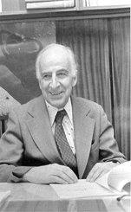
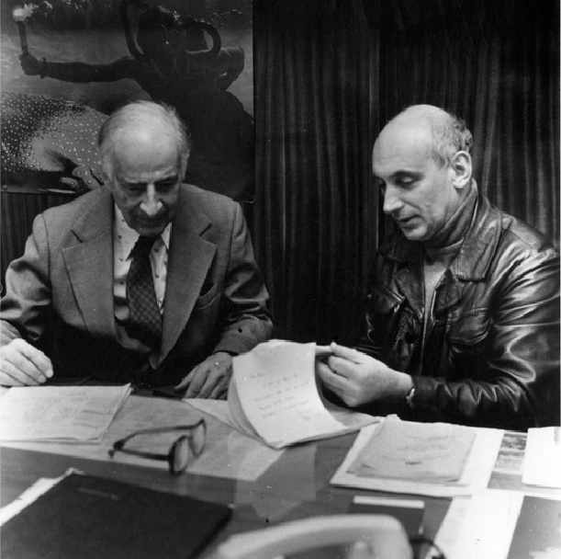
Theoretical Prediction of Neutrino Oscillations:
1957-58: Pontecorvo:
states for first time possibility of Neutrino Oscillations
(But: at that time only v_{e} were known, so he was thinking
of Neutrino ↔ Anti-Neutrino oscillations)
B. Pontecorvo, J.Exptl. Theoret. Phys.34(1958) 247 [Sov. Phys. JETP7(1958) 172]
1962 Maki, Nakagawa, Sakata:
describe mixing of 2 flavors and discuss
transitions between neutrino flavors.
1967 Pontecorvo :
thorough discussion of 2 flavor mixing,
oscillations of solar-neutrinos
and possible existence of sterile neutrinos.
Also possibility of Cl-Ar experiments
Bilenky
1928-2020
Pontecorvo
Bruno Pontecorvo
(1913 – 1993)
Very nice overview on history:
Samoil M. Bilenky „Neutrino oscillations: brief history and present status“
arXiv:1408.2864v1 [hep-ph] 12 Aug 2014

Slide 14
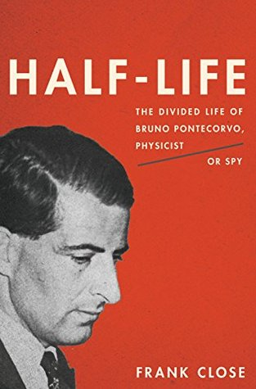
One of last great unsolved cold-war science mysteries
…and here a talk by F. Close
https://youtu.be/d4rCjoWiOrw
And a discussion of this book in Nature
https://www.nature.com/articles/518032a
in german: Physik Journal 12 (2013) Nr.10

Slide 15
The Pioneers & Discovery
3

Slide 16
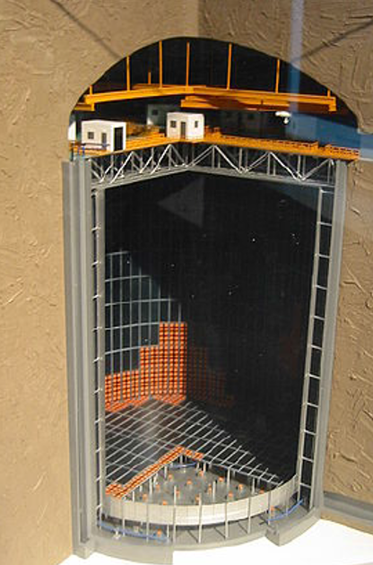
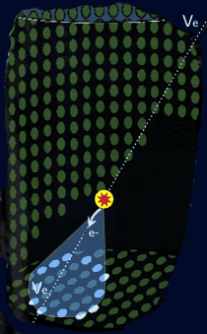
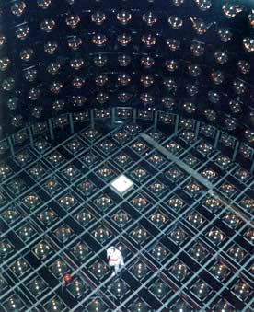
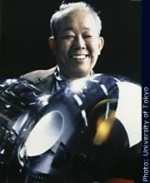
KamiokaNDE
3 kt Water Cerenkov detector, build for searching proton decay
Nucleon Decay Experiment
M. Koshiba
Nobelprize 2002
"for pioneering contributions to astrophysics,
in particular for the detection of cosmic neutrinos"
Notes:
Atmosphaerisch ohne th

Slide 17
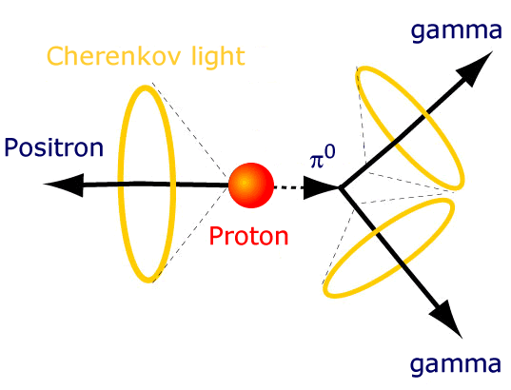
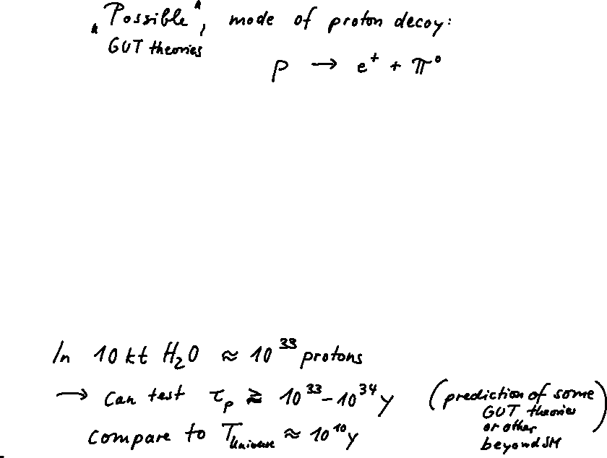
Energy threshold for
Cerenkov emmission (in water):
Muon: > 170 MeV
Electron: > few MeV

Slide 18
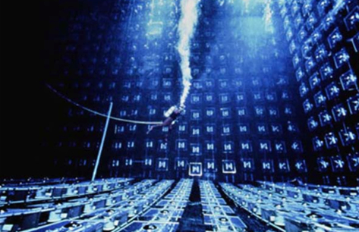
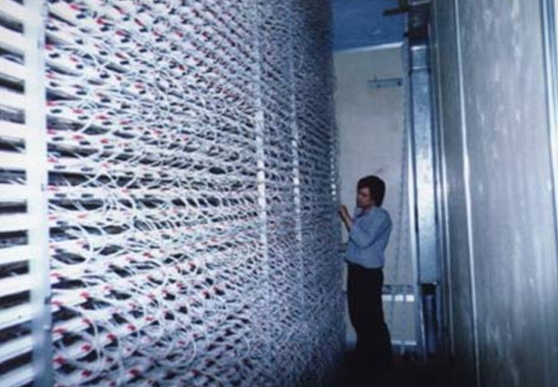
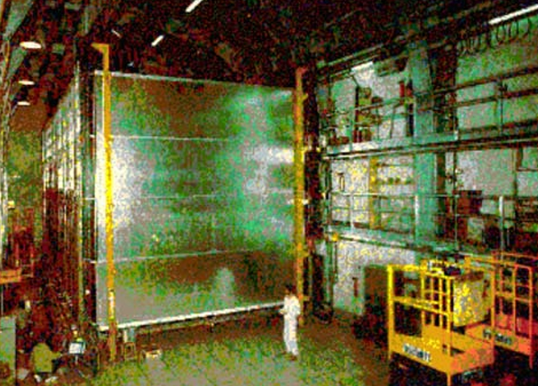
Proton Decay Experiments in the 1980s
KamiokaNDE (water cerenkov, FV = 1000t)
IMB (water cerenkov, FV = 3300t)
NUSEX (iron tracking calorimeter, FV = 130t)
Frejus (iron tracking calorimeter, FV = 700t)
…
Atmospheric neutrinos had been discovered in 1965
and were considered as a background

Slide 19
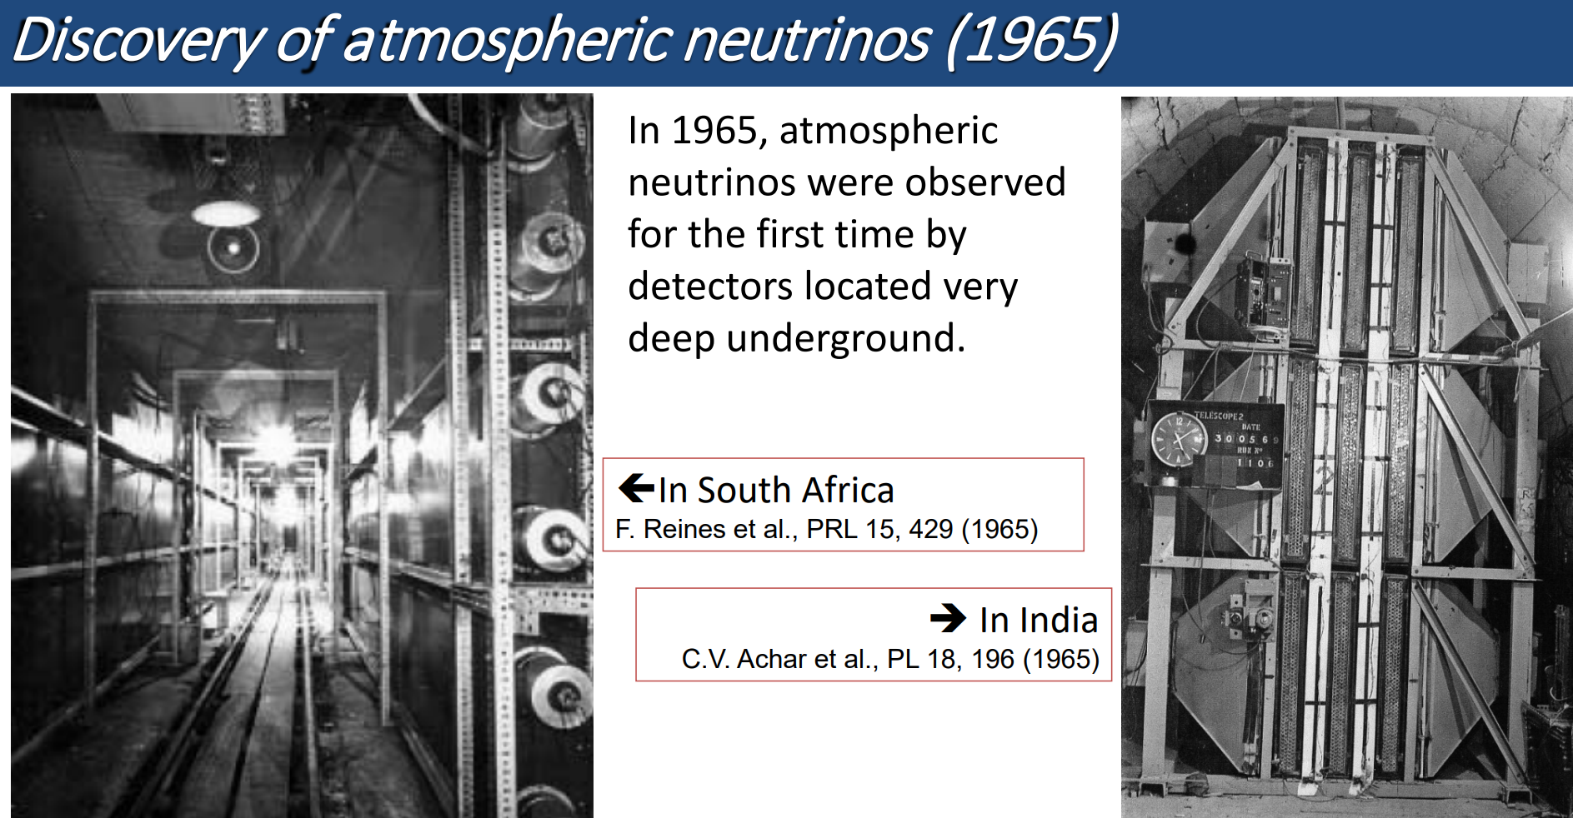
After muon neutrino was discovered in 1962 (in accelerator experiments)
Also interesting:
„PERSPECTIVES OF EXPERIMENTAL NEUTRINO PHYSICS IN INDIA“, V.S.Narasimham
Proc Indian Natn Sci Acad, 70, A, No.1, January 2004, pp.11–25
Slide by T.Kajita
Notes:
1962 muon neutrino discovered by Lederman, schwartz, steinberger -> NP in 1988

Slide 20

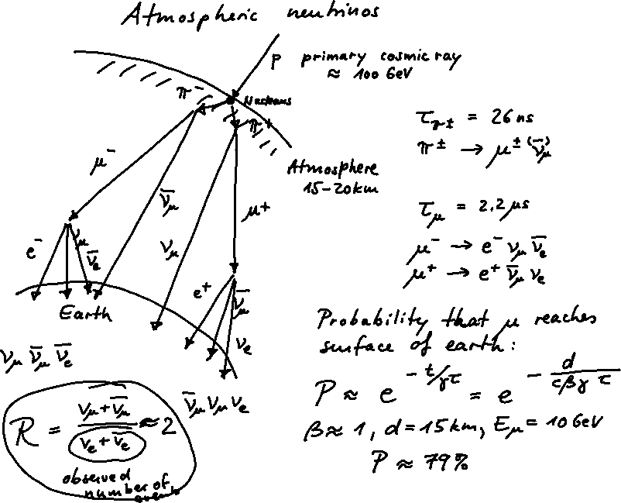

Slide 21
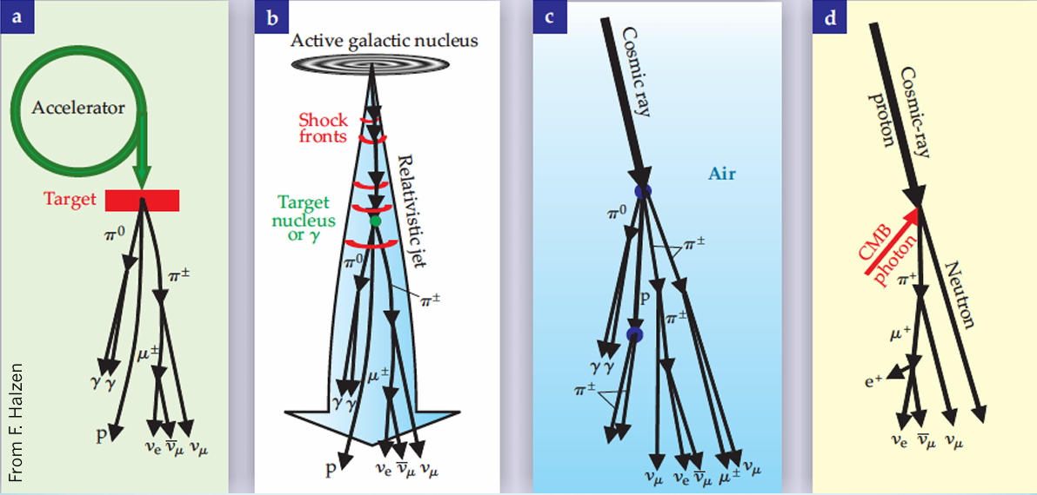
Neutrino production by protons hitting a target
Neutrino beams
Astrophysical neutrinos
Atmospheric neutrinos
Cosmogenic neutrinos

Slide 22
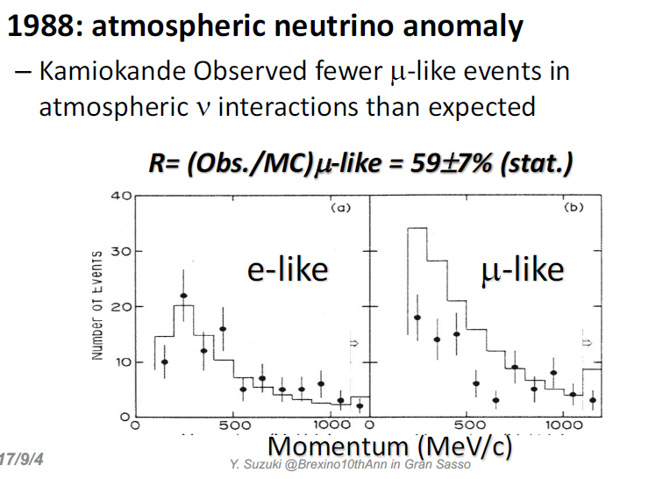
But then: Kamiokande sees something strange in 1988…

Slide 23
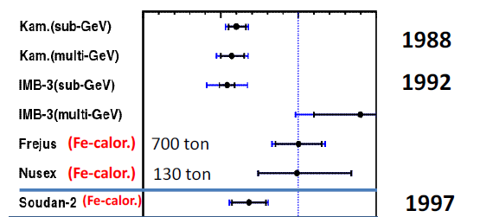

Other experiments start looking at this so called atmospheric neutrino anomaly…
Result: Confusion!
Half of the muon neutrinos seem to be missing!
But only in the water Cerenkov detectors?
Conclusion: Need bigger and better detector (SuperKamiokande) to solve the puzzle

Slide 24
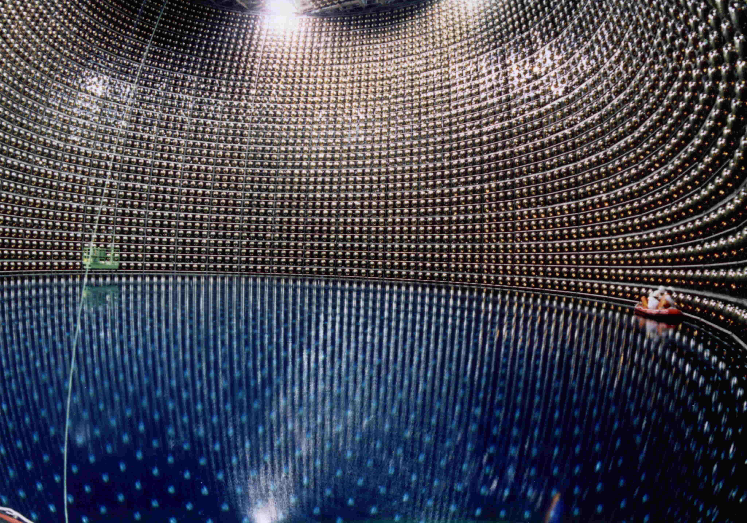
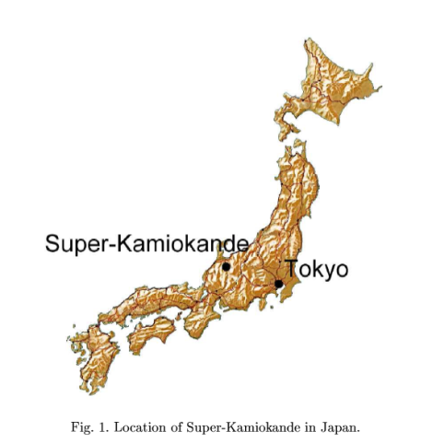
Super-Kamiokande

Slide 25
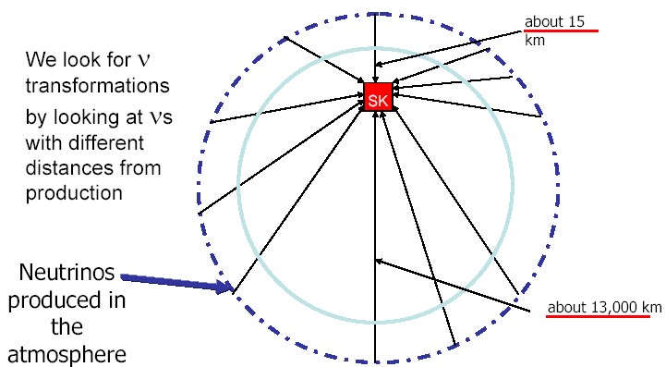
Zenith angle distribution
Oscillation probability
changes with zenith angle θ
L ≈ 20 km
θ
atmospheric
neutrinos:
E_{v} few GeV
Erde
L ≈ 13000 km
Atmosphere

Slide 26
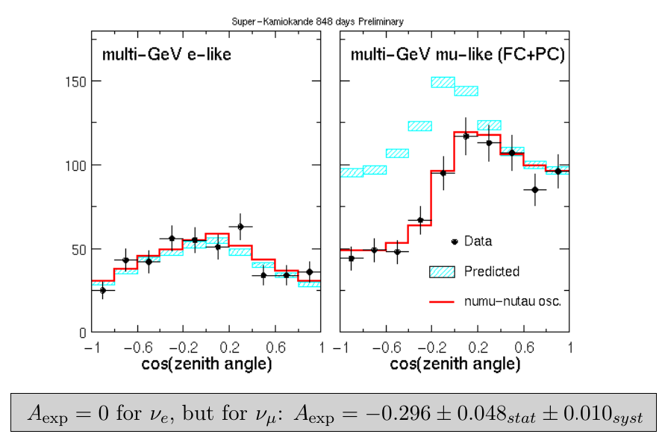
SuperK – First Evidence for Neutrino Oscillations 1998
ν_{μ}
ν_{e}
μ
e
Notes:
Aus hep-ex/0212035: Wilkes 15.12.2002 Conference Report

Slide 27
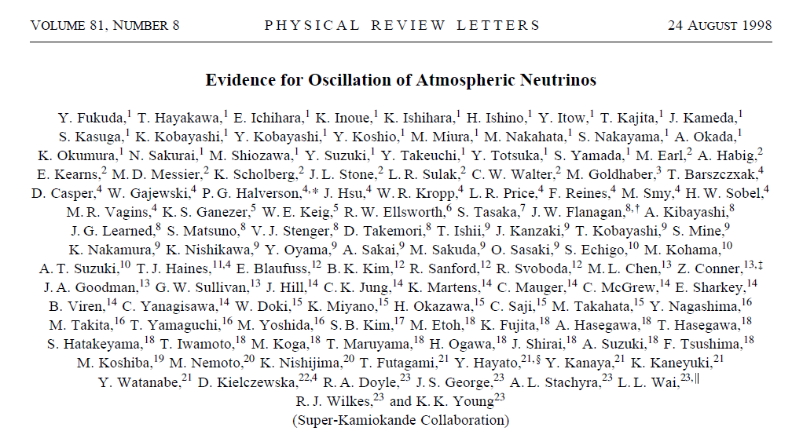
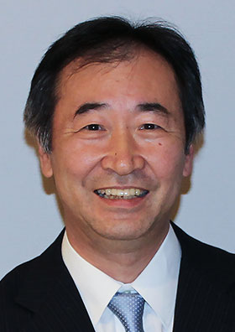
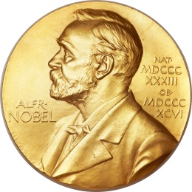
Nobelprize 2015 for T. Kajita

Slide 28
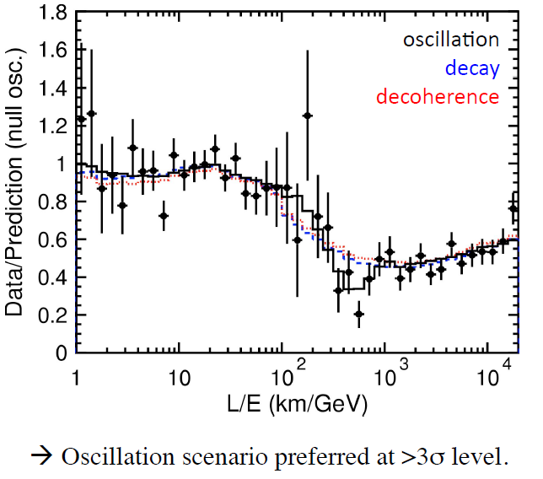
Super-K L/E Analysis (2005): alternative mechanisms disfavoured

Slide 29
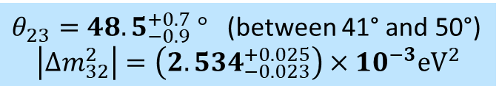
This was confirmed by neutrino beam experiments
$$P\left(ν_{μ}→ν_{μ}\right)=1−\sin^{2}\left(2θ_{23}\right)⋅\sin^{2}\left(1.267\frac{Δm_{23}^{2}\left(\text{in} \text{e}{\text{V}}^{2}\right)⋅L\left(\text{in} \text{km}\right)}{E\left(\text{in} \text{GeV}\right)}\right)$$
Disappearence of v_{μ}
$θ_{23}={48.5}_{−0.9}^{+0.7} °$ (between 41° and 50°)
$$\left|∆m_{32}^{2}\right|=\left({2.534}_{−0.023}^{+0.025}\right)×{10}^{−3}{\text{eV}}^{2}$$
Octant Problem:
This is symmetric around 45°:
e.g. 50° and 40° give same value for sin²2θ
Mass Ordering?:
Same value for
m₂ < m₃ and for m₃ < m₂
K2K
MINOS
Today: NOvA, T2K
…further confirmed by atmospheric neutrinos in SK and Icecube

Slide 30

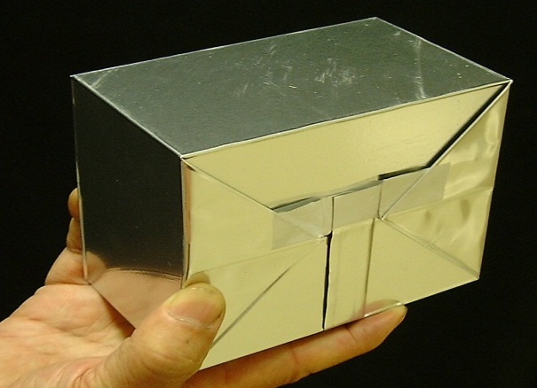
OPERA: Appearence of v_{τ} (2015)
τ⁻
τ-decay:
v_{τ}
W
p,n
hadrons
1 mm
10X₀
Typical topology of τ-decay:
“Kink” within 1mm from vertex
t⁻
μ⁻
v_{τ}
8kg
lead-emulsion-brick
(total ≈ 150.000)
Hadrons
Lead
target mass:
≈ 1,35 kton
Emulsions

Slide 31
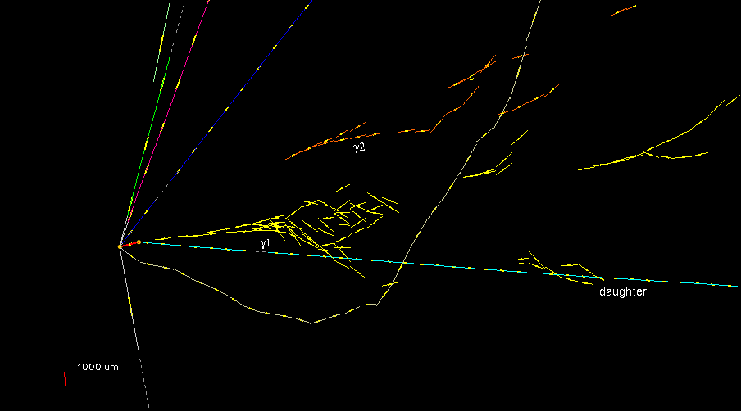
First v_{Tau} Candidate Event (22/08/2009)
Opera Coll., “Search for nu-mu - nu-tau oscillation with the OPERA experiment in the CNGS beam”, New J. Phys. 14 (2012) 033017

Slide 32
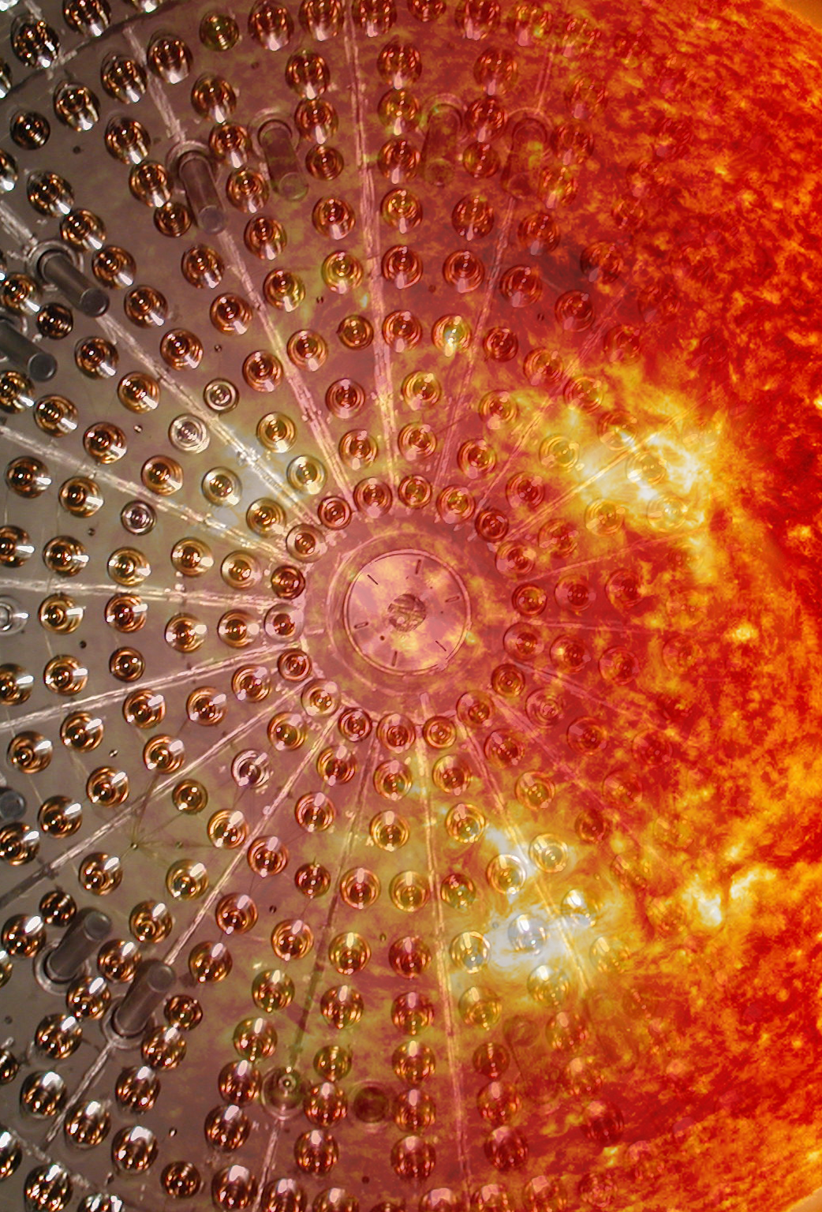
Why Matter matters, even for neutrinos
4

Slide 33
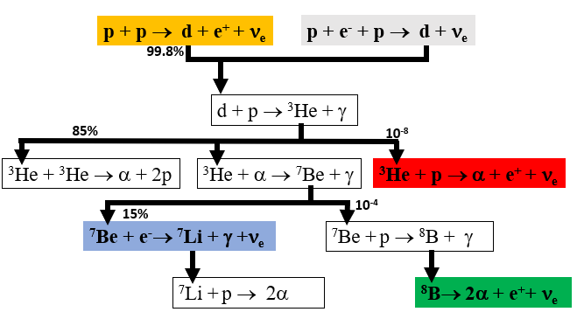
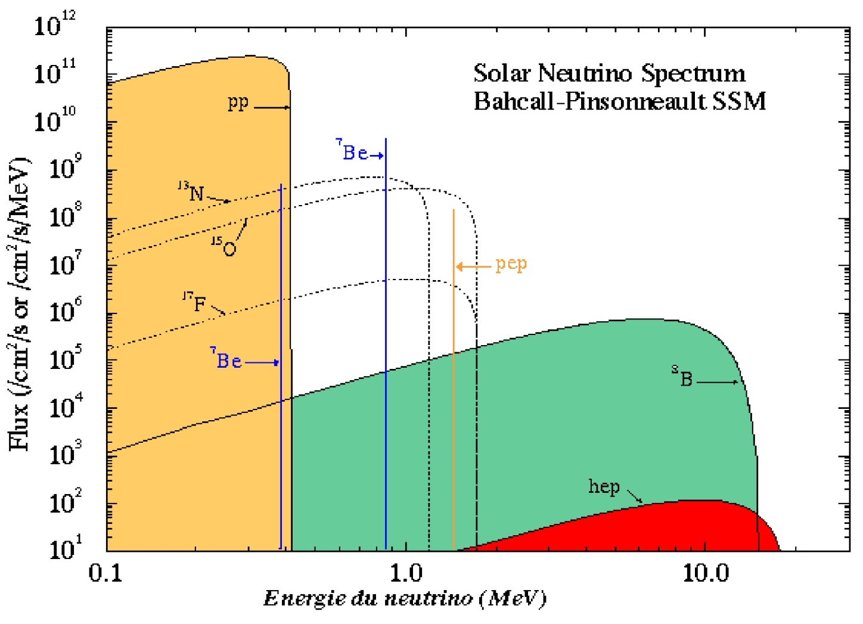
Standard Solar Model (SSM) predicted solar neutrino fluxes
energy of the neutrinos in MeV
Notes:
die geburt of die sonne und der Triumph of Bacchus"
Corrado Giaquinto - öl an segeltuch - 168 x 140 cm - 1762 - (Museo del Prado (Madrid, Spain))

Slide 34
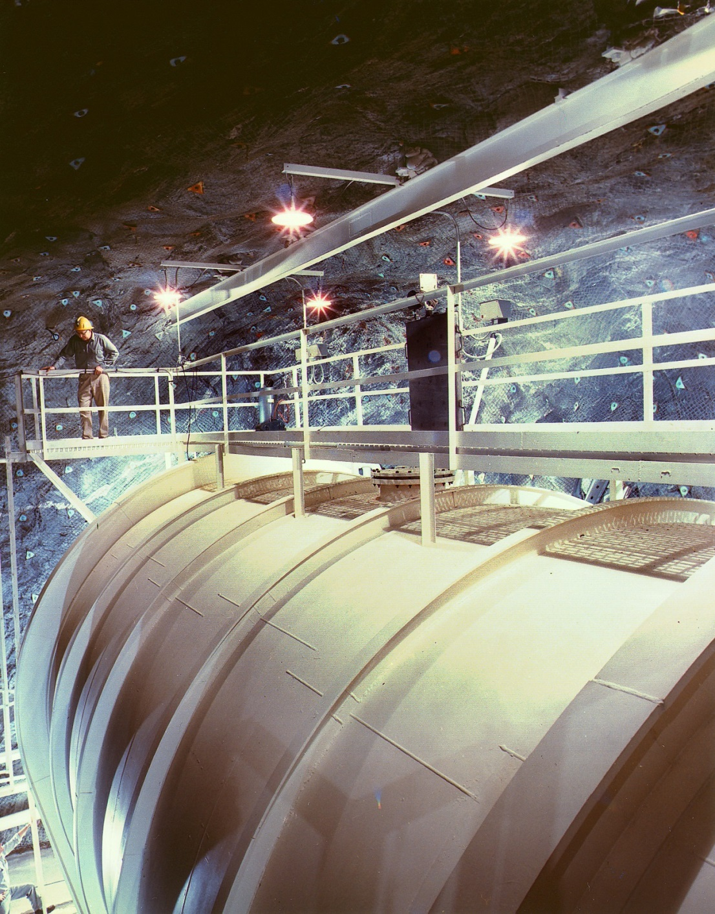
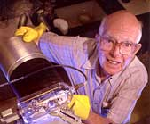

Solar Neutrinos: First Detection
1970 - 1994
$$ν_{e}+{}_{}^{37}{\text{Cl}}→{}_{}^{37}{\text{Ar}}+e^{−}$$
E_{ν} > 814 keV (⁸B, ⁷Be Neutrinos)
Raymond Davis Jr.,
Homestake Experiment
Notes:
Atmosphaerisch ohne th

Slide 35



How to count single ³⁷Ar atoms
SSM
First detection of solar neutrinos
BUT: R_{exp} = 0.34 × R_{SSM}

Slide 36




Davis & Bahcall (1964)

Slide 37



GALLEX/GNO Experiment at LNGS (SAGE at Baksan)
(1992-2004)
E_{v} > 233 keV, pp-neutrinos!
pp - neutrinos detected
BUT: R_{exp} = 0.6 × R_{SSM}

Slide 38



The Sun shines in neutrino light
as seen by Super-Kamiokande

Slide 39

The solar neutrino puzzle
(around 1995)
neutrino energy < 1 MeV: 60% of v_{e} observed
neutrino energy > 1 MeV: 30% of v_{e} observed
Notes:
Edvard munch

Slide 40





SNO: The Solution of the Solar Neutrino Puzzle
Nobelprize 2015
Arthur McDonald
1000t D₂O
9500 PMTs

Slide 41


Only ⁸B Neutrinos:
CC
v_{e}
ES
v_{e(μτ)}+
v
NC
v_{eμτ}+
v
SNO Result (salt-phase, PRL 92, 181301, 2004):
Φ_{CC} = Φ_{e}
Φ_{μτ}
The total number of neutrinos agrees with SSM
Φ_{ES} = Φ_{e} + ε∙Φ_{μτ}
Φ_{NC} = Φ_{e} + Φ_{μτ}
And:
1/3 of v_{e} arrive on Earth as v_{e} .
2/3 of v_{e} have transformed into v_{μ} or v_{τ} .
Φ_{e}

Slide 42

Allowed values for neutrino parameters to explain solar neutrino observations
Spring 2002
LMA
SMA
LOW
VAC
10
tan²θ

Slide 43




KamLAND result 2004
Average distance of japanese nuclear power plants to KamLAND: 175km
Oscillation length for
125km
L
„First evidence of deformation in energy spectrum for solar/reactor neutrinos“

Slide 44




Is this the explanation for all solar neutrino results?
Let us assume: $Δm_{12}^{2}=8×10^{−5}\text{e}{\text{V}}^{2}, θ_{12}=33°$
2 Flavour Oscillation in Vacuum:
8·10⁻⁵ eV²
1.5·10¹¹ m
$$P\left(υ_{e}→υ_{μ}\right)={\text{sin}}^{2}\left(2θ_{12}\right)∙{\text{sin}}^{2}\left(1.27∙\frac{∆m_{12}^{2}L}{E}\right)$$
0.1-10 MeV
Therefore the sin² averages out to ½ (incoherent mixture) and we loose the energy/distance dependence, the survival probability for v_{e} is then:
$P\left(υ_{e}→υ_{e}\right)={\text{1 − }1/2 \text{sin}}^{2}\left(2θ_{12}\right)$ = 0.6
Explains the low energy (E < 1MeV) part of solar neutrino experiments (Gallex/GNO,Sage)
Need other mechanism for E > 1 MeV

Slide 45

Neutrino Propagation in Matter (Overview)
Important: v_{e} and v_{μ,τ} have different interaction with matter
(v_{e} can do both CC and NC, v_{μ,τ} only NC!)
ν_{e,μ,τ}
ν_{e,μ,τ}
Relevant for propagation is elastic forward scattering
Vacuum:
Matter:
Center of the Sun:

Slide 46

$$θ_{m}=\frac{π}{4}$$
pp-neutrinos, ⁷Be-neutrinos
In these equations the sign of Δm² matters!
⁸B-neutrinos

Slide 47


For ⁸B Neutrinos at center of the Sun:
For ⁸B Neutrinos in vacuum (at earth):
$$\left(\begin{matrix}v_{1} \\ v_{2}\end{matrix}\right)=\left(\begin{matrix}\cos{θ_{12}} & −\sin{θ_{12}} \\ \sin{θ_{12}} & \cos{θ_{12}}\end{matrix}\right)\left(\begin{matrix}v_{e} \\ v_{μ}\end{matrix}\right)$$
The probability that v₂ is a v_{e} is sin²θ₁₂
This means, the probability that v_{e} has mass m₂ is sin²(73°) = 91%
30% v_{e}
detector
m₂
adiabatic density change
It is NOT an oscillation

Slide 48



Neutrino Propagation in Matter: MSW mechanism
Important for solar neutrinos:
Survival probability
Stanislav Mikheev
(1940-2011)
Alexei Smirnov
Lincoln Wolfenstein
(1923-2015)
Quasi-Vacuum
Oscillation
Matter-Effect
L. Wolfenstein, Phys. Rev. D17 (1978) 2369
S. P. Mikheev and A. Yu. Smirnov, Nuovo Cim.C9 (1986)17
Interaction of v_{e} and v_{μ,τ} with electrons different.
→ Effective masses, effective mixing angles
depending on electron density N_{e} and
energy of neutrino
Important: m₂ > m₁
Transistion at 1-2 MeV

Slide 49


BOREXINO at LNGS
2200
300t
18m

Slide 50


Slide 51



Photomultipliers and light concentrators in Borexino

Slide 52



elastic scattering of neutrinos on electrons:
neutrino „lines“ → Compton-like edge in spectrum of recoil electrons
⁷Be
pep

Slide 53

BX Analysis 2018: Flavor Transition in Matter
Borexino Coll. „Comprehensive measurement of pp-chain solar neutrinos“, Nature Vol562, pages505–510 (2018)

Slide 54

The third mixing angle: towards precision
5

Slide 55


$U_{PMNS}=\left(\begin{matrix}1 & 0 & 0 \\ 0 & \cos{θ_{23}} & \sin{θ_{23}} \\ 0 & −sin{θ_{23}} & \cos{θ_{23}}\end{matrix}\right)$ $\left(\begin{matrix}\cos{θ_{13}} & 0 & \sin{θ_{13}e^{−iδ}} \\ 0 & 1 & 0 \\ −sin{θ_{13}e^{+iδ}} & 0 & \cos{θ_{13}}\end{matrix}\right)$ $\left(\begin{matrix}\cos{θ_{12}} & \sin{θ_{12}} & 0 \\ −sin{θ_{12}} & \cos{θ_{12}} & 0 \\ 0 & 0 & 1\end{matrix}\right)$
$θ_{23}={48.5}_{−0.9}^{+0.7} °$ (between 41° and 50°)
$$\left|∆m_{32}^{2}\right|=\left({2.534}_{−0.023}^{+0.025}\right)×{10}^{−3}{\text{eV}}^{2}$$
$$θ_{12}=33.7±0.7°$$
$$∆m_{21}^{2}=\left(7.5±0.2\right)×{10}^{−5}{\text{eV}}^{2}$$
Θ₁₃?
Around 2010 many experiments started to measure it:
It was assumed, that likely it would be very small .
Two methods were used:
Appearence of v_{e} in v_{μ} beams
Disappearence of anti-v_{e} from nuclear power plants
3 Flavour Oscillation effect, needs precision

Slide 56


Neutrino Mixing and Oscillations (3 flavours)
$$\left(\begin{matrix}ν_{e} \\ ν_{μ} \\ ν_{τ}\end{matrix}\right)=\left(\begin{matrix}U_{e1} & U_{e1} & U_{e1} \\ U_{μ1} & U_{μ2} & U_{μ3} \\ U_{τ1} & U_{τ2} & U_{τ3}\end{matrix}\right)\left(\begin{matrix}ν_{1} \\ ν_{2} \\ ν_{3}\end{matrix}\right)=\left(\begin{matrix}c_{12}c_{13} & s_{12}c_{13} & s_{13}e^{−iδ} \\ −s_{12}c_{23}−c_{12}s_{23}s_{13}e^{iδ} & c_{12}c_{23}−s_{12}s_{23}s_{13}e^{iδ} & s_{23}c_{13} \\ s_{12}s_{23}−c_{12}c_{23}s_{13}e^{iδ} & −c_{12}s_{23}−s_{12}c_{23}s_{13}e^{iδ} & c_{23}c_{13}\end{matrix}\right)\left(\begin{matrix}ν_{1} \\ ν_{2} \\ ν_{3}\end{matrix}\right)$$
c₁₂ stands for cosϑ₁₂ , s₁₂ stands for sinϑ₁₂ etc., δ is the Dirac CP-phase
Probability for neutrino oscillation (neutrino with energy E, after distance L) from flavour α to flavour β
with:

Slide 57
Survival of v_{e} from nuclear power plants: θ₁₃

Slide 58


${\overline{v}}_{e}$- flux from nuclear power plants
Antineutrino Global Map 2015, Sci.Rep.5 (2015) 13945

Slide 59

prompt signal
E_{v} – 0.77MeV
delayed signal

Slide 60
Antineutrino Detection in Reactor Experiments
Inverse Beta Decay:
Prompt Event: e⁺
gives neutrino energy E_{v}
e⁺
Delayed Event: n
capture on Gd
(8MeV γ-emmission)
Delay: ca. 30µs
n
Gd

Slide 61


Daya Bay Result: precision measurement of Θ₁₃
Θ₁₃ ≈ 9º
Globat Fit: Θ₁₃ = (8.5 ± 0.5)º (nu-fit, 09/24)
Daya Bay Coll.,PRL 115, 111802 (2015)

Slide 62
Into the Unknown
6

Slide 63


What is the Mass Ordering of Neutrinos?
m₁ < m₃
m₁ > m₃
or
ν₃
ν₁
ν₃
ν₁
Normal Ordering
Inverted Ordering

Slide 64




Determination of MO in a Reactor Neutrino Experiment
With Δ_{ij} = 1.27 |Δm²_{ji} (eV²)| L(m)/E(MeV)
sin²2Θ₁₃
sin²2Θ₁₂
50 – 60km
Notes:
S.T. Petcov et al.,
PLB533(2002)94
S.Choubey et al.,
PRD68(2003)113006
J. Learned et al.,
hep-ex/0612022
L. Zhan, Y. Wang, J. Cao, L. Wen,
PRD78:111103, 2008,
PRD79:073007, 2009

Slide 65

Anti-neutrino Energy Spectrum at 52.5 km from Nuclear Power Plant

Slide 66

JUNO: Detector Concept
S

Slide 67

17612 Large PMTs (20 inch)
25600 Small PMTs (3 inch)

Slide 68


Slide 69

Just starting!

Slide 70



How to search for CP-phase: Appearance of v_{e} in a beam of v_{μ}
Oscillation probability P(v_{μ}→ v_{e}) is approximately given by (expansion by order of small parameter α):
-
Compare and
$$P\left(ν_{μ}→ν_{e}\right)$$
$$P\left({\overline{ν}}_{μ}→{\overline{ν}}_{e}\right)$$
with:
Leading term ~ Θ₁₃
Octant of Θ₂₃
Matter effects enhance v_{e}(NH), ${\overline{ν}}_{e}$ (IH)
Sign change for anti-neutrinos
(measurement of δ_{CP})

Slide 71

Slide by Tamer Tolba
Notes:
Add beam power from beam to super beam!

Slide 72

Dune
NOvA
T2K /T2HK
matter effects

Slide 73



How to measure oscillation parameters with ${ν_{μ}/\overline{ν}}_{μ}$ beams
disappearance of ${ν_{μ}/\overline{ν}}_{μ}$ :
appearance of ${ν_{e}/\overline{ν}}_{e}$ :
leading order dependence on sin²2θ₂₃
little power to distinguish whether
θ₂₃ < 45°, θ₂₃ = 45° or θ₂₃ > 45°.
leading order dependence on |Δm²₂₃|.
Does not depend on mass ordering.
leading order dependence on sin²2θ₁₃ and sin²θ₂₃.
Can separate octant, meaning whether
θ₂₃ < 45°, θ₂₃ = 45° or θ₂₃ > 45°.
sub-leading order dependence on sin²2θ₁₃ and sin²2θ₂₃.
Can detect CP-violation.
sub-leading order dependence on |Δm²₂₃|through matter effect. Can measure mass ordering.
Notes:
Plots are for T2K

Slide 74

How to measure CPV by comparing appearance of $ν_{e}$/${ \overline{ν}}_{e}$ in $ν_{μ}/{ \overline{ν}}_{μ}$ beams
Difficult to disentangle degeneracies
between parameters in one experiment alone
Can be solved by combining results
from different experiments
with different baselines

Slide 75


Running since >10 years: NOvA and T2K
NOvA:
Distance ND – FD: 810 km
both detectors 14mrad off-axis
neutrino flux peak at 1.8 GeV,
typical beam power 900 kW
FD: 14kton Liquid Scintillator in cells
T2K:
Distance ND – FD: 295 km
2.5° off-axis
neutrino flux peak at 0.6 GeV,
Plan to increase beam power 1300 kW (2027)
FD: SK 50kton Water Cerenkov, ND different

Slide 76

NOvA result on disappearance of ${ν_{μ}/\overline{ν}}_{μ}$ (26.6x10²⁰pot)
From J. Wolcott Neutrino24

Slide 77

NOvA result on appearance of ${ν_{e}/\overline{ν}}_{e}$ (26.6x10²⁰pot)
Observed 181 events,
expect 62 from background
Observed 32 events,
expect 12 from background
From J. Wolcott Neutrino24

Slide 78

NOvA analysis of appearance of ${ν_{e}/\overline{ν}}_{e}$ (26.6x10²⁰pot)
Strong synergy with reactor exp:
Constraint on θ₁₃ enhances
Upper Octant preference
Constraint on Δm²₃₂ enhances
Normal Ordering preference
From J. Wolcott Neutrino24

Slide 79

NOvA analysis of mass ordering and CPV (26.6x10²⁰pot)
From J. Wolcott Neutrino24

Slide 80


T2K result on appearance of ${ν_{e}/\overline{ν}}_{e}$ (2023)
In contrast to NOvA they see a strong asymmetry between electron neutrino and antineutrino event numbers
Attention: T2K use other convention for CP-phase:
- ½ π instead of 3/2 π
Values that maximize asymmetry are favoured
Normal ordering and upper octant are favoured, with nearly maximally CP-violating phase

Slide 81

Combining NOvA and T2K results:
Still compatible at > 90%
However, favoured regions of CP-phase
are opposite in NO

Slide 82


(slides by Jeremy Wolcott, Neutrino24)

Slide 83


The Future: DUNE & Hyper-K, ESSvsb
DUNE:
Distance ND – FD: 1300 km
both detectors 14mrad off-axis
neutrino flux peak at 1.8 GeV,
typical beam power > 2000 kW
FD: 40kton Liquid Argon TPC
Hyper-K:
Distance ND – FD: 295 km
2.5° off-axis
neutrino flux peak at 0.6 GeV,
Plan to increase beam power 1300 kW (2027)
FD: 5 x SK 50kton Water Cerenkov

Slide 84


CP-violation measurement in DUNE
2nd osc. max.
1st osc. max.
build wideband beam to observe both

Slide 85



The European Spallation Source (ESS, under construction in Lund, Sweden)
with ESSnuSB (ESS neutrino super beam) beam power: 5MW

Slide 86

Summary & Outlook
7

Slide 87


Global Fit on (almost) all experimental data
Here from: www.nu-fit.org

Slide 88

Precision Era: Unitary Triangle for Leptonic Sector

Slide 89

What can we learn from oscillation experiments?
What is the neurtino mass ordering?
Is CP-symmetry violated?
What is behind neutrino flavor structure?
  Why is the structure of lepton mixing so different from quark mixing?
  What flavor symmetry can produce this pattern of mixing and how is it broken?
  Is ν_{μ}↔ ν_{τ} mixing symmetric (octant)? If so, why – possible new symmetry?
Is the neutrino mixing matrix unitary? Are there BSM effects impacting neutrino oscillation?
Precision measurements allow model discrimination
0.2

Slide 90

Merci!

