Slide 1


DRD4
I.Laktineh

Slide 2
Outline
DRD4 in a few words
IN2P3 participation
PICMIC

Slide 3
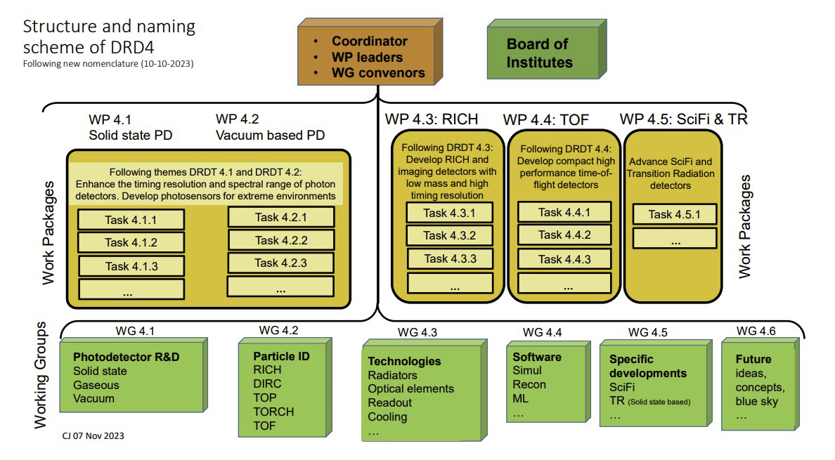

Slide 4

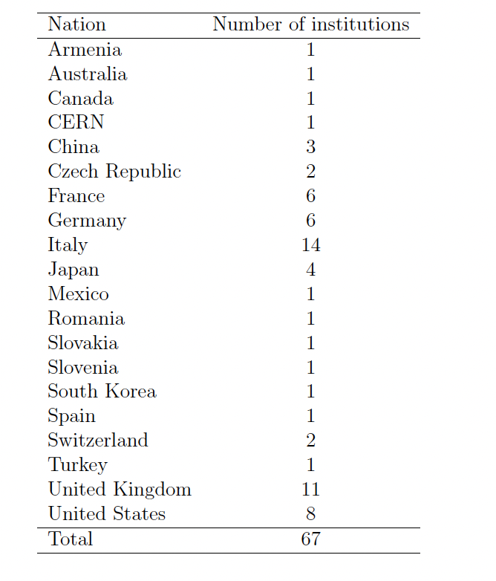

Slide 5
DRD4 Collaboration Board Chair: Guy Wilkinson (Oxford)
DRD4 Spokesperson: Massimiliano Fiorini (Ferrara)
WP1 Leader: Rok Pestotnik (Ljubljana)
WP2 Leader: Imad Laktineh (Lyon)
WP3 Leader: Roberta Cardinale (Genova)
WP4 Leader: Jon Lapington (Leicester)
WP5 Leader: Blake Leverington (Heidelberg)
WG1 leader: Fabrice Retière (Triumf)
WG2 Convener: Sajan Easo (RAL)
WG3 Convener: Fulvio Tessarotto (Trieste)
WG4 Convener: Maurizio Martinelli (Milano Bicocca)
WG5 convener: Sune Jakobsen (CERN)
WG6 Convener: Suat Ozkorucuklu (Istanbul)
Participation IN2P3
IP2I: WG1, WP2 (task 1,2 and 3)
OMEGA: WG1, WP2 (task3)
CPPM:WG1, WG4, WP4 (task 1)
LPSC: WG1, WG4
LPCA: WG5

Slide 6
WP4.4
Time of Flight Detectors
CPPM: 0.3 FTE (Ch. Morel& M. Dupont) et une demande de CDD 24 mois
Collaboration with IP2I on the simulation
6

Slide 7
WP4.2
Vacuum Photo-Detector
4.2.1: VPD: New material, new coatings, longevity and rate capability study
  D4.2.1: Production and characterisation of a new generation of MCP-PMT using innovative techniques. We will develop new MCP either with low resistivity lead glass or other materials (alumina, silicon, etc) with smaller pitch to reach better spatial and time resolution. ALD techniques will be tested to prolong the lifetime of the new MCP
4.2.2: VPD-PMT: New photocathode materials, structure and high quantum efficiency VPD
  D4.2.2:Production and characterisation of photocathodes either transmissive or reflective made of different materials using different structures and in particular a granular one to improve on the spatial resolution
4.2.3: VPD time and spatial resolution performance
  D4.2.3: Production and test of read-out system demonstrators able to fully exploit simultaneously timing and spatial resolution of the MCPs (tens of microns and tens of ps). The development will use the PICMIC and Timepix concepts as baseline to advance the state of the art.

Slide 8
Physicists:
I.Laktineh
P.Nedelec
L. Mirabito
G.Grenier
H. Abreu
G. Garillot
Eng:
E. Bechetoille
H. Mathez
K. Sabra
X.Chen
L. Balleguyer
Ch. Combaret
S. Conforti
N. Seguin
Ch. de la Taille
Several engineers (IJCLAB, IPHC) are contributing through Master Project PICMIC
6 physicists/chemists + 3 Eng from labs outside IN2P3
The funding of IP2I is for the most part from the PolyNanoPad & NCP ANR.

Slide 9

NCP: 2023-2027
NanoPolyPad: 2021-2024
 | Partner IP2I | Partner INL | Partner ILM
Staff expenses | 108 000 | 114 000 | 0
Instruments and material cost (including the scientific consumables) | 80 000 | 45 000 | 20 000
Building and ground costs
Outsourcing/subcontracting | 107 000 | 15000 | 40 000
Travel costs | 10 000 | 10 000 | 5 000
Administrative management and structure cost** | 40 000 | 23 500 | 8.5
Sub-total | 345 000 | 207 500 | 73 500
Requested funding | 626 000 €
Master projet: PICMIC 15-20 k euros/year

Slide 10

  To fully exploit MCP we propose the following scheme:
  A transparent grid placed downstream the MCPs and read out by sensors with excellent time resolution. Followed by:
  A detection matrix with micrometric pixels to measure with great precision the position of the avalanche while requiring limited number of electronics channels.
Patented concept:
PCT/EP2020/050058
Concept description
The avalanche crosses a transparent grid connected on its periphery to a few
timing sensors
The avalanche is then collected by pixels
1- Measure X,Y, from the fired woven strips by crossing them geometrically
2- Measure T_i (from time sensors)
3-Substract time propagation
using speed propagation and X-Y)
4- average on the (T_i-T_i(propag))
T_{abs} = $\frac{\sum_{0}^{N}{T_{i}−T_{i−propag}}}{N}$
MCP
T₃
T₂
Metallic Grid
T₄
T₁
Time + position
T₅
T₆
Pixels
X,Y
Position+ time

Slide 11
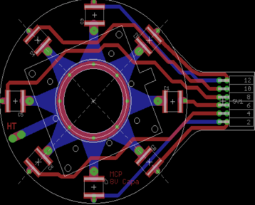
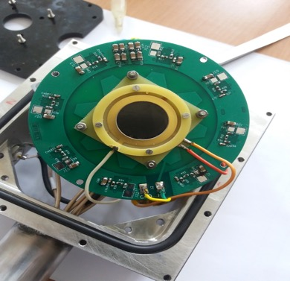
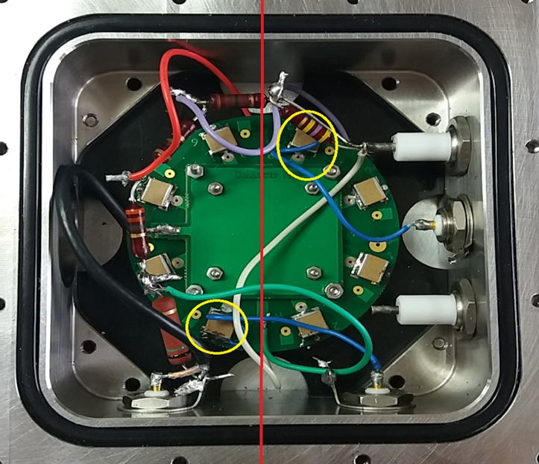
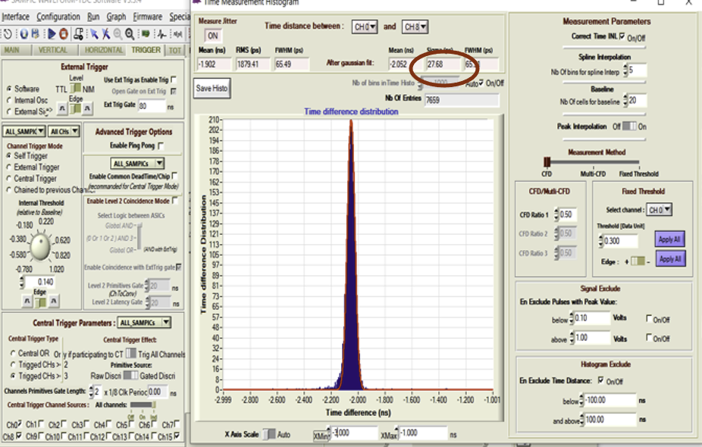
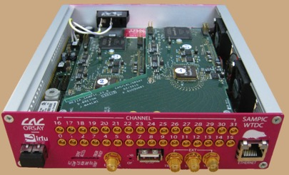
Time Measurement
IP2I+IJCLAB
8-point PCB for the time measurement.
PCB to be in contact with the grid
System tested on 2-MCP system of 25mm diameter using α source
SAMPIC: TDC ASIC allowing
to reach 3 ps time resolution
Time resolution of arrival time of two channels
is of 30 ps → 10 ps by exploiting 8 channels

Slide 12
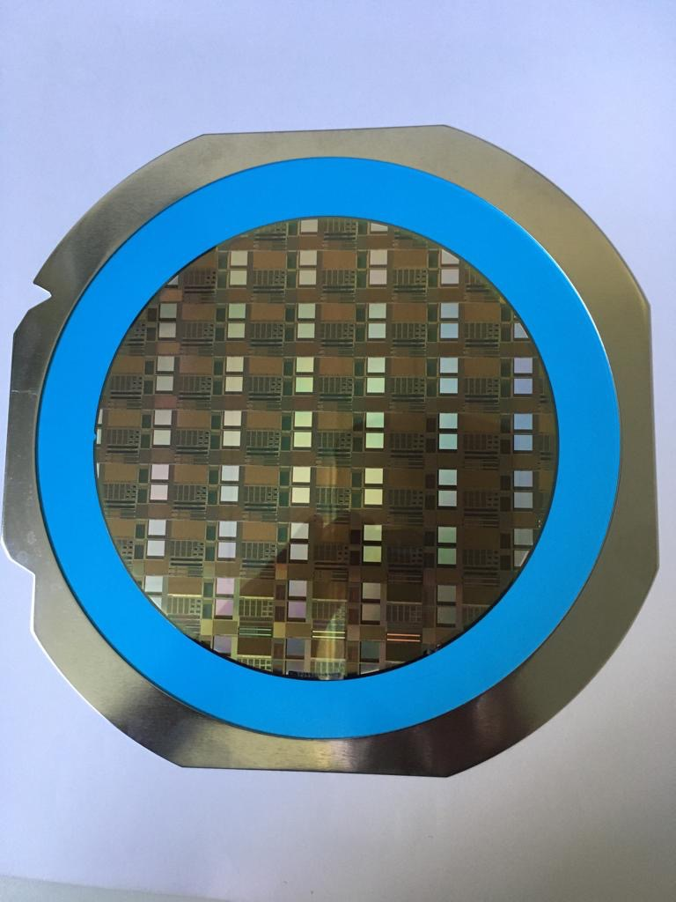
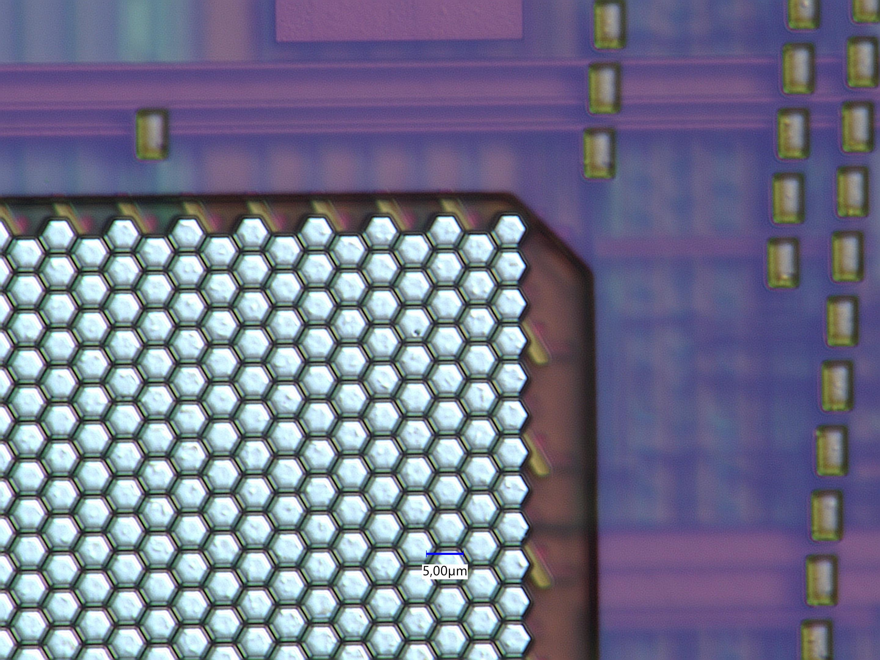
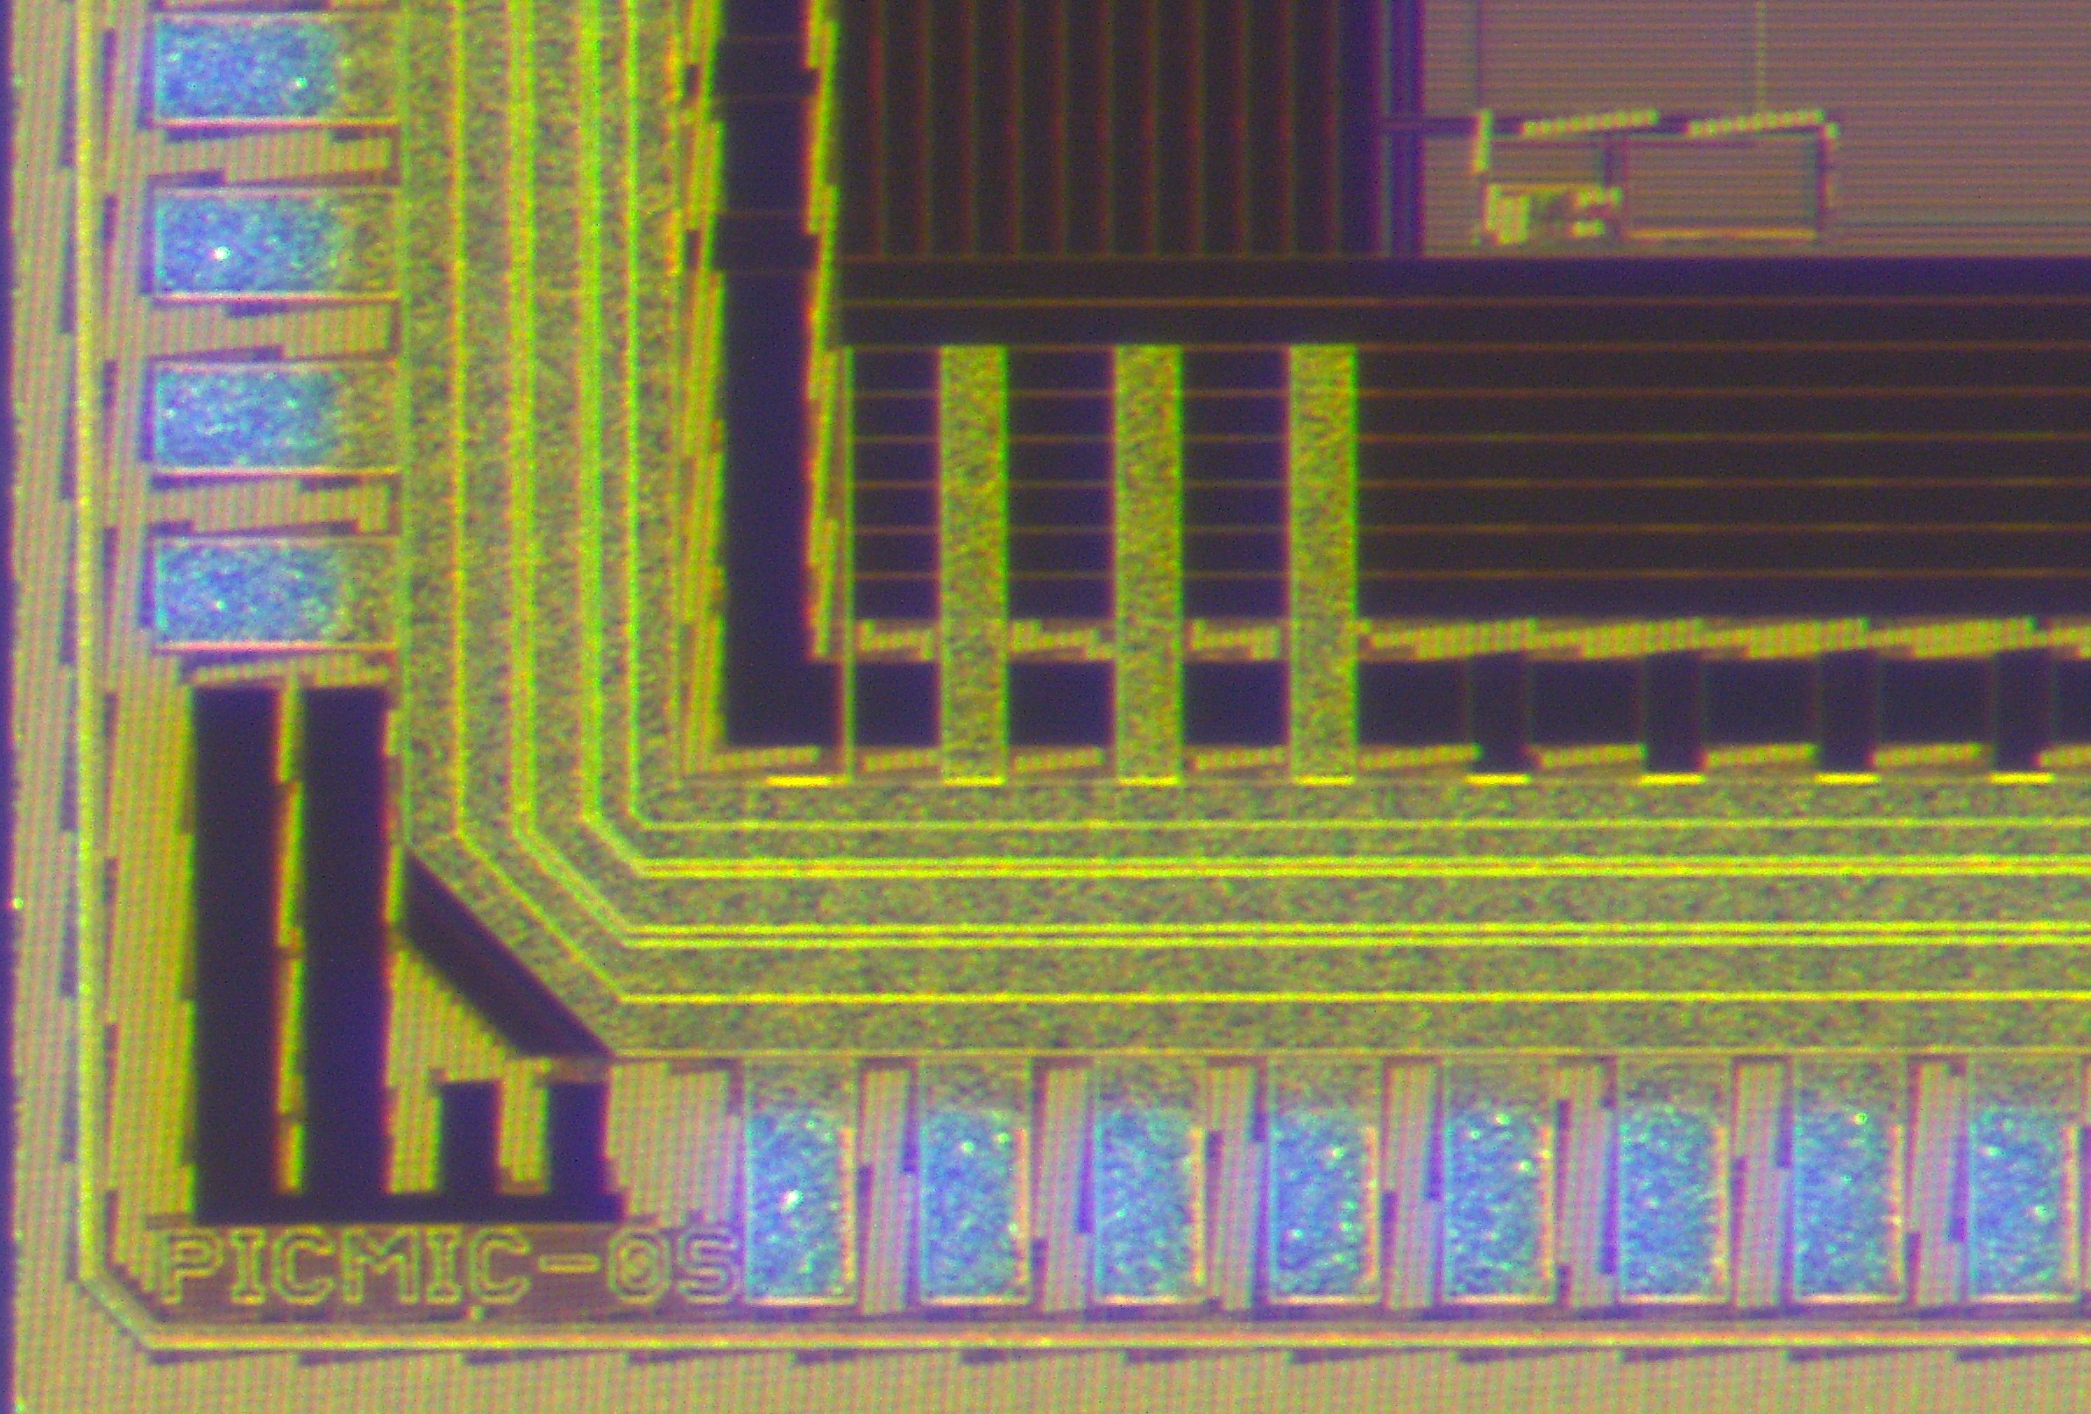
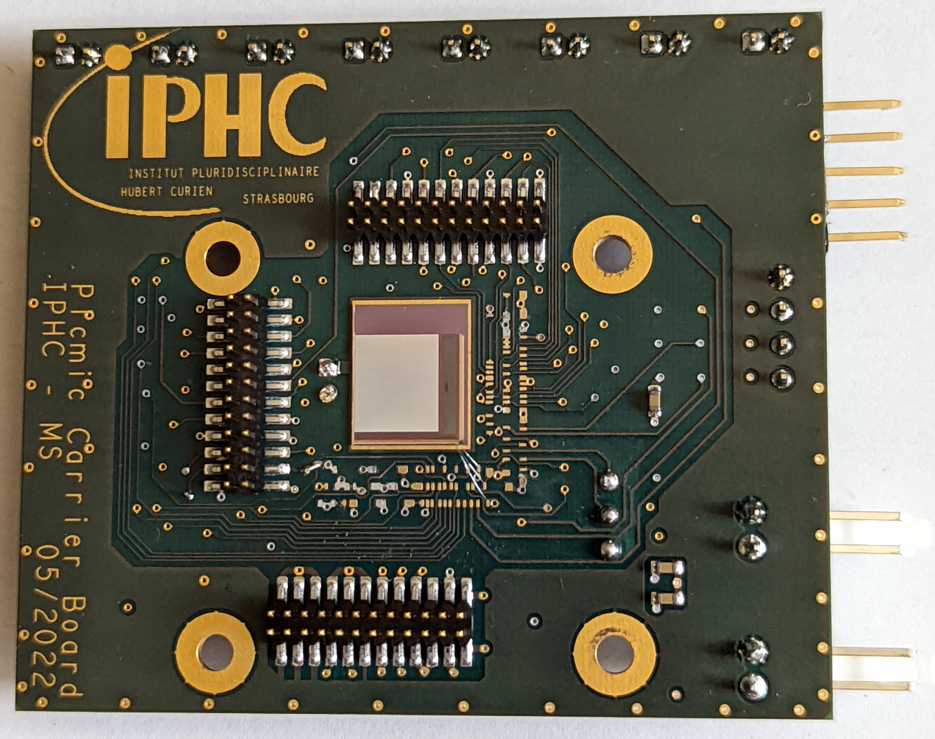
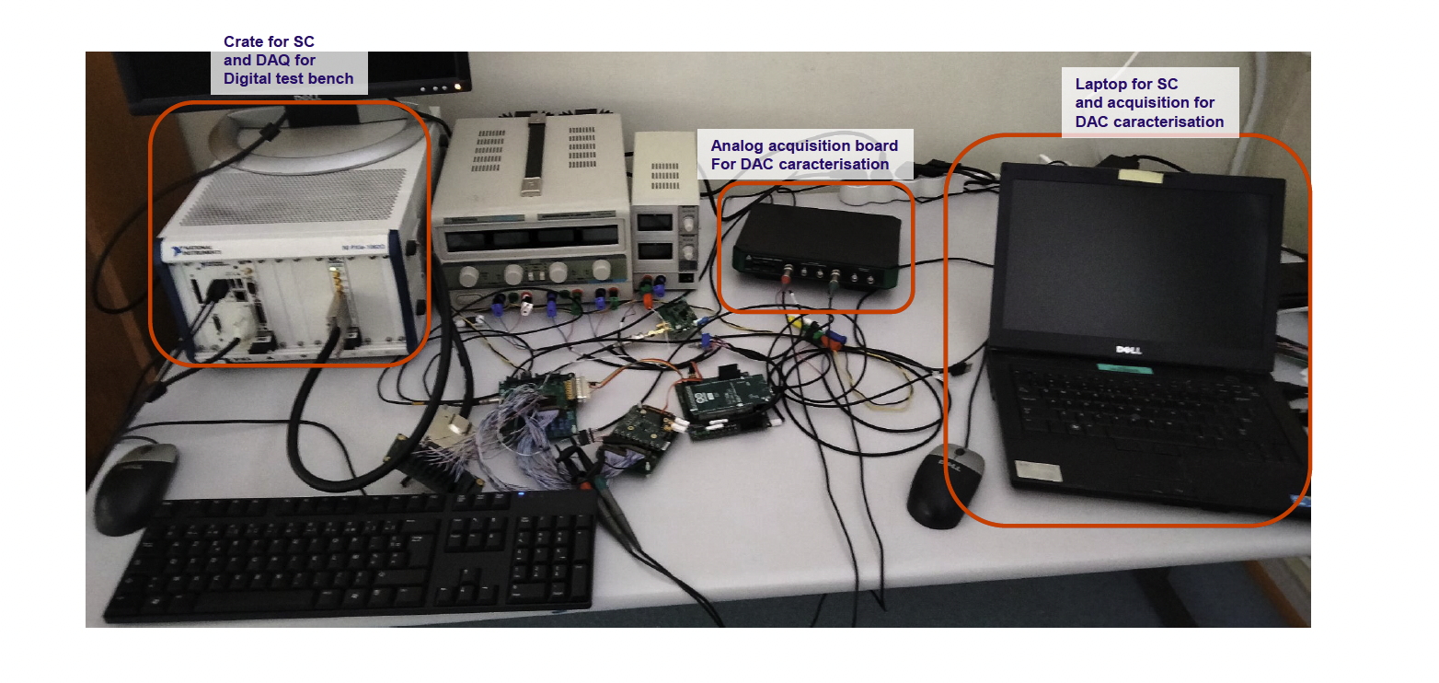
Pixel chip
The chip was submitted in November 2021 (TowerJazz) and received on July 2022
IP2I+IHCP+SDU
TJ wafer
Hexagonal pixels
External links
1W/cm²
First mezzanine
First tests

Slide 13
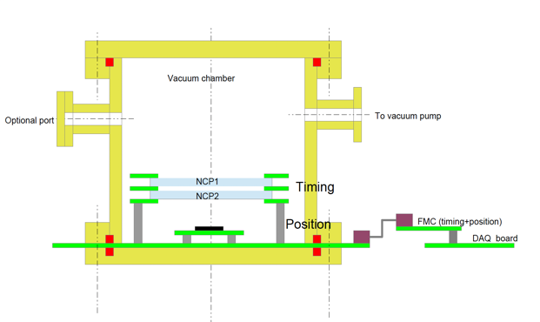
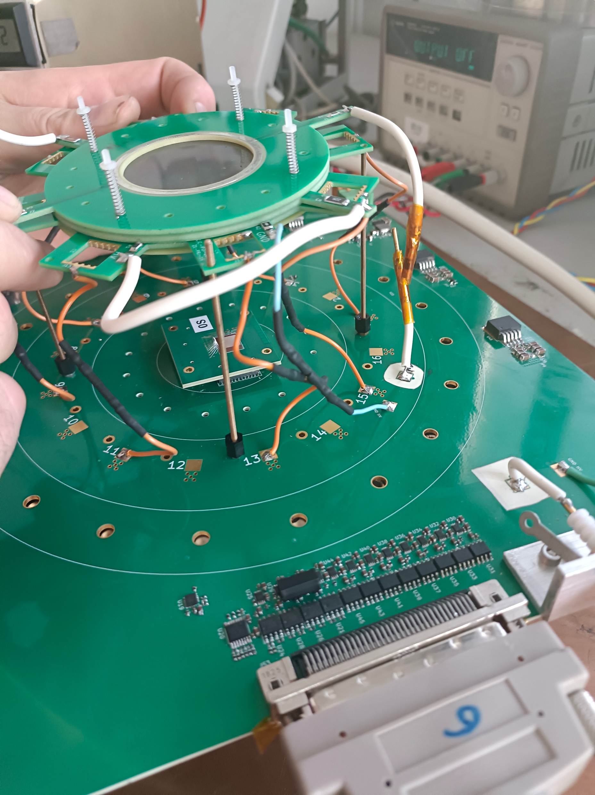
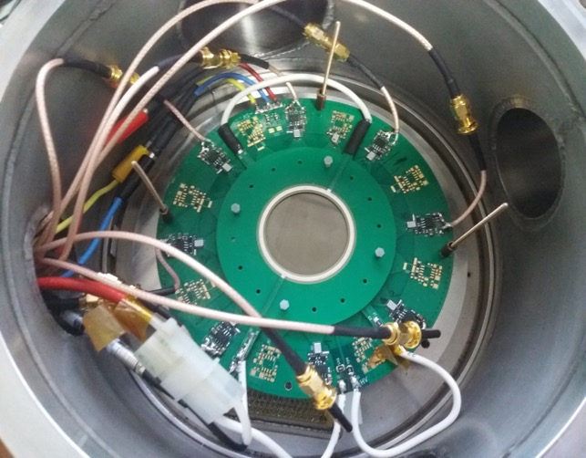
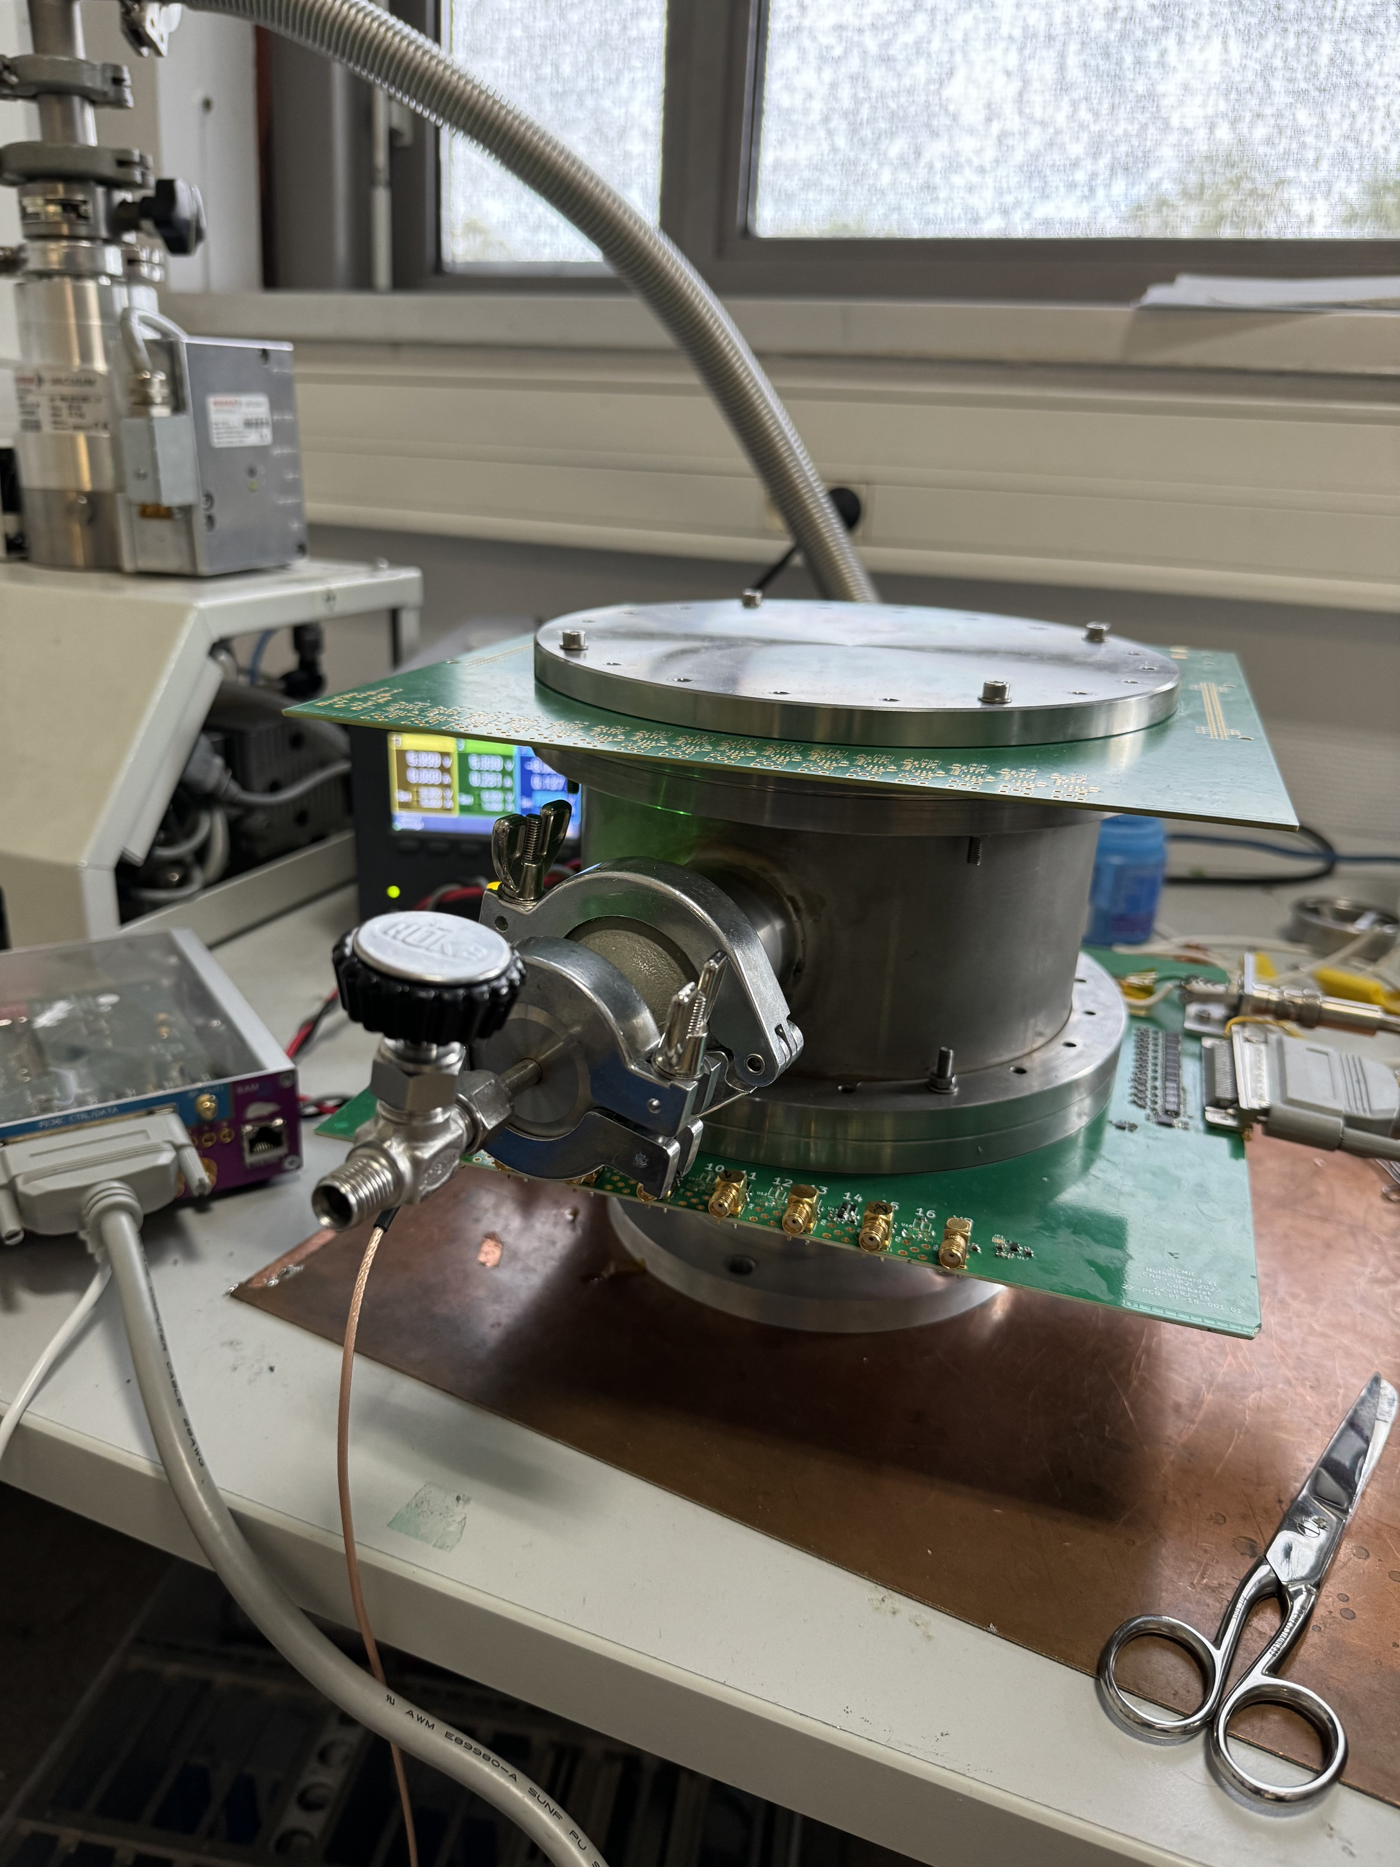
Towards the first PICMIC demonstrator
The first prototype including:
Two 5-cm diameter MCP
A board hosting 16 timing sensors (only 8 were cabled)
A mezzanine hosting the pixel sensors
A Master board
All are placed within a vacuum system ( <10e-5 mB)

Slide 14
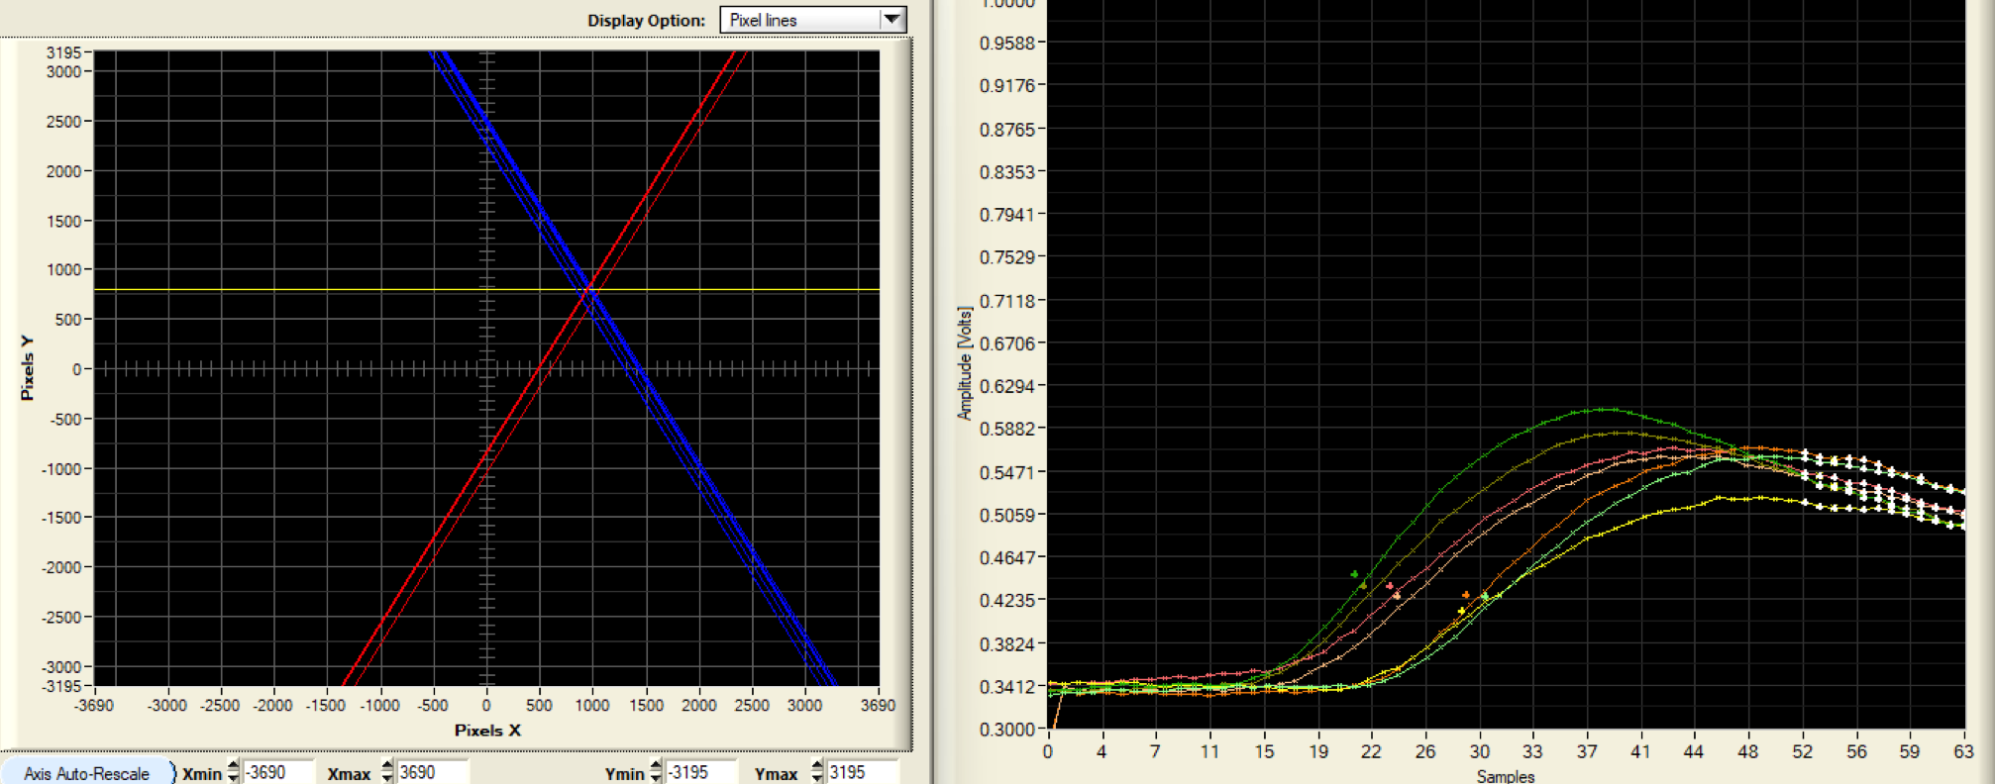
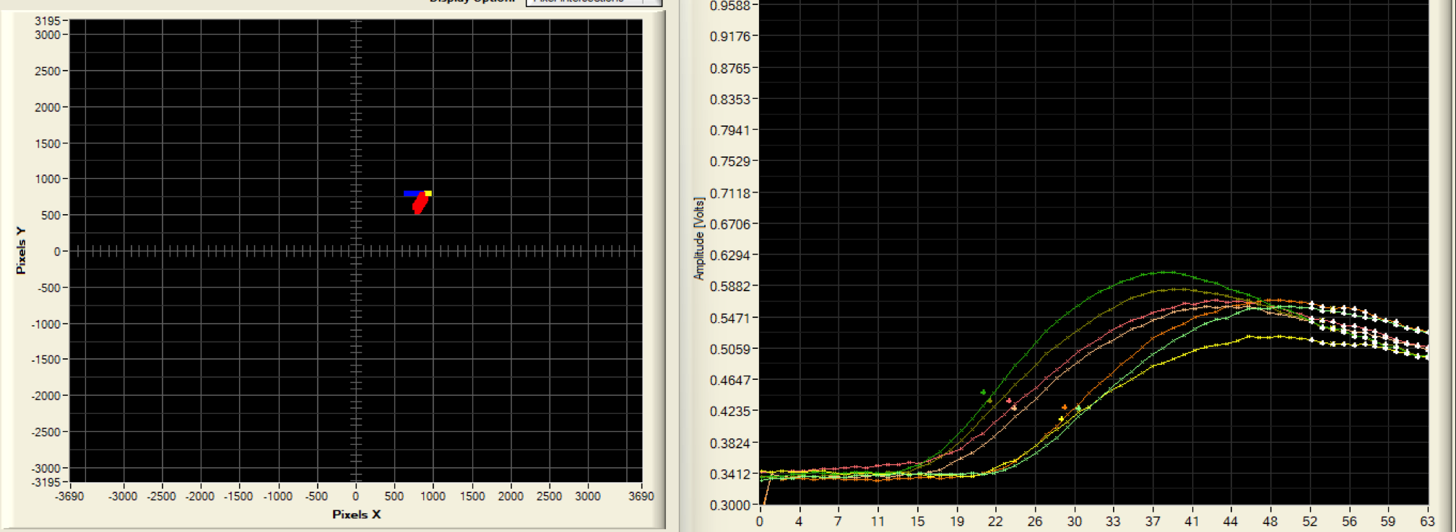
The whole system was tested by using collimated α and γ sources

Slide 15
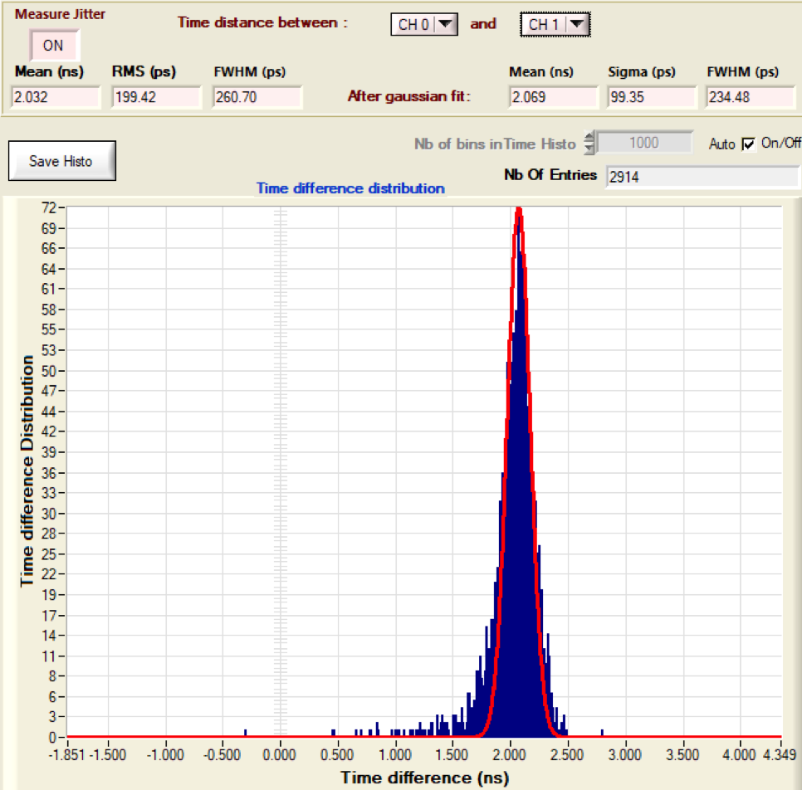
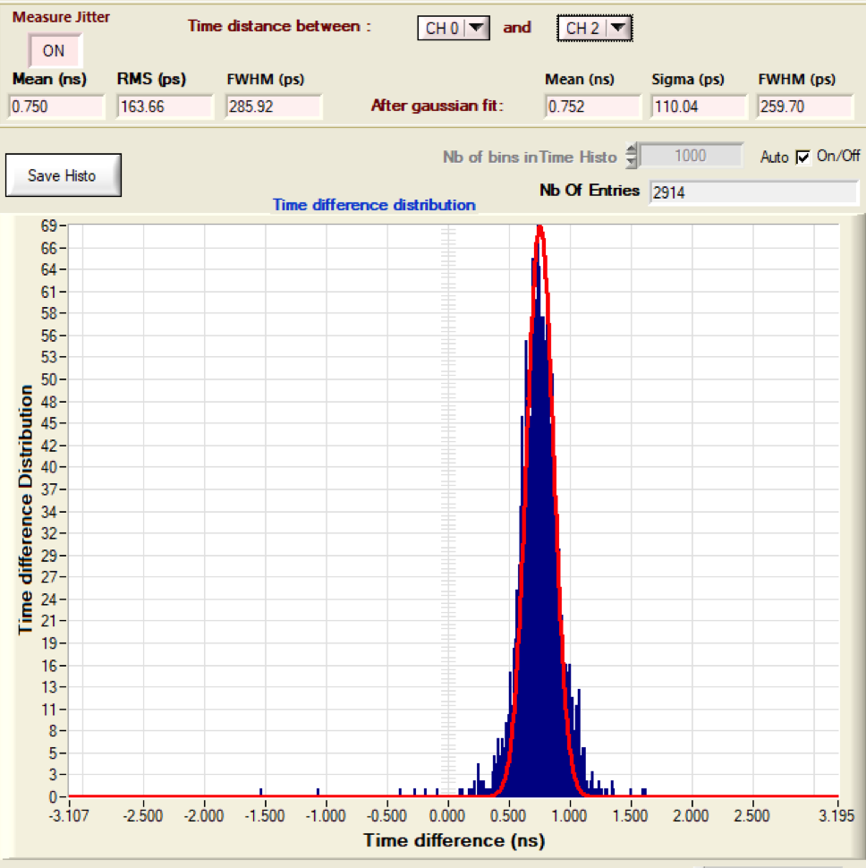
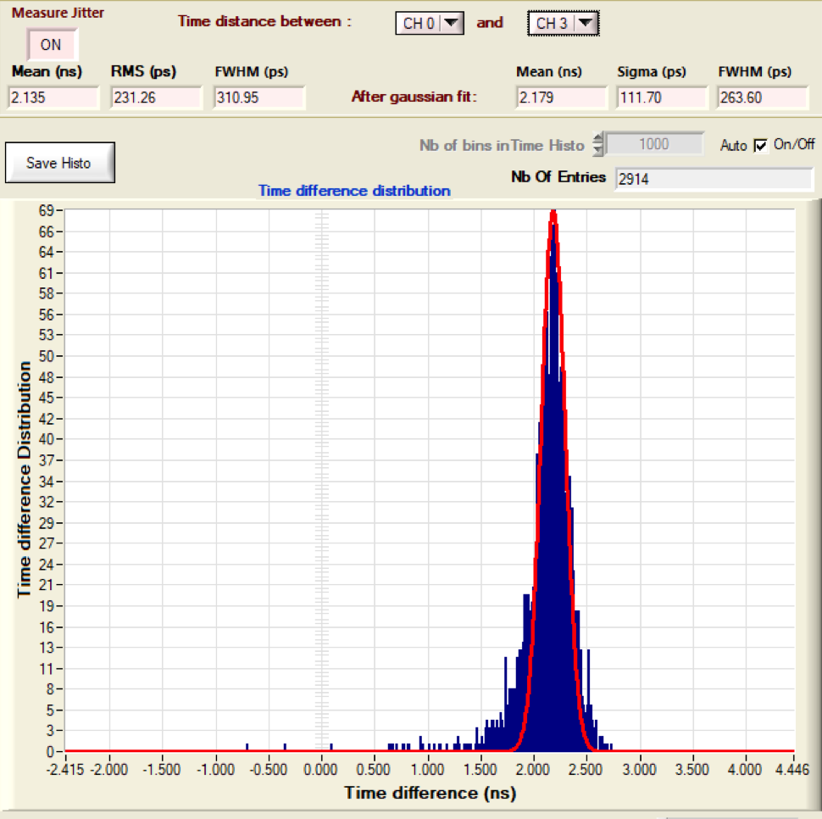
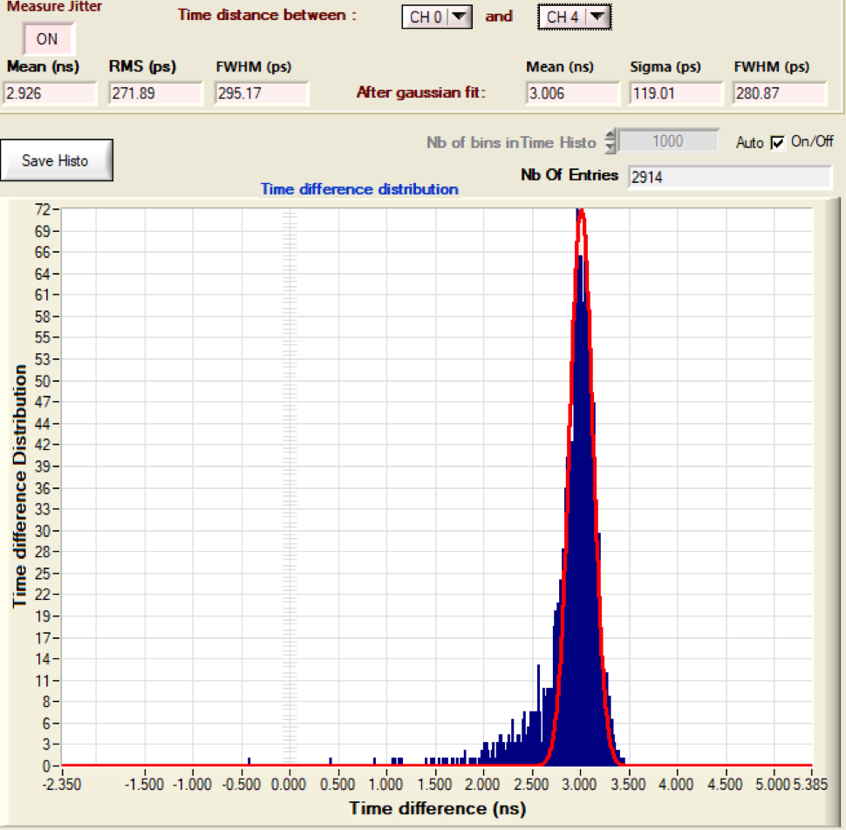
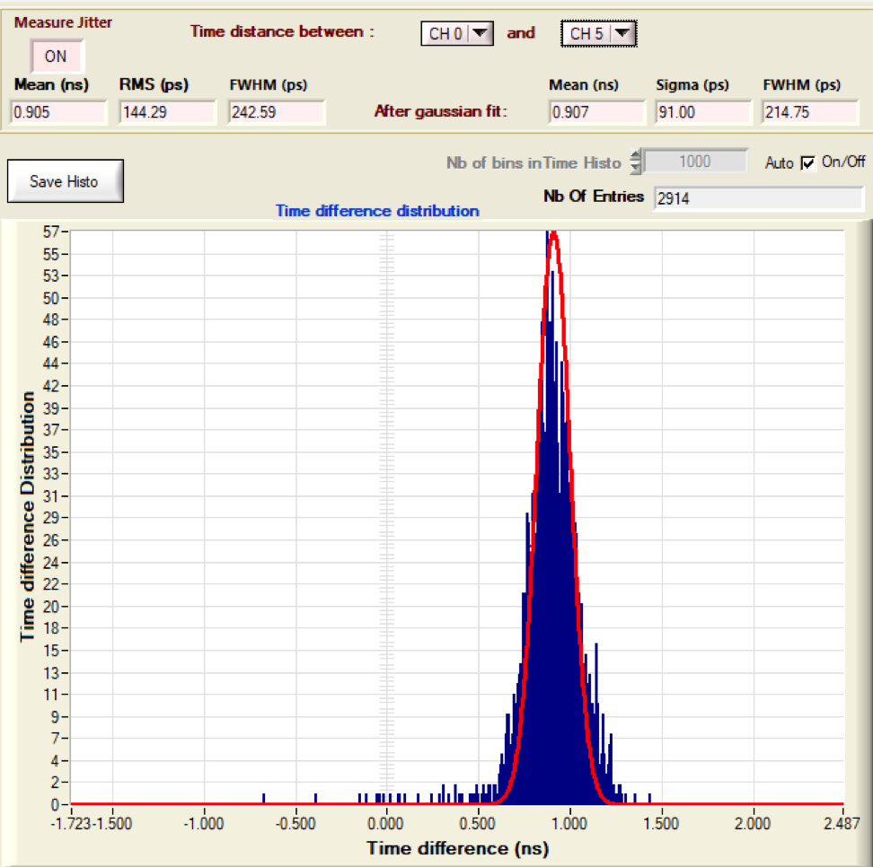
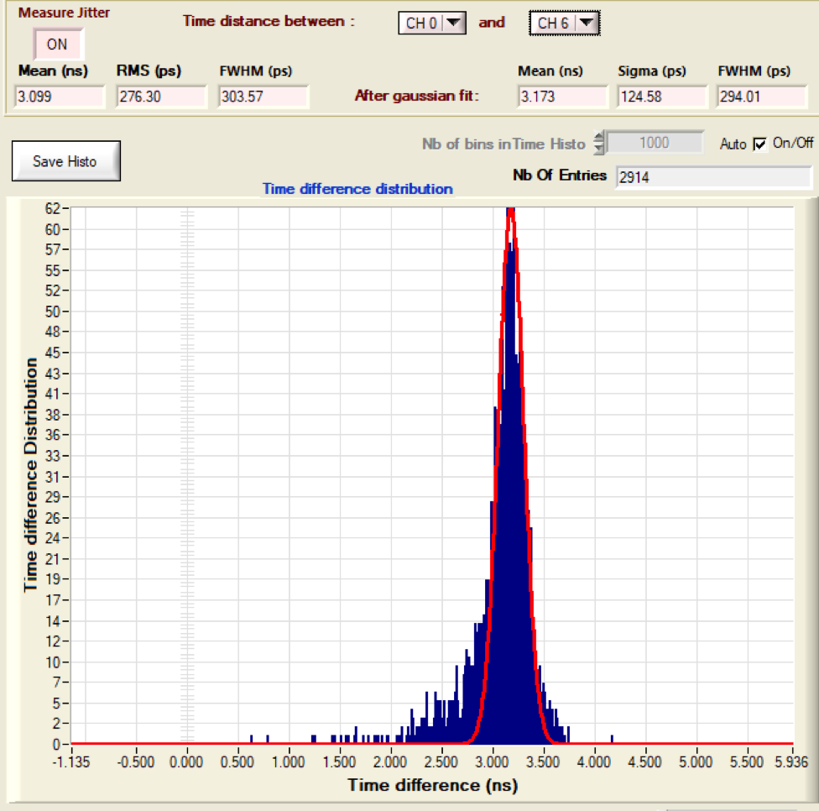
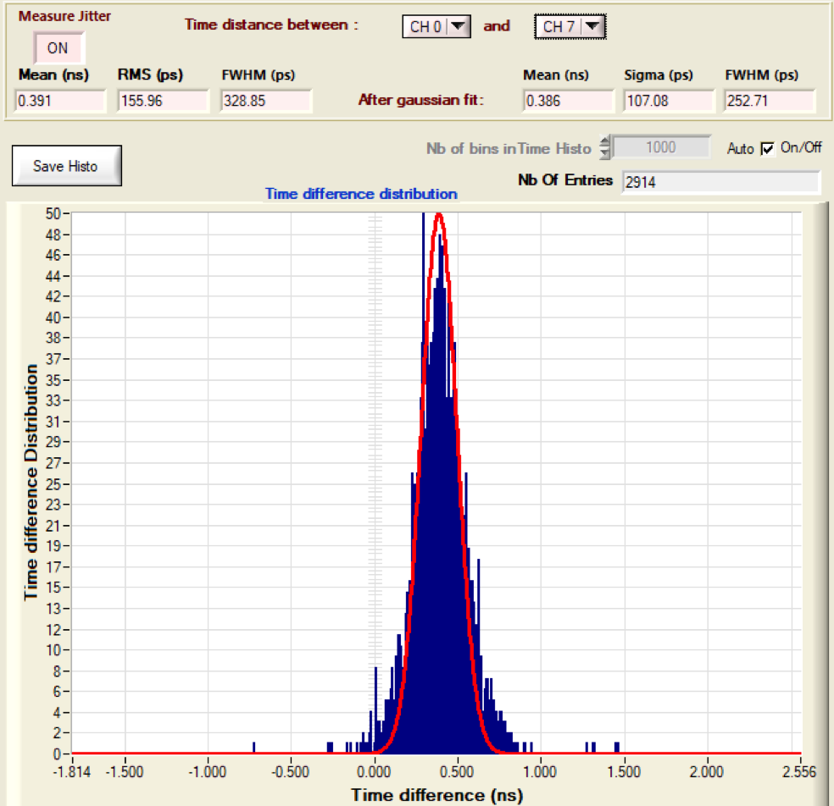
First results
Histograms of arrival time difference of Ch1,Ch2, Ch3, Ch4, Ch5, Ch6,Ch7
and Ch0 (700 V/MCP)
σ (T_{i} -T_{j}) is 100-120 ps
σ_{abs} is expected around 25-30 ps

Slide 16
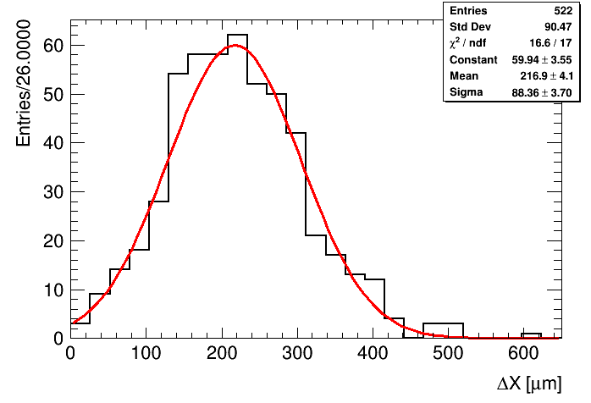
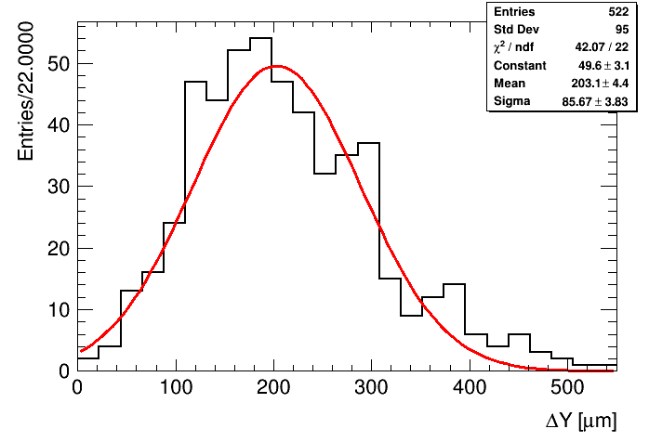
First results
Average span in X and Y of pixel clusters obtained with an α source
X_{max}-X_{min}
Y_{max}-Y_{min}
Spatial resolution < 100 µm

Slide 17
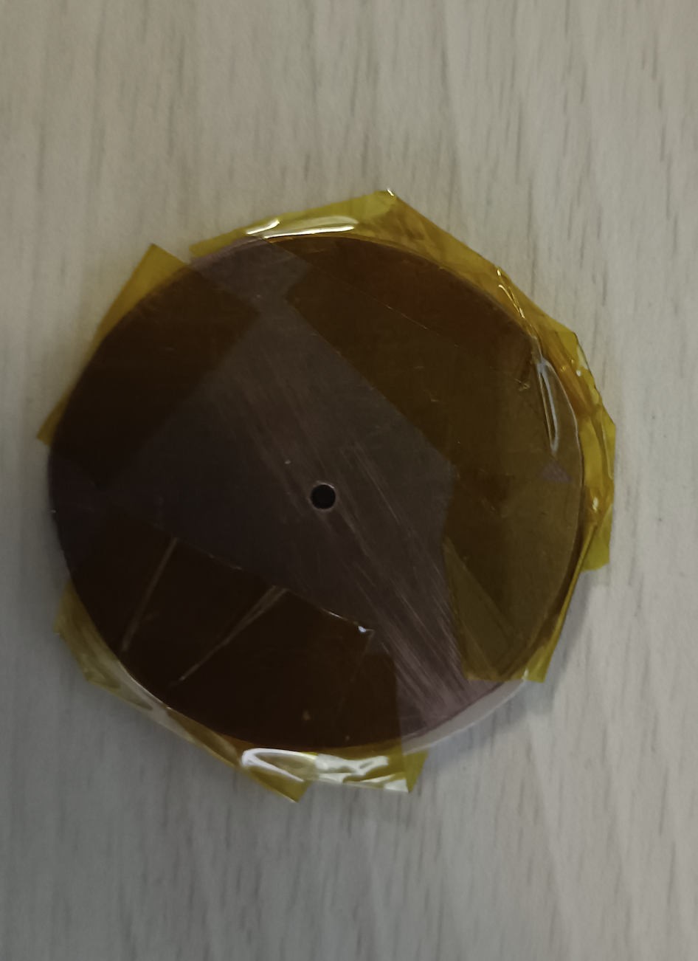
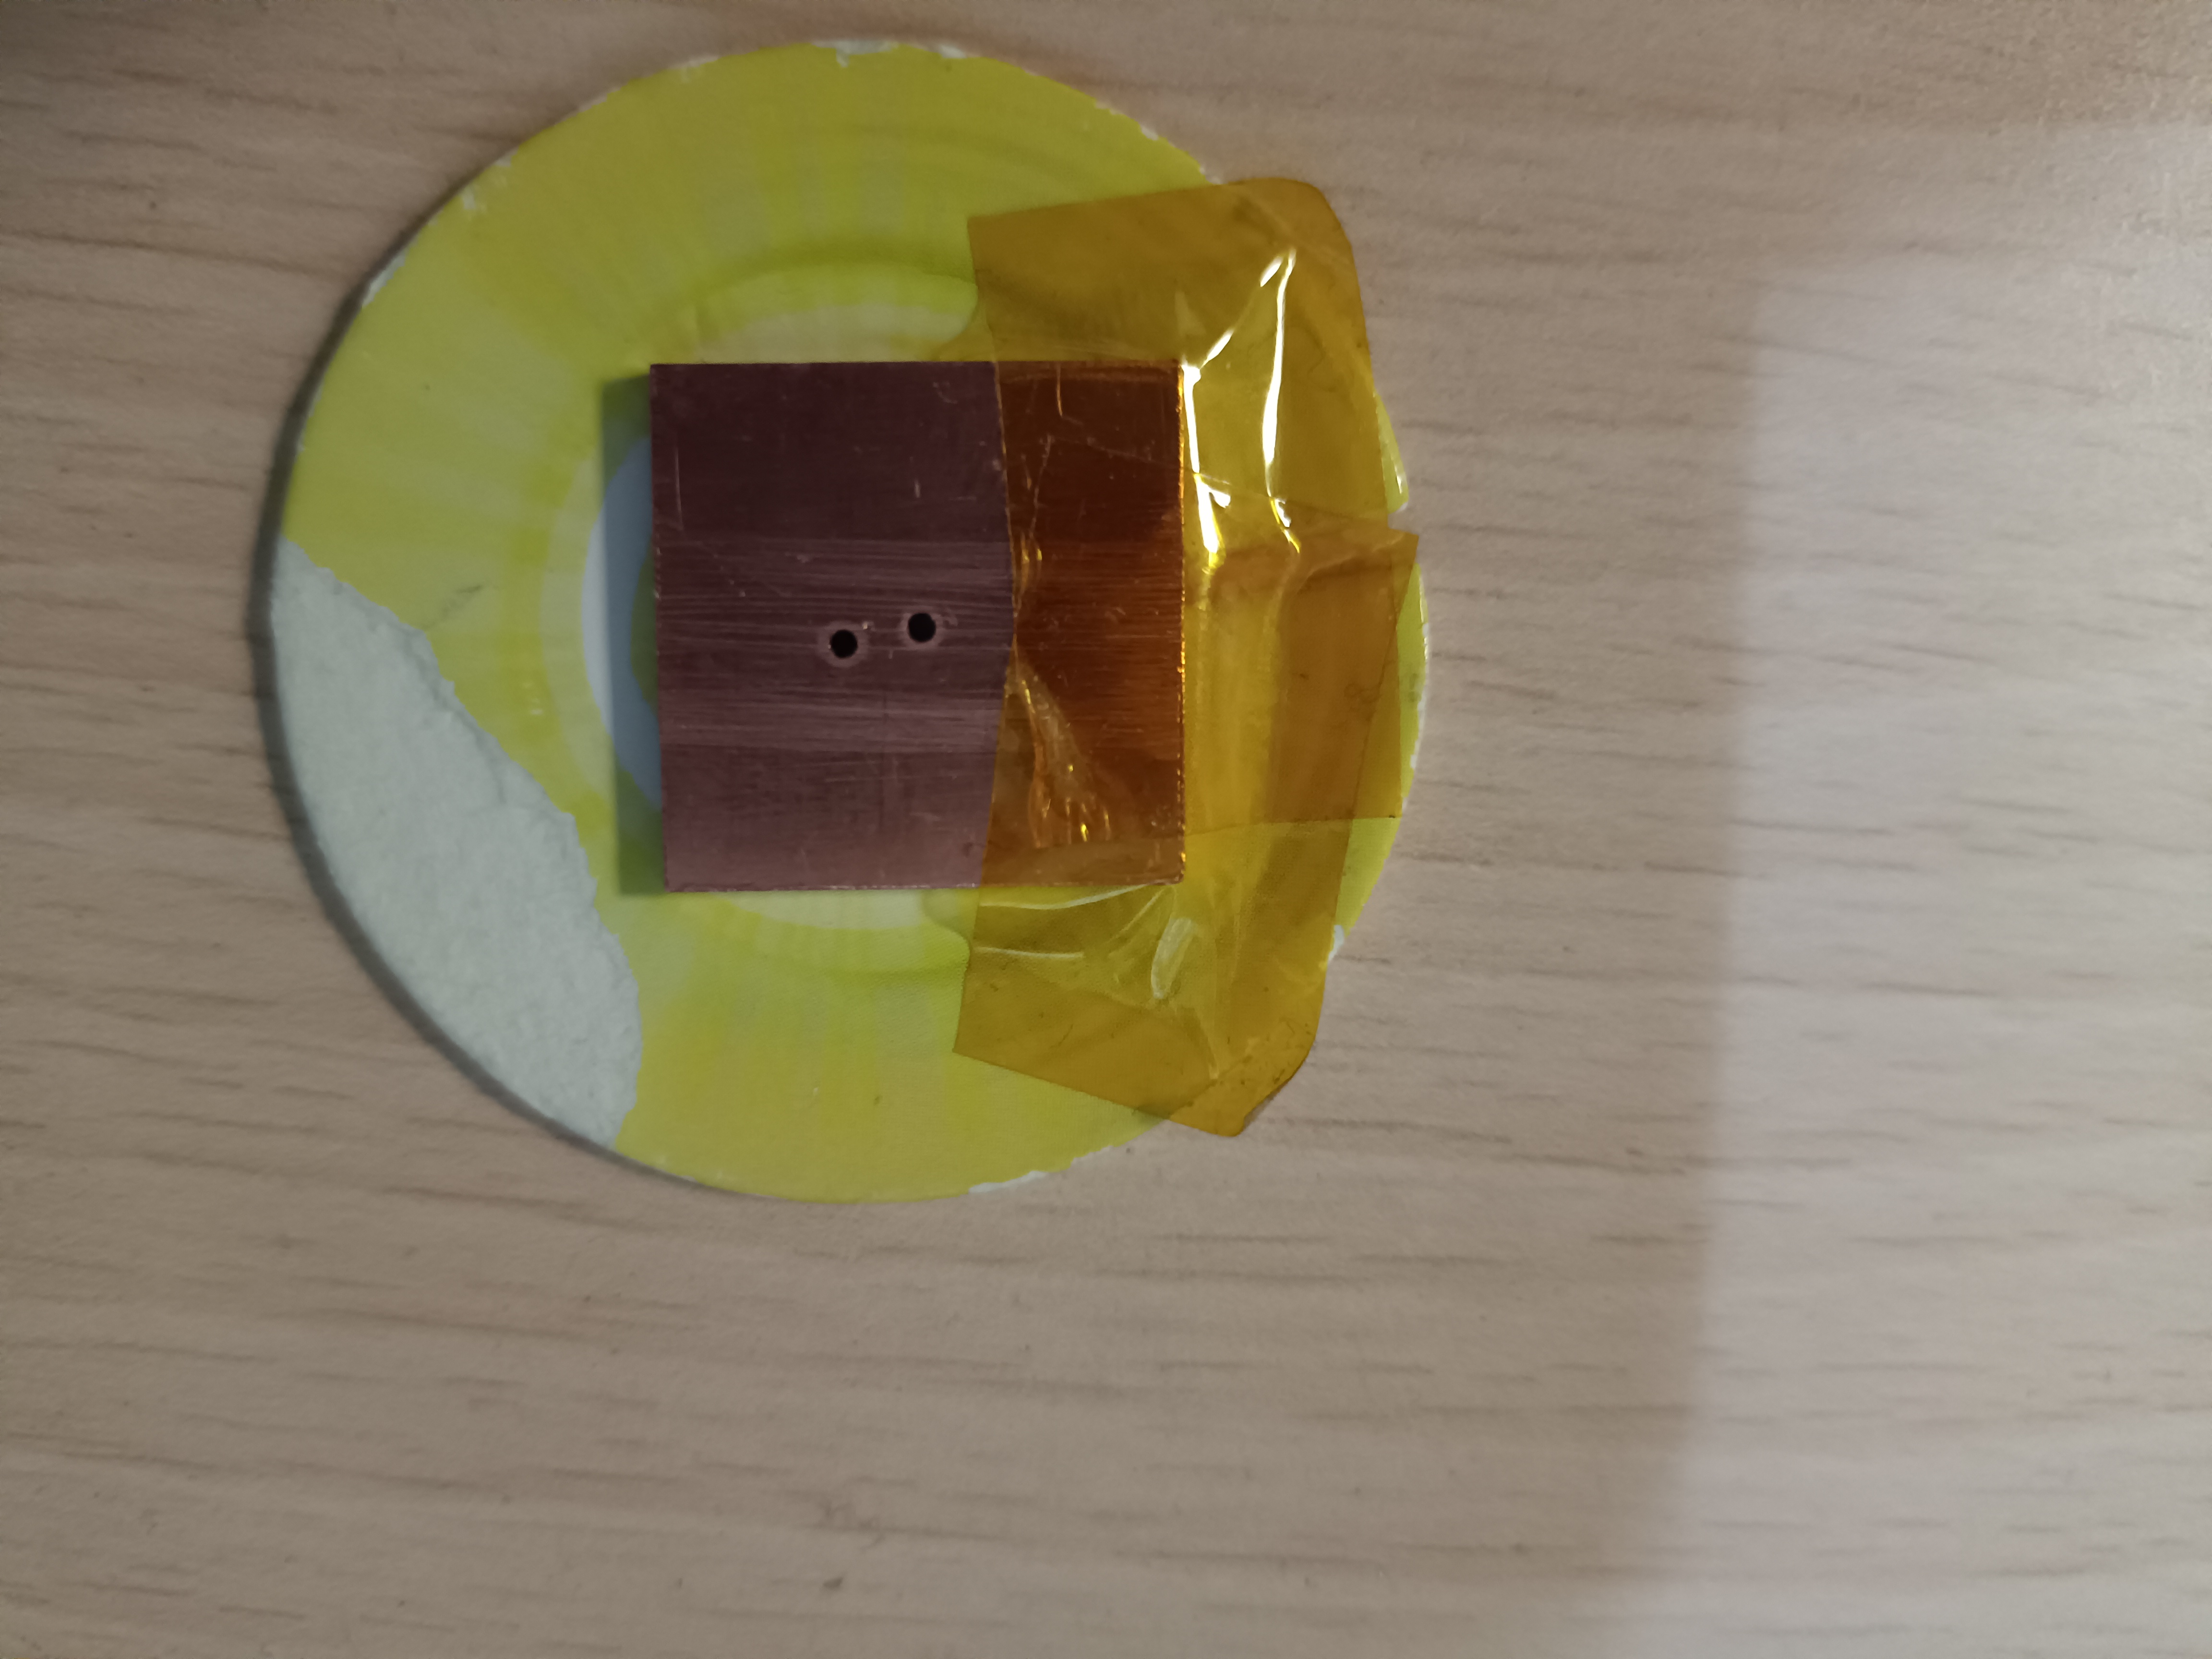
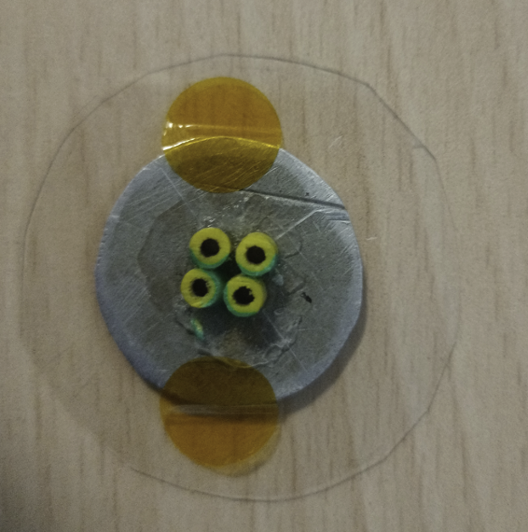
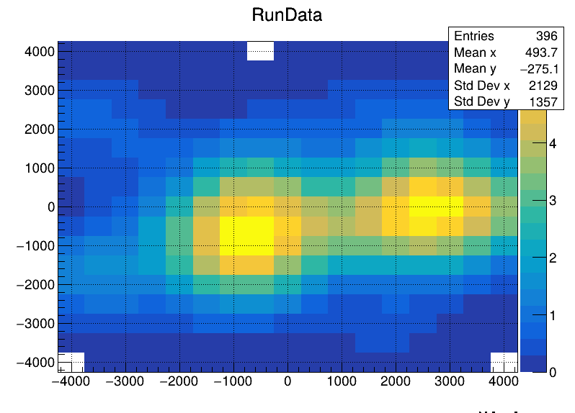
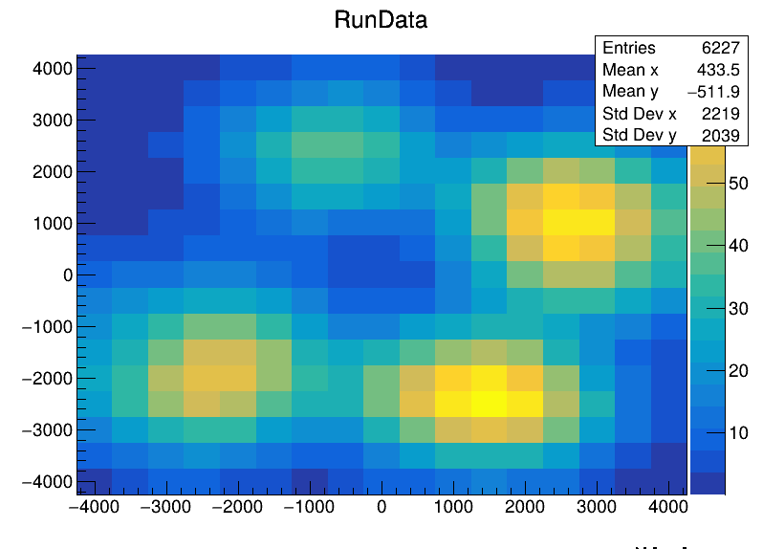
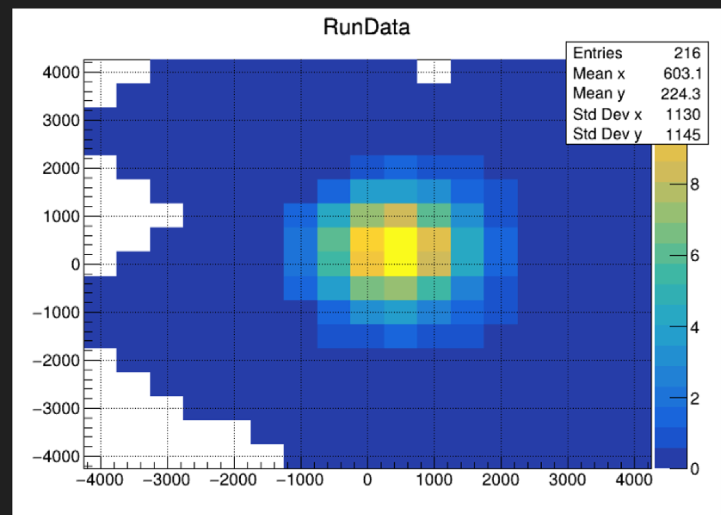
The whole system was tested by using alpha and gamma sources
1 mm diameter hole

Slide 18
Next step

Slide 19
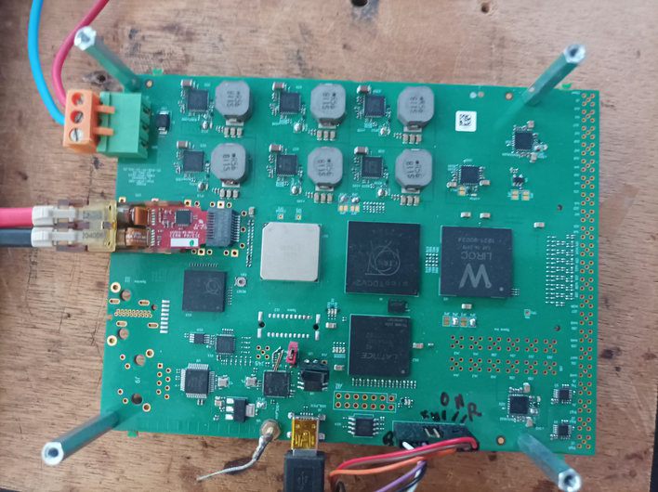
Next step: Time Measurement
SAMPIC is an excellent tool but has a dead time of about 1 µs.
Another timing measurement having a TDC with a negligible dead time is needed to use PICMIC in higher rate modes.
A board integrating a low-jitter timing preamplifier and discriminator (LIROC-OMEGA) as well as a precise TDC (picoTDC-CERN) was conceived.
The board will use the GBTX developed by the CERN to communicate with
the DAQ system.
VTRx
GBTX
PicoTDC
Liroc
GBT
SCA
FPGA

Slide 20
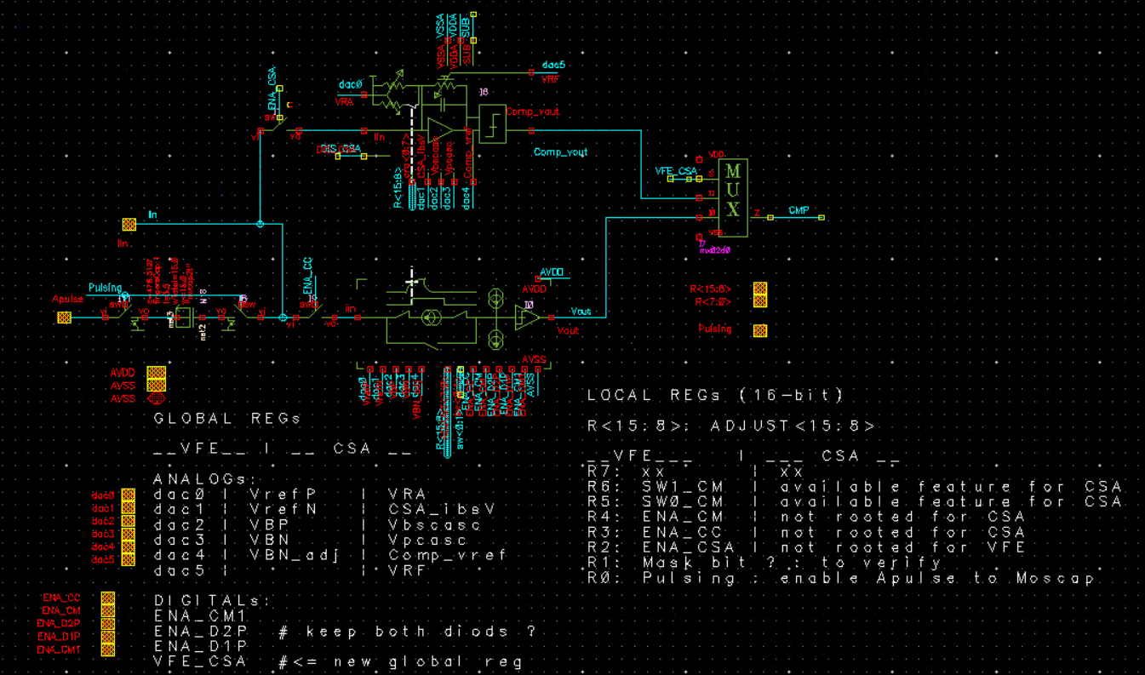
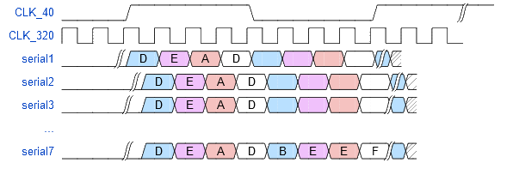
Next step: Spatial Measurement
The PICMIC0 chip was the first attempt to demonstrate the concept. We need to improve on several features:
Better calibration possibilities (8-bit DAC) to get better uniformity
By reading out each column separately
By increasing the surface of the sensor by a factor of 4 (1.2 cm x 1.4 cm)
Adding a charge preamplifier to avoid current smearing problems for long tracks.
Higher acquisition rate (1 MHz → 10-30 MHz)
PICMIc1 is ready for submission

Slide 21
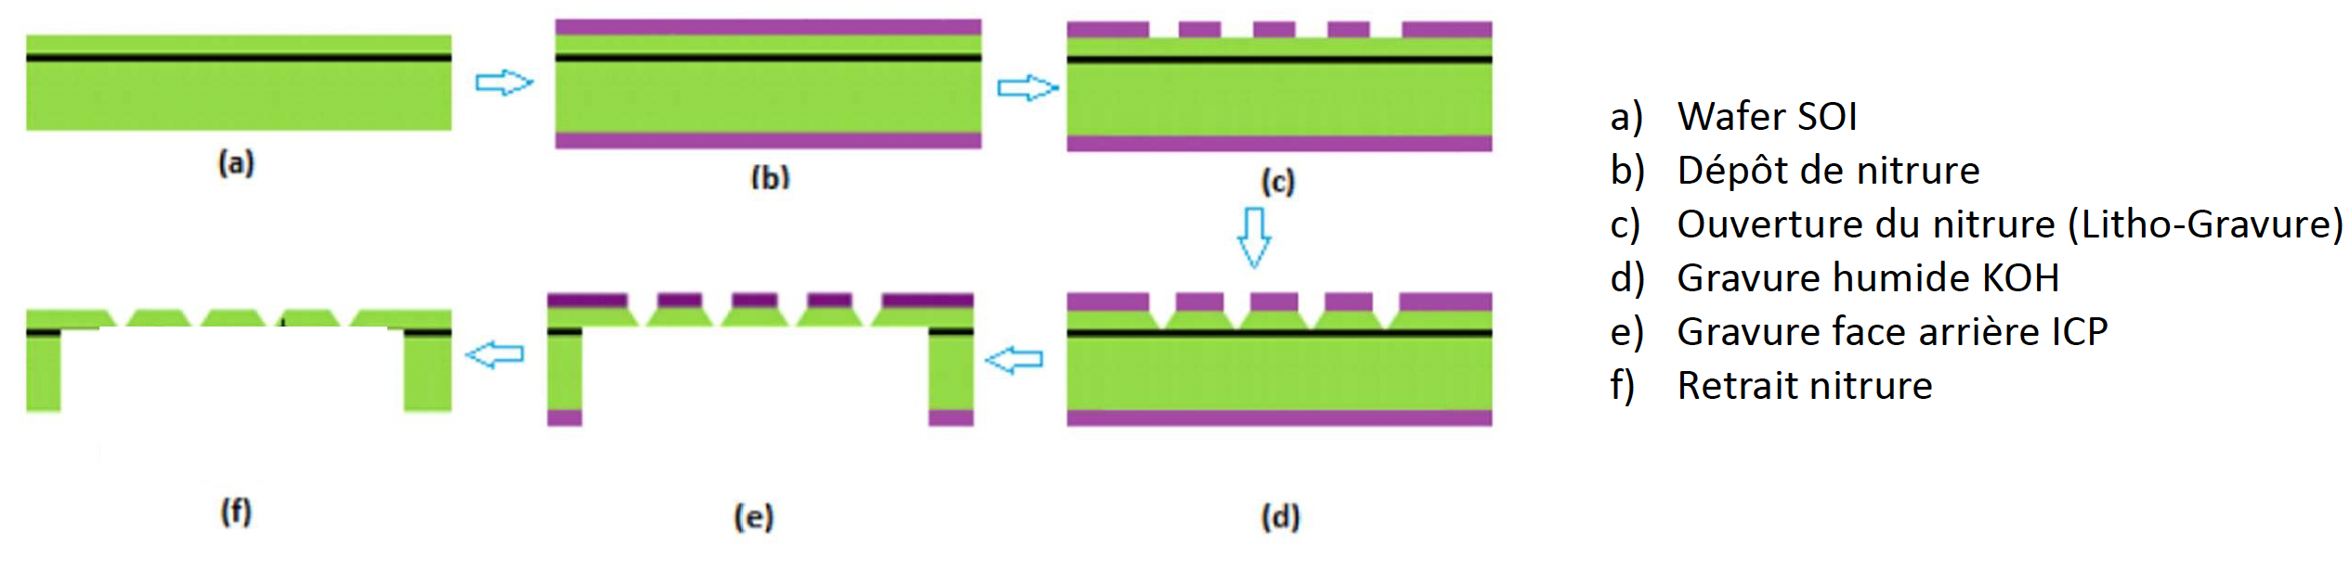
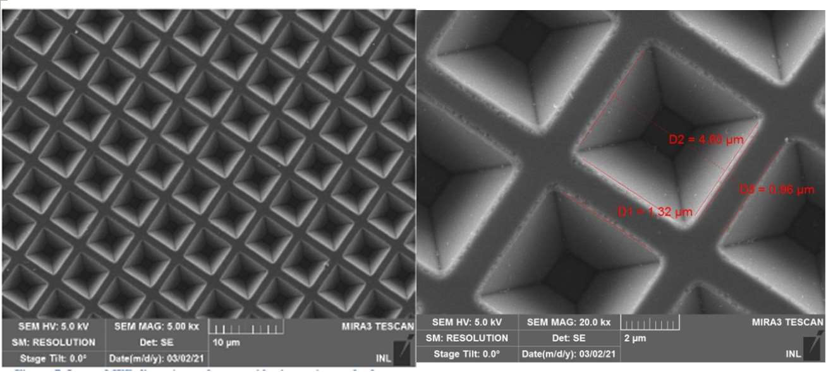
PICMIC for photodetection
We are developing a highly granular reflective photocathode. Photocathode is made of holes with conic shape.
Exploit the high spatial resolution the MCP offers
Increase the quantum efficiency
The structure will be coated with different kinds of photocathode materials and then cast on MCP to test PICMIC as a photodetector concept.
A few mm size

Slide 22
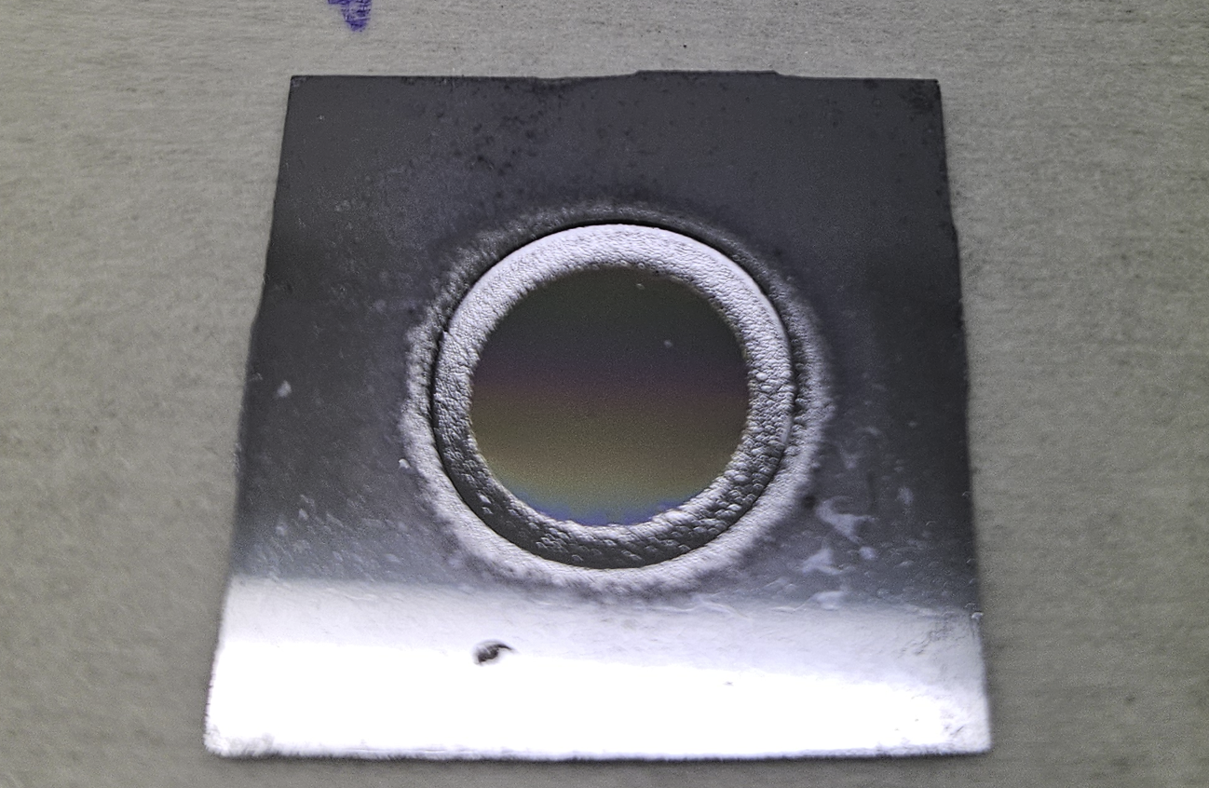
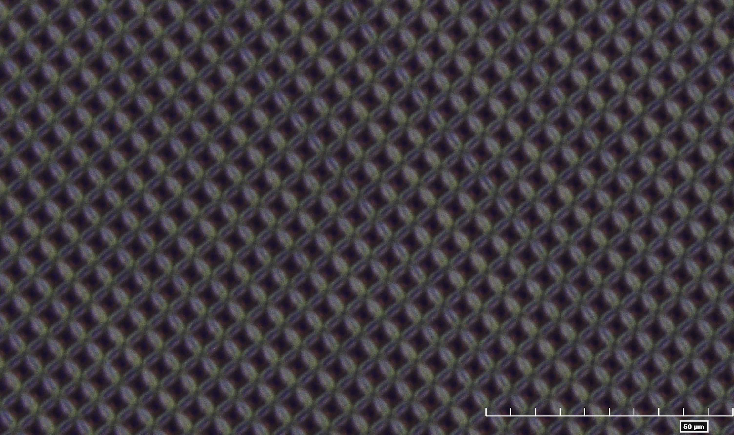
1 cm radius
Next step → a few cm radius
Photonis has produced a 1cm MCPs for us to be used with this future photocathode

Slide 23
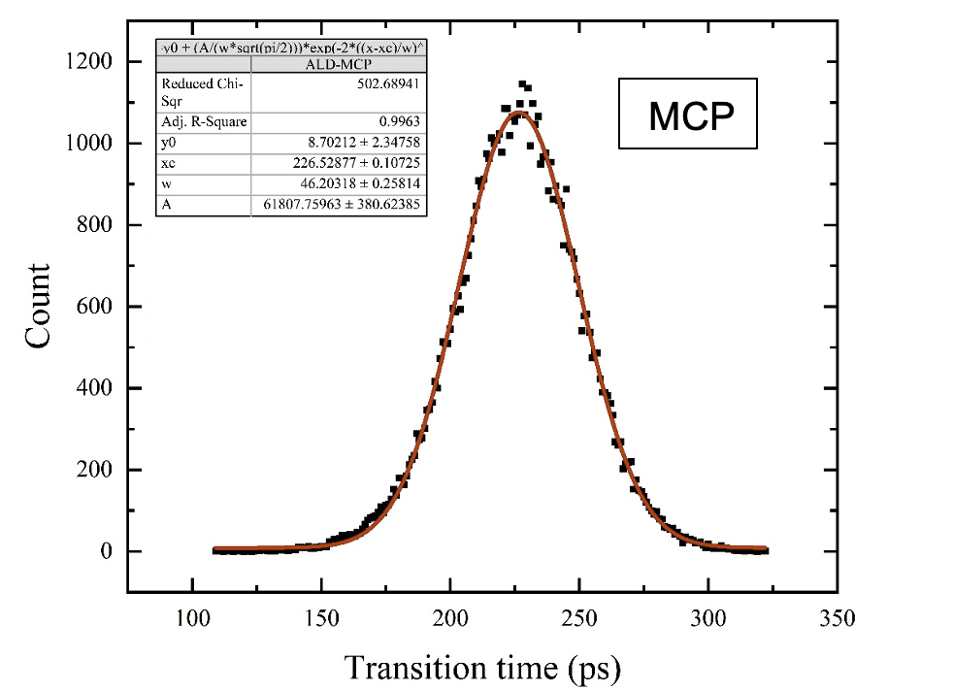
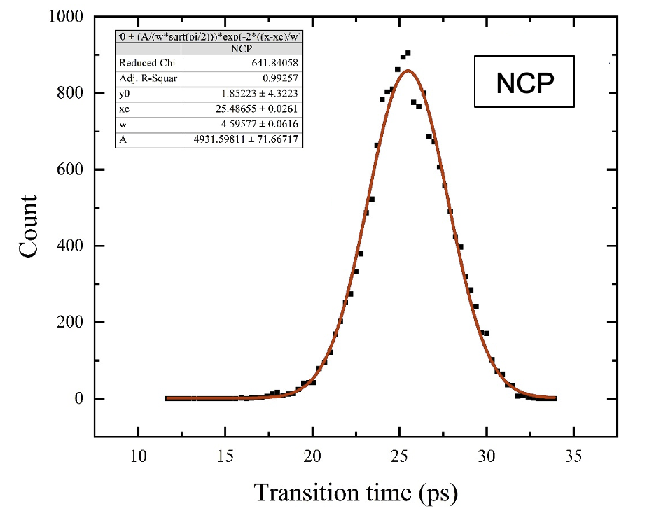
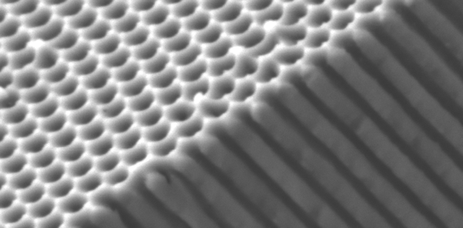

NCP
A new kind of MCP that we call NanoChanel Plate (NCP) is being developed.
It aims at producing structures with nanoholes that could be coated with emissive and resistive materials.
Three technologies are followed:
Anodized Aluminium Oxide AAO (with IMP→ ANR NanoPolyPad)
Silicon electrochemical etching (with INL →ANR NCP)
Femto-laser digging (with LHC→ ANE LAMP?)
SiNCP
AAO

Slide 24
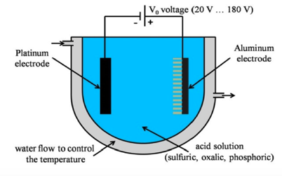
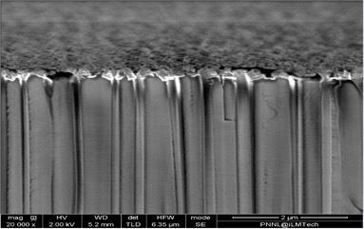
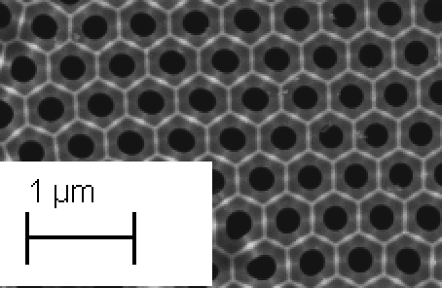
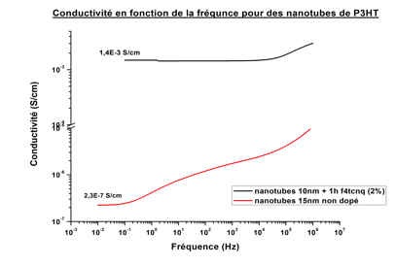
NCP-AAO
Conductivity
3
3
3

Slide 25
Summary

Slide 26
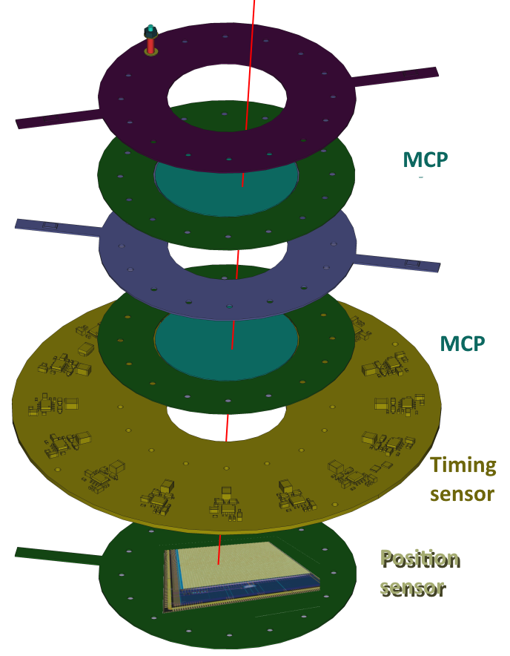
The structure of a PICMIC device

Slide 27
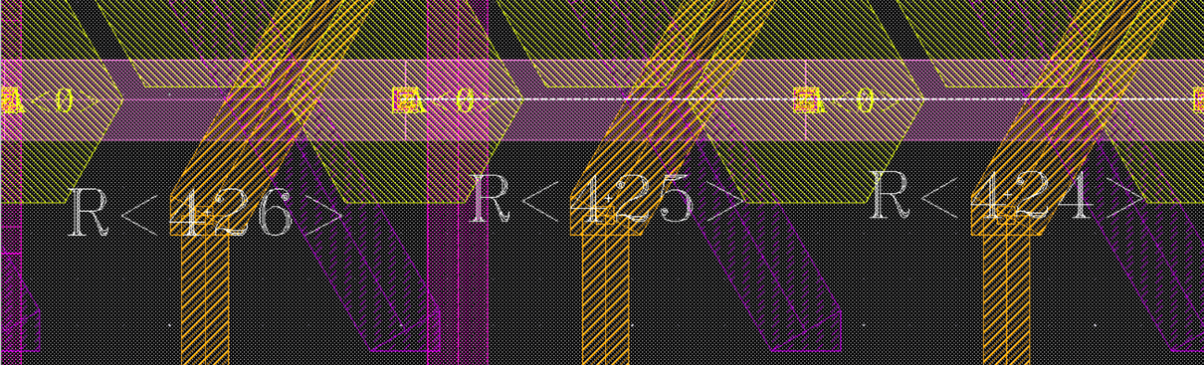
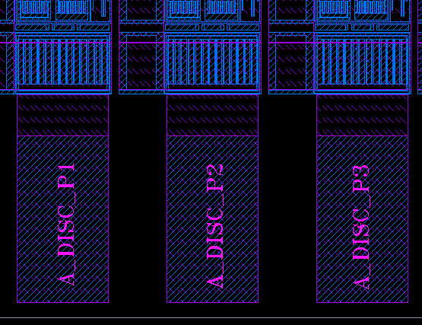






Injections Studies
(1/2)
PICMIC allows external signal injection trough the (PAD):
- R424[R68,C28],R425[R103,C35] and R426[R6,C15].
- * it also allows to excite whole columns in the channel matrix (no shown in above layouts).
Voltage injection through external 1pF, then scan of the threshold of Current Comparator.
Below the current threshold, the falling edge sensitive does not trig.
The signal is recorded on falling edge, so above a certain value of iRefN added to threshold current, the comparator does not trig anymore-→ chapeau!
Efficiency [%]
VRefN [udac]
iComp
iComp
iComp
iRefN
‘1’
VPULSE
Dout
ith+iin
iRefN
ith+iin
iRefN
ith+iin
1pF
Vout
1
Vout
1
Vout
1
0
No edges
0
0
fall edge
No edges
Dout
Dout
Dout
1
27
1
1
0
0
0

Slide 28


The time resolution was exploited to determine the position of the sources with a triangulation- based method

Slide 29

Noise level distribution

Slide 30
Position measurement
To reach few microns resolution with a limited number of electronic channels, a new concept was developed, successfully tested and patented.
Connect the pixels in woven strips
Two neighboring pixels are connected to two different strips
Each strip is connected to one electronic channel
Share the charge among a few ones
Cross the fired strip to determine the position
NXN → 3N : Reduction of electronic channels, power consumption and occupancy

Slide 31

Position Measurement
Although no silicon sensor is used, the CMOS
wafer technology was used.
Pixels, the interconnections as well as the
readout electronics are conceived in
TJ 180 nm (6 metal layers) technology.
Parameters | Value
Design Flow | Cadence DoT flow
Technology | TJ CIS 180nm
Power supplies | 1.8V
Power density | >172mW/cm²
Die dimension | ~7.5x7.5 mm² (6.5x7.5mm² active)
Anode dimension | ~22µ²(5µm hexagonal pitch)
Readout pixel dimension | 50µmx140µm
Readout matrix | 128x54 cells (only 2556 active)
Input clock | 40MHz
Read-out port | 13-bit parallel, 1 sync clock out, 1 marker
I/O Pad | CMOS
Slow control | I2C
Max data rate (1Mhz hit rate) | 390Mbps

Slide 32

Cross-talk study is ongoing. This will determine the nature of the discriminator to be used ( most probably current conveyer)

Slide 33


Pedestal threshold calibrations
Freeze a set of DAC(Global) values driven by :
- small dispersion between s-Curves
- bigger number of sCurves in a given
space of phase vs VRefN(quite sensitive)
Then, additional scan in local values are performed:
- iadj<3bits>, sw<2bits>, EN_CM, EN_CC.
To determine value @50% inflection point.
To select the closest sCurves@50% in VRefN

Slide 34


Towards the first PICMIC demonstrator
With both time and position sensors tested, a DAQ board was conceived to
Distribute the same clock (40 MHz) to both the timing and position chips
Collect data from both and associate them.
The DAQ board was placed within the SAMPIC module.

Slide 35

PICMIC will be soon tested with a channeltron producing single electron of energy up to 30 keV in a MEB to have independent time and resolution measurement

