Slide 1
T-SDHCAL a highly-granular hadronic calorimeter for future colliders
I. Laktineh

Slide 2
Outline
SDHCAL for ILC
T-SDHCAL for FCCee
R&D
Participation to DRD6 and DRD1

Slide 3
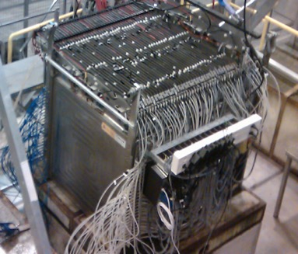
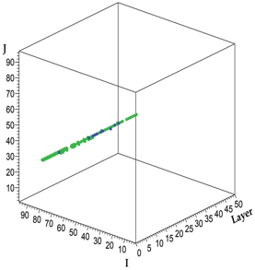
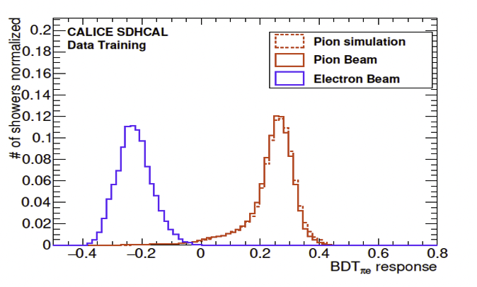
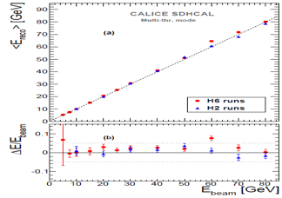
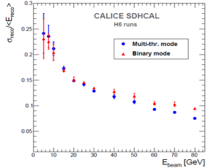
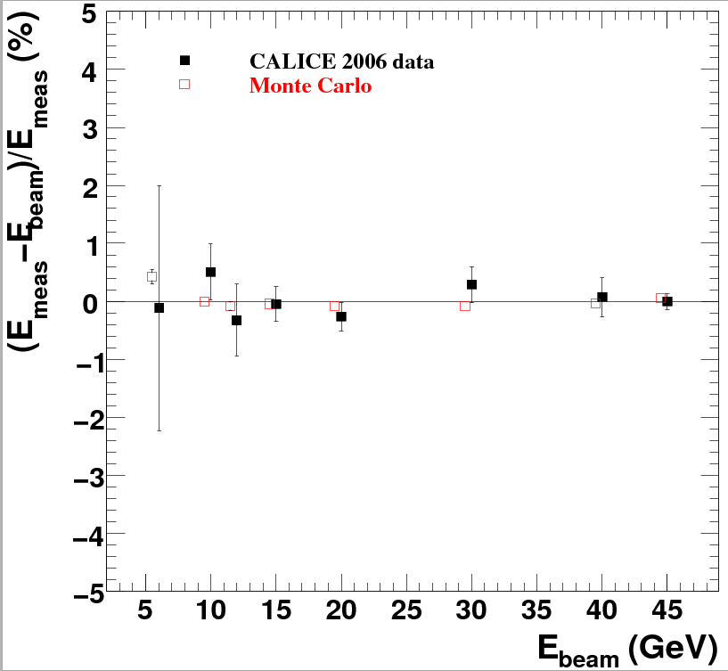
SDHCAL- ILC
48 layers of 2 cm stainless steel interleaved with
planes made of Glass RPC and their embedded readout 2-bit electronics allowing a lateral segmentation of 1 cm²
A technological prototype of 48 layers fulfilling all the ILD-ILC requirements :
Compactness
Self-supporting mechanical structure.
riggerless mode
Power-pulsing mode
was built and expensively and successfully tested
muon
Hough transform tracks to
Control the detectors insitu
Pion/electron separation in SDHCAL
E_{rec =} α (N_{tot}) N₁ + β (N_{tot}) N₂ + γ (N_{tot}) N₃
electron data (2006)
MOKKA (geant4) simulation
electron data (2006)
MOKKA (geant4) simulation
non-linearity<1%
non-linearity<1%
Ebeam
Ebeam

Slide 4
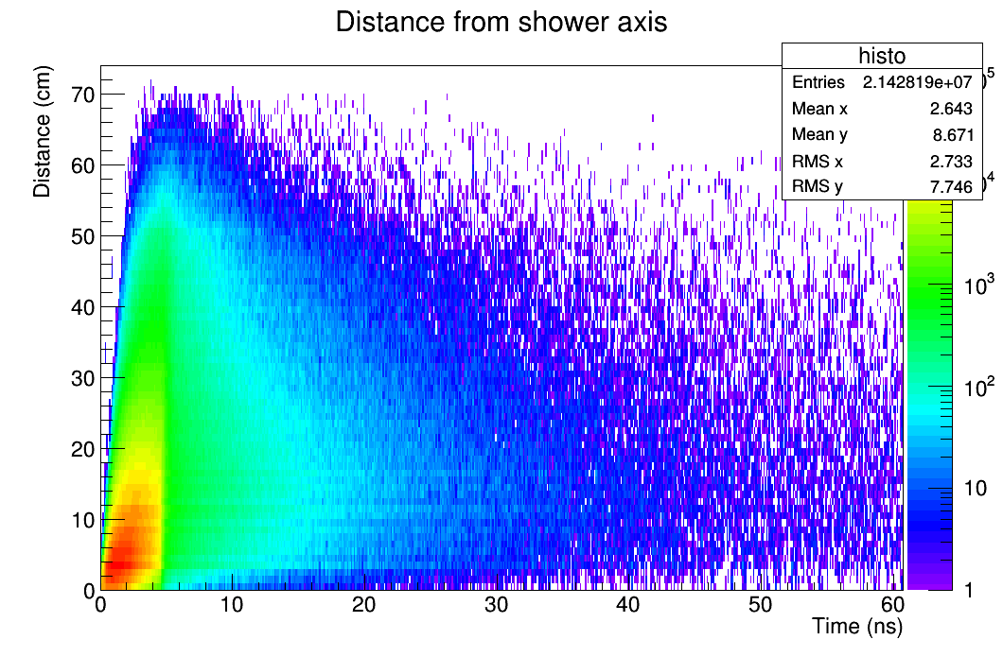
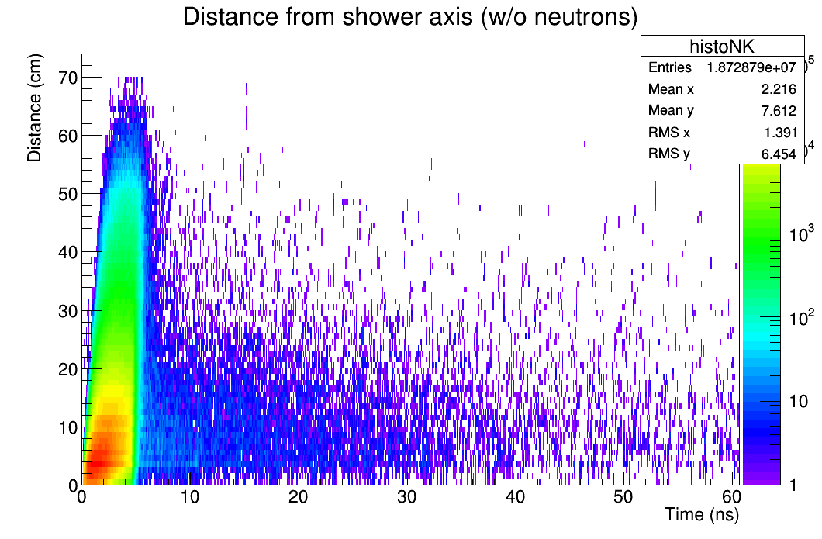
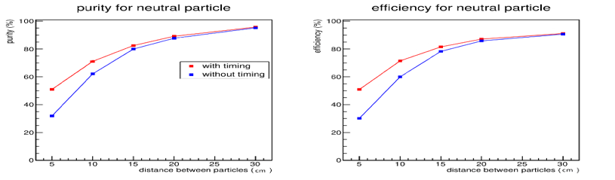
SDHCAL-ILC→ T-SDHCAL-FCCee
SDHCAL needs to be adapted to cope with circular collider requirements
  Continuous readout, cooling
  Higher rate
In addition, we found that time information could improve significantly hadronic showers separation at lower distances → Powerful tool for PFA.
Timing with GNN was shown to improve energy reconstruction (N. Akchurin et al)
  RPC→MRPC
σ=100 ps
Contribution of delayed neutrons could be separated→ better energy reconstruction and better close-by showers separation
PFA-April extended to include time information improves close-by shower separation
electron data (2006)
MOKKA (geant4) simulation
electron data (2006)
MOKKA (geant4) simulation
non-linearity<1%
non-linearity<1%
Ebeam
Ebeam

Slide 5
Strategy
in Master Project TMRPC4HC
First step
Simulation and detailed study of the time impact on the energy reconstruction and showers separation
Simulation of MRPC
Construction of small to medium MRPC of different gaps (3,4,5..)
Exploit the readout electronics already available (petiroc, liroc…) to determine the number of gaps allowing to reach the 100ps time resolution
Contribute to the new readout electronics of OMEGA → DAQ
Second step
Build a few large MRPC with the new electronics and place them in the present prototype and study hadronic showers combining both the RPC and MRPC

Slide 6
Strategy
To develop the T-SDHCAL we joined two collaborations following the spirit proposed by the ECFA panel:
DRD1 (gaseous detectors) : to develop the required active layers and their readout
DRD6 (calorimetry): to develop the detection system (mechanical structure, cooling, DAQ)
In DRD6 we are part of the WP1 that includes all activities on granular calorimeters and with 9 international groups we contribute to the T-SDHCAL subtask
in DRD1 we are in two work packages: WP5 (gaseous calorimetry) and WP7 (timing)

Slide 7
DRD1-WP5
Milestones and Deliverables | Title | Description | Start Date | End Date
M1.1 | Conception of small detectors of the different technologies | Conception of small detectors of the different technologies (M)RPC, MicroMegas, µRWELL, RPWELL) equipped with electronics readout with pads of a few cm² to test their efficiency and their uniformity | 0 | 12M
M1.2 | Realization of large detectors with different technologies | Realization of medium-size detectors (L > 20 cm, l > 20 cm) with different technologies featuring efficient gas circulation systems, small dead zones and equipped with Active Sensitive Units (ASU) hosting readout electronics allowing to measure efficiency and uniformity | 12M | 24M
D1.1 | Construction and performance studies of large detectors of different technologies | Construction and performance studies of large detectors of different technologies (M)RPC, MicroMegas, µRWELL, RPWELL) instrumented with pickup pads of 1 cm², featuring dead zones less than 2%, highly uniform response to MIPs and time resolution of better than a few nanoseconds as well as high detection rate capabilities up to a few KHz/cm2. The new detectors should be designed to fulfil the requirements of compactness required to be part of highly granular hadronic calorimeters using PFA techniques. | 0 | 36M

Slide 8
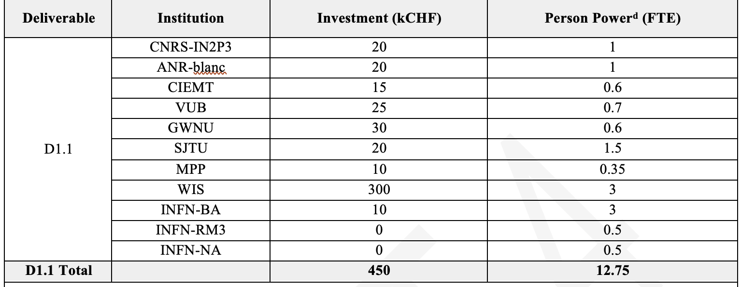
DRD1-WP5-calo
Institut de la physique des 2 infinis (IP2I)
Centro de Investigaciones Energéticas, Medioambientales y Tecnológicas (CIEMAT)
Vrije Universiteit Brussel (VUB)
Gangneung-Wonju National University
Shanghai Jiao Tong University (SJTU)
Max-Planck Institute for Physics (MPP)
Weizmann Institute of Science (WIS)
Bari INFN & University (INFN-ba)
ROME3 University (ROME3)
Naples INFN (INFN-Na)
Funding from France 20 for 3 years

Slide 9
DRD1-WP7-B/(M)RPC
Milestones and Deliverables | Title | Description | Start Date | End Date
M7.B.1 | Production of small MRPC with different technologies | Production of small detector O(10 cm) of 4-8 gaps prototypes using different technologies | 0 | 12M
D7.B.1 | Production of large MRPC with different technologies | Two techniques to build large 4-8 gap RPC will be used. One is using the standard fishing line-based method and the second is using home-made spacers. The two techniques will be worked out to ensure efficient gas circulation as well as gas tightness system. The cassette to host the detectors and their readout electronics with reduced dead zones will be also designed and produced. | 12 | 24 M
M7.B.2 | Review of timing readout electronics | Review of the needed electronics components to achieve 100 ps for strips and pad-like and performance comparison between direct and differential readout techniques. | 12M | 24M
D7.B.2 | Production of large PCB of strip and PAD-based pickup configurations equipped with electronics able to reach better than 100 ps time resolution | To exploit the timing performance of MRPC, large PCBs hosting the strip or the PAD need to be designed and produced. These PCBs should be read out using a system equipped with Front-End electronics able to reach tens of ps time resolution and an acquisition system able to deal with a large amount of data. The possibility to reach sub-millimetre spatial resolution with the same readout electronics and adequate PCBs will be investigated | 24M | 36M
M7.B.3 | Production of a small single cell MRPC with very high-rate capability | Conception and construction of a small MRPC using low resistive material to achieve high rate detection capability with excellent time resolution | 0 | 18M
D7.B.3 | Production of a stable (single cell) MRPC with very high-rate capability (> 50 kHz/cm2) and time resolution better than 100 ps | The MRPC developed in the task will use low resistivity material and thin gas gap to achieve both high rate and excellent time resolution. This intends to provide T0 for ToF-based PID system in fixed target experiments and colliders. It will also be used as a reference for high rate and detector test | 18M | 36M
M7.B.4 | Construction of small double-gap RPC | The goal is to build a few small double-gap RPC featuring time resolution better than 200 ps. | 0 | 18M
D7.B.4 | Construction of large-area double-gap RPC with a time resolution better than 200 ps | we aim to develop a large area standard single/double gap RPC with O(200 ps) by optimizing the gas gap thickness and the gap assembly procedures. To achieve high efficiency, dedicated low threshold readout should be implemented | 18M | 36M
M7.B.5 | Tests of small (M)RPC chambers with eco-friendly gas mixtures | The goal is to validate the performances of the new chambers and their electronics using eco-friendly gases | 12M | 24M
D7.B.5 | Timing and spatial resolution studies versus different gas mixtures | The different kinds of (M)RPC developed in the previous tasks will be thoroughly tested to validate their performances. This concerns the so-called standard gas mixture (TFE, Isobutane/CO2, SF6) but more importantly the gas mixtures using eco-friendly gases studying the impact of the latter on the detector performances | 24M | 36M

Slide 10
DRD1-WP7-B/(M)RPC
D B.1: Production and comparison of full large (> 1 m2) MRPC detectors with different techniques (24M).
M B.1: production of small detector O(10 cm) of 4-8 gaps prototypes using different technologies.
D B.2: Production of large PCB of strip and PAD-based pickup configuration
equipped with electronics able to reach better than 100 ps time resolution (36 M)
M B.2: Review of the needed electronics components to achieve 100 ps for strips
and pad-like and performance comparison between direct and differential readout techniques.
D B.3: Production of a stable single cell MRPC with very high-rate capability
(> 100 kHz/cm2) and time resolution better than 100 ps (36M).
M B.3: High-rate tests with small detector prototypes (24M)
D B.4: Construction of large-area double-gap RPC with a time resolution betterthan 200 ps (36M).
M B.4: Construction of small prototype (50x50 cm2) reaching 200 ps (24M).
D B.5: Timing and spatial resolution studies versus different gas mixtures (48M).
M B.5: preliminary results of timing and spatial resolution with standard gas
Mixture (36M)

Slide 11
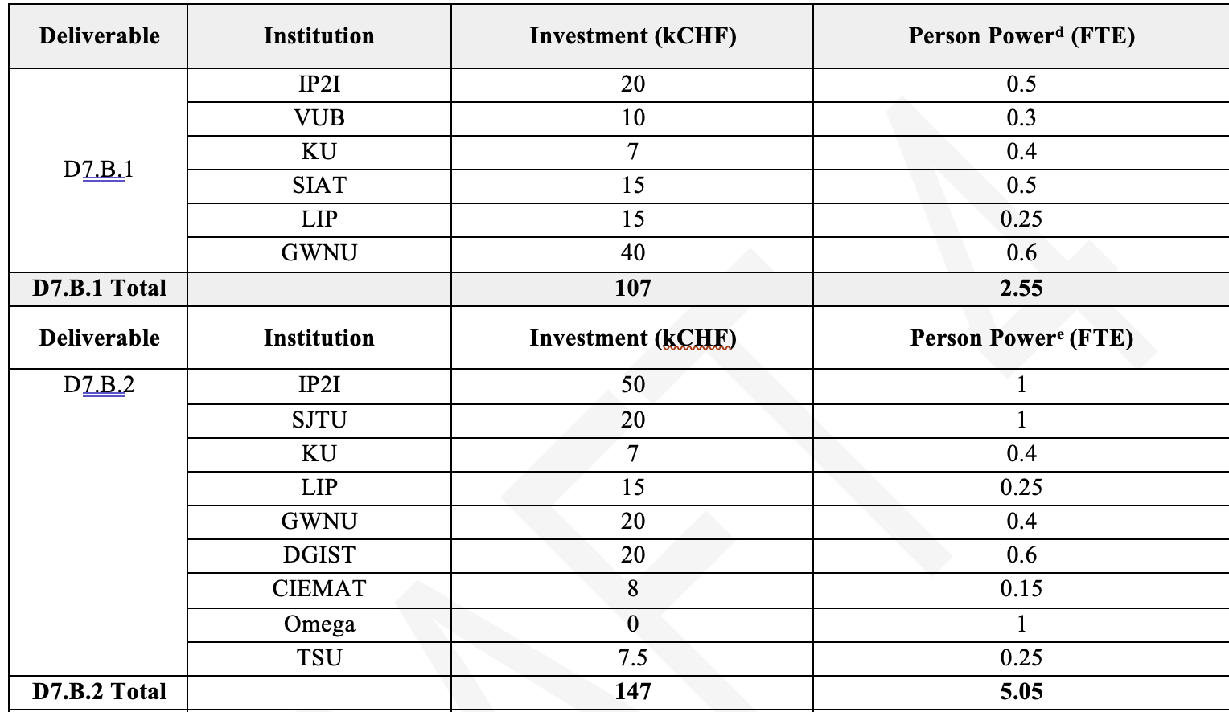
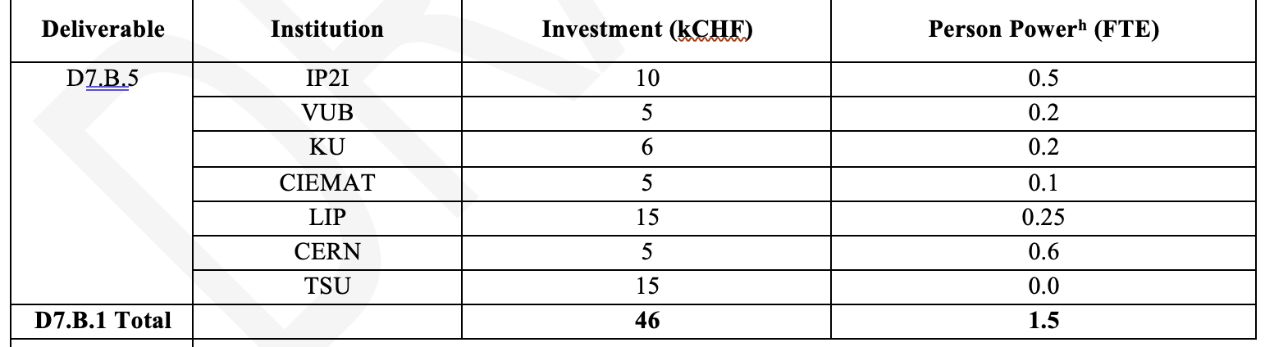
Institut de la physique des 2 infinis de Lyon (IP2I)
Centro de Investigaciones Energéticas, Medioambientales y
Tecnológicas (CIEMAT)
Vrije Universiteit Brussel (VUB)
Gangneung-Wonju National University (GWNU)
Shanghai Jiao Tong University (SJTU)
Organisation de Micro-Électronique Générale Avancée (OMEGA)
Physikalisches Institut, Heidelberg University (HDU)
Kyoto University (KU), RCNP, Kyoto Sangyo (Kyoto)
Laboratório de Instrumentação e Física Experimental de Partículas (LIP)
Tsinghua University (TSU)
Shenzhen Institute of Advanced Technology (SIAT)
Daegu Gyeongbuk Institute of Science and Technology (DGIST)
Max-Planck Institute for Physics (MPP)
INFN-BARI
Roma Ter Vergata
Hanyang University
CERN EP-DT gas team
Academia Sinica and NCU (Taiwan)
Funding from France 80 for 4 years

Slide 12
DRD6
Goals
1. Simulation study of hadronic showers with time information.
2. Simulation study of cooling system required for the T-SDHCAL unit based on the
present knowledge of the Liroc ASIC power consumption as well as the other
components to be used.
3. Conception of a new cassette structure with the cooling system.
4. Conception and production of fast-time electronics (Liroc+TDC)
5. Conception of a thin and large ASU hosting the readout electronics to be associated
to the MRPC in a cassette.
6. A DAQ system allowing the communication and the synchronization of a few TSDHCAL
units.
7. Construction of a few T-SDHCAL units.
8. Construction of cooling units for the T-SDHCAL units.
9. Validation of the new T-SDHCAL units in beam tests first in independent way and
then with the other SDHCAL units.
10. Comparison with the simulation.
Deliverable
Construction and tests of 4 T-SDHCAL units

Slide 13
Institut de la physique des 2 infinis (IP2I)
Organisation de Micro-Électronique Générale Avancée (OMEGA)
Centro de Investigaciones Energéticas, Medioambientales y Tecnológicas (CIEMAT)
University of Córdoba (UCO)
Vrije Universiteit Brussel (VUB)
Gangneung-Wonju National University
Shanghai Jiao Tong University (SJTU)
Yonsei Cancer Center (YCC)
Université de Tunis El Manar
Insitute | FTE/year | Requested funding
IP2I | 2Ph+ 0.5En | 50 KCHF
OMEGA | 1En | 50. KCHF
All. | 7.6Ph+3.8 | 210 KCHF
P2I: 50 k CHF for MRPC, readout
boards, DAQ boards
OMEGA : 50 kCHF for ASIC production

Slide 14
Summary of the requests for the 3 years to come
Institue | DRDx | Needed funding kCHF | Available Funding KCHF | Origine of the available funding | Needed
IP2I | DRD6 | 50 | 30 | ANR -Tcalo | 20
IP2I | DRD1 | 100 | 50 | Aidainnova overhead | 50
OMEGA | DRD6 | 50 | 0 |  | 50
Total |  | 200 | 70 |  | 120
FTE (IP2I) : 3 physicists (0.5 FTE each) + 2 PhD (1 FtE each) + 1. Eng. (0.5 FTE)

Slide 15
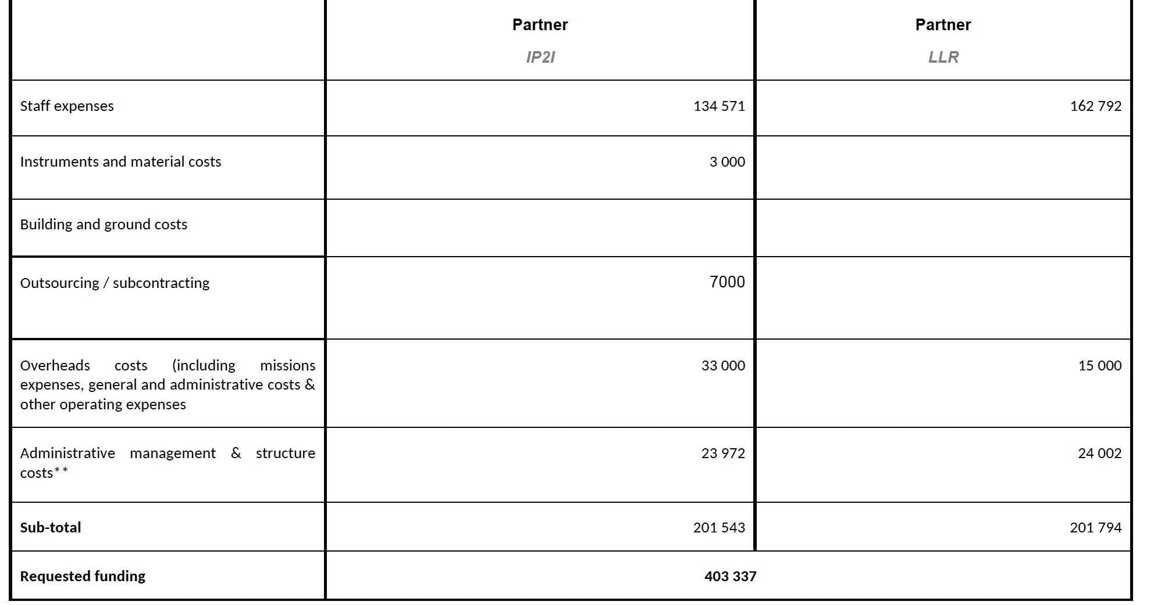
ANR: T-CALO

Slide 16
Master Project TMRPC4HD Vs DRDx
Première phase
Développement de petits détecteurs MRPC
3-6 gaps
Mise en place d’un système de lecture et d’acquisition
Simulation de MRPC pour le
T-SDHCAL
Test des MRPC
DRD1
DRD6
DRD1
DRD6
Seconde phase
Développement de grands détecteurs MRPC (1 m²)
Développement de l’électronique de lecture ASIC+TDC intégrée
Développement d’une cassette pour les grands détecteurs
Développement d’un système de refroidissement
Développement d’un système d’un système d’acquisition hybride
DRD1
DRD6
DRD1
DRD6
DRD6

Slide 17
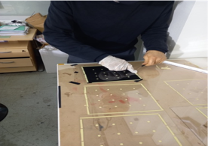
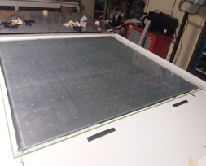
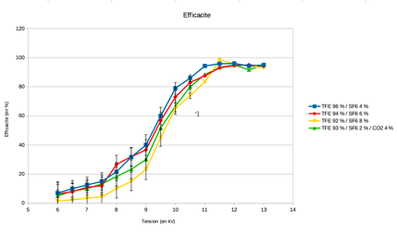
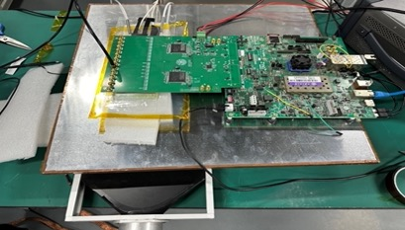
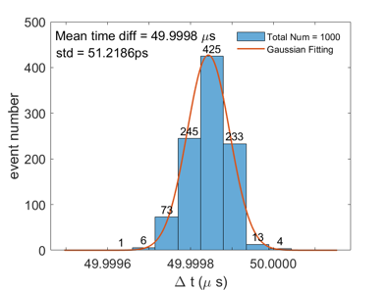
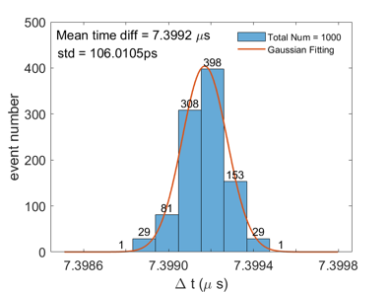
RPC→ MRPC
MRPC provides excellent time resolution (down to 50-70 ps with 2x4 gaps)
MRPC has higher detection rate
New way of producing MRPC was developed in Lyon→ easy production, cheap detector
New eco-friendly gases: HFO1234 and NOVEC could replace present nasty gases R134a and SF6 currently used→ new results from partners confirm this.
Electronics:
HR2 (no timing)→ Petiroc (timing + TDC but large dead time) →Caloroc (timing + TDC)
σ_{t} = 36 ps
σ_{t} = 75 ps
Electronics only
petiroc

Slide 18
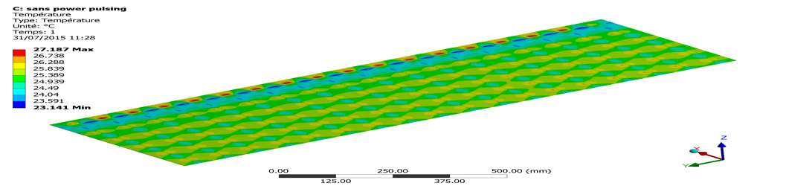
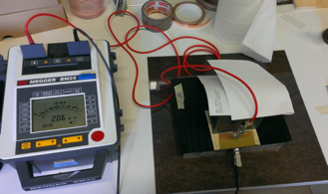
Cooling
Previous studies were performed on HARDROC (full regime) showed efficient heat absorption.
Using water circulating in cooper tubes in contact with the ASICs
We need to re do the studies with the new ASICs and the mechanical structure in mind
High-rate capability
Low-resistivity glass developed by Tsinghua U.
→ problem with the glass thickness and dimensions
Low-resistive PEEK (10⁹ Ω.cm) developed by IP2I-Lyon
Some efforts to have better homogeneity is needed

Slide 19
Summary
French groups involved in the T-SDHCAL related activities are strongly involved in the DRD1 and 6 and they have a leadership roles of both
Master project (TMRPC4HC) started in éàé4 and the ANR (T-CALO) started in 2024 as well as overhead from AIDINNOVA allows the project to be funded except for the ASIC production that could be discussed globally
We have already achieved a part of the milestones and the deliverables seem to be achievable
T-SDHCAL has been submitted as an EoI for FCCee

