Slide 1
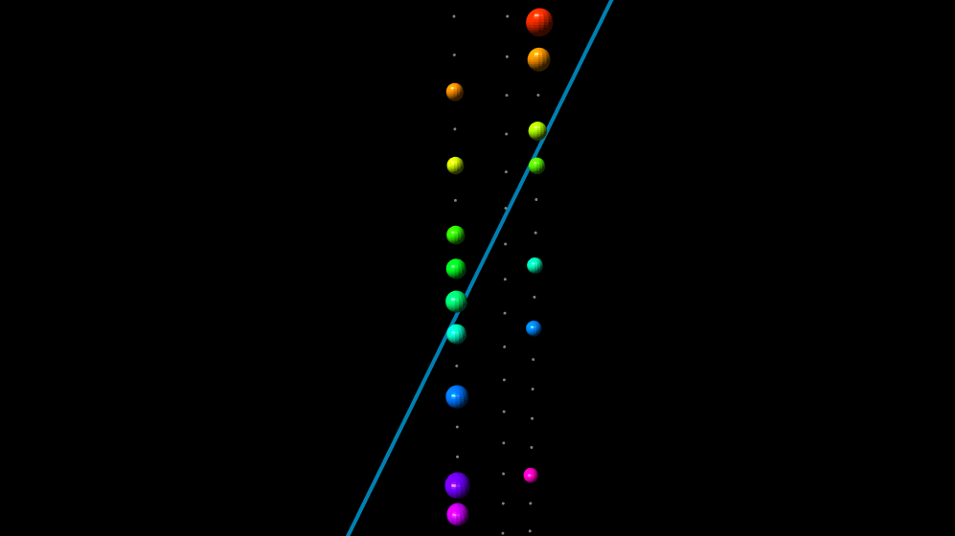
Muon bundle observation
And
Primary cosmic ray studies
Akash Parmar, LPC-Caen
13 February 2025, Thursday
Supervisor
Marc LaBalme
Co-Supervisor
Valentin Pestel

Slide 2
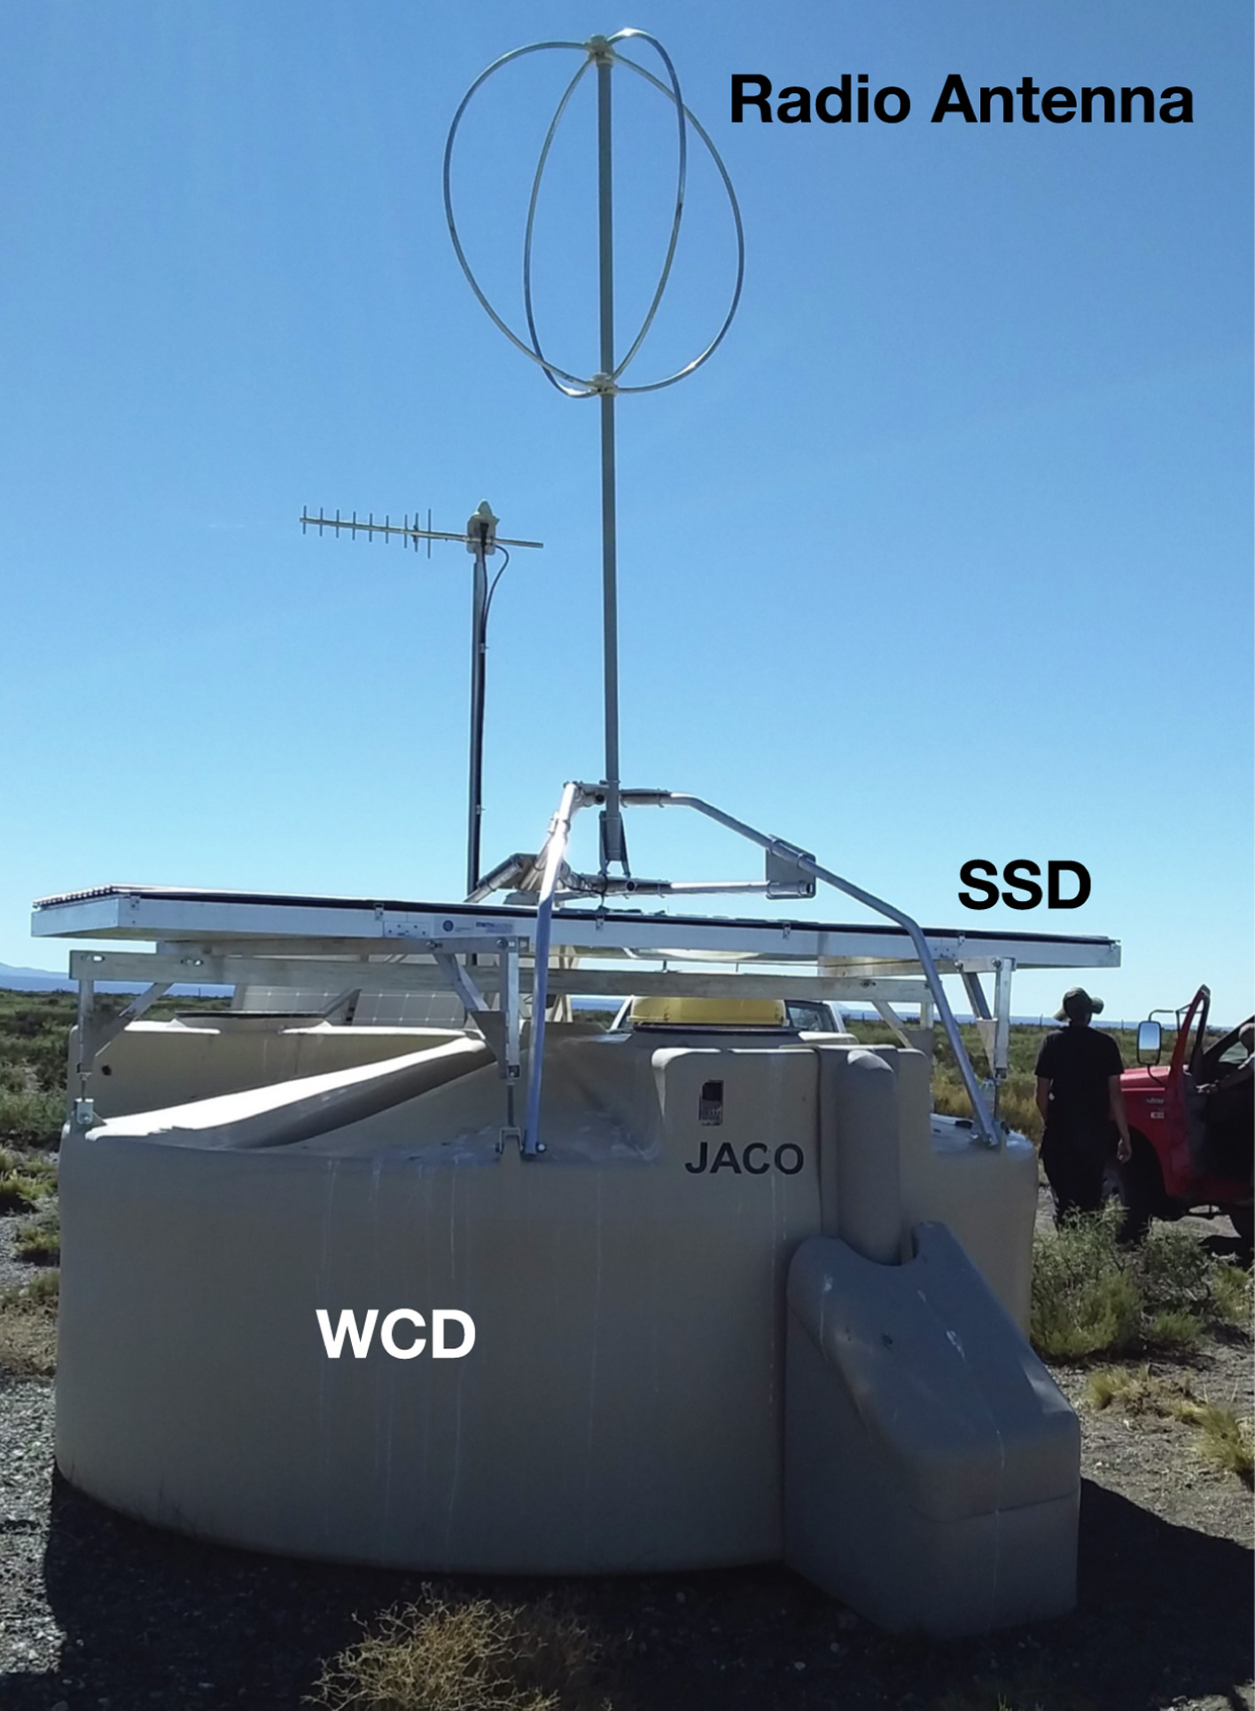
Master Thesis
Topic: Study of Mass Composition of Ultra-High Energy Cosmic Rays with AugerPrime using Machine Learning
Primary Goal: Explore capabilities of Surface Scintillator Detectors.
A SD station with RD, WCD and SSD [Gioacchino Alex Anastasi, Nuclear Instruments and Methods in Physics Research Section A: Accelerators, Spectrometers, Detectors and Associated Equipment 1044, 2022].

Slide 3
Muon Bundle Study (Motivation & Scientific Goals)
Testing Hadronic Interaction Models:
Models like SIBYLL, QGSJET, EPOS predict different muon bundle characteristics.
Comparing predictions with KM3NeT data helps determine which model best describes reality.
Understanding Cosmic Ray Composition:
The number and spread of muons help distinguish light vs. heavy cosmic ray primaries.

Slide 4
Muon Bundle Characteristics - First Step
What???
Muon Multiplicity:
The number of muons in the bundle.
Lateral Distribution:
The spatial spread of muons from the core of the bundle.
How???
Cherenkov Light Information:
Time residuals (how well detected hits agree with expected signal timing)
Assess spatial and temporal patterns of detected light.
Likelihood-based Methods:
Use reconstruction algorithms to refine event topology.
x
x
Detector Can

Slide 5
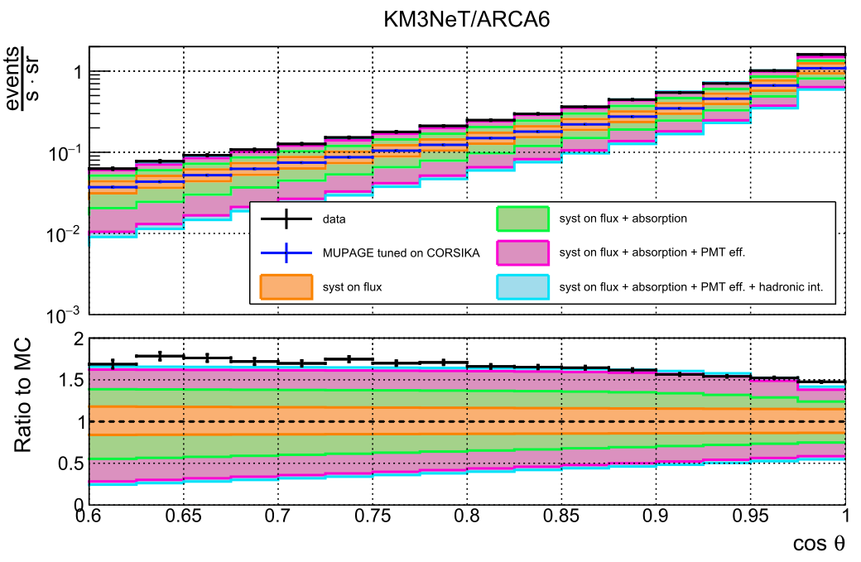
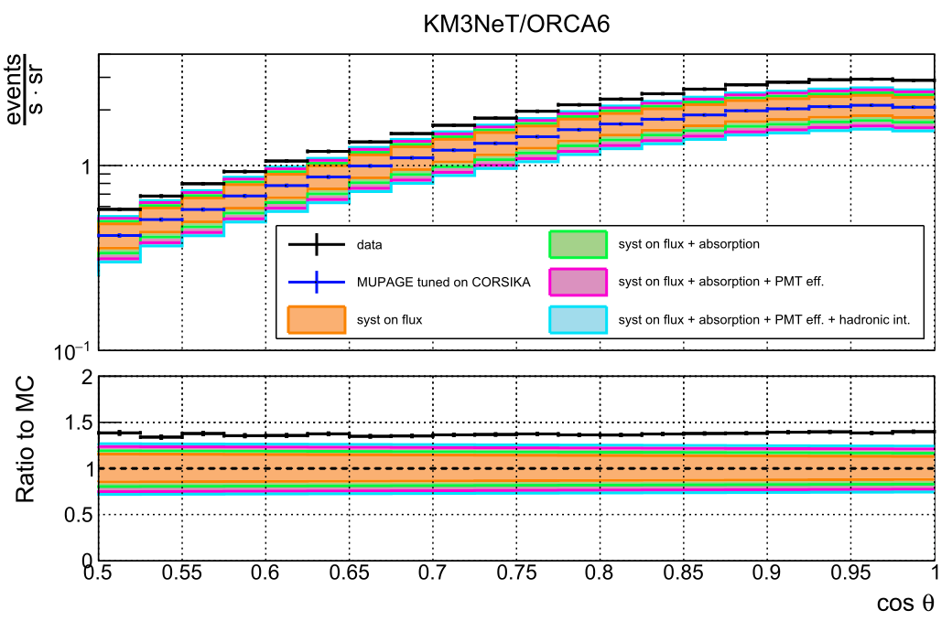
A View At The Muon Puzzle
Reconstructed muon rate as a function of the cosine of the zenith angle (top) and ratio between the data and the simulations (bottom) for ARCA6 and ORCA6. [DOI:https://doi.org/10.1140/epjc/s10052-024-13018-8].
Reconstructing muon multiplicity and lateral spread will provide access to new phase-space regions for studying the Muon Puzzle.

Slide 6
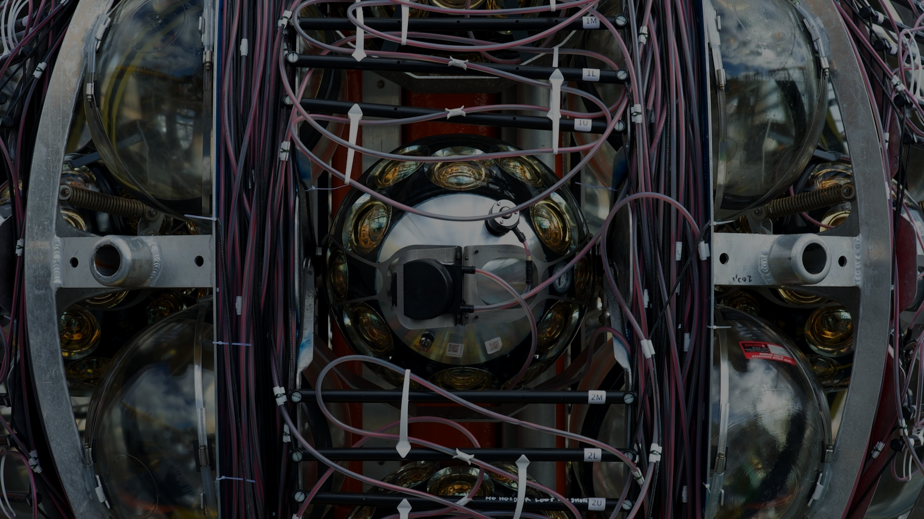
KM3NeT AHRS
Calibration Analysis
Service Task

Slide 7
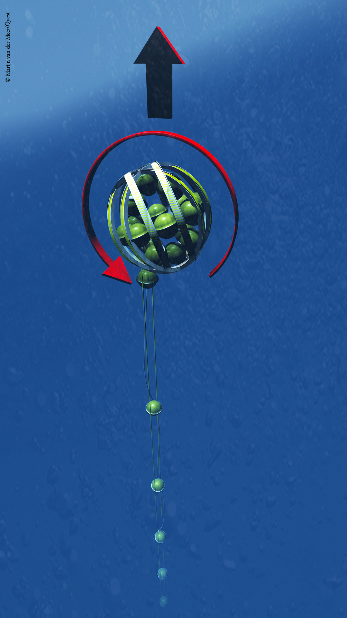
GOAL: Generate compass (AHRS) calibration using data obtained
during unfurling of the DOM deployment
WHY: Absence of the AHRS lab calibration for 3 DUs
3 DUs composing D0ARCW003 - (35, 42, 47)
HOW:
Obtain data from DU with available lab calibration
Generate unfurling lab calibration for known DU
Compare the lab calibration and unfurling calibration
Generate unfurling lab calibration for other 3 DUs
Apply and test calibration on the data after deployment
Copyright: Marijn van der Meer/Quest

Slide 8
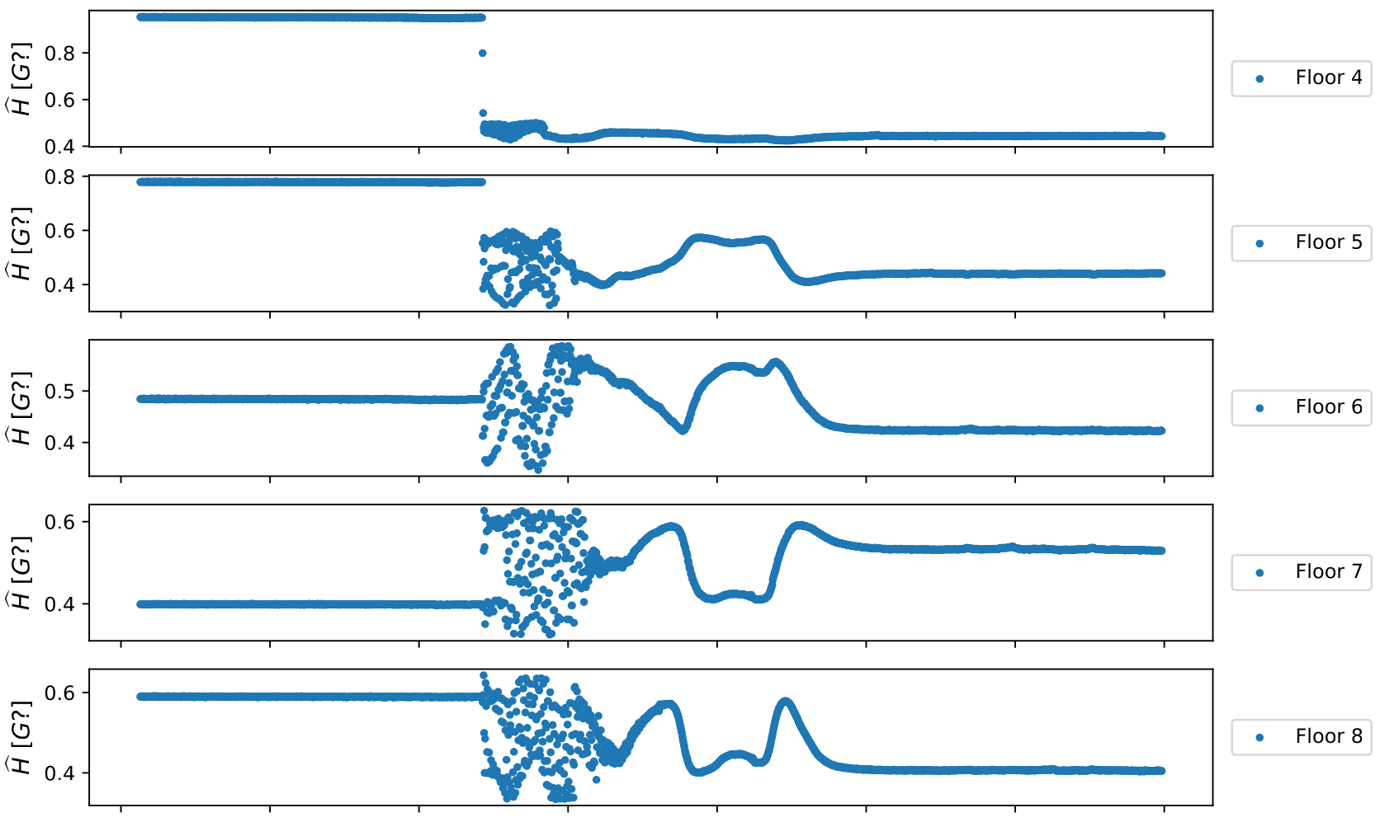
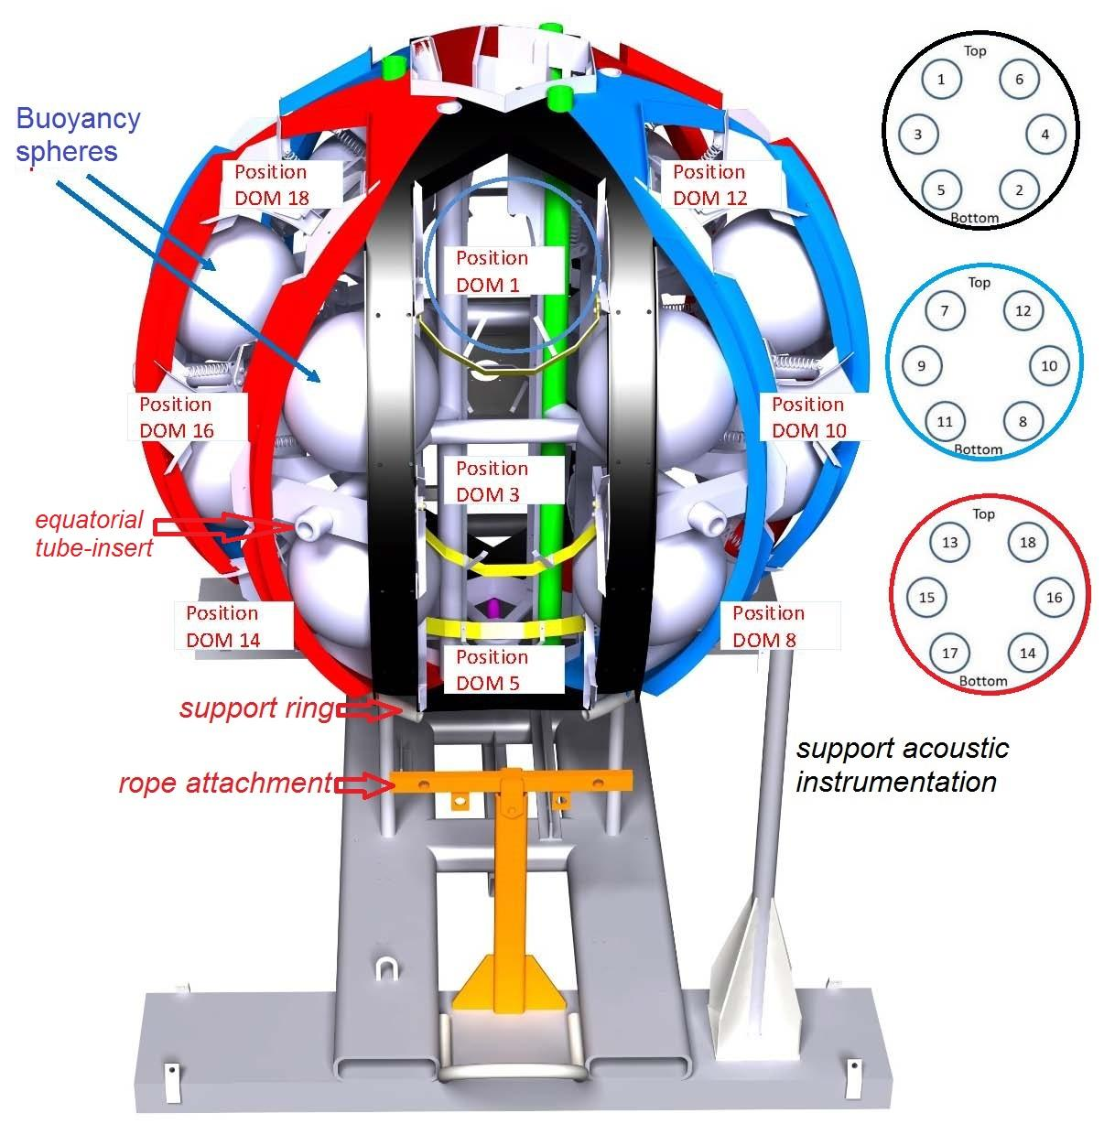
Raw Unfurling Data
Why only unfurling data?
Anonymous magnetic field
observed before start of unfurling.
Could be due to power supply in base module
Uncalibrated Magnetic field magnitude of DU-6, floor 4-8.
Artist impression of the base module attached with Launcher of Optical Module (LOM). [DOI 10.1088/1748-0221/15/11/P11027]

Slide 9
Calibration From Unfurling
What does “calibration from unfurling” mean?
Apply elliptic fit on the unfurling data to generate values of calibration, i.e., norm, offset and rotation.
Observation after calibration:
Obtained calibration from unfurling
data (green) is good agreement
with lab calibration (orange).
Uncalibrated, lab calibrated and unfurling calibrated magnetic field magnitude a single DOM.

Slide 10
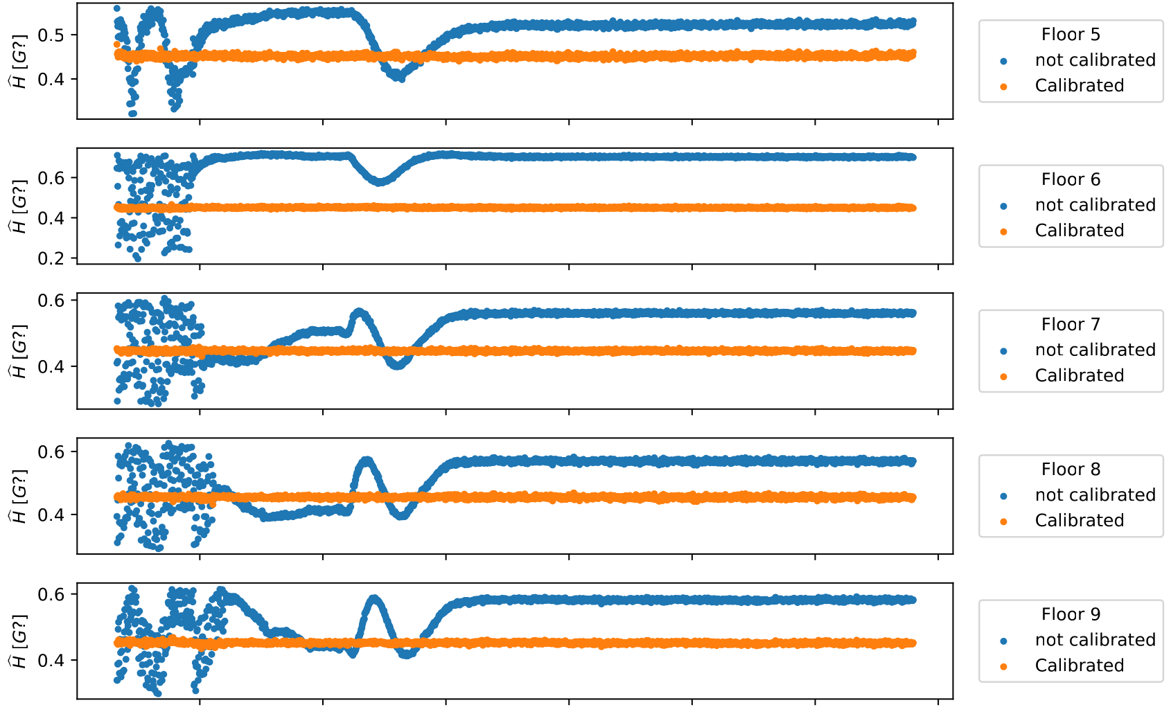
Calibration From Unfurling (Other DOMs)
Obtained new calibration from unfurling for other DUs gives stable magnetic field, which is desired result.
Figure: Uncalibrated and unfurling calibrated magnetic field of DU-47.

Slide 11
What’s next?
Apply calibration on sea data after unfurling to check calibration validity.
Upload the calibration to DB.

Slide 13
BACKUP

Slide 14
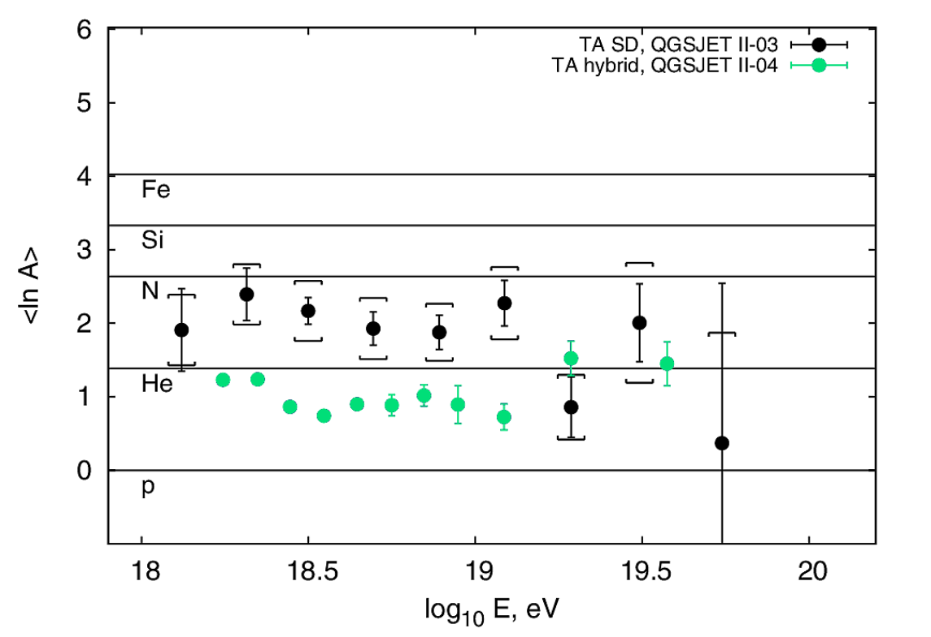
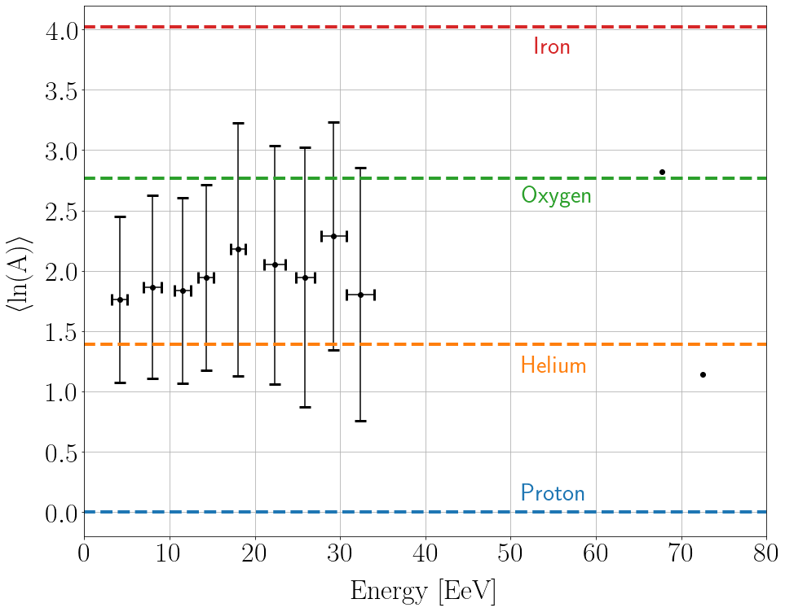
Master Thesis (Result comparison)
Telescope Array
AugerPrime
William Hanlon, EPJ Web Conf. 210, 2019
Northern hemisphere
Area: 700 km²
No. of Events: 18007
Analysis Method: Single Decision tree classifier
Southern hemisphere
Area: ~383 km²
No. of Events: 636
Analysis Method: Random Forest Regression

Slide 15
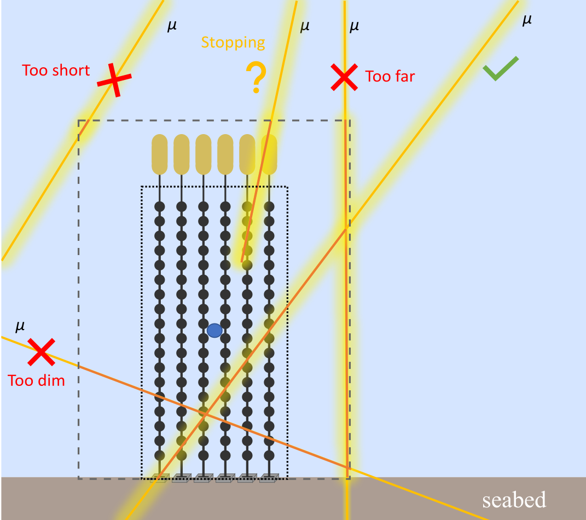
Muon Selection
Source: PhD Thesis, Piotr Kalaczyński, 2024

Slide 16
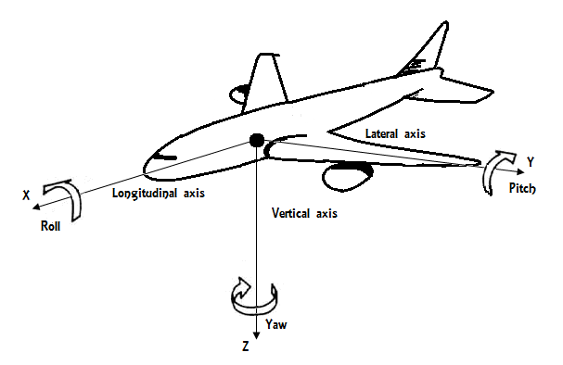
AHRS (Attitude and Heading Reference System)
Provides real-time information about the orientation (attitude), heading, and movement of an object using accelerometers, gyroscopes, and magnetometers
Figure: Three measurement axes in AHRS. [Inertial Navigation Systems and Its Practical Applications, Aleksander Nawrat et al., October 2012, DOI: 10.5772/50578].

Slide 17
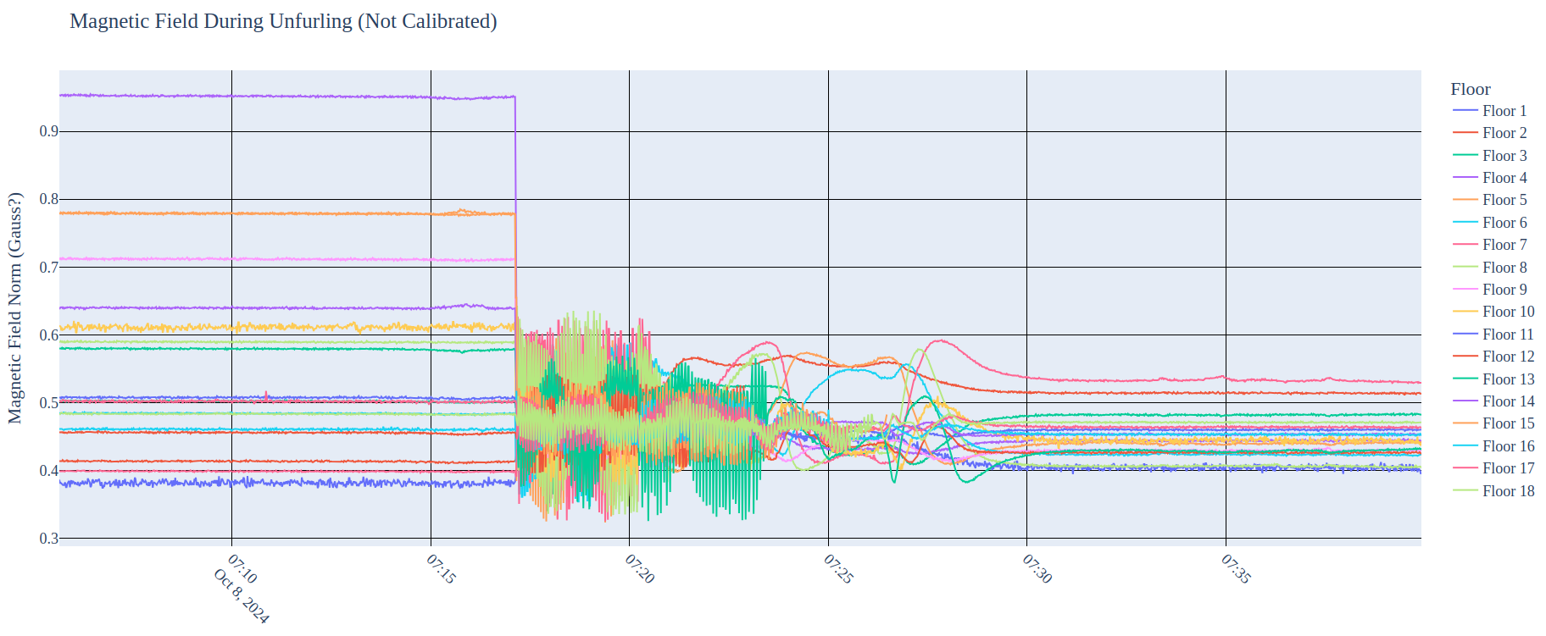
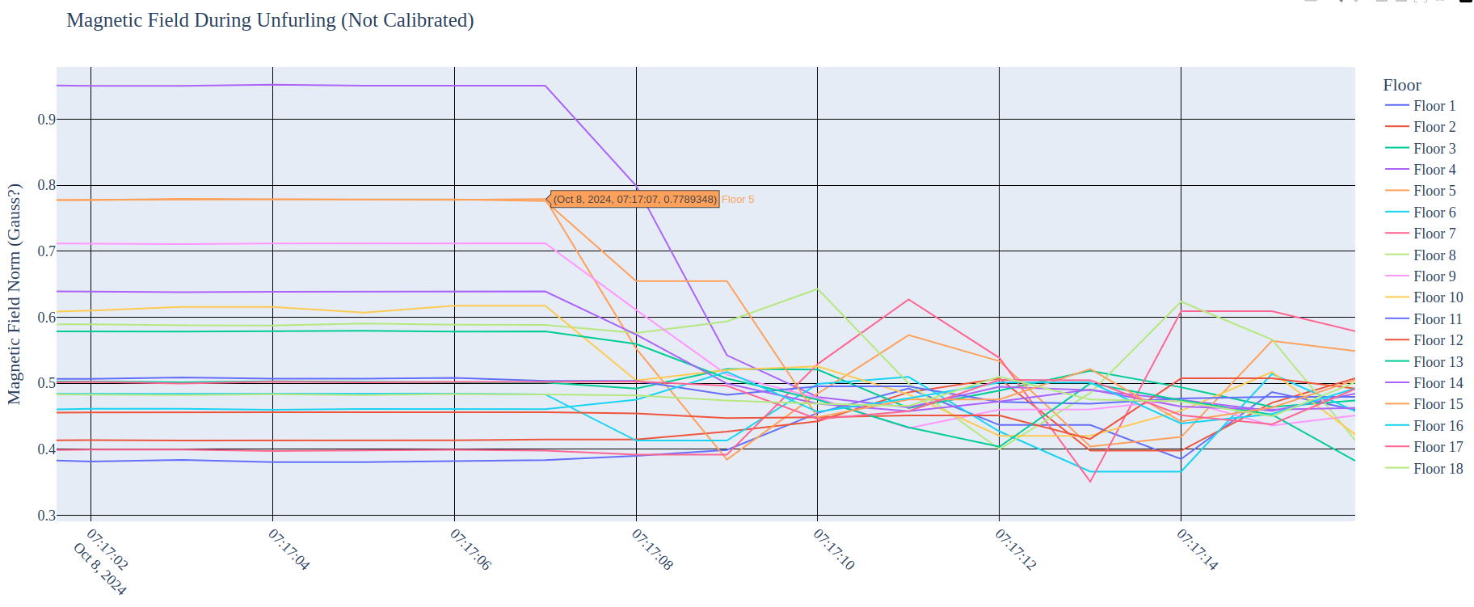
Obtaining unfurling start-time
Sudden change in magnitude of H is starting time of unfurling of DU.
Start-time values obtained visually from plot.
Demonstrating visually obtained unfurling start-time of DU006 (2024-10-08T07:17:07).

Slide 18
3 aspects of calibration:
Magnitude
Amount by which values are off from expected value
(Example: magnitude of acceleration should be 1 g (9.81 m/s²))
Offset
Misalignment of origin of coordinates
([0.0, 0.0, 0.0] if all axes are perfectly aligned with origin)
Rotation of axes
Coordinate system is rotated by certain amount.
[1 0 0]
[0 1 0] if there is no rotation.
[0 0 1]

Slide 19
What about calibration of acceleration?
Manually setting the values of norm, offset and rotation matrix:
A norm = 1 A xyz offsets = [0 0 0] A rotation matrix = [[1 0 0]
[0 1 0]
[0 0 1]]
Comparing manual calibration with lab calibration:
Unfurling
Laboratory
DOMs were vulnerable between time of both observations which could have led biased observation during unfurling however, test for both seems in good agreement.
Figure: Acceptance test of manual calibration and lab calibration.

Slide 20
DOMs with no AHRS observation
Two DOMs in DU0035 gives no value of AHRS.
Figure: Uncalibrated magnetic field of DU-35, floor 6 & 14.
Generate no calibration for such DOMs.

