Slide 1
1

Slide 2
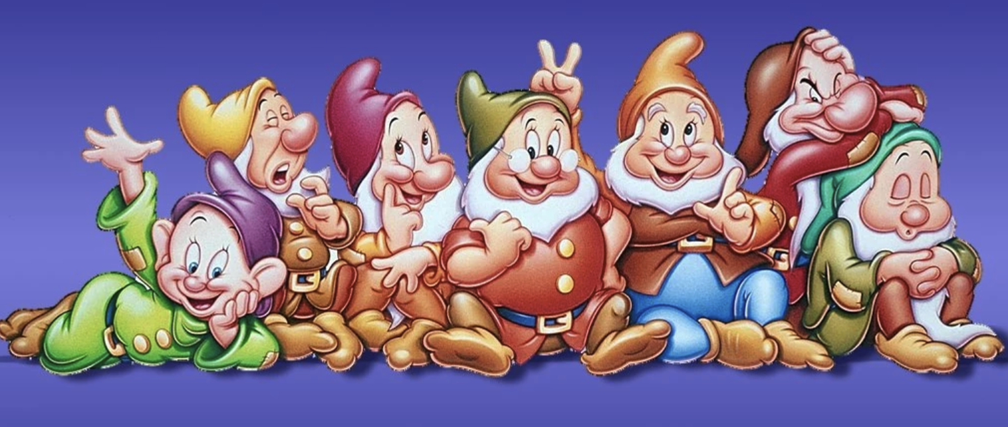
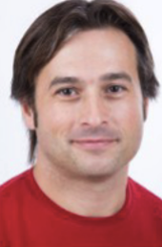
Introduction
In 2024, started an national effort of prospective in view of defining the French priorities for the future collider at CERN. Contribution to the European Strategy for Particle Physics Update (ESPPU).
A strange bunch of people (the Top-LHC-France organisation committee) prepared a short contribution dedicated to top-quark physics.
A summary of the contribution is presented here. Contributions (top-France and national) on the indico page.

Slide 3
ESPPU timeline

Slide 4
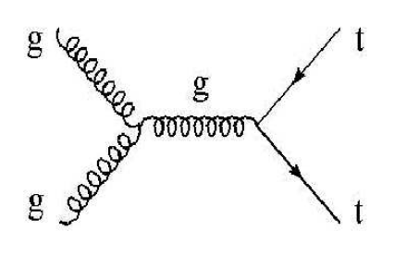
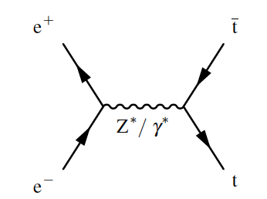
Top quark production at colliders
LO pp
LO $e^{+}e^{−}$
The chatGBT word
pp | ee
Dominant production through QCD ($t\overline{t}g$ couplings). | Dominant production through EWK ($t\overline{t}Z$ couplings).
Significant single top production cross sections. | No single top production cross sections within the SM.
Precise initial state unknown (PDF). | Initial state very well known.
Large backgrounds of various kinds. | Much small background level, easier to control ! No pileup.
High Luminosity, high cross section | Lower Luminosity, lower cross section.
Large number of pile-up | Presence of beam backgrounds. Control of beam essential.

Slide 5
Top quark production at colliders
LO pp
LO $e^{+}e^{−}$
The chatGBT word
pp | ee
Dominant production through QCD ($t\overline{t}g$ couplings). | Dominant production through EWK ($t\overline{t}Z$ couplings).
Significant single top production cross sections. | No single top production cross sections within the SM.
Precise initial state unknown (PDF). | Initial state very well known.
Large backgrounds of various kinds. | Much small background, easier to control !
High Luminosity, high cross section | Lower Luminosity, lower cross section
Large number of pile-up | Presence of beam backgrounds. Control of beam essential.
ee is about

Slide 6
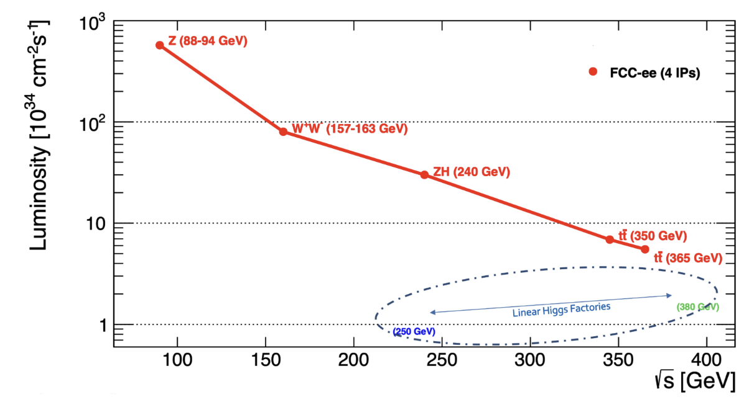
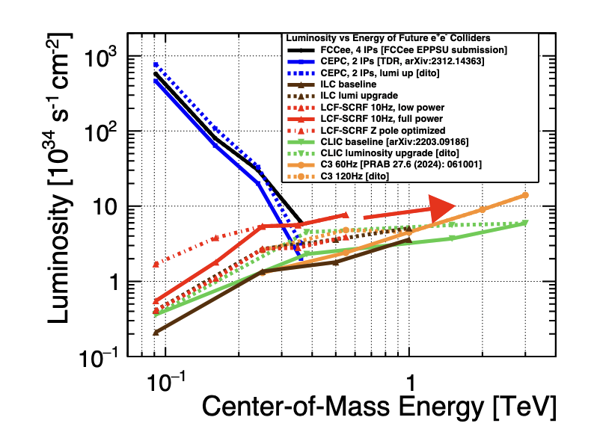
Different $e^{+}e^{−}$ options
FCC feasibility studies (link)
Circular colliders (FCCee, CEPC)
Larger luminosities,
Wider range of energies,
2-4 collisions points (X2-4 in luminosities),
Limited in energy (?),
No beam polarisation.
Linear collider (ILC, CLIC),
Lower luminosities,
Targeting higher energies, even if feasibility of lower energies under investigations,
1-2 detectors (only one collision point),
Beam polarisation.
Three distinct energy ranges are considered (for top-quark physics):
At the 240 GeV (ZH run), below the $t\overline{t}$ threshold,
At $t\overline{t}$ threshold, with $\sqrt{s}$ ranging from 340 to 350 GeV,
Above the $t\overline{t}$ threshold at 365 GeV or 500 GeV.
LC vision (link)

Slide 7
Top quark physics at 240 GeV ?

Slide 8
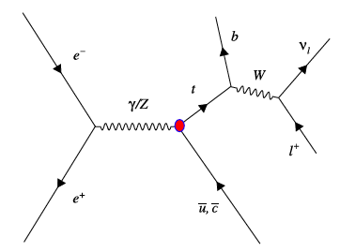
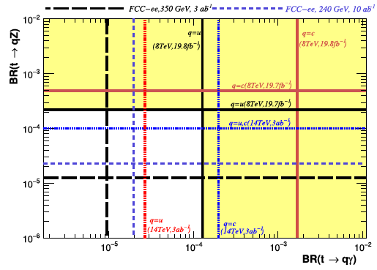
Top quark physics at 240 GeV
At 240 GeV : not enough energy for on-shell $t\overline{t}$ production.
No single top production exists in the SM => single top production necessarily BSM.
Single top production possible through top-quark FCNC couplings to $γ, Z, H$.
Sensitivity at FCCee exists for $tγ$ and $tZ$-FCNC couplings.
Even at 240 GeV, limits can be competitive with the current LHC limits,
Further improvement expected from $t\overline{t}$ events…
PLB 775(2017) 25-31

Slide 9
Top quark physics at the $t\overline{t}$ threshold

Slide 10
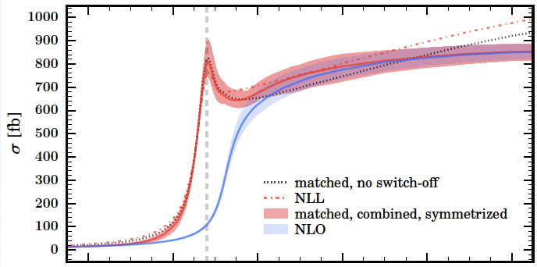
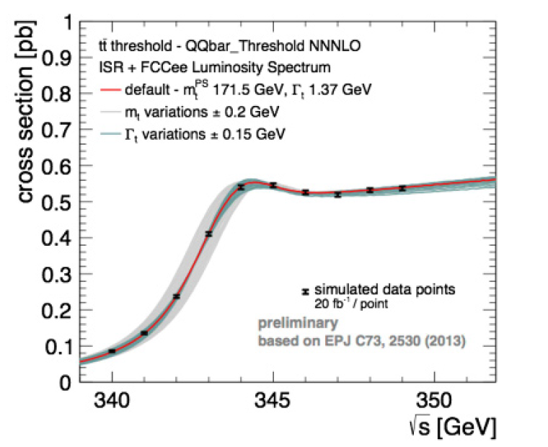
Top mass measurement
Top mass measurement from cross sections => resolving top mass “ambiguities” : MC mass vs mass in various renorm. scheme. Also important to study vacuum stability.
Typical mass difference in the various renorm. schemes ~200 MeV.
Mass extracted from various cross section measurements while scanning $\sqrt{s}$ , and then compared to theoretical predictions.
Cross section measurement precision : 1-2% to reach <200 MeV.
Importance of modelling and events generation !
Whizard
JHEP 1803 (2018) 184
Non-relativistic effects
Link with toponium ?
CDR FCCee
$$α_{s}$$
$$y_{t}$$
$$m_{t}$$
$$Γ_{t}$$

Slide 11
Top mass measurement
Top mass measurement from cross sections => resolving top mass “ambiguities” : MC mass vs mass in various renorm. scheme. Also important to study vacuum stability.
Typical mass difference in the various renorm. schemes ~200 MeV.
Mass extracted from various cross section measurements while scanning $\sqrt{s}$ , and then compared to theoretical predictions.
Cross section measurement precision : 1-2% to reach <200 MeV.
Importance of modelling and events generation !
Whizard
JHEP 1803 (2018) 184
Non-relativistic effects
Link with toponium ?
colliders
CDR FCCee
$$α_{s}$$
$$y_{t}$$
$$m_{t}$$
$$Γ_{t}$$

Slide 12
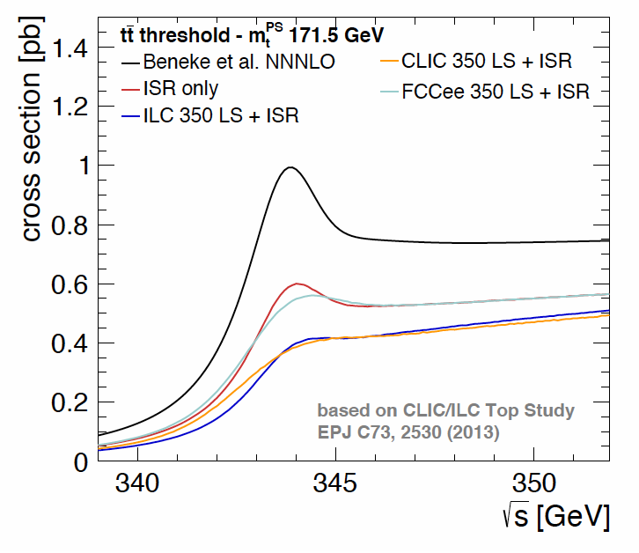
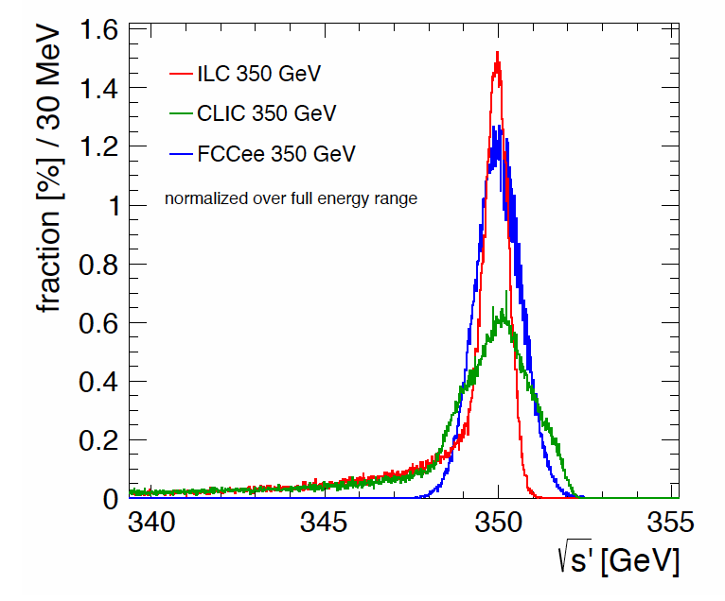
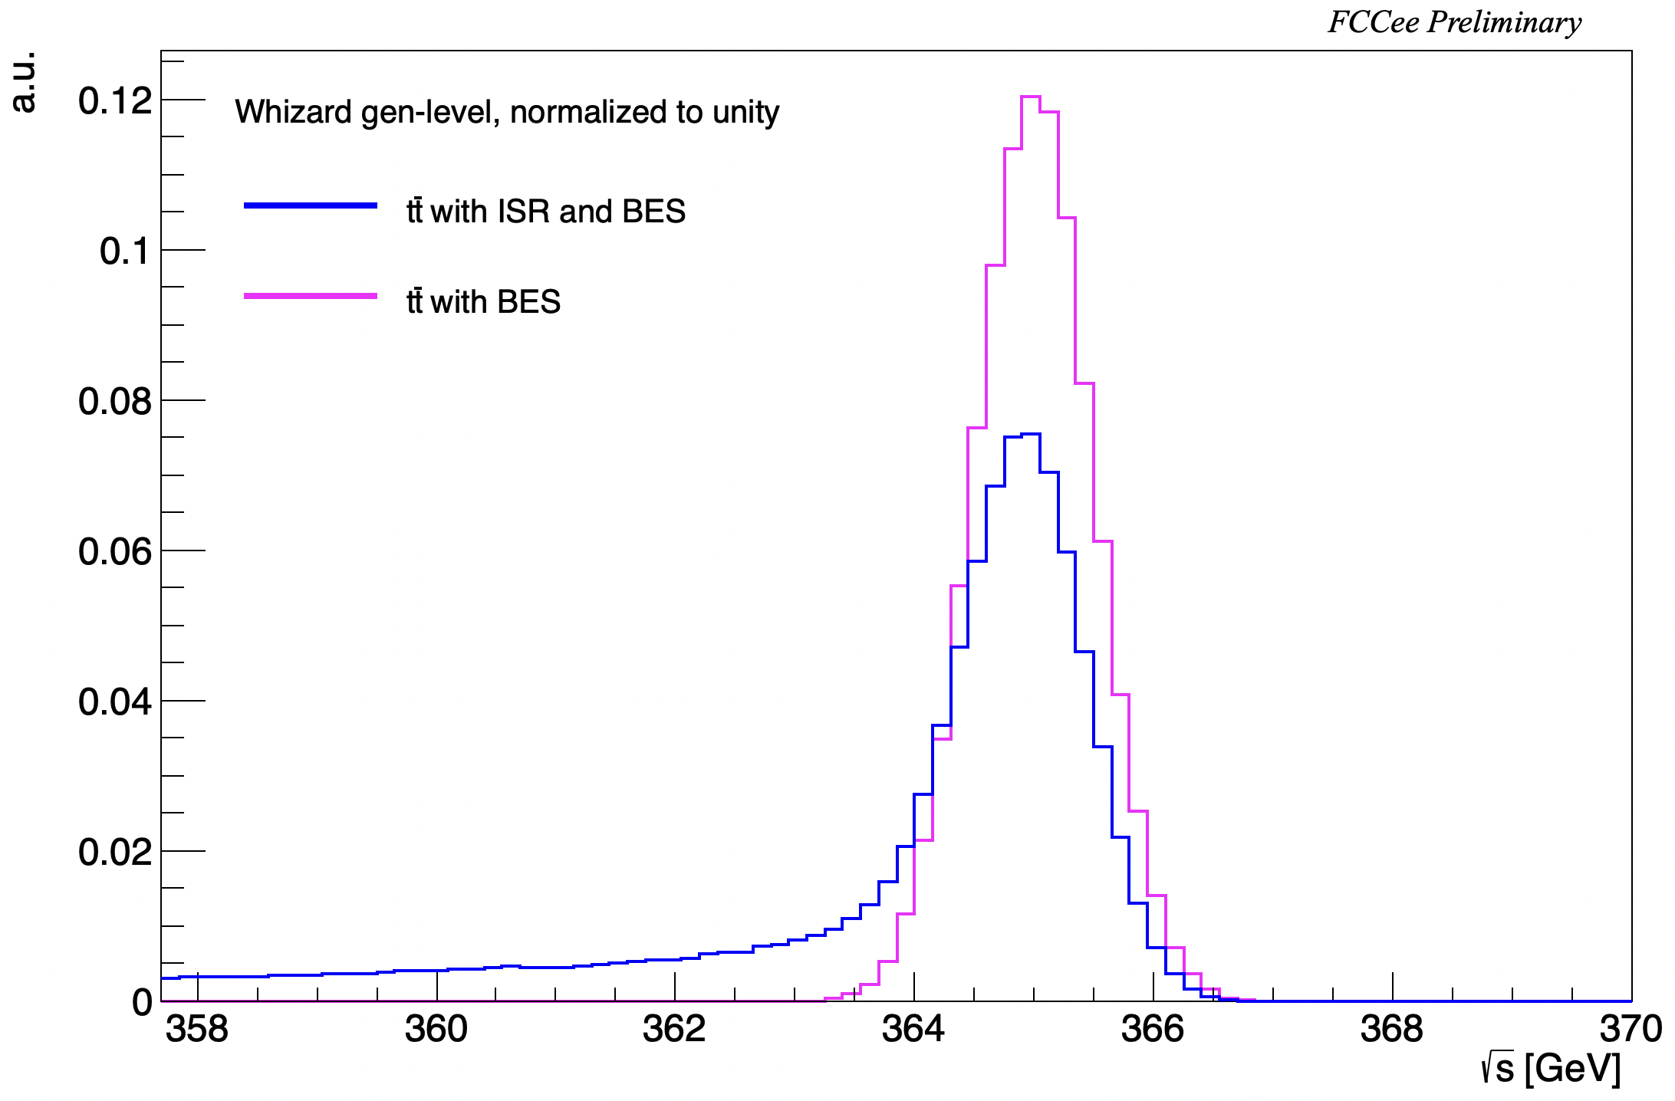
Beam characteristics and impact on $t\overline{t}$ at FCCee
F.Simon, PoS (ICHEP 2016) 872
Due to the energies involved and beam optimisation, there is some beam energy spread at $t\overline{t}$ threshold.
ISR, Beam Energy Spread (BES) and Beamstrahlung (BS) affect the precision on $\sqrt{s}$.
At FCCee : narrow and small tails toward lower energies
Beamstrahlung effects on beam profile small, energy loss recovered by RF.
Impact of beam effects:
lower effective cross sections (fraction of the lumi below the threshold),
broader ”turn-on” ,
FCCee in a favourable position.
ISR
BES
BS
365 GeV

Slide 13
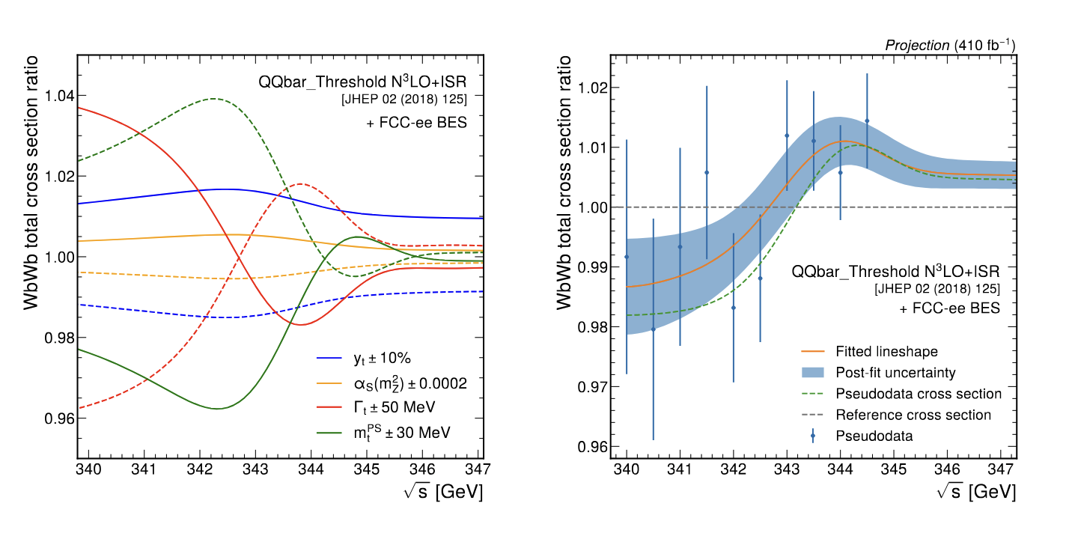
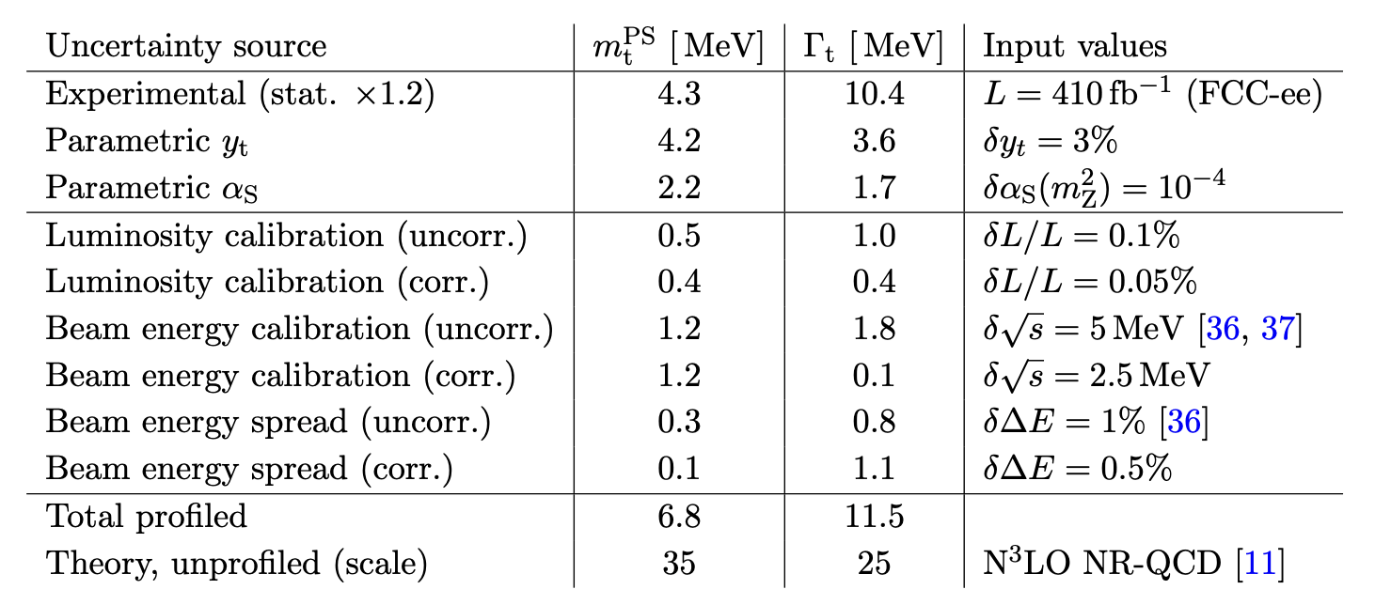
Extracting top mass measurement from energy scan
Recent prospective of top quark measurements from cross section link.
Analysis strategy : cross sections from fit of $N_{jets}$ and $N_{b−jets}$ distributions.
Include systematics, experimental uncertainties treated as nuisance parameters.
Conclusions : total uncertainties below 50 MeV, and dominated by theoretical (scale) uncertainties.
N³LO model used for interpretation (Comput. Phys. Commun. 209 (2016) 96)

Slide 14
Top quark physics above the $t\overline{t}$ threshold

Slide 15
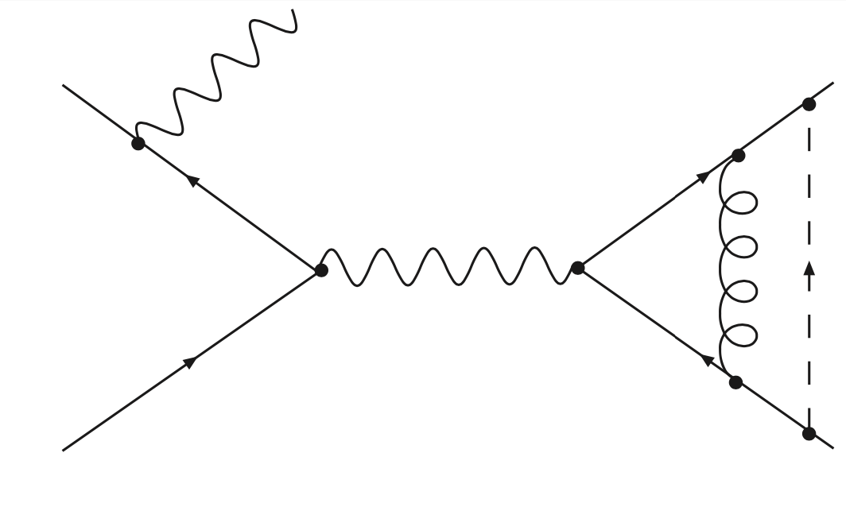
Precision of $t\overline{t}$ cross section measurements
Above the $t\overline{t}$ threshold, a large verity of studies can be made from precision measurements.
EWK coupling studies (and related EFT) are some of the most explored topics.
Even at 365 GeV, some indirect sensitivity to top-Higgs coupling can be achieved (although not competitive with a hadronic collider).
$$α_{s},t\overline{t}g$$
Examples of the measurement of top-Yukawa couplings
~5% at ILC500,
~10% at FCCee365,
While HL-LHC targets ~4%.
%-level accuracy at $e^{+}e^{−}$ colliders requires direct $t\overline{tH}$ (TeV scale).
FCChh would bring the large improvements.
$$t$$
$$e^{+}$$
$$Z/γ^{∗}$$
$$g$$
$$H$$
$$e^{−}$$
$α,t\overline{t}Z$, $t\overline{t}γ$
$$\overline{t}$$
$$y_{t},t\overline{t}H$$

Slide 16
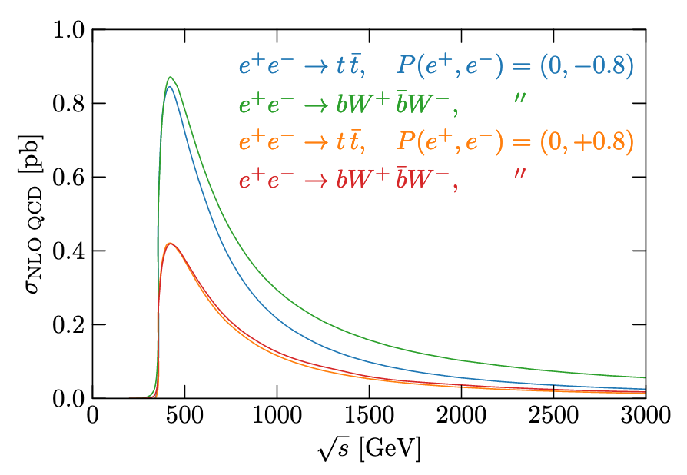
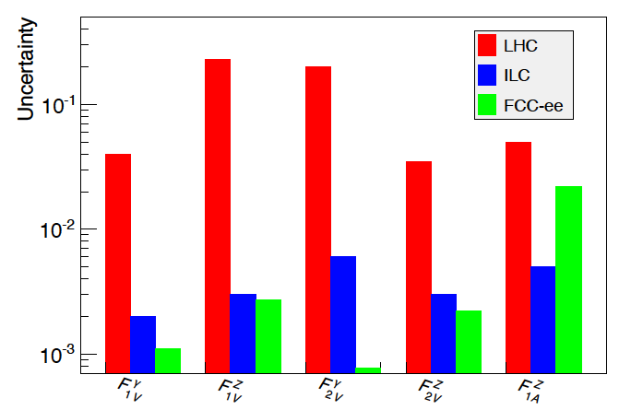
Top-quark EFT : polarization vs statistics
At linear colliders, to constrains EFT operators
beams polarization give an extra handle,
High energies can help to improve the sensitivity on some couplings.
Investigating EFT at FCCee (no polarisation, 365 GeV) :
Low beam backgrounds and less ISR at lower energies,
Lower backgrounds at 365 GeV,
Larger statistics (for instance ~factor of 2-4 compared to the 500 ${fb}^{−1}$ baseline ILC scenario).
Sensitivity on (anomalous) $t\overline{t}$ EWK couplings at FCCee. Based on lepton energy and polar angle :
very low expected experimental uncertainties,
dominated by stat. uncertainties (and theory).
➔ high constrains without the need for polarisation, higher energies doesn’t always help for all couplings.
Sensitivity can be pushed further:
Differential measurements and combinations : benefit the most of the large statistics,
New observables and combinations to be investigated,
Collaborations with theorists required.
JHEP10(2018)168
JHEP(2015)182

Slide 17
Conclusion
Explorations of top-quark physic opportunities were made, through bibliography searches, in view of contribution to the ESPPU-France effort.
Focus is made on $e^{+}e^{−}$ colliders, although a muon collider is also shortly discussed.
Findings are discussed through various energy ranges :
The physics reach at $\sqrt{s}$=240 is limited to BSM single top production,
Major improvements on the top mass and width measurements can be expected from a scan close to the $t\overline{t}$ mass threshold,
Beyond the $t\overline{t}$ threshold
significant improvements in probing top-EWK couplings can be expected at 365 GeV already, with a large statistic,
5-10% precision on top-yukawa from 365-500 GeV. Percent level precision at TeV scale,
Possible sensitivity to BMS, for example new low mass couplings to top quarks.

Slide 18
Conclusion (bis)
Sometimes references lack proper accounting of experimental aspects, or are rudimentary estimations.
Although it is getting better with the results of the FCC feasibility studies
Expertise and know-how from the LHC-top community would be a huge asset to improve e+e- analyses and develop new ideas.

Slide 19
Conclusion (bis-bis)
Sometimes references lack proper accounting of experimental aspects, or are rudimentary estimations.
Although it is getting better with the results of the FCC feasibility studies
Expertise and know-how from the LHC-top community would be a huge asset to improve e+e- analyses and develop new ideas.
FCC

