Slide 1

Project Manager Report
2025
Emmanuel Clément (GANIL) on behalf of the AMB
AGATA week Sept 2025
25° AGATA WEEK

Slide 2

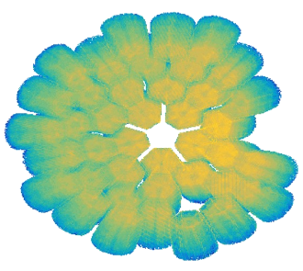
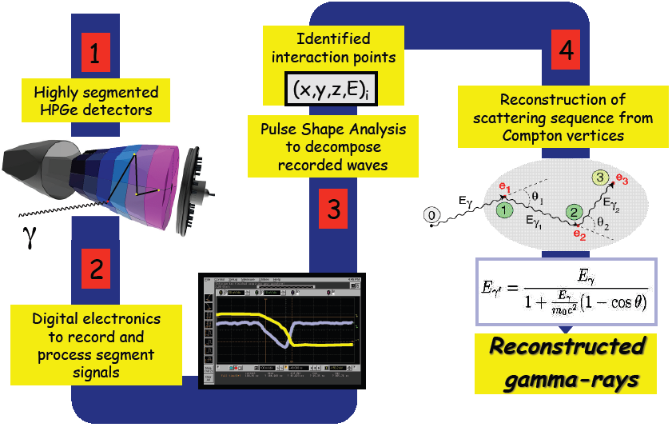
AGATA : PBS
6
Doppler Correction
Complementary Detectors
5
β, θ, φ, E*

Slide 3
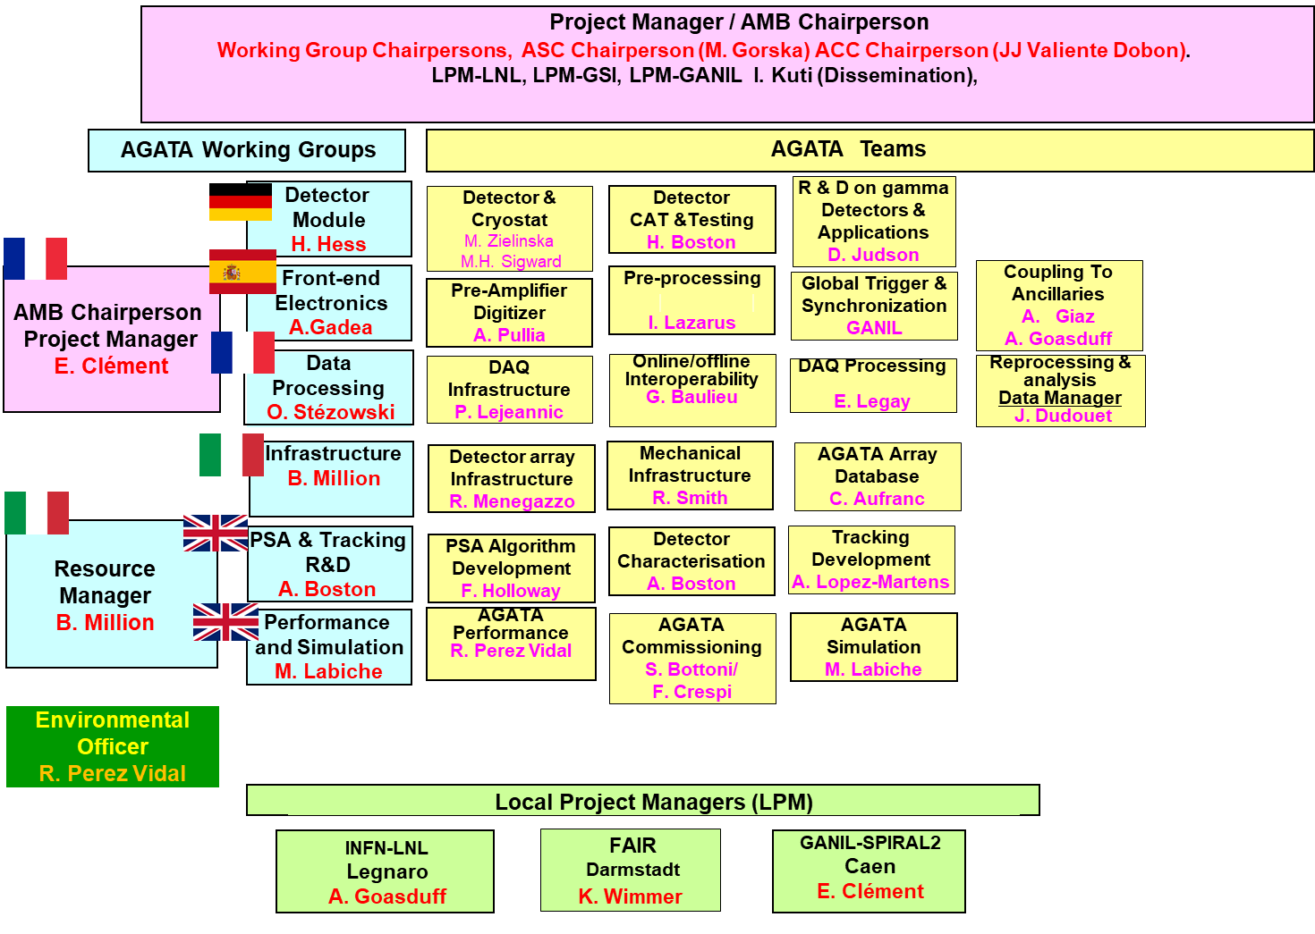
AGATA : WBS
1
2,5
The AMB meets every month by zoom
Excellent stability and smooth evolutions of the board
One AMB meeting per year in presence
3 AMB meetings per year include all team leaders.
The AMB organises the annual AGATA week
The 2025 edition (25th) is in GSI
3,5,6
1,2
3,4
6
Most likely the 2026 AW will be proposed to Poland

Slide 4
AGATA MoU Phase 2 : mid term review
2026-2030
39 capsules
7,7 M€
2021
120 capsules
2009-2020
57 capsules
2021-2025
(MoU is 39 capsules)
24 capsules
10 cryostats 2,0 M€
CTT/MIRION
2026-2030
54 capsules
9,1 M€
10 cryostats CTT
135 capsules
15 cryostats 2,9 M€
CTT/MIRION
MoU Phase 2
Mid-term review 22 apr. 2025 by AGATA Ressource Board
ASC/AMB/ACC document : ATRIUM-1080389

Slide 5
AGATA MoU Phase 2 : mid term review
2026-2030
39 capsules
7,7 M€
2021
120 capsules
2009-2020
57 capsules
2021-2025
(MoU is 39 capsules)
24 capsules
10 cryostats 2,0 M€
CTT/MIRION
2026-2030
54 capsules
9,1 M€
10 cryostats CTT
135 capsules
15 cryostats 2,9 M€
CTT/MIRION
MoU Phase 2
Mid-term review 22 apr. 2025 by AGATA Ressource Board
ASC/AMB/ACC document : ATRIUM-1080389

Slide 7
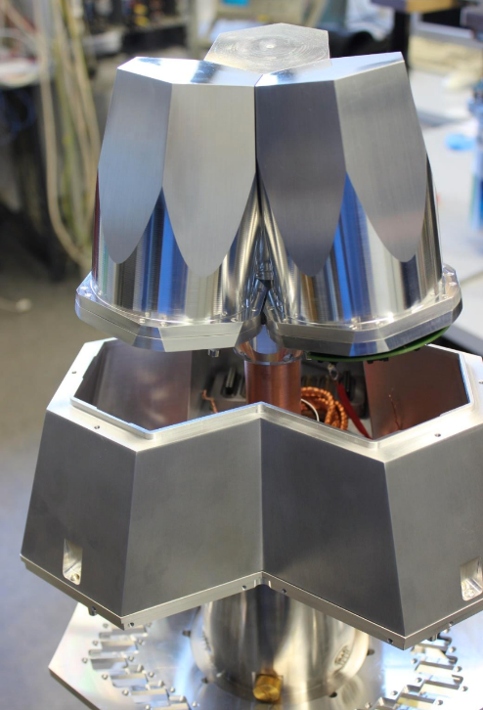
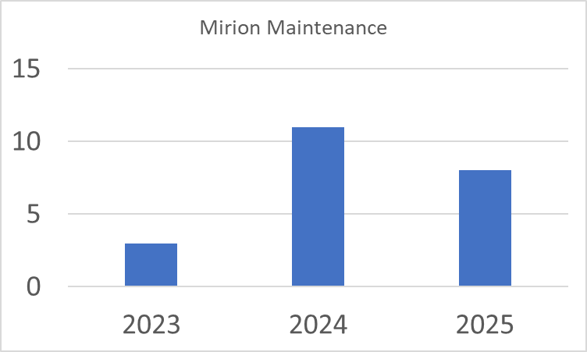
Detector status (Sep. 2025)
Detector procurement
The total number of delivered AGATA asym-capsules is 72
+ 1 DEGAS ATC completed in IKP
+ 1 ORTEC prototype, not functional
+ 3 symmetric capsules
3 x encapsulated HPGe crystal from MIRION®
Open Orders: 5 capsules in prod
3 x Owner Italy/INFN delivery expected in 2026
2 x Owner France/GANIL delivery expected in 2025
1 x cryostat from CTT®
Cluster Assembly
ATC24 (GSI) delivered
ATC25 (GANIL) in progress
ATC16 (conversion of ADC03 - GANIL): completed
Test cryostats refurbishment done
AGATA Triple Cluster (ATC)
Maintenance
A 4 years contract (1.6 M€) between GANIL and MIRION for new orders/ annealing / repairs has been signed using the OC located in the GANIL common account. Started in January 2025
Allow a flexible and efficient repair/maintenance of the capsules
Source : Marie-Hélène data base for the detector team

Slide 8
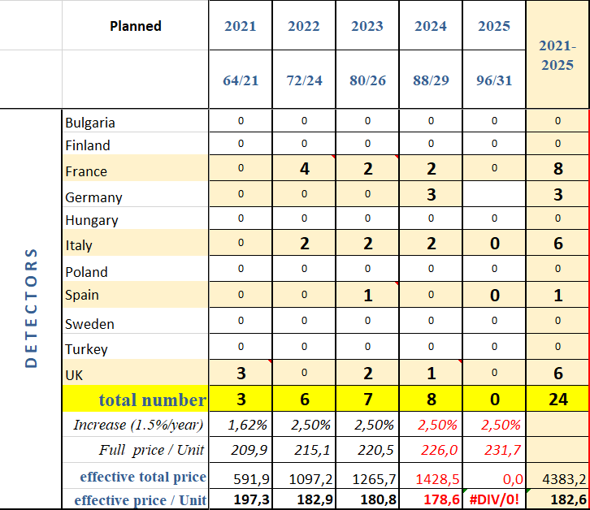
Detector status (Sep. 2025)
Phase 0 + 1 = 53 caps
+ 1 DEGAS Triple available to the collaboration
+ 1 ORTEC prototype – non functional
---------------------------------------------------------------57 capsules
Phase 2, ½ = 24 out of the 39 scheduled achieved
--------------------------------------------------------------- 81 funded
Soon the D-AGATA
More details if you wish

Slide 9
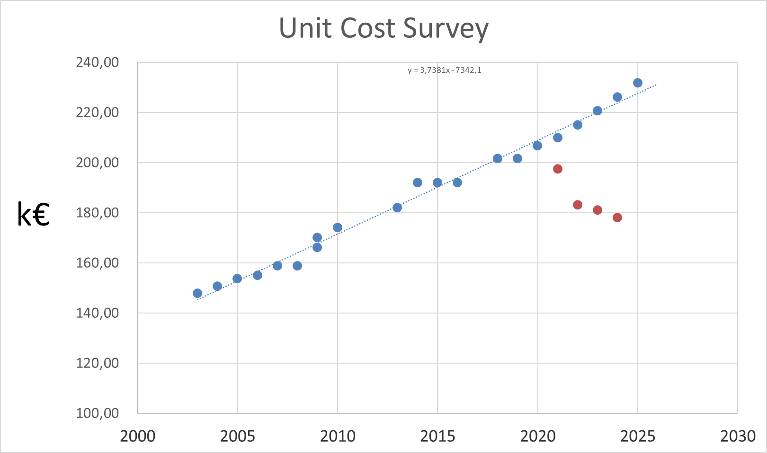
Detector status ; Project Definition
Procurements :
Capsules procurement at 2025 milestone will be 85% of the objective [2010-2025]
Cryostat procurement at 2025 milestone will be 100% of the objective
Improvements :
Improving the vacuum in the cryostat by new getter → done
Survey of obsolete component for the preamps → done
R&D :
-ORTEC option → went far thanks to the UK investment
- p-type design, electric cooling, ASIC preamps → to be continue in the second part of the decade
Cost optimisation :
Efforts :
Based on the involvement of Univ. of Cologne, Univ. of Liverpool, IRFU Saclay, IPHC Strasbourg, Host Lab’s.
The detector laboratories are committed to pursue their activity for AGATA with perspectives of acquiring more knowhow
Toward a GRETA business model with the CTT-MIRION agreement
→ [2021-2024] 890k€ saved (17%) thanks to the coordination effort

Slide 10
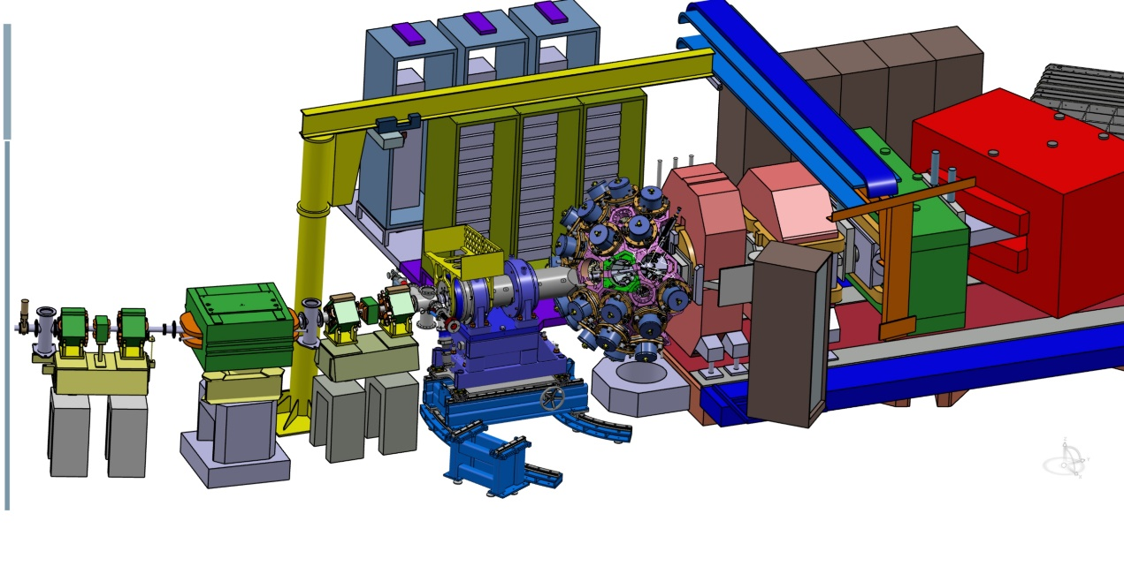
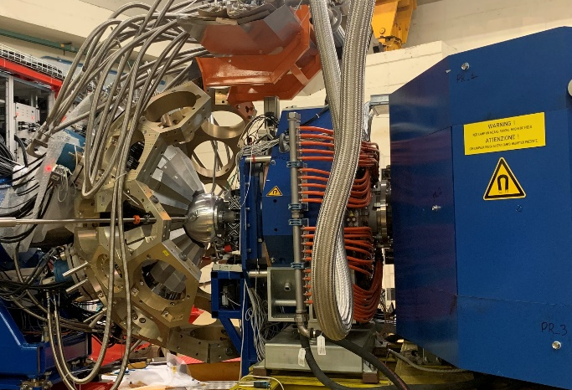
Infrastructures
Mechanics (STFC, LNL, GANIL) :
Involved in LNL campaign (STFC- LNL – PD)
Involved in the next Host Lab discussion
EMC (IJCLab)
Detector Support System (CEA)
Phase 2 LVPS designed (CEA) and 2π delivered, operational at LNL. Critical spare parts are about be secured up to 4π
HV replacement funded. Done.
LN2 system for phase 2 designed (CEA), delivered and operation at LNL
Design of the mechanical support completed, 2π delivered (STFC)
The 2π solid angle is covered
→ Manufacture the 2nd 2π to speed-up the next moves ?

Slide 11
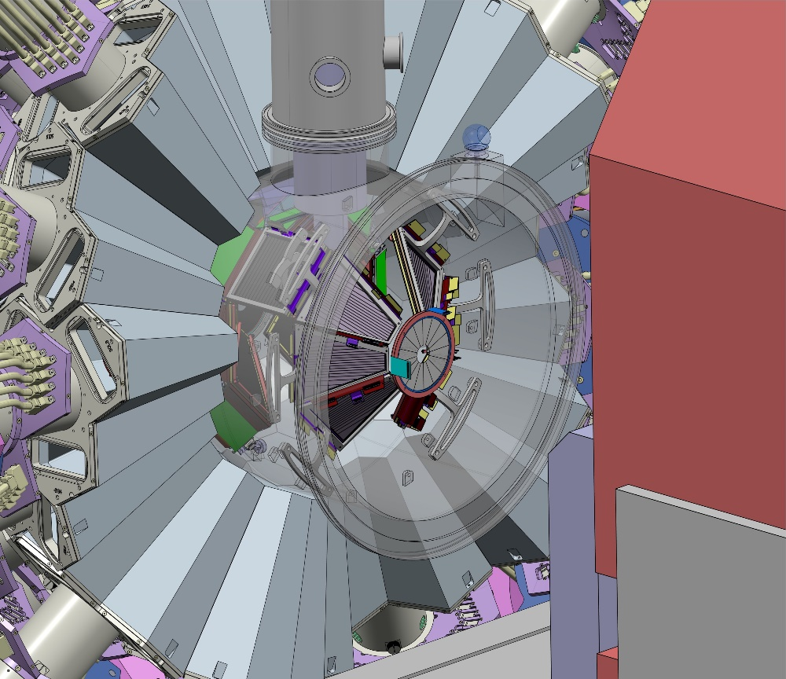
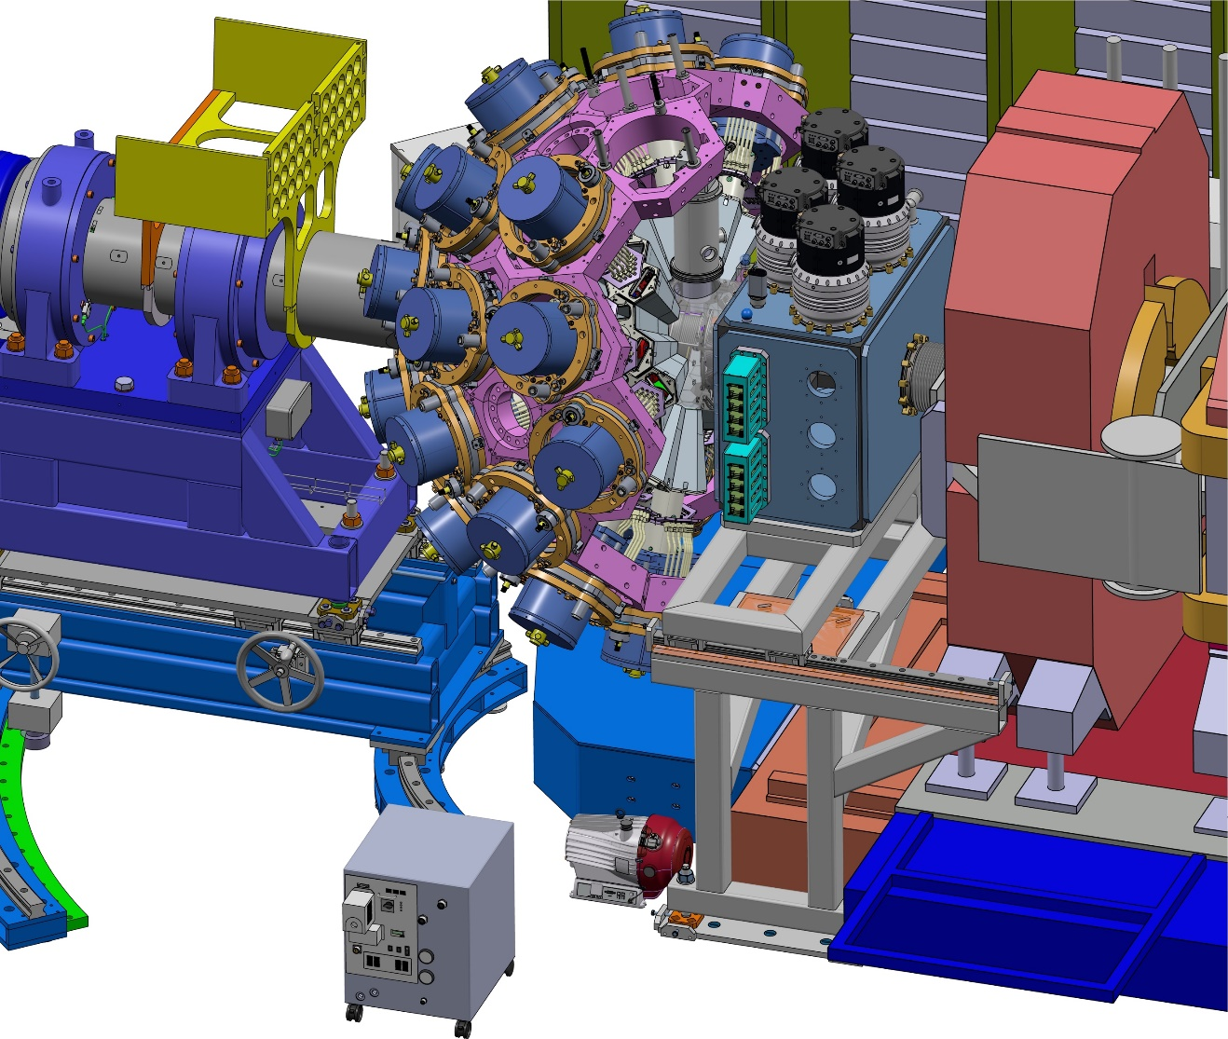
General view

Slide 12
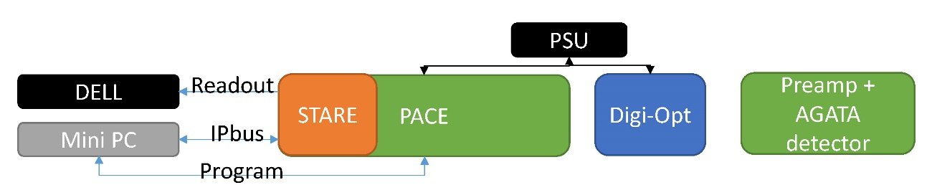

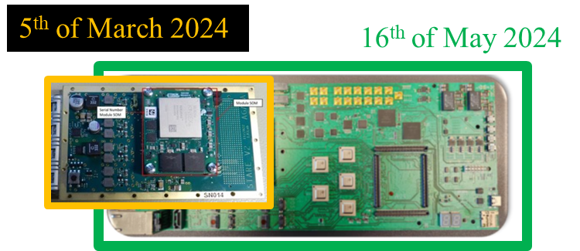
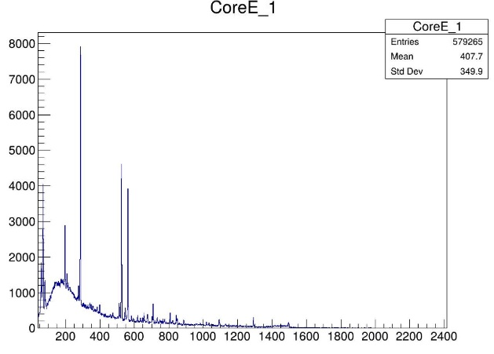
Phase 2 FEBEE ; evaluation status
The most challenging R&D of phase 2
Mass production has started for all hardware parts in 2024. Procurement delays are > 12 months
The critical path is the integration at the firmware level in the existing system (GTS, network, flow, RUDP etc…) due to human resource availability
The ASC approved to charge the OC for the maintenance of the firmware with the ZeptoNova company contract (52 k€)
→ Signed by GANIL on February 2025
SLC – Monitoring great progress
Data formatting – LNL ←→Zepto ←→Orsay ←→Lyon ←→ Valence
→ long latencies . FW version 2.23
DIGOPT mass production is on time
3 years delay in the mass production of PACE/STARE boards due to difficulties now resolved
75 x complete chains are now ordered and to be delivered by summer 2025
Integration work to coupled with phase 1 (> 100 channels)
Expected delivery end of 2025
2026- 2030 period, extending the system to cover the full AGATA solid angle
2 test benches in LNL and 2 test benches in Orsay (STARE, Daq, soon STARE→DAQ)
*
X *
*
*
¹⁹⁷Au * coulex@LNL
Courtesy Alain G.
First V2 in-beam test 20/6/2025

Slide 13
Mass production
STARE 63 boards (hardware) are ready. Firmware under test to verify that it works with all SOM types.
PACE first 90 boards ready now; (test system now operational).
Expect 74 PACE cards tested by end of June limited by SOMS with reminder of SOMS arriving November 2025
GANIL Order 139,5k€ (2025) – + recent INFN orders : All V2 SoM Procured (3π + spare)
50 PSU by end of June; remainder New PCB with new component- Design done
59 heat exchangers ready now, passivated faces done but not fitted. Continuing through the year.
20 complete sets exist now (PACE redesigned cooling blocks). Most of the mechanics is ready.
STARE firmware: the only issue to work on is the PLL (qualification on multiple SOM cards ongoing). NB this is UDP; RUDP comes later. Expect to release a full tested UDP firmware in time for Autumn 2025. RUDP comes later
PACE firmware: Minimum release version with GTS and data integrity earliest mid-July.
LNL system with updated STARE is in use for ADF tests.
GTS test bench system will be ready mid-June in LNL to start GTS integration (ready to test GTS firmware (8b/10b encoding and clock changes) by end of June)
DIGOPT12 : 90 channel (2π) procured
Message : all V2 2π (90 channels) items are funded and secured
Test bench at LNL July, 1 fully tested PACE t58 board + production STARE + the cooling and casing mechanics at LNL and a second t58 PACE board delivered
Hardware and PLL setting debuging and require extra work on firmware.

Slide 14
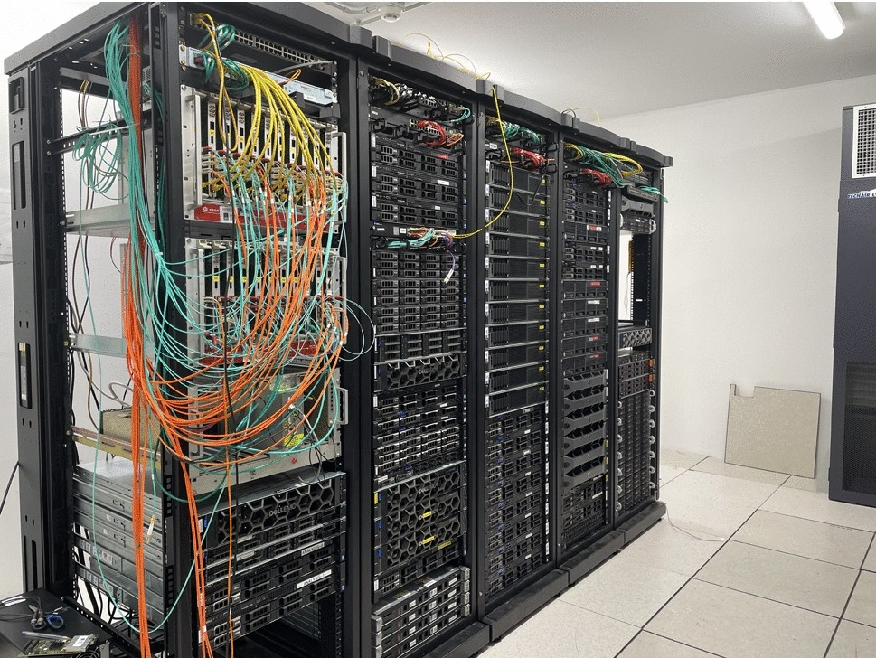
Data flow and Acquisition status
Maintaining the present system with upgrades
The phase 2 data pipe line is ready
Software Slow Control installed in LNL
Performances are testes using an V2 emulator and real data taken in LNL
Preparing the migration to new PSA including the use of GPU
Mini daq box for data flow R&D setup in Orsay to validate the most recent technologies (PSA > 20 kHz reached on recent technologies)
Improvements in accessing the data from GRID and maintaining the identification process → Iam - indigo
The investment remained low in 2020-2025 due to a constant number of channel to be instrumented
After V2 implementation, due to the rapid increase of the number of detector, a massive investment will be needed in 2026 -2030 (0.9M€) with savings possible thanks to the CNRS accord cadre
Recent highlight : major upgrade of the CEPH by Orsay (improved capacity and performances)
DAQbox at LNL

Slide 15
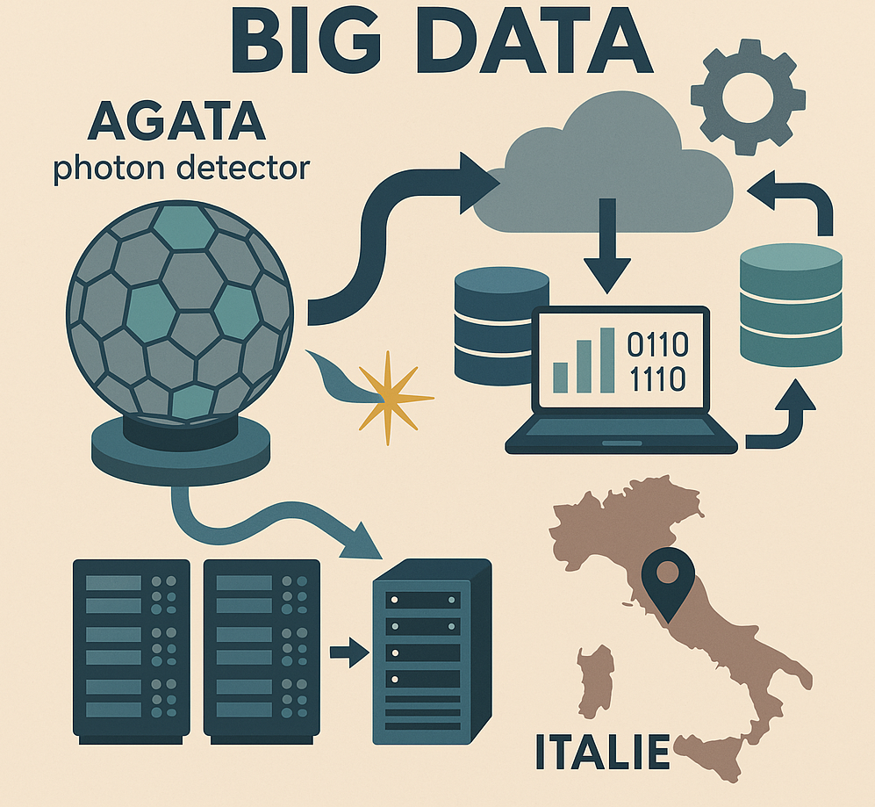
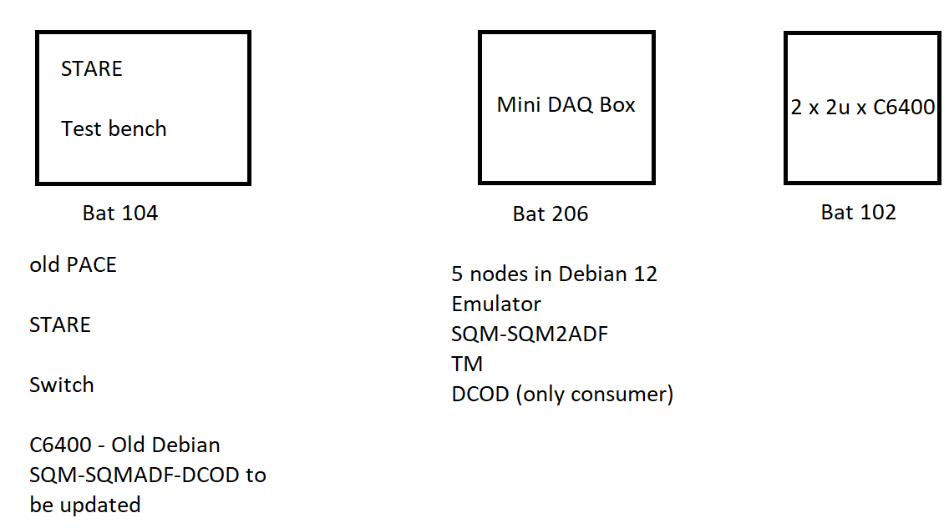
Data flow and Acquisition status
The monitoring will be extensively benchmarked to correct for weaknesses
It will be extended also to all processing nodes
The processing of few tens of emulated crystals will be tested
At high/low rates, possibly including new PSA/Tracking
The data transfer through the UDP (RUDP) protocol should be mastered to avoid loss
Advanced data & metadata management tools (solutions such as ami/rucio) will be tested
100 Gb/sec
validated
5 kHz events
UDP
100 Gb/sec
validated
Goal : Stability at 5kHz event without RUD ?
Otherwize : the highest priority will be to deliver the RUDP
Full chain
Update !

Slide 16
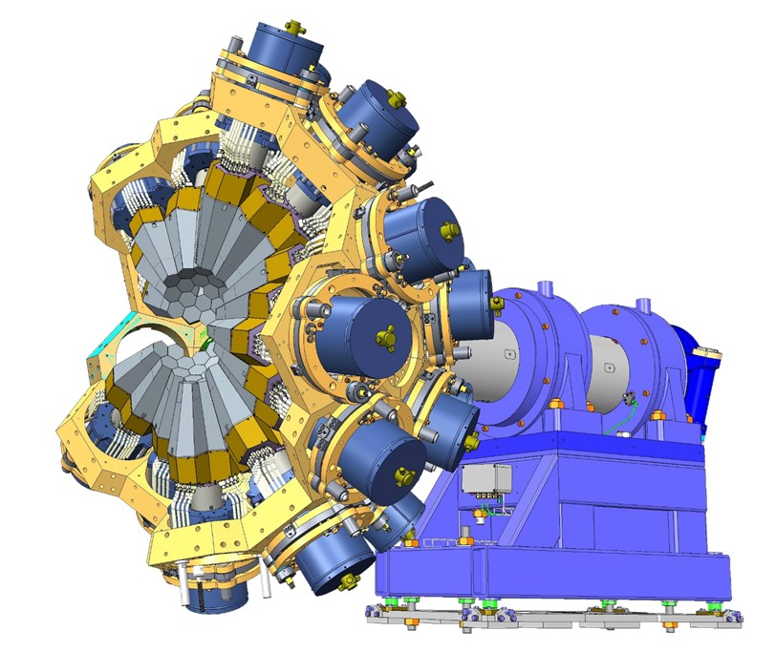
Phase2, 2π objective status
Phase 2 LVPS 2π delivered,
LN2 system for phase 2 designed, delivered and operation at LNL
Design of the mechanical support completed, 2π delivered
all FEBEE V2 2π (90 channels) items are funded and secured (in prod)
81 capsules and cryostats funded, + 3D-AGATA, +5 ordered in 2026 => 89 identified by 2026 with cryostats
Data acquisition for 2π is either delivered or funds have been secured in IJClab
Firmware development and overall system integration are currently our weak points and are limiting the deployment of the detector.
This is not a financial issue. It is a difficulty in human resources and management of the partners involved in the most complex part of phase 2.

Slide 17
Performances and Simulations ; status
Neutron damage : the Performance team monitors the resolution of the array after the neutron damage following the high luminosity.
Operation Cost are fundamental for this operation.
The AGATA package is maintained following the GEANT4 releases → done
Including new ancillaries → done
Event generators :Integration of the FAIR MOCADI frameworks → done
The improve characterization of the crystal geometry or sensitivity relies on the systematic study of the measured efficiency and performances as well as the scanning data in tomography mode
→ to be completed in this second half of the MoU

Slide 18
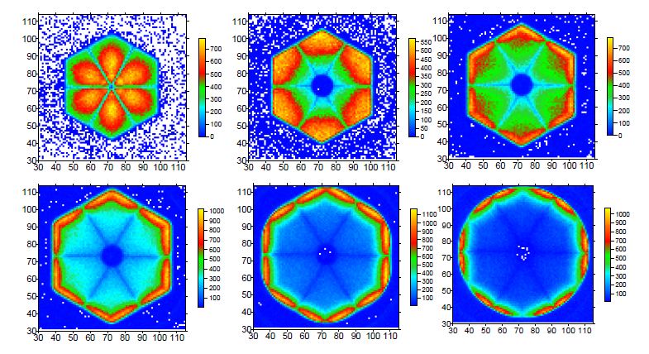


PSA-Tracking R&D ; status
New simulation package, AGATAGeFEM
→ J. Ljungvall, EPJA 57, 198 (2021) 10.1140/epja/s10050-021-00512-w
→ Dependencies investigation
→ Improved geometries
Characterization with IPHC scanning tableand the analysis by IP2i applied to in-beam data !
→ See Jeremie’s talk on Wednesday
workshops
AGATA – GRETINA in ANL (Nov. 2024)
https://indico.in2p3.fr/event/32594/overview
Implementation of the multi-interaction PSA grid search using the GRETINA approach : (Univ. Liverpool)
Machine learning is a game changer
→ See overview by Fraser on Wednesday

Slide 19
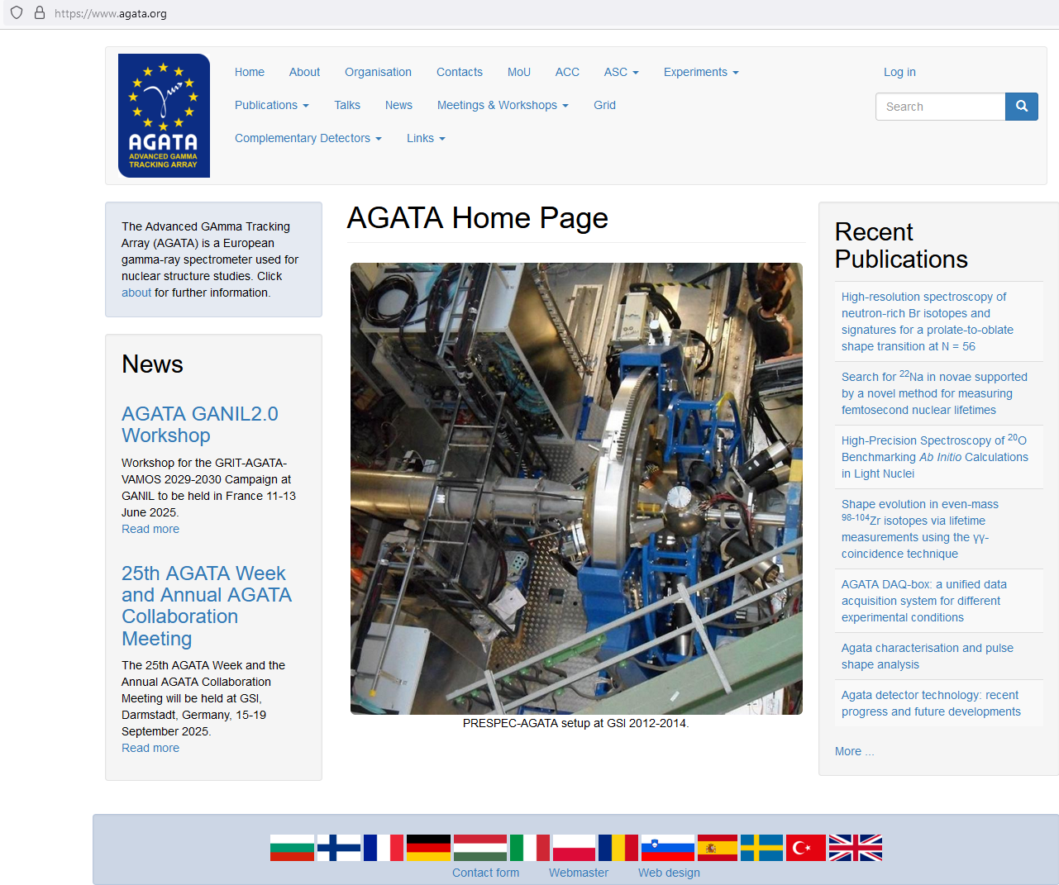
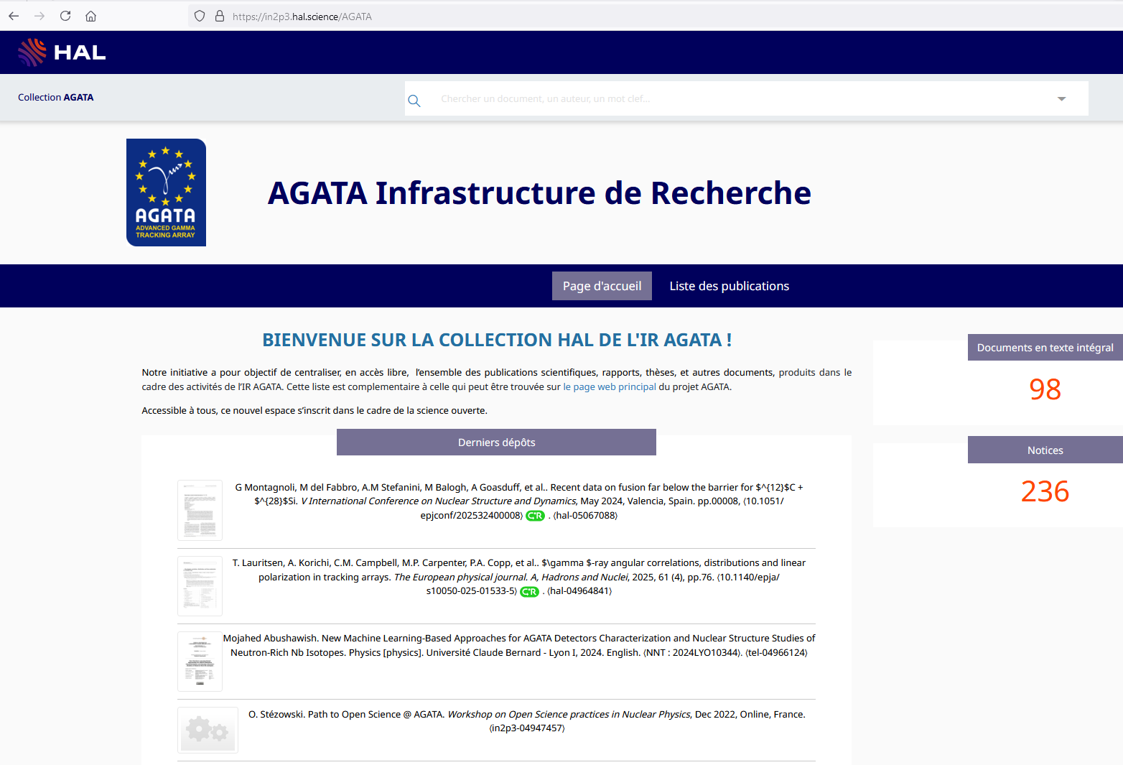
Dissemination
J. Nyberg → I. Kuti

Slide 20
Thanks to all AGATA contributors The local team LNL/PD

Slide 21
Phase 0 + 1 = 53 caps
+ 1 DEGAS Triple available to the collaboration
+ 1 ORTEC prototype – non functional
---------------------------------------------------------------57 capsules
Phase 0+1
B025
CEA Saclay
A025
INFN
+ Fr(2, GANIL) :, B024, C025 (2025)
+ INFN(3) : A026, C024, C026 → 2026 delivery

Slide 22
Phase 0 + 1 = 53 caps
+ 1 DEGAS Triple available to the collaboration
+ 1 ORTEC prototype – non functional
---------------------------------------------------------------57 capsules
Phase 2, ½ = +39 (according to MoU) → 24 achieved
Phase 2 ^{2/2} = +39 (according to Mou)
Phase 0+1
B025
CEA Saclay
A025
INFN
Total funded so far = 57 + 24 = 81 capsules

Slide 23
Phase 0 + 1 = 53 caps
+ 1 DEGAS Triple available to the collaboration
+ 1 ORTEC prototype – non functional
---------------------------------------------------------------57 capsules
Phase 2, ½ = +39 (according to MoU) → 24 achieved
Phase 2 ^{2/2} = +39 (according to Mou)
Soon the D-AGATA
More details if you wish
Phase 0+1
B025
CEA Saclay
A025
INFN
Total funded so far = 57 + 24 = 81 capsules

