Slide 1
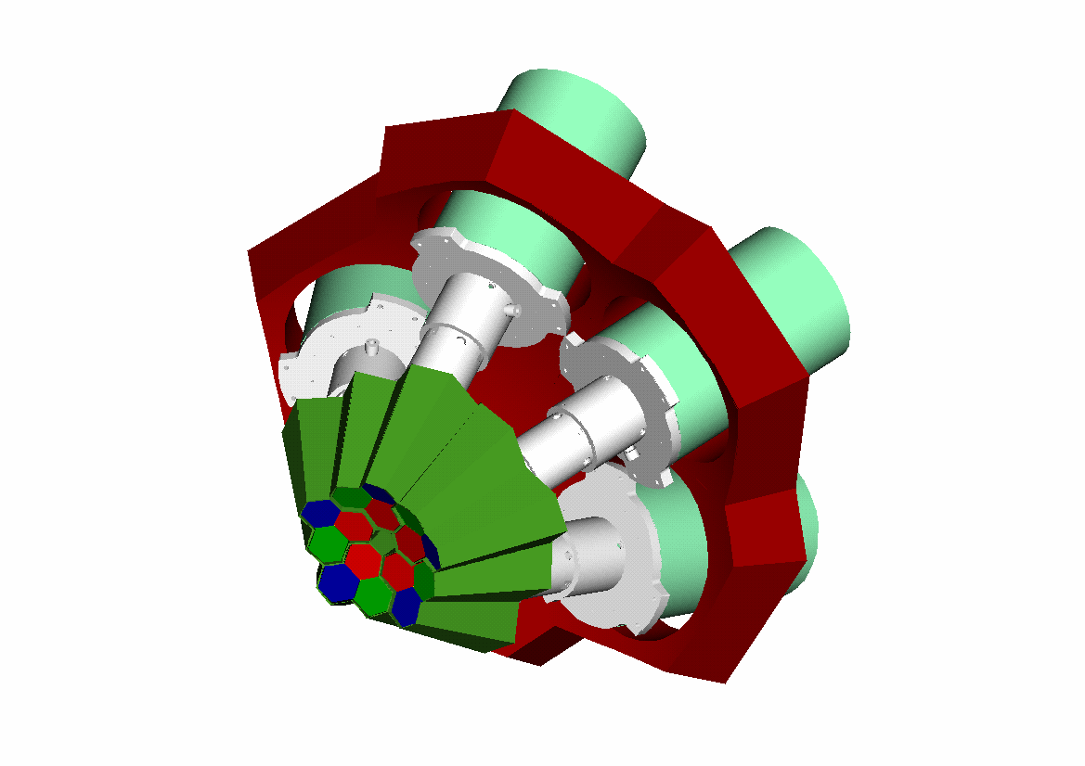


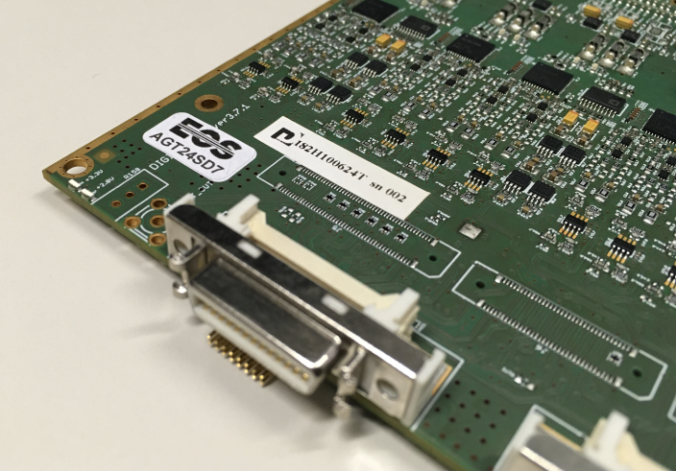
INFN - Milano University of Milano
Department of Physics
Digitizers (DIGI-OPT12) Status, Advancements and Production of v3.7.1
Alberto Pullia
25th AGATA Week 15-19 September, 2025 GSI Darmstadt, Germany

Slide 2
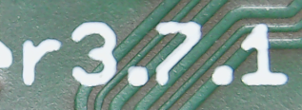
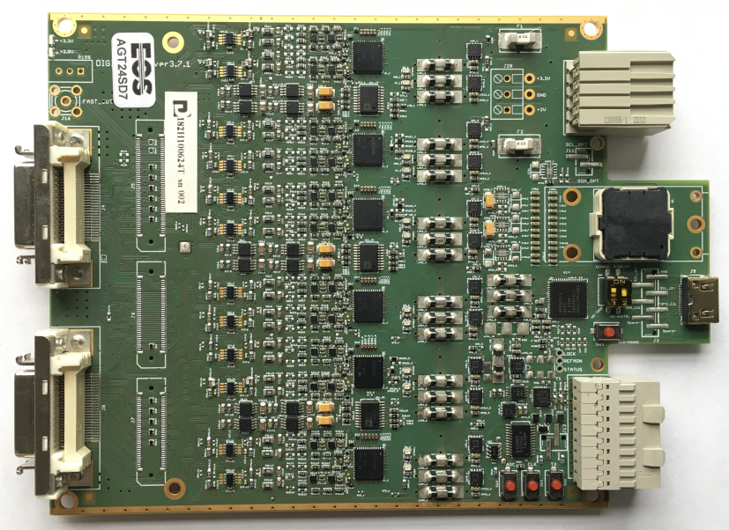
DIGI-OPT12 v3.7.1 cards fully optimized w ADC32J44 chip
Manual patch needed (noisy ch)
v3.7
• Segment cards v3.7.1 7 realized (7 tested)
• Core cards v3.7.1 8 realized (5 tested)
No patch needed, fully optimized
v3.7.1
• Production yield: 83.3%
• Yield after repairs: 100%
First bunch of v3.7.1 cards delivered in March 2025

Slide 3
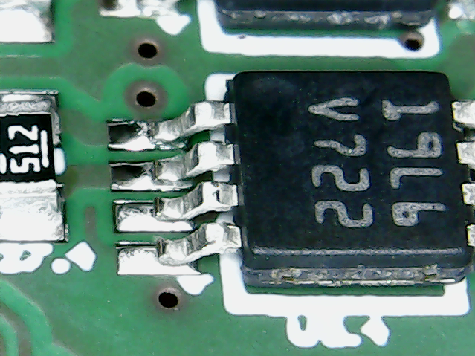
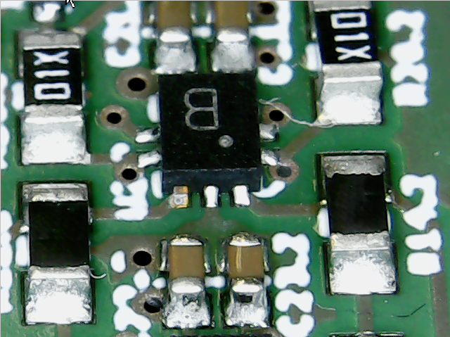
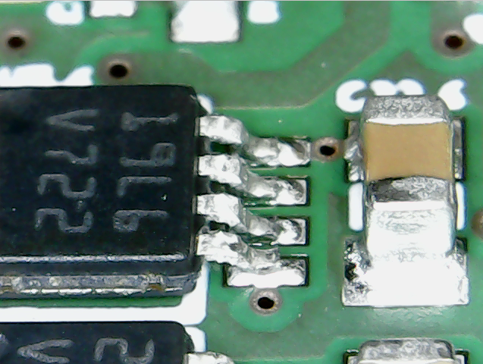
Minor problems in v3.7.1 cards
3 mm
1.3 mm
3 mm
• Fix easily implemented
• BUT diagnostics not easy

Slide 4
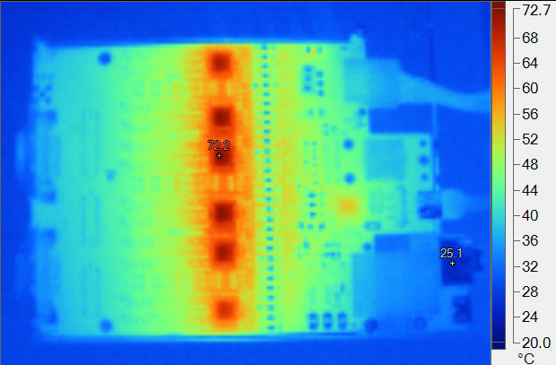
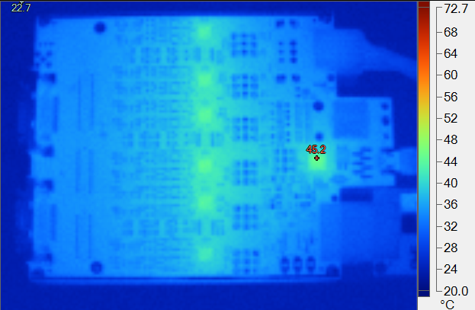
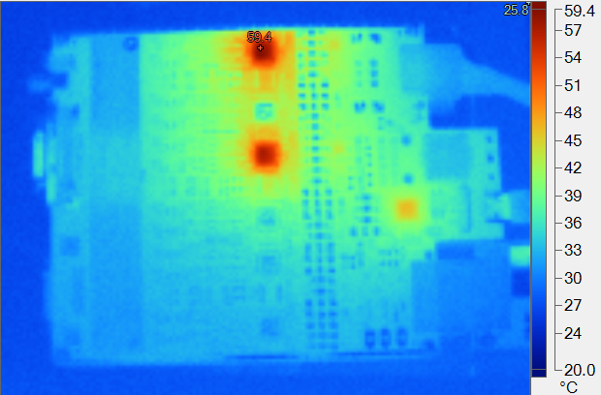
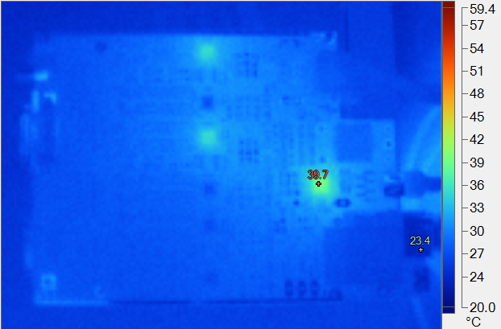
Thermal pictures
Segment card v3.6.x
Segment card v3.7.x
P = 8.6 W
P = 3.3 W
Core card v3.6.x
Core card v3.7.x
P = 3.4 W
P = 1.6 W

Slide 5
Why v3.7.1? Noisy channel of v3.7
Anomalous channel (noisy)
“Ch 10“ on the PCB numbering scheme
v3.7 equipped with AD8030 opamp
Data taken at LNL
by Alain and Andres
22 Jan 2024
v3.6.x equipped with AD8030 opamp
MDR cables disconnected
7 MeV range selected
v3.6.x equipped with LTC6247 opamp

Slide 6
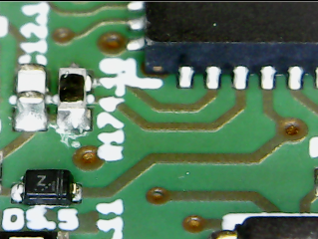
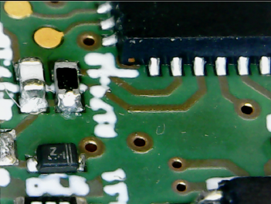
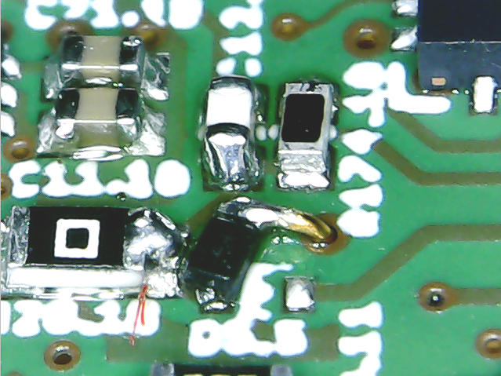
From v3.7 to v3.7.1
v3.7
v3.7.1
Ch 10
Ch 10
2 mm
Ch 10
v3.7.1 prototype card delivered in late June 2024

Slide 7
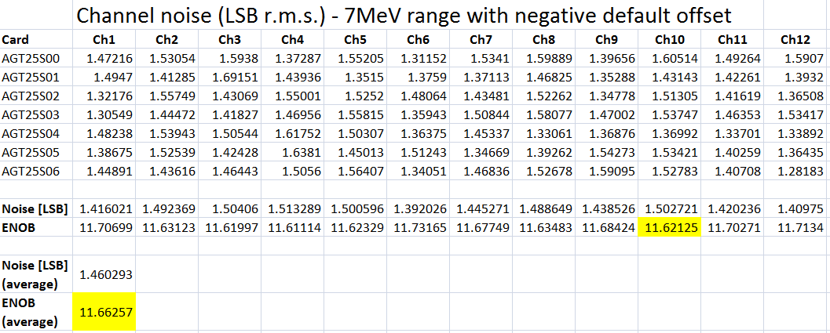
v3.7.1 noise performance – Milano testbench – no detector

Slide 8
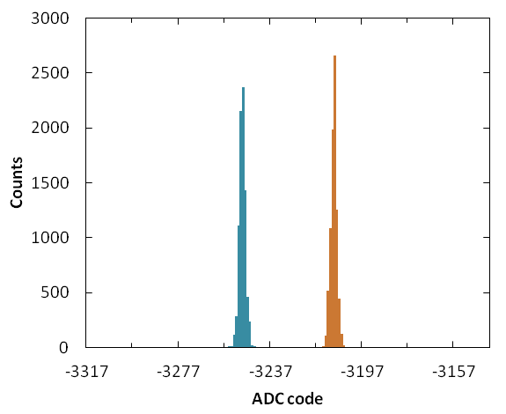
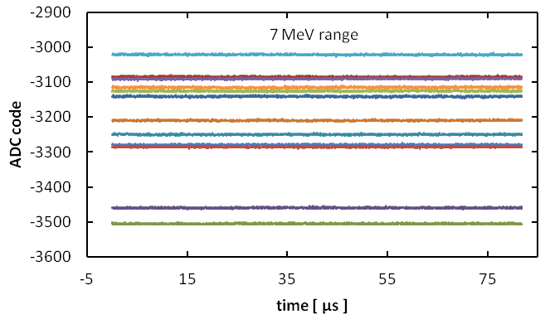
Noise performance – Milano testbench – no detector
12 chs of v3.7.1 card w LTC6247 opamps
<σ>_{12ch} = 1.46 LSB
σ = 1.47
σ = 1.41
DIGI-OPT12 | Opamp | Energy Range | Noise [LSB rms] | ENOB
v3.6.x | AD8030 “standard” | 7 MeV | 2.27 | 11.03
 |  | 20 MeV | 1.43 | 11.69
 | LTC6247 | 7 MeV | 1.63 | 11.50
 |  | 20 MeV | 1.35 | 11.78
v3.7.x | AD8030 “standard” | 7 MeV | 1.73 | 11.42
 |  | 20 MeV | 1.42 | 11.70
 | LTC6247 | 7 MeV | 1.46 | 11.66
 |  | 20 MeV | 1.33 | 11.80
Previous generation
J
New generation
J

Slide 9
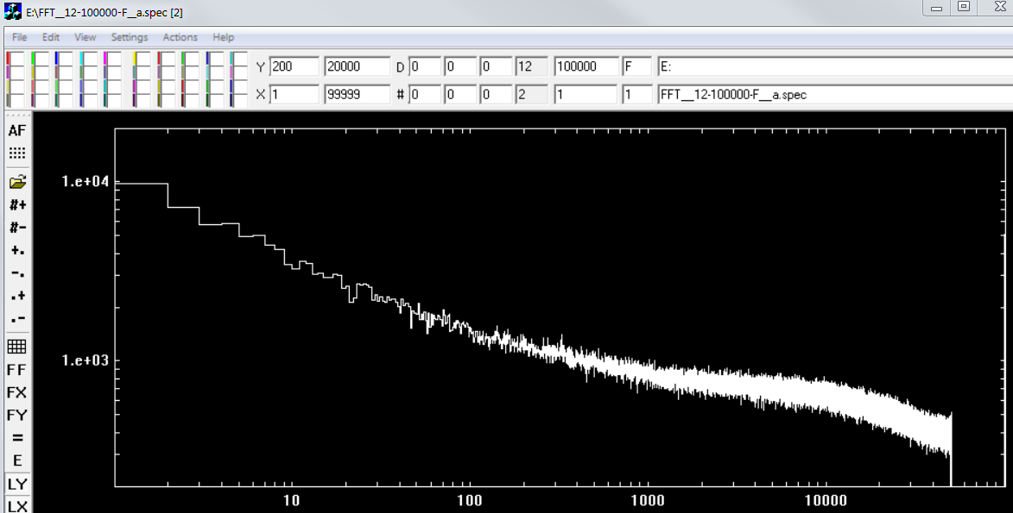
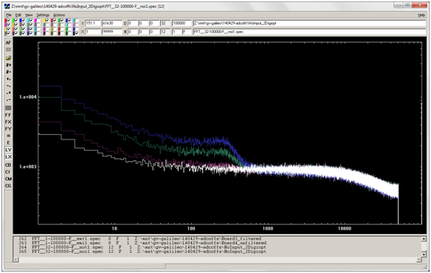
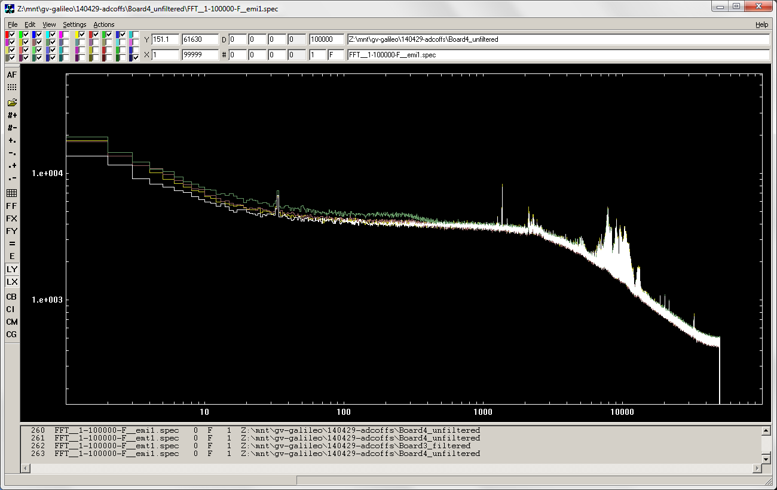
Noise spectral density
New generation
(v3.7.x – AD8030)
without detector
no change vs offset
kHz
Previous generation
(v3.6.x – AD8030)
(4)
with detector
(3)
(2)
(1)
Offsets
without detector
(1) 127 (middle)
(2) 140
(3) 160
(1) 180
kHz
Courtesy of D. Bazzacco

Slide 10
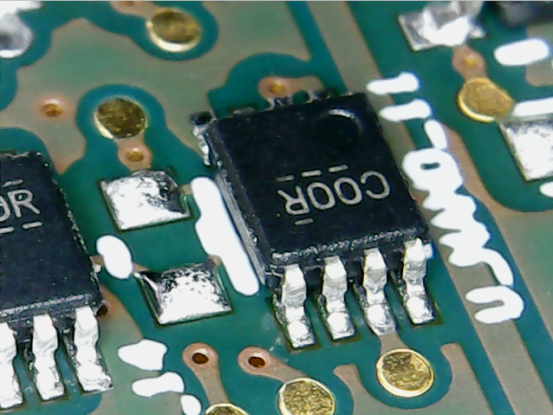
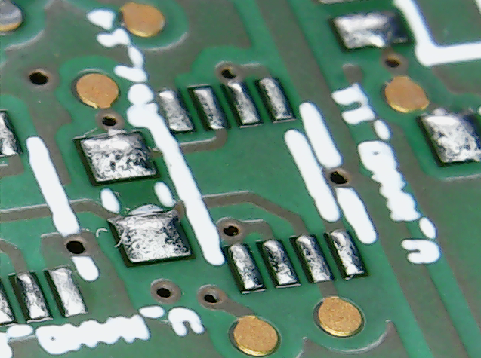
Fast-reset ON/OFF option
Signal seen at 1st stage output
Signal seen at 2nd stage output
Cosmic ray (~20MeV) Fast reset is active
Cosmic ray (~20MeV)
1.7 MeV event
1.7 MeV event
U_NAND_11 chip is installed
in core digitizer cards
U_NAND_11 chip is NOT installed
in segment digitizer cards v3.6.x- v3.7
Segment cards may be patched by mounting missing chip

Slide 11
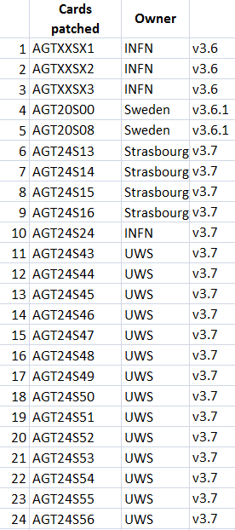
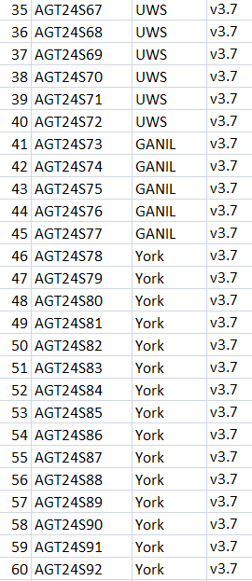
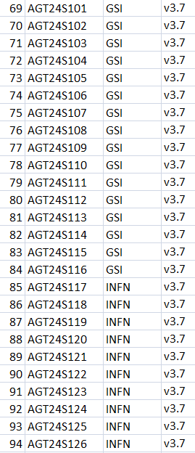
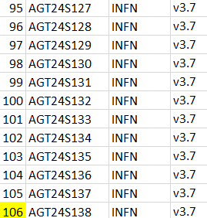
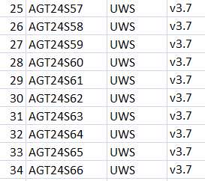
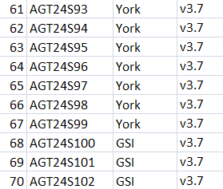
Cards patched for on/off option of segment fast-reset

Slide 12
Summary
New ADC chip ADC32J44 yields substantial reduction in power consumption
v3.7 → v3.7.1 cures anomalous noise of ch10
Fine parameter optimization of v3.7.1 completed
Missing NAND chip in segment cards → ON/OFF of fast-reset not working
NAND chip installed in 106 segments cards

