Slide 1

GANIL Campaign
AGATA Week 2025
Emmanuel Clément (GANIL)

Slide 2
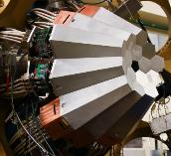
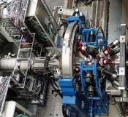
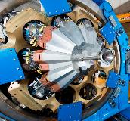
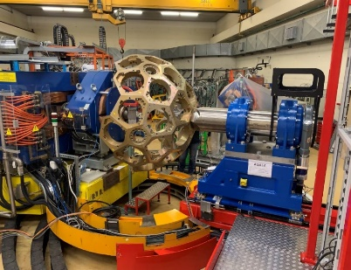
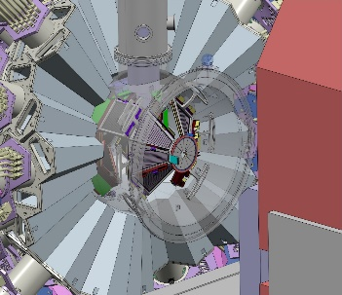
The AGATA project : THE ultimate spectrometer
1st AGATA Steering Committee and Management Board (2002)
March 2022
MoU Phase 1 + Addendum
MoU Phase 2
2010-2012
Legnaro, Italy
Intense stable beams
15 detectors
AGATA Demonstrator + PRISMA at LNL
2012-2014
GSI, Germany
Fast fragmentation beams
25 detectors
AGATA at GSI
2014- 2021
GANIL, France
ISOL and stable beams
approaching 1π (45)
AGATA at GANIL
2021- 2028
LNL, Italy
Stable beams
SPES radioactive beams
AGATA at LNL
2.0
2028- 2030
GANIL, France
SPIRAL1 radioactive beams GRIT; VAMOS
AGATA at GANIL
2.0

Slide 3
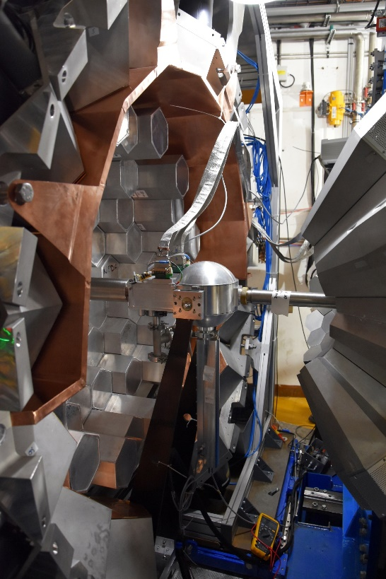
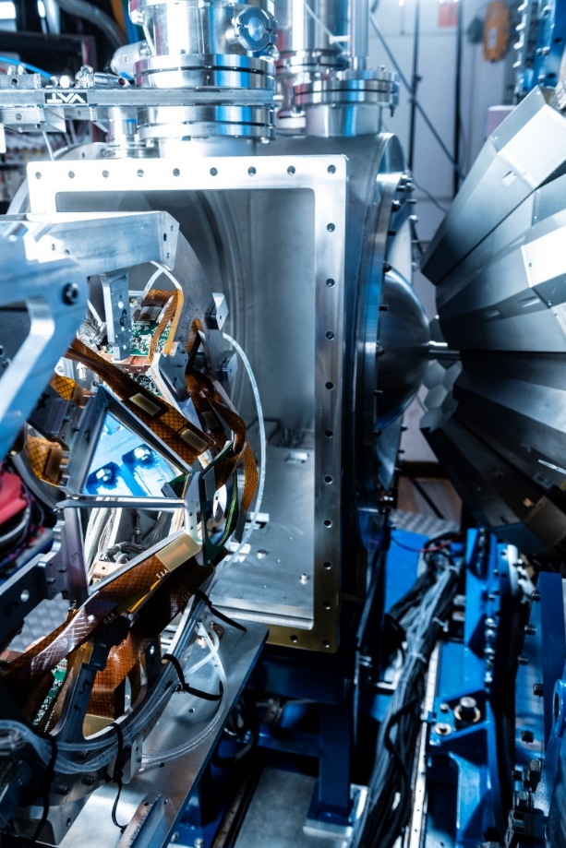
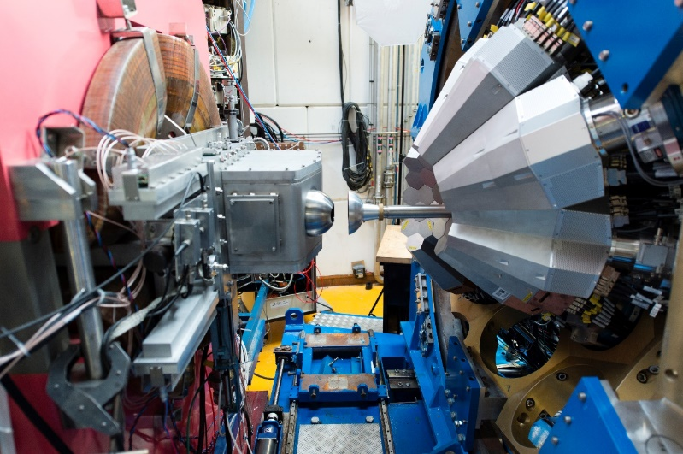
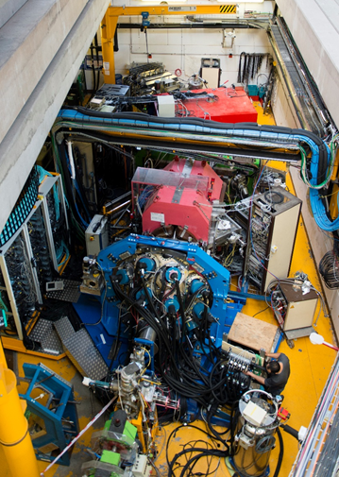
AGATA@GANIL.1 were many sub-campaigns
2018
2019-2021
2015-2017
2021
AGATA coupled to VAMOS, FATIMA, PARIS
36 capsules
24-34 capsules
Exotic nuclei spectroscopy by MNT transfer and fission reaction
AGATA coupled to NEDA- DIAMANT
N~Z nuclei spectroscopy by fusion evaporation
AGATA coupled to VAMOS MUGAST
40-41 capsules
AGATA coupled to VAMOS, EXOGAM, 2nd Arm, LEPS
40-41 capsules
Exotic nuclei spectroscopy by transfer reaction using RIB
Exotic nuclei spectroscopy by MNT transfer

Slide 4
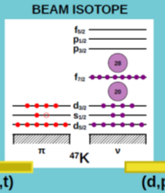
Recent (2025) publications from the GANIL campaign
⁴⁷K(d,p)⁴⁸K, Ch. Paxman et al. Phys. Rev. Lett. 134, 162504 – Published 25 April, 2025

Slide 5
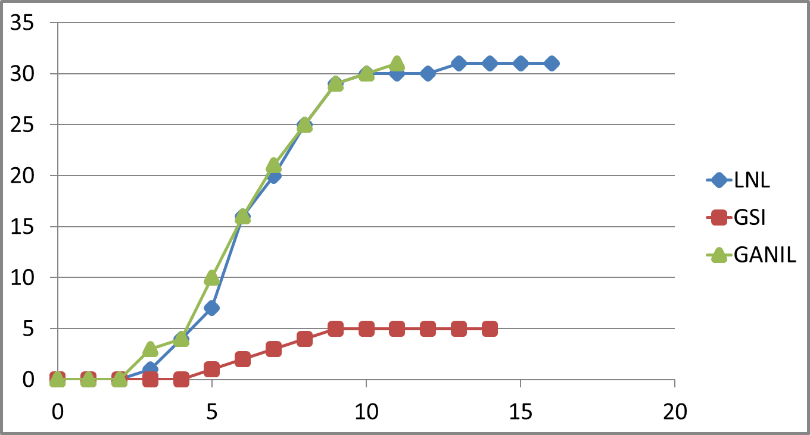
Recent (2025) publications from the GANIL campaign
Evolution of excitation modes in the La isotopes beyond the N=82 shell closure, Accepted at PRC, 12th of September 2025, A. Navin et al.
⁴⁶Ar(³He,d)47K, submission at PRL, D. Brugnara et al.
Anomalous quadrupole transition probabilities in the f_{7/2} mirror nuclei“, submitted to PRC, E. Escudeiro et al
Lifetime Measurements Probe the Evolution of the N=50 Gap Towards ⁷⁸Ni, submitted to for PRC, A. Gottardo et al
Shape evolution in neutron-rich odd-even ¹⁰⁵⁻¹⁰⁹Nb isotopes, submitted to PRC, J. Dudouet et al
First observation of multi-phonon γ vibrational bands in an odd-odd nucleus ¹⁰⁴Nb, submitted to PRL. A. Navin et al .
Triaxiality of neutron-rich ruthenium nuclei studied by lifetime measurements, submitted to EPJA, J. S. Heines et al
Alternative approach to nuclear-structure studies: “unsafe”Coulomb excitation of ¹⁰⁶Cd, D. Kalaydjieva, to be submitted to EPJA
In draft :
⁴⁷K(d,t)⁴⁶K, Ch. Paxman et al (Univ. Surrey – GANIL – LPC) , for PRC
Ge and Zn spectroscopy in IPHC
¹⁵O-alpha transfer, N. De Sereville, Ch. Diget et al,
n-rich Au, Kim Y-H et al, MNT at N=126
https://www.agata.org/list_of_publications
https://in2p3.hal.science/AGATA

Slide 6
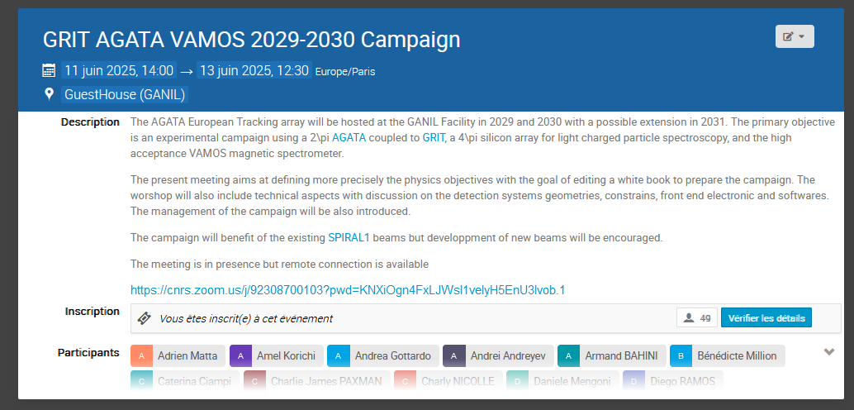
https://indico.in2p3.fr/event/34661/
The goal of the workshop was to start the preparation of the 2029-2030 campaign
From the science drivers : the final configurations of the setup ? The clear needs guiding the developpments (beams, electronics, geometries)
Start or continue the collaborative effort on : Mechanics, Front End Electronics, Data Flow, Data Analysis, Post-experiment efforts, publications policy

Slide 7
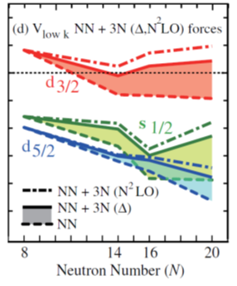
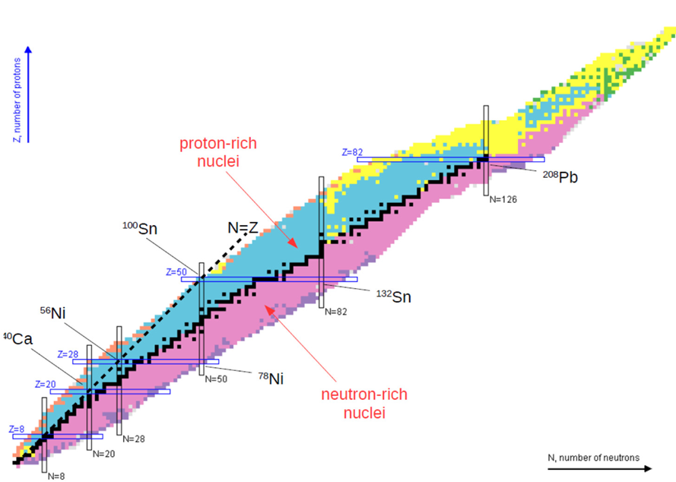
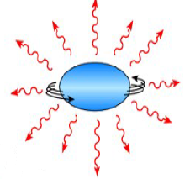
Microscopic origins of shape coexistence at N, Z ∼ 40 explored through direct transfer Charlie James PAXMAN
Probing mixed-spin np pairing in the super-collective Z~60 and A~130 region, J. Dudouet al
Neutron-proton pairs in the self-conjugate
Nuclei (Ti,Ni) of the fp-shell through two-nucleon;
M. Assié, et al
Clustering in medium-mass proton-rich nuclei (Ar) studied
through Li-induced stripping reactions, D Beaumel et al
Spectroscopy of proton-rich nuclei using charge-exchange reactions and proton adding with a ³He target, B. Fernandez-Dominguez et al.,
Andrea Gottardo : Investigating the possible bubble nucleus 46Ar
Possibilities offered by (3He,n) reactions with AGATA and SPIRAL1 beams, Jose Javier Valiente Dobon
Nuclear structure and astrophysics with neutron-deficient SPIRAL1 beams, Daniele Mengoni
Structure of light neutron-rich nuclei probed with direct reactions Simone Botton
single-particle structure in spherical and deformed f7/2 nuclei: the 48Cr and 56Ni cases Franco Galtarossa
Order of magnitude lifetime measurements in 66Ni
Joa Ljungvall
Ab-Initio test ²³Ne(d,p)²⁴Ne by DSAM on the 2⁺_{2,} E. Clément et al
RIB from SPIRAL1
Studying X-ray Bursts with the AGATA-GRIT-VAMOS Setup G. Lotay et al

Slide 8
Beam requests : ISOL developments
This Workshop:
¹³O, ⁶²Zn, ⁴⁴Ti, ⁵⁵Co, ⁵⁶Ni, ⁵⁷Ni
Rate on target > 1E5 pps
Purity > 50%
Energy > 8 AMeV
Last Workshop:
Rate on target > 1E4 pps
Max rate : 1E6 pps (limited by VAMOS 0°)
Purity > 1%

Slide 9
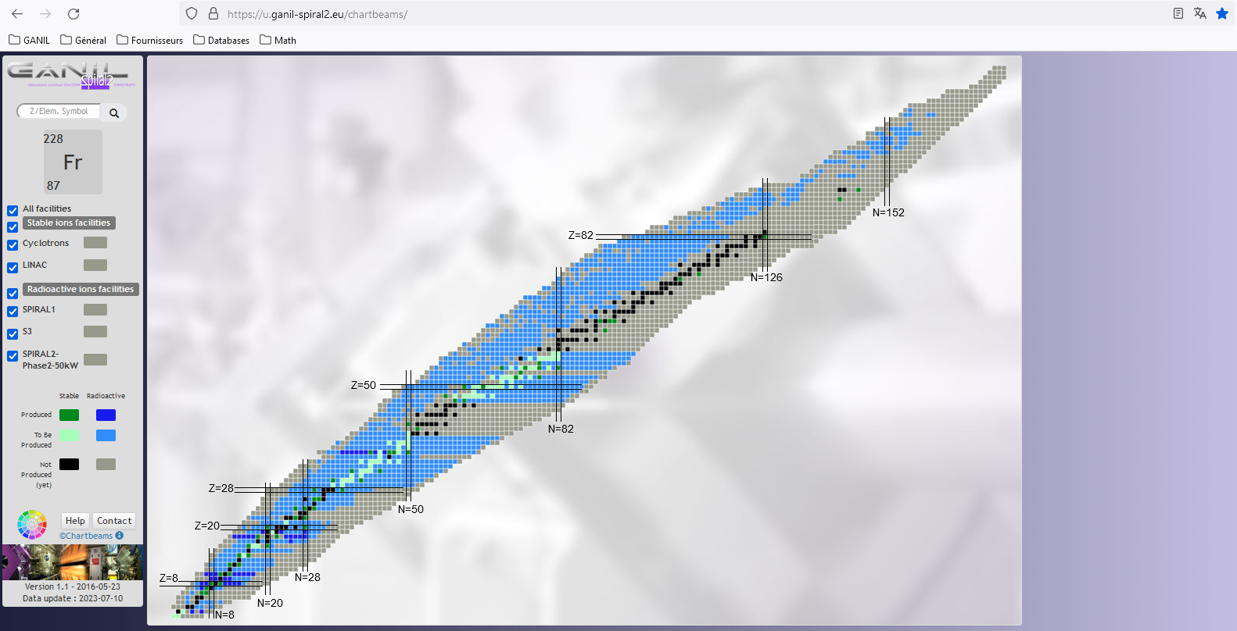
Takeway messages
Basic information on beams: https://u.ganil-spiral2.eu/chartbeams/
⁵⁵Co, ⁵⁷Ni and ⁴⁴Ti probably technically feasible
⁵⁶Ni and ⁶²Zn not feasible at the 1E5 pps rate goal without contamination
⁵⁵Co, ^{56,57}Ni are being developed, others have to be supported by LoI, proposals, etc (otherwise no development)
Laser ionization would help all of those beams but ¹³O to exploit the full post-accelerated rate.
More beam could be feasible
  Check the possible rates on the beam chart
  Keep sending us requests with minimum purity, minimum rate and energy
inquiries to be sent at chartbeams-spiral1@ganil.fr
Contamination is the highest problem because of the lack of technological option
^{6,8}He, ⁸Li, ¹⁵O, F, Ne, K, Ar, Kr available

Slide 10
Cryogenic
JJVD+ NEDA
(³He,n)
Marlène
Andrea
Simone
Franco
Bea
Gavin
Gavin
Backward
Forward
Gavin
Charlie
Simone
Jérémie
Daniele
Charlie
Emmanuel
Joa
Franco
Didier
Andrea
Daniele
Franco
Gavin
³H ???
Standard

Slide 11
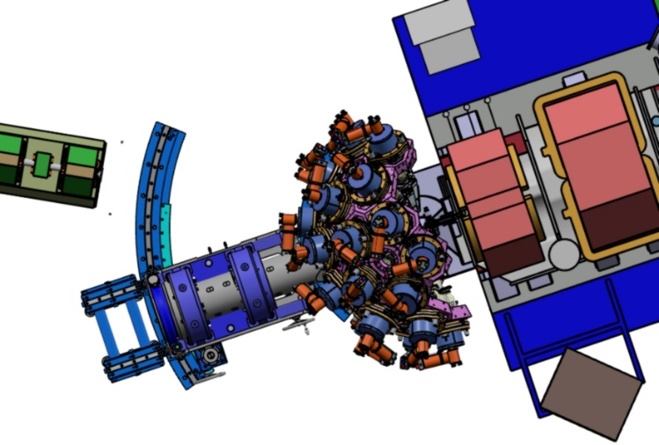
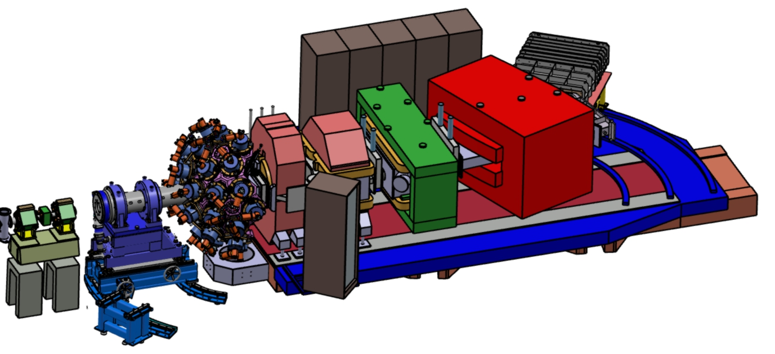
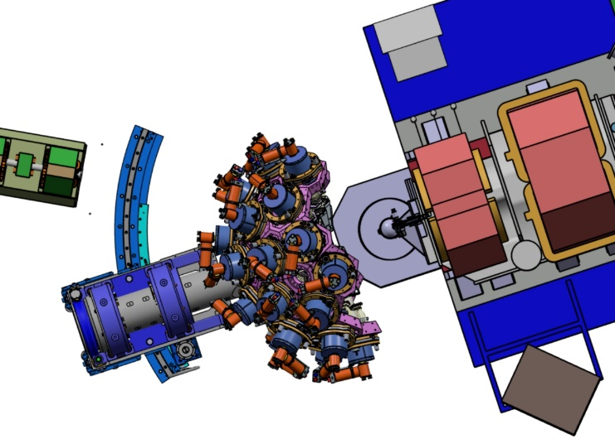
AGATA-2 @ GANIL, Mechanical integration
Beam throught a hole
of a détector off
IMPLANTATION OF AGATA
- kept the actual base under the shaft with the adjustments X-Y-Z.
- install on the ground 2 rails for rotating -1° to 29 °.
- At 28°, we will have a back stand to move back Agata. Target chamber access 550mm.
- The translation and rotation of AGATA will be done manually.
- The rotation of AGATA on the beam axle remains motorized.
Beam
Vamos Agata at 28°
Agata bearings and base
550mm
Beam
Beam
Vamos Agata at 0°
New stands and curve rails
Access target chamber

Slide 12
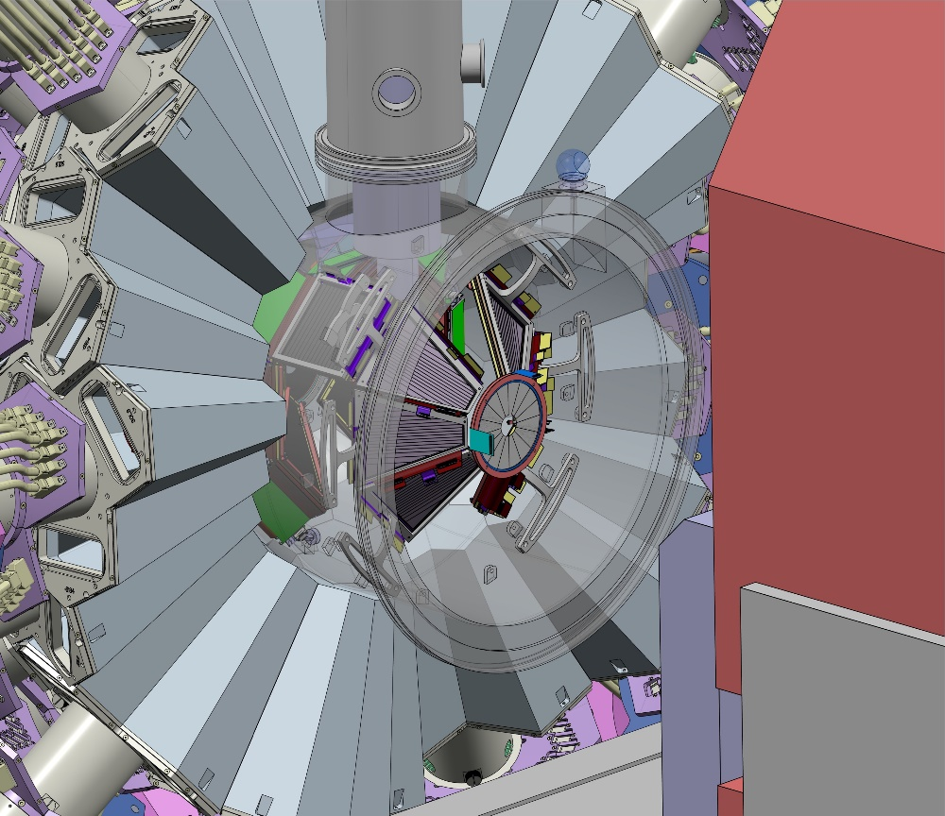
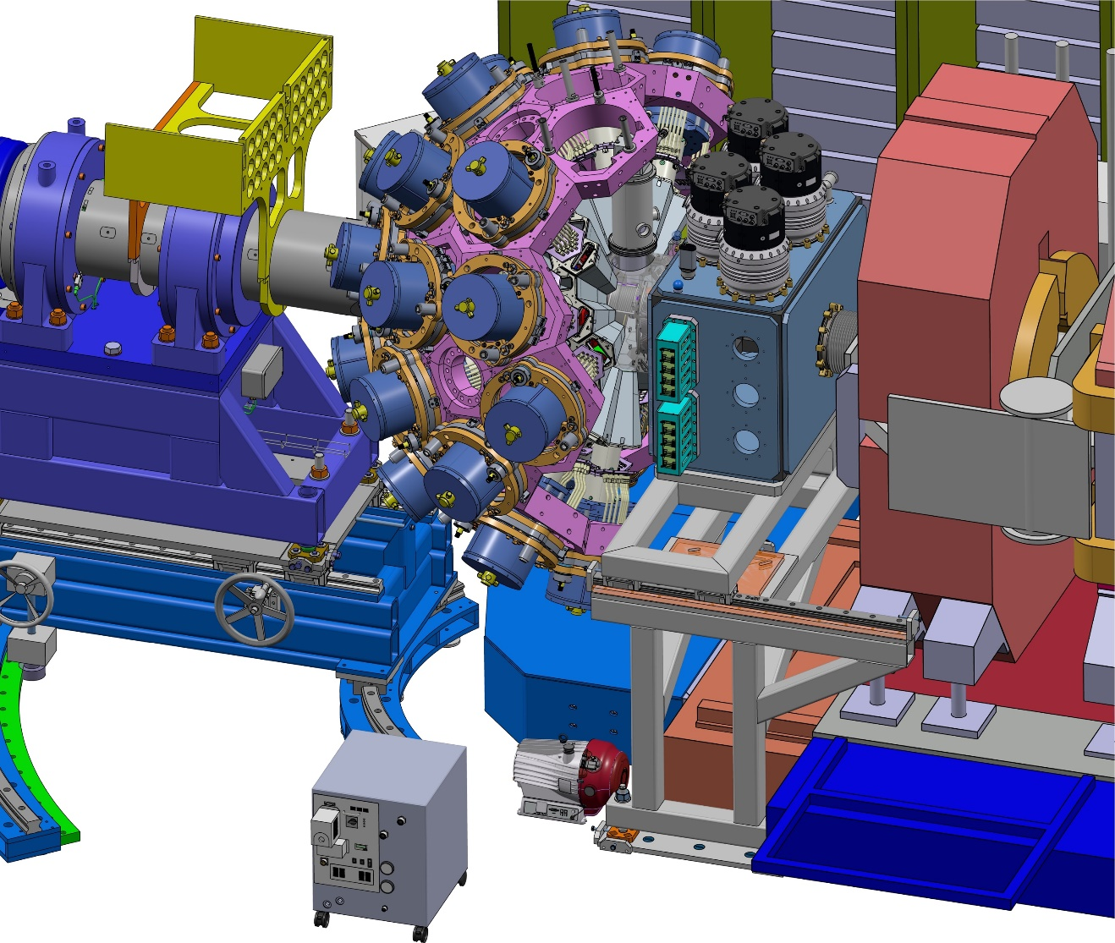
General view
Main constraint =
Integration of the cryogenic ³He target (CTADIR and ATRACT)
in DN150
(see Marlene’s presentation on Friday)

Slide 13
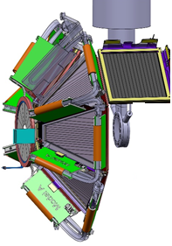
GRIT Phase 0 configuration
UPSTREAM (AGATA side)
90 degrees
DOWNSTREAM (VAMOS side)
1 square detector (1 or 2 stages ?)
read by Mesytec
Depending on Physics cases !
6 trapezoidal detectors (2 stages)
read by GRIT electronics (PLAS)
+ 1 annular detector (1stage)
read by Mesytec
+ 1 annular detector
read by Mesytec
Total : ~ 4300 strips (1920 read by GRIT electronics)

Slide 14
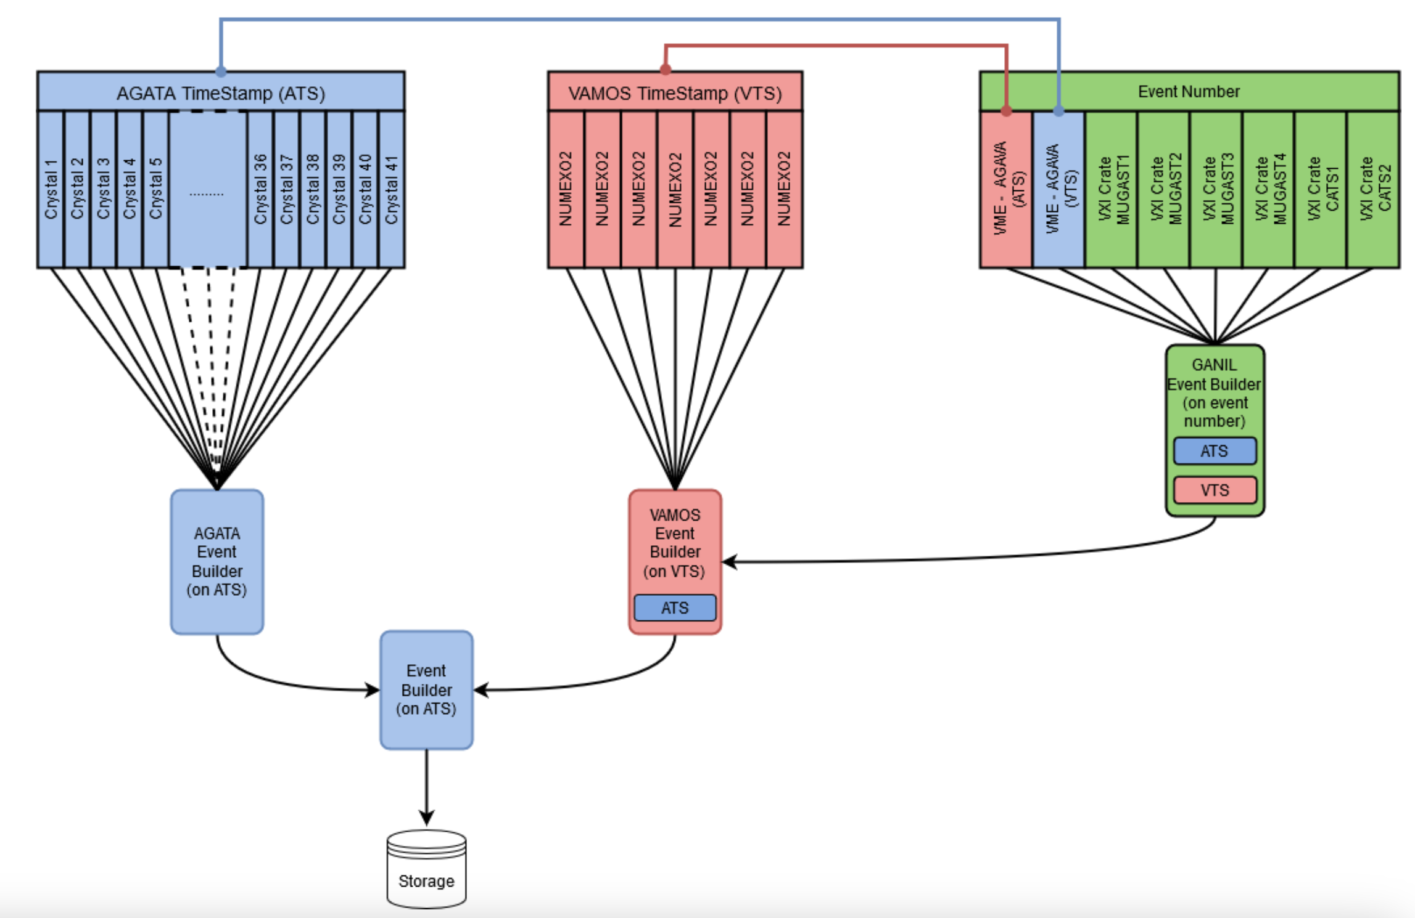
https://gitlab.in2p3.fr/ip2igamma/agapro
https://gitlab.in2p3.fr/ganilanalysis/ganalysis
https://gitlab.in2p3.fr/np/nptool
SMART
GANIL RCC
ssh scripts toward the subsystems with minimum info’s
AGATA V2
Mesytec
FASTER V3
ADVANTAGES:
- Parallel analysis
- Full compatibility
RISKS:
- Lost of versioning
- Latency in
data quality checks
- Lost of run index
synchronization
- Individual Analysis Process (versioning)
PSA
GAna
nptool
- RootFiles without specific libraries dependences
RootFile
(TS Branch)
RootFile
(TS Branch)
RootFile
(TS Branch)
Merged RootFile
- Automatic Merge Process
D. Ramos adapted
Each collaboration has already a strong policy for meta data and data integrety checks

Slide 15
