Slide 1
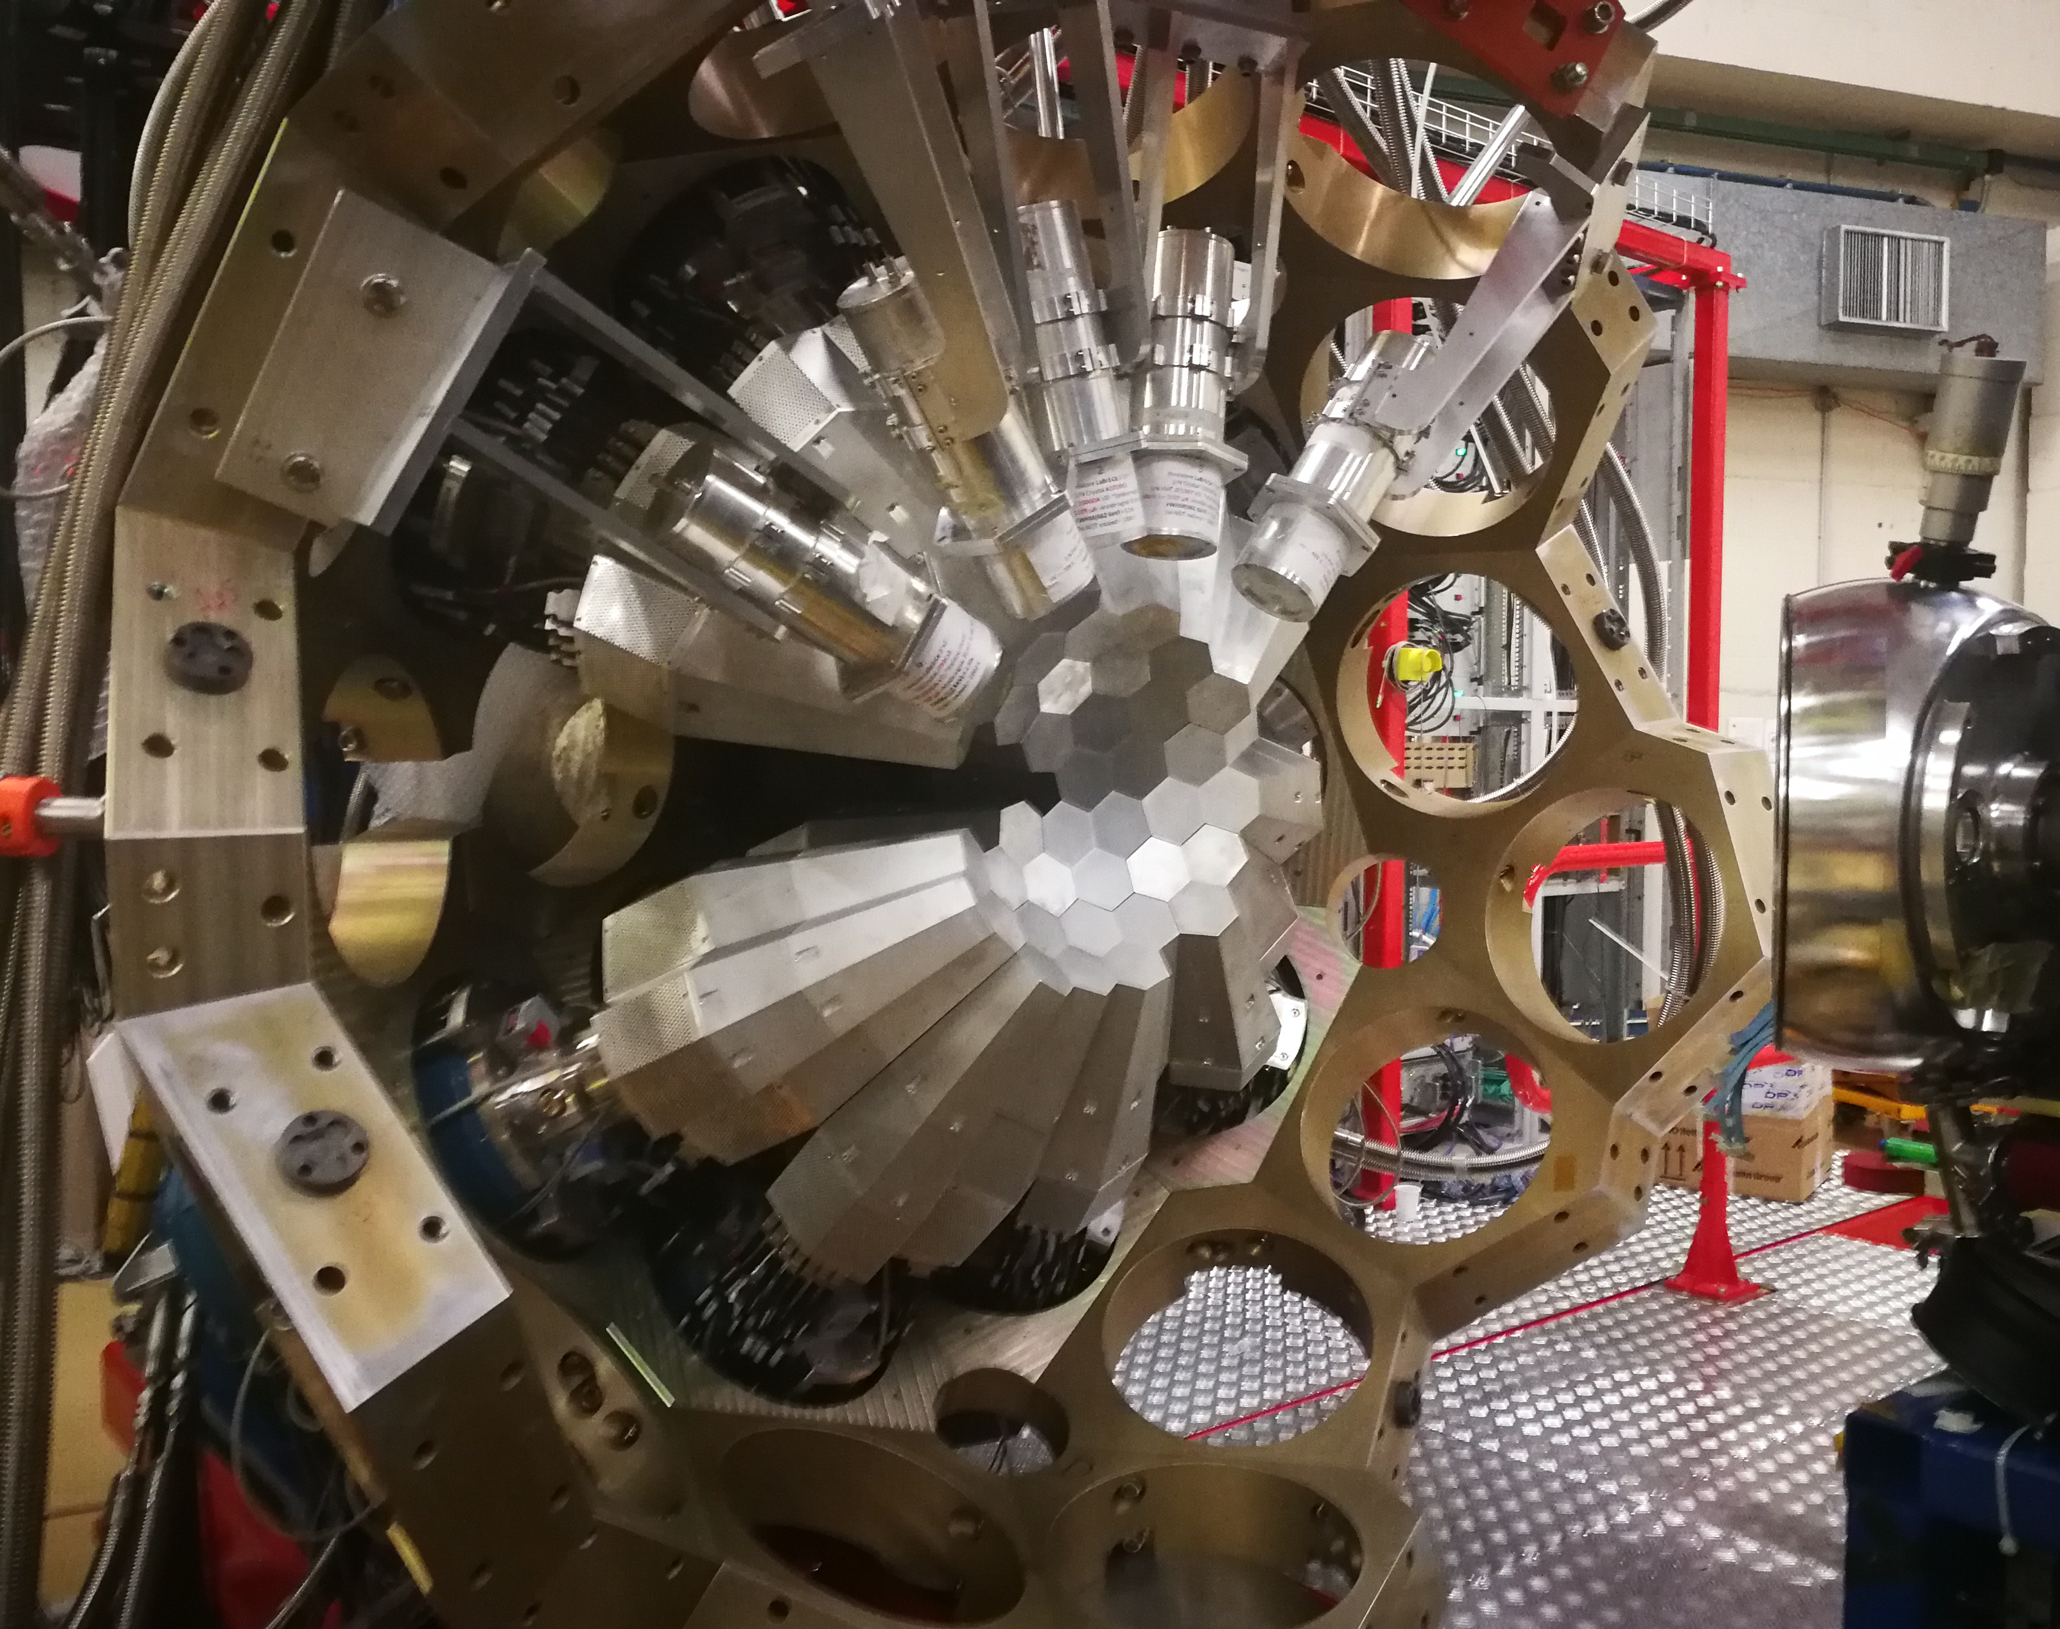

The AGATA campaign at LNL
25th ACC meeting - Agata Week GSI Alain Goasduff (INFN LNL)

Slide 2
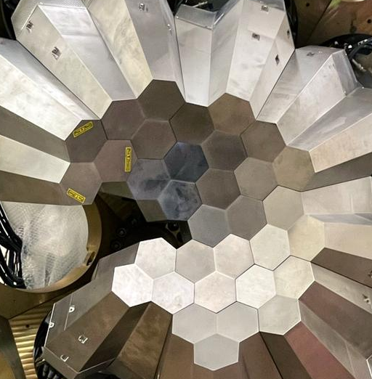
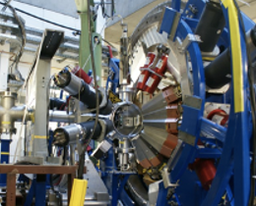
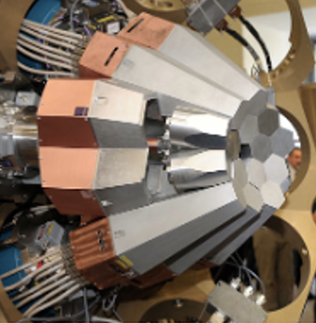
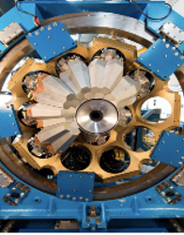
The AGATA Timeline
Local project manager
J.J. Valiente-Dobón – A. Goasduff
Scientific coordinator
M. Zielinska
AGATA@GSI
2009
2014
2029-203X
PHASE 2
2011
2021
AGATA@LNL
AGATA@GANIL
AGATA@GANIL

Slide 3
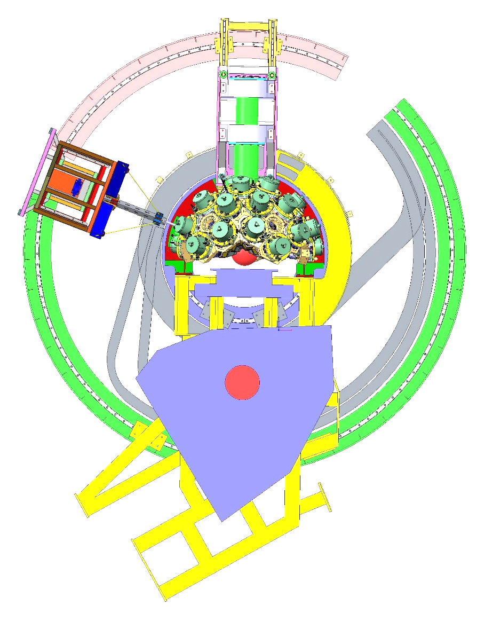
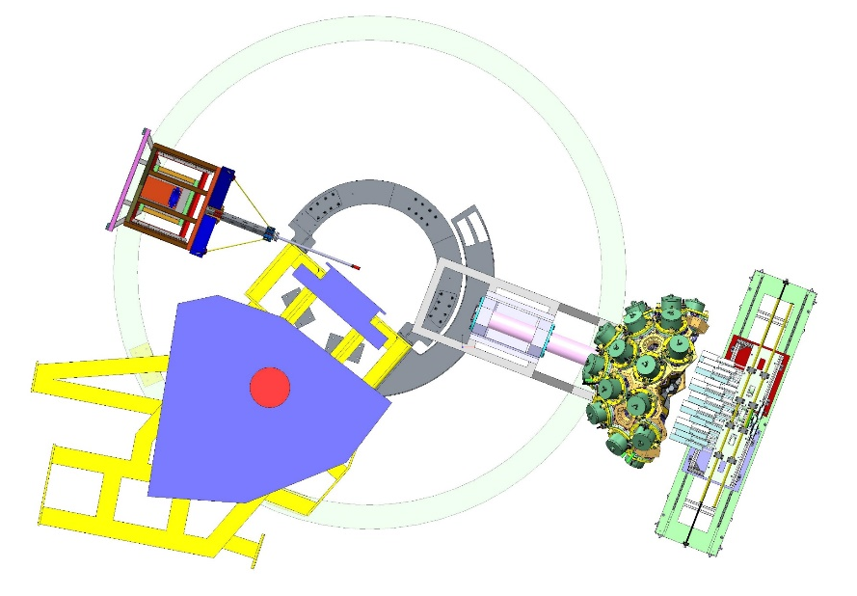
AGATA @ LNL: 2021 - 2028
Two configurations:
2021 – mid-2026: AGATA coupled to PRISMA
Mid-2026 – mid-2028: AGATA at “zero-degree”
AGATA coupled with PRISMA
Current configuration
NEDA
AGATA zero degrees

Slide 4
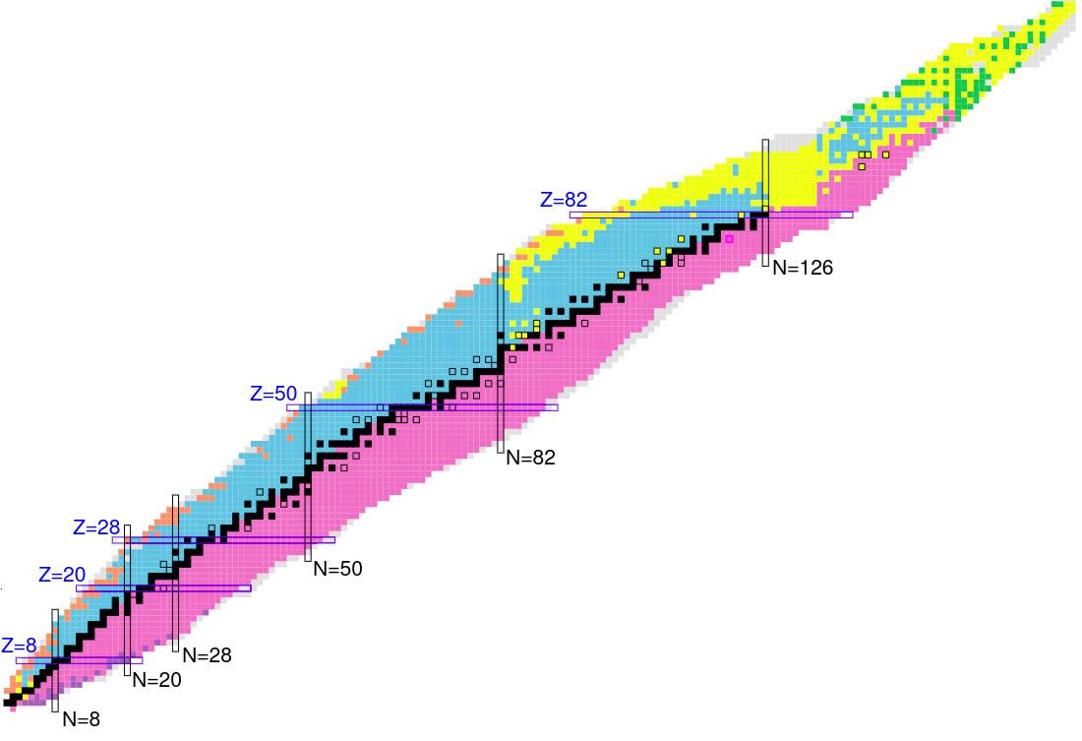
The physics campaign (so far)
Search for octupole structures in the light U Th and Pa isotopes via Multinucleon transfer reactions
(A. Goasduff G. De Angelis)
Octupole correlations in the neutron deficient plutonium isotopes (J.F.Smith,D.Mengoni )
Accessing neutron-rich nuclei close to ²⁰⁸Pb via multi-nucleon transfer reactions (F. Galtarossa, T. Mijatovic)
45 experiments performed in 3.5 year
Decay-out of the oblate, triaxial and highly-deformed bands in ^{136,137}Nd (C. Petrache/O. Stezowski )
Understanding the nature of 0⁺ states in ¹¹⁰Sn and ¹¹²Sn and ¹⁰⁸Cd
( N. Marginean, M.Ciemala, F.Crespi)
Lifetimes in the ¹⁹⁶Os region populated with multinucleon transfer reactions
(D. Brugnara, M. Sedlak, J. Pellumaj)
Probing Multiple Shape Coexistence in ¹¹⁰Cd with Coulomb Excitation (M.Zielinska, K.Wrzosek Lipska, A.Nannini, P.Garrett)
Pathway to nuclear structure in heavy neutron rich nuclei in the vicinity of N=126 and nuclei northwest of ¹³²Sn via multinucleon transfer reactions (P.Reiter)
Search for a Josephson like effect in the ¹¹⁶Sn+⁶⁰Ni system
(L. Corradi, S. Szilner)
Probing nucleon nucleon correlations in the ⁴⁸Ca+²⁰⁸Pb system below the Coulomb barrier
(T. Mijatovic L. Corradi)
Combined lifetime and transition-probability measurements in ⁹⁶Zr via unsafe Coulomb excitation (M. Zielinska, F. Ercolano, N. Marchini, J.J. Valiente Dobon)
Two-Phonon Octupole excitation in ⁹⁶Zr
(D. Stramaccioni, J.J. Valiente-Dobon, A. Gadea)
Shape Coexistence Coulex of ⁷⁴Se
(W.Korten, K.Wrzosek Lipska, E.Clement)
Coexisting Shapes in ⁹⁶Zr
(D. Doherty, N. Marchini, M. Zielinska)
The emergence of enhanced collectivity near magic nuclei: Coulomb excitation of ⁶⁰Ni (K. HadinskaKleck, N. Marchini, M. Rocchini,)
Fusion fission for gamma ray spectroscopy of neutron rich nuclei around N=50 (A. Gottardo, M. Caamano, D. Ramos, JJVD)
Nuclear structure in the vicinity of the Z=28 neutron rich isotopes with AGATA and PRISMA
(R.M.Pérez Vidal, S.Bottoni, E.Sahin,A.Illana, J. Benito, J. Ljungvall, M. Doncel, A.Gadea, L.M. Fraile)
Study of shape coexistence in ⁶⁰Fe via lifetime measurement of excited 0⁺ states (G.Pasqualato/J.Ljungvall)
The low energy fusion in the system ¹²C + ²⁶Mg (G. Montagnoli)
Precise measurement of the B(E2; 2⁺₁ → 0⁺₁) in ⁵⁶Ni (F. Galtarossa, A. Gottardo)
Test of the CKM unitarity and the existence of Fierz interference through the measurement of superallowed beta decay of light nuclei
(J.Ha/F.Recchia )
Lifetime measurements around ⁴⁸Ca
(C. Fransen, A. Gottardo, D. Menogni)
Evolution of the mixing between single particle and intruder configurations at N=20 (F. Galtarossa, A. Gottardo)
Shell and shapes above ⁵⁶Ni: lifetime measurements in ground-state and side band of ⁶⁰Zn (E. Pilotto, G. Pasqualato)
Spectroscopy and lifetime measurements toward the Island of Inversion (K.Wimmer, S.Bottoni, G.Benzoni, F.Recchia, P.Aguilera)
Lifetime of the 6793 keV state in ¹⁵O (J.Skowronski, E. Pilotto)
Lifetime measurements intruder states towards the island of inversion along the N=20 shell closure (Z. Irene, D. Brugnara)

Slide 5
The physics campaign (so far)
8533 hours of beam on AGATA target in 3.5 years

Slide 6
The Physics Campaign (so far)
To date, data from the AGATA@LNL campaign are used for:
8 Master thesis
17 Ph.D. Thesis
2 draft of publications already circulating, more to come

Slide 7
The Physics Campaign to come (2025-2026)
24 Experiments with AGATA submitted to the last PAC (October 2025):
11 TANDEM Only
2 TANDEM+ALPI
11 PIAVE+ALPI mostly with the ²³⁸U beam

Slide 8
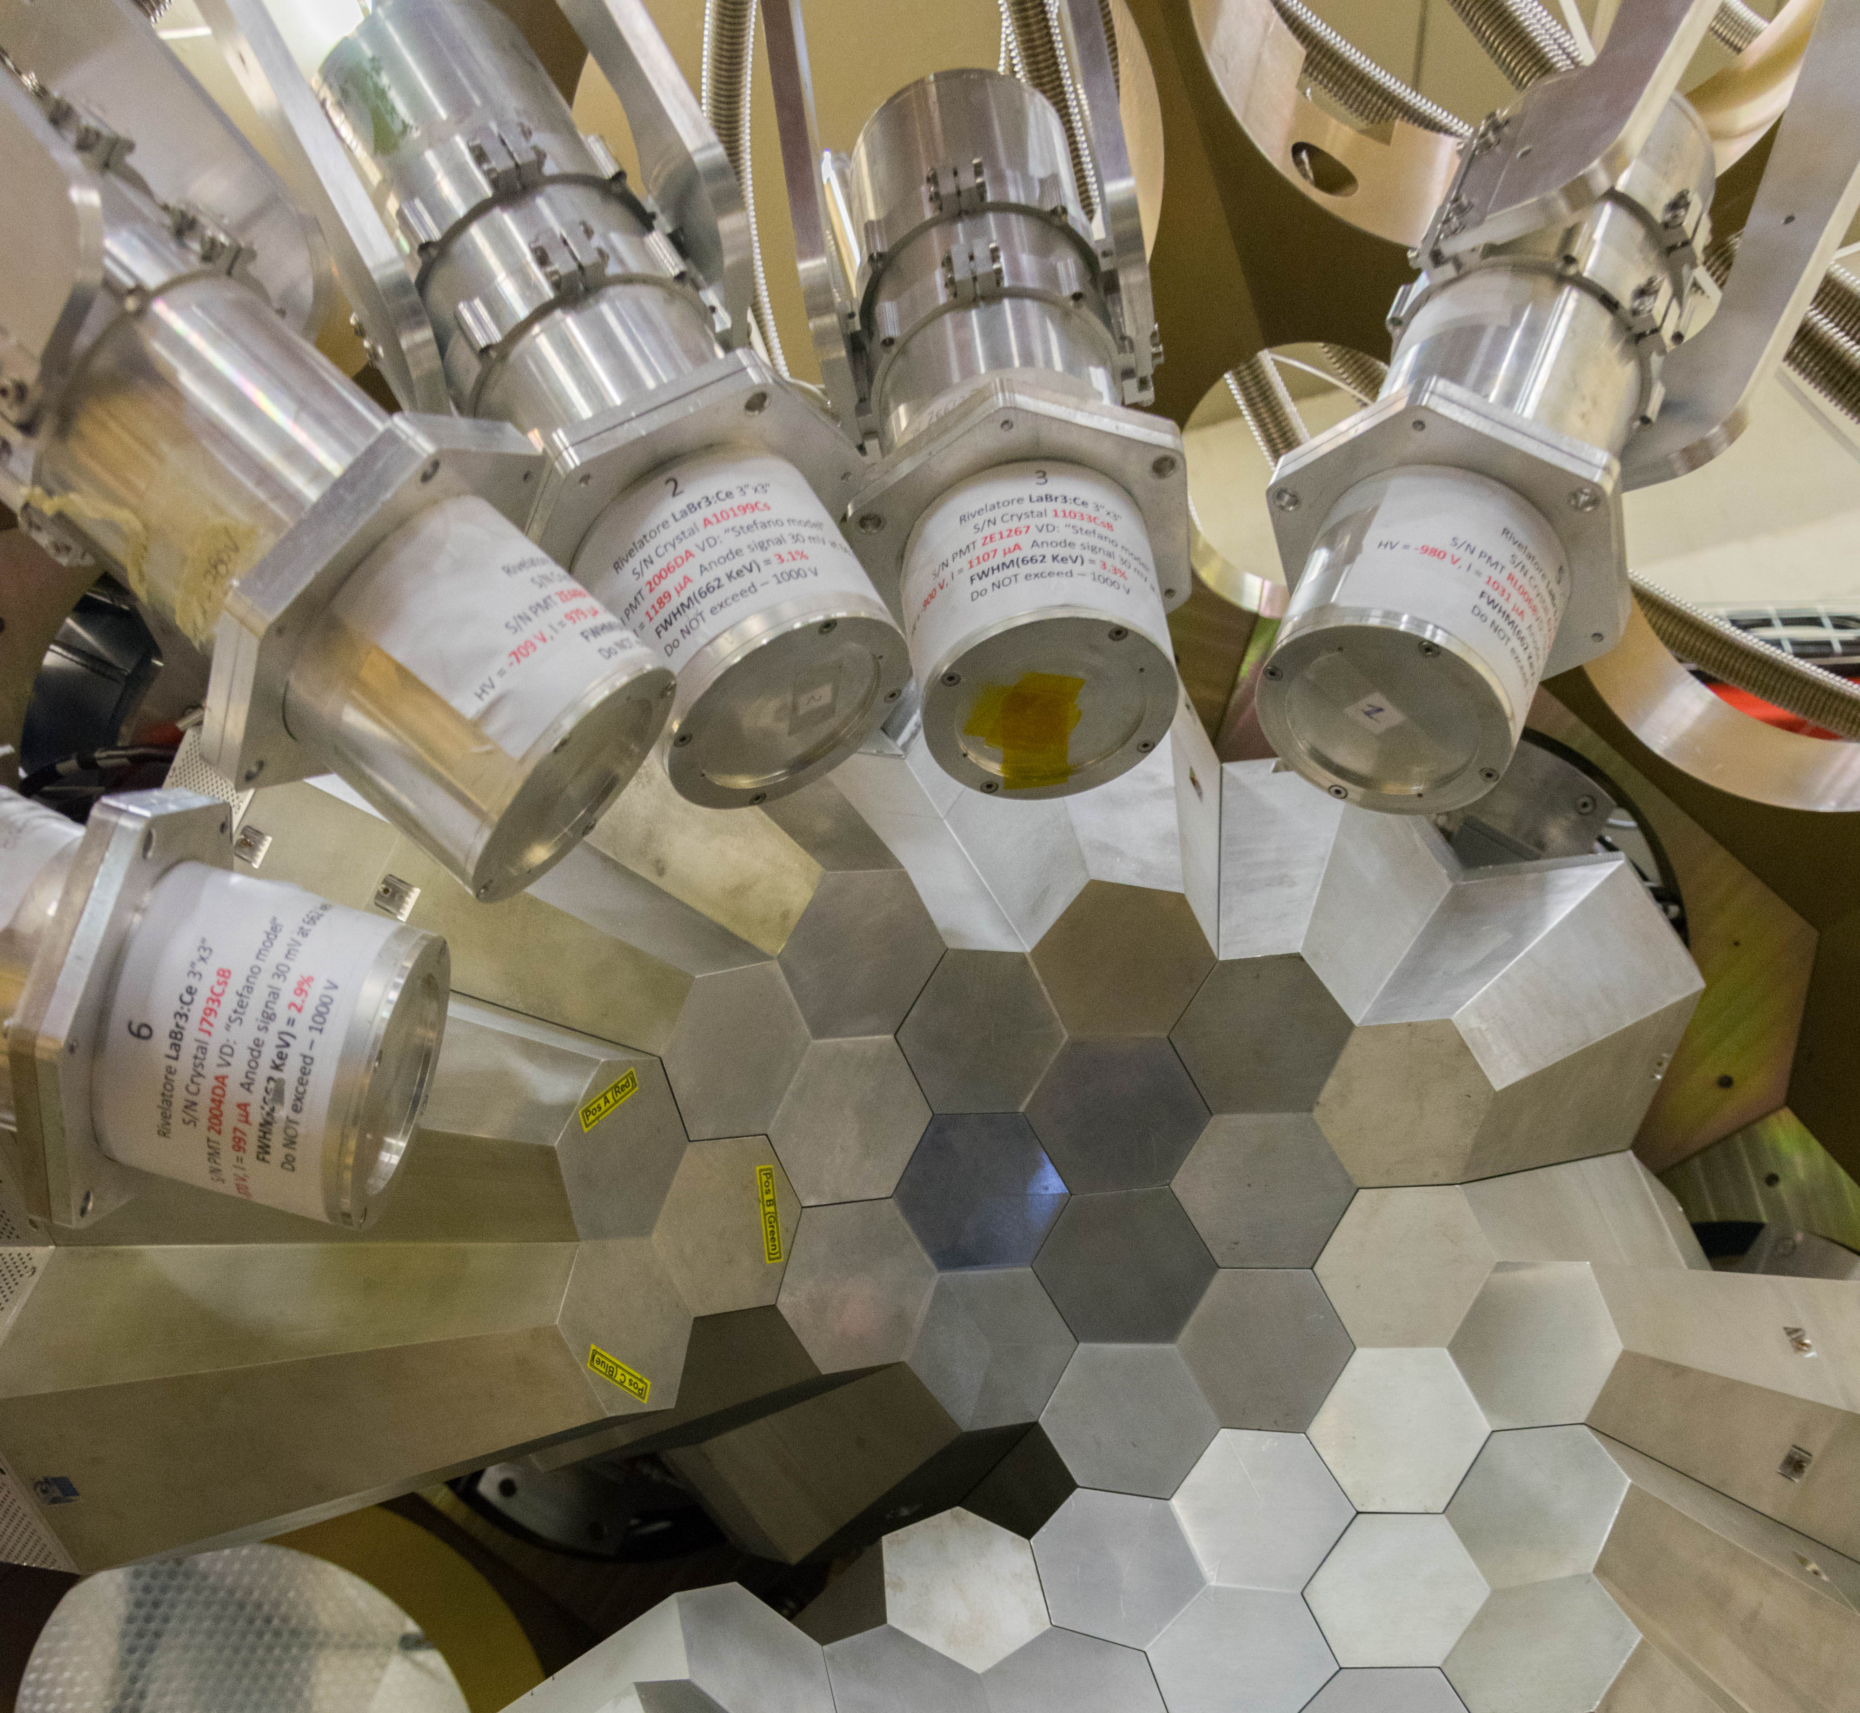
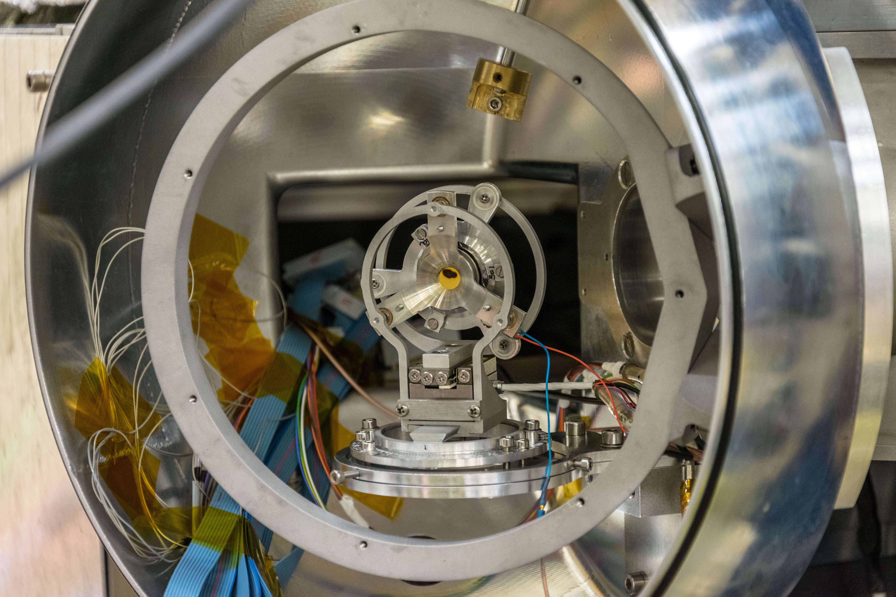
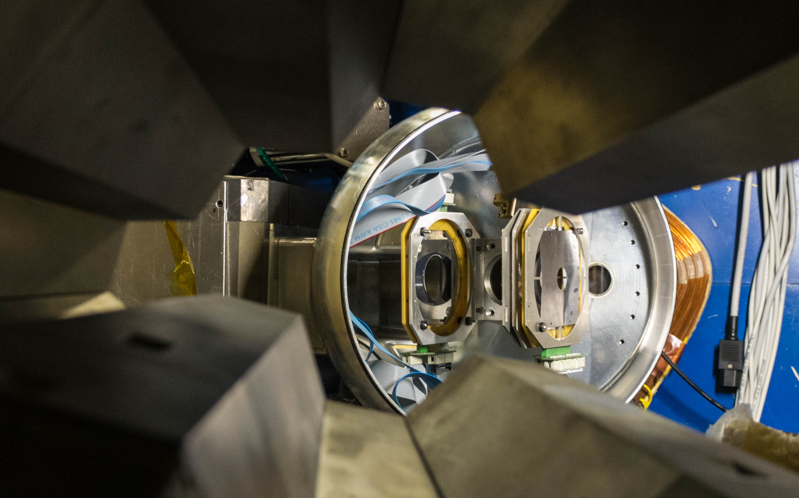
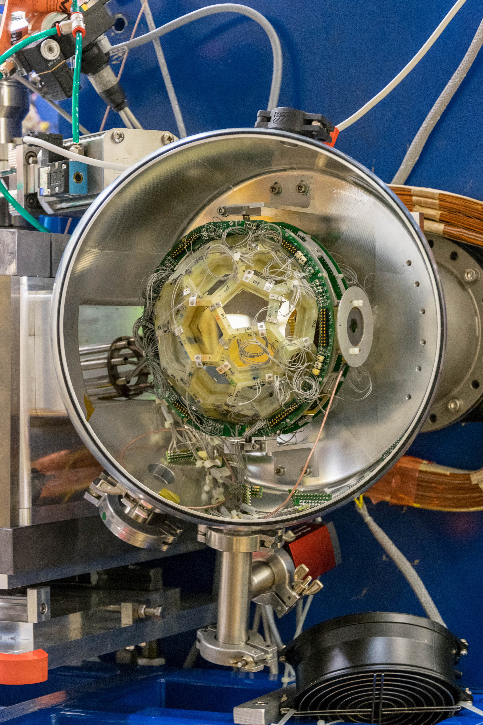
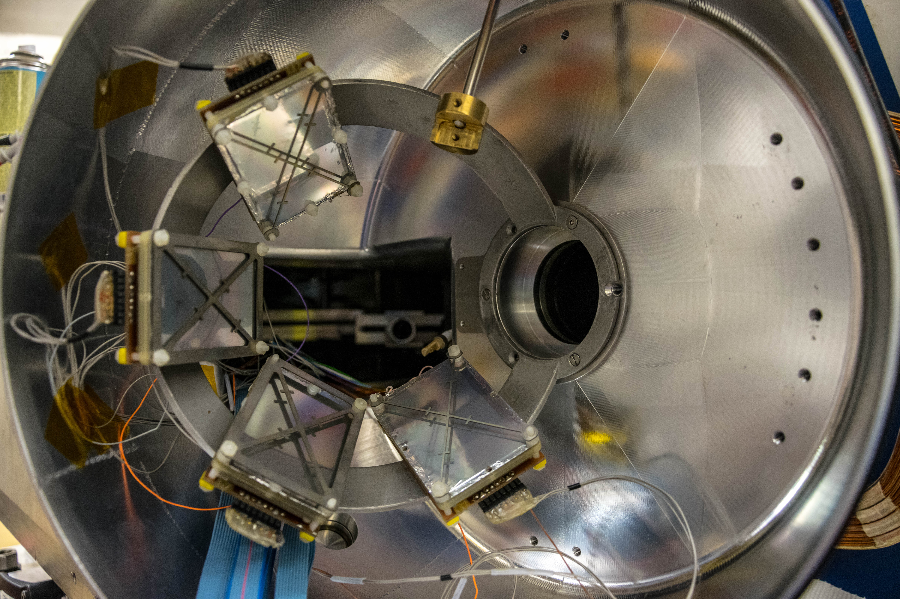
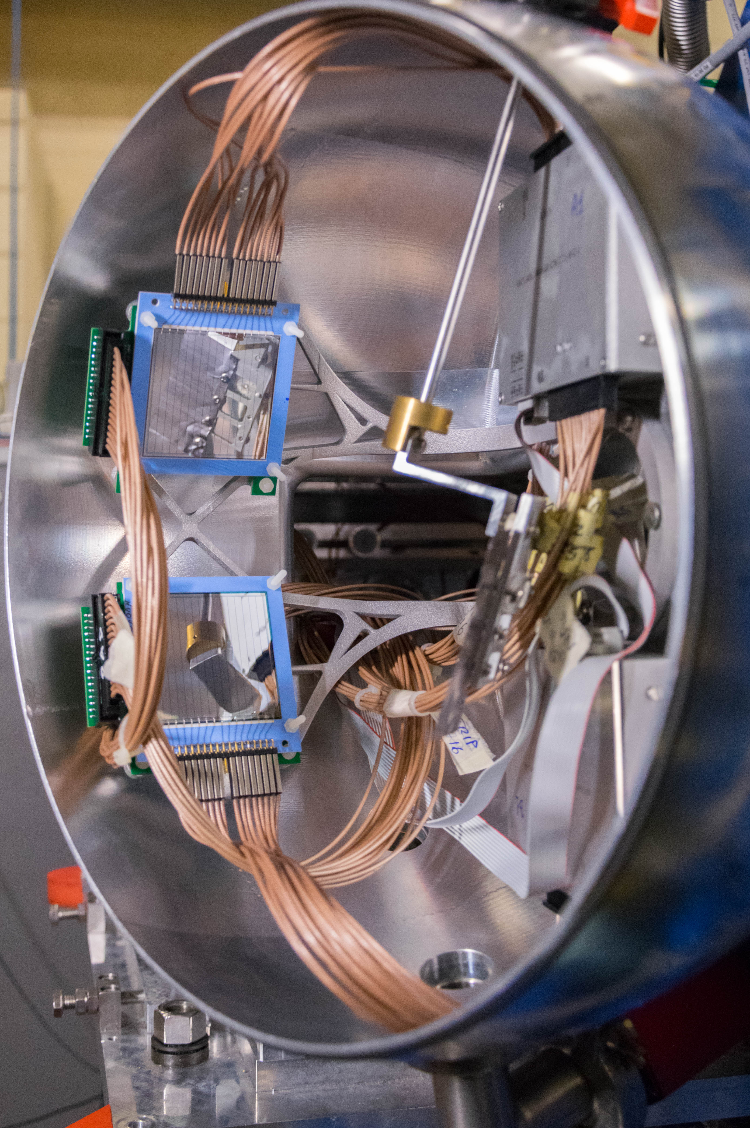
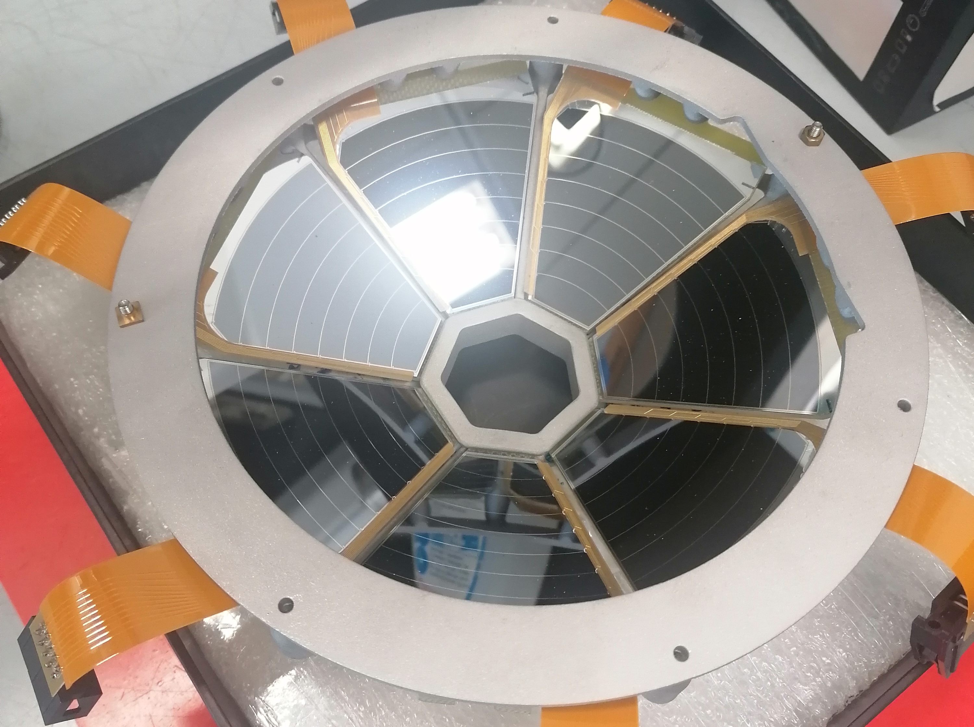
A wealth of Complementary detectors
Heavy ions:
PRISMA
SPIDER
DANTE
OSCAR
Light charged particles:
SPIDER
EUCLIDES
SAURON
AGATRACE
Lifetimes
Plungers
Scintillators
LaBr₃
Courtesy of M. Balogh

Slide 9
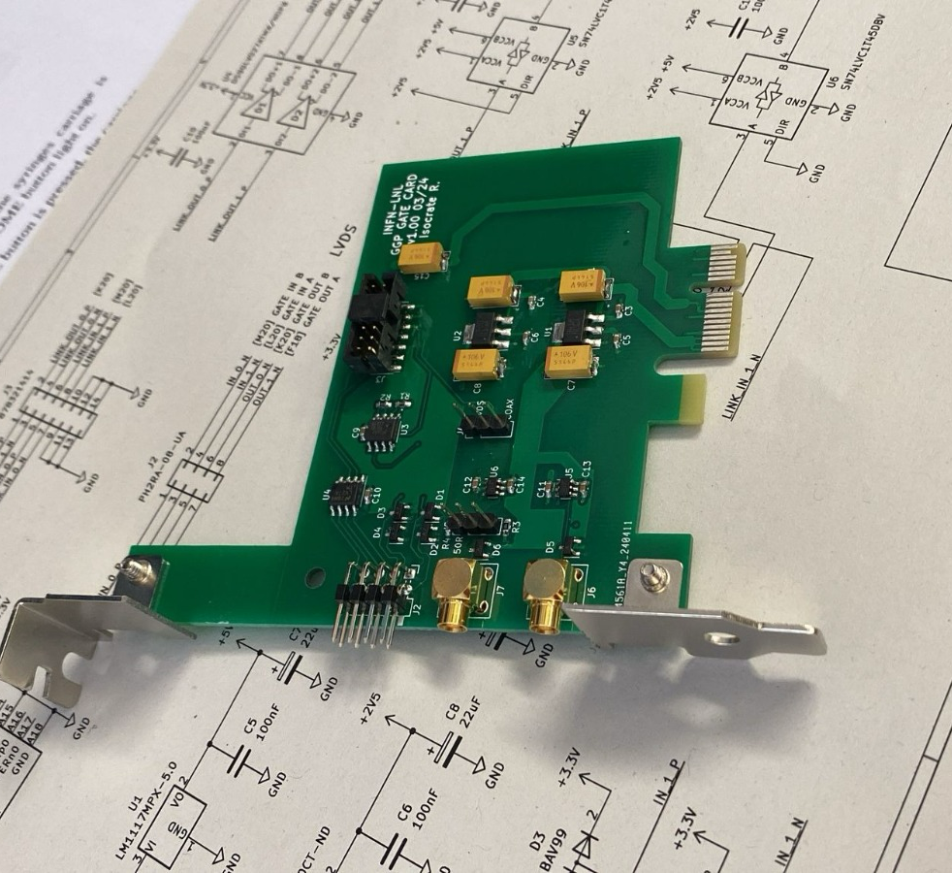
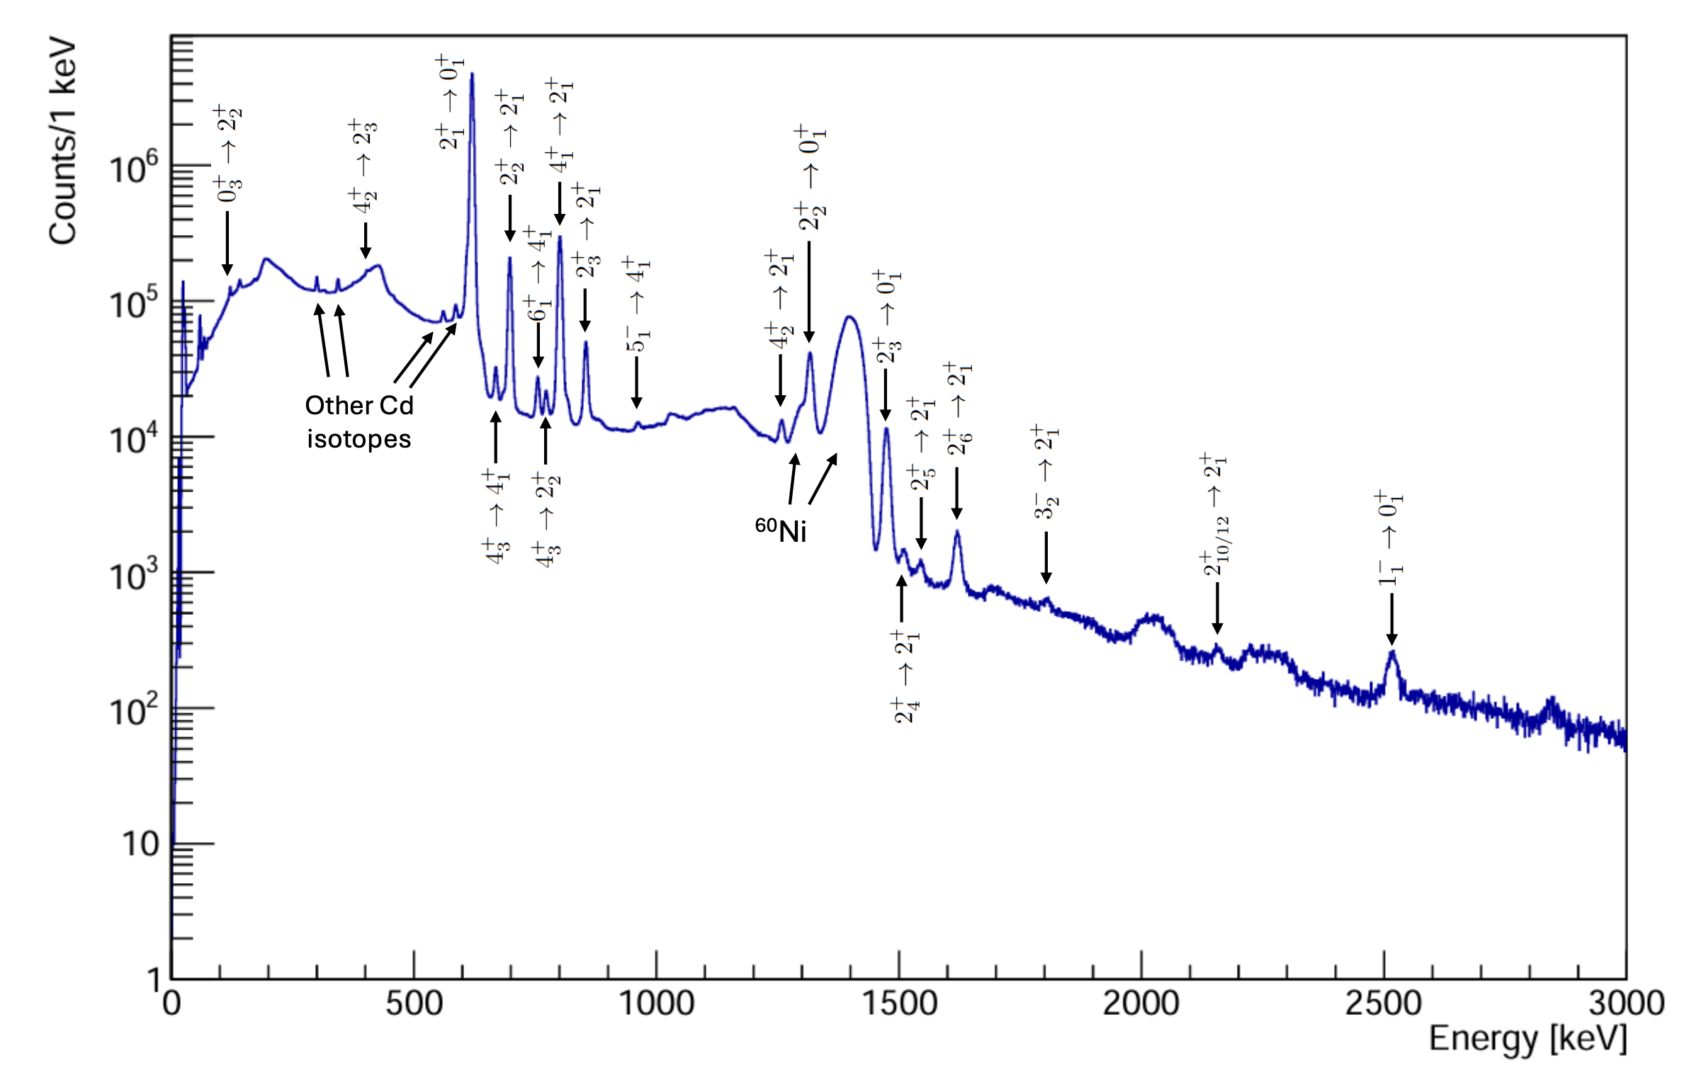
New hardware trigger system for AGATA
AGATA in-beam and source efficiency compatible
No AGAVA limitation for coincidences with Si-detectors
Reduced dead-time on high-rate experiments due to TP limitation
Courtesy of T. La Marca

Slide 10
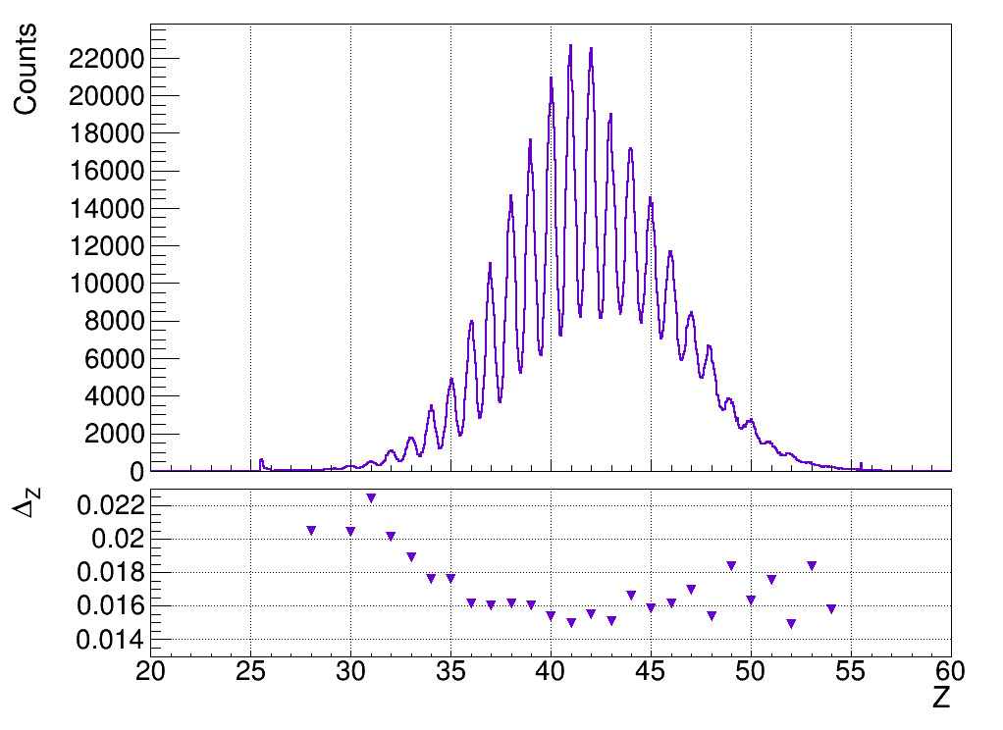
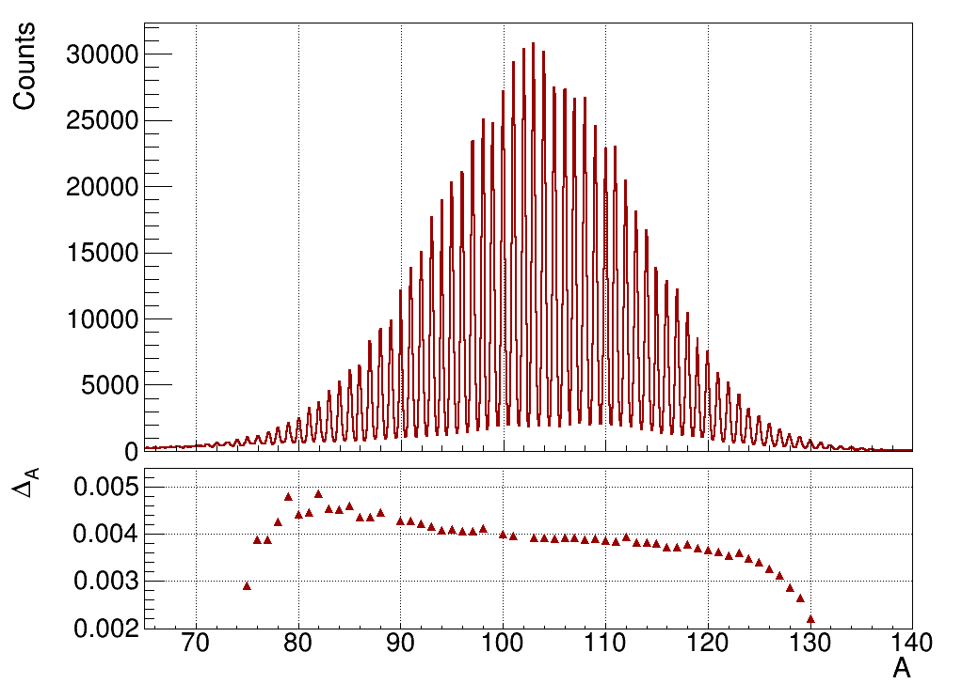
Pushing PRISMA identification of heavy ions
Courtesy of F. Angelini - https://indico.in2p3.fr/event/34092

Slide 11
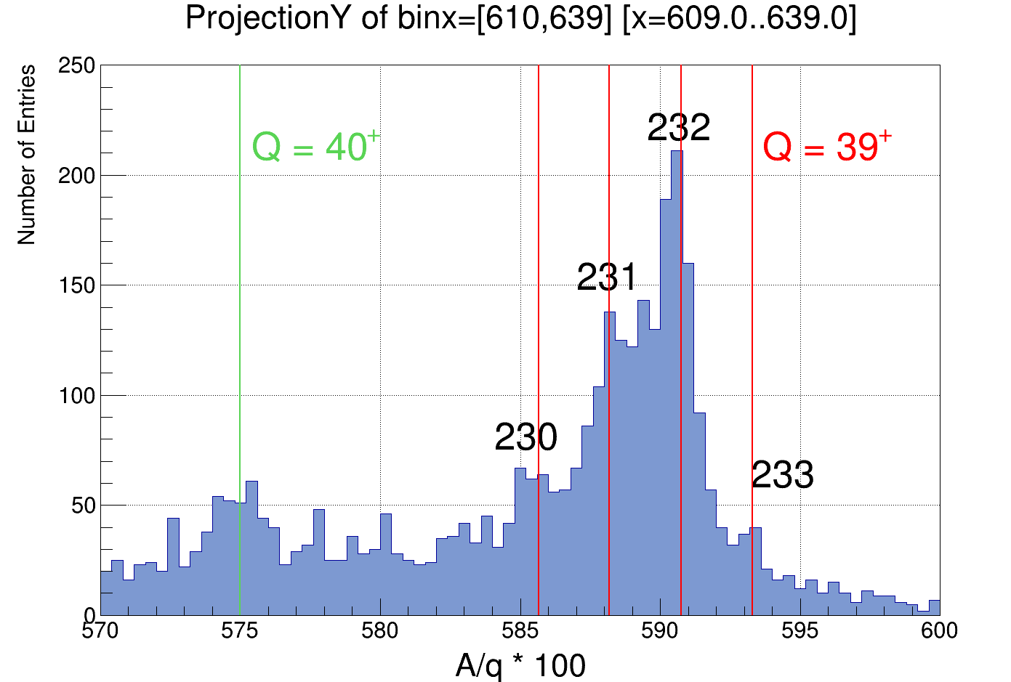
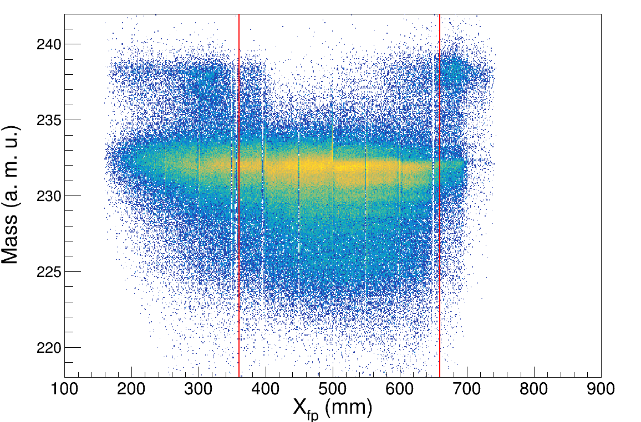
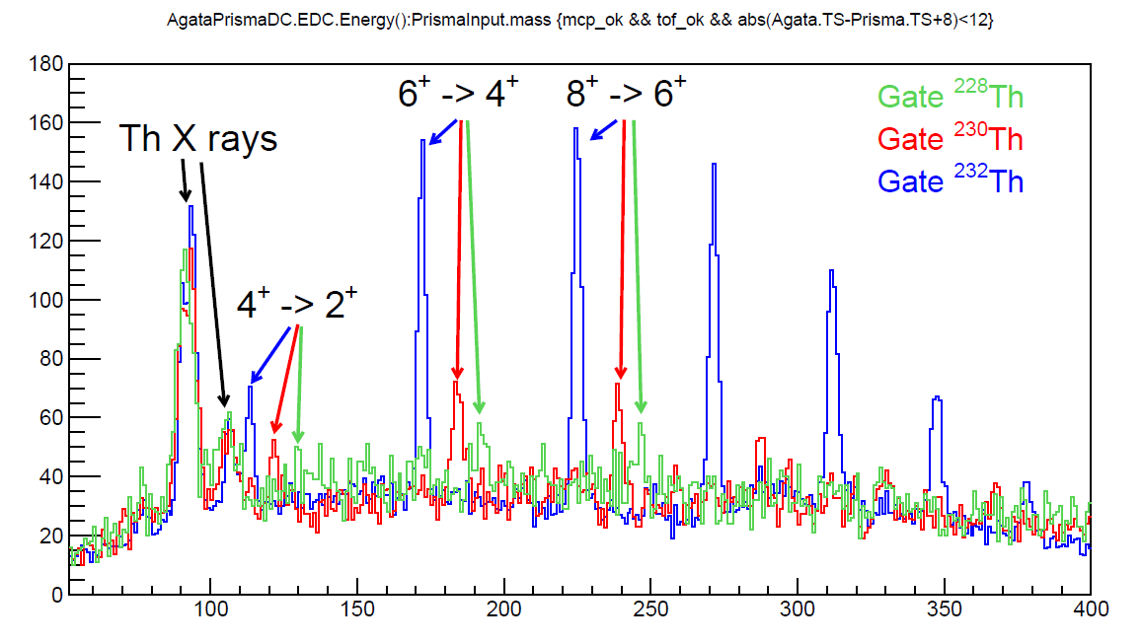
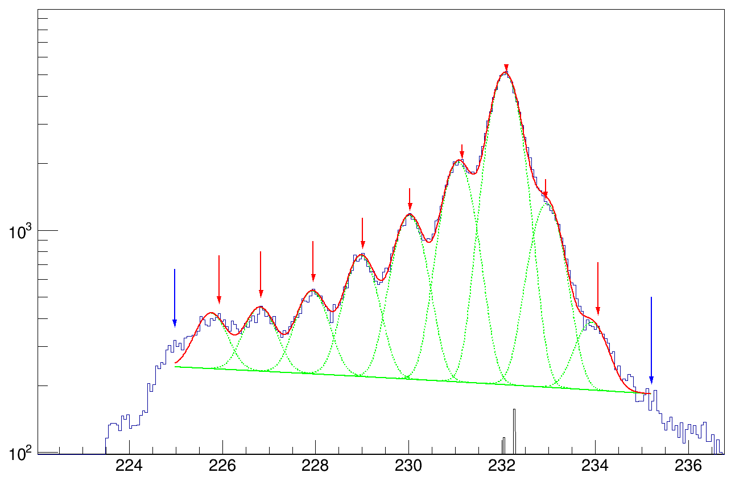
Direct mass identification in PRISMA of ions in the actinide region
Summing over all 12 charge states and correcting for aberrations
Single Q and small portion of the focal plane: seems promising
Taking a portion of the focal plane…
Gamma rays confirm the identification
First heavy partner mass spectrum identified in PRISMA!
ΔA/A ~ 1/300
Courtesy of F. Galtarossa – See his talk at EUNPC25

Slide 12

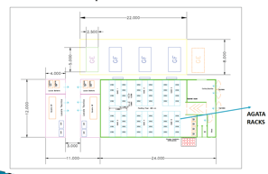
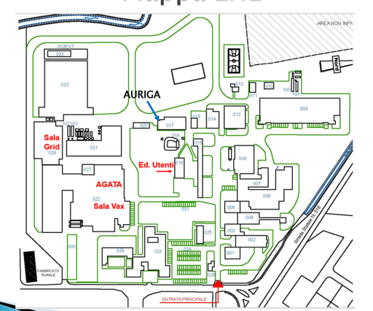
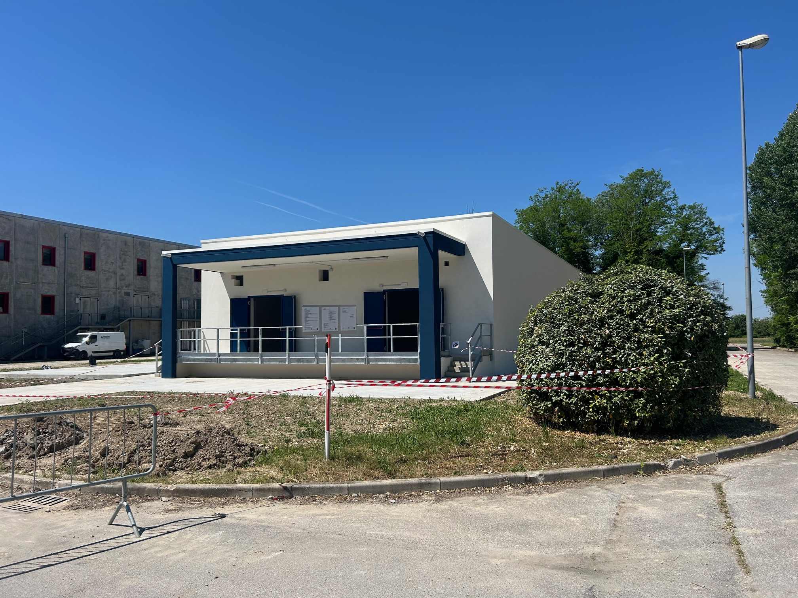

Status of LNL Infrastructure
New Data Center has been delivered
AGATA Services Network has been ported to the new CC
Test of the link with ancillary servers foreseen for fall 2025
Move of all ancillary machines + AGATA analysis and services nodes Winter 2025
AGATA DAQ Servers
Sala VAX → V1 electronics
New data centre → V2 electronics
Delivered June 2025

Slide 13
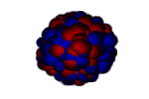
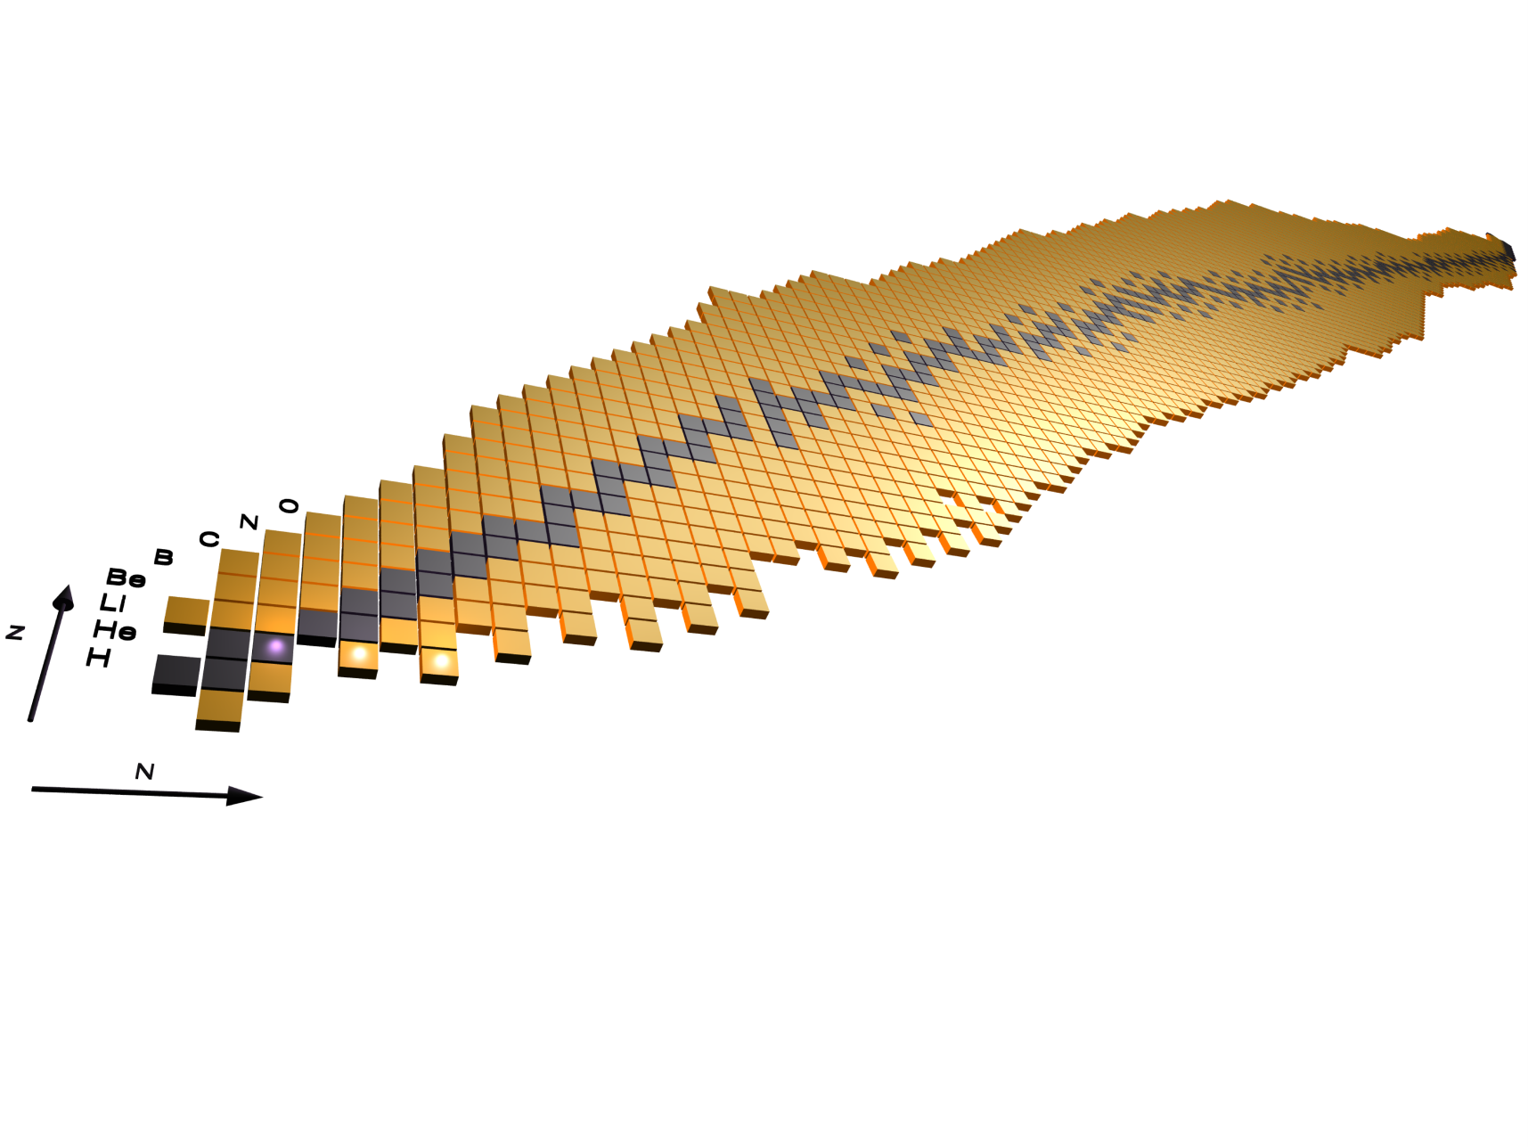
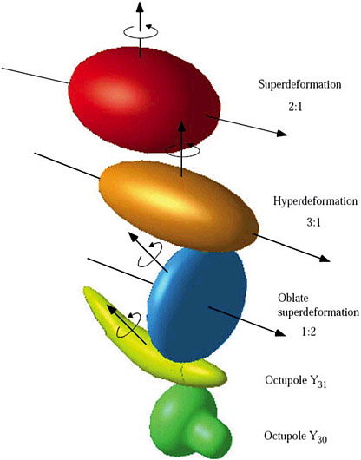
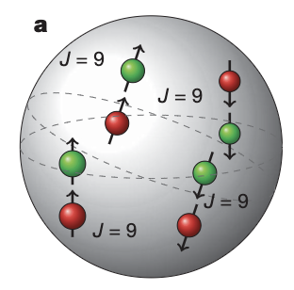
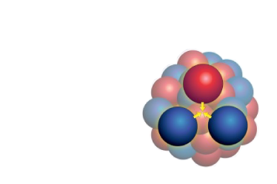
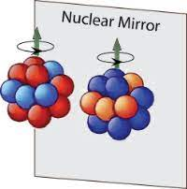
The future zero degree campaign: 2027 – mid 2028
Hot rotating nuclei, GDR,
superdeformation, high-spin states…
Isospin symmetry, proton neutron pairing and spectroscopy of N~Z nuclei
Reactions relevant for astrophysics, structure of ¹²C, three-body force ¹⁶C

Slide 14
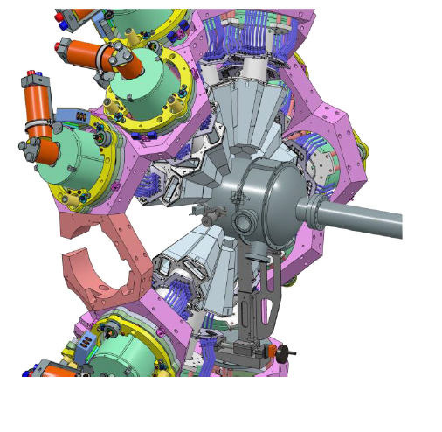
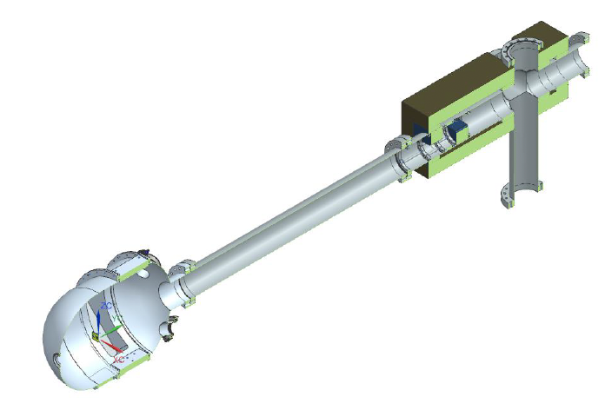
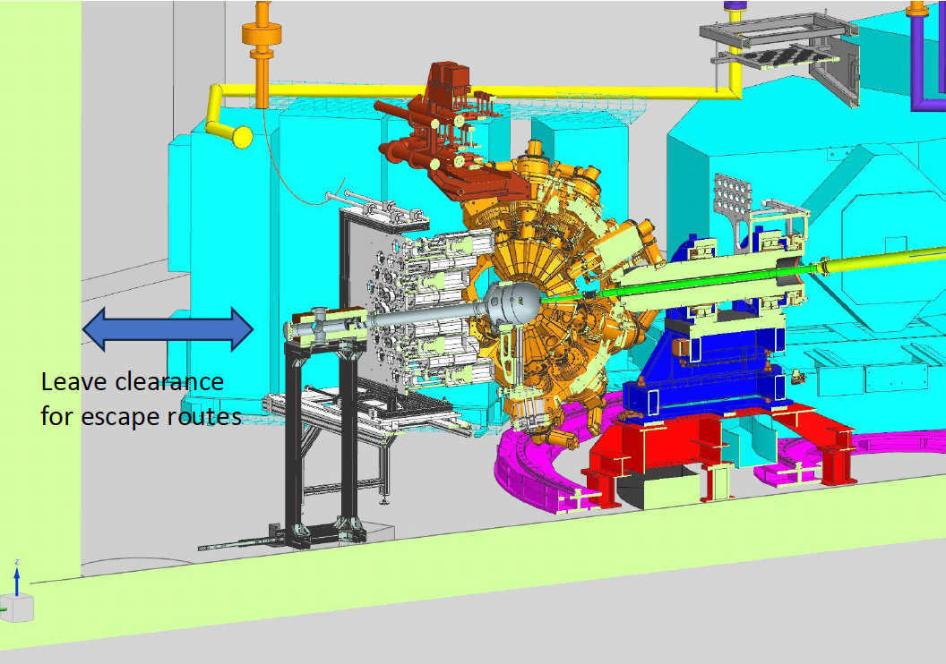
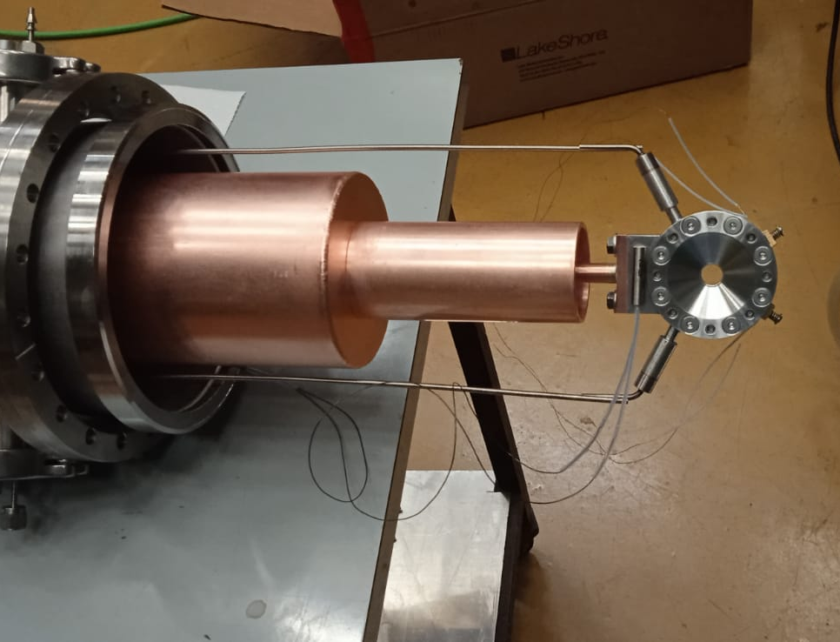
Status of the zero degree campaign
Mechanical design have been finalized.
Production of the new AGATA support has been made.
All infrastructure (LN2, …) is finalized
Production of the new reaction chamber and beam dump is on-going
Integration of the ancillaries and new target system on-going
Courtesy of G. Benzoni

Slide 15
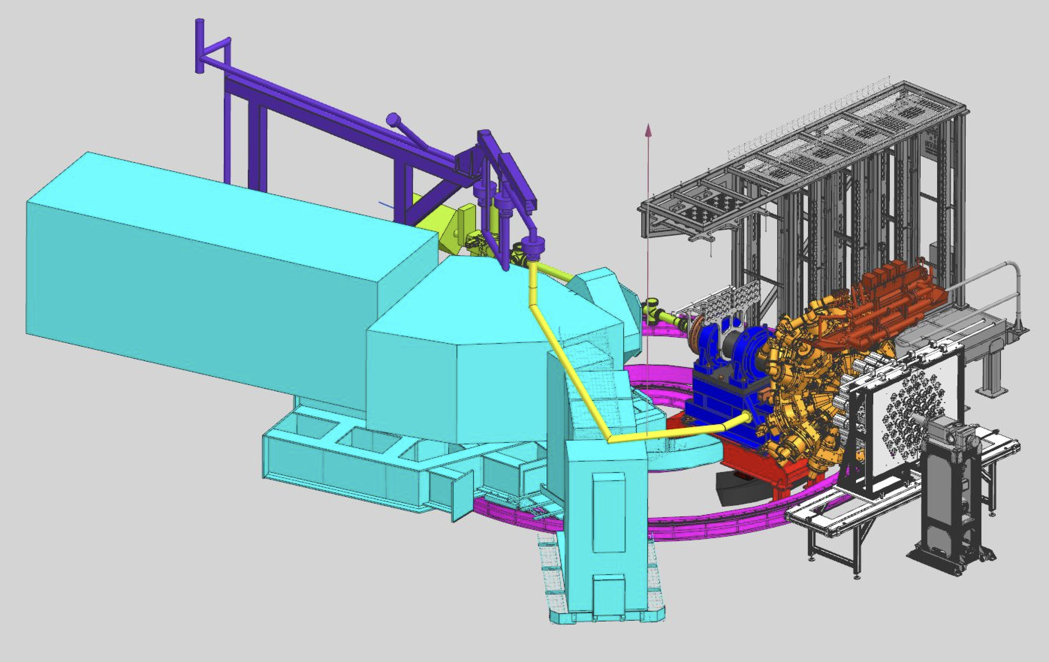
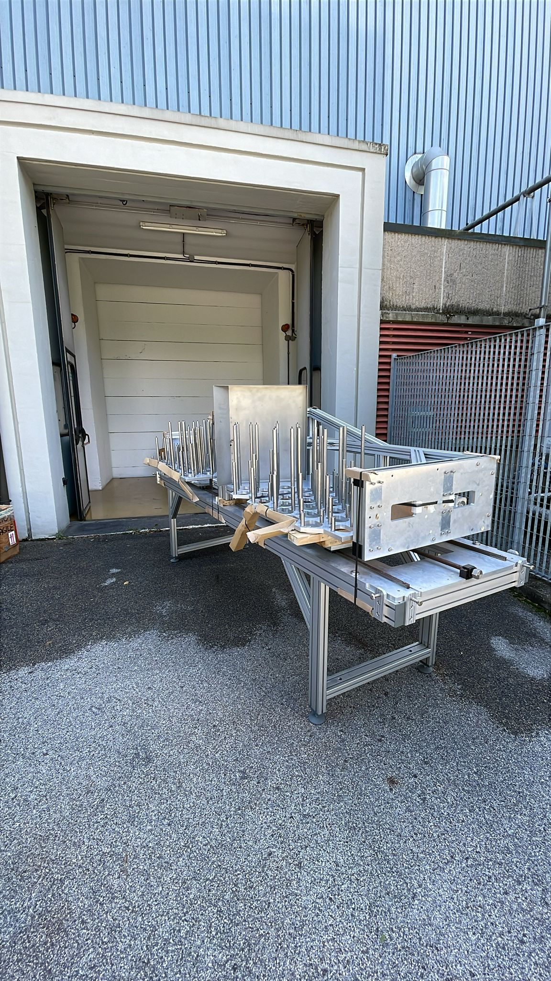
Zero degree campaign “bulky” ancillaries
NEDA Neutron Detector Array
54 liquid scintillator cells
50 cm from the target
Neutron discimination:
PSA
Time of flight
Digital electronics compatible with AGATA
DAQ integration is on-going
J.J. Valiente Dobón, Nucl. Inst. Meth. A 927 (2019) 81

Slide 16
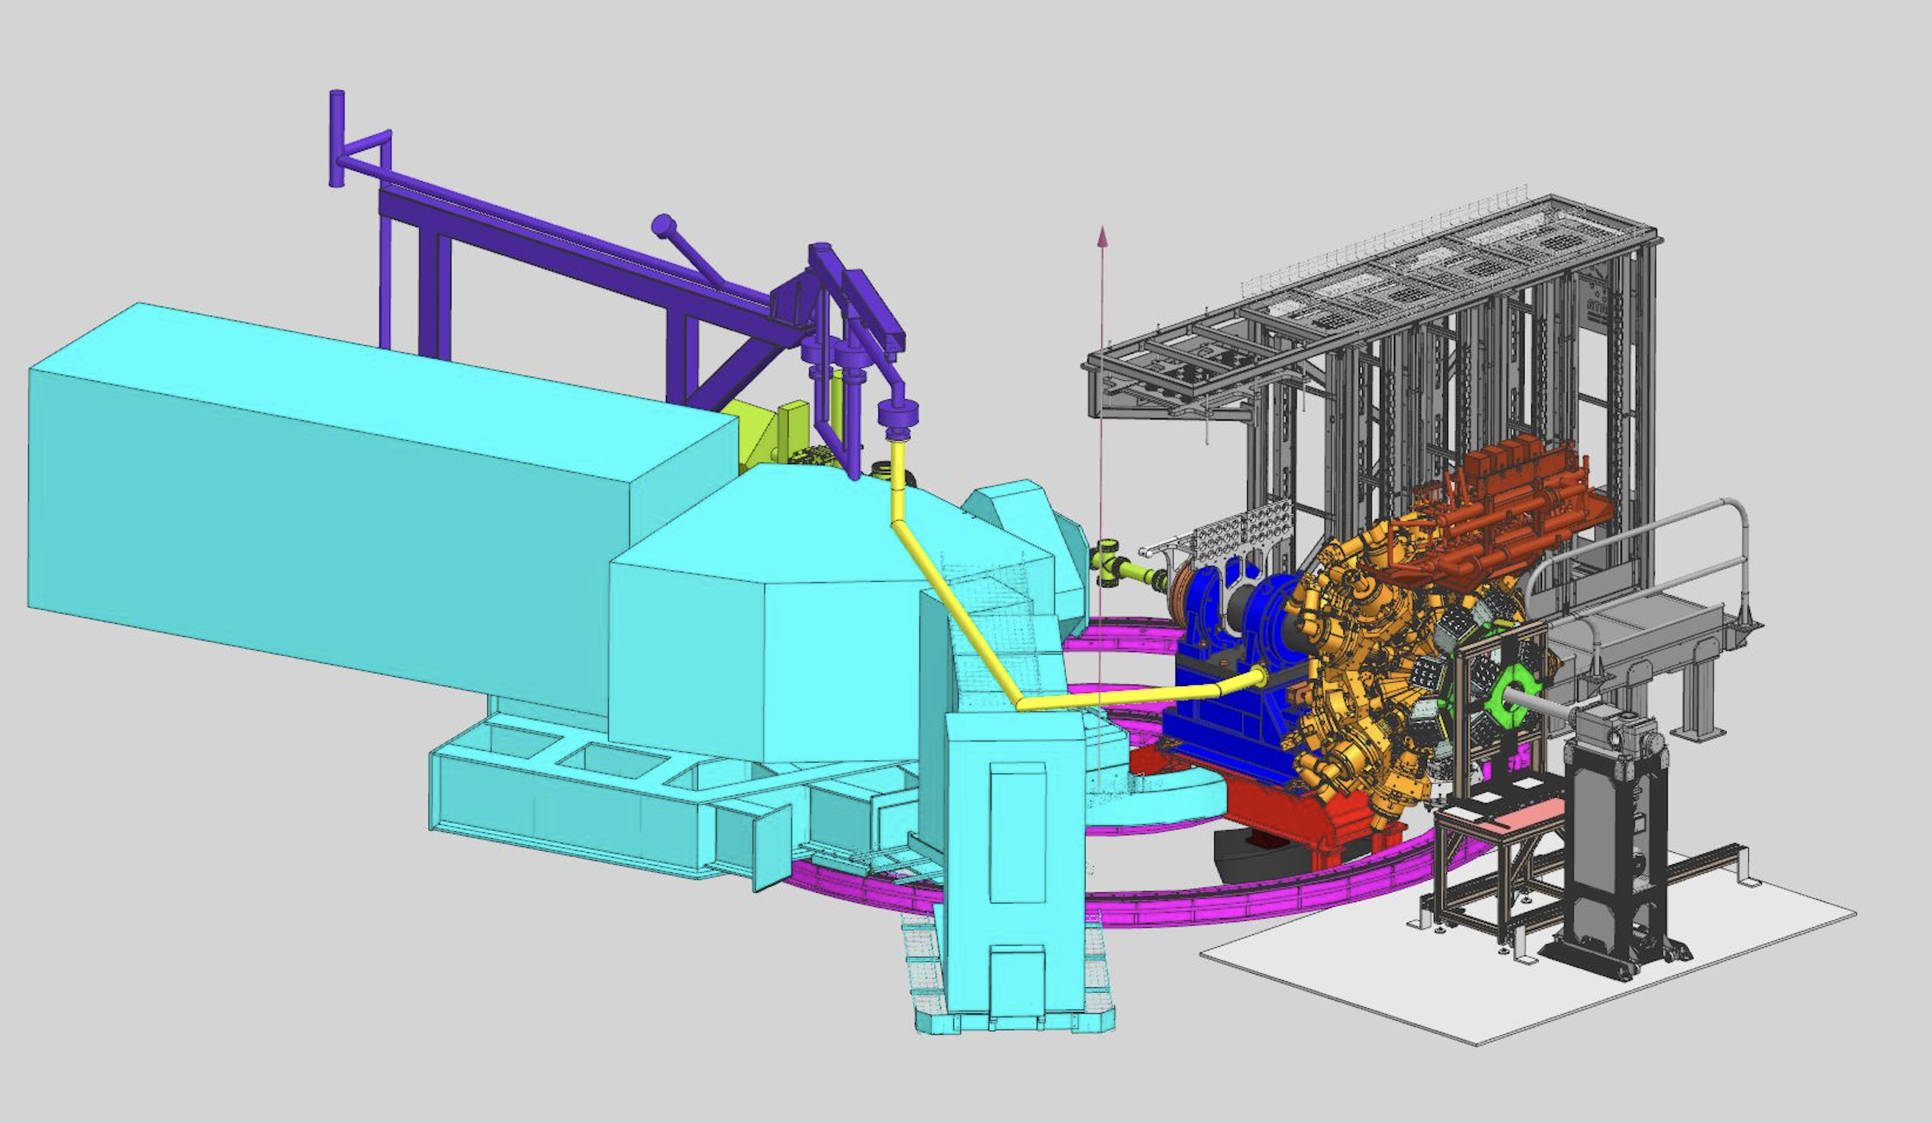
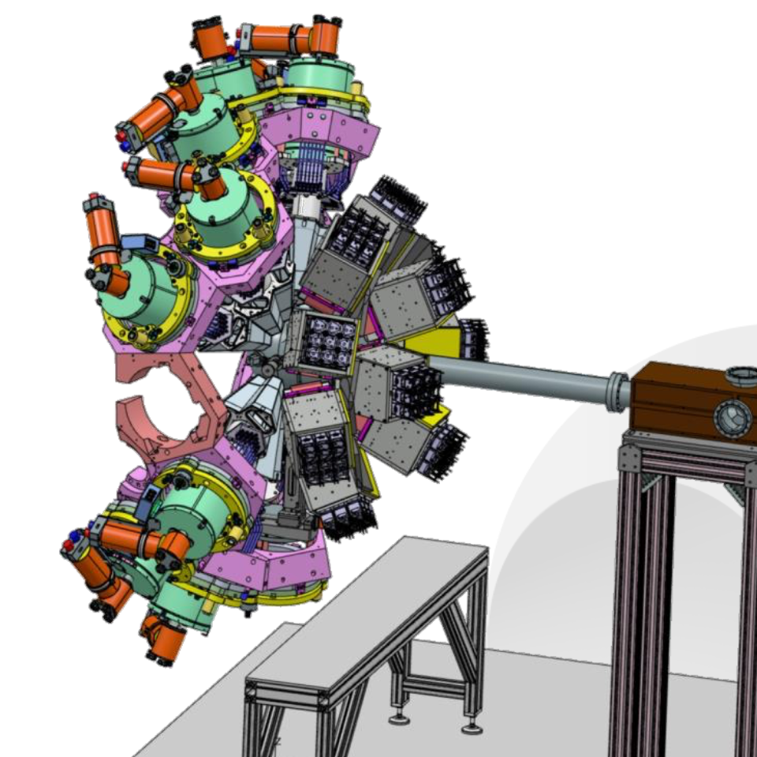
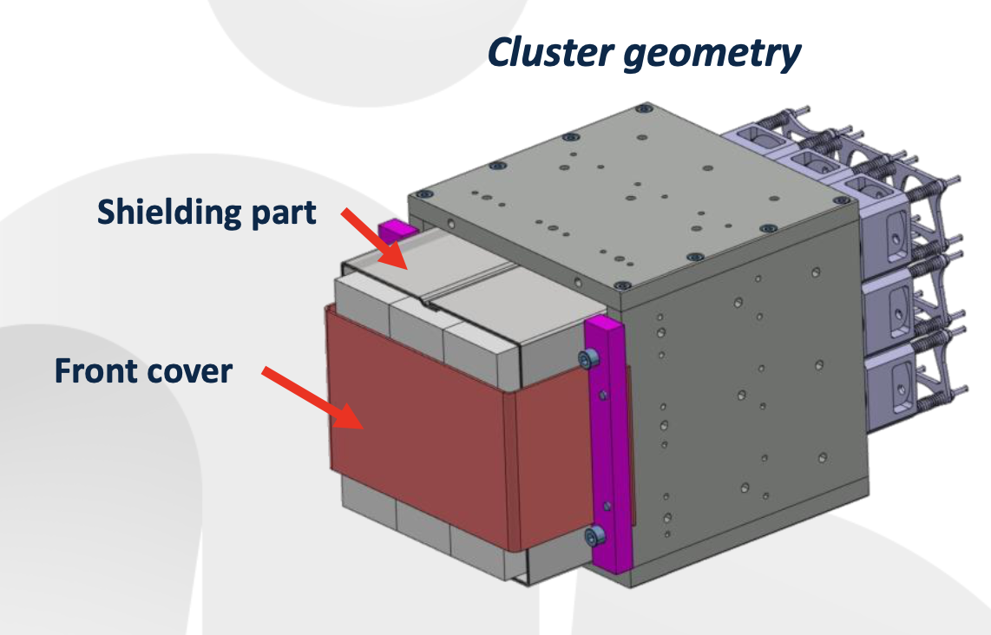
Zero degree campaign “bulky” ancillaries
PARIS phoswich array
10 cluster made of 9 phoswiches
2 rings at forward angles:
6 clusters at 60 degrees
4 clusters at 15 degrees
Same electronics than present LaBr₃ – fully integrated
http://paris.ifj.edu.pl

Slide 17
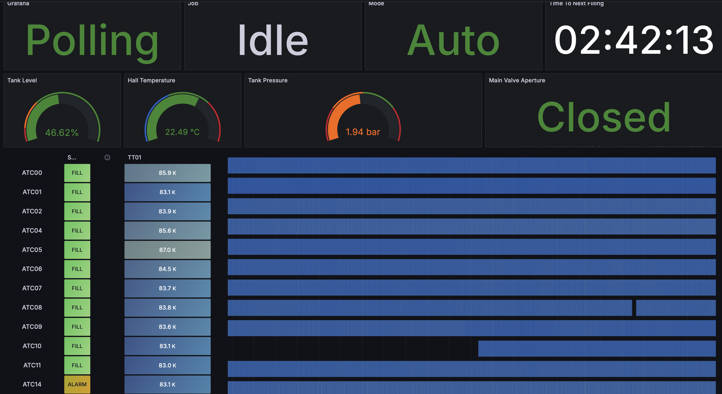
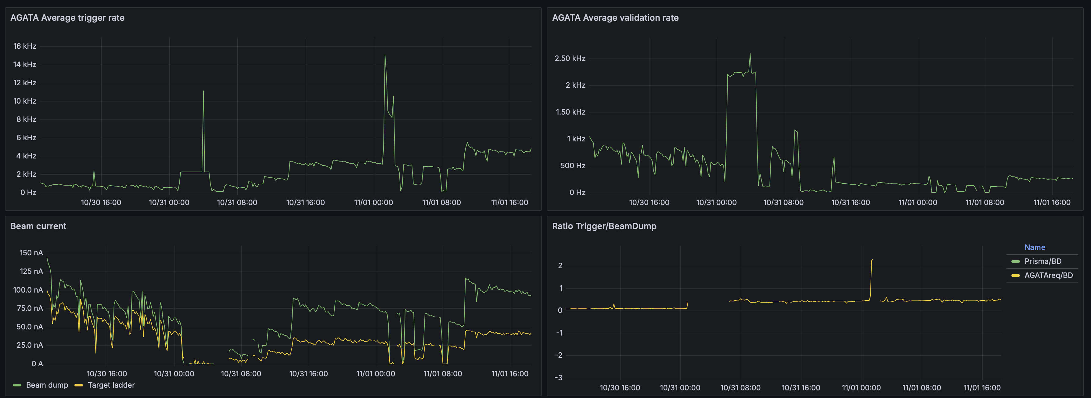
Dedicated monitoring system
Since the installation at LNL:
AGATA parameters. (LN2, HV, Crystal rates, …)
Complementary instrumentation (HV, rates, …)
Electronics (temperatures, failure flags, …)
DAQ (buffer rates, bandwidth, …)
Experimental parameters (current on the beam dump and target, …)
All parameters are pushed to a time series database (CARBON) and visualized through GRAFANA:
Simple user monitoring of the system and experimental conditions
Used by the operators to control the beam current
Generation of meta-data for the user:
For each run the run control is able to export selected parameters from the database using the start-stop times

Slide 18
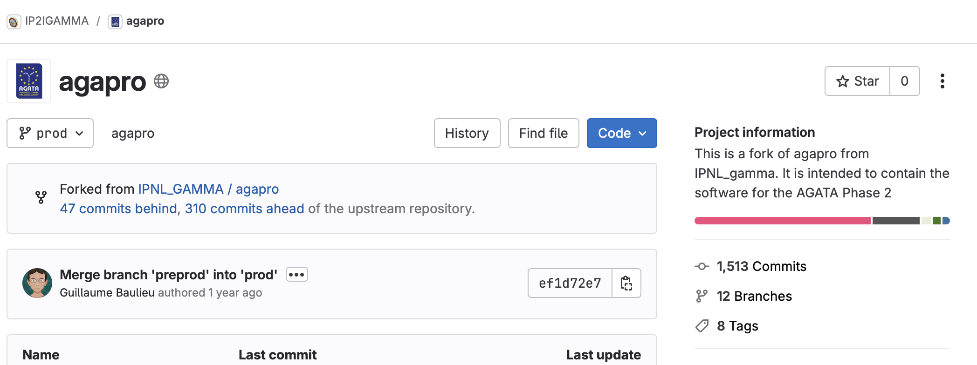

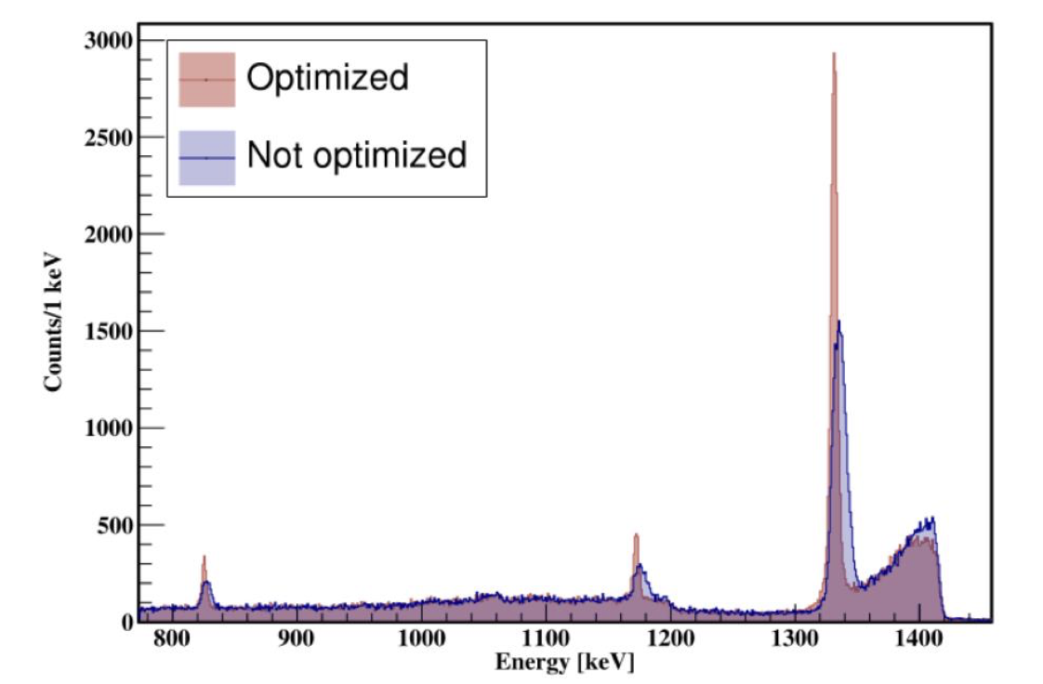
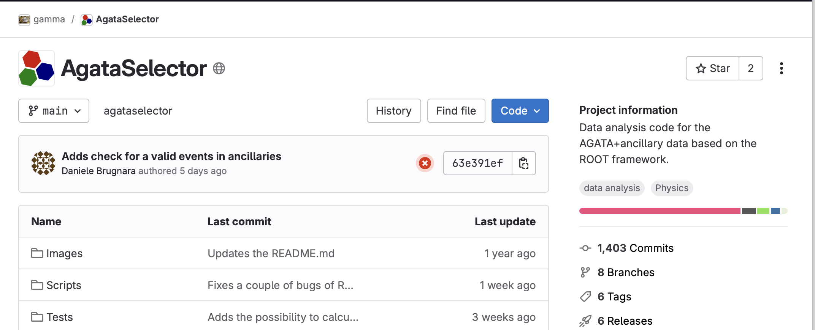
NEAR-LINE analysis
Dedicated new analysis package:
Using the ROOT output of the agapro package
Distributed analysis on 4 analysis nodes
Full analyzed of the ancillaries+AGATA data
Full analysis package citable:
Courtesy of D. Brugnara

Slide 19

Conclusions
Very successful campaign
The official end of the LNL campaign is set to mid-2028
New complementary detectors will be installed to fully exploit the next campaign beams
The zero degrees campaign will be divided in two sub-campaign: PARIS – NEDA
Preparation of the two is on-going in parallel
Order of the sub-campaign will be driven by
Availability of the two arrays
Users requests
Strong collaboration with well established and documented procedure for data analysis.

Slide 20
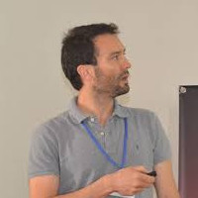
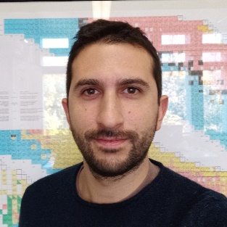
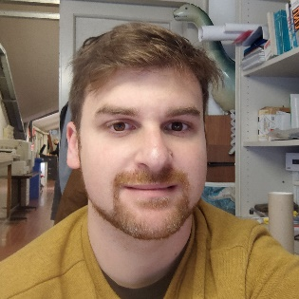
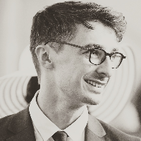

































Thanks to the local team
Big thanks to the AGATA collaboration, GAMMA group and LNL/PD/Mi technical staff

Slide 21

Thank you
Alain.goasduff@lnl.infn.it
http://gamma.lnl.infn.it
https://www.agata.org

